Slide 1
Hyperbolic Geometry of
Complex Network Data
Konstantin Zuev
http://www.its.caltech.edu/~zuev/
University of Nevada, Reno
Mathematics & Statistics Colloquium
Feb 18, 2016

Slide 2
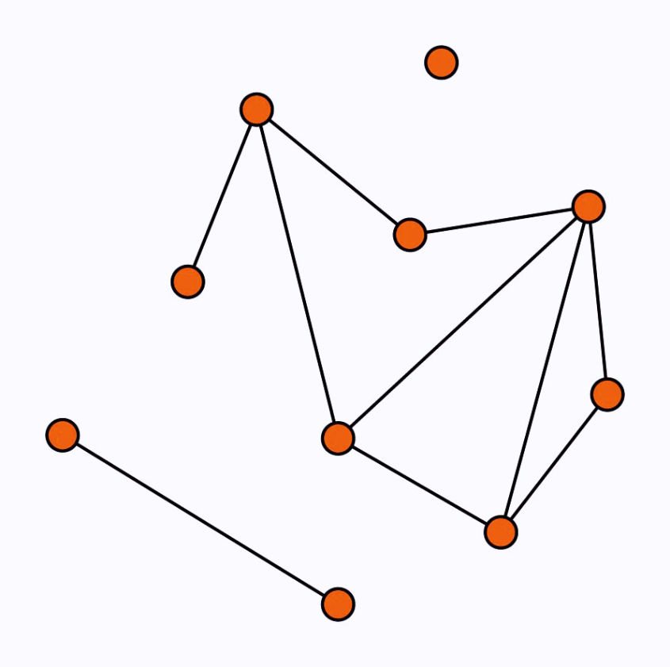
Background: Complex Networks
What are networks?
The Oxford English Dictionary: “a collection of interconnected things”
Mathematically, network is a graph
Network = graph + extra structure
“Classification”
Technological Networks
Social Networks
Information Networks
Biological Networks
Notes:
Let me start with a general discussion about complex networks. First of all, what are networks? The Oxford English Dictionary defines a network as …
So this is exactly what mathematicians call a graph. Why a new term? What is different.? A network “a graph with some context-dependent extra structure” (Aldous). What it means. Graphs are purely mathematical abstract structures. Networks are real, nodes and edges have certain physical meanings. When we study networks we keep this “extra structure” in mind and take it into account. It is useful to think about a network as a simplified representation of a complex system, its structural skeleton that captures the pattern of connection between system components.
There are four general classes of networks. This classification is of course conventional.
Recent years have witnessed an explosion of network data. Large datasets of social, biological, technological, and information networks are analyzed by thousands of scientists around the world, making probabilistic modeling and statistical analysis of network data a mainstream research area in computer science, social sciences, system biology, physics, and statistics

Slide 3
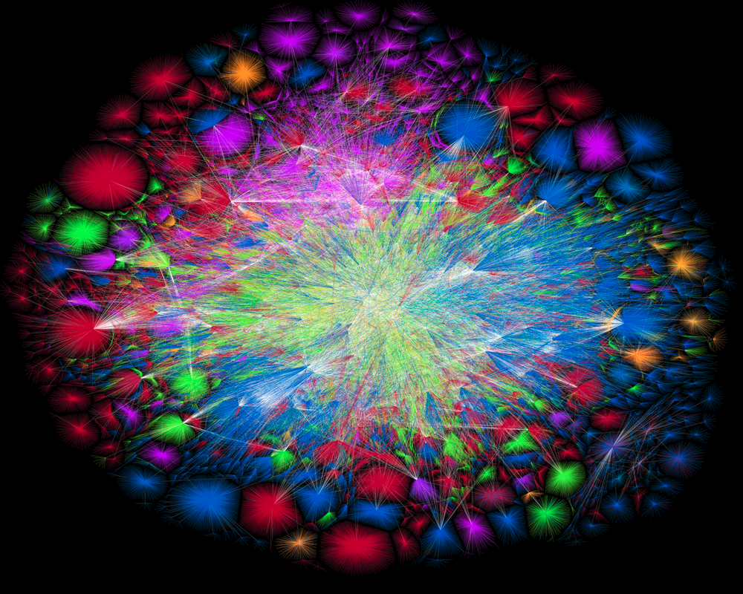
Technological Networks
Example
The Internet
(“drosophila” of network science)
Nodes: computers
Links: physical connections
(optical fiber cables or telephone lines)
North America
Europe
Latin America
Asia Pacific
Africa
The Opte Project (http://www.opte.org/)
Notes:
Technological networks are engineered networks that form the backbone of modern technological societies. Telephone networks, Power grids, Transportation networks, Distribution networks
The Internet is a “drosophila" of network science, the most studied complex network.

Slide 4
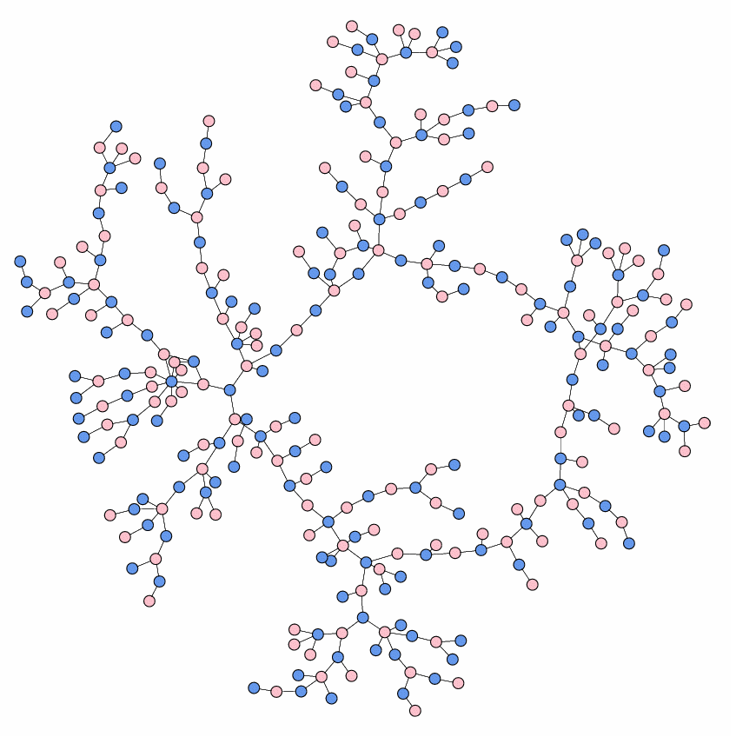
Social Networks
Example
High School Dating
(Data: Bearman et al (2004))
Nodes: boys and girls
Links: dating relationship
Notes:
The vertices (actors) are people, groups of people, or animals, and the edges (ties) represent social interaction between them.
Friendship networks, Online social networks, Networks of sexual contact, Affiliation networks, Financial networks.

Slide 5
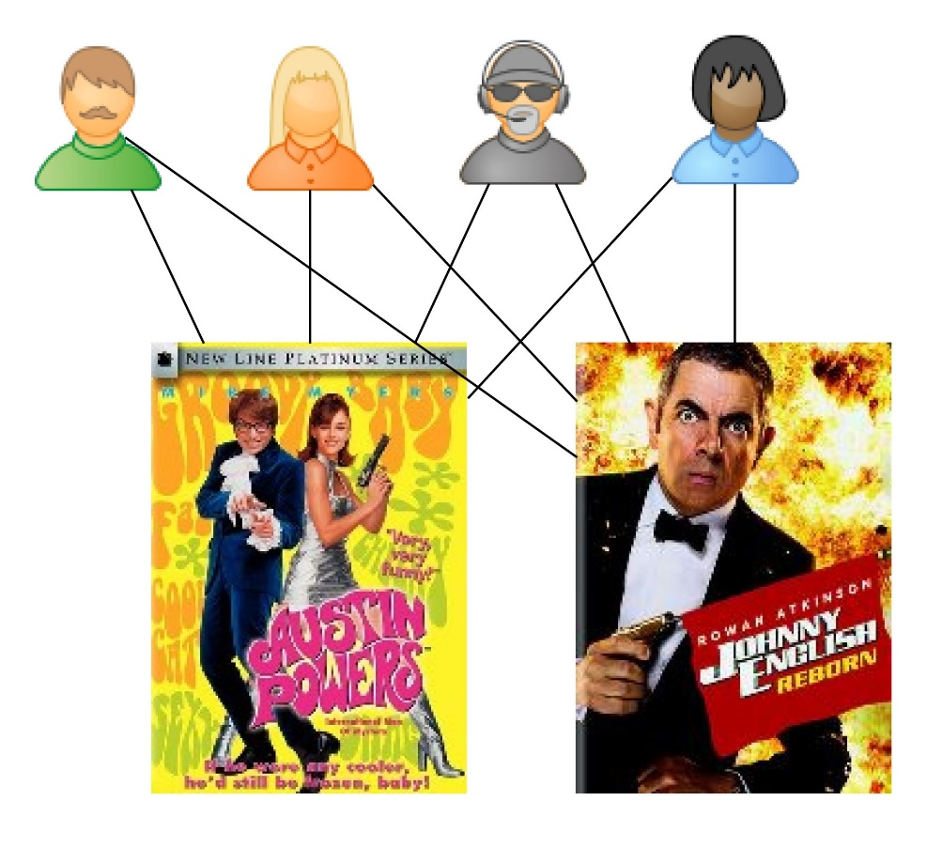

Information Networks
new
customer
Example
Recommender networks
Bipartite: two types of nodes
Used by
  Microsoft
  Amazon
  eBay
  Pandora Radio
  Netflix
Notes:
The vertices are items of data, and the edges represent relatedness between these data.
The World Wide Web, Citation networks, Recommender networks.
Recommender networks represent people's preferences for different things, such as books, music, films, etc.
The fundamental representation of a recommender network is a bipartite network, a network with two types of nodes, one representing the products and the other representing the people, with edges connecting people with products they buy or like. Recommender networks are used by many companies (Amazon.com, eBay, Pandora Radio, Netix, etc) to develop algorithms (recommender systems) that attempt to guess items that people will buy or like.

Slide 6
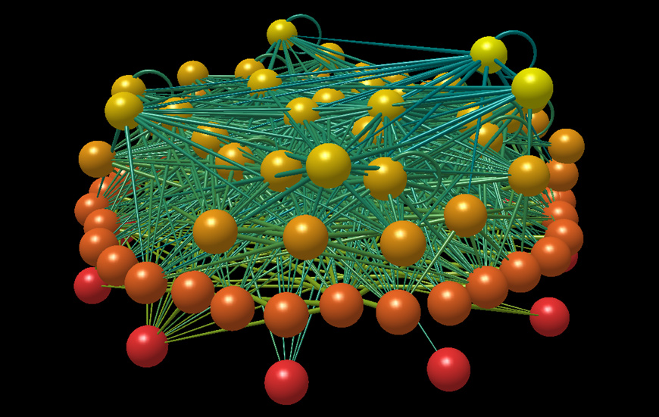
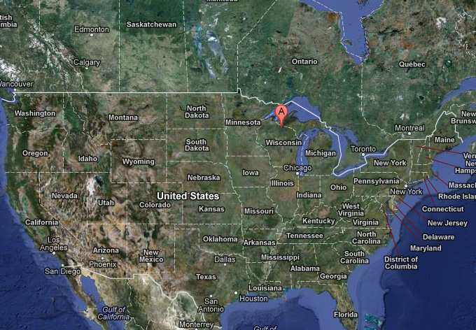
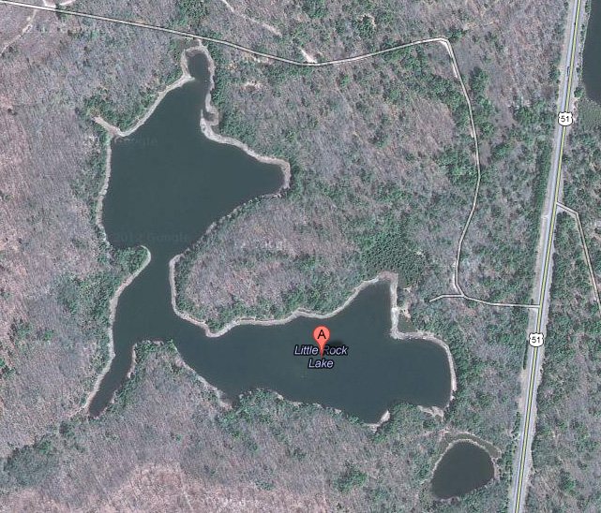
Biological Networks
Example
Food webs
Nodes: species in an ecosystem
Links: predator-prey relationships
Martinez & Williams, (1991)
92 species
998 feeding links
top predators at the top
Wisconsin
Little Rock Lake
Notes:
Used to represent patterns of interaction between biological elements.
Biochemical networks, Neural networks, Food webs.
A food web is an ecological network. A food web is a directed network that represents which species prey on which others in a given ecosystem. The vertices correspond to species and the directed edges to predator-prey interactions.

Slide 7
They can help to shed some light on:
Networks are Everywhere!
Spread of epidemics in human networks
  Newman “Spread of Epidemic Disease on Networks” PRE, 2002.
Prediction of a financial crisis
  Elliott et al “Financial Networks and Contagion” American Economic Review, 2014.
Theory of quantum gravity
  Boguñá et al “Cosmological Networks” New J. of Physics, 2014.
How brain works
  Krioukov “Brain Theory” Frontiers in Computational Neuroscience, 2014.
How to treat cancer
  Barabási et al “Network Medicine: A Network-based Approach to Human Disease” Nature Reviews Genetics, 2011.
Notes:
So if we look careful, we will see that networks are in fact everywhere. It is important to study network data, because this can help to shed some light of many questions and phenomena in complex systems: spread of diseases in human networks, prediction of a financial crisis. In business applications, such as identification of the gender of a user based on the keywords he or she typed into the search line. Some researchers think that studying complex networks may even help to understand how brain works and how to fight cancer.

Slide 8
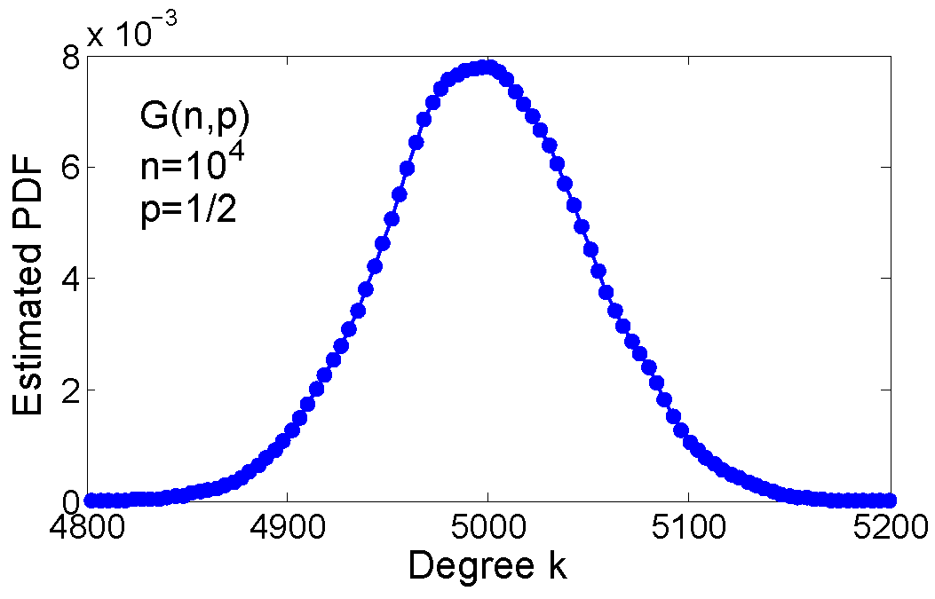

How do complex networks grow?
Erdős–Rényi Model G(n,p)
Take n nodes
Connect every pair of nodes
at random with probability p
Real networks
are “scale-free”
$$≠$$
Notes:
One of the fundamental problems in the study of complex networks is to uncover hidden evolution
mechanisms that shape the structure and dynamics of large real networks.
In ER networks, the degree distribution is binomial, which for large N is well approximated by Poisson distribution.

Slide 9
Scale-free networks with
Preferential Attachment Mechanism
Barabási–Albert Model
Start with n isolated nodes.
New nodes come one at a time.
A new node i connects to m old nodes.
The probability that i connects to j
j
i
“rich gets richer”
Issues with PA
Zero clustering
No communities
Notes:
The preferential attachment (PA) mechanism, where new connections are made preferentially to more popular nodes, is widely accepted as the plausible explanation for
the emergence of the scale-free structures (i.e. the power-law degree distributions) in large networks. BA showed empirically, Krapivsky, Dorogovtsev, etc, analytically.
Nevertheless, PA alone cannot explain two other empirically observed universal properties of complex networks: strong clustering 14 and significant community structure.
Namely, in synthetic networks generated by standard PA, clustering is asymptotically zero and there are no communities

Slide 10

Universal Properties of Complex Networks
Heavy-tail degree distribution
(“scale-free” networks)
Strong clustering
(“many triangles”)
Community structure
PA
Friendship network of
children in a U.S. school
Notes:
The concept of clustering, originally introduced in Watts, D. J. & Strogatz Nature 1998, quantifies the tendency to form cliques (complete subgraphs) in the neighborhood of a given node. Specifically, the local clustering coefficient of node s is defined as the probability that two nodes s’ and s’’, adjacent to s, are also connected to each other.
In social networks, the presence of communities, that might represent groupings based on certain social factors such as economic status or political beliefs, is intuitively expected. A remarkable observation 15, 22–26 is that many other networks, including food webs, the world wide web, metabolic, biochemical, and financial networks, also admit a reasonable devision into informative communities. Since that discovery, community detection has become one of the main tools for the analysis and understanding of network data. Despite an enormous amount of attention to community detection algorithms and their efficiency, there were very few attempts to answer a more fundamental question: what is the actual mechanism that induces community structure in real networks?
Surprisingly, there exists no simple generative mechanism explaining all the three properties at once in growing networks. Here we show how the hidden geometric space underlying the network and preferential attachment of nodes to this space induce community structure as well as the power-law degree distribution and strong clustering. We prove that these universal properties of complex networks naturally emerge from the new mechanism, called geometric preferential attachment (GPA). Using the Internet as example, we demonstrate that GPA generates synthetic networks that are similar to real complex networks.

Slide 11
Popularity versus Similarity
Intuition
How does a new node make connections?
It connects to popular nodes
  Preferential Attachment
It connects to similar nodes
  “Birds of feather flock together”
  Homophily
Popular node
New node
Similar node
Key idea: new connections are formed by
trade-off between popularity and similarity
Notes:
In growing networks the concept of popularity that PA exploits is just one aspect of node attractiveness; another important aspect is similarity [36]. Namely, if nodes are similar
(“birds of feather”), then they have a higher chance of being connected (“flock together”), even if they are not popular. This effect, known as homophily in social sciences [37],
has been observed in many real networks of various nature [38, 39].

Slide 12

Popularity-Similarity Model
In a growing network:
The popularity of node is modeled by its birth time
The similarity of is modeled by distributed over a similarity space
  The angular distance quantifies the similarity between s and t.
Mechanism:
a new node connects to an existing node
if is both popular and similar to , that is if:
is small
controls the relative contributions of popularity and similarity
Notes:
All other things being equal, the older the node (i.e. the smaller t), the more popular it is.
One can think of the similarity space as an image of a certain projection p from a space of unknown or not easily measurable attributes (a1; : : : ; ak) 2 A of nodes.
For social networks, these attributes could be political beliefs, education, and social status, whereas for biological networks, they may represent chemical properties of metabolites or geometric properties of protein shapes. While the absolute value of the similarity coordinate does not have any specific meaning, the angular distance quantifies the similarity between two nodes.
Upon its birth, a new node t connects to an existing node s < t if s is both popular enough and similar to t, that is if sst is small, where beta is a parameter that controls the relative contributions of popularity and similarity.

Slide 13
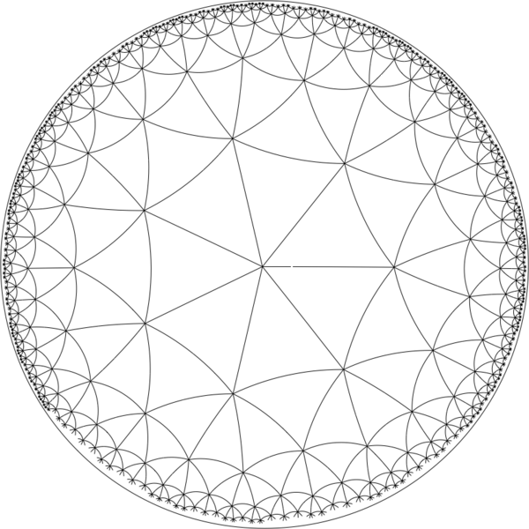
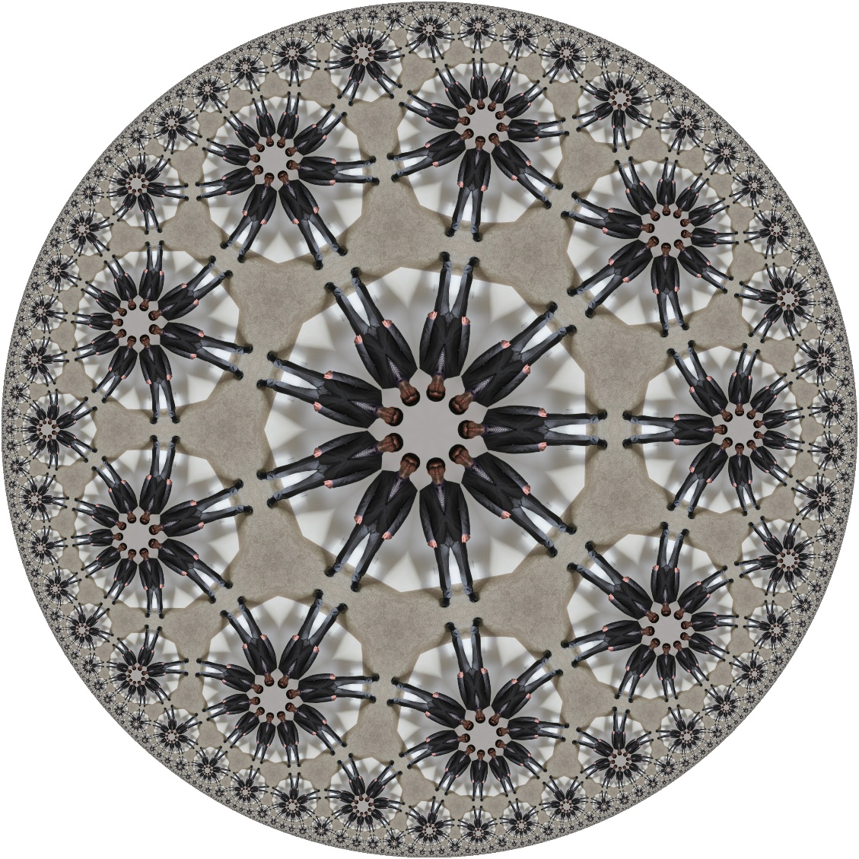
Geometric Interpretation using Hyperbolic Geometry
Tessellation of the Poincare disc with the Schläfli symbol {9, 3},
rendering an image of the speaker (the Poincare tool by B. Horn).
Poincare model of hyperbolic plane
Notes:
See the Hyperbolic geometry paper for a few words here
The exponentially growing number of people lying on the hyperbolic fl oor illustrates the exponential expansion of the hyperbolic space. All people are of the same hyperbolic size.

Slide 14
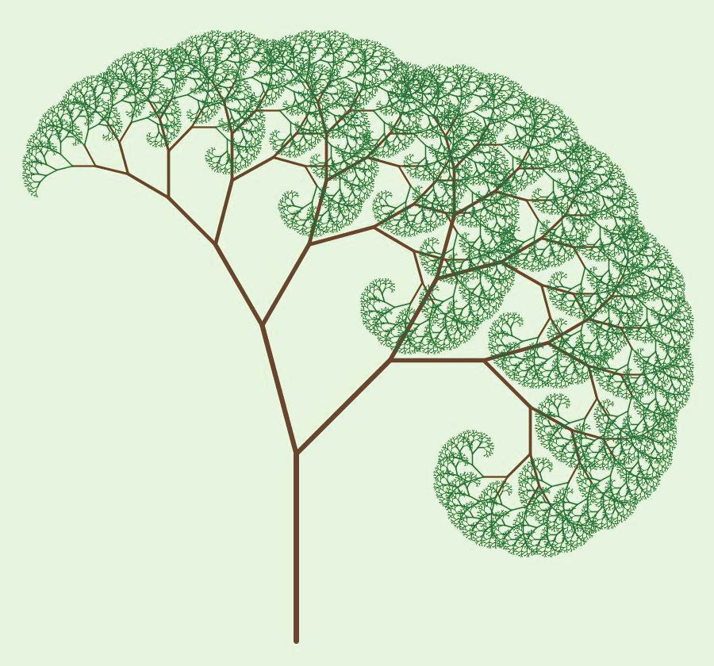
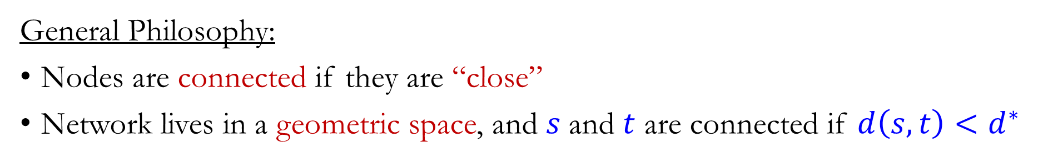
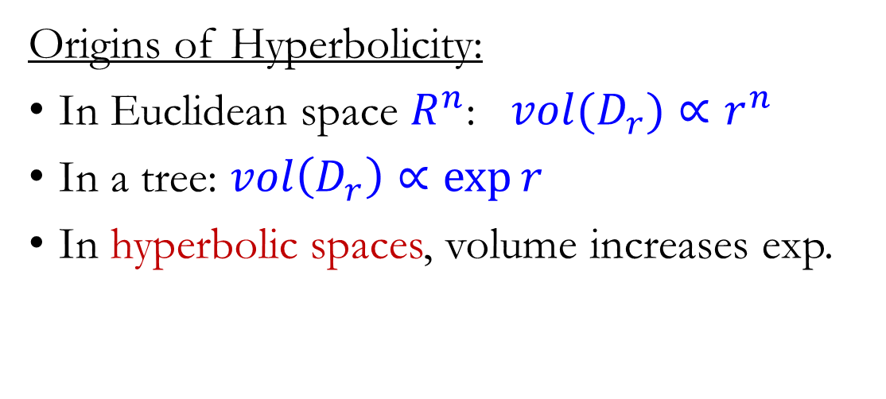
Why Geometry? Why Hyperbolic?
General Philosophy:
Nodes are connected if they are “close”
Network lives in a geometric space, and $s$and $t$ are connected if $d\left(s,t\right)<d^{∗}$
Origins of Hyperbolicity:
In Euclidean space $R^{n}$: $vol(D_{r})∝r^{n}$
In a tree: $vol\left(D_{r}\right)∝\exp{r}$
In hyperbolic spaces, volume increases exp.
Hyperbolical spaces are natural homes
for complex networks

Slide 15
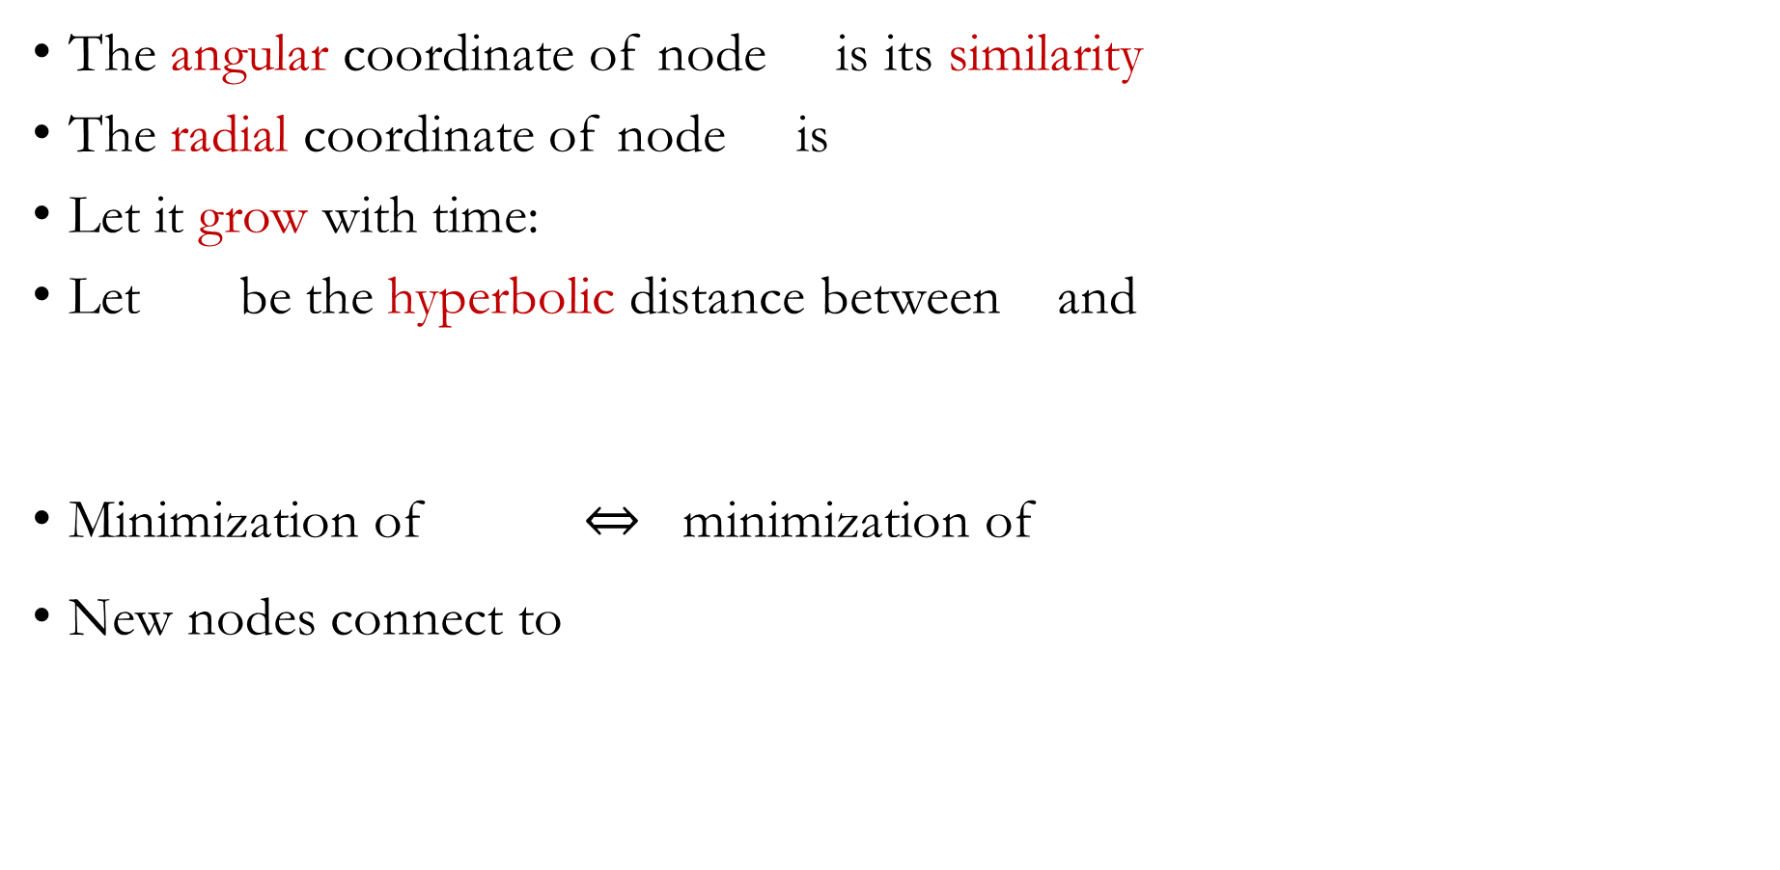
Complex Network in a Hyperbolic Disk
The angular coordinate of node is its similarity
The radial coordinate of node is
Let it grow with time:
Let be the hyperbolic distance between and
Minimization of minimization of
New nodes connect to
hyperbolically closets existing nodes
Hyperbolic Disk
We call this mechanism: Geometric Preferential Attachment
Notes:
The described rule for establishing new connections admits a simple geometric interpretation which is very useful for analytical treatment of the model.
Note that the increase of the radial coordinate rs(t) makes a node younger (decreases its popularity), and thus models the effect of popularity
fading observed in many real networks.

Slide 16
Geometric Preferential Attachment
How does a new node find its position in the similarity space ?
Fashion: contains “hot” regions.
Attractiveness of for a new node
is the number of existing nodes in
The higher the attractiveness of ,
the higher the probability that
Notes:
The main assumption of our model is that the hidden attribute space A of a growing network is likely to contain “hot” regions (e.g. of human activity), and that the hotter the region, the more attractive it is for new nodes. Hot regions can for instance represent some hot areas in science. When these regions are projected onto the similarity space S1, the hotness manifests itself by a higher node density, more scientists working in a hot area. The higher attractiveness of a hot region is then modeled by placing a new node in this region with the higher probability, the hotter this region is, i.e. the higher the node density in it. That is, new scientists are expected to begin their careers working in hot areas where many existing scientists are already active, versus jumping onto some obscure developments that nobody understands. Therefore the higher the node density in a particular section of our similarity space S1, the higher the probability that a new node is placed in this section.

Slide 17
GPA Model of Growing Networks
Initially the network is empty. New nodes appear one at a time.
The angular (similarity) coordinate of is determined as follows:
  Sample uniformly at random (candidate positions)
  Compute the attractiveness for all candidates
  Set with probability
  is initial attractiveness
The radial (popularity) coordinate of node is set to
The radial coordinates of existing nodes are updated to
Node connects to hyperbolically closet existing nodes.
models popularity fading

Slide 18
GPA as a Model for Real Networks
GPA is the first model that generates networks with
  Heavy-tail degree distribution
  Strong clustering
  Community structure
Can we estimate the model parameters from the network data?
The model has three parameters:
  the number of links established by every new node
  the speed of popularity fading
  the initial attractiveness
“Universal” properties
of complex networks
Notes:
And so what? Just another model for network evolution?
It turns out that estimating m and beta is straightforward, but estimating Lambda is more difficult.
In order to use the model (for example for predicting the network growth), we should be able to estimate the model parameters

Slide 19
Inferring Model Parameters
Assumption: Real network G is generated by the GPA model:
controls the average degree in GPA-networks:
controls the power-law exponent in GPA-networks:

Slide 20
Inferring
controls the heterogeneity
of the angular node density
Kolmogorov-Smirnov statistic
inference is challenging
inference is easy
Thanks to communities, we expect real networks to have small values of
Notes:
Figure~2 shows the simulation results for networks of size $n=10^3$ generated by the GPA model with $m=3$ (i.e. each new node connects to the three hyperbolically closest nodes), $\beta=2/3$, and different values of $\Lambda$. As expected, the smaller the value of $\Lambda$, the more heterogeneous the distribution of angular coordinates is. To quantify the difference between the empirical distribution of the angular coordinates and the uniform distribution on $[0,2\pi]$, we use the Kolmogorov-Smirnov (KS) statistic, one of the standard distances that measures the difference between two probability distributions. Recall that the KS statistic $\rho$ is defined as the maximum difference between the values of the empirical distribution $\hat{F}_n(\theta)$ of the sample $\theta_1,\ldots,\theta_n$ and the uniform distribution $F_{U[0,2\pi]}(\theta)=\theta/2\pi$.
he KS statistic as a function of $\Lambda$ is shown in the bottom panel of Fig.~2. As expected, $\rho(\Lambda)$ is a decreasing function.

Slide 21
Hyper Map
To infer we need to embed
into the hyperbolic plane
Hyperbolic Atlas of the Internet
Nodes are autonomous systems
Two ASs are connected if they
exchange traffic
Node size
Font size
Notes:
An AS is, roughly, a part of the Internet owned and administered by the same organization. ASs range in size from small companies, or even private users, to huge international corporations.
Connections between ASs are results of local independent decisions based on business agreements between AS pairs.
The size of AS nodes is proportional to the logarithm of their degrees. The font size of the country names is proportional to the logarithm of the number of ASs that
the country has.
Surprisingly, we find that even though our mapping method is completely geography agnostic, it discovers meaningful groups or communities of ASs belonging to the same country. we find many cases of geographically or politically close countries placed close to each other in our hyperbolic map. ASs belonging to the same country, geographicregion or geo-political or economic group are connected more densely to each other than to the rest of the world, then this higher connection density translates to a higher attractive force that tries to place all such ASs close to each other in our map.
MAPPING ASs TO COUNTRIES The AS-to-country mapping is taken from the CAIDA AS ranking project [47]. It uses two methods for this task. The first method is IP-based. It splits the IP address space advertised by an AS into small blocks, and then maps each block to a country using [72]. If not all IP blocks of an AS map to the same country, then the other, WHOISbased method is used, which reports the country where the AS headquarters are located according to the WHOIS database [73]. Since large ASs have points of presence in many countries, they tend to map to multiple countries using the IP-based method. Therefore, if we did not apply the WHOIS-based method to them, they would no longer map to a single country. If we ignored such ASs, the angular distributions of the remaining ASs belonging to a given country would be even more localised, including the US, EU, and UK ASs. In our hyperbolic map data, we release the AS-to-country associations using both methods, IP+WHOIS-based and IP-based. The latter has no country information for many ASs with conflicting country mappings.

Slide 22
Maximum Likelihood Estimation
Given the network embedding
The log-likelihood:
Using Monte Carlo:
Notes:
where $A_t(\varphi)$ is the attractiveness of location $\varphi\in\mathbb{S}^1$, %(\ref{attractiveness}),
that is the number of existing nodes at time $(t-1)$ that lie within distance $r_t$ from $(r_t,\varphi)$. The log-likelihood is then (up to an additive constant):
The multiple integrals in (\ref{logLiklihood}) cannot be calculated analytically, since the attractiveness function cannot be written in closed-form. Nevertheless, the log-likelihood can be efficiently estimated be the Monte Carlo method.

Slide 23
MLE in Synthetic GPA networks
As expected:
the smaller , the easier to estimate it
Notes:
Table~1 shows the MLEs $\widehat{\Lambda}_{\mathrm{MLE}}(n_0)$ obtained from the first $n_0=100, 200, 500$, and $1000$ nodes of the networks generated by the GPA model with $\Lambda=0, 0.2, 0.5, 0.7, 1,$ and $2$.
True values of the initial attractiveness parameter and its MLEs MLE(n0) based on the first n0 = 100; 200; 500; and 1000 nodes. In all simulations, N = 100 Monte Carlo samples were used
The corresponding log-likelihood functions are shown in Fig.~6. The estimated log-likelihood functions $l(\Lambda|\theta_1,\ldots,\theta_n)$ for synthetic networks of size $n=10^3$ generated by the GPA model with $\Lambda=0, 0.2, 0.5, 0.7, 1,$ and $2$. Each log-likelihood is estimated by (\ref{LogLikMC}) using $N=100$ Monte Carlo samples and $n_0=500$ first nodes.}

Slide 24
The Internet
AS Internet topology as of Dec 2009
N=25910 nodes
M=63435 links
Power-law exponent
Average degree
Initial attractiveness
Box Plot: 100 GPA networks
(with the same parameters)
Notes:
Figure 5(a) shows the histogram of the angular node density for the AS Internet snapshot. Notice that it is far from being uniform.
We quantify the degree of heterogeneity of the angular density by the KS distance from the uniform distribution (\ref{KS_def}) and juxtapose it against the KS distances computed for networks generated by the GPA model with $\Lambda=0.7$ (Fig.~5(b)). The Internet value lies within the 25th and 75th percentiles of the synthetic values, which shows that the degrees of non-uniformity in the Internet and GPA networks are comparable.

Slide 25
References
General text on Complex Networks
  M. Newman Networks: An Introduction 2009 aka Big Black Book
Hyper Map
  F. Papadopoulos et al “Network Mapping by Replaying Hyperbolic Growth”
  IEEE/ACM Transactions on Networking, 2015 (first arXiv version 2012 )
Geometric Preferential Attachment
  K. Zuev et al “Emergence of Soft Communities from Geometric Preferential Attachment” Nature Scientific Reports 2015.

Slide 26



Collaborators
Dima Krioukov
Northeastern University
Marián Boguñá
Universitat de Barcelona
Ginestra Bianconi
Queen Mary University of London

