Slide 1
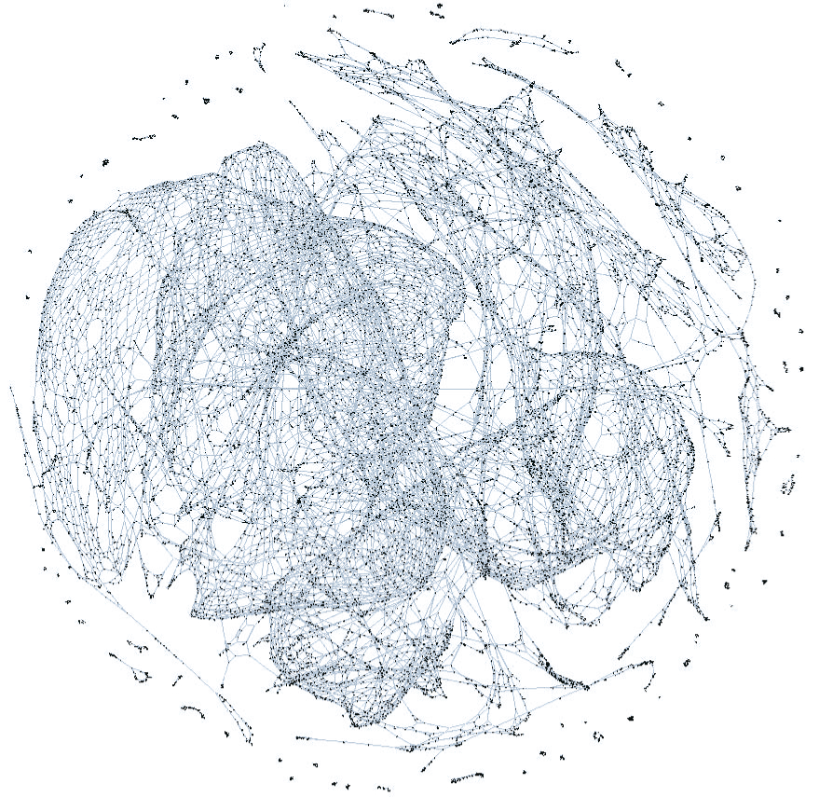
Reliability of Critical Infrastructure Networks at Local and Global Scale
Konstantin Zuev
http://www.its.caltech.edu/~zuev/
Clemson University
October 28, 2016

Slide 2





Research Interests: A Big Picture
Area
Applications of Probability & Statistics to Reliability Engineering
Rare Event Estimation
Infrastructure Networks
Topics
Markov Chain Monte Carlo
Bayesian
Inference
Uncertainty
Quantification
Honors
Invited Author, 2015, 2016
• Springer Handbook on
Uncertainty Quantification
• Springer Encyclopedia of
Earthquake Engineering,
Elected Chairman, 2015-2017
Committee on Probability and Statistics
in the Physical Sciences, Bernoulli Society
Organizer, 2015
Workshop “Random graphs,
simplicial complexes, and applications,” Boston, MA,
sponsored by DARPA
Associate Editor, since 2016
ASCE-ASME Journal of Risk and Uncertainty In Engineering Systems
Keynote Speaker, 2016
ASCE workshop “Resiliency of Urban Tunnels and Pipelines,” Reston, VA

Slide 3
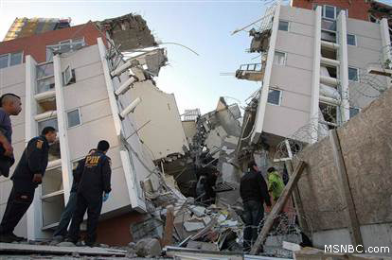
Reliability Problem: Local Scale
Problem: Estimate the probability of failure of a complex engineered system or system component considered in isolation and subject to external excitations.
represents the uncertain excitation of the system
  Random vector with the joint PDF
is a failure domain (unacceptable system performance)
is the limit state function (loss function)
is a critical threshold for performance
if and otherwise

Slide 4
Why is the Reliability Problem Challenging ?
Typically in Applications:
The dimension is very large,
The probability of failure is very small,
We can compute for any but this computation is expensive
Consequences:
Numerical Integration is computationally infeasible
Monte Carlo method is too expensive
advanced simulation methods
Idea: to use , e.g. Subset Simulation

Slide 5
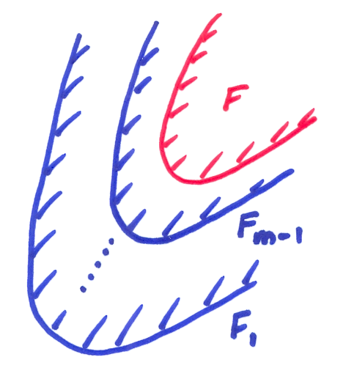

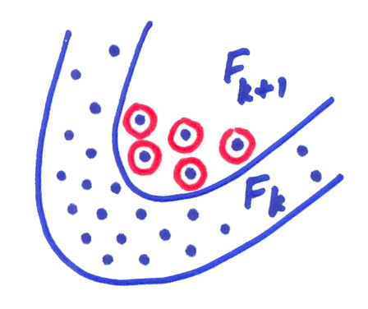
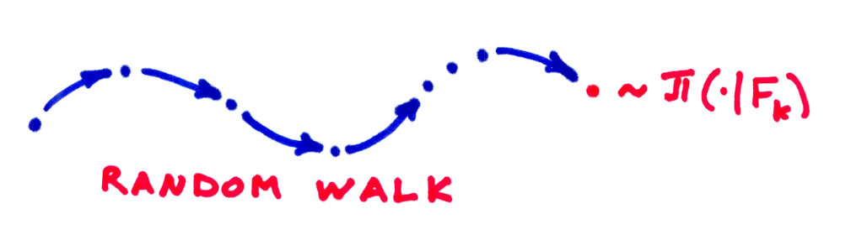
Q: How to estimate ?
Subset Simulation
Conceptual Idea
Technical Idea
Q: How to sample from ?
A: Use an MCMC algorithm

Slide 6
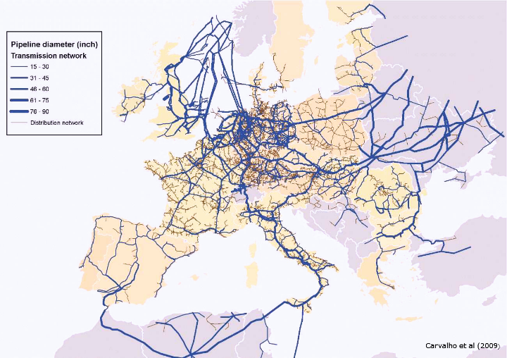
MCMC Revolution
P. Diaconis (2009), “The Markov chain Monte Carlo revolution”:
Originated in Statistical Physics: sampling from Boltzman distribution
A key computational tool in Bayesian Statistics: sampling from the posterior
Extensively used in Computer Science, Biochemistry, Finance, Engineering
...asking about applications of Markov Chain Monte Carlo (MCMC) is a little like asking about applications of the quadratic formula... you can take any area of science, from hard to social, and find a burgeoning MCMC literature specifically tailored to that area.
MCMC is useful for
efficient reliability estimation

Slide 7
Efficiency of Subset Simulation
SS estimator:
Statistical properties:
  asymptotically unbiased, and bias ~
  consistent and its C.O.V. ~
Efficiency:
What is the total number of samples required to achieve a given accuracy in ?
  Standard Monte Carlo:
  Subset Simulation: , where
Subset Simulation is very efficient when estimating small failure probabilities

Slide 8
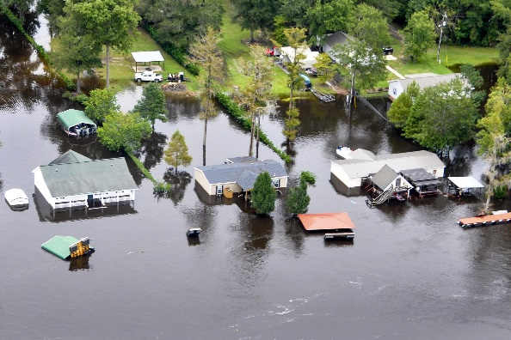
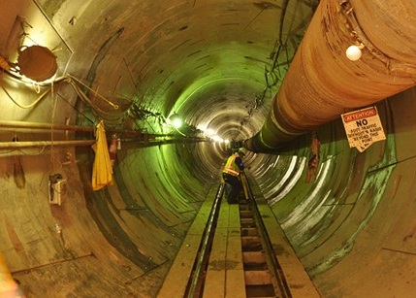

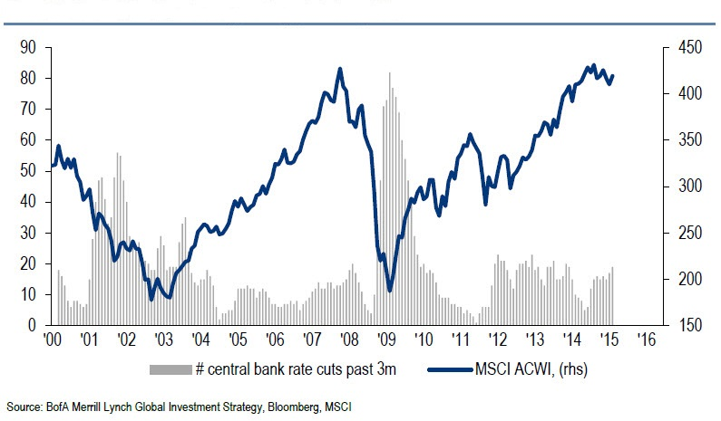
Applications of Subset Simulation
Geotechnical Engineering
  Sansoto et al (2011)
Fire Risk Analysis
  Au et al (2007)
Aerospace Engineering
  Pellissetti et al (2006)
  Thunnissen et al (2007)
Wind Turbine Reliability
  Sichani et al (2013)
Potential Areas of Application
Flood Risk Management
Underground Engineering
Insurance estimation
U.S. Department of Agriculture

Slide 9
Contribution to Local Reliability Estimation
For Students
64
citations
63
citations

Slide 10
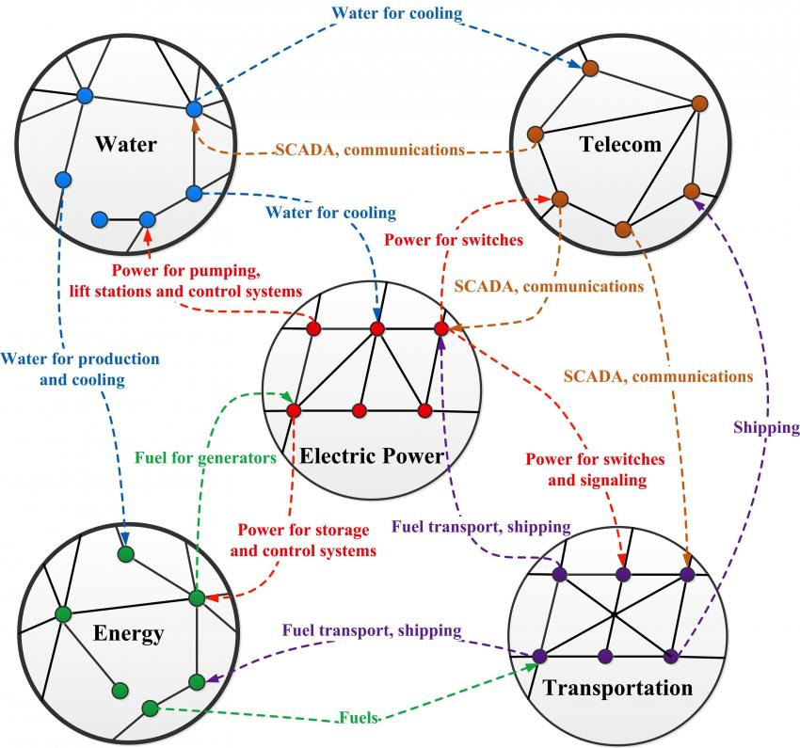
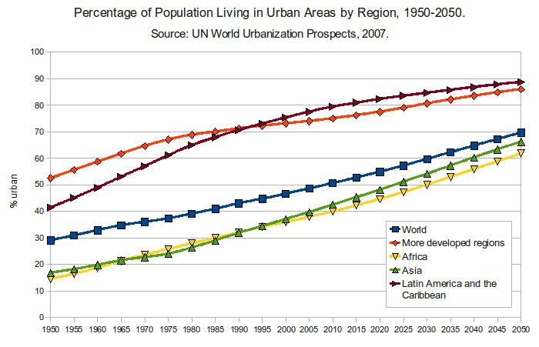
Infrastructure Networks in Urbanized World
J. Gao et al (2014) NSR
Provide energy, water, electric power, transportation, etc.
Facilitate transport-dependent economic activities.
Make communication and access to information fast and efficient.
2007

Slide 11
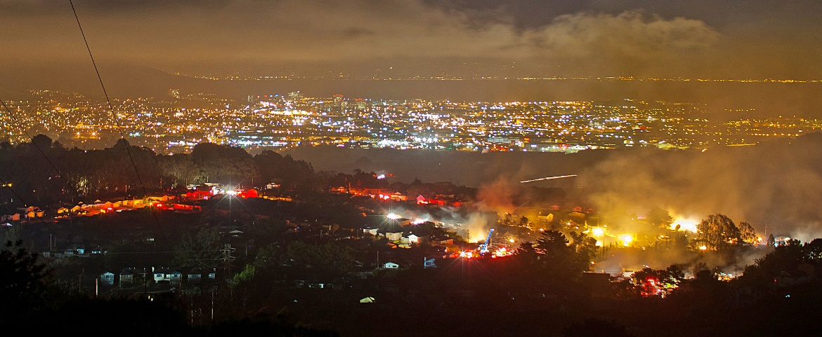
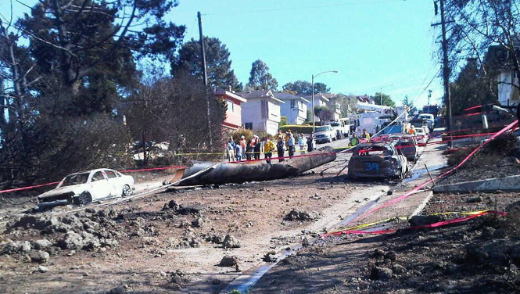
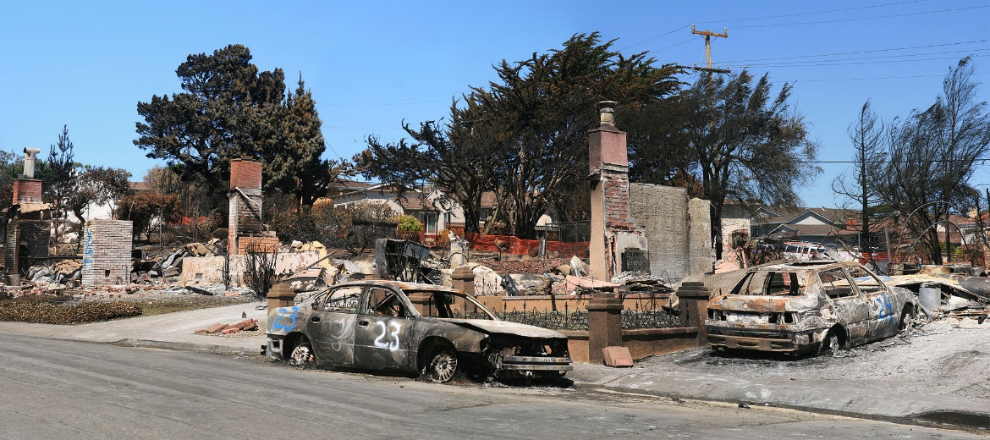
Resiliency of Critical Infrastructures
2010 San Bruno pipeline explosion
8 killed
58 injured
38 homes destroyed
Local
Failure

Slide 12
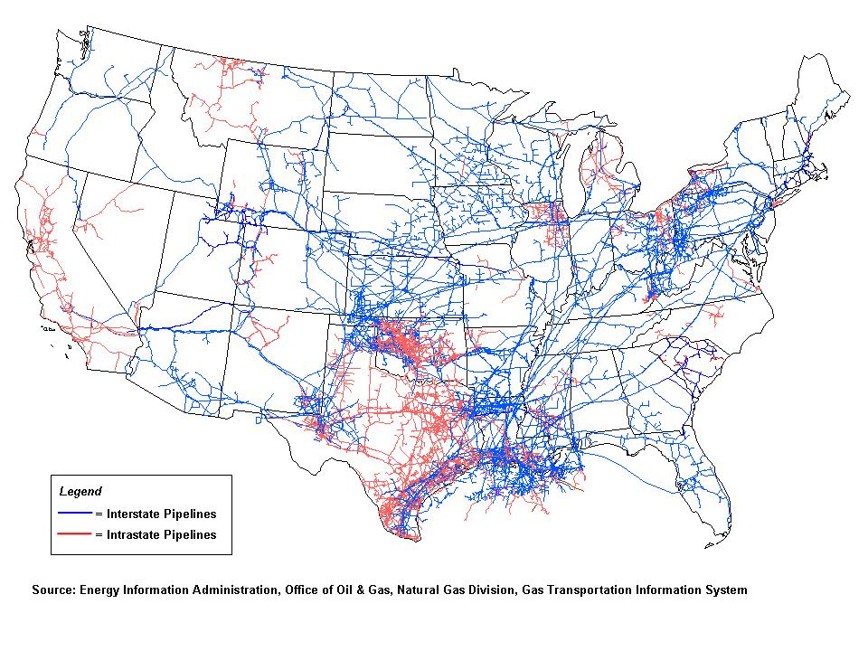
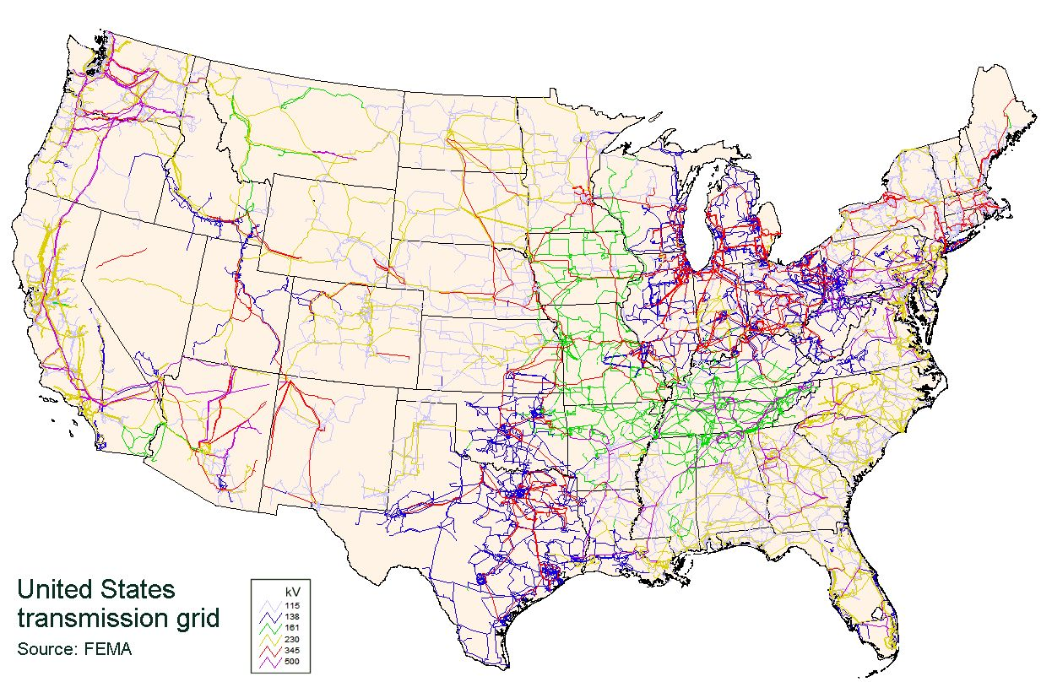



Failure Propagation in Coupled Infrastructure Networks
U.S. Natural Gas Pipeline Network
U.S. Power Grid
fuel for generators
power for compressors, storage, control systems

Slide 13
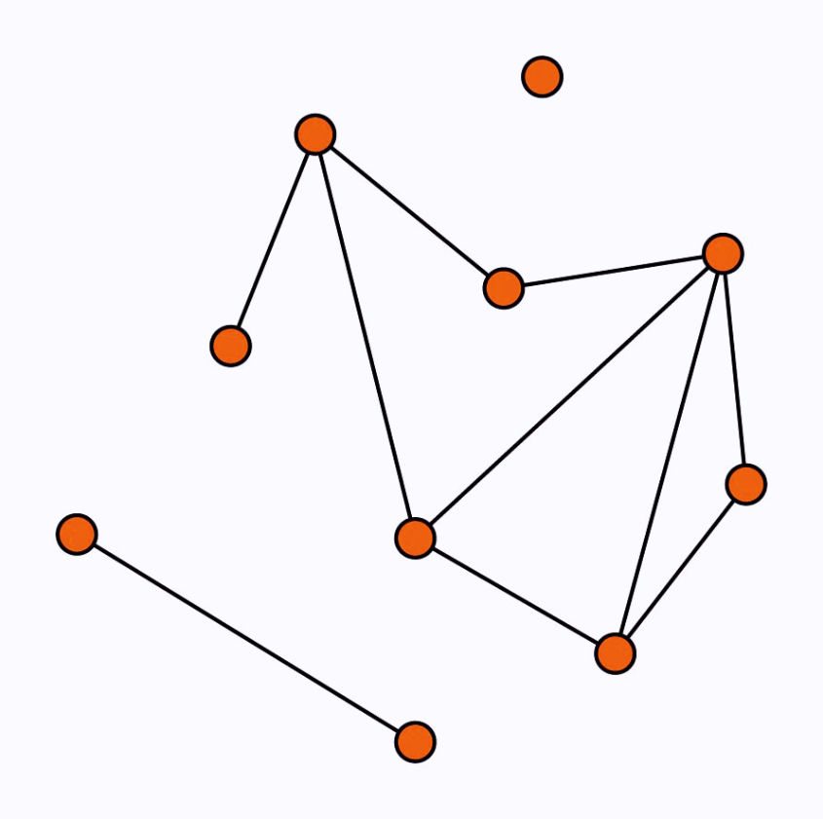
Background: Complex Networks
What are networks?
The Oxford English Dictionary: “a collection of interconnected things”
Mathematically, network is a graph
Network = graph + extra structure
“Classification”
Infrastructure Networks
Social Networks
Information Networks
Biological Networks

Slide 14
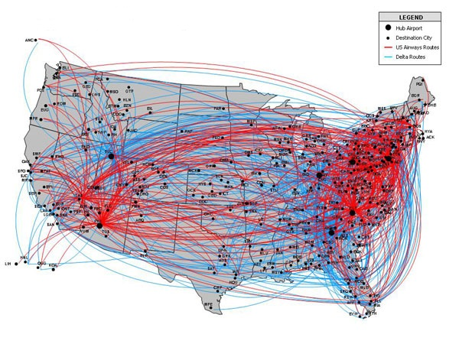
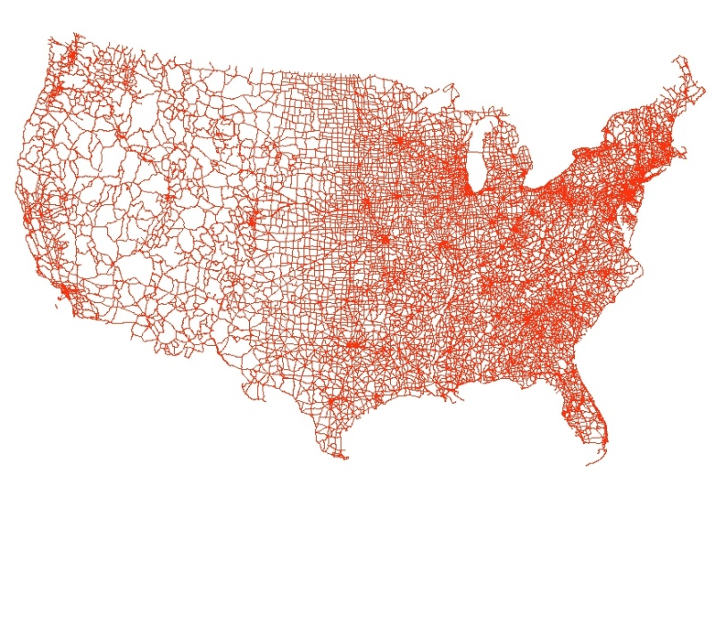
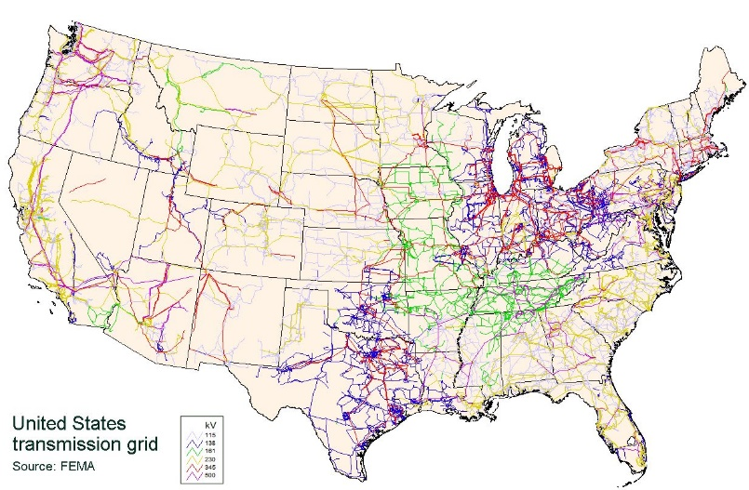
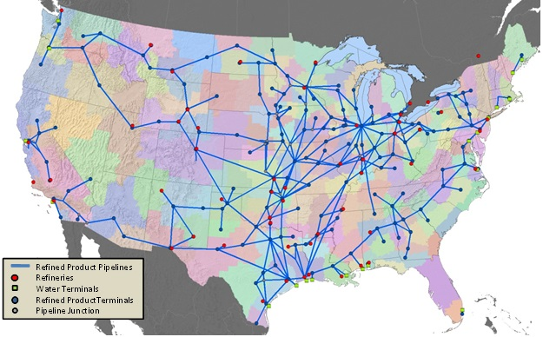
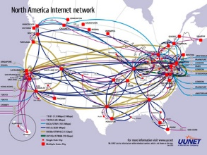
Infrastructure Networks
Road network
Airline network
Power grid
Gas network
Petroleum network
Internet

Slide 15
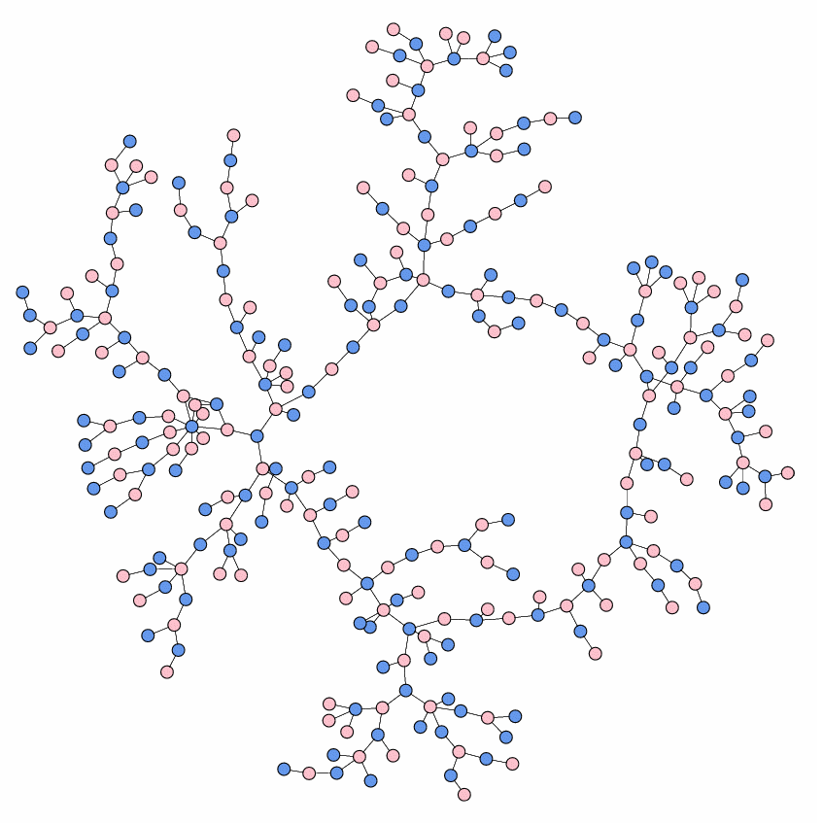
Social Networks
Example
High School Dating
(Data: Bearman et al (2004))
Nodes: boys and girls
Links: dating relationship

Slide 16
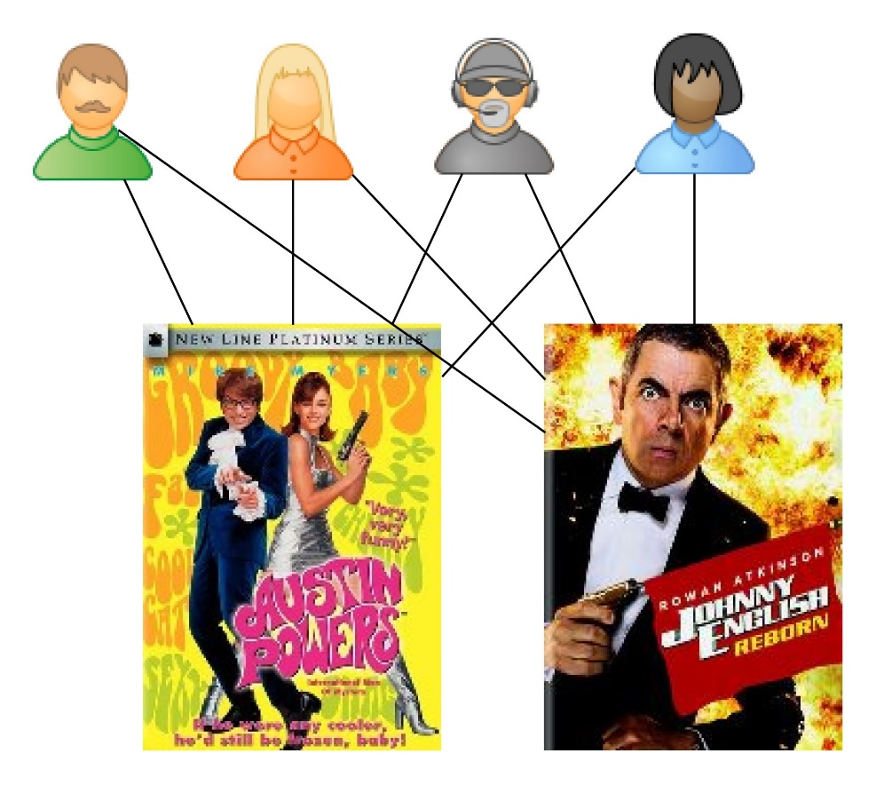

Information Networks
new
customer
Example
Recommender networks
Bipartite: two types of nodes
Used by
  Microsoft
  Amazon
  eBay
  Pandora Radio
  Netflix

Slide 17
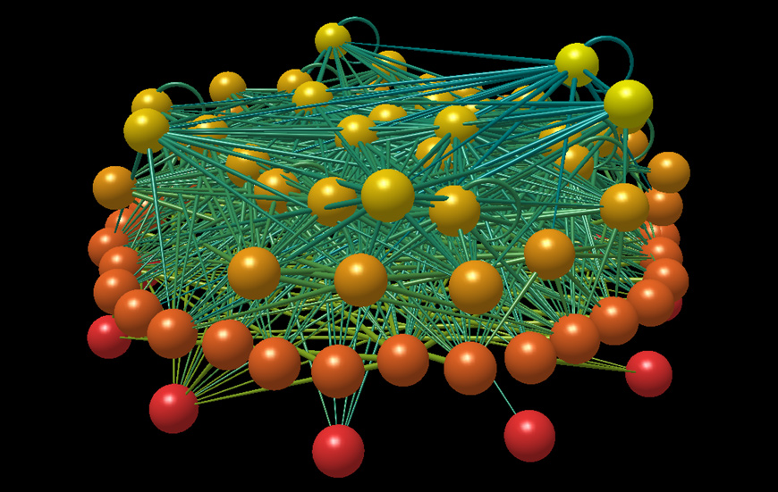
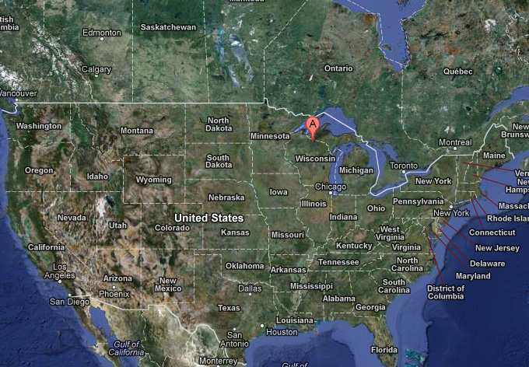
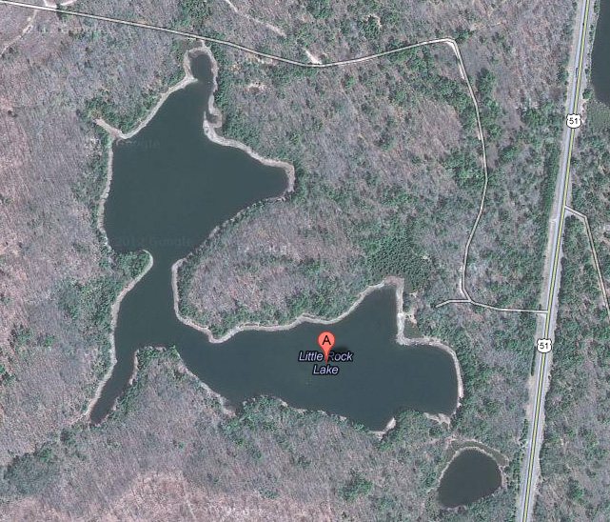
Biological Networks
Example
Food webs
Nodes: species in an ecosystem
Links: predator-prey relationships
Martinez & Williams, (1991)
92 species
998 feeding links
top predators at the top
Wisconsin
Little Rock Lake

Slide 18
Networks are used to analyze:
Networks are Everywhere!
Spread of epidemics in human networks
  Newman “Spread of Epidemic Disease on Networks” PRE, 2002.
Prediction of a financial crisis
  Elliott et al “Financial Networks and Contagion” American Economic Review, 2014.
Theory of quantum gravity
  Boguñá et al “Cosmological Networks” New J. of Physics, 2014.
How brain works
  Krioukov “Brain Theory” Frontiers in Computational Neuroscience, 2014.
How to treat cancer
  Barabási et al “Network Medicine: A Network-based Approach to Human Disease” Nature Reviews Genetics, 2011.

Slide 19
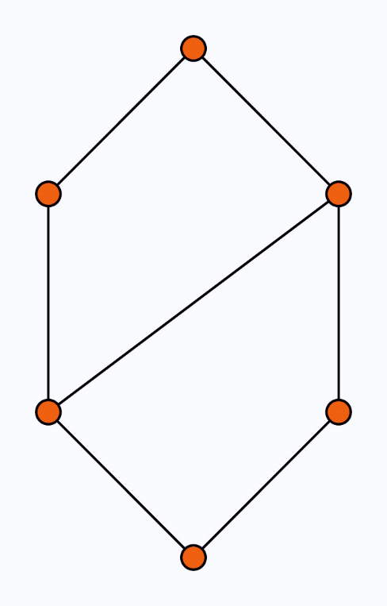
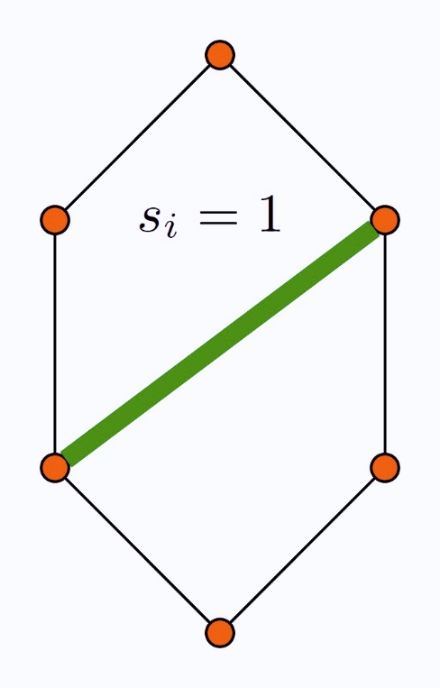
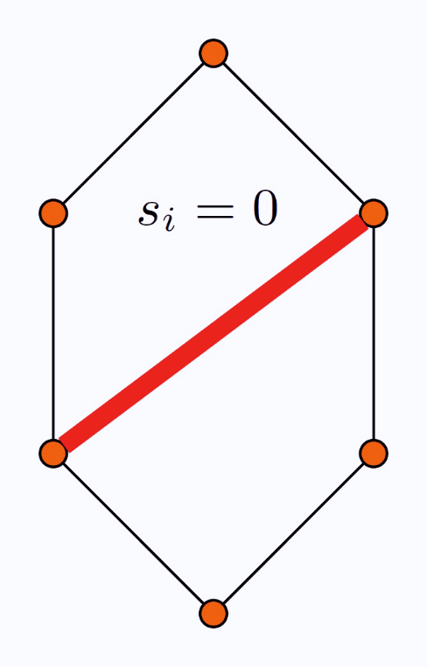
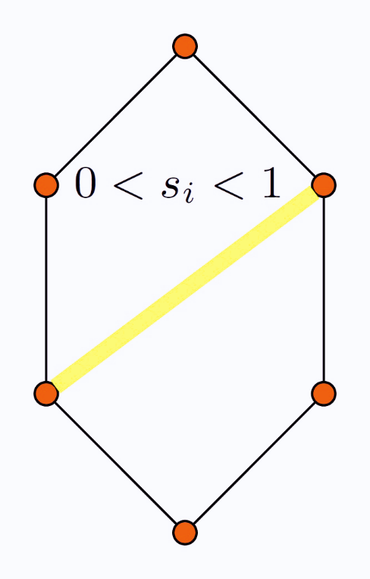
Network Reliability Problem: Global Scale
Network topology is represented by a graph
  set of all nodes
  set of all links
Network state is where
  if link is fully operational
  if link is partially operational
  if link is fully failed
Network state space is
Let be a probability distribution on
Let be a performance function (utility function)
Failure domain is
Network Reliability Problem:

Slide 20
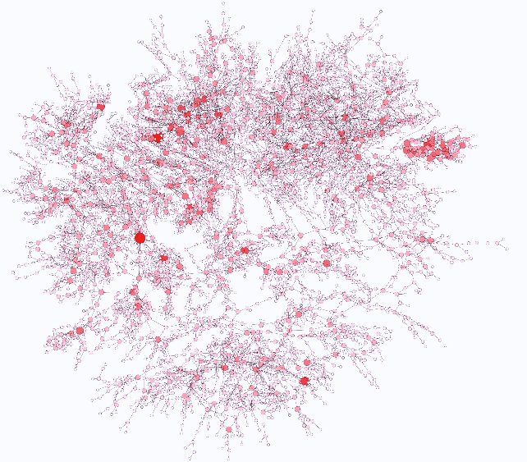
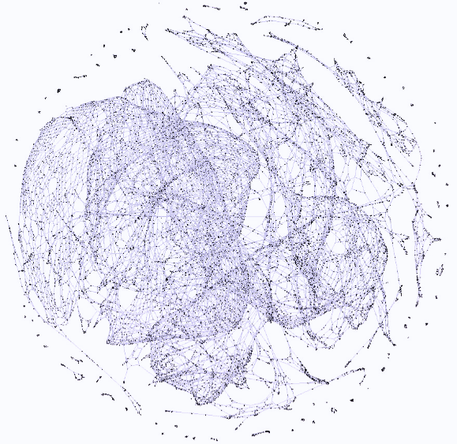
Why is the network reliability problem challenging?
US Western States Power Grid
California Road Network
In real networks:
Number of links is very large
Probability of failure is very small
Computing is time-consuming
Consequences:
Numerical integration is computationally infeasible
Monte Carlo method is too expensive
First Step:
Subset Simulation

Slide 21
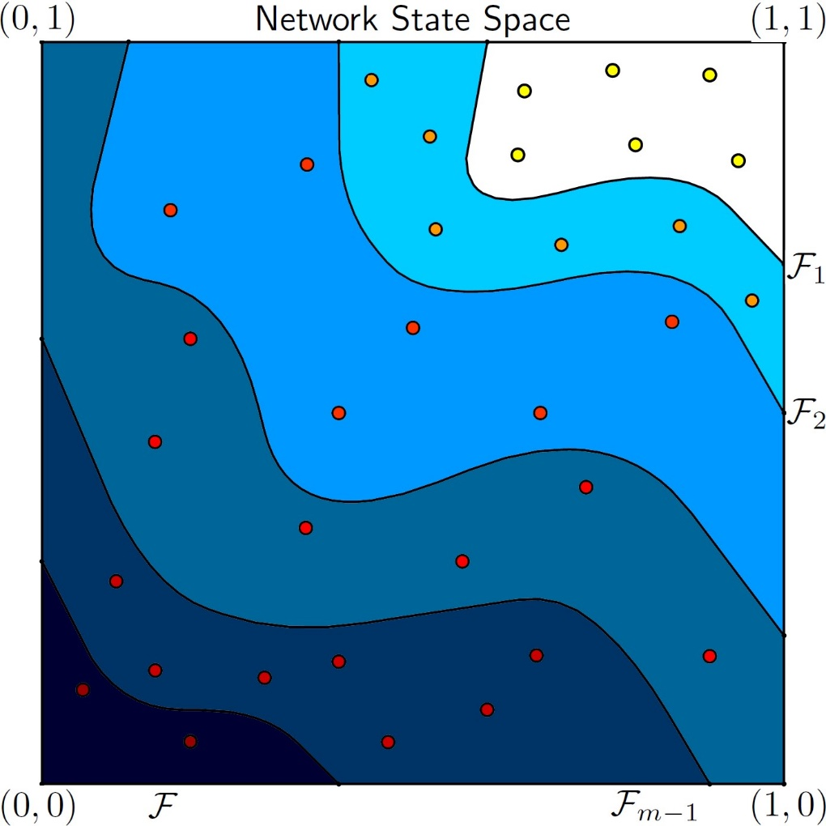
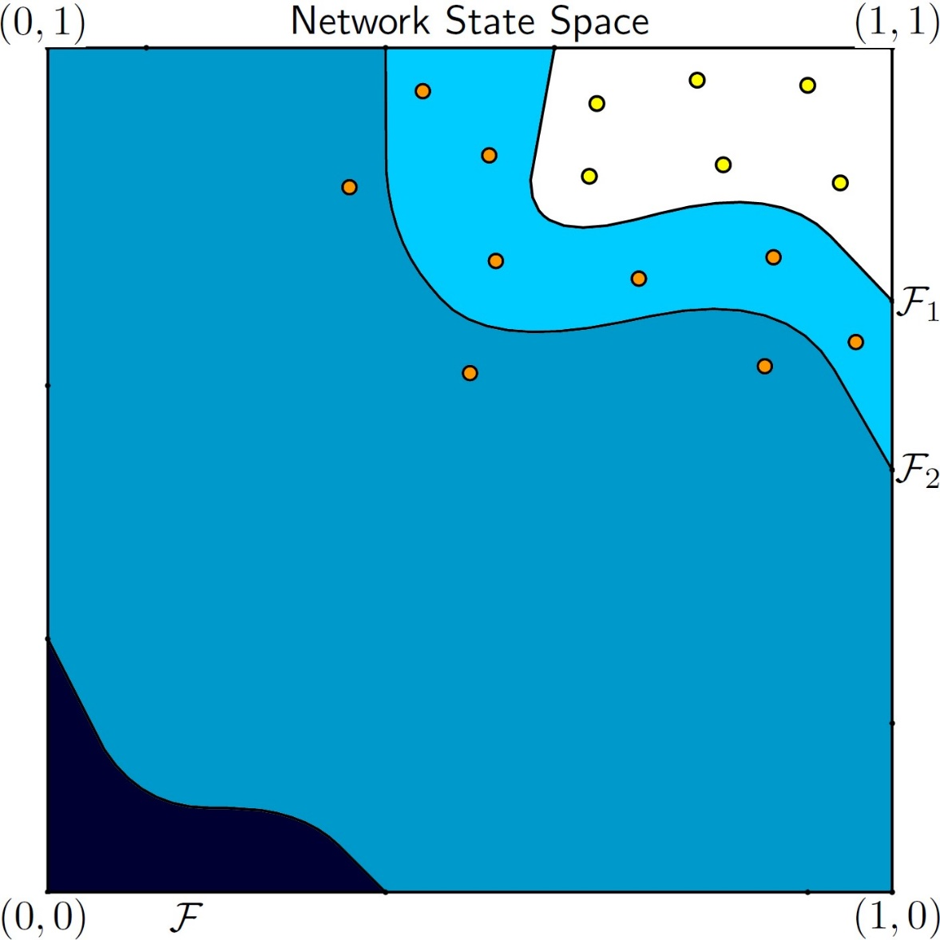
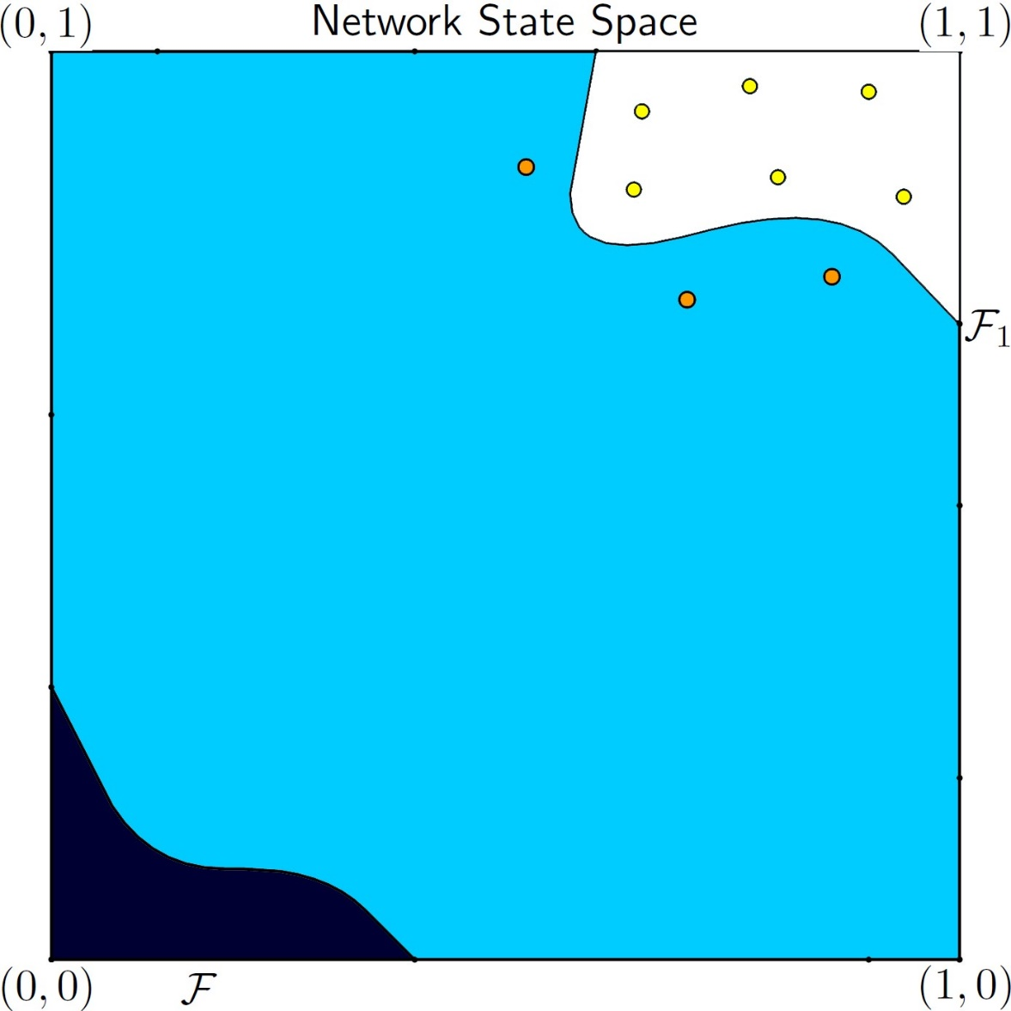

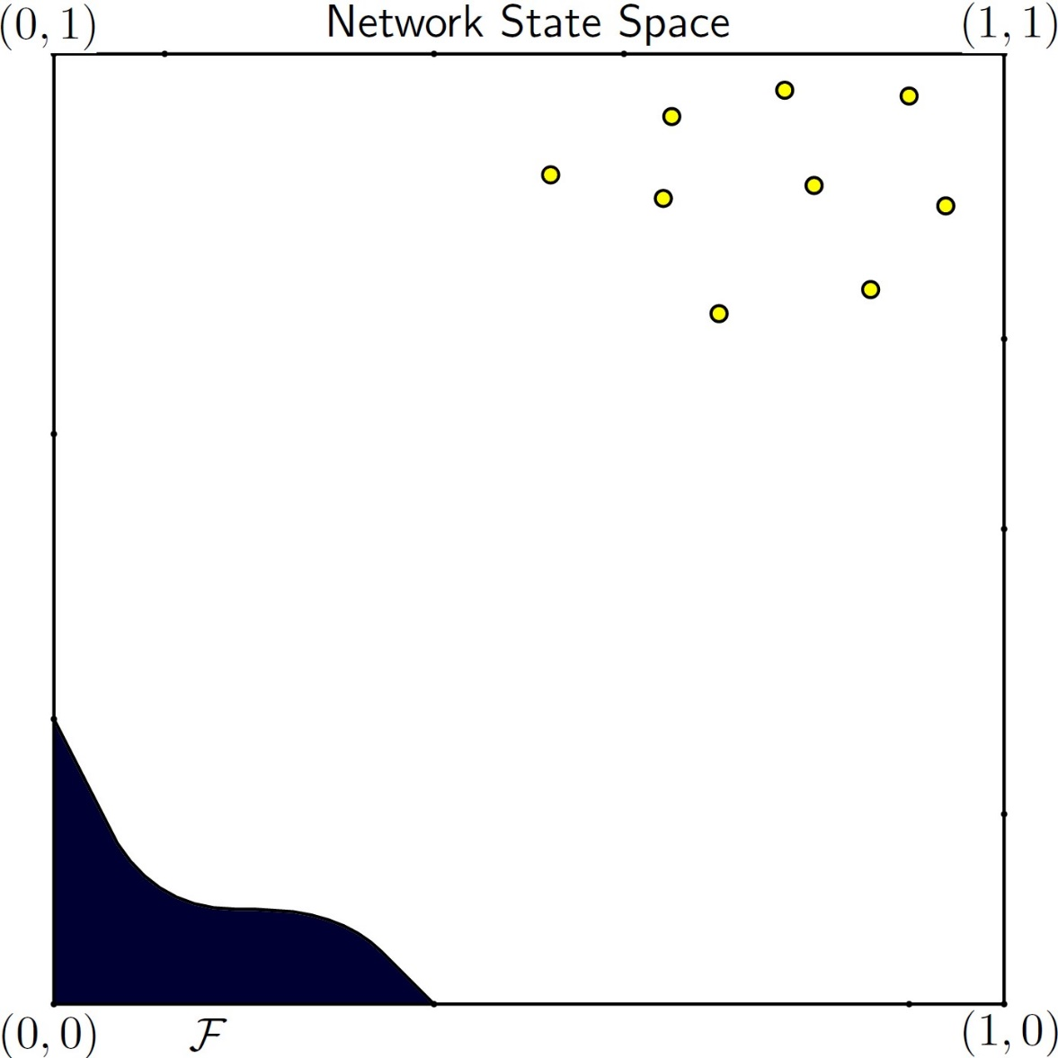


Subset Simulation: Schematic Illustration
Monte Carlo samples
MCMC samples
“seeds”
SS estimate:

Slide 22
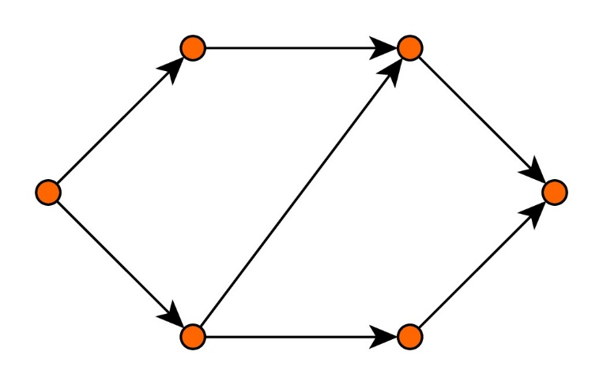
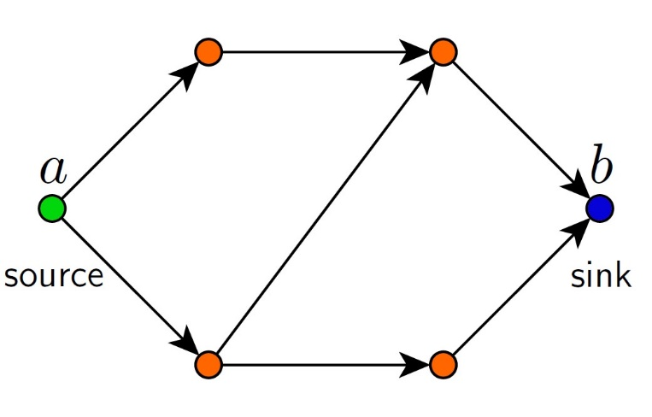
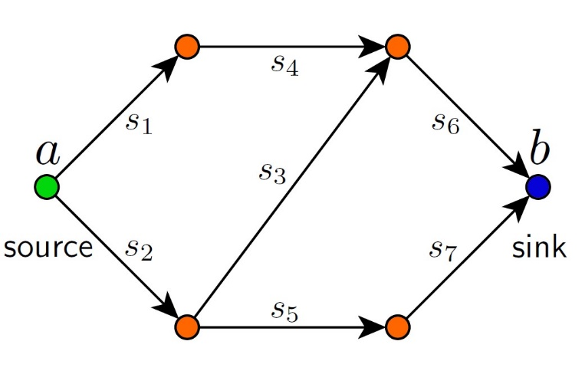
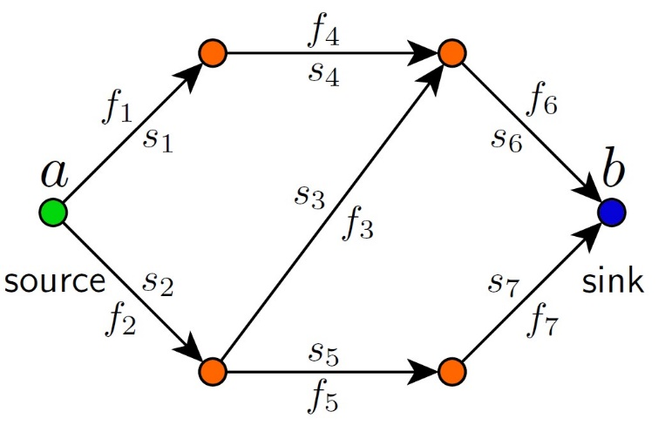
Example: Maximum-Flow Reliability Problem
Maximum-Flow Problem
Maximum-Flow Reliability Problem
Assume capacities are normalized:
For given
the max-flow performance function:
A flow on is
Let be a probability model for
link capacities:
  Capacity constraint:
  Flow conservation:
The failure domain:
The value of flow is
Reliability problem:
Max-Flow problem:

Slide 23
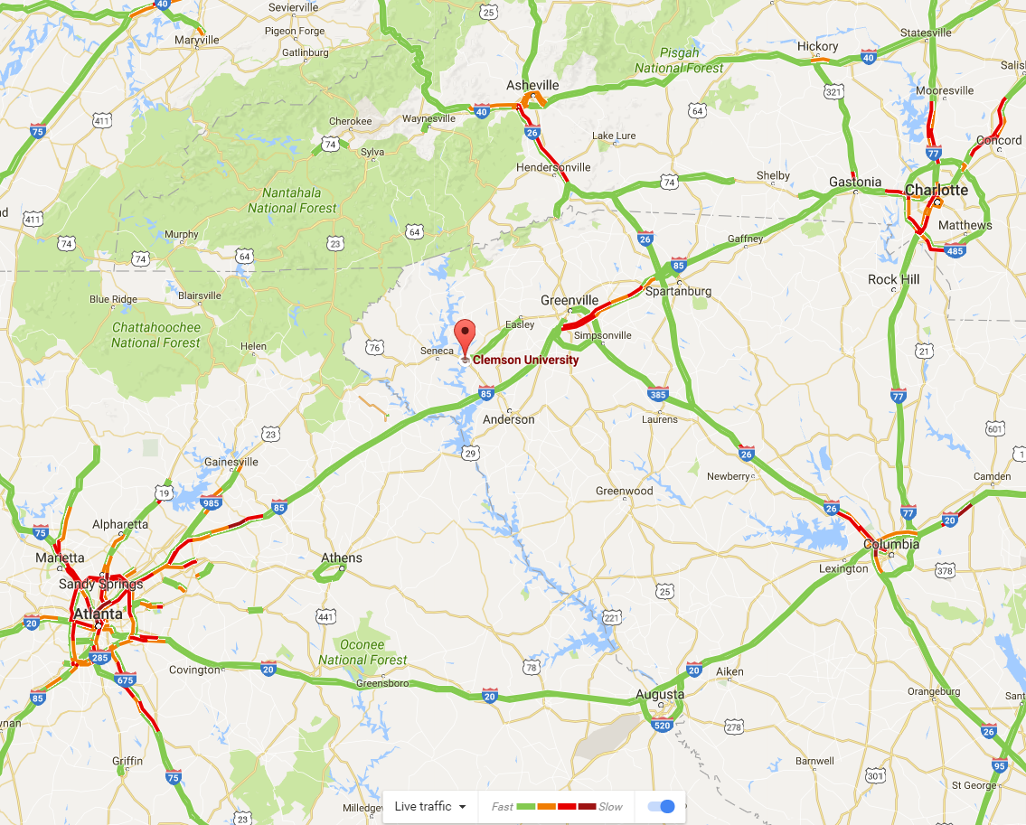
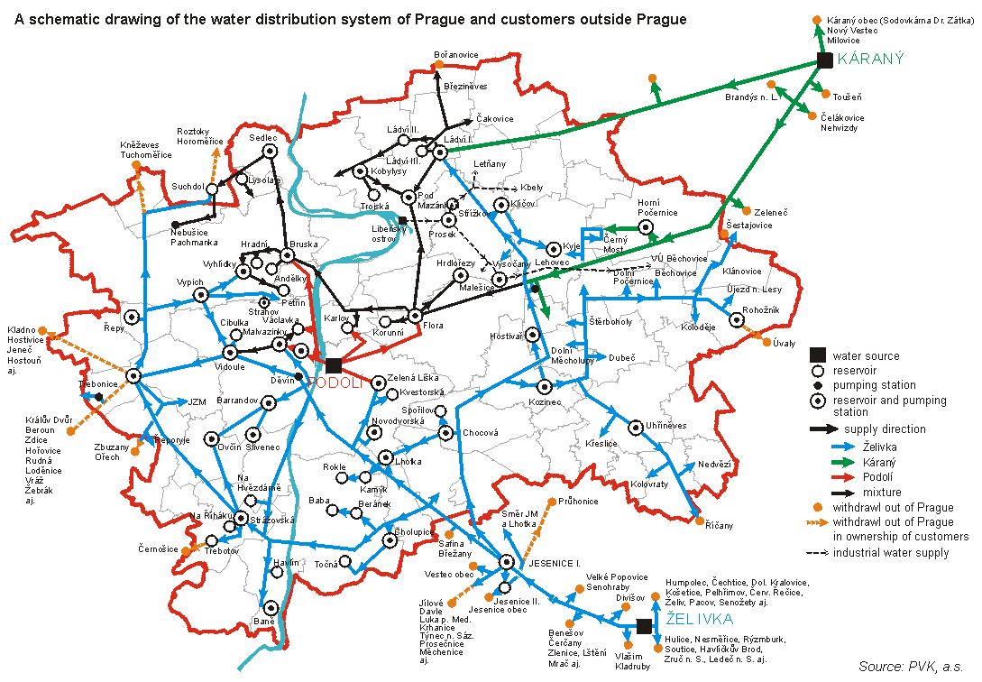
Potential Applications
Transportation Networks
Water Distribution Networks
Google Maps Traffic: 10/21/2016 4:38 PM
WDN Prague, http://envis.praha-mesto.cz/

Slide 24
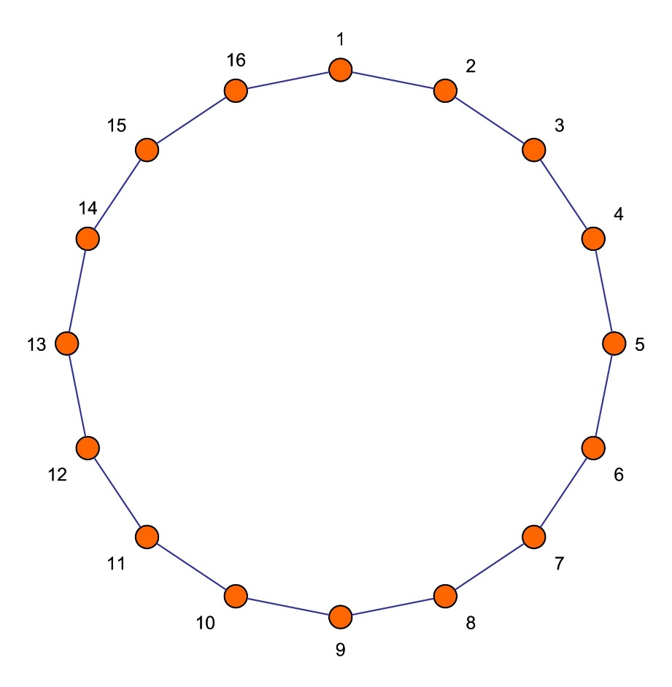
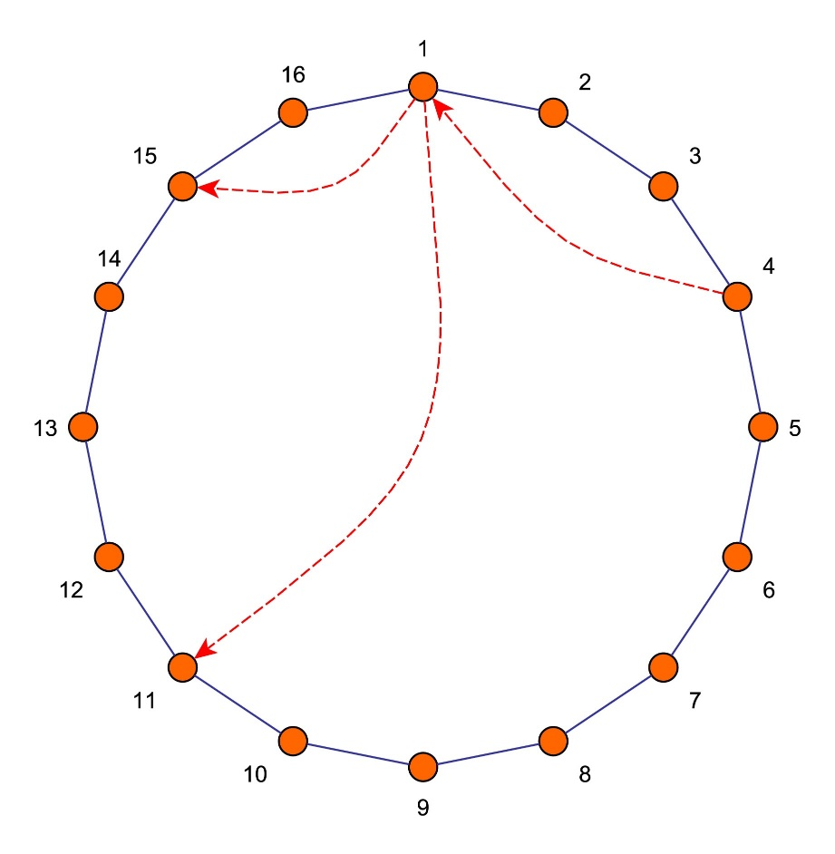
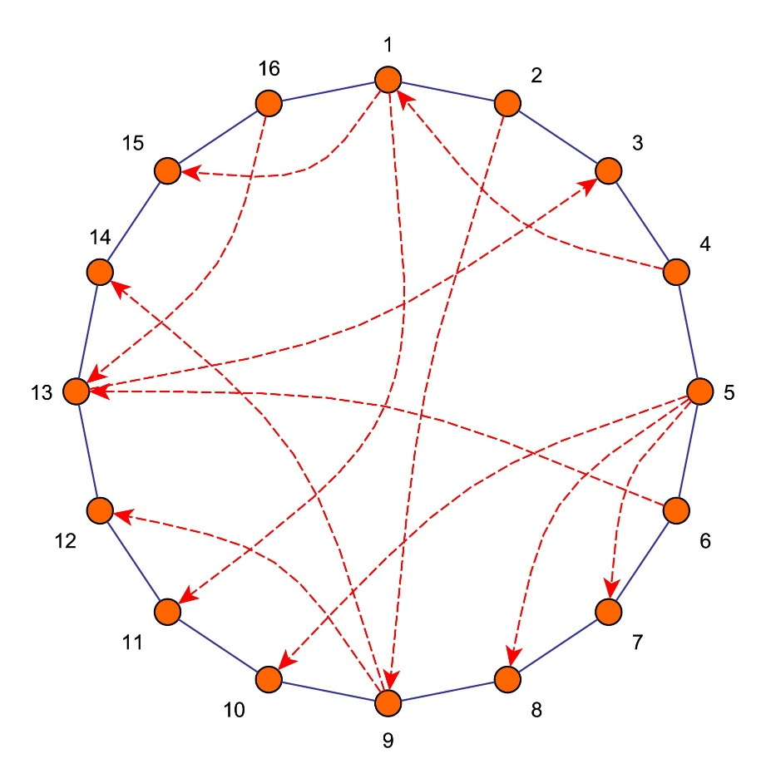
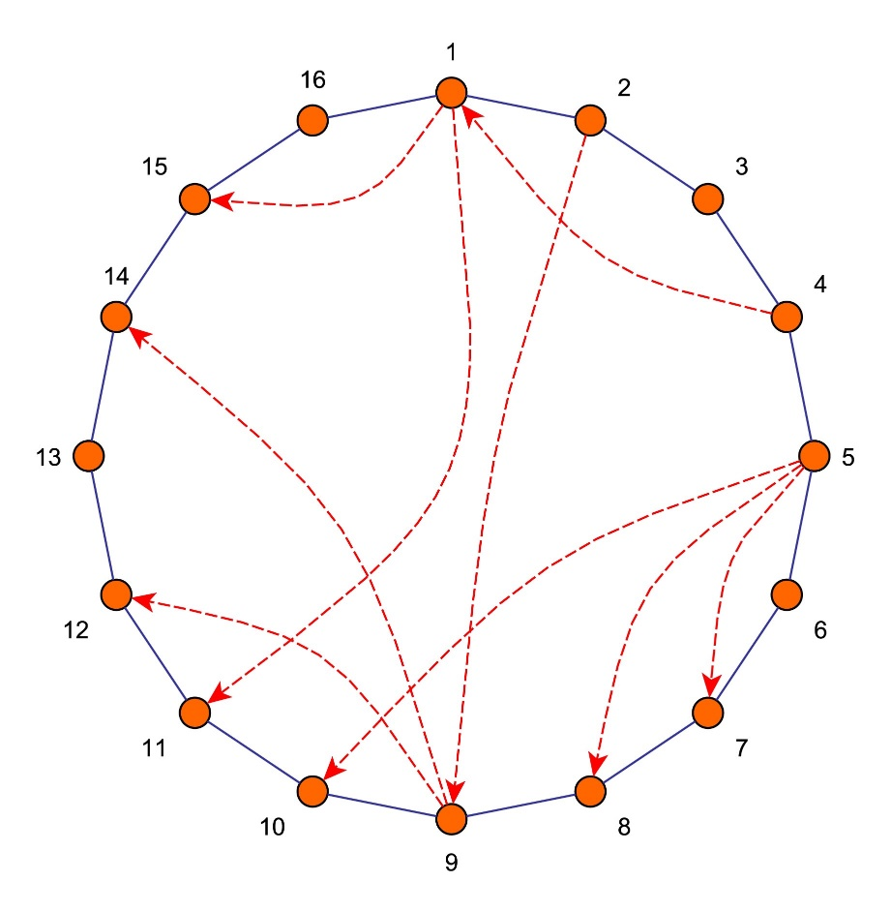
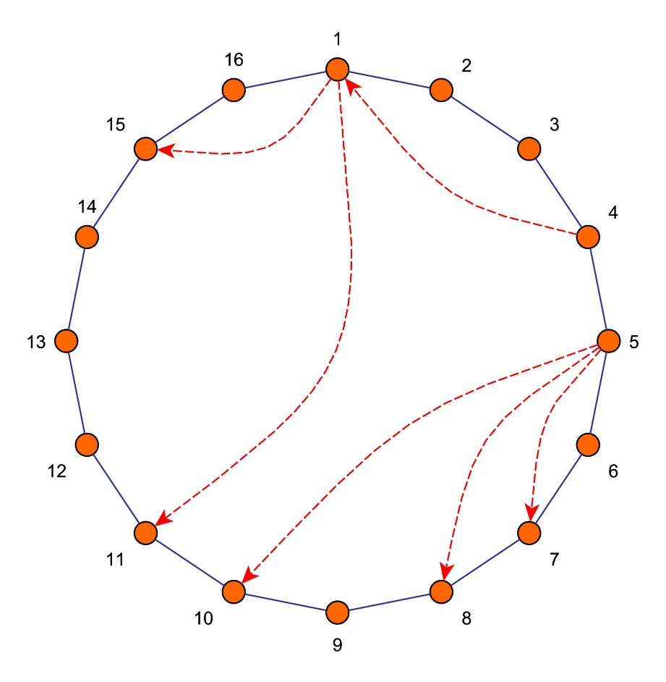
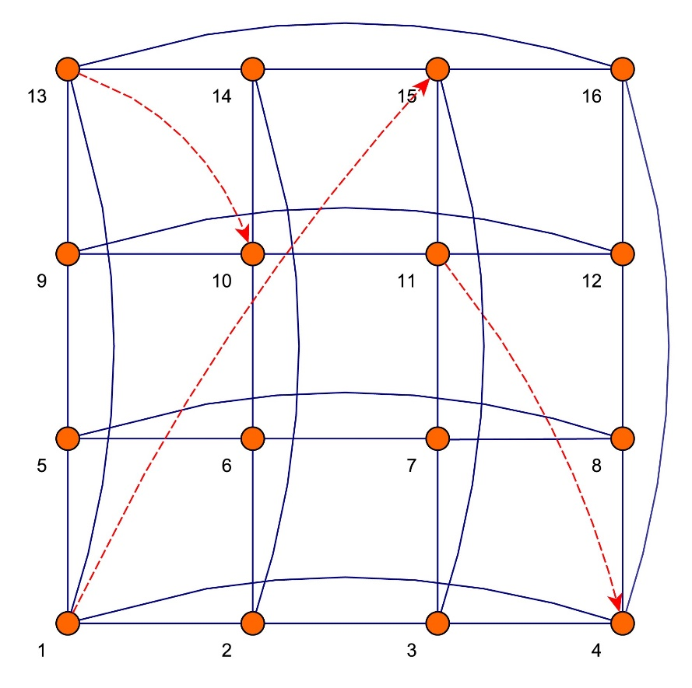
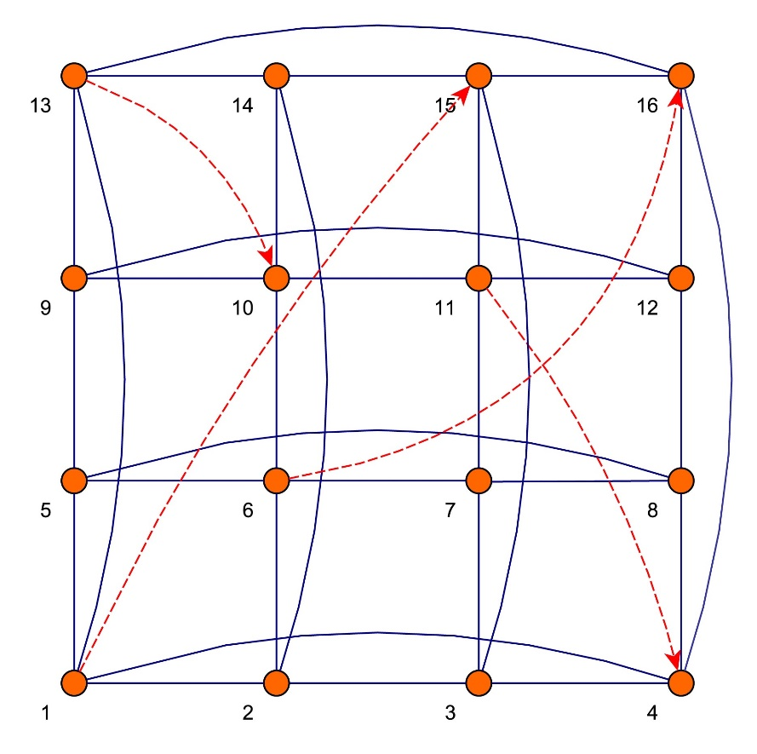



Example: Ring and Square Network Models
Random Ring Model
Random Square Model
Realization of
Realization of
Componentwise:
has more regular links
Topologically:
has more random links
Question: What model, or , produces more reliable networks?

Slide 25

How to Compare Two Network Models?
Given
  Network realization
  Source-sink pair
  Critical threshold
we can estimate the failure probability
using Subset Simulation
expected failure probability for a given threshold for the Ring Model:
expected failure probability for a given threshold for the Square Model:

Slide 26



How to Compare Two Network Models?
We are interested in the relative behavior of and
If we plot vs treating as a parameter, we obtain a curve that
  Lies in the unit square
  Starts at
  Ends at
We refer to this curve as
the relative reliability curve
Rare events

Slide 27


Simulation Results
The Square Model produces
more reliable networks than
the Ring Model
As k increases,
the relative reliability curve shifts towards
the equal reliability line

Slide 28
Challenges: Cascading Failures
Subset Simulation solves the network reliability problem only approximately
Subset Simulation assumes that
are independent
In infrastructure networks,
and are correlated
Real networks are prone to
cascading failures
Model of Cascading Failures
Subset Simulation

Slide 29



Interconnected Infrastructures: Multilayer Networks
S.M. Rinaldi et al (2001)
Illustration: L. Dueñas-Osorio

Slide 30
Interdisciplinary Collaboration is the Key
Engg
E.M. Adam et al (2015)
Towards an Algebra for Cascade Effects
Soc.
Sci.
Med
Phys
Network Science
Bio
Topological closure and isomorphism
Universal algebra theory
Theory of partially ordered sets
Theory of the Tarski consequence operator
CS
Stats
Math

Slide 31
Summary
A network view on critical infrastructure is important for proper assessment of its reliability and resilience.
The Subset Simulation method is one of the first steps towards efficient estimation of reliability of critical infrastructure networks.
To make it practical, realistic models for link correlations, cascading failures and multilayer networks are required.
To succeed in these tasks, interdisciplinary collaboration is a must.

Slide 32
References
Subset Simulation
  Au & Beck (2001) “Estimation of small failure probabilities in high dimensions by subset simulation,” Probabilistic Engineering Mechanics.
  Zuev et al (2015) “General network reliability problem and its efficient solution by Subset Simulation,” Probabilistic Engineering Mechanics.
  Zuev (2015) “Subset Simulation method for rare event estimation: an introduction,” Springer Encyclopedia of Earthquake Engineering.
  Beck & Zuev (2017) “Rare event simulation,” Springer Handbook on Uncertainty Quantification.
Cascading Failures
  Dueñas-Osorio & Vemuru (2009) “Cascading failures in complex infrastructure systems,” Structural Safety.
  Buldyrev et al (2010) “Catastrophic cascade of failures in interdependent networks,” Nature.
  Adam et al (2015) “Towards an algebra for cascade effects,” 53rd IEEE Conference on Decision and Control
Multilayer Networks
  Rinaldi et al (2001) “Identifying, understanding, and analyzing critical infrastructure interdependencies,” IEEE Control Systems Magazine.
  Zio (2007) “Reliability analysis of complex network systems: research and practice in need, ” IEEE Reliability Society 2007 Annual Technology Report.
  Kivelä et al (2014) “Multilayer networks,” Journal of Complex Networks.

Slide 33

Call for Papers

