Slide 1
AAReST Structural Redesign
October 4th, 2018
Alexander Wen
Charles Sommer
Christophe Leclerc
Antonio Pedivellano

Slide 2
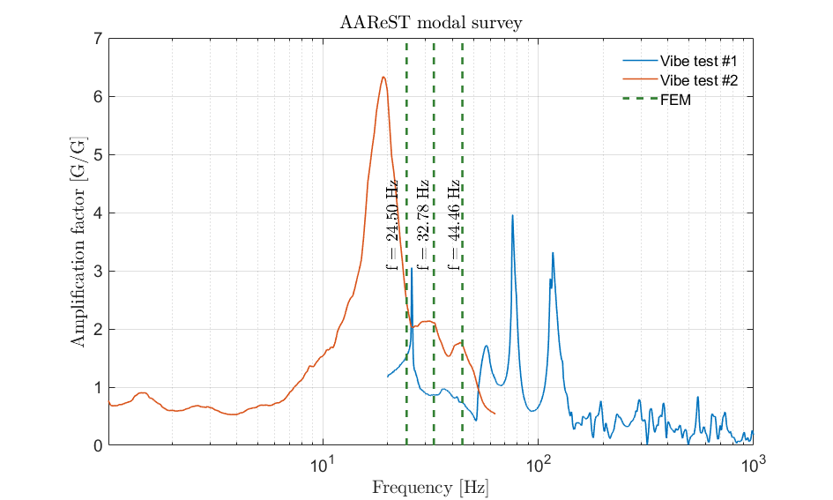
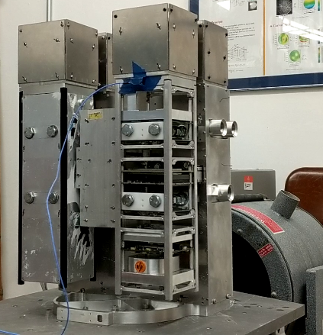
AAReST Modal Survey
Sine sweep performed in August on Surrey MirrorSat and full AAReST to experimentally measure natural frequencies;
FEM improved to better match experiments.
 | Test #1 | Test #2 | FEM
Mode 1* [Hz] | 25.89 | 19.47 | 24.50
Mode 2 [Hz] | 37.6 | 31.63 | 32.78
Mode 3 [Hz] | 57.45 | 43.71 | 44.46
* no data available below 20 Hz in Test #1
Test #2 at Caltech

Slide 3
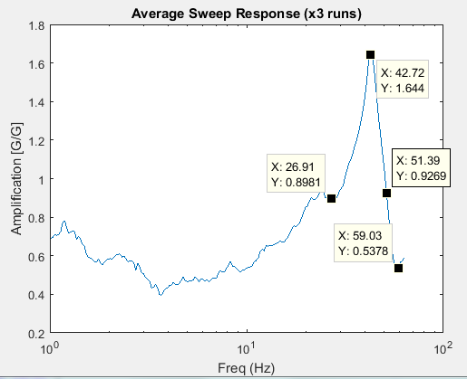
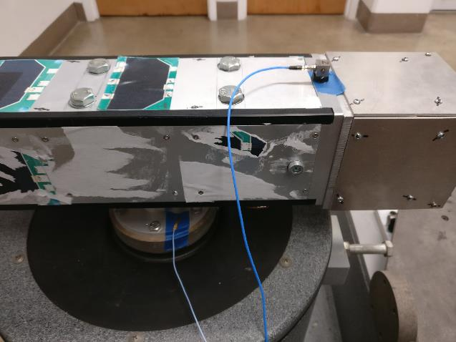
Surrey MirrorSat Modal Survey
Surrey MirrorSat
Experiment
FEM
38.6 Hz
87.8 Hz
FEM underestimates first frequency by about 10 %

Slide 4
Surrey MirrorSat FEM Results
5 mm-thick steel frangibolt plate
0.5 mm-thick aluminum side plates
BC’s: Male interface (CoreSat) clamped

Slide 5
AAReST FEM

Slide 6
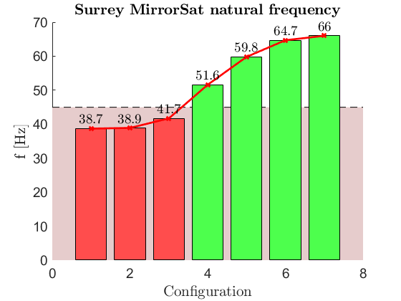
Increasing the natural frequency: MirrorSats
Extra rib
No rib
In-lab vibe test
Stiffer side panels
Single part titanium plate with pyramid
Single part steel plate with pyramid
Adding extra rib
Current configuration:
5 mm thick steel plate
0.5 mm thick aluminum side panels
Titanium Frangibolt interface

Slide 7
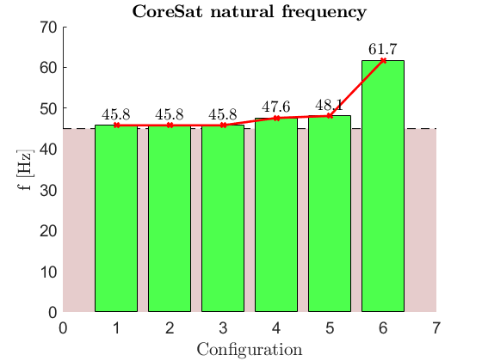
Increasing the natural frequency: CoreSat
Model Description
MirrorSats replaced with point masses placed at their CG $⟹$ MirrorSats perfectly rigid
Steel Frangibolt interface
Reinforced LVI plate
Load path
Reference configuration
Reinforced MirrorSat boxes
Reinforced –X plate
Reinforced –Z frame

Slide 8
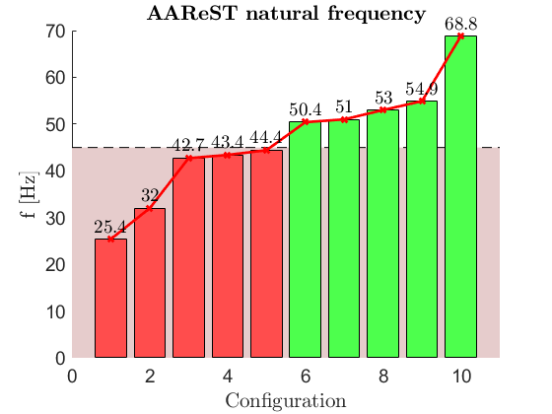
Increasing the natural frequency: full model
Single part MirrorSat plate with pyramid
Redesigned LVI plate
Maximum frequency achievable: above this limit, camera drives natural frequency
In-lab vibe test:
5 mm thick steel Frangibolt plates on MirrorSats
0.5 mm thick aluminum side panels on Surrey MirrorSat
No side panels on IIST MirrorSat
Rigid LVI plate, steel MirrorSat plates, extra rib, 9 screws
In-lab vibe test
Rigid LVI plate, steel MirrorSat plates, extra rib
0.5mm aluminum side panels on both MirrorSats
Steel
Rigid
Steel LVI plate
Rigid LVI plate
Steel with extra rib

Slide 9
Suggested improvements for stiffness
Frangibolt interface (pyramid) and MirrorSat plate should be made out of a single part
LVI plate needs to be redesigned
An extra rib on the MirrorSat structure would add extra support to the Frangibolt plate and increase the natural frequency

Slide 10
Strength calculation Model
Sine vibrations run on stiffened structure (amplification factors and natural frequencies closer to flight version)
5mm-thick steel MirrorSat interface plates bonded to Frangibolt female
Additional support rib behind the interface plate
6 screws on the interface plate
Stiffened LVI plate
Damping factor used: 5 %

Slide 11
Strength calculation Assumptions
Screw sizing formula:
${\left(\frac{F_{N}}{F_{N}^{max}}\right)}^{2}+{\left(\frac{F_{T}}{F_{T}^{max}}\right)}^{2}=\frac{1}{K^{2}}$ $d_{min}=\sqrt{\frac{2K}{πσ_{y}}\sqrt{F_{N}^{2}+4 F_{T}^{2}}}$
A286 high-strength stainless steel used as reference: $σ_{y}=$960 MPa
Safety factor used: $K=2$
Assumed $τ_{y}=\frac{σ_{y}}{2}$
[1]
$F_{N}≡$ Normal load $F_{T}≡$ Shear load
$σ_{y}≡$ Yielding uniaxial stress
$τ_{y}≡$ Yielding shear
$d_{min}≡$ Minimum screw diameter
[1] Barrett R.T., Fastener Design Manual, 1990, NASA Reference Publication 1228.

Slide 12
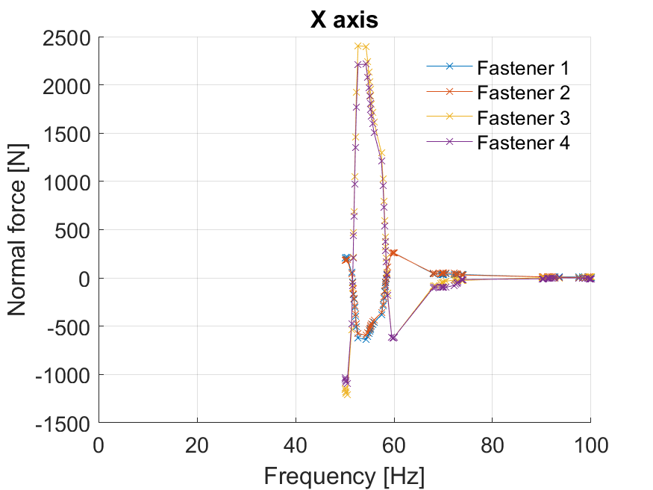
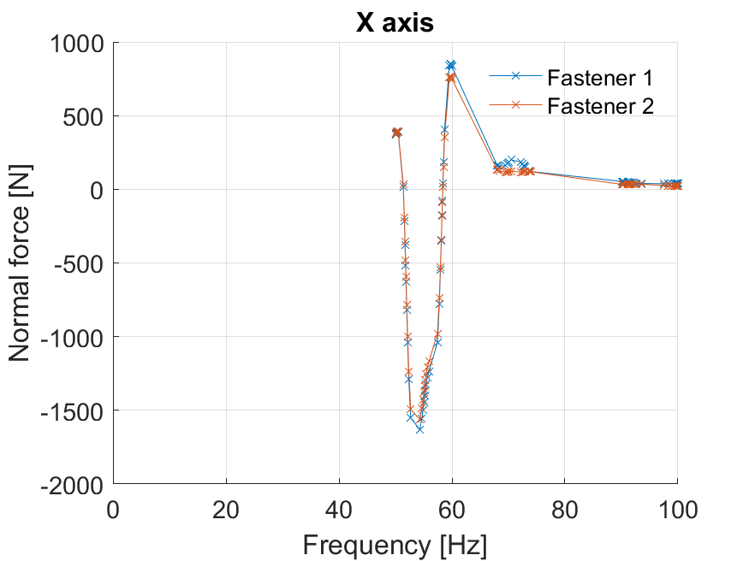
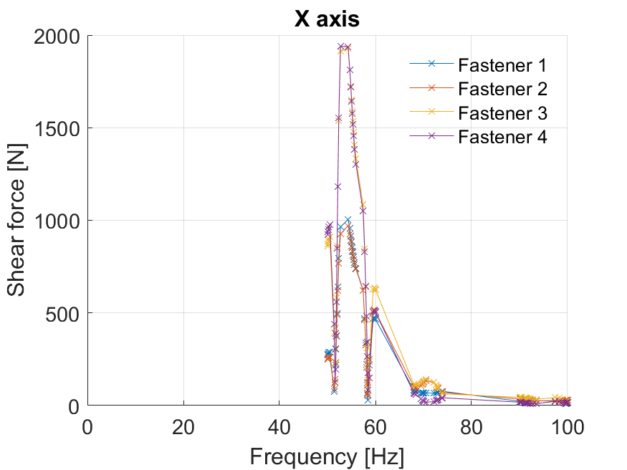
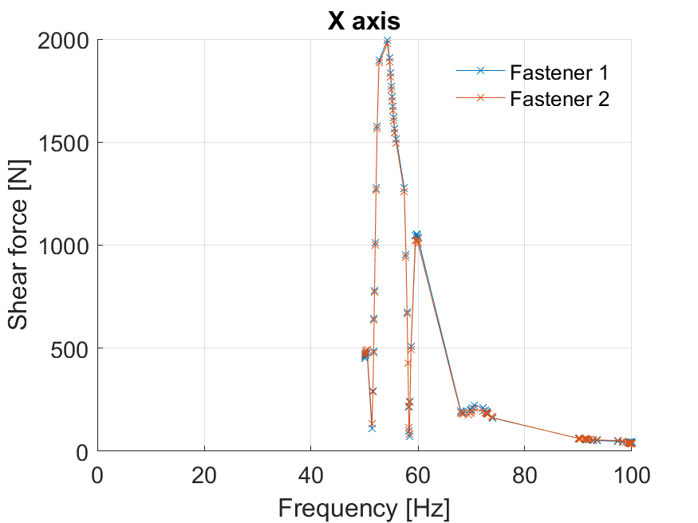
IIST MirrorSat Maximum load
Corner screws
Rib screws

Slide 13
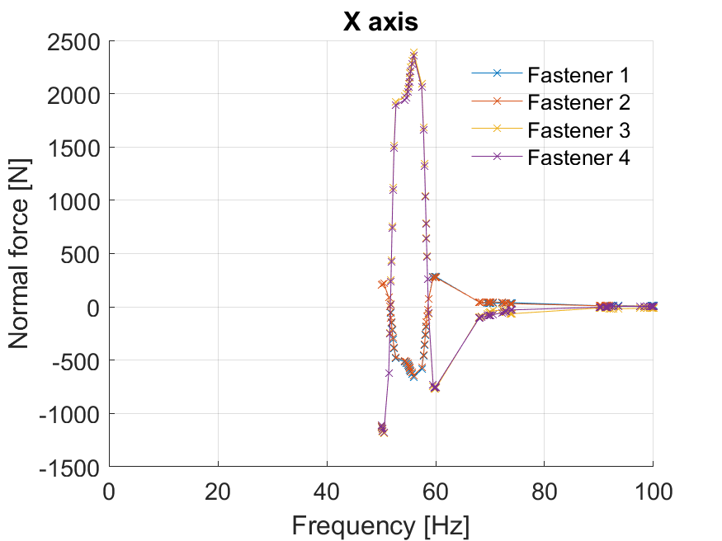
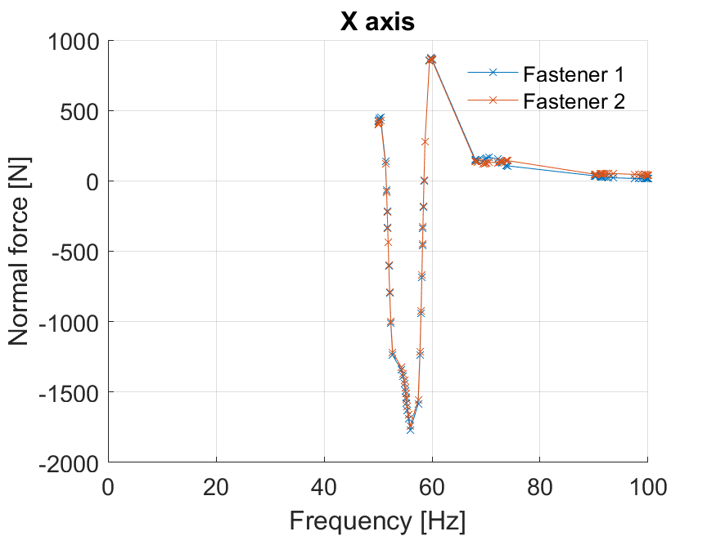
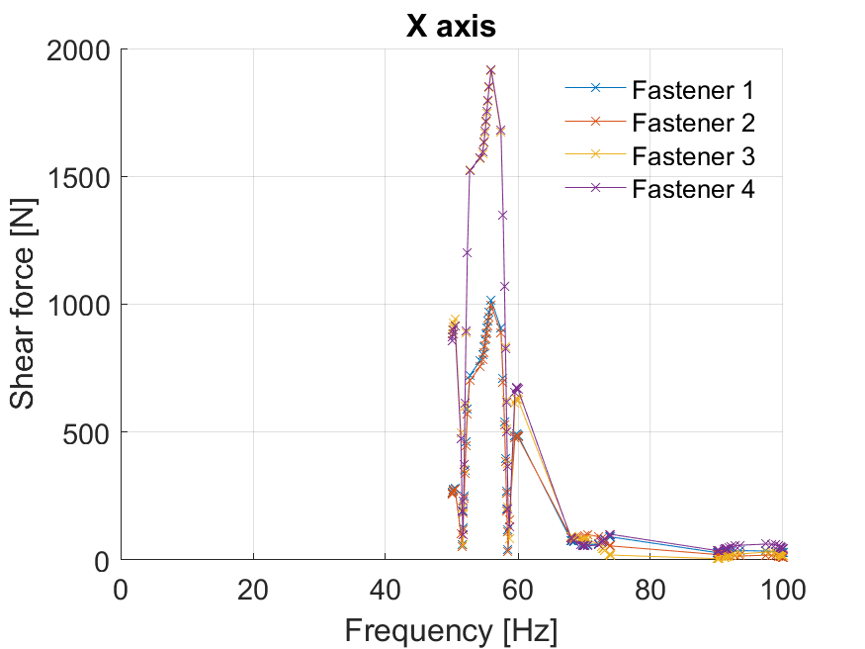
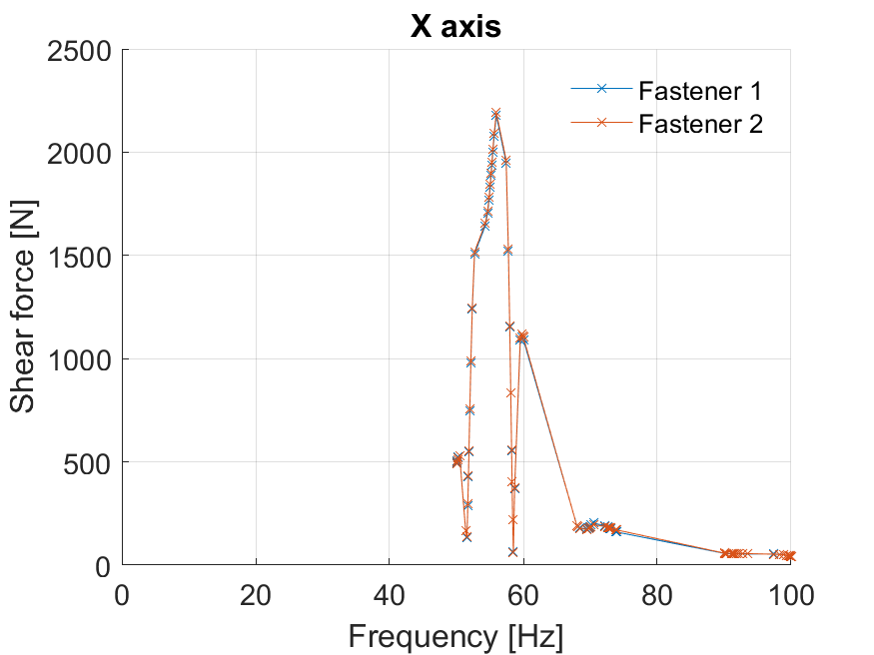
Surrey MirrorSat Maximum load
Corner screws
Rib screws

Slide 14
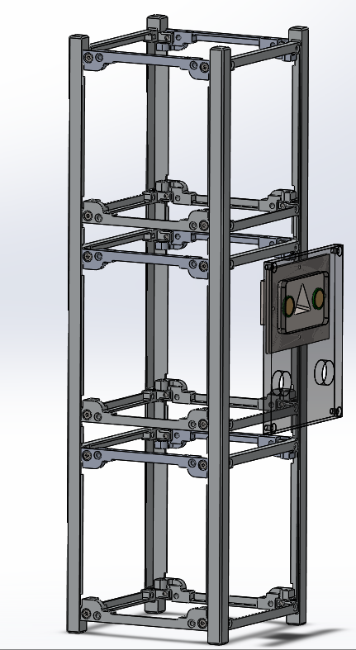
Conclusion Suggested structural modifications
CoreSat
Redesign LVI plate
MirrorSats
Increase rib dimensions to fit bigger screws (M4)
Add extra rib to allow the use of additional 2 screws (M4)
Interface
Redesign the Frangibolt interface plate in a single piece

