Slide 1
Antenna Status
Corentin Lubeigt
October 22st, 2019

Slide 2
Overview
Tape measure ¼ of wavelength antennas
UHF: 436 MHz → 172mm
VHF: 144.5 MHz → 512mm
Antenna system
Two UHF antennas (one for transponder, one for transceiver)
One VHF antenna shared by the two units (use of a Wilkinson Power Splitter)
LC network for impedance match

Slide 3
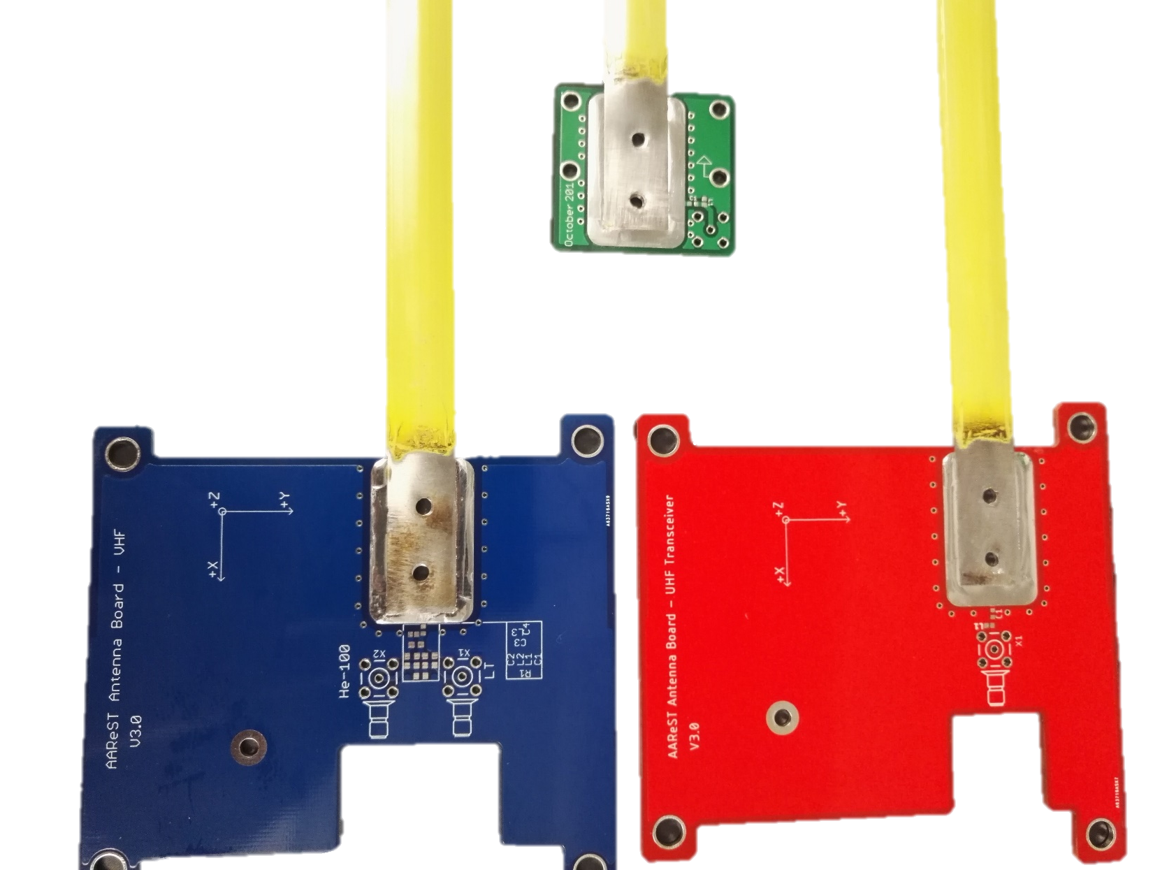
Antenna Boards
Transceiver UHF antenna
VHF antenna shared by both transponder and radio
Radio UHF antenna

Slide 4
Status
Deployment test done on a test structure
New assembly process
Heat gun to solder antenna on PCB
MGSE to assure perpendicularity between antenna and ground plane
Test with network analyzer to determine actual impedance

Slide 5
Open issues and solutions
Actual impedance is very sensitive to manufacture
Several flight antennas will be delivered and the best antenna will be selected

Slide 6
Upcoming steps
Finish tests on current antennas (L-net, Wilkinson Power Splitter)
Manufacture flight antennas (three of each), tests will be done on the mass model to reproduce the actual ground plane
Manufacture mounting parts

Slide 7
Transceiver tests Status
Corentin Lubeigt
October 22st, 2019

Slide 8
Brief
AstroDev Helium 100
Amateur Radio bands
TX: UHF band (19.2kbps)
RX: VHF band (19.2kbps)
Receive sensitivity: -104.7 dBm @ BER 10⁻³
Power:
12V line power: 7W
Transmit power: ~1.35W

Slide 9
Status
Radio tested with SDR and GNURadio
in lab tests, transmit power < 10mW
Firecode system tested (sends a pulse when key detected)

Slide 10
Open issues and solutions
Need to do outdoor test with the tape measure antennas
Receiver bandwidth very large (~200kHz), it may catch any AX.25 signals.
Need to filter out signal as soon as they are received by the OBC

Slide 11
Upcoming steps
Wire the Firecode pin to the PC104 H1 pin 3 to send it to the R-IFB
Test with EPS, R-IFB and Radio
Outdoor test with tape measure antenna

