Slide 1
Deformable mirror
Glass slumping / Carbon fiber
Context / General characteristics
Manufacturing limitations
Potential solutions
System implementation

Slide 2
Deformable mirror
Glass slumping / Carbon fiber
Context / General characteristics
Manufacturing limitations
Potential solutions
System implementation

Slide 3
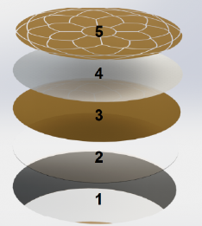
General characteristics
41 electrodes: Ti + Au
PZT – Meniscus, 0.2-0.4mm thick
Ground layer: Ti + Au
Substrate: Glass or Carbon fiber shell
Reflective coating: Cr + Al + SiO2
Two DMs
100 mm diameter - 1 mm thick
100 nm rms surface error requirement
Glass slumping
Initial solution
Development from 2010 to 2017
Decision made in early 2018 to stop working on it
Advantages:
TRL 9
thermally stable
low CTE, no outgassing
good adhesion of reflective coating (pass TVAC)
low stiffness (flexible)
Limitations:
Surface error after manufacturing limited to few microns rms (dimples)
Carbon fiber
Development from 2010 to 2017
Decision made in early 2018 to use this technology
Advantages:
Low outgassing
Limitations:
Never demonstrated in space: TRL 4
Surface error after manufacturing limited to ~20 um rms (shrinkage of resin)
Surface roughness
Thermally unstable (high CTE + chemical reaction with the reflective coating)
High stiffness (low capability of correction w/ PZT)
Integration:
Substrate
Glass / CF shell
Surface resin coating if CF shell
PZT bonding
Reflective coating

Slide 4
Deformable mirror
Glass slumping / Carbon fiber
Context / General characteristics
Manufacturing limitations
Potential solutions
System implementation

Slide 5
Main objectives
Carbon Fiber Mirror
=
Shell
(global surface error)
+
Surface coating
(precise shape + roughness)
+
Reflective coating
(reflectivity + protection)
Space qualification
Low outgassing
(Fits NASA requirements)
+
High thermal stability
(image quality)
+
Surface/Coating quality
Notes:
Give them the shell + surface coating + reflective coating

Slide 6
Problematics
Physics
Time
Process
Non-linear
Numerous variables
→ Parametric study
+
Chemistry
Thermal
100 nm rms surface error requirement
Mandrel | Prepreg | Surface coating | Reflective coating
Surface roughness CTE Thermal conductivity | Fiber type Fiber density Matrix resin Viscosity / Polymerization CTE Thermal conductivity | Thickness Matrix resin Viscosity / Polymerization CTE Thermal conductivity | Materials Cleaning Thickness Deposition rate Vacuum
Preparation
Cleaning Release agent
Handling
Error minimization
Curing process
Temperature Pressure Vacuum
Thermal vacuum cycling

Slide 7
Main limitations
Global shape
Surface roughness
Reflective coating adhesion
Shrinkage
Low degree of cure
Thermally unstable
Global shape
Mandrel / Prepreg CTE mismatch
Global shape
Shrinkage
Low degree of cure
High stiffness: DM ?
Thermal vacuum cycling
Mandrel | Prepreg | Surface coating | Reflective coating
Surface roughness CTE Thermal conductivity | Fiber type Fiber density Matrix resin Viscosity / Polymerization CTE Thermal conductivity | Thickness Matrix resin Viscosity / Polymerization CTE mismatch w/ prepreg Thermal conductivity | Materials Cleaning Thickness Deposition rate Vacuum
Preparation
Cleaning Release agent
Handling
Error minimization
Curing process
Temperature Pressure Vacuum

Slide 8
 | Up to 2018 | Mai 2019 – October 2019
Prepreg | Epoxy 120Ep/T800, 30 gsm Nominal Cure @ 120°C CTE: ~ 2 ppm/°C | Cyanate ester CE380/T800, 30 gsm Nominal Cure @ 180°C CTE: -0.25 ppm/°C Fit NASA Low outgassing
Surface coating | Epotek 301 | NTPT - CE380 | Toray - EX1516
Characteristics | Toughened epoxy High flexibility | Cyanate ester Brittle | Cyanate ester Good flexibility
Thickness [µm] | No control | 40 | 65
Curing temperature | Nominal: 24h @23°C Used: 24h @23°C | Nominal: 2h @120°C + 2h @180°C Considered: 10h @ 90°C | Nominal: 3h @120°C Considered: 5h @90°C (low temp is the key!)
Composition | ? Very high shrinkage | Phenolic Triazine + catalizer Medium shrinkage Low wettability | ? + Nonylphenol (surfactant) Very Low shrinkage High wettability
Moisture | few % | 0.15 % | 0.6 %
Outgassing (Nasa TML < 1 %) (Nasa CVM< 0.1 %) | TML = 1.21 % CVM = 0.01 % WVR = 0.26 % | TML < 0.20 % CVM < 0.08 % WVR = 0.18 % | TML = 0.23 % CVM = 0.02 % WVR = 0.18 %
CTE [ppm/°C] | 39 | 28 | 61
Thermal stability | - - -
Transition temperature [°C] | 65 | 350 | 120
Reflective coating | Al + SiO2 Fail TVAC + tape test | Cr + Al + SiO2 Pass TVAC + tape test | Cr + Al + SiO2 To be tested
General
Chemistry
Thermal

Slide 9
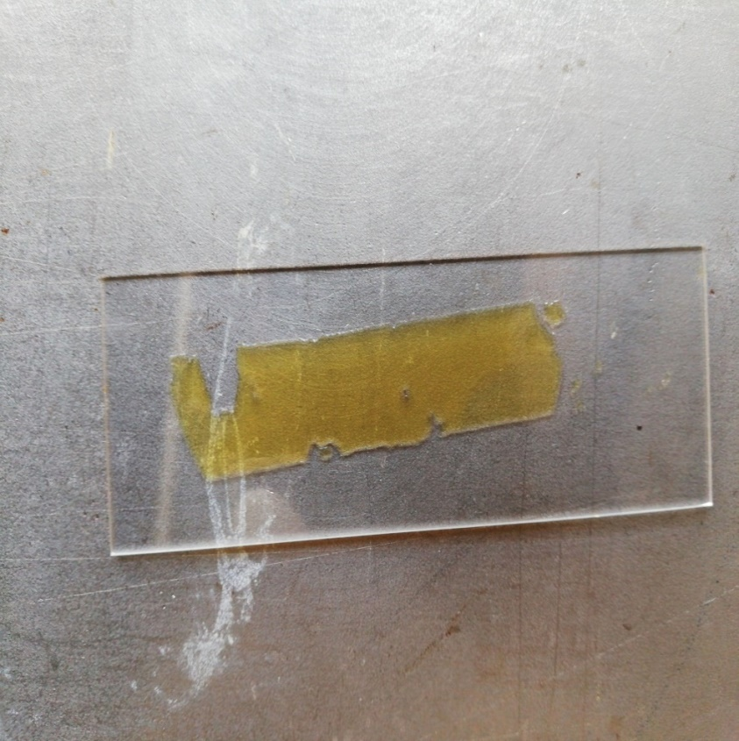
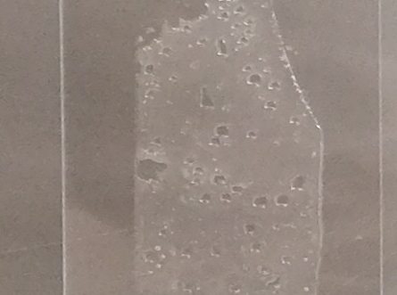
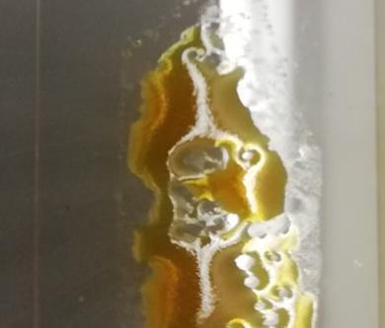
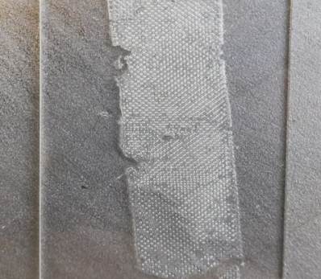
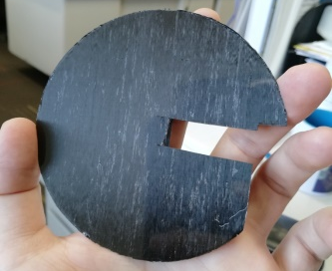
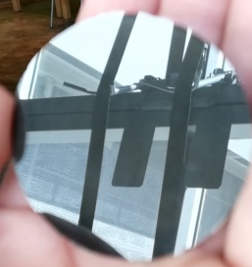
Surface coating:
NTPT - CE380 (same as prepreg) | Toray - EX1516
Large amount of catalizer + High surface tension
= Large shrinkage
Small amount of catalizer + Surfactant (Low surface tension) = Small shrinkage
Before curing
After curing
Before curing
After curing
 | CTE [ppm/C]
Prepreg | Epoxy 120Ep/T800 | Cyanate ester CE380/T800
 | 2 | -0.25
Resin coating | Epotek 301 | NTPT - CE380 | Toray – EX1516
 | 40 | 28 | 61
Glass mandrel | 0.5

Slide 10
Surface coating / Roughness
 | Toray - EX1516
High degree of cure
- - large shrinkage
- - fiber print-through = high roughness = straylight
++ good adhesion of refl. coating
Low degree of cure
++ lower shrinkage
++ no print-through
- - reaction with refl. coating

Slide 11
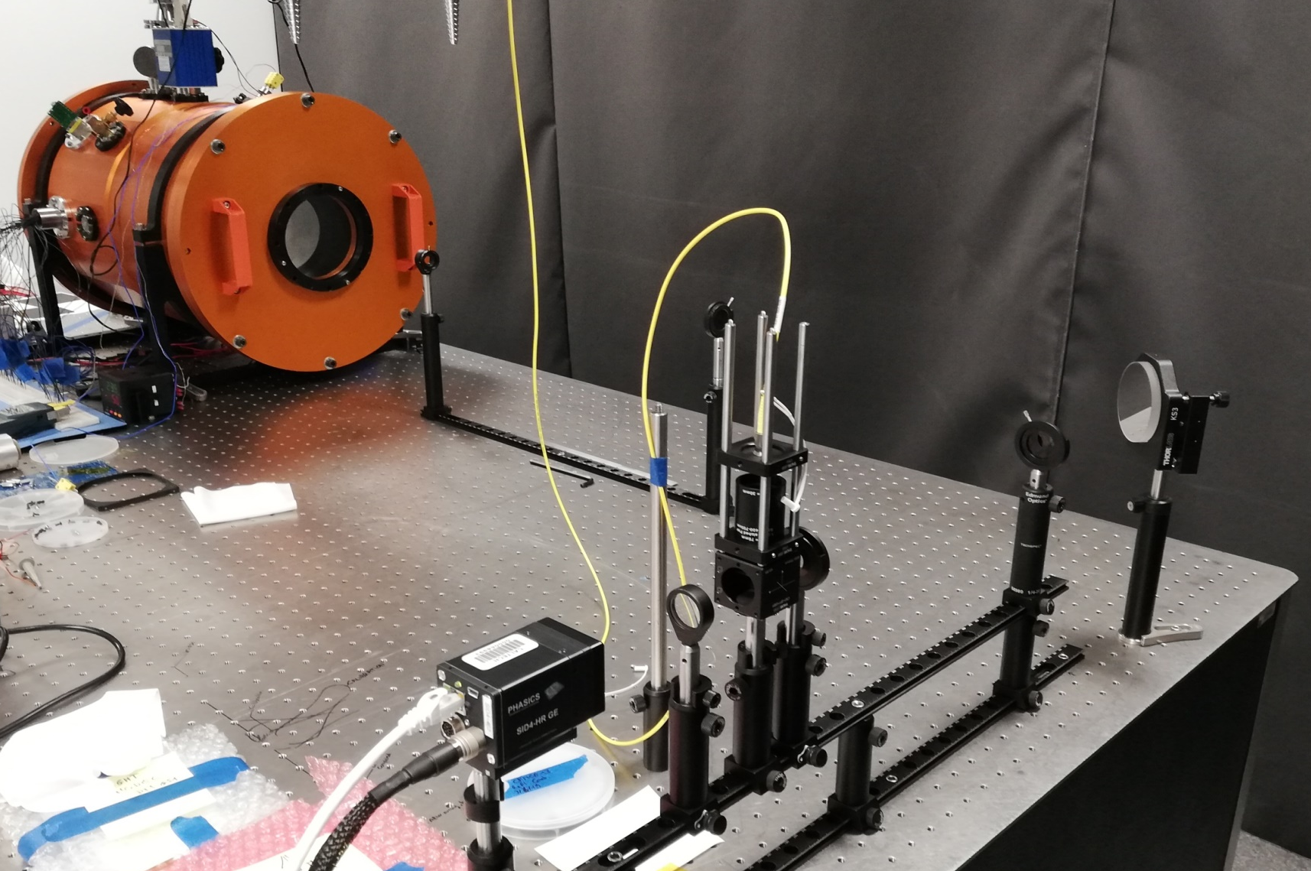
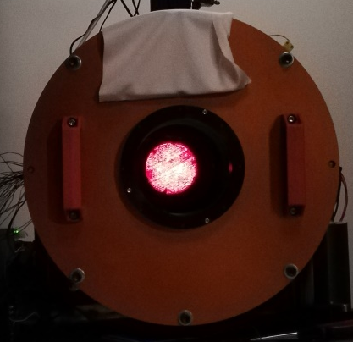
Thermal vacuum tests: WFE measurement + Reflective coating quality
Vacuum: 10⁻⁵ torr
Temp cycle: -10°C / +65°C
WFE testbed : 35 nm rms
Thermal vacuum chamber
Laser HeNe
point source
Beam splitter
Collimator
Interferometer

Slide 12
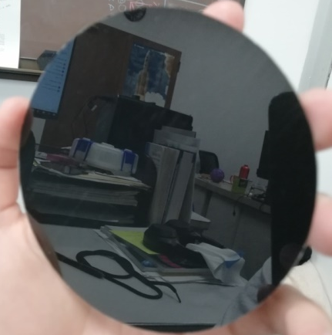
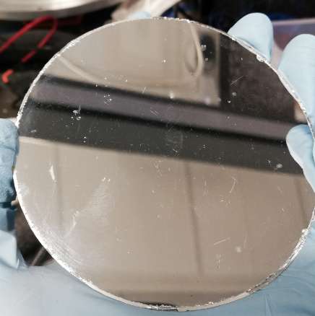

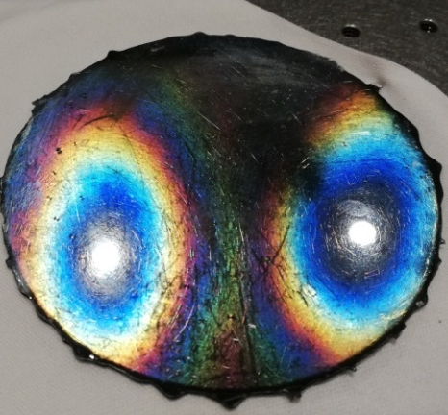
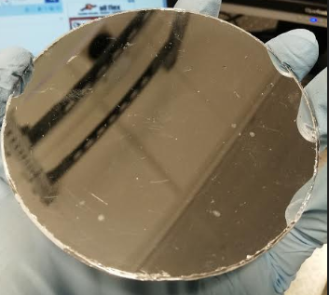
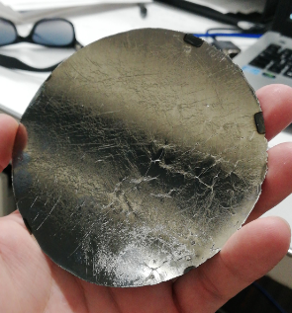
Up to 2018 Epoxy 120Ep/T800, 30 gsm | May 2019 – October 2019 Cyanate ester - CE380/T800, 30 gsm
Epotek 301 | NTPT – CE380 | Toray - EX1516
12
To be coated
Before TVAC
Room temp cure : 22°C
Degree of cure: ?
High temp cure : 180°C
Degree of cure: 40%
Low temp cure : 80°C
Degree of cure: small
High temp cure : 120°C
Degree of cure: higher
Surface error
Roughness
31 um rms – 142 um pv
3 nm rms
Several hundreds um rms
Few tens of nm rms
15 um rms – 120 um pv
13 nm rms
Several tens um rms
Few tens of nm rms
After TVAC
To be tested
Should pass
FAIL
PASS
FAIL

Slide 13
Shell manufacturing
Shell 1 to 12
Shell 13 to 16
Shell 17 to 19
Large shrinkage
SE ~ 30 um rms
Lower shrinkage
SE < 10 um rms
Lower shrinkage expected
To be investigated
Shell manufacturing:
Is the shrinkage linked to the degree of cure or the ramp-up rate? Both?
Exothermic reaction: how does it influence the global shape? Tune the temp profile?
Surface coating:
Are the effects similar?
Is the chemical reaction w/ the reflective coating in TVAC depends on the degree of cure?
May this issue be solved?

Slide 14
Potential solutions
41 electrodes
PZT – Meniscus, 0.2-0.4mm thick
Ground layer
Substrate: Glass or Carbon fiber mirror
Reflective coating
Glass slumping
Immediate:
Use a slumped glass Steve Bongiorno did
(to be measured)
Mid-term:
Restart the glass slumping activity at Caltech
Long term:
Find a subcontractor ( few $k )
Carbon fiber
Immediate:
Continue investigating the link between the degree of cure of the resin / temperature of cure / adhesion of the reflective coating → TVAC test is the key test
Mid-term:
Consider pourable UV cure resins: easy process, good replication = good surface roughness, high degree of cure achievable
Long term:
Change the resin matrix of the prepreg
Consider near-0 CTE resins, especially for surface coating
Work with a chemist (long term research project)

Slide 15
Deformable mirror
Glass slumping / Carbon fiber
Context / General characteristics
Manufacturing limitations
Potential solutions
System implementation

Slide 16
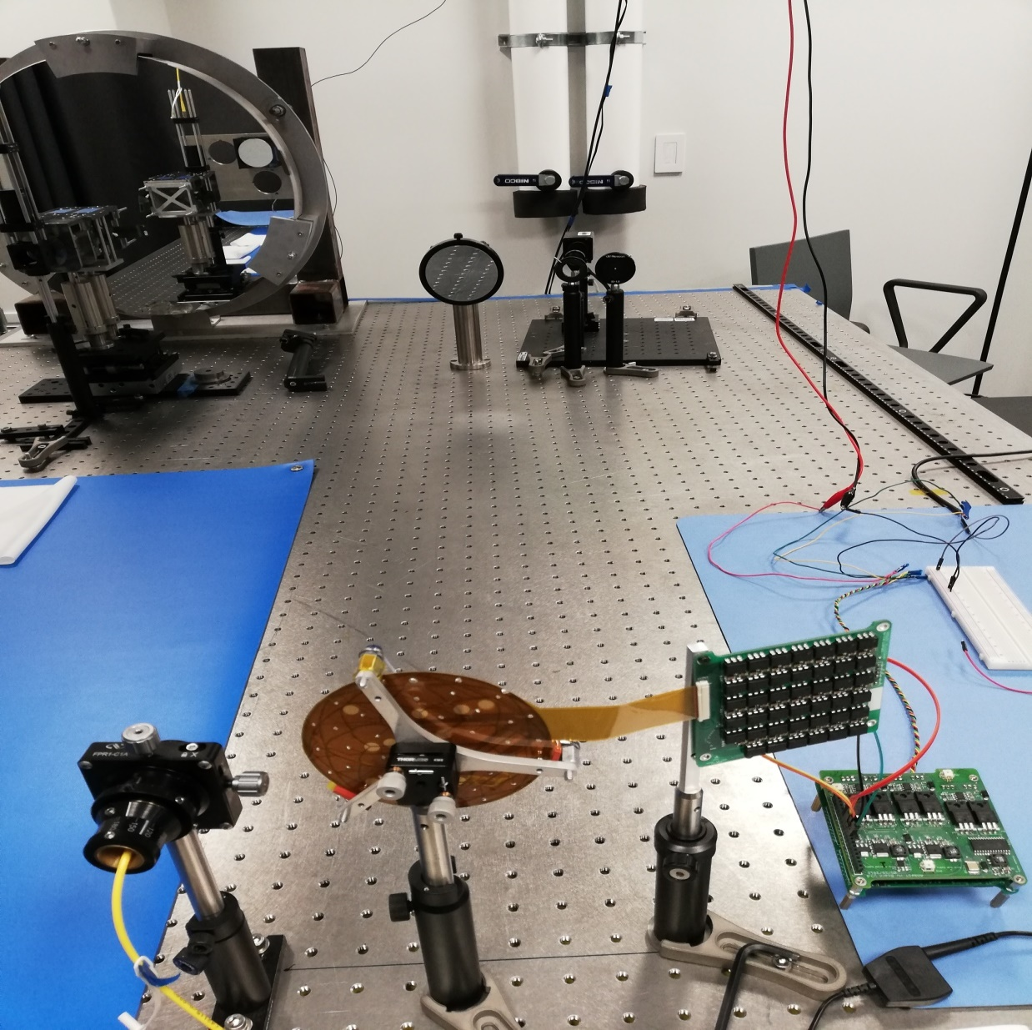
Deformable Mirror – Characterization testbed
Current status
Aligned for testing Narrow / Wide
Algorithms in Matlab
Wavefront measurement
Influence functions
Closed loop performance
To be done
Convert algorithms in C (flight)
Interferometer Narrow or Wide configuration
Off Axis parabola
Converging beam
Collimated beam
Diverging beam
Laser point source
Deformable mirror
Electronics

Slide 17
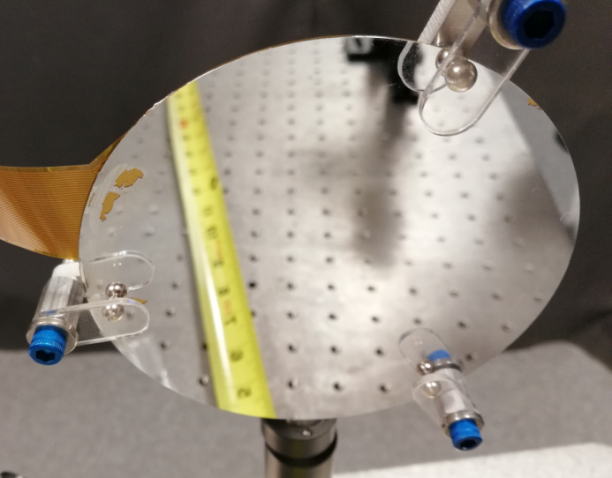
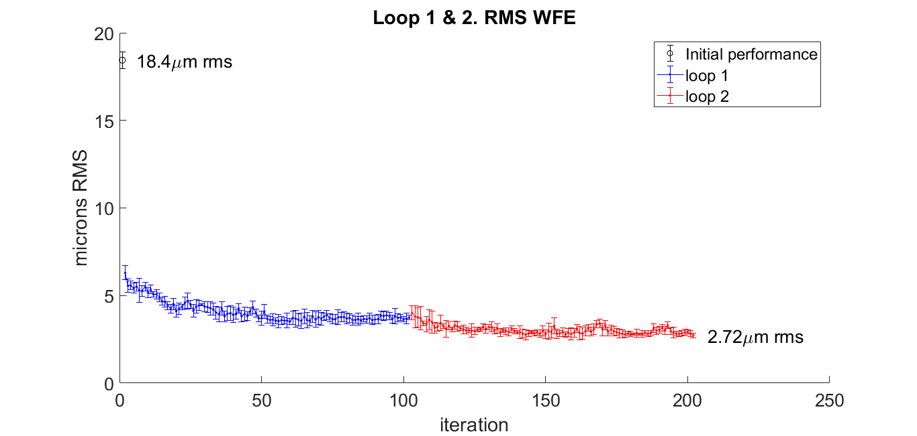
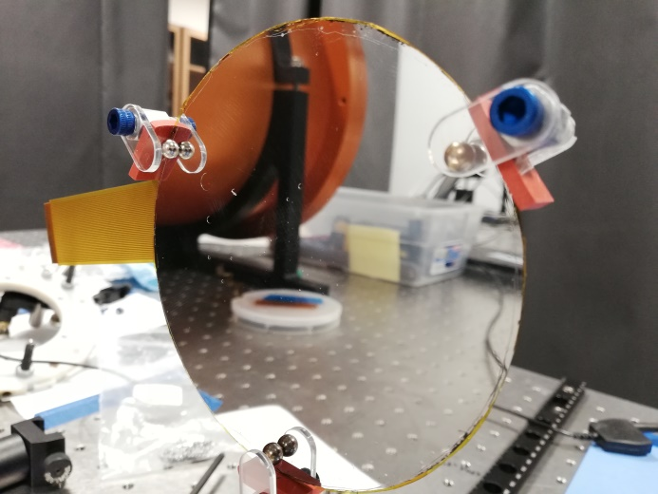
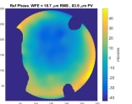
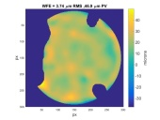
Influence function computation
DM-GS1
Now we use 16 plies CF shell
+ More flexible
+ Higher IF values
- Larger shape deformation
Damaged PZT
Reduction by a factor 2 to 3
DM-CFM4
32 plies
DM-GS1
3.74 µm rms
Too stiff

Slide 18
Camera
Telescope testbed

Slide 19
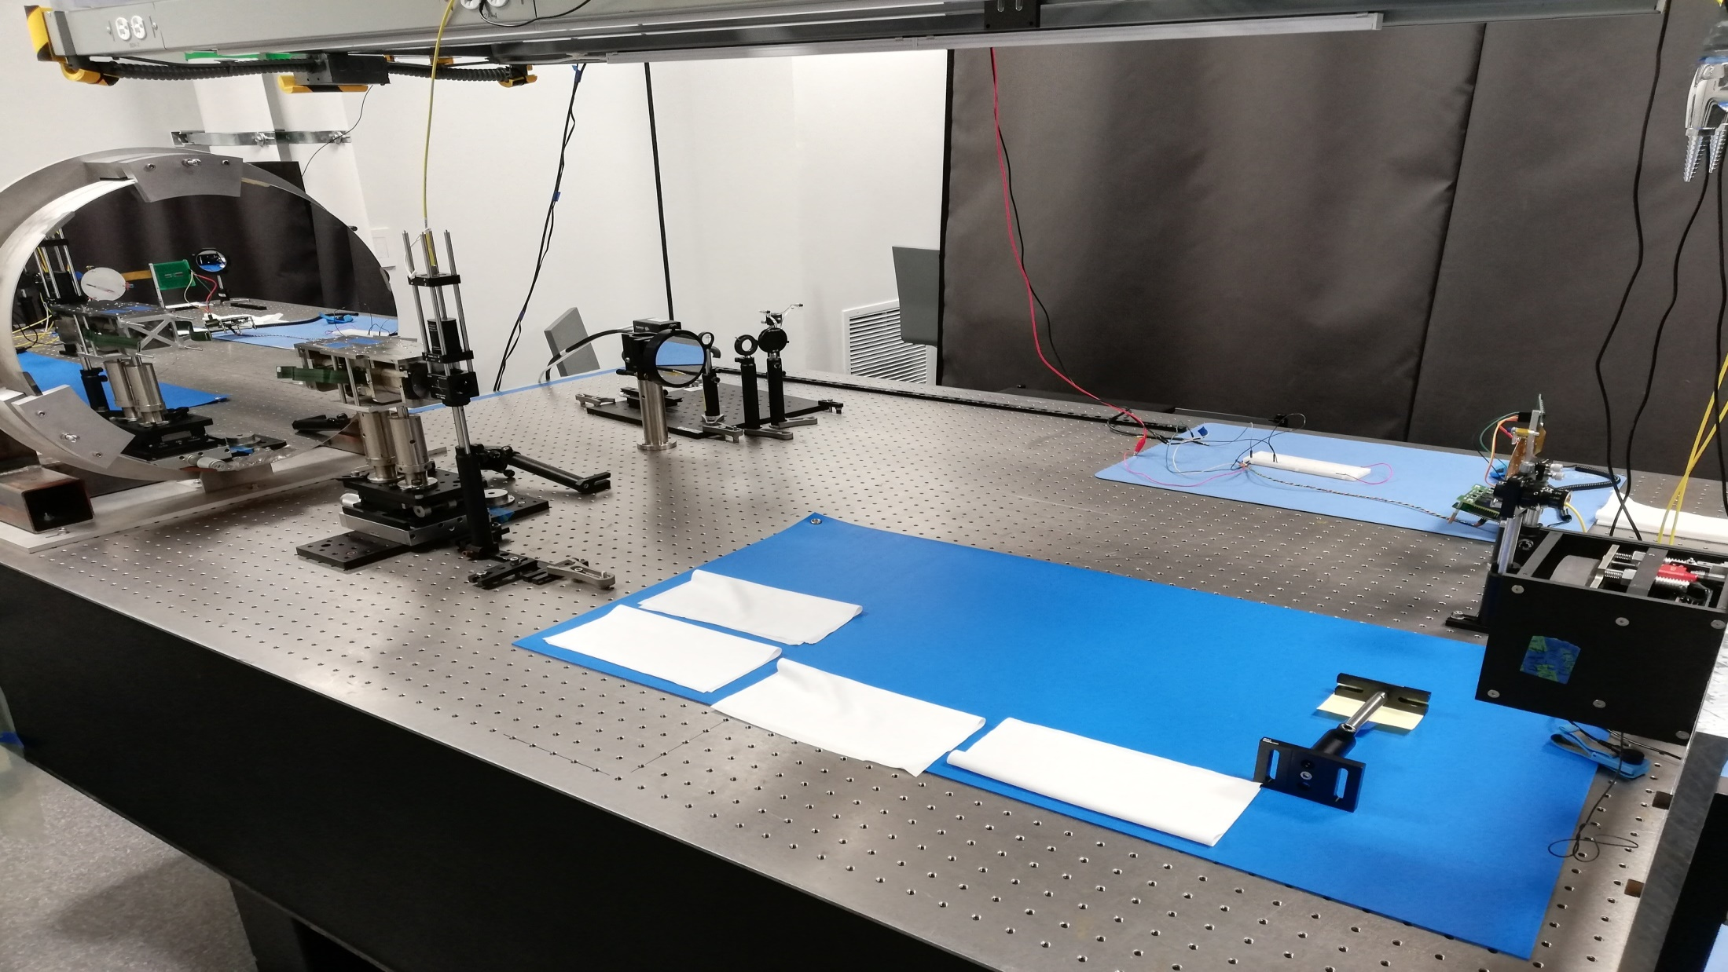
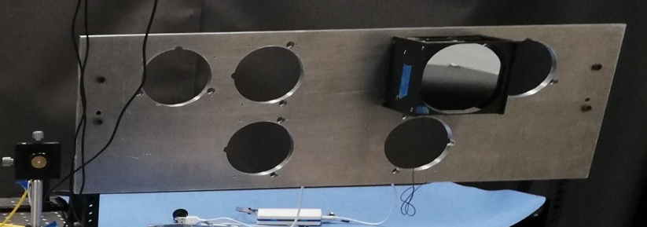
Aarest telescope integration testbed
Flat mirror
Simulation of star at ∞
Current status
AAReST telescope is aligned: PM mount + RM box + Illumination system
Characterization of the AAReST DM
Electro-optical characterization of CMOS sensors:
- conversion gain: SNR, star magnitude
- bias, dark, flat, noises: image processing
Aarest camera
Laser point source
Beam splitter
Aarest Rigid mirror box
Front view of Aarest primary mirror testbed structure

Slide 20
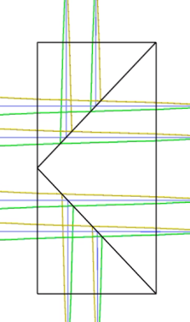
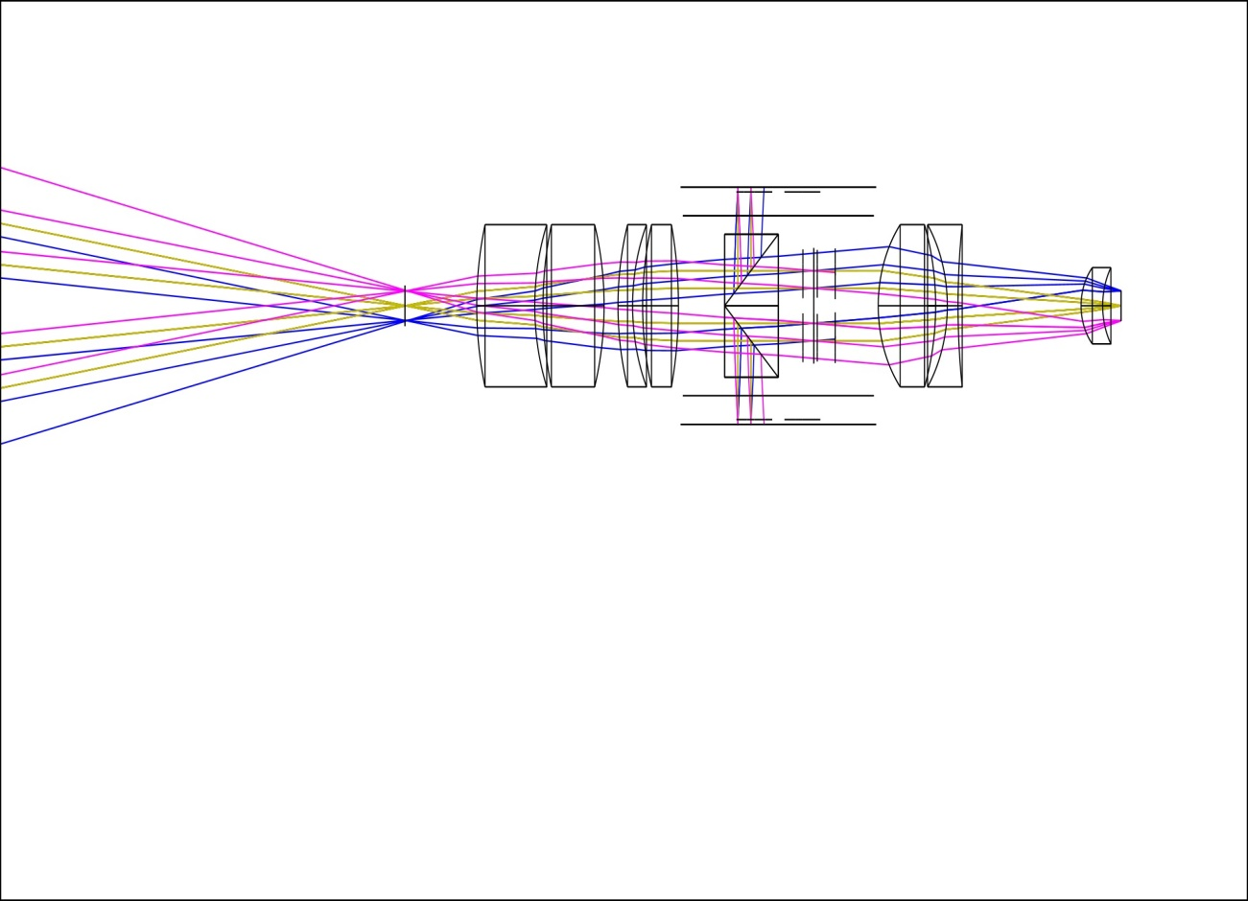
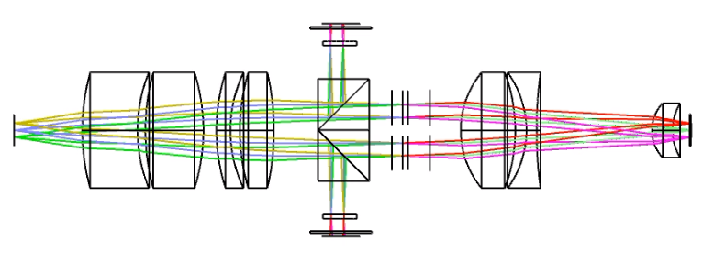
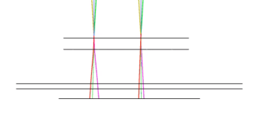
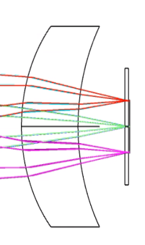
Camera – Status October 2019
Up to 2017
Oct 2019
Version 2011-2018 | October 2019
Zemax / CAD errors | Fully assembled
Distance L2 / L3 | Updated
Distance L4 / beamsplitter | Updated
Centered beamsplitters | Decentered BS Bonding gap
SHWS w/o cover glass | SHWS w/ cover glass
Distance L6/L7 | Updated
Sc.S w/o cover glass | Sc.S w/ cover glass
L1
Optical
axis
SHWS
Microlens Array
Cover Glass
SHWS
L7
Sc.S
Cover Glass
Science sensor

Slide 21
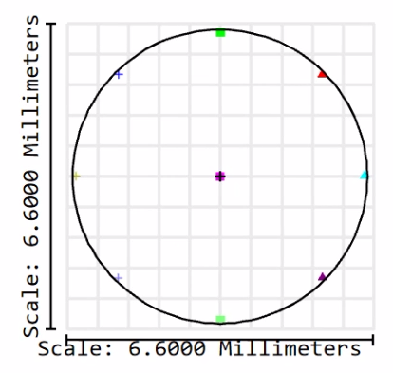
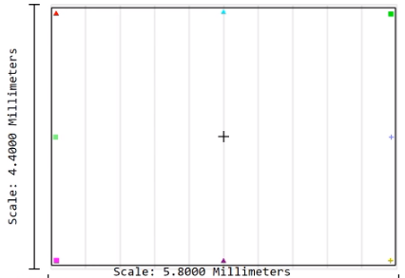
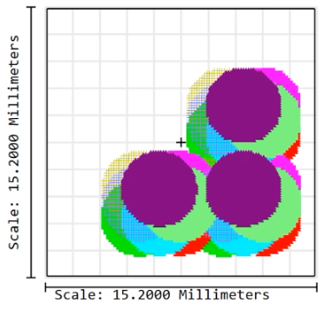
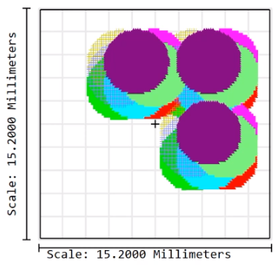
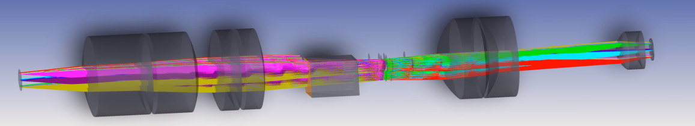
Camera – Status October 2019
Up to 2017
Oct 2019
Version 2011-2018 | Version May 2019
Zemax errors
Missing FoV Useless FoV | Optimized to science sensor
Footprint offset on BS | Footprint centered on BS
Science sensor
Useless for optimization
Updated FoV
Not considered for optimization
BS position has been corrected

Slide 22


Camera – Spectral responses
$$28\%$$
$$3.6\%$$

Slide 23
Camera – WFS – Calibration
Flux calculation
Integration:
F = 5.98e5 electron.s⁻¹.cm⁻²

Slide 24
Camera – WFS – SNR
Case 2: Given magnitude + t_{int} → SNR
Saturation: binning 2x2
Saturation: binning 1x1

Slide 25
Camera – WFS – Star mag
Case 3: Given SNR + t_{int} → Magnitude
Review Sep 2019
Saturation: binning 2x2
Saturation: binning 1x1

Slide 26
Software - To be done
Calibration on testbed
Spectral responses w/ a calibrated light source for the WFS and Science channels
Consider a catalog of stars – Compute their magnitudes for the WFS and Science channels – Compute the max integration time + SNR vs Integration time
Software
Improve the « Blind search algo» + « focusing algo » : RM + DM tip/tilt/piston correction → JWST alignment sequence
Convert the Matlab algorithms into C + test w/ the flight camera
  RM + DM: « Blind search algo» + « focusing algo »
  DM: computation of influence functions (to be done in space) + closed-loop control

Slide 27
How to define the mission success for the payload?
Download data/images from
SC: visual check (detection, integration time) + FWHM computation = Spot size value
SHWS: WFE maps/values + Zernike decomposition (Focus, Astigmatism)
For each Rigid Mirror + Deformable Mirror
Before starting « blind search algo »: misalignment
  Once « blind search algo » is completed (star is detected):
      SH images: WFE maps/values + Zernike decomposition
      SC images: visual check + FWHM
  Run « focusing algo »:
      SH images: WFE values vs Iterations + Zernike decomposition vs Time: Focus + Astig decrease
      SC images: visual check + FWHM → Smaller spot size
For each Deformable Mirror
Run « closed-loop algo »:
      SH images: WFE maps/values vs Time + Zernike decomposition vs Time
      SC images: visual check + FWHM → Smaller spot size

