Slide 1
MirrorBox Status
Charles Sommer – Serena Ferraro – Thibaud Talon
October 21st, 2019

Slide 2
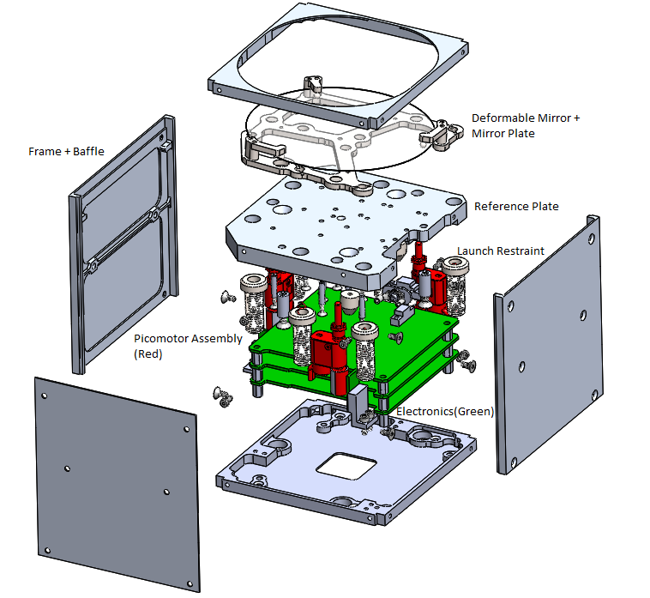

Slide 3
Status
Deformable MirrorBox vibe tested with
real Carbon Fiber Mirror (CFM)
real electronics
Engineering model of electronic boards was TVAC
5 cycles of -15 to +45C
Flight electronic boards mostly soldered
Microcontroller software fully working

Slide 4
Open issues and solutions
PZT of Mirror broke during vibe test
Bad assembly: too constrained and not damped enough
Need to update assembly document
Inductor broke on Microcontroller board
Will epoxy every inductors
Separation System Lid not manufactured
Microcontroller board browns-out with long wires

Slide 5
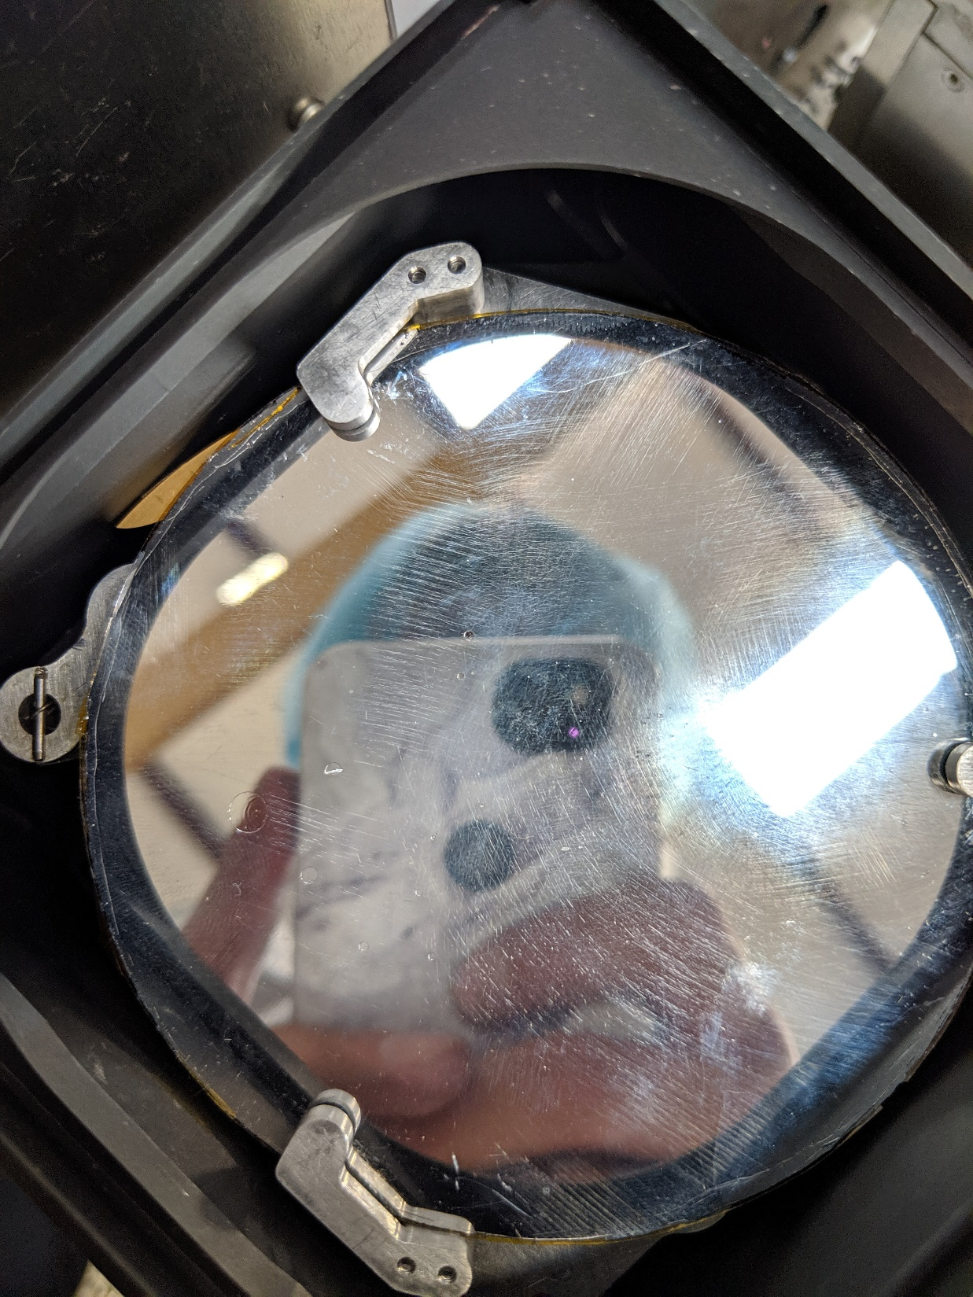
A piece of PZT broke during
Z axis sine vibe.

Slide 6
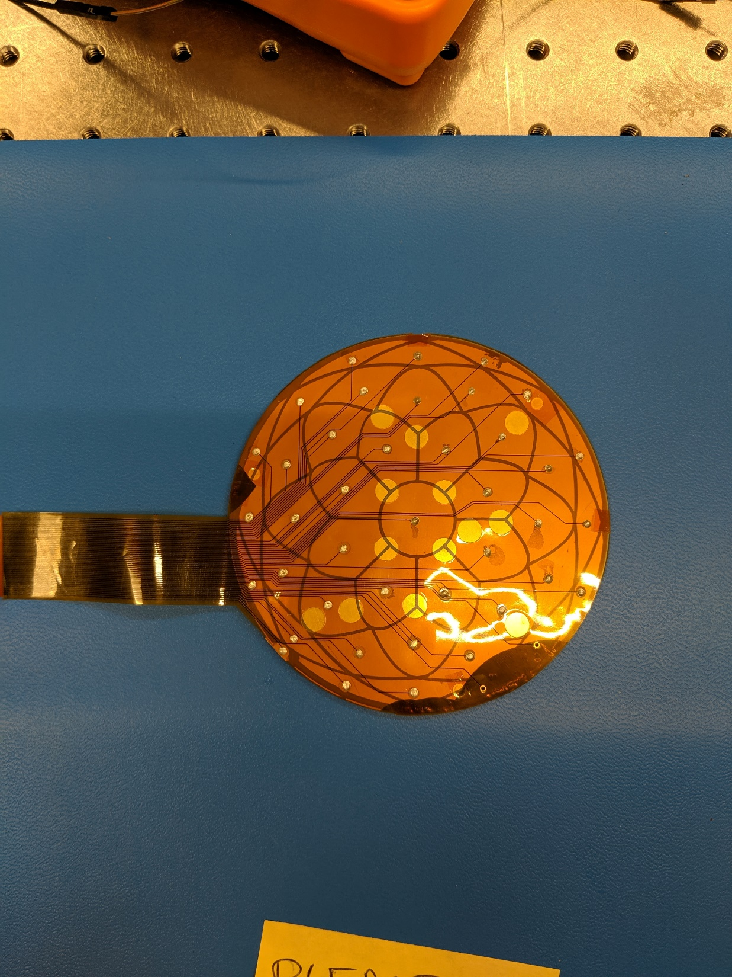
A piece was already broken
during PZT bounding (yellow).

Slide 7
Forthcoming steps
Manufacture Separation System Lid
Finish wiring all Flight picomotors (for Deformable and Rigid)
TVAC one of each full Deformable and Rigid MirrorBox
Vibe test DM MirrorBox at Caltech to double check survivability
Fully assemble 2 FM Deformable MirrorBox and place them on optical table
Reassemble 2 FM Rigid MirrorBox with Flight electronics and Flight picomotors
Epoxy all Deformable and Rigid picomotors once every tests have been done

