Slide 1
EPS - Kill Switch Board Status
Charles Sommer - Corentin Lubeigt
October 22st, 2019

Slide 2
EPS Status
All EPS channels controllable
EPS controllable through CAN bus

Slide 3
EPS issues
32V measured on CAN bus
GOMSpace does not know why
GOMSpace kill switch not fail safe
Switching OFF did not work anymore
EPS Battery leaks through EPS Dock
32V to 13V after letting the system hooked up and supposedly OFF

Slide 4
Solution: Kill Switch Board (KSB)
Before:
VBAT was going to Dock
GND was switched via GOMSpace Kill Switch
Now:
VBAT and GND are going to KSB
They are both switched on KSB

Slide 5
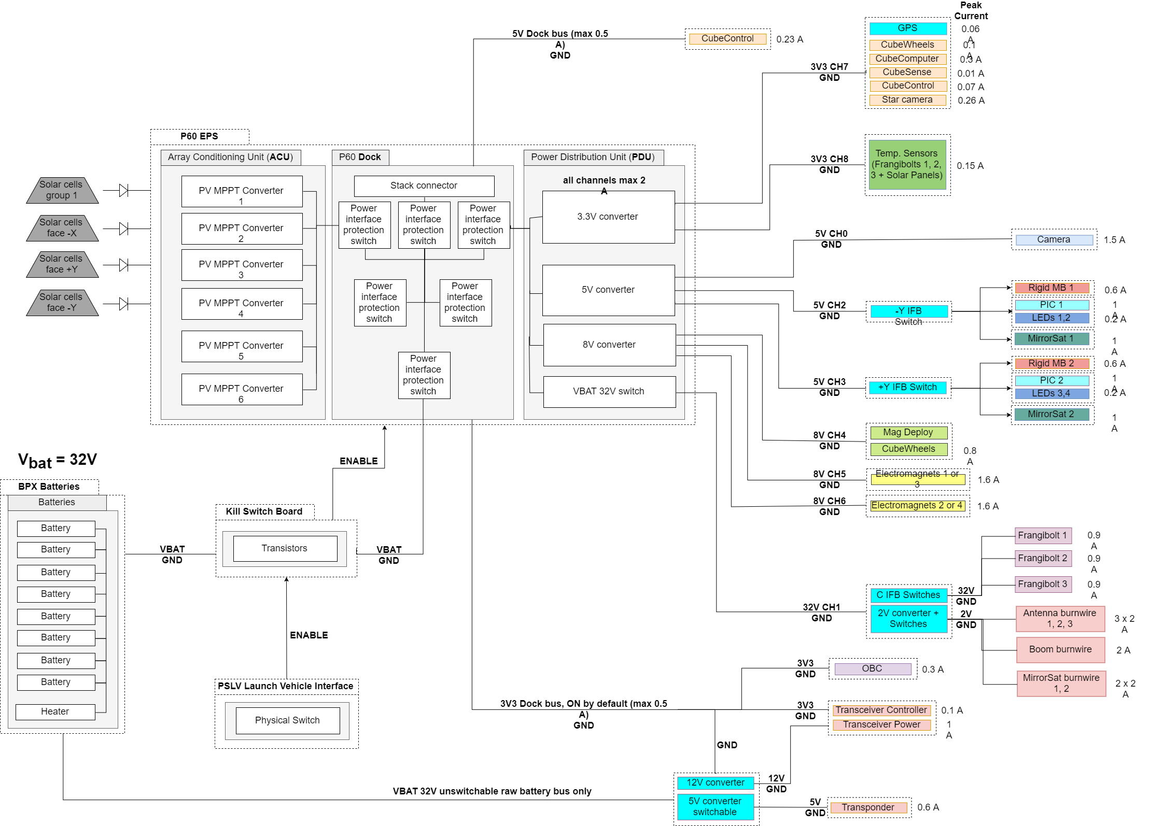

Slide 6
KSB Status
Version 1.0 received, soldered, being tested

Slide 7
KSB: Open issues and solutions
Current version (v1.0) has design issues (N-channel MOSFET for the high side which is not efficient)
New components (P-channel) coming in soon
test on the current PCB with a few wiring to accommodate new design.

Slide 8
Forthcoming steps
Adapt current PCB to accommodate new MOSFET
Test with dummy load
Test with actual EPS, verify if leak-proof
New version (v2.0) implementing the tested design
Integrate to Flat Sat
TVAC
FM board

Slide 9
Solar Panels Status
Corentin Lubeigt
October 22st, 2019

Slide 10
Overview
4 sets of solar panels
-Y: 6 cells
+Y: 6 cells
+X: 24 cells
-X: ~23 cells (face that mainly points to the Sun)
Solar cells around MirrorBoxes (12 cells)

Slide 11
Solar Panels Status
AE105 2018
Study on the previous version of the CAD
Cells routing consideration (same sets of cells to have same performance for each set in parallel)
Electrical design started (libraries edited)
Current CAD
Rough estimate of cells position

Slide 12
Solar panel open issues and solutions
CAD very variable: no final version of the CAD yet, hence no final version of the solar panels
When the flight structure is validated, we can resume the work

Slide 13
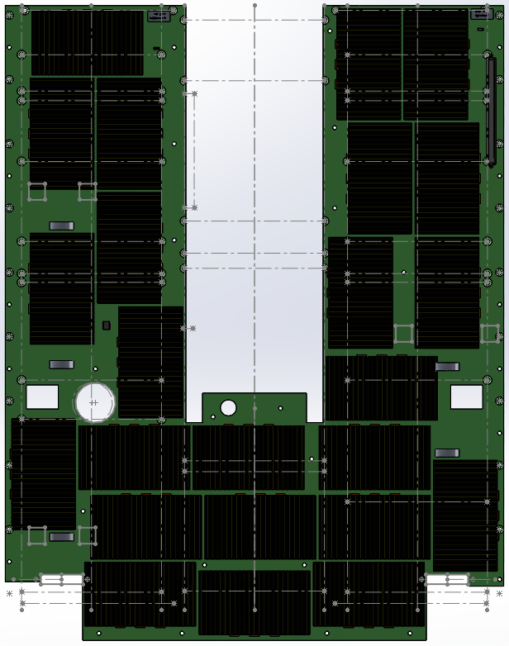
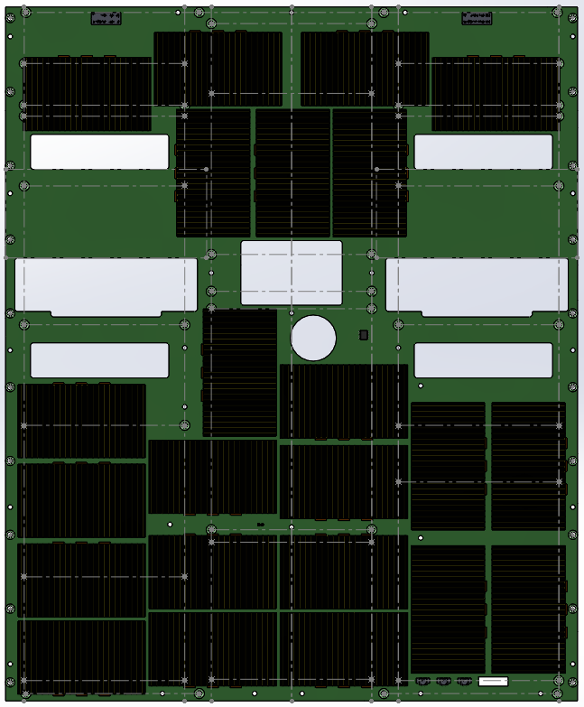
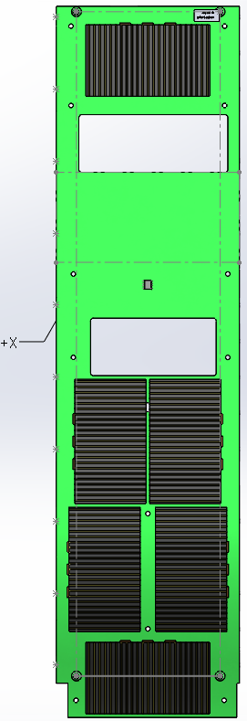
Last year status
-X
+X
-Y
+Y

Slide 14
Forthcoming steps
Update CAD PCB design and cells layout with new inputs (antennas, burnwire, connectors)
Electrical design
Test with battery with EPS and Interface Board in the middle
Outdoor test

