Slide 1
Radio Interface Board Status
Corentin Lubeigt
October 22st, 2019

Slide 2
Overview
Board between the Central Stack and Radio + Transponder stack
Functionalities:
Convert VBAT (direct from battery) to 12V for the Radio
Convert VBAT to 5V (with on/off feature) to 5V for the Transponder
Current and voltage sensing of 12V and 5V with a I2C ADC
Forward data signals (CAN for Transponder, UART for Radio)
Process and forward Firecode generated by Radio to the EPS

Slide 3
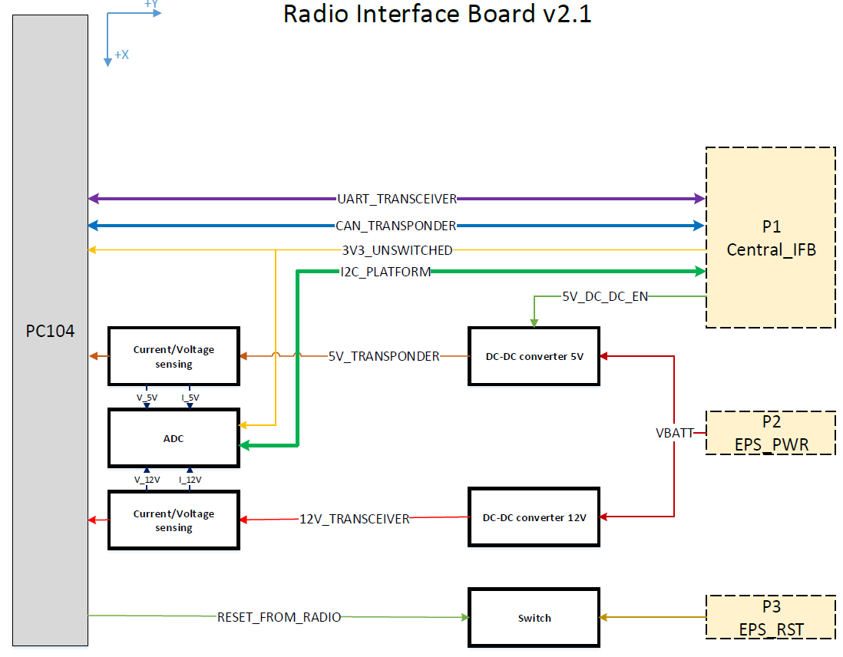

Slide 4
Status
Version 2.1 soldered, tested through TVAC
Radio powered with the Radio IFB in the middle

Slide 5
Open issues and solutions
Problem on 5V lines: 5V is shared by MirrorSat, PIC and MirrorBox. The two last are microcontroller and cannot stand a too low input voltage. When current drawn increases, we observe voltage drop.
Test different switches to pick the most efficient one to minimize voltage drop through the board
Cable analysis and design to estimate the voltage drop (through Central IFB to Y IFB harness and and through Y IFB to MirrorBox harness)

Slide 6
Forthcoming steps
Solder new IFB when it comes in
Functional test with actual cable length
TVAC final version of IFB
Integrate to FlatSat
Order FM boards

Slide 7
+/-Y Interface Boards Status
Corentin Lubeigt
October 22st, 2019

Slide 8
Overview
Board between the Central Stack and Solar Panels, MirrorBox, the Payload Interface Computer and its electromagnet boards
Functionalities:
Provide 5V switched to PIC, MirrorBox and MirrorSat (this one isolated)
Generate UART from I2C to talk to the MirrorBox
On-board temperature sensing
Interface with Solar Panels, ADCS (coarse sun sensor) and EPS (ACU)
Burnwires mechanism for antenna deployment

Slide 9
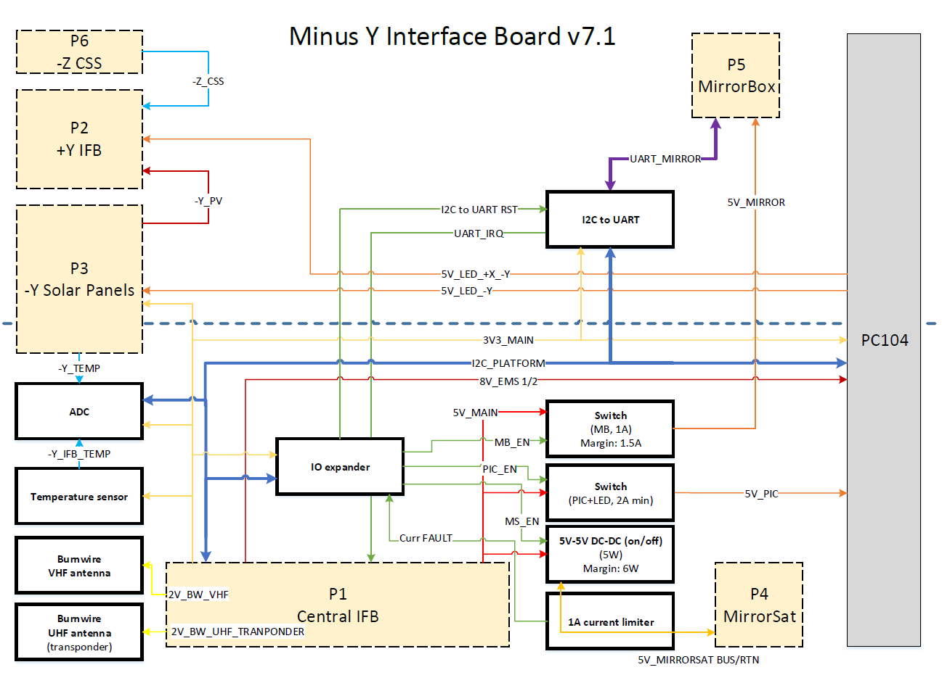

Slide 10
Status
Version 6.4 soldered and tested
Most of the board passed save the 5V lines (see next slide)
Next version (v7.x) ordered
-Y interface board serve as a EM for the +Y interface board

Slide 11
Open issues and solutions
Problem on 5V lines: 5V is shared by MirrorSat, PIC and MirrorBox. The two last are microcontroller and cannot stand a too low input voltage. When current drawn increases, we observe voltage drop.
Test different switches to pick the most efficient one to minimize voltage drop through the board
Cable analysis and design to estimate the voltage drop (through Central IFB to Y IFB harness and and through Y IFB to MirrorBox harness)

Slide 12
Forthcoming steps
Solder new IFB when it comes in
Functional test with actual cable length
TVAC final version of IFB
Integrate to FlatSat
Order FM boards

Slide 13
Central Interface Board Status
Fabien Royer - Charles Sommer – Corentin Lubeigt – Thibaud Talon
October 22st, 2019

Slide 14
Overview
4 layers board in central stack:
Top layer: data and low power lines
Middle top layer: high power lines
Middle bottom layer: ground
Bottom layer: data and low power lines
Functionalities:

Slide 15
Status
Received first version of the board and components

Slide 16
Open issues and solutions
So far no issues detected

Slide 17
Forthcoming steps
Solder components on board
Perform functional test on board

Slide 18
Flight Preparation Panel Board Status
Corentin Lubeigt
October 22st, 2019

Slide 19
Overview
Board meant to access the Central stack PC104 from the outside of the spacecraft. It is the main interface between test engineer and the spacecraft
Functionalities: route all the PC104 lines from the PC104 of the central stack the outside of the spacecraft
Data lines to be monitored (UARTs, I2Cs, CAN, SPI, GPIOs)
Power lines from the EPS
Probed lines from the Central IFB

Slide 20
Status
First version ordered

Slide 21
Open issues and solutions
No issue so far for the board has not arrived yet

Slide 22
Forthcoming steps
Solder new IFB when it comes in
When Central stack is assembled, plug it in and let it be the only interface used for testing

