Slide 1
Camera Status
Charles Sommer – Serena Ferraro – Thibaud Talon
October 21st, 2019

Slide 2
Status
Vibration tested (?)
Flight pieces are manufactured
EM of electronic boards + optical sensors were TVAC
5 cycles of -15 to 45C
Base software fully coded
CAN control
Low level drivers

Slide 3
Open issues and solutions
Science camera has heating issues
Overheats in vacuum
Operating temperature range is limited: 0 to 50 degrees C
Designed heat dissipation + heating solutions
Already re-designed electronics to host heater
Science camera and Boom Inspection camera are the same
Will cover it by adding black anodized aluminum around it
Temperature sensors were not working correctly
Switched to thermistors and changed electronics

Slide 4
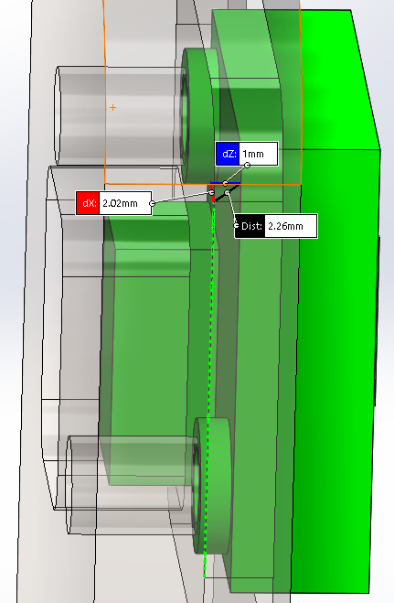
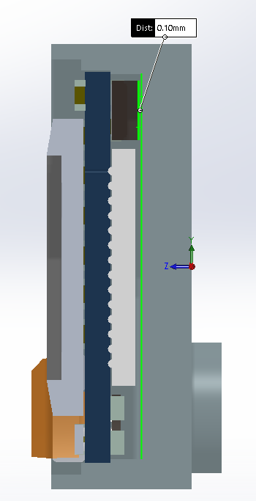
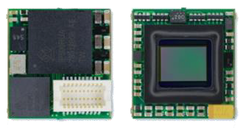
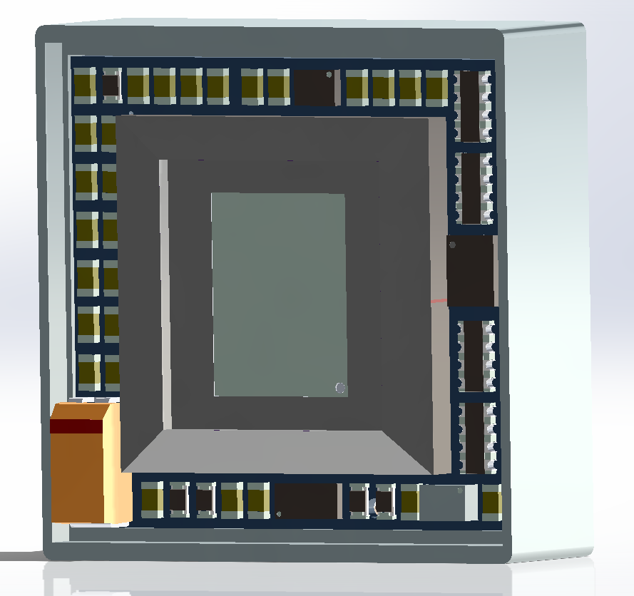
Science camera thermal
Add 1mm thermal pad
between box and bracket
Add 100um thermal pad
at the bottom of the box
Buy new MU9PM, board level
Reuse or buy new camera box
Add heater film
around casing

Slide 5
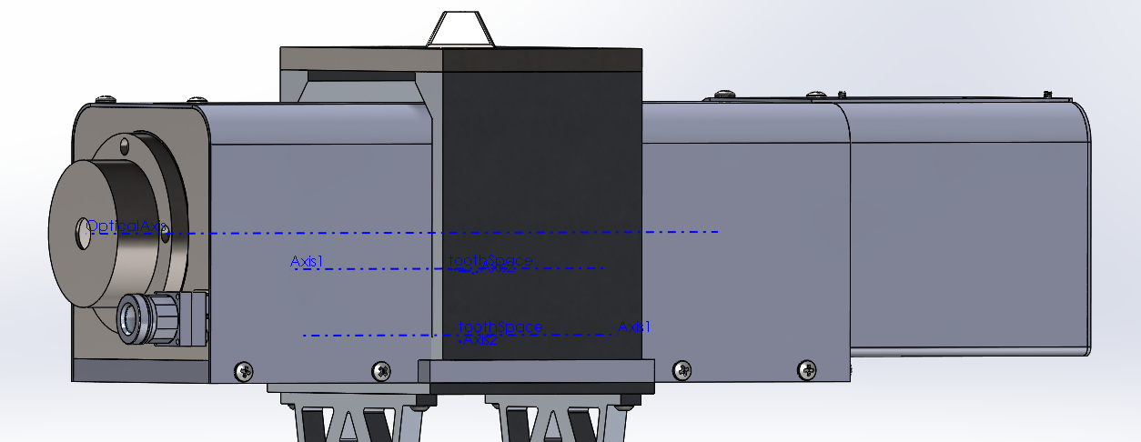
Boom inspection camera thermal
Surround camera with black
anodized aluminum + add
dissipation

Slide 6
Upcoming steps
Solder new version of camera electronics
Replace Science Camera
Manufacture surroundings for Boom Inspection Camera
TVAC camera electronics with heater + thermistors + dissipators

