Slide 1
ADCS testing Status
Corentin Lubeigt
October 21st, 2019

Slide 2
Status
CubeSpace Health check tested
Generated code tested with OBC

Slide 3
Open issues and solutions
CubeSpace is doing a major firmware update that will lead to code changes by the end of the year
May need to adapt our code
Re-do health check

Slide 4
Upcoming steps
Proceed to firmware update
Re-do health check
Re-generate configuration values with the latest CAD changes

Slide 5
GPS Status
Corentin Lubeigt
October 21st, 2019

Slide 6
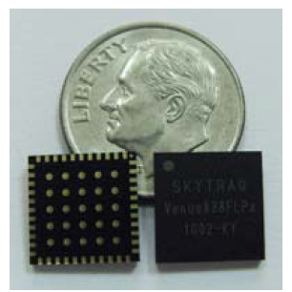
Overview
GPS receiver to:
Provide UTC time to the spacecraft
Provide Two Line Elements to the spacecraft derived from an estimate of the orbit (in order to initialize the ADCS algorithm)
This GPS is located on the Central Interface Board (top of the central stack)

Slide 7
Status
Circuitry tested on a test board
Able to obtain estimate of the position and velocity every second
Tested on a bike in Pasadena
Accommodation of the antenna in the middle on the launch interface
Base software fully coded
SPI to UART chip to generate a UART
Low level drivers

Slide 8
Open issues and solutions
The GPS receiver is sometime providing chaotic data that need to be filtered out.
It is likely to be an error introduced by a design issue that would degrade the RF signal → A new PCB layout is coming in with the new interface board.

Slide 9
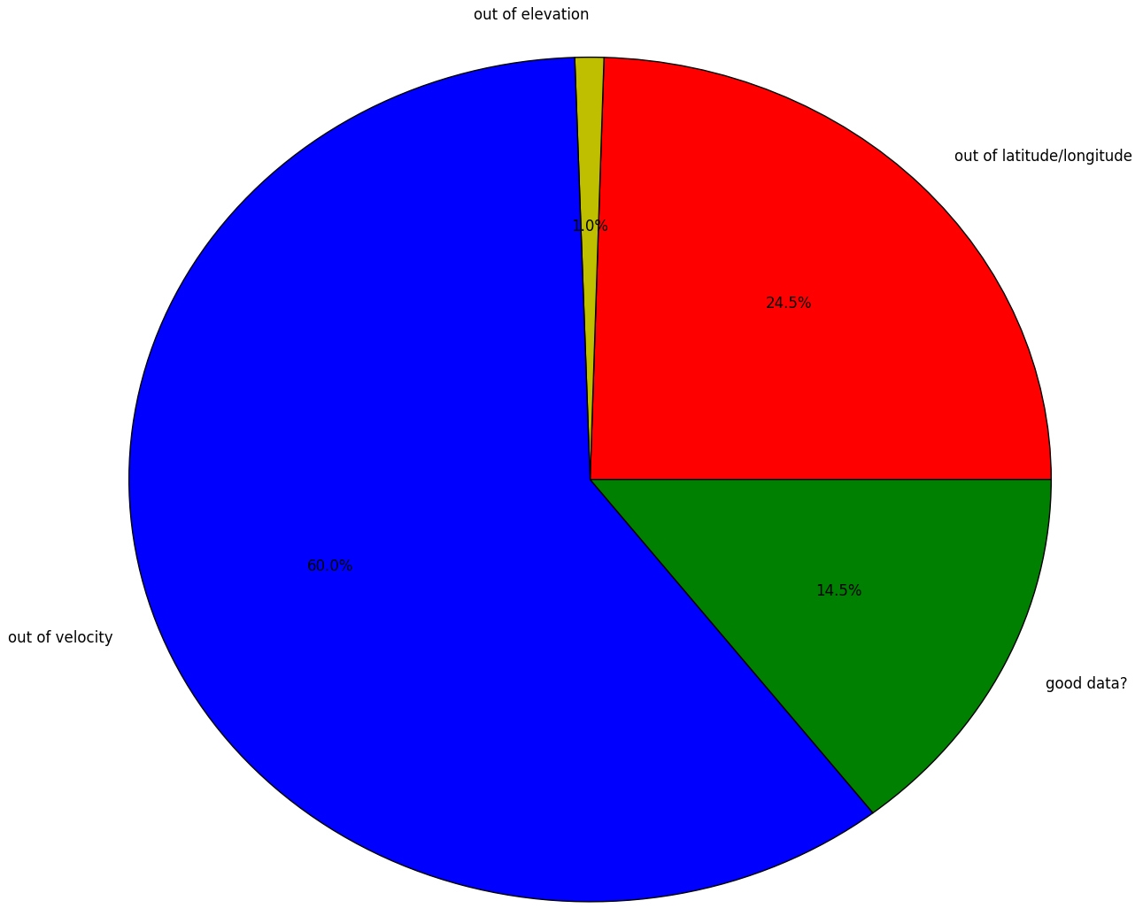
Out of range data set
Elevation
Latitude/longitude
Velocity
Good data?

Slide 10
Upcoming steps
Solder new Central Interface Board with new PCB layout for the GPS receiver
Test it outdoor in an open environment to highlight any differences with the previous design
With this new configuration, develop an orbit estimator depending of the degree of confidence on the data with a Extended Kalman Filter (EKF)
Feed ADCS with the TLEs (Two Line Elements) derived from the output of the EKF
Integrate the whole system in the spacecraft (cabling from the interface board to the antenna)

