Slide 1
Evolution & ethics

Slide 2
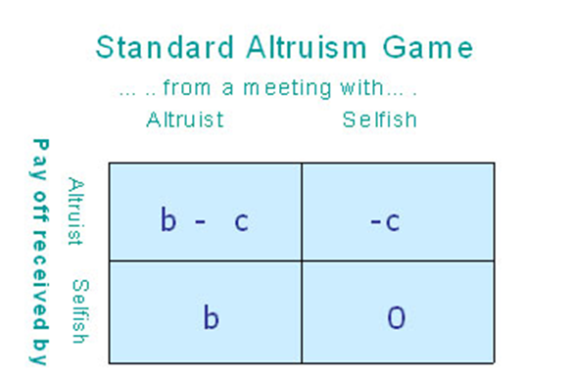
Altruism
a social behavior counts as altruistic if it reduces the fitness of the organism performing the behavior, but boosts the fitness of others.

Slide 3
Evolutionary Game Theory
Game theory with fitness rewards and punishments that then iterate over generations
Fundamental findings: altruism is an evolutionary unstable strategy. A population of altruists can be invaded by selfish agents, who then drive down the proportion of altruists to 0

Slide 4
Public Goods Games
In the basic game, subjects secretly choose how many of their private tokens to put into the public pot. The tokens in the pot are multiplied by a factor (>1) and this “public good" payoff is evenly divided among players. Each subject also keeps the tokens they do not contribute.
Nash equilibrium (solution) = 0
Problem of ‘free-rider’

Slide 5
So, how does cooperation evolve?
kin selection (Hamilton 1964)
reciprocal altruism (Trivers 1971)
commitment mechanisms (Frank 1988);
social norm and punishment mechanisms (social selection)
Sexual selection (Miller)

Slide 6
Sexual selection
Competition for reproduction
  Intersexual selection – attractive to opposite sex (mate choice)
  Intrasexual selection (intimidating, defeating same-sex rivals)
Sexual strategies:
  Short-term: good genes
  Long-term: genes, parenting, partners

Slide 7
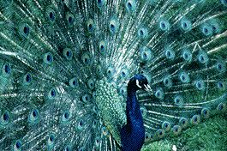
Mate Choice
costly signaling a signal is so costly that only high health, high status, high condition animals can afford to produce it, the signal can remain evolutionarily reliable

Slide 8
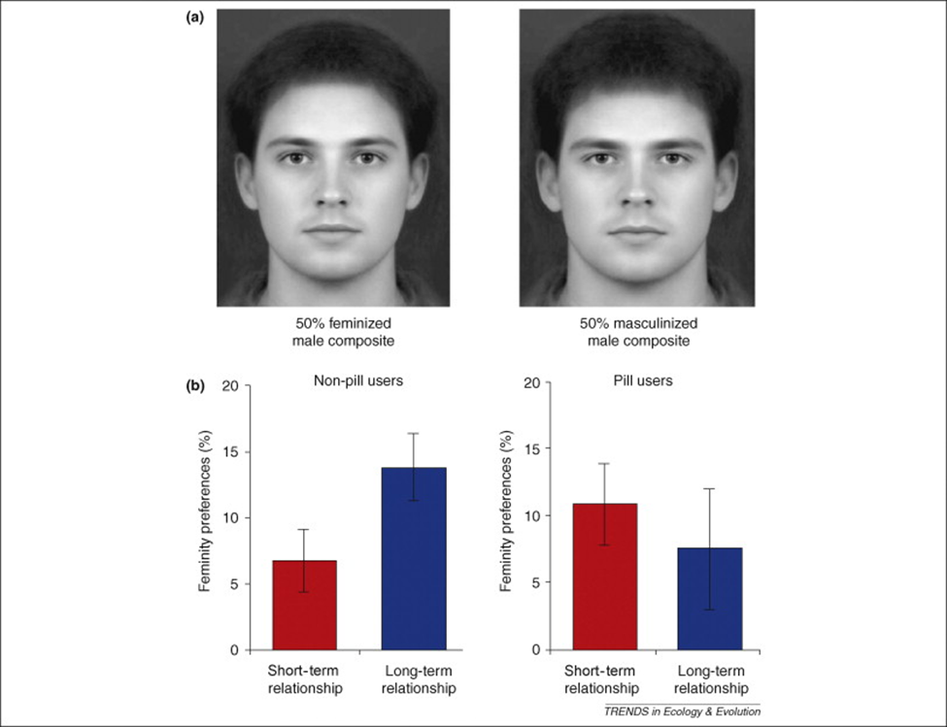
Facial signals

Slide 9
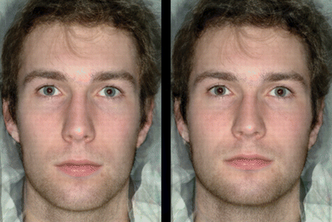
facial-width ratio

Slide 10
Moral Virtues as costly signals
Apart from physical appearance and social status, which traits most excite our romantic impulses? People often fall in love based on positive assessments of each other’s generosity, kindness, honesty, courage, social sensitivity, political idealism, intellectual integrity, empathy to children, respectfulness to parents, or loyalty to friends.

Slide 11
Attractive moral virtues
kindness: emotional responsiveness to the needs of others
empathy: lovingness, affection, fondness, commitment, forgivingness, trust, and perspective-taking
niceness: agreeableness and nonviolence
honesty
heroism

Slide 12
Moral Behavior
Morality through mate-choice model also has distinctive strengths and weaknesses that can explain some moral virtues—especially those that show high sexual attractiveness, assortative mating, phenotypic and genetic variance, heritability, condition-dependent costs, conspicuous display in courtship settings, and young adult age peaks in display
not to suggest that human morality is sexually motivated at the level of individual behavior. Evolutionary functions do not equal proximate motivations

Slide 13
What online ad really means?
SF, 26, seeks kind, generous, romantic, honest man
single female, 26, seeks a healthy male of breeding age with a minimal number of personality disorders that would impair efficient coordination and parenting in a sustained sexual relationship, and a minimal number of deleterious mutations on the thousands of genes that influence the development of brain systems for costly, conspicuous, altruistic displays of moral virtue.”

