Slide 1
Emotions and moral judgment

Slide 2
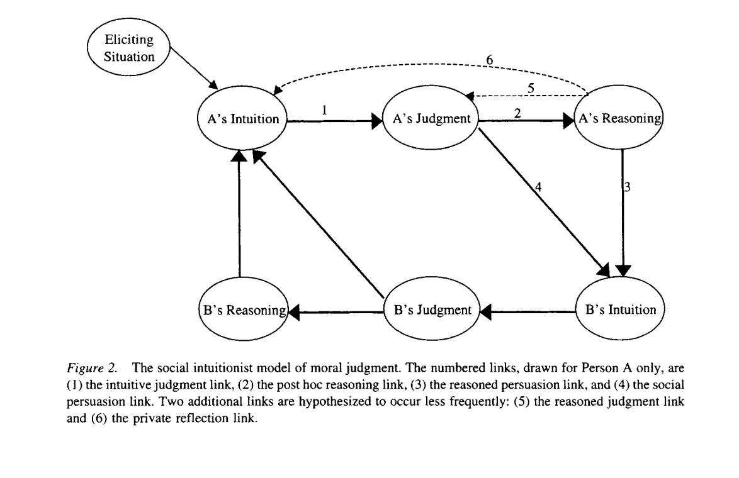
Haidt’s social intuitionism

Slide 3
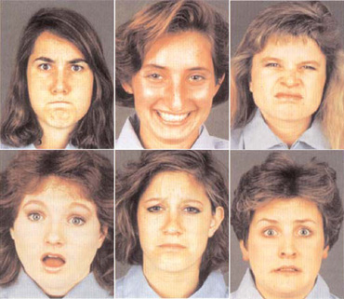
6 or 7 Universal emotions

Slide 4
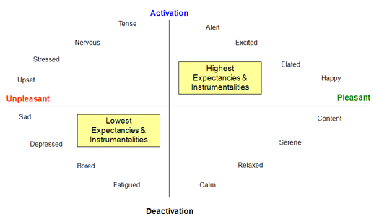
+/- high/low

Slide 5
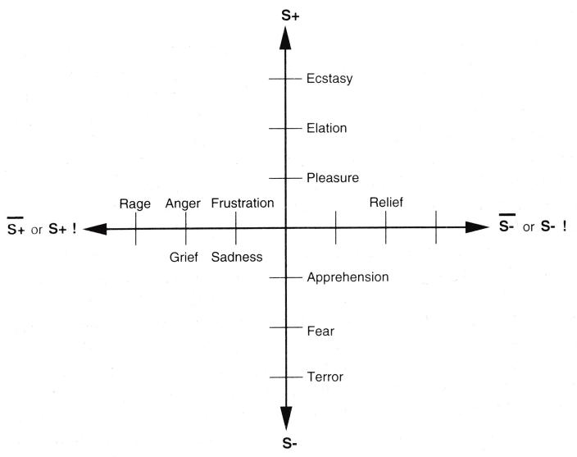
Reward & emotions
1. the presentation of a positive reinforcer S+
2. the presentation of a negative reinforcer S-
3. the omission of a positive reinforcer S+
4. the termination of a positive reinforcer S+!
5. the omission of a negative reinforcer S-
6. the termination of a negative reinforcer S-!

Slide 6
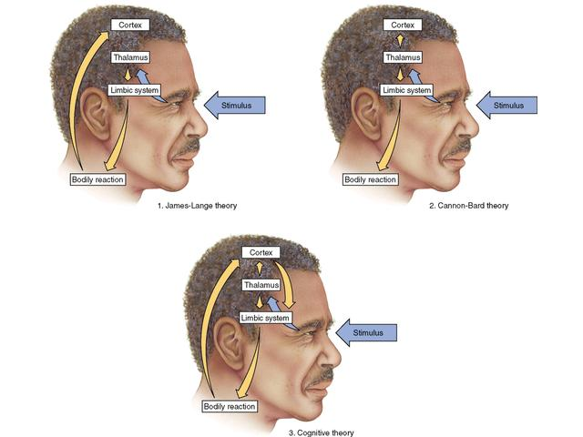
Cognitive vs somatic theory

Slide 7
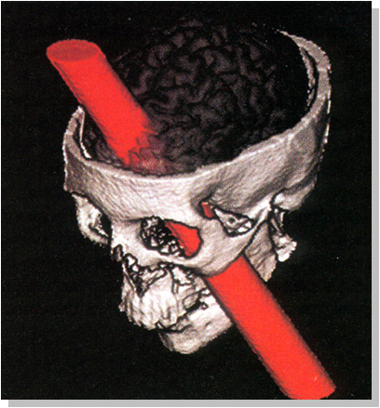
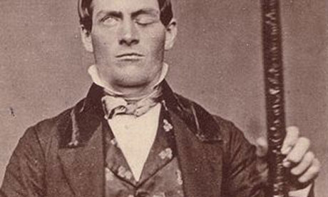
Phineas Gage

Slide 8
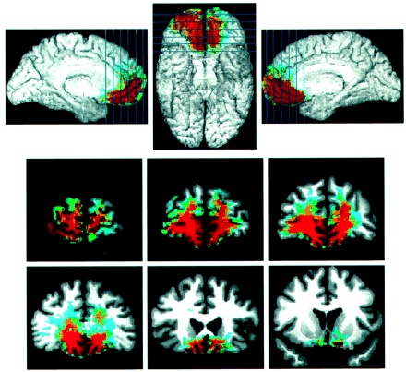
Damasio’s somatic marker

Slide 9
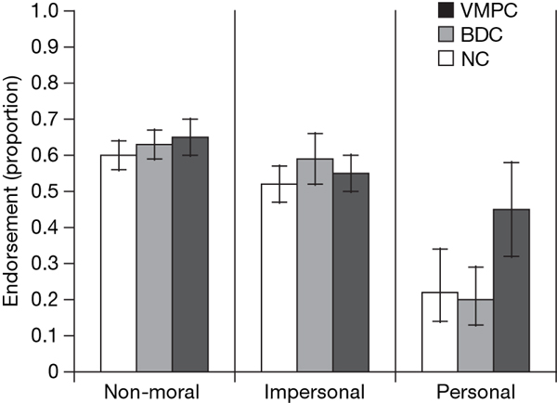
VMPC and Utilitarian judgment

Slide 10
Mismeasure of morals study
Psychopathy: a personality style characterized by low empathy, callous affect, and thrill-seeking
Machiavellianism: degree to which people are cynical, emotionally detached from others, and manipulative
  Both share emotional coldness, aggression, and willingness to engage in or rationalize deceit
No Meaning Scale measures people’s melancholic existential concerns—how meaningful they perceive life to be. If life is perceived to be meaningless, we reasoned, then the question of whether to kill one to save five may well reduce to a simple “math problem”—a dispassionate comparison of utilities.

Slide 11
Some scenarios
You and five others are exploring a seashore cave. A rock falls and blocks your exit. The tide is rising. You spot a hole elsewhere and let a large man in your group out first. He gets stuck, and unless you get out soon, everyone but this man (whose head is sticking out of the cave) will drown. You have a stick of dynamite that will not move the rock, but will blast the man out of the hole. He does not want to die; neither do you or the others
You are the captain of a small military submarine traveling underneath a large iceberg. An onboard explosion has dramatically decreased the oxygen supply and has injured a member of the crew. He may die from his injuries. The remaining oxygen is not sufficient for the entire six-man crew to make it to the surface. If you shoot the injured crewmember, there will be just enough oxygen for everyone else to survive

Slide 12
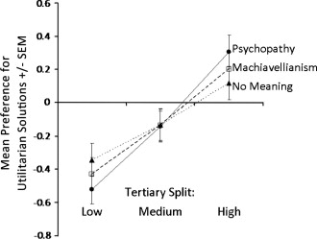
Utilitarian preferences

