Slide 1
Hubbert Analysis for Coal
Dave Rutledge
Engineering and Applied Science Caltech
Food, Energy, and Water
American Chemical Society, NOLA, March 2018

Slide 2
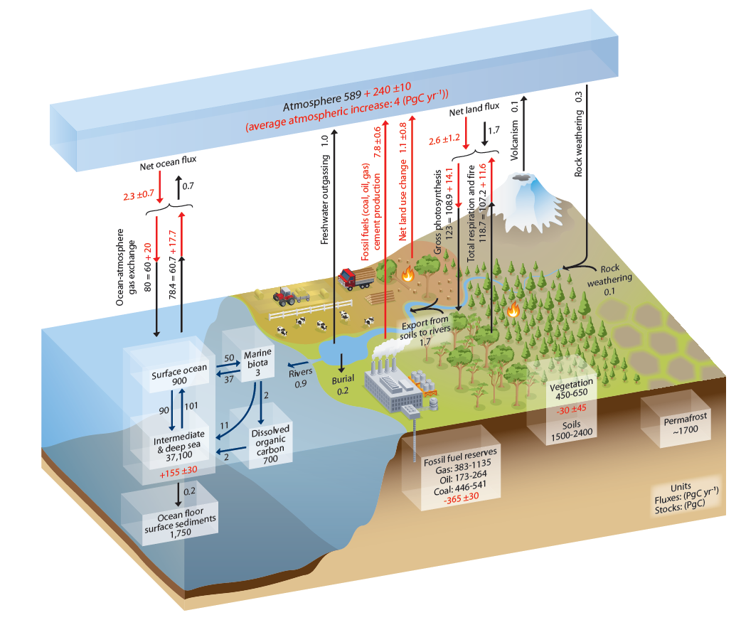
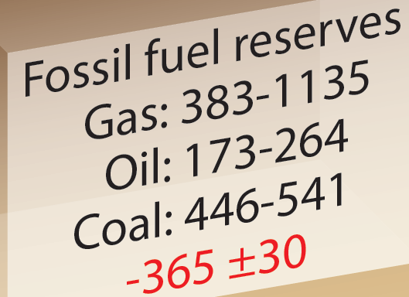
The Global Carbon Cycle from the IPCC 5th 2014 Assessment Report (WG1, Figure 6.1)
How long will our fossil fuels last?
How much will we burn?
Note that the BP 2014 gas reserves are 107GtC
Notes:
Atmospheric inventories calculated at 2.12GtC/ppm
Gas reserves ±50%
Oil reserves ±20%
Coal reserves ±10%

Slide 3
Hubbert Analysis for Coal
Historical energy production and impacts
Models for coal production
CO₂ emissions in climate scenarios (RCPs)
Are the logistic models likely to be a better guide than the RCPs?

Slide 4
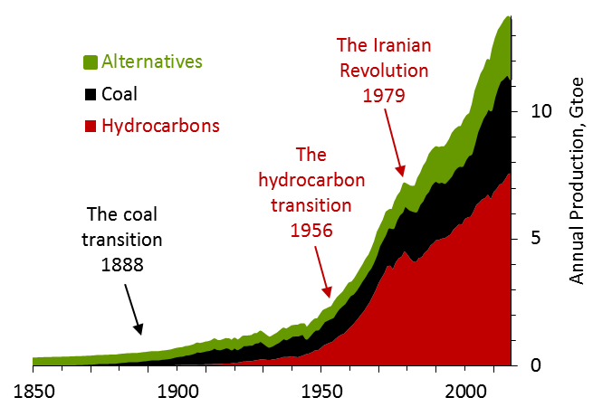
History of World Energy Production
Gtoe = billions of metric tons of oil equivalent, 1 toe = 42GJ
Wood and water from Arnulf Grubler, 2003, Technology and Global Change
Coal, oil, gas, and alternatives from Brian Mitchell, International Historical Statistics, BP Statistical Review and the FAO (UN) on-line data base
Hydrocarbons include natural gas, crude oil, and the natural gas liquids
Hydrocarbons passed coal in 1956—87% of fossil-fuel production has occurred since then
Notes:
88% of fossil-fuel production since 1950

Slide 5
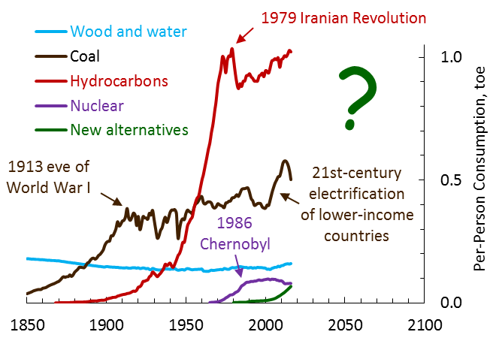
World Per-Person Energy Production
UN Population Division on-line data base
Sources tend to rise until there is a shock, like World War I and the Iranian Revolution
New alternatives: wind, sun, geothermal, biofuels, biogas …

Slide 6
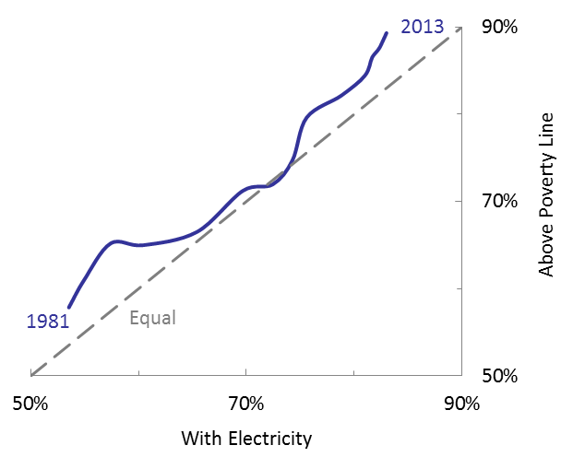
Moving Toward Universal Electricity Access
Poverty $1.90/d 2011 PPP from http://iresearch.worldbank.org/PovcalNet/index.htm?0
Electricity access from various editions of the IEA World Energy Outlook
With electricity access, many good things happen—communities can provide clean water, people can preserve their food, hospitals can run operating rooms, people can deal with hot and cold

Slide 7
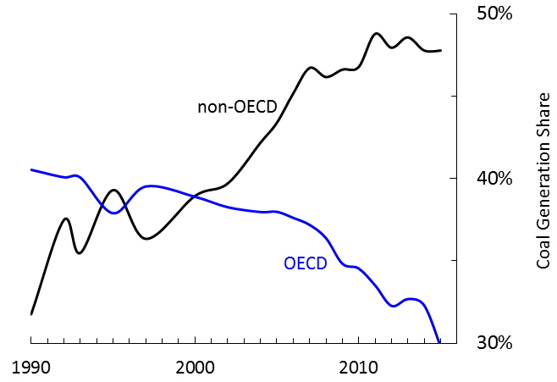
Coal Share of Electricity Generation in OECD and non-OECD Countries
From various editions of the IEA World Energy Outlook

Slide 8
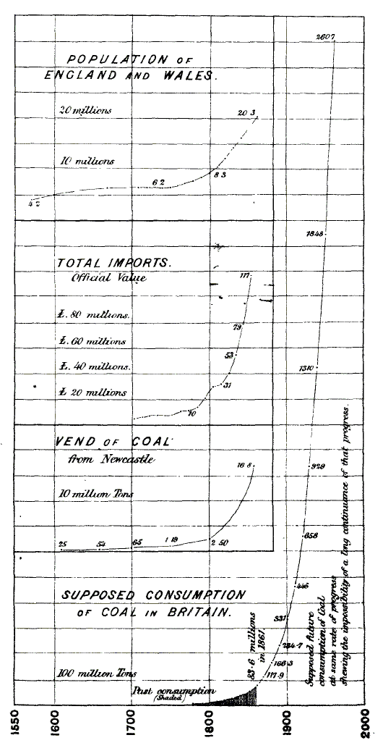
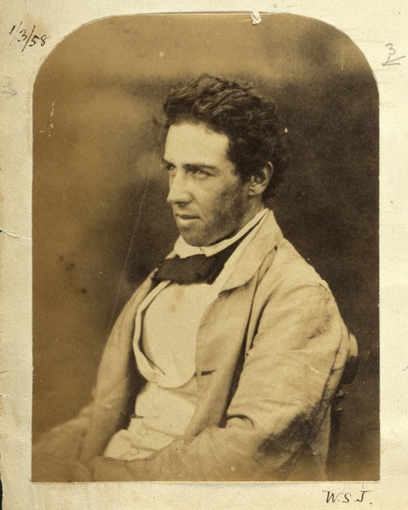
Models for Fossil Fuel Production
Stanley Jevons The Coal Question, 1865

Slide 9
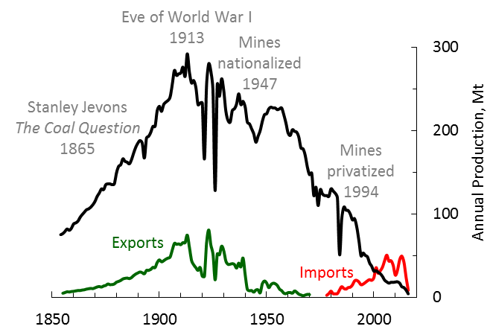
British Coal Production
From the UK Department of Energy and Climate Change
Mt = millions of metric tons
The last underground mine closed in 2015

Slide 10
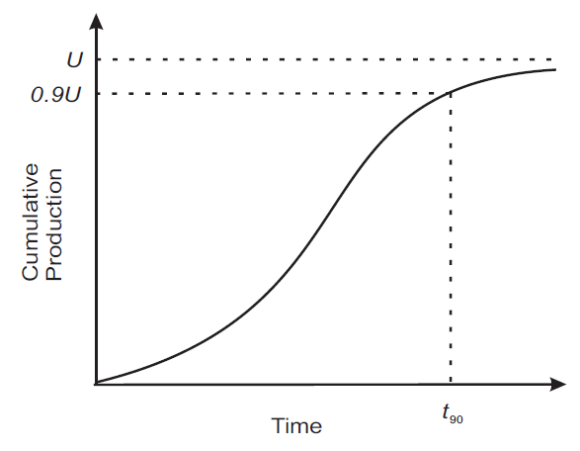
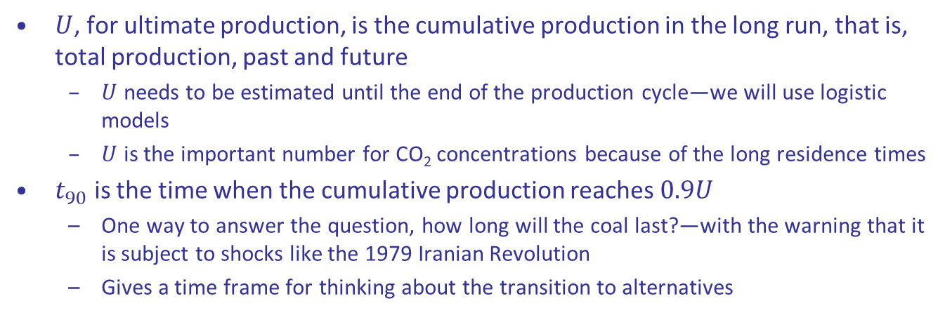
A Representative Cumulative Production Curve
$U$, for ultimate production, is the cumulative production in the long run, that is, total production, past and future
$U$ needs to be estimated until the end of the production cycle—we will use logistic models
$U$ is the important number for CO₂ concentrations because of the long residence times
$t_{90}$ is the time when the cumulative production reaches $0.9U$
One way to answer the question, how long will the coal last?—with the warning that it is subject to shocks like the 1979 Iranian Revolution
Gives a time frame for thinking about the transition to alternatives

Slide 11
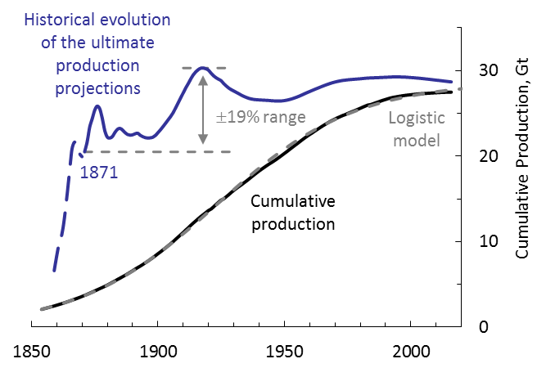
Logistic Model for the UK Coal Production
It appears that the total production will amount to 28Gt
A logistic fit in 1871 or any time since then would have been close to this value

Slide 12
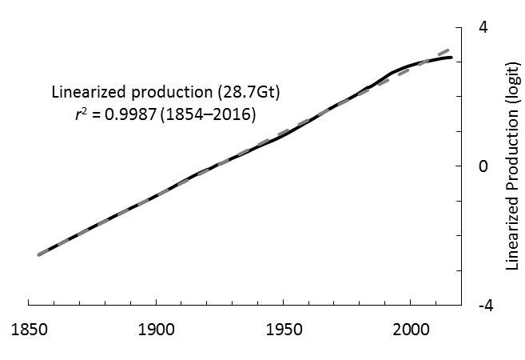
Linearized with the Logit Transform (UK)
British coal records began in 1854 (from Jevons)
Approach described in David Rutledge, 2011, “Estimating long-term world coal production with logit and probit transforms,” International Journal of Coal Geology—the paper also includes information on individual regions
Effectively vary U to give zero curvature—the line parameters give t₁₀, t₉₀

Slide 13
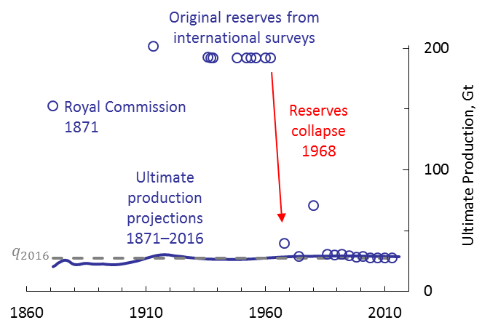
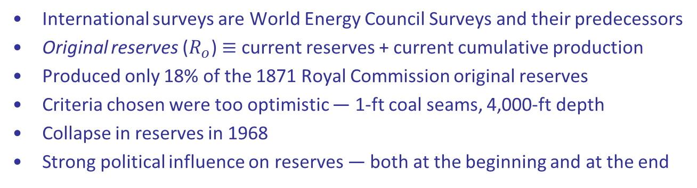
Projections Compared with Reserves (UK)
International surveys are World Energy Council Surveys and their predecessors
Original reserves ($R_{o}$) $≡$ current reserves + current cumulative production
Produced only 18% of the 1871 Royal Commission original reserves
Criteria chosen were too optimistic ― 1-ft coal seams, 4,000-ft depth
Collapse in reserves in 1968
Strong political influence on reserves ― both at the beginning and at the end

Slide 14
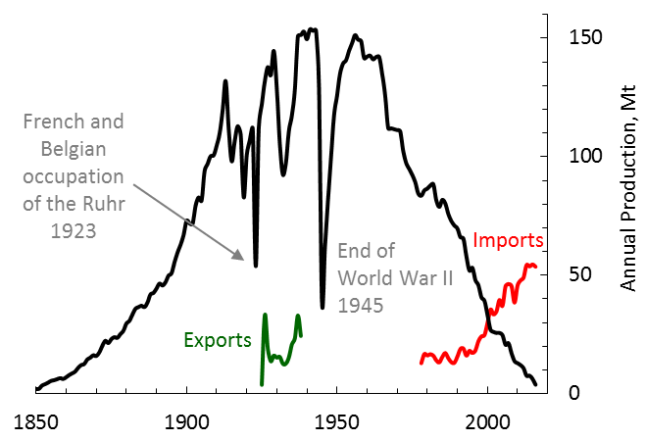
German Hard Coal Production
From the Statistik der Kohlenwirtschaft
German hard coal (steinkohle) corresponds to the US bituminous and anthracite coal—production is concentrated in the Ruhr Valley
2 mines left—they close this year
There is still a market for hard coal in Germany, but it is imported
Heavily subsidized (200G€ so far)—the deepest mines are 1000m

Slide 15
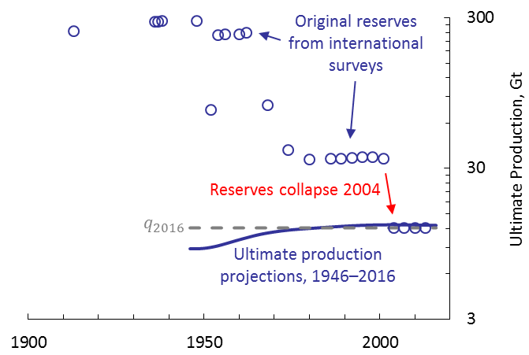
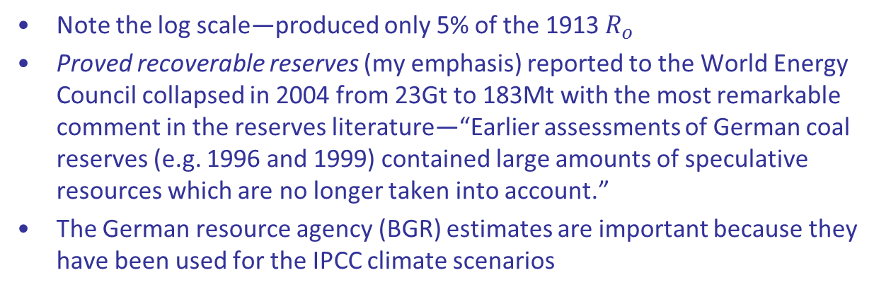
Projections Compared with Reserves (Germany)
Note the log scale—produced only 5% of the 1913 $R_{o}$
Proved recoverable reserves (my emphasis) reported to the World Energy Council collapsed in 2004 from 23Gt to 183Mt with the most remarkable comment in the reserves literature—“Earlier assessments of German coal reserves (e.g. 1996 and 1999) contained large amounts of speculative resources which are no longer taken into account.”
The German resource agency (BGR) estimates are important because they have been used for the IPCC climate scenarios

Slide 16
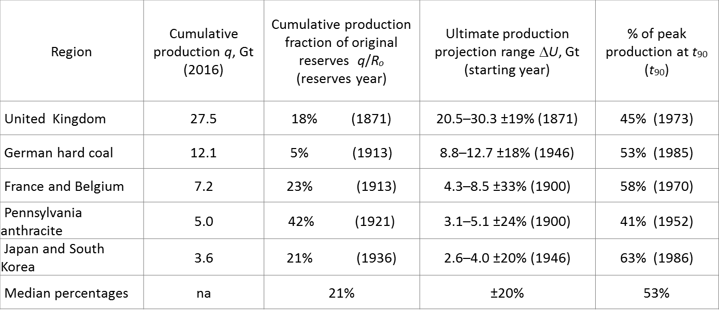
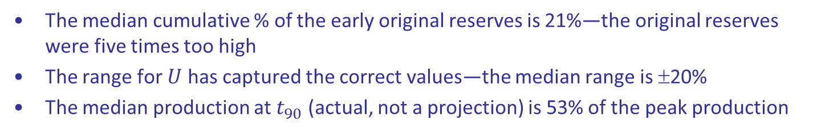
Summary for Mature Coal Regions
The median cumulative % of the early original reserves is 21%—the original reserves were five times too high
The range for $U$ has captured the correct values—the median range is ±20%
The median production at $t_{90}$ (actual, not a projection) is 53% of the peak production

Slide 17
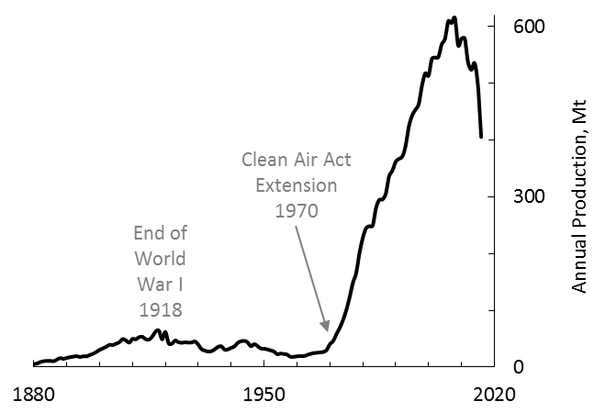
Western US Coal Production
From the USGS and the Energy Information Administration
Early production cycle peaked in 1918—centered on underground mines in Colorado, extremely limited by lack of railroad capacity to get customers
New start after the 1970 Clean-Air Act Extension, which encouraged the use of low-sulfur coal, and the 1980 Staggers Rail Act, which deregulated the railroads—now centered on surface mining in Wyoming
The recent peak is 2008, the last year of the second Bush Administration—before the fracking revolution and before the Obama Administration attacks on coal

Slide 18
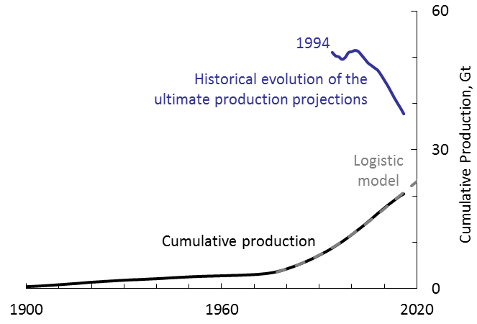
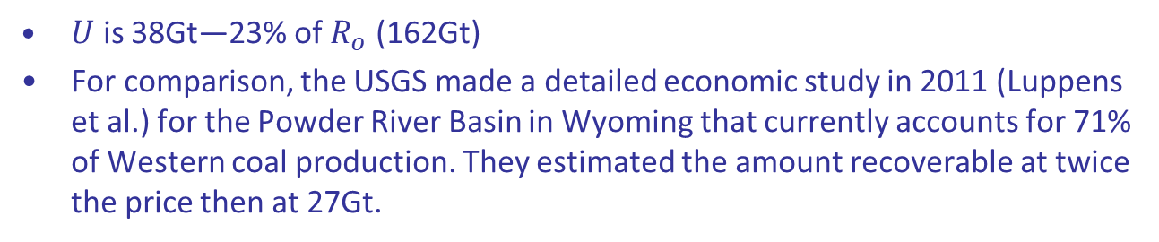
Western US Coal Production
$U$ is 38Gt—23% of $R_{o}$ (162Gt)
For comparison, the USGS made a detailed economic study in 2011 (Luppens et al.) for the Powder River Basin in Wyoming that currently accounts for 71% of Western coal production. They estimated the amount recoverable at twice the price then at 27Gt.
Notes:
Talked to the manager of the North Antelope Rochelle mine 107Mt/y
Met with researchers at Consol

Slide 19
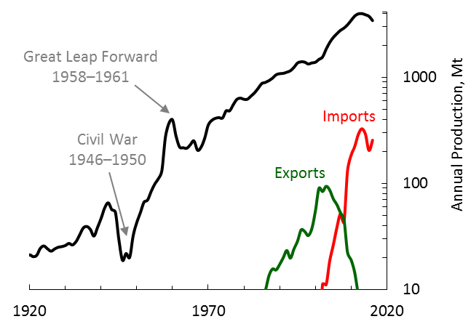
Chinese Coal Production
From Elspeth Thomson and the BP Statistical Review
51% of world’s consumption in 2016
Production may have peaked in 2013—now the world’s largest importer

Slide 20
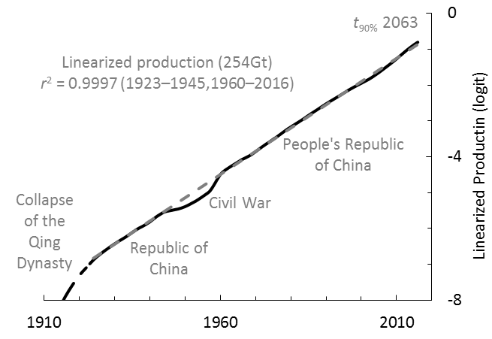
Linearized with the Logit Transform (China)

Slide 21
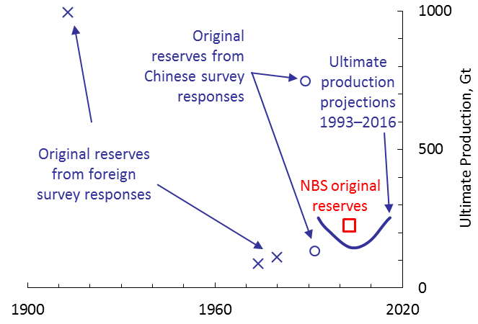
Projections Compared with Reserves (China)
The current projection of 254Gt is consistent with the 2003 reserves from the Chinese National Bureau of Statistics
Xie Heping, president of Sichuan University, stated in 2013 that “shallow coal resources in the key coal areas [in China] have been depleted, leaving an average mining depth of approximately 600m”
Notes:
NBS statistics quote in IEA 2009 “Cleaner Coal in China”
Xie Heping Liu Hong Wu Gang, Cornerstone Magazine, 2013 China’s Coal Industry Must follow the path of sustainable production capacity average depth

Slide 22
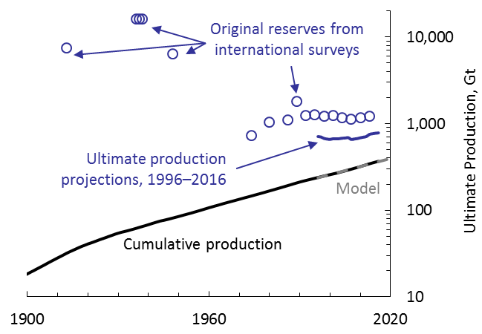
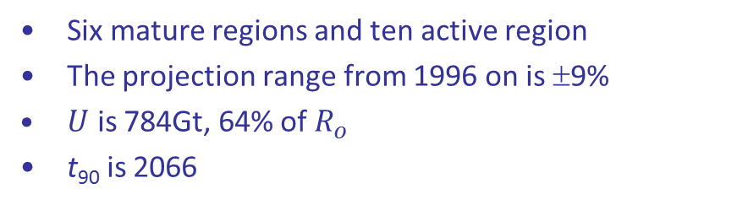
World Coal Production
Six mature regions and ten active region
The projection range from 1996 on is ±9%
$U$ is 784Gt, 64% of $R_{o}$
t₉₀ is 2066

Slide 23
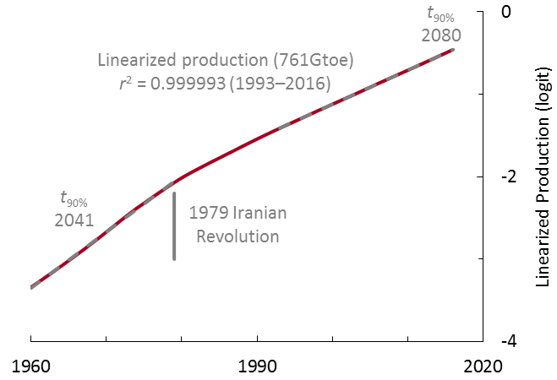
Logit Transform for World Hydrocarbons
Slowdown in the production pace from 1979 on causes a change in the linearized slope—should consider t₉₀ as a current trend that could be changed by a future shock
The impact of the new shale gas and tight oil technology
The EIA (2013) estimates 47% increased gas resources and 11% increased oil resources
Will there be significant new production from the new technologies outside of North America?

Slide 24
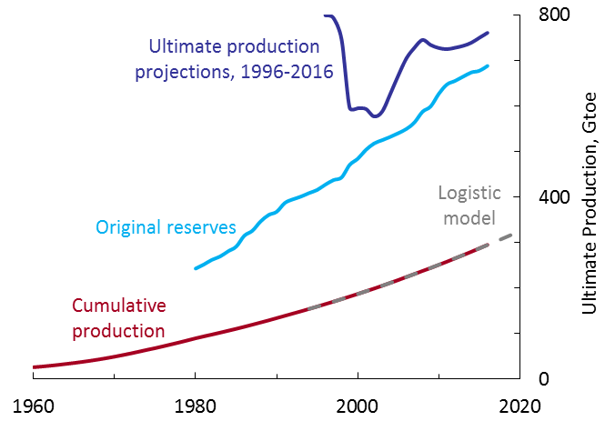
Projections Compared with Reserves for Hydrocarbons
In contrast to coal, the projections are higher than the original reserves
The reserves have been rising—78% of the increase in oil reserves is OPEC

Slide 25
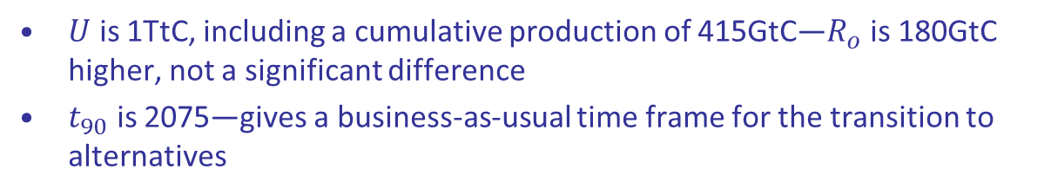
Combining the Fossil Fuels on a CO₂ Basis
 | Cumulative production GtC | Ultimate production projection GtC | t₁₀ | t₉₀ | Original reserves GtC
Hydrocarbons | 216 | 583 | 1977 | 2080 | 527
Coal | 199 | 423 | 1947 | 2066 | 659
Fossil Fuels | 415 | 1,006 | 1968 | 2075 | 1,186
$U$ is 1TtC, including a cumulative production of 415GtC—$R_{o}$ is 180GtC higher, not a significant difference
$t_{90}$ is 2075—gives a business-as-usual time frame for the transition to alternatives

Slide 26
Reserves, Resources and Occurrences
Shale gas technology
Reserves: proved, recoverable, economic
Resources: economically interesting
Occurrences:
not economically interesting
Closed mines
Proved means within a specified distance from an observation point
Recoverable means adjusted for feasibility and losses in production
Economic means that one could make money from production now
Economically interesting means that there is a better than even chance that one would be able to make money in the future
Resources may be hypothetical, that is undiscovered

Slide 27
Coal Resources in the IPCC 5th Assessment Report
This report uses new scenarios called Representative Concentration Pathways (RCPs)
The report is 4,852 pages long—there are two mentions of coal resources
From WGIII, Chapter 7, p. 525 “For both reserves and resources, the quantity of hard (black) coal significantly outnumbers the quantity of lignite (brown coal), and despite resources being far greater than reserves, the possibility for resources to cross over to reserves is expected to be limited since coal reserves are likely to last around 100 years at current rates of production.” (Rogner et al., 2012)
“… coal reserves are likely to last around 100 years at current rates of production.” is not consistent with the 5x increase in the RCP8.5 scenario
“… resources to cross over to reserves…”—historically coal reserves have turned into occurrences rather than the other way around
The single reference to Rogner et al. is to a book edited by a lead author for a different chapter in the Assessment Report
Table 7.2 on the same page lists coal resources as 14-21Tt (Rogner et al., 2012) [converted at 21GJ/t]—the coal resources number can be traced to the German resources agency, the BGR

Slide 28
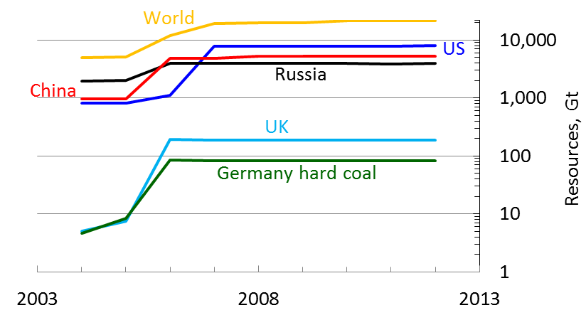
Coal Resources from the German Resources Agency (BGR)
The coal resources for the earlier SRES scenarios came from the World Energy Council (3.4Tt in 1998)—but the WEC reduced its resources to 180Gt in 2007
For the RCPs, the coal resources come from the BGR, which increased its resources after Sandro Schmidt took over from Thomas Thielemann in 2006
German hard coal 8Gt ⇒ 84Gt (should be an occurrence, not a resource)
UK 8Gt ⇒ 191Gt (should be an occurrence, not a resource)
US 806Gt ⇒ 7,857Gt, the largest component is 3,500Gt for undiscovered coal on the North Slope of Alaska (16% of the world resources)

Slide 29
Comparisons With the RCPs
Scenario | CO₂ TtC | Google links
RCP 2.6 | 0.3 | 61,500
RCP 4.5 | 1.5 | 101,000
RCP 6.0 | 2.4 | 65,800
RCP 8.5 | 5.6 | 149,000
Projection | 1.0
Reserves | 1.2
From the RCP data base — the CO₂ totals include the past production
I do not recommend RCP 2.6 — there is no sign that carbon sequestration will take place on a significant scale
I cannot recommend using RCP 6.0 or 8.5, because they are not consistent with the historical experience of coal mining — for example, the production proportional to resources for RCP8.5 for the North Slope would be 1Tt, compared with the current cumulative US production, 74Gt

Slide 30
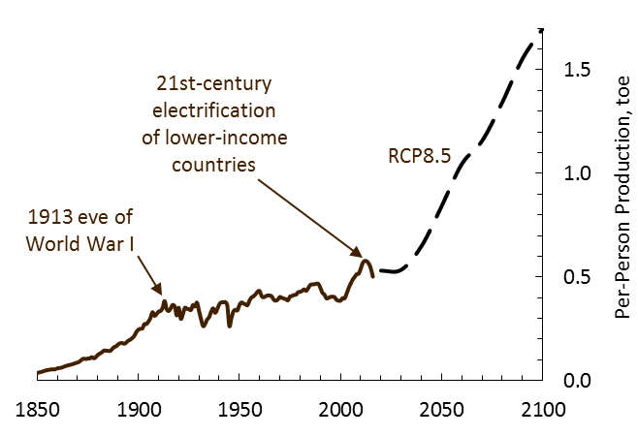
Per-Person Coal Consumption in RCP8.5
RCP8.5 digitized from Keywan Riahi et al. 2012 RCP8.5 – “A scenario of comparatively high greenhouse gas emissions”
Historical data is replot from an earlier slide
Justin Ritchie of the University of British Columbia alerted me to this – why would all this coal be burned?

Slide 31
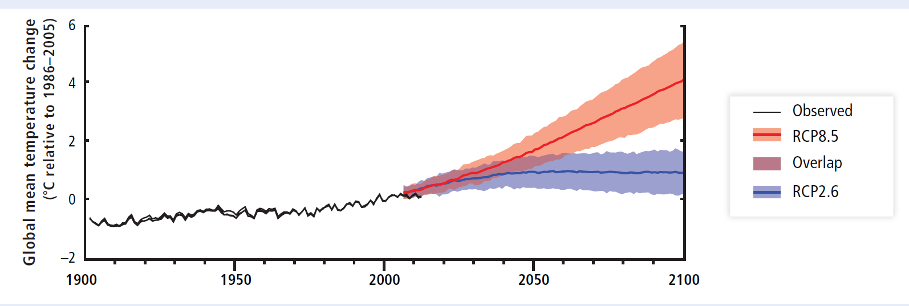
Temperature in the IPCC 5th Assessment Report, WGII, Summary for Policy Makers (Figure SPM.4b)
RCP2.6 and RCP8.5 are the only scenarios that appear in the SPM
RCP2.6 has net negative future carbon-dioxide emissions—massive carbon capture and sequestration is assumed

Slide 32
The Global Carbon Cycle from the IPCC 5th Assessment Report (WG1, Figure 6.1)
How long will our fossil fuels last? t₉₀ = 2075 (RCP8.5 2227)
How much will we burn? U = 1TtC (RCP8.5 6TtC)
Gas reserves are actually 108GtC (BP)
Notes:
Atmospheric inventories calculated at 2.12GtC/ppm
Gas reserves ±50%
Oil reserves ±20%
Coal reserves ±10%

Slide 33
Summing Up
Comparing the logistic projections with original reserves
For coal, the projections have been more accurate than original reserves
The projections are less sensitive to political meddling than reserves
How do we get a sense of whether my projections are on the right track, compared to the RCP8.5 scenario?
Hydrocarbon production has been twice coal production since 1970—there is no sign of this changing
India is now the number 2 coal producer, passing the United States in 2016—however, I believe that India’s reserves are simply not good enough to move the needle
Chinese coal production has been declining since 2013—this is evidence that the 600m average mine depth is correctly indicating significant exhaustion

