Slide 1
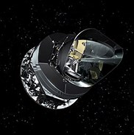

Is Cosmology in 300BC?
The Search for Alternate Universes
Ranga Ram Chary
U.S. Planck Data Center, IPAC/Caltech
Planck Collaboration including RC et al. 2015
R. Chary 2016, ApJ, 817, 33
HFI PI is J-L Puget; Data manager is F. Bouchet
Notes:
----- Meeting Notes (10/25/15 17:30) -----
was thought to be highly speculative
but this is data driven as a result of involvement with Planck
acknowledgements

Slide 2


World view of 17th Century
The World view at 300 BC; courtesy of the Ionians

Slide 3
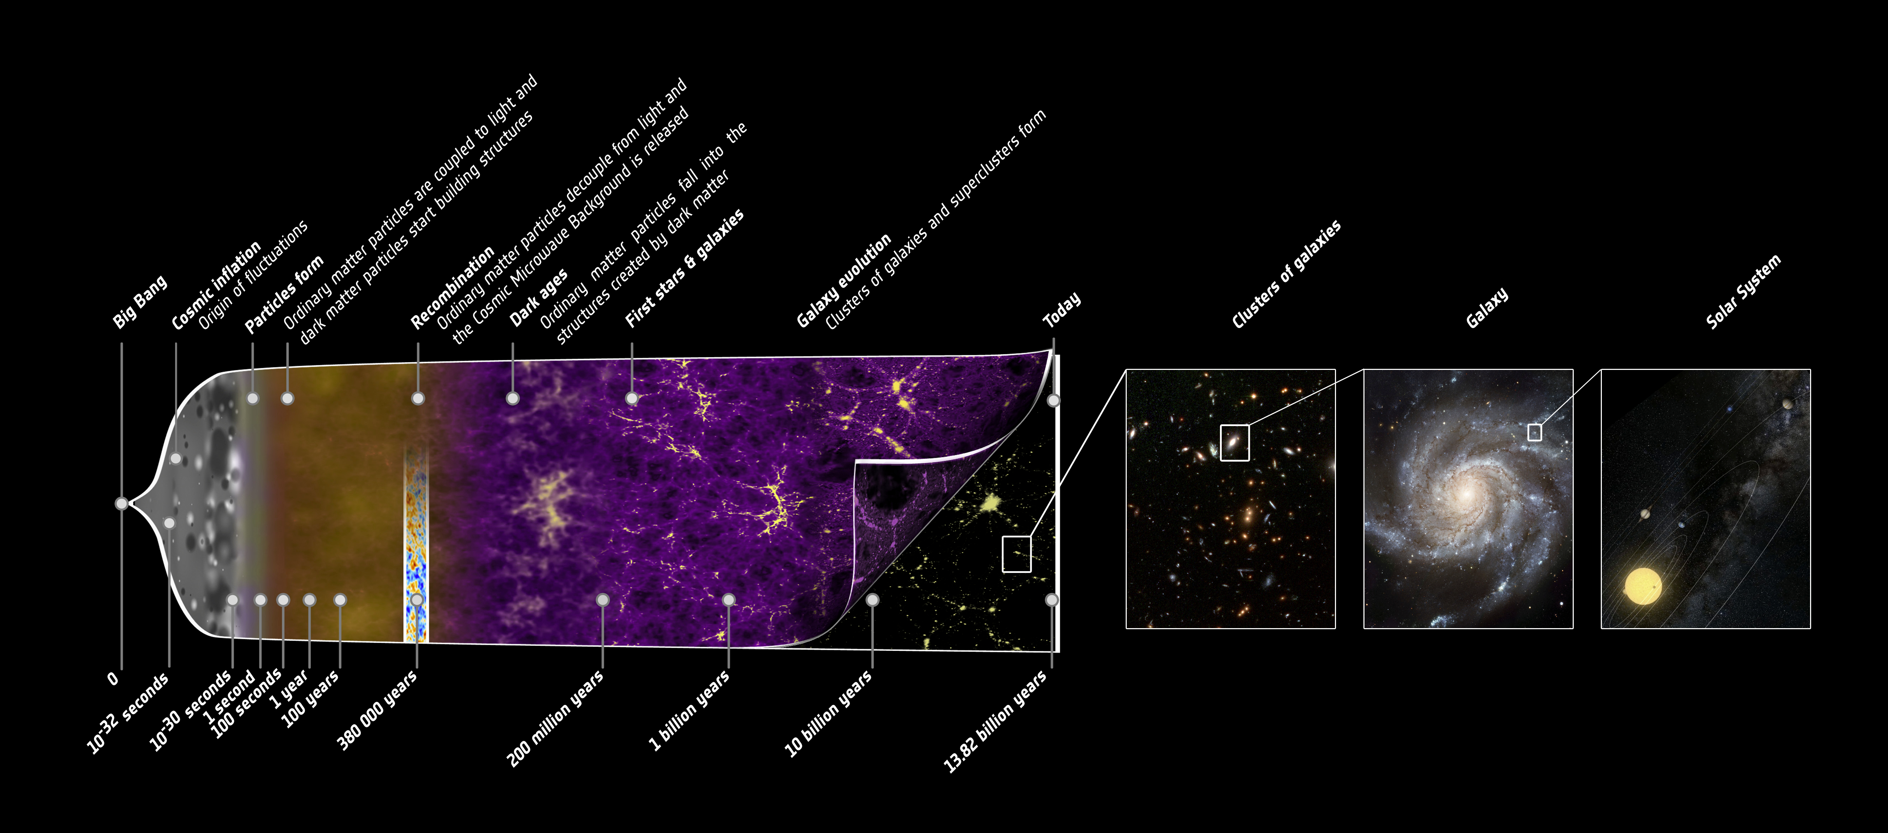
Is our current picture of the Universe grossly incomplete?

Slide 4
The Inflationary Big Bang
Explains the existence of the 2.725K cosmic microwave background and elemental abundances
Inflation explains the flatness and the isotropy of our Universe.
  Factor of 10²⁶ expansion in the first ~10⁻³²s
There has been a multi-project quest to detect GW through CMB polarization to characterize the inflaton
  Polarization is hard, particularly on large angular scales
  Reliable polarization calibrators are hard to find
  Bandpass leakage, loads of systematics
  GW that induce B-mode polarization (r<0.01) may be below Galactic ISM foregrounds and undetectable
See Planck+Keck Collaboration 2015 for details

Slide 5
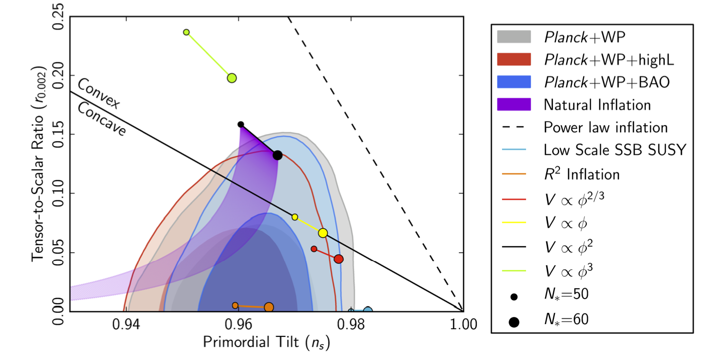
Parameters resulting from Higgs Inflation (r~0.0033,n_{s}~0.97)
Strength of B-mode Polarization Signal
Tilt in Temperature Power Spectrum
Courtesy of Bezrukov & Shaposhnikov 2008/2009, WMAP and Planck Collaborations 2015

Slide 6
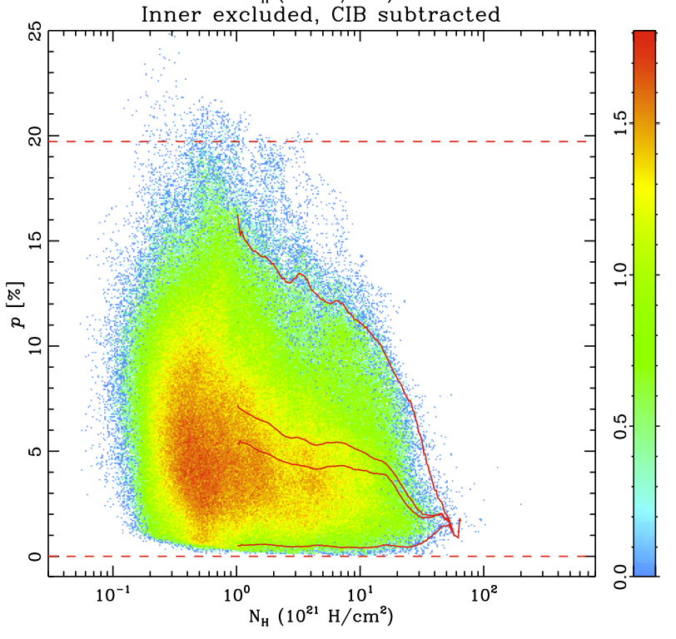
Foregrounds (Dust+Synchrotron) make B-mode detection unlikely in the future
High dust polarized fractions in low dust intensity regions!
Planck Intermediate Results XIX (arXiv: 1405.0871) led by J-P Bernard;
See also PIP led by J. Aumont; including RC

Slide 7
Big Problems….
Inflaton needs to be damped by an unknown mechanism at a very precise time (within a millionth billionth billionth of a second) all over the Universe’s horizon
Has no mechanism to explain the strength of the vacuum energy which is 10⁻¹²⁰ times weaker than predicted.
Planck probes unique observational phase space compared to WMAP by straddling wavelengths where Hydrogen recombination signals are present and by being a factor of ~40 sharper than COBE/FIRAS.

Slide 8
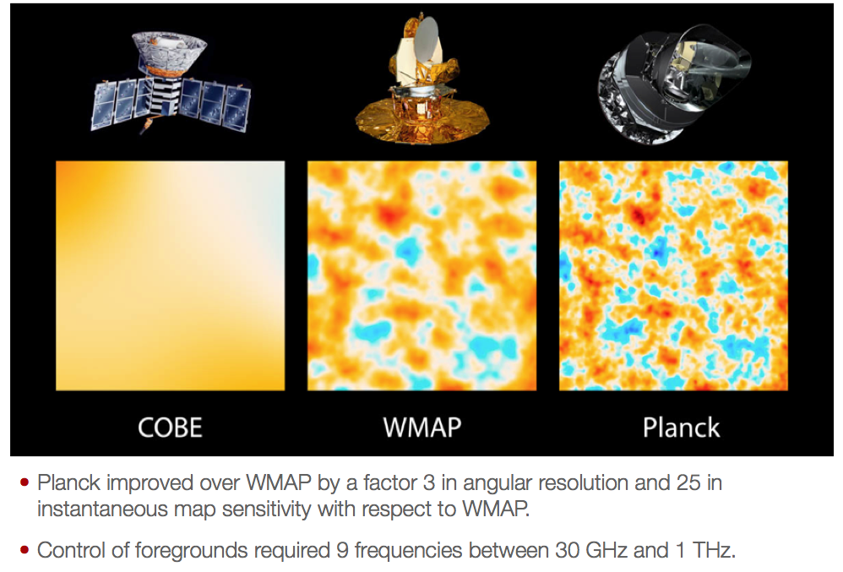
R. Hurt

Slide 9
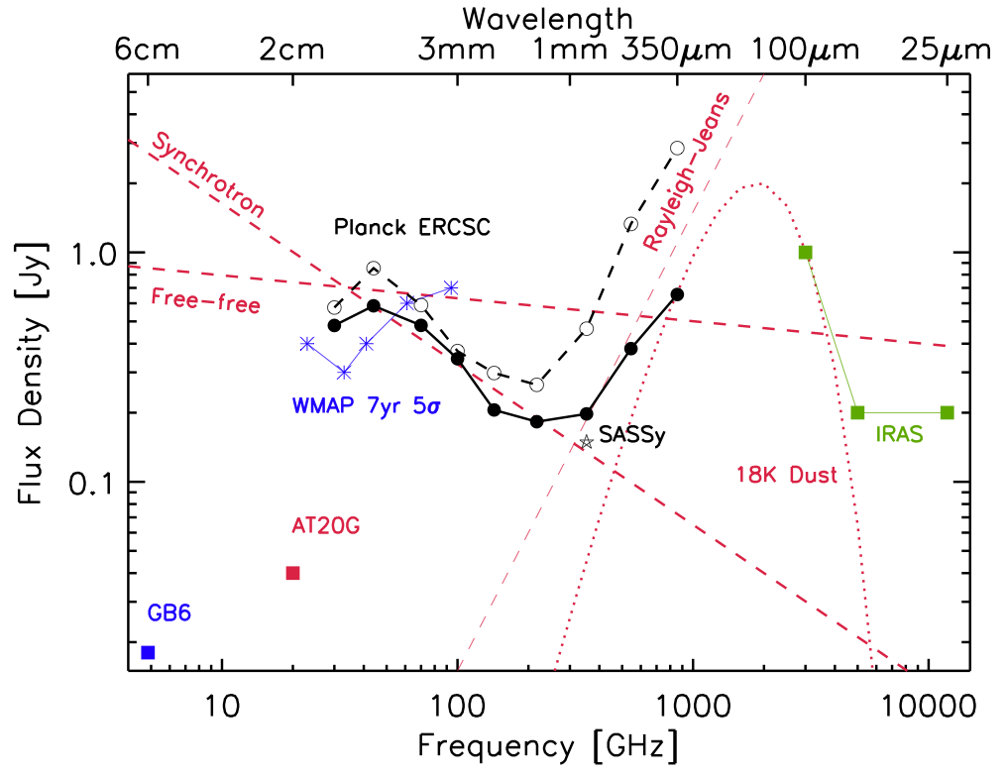
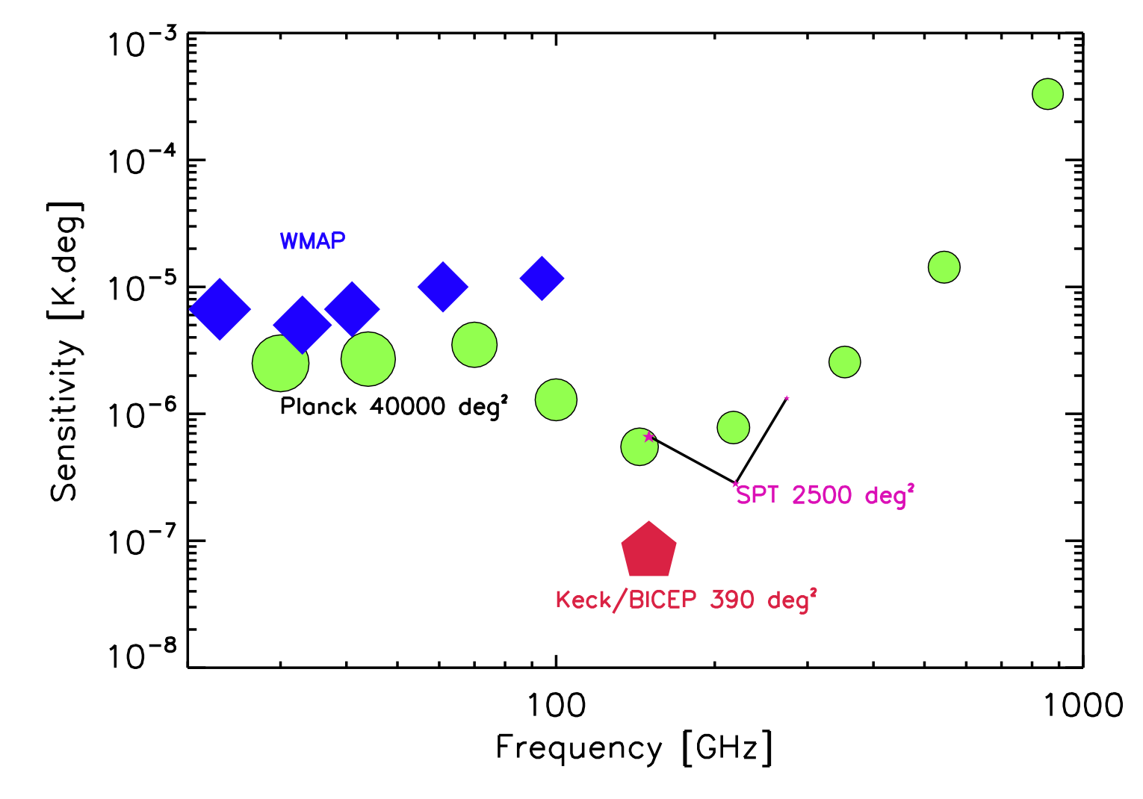
Comparison between
CMB Experiments
Planck Collaboration 2011, led by RC
Notes:
Important to note that Planck is most sensitive at 143 GHz.Other expts are not all sky.

Slide 10
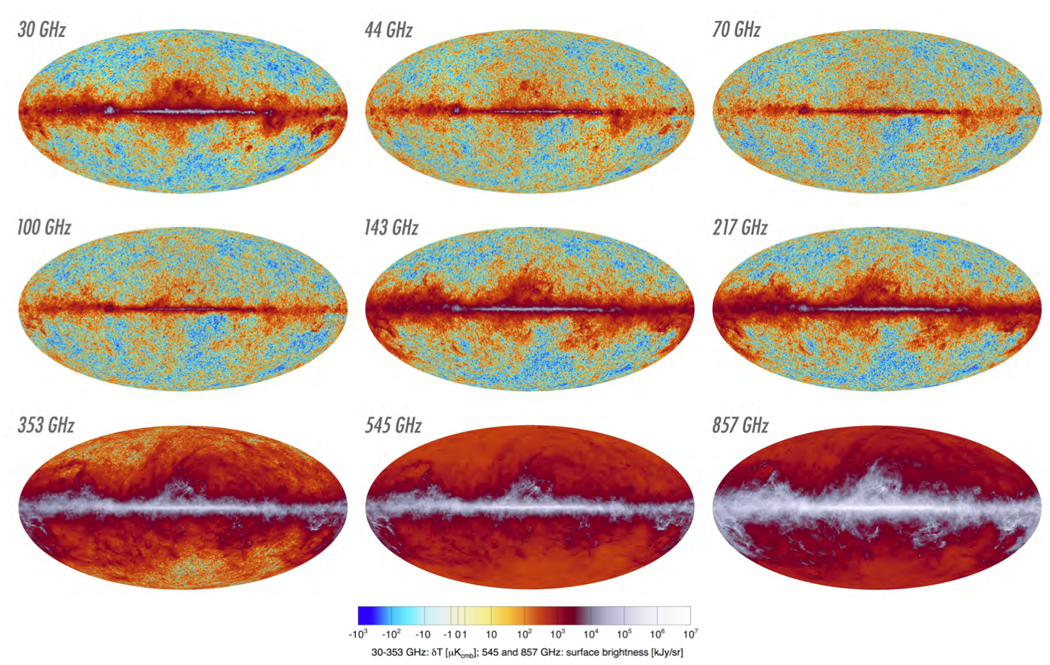
Planck Data: All-Sky Temperature Maps

Slide 11
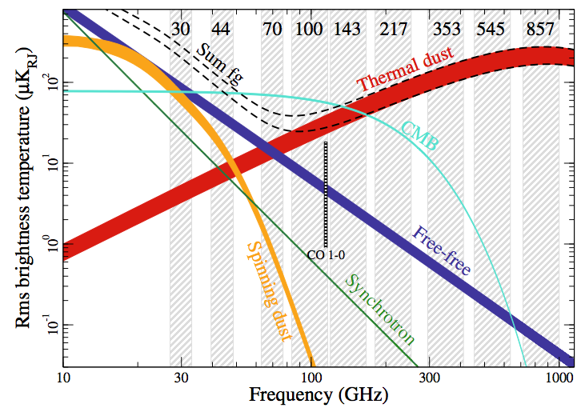
One persons signal is another persons noise
Planck Collaboration 2015; Overview paper
Relative intensities of high latitude foregrounds

Slide 12
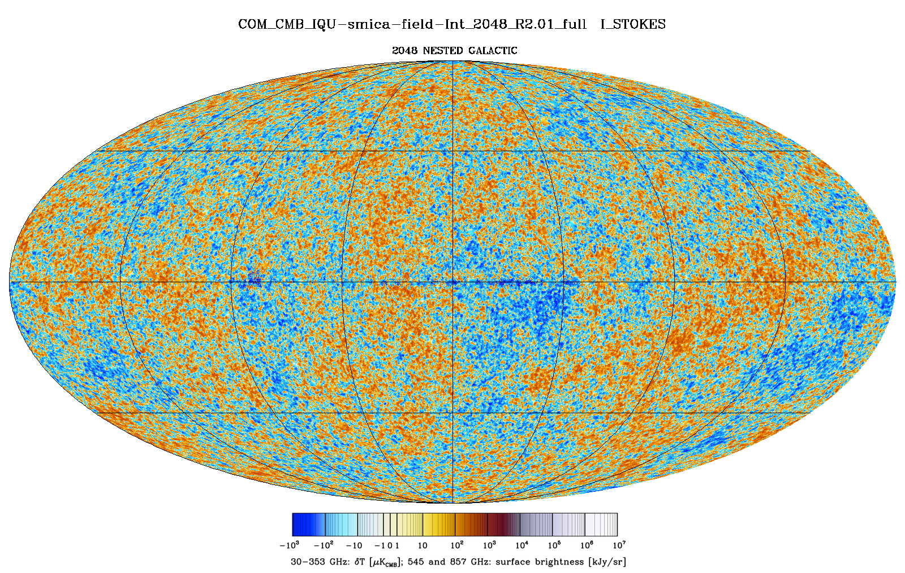
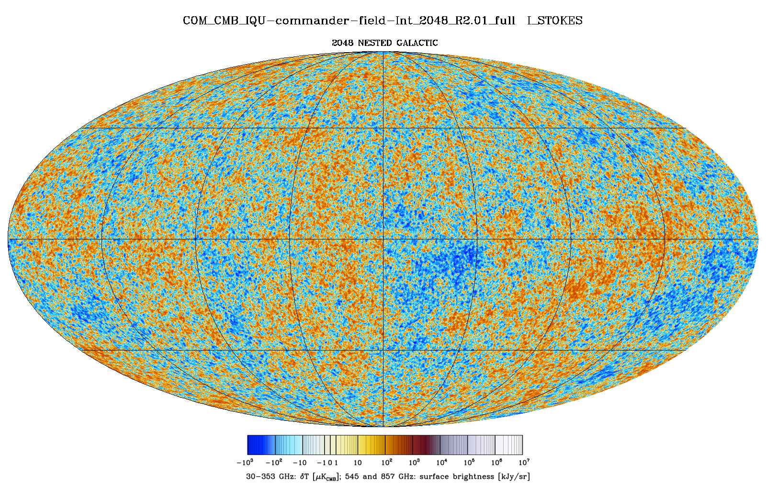
CMB map
This is the CMB map resulting from a multi-frequency fit to foregrounds
But what about the frequency dependence of the CMB?
Notes:
Hot spots are regions of underdensity, cold spots overdensity, statistically the same across the sky?

Slide 14
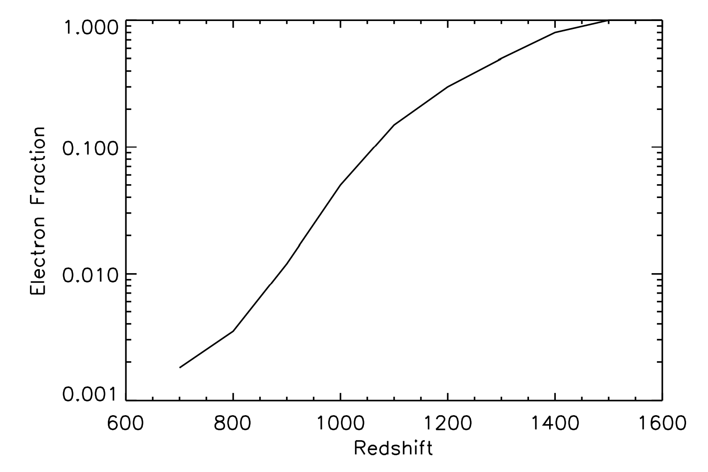
Hydrogen Recombination
1.2 Myr
550,000 yrs
270,000 yrs
Initial work by Seager et al. 1999, 2000
Built upon by Chluba & Sunyaev, Rubino-Martin et al., Ali-Haimoud&Hirata, Lewis et al.

Slide 15
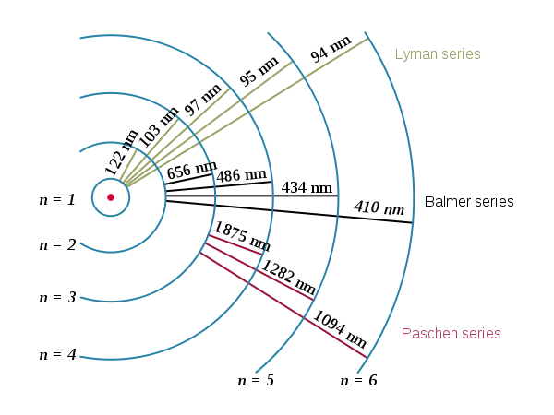
Hydrogen transitions
Redshift them from z~1000 to Planck bandpasses

Slide 16
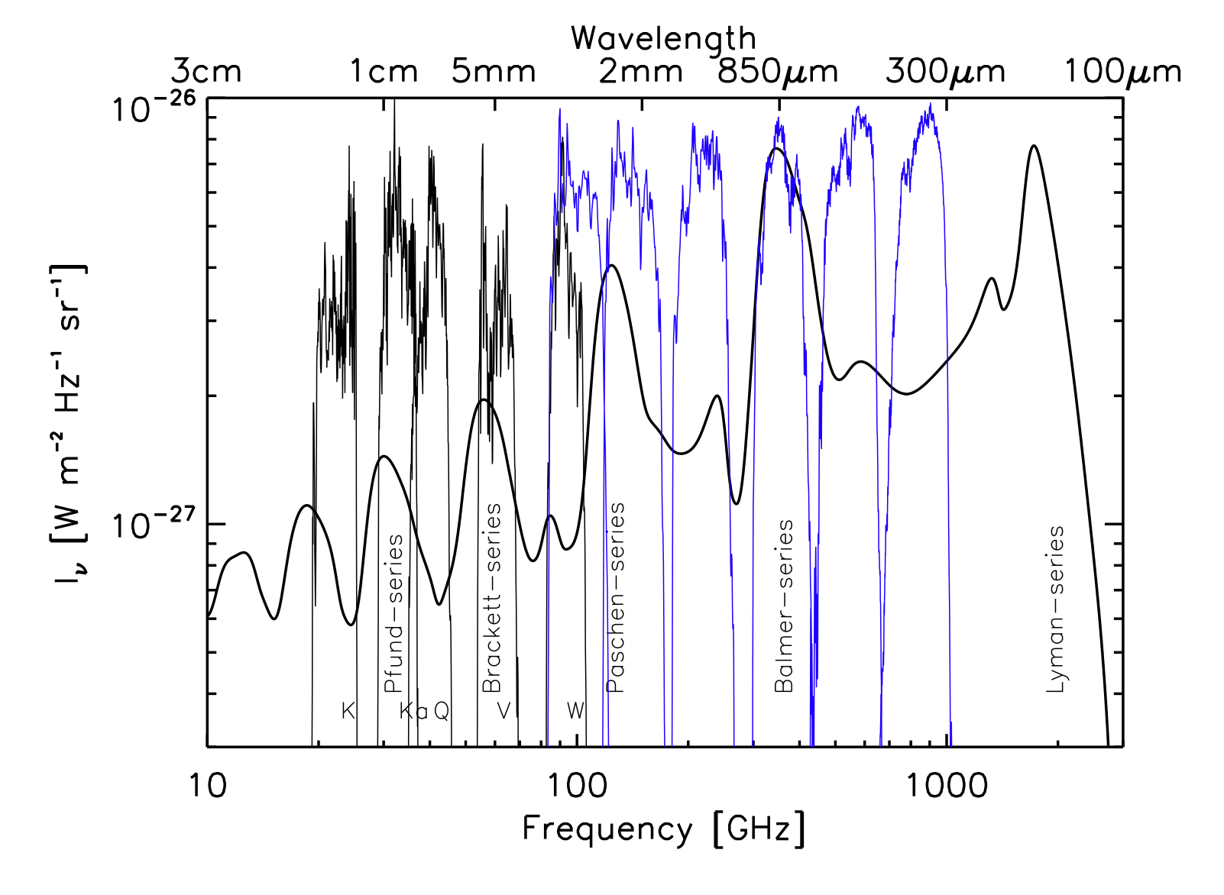
Recombination model of Chluba & Sunyaev 2006, 2007; Rubino-Martin et al. 2008
Notes:
Our baryon density would be factor of several 1000 below the noise limit

Slide 17
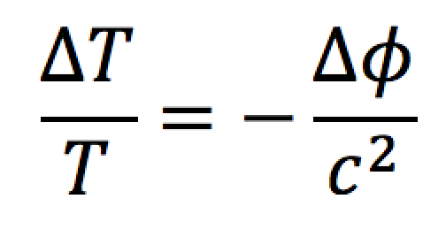
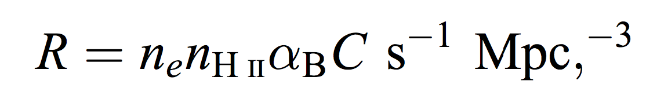
Are Cold Spots Regions of Higher Recombination Rate?
Sachs & Wolfe 1965; RC 2008

Slide 18
The Data Processing Pipeline
Mask out individual sources and SZ clusters
Mask out Galactic Plane |b|<20 deg.
Subtract off joint-fit CMB from all frequencies
  Use two best-estimate fits for the CMB (Commander & SMICA)
Subtract off ISM foregrounds at all frequencies
  Use 857 GHz as template for ISM
  Use location of hot spots to estimate foregrounds at cold spots with search radii of 0.5 and 1.5 deg
Fit for residual emission
  Some synchrotron and free-free is present
Search for excess at all frequencies in low ISM regions

Slide 19
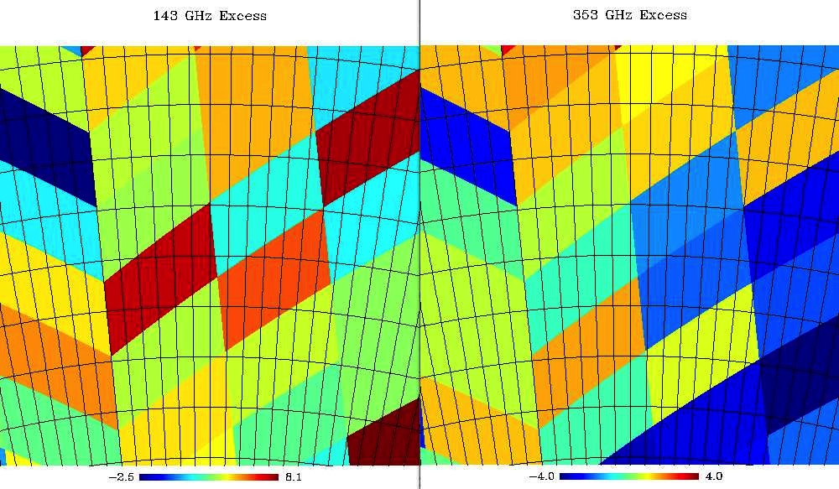
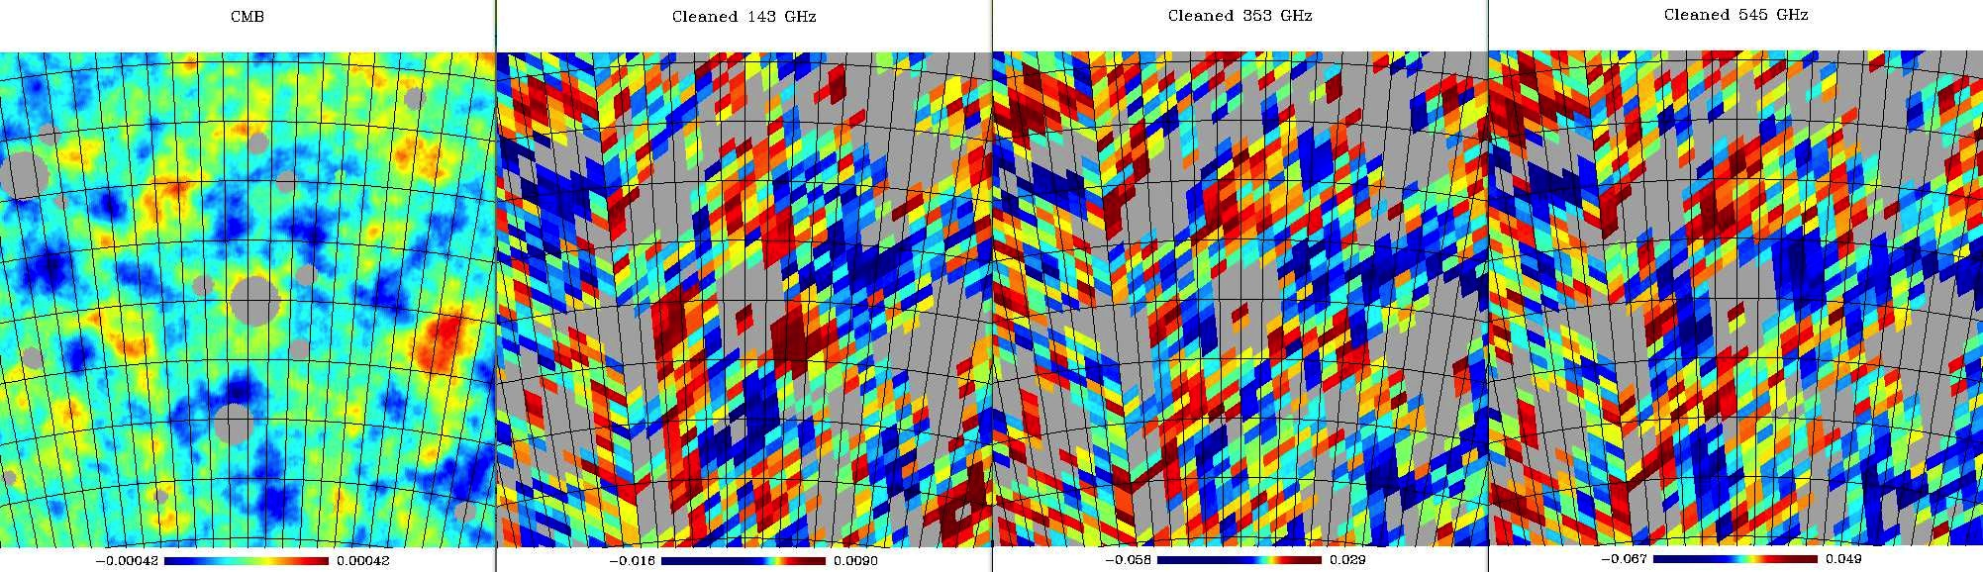
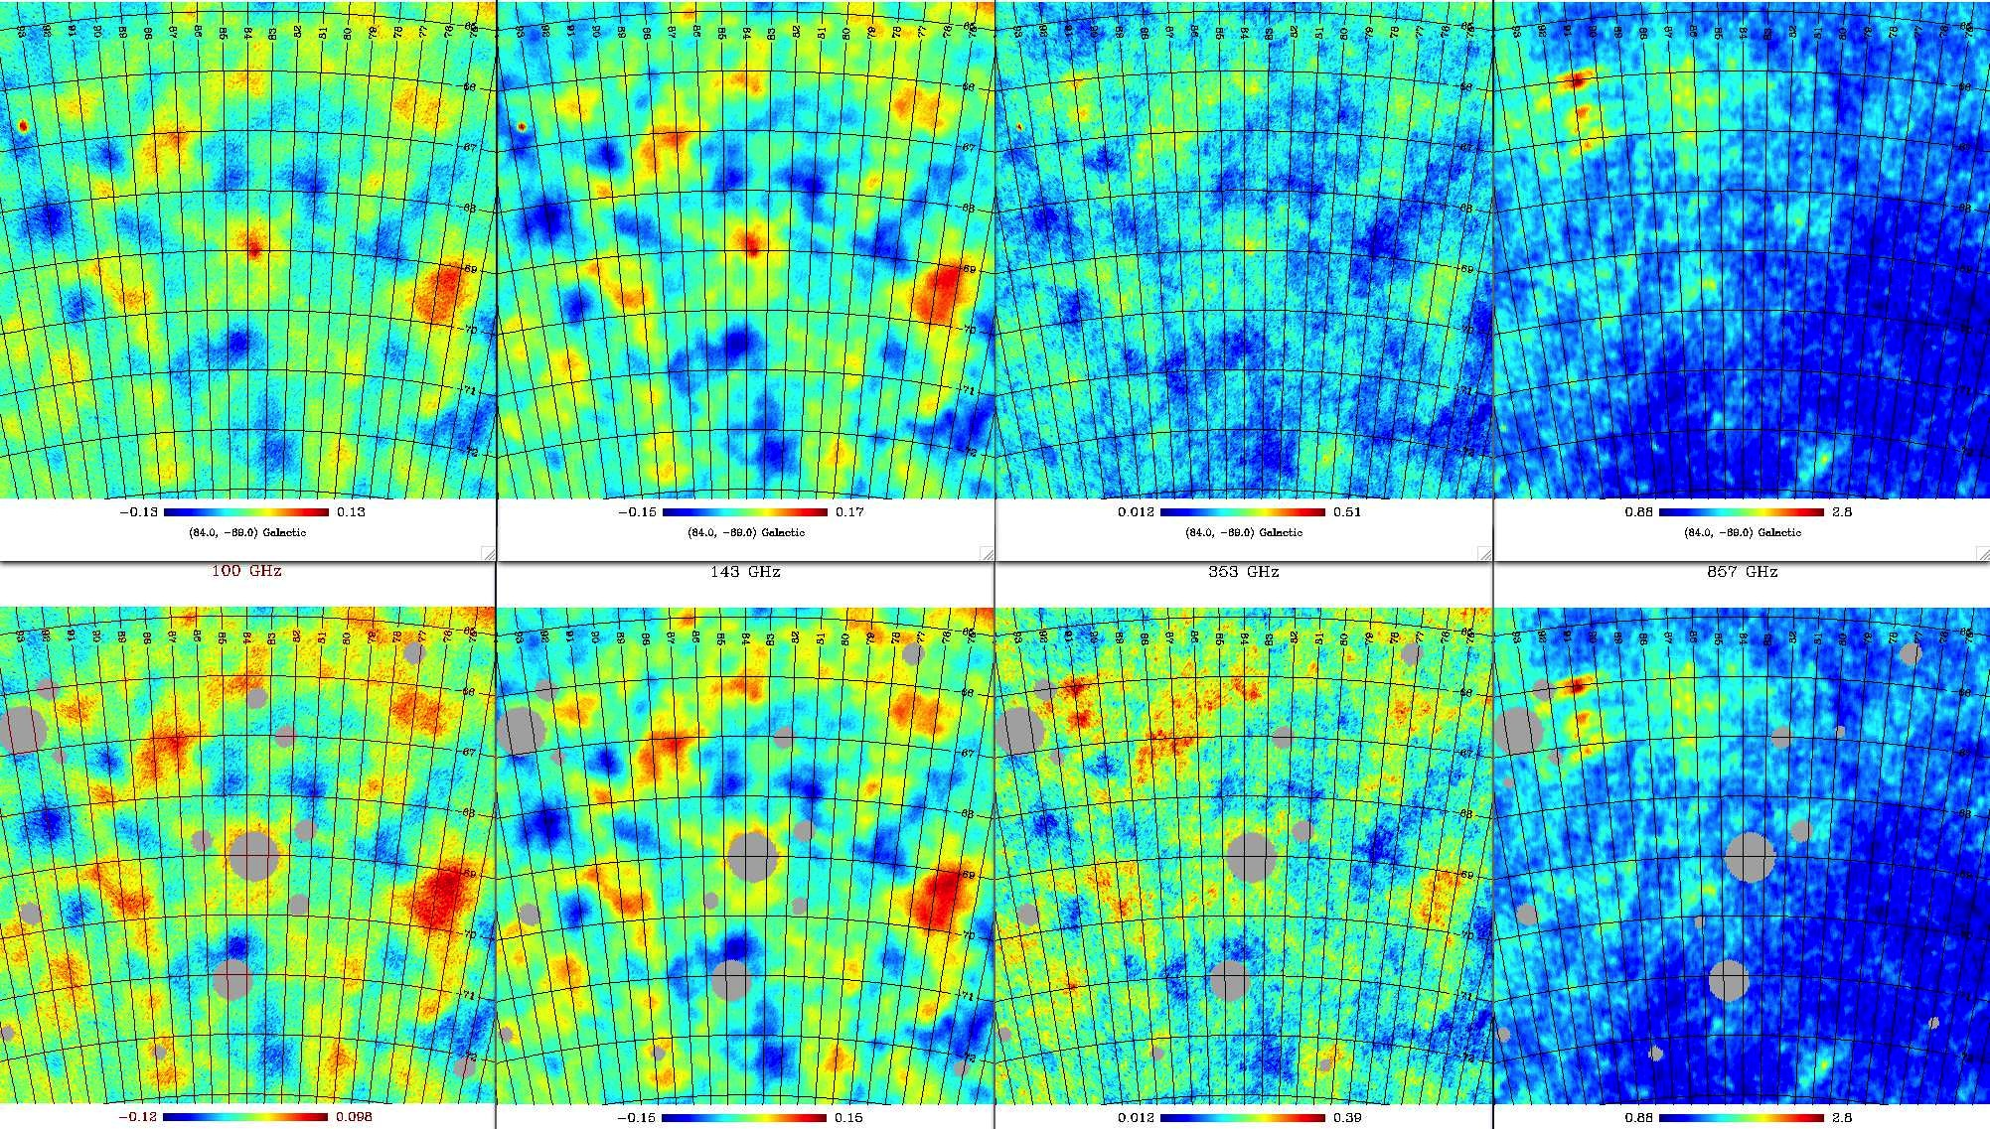
Data processing (8° images)

Slide 20
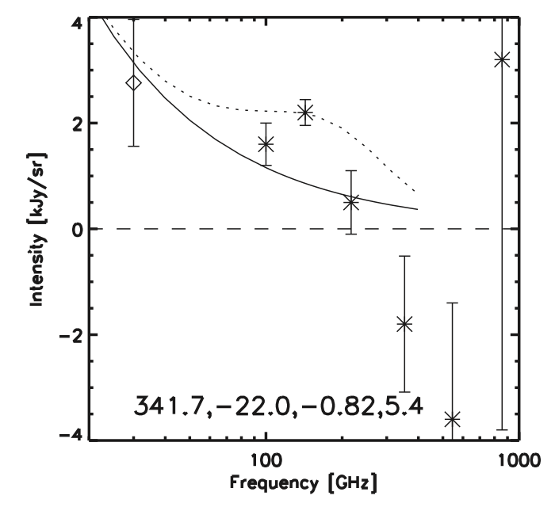
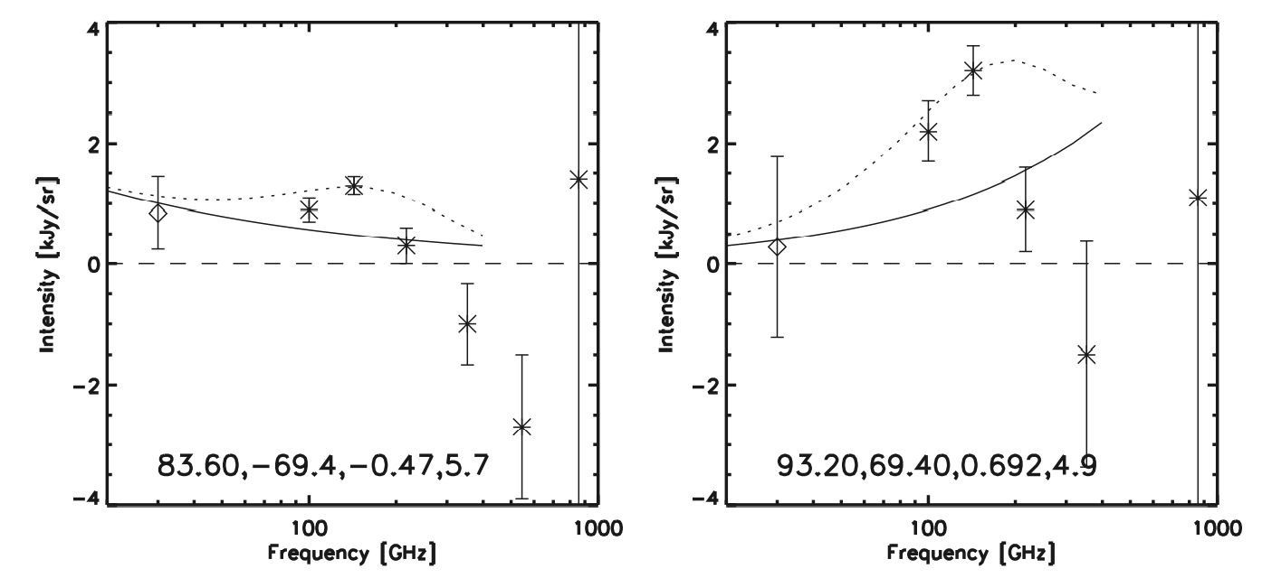
>5σ Excess 143 GHz Emission towards 3 CMB cold spots
5sigma should occur only
1 in 70 maps
5.7sigma has a 1 in 70000
maps
Solid line is best fit residual foregrounds
Dotted line is adding a 3K continuum which violates 100 & 217 GHz
μ~3-9E-6, x30-100 below FIRAS constraints

Slide 21
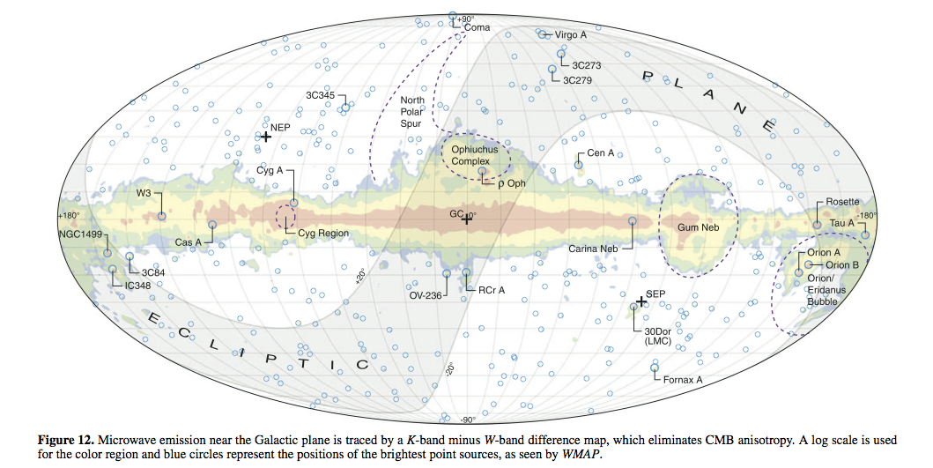
Spectral Anisotropies in
CMB Cold Spots
RC 2016, ApJ, 817, 33

Slide 22
Features of this emission
So far, only at 143 GHz (2mm)
  353 GHz residuals contaminated by variation in foreground ISM colors [work in progress]
Outside Galactic Plane in regions of low-ISM emission
Strong at location of CMB cold spots
Spanning 2-4 deg across

Slide 23
Some astrophysical implications?
Residual thermal dust (ISM):
  Needs to be unphysically cold ~3K and violates 217 GHz limits.
Residual CMB:
  Violates limits at 217 GHz
Gigahertz peaked radio sources:
  Appears to be x5 below what the intensity measured
[CII] from z>10:
  x100 lower than measured
Unusual CS3->2?:
  Plausible but its not a strong line and these are regions of low ISM.
Carbon Monoxide:
  Need unphysical velocities for the gas for 115 GHz line to enter 143 GHz bandpass. CO2->1 at z~0.7 structure would be too large spatially.
All are disfavored!

Slide 24
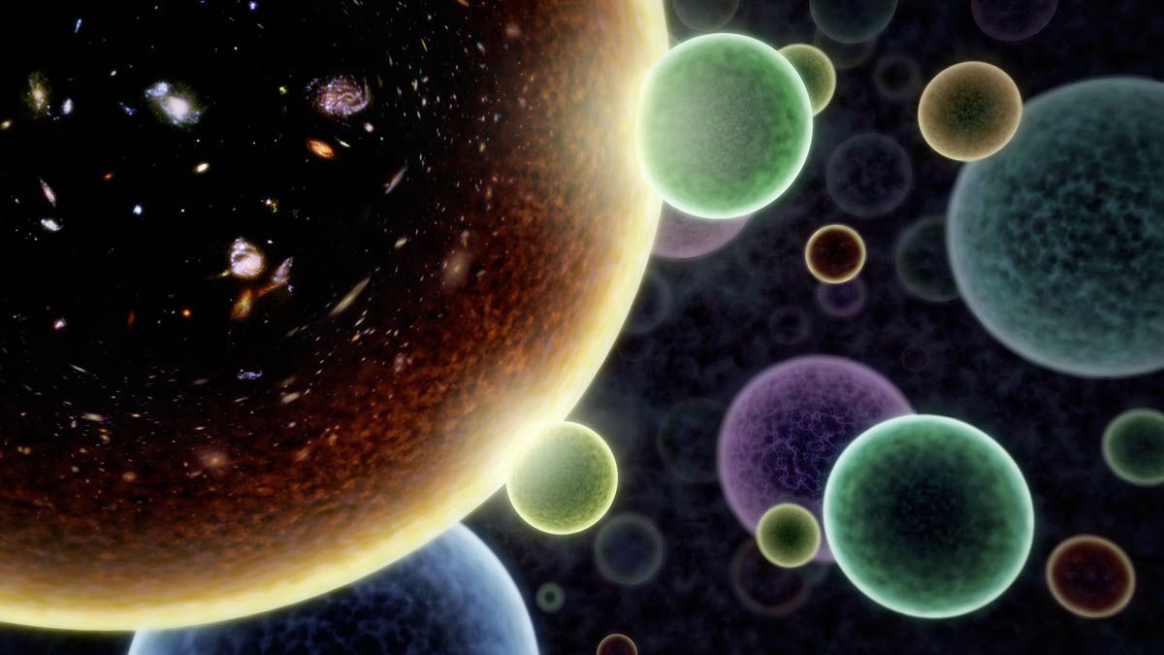
Enhanced Hydrogen Paschen-series lines from recombination?
Stronger recombination signal in the direction of certain cold spots (~2-4 deg)?
Requires a higher baryon density in those regions; enclosed mass is ~1E13 Msun
The three regions would have 3000-10000 times more baryons than our Universe
Would have to be from collisions with our bubble
RC, 2016, ApJ

Slide 25
Innovations in Analysis
All-sky data products from Planck spanning a wide range of frequencies that straddle Hydrogen lines
  Planck Collaboration (2015)
Differential foreground subtraction between cold and hot spots at each frequency
Studying spectral variations instead of spatial variations
Concept of using a broadband to search for narrow lines
  Thanks to redshift, they arent that narrow (~50 GHz)
  Chary et al. (2005); Shim, RC et al. (2011)
Utilizing accurate models for recombination of Hydrogen to get line and continuum emission
  Chluba & Sunyaev (2006, 2007), Ali-Haimoud et al.

Slide 26
Summary
We are finding spectral anomalies (μ~3-9×10⁻⁶) in the direction of CMB cold spots at 143 GHz with Planck i.e. excess emission.
At the >5sigma level after removal of all foregrounds. Anomalies subtend 2-4 degrees, larger than Hubble horizon at z~1000.
Due to Hydrogen Paschen-series redshifted from epoch of recombination at z>1000?
Requires x4500 enhanced baryon density, which cannot be in our Universe and must be an alternate bubble.
  Baryons from an alternate Universe falling into the fluctuations of ours?
Need confirmation through spectral-mapping and detection of alternate Hydrogen transitions.
  Proposed for GBT observations
  COMap(PI: Cleary) could detect redshift Pfund-series at 30 GHz
If true would favor eternal inflation models, with our Universe being a chance fluctuation among ~10¹⁰⁰⁰ and a way to test string theory.
    Does she play dice after all?

Slide 27
Important to keep an open mind about the Multiverse
Martin Rees: I am sufficiently confident about the multiverse to bet my dog’s life on it
Andrei Linde: I am confident enough about the multiverse to bet my own life.
S. Weinberg: I have just enough confidence about the multiverse to bet the lives of both Andrei Linde and Martin Rees’s dog.
Needs very very good data from independent observations. We currently have >5sigma anomalies at one frequency (143 GHz) from one mission (Planck).
R. Chary, 2016, ApJ, 817, 33

Slide 28
Extra Material

Slide 29
Where do we go from here?
Trying follow-up observations with the Green Bank Telescope
Undertake large scale computational simulations of our Galaxy to assess scatter in noise properties
Undertake deeper observations with existing facilities in these patches of sky in at least 2 frequencies (e.g. SPT/Keck)
  We can cross-calibrate with Planck and search for anomalies
  But O₂ absorption line at 118 GHz
Develop a dedicated spectral mapping experiment in the millimeter to measure spectral profile of excess.
  Sensitivity (0.1 kJy/sr = 0.3 microK_{CMB}) is challenging from the ground but can be done over a few years.

Slide 30
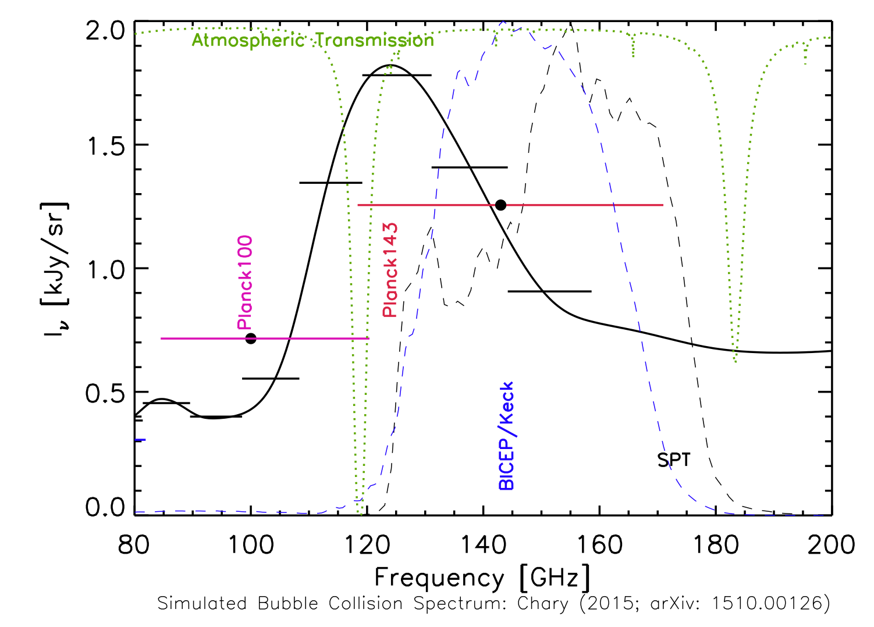
But there are considerable challenges from the ground…..
Notes:
O2 line at 118 GHz

Slide 31
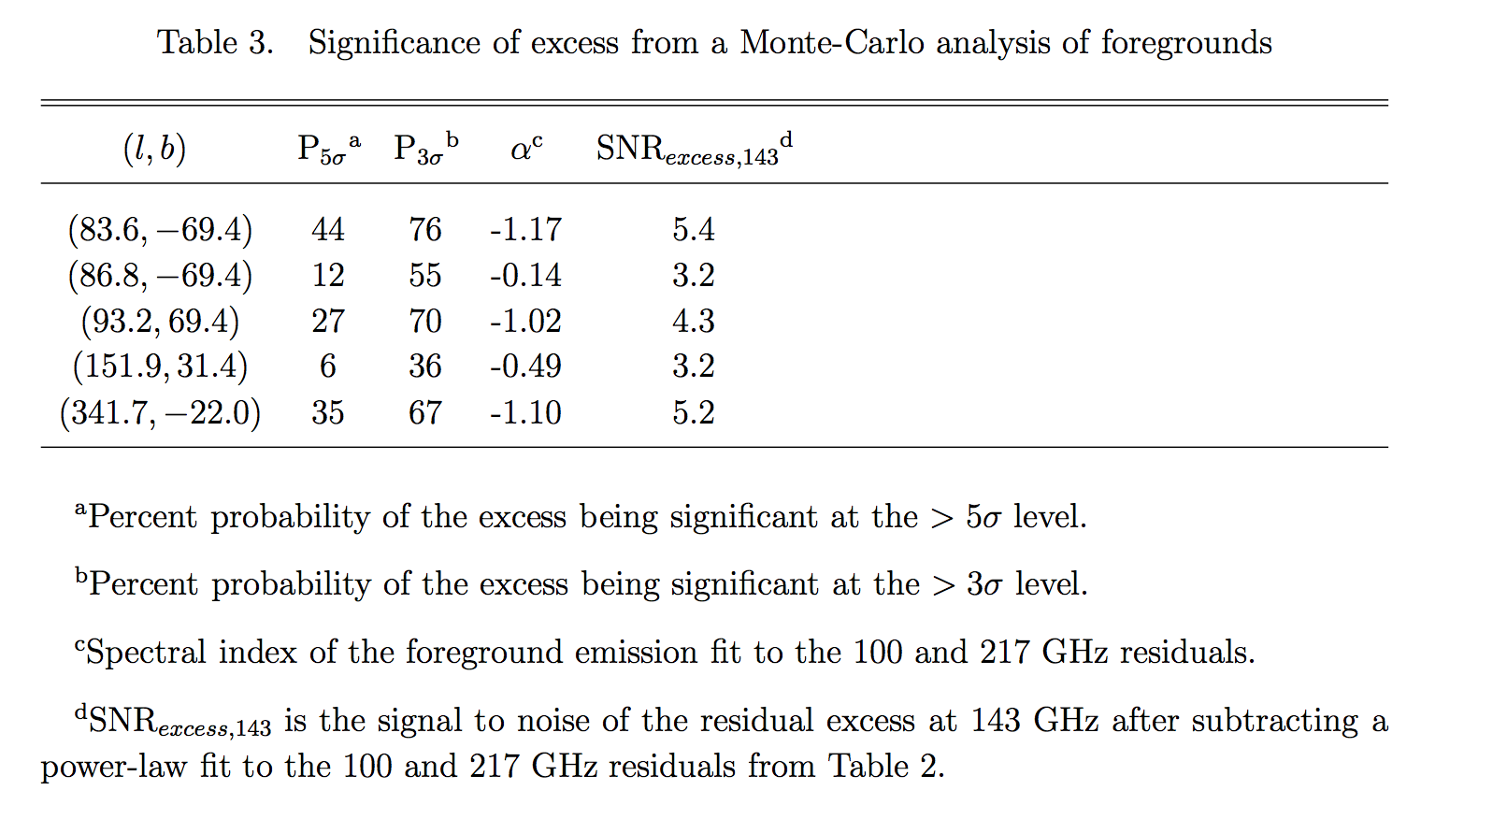
Statistical significance allows only a tentative detection
Notes:
Explain what SNRexcess,143 really is

Slide 32
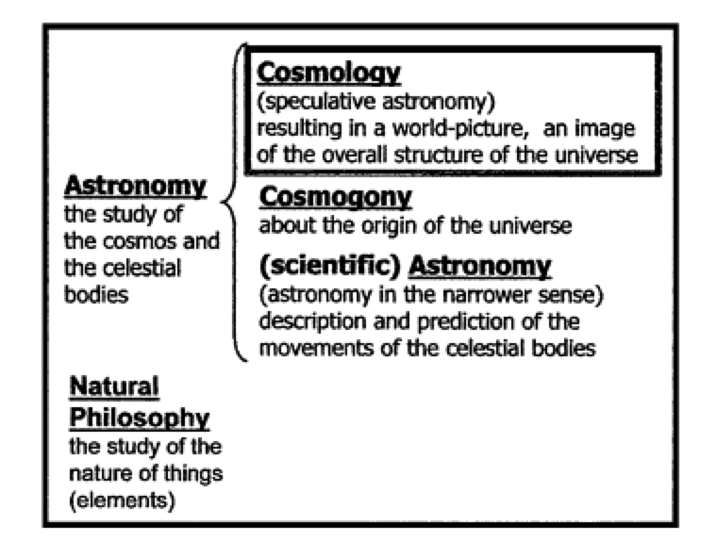
The Lay of the Land
Data driven picture of the origin and evolution of the Universe
Heaven & Earth in Ancient Greek Cosmology
D. L. Couprie

Slide 33
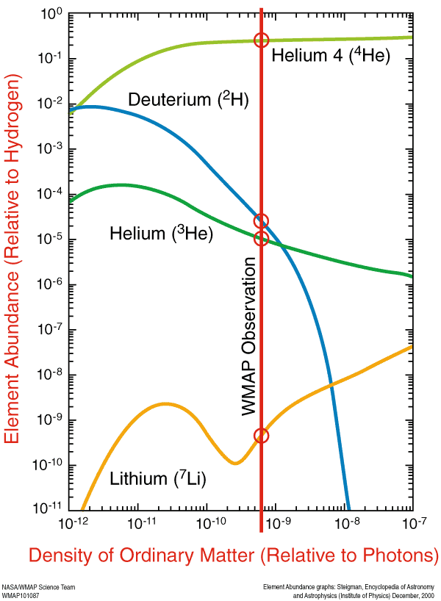
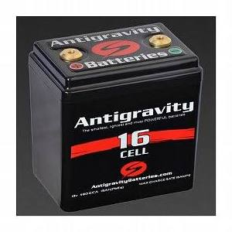
What happens in a Universe with too many baryons?
..all other constants remaining the same.

Slide 34
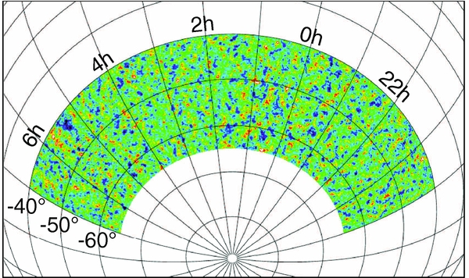
SPT 2540 deg² Survey Area
(Story et al. 2013)
RA between 20 hrs and 7 hrs
Dec between -40 and -65 deg

Slide 35
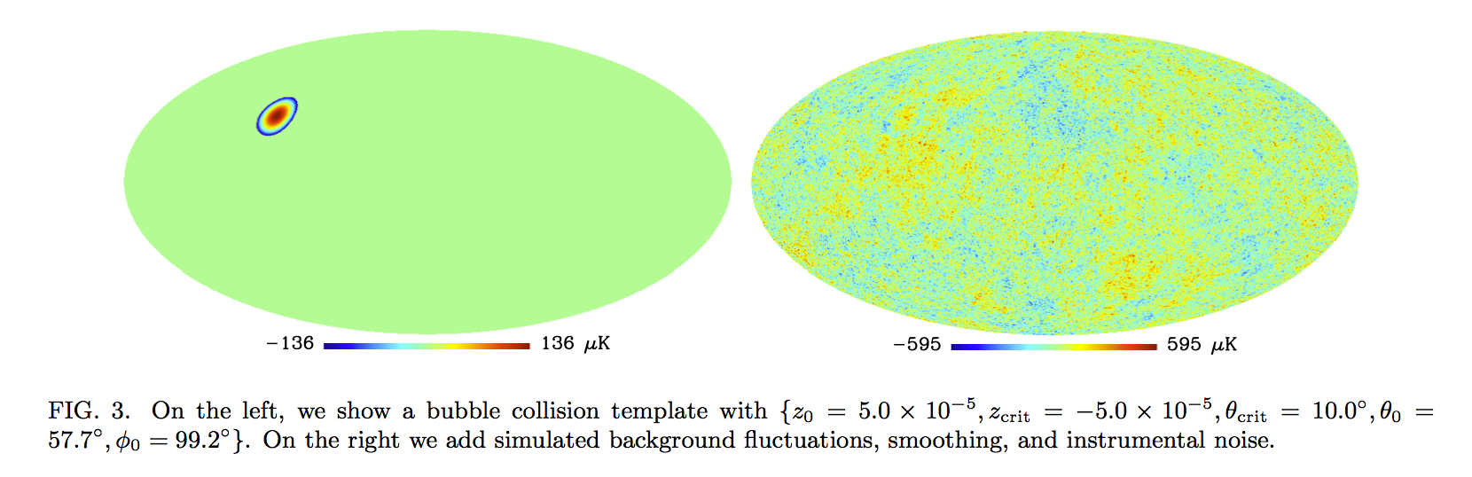
Very similar to what has been calculated
S. Feeney; UCL PhD Thesis
Feeney et al. 2015, 2011

Slide 36
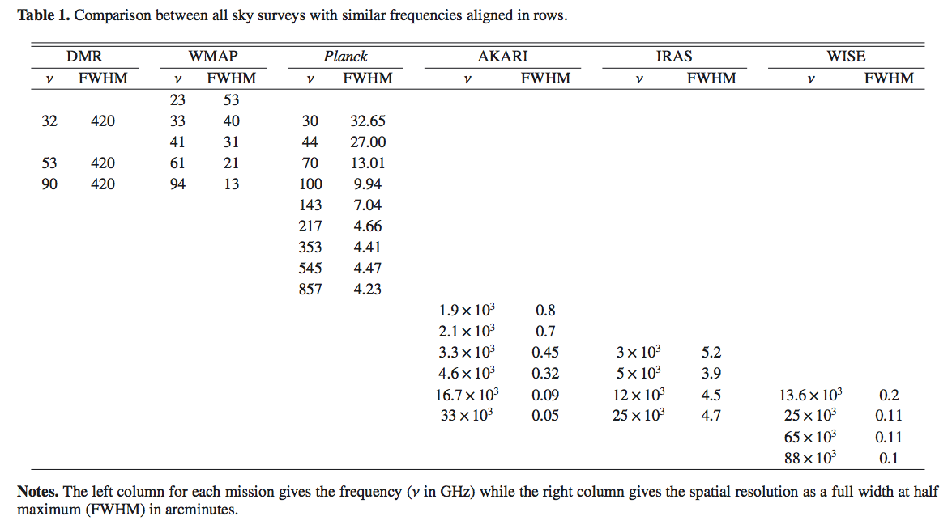

Slide 37
Properties of Residuals
Only 100 and 143 GHz have a non-zero mean in the residual. The spectral
Index (-0.7) is consistent with synchrotron emission.

Slide 38
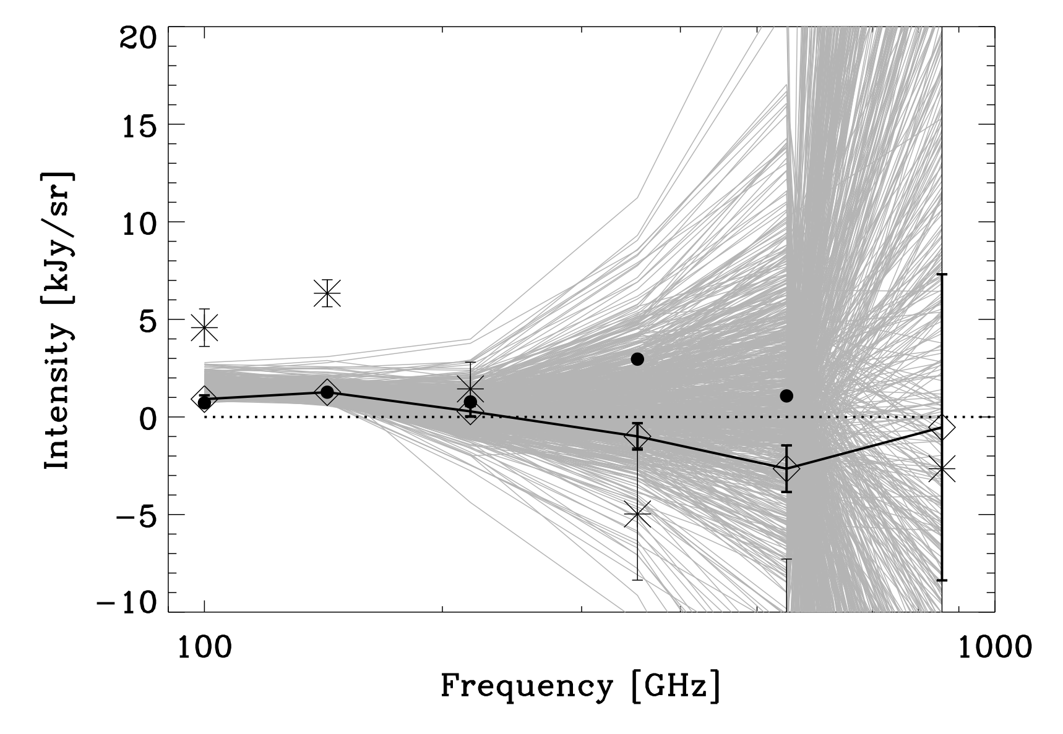
Unusual excess intensity at 143 GHz
RC 2015, ApJ

