Slide 1
PH1a: non-inertial frames
Message to take away
An observer moving with an accelerated motion with respect to an inertial observer (one where Newton’s laws hold) will feel the existence of some “ficiticious forces” that apply to all bodies in the same manner and have no apparent microscopic explanation.
In particular, as far as the Principle of Equivalence holds, these non-inertial forces are equivalent to a local gravitational field (although there’s no local distribution of mass to justify it, so they are still quite mysterious forces).
Sergi Hildebrandt (srh@caltech.edu. Cahill 364)

Slide 2
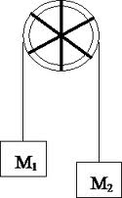
First example
An elevator is moving with constant acceleration, a, with respect to the Earth surface. Consider that the gravitational acceleration is constant, the string is massless and the pulley is frictionless and massless. Solve for the acceleration of M₁ and M₂ from the perspective of an observer inside the elevator. Discuss the results in terms of the local equivalence of gravity and acceleration.
a

Slide 3
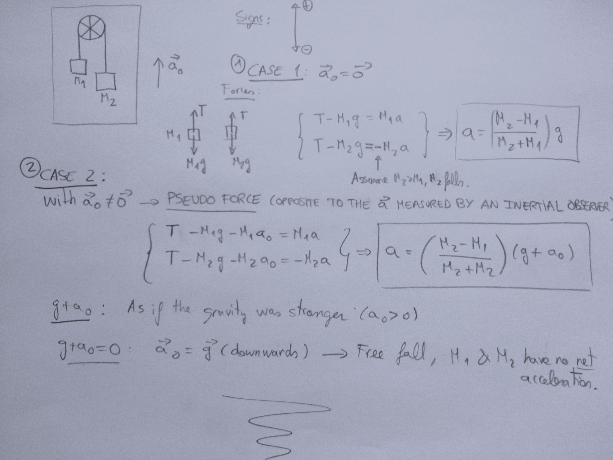
Quiz Time

Slide 4
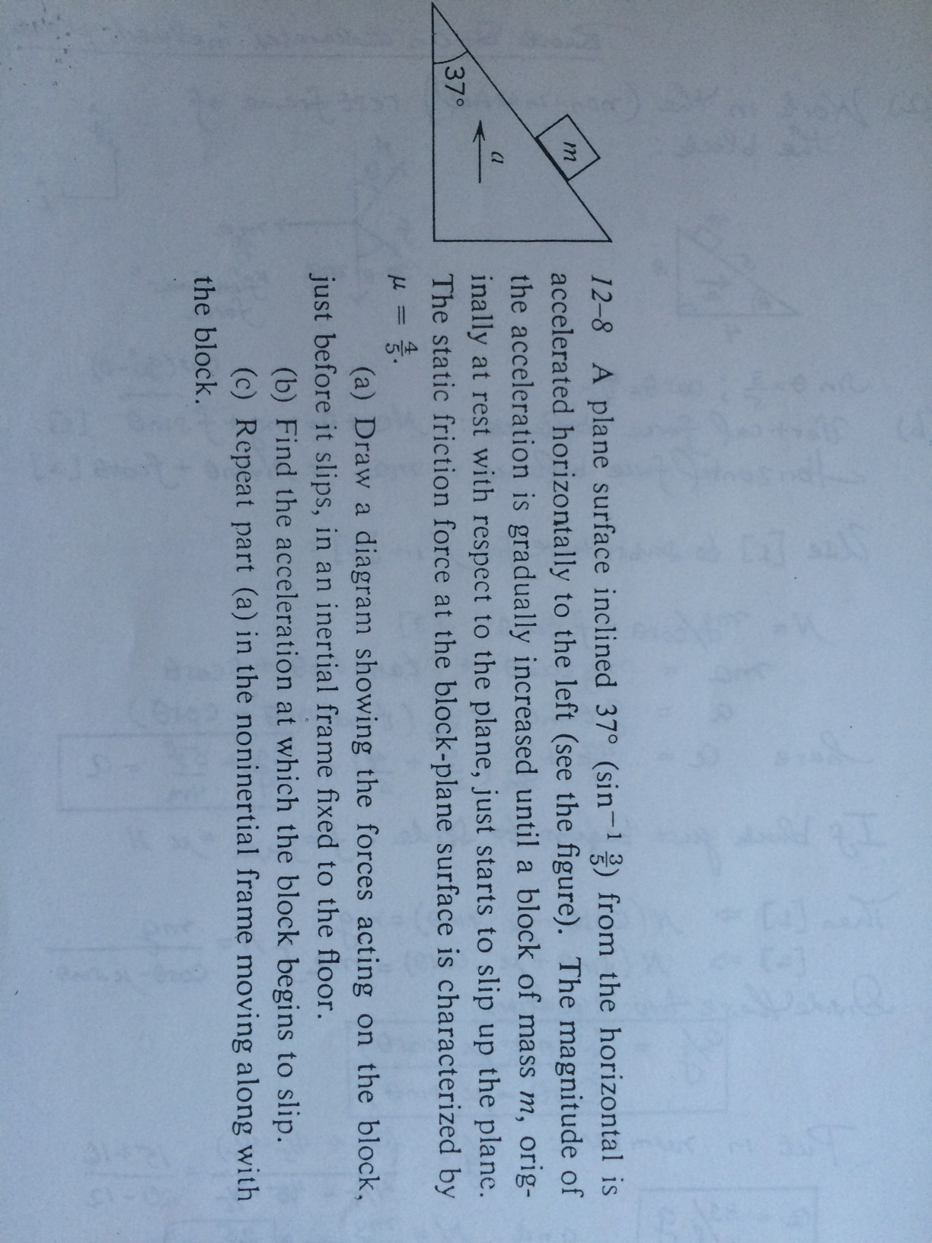
Second example: accelerated incline

Slide 5
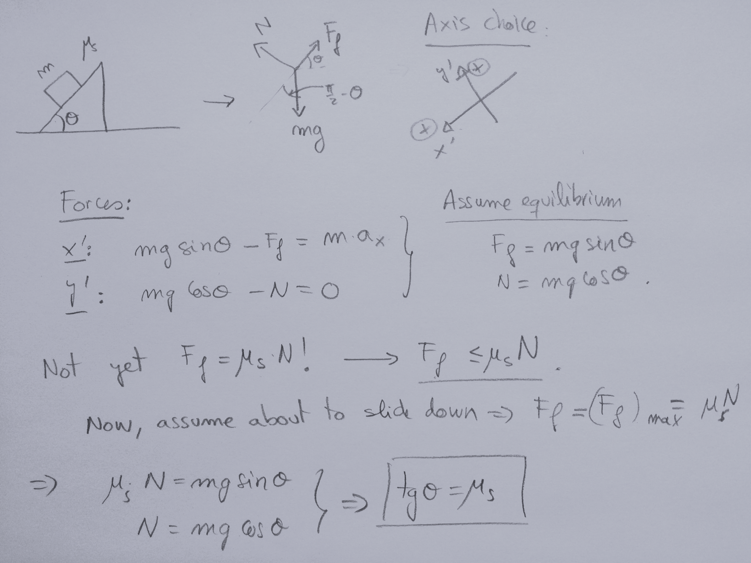
BEGIN WITH NON ACCELERATED
INCLINE (TYPICAL CASE)
Quiz Time

Slide 6
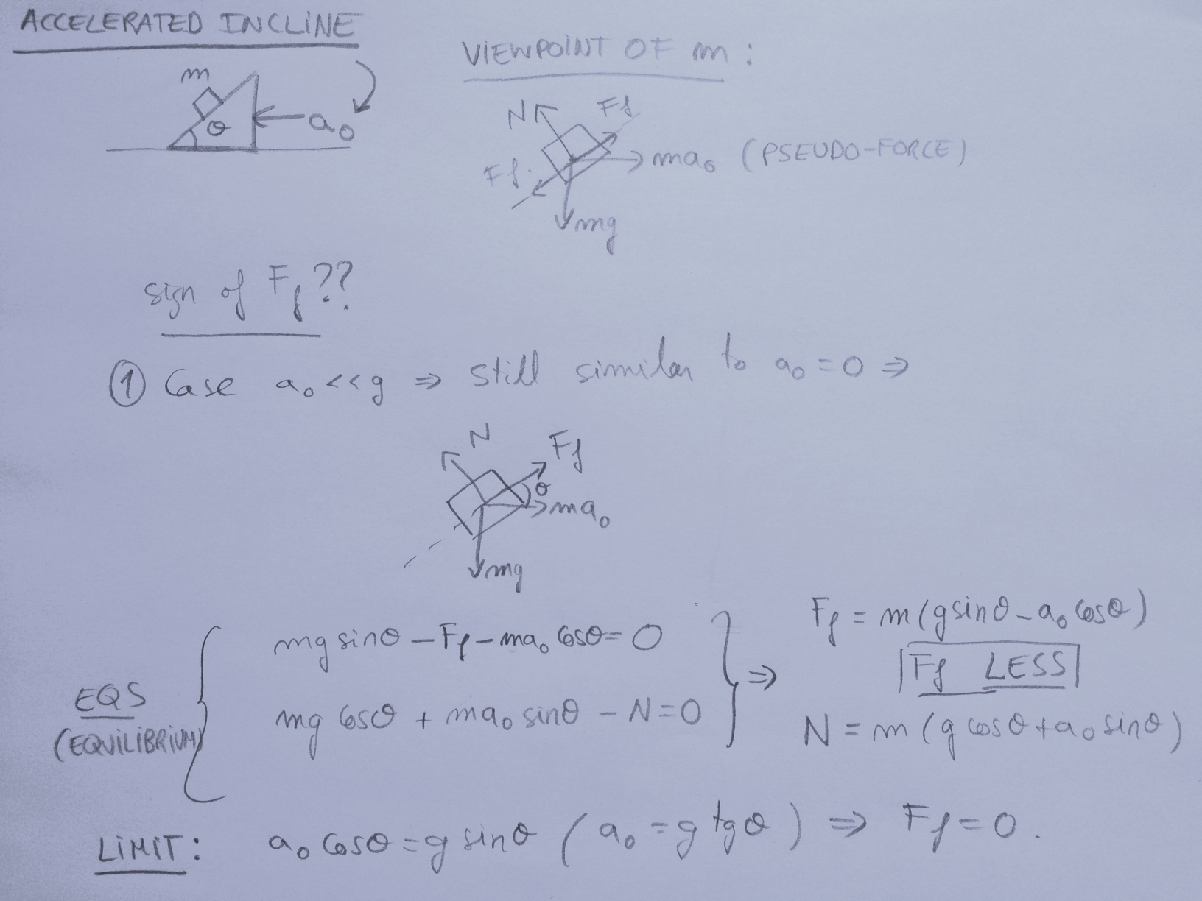
Quiz Time

Slide 7
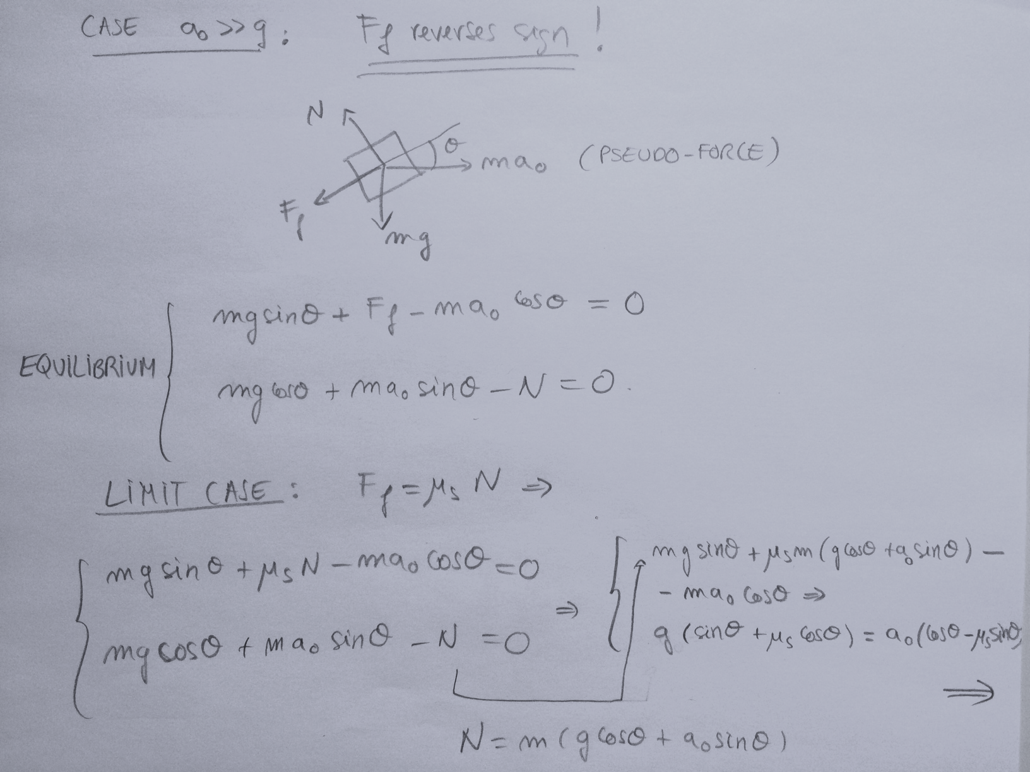
Quiz Time

Slide 8
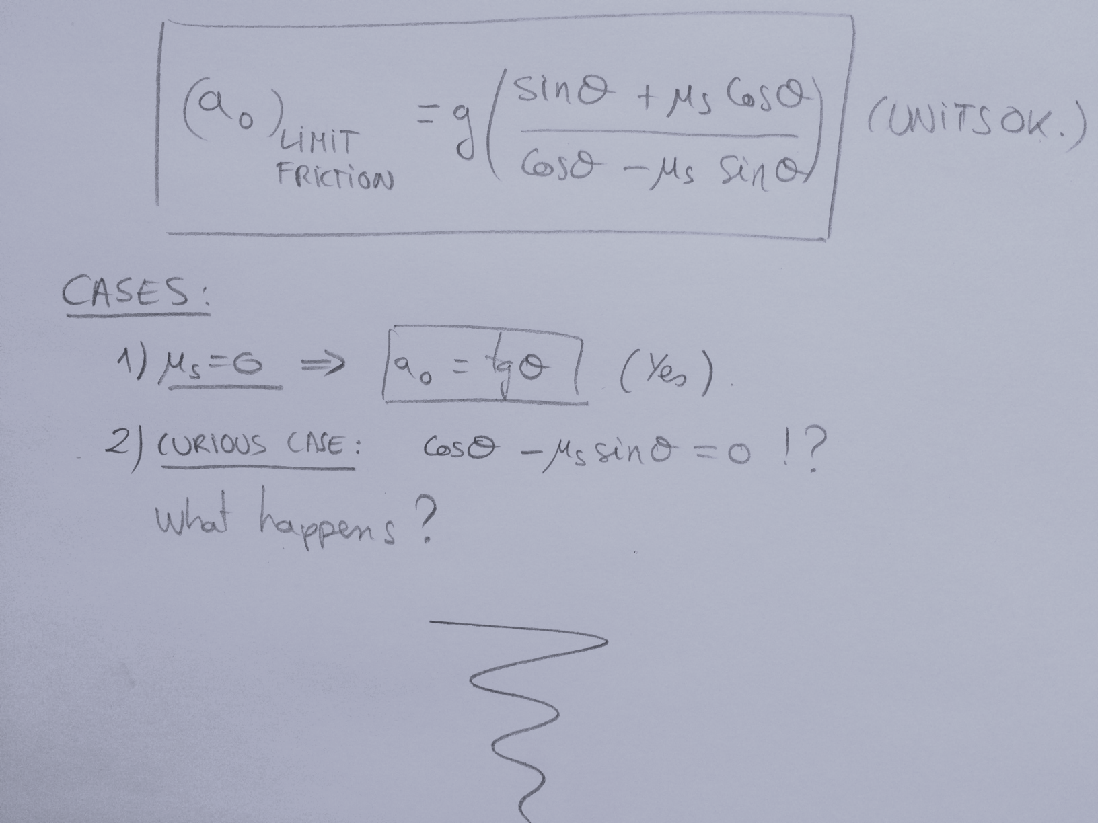
Quiz Time
g

Slide 9
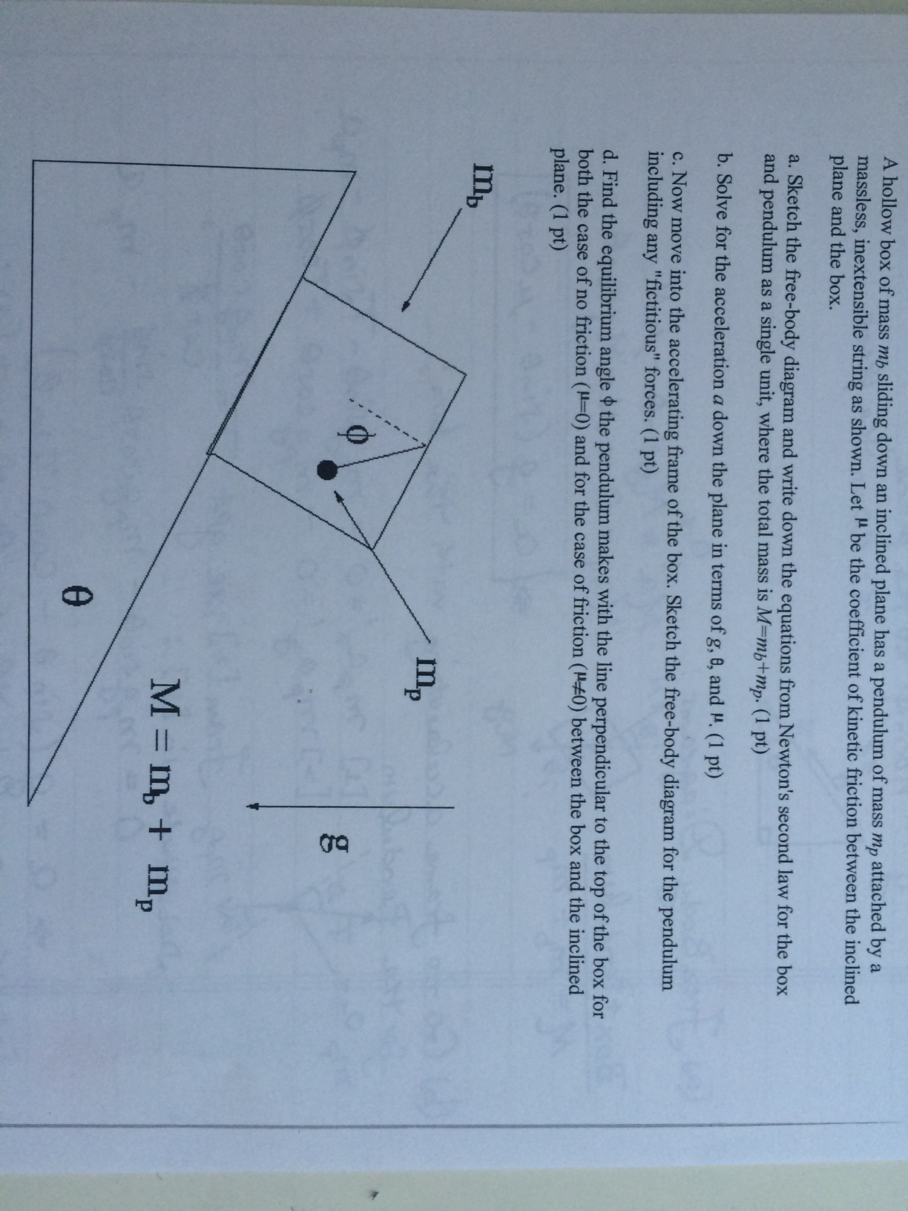
QP5
Final Test time

Slide 10
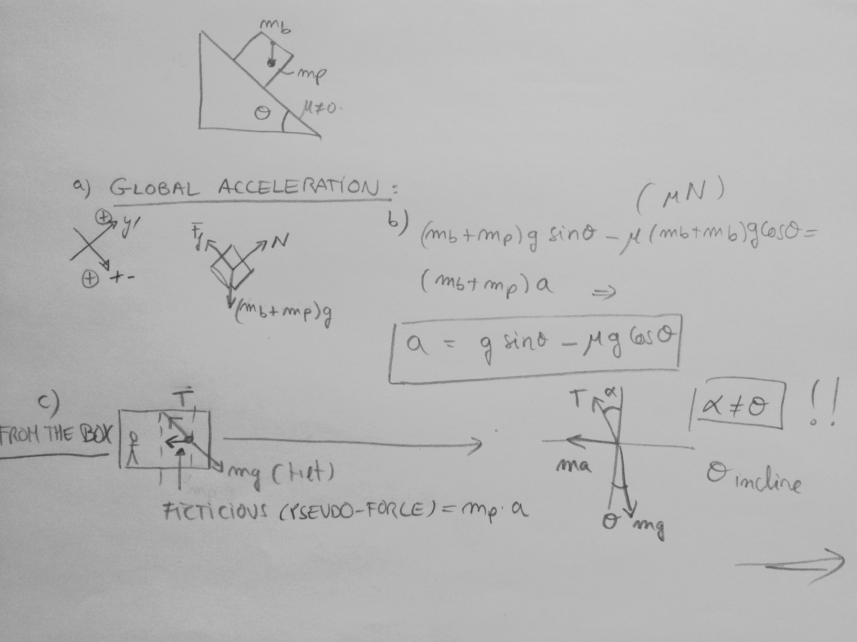
Final Test time
p

Slide 11
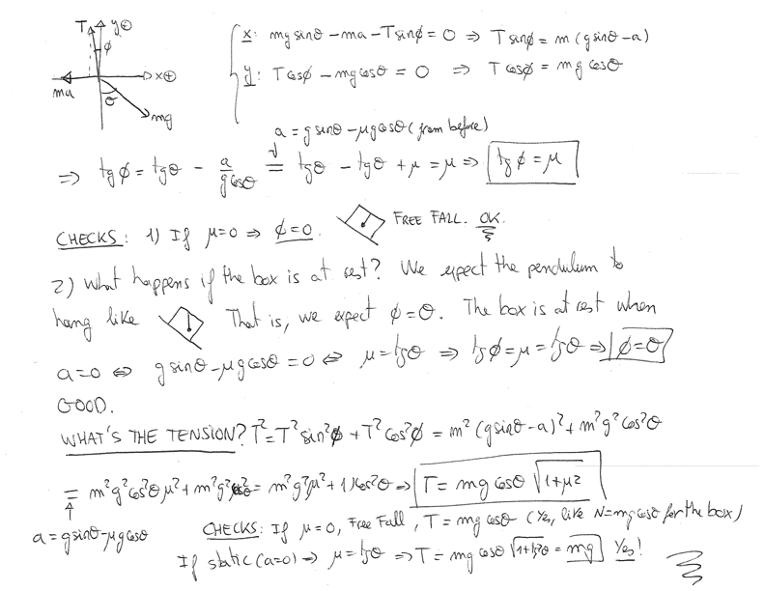

Slide 12
An incline has two masses connected by a massless string and a massless and frictionless pulley, as shown in the figure below.
a) Find the acceleration of the masses, assuming: the incline is fixed to the ground, and there is no friction at any surface.
Now imagine a situation where (only) the vertical side of the incline has some friction. Further, let’s not assume the inclined itself is fixed to the ground:
b) How fast should the incline accelerate to prevent the motion of the masses relative to itself? Consider that the incline is accelerated to the right.
c) Is it always possible? Is the friction necessary?
m₁
μ=0
m₂
μ > 0 (for questions b and c)

Slide 13
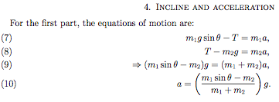
Final Test Time
m₁
μ=0
m₂
μ > 0

Slide 14

Final Test Time

Slide 15

Final Test Time
REMEMBER, WHITOUT ACCELERATION
m₁
μ=0
NOW
m₂
a
μ > 0

Slide 16

Final Test Time

Slide 17
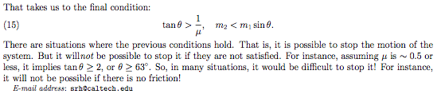
Final Test Time
Last remark: if the assumption is changed to the other case, namely, that in the absence of ‘a’ the system tends to fall in the direction of m₂, then one can see that there is always a well defined ‘a’ that would stop the blocks. Check it.

