Slide 1
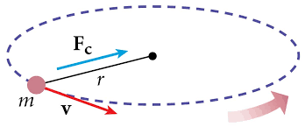
PH1a: circular motion
Centrifugal/centripetal force
Sergi Hildebrandt (srh@caltech.edu. Cahill 364)

Slide 2
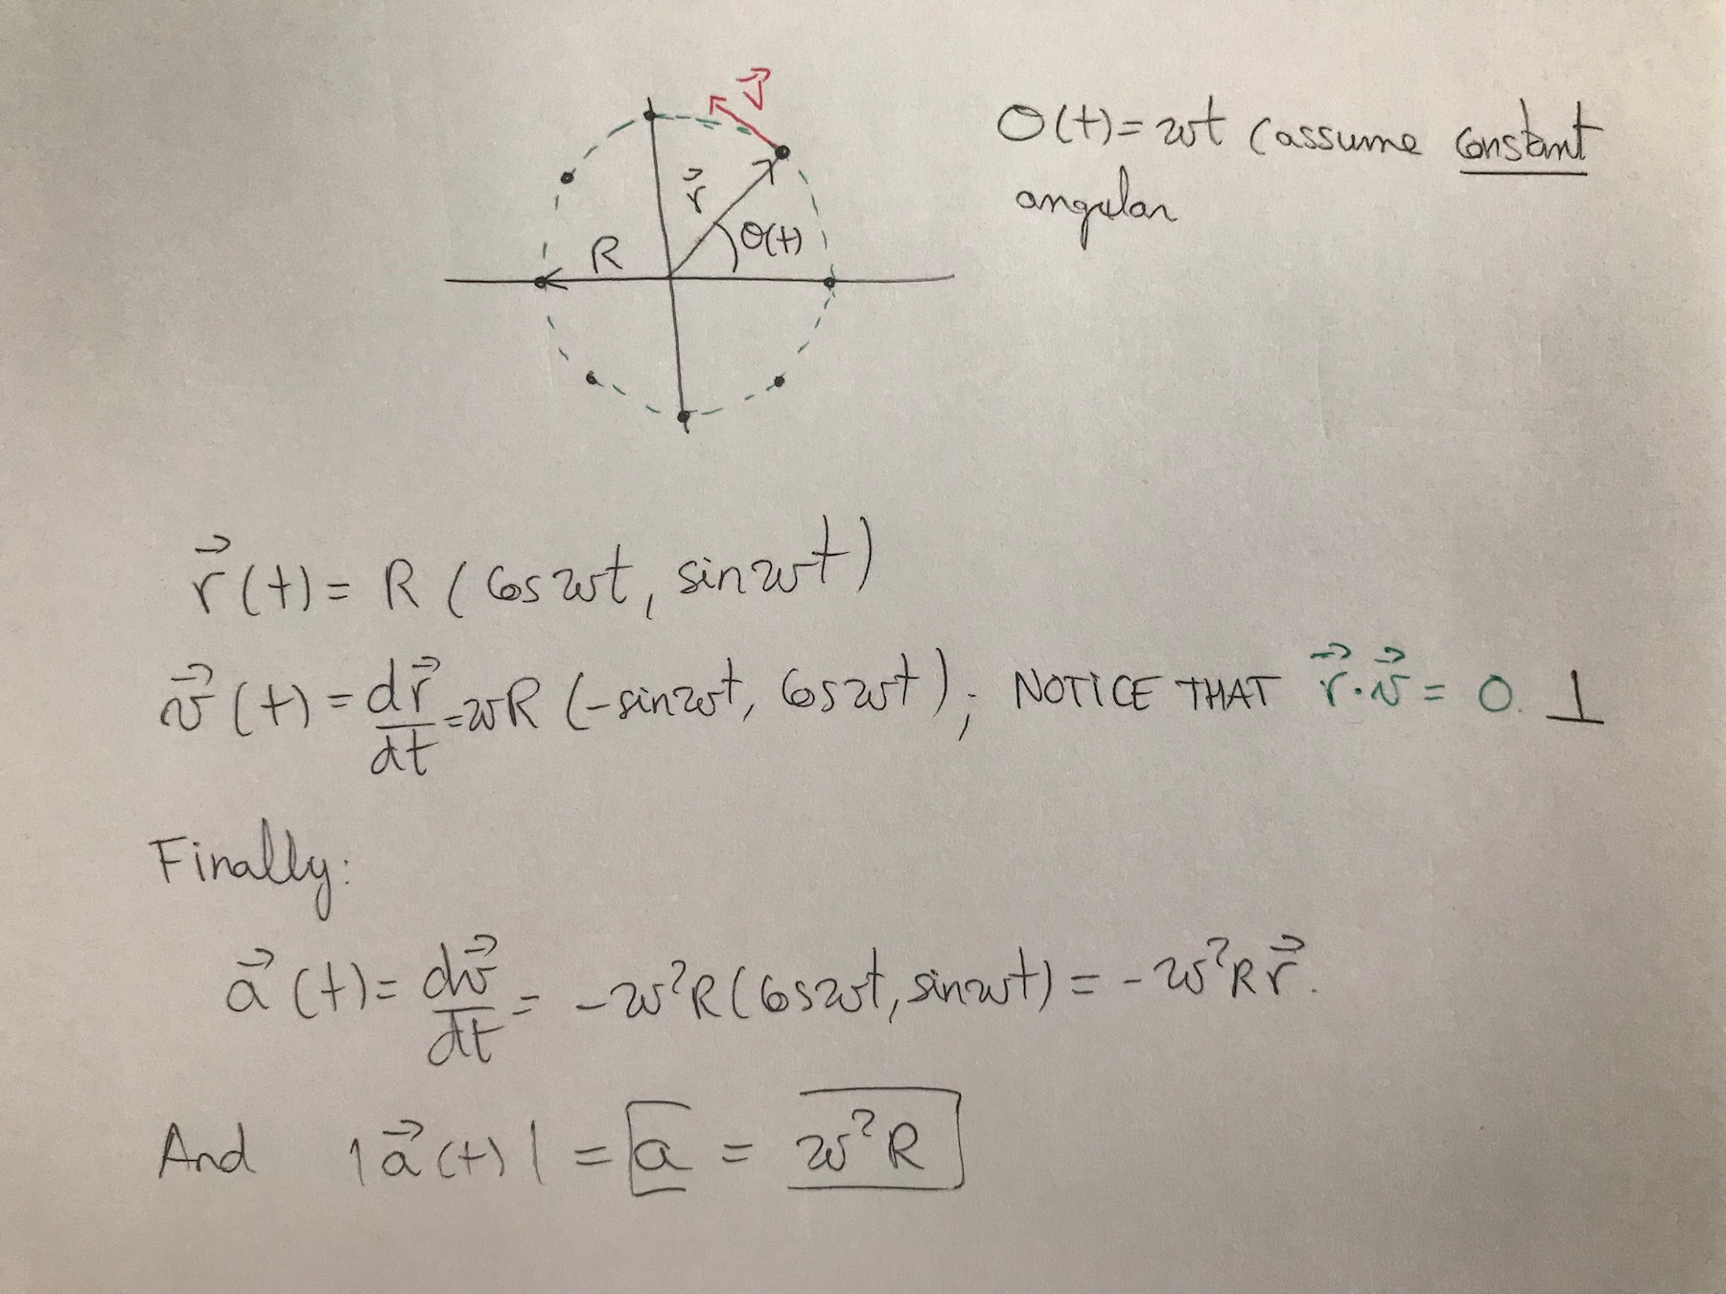
Derivation of the centripetal acceleration:
If a body follows a circular motion, there must be some force that makes it turn.
We can provide a mathematical derivation of the factor a_{c}=ω²r

Slide 3

PH1a: let’s practice
ω
θ
R
m
μ_{s}
Q1: what’s the minimum μ_{s} for the block not to slide down given ω?
Q2: what’s the minimum ω given μ_{s}?
Q3: What happens when ω is too small?

Slide 4
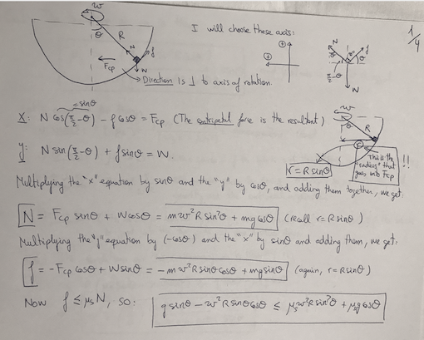

Slide 5
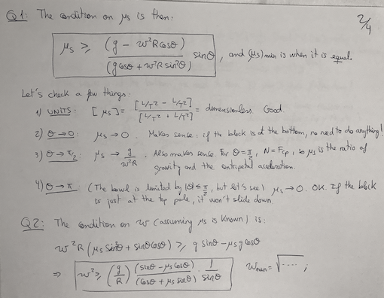

Slide 6
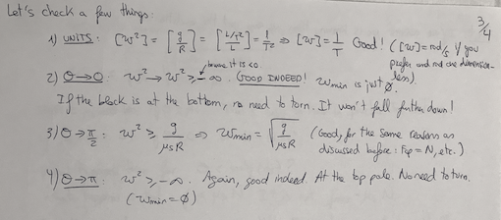
If you have time, always check limit cases.

Slide 7
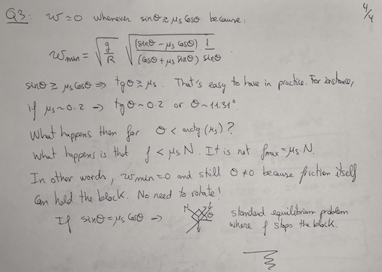

Slide 8
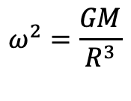
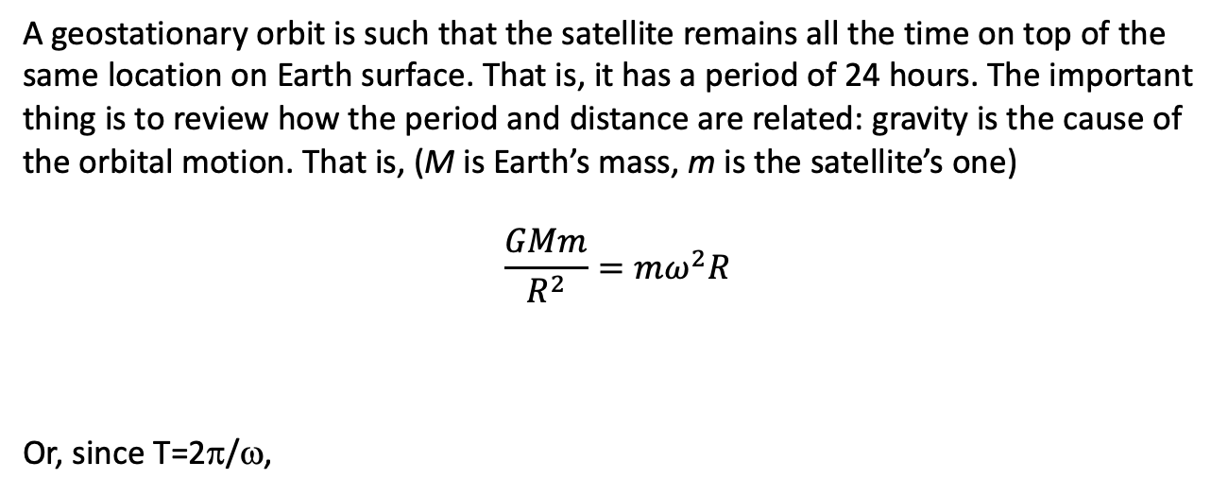


PH1a: circular motion and gravity
First Exercise
What’s the orbital radius of a geostationary orbit?
A geostationary orbit is such that the satellite remains all the time on top of the
same location on Earth surface. That is, it has a period of 24 hours. The important thing is to review how the period and distance are related: gravity is the cause of the orbital motion. That is, (M is Earth’s mass, m is the satellite’s one)
$$\frac{GMm}{R^{2}}=mω^{2}R$$
Or, since T=2π/ω,
$$ω^{2}=\frac{GM}{R^{3}}$$
$T^{2}=\left(\frac{4π^{2}}{GM}\right)$ R³
, or
$$R= \sqrt[3]{GMT^{2}/4π2}$$
Substituting the Earth’s mass and period of a day, we get R = 42,156 km or approximately 35,786 km above the surface

Slide 9
PH1a: circular motion and gravity
Second Exercise
m
R
M
D
o
D
M
Imagine a binary star system of equal masses M. Let’s assume that the stars orbit one another in a circular stable orbit of radius D. Is it possible to have a planet in a circular orbit around them? Consider the mass of the planet much smaller than the one of the stars.

Slide 10
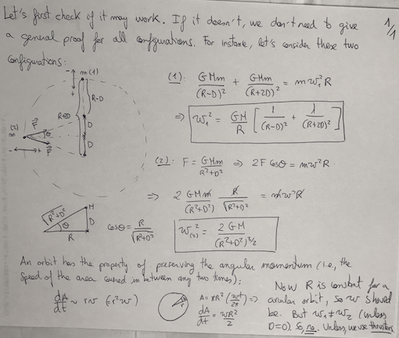

Slide 11
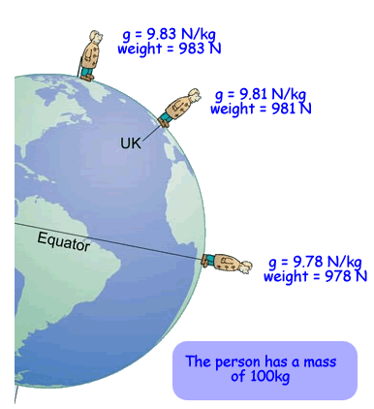
A harder problem
Find the net force experienced by a person at different latitudes. Take into account, the Earth’s period and assume the Earth is a sphere of radius R, with surface gravity g = GM/R² = 9,81 m/s².
Image source: http://www.cyberphysics.co.uk/topics/forces/gravity.htm

Slide 12
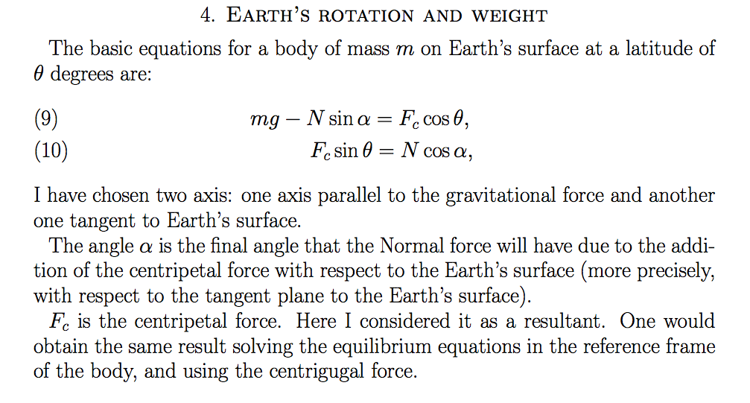
A harder problem: solution

Slide 13
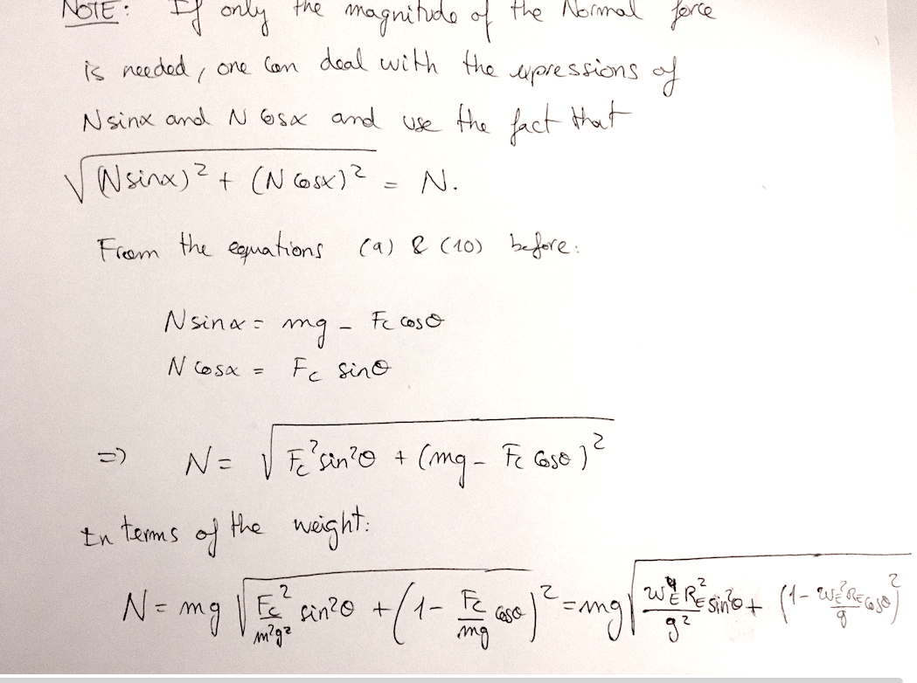

Slide 14
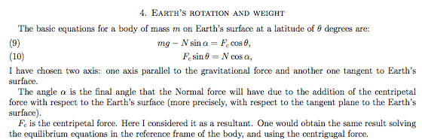
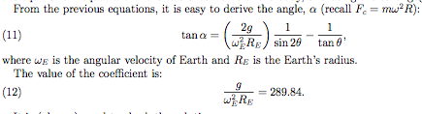
A harder problem: solution

Slide 15
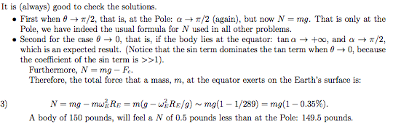
A harder problem: solution

Slide 16
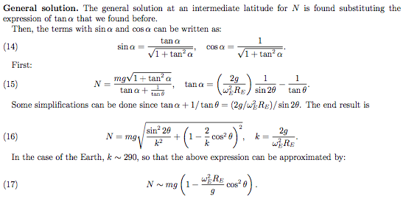
A harder problem: solution

Slide 17
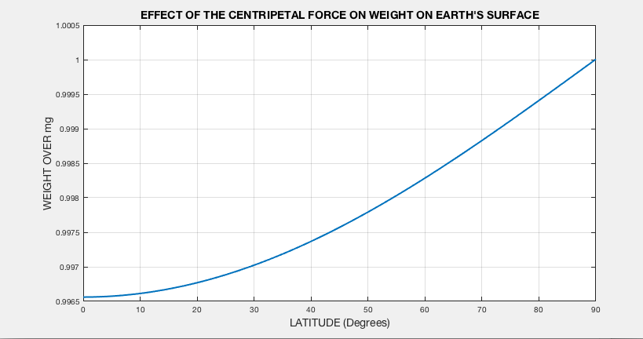
A harder problem: plotting the solution
This is a plot of how the weight measured by a scale would change with respect to mg. Notice that the maximum difference is at the equator, as expected, and it is a 0.35% (150 pounds would weight 0.5 pounds less at the equator). At the poles there’s no difference as expected, as well.

Slide 18
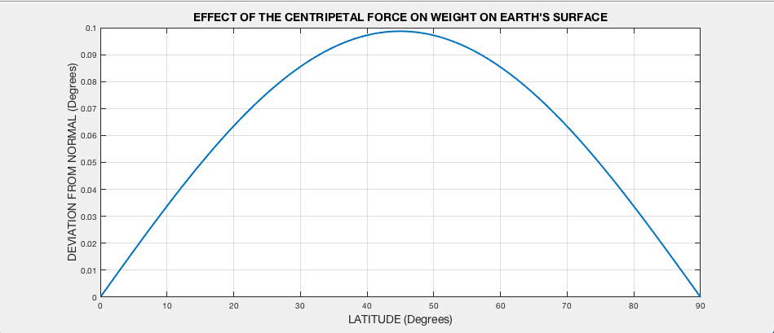
A harder problem: plotting the solution
This is a plot of how the resultant weight deviates from the normal direction to Earth’s surface. The resultant weight is bent. Notice that the there is no bent either at the equator or at the poles, as expected. The maximum deviation occurs at latitude 45 degrees and it is 0.1 degrees. That is the latitude of Augusta in Maine.

Slide 19
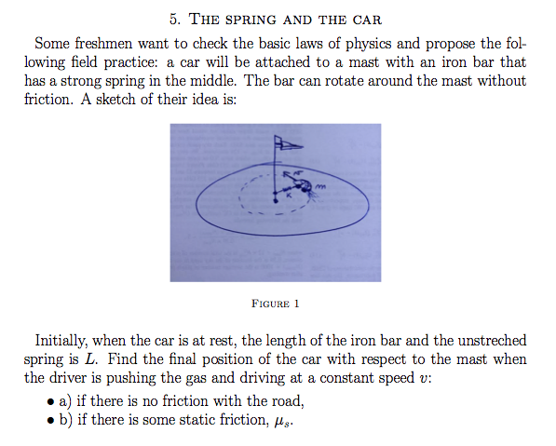

Slide 20
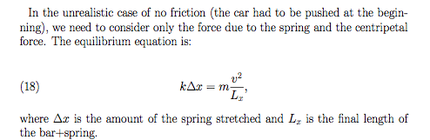

Slide 21
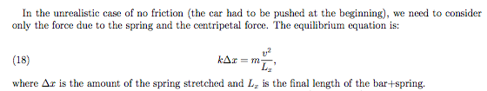


Slide 22
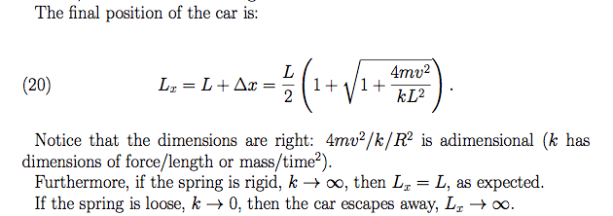

Slide 23
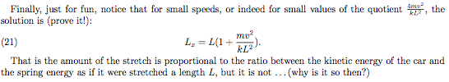
Check this is a consistent conclusion to first order in (mv²/kL²)

Slide 24
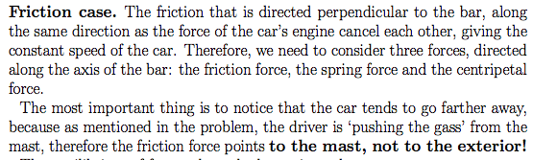
We will consider the case when the driver is going as fast as possible, so that the friction along the radial direction points toward the center of rotation, and not the other way. One may solve the other case, as well, but we will just focus on the fast case.

Slide 25
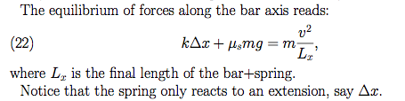

Slide 26


Slide 28
