Slide 1


Changes in the Brain during Chronic Exposure to Nicotine
Behavior
Circuits
Synapses
May 2010
Henry Lester
Neurons
Nicotine
Addiction
Intracell.
Parkinson’s
Disease
Binding
Inadvertent therapeutic effects of chronic nicotine
Nic vs ACh
ADNFLE
Proteins
RNA
Genes

Slide 2
The nicotine video
Produced for Pfizer to explain varenicline (Chantix) to physicians
This summarizes knowledge in ~ 2004.
“physical” addiction vs “psychological” addiction.
Desensitization and “Upregulation”
Behavior
Circuits
Synapses
Neurons
Nicotine
Addiction
1 million
channels
Intracell.
Parkinson’s
Disease
Binding
Closed states(s) more stable
than open states
Nic vs ACh
ADNFLE
Proteins
RNA
Genes
nicotine
20 seconds

Slide 3
Nicotine and ACh act on many of the same receptors, but . . .
1. Nicotine is highly membrane-permeant. ACh is not.
Ratio unknown, probably > 1000.
2. ACh is usually hydrolyzed by acetylcholinesterase (turnover rate ~10⁴ /s.) In mouse, nicotine is eliminated with a half time of ~ 10 min.
Ratio: ~10⁵
EC₅₀ at muscle receptors: nicotine, ~400 μM; ACh, ~ 45 μM.
Ratio, ~10. Justified to square this because nH = 2. Functional ratio, ~100.
For nicotine, EC₅₀(muscle) / EC₅₀(α4β2) = 400
We studied this difference (next 4 slides)

Slide 4
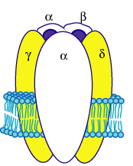
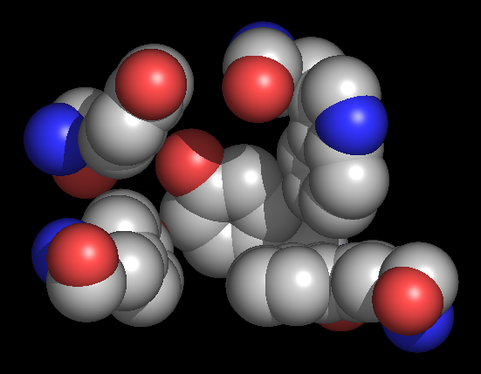
The AChBP interfacial “aromatic box” occupied by nicotine (Sixma, 2004),
Probed functionally by unnatural amino acid mutagenesis
H-bond 12-fold tighter binding vs muscle
Additional H-bond to non-α subunit
αY198
C2
αW149
B
αY93
A
Cation-π interaction
16-fold tighter binding vs muscle
αY190
C1
non-αW55
D
(Muscle Nicotinic numbering)

Slide 5
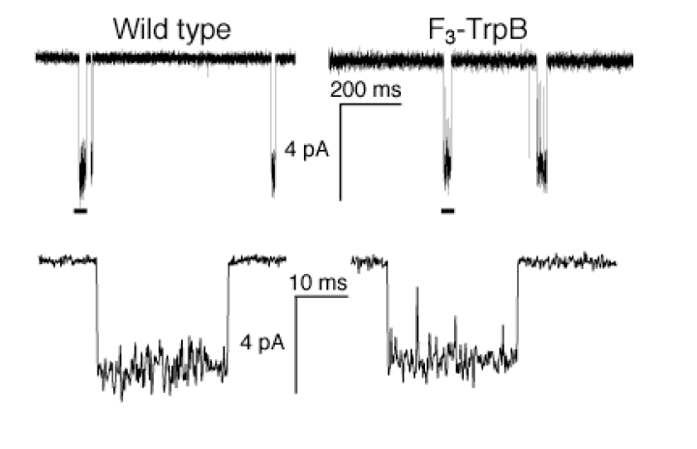
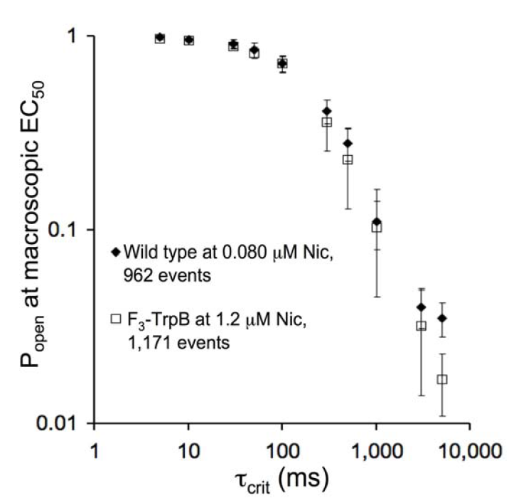
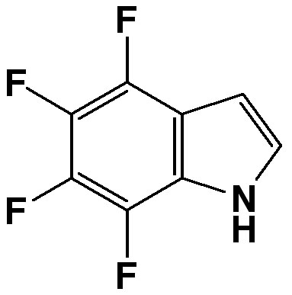
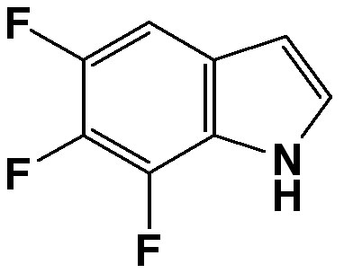
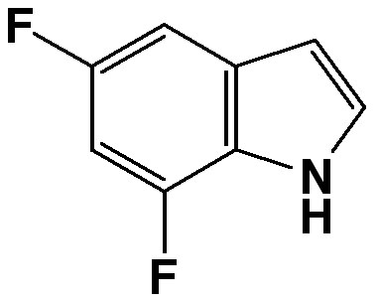
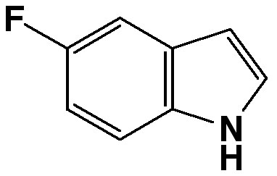
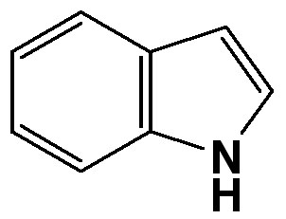
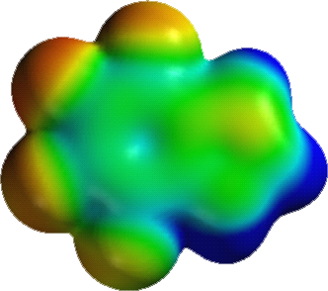
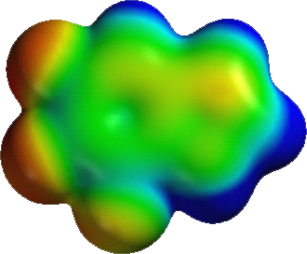
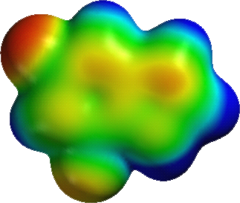
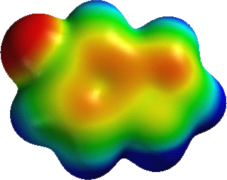
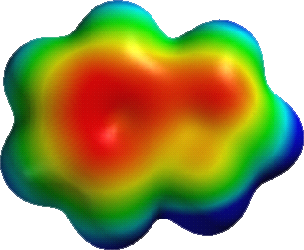
Nicotine makes a stronger cation-π interaction with Trp B
at α4β2 receptors than at muscle receptors;
this partially explains α4β2 receptors’ high binding affinity for nicotine.
WT
WT,
without cation-π
interaction

Slide 6
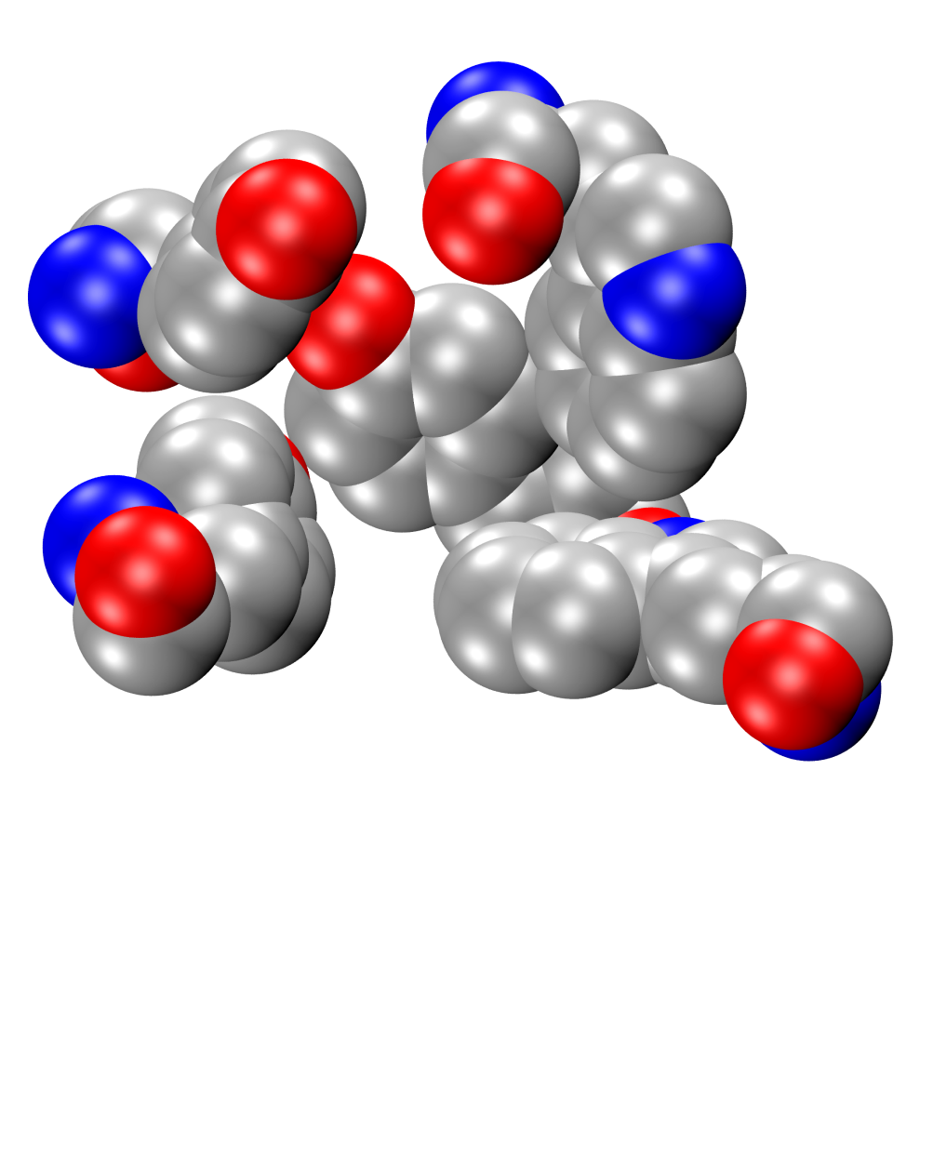
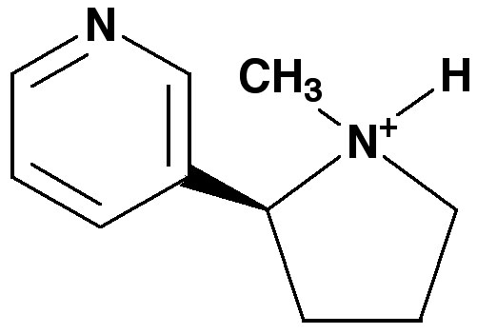
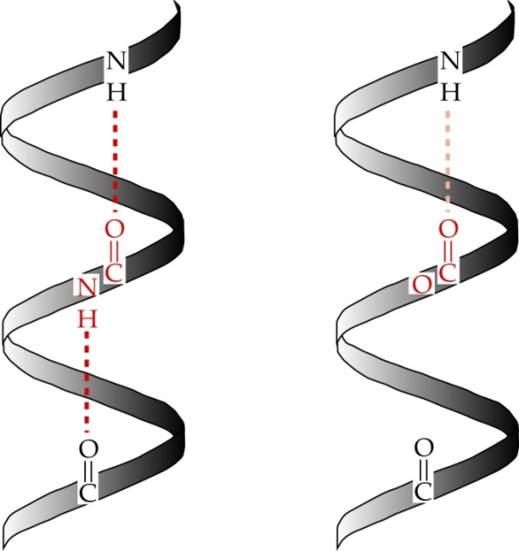
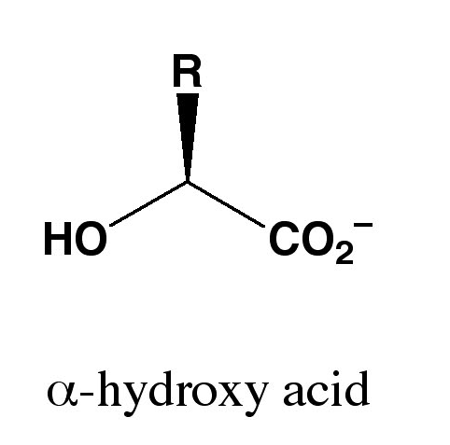
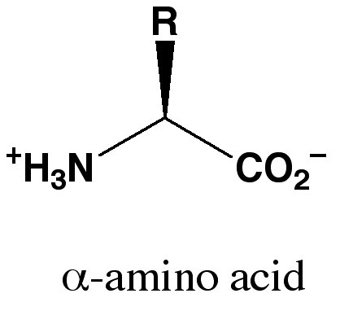
Nicotine makes a stronger H-bond to a backbone carbonyl at α4β2 than at muscle receptors:
Shown by amide to ester substitution:
Fold EC₅₀ increase
α4β2 | 20
muscle | 1.5
C2
B
A
C1
D
Weaker hydrogen bond
Deleted hydrogen bond

Slide 7
Nicotine EC50 values:
Muscle nAChR single component ~ 400 μM
α4β2 two components ~ 1 μM, ~200 μM
Underlying the 400-fold higher nicotine sensitivity
of
neuronal vs muscle receptors:
Factor of ~16 for the cation-π interaction;
Factor of ~ 12 for the H-bond;
16 x 12 = 192. We still can’t explain a factor of 400/192 ~ 2.
Xiu et al, Nature 2009

Slide 8
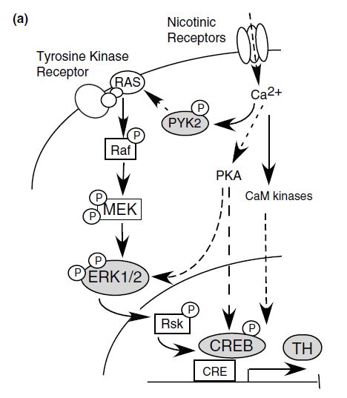
Possible molecular mechanism #1 for changes with chronic nicotine:
Signal transduction triggered by a ligand-gated channel
receptor
G protein
i
q
s
t
effector
channel
enzyme
NMDA receptors
and
nAChRs
are highly permeable to Ca²⁺
as well as to Na⁺.
intracellular
messenger
Ca²⁺
cAMP
Brunzell, Russell, & Piccotto,
2003
kinase
phosphorylated
protein

Slide 9
Possible Mechanism #2 for changes with chronic nicotine:
Upregulation with chronic nicotine
(1983: Marks & Collins; Schwartz and Kellar)
Brain Region
Cell type:
DA vs GABA vs Glut
Behavior
Subcellular Compartment:
Axon terminal
vs Somatodendritic
Chronic nicotine upregulates nAChRs
We now appreciate that upregulation displays
specificity at all levels studied
Circuits
Synapses
Pharmacological subtype:
low vs high affinity
Neurons
Intracell.
Detailed stoichiometry:
subunit composition
Binding
auxiliary subunit
 | sensitivity | up-regulated?
α4 | Low | Probably not
β2 | High | Yes, but selectively
α5 | High | Unknown
Nic vs ACh
Proteins
agonist
binding
interfaces
β2
α4
RNA
α4
Genes
β2

Slide 10
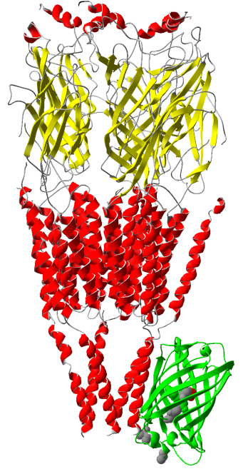
The SePhaChARNS mechanism: Upregulation occurs because
Nicotine is a Selective Pharmacological Chaperone of
Acetylcholine Receptor Number and Stoichiometry
Endoplasmic
reticulum
Golgi
complex
Plasma
membrane
Early
endosome
out
COPI
ERGIC
Clathrin
COPII
COPI
nAChR
nAChR
Secretory vesicle
Secretory pathway
Pharmacological chaperoning: upregulation starts here
(Oversimplification)
Early LTP / Opioids: regulation starts here
(Oversimplification)

Slide 11
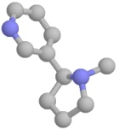
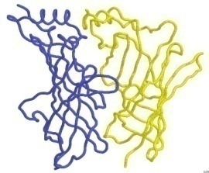
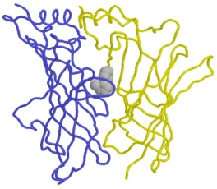
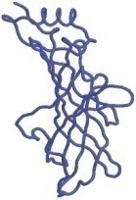

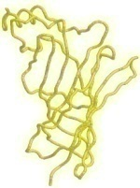
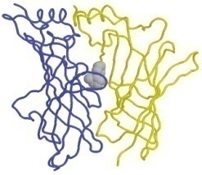
SePhaChARNS: Thermodynamics
. . . . But
#3 reversible events may be amplified by covalent bonds
#1. Binding eventually favors high-affinity states
Bound
states
with
increasing
affinity
unbound
+
C
Highest affinity
bound state
+ nicotine
Covalently
stabilized
AR*_{HS}
?
R_{LS}
R_{HS}
AC
Degradation
Free Energy
A₂C
A₂O
Nicotine
Reaction Coordinate
A₂D
High-
Sensitivity
Receptors
#2. Nicotine binds to subunit interfaces, favoring assembled receptors (“matchmaking”)
Increasingly
stable
assembled
states
hr
Free
subunits
+
+
0
20
40
60
Free Energy
Reaction Coordinate

Slide 12
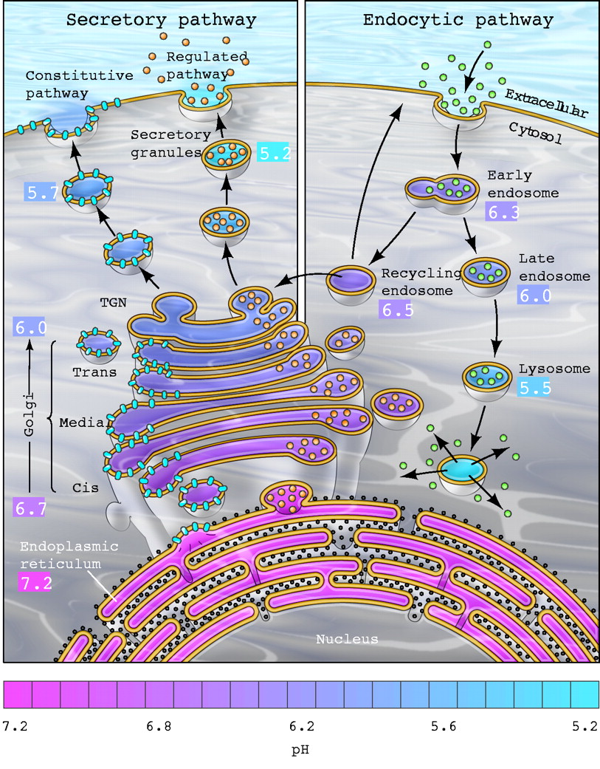
Thermodynamics of SePhaChARNS
#4. Acid trapping may keep intracellular nAChRs desensitized
Nicotine accumulates slightly
in cytoplasm
1 μM Nicotine⁺
(pKa = 7.8)
pH 7.4
pH 7.0
2.5 μM Nicotine⁺
. . . and then markedly
in intracellular organelles.
P. Paroutis, N. Touret, S Grinstein (2004) Physiology 19: 207-215
nicotine⁺/nicotine:
10
30
100
300

Slide 13
Fluorescent AChRs for localization and Förster resonance energy transfer (FRET)
M3
β2
α4
-
M4
N
loop
C
N
C
M3
-
Ligand binding
M4 loop
M1
M2
M3
M4
M4
Raad Nashmi
Rahul Srinivasan
HA tag
XFP
c
-
myc tag
XFP
α
β
2
-
4
XFP
-
XFP
λ
FRET pairs
(m = monomeric)
XFP =
mCerulean
ECFP
mEGFP
mEYFP
mVenus
mCherry
Neuro2a

Slide 14
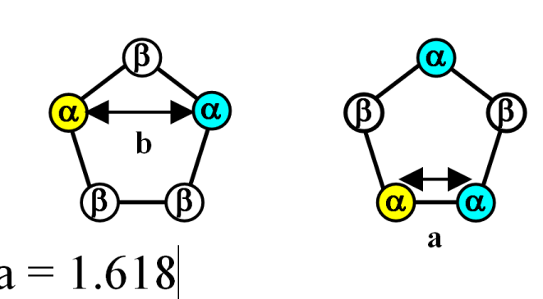
Theory of FRET in pentameric receptors with α_{n}β_{(5-n)} subunits
50% α-CFP, 50% α-YFP
1/2
1/4
1/4
E
No FRET
b/a =1.62; 1.62⁻⁶ = 0.055
1/8
1/4
1/8
1/4
1/8
1/8
E1
E2
E3
E4
No FRET
100% α₃β₂
100% α₂β₃
% receptors with α₃
Cagdas Son

Slide 15
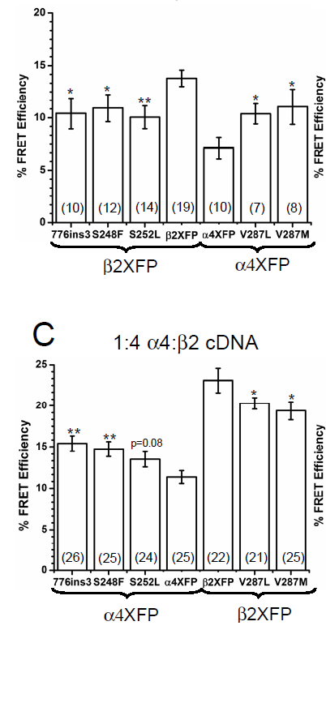
Autosomal Dominant Nocturnal Frontal Lobe Epilepsy:
Five M2 Domain Mutations Cause Excess Intracellular (α4)₃(β2)₂ Stoichiometry
We studied the
α4 subunit
mutations
We studied the
β2 subunit
mutations
WT
We placed the
FRET pair
in the WT subunits
In the two cases tested, these differences are abolished by 24-48 h incubation in 1 μM nicotine.
Son et al, Mol Pharm 2009
We placed the
FRET pair
in the
mutant subunits
Neuro2a
Cagdas Son

Slide 16
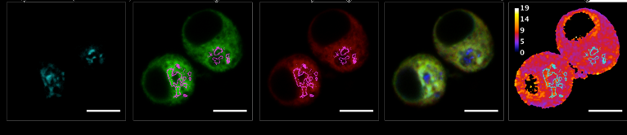
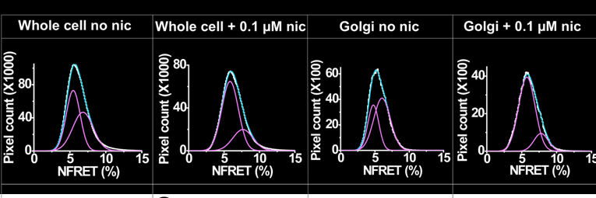
Pixel-by-pixel NFRET measurements:
48 h incubation in nicotine shifts nAChR stoichiometry: α4₃β2₂ → α4₂β2₃
. . . and the change occurs upstream of the Golgi (presumably in the ER)

Slide 17
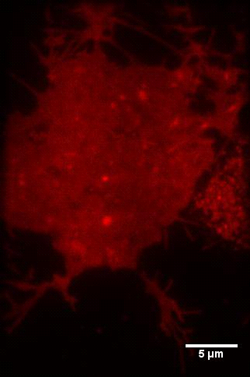
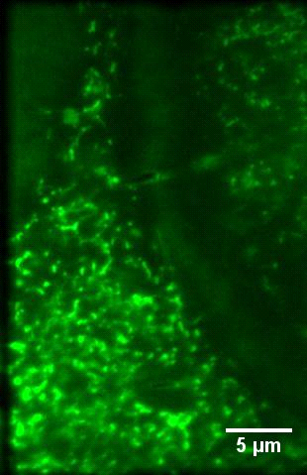
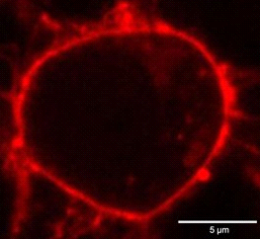
Total internal reflection fluorescence (TIRF) microscopy
highlights events at and near the plasma membrane
evanescent wave
coverglass
Confocal
N2a cell pCS2-mcherry (plasma membrane label)
(ER) Tracker green

Slide 18
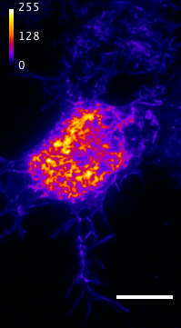
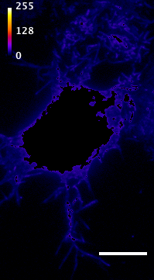
TIRF measurements recapitulate α4β2 nAChR upregulation at the plasma membrane
α4-eGFP β2
ER + PM
ER subtracted
PM integrated intensity:
Thousands
of
arbitrary units
5 μM
**
ER + PM
PM subtracted
ER + PM (ROIs)
(42)
(50)
0 0.1
[Nic] µM
48 hr

Slide 19
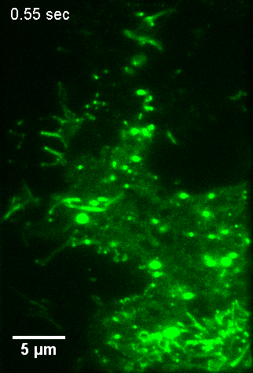
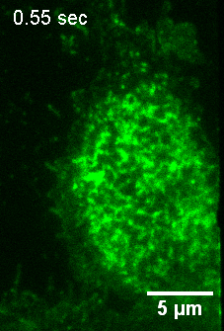
x
Sequences in the β subunit M3-M4 loop mediate ER retention of α4β nAChRs
α4eGFPβ4
α4eGFPβ2
putative COP 1 retrieval motif
Mouse
β2
β4
VHHRSPTTHTMAPWVKVVFLEKLPTLLFLQQPRHRCARQRLRLRRRQREREGAGTLFFREG
VHHRSPSTHTMASWVKECFLHKLPTFLFMKRPGLEVSPARVPHSSQLHLTTAEATSTSALG
putative ER export motif
Rigo Pantoja, Rahul Srinivasan

Slide 20
The β2 nAChR subunit mediates ER retention of receptors
α4eGFPβ2
α4eGFPβ4
Rigo Pantoja
Rahul Srinivasan

Slide 21
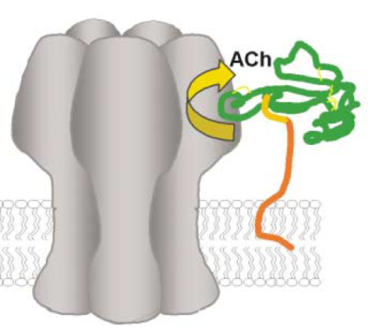
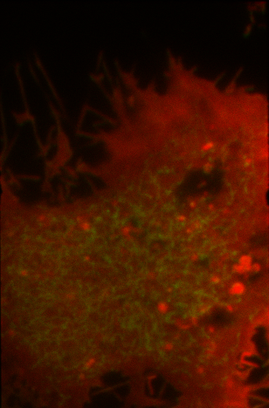
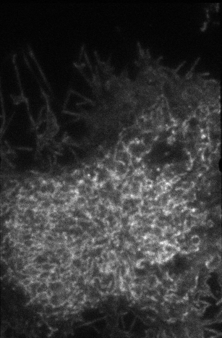
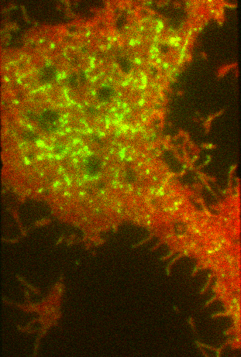
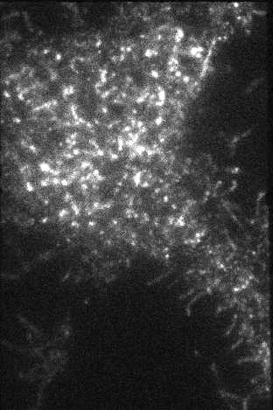
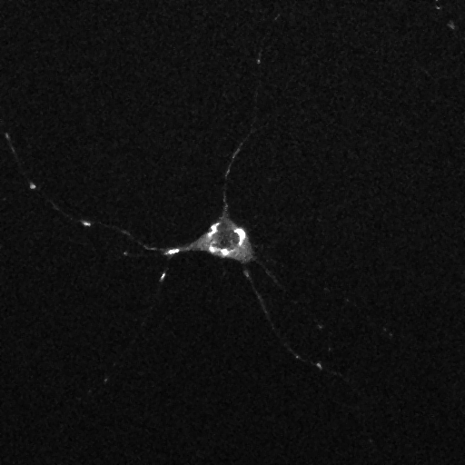
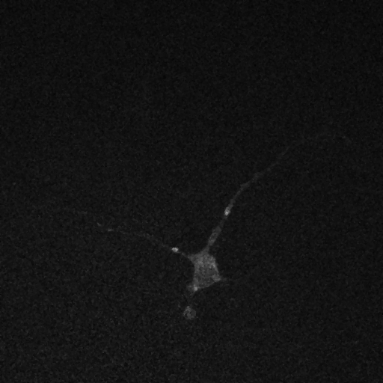
Lynx proteins: endogenous chaperones for α4β2 nAChRs?
α4GFP β2
no additional transfections
Lynx co-transfected cells
Neuro2a
(HEK)
Organized
smooth ER?
Golgi outposts at
branch points
Julie Miwa
lynx1-KO Wild-type
21

Slide 22
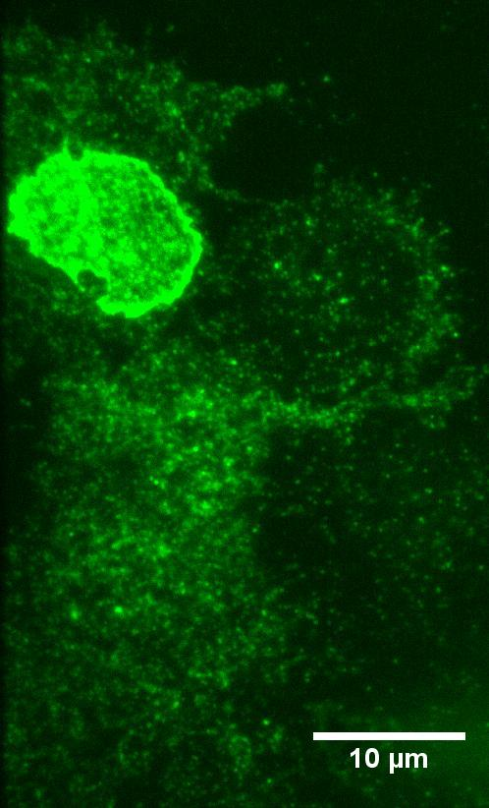
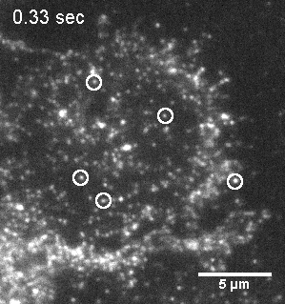
Toward single-molecule resolution of α4β2* nAChRs in mammalian cells:
receptor clusters and subunit stoichiometry
α4GFPβ2 (4:1)
Immobile diffraction-
limited puncta
Photobleaching profile
Criteria for plasma membrane inserted nAChRs
Immobile
Diffraction limited
Discrete photobleaching steps
Rigo Pantoja, Chris Richards

Slide 23
How does nicotine upregulate
Wild type nAChRs on the plasma membrane?
Our best current hypotheses
Endoplasmic
reticulum
Golgi
complex
Plasma
membrane
COPI
ERGIC
Clathrin
COPII
COPI
nAChR
nAChR
≥ 3 β2 subunits
≤ 2 β2 subunits
Remove ER retention motifs
Co-express lynx1
Insert ER exit motifs
β4 replaces β2 subunit

Slide 24
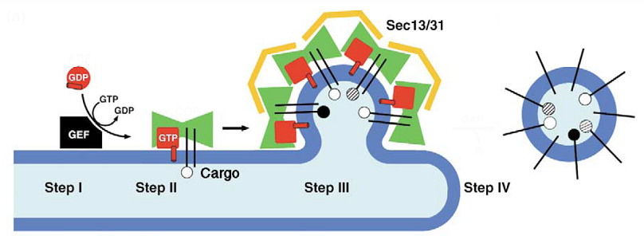
Most membrane proteins exit the ER in a COPII-dependent manner at ER exit sites (ERES)
Endoplasmic
reticulum
Golgi
complex
Early
endosome
Plasma
membrane
COPI
ERGIC
Clathrin
COPII
COPI
nAChR
nAChR
Secretory vesicle
GTPase: Sar1
COP II: Sec23/24
heterodimer
scission
ER lumen
Mancias &
Goldberg,
Traffic 2005
ER membrane
Cytosolic compartment

Slide 25
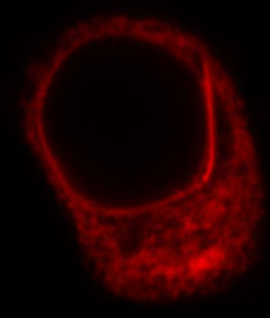




ER exit sites and nAChRs
α4-mCherry + β2
(500 ng each)
Sec24D-eGFP
(250 ng)
Merge
ERES selection
Outlines of selected ERES
Transfect N2a cells with nAChRs + ERES marker
Incubate with drug (48 h)
ERES number (Confocal)
ERES intensity (Confocal)
ERES dynamics (TIRFM)
Methodology
Rigo Pantoja
Rahul Srinivasan

Slide 26

48 h exposure to nicotine increases number of ER exit sites (ERES),
and this depends on nAChR receptor expression
P < 0.01
p < 0.01
p < 0.05
n = 18
NS
n = 30
n = 19
n = 25
A cell-delimited phenomenon related to PD neuroprotection?
Rigo Pantoja, Rahul Srinivasan

Slide 27
We’re testing a formal model for SePhaChARNS
by matching seven measured fluorescence ratios: nicotine/control, mutant/WT
Changed by M3-M4 mutations
ExMach
10 COPII
Folded & Assembled
Fully
ERES
9 ExMach binds
21 Insertion
nicotine
8b folding
8a unfolding
23 COPI
C1Unfolded
Golgi
PM
Partially
5,6 ERAF
Folded & Assembled
Plasma membrane
13 misfolding
Misfolded
22 Surface degradation
14 Cochaperone1
15 ERAD
ER
Endosomes &
L
ysosomes
Based on FoldEx Wiseman, Powers, Buxbaum, Kelly & Balch Cell 2007
Rahul Srinivasan, HAL

Slide 28
Cellular and subcellular specificity of SePhaChARNS: α4* nAChRs
CA
EC
MH
DG
Medial Perforant Path
IPN
 | Upregulation?
Transmitter | Soma | Term. | Region / projection
Glu | ?? | Yes | Entorhinal cortex → dentate gyrus
ACh | No | No | Medial habenula → Interpeduncular nucleus
DA | No | Yes | Ventral tegmental area, substantia nigra pars compacta → Striatum
GABAA | Yes | Yes | SN pars reticulata, VTA → SNC, VTA
Striatum
SNc, VTA
Thalamus,
superior
colliculus
SNr,
VTA
Nashmi et al J Neurosci 2007; Xiao et al, J. Neurosci 2009

Slide 29
α6* nAChRs are much simpler
 | Upregulation?
Transmitter | Soma | Term. | Region / projection
Glu |  |  | No expression
ACh |  |  | No expression
DA | No | No | Ventral tegmental area, substantia nigra pars compacta → Striatum
GABAA |  |  | No expression
Striatum
SNc, VTA
Drenan et al, Neuron 2008; papers from several other labs

Slide 30

Strategy to evaluate the cellular and subcellular specificity of α4* upregulation
1. Generate knock-in mice with fully functional, fluorescent α4* receptors
2. Expose the mice to chronic nicotine
3. Find the brain regions and cell types with changed receptor levels
4. Perform physiological experiments on these regions and cells to verify function
5. Model the cellular and circuit changes
CFP
Leu9’Ala-YFP,
YFP,

Slide 31
Either activation and/or desensitization can be amplified by upregulation
No endogenous activation;
Nicotine activates nAChRs
B. Activation by endogenous ACh;
Nicotine desensitizes nAChRs
upregulated
before
acute nicotine
upregulated
drug-naive
drug-naive
nicotine
activates
nAChR activation
before acute nicotine
nicotine
desensitizes
0
0

Slide 32









The Caltech α4 fluorescent mice . . . normal in all respects

Slide 33











Chronic nicotine increases medial perforant path α4 fluorescence ~ 2-fold.
Relevant to cognitive sensitization?
Humans:
Some smokers report that they think better when they smoke;
smokers who smoke nicotine cigarettes (but not nicotine-free cigarettes) display certain cognitive enhancements (Rusted and Warburton, 1992; Rusted et al., 1995).
Rodents:
Mice show more contextual fear conditioning if, one day after withdrawal from chronic nicotine, they receive an acute nicotine dose (Davis et al., 2005); this is α4β2* dependent.
Also chronic nicotine produces better spatial working memory performance in the radial arm maze (Levin et al., 1990; Levin et al., 1996).
Alveus
Py
Or
Rad
LMol
200 μm
Medial Perforant Path
Temperoammonic Path

Slide 34

Simple model for
cognitive
sensitization:
chronic nicotine
+
acute nicotine
lowers the threshold for perforant pathway LTP
Acute Nicotine
Acute Saline
10 min
80 min
Chronic
10 min
80 min
Chronic
Saline
Saline
0.5 mV
0.5 mV
10 ms
5 ms
Nicotine
Nicotine
1mV
10 ms
1 mV
10 ms
1 mV
10 ms
Acute Nicotine
Acute Saline
Chronic Nicotine
Acute
Chronic
Chronic

Slide 35

Acute nicotine increases sEPSC frequency in 1-day nicotine-treated animals
2
1 μM Nicotine
1.5
normalized sEPSC amplitude
1
0.5
min
0
0
10
min
Normalized sEPSC frequency
20
30
2.5
0.3 μM DHβE
2
1.5
1
10 μM
bicuculline
0.5
Patch
electrode
0
0
10
20
30
min

Slide 36
VTA GABAergic and DA neurons have contrasting responses to nicotine in vivo
6
α4*, α6*, and/or α7
DA neuron, ~ 1700 spikes
Nicotine
injection
4
Frequency, Hz
0.05 mV
2
2 ms
A B C D
0
25
α4*
only
20
0.1 mV
15
0.5 ms
Frequency, Hz
10
5
GABAergic neuron
(5 s smoothing), ~ 8300 spikes
0
0
100
200
300
400
500
600
700
s

Slide 37


α4-YFP knock-in: substantia nigra pars compacta neurons
Spectrally unmixed α4YFP
Spectrally unmixed background autofluorescence
10 μm
10 μm
Raad Nashmi

Slide 38
Midbrain data show cell specificity of SePhaChARNS
Chronic nicotine does not change
α4 levels
in dopaminergic neuron somata . . .
Substantia Nigra
Pars Compacta
(& VTA, not shown)
α4 intensity per TH+ neuron
. . . but does upregulate
α4 levels
in GABAergic inhibitory
neuron somata.
Substantia Nigra
Pars Reticulata
(& VTA, not shown)
α4 intensity per GAD+ neuron

Slide 39

Test for functional α4* upregulation:
Electrophysiology in slices
and
intact anesthetized mice
Including studies with α4 knockout (KO) mice
ACh, nicotine puffs
V
(Tyrosine hydroxylase immunostain)
Cheng Xiao

Slide 40


Chronic nicotine modifies α4* currents in substantia nigra neurons
SN pars reticulata GABAergic somata
SN pars compacta DA somata
α4
KO

Slide 41
Chronic nicotine cell-specifically up-regulates functional α4* receptors:
Hyothesis for circuit-based tolerance in midbrain
(Nashmi et al, 2007)
Chronic Saline
Chronic Nicotine →Tolerance
Upregulated α4* nAChRs
Endogenous
ACh
Craving
VTA
NAc
2A
LDT
1A
DAergic
Endogenous ACh
Endogenous ACh
Cholinergic
GABAergic
4.0
Yoked saline
2B
3.5
Yoked nicotine
1B
1B
Reward
Decreased Reward
3.0
2.5
1A
Dialysate DA (nM)
2.0
Plus Acute Nicotine
(repeated exposure)
1.5
Plus Acute Nicotine
(1st expsoure)
1.0
2B
0.5
2A
0.0
Saline
Nicotine
-40
-20
0
20
40
60
80
100
120
140
160
180
+ acute nicotine
Time (min)
Rahman et al, 2004

Slide 42

Chronic nicotine modifies firing rates in substantia nigra neurons:
the role of α4* nAChRs on GABAergic neurons
SN pars reticulata GABAergic neurons
SN pars compacta DA neurons
α4 KO
vv
Also Tan . . . Laviolette
Neuropharm 2009
vv
α4 KO
α4 KO
α4 KO

Slide 43
2nd Hypothesis for PD neuroprotection by Chronic nicotine:
Circuit-based mechanism in substantia nigra
via
Cholinergic, Dopaminergic, and GABAergic neurons in Hindbrain & Midbrain
. . . Analogous to
“deep brain stimulation” in subthalamic nucleus?
STN
SNc
Striatum
DAergic
PPTg
GABAergic neurons
have increased
(or more regular?) firing
in chronic nicotine. . .
Thalamus,
superior
colliculus
Cholinergic
GABAergic
SNr
Endogenous ACh
Upregulated a4* nAChRs

Slide 44

Regional specificity of α4* nAChR upregulation by chronic nicotine
We sought α4* nAChRs in striatal neurons, using fluorescence and electrophysiology.
We found none. Therefore,
we developed assays for the α4* nAChRs on dopaminergic nerve terminals in striatum . . .

Slide 45


Chronic nicotine augments nicotinic modulation of sEPSCs in MSNs
V

Slide 46

Chronic nicotine regulates the nigrostriatal pathway
via α4β2* nAChR upregulation, with cellular and subcellular selectivity

Slide 47


In planning & construction phases
Knock-in and BAC Transgenic mice with
Monomeric GFP and Cherry nAChR subunits
for studies on localization & assembly (FRET)
anti-GFP
anti-TH
Subunit | Known FRET partners | References
α6 | α4, α6, β2, β3 | Drenan et al, 2008
β2 | α4, α6, β2, β3 | Nashmi et al, 2003 Drenan et al, 2008
β3 | α4, a6, β2, not β3 | Drenan et al, 2008
α7 | α7 | T. Murray, SFN
α5 | α4 | C. Dilworth, unpub

Slide 48



Engineering α-subunit nAChR hypersensitive mice:
TM2 Pore-Lining Leu9’ Residue Controls Receptor Sensitivity
Leu9’ Lines the Ion Channel Pore
Leu9’ Mutations Shift Dose-Response Curve to Left
Leu9’ Mutations are Dominant & Gain of Function
α4 data, not α6!
Miyazawa, Fujiyoshi, Unwin, Nature 2003
Fonck, et al. J. Neurosci. 2005
48

Slide 49

Carbon fiber electrochemistry shows that hypersensitive α6* nAChRs c
can lead to burst-enhanced DA release
A
carbon fiber
Ryan Denan

Slide 50

Selective Activation of DA Neurons via α6* nAChRs Stimulates Locomotor Activity . . .
. . . but, unlike selective α4 activation,
shows no sensitization,
possibly because α6* receptors do not participate in SePhaChARNS

Slide 51
SePhaChARNS participates in sequelae of chronic exposure to nicotine
1. Nicotine potently activates some neuronal nAChRs (because it participates in both cation-π and H-bond interactions within the conserved aromatic box).
2. This high affinity allows nicotine to act as a selective pharmacological chaperone of acetylcholine receptor number and stoichiometry.
3. These processes lead to α4β2* upregulation, with cellular and subcellular specificity.
Behavior
Circuits
4. Chaperoning may underlie chronic nicotine’s effects on suppression of ADNFLE seizures.
Synapses
Neurons
Intracell.
5. β2 vs β4 subunits are processed and trafficked differentially, iun part because of distinct trafficking motifs in the M3-M4 loops.
Binding
Nic vs ACh
6. Lynx proteins may also function as chaperones.
Proteins
RNA
7. These phenomena may soon be resolved at the single molecule level.
Genes

Slide 52
Selective nAChR upregulation during chronic exposure to nicotine
8. In the medial perforant path, α4* upregulation explains enhanced LTP, via a direct presynaptic mechanism. This is a simple model for cognitive sensitization.
Nicotine
Addiction
9. a. In midbrain, α4* upregulation in GABAergic neurons explains tolerance to chronic nicotine, via the GABAergic-DA circuit.
b. A similar circuit mechanism may protect DA neurons against harmful burst firing in PD.
Parkinson’s
Disease
Behavior
Circuits
ADNFLE
Synapses
Neurons
10. In striatal DA terminals, α4* upregulation may increase the influence of cholinergic interneurons on DA release.
Subcell.
Binding
Nic vs ACh
11. Repeated selective activation of DA neurons, via hypersensitive α6* receptors, produces neither locomotor tolerance nor sensitization.
Proteins
RNA
Genes

Slide 53
We do not yet understand several processes, e. g.
somatic signs of withdrawal,
stress-induced nicotine use,
weight gain in people who stop smoking,
and ANFLE circuitry.
SEBASTIAN JUNGER NY Times April 21, 2010
Farewell to Korengal
For much of 2007 and 2008, I was an embedded reporter with a platoon of airborne infantry at a remote outpost called Restrepo . . .
The psychological pressure was enormous. One soldier told me,
“I’ve only been here for four months and I can’t believe how messed up I am. I went to the counselor and he asked if I smoked cigarettes and I told him no and he said, ‘Well, you may want to think about starting.’”

Slide 54
Caltech
Prof. Dennis Dougherty, Nyssa Puskar,
Jai Shanata, Joanne Xiu
Caltech
Purnima Deshpande, Crystal Dilworth, Ryan Drenan, Elisha Mackey, Sheri McKinney, Julie Miwa, Raad Nashmi, Rigo Pantoja, Rachel Penton, Chris Richards, Johannes Schwarz, Rahul Srinivasan, Cagdas Son, Andrew Tapper, Ying Wang, Cheng Xiao
Al Collins, Sharon Grady, Mike Marks, Erin Meyers, Tristan McClure-Begley, Charles Wageman, Paul Whiteaker
Univ of Colorado, Boulder
Univ. of Colorado, Denver
Robert Freedman, Sherry Leonard
Univ. Utah
J. Michael McIntosh
Univ. Michigan
Dan Axelrod
Support: NIH (NIDA, NINDS, NIA),
Targacept, CA Tobacco-Related Disease Research Program, MJ Fox Foundation
Louis & Janet Fletcher

Slide 55


Recapitulation of Endogenous α6 Expression in BAC Transgenic Mice:
α6 is Expressed in DA Neurons but not GABA Neurons;
But α4 is expressed in both

Slide 56
Upregulation is a part of SePhaChARNS
Nicotine is a
“Selective Pharmacological Chaperone
of
Acetylcholine Receptor Number and Stoichiometry”
Related phenomena:
1. Chronic nicotine
ADNFLE mutations
3. β2 vs β4 subunit
Trafficking motifs
Lynx proteins
Single molecules
Neuro2a

Slide 57


Selective activation of DA neurons
via α6 subunits & bacterial artificial chromosome (BAC) Transgenics
BACs:
50-300kb
Easily manipulated
Includes most gene expression regulatory elements
Faithfully replicates expression pattern of endogenous gene
Plasmid-based Transgenic
gene of interest
transgene
BAC Transgenic
gene of interest
α6 mRNA
transgene
α6 BAC

Slide 58

Chronic nicotine enhances the subcellular distribution differences imposed by trafficking mutants
Rigo Pantoja
Rahul Srinivasan

Slide 59

α4* nAChRs and dopamine D2/D3 receptors modulate sEPSCs in MSNs
α4 KO

Slide 60


α6β2* nAChRs are expressed in midbrain dopamine neurons,
but their biology and upregulation were poorly studied
Highest affinity for nicotine (function)
Involved in nicotine-stimulated DA release
Selectively lost in PD
Bregma -3.08 mm
Mike Marks

Slide 61

α4β2* nAChRs may modulate eEPSPs onto medium spiny neurons
V
α4 KO

Slide 62
How does nicotine upregulate
Wild type nAChRs on the plasma membrane?
Our best current hypotheses
Endoplasmic
reticulum
Golgi
complex
Plasma
membrane
COPI
ERGIC
Clathrin
COPII
COPI
nAChR
nAChR
≥ 3 β2 subunits
≤ 2 β2 subunits
Remove ER retention motifs
Co-express lynx1
Insert ER exit motifs
β4 replaces β2 subunit

Slide 63
(α4)₂(β3)₃ |  | (α4)₃(β3)₂
 | Pharmacology
Higher agonist sensitivity (EC50 ~ 1 μM ACh) |  | Lower agonist sensitivity (EC50 ~ 100 μM ACh)
~50% | Native distribution | ~50%
 | Effects on stoichiometry
24 h nicotine > 100 nM |  | Lynx co-expression
Other nicotinic ligands |  | 5 tested ADNFLE mutations

