Slide 1
TA “Survival Seminar”
Agenda:
TA Survival Seminar: Introduction and Goals
What Matters to Early Career Teachers?
TAs in Action! Video clips
Caltech TA Scenarios
Next Steps and Action Plan

Slide 2
TA “Survival Seminar”
TA Survival Seminar: Introduction and Goals
Launch You! Give you a Taste of TAing
Answer some Questions
Attach you to some Resources
Get you Thinking about your own Next Steps

Slide 3
TA “Survival Seminar”
What Matters to Early Career Teachers?
You Make a Difference!
Teaching is Developmental…
Not hard-wired into your DNA…

Slide 4
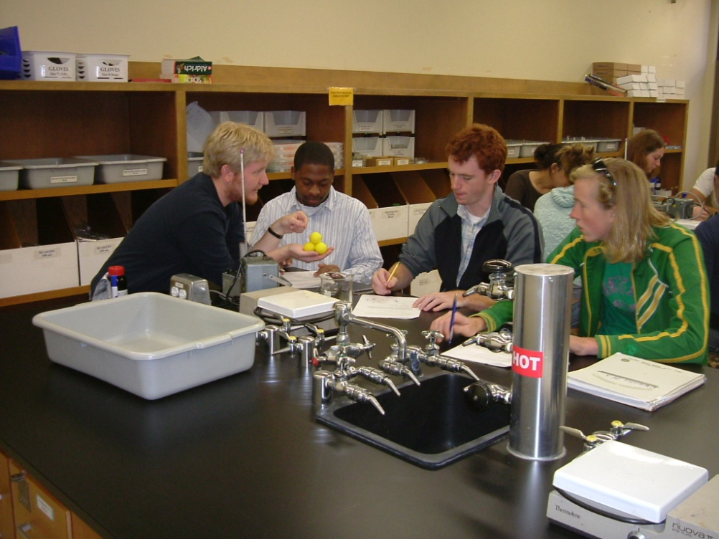
Developmental Stages of TAs and RAs (based on model by Nyquist and Wulff, 1996)
Concerns: Self/Survival
TA
How will my students like me?
Do I know more than they do?
What do I wear?
RA
How will I fit on this research team?
Will I be able to do the tasks asked of me?

Slide 5
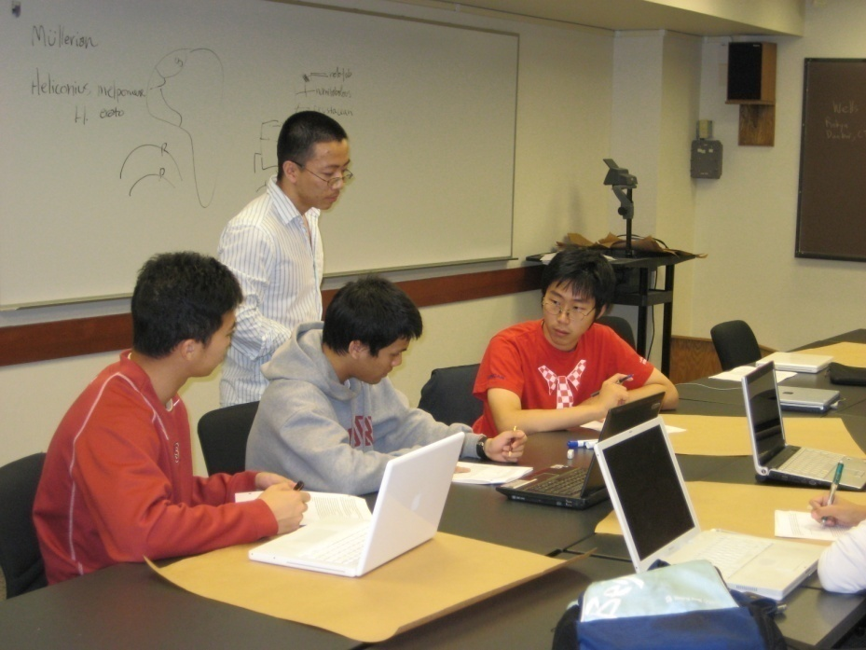
Developmental Stages of TAs and RAs (based on model by Nyquist and Wulff, 1996)
Concerns: Skills
TA
How do I run a problem session?
What do I do if they are unprepared?
RA
How should sampling be done to ensure a good result?
What is the best way to report these data?

Slide 6
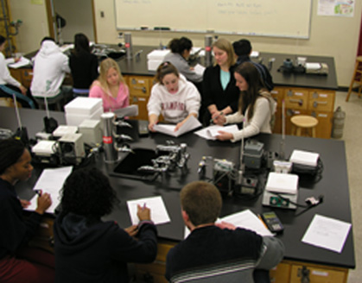
Developmental Stages of TAs and RAs (based on model by Nyquist and Wulff, 1996)
Concerns: Outcomes
TA
Are my students getting it?
Can they can apply this concept to a new or novel situation?
RA
What is the significance of this finding?

Slide 7
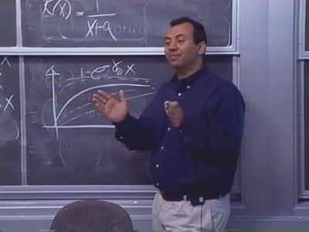
TAs in Action!

Slide 8
Caltech TA Scenarios
Select one of the 8 scenarios to discuss with a partner:
First, think about it yourself for a minute
Exchange thoughts with your partner
Draft one or two index cards
Write the challenge at the top
Generate some solutions or advice for that challenge

Slide 9
TA Take-Aways
“Stuff to Remember”
Do you have a list of at least 5 things?
“Action”
Which 2-3 will you build into your own teaching?
What resources do you need to pull this off?
Nyquist, J. D. and Wulff, D.H.,1996, Working Effectively with Graduate Assistants, Thousand Oaks, Sage Publ.

