Slide 1
Biology 227: Methods in Modern Microscopy
Andres Collazo, Director Biological Imaging Facility
Steven Wilbert, Graduate Student, TA
Week 7: Super-Resolution Microscopy

Slide 2
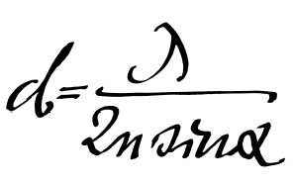
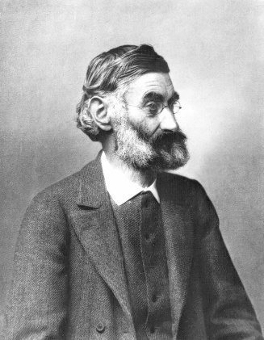
Spatial Resolution of Biological Imaging Techniques
Resolution is diffraction limited.
Abbe (1873) reported that smallest resolvable distance between two points (d) using a conventional microscope may never be smaller than half the wavelength of the imaging light (~200 nm)
Ernst Abbe (1840-1905)
Notes:
http://www.nature.com/milestones/milelight/full/milelight03.html

Slide 3
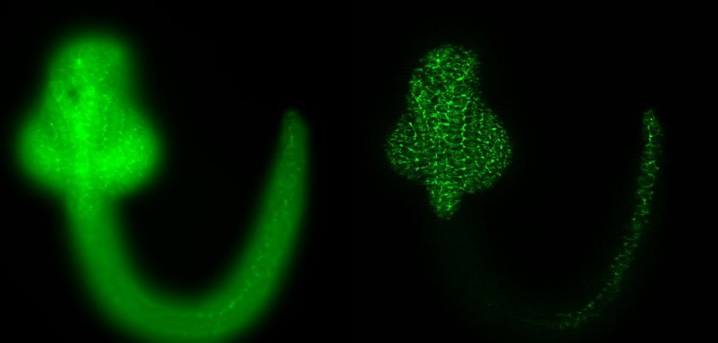
Confocal microscopy can improve optical resolution
Assignment 5 will compare resolution improvements over wide-field microscopy
First part will use LSM 410s/310 confocals with 63X 1.4 NA oil lens
Will collect Z-stacks with pinhole closed and wide open
Zebrafish wide-field, optical section
Notes:
http://www.nature.com/milestones/milelight/full/milelight03.html

Slide 4
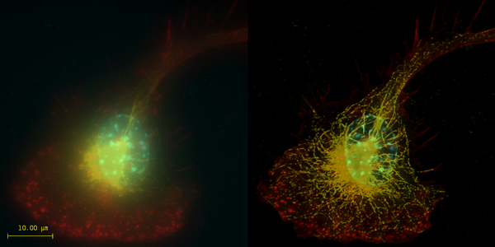
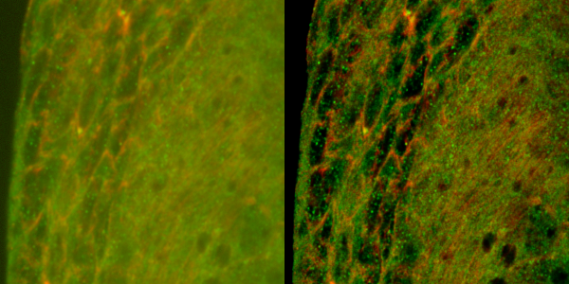
Deconvolution can also improve optical resolution
Assignment 5 will compare resolution improvements over wide-field microscopy
First part will use LSM 410s/310 confocals with 63X 1.4 NA oil lens
Will collect Z-stacks with pinhole closed and wide open
Top: Macrophage - tubulin, actin & nucleus.
Bottom: Imaginal disc – α-tubulin, γ-tubulin.
Notes:
Top right: Macrophage fluorescently stained for tubulin (yellow), actin (red) and the nucleus (DAPI, blue). Left: original image, recorded with a wide field microscope. Right: the same dataset, deconvolved using Huygens Professional. The datasets are visualized with top-view maximum intensity projections.
Data courtesy of Dr. James Evans, Whitehead Institute, MIT Boston MA, USA. (See the EvansMacrophage for more image details).
Bottom right: Detail of an imaginal disc from a third instar Drosophila Melanogaster larva. Left: a slice of the original data, imaged using an Andor Revolution spinning disc confocal microscope.Right: the same slice, deconvolved using Huygens Professional. The fixed sample was stained against alfa-tubulin (green) and gamma-tubulin (red).
Recorded by Dr. Paula Sampaio, Advanced Light Microscopy Facility, University of Porto.

Slide 5
Super-resolution microscopy
Assignment 5 will compare resolution improvements over wide-field microscopy
First part will use LSM 410s/310 confocals with 63X 1.4 NA oil lens
Will collect Z-stacks with pinhole closed and wide open
Second part will use LSM 880 Airyscan
Each group reserve time ASAP when Steve or I available
True super-resolution microscopy

Slide 6

Super-resolution microscopy
Many ways to achieve
Some more super than others.
Notes:
They fall into two broad categories, "true" super-resolution techniques, which capture information contained in evanescent waves, and "functional" super-resolution techniques, which use clever experimental techniques and known limitations on the matter being imaged to reconstruct a super-resolution image.^{[2]}
True subwavelength imaging techniques include those that utilize the Pendry Superlens and near field scanning optical microscopy, the 4Pi Microscope and structured illumination microscopy technologies like SIM and SMI. However, the majority of techniques of importance in biological imaging fall into the functional category.
There are two major groups of methods for functional super-resolution microscopy:
Deterministic super-resolution: The most commonly used emitters in biological microscopy, fluorophores, show a nonlinear response to excitation, and this nonlinear response can be exploited to enhance resolution. These methods include STED, GSD, RESOLFT and SSIM.
Stochastic super-resolution: The chemical complexity of many molecular light sources gives them a complex temporal behaviour, which can be used to make several close-by fluorophores emit light at separate times and thereby become resolvable in time. These methods include SOFI and all single-molecule localization methods (SMLM) such as SPDM, SPDMphymod, PALM, FPALM, STORM and dSTORM.

Slide 7
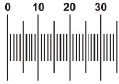
Super-resolution microscopy
Could always do super-resolution if could label points with different colors
Separate with different fluorescent filters (spectral unmixing)
Why fluorescence is such an important illumination technique
Hell, S.W., 2009. Microscopy and its focal switch. Nat Meth 6, 24-32.
Notes:
http://www.nature.com/nmeth/journal/v6/n1/full/nmeth.1291.html

Slide 8
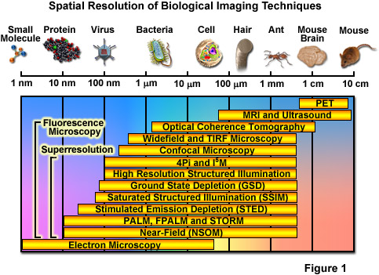
Spatial Resolution of Biological Imaging Techniques
Notes:
http://zeiss-campus.magnet.fsu.edu/articles/superresolution/introduction.html

Slide 9
Super-resolution microscopy
“True” super-resolution techniques
  Subwavelength imaging
  Capture information in evanescent waves
“Functional” super-resolution techniques
  Deterministic
    Exploit nonlinear responses of fluorophores
  Stochastic
    Exploit the complex temporal behaviors of fluorophores
Notes:
They fall into two broad categories, "true" super-resolution techniques, which capture information contained in evanescent waves, and "functional" super-resolution techniques, which use clever experimental techniques and known limitations on the matter being imaged to reconstruct a super-resolution image.^{[2]}
True subwavelength imaging techniques include those that utilize the Pendry Superlens and near field scanning optical microscopy, the 4Pi Microscope and structured illumination microscopy technologies like SIM and SMI. However, the majority of techniques of importance in biological imaging fall into the functional category.
There are two major groups of methods for functional super-resolution microscopy:
Deterministic super-resolution: The most commonly used emitters in biological microscopy, fluorophores, show a nonlinear response to excitation, and this nonlinear response can be exploited to enhance resolution. These methods include STED, GSD, RESOLFT and SSIM.
Stochastic super-resolution: The chemical complexity of many molecular light sources gives them a complex temporal behaviour, which can be used to make several close-by fluorophores emit light at separate times and thereby become resolvable in time. These methods include SOFI and all single-molecule localization methods (SMLM) such as SPDM, SPDMphymod, PALM, FPALM, STORM and dSTORM.

Slide 10
Spatial Resolution of Biological Imaging Techniques
“True” super-resolution
“Functional”
Notes:
http://zeiss-campus.magnet.fsu.edu/articles/superresolution/introduction.html

Slide 11
“Functional” super-resolution techniques
Deterministic
  Reversible Saturable (or Switchable) OpticaL Fluorescence Transitions (RESOLFT)
    STimulated Emission Depletion (STED)
    Ground State Depletion (GSD)
Stochastic
  STochastic Optical Reconstruction Microscopy (STORM)
  Photo Activated Localization Microscopy (PALM)
  Fluorescence Photo-Activation Localization Microscopy (FPALM)
Notes:
A trio of techniques independently surfaced during a four-month period in 2006 that elegantly demonstrated the sequential and stochastic readout with precise localization of multiple single molecules from specimens that were fluorescently labeled with photoswitchable dyes or optical highlighter fluorescent proteins at densities approaching those commonly employed in widefield and confocal fluorescence microscopy (ranging up to 100,000 molecules per square micrometer). These nearly identical single-molecule superresolution imaging techniques have been termed stochastic optical reconstruction microscopy (STORM; see Figure 1), photoactivated localization microscopy (PALM), and fluorescence photoactivation localization microscopy (FPALM). They rely on an activation laser applied at low power to trigger emission switching so that any particular molecule has a small probability of being photoactivated, but the majority of the population remains in the original (dark or native) emissive state. Although the major difference between the methods as they were originally published was simply the nature of the fluorescent probes used to achieve superresolution imaging, these techniques are virtually identical. In fact, the original STORM research report mentioned the use of fluorescent proteins, whereas the first PALM paper discussed the application of caged synthetic fluorophores.
http://www.microscopyu.com/articles/superresolution/stormintro.html
They fall into two broad categories, "true" super-resolution techniques, which capture information contained in evanescent waves, and "functional" super-resolution techniques, which use clever experimental techniques and known limitations on the matter being imaged to reconstruct a super-resolution image.^{[2]}
True subwavelength imaging techniques include those that utilize the Pendry Superlens and near field scanning optical microscopy, the 4Pi Microscope and structured illumination microscopy technologies like SIM and SMI. However, the majority of techniques of importance in biological imaging fall into the functional category.
There are two major groups of methods for functional super-resolution microscopy:
Deterministic super-resolution: The most commonly used emitters in biological microscopy, fluorophores, show a nonlinear response to excitation, and this nonlinear response can be exploited to enhance resolution. These methods include STED, GSD, RESOLFT and SSIM.
Stochastic super-resolution: The chemical complexity of many molecular light sources gives them a complex temporal behaviour, which can be used to make several close-by fluorophores emit light at separate times and thereby become resolvable in time. These methods include SOFI and all single-molecule localization methods (SMLM) such as SPDM, SPDMphymod, PALM, FPALM, STORM and dSTORM.

Slide 12
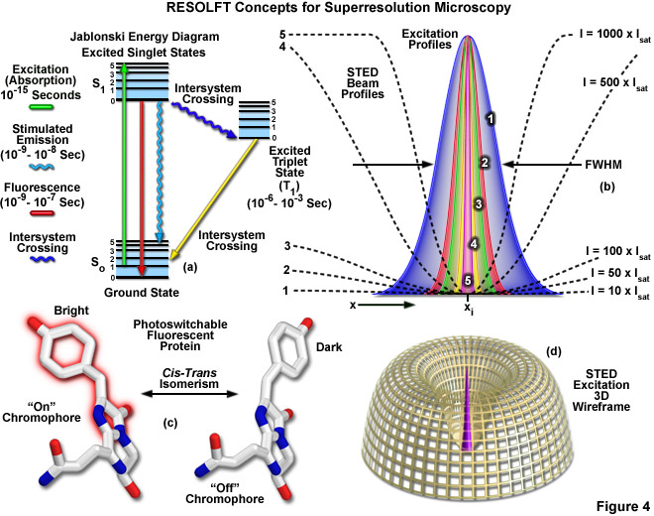
Reversible Saturable (or Switchable) Optical Fluorescence Transitions (RESOLFT)
Includes
STED
GSD
Notes:
Extremely high intensities are necessary for switching off the excited singlet state with STED (using what is termed a depletion laser), but switching to a metastable triplet or similar dark state (GSD) requires a light intensity between a thousand and a million times lower.
http://zeiss-campus.magnet.fsu.edu/articles/superresolution/introduction.html
http://www.microscopyu.com/articles/superresolution/stormintro.html

Slide 13
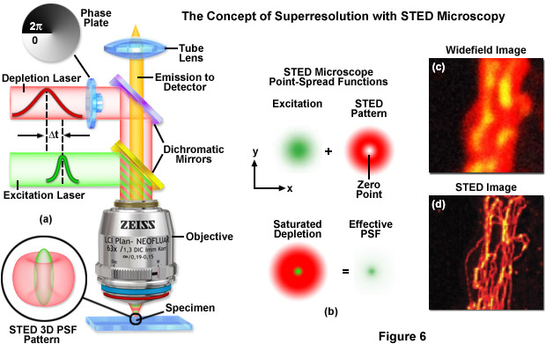
STED: STimulated Emission Depletion
http://zeiss-campus.magnet.fsu.edu

Slide 14

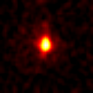
STED Microscopy means scanning a smaller focal spot across the sample
Point Spread Function: Confocal vs STED
measured with fluorescent nanoparticles under the same conditions
Typical lateral (X-Y)
resolution in a Confocal:
200x200 nm
Typical lateral (X-Y) FWHM
(Full Width Half Maximum)
in STED is 90x90 nm
STED z resolution is
confocal (500 nm)
STED enables separation
of structures even smaller
than its FWHM due to the
sharp peak. Actual
resolution is in the order
of 70 nm for raw data
(without deconvolution)
y
y
x
x

Slide 15
“Functional” super-resolution techniques
Deterministic
  Reversible Saturable (or Switchable) OpticaL Fluorescence Transitions (RESOLFT)
    STimulated Emission Depletion (STED)
    Ground State Depletion (GSD)
Stochastic
  STochastic Optical Reconstruction Microscopy (STORM)
  Photo Activated Localization Microscopy (PALM)
  Fluorescence Photo-Activation Localization Microscopy (FPALM)
Notes:
A trio of techniques independently surfaced during a four-month period in 2006 that elegantly demonstrated the sequential and stochastic readout with precise localization of multiple single molecules from specimens that were fluorescently labeled with photoswitchable dyes or optical highlighter fluorescent proteins at densities approaching those commonly employed in widefield and confocal fluorescence microscopy (ranging up to 100,000 molecules per square micrometer). These nearly identical single-molecule superresolution imaging techniques have been termed stochastic optical reconstruction microscopy (STORM; see Figure 1), photoactivated localization microscopy (PALM), and fluorescence photoactivation localization microscopy (FPALM). They rely on an activation laser applied at low power to trigger emission switching so that any particular molecule has a small probability of being photoactivated, but the majority of the population remains in the original (dark or native) emissive state. Although the major difference between the methods as they were originally published was simply the nature of the fluorescent probes used to achieve superresolution imaging, these techniques are virtually identical. In fact, the original STORM research report mentioned the use of fluorescent proteins, whereas the first PALM paper discussed the application of caged synthetic fluorophores.
http://www.microscopyu.com/articles/superresolution/stormintro.html
These three methods were published independently during a short period of time and their principle is identical. STORM was originally described using Cy5 and Cy3 dyes attached to nucleic acids or proteins,^{[47]} while PALM and FPALM was described using photoswitchable fluorescent proteins.^{[48][49]}
http://en.wikipedia.org/wiki/Super-resolution_microscopy#Stochastic_functional_techniques
They fall into two broad categories, "true" super-resolution techniques, which capture information contained in evanescent waves, and "functional" super-resolution techniques, which use clever experimental techniques and known limitations on the matter being imaged to reconstruct a super-resolution image.^{[2]}
True subwavelength imaging techniques include those that utilize the Pendry Superlens and near field scanning optical microscopy, the 4Pi Microscope and structured illumination microscopy technologies like SIM and SMI. However, the majority of techniques of importance in biological imaging fall into the functional category.
There are two major groups of methods for functional super-resolution microscopy:
Deterministic super-resolution: The most commonly used emitters in biological microscopy, fluorophores, show a nonlinear response to excitation, and this nonlinear response can be exploited to enhance resolution. These methods include STED, GSD, RESOLFT and SSIM.
Stochastic super-resolution: The chemical complexity of many molecular light sources gives them a complex temporal behaviour, which can be used to make several close-by fluorophores emit light at separate times and thereby become resolvable in time. These methods include SOFI and all single-molecule localization methods (SMLM) such as SPDM, SPDMphymod, PALM, FPALM, STORM and dSTORM.

Slide 16
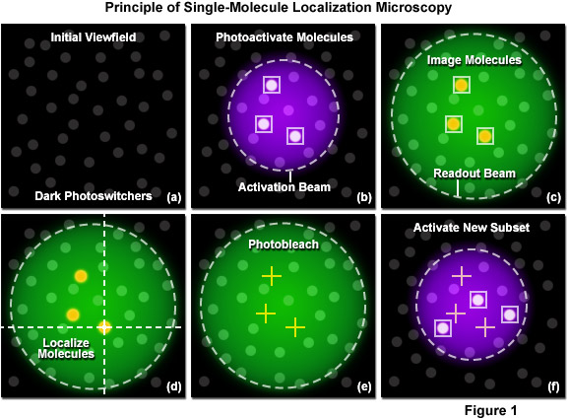
Single-molecule localization (SML) microscopy
Stochastic functional techniques
Notes:
http://zeiss-campus.magnet.fsu.edu/articles/superresolution/palm/practicalaspects.html
http://www.microscopyu.com/articles/superresolution/stormintro.html

Slide 17
Single-molecule localization microscopy
Stochastic functional techniques
STED vs STORM
How STORM works

Slide 18
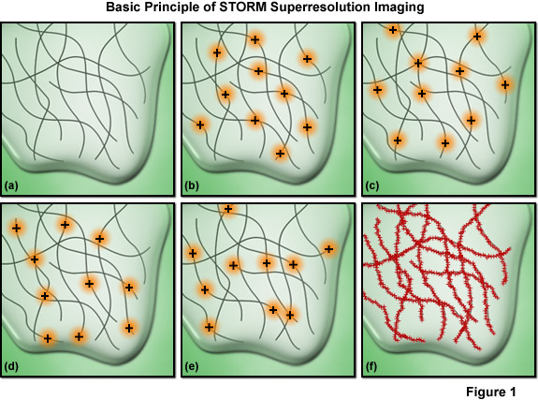
Single-molecule localization microscopy
Must have sufficient density of molecules being localized
Notes:
Among the critical aspects that must be considered are the accuracy of each individual localization measurement, the density of probes that have been localized in the final image (commonly termed molecular density), and the physical size of the labels themselves. The relationship between resolution and the localization precision of a single molecule is readily determined. The ability to resolve two fluorescent molecules as separate entities is limited by the localization precision, which determines the position (and uncertainty) of each molecule and thus the distance between the pair. The localization precision, in turn, is primarily dependent upon the number of photons collected from the fluorescent molecules during a single activation-deactivation cycle, provided the background noise is negligible.
Presented in Figure 7 is an important concept involving one of the most critical factors influencing spatial resolution in single-molecule superresolution imaging. The resolution versus molecular density is represented in Figure 7 as a series of yellow pixels in a test pattern. Features that might be present in a specimen are imaged at a progressively lower signal-to-noise ratio (fraction of pixels measured) as the molecular density decreases (from the bottom to the top of Figure 7) and these features become unresolvable when the mean molecular separation approaches feature size (the top row in Figure 7). Thus, as described in Equation (5), in order to achieve N-fold higher resolution in dimensions D, N^{D}-fold more pixels must be acquired. In order to realize such a resolution gain without compromising either the imaging speed or the signal-to-noise ratio, the signal collection rate (photons detected per second) must increase by a factor of at least N^{D}, which requires an N^{D}-fold higher exposure to the excitation laser for each image required.

Slide 19
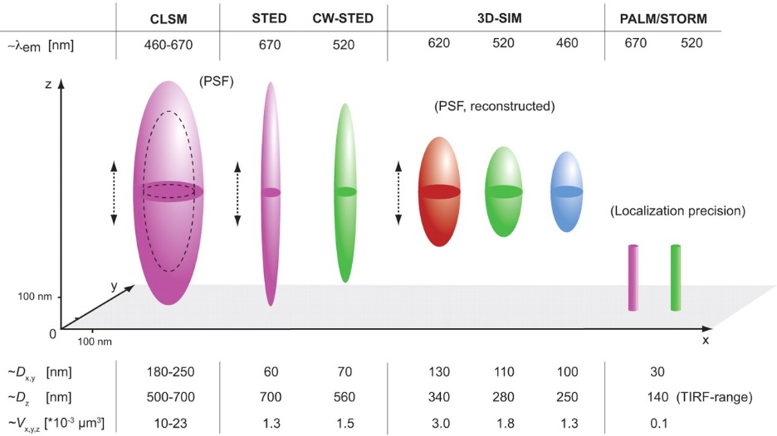
Each super-resolution techniques have pluses and minuses but all methods are improving
Schermelleh, L., Heintzmann, R., Leonhardt, H., 2010. A guide to super-resolution fluorescence microscopy. The Journal of Cell Biology 190, 165-175.
Notes:
http://jcb.rupress.org/content/190/2/165.full

Slide 20
Super-resolution requirements
High power lasers
Special fluorophores
Concentration of fluorophores
Special optics
Computational processing
Fast detectors
Sensitive detectors
Precise X,Y,Z positioning

Slide 21
Super-resolution microscopy
Functional super-resolution techniques won Nobel
SIM did not win
SIM not considered to be super-resolution
Notes:
They fall into two broad categories, "true" super-resolution techniques, which capture information contained in evanescent waves, and "functional" super-resolution techniques, which use clever experimental techniques and known limitations on the matter being imaged to reconstruct a super-resolution image.^{[2]}
True subwavelength imaging techniques include those that utilize the Pendry Superlens and near field scanning optical microscopy, the 4Pi Microscope and structured illumination microscopy technologies like SIM and SMI. However, the majority of techniques of importance in biological imaging fall into the functional category.
There are two major groups of methods for functional super-resolution microscopy:
Deterministic super-resolution: The most commonly used emitters in biological microscopy, fluorophores, show a nonlinear response to excitation, and this nonlinear response can be exploited to enhance resolution. These methods include STED, GSD, RESOLFT and SSIM.
Stochastic super-resolution: The chemical complexity of many molecular light sources gives them a complex temporal behaviour, which can be used to make several close-by fluorophores emit light at separate times and thereby become resolvable in time. These methods include SOFI and all single-molecule localization methods (SMLM) such as SPDM, SPDMphymod, PALM, FPALM, STORM and dSTORM.

Slide 22
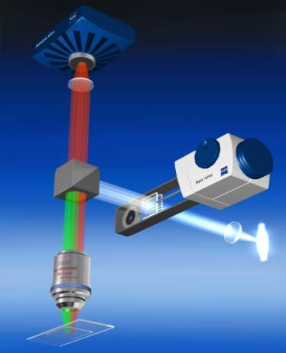
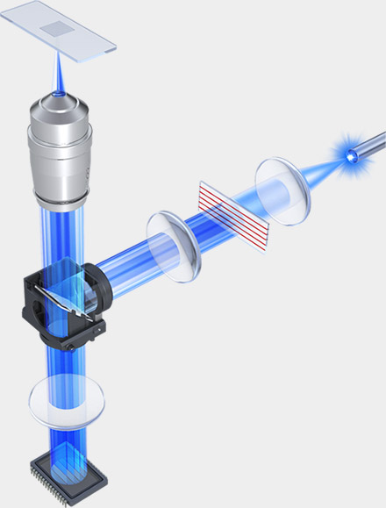
Structured Illumination Microscopy (SIM)
Option for wide-field microscope
Zeiss Apotome 2
Keyence BZ-X700
Notes:
Grab bag of methods that are not

Slide 23
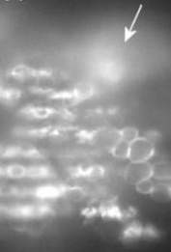
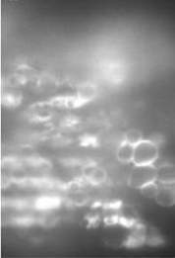
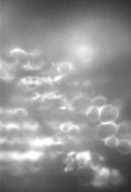
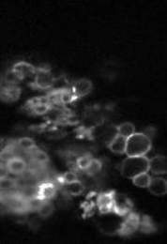
Structured Illumination
- The Contrast is the Key
No visible grid → out of focus light
Position 1
Position 2
Position 3
Optical section
Visible grid → structures in focus
Notes:
The algorithm is looking for a change in the local contrast. The algorithm is demodulating the images.
Simple image analysis algorithm detects the brightness differences of the 3 raw images and removes the out-of-focus signals in the image (demodulation)

Slide 24
How does super-resolution SIM differ from normal SIM?
It’s all due to the number of different gratings
Zeiss Apotome uses 1 grating
Keyence uses up to 2 gratings
For super-resolution Mats Gustafsson found that 3 different grating orientations were required (gratings finer also)
Notes:
Heintzmann, R., Cremer, C.G., 1999. Laterally modulated excitation microscopy: improvement of resolution by using a diffraction grating, pp. 185-196.
Gustafsson, M.G.L., 2000. Surpassing the lateral resolution limit by a factor of two using structured illumination microscopy. Journal of Microscopy 198, 82-87.
Fig. 1. Concept of resolution enhancement by structured illumination. (a) If two line patterns are superposed (multiplied), their product will
contain moireÂ fringes (seen here as the apparent vertical stripes in the overlap region). (b) A conventional microscope is limited by diffraction.
The set of low-resolution information that it can detect defines a circular `observable region' of reciprocal space. (c) A sinusoidally striped
illumination pattern has only three Fourier components. The possible positions of the two side components are limited by the same circle that
defines the observable region (dashed). If the sample is illuminated with such structured light, moireÂ fringes will appear which represent
information that has changed position in reciprocal space. The amounts of that movement correspond to the three Fourier components of the
illumination. The observable region will thus contain, in addition to the normal information, moved information that originates in two offset
regions (d). From a sequence of such images with different orientation and phase of the pattern, it is possible to recover information from an
area twice the size of the normally observable region, corresponding to twice the normal resolution (e).

Slide 25
Examples of SR-SIM images from Gustafsson
121 nm beads
Actin cytoskeleton
Notes:
Fig. 3. A cluster of fluorescent microspheres of nominal diameter
121 nm, as imaged by conventional (a), confocal (b), and
structured illumination (c) microscopy. The confocal microscope
was operated under maximum resolution conditions. The apparent
size (FWHM) of isolated beads is approximately 130 nm in the
structured illumination image, compared to 290 and 210 nm for
conventional and confocal microscopy.
Fig. 4. The actin cytoskeleton at the edge of a HeLa cell, as imaged by (a, c) conventional and (b, d) structured illumination microscopy. (c, d)
Enlargements of the boxed areas in (a) and (b), respectively. Fibres separated by less than the resolution limit of the conventional microscope
are well resolved using structured illumination (d). The apparent widths (FWHM) of the finest protruding fibres [small arrows in (a, b)] are
lowered to 110±120 nm in (b), compared to 280±300 nm in (a).

Slide 26
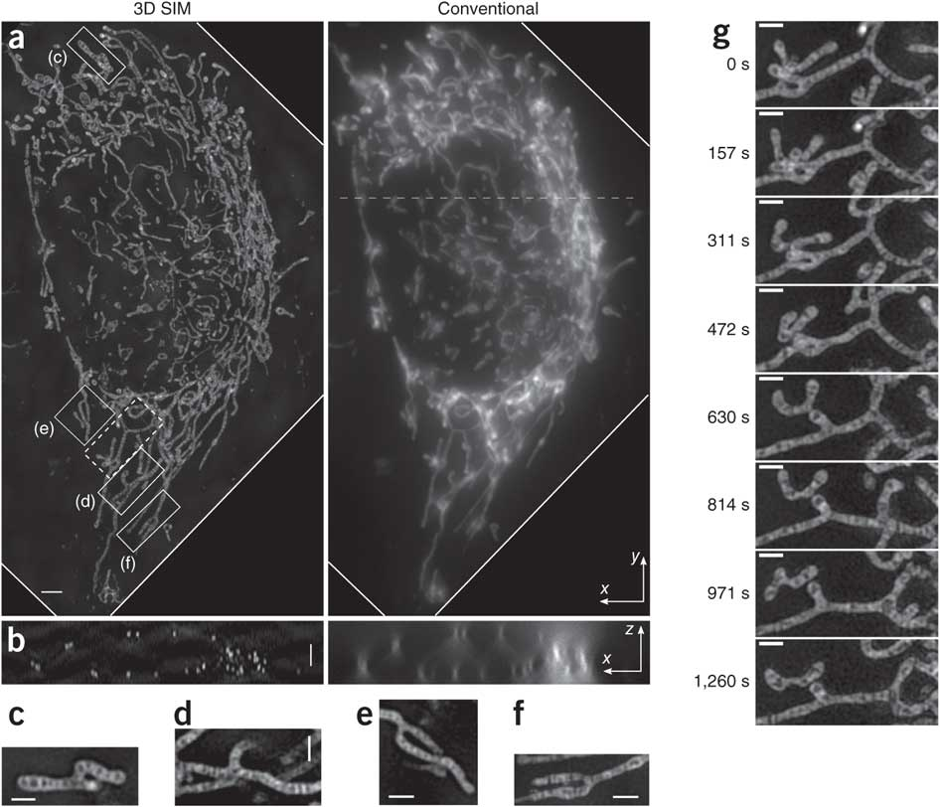
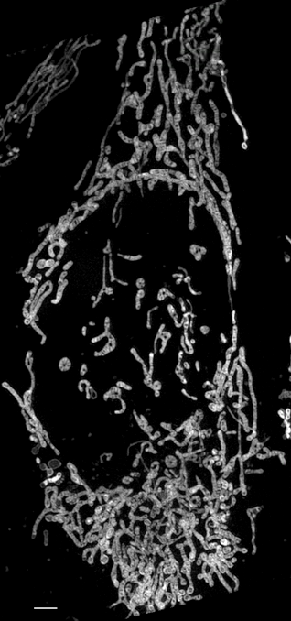
3D SR-SIM uses SLM from Gustafsson (2011)
MitoTracker Green acquired at 20 sec intervals
Notes:
Figure 2 | Live 3D SIM and conventional wide-field microscopy images of a HeLa cell stained with MitoTracker Green. (a) Maximum-intensity projection along z dimension through the cell volume at time 0 of a 50-time-point series. Each SIM volume was acquired in 20.33 s (that is, 35-ms exposure time × 38 axial planes × 15 patterns + 38 axial planes × 10-ms z-stage settle time). (b) One x–z cross-section of the same volume sliced through the dashed line shown in a. (c–f) Single-plane x–y slices corresponding to the boxed regions in a. (g) Eight time frames of the region boxed with dashed line in a. Each frame is a maximum-intensity projection along z over a 1.3 μm thickness that contains the featured ‘Y’-shaped mitochondrion. Scale bars, 2 μm (a,b) and 1 μm (c–g).
Shao, L., Kner, P., Rego, E.H., Gustafsson, M.G.L., 2011. Super-resolution 3D microscopy of live whole cells using structured illumination. Nat Meth 8, 1044-1046.

Slide 27
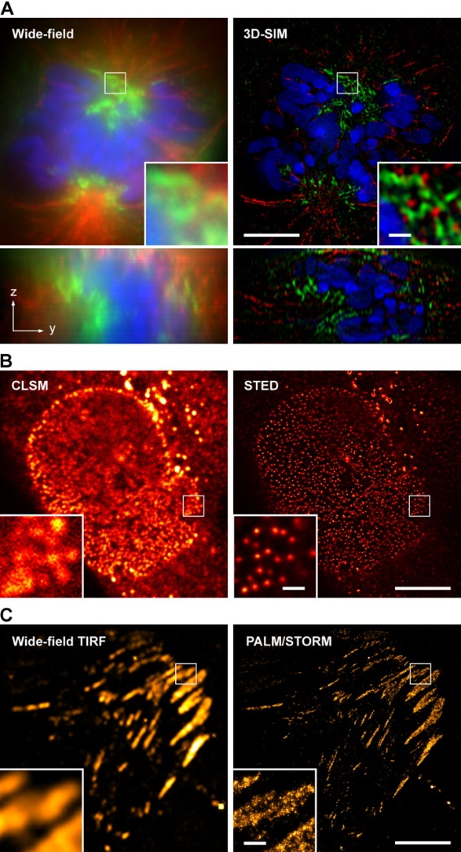
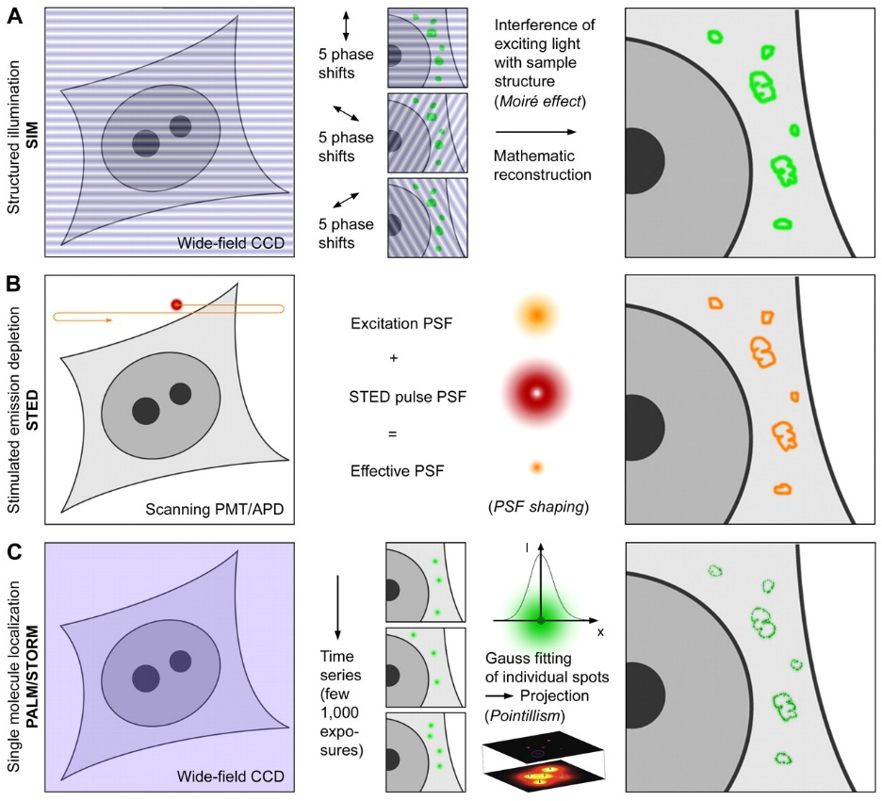
Schermelleh, L., Heintzmann, R., Leonhardt, H., 2010. A guide to super-resolution fluorescence microscopy. The Journal of Cell Biology 190, 165-175.
Notes:
http://jcb.rupress.org/content/190/2/165.full

Slide 28
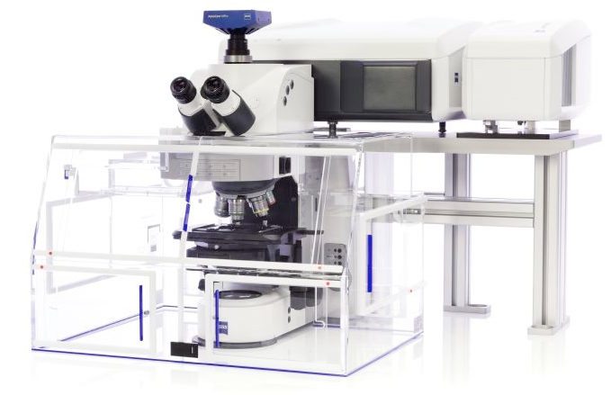
Zeiss Airyscan yet another means to achieve super-resolution
Available here at Caltech in the BIF

Slide 29

Conventional scanning confocal and the 1 A.u. limit.
PH = 1 A.u. is the standard setting for resolution.
PH = 1 A.u.
A point-like emitter generates a
diffraction limited pattern (~ PSF)
excitation
excitation and detection
are scanned in sync
detection
scan
At 1 A.u. The PSF is mapped directly 1:1
Intensity
~ 240 nm
scan
Notes:
The practical limit for the pinhole-size in confocal microscopy is 1.A.u. the resolution achieved at that setting is comparable to the classical limits postulated by Abbé or Rayleigh. The spatial image of a point-like emitter recorded with a confocal microscope with a 1 A.u. pinhole will correspond to the classically defined PSF.

Slide 30
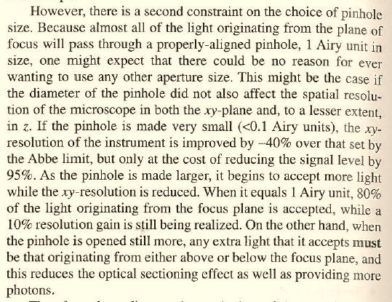
Scanning confocal and the 1 Airy unit pinhole “limit”.
At PH < 1 AU signal loss is larger than gain in resolution.
The potential to increase resolution by closing the pinhole (PH) is not a new idea (red)
One finds this idea described in many places, including Pawley’s Handbook of Confocal Microscopy
The price to pay, however, is
sacrificing 95% of the signal
(green).
The famous 1 AU setting
is more of a practical barrier
than a theoretical limit.
Fortunately, now there is
a clever workaround with
Airyscan...
Notes:
One main aspect of Airyscan is its capability to achieve superresolution (in the sense of Abbé or Rayleigh). The idea, indeed, is not new – It is widely known that confocal microscopes carry the capability to convolve excitation with detection and result in a factor-sqrt(2) ammeliorated resolution. However, in order to tap into this regime, the pinhole must be much smaller than the PSF itself. The loss of signal in this case poses, in the mojority of cases, an unsurmountable difficulty. As noted previously, Airyscan acts as if scanning with 0.2 A.u. pinholes, however, because the light is collected from the whole array, each pixel is in effect scanned at least 32 times. Since all photons are collected the loss of signal is virtually avoided.

Slide 31
Airyscan: PH ~ 0.2 A.u. scanning without loss.
A single element improves resolution
PH = 0.2 a.u.
A point-like emitter generates a
diffraction limited pattern (~ PSF)
excitation
By collecting just the central element
the PSF is weaker but smaller
detection
scan
Intensity
~170nm
scan
Notes:
Airyscan acts as if scanning with 0.2 A.u. pinholes, however, because the light is collected from the whole array, each pixel is - in effect - scanned at least 32 times. Since all photons are collected the loss of signal is virtually avoided. The PSF can be re-mapped as shown, generating a smaller PSF by a factor sqrt(2). This is true in every direction (including z – not shown, here). At this level of oversampling, one is generating ideal conditions for deconvolution. A deconvolution step applied to these images generates a further increase, of about 1.2-fold, in resolution. This additional push in resolution, however, depends on image quality and cannot be expected to work perfectly all the times.

Slide 32
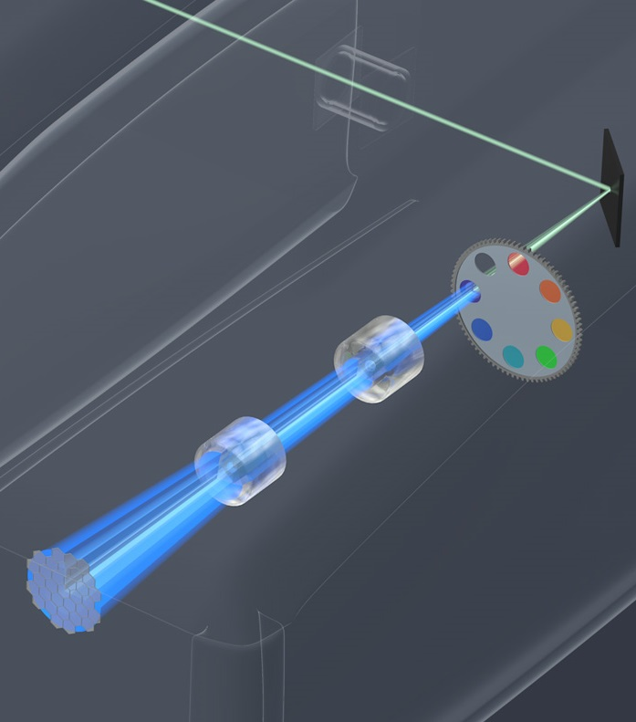
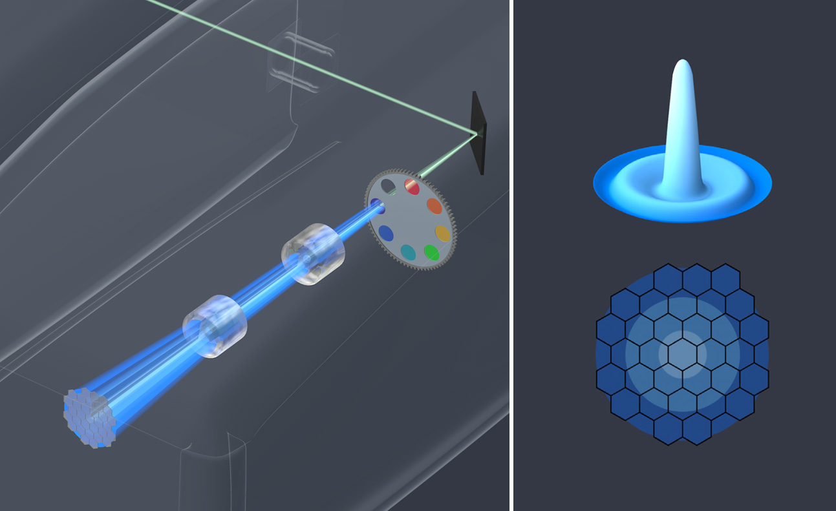
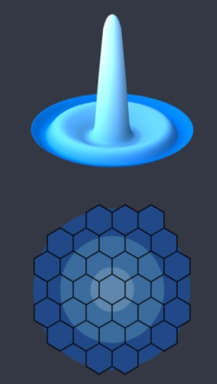
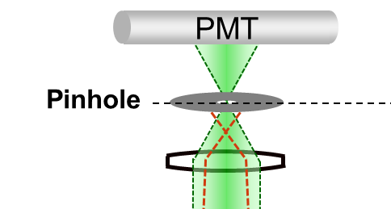

Airyscan Detection
Unique 32 GaAsP-PMT design
Replaced with New Design
LSM 880 output port
filter wheel
Y
adaptive zoom optics
32 GaAsP-PMT array
X
Notes:
Airyscan is a 32-channel GaAsP detector array arranged in a hexagonal grid. The full intensity distribution passing the pinhole reaches this detector. Each GaAsP subunit can be seen as a detector with a smaller pinhole. In effect every pixel on the image is generated from 32 subunits – either using the space information to generate superresolution or collecting all photons as an ordinary detector...

Slide 33
Airyscan: PH ~ 0.2 A.u. scanning without loss.
A single element improves resolution
PH = 1,25 a.u.
A point-like emitter generates a
diffraction limited pattern (~ PSF)
excitation
By collecting just the central element
the PSF is weaker but smaller
detection
subunit
~ 0.2 A.u.
scan
Intensity
~170nm
scan
Notes:
Airyscan acts as if scanning with 0.2 A.u. pinholes, however, because the light is collected from the whole array, each pixel is - in effect - scanned at least 32 times. Since all photons are collected the loss of signal is virtually avoided. The PSF can be re-mapped as shown, generating a smaller PSF by a factor sqrt(2). This is true in every direction (including z – not shown, here). At this level of oversampling, one is generating ideal conditions for deconvolution. A deconvolution step applied to these images generates a further increase, of about 1.2-fold, in resolution. This additional push in resolution, however, depends on image quality and cannot be expected to work perfectly all the times.

Slide 34
Airyscan: PH ~ 0.2 A.u. scanning without loss.
A single element – even if offset still improves resolution
PH = 1,25 a.u.
A point-like emitter generates a
diffraction limited pattern (~ PSF)
excitation
By using an element offset from the
center, resolution is still improved
detection
subunit
~ 0.2 A.u.
scan
Intensity
scan
Notes:
Airyscan acts as if scanning with 0.2 A.u. pinholes, however, because the light is collected from the whole array, each pixel is - in effect - scanned at least 32 times. Since all photons are collected the loss of signal is virtually avoided. The PSF can be re-mapped as shown, generating a smaller PSF by a factor sqrt(2). This is true in every direction (including z – not shown, here). At this level of oversampling, one is generating ideal conditions for deconvolution. A deconvolution step applied to these images generates a further increase, of about 1.2-fold, in resolution. This additional push in resolution, however, depends on image quality and cannot be expected to work perfectly all the times.

Slide 35
Airyscan: PH ~ 0.2 A.u. scanning without loss.
Combining the data
PH = 1,25 a.u.
Image formation:
1 = Offset signal
2 = Add signal
excitation
detection
subunit
~ 0.2 A.u.
scan
Intensity
scan
Notes:
Airyscan acts as if scanning with 0.2 A.u. pinholes, however, because the light is collected from the whole array, each pixel is - in effect - scanned at least 32 times. Since all photons are collected the loss of signal is virtually avoided. The PSF can be re-mapped as shown, generating a smaller PSF by a factor sqrt(2). This is true in every direction (including z – not shown, here). At this level of oversampling, one is generating ideal conditions for deconvolution. A deconvolution step applied to these images generates a further increase, of about 1.2-fold, in resolution. This additional push in resolution, however, depends on image quality and cannot be expected to work perfectly all the times.

Slide 36
Airyscan: PH ~ 0.2 A.u. scanning without loss.
With 32 detectors all photons are recorded and mapped at the same time
PH = 1,25 a.u.
excitation
All elements are acquired simultaneously, and can be remapped for better resolution and sensitivity
The PSF is mapped directly 1:√2
detection
subunit
~ 0.2 A.u.
Intensity
Get an extra push beyond the limit using deconvolution (down to 1:1,7)
~ 140 nm
scan
Notes:
Airyscan acts as if scanning with 0.2 A.u. pinholes, however, because the light is collected from the whole array, each pixel is - in effect - scanned at least 32 times. Since all photons are collected the loss of signal is virtually avoided. The PSF can be re-mapped as shown, generating a smaller PSF by a factor sqrt(2). This is true in every direction (including z – not shown, here). At this level of oversampling, one is generating ideal conditions for deconvolution. A deconvolution step applied to these images generates a further increase, of about 1.2-fold, in resolution. This additional push in resolution, however, depends on image quality and cannot be expected to work perfectly all the times.

