Slide 1
Biology 227: Methods in Modern Microscopy
Andres Collazo, Director Biological Imaging Facility
Yonil Jung, Graduate Student, TA
Week 10 Multispectral Imaging

Slide 2
Multispectral Imaging
Spectral or Lambda Scanning
Instead of Z – stacks, collect λ – stacks

Slide 3
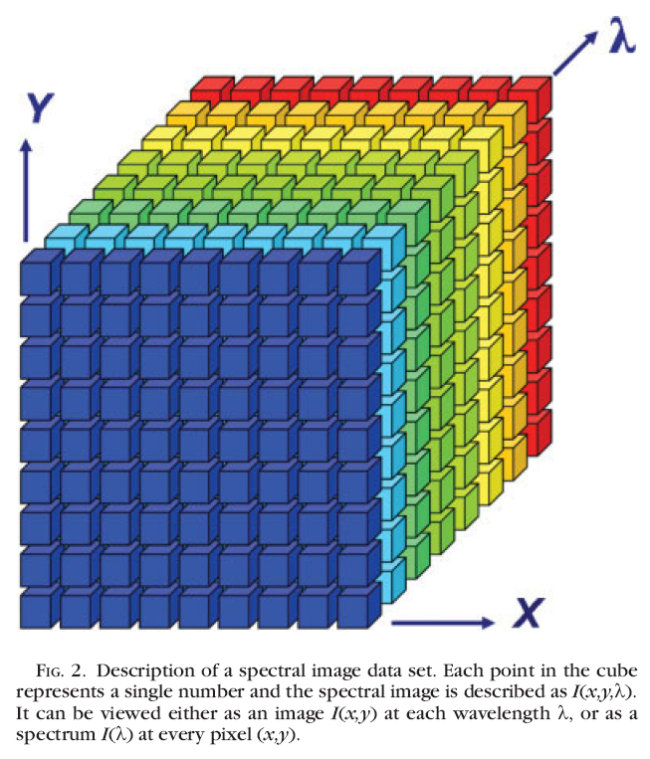
Spectral image dataset
λ-stack
λ can be:
(i) λ_{excitation}
images acquired in a single channel at different λ_{excitation}
(ii) λ_{emission}
images acquired at a single λ_{excitation} in several channels at different (λ_{emission})
Garini et al, Cytometry Part A, 2006

Slide 4
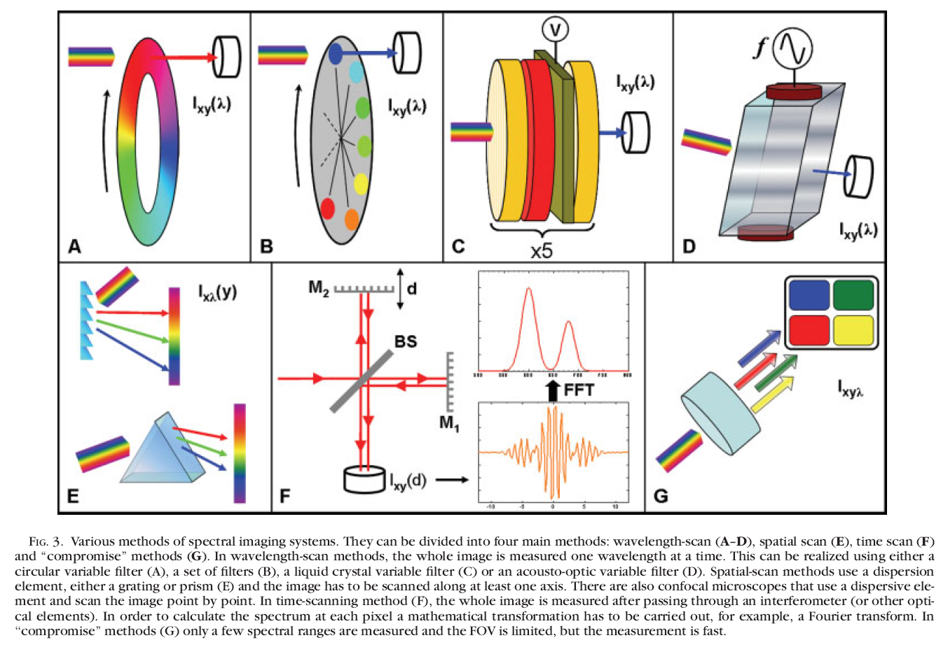
Spectral image dataset
Garini et al, Cytometry Part A, 2006
Notes:
Wave-length scans (A-D); Spatial Scan (E) is what will concentrate on.

Slide 5
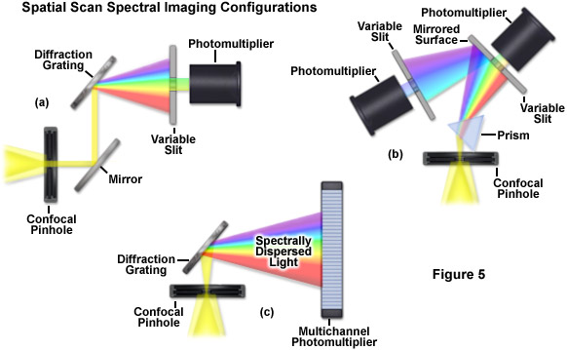



Spectral imaging methods: Spatial-scan
3 Different ways used by microscope companies
Notes:
http://zeiss-campus.magnet.fsu.edu/articles/spectralimaging/introduction.html

Slide 6
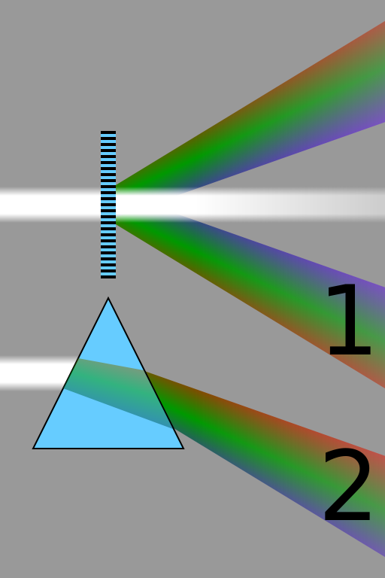
Dispersion through refraction versus diffraction
Diffraction grating
Refraction through prism
Note how longer wavelengths (red) diffract at greater angle than shorter wavelengths (blue) but they refract at smaller angle than shorter wavelengths.
Notes:
Comparison of the spectra obtained from a diffraction grating by diffraction (1), and a prism by refraction (2). Longer wavelengths (red) are diffracted more, but refracted less than shorter wavelengths (violet).
"Comparison refraction diffraction spectra" by Cmglee - Own work. Licensed under CC BY-SA 3.0 via Wikimedia Commons - http://commons.wikimedia.org/wiki/File:Comparison_refraction_diffraction_spectra.svg#mediaviewer/File:Comparison_refraction_diffraction_spectra.svg

Slide 7

Monochromator: Optical instrument for generating single colors
Used in optical measuring instruments
How a monochromator works according to the principle of dispersion
Most actually disperse through diffraction, not prism
Monochromator (Prism Type)
Entrance Slit
Exit Slit
Notes:
A monochromator is an optical device that transmits a mechanically selectable narrow band of wavelengths of light or other radiation chosen from a wider range of wavelengths available at the input.

Slide 8
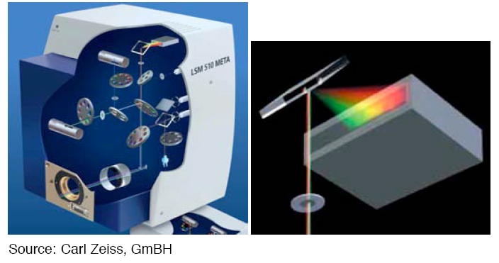
Spectral imaging with a grating

Slide 9
History of the Zeiss META detector
Where did the idea of a multichannel detector come from?

Slide 10


History of the Zeiss META detector
Where did the idea of a multichannel detector come from?
Collaboration between the Jet Propulsion Laboratory, Scott Fraser’s lab here at Caltech and Zeiss

Slide 11
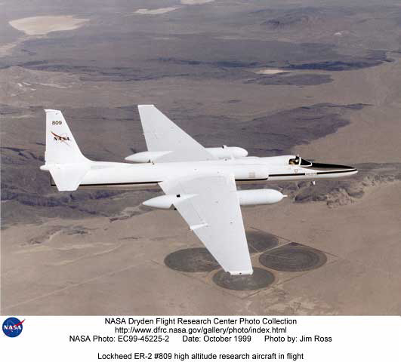
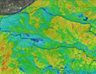

Airborne Visible/Infrared Imaging Spectrometer (AVIRIS)
Instrument for earth imaging and ecological research.
Instrument has 224 detectors.
Covers a range from 380 nm to 2500 nm.
Notes:
http://www.dfrc.nasa.gov/Gallery/Photo/SR-71/HTML/EC94-42883-2.html

Slide 12
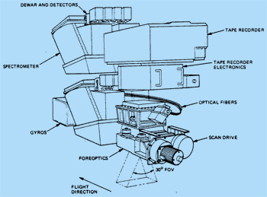
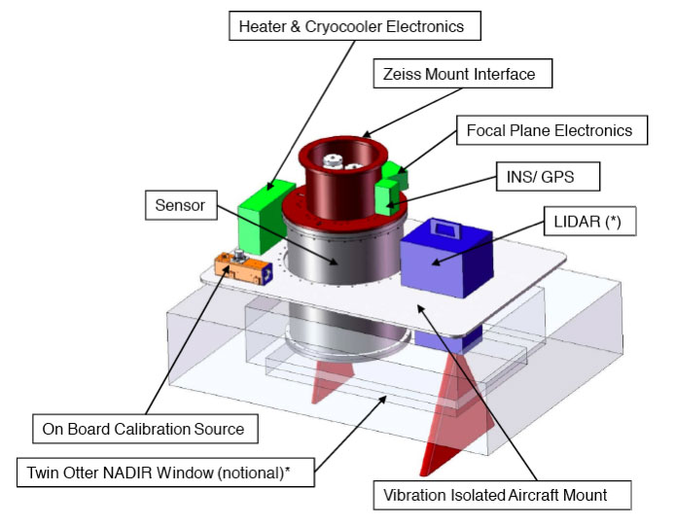
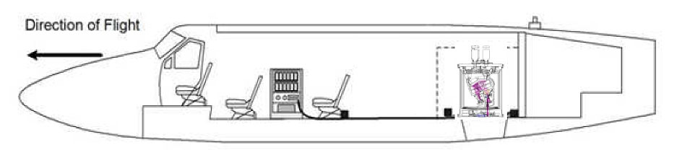
Airborne Visible/Infrared Imaging Spectrometer (AVIRIS)
Original
Next Generation (AVIRISng)
Notes:
Note size of the detector. Too big for confocal.
http://airbornescience.jpl.nasa.gov/instruments/avirisng
http://aviris.jpl.nasa.gov/aviris/concept.html

Slide 13
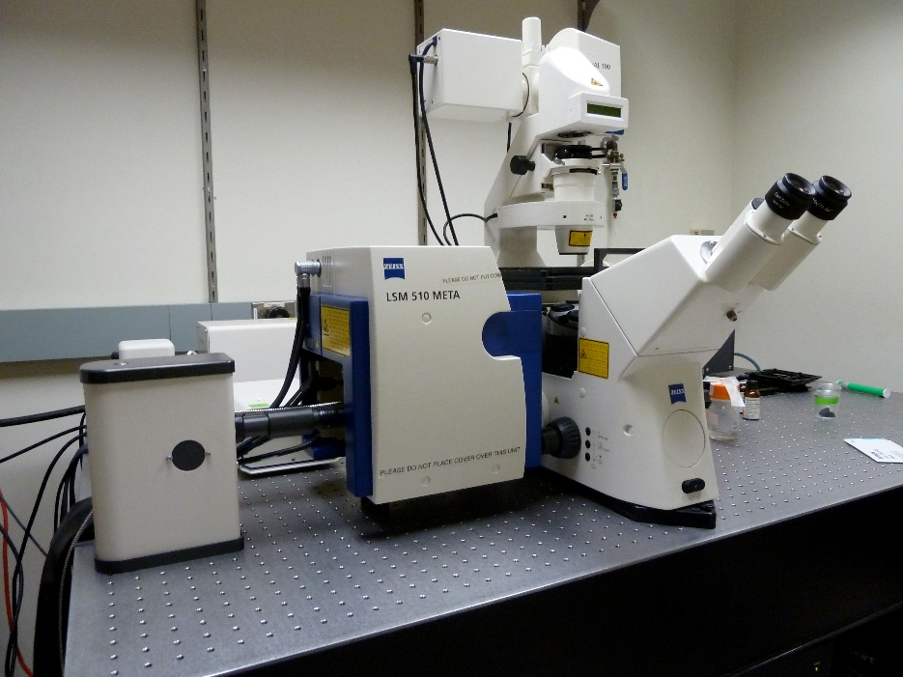
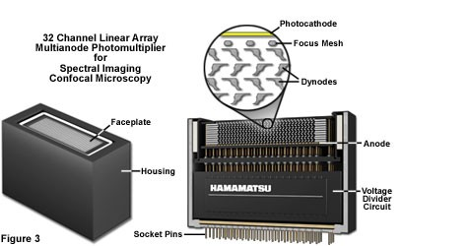
History of the Zeiss META detector
Zeiss META had 8* channel detector
Replaced by 32 channel Quasar detector
Notes:
First Meta
http://bair.beatson.gla.ac.uk/pages1/confocals/SpectralUnmixing.htm
http://www.zeiss.com/microscopy/en_us/campus/spectral-imaging/practical-aspects-of-spectral-imaging.html#configuration

Slide 14

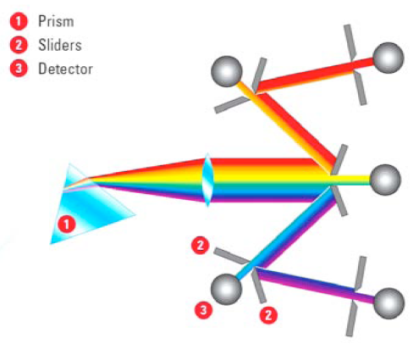
Spectral imaging with a prism and mirrors

Slide 15
Spectral image dataset
λ-stack
λ can be:
(i) λ_{excitation}
images acquired in a single channel at different λ_{excitation}
(ii) λ_{emission}
images acquired at a single λ_{excitation} in several channels at different (λ_{emission})
Garini et al, Cytometry Part A, 2006
Notes:
Leica feature

Slide 16
Leica lambda squared map
White light laser that emits from 470 to 670 nanometers

Slide 17
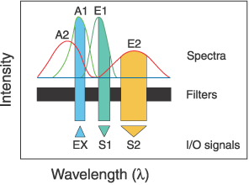
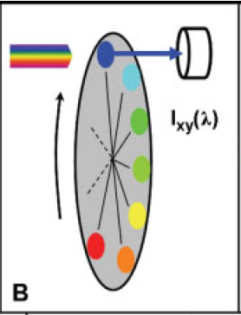
Choose spectrally well-separated dyes
Source: Zimmermann, T., 2005. Spectral Imaging and Linear Unmixing in Light Microscopy, in: Rietdorf, J. (Ed.), Microscopy Techniques. Springer Berlin Heidelberg, pp. 245-265.
if not possible: use spectral unmixing!
Notes:
Wave-length scans (A-D);

Slide 18
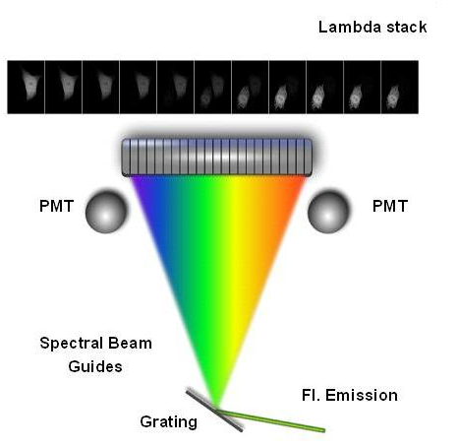

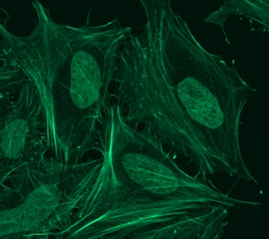
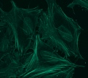
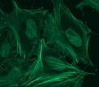
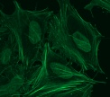
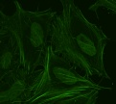
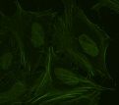
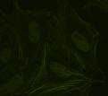
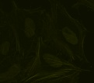
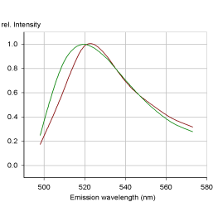
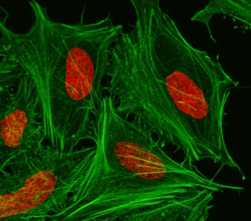
Spectral unmixing: general concept
Multi-channel Detector
Collect Lambda Stack
Raw Image
FITC
Sytox-green
Derive Emission Fingerprints
Unmixed Image
Notes:
Important! For this experiment need 3 samples! One with each color alone then one with both. Crucial for distinguishing overlap.
http://bair.beatson.gla.ac.uk/pages1/confocals/SpectralUnmixing.htm

Slide 19
Spectral unmixing
8 channel detector (can you guess the instrument used?)
Using Emission spectra
Example of parallel acquisition
Reference spectra important
Notes:
Fig. 2 Spectral imaging of fluorescence signals.Contributions of CFP, GFP and YFP to eight
successive spectral channels are shown. The distribution of emission signal to the channels
is a direct representation of the fluorophore emission spectrum and constitutes a spectral
signature.With linear unmixing using these spectral signatures as reference, even combined
and mixed signals can be clearly separated into the fluorophores that contribute to the total
signal

Slide 20
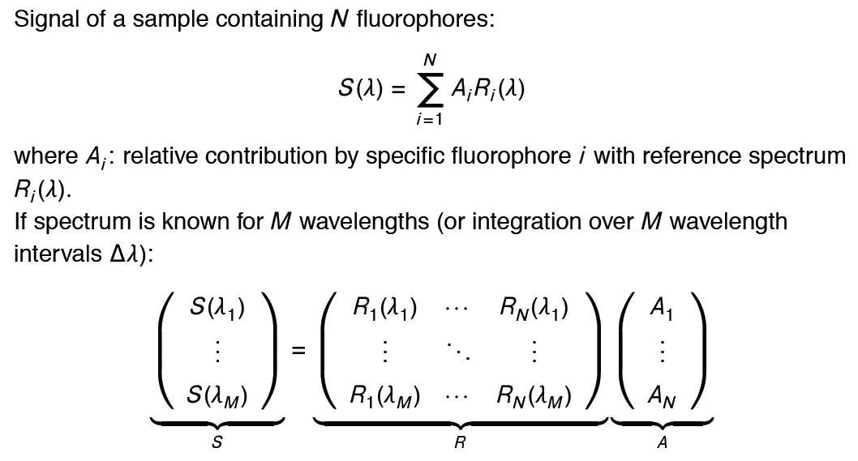
Linear spectral unmixing: principle
To solve and obtain Ai for each pixel
From Michael Liebling, UCSB
Notes:
Signal = relative contribution X reference spectra

Slide 21
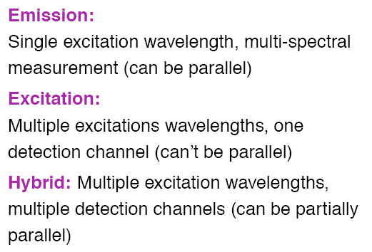
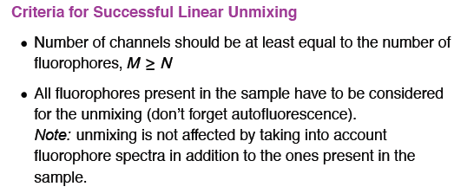
Linear spectral unmixing: principle
2 possibilities:
From Michael Liebling, UCSB

Slide 22
Linear Unmixing, Class example
8 Colors
Green: 503-511 511-524
Orange: 541-555, 545-565
Red: 578-605 589-613
Far Red: 657-676 671-692

Slide 23
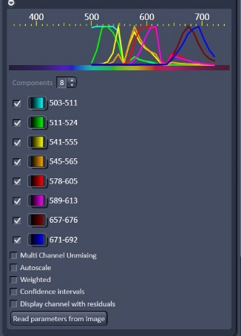
Linear Unmixing, Class example
8 Colors, Reference Spectra
Collect reference spectra for each color
Ideally 9 samples
  8 for each color alone
  1 with all 8 together
Sample slide had 8 colors across 4 wells
Linear unmixing with Zeiss Zen software
Note notches in sprecta

Slide 24
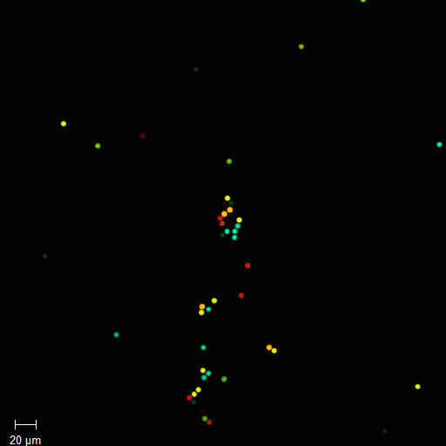
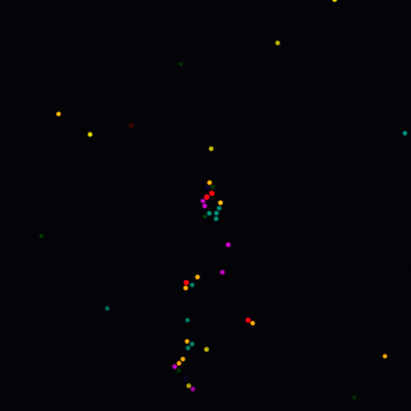
Linear Unmixing, 9 nm step size
8 Colors

Slide 25
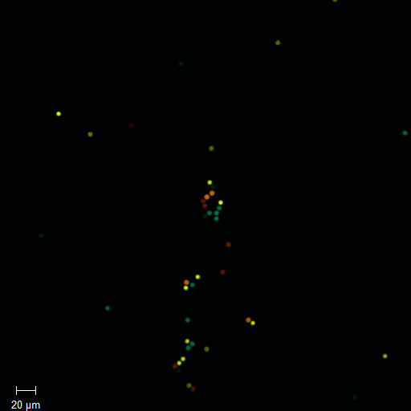
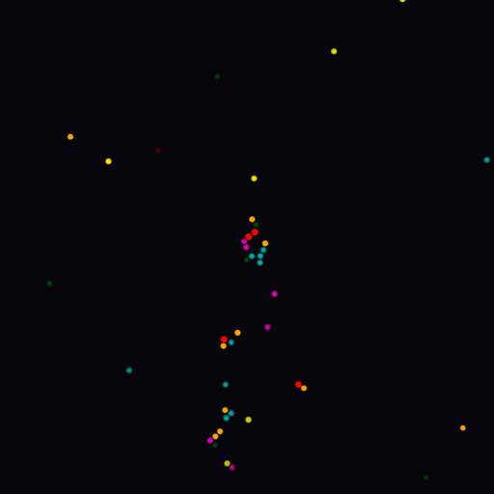
Linear Unmixing, 3 nm step size
8 Colors

Slide 26
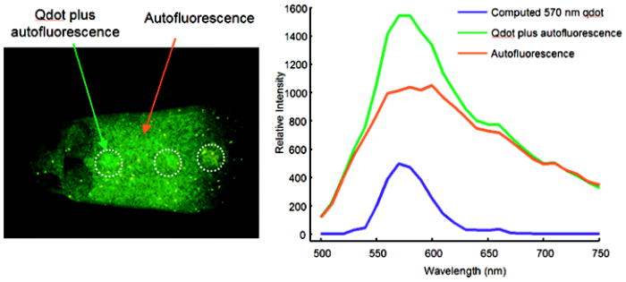
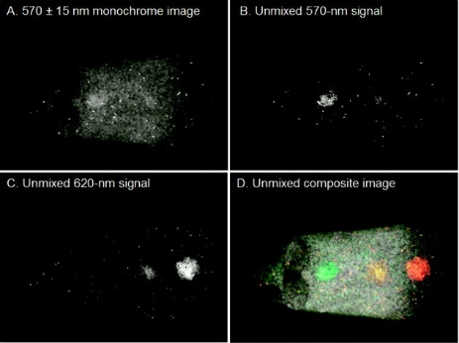
Spectral unmixing of autofluorescence
Red and green arrows indicate regions from which sample spectra were obtained.
Blue = computed spectrum
(a) Image obtained at the peak of one of the quantum dots.
(b) Unmixed image of the 570-nm quantum dot.
(c) Unmixed image of the 620-nm quantum dot.
(d) Combined pseudocolor image of (b) (green), (c), and autofluorescence channel (in white).
Mansfield et al, Journal of Biomedical Optics (2005)

Slide 27
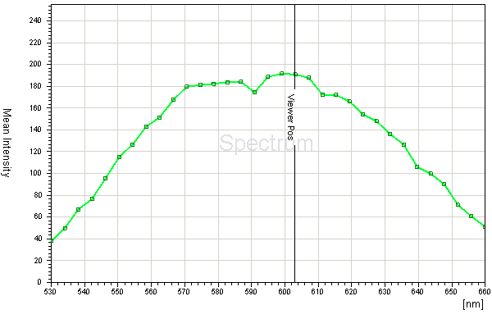
Determine the two photon spectra of uncharacterized dye
In vivo Hair Cell Dye, FM1-43 Spectra

Slide 28
Spectral or Lambda Scanning
Separate very similar colored fluorophores
  e.g. FITC and Sytox green.
Could be used to eliminate non-specific background fluorescence that has different emission spectra.
Different technologies for spectrum detection
  Sequentially (Leica SP)
  Simultaneously (Zeiss QUASAR)

Slide 29
Course Business
The Teaching Quality Feedback Report (TQFR) survey period for WI 2015-16 will open next Monday, March 14, 2015. Students will have several weeks to submit their reviews; however, you will be able to view student responses beginning on Monday, March 21 via the TQFR Reports link in access.caltech (https://access.caltech.edu).
Feedback

Slide 30
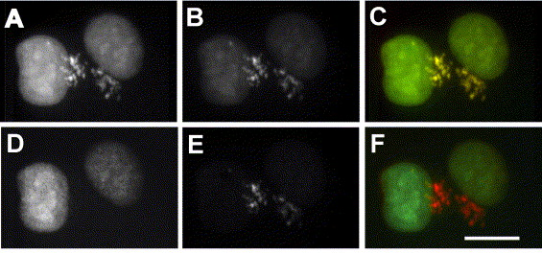
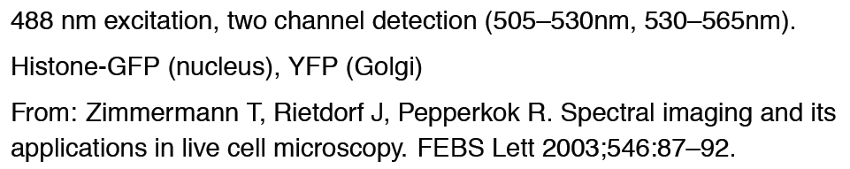
Spectral unmixing: GFP/YFP

Slide 31


