Slide 1
Biology 227: Methods in Modern Microscopy
Andres Collazo, Director Biological Imaging Facility
Yonil Jung, Graduate Student, TA
Week 8 Fluorescent Correlation Spectroscopy (FCS)

Slide 2
Fluorescence correlation spectroscopy (FCS)
In 1972 Watt Webb’s laboratory at Cornell put fluorescence microscopy to new use
Studied reaction kinetics
Ethidium bromide binding to DNA
  Individually don’t fluoresce but together glow under UV
Could detect single molecules but could not repeatedly detect the same molecule
Notes:
http://www.nature.com/milestones/milelight/full/milelight10.html
1990 invented two photon confocal microscopy

Slide 3
Fluorescence Fluctuation Spectroscopy (FFS)
Fluorescence Correlation Spectroscopy (FCS)
Photon Counting Histogram (PCH)
Fluorescence Cross-Correlation Spectroscopy (FCCS)
  FCS with more than 1 color

Slide 4
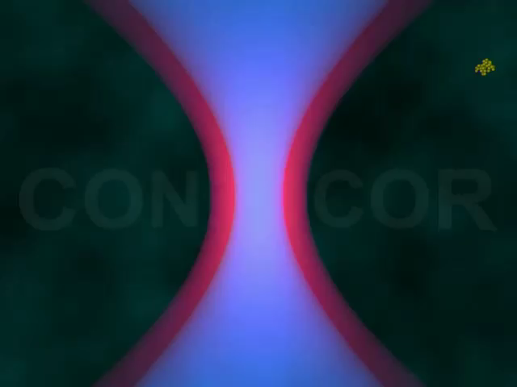
Fluorescence Fluctuation Spectroscopy (FFS)
Causes of fluctuations
Diffusion of labeled molecules due to Brownian motion
  In cells wide range of things cause movement (cellular trafficking, protein interaction etc.)
Photophysical processes of labeled molecules

Slide 5
Fluctuations Carry the Information
Measured intensity fluctuations reflects (mobile fraction only)
  Number of particles
    concentration
  Diffusion of particles
    interaction
  Brightness
    Oligomerization
A particle that transits the confocal volume will generate groups of pulses.
  The correlation function calculates the mean duration time t of these groups.
  The variance/histogram of the signal yields information about oligomeric state
δI(t)
<I(t)>
δI(t)
FCS
PCH
Notes:
The principle of FCS is being able to observe one or a few fluorescent particles enter and leave a small illuminated volume. If the sample, solution or cell, has a high concentration of tagged molecules it becomes hard to observe the needed fluctuations. I generally give the analogy of a crowded lecture hall. If the lecture hall is crowded and you were observing the lecture hall you would be less apt to notice if some one entered or left the room (i.e. a small fluctuation from the mean number of people in the hall). If only a few people were in the hall, then if someone left it would be very easy to notice (i.e. a large fluctuation from the mean number of people in the hall). This is why a large immobile population is not good for FCS. Fluctuations about the mean intensity is the information used for all FFS techniques.

Slide 6
Fluorescence Fluctuation Spectroscopy (FFS)
Bacia et al., Nature Methods 2006
Notes:
Bacia, K., Kim, S.A., Schwille, P., 2006. Fluorescence cross-correlation spectroscopy in living cells. Nat Methods 3, 83-89.

Slide 7
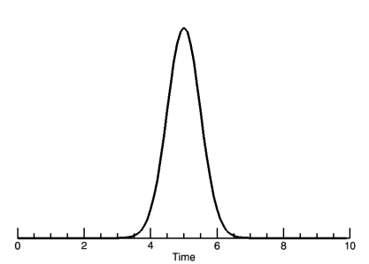
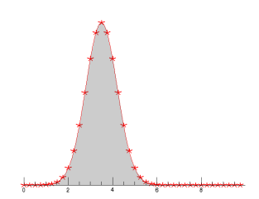
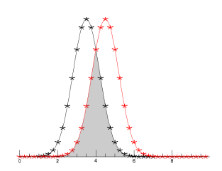
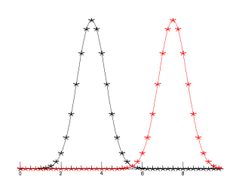
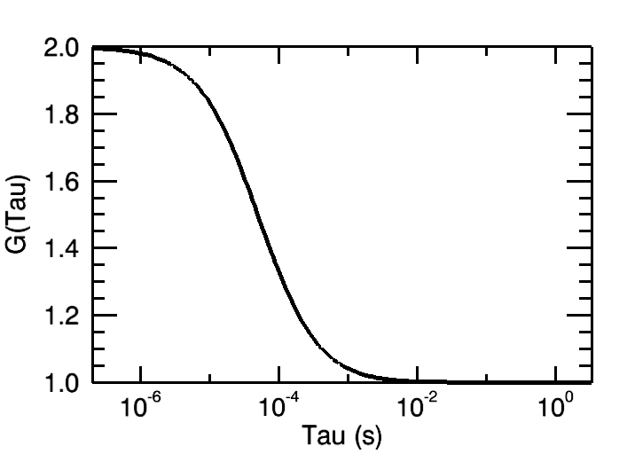
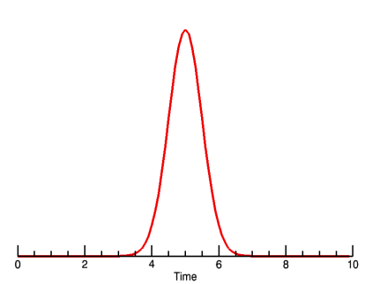
Creating the Autocorrelation Function
τ=0
τ=τ_{D}
τ=inf
Photon Burst
δI(t)
δI(t+τ)
“Copy” signal
Notes:
The fluctuations generated can be analyzed in many ways. FCS relies on the auto-correlation function which is a signal processing technique. The autocorrelation compares a signal against itself. In this case, a particle enters the focal volume and generates a photon burst. The collected signal is “copied” and the two copies are compared against one another as you shift the “copy” in time. The copy signal is shifted by some amount of time given by the greek symbol tau. All data analysis will be done in reference to the shift time tau.

Slide 8
FCS Correlation Function
The correlation function
CF G(τ)
amplitude: number of molecules
Decay time: diffusion time
offset: very slow processes

Slide 9
Autocorrelation Function
Factors influencing the fluorescence signal:
κQ = quantum yield and detector sensitivity (how bright is our probe). This term could contain the fluctuation of the fluorescence intensity due to internal processes
C(r,t) is a function of the fluorophore concentration over time. This is the term that contains the “physics” of the diffusion processes
W(r) describes our
observation volume
Notes:
Lecture 5
FCS, Autocorrelation, PCH, Cross-correlation
Enrico Gratton

Slide 10
Autocorrelation Yields Diffusion and Concentration
Fit Autocorrelation curve for Diffusion time (τ_{D}) and particle concentration N
Notes:
The larger the particle, the longer it will take to transverse the focal volume thus the photon burst will be longer in time. This results in the correlation function moving the left for larger particles. The diffusion time gives information about the diffusion coefficient, the molecular weight and possibly the viscosity of the media. The correlation curve amplitude is inversely proportional to the particle concentration. The concentration, N, is the average number of molecules in the focal volume at one time. Standard dye solutions with known diffusion coefficients can be used to characterize the focal volume. Once that is done, you can use the focal volume information and the Number of particles to get an accurate measure of the MOBILE concentration (mol/L). The curve amplitude being inversely proportional to the particle number makes sense because the higher the N, the smaller the fluctuations will be from the mean intensity giving less correlation.
ALL DATA IS FIT USING A NON-LINEAR LEAST SQUARES ERRORS FUNCTION TO GET DIFFUSION TIMES AND N. You will run the risk of getting bad results with bad curve fitting or curve fitting interpretation.

Slide 11
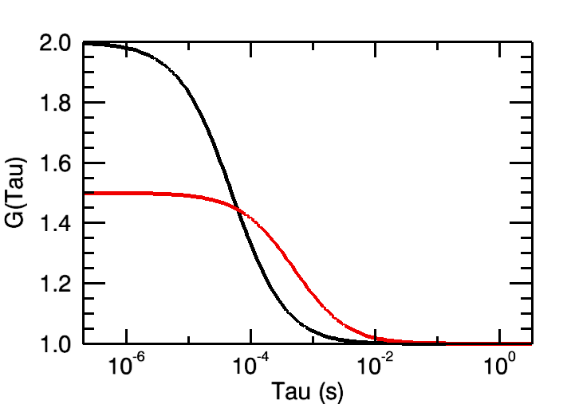
Autocorrelation Yields Diffusion and Concentration
Fit Autocorrelation curve for Diffusion time (τ_{D}) and particle concentration N
Notes:
The larger the particle, the longer it will take to transverse the focal volume thus the photon burst will be longer in time. This results in the correlation function moving the left for larger particles. The diffusion time gives information about the diffusion coefficient, the molecular weight and possibly the viscosity of the media. The correlation curve amplitude is inversely proportional to the particle concentration. The concentration, N, is the average number of molecules in the focal volume at one time. Standard dye solutions with known diffusion coefficients can be used to characterize the focal volume. Once that is done, you can use the focal volume information and the Number of particles to get an accurate measure of the MOBILE concentration (mol/L). The curve amplitude being inversely proportional to the particle number makes sense because the higher the N, the smaller the fluctuations will be from the mean intensity giving less correlation.
ALL DATA IS FIT USING A NON-LINEAR LEAST SQUARES ERRORS FUNCTION TO GET DIFFUSION TIMES AND N. You will run the risk of getting bad results with bad curve fitting or curve fitting interpretation.

Slide 12
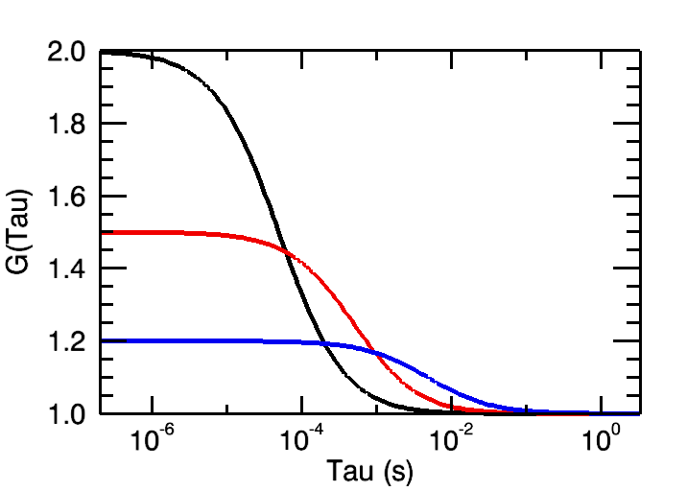
Autocorrelation Yields Diffusion and Concentration
Fit Autocorrelation curve for Diffusion time (τ_{D}) and particle concentration N
Notes:
The larger the particle, the longer it will take to transverse the focal volume thus the photon burst will be longer in time. This results in the correlation function moving the left for larger particles. The diffusion time gives information about the diffusion coefficient, the molecular weight and possibly the viscosity of the media. The correlation curve amplitude is inversely proportional to the particle concentration. The concentration, N, is the average number of molecules in the focal volume at one time. Standard dye solutions with known diffusion coefficients can be used to characterize the focal volume. Once that is done, you can use the focal volume information and the Number of particles to get an accurate measure of the MOBILE concentration (mol/L). The curve amplitude being inversely proportional to the particle number makes sense because the higher the N, the smaller the fluctuations will be from the mean intensity giving less correlation.
ALL DATA IS FIT USING A NON-LINEAR LEAST SQUARES ERRORS FUNCTION TO GET DIFFUSION TIMES AND N. You will run the risk of getting bad results with bad curve fitting or curve fitting interpretation.

Slide 13
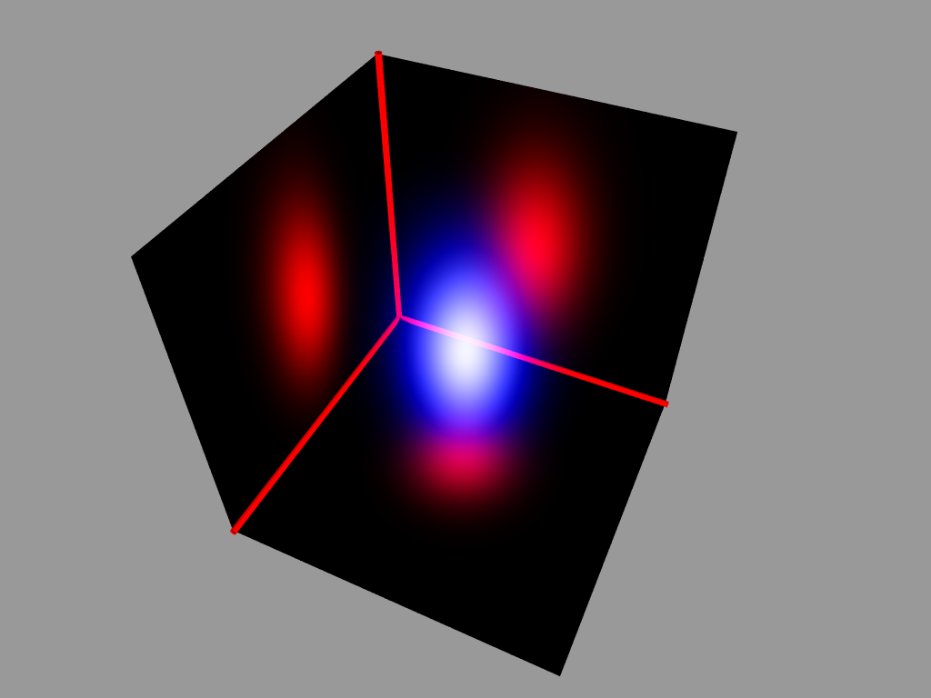
What about the excitation (or observation) volume shape?

Slide 14
Effect of Shape on the (Two-Photon) Autocorrelation Functions:
For a 2-dimensional Gaussian excitation volume:
1-photon equation contains a 4, instead of 8
For a 3-dimensional Gaussian excitation volume:

Slide 15
Independent Processes Contribute Fluctuations
Contributions of single independent processes multiply
More process system
1.5
exponential
1.4
1.3
triplet
)
τ
G(
1.2
diffusion
1.1
1.0
1E-6
1E-5
1E-4
1E-3
0.01
0.1
1
10
100
1000
10000
τ
[ms]

Slide 16
Additional Equations for these independent processes:
3D Gaussian Confocor analysis:
... where N is the average particle number, τ_{D} is the diffusion time (related to D, τ_{D}=w²/8D, for two photon and τ_{D}=w²/4D for 1-photon excitation), and S is a shape parameter, equivalent to w/z in the previous equations.
Triplet state term:
..where T is the triplet state amplitude and τ_{T} is the triplet lifetime.

Slide 17
Combining the Processes
τ_{D1} = 100 μs
τ_{D2} = 50 ms
f₁ = 40%
f₂ = 60%
N_{diff} = 0.2
SP = 5
TF = 10%
τ_{T} = 1 ms

Slide 18
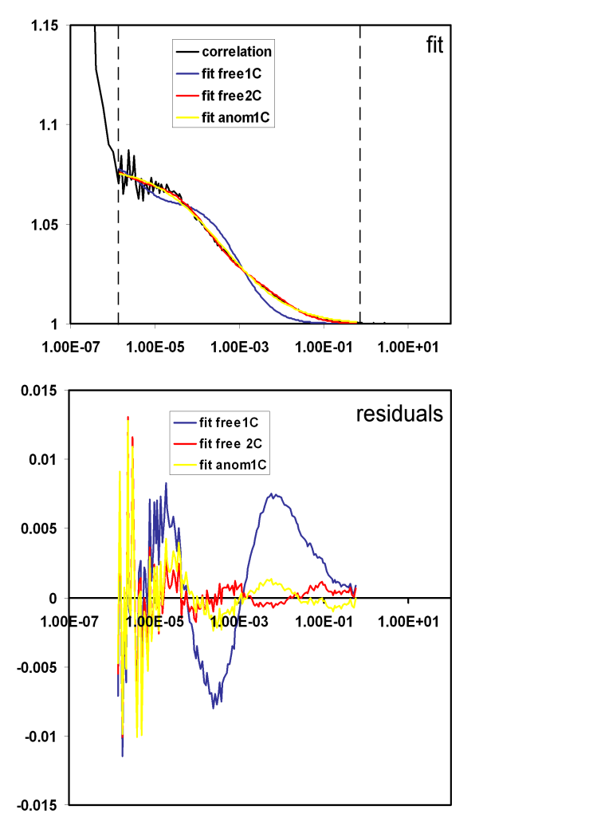
Fitting with Correct Model

Slide 19
Fitting with Correct Model
Schwille and Haustein 2004

Slide 20
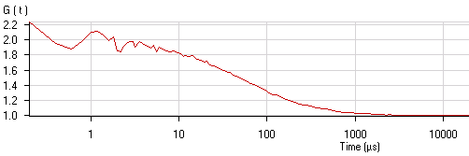
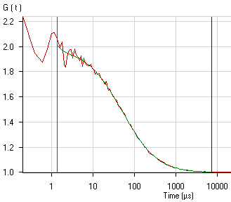
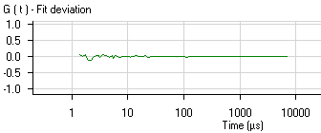


Work Flow for FCS
Diffusion coefficient:
ωr²
4τ_{d,i}
D=
I(t)
AC: compare signal w/ itself
CC: compare signal w/ another
1
<I>
δI(t)
2
t
3
Principle steps
Measuring fluctuation intensities
Calculating correlation function
Fitting to biophysical model

Slide 21
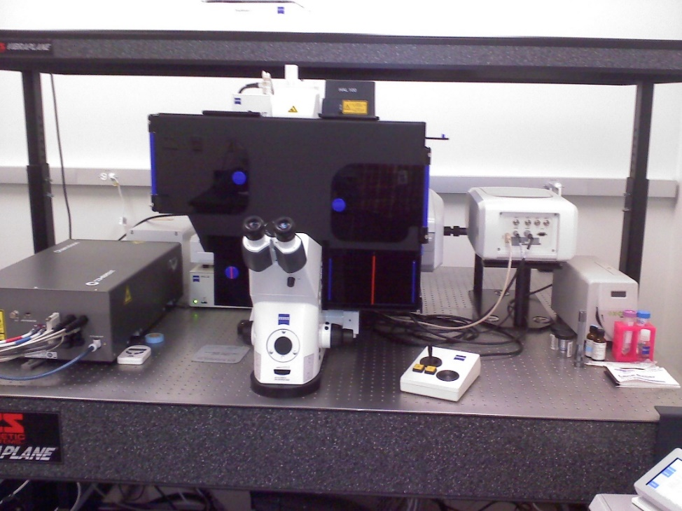
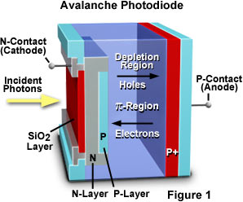
Zeiss ConfoCor3: FCS Setup on a Laser Scanning Confocal Microscope
Avalanche Photodiode Detector (APD)
Single Photon Sensitivity
Focus to tiny volume (<1 femtoliter)
Schwille and Haustein 2004
Notes:
http://hamamatsu.magnet.fsu.edu/articles/avalanche.html
http://www.photonics.com/EDU/Handbook.aspx?AID=25535

Slide 22
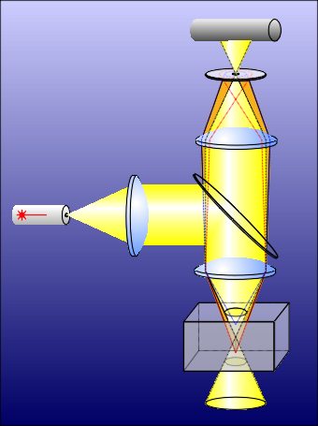
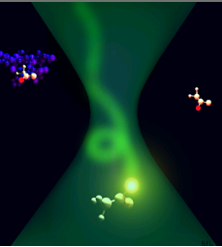
ConfoCor 3: Confocal Volume
Diffraction limited spot
Advanced confocal optics realized in the ConfoCor 3 limits detection to a cylinder approximately 1,5 µm in height and 0.3 μm in diameter.
Focus and confocal detection define a measuring volume smaller than 1/4 femto liter (1 femto liter = 10⁻¹⁵ liter).
0,3 μm
Sample
1,5 μm

Slide 23
Fluorescence Fluctuation Spectroscopy (FFS)
Diffusion coefficient:
ωr²
4τ_{d,i}
D=
Bacia et al., Nature Methods 2006
Notes:
Bacia, K., Kim, S.A., Schwille, P., 2006. Fluorescence cross-correlation spectroscopy in living cells. Nat Methods 3, 83-89.

Slide 24
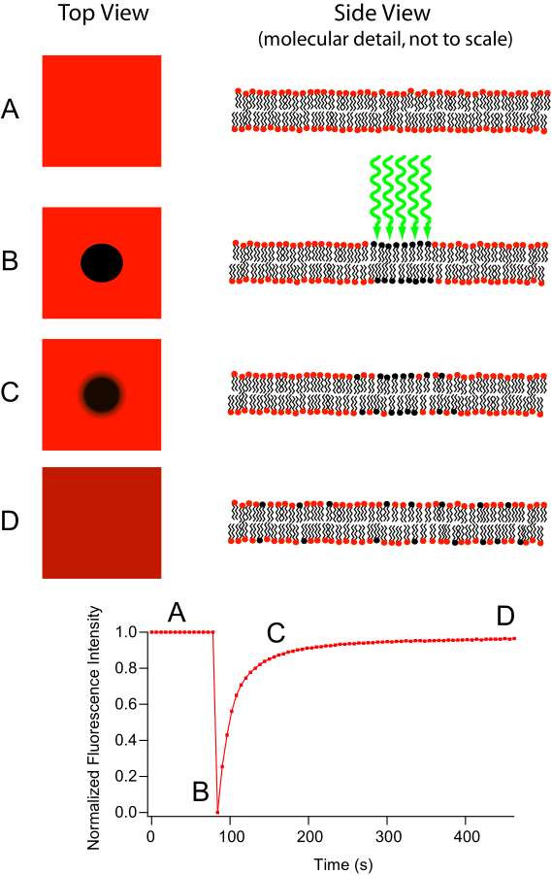
Fluorescent recovery after photobleaching (FRAP)
Diffusion coefficient:
ωr²
4τ_{d,i}
D=
Like FCS also used for calculating diffusion
Notes:
The major difference between these two microscopy techniques is that FRAP involves the study of a cell’s ability to recover after a single photobleaching event whereas FLIP involves the study of how the loss of fluorescence spreads throughout the cell after multiple photobleaching events. This difference in purpose also leads to a difference in what parts of the cell are observed. In FRAP, the area that is actually photobleached is the area of interest. Conversely, in FLIP, the region of interest is just outside the region that is being photobleached. Another important difference is that in FRAP, there is a single photobleaching event and a recovery period to observe how well fluorophores move back to the bleached site. However, in FLIP, multiple photobleaching events occur to prevent the return of unbleached fluorophores to the bleaching region.
http://en.wikipedia.org/wiki/Fluorescence_loss_in_photobleaching
http://en.wikipedia.org/wiki/Fluorescence_recovery_after_photobleaching
http://www.olympusconfocal.com/applications/flipandfrap.html
"Frap diagram" by MDougM - Own work. Licensed under Public Domain via Wikimedia Commons - http://commons.wikimedia.org/wiki/File:Frap_diagram.svg#mediaviewer/File:Frap_diagram.svg
"Fluorescence Loss in Photobleaching Schematic" by Steven Lentz - was sent to me personally. Licensed under CC BY-SA 3.0 via Wikimedia Commons - http://commons.wikimedia.org/wiki/File:Fluorescence_Loss_in_Photobleaching_Schematic.jpg#mediaviewer/File:Fluorescence_Loss_in_Photobleaching_Schematic.jpg

Slide 25
Fluorescence Fluctuation Spectroscopy (FFS)
Fluorescence Correlation Spectroscopy (FCS)
Photon Counting Histogram (PCH)
Fluorescence Cross-Correlation Spectroscopy (FCCS)
  FCS with more than 1 color
Advantages over FRAP and FRET

Slide 26
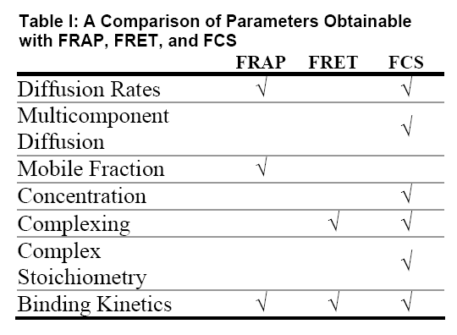
Fluorescence Fluctuation Spectroscopy (FFS)
Advantages over FRAP and FRET
Table: http://www.fcsxpert.com/

Slide 27
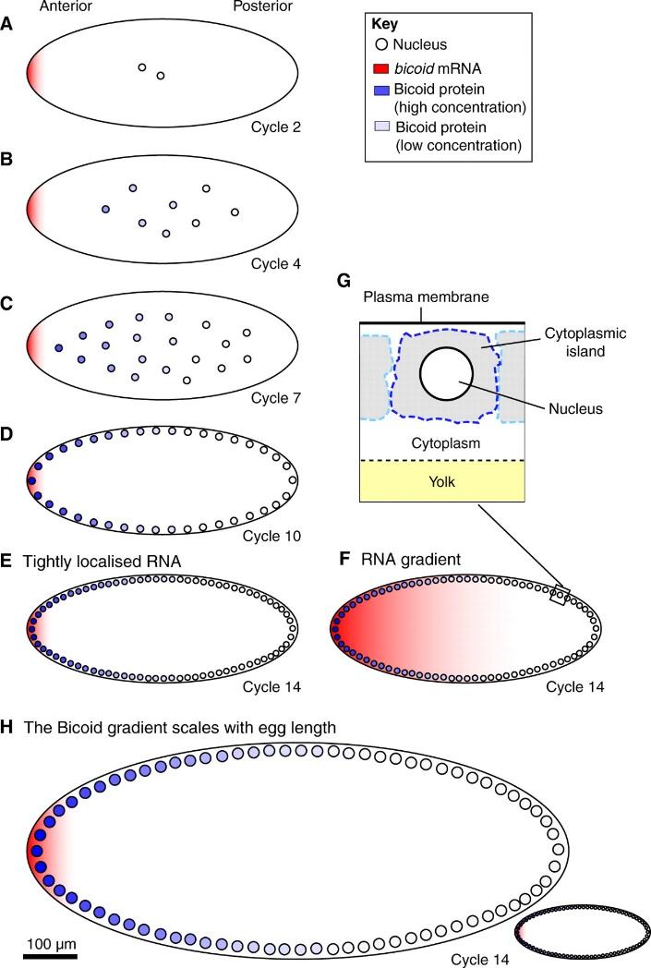
But what do you do when FRAP and FCS give different results?
Drosophila bicoid protein gradient
With FRAP measured D=0.3 μm²/second
With FCS measured D=∼7 μm²/second
Which result do you believe?
Notes:
http://www.sciencedirect.com/science/article/pii/S0092867407006630
Wieschaus Cell paper
http://www.ncbi.nlm.nih.gov/pmc/articles/PMC2920644/
FCS paper
Development paper by Wieschaus reviewing his result
http://dev.biologists.org/content/137/14/2253.full
Schematic of the Bicoid gradient in the syncytial Drosophila embryo. (A-G) Bicoid, as a transcription factor, accumulates within nuclei during interphase. The nuclear Bicoid gradient, which decreases in concentration with distance from the anterior pole, forms in less than 3 hours in a Drosophila embryo that is ~500 μm long (AP axis) and can be observed (B) before nuclei migrate to the surface of the embryo. During the first ~80 minutes (corresponding to cell cycles 1-8), nuclei proliferate in the centre of the embryo (A-C), and then migrate to the surface of the embryo in cycle 9. During the last five cell cycles, nuclei divide at the surface of the embryo (D,E). Nuclei replicate every ~9 minutes during the first nine cell cycles, but this slows to ~20 minutes in cycle 13. Nuclei are ~10 μm in diameter in pre-cycle 14 embryos (A-D) but ~6 μm in cycle 14 (E). The extent to which the mRNA encoding Bicoid, which is initially tightly localised to the anterior pole (A), becomes delocalised is a matter of controversy. Two alternative bicoid RNA distributions during cycle 14 are shown in E and F. (G) Illustration of the nucleus and surrounding cytoplasm. (H) In species that produce larger or smaller eggs than Drosophila melanogaster, the Bicoid gradient scales with egg length.

Slide 28
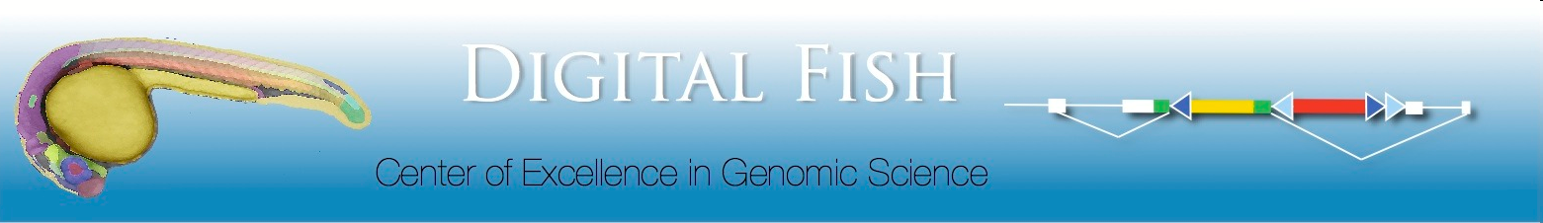
FlipTrap Screen; Le Trinh & Scott Fraser (Caltech)
Transposon-based gene-trapping technology
Gene trapping vector: Citrine (YFP) flanked by splice acceptor & donor, forward orientation; mCherry (RFP) polyadenylation signal, reverse orientation; lox & FRT sites
Insertion of artificial citrine exon into intron of an actively expressed gene by Tol2-mediated transposition
Produces full-length fluorescent fusion protein
Endogenous expression of Citrine labeled protein
lox sites allow Cre-mediated excision of citrine & splice donor sequence, “flipping” mCherry & polyA signal into forward orientation, mutating gene
http://www.fliptrap.org

Slide 29
Flip Trap Screen Labels Endogenous Proteins:
Different Sub-Cellular Compartments and Cell Types
Zebrafish Ear Development
α- Catenin
Hmga2
Hmga2
1 day
memCherry
Cell Membrane
Nuclei
2 days
Rbms3
Rab3ab
memCherry
3-4 days
FM1-43
Cytoplasm
Cytoplasm+Nuclei

Slide 30
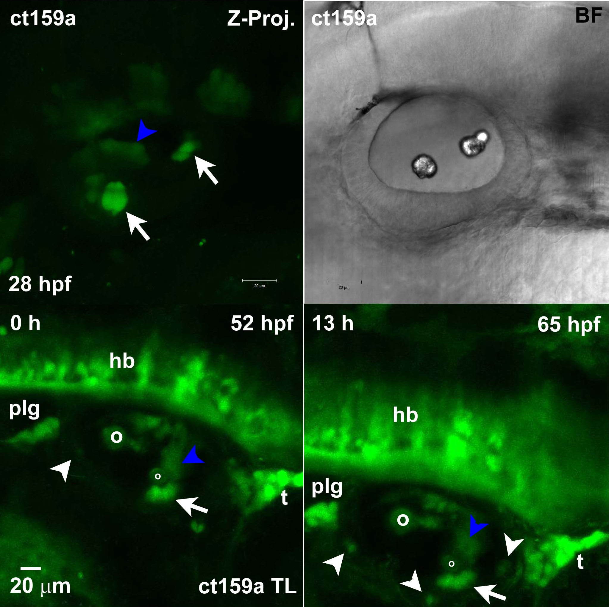
Rab3ab is a Ras Oncogene Restricted to Hair Cells in Inner Ear
Rab3ab expressed in sensory hair cell nuclei and cytoplasm
Turns on as hair cells differentiate
Expressed in auditory ganglion neurons
Time-lapse beginning 52 hpf, 15 hrs, 40 min
D
A

Slide 31
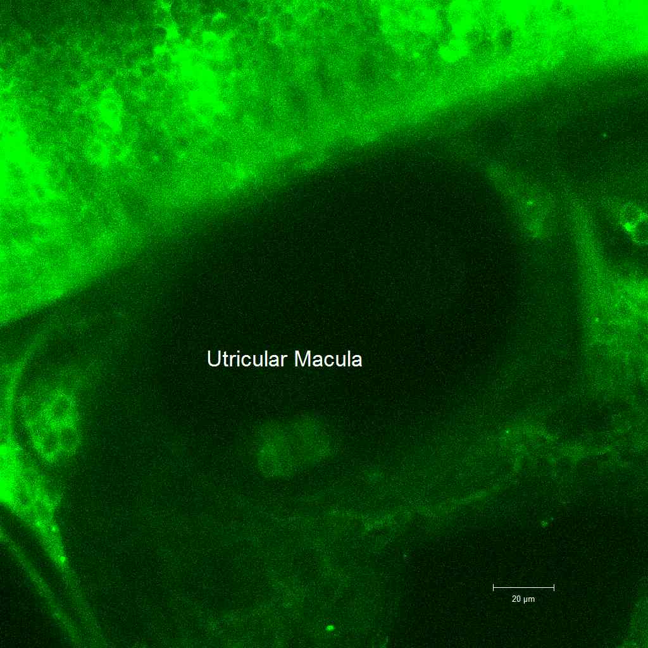
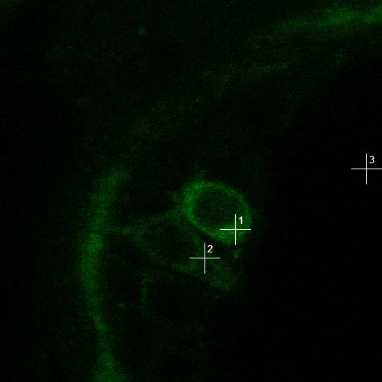
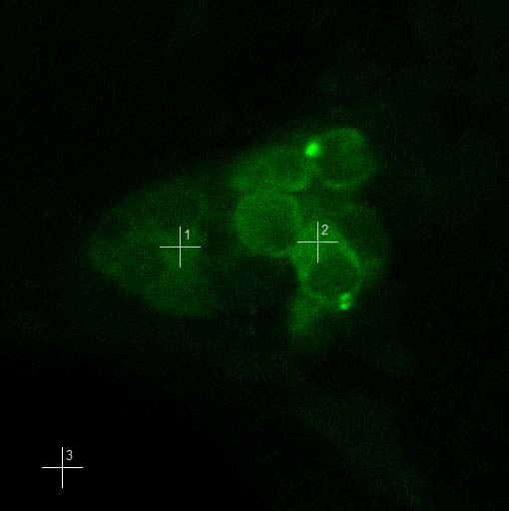
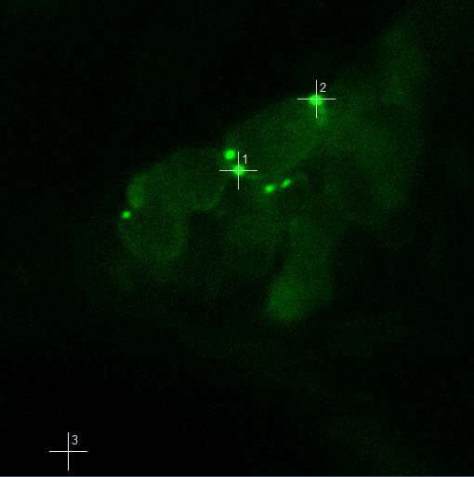
Guanine Nucleotide Binding Protein (G protein) Beta Polypeptide 2 (Gnb2)
Heterotrimeric G proteins act as molecular switches between G-protein-coupled-receptors and transduction pathways
In otocyst restricted to sensory hair cell cytoplasm
50 hpf
Gt(gnb2-citrine)^{ct172a}
SA
citrine
SD
pA
mCherry
v
f
citrine
α
γ
WD40
WD40
β
Hair cells
Neurons PLLG
Puncta
83 hpf
83 hpf
83 hpf

Slide 32
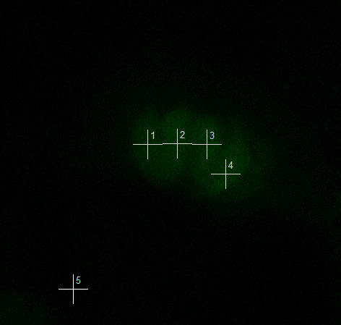
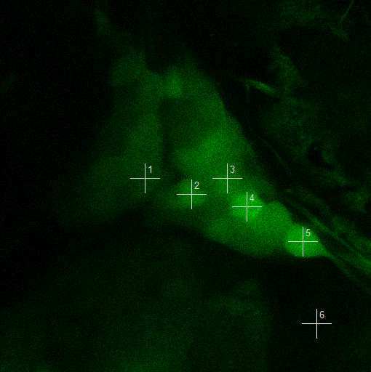
Rab3ab Mobility Decreases in Neurons not Hair Cells during Development
Gt(rab3ab-citrine)^{ct159a}
citrine
GTPase
rab
GTP
endosome
Hair Cells
Trigeminal Neurons
Diffusion Coeff. (μm²/sec)
hair cells
neurons
N=18
N=42
N=28
N=32
N=38
N=31
30 hpf
50 hpf
78 hpf

Slide 33
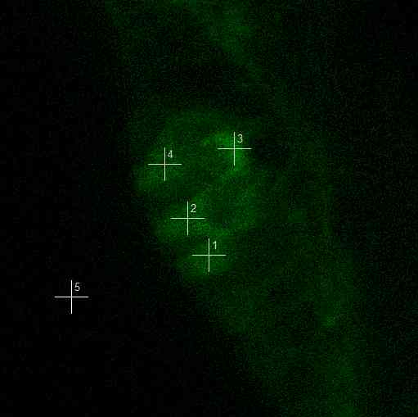
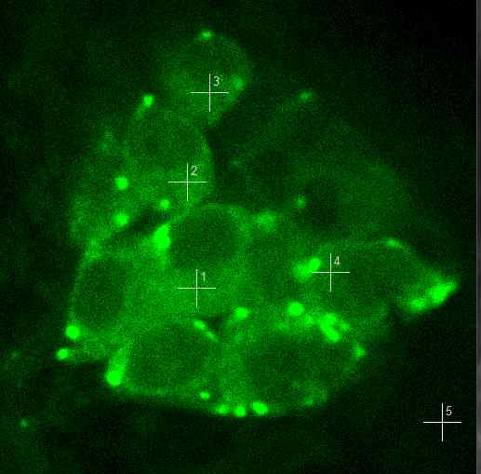
In Contrast Gnb2 Mobility Varies in Hair Cells but not Neurons
Gt(gnb2-citrine)^{ct172a}
SA
citrine
SD
pA
mCherry
citrine
α
γ
WD40
WD40
β
Hair Cells
Post LLg Neurons
P=6.9X10⁻⁵
P=3.7X10⁻⁵
hair cells
Diffusion Coeff. (μm²/sec)
neurons
N=25
N=41
N=17
N=27
N=32
N=31
30 hpf
50 hpf
83 hpf

Slide 34
What Do Differences in Diffusion Coefficients Mean?
Binding to larger protein?

Slide 35
What Do Differences in Diffusion Coefficients Mean?
Binding to larger protein?
  But 100x the mass only 1/3 reduction.

Slide 36
What Do Differences in Diffusion Coefficients Mean?
Binding to larger protein?
  But 100x the mass only 1/3 reduction.
Cell Membrane
More likely causing interactions with cytoskeleton, organelles or other structures
Nucleus
Mitochondria

