Slide 1
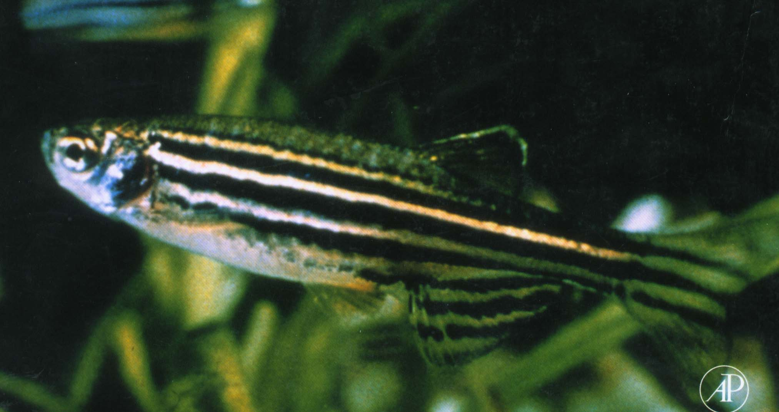
Biology 227: Methods in Modern Microscopy
Andres Collazo, Director Biological Imaging Facility
Yonil Jung, Graduate Student, TA
Week 5 Live imaging II: zebrafish embryos

Slide 2
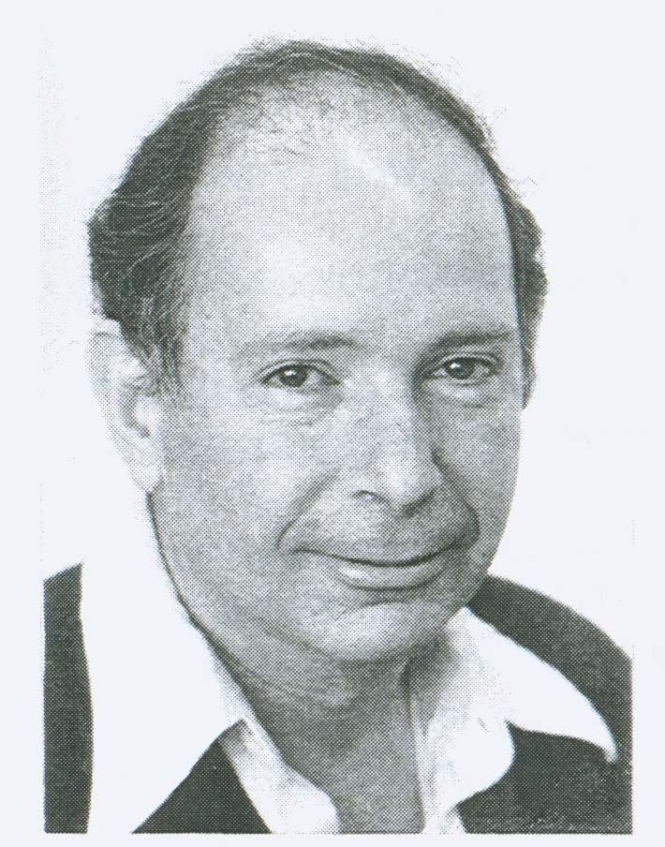
George Streisinger developed zebrafish as a model system
From Viruses to Zebrafish
A Vertebrate Genetic System

Slide 3
Number of Known Vertebrate Species and Taxonomic Distribution (Total 43,173)
Teleosts
Other Fishes
Salamanders
Other amphibians
Other vertebrates

Slide 4
Phylogeny of Deuterostomes
Echinoderms
Acorn Worms
Hemichordates
Amphioxus
Cephalochordates
Ascidians
Urochordates
Hagfish
Myxinoidea
Lamprey
Petromyzontida
Neural Crest
Shark
& Placodes
Chondrichthyes
Sturgeon
Chondrostei
Jawed
Gar
Vertebrates
Ginglymodi
Amia
Halecomorphi
Teleostei
Coelacanth
Actinistia
Lungfish
Dipnoi
Amniota
Amphibia

Slide 5
ADVANTAGES OF ZEBRAFISH
Small size
Rapid development
Genetic system
Transparent
Easy to manipulate embryos
All stages accessible

Slide 6
DISADVANTAGES OF ZEBRAFISH
Small size
Gene duplication
Not a mammal

Slide 7
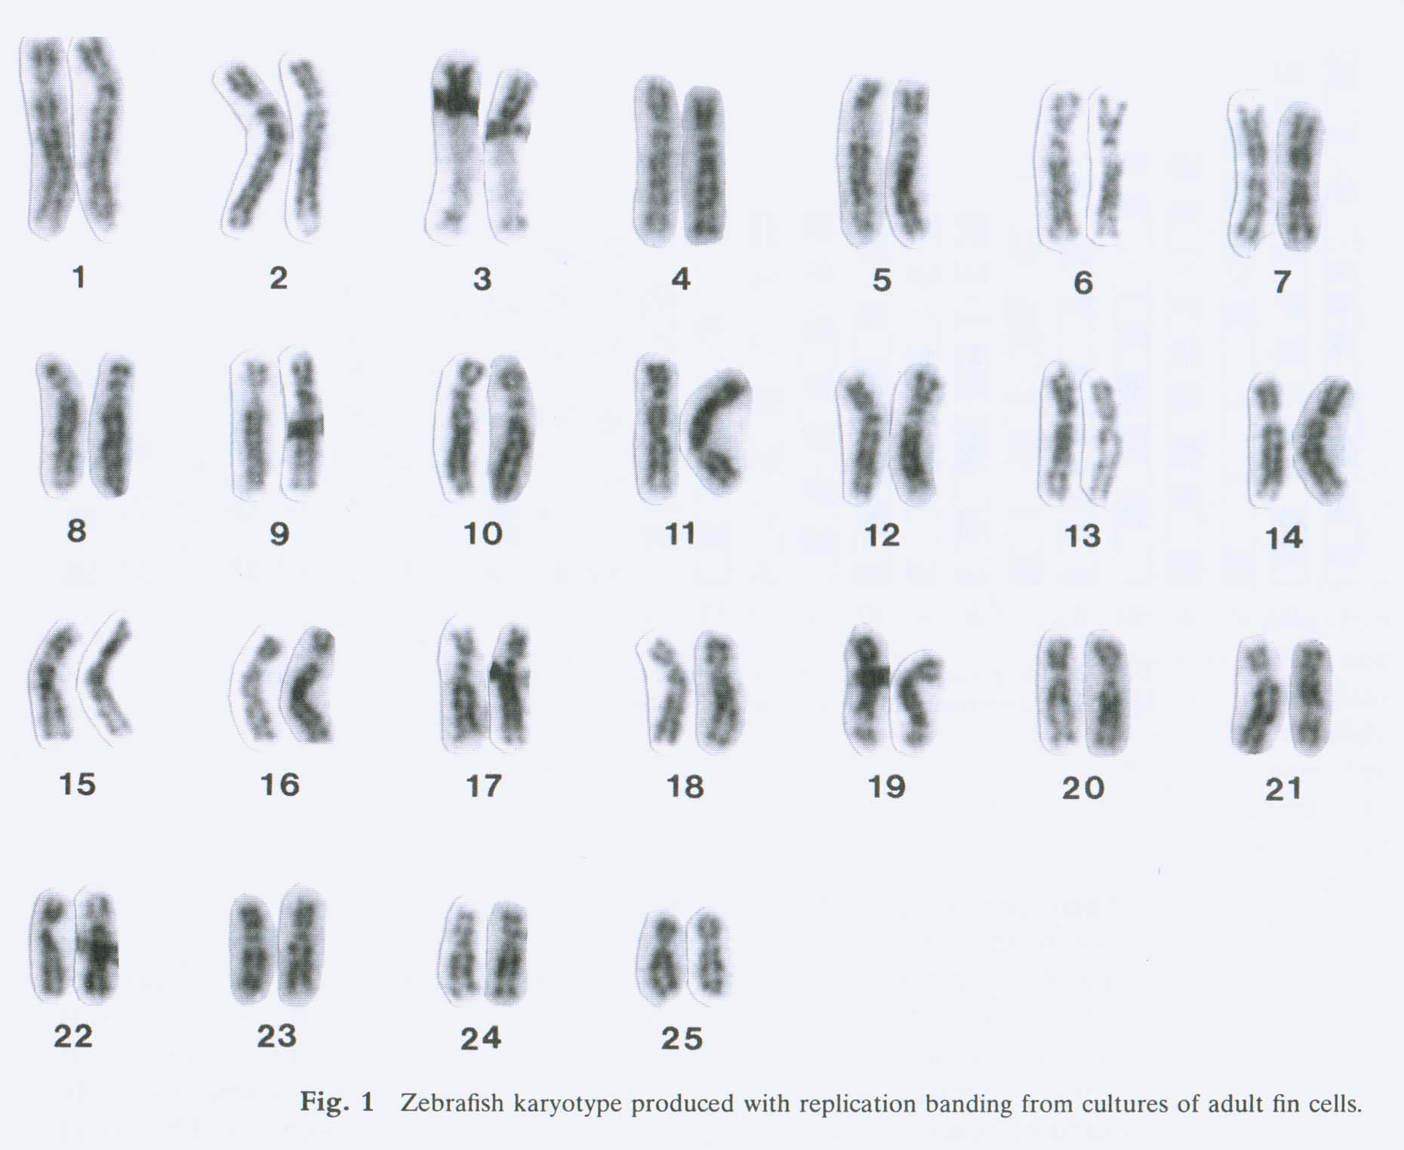
Zebrafish Chromosomes
Amores and Postlethwait 1999

Slide 8
Synteny between Fish and Humans
LG9 | Hsa2
hoxda | HOXD
evx2 | EVX2
dlx1 | DLX1
dlx2 | DLX2
Postlethwait et al. 1999.

Slide 9


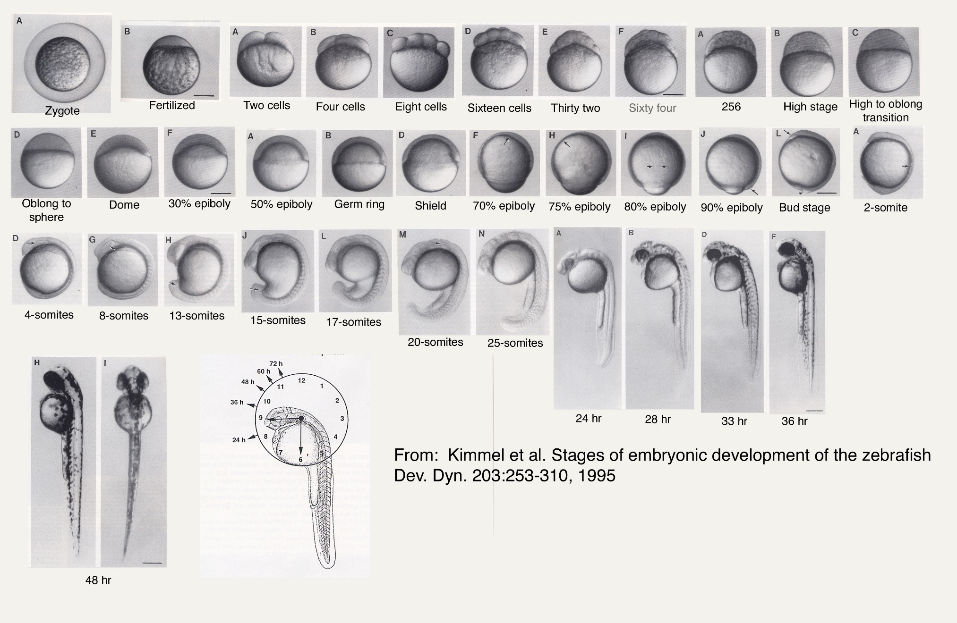
Zebrafish Development
Movies from Haffter et al. 1996

Slide 10
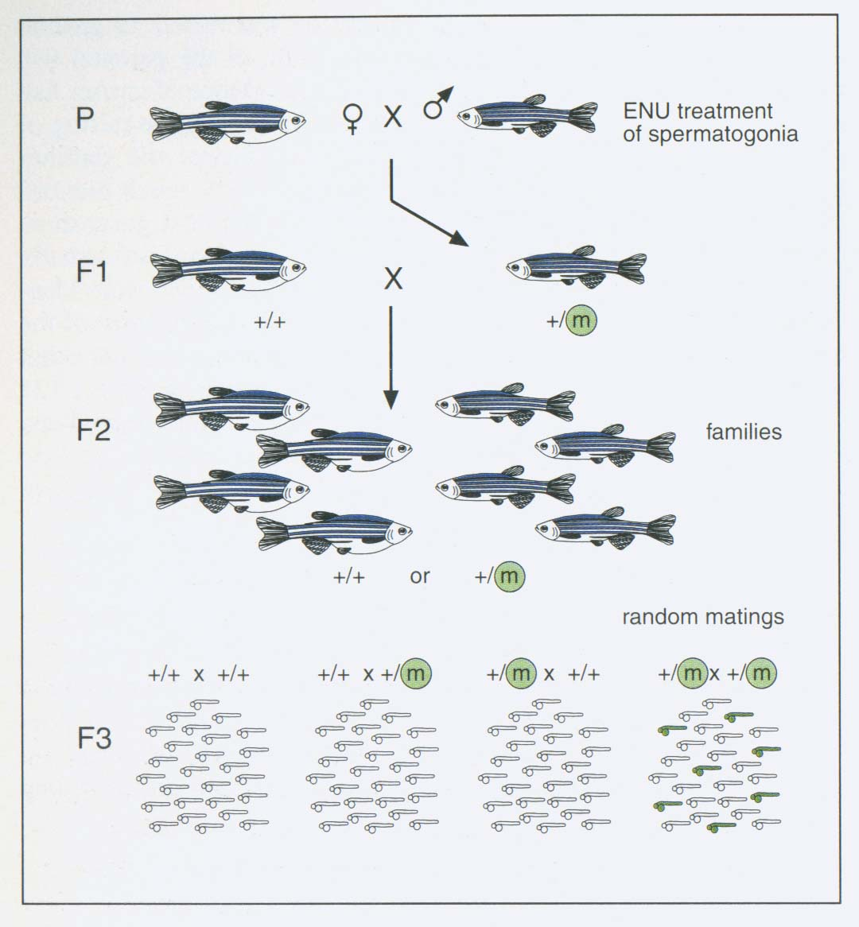
ENU (Ethylnitrosourea) Mutagenesis
Haffter et al. 1996

Slide 11
ZEBRAFISH ENU MUTAGENESIS

Slide 12
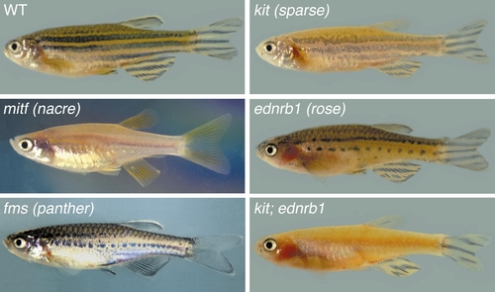
Examples of Zebrafish Mutants

Slide 13
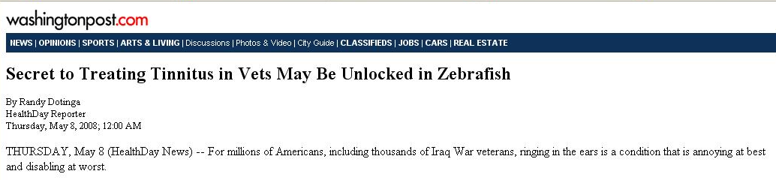
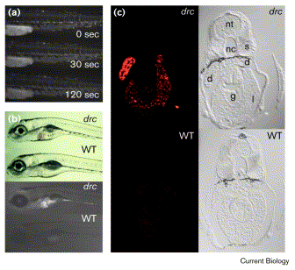

Zebrafish as a Model of Human Pathologies

Slide 14
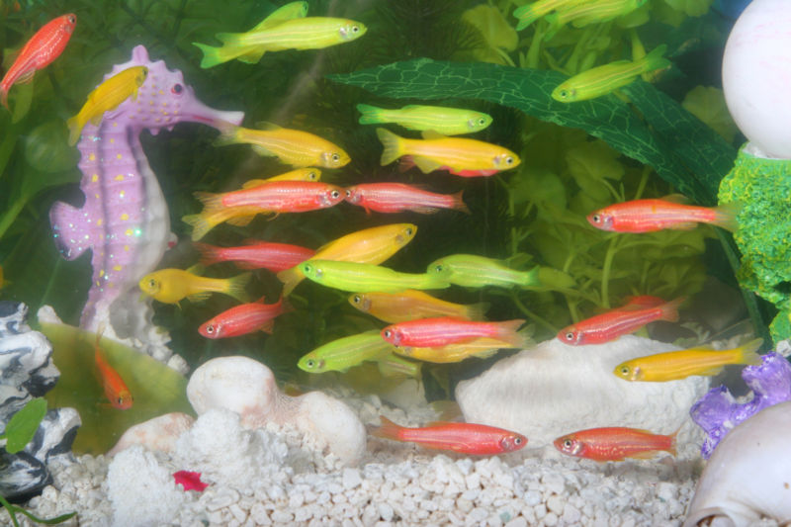
Transgenic Zebrafish

Slide 15
Week 5 Live imaging II: zebrafish embryos
Tissue to be imaged is migratory cell type, the neural crest
Embryos will be available Monday and Wednesday
  Treated with PTU to inhibit melanin
Confocal and “wide field” images collected on LSM 410 or 310.
Deconvolution will use Huygens software
  Need to create account on Linux computer running the Huygens
Overnight time lapse of migrating neural crest cells
Notes:
PTU - 1-phenyl-2-thiourea

Slide 16
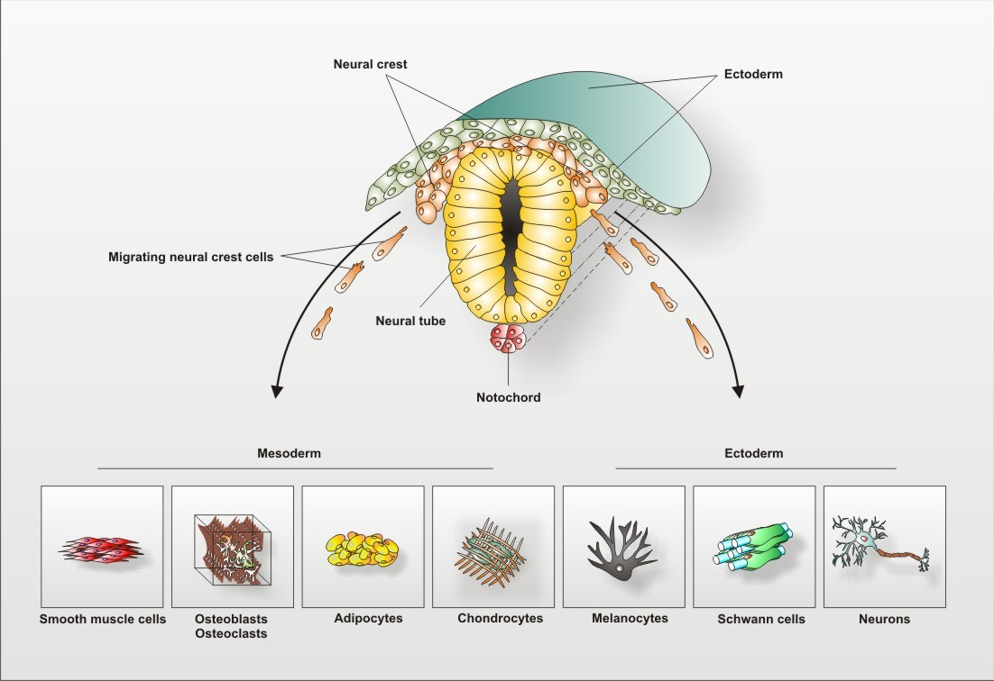
Neural crest: A migratory cell type
Notes:
Ectodermal tissues in embryo
Together form Peripheral Nervous System
Highly migratory
http://web.biologie.uni-bielefeld.de/cellbiology/index.php/research/neural-crest-derived-stem-cells

Slide 17
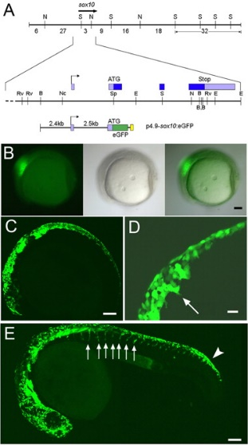
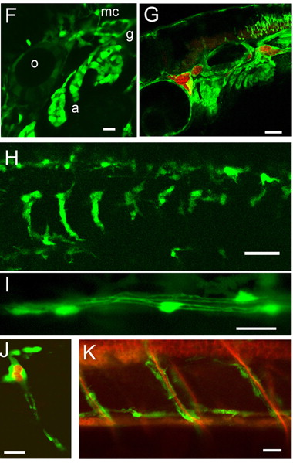
Sox 10 promoter drives GFP in zebrafish neural crest
Carney TJ, Dutton KA, Greenhill E, Delfino-Machín M, Dufourcq P, Blader P, Kelsh RN. 2006. A direct role for Sox10 in specification of neural crest-derived sensory neurons. Development 133:4619-4630.

Slide 18
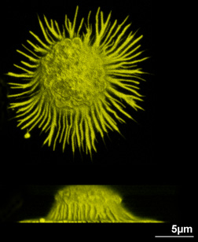
Image deconvolution
Inputs:
  3-D image stack
  3-D PSF (bead image)
Requires:
  Time
  Computer memory
Artifacts?
  Algorithms so good now
Note: z-axis blurring from the missing cone is minimized but not eliminated

Slide 19
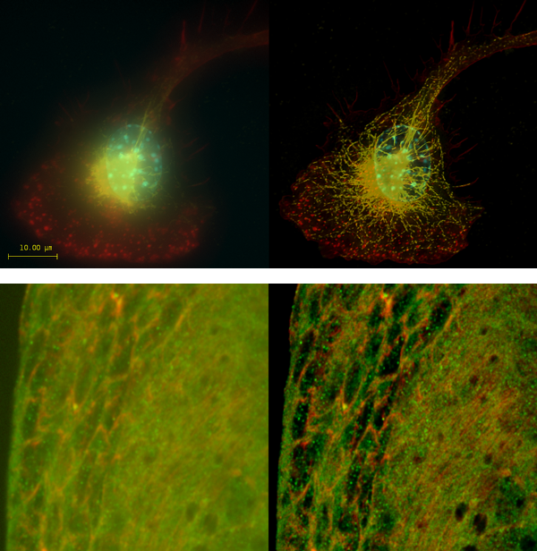

Image deconvolution using the Huygens software from SVI
Point-Spread function (PSF) information is used to calculate light back to its origin
Post processing of an image stack using Huygens
A
Top: Macrophage - tubulin, actin & nucleus.
Bottom: Imaginal disc – α-tubulin, γ-tubulin.
Notes:
Top right: Macrophage fluorescently stained for tubulin (yellow), actin (red) and the nucleus (DAPI, blue). Left: original image, recorded with a wide field microscope. Right: the same dataset, deconvolved using Huygens Professional. The datasets are visualized with top-view maximum intensity projections.
Data courtesy of Dr. James Evans, Whitehead Institute, MIT Boston MA, USA. (See the EvansMacrophage for more image details).
Bottom right: Detail of an imaginal disc from a third instar Drosophila Melanogaster larva. Left: a slice of the original data, imaged using an Andor Revolution spinning disc confocal microscope.Right: the same slice, deconvolved using Huygens Professional. The fixed sample was stained against alfa-tubulin (green) and gamma-tubulin (red).
Recorded by Dr. Paula Sampaio, Advanced Light Microscopy Facility, University of Porto.

Slide 20
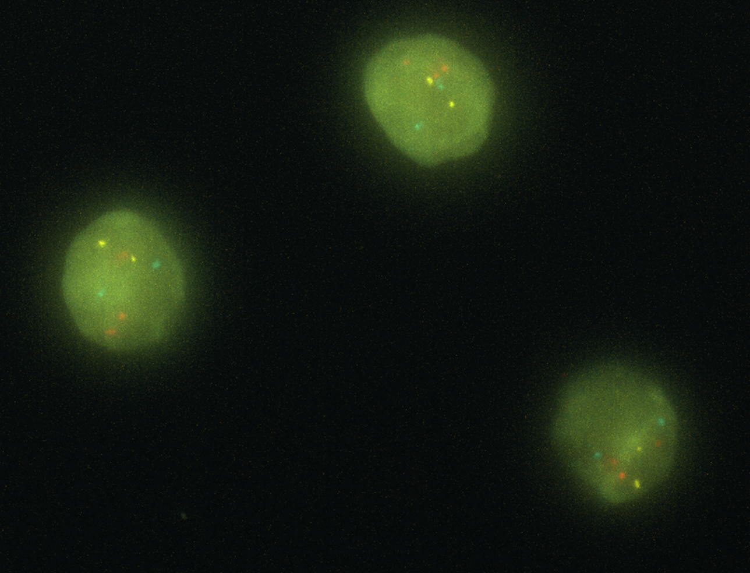
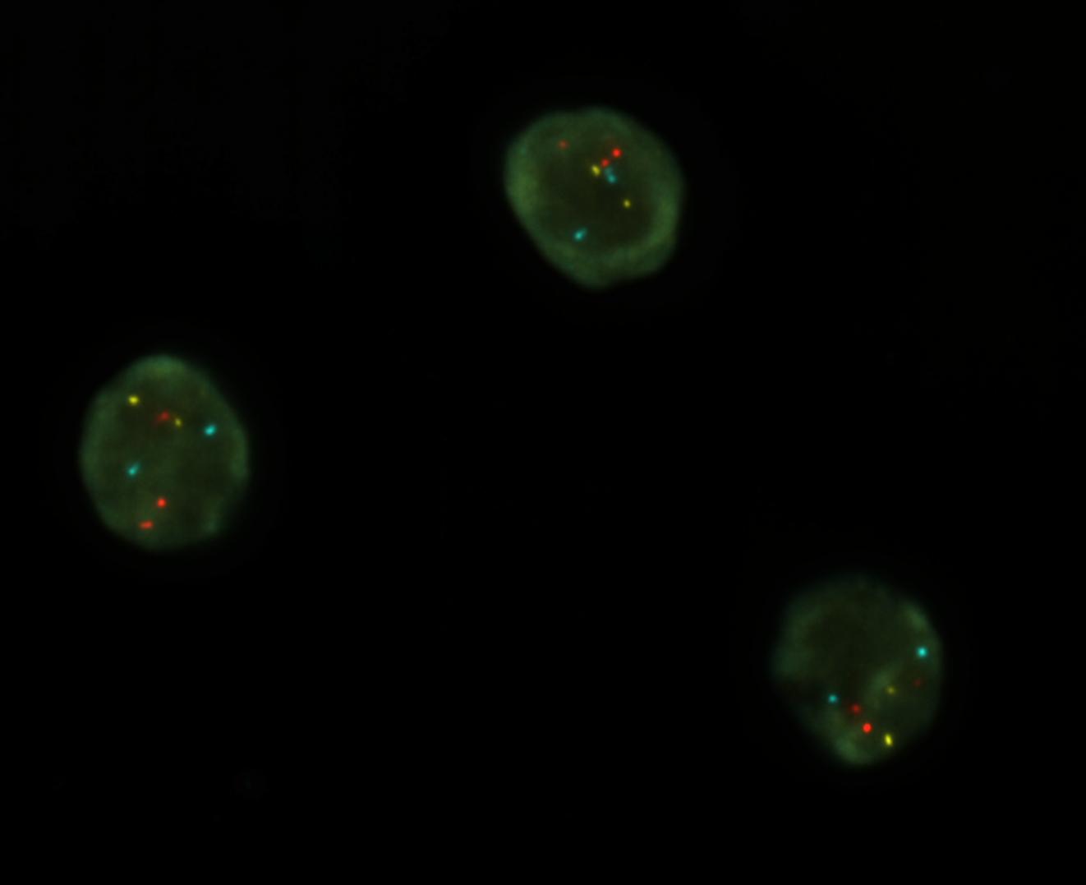
Z-projection of DNA-FISH performed on P2C2 immune cells, BAC probes, three loci (three colors).
Say-Tar Goh, Graduate student in the Wold lab.
Un-deconvolved
Deconvolved
Notes:
0.1um/section (~15um/stack), red/cyan/yellow are the FISH stains (DAPI not shown, the "green" is non-specific staining background). I used the red/cyan/yellow scheme because in RGB, blue looks really bad on screen. 100x, 65nm x 65nm pixels.

Slide 21
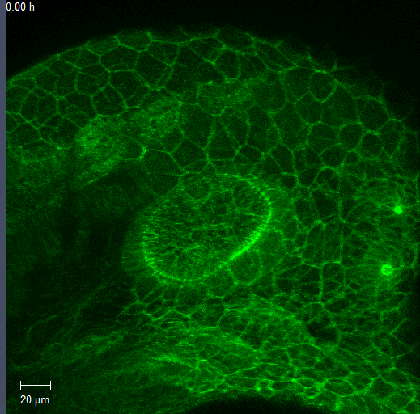
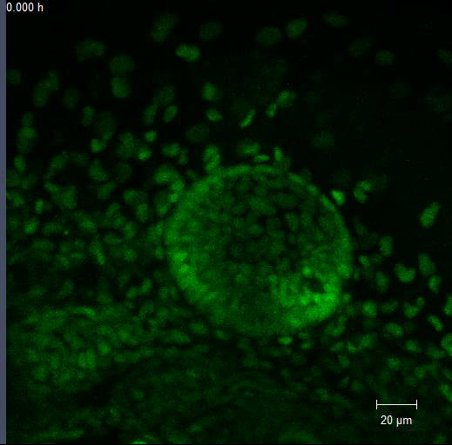
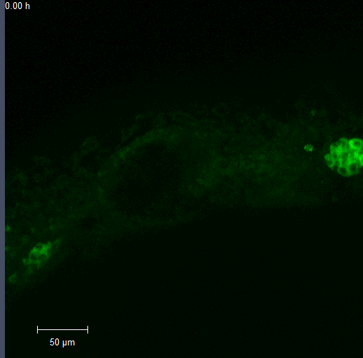
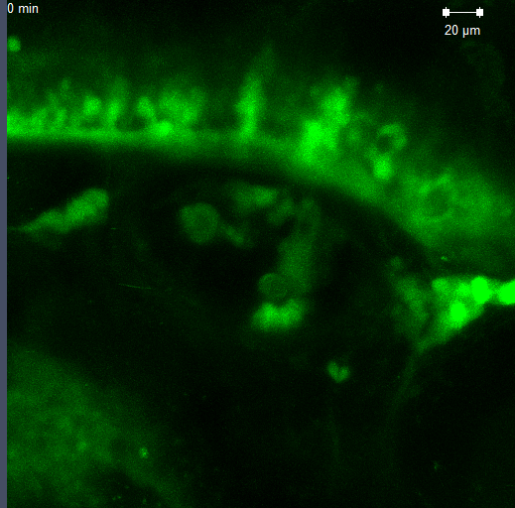
Time lapse movies of developing zebrafish: Focus on the inner ear and surrounding tissues
α- Catenin
Hmga2
Cell Membrane
Nuclei
Rbms3
Rab3ab
Cytoplasm
Cytoplasm+Nuclei

Slide 22
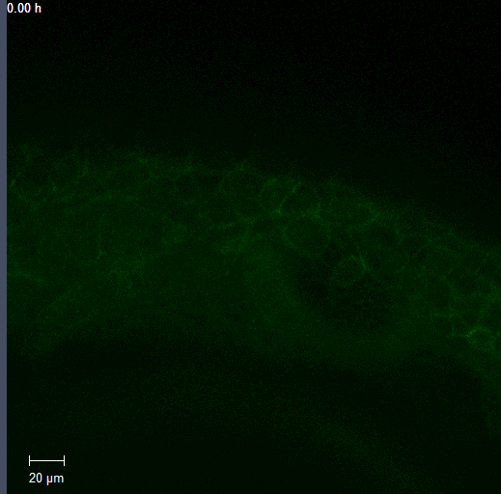
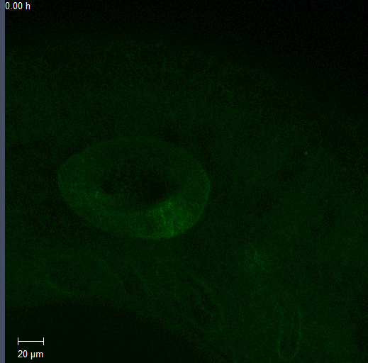
Other examples of time lapses showing neural crest
Erythrocyte Membrane Protein Band 4.1-like 3b (Epb41l3b)
Time lapse 18+ hours, beginning at ~30 hpf, end at ~2 dpf
Discs large homolog 1-like protein (Dlg1l)
Time-lapse 18 hours, 10 min; Starting at ~28 hpf

Slide 23
Week 5 Live imaging II: zebrafish embryos
Tissue to be imaged is migratory cell type, the neural crest
Embryos will be available Monday and Wednesday
  Treated with PTU to inhibit melanin
Confocal and “wide field” images collected on LSM 410 or 310.
Deconvolution will use Huygens software
  Need to create account on Linux computer running the Huygens
Overnight time lapse of migrating neural crest cells
Notes:
PTU - 1-phenyl-2-thiourea

Slide 24
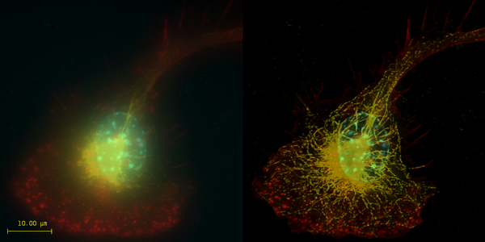
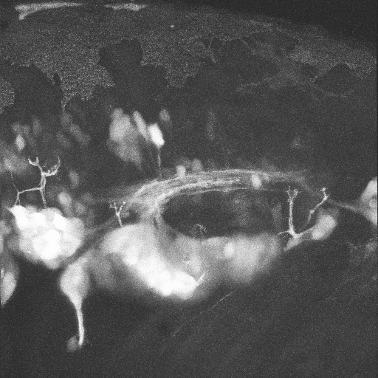
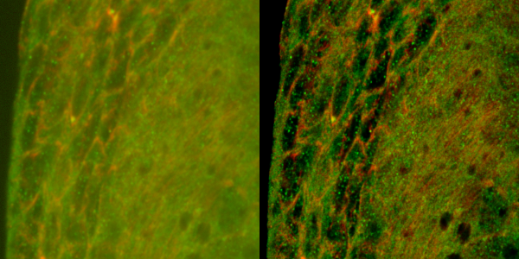
Optical sectioning even when 3D image stack is incomplete
Deconvolution
Confocal microscopy
A
A
P
Top: Macrophage - tubulin, actin & nucleus.
Bottom: Imaginal disc – α-tubulin, γ-tubulin.
Neural Gata-2 Promoter GFP-Transgenic Zebrafish; with Shuo Lin, UCLA
Notes:
Top right: Macrophage fluorescently stained for tubulin (yellow), actin (red) and the nucleus (DAPI, blue). Left: original image, recorded with a wide field microscope. Right: the same dataset, deconvolved using Huygens Professional. The datasets are visualized with top-view maximum intensity projections.
Data courtesy of Dr. James Evans, Whitehead Institute, MIT Boston MA, USA. (See the EvansMacrophage for more image details).
Bottom right: Detail of an imaginal disc from a third instar Drosophila Melanogaster larva. Left: a slice of the original data, imaged using an Andor Revolution spinning disc confocal microscope.Right: the same slice, deconvolved using Huygens Professional. The fixed sample was stained against alfa-tubulin (green) and gamma-tubulin (red).
Recorded by Dr. Paula Sampaio, Advanced Light Microscopy Facility, University of Porto.

