Slide 1
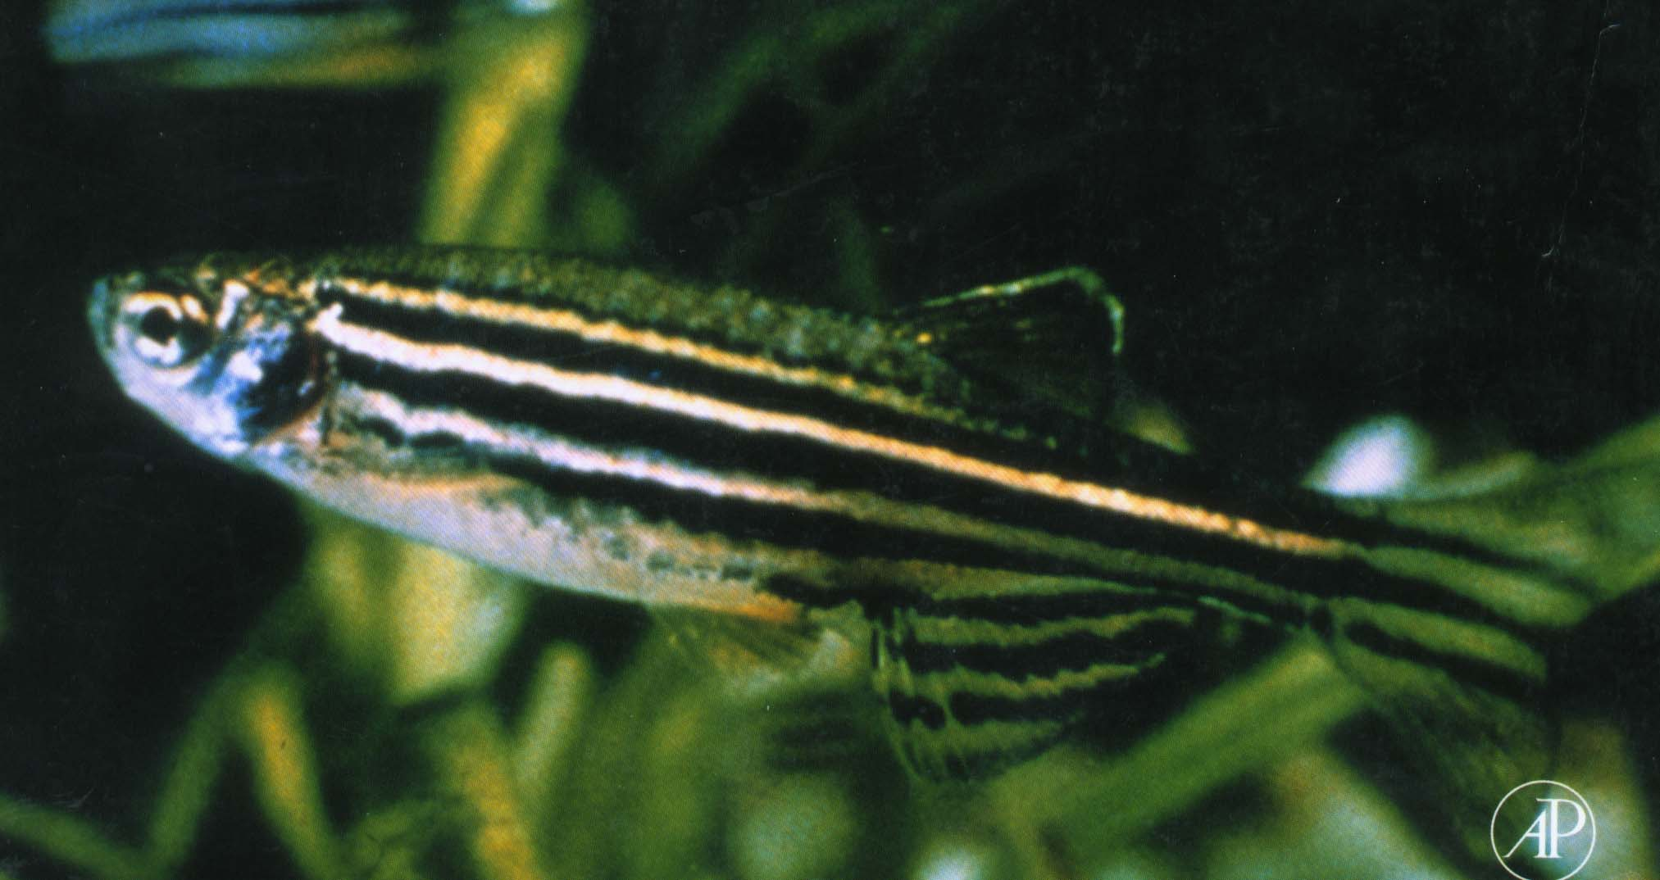
Biology 227: Methods in Modern Microscopy
Andres Collazo, Director Biological Imaging Facility
Steven Wilbert, Graduate Student, TA
Week 4 Live imaging: zebrafish embryos

Slide 2
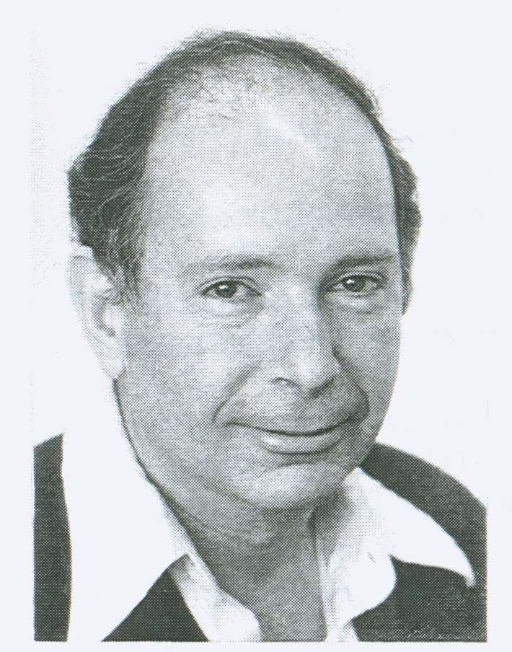
George Streisinger developed zebrafish as a model system
From Viruses to Zebrafish
A Vertebrate Genetic System

Slide 3
Number of Known Vertebrate Species and Taxonomic Distribution (Total 43,173)
Teleosts
Other Fishes
Salamanders
Other amphibians
Other vertebrates

Slide 4
Phylogeny of Deuterostomes
Echinoderms
Acorn Worms
Hemichordates
Amphioxus
Cephalochordates
Ascidians
Urochordates
Hagfish
Myxinoidea
Lamprey
Petromyzontida
Neural Crest
Shark
& Placodes
Chondrichthyes
Sturgeon
Chondrostei
Jawed
Gar
Vertebrates
Ginglymodi
Amia
Halecomorphi
Teleostei
Coelacanth
Actinistia
Lungfish
Dipnoi
Amniota
Amphibia

Slide 5
ADVANTAGES OF ZEBRAFISH
Small size
Rapid development
Genetic system
Transparent
Easy to manipulate embryos
All stages accessible

Slide 6
DISADVANTAGES OF ZEBRAFISH
Small size
Gene duplication
Not a mammal

Slide 7
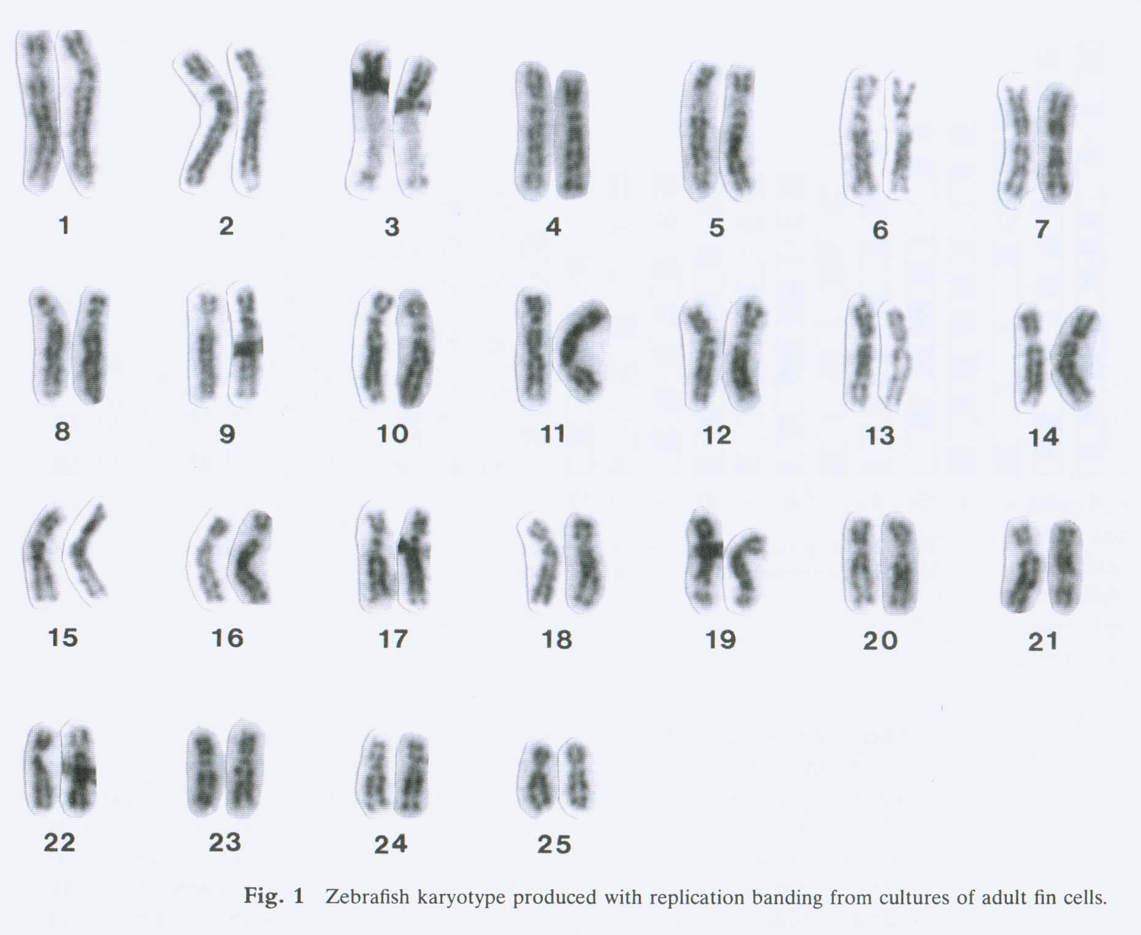
Zebrafish Chromosomes
Amores and Postlethwait 1999

Slide 8
Synteny between Fish and Humans
LG9 | Hsa2
hoxda | HOXD
evx2 | EVX2
dlx1 | DLX1
dlx2 | DLX2
Postlethwait et al. 1999.

Slide 9


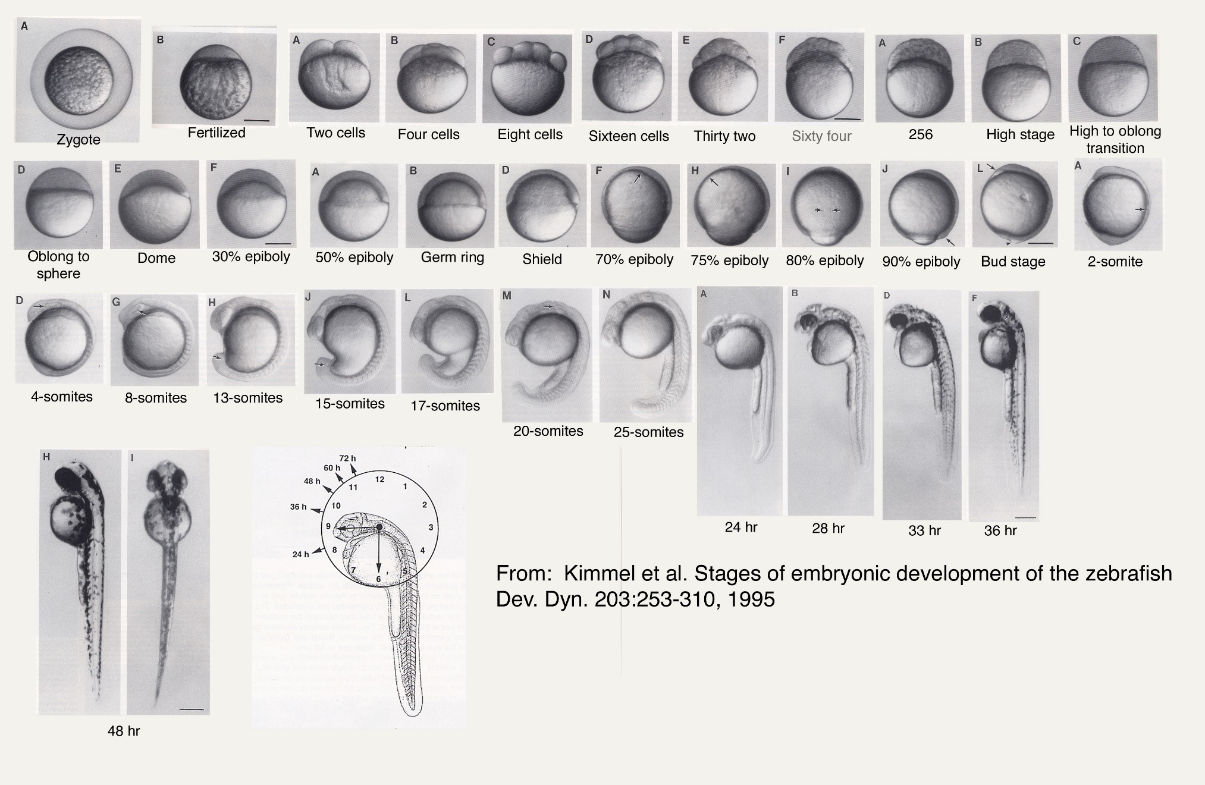
Zebrafish Development
Movies from Haffter et al. 1996

Slide 10
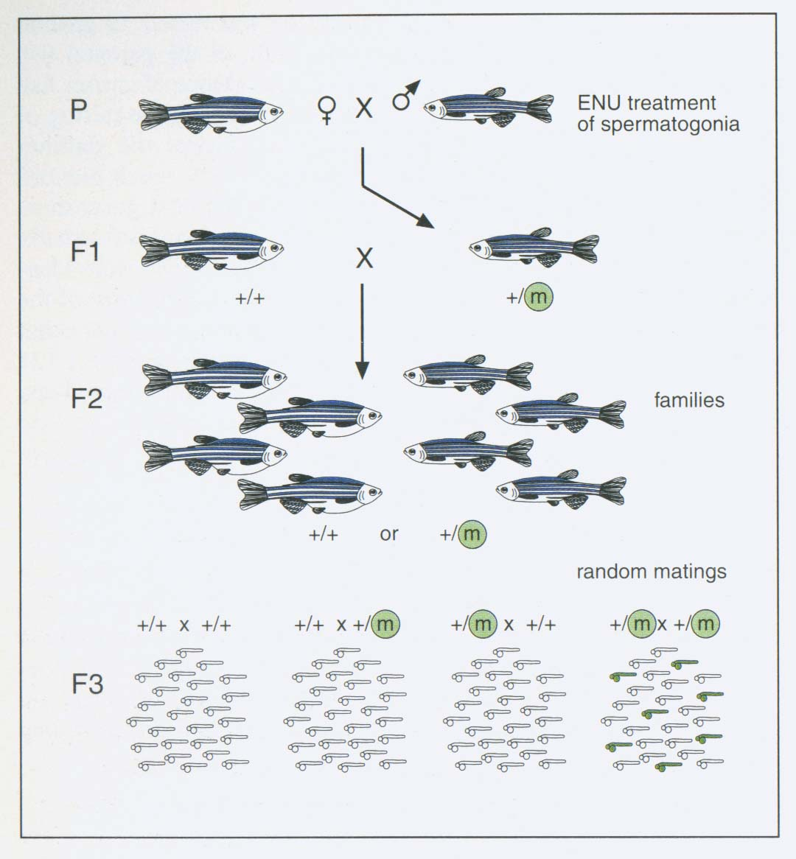
ENU (Ethylnitrosourea) Mutagenesis
Haffter et al. 1996

Slide 11
ZEBRAFISH ENU MUTAGENESIS

Slide 12
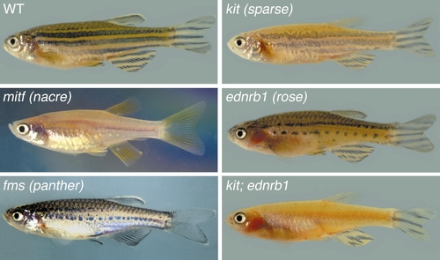
Examples of Zebrafish Mutants

Slide 13
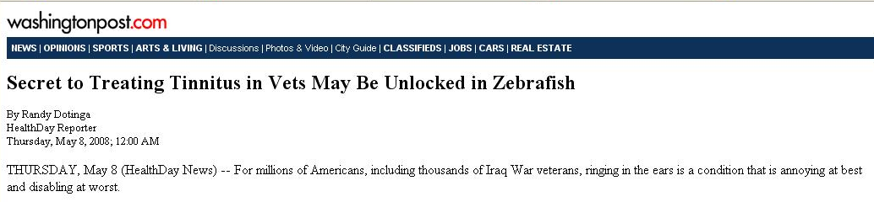
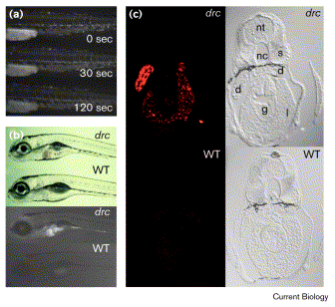

Zebrafish as a Model of Human Pathologies

Slide 14
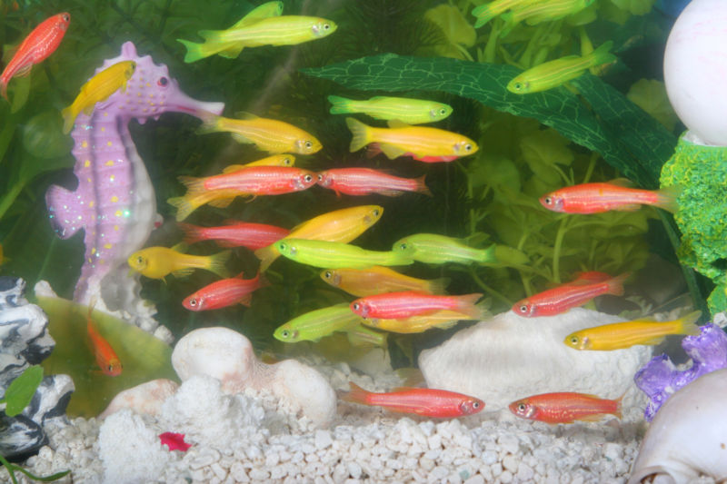
Transgenic Zebrafish

Slide 15
Week 4 Live imaging: zebrafish embryos
Tissue to be imaged is migratory cell type, the neural crest
Labeled with modified Brainbow protocol driven by Sox10 promoter
Will image using Zeiss Z1 light sheet fluorescence microscope
Steven will do the demo on the Z1 Wednesday during lab time.
Overnight time lapse of migrating neural crest cells
Notes:
PTU - 1-phenyl-2-thiourea

Slide 16
Week 4 Live imaging: zebrafish embryos
Modified Brainbow reagent.
Gupta V, Poss KD. Clonally dominant cardiomyocytes direct heart morphogenesis. Nature. 2012; 484 (7395):479-84.
Sox10 promoter line
Mongera A, Singh AP, Levesque MP, Chen YY, Konstantinidis P, Nusslein-Volhard C. Genetic lineage labeling in zebrafish uncovers novel neural crest contributions to the head, including gill pillar cells. Development. 2013; 140(4):916-25.

Slide 17
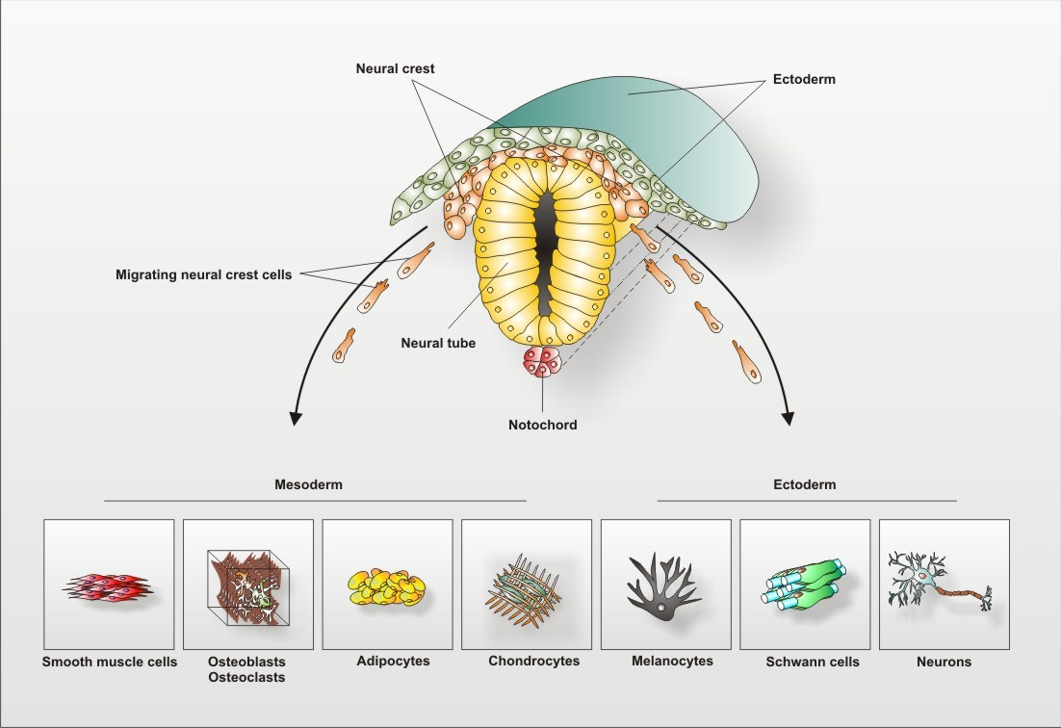
Neural crest: A migratory cell type
Notes:
Ectodermal tissues in embryo
Together form Peripheral Nervous System
Highly migratory
http://web.biologie.uni-bielefeld.de/cellbiology/index.php/research/neural-crest-derived-stem-cells

Slide 18
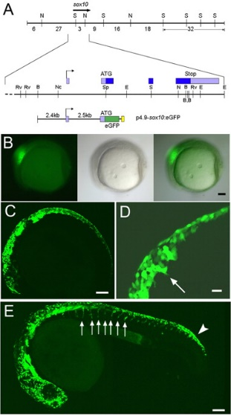
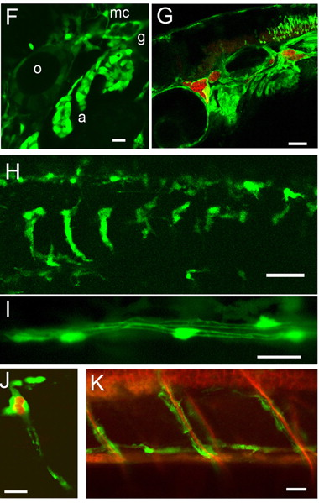
Sox 10 promoter drives GFP in zebrafish neural crest
Carney TJ, Dutton KA, Greenhill E, Delfino-Machín M, Dufourcq P, Blader P, Kelsh RN. 2006. A direct role for Sox10 in specification of neural crest-derived sensory neurons. Development 133:4619-4630.

Slide 19
ENU (Ethylnitrosourea) Mutagenesis
Haffter et al. 1996

Slide 20
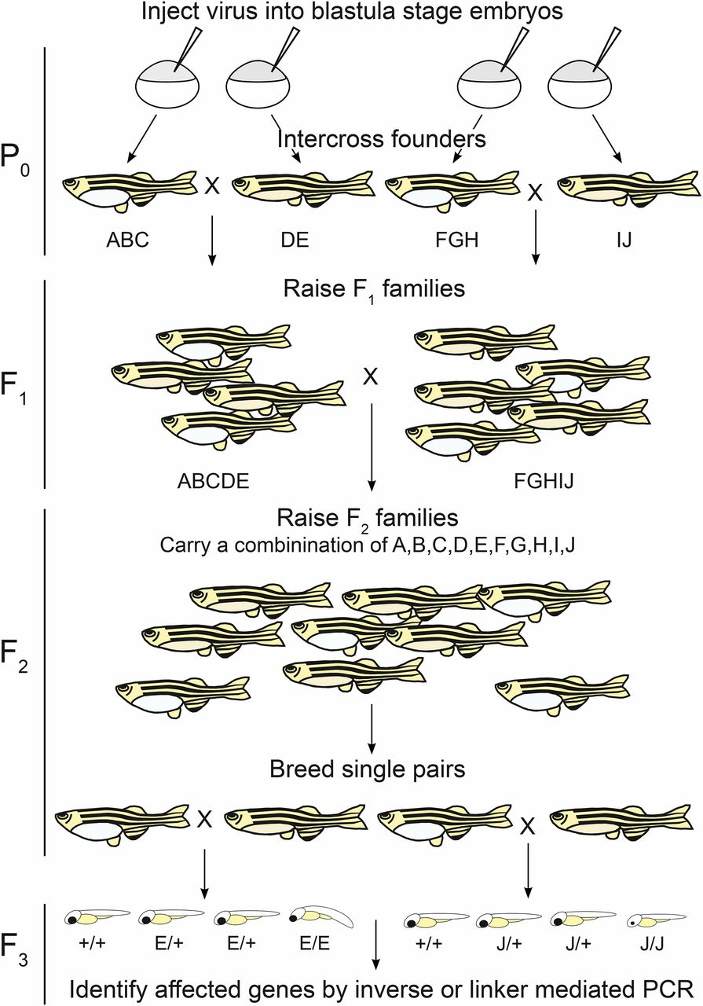
Insertional mutagenesis screen from Nancy Hopkin’s lab at MIT
Holtzman, N.G., Iovine, M.K., Liang, J.O., Morris, J., 2016. Learning to Fish with Genetics: A Primer on the Vertebrate Model Danio rerio. Genetics 203, 1069-1089.
Notes:
. The gene af-fected by the insertion is identified by inverse or linker-mediated PCR, which amplifies genomic DNA flanking the insertion. Figure based on Amsterdam(2003) and Huanget al.(2012)

Slide 21
Flip trap screen (http://www.fliptrap.org)
Le Trinh et al. Gene Dev. 2011
Transposon based gene trapping technology (Tol2)
Gene trapping vector: Citrine (YFP) flanked by splice acceptor & donor, forward orientation; mCherry (RFP) polyadenylation signal, reverse orientation; lox & FRT sites
Notes:
Visualize proteome via fluorescent tagging of full-length endogenous proteins
Flip trap screen done in the laboratories of Scott Fraser and Marianne Bronner at Caltech published in 2011

Slide 22
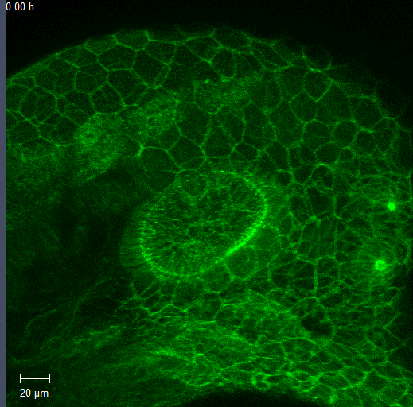
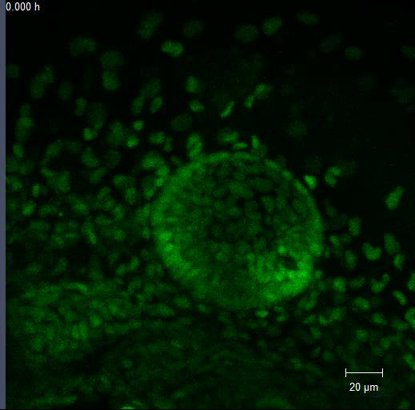
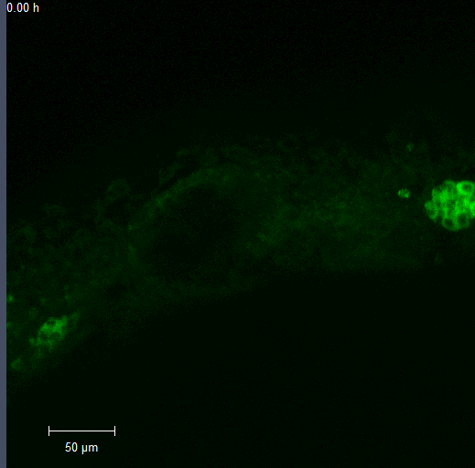
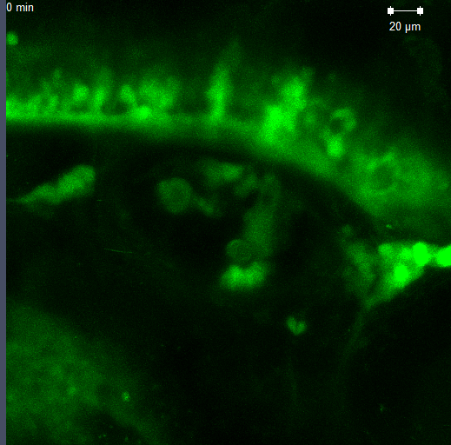
Time lapse movies of developing zebrafish: Focus on the inner ear and surrounding tissues
α- Catenin
Hmga2
Cell Membrane
Nuclei
Rbms3
Rab3ab
Cytoplasm
Cytoplasm+Nuclei

Slide 23
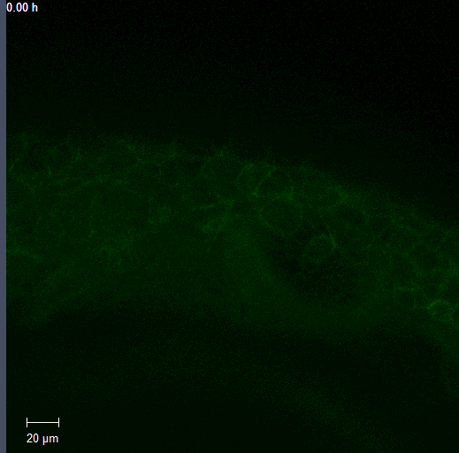
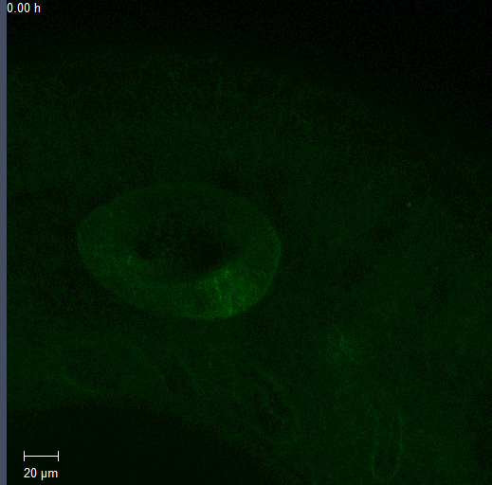
Examples of time lapses showing neural crest
Erythrocyte Membrane Protein Band 4.1-like 3b (Epb41l3b)
Time lapse 18+ hours, beginning at ~30 hpf, end at ~2 dpf
Discs large homolog 1-like protein (Dlg1l)
Time-lapse 18 hours, 10 min; Starting at ~28 hpf

Slide 24
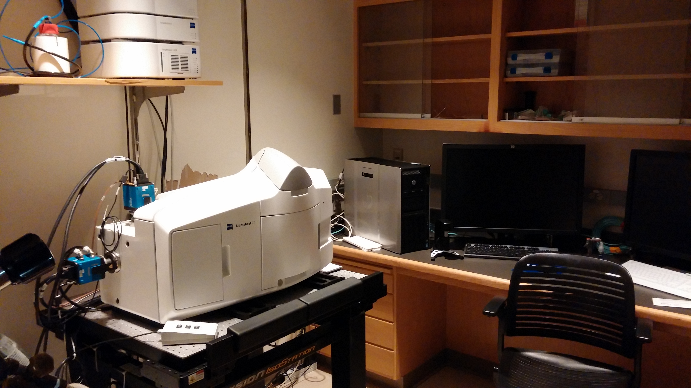
Zeiss Z1 digital light sheet fluorescence microscope. Meet Wednesday in BI rm B133

