Slide 1
Biology 227: Methods in Modern Microscopy
Andres Collazo, Director Biological Imaging Facility
Chai Tong Ng, Graduate Student, TA
Week 5 Fluorescent Correlation Spectroscopy (FCS) vs Fluorescent recovery after photobleaching (FRAP)

Slide 2
Fluorescence correlation spectroscopy (FCS)
In 1972 Watt Webb’s laboratory at Cornell put fluorescence microscopy to new use
Studied reaction kinetics
Ethidium bromide binding to DNA
  Individually don’t fluoresce but together glow under UV
Could detect single molecules but could not repeatedly detect the same molecule
Notes:
http://www.nature.com/milestones/milelight/full/milelight10.html
1990 invented two photon confocal microscopy

Slide 3
Fluorescent recovery after photobleaching (FRAP)
FRAP has been around since 1976
Again developed by Watt Webb’s laboratory at Cornell
Unlike FCS not a single molecule technique
Looks at dynamics of populations of molecule
Though it’s been around for a while can you guess what development really made FRAP take off?
Notes:
http://www.ncbi.nlm.nih.gov/pmc/articles/PMC1334945/

Slide 4
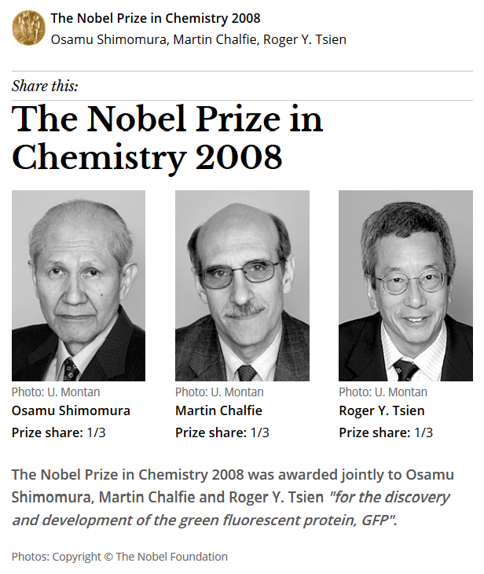
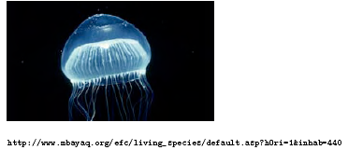
Green Fluorescent Protein
From marine invertebrate, Crystal jelly (Aequorea Victoria)
Can be coded in genes and made by the organism

Slide 5
Techniques for studying molecular diffusion
Fluorescence correlation spectroscopy (FCS)
Fluorescent recovery after photobleaching (FRAP)
Notes:
http://www.ncbi.nlm.nih.gov/pmc/articles/PMC1334945/

Slide 6
Techniques for studying molecular diffusion
Fluorescence correlation spectroscopy (FCS)
Fluorescent recovery after photobleaching (FRAP)
Notes:
http://www.ncbi.nlm.nih.gov/pmc/articles/PMC1334945/

Slide 7
Fluorescence Fluctuation Spectroscopy (FFS)
Fluorescence Correlation Spectroscopy (FCS)
Photon Counting Histogram (PCH)
Fluorescence Cross-Correlation Spectroscopy (FCCS)
  FCS with more than 1 color

Slide 8
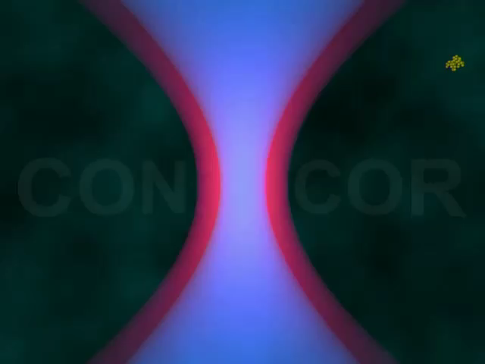
Fluorescence Fluctuation Spectroscopy (FFS)
Causes of fluctuations
Diffusion of labeled molecules due to Brownian motion
  In cells wide range of things cause movement (cellular trafficking, protein interaction etc.)
Photophysical processes of labeled molecules

Slide 9
Fluctuations Carry the Information
Measured intensity fluctuations reflects (mobile fraction only)
  Number of particles
    concentration
  Diffusion of particles
    interaction
  Brightness
    Oligomerization
A particle that transits the confocal volume will generate groups of pulses.
  The correlation function calculates the mean duration time t of these groups.
  The variance/histogram of the signal yields information about oligomeric state
δI(t)
<I(t)>
δI(t)
FCS
PCH
Notes:
The principle of FCS is being able to observe one or a few fluorescent particles enter and leave a small illuminated volume. If the sample, solution or cell, has a high concentration of tagged molecules it becomes hard to observe the needed fluctuations. I generally give the analogy of a crowded lecture hall. If the lecture hall is crowded and you were observing the lecture hall you would be less apt to notice if some one entered or left the room (i.e. a small fluctuation from the mean number of people in the hall). If only a few people were in the hall, then if someone left it would be very easy to notice (i.e. a large fluctuation from the mean number of people in the hall). This is why a large immobile population is not good for FCS. Fluctuations about the mean intensity is the information used for all FFS techniques.

Slide 10
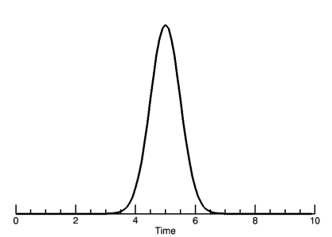
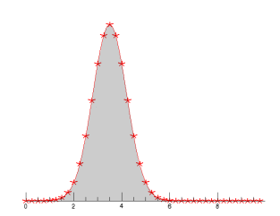
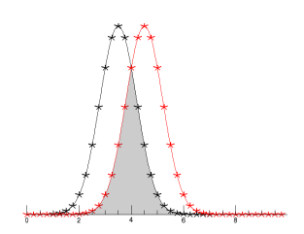
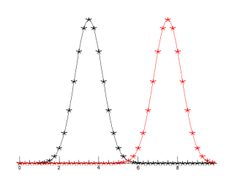
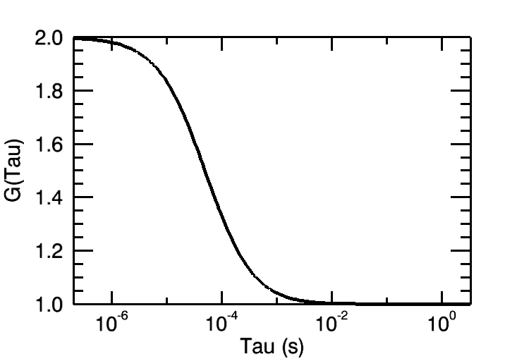
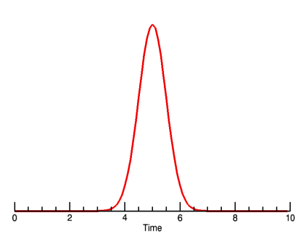
Creating the Autocorrelation Function
τ=0
τ=τ_{D}
τ=inf
Photon Burst
δI(t)
δI(t+τ)
“Copy” signal
Notes:
The fluctuations generated can be analyzed in many ways. FCS relies on the auto-correlation function which is a signal processing technique. The autocorrelation compares a signal against itself. In this case, a particle enters the focal volume and generates a photon burst. The collected signal is “copied” and the two copies are compared against one another as you shift the “copy” in time. The copy signal is shifted by some amount of time given by the greek symbol tau. All data analysis will be done in reference to the shift time tau.

Slide 11
Autocorrelation Yields Diffusion and Concentration
Fit Autocorrelation curve for Diffusion time (τ_{D}) and particle concentration N
Notes:
The larger the particle, the longer it will take to transverse the focal volume thus the photon burst will be longer in time. This results in the correlation function moving the left for larger particles. The diffusion time gives information about the diffusion coefficient, the molecular weight and possibly the viscosity of the media. The correlation curve amplitude is inversely proportional to the particle concentration. The concentration, N, is the average number of molecules in the focal volume at one time. Standard dye solutions with known diffusion coefficients can be used to characterize the focal volume. Once that is done, you can use the focal volume information and the Number of particles to get an accurate measure of the MOBILE concentration (mol/L). The curve amplitude being inversely proportional to the particle number makes sense because the higher the N, the smaller the fluctuations will be from the mean intensity giving less correlation.
ALL DATA IS FIT USING A NON-LINEAR LEAST SQUARES ERRORS FUNCTION TO GET DIFFUSION TIMES AND N. You will run the risk of getting bad results with bad curve fitting or curve fitting interpretation.

Slide 12
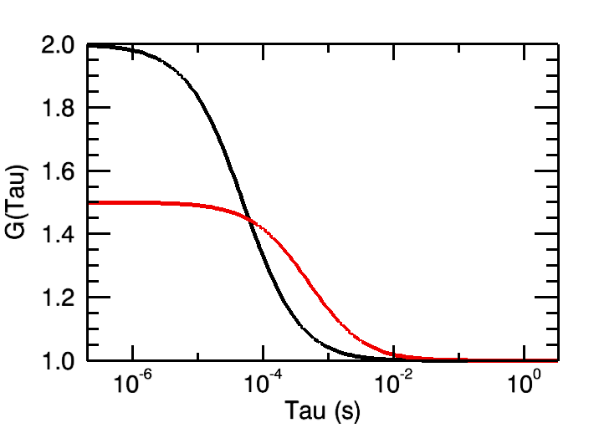
Autocorrelation Yields Diffusion and Concentration
Fit Autocorrelation curve for Diffusion time (τ_{D}) and particle concentration N
Notes:
The larger the particle, the longer it will take to transverse the focal volume thus the photon burst will be longer in time. This results in the correlation function moving the left for larger particles. The diffusion time gives information about the diffusion coefficient, the molecular weight and possibly the viscosity of the media. The correlation curve amplitude is inversely proportional to the particle concentration. The concentration, N, is the average number of molecules in the focal volume at one time. Standard dye solutions with known diffusion coefficients can be used to characterize the focal volume. Once that is done, you can use the focal volume information and the Number of particles to get an accurate measure of the MOBILE concentration (mol/L). The curve amplitude being inversely proportional to the particle number makes sense because the higher the N, the smaller the fluctuations will be from the mean intensity giving less correlation.
ALL DATA IS FIT USING A NON-LINEAR LEAST SQUARES ERRORS FUNCTION TO GET DIFFUSION TIMES AND N. You will run the risk of getting bad results with bad curve fitting or curve fitting interpretation.

Slide 13
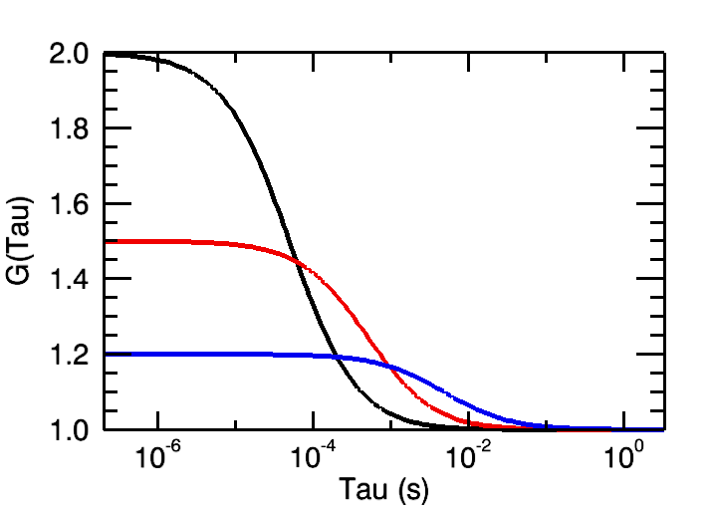
Autocorrelation Yields Diffusion and Concentration
Fit Autocorrelation curve for Diffusion time (τ_{D}) and particle concentration N
Notes:
The larger the particle, the longer it will take to transverse the focal volume thus the photon burst will be longer in time. This results in the correlation function moving the left for larger particles. The diffusion time gives information about the diffusion coefficient, the molecular weight and possibly the viscosity of the media. The correlation curve amplitude is inversely proportional to the particle concentration. The concentration, N, is the average number of molecules in the focal volume at one time. Standard dye solutions with known diffusion coefficients can be used to characterize the focal volume. Once that is done, you can use the focal volume information and the Number of particles to get an accurate measure of the MOBILE concentration (mol/L). The curve amplitude being inversely proportional to the particle number makes sense because the higher the N, the smaller the fluctuations will be from the mean intensity giving less correlation.
ALL DATA IS FIT USING A NON-LINEAR LEAST SQUARES ERRORS FUNCTION TO GET DIFFUSION TIMES AND N. You will run the risk of getting bad results with bad curve fitting or curve fitting interpretation.

Slide 14
Fitting with Correct Model
Schwille and Haustein 2004

Slide 15
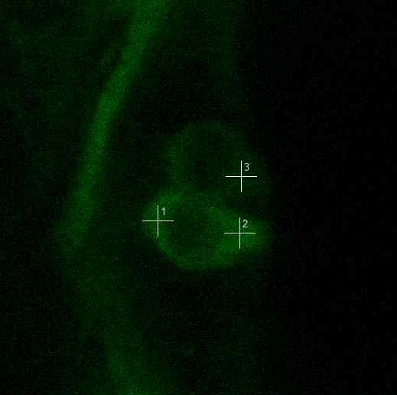
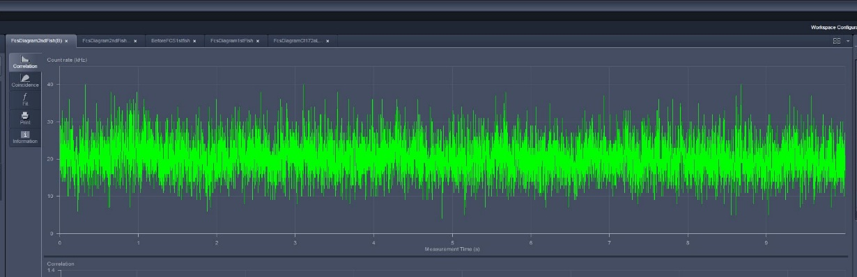

Work Flow for FCS
1
Gnb2 in Hair Cells
Diffusion coefficient:
ωr²
4τ_{d,i}
D=
2
Autocorrelation function:
G(τ)=1+G_{t}(τ)*G_{d}(τ)
Principle steps
Measuring fluctuation intensities
Calculating correlation function
Fitting to biophysical model
3
Blinking correlation:
G_{t}(τ)=1+
T_{b}*e^{-τ/τ}_{b}
1-T_{b}
Translational correlation:
Φ_{Ι}
G_{d}(τ)=
e_{d2}
τ
α_{Ι}
e_{d1}
τ_{d,i}
0.5
1+
τ_{d,i}
1+
τ
α_{Ι}
1
S
*
*

Slide 16
Work Flow for FCS
1
Gnb2 in Hair Cells
Diffusion coefficient:
ωr²
4τ_{d,i}
D=
2
Autocorrelation function:
G(τ)=1+G_{t}(τ)*G_{d}(τ)
Principle steps
Measuring fluctuation intensities
Calculating correlation function
Fitting to biophysical model
3

Slide 17
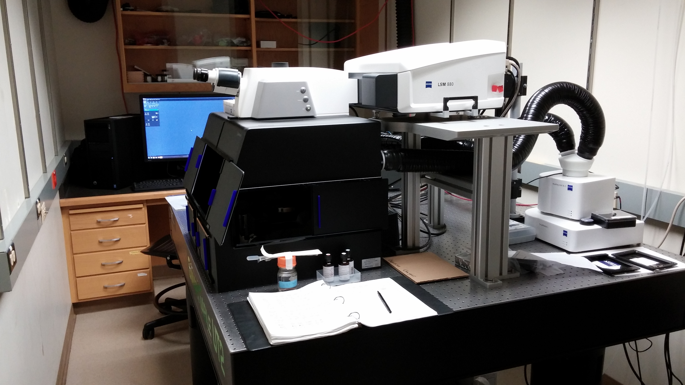
Zeiss LSM 880: FCS Setup on a Laser Scanning Confocal Microscope
Gallium arsenide phosphide (GaAsp) detectors
Single Photon Sensitivity
Focus to tiny volume (<1 femtoliter)
Schwille and Haustein 2004
Notes:
http://www.photonics.com/EDU/Handbook.aspx?AID=25535

Slide 18
Fluorescence Fluctuation Spectroscopy (FFS)
Diffusion coefficient:
ωr²
4τ_{d,i}
D=
Bacia et al., Nature Methods 2006
Notes:
Bacia, K., Kim, S.A., Schwille, P., 2006. Fluorescence cross-correlation spectroscopy in living cells. Nat Methods 3, 83-89.

Slide 19
Techniques for studying molecular diffusion
Fluorescence correlation spectroscopy (FCS)
Fluorescent recovery after photobleaching (FRAP)
Notes:
http://www.ncbi.nlm.nih.gov/pmc/articles/PMC1334945/

Slide 20
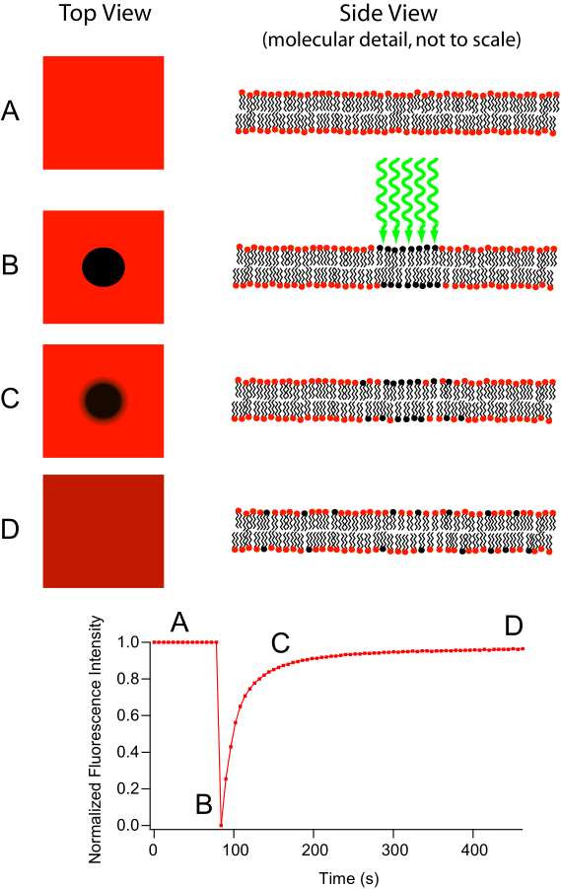
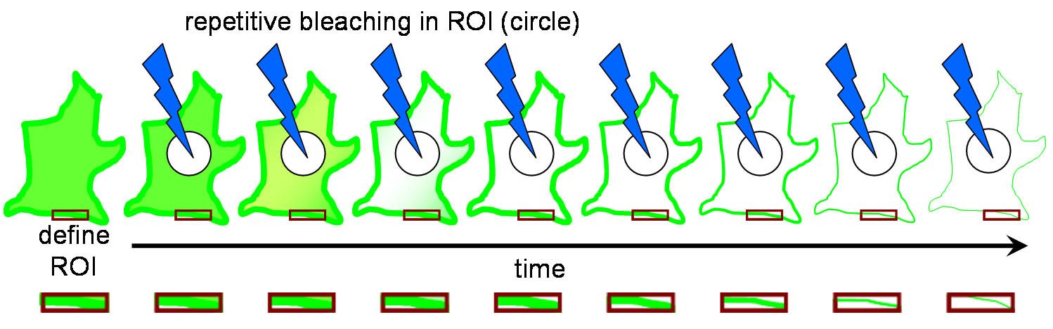
Fluorescent recovery after photobleaching (FRAP)
Diffusion coefficient:
ωr²
4τ_{d,i}
D=
Like FCS also used for calculating diffusion
Fluorescence Loss in Photobleaching (FLIP) related technique
Primary use of FLIP is to determine continuity of membranous organelles.
Notes:
The major difference between these two microscopy techniques is that FRAP involves the study of a cell’s ability to recover after a single photobleaching event whereas FLIP involves the study of how the loss of fluorescence spreads throughout the cell after multiple photobleaching events. This difference in purpose also leads to a difference in what parts of the cell are observed. In FRAP, the area that is actually photobleached is the area of interest. Conversely, in FLIP, the region of interest is just outside the region that is being photobleached. Another important difference is that in FRAP, there is a single photobleaching event and a recovery period to observe how well fluorophores move back to the bleached site. However, in FLIP, multiple photobleaching events occur to prevent the return of unbleached fluorophores to the bleaching region.
http://en.wikipedia.org/wiki/Fluorescence_loss_in_photobleaching
http://en.wikipedia.org/wiki/Fluorescence_recovery_after_photobleaching
http://www.olympusconfocal.com/applications/flipandfrap.html
"Frap diagram" by MDougM - Own work. Licensed under Public Domain via Wikimedia Commons - http://commons.wikimedia.org/wiki/File:Frap_diagram.svg#mediaviewer/File:Frap_diagram.svg
"Fluorescence Loss in Photobleaching Schematic" by Steven Lentz - was sent to me personally. Licensed under CC BY-SA 3.0 via Wikimedia Commons - http://commons.wikimedia.org/wiki/File:Fluorescence_Loss_in_Photobleaching_Schematic.jpg#mediaviewer/File:Fluorescence_Loss_in_Photobleaching_Schematic.jpg

Slide 21
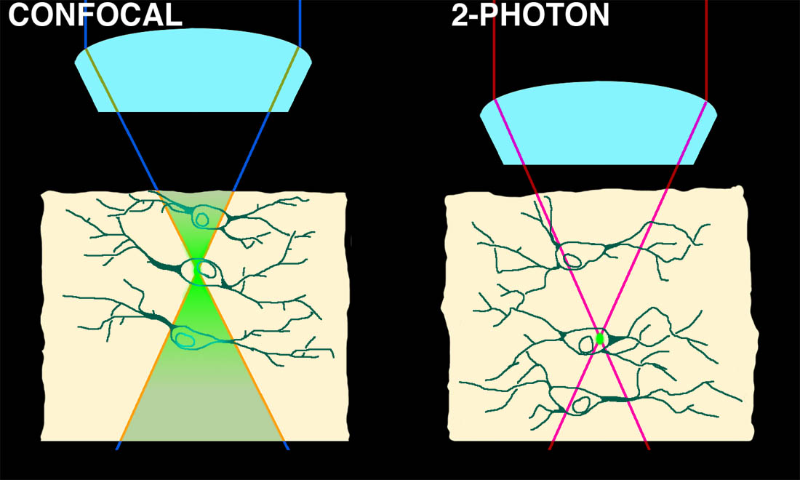

Two-Photon microscopy: Good for FRAP?
Optical sectioning by non-linear absorbance
Notes:
While FRAP has been around for a while what development really made this technique take off?

Slide 22
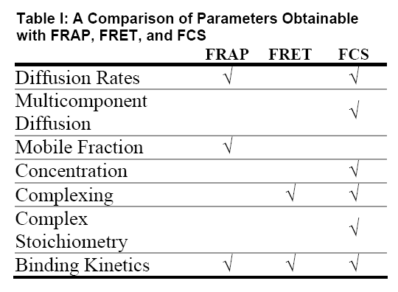
Techniques for studying molecular diffusion
Fluorescence correlation spectroscopy (FCS)
Fluorescent recovery after photobleaching (FRAP)
Table: http://www.fcsxpert.com/
Notes:
http://www.ncbi.nlm.nih.gov/pmc/articles/PMC1334945/

Slide 23
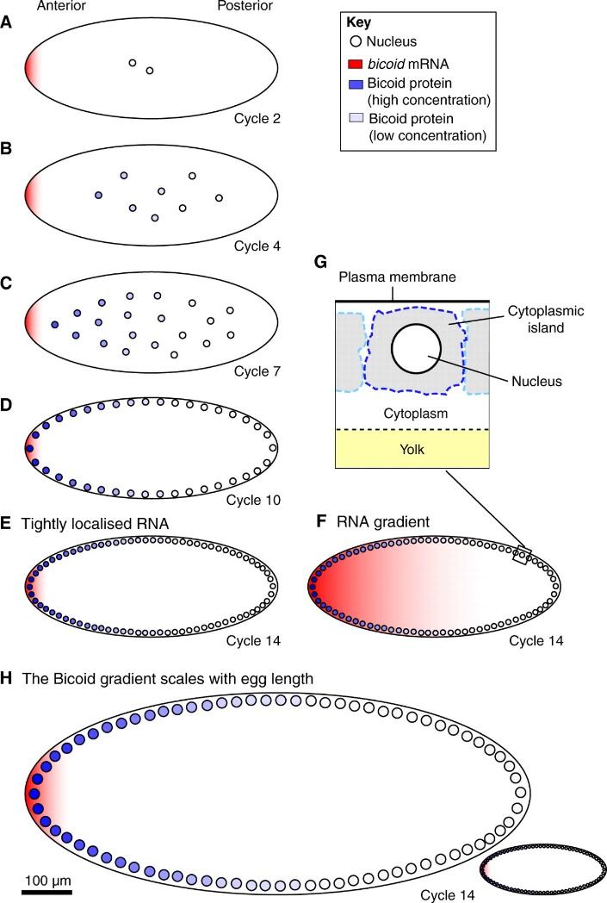
But what do you do when FRAP and FCS give different results?
Drosophila bicoid protein gradient
With FRAP measured D=0.3 μm²/second
With FCS measured D=∼7 μm²/second
Which result do you believe?
Notes:
http://www.sciencedirect.com/science/article/pii/S0092867407006630
Wieschaus Cell paper
http://www.ncbi.nlm.nih.gov/pmc/articles/PMC2920644/
FCS paper
Development paper by Wieschaus reviewing his result
http://dev.biologists.org/content/137/14/2253.full
Schematic of the Bicoid gradient in the syncytial Drosophila embryo. (A-G) Bicoid, as a transcription factor, accumulates within nuclei during interphase. The nuclear Bicoid gradient, which decreases in concentration with distance from the anterior pole, forms in less than 3 hours in a Drosophila embryo that is ~500 μm long (AP axis) and can be observed (B) before nuclei migrate to the surface of the embryo. During the first ~80 minutes (corresponding to cell cycles 1-8), nuclei proliferate in the centre of the embryo (A-C), and then migrate to the surface of the embryo in cycle 9. During the last five cell cycles, nuclei divide at the surface of the embryo (D,E). Nuclei replicate every ~9 minutes during the first nine cell cycles, but this slows to ~20 minutes in cycle 13. Nuclei are ~10 μm in diameter in pre-cycle 14 embryos (A-D) but ~6 μm in cycle 14 (E). The extent to which the mRNA encoding Bicoid, which is initially tightly localised to the anterior pole (A), becomes delocalised is a matter of controversy. Two alternative bicoid RNA distributions during cycle 14 are shown in E and F. (G) Illustration of the nucleus and surrounding cytoplasm. (H) In species that produce larger or smaller eggs than Drosophila melanogaster, the Bicoid gradient scales with egg length.

Slide 24
Do FRAP and FCS give different results?
You will do the experiment in same cell type
Recent paper did this experiment:
  Macháň, R., Foo, Yong H., Wohland, T., 2016. On the Equivalence of FCS and FRAP: Simultaneous Lipid Membrane Measurements. Biophysical Journal 111, 152-161.
Paper presents a hypothesis for why these techniques sometimes give different results
Notes:
Macháň, R., Foo, Yong H., Wohland, T., 2016. On the Equivalence of FCS and FRAP: Simultaneous Lipid Membrane Measurements. Biophysical Journal 111, 152-161.
Bleaching correction

Slide 25
Techniques for studying molecular diffusion
Fluorescence correlation spectroscopy (FCS)
Fluorescent recovery after photobleaching (FRAP)
Notes:
http://www.ncbi.nlm.nih.gov/pmc/articles/PMC1334945/

Slide 26
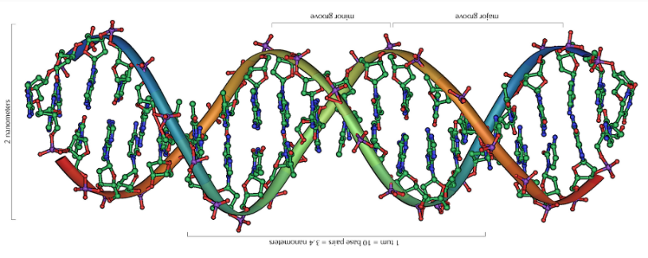
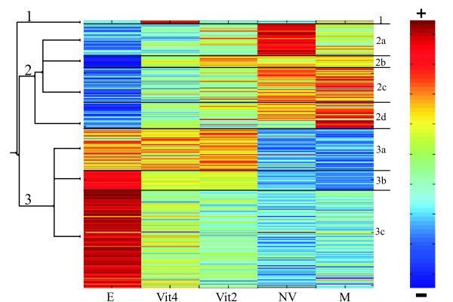
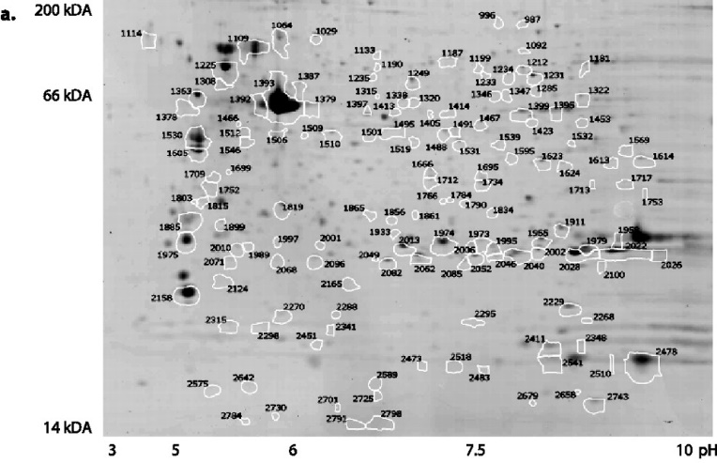
Meeting Summary on Impact of Genomics on Drug Discovery and Development
Genome (What could happen)
Transcriptome (What might be happening)
Levi, L., et al. (2009). Revealing genes associated with vitellogenesis in the liver of the zebrafish (Danio rerio) by transcriptome profiling. BMC Genomics 10, 141.
Proteome (What is happening)
Lucitt, M. B., et al. (2008). Analysis of the Zebrafish Proteome during Embryonic Development. Molecular & Cellular Proteomics 7, 981-994.
Rastan, S. (2001). Genomics: saviour or millstone? Trends in Genetics 17, 247-248.

Slide 27
Flip trap screen (http://www.fliptrap.org)
Le Trinh et al. Gene Dev. 2011
Transposon based gene trapping technology (Tol2)
Gene trapping vector: Citrine (YFP) flanked by splice acceptor & donor, forward orientation; mCherry (RFP) polyadenylation signal, reverse orientation; lox & FRT sites
Notes:
Visualize proteome via fluorescent tagging of full-length endogenous proteins
Flip trap screen done in the laboratories of Scott Fraser and Marianne Bronner at Caltech published in 2011

Slide 28
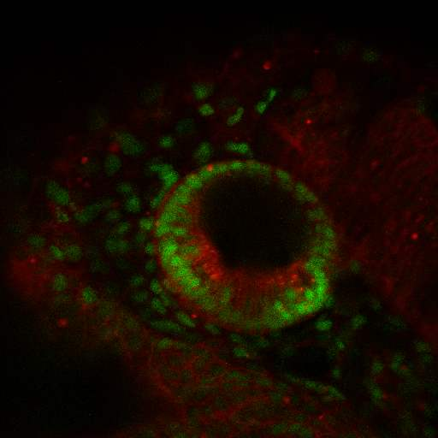
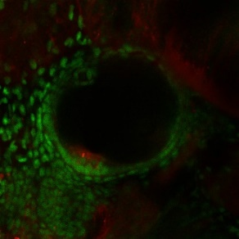
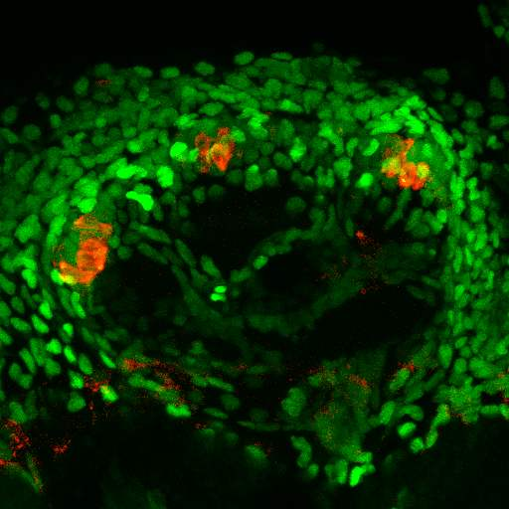
Flip Trap Screen Labels Endogenous Proteins:
Different Sub-Cellular Compartments and Cell Types
Zebrafish Ear Development
α- Catenin
Hmga2
Hmga2
1 day
memCherry
Cell Membrane
Nuclei
2 days
Rbms3
Rab3ab
memCherry
3-4 days
FM1-43
Cytoplasm
Cytoplasm+Nuclei

Slide 29
Nucleus has Distinct Structural and Functional Compartments
Lanctot, C., T. Cheutin, et al. (2007). "Dynamic genome architecture in the nuclear space: regulation of gene expression in three dimensions." Nat Rev Genet 8(2): 104-115.

Slide 30
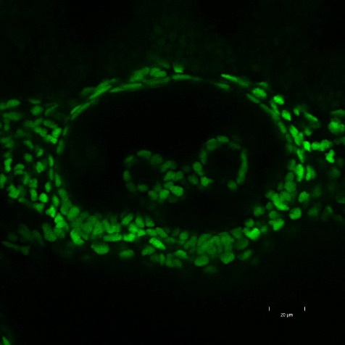
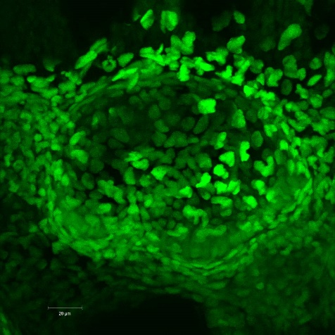
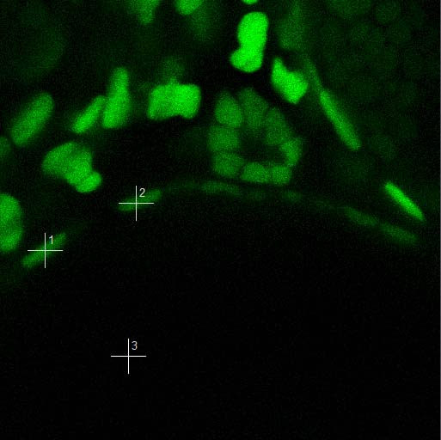
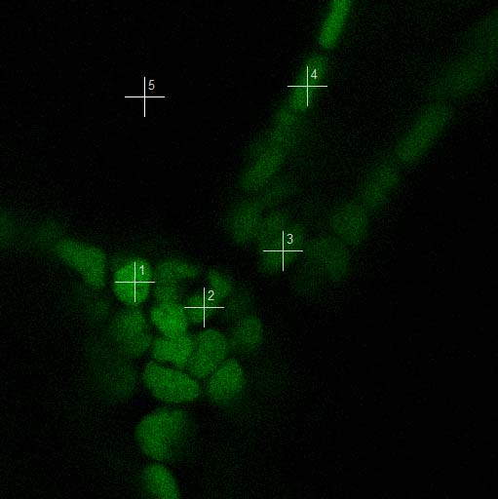
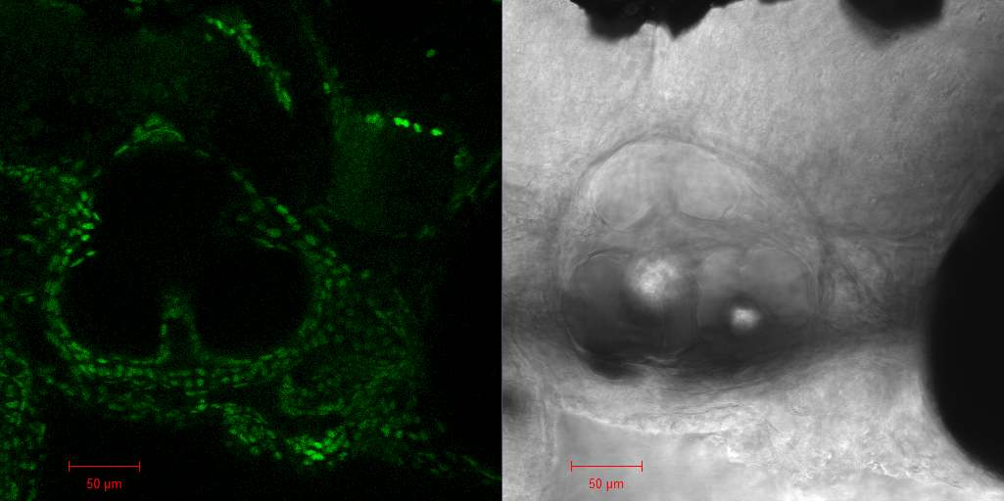
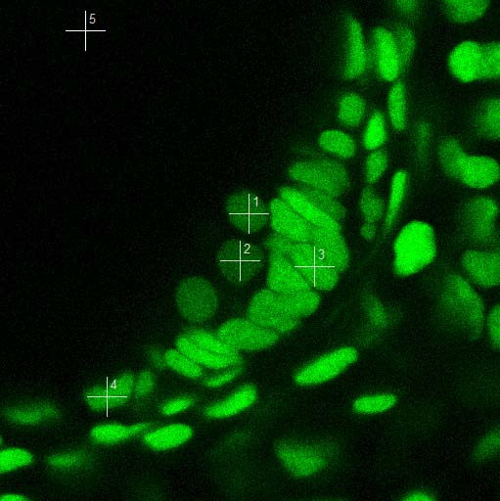
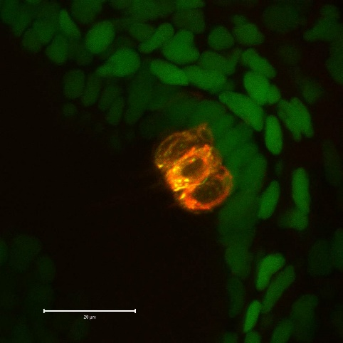
FCS + Ubiquitously Expressed Proteins Can Reveal Hidden Variations
High Mobility Group AT-Hook 2 (Hmga2)
SA
citrine
SD
pA
mCherry
Expressed in all nuclei
Part of transcriptional complex
Down-regulated in hair cells
Hmga2
transcription
citrine
AT-hook
55 hpf
Z-Proj
Dorsal roof
76 hpf
Canal
76 hpf
76 hpf
Hair cells
80 hpf
D
FM1-43
A

Slide 31
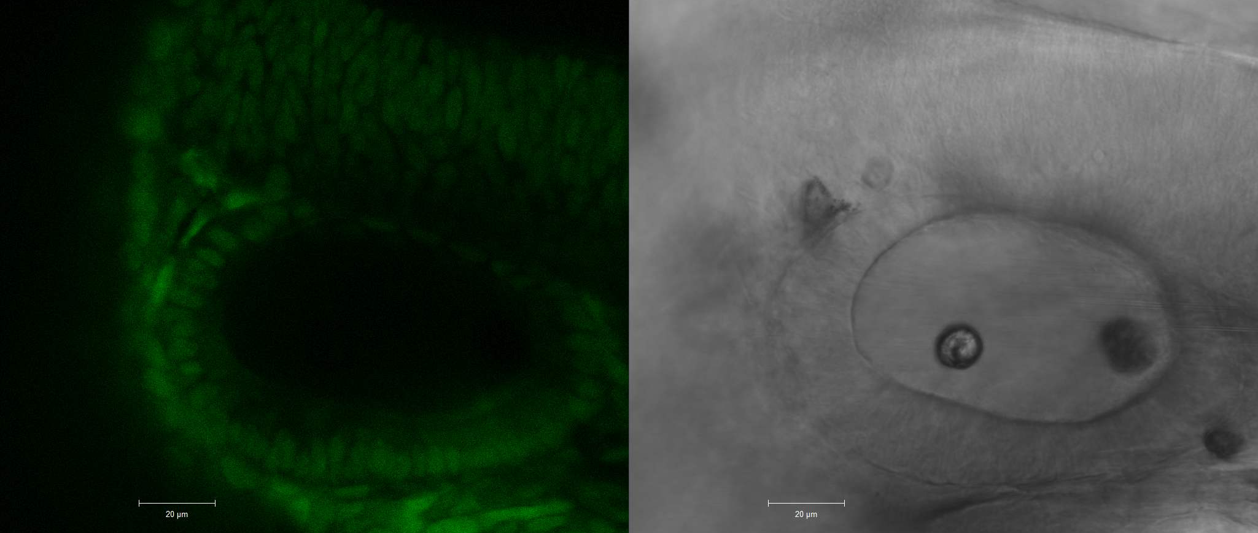
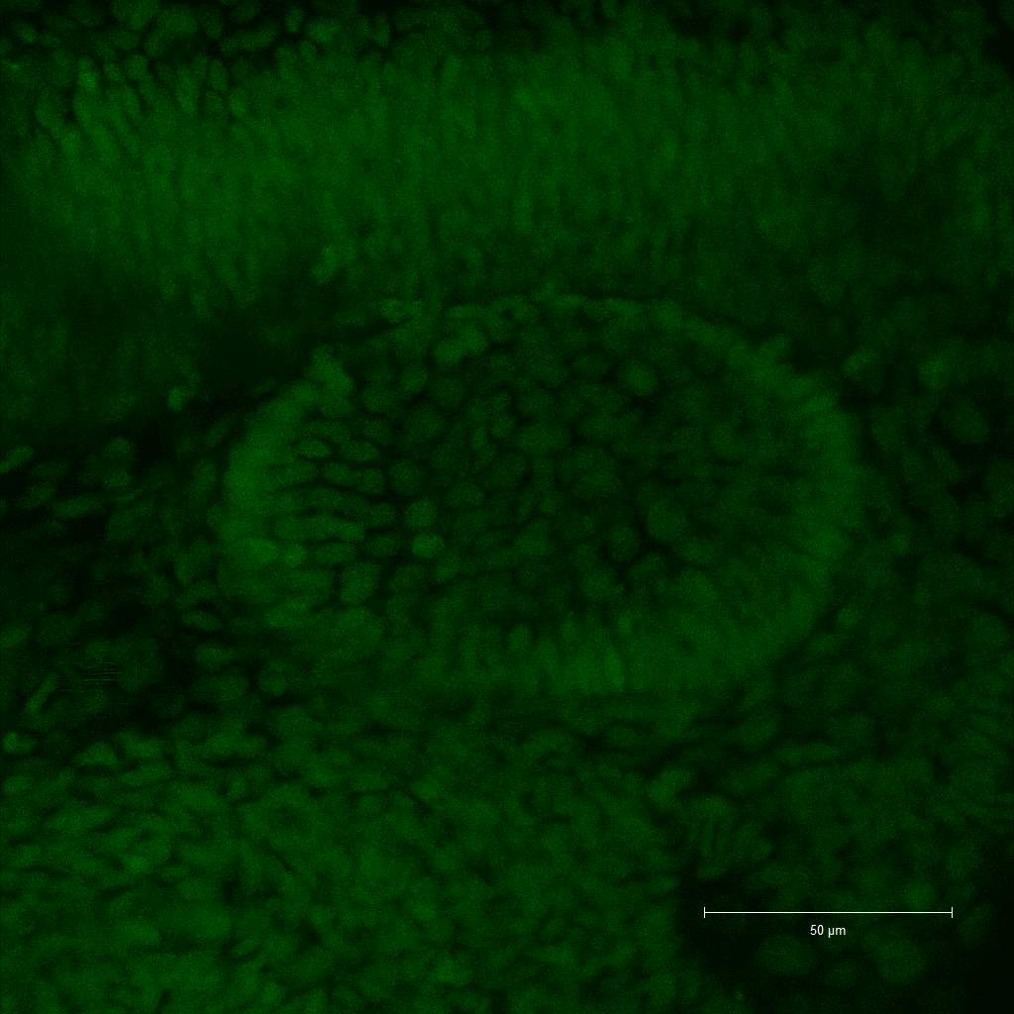
Synergistic Lethal with U5 snRNA 7 (Slu7)
Another Ubiquitously Expressed Nuclear Protein
Different nuclear compartment than Hmga2
Part of pre-mRNA spliceosome complex
Also down-regulated in hair cells
SA
citrine
SD
pA
mCherry
SLU7
5’
snRNP
3’
spliceosome
complex
Znf
citrine
27 hpf
30 hpf
Z-Proj
D
D
A
A

Slide 32
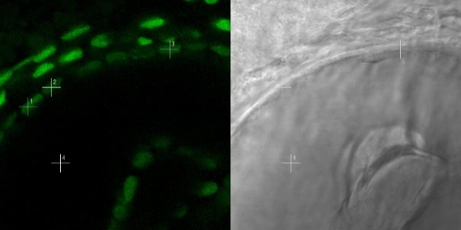
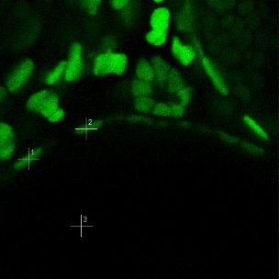
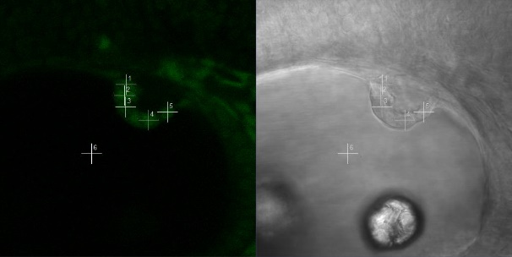
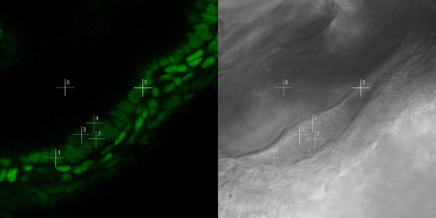
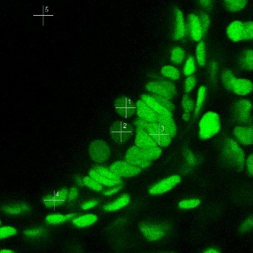
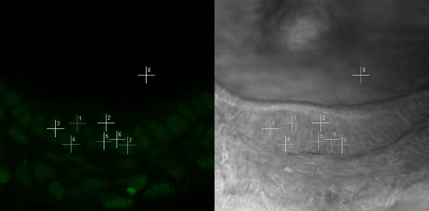
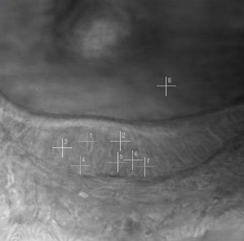
In Vivo Readout of Transcriptional Activity:
Faster Mobility in Dorsal Roof Cells
Gt(hmga2-citrine)^{ct29a}
Gt(slu7-citrine)^{ct94a}
55 hpf
76 hpf
48 hpf
P=4.3 x10⁻³
P=3.1x10⁻³
P=2.4x10⁻³
Diffusion Coeff. (μm²/sec)
Diffusion Coeff. (μm²/sec)
N=11
N=13
N=24
N=22
N=8
N=39
N=16
N=8
N=8
hair
cells
support
cells
canal
cells
dorsal
roof
hair-
cells
support
cells
canal
apex
canal
base
dorsal
roof

Slide 33
Developmental Stage Dependent Decrease of Histone (H2B) Mobility in Dorsal Roof Cells
H2B mobility at 30hpf
H2B mobility at 50hpf
P=0.19
P=6.9x10⁻³
Diffusion Coeff. (μm²/sec)
Diffusion Coeff. (μm²/sec)
N=16
N=8
N=23
N=20
N=12
N=17
N=18
hair
cells
support
cells
dorsal
roof
hair
cells
support
cells
canal
cells
dorsal
roof
Model
Hmga2
SLU7
3’
5’
snRNP
faster diffusion of histone at transcription site
inactive chromatin
Slu7
Lanctot, C., T. Cheutin, et al. (2007). Nat Rev Genet 8(2): 104-115.

Slide 34
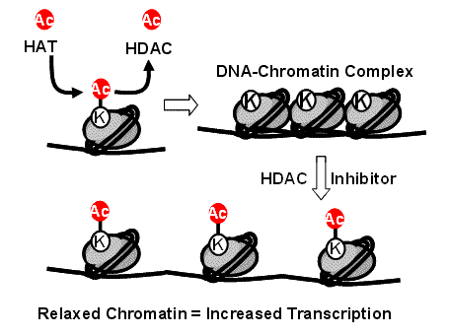
In Vivo Readout of Transcriptional Activity:
Trichostatin A (TSA) treatment Slows Hmga2 Protein Diffusion
TSA pharmacological inhibitor of Histone Deacetylase (HDAC)
Hmga2 slowed both dorsal and ventral versus DMSO control
P=5.7x10⁻⁴
N=29
N=26
P=0.006
N=32
N=28
http://blog.biotek.com/2010/04/sbs-2010-conference-epigenetics.html

Slide 35
What Do Differences in Diffusion Coefficients Mean?
Binding to larger protein?

Slide 36
What Do Differences in Diffusion Coefficients Mean?
Binding to larger protein?
  But 100x the mass only 1/3 reduction.

Slide 37
What Do Differences in Diffusion Coefficients Mean?
Binding to larger protein?
  But 100x the mass only 1/3 reduction.
Cell Membrane
More likely causing interactions with cytoskeleton, organelles or other structures
Nucleus
Mitochondria

