Slide 1
Biology 227: Methods in Modern Microscopy
Andres Collazo, Director Biological Imaging Facility
Yonil Jung, Graduate Student, TA
Week 2 Applying Geometrical Optics (Making the Rochester Cloak)

Slide 2
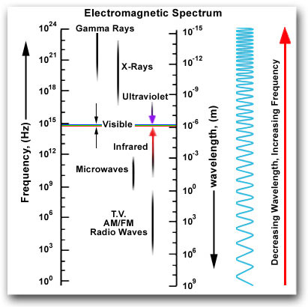
Something special about visible light
Planck–Einstein relation
(λ)
E = h ν
ν = c/λ
E = hc/λ
(ν)
Notes:
Within this vast range of wavelengths, there are three or more regions of approximation which are especially interesting. In one of these, a condition exists in which the wavelengths involved are very small compared with the dimensions of the equipment available for their study; furthermore, the photon energies, using the quantum theory, are small compared with the energy sensitivity of the equipment. Under these conditions we can make a rough first approximation by a method called geometrical optics. If, on the other hand, the wavelengths are comparable to the dimensions of the equipment, which is difficult to arrange with visible light but easier with radiowaves, and if the photon energies are still negligibly small, then a very useful approximation can be made by studying the behavior of the waves, still disregarding the quantum mechanics. This method is based on the classical theory of electromagnetic radiation, which will be discussed in a later chapter. Next, if we go to very short wavelengths, where we can disregard the wave character but the photons have a very large energy compared with the sensitivity of our equipment, things get simple again. This is the simple photon picture, which we will describe only very roughly. The complete picture, which unifies the whole thing into one model, will not be available to us for a long time.
Planck constant = 6.62606957(29)×10⁻³⁴ joule seconds (J·s) or (N·m·s)

Slide 3
Geometrical optics: Light as collection of rays
Refraction: light bends as it passes from one material to another
Snell’s Law: η1 sin θ1 = η2 sin θ2
θ1
θ2
θ1
n₁
n₂
n₁

Slide 4
Refractive index η
Medium Refractive Index
Air 1.0003
Water 1.33
Glycerin 1.47
Immersion Oil 1.518
Glass 1.56 – 1.46
Diamond 2.42
Velocity in medium
299203
225032
203600
197162
191854 - 204995
123675

Slide 5
Could apply Snell’s Law to something as complex as a lens
η1 sin θ1 = η2 sin θ2 = η3 sin θ3 = ….
η1
η2

Slide 6
Thin lens laws
1. Ray through center of lens is straight

Slide 7
Thin lens law 2
2. Light rays that enter the lens parallel to the optical axis leaves through Focal Point
Focal
Point
Notes:
CONVERGENCE LENS. Convex lens

Slide 8
Thin lens law 3
3. Light rays that enter the lens from the focal point exit parallel to the optical axis.
Focal
Point

Slide 9
Applying thin lens law to our object, a gold can

Slide 10
1. Ray through center of lens is straight

Slide 11
2. Light rays that enter the lens parallel to the optical axis leaves through Focal Point

Slide 12
3. Light rays that enter the lens from the focal point, exit parallel to the optical axis.

Slide 13
Where the three lines intersect is where that point of the object is located
Notes:
Note that the object is magnified and inverted. Real Image.

Slide 14
Ray tracing convention for optics generally uses arrows to represent the object.
Notes:
Note that the object is magnified and inverted. Real Image.

Slide 15
Same three rules can be applied for each point along the object.

Slide 16
Thin Lens Equation
1/f = 1/o + 1/i
Magnification = i/o
f
i
o

Slide 17
For object directly on focal point, rays focused to infinity.
Where would this be useful?
∞
Notes:
Object located at greater than 2 x the focal distance result in small image. How cameras work.

Slide 18
For object within the focal point, a virtual image is created.
Only need two rays to locate object.
Notes:
Virtual images are located on side of lens opposite to viewer. Bad naming conventions as virtual images are as “real” as a real image.

Slide 19
Of course can use all three rules to trace three rays.

Slide 20
Same three rules can be applied to a concave lens.
Notes:
All concave lenses make virtual images that are smaller no matter where the object is located.
DISPERSION LENS

Slide 21
But again two rays are enough to locate virtual image.

Slide 22
Concave lens makes virtual image that is smaller no matter where object is located.
Notes:
All concave lenses make virtual images that are smaller no matter where the object is located.

Slide 23
Principle ray approach works for complex lens assemblies.
Focal lengths add as reciprocals:
1/f(total) = 1/f1 + 1/f2 + ... + 1/fn Remember: for concave lens f is negative
Notes:
Focal lengths add as reciprocals:
1/f(total) = 1/f1 + 1/f2 + ... + 1/fn - Remember: for concave lens f is negative
Problem: Two thin lenses together don’t make a thin lens. Notice that the central ray misses the image.
Solution: Use principle rays to define image from first lens. Then use the first image as the object for the second lens.

Slide 24
Another example: Begin with one convex lens.

Slide 25
Another example: Add a second convex lens.

Slide 26
Another example: Can determine real image formed by two convex lenses.
Notes:
Note that two convex lenses make a smaller image

Slide 27
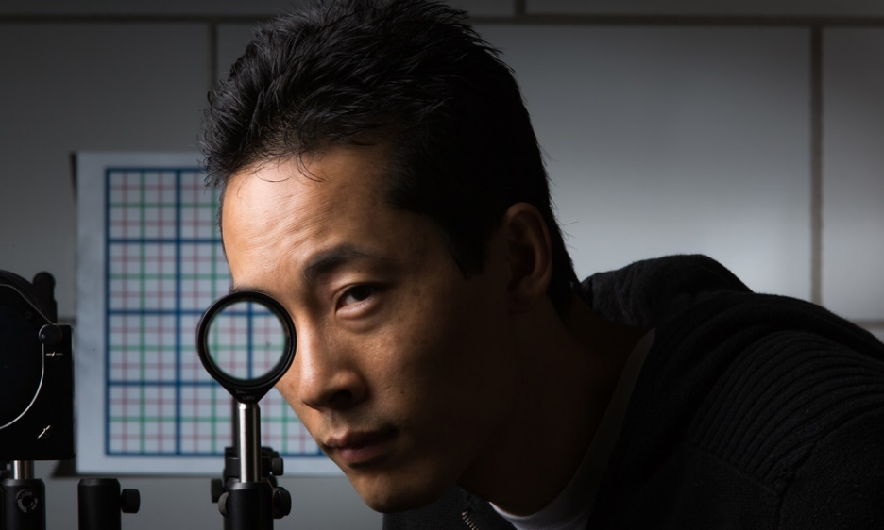
Applying geometrical optics. Cloaking objects with simple lenses
Making objects invisible
Ray tracing still important for optical research
Paper by Choi and Howell from University of Rochester published 2014
Choi JS, Howell JC. Paraxial ray optics cloaking. Optics express. 2014; 22(24):29465-78.

Slide 28
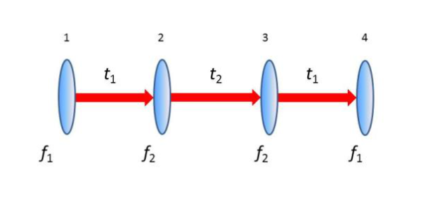
Perfect cloak at small angles using simple optics
Paraxial rays are those at small angles
Uses 4 off the shelf lenses: two with a focal length of f₁ and two with focal lengths of f₂

Slide 29
Perfect cloak at small angles using simple optics
Lens with f₁ separated from lens with f₂ by sum of their focal lengths = t₁.
Separate the two sets by t₂=2 f₂ (f₁+ f₂) / (f₁— f₂) apart, so that the two f₂ lenses are t₂ apart.

Slide 30
Perfect cloak at small angles using simple optics
Lenses used are achromatic doublets
For first and last lenses (1 and 4), 200 mm focal length, 50 mm diameter composed of BK7 and SF2 glass.
For center two lenses (2 and 3), 75 mm focal length, 50 mm diameter composed of SF11 and BAF11 glasses.

Slide 31
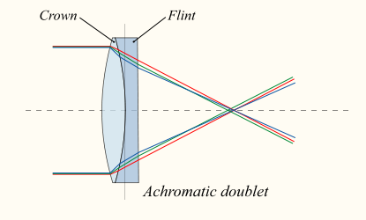
Achromat doublet
Convex lens of crown glass: low η and high Abbe number
Concave lens of flint glass: high η and low Abbe number
Notes:
Flint glass is optical glass that has relatively high refractive index and low Abbe number (high dispersion). Flint glasses are arbitrarily defined as having an Abbe number of 50 to 55 or less. The currently known flint glasses have refractive indices ranging between 1.45 and 2.00. A concave lens of flint glass is commonly combined with a convex lens of crown glass to produce an achromatic doublet lens because of their compensating optical properties, which reduces chromatic aberration (colour defects).
With respect to glass, the term flint derives from the flint nodules found in the chalk deposits of southeast England that were used as a source of high purity silica by George Ravenscroft, circa 1662, to produce a potash lead glass that was the precursor to English lead crystal.
Traditionally, flint glasses were lead glasses containing around 4–60% lead oxide; however, the manufacture and disposal of these glasses were sources of pollution. In many modern flint glasses, the lead can be replaced with other additives such as titanium dioxide and zirconium dioxide without significantly altering the optical properties of the glass.
Flint glass can be fashioned into rhinestones which are used as diamond simulants.
Electric Bulbs and Spectacle glasses are made of Flint glass.
Crown glass is a type of optical glass used in lenses and other optical components. It has relatively low refractive index (≈1.52) and low dispersion (with Abbe numbers around 60). Crown glass is produced from alkali-lime (RCH) silicates containing approximately 10% potassium oxide and is one of the earliest low dispersion glasses.
As well as the specific material named crown glass, there are other optical glasses with similar properties that are also called crown glasses. Generally, this is any glass with Abbe numbers in the range 50 to 85. For example, the borosilicate glass Schott BK7^{[1]} is an extremely common crown glass, used in precision lenses. Borosilicates contain about 10% boric oxide, have good optical and mechanical characteristics, and are resistant to chemical and environmental damage. Other additives used in crown glasses include zinc oxide, phosphorus pentoxide, barium oxide, fluorite and lanthanum oxide.
An achromatic doublet, which combines crown glass and flint glass.
A concave lens of flint glass is commonly combined with a convex lens of crown glass to produce an achromatic doublet. The dispersions of the glasses partially compensate for each other, producing reduced chromatic aberration compared to a singlet lens with the same focal length.

Slide 32
Abbe number (V)
Measure of a material’s dispersion in relation to refractive index
Refractive indices at wavelengths of Fraunhofer D-, F- and C- spectral lines (589.3 nm, 486.1 nm and 656.3 nm respectively)
Instead of Na line can use He (V_{d}) or Hg (V_{e}) lines
High values of V indicating low dispersion (low chromatic aberration)
$$V_{D}=\frac{η_{D} − 1}{η_{F} − η_{C}}$$
Notes:
In physics and optics, the Abbe number, also known as the V-number or constringence of a transparent material, is a measure of the material's dispersion (variation of refractive index with wavelength) in relation to the refractive index, with high values of V indicating low dispersion (low chromatic aberration). It is named after Ernst Abbe (1840–1905), the German physicist who defined it.
Due to the difficulty and inconvenience in producing sodium and hydrogen lines, alternate definitions of the Abbe number are used in some contexts (ISO 7944).

Slide 33
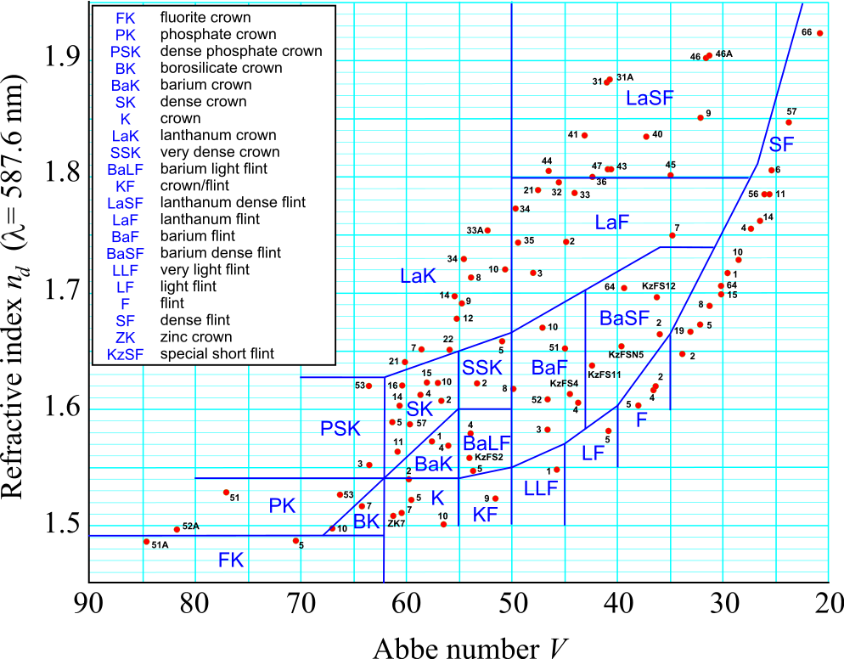
Abbe number (V)
Notes:
The most common types of glasses used in optics are crown glasses and flint glasses, designations based on their dispersions. Flint glasses contain lead. For example, a strong positive crown lens with its low dispersion may be used in a doublet with a weaker negative lens of flint glass (high dispersion) to correct for chromatic aberration.
http://hyperphysics.phy-astr.gsu.edu/hbase/geoopt/glass.html
In physics and optics, the Abbe number, also known as the V-number or constringence of a transparent material, is a measure of the material's dispersion (variation of refractive index with wavelength) in relation to the refractive index, with high values of V indicating low dispersion (low chromatic aberration). It is named after Ernst Abbe (1840–1905), the German physicist who defined it.
Due to the difficulty and inconvenience in producing sodium and hydrogen lines, alternate definitions of the Abbe number are used in some contexts (ISO 7944).

Slide 34
Other ways to make a cloak?

Slide 35
Other ways to make a cloak?
Project image from behind object onto it
Clear object so same refractive index throughout
Metamaterials
Artificial materials engineered to have properties that have not yet been found in nature.

