Slide 1
Biology 227: Methods in Modern Microscopy
Andres Collazo, Director Biological Imaging Facility
Steven Wilbert, Graduate Student, TA

Slide 2
Biology 227: Methods in Modern Microscopy
227 TA: Steven Wilbert
  Email: (swilbert@caltech.edu)
Will work in groups
Course work:
  Lab Assignments, Five (50% of grade)
  Final Project (50% of grade)
  Final Project proposal due February 5th.
  Final Project due March 16.
  No exams
Course web site:
  http://www.its.caltech.edu/~bi227/2020/

Slide 3
Biology 227: Final Project Proposal (16 pts total)
Explain your sample/organism and describe how you will image. (3pts)
Explain the problem you hope to solve or explore. (4pts)
Include an expected timeline. (Do samples need a week just for preparation? Do you need to image a time lapse over 1 hour or 2 days?). (3pts)
Include an itemized list of all necessary supplies you want the class to provide. Preferably, these items should available at the campus stockrooms. If they are not available in the stockrooms, you must either provide these items yourself or give us enough time to order them for you. (3pts)
Include at least 1 outside reference, such as a journal paper, showing feasibility. A full copy of the reference must be included. (3pts)

Slide 4
Biology 227: Final Project (34 pts total)
Introduction to the topic/problem. (3pts)
What role does confocal microscopy play in addressing the problem? (3pts)
What was your specific approach and results? (4pts)
What techniques did you use that were or were not taught in the class? (3pts)
Describe the methods required to recreate the experiment.
  Sample preparation. (3pts)
  Imaging. (3pts)
What problems did you encounter and how did you or would you solve them? (3pts)
What would be the next set of experiments? (3pts)
Relevant references cited? Be sure to include at least 1 outside reference showing interest and relevance to the current scientific community. Include the references from the proposal. (3pts)
Image quality. (3pts)
Figure captions & annotations. (3pts)

Slide 5
Biology 227: Methods in Modern Microscopy
Week 1 Introduction to Microscopes (Kohler illumination, Confocal microscope training)
Week 2 3D Laser Scanning Confocal Microscopy (LSCM)
Week 3 Begin Building a Light Sheet Microscope (openspim.org)
Week 4 Live Imaging: Zebrafish embryos
Week 5 Fluorescence Correlation Spectroscopy (FCS) vs Fluorescence Recovery After Photobleaching (FRAP)
Week 6 Multispectral Imaging
Week 7 Super Resolution Light Microscopy
Week 8 Work on Assignments and building light sheet
Week 9 Work on Assignments and building light sheet
Week 10 Work on Assignments and present final projects

Slide 6
Biology 227: Methods in Modern Microscopy
Week 1 Introduction to Microscopes (Kohler illumination, Confocal microscope training)
Week 2 3D Laser Scanning Confocal Microscopy (LSCM), Assignment 2
Week 3 Begin Building a Light Sheet Microscope (openspim.org)
Week 4 Live Imaging: Zebrafish embryos
Week 5 Fluorescence Correlation Spectroscopy (FCS) vs Fluorescence Recovery After Photobleaching (FRAP)
Week 6 Multispectral Imaging
Week 7 Super Resolution Light Microscopy
Week 8 Work on Assignments and building light sheet
Week 9 Work on Assignments and building light sheet
Week 10 Work on Assignments and present final projects

Slide 7
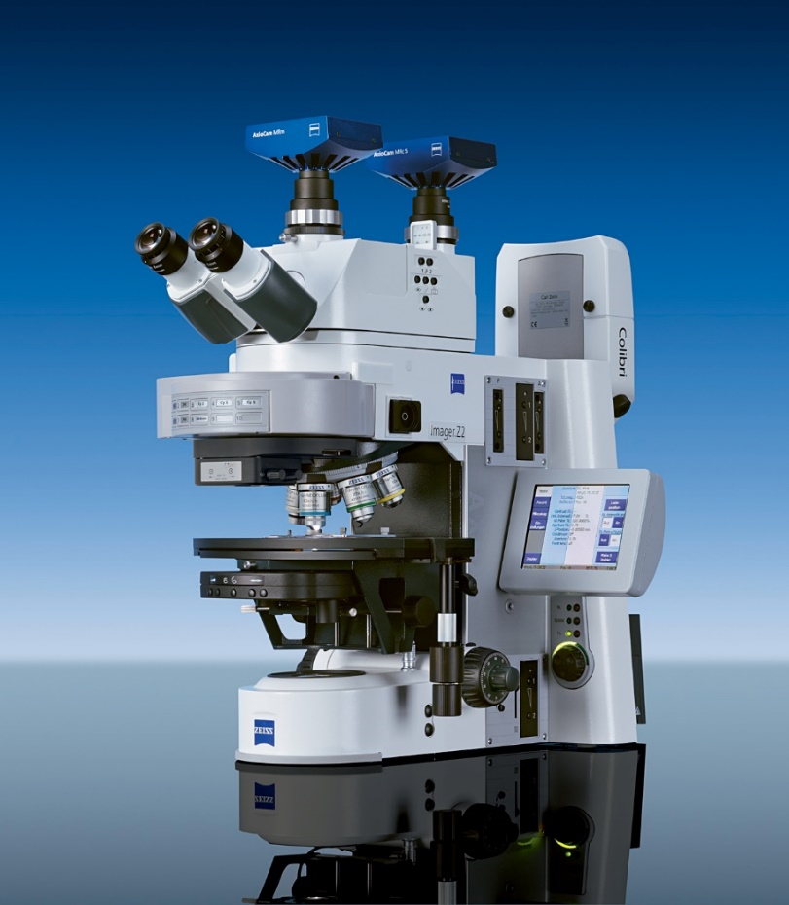
Improve fluorescence with optical sectioning
Wide-field microscopy
  Illuminating whole field of view
Confocal microscopy
  Spot scanning
Near-field microscopy
  For super-resolution
  TIRF
Remember, typical compound microscope is not 3D, even though binocular

Slide 8
Improve fluorescence with optical sectioning
Overview of Optical sectioning Methods
Confocal and Multi-photon Laser Scanning Microscopy
  Pinhole prevents out-of-focus light getting to the sensor(s) (PMT - Photomultiplier)
  Multi Photon does not require pinhole
Deconvolution
  Point-Spread function (PSF) information is used to calculate light back to its origin
  Post processing of an image stack
Spinning disk confocal systems
  A large number of pinholes (used for excitation and emission) is used to prevent out-of-focus light getting to the camera
  Especially those using Nipkow disk and microlens
Structured Illumination Microscopy (SIM)
Light sheet fluorescence microscopy, also called selective/single plane illumination microscopy (SPIM)
Notes:
Deconvolution mostly used with wide field microscopes but can be used for confocal data as well

Slide 9
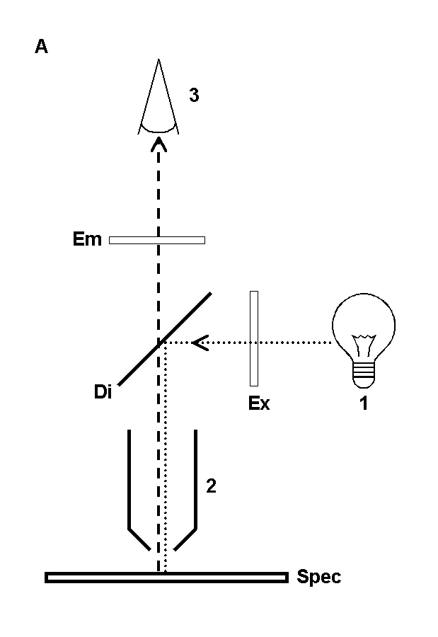
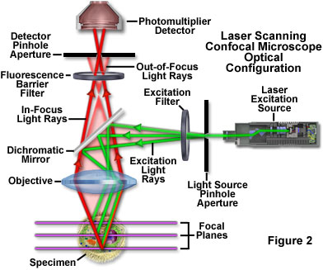
Confocal Microscopy just a form of
Fluorescence Microscopy
www.olympusfluoview.com

Slide 10
Confocal Microscopy just a form of
Fluorescence Microscopy
Illumination source
  Laser instead of Mercury lamp or LED
Spot scanning
  Scanning mirrors
Pinhole aperture
  Specimen focal plane
Detector
  Photomultiplier tube (PMT) instead of CCD camera
Computer to reconstruct image
  Result of spot scanning
Notes:
Deconvolution mostly used with wide field microscopes but can be used for confocal data as well

Slide 11
Confocal Microscopy just a form of
Fluorescence Microscopy
Illumination source
  Laser instead of Mercury lamp or LED
Spot scanning
  Scanning mirrors
Pinhole aperture
  Specimen focal plane
Detector
  Photomultiplier tube (PMT) instead of CCD camera
Computer to reconstruct image
  Result of spot scanning
Notes:
Deconvolution mostly used with wide field microscopes but can be used for confocal data as well

Slide 12
Confocal Microscopy just a form of
Fluorescence Microscopy
www.olympusfluoview.com
Notes:
CW lasers

Slide 13
Confocal Microscopy just a form of
Fluorescence Microscopy
HBO
www.olympusfluoview.com
Notes:
CW lasers

Slide 14
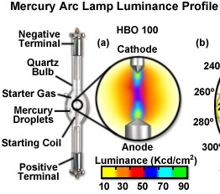
Mercury Arc lamps
10-100 x brighter than incandescent lamps
Started using in 1930s
Also called HBO ™ lamps (H = mercury Hg, B = symbol for luminance, O = unforced cooling).

Slide 15
Confocal Microscopy just a form of
Fluorescence Microscopy
Illumination source
  Laser instead of Mercury lamp or LED
Spot scanning
  Scanning mirrors
Pinhole aperture
  Specimen focal plane
Detector
  Photomultiplier tube (PMT) instead of CCD camera
Computer to reconstruct image
  Result of spot scanning
Notes:
Deconvolution mostly used with wide field microscopes but can be used for confocal data as well

Slide 16
Confocal Microscopy just a form of
Fluorescence Microscopy
www.olympusfluoview.com

Slide 17
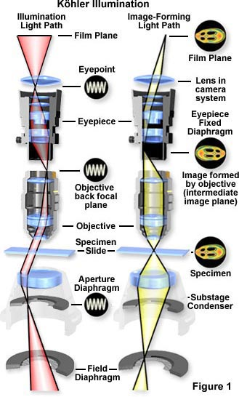
Kohler Rays
Kohler Illumination gives the most uniform illumination
Each part of the light source diverges to whole specimen
Each part of the specimen gets light that converges from the whole light source
Arrows mark
conjugate planes

Slide 18
Kohler Rays
Kohler Illumination gives the most uniform illumination
Each part of the light source diverges to whole specimen
Each part of the specimen gets light that converges from the whole light source
Arrows mark
confocal planes

Slide 19
Pinhole: Axial Filtering
Identical Lens
Focal Points

Slide 20
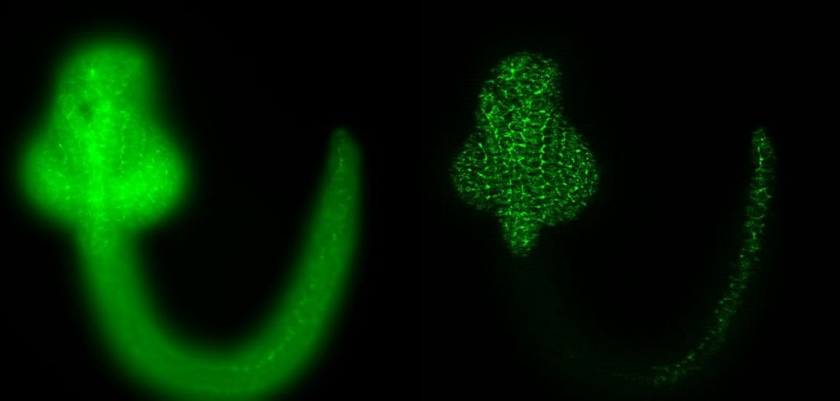
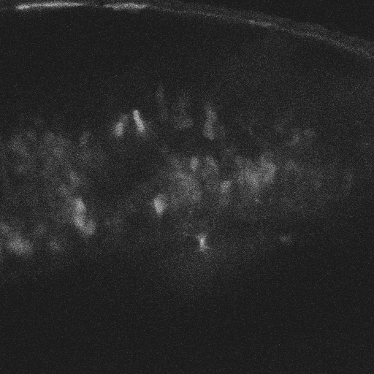
Optical Sectioning: Increased Contrast and Sharpness.
Examples: Zebrafish images, Inner ear
Zebrafish wide-field, optical section
Confocal microscope Z-stack
Notes:
Bit Depth
8 bits = 256
12 ” = 4,096
16 ” = 65,536
Maximize Histogram

Slide 21
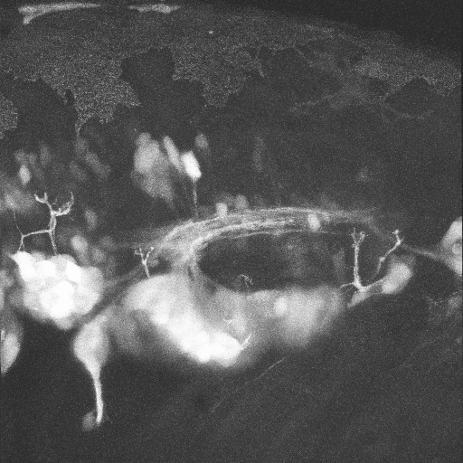
Optical Sectioning adds the 3rd Dimension
Confocal Z-stack
3D Reconstruction
A
A
P
A
P
Neural Gata-2 Promoter GFP-Transgenic Zebrafish; Shuo Lin, UCLA
Neural Gata-2 Promoter GFP-Transgenic Zebrafish; with Shuo Lin, UCLA
Notes:
Top right: Macrophage fluorescently stained for tubulin (yellow), actin (red) and the nucleus (DAPI, blue). Left: original image, recorded with a wide field microscope. Right: the same dataset, deconvolved using Huygens Professional. The datasets are visualized with top-view maximum intensity projections.
Data courtesy of Dr. James Evans, Whitehead Institute, MIT Boston MA, USA. (See the EvansMacrophage for more image details).
Bottom right: Detail of an imaginal disc from a third instar Drosophila Melanogaster larva. Left: a slice of the original data, imaged using an Andor Revolution spinning disc confocal microscope.Right: the same slice, deconvolved using Huygens Professional. The fixed sample was stained against alfa-tubulin (green) and gamma-tubulin (red).
Recorded by Dr. Paula Sampaio, Advanced Light Microscopy Facility, University of Porto.

Slide 22
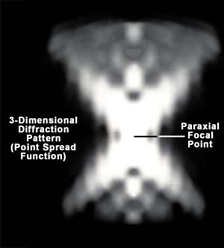
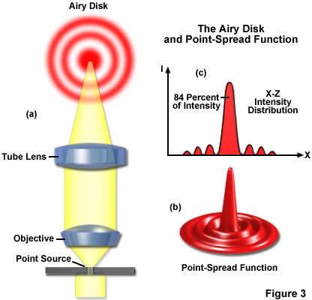
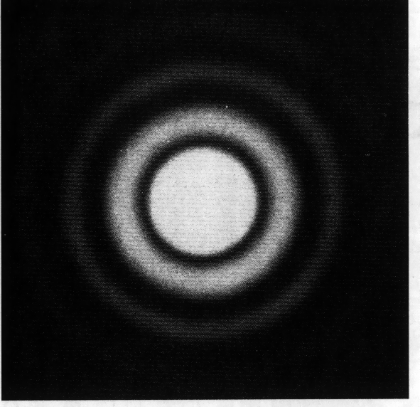
Relationship between diffraction, airy disk and point spread function
Airy disk – 2D
Point spread function -3D
Though often defined as the same that is not quite true
Notes:
https://micro.magnet.fsu.edu/primer/java/imageformation/depthoffield/index.html

Slide 23
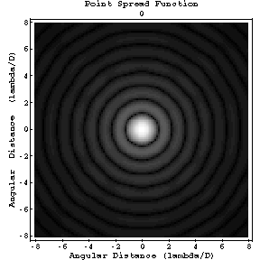
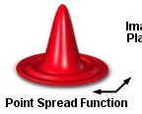
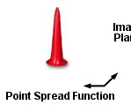
Aperture trims the PSF: increased resolution in XY plane
How N.A. and air disk effects resolution
But at a cost in brightness:
  Thinner section means less labeled material in image
  Aperture rejects some in focus light
  Subtle scattering or distortion rejects more light

Slide 24
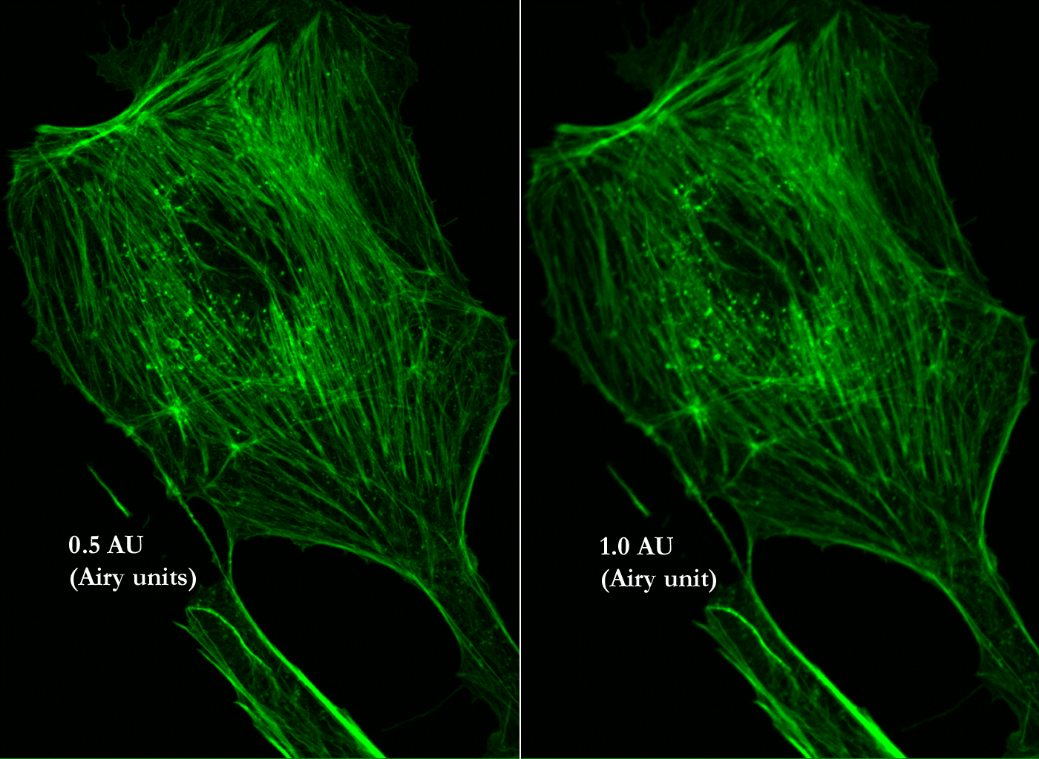
Resolution, Signal and Pinhole Diameter
Best Resolution
Best Signal to Noise
http://depts.washington.edu/keck/leica/pinhole.htm

Slide 25
Confocal Microscopy just a form of
Fluorescence Microscopy
Illumination source
  Laser instead of Mercury lamp or LED
Spot scanning
  Scanning mirrors
Pinhole aperture
  Specimen focal plane
Detector
  Photomultiplier tube (PMT) instead of CCD camera
Computer to reconstruct image
  Result of spot scanning
Notes:
Deconvolution mostly used with wide field microscopes but can be used for confocal data as well

Slide 26
But this arrangement generates an “image” of only one point in the specimen
Only a single point is imaged at a time.
Detector signal must be decoded by a computer to reconstruct image.
Imaging point needs to be scanned somehow.

Slide 27
Scan Specimen
Good:
Microscope works on axis
Best correction for optical aberrations
Most uniform light collection efficiency
Bad:
Slow
Sloshes specimen

Slide 28
Scan Microscope Head
Good:
Specimen doesn’t move
Microscope works on axis
Best correction for optical aberrations
Most uniform light collection efficiency
Bad:
Slow
Optics can be more complicated

Slide 29
Scan Laser
Good:
Faster
Specimen moves slowly—less sloshing
Bad:
Very high requirements on objective
Light collection may be non-uniform off-axis
More complicated

Slide 30
How to scan the laser beam?
www.olympusfluoview.com

Slide 31
How to scan the laser beam?
LSM 410 light path
Notes:
https://www.olympus-lifescience.com/en/microscope-resource/primer/techniques/confocal/confocalscanningsystems/
Figure 5
Figure 5-4 from full LSM 410 manual
A galvanometer is a type of sensitive ammeter: an instrument for detecting electric current. It is an analog electromechanical actuator that produces a rotary deflection of some type of pointer in response to electric current through its coil in a magnetic field.
"DynAXIS L" by Scanlab7 - Own work. Licensed under CC BY-SA 3.0 via Wikimedia Commons - http://commons.wikimedia.org/wiki/File:DynAXIS_L.jpg#mediaviewer/File:DynAXIS_L.jpg
Mirror galvanometer systems are used as beam positioning or beam steering elements in laser scanning systems.^{[citation needed]} For example, for material processing with high-power lasers, mirror galvanometer are typically high power galvanometer mechanisms used with closed loop servo control systems. The newest galvanometers designed for beam steering applications can have frequency responses over 10 kHz with appropriate servo technology. Closed-loop mirror galvanometers are also used in stereolithography, in laser sintering, in laser engraving, in laser beam welding, in laser TV, in laser displays, and in imaging applications such as Optical Coherence Tomography (OCT) retinal scanning. Almost all of these galvanometers are of the moving magnet type.^{[citation needed]}

Slide 32
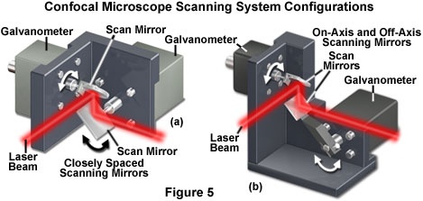
How to scan the laser beam?
Place galvanometer mirror at the telecentric point
LSM 410 light path
Notes:
https://www.olympus-lifescience.com/en/microscope-resource/primer/techniques/confocal/confocalscanningsystems/
Figure 5
Figure 5-4 from full LSM 410 manual
A galvanometer is a type of sensitive ammeter: an instrument for detecting electric current. It is an analog electromechanical actuator that produces a rotary deflection of some type of pointer in response to electric current through its coil in a magnetic field.
"DynAXIS L" by Scanlab7 - Own work. Licensed under CC BY-SA 3.0 via Wikimedia Commons - http://commons.wikimedia.org/wiki/File:DynAXIS_L.jpg#mediaviewer/File:DynAXIS_L.jpg
Mirror galvanometer systems are used as beam positioning or beam steering elements in laser scanning systems.^{[citation needed]} For example, for material processing with high-power lasers, mirror galvanometer are typically high power galvanometer mechanisms used with closed loop servo control systems. The newest galvanometers designed for beam steering applications can have frequency responses over 10 kHz with appropriate servo technology. Closed-loop mirror galvanometers are also used in stereolithography, in laser sintering, in laser engraving, in laser beam welding, in laser TV, in laser displays, and in imaging applications such as Optical Coherence Tomography (OCT) retinal scanning. Almost all of these galvanometers are of the moving magnet type.^{[citation needed]}

Slide 33
Confocal Microscopy just a form of
Fluorescence Microscopy
Illumination source
  Laser instead of Mercury lamp or LED
Spot scanning
  Scanning mirrors
Pinhole aperture
  Specimen focal plane
Detector
  Photomultiplier tube (PMT) instead of CCD camera
Computer to reconstruct image
  Result of spot scanning
Notes:
Deconvolution mostly used with wide field microscopes but can be used for confocal data as well

Slide 34
Confocal Microscopy just a form of
Fluorescence Microscopy
www.olympusfluoview.com

Slide 35
Detectors for microscopy
Film
CMOS (Complementary metal–oxide–semiconductor)
CCD (Charge coupled device)
PMT (Photomultiplier tube)
GaAsP (Gallium arsenide phosphide)
APD (Avalanche photodiode)
Array of detectors, like your retina
Single point source detectors

Slide 36
Photomultiplier Tube (PMT)
PMTs use electric potential to amplify electrons
Photons impact a phosphor screen creating electrons
Electrons are multiplied by impacting other surfaces (Dynode chain)
Increasing the gain increases the number of electrons produced in a non-linear fashion
So increasing Gain increases signal

Slide 37
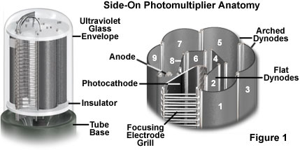
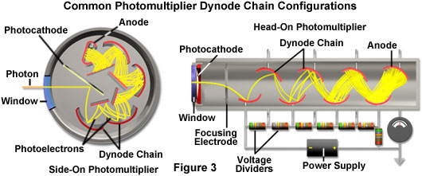
Photomultiplier Tube (PMT)
Two types of Photomultipliers
  Side-on, most popular due to high performance rating and low cost
  Head-on
Notes:
Point source detector
The two most popular photomultiplier designs have configurations that place the sensitive photocathode element either at the end (head-on) or on the side (side-on) of the vacuum tube (see Figure 3). Incident light is detected through a window at the top of the glass envelope in head-on designs, and through the curved side in side-on photomultipliers. Due to their high performance ratings and low cost, side-on photomultipliers are the most widely used tubes for general photometric applications, such as spectrophotometry, fluorimetry, and confocal microscopy. Side-on photomultipliers contain an opaque and relatively thick reflection-mode photocathode surrounded by a circular cage-like dynode element chain. Incident photoelectrons do not pass through the photocathode in a side-on photomultiplier, but instead are ejected from the front face and angled toward the first dynode element.
In contrast, the photocathode in an end-on photomultiplier must be of precise thickness as well as composition, and is semi-transparent. The photoemissive material is deposited on the surface of an optical window so that electrons are emitted from the side of the photocathode opposite that of the incident radiation. If the photocathode is too thick, more photons will be absorbed but fewer photoelectrons will be emitted from the rear surface. Alternatively, if the photocathode is too thin, photons may pass straight through without being absorbed. Because of these differences in design, side-on photomultipliers having photocathodes of similar composition to head-on tubes often exhibit higher quantum efficiencies.
http://www.olympusmicro.com/primer/techniques/confocal/pmtintro.html

Slide 38
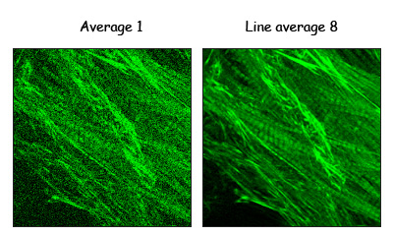
The cost of increasing gain
More electrons means more noise
This is what causes the noise in scanning confocal images
  Averaging can decrease the noise
Notes:
http://microscopy.duke.edu/learn/introtomicroscopy/confocals.html

Slide 39
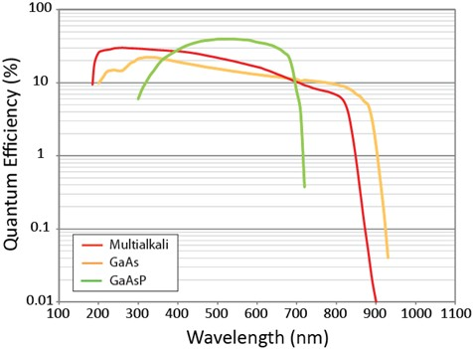
Photomultiplier Tube (PMT)
PMTs less sensitive in the red
Most PMTs multialkali photocathode material
GaAsP detectors more sensitive
Can buy PMTs that are more “green” sensitive or more “red”sensitive
  But not much difference
Notes:
As is evident in Figure 2, most photocathode materials have good response in the shorter wavelength regions of the visible and ultraviolet spectrum, between approximately 200 and 400 nanometers. Photomultipliers that have photocathodes composed of bialkali materials have a higher quantum efficiency and lower noise level in the green region of the spectrum (550-nanometers), while those with multialkali photocathodes respond better in the red and near-infrared. Bialkali photocathodes are composed of an alloy containing antimony and several alkali metals, such as rubidium, potassium, and cesium. The spectral response of bialkali photocathodes is excellent in the ultraviolet and blue regions, but drops quickly as visible wavelengths stretch into the green and red regions. Multialkali photocathodes (often referred to as S20) are composed of similar materials, but with the addition of at least three alkali metals, and have a wider spectral response region that extends into the red and near-infrared portions.
Even with their superior gain characteristics, photomultipliers have some disadvantages when compared to other types of detectors. The gain and dark current performance of individual photomultipliers from the same production run can vary widely, often by a factor of 2 to 5 for a particular design. In addition, the devices can be damaged by exposure to high illumination levels, often requiring very long recovery times (some never recover from high intensity illumination). Modern photocathodes yield very good visible and ultraviolet performance, but sensitivity drops dramatically in the longer visible wavelengths and infrared. Photomultipliers require a stabilized high voltage power supply, which increases the cost of using these detectors. Finally, even in the most sensitive wavelength region, about two-thirds of the incident light is not detected by the photocathode and does not contribute to photomultiplier gain.
http://www.olympusmicro.com/primer/techniques/confocal/pmtintro.html
Picture from
https://www.semrock.com/multimodal-nonlinear-optical-nlo-imaging.aspx

Slide 40
Biology 227: Methods in Modern Microscopy
Signing up to use microscopes in Beckman Institute Biological Imaging Facility (BIF), B133 Beckman Institute
Contact Dr. Giada Spigolon for training
  giadas@caltech.edu
Web site for BIF
  bioimaging.caltech.edu
  http://www.its.caltech.edu/~bif/
Go to Calendar link and login in as an outside user
  Login: bi227@caltech.edu
  Password: 1562915629
Notes:
Manuals for BIF at BIF web site

Slide 41
Confocal Microscopy sounds great but has some limitations
www.olympusfluoview.com

Slide 42
Limitations: Phototoxicity
Sample is continuously exposed to light.
Weaker signal within sample requires stronger excitation and causes more toxicity.

Slide 43
Limitations: Photobleaching
Scanning causes repeated exposure above and below.

Slide 44
Loss of sectioning by Scattering

Slide 45
Biology 227: Methods in Modern Microscopy
Microscopes available in course lab, Church B168
  LSM 410 (x 2) inverted microscope
  LSM 310 upright microscope
  Stereo microscope, fluorescent
Will open up LSM 410 to look at the insides
Helpful for translating published light paths and visualizing the real thing
Notes:
Manuals for BIF at BIF web site

Slide 46
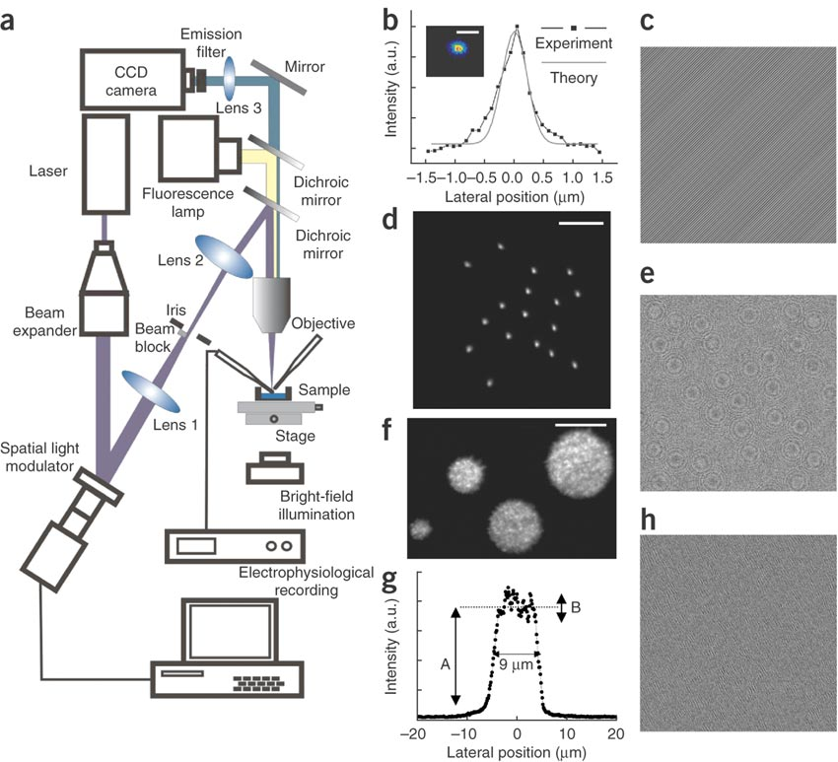
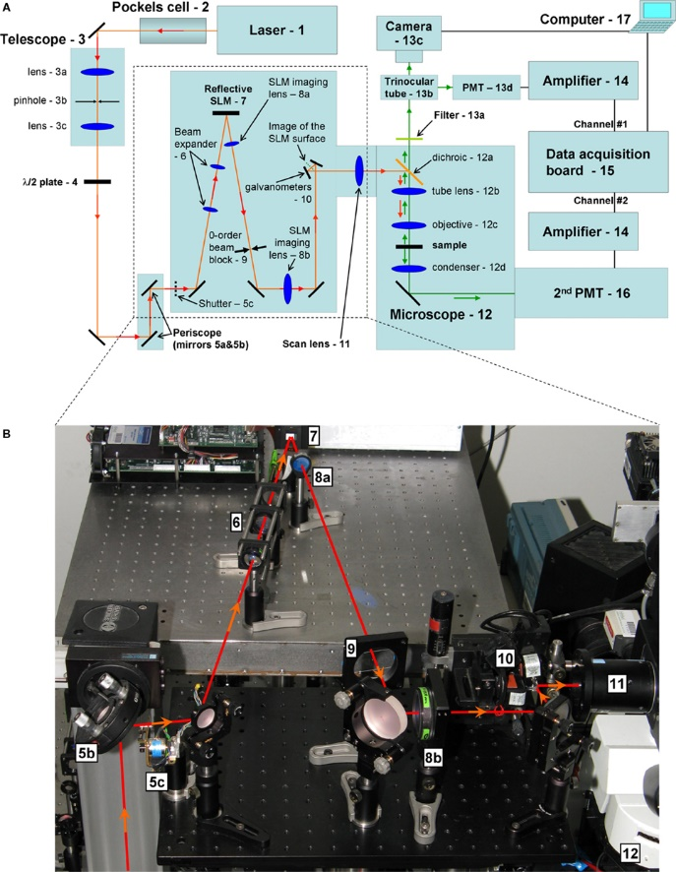
Holographic or Spatial Light Modulator (SLM) microscope (2008)
Holographic microscope
SLM microscope
Notes:
Layout of the optical setup. (b) A near diffraction-limited spot generated at a chosen position. Scale bar, 1 m. (c) Phase hologram used to generate the spot in b, showing the typical structures of a diffraction grating. (d) Simultaneous generation of 15 spots. Scale bar, 10 m. (e) Phase hologram used to create the multiple spots in d. Fresnel lenses are visible. These were used to focalize the different spots, superimposed on grating-like structures to control their lateral positions. (f) Excitation with multiple spots of diameters s = 12, 9.0, 6.5 and 3.5 m. Scale bar, 10 m. (g) Intensity profile across the spot in f with diameter of 9 m. A, mean intensity value; B, variation in intensity. (h) Phase hologram used to create the spots in f. The diffraction efficiency, , defined as the integrated intensity of the first order over the integrated intensity of the zeroth order with SLM off, was 63%, 46% and 50% for the phase holograms in c,e and h, respectively.
http://www.nature.com/nmeth/journal/v5/n9/full/nmeth.1241.html
Holographic microscope
http://journal.frontiersin.org/article/10.3389/neuro.04.005.2008/full
SLM microscope
http://www.opticsinfobase.org/oe/fulltext.cfm?uri=oe-21-13-16007&id=258369

Slide 47
LSM 410 Detector beam path
Short λ to PMT3
Medium λ to PMT2
Long λ to PMT1
Short λ to PMT2
Long λ to PMT1
Notes:
Figure 3-1 from full LSM 410 manual

Slide 48
LSM 410 Beam path schematic
Notes:
Figure 2-3 in LSM410 full manual

Slide 49
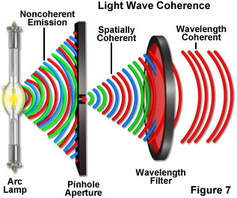
Coherence of light
Lasers provide coherent illumination
Sunlight on cloudy day is noncoherent
Notes:
Brighter and with more Speckles when coherent
For brightfield and reflected microscopy applications, illumination having low coherence is generally desired, while light with higher coherence is required for phase and interference imaging modes. The process of fluorescence involves a sufficient number of steps between excitation and emission that the coherence of the illuminating light is usually unimportant, and the light emitted from the specimen is basically non-coherent.
http://zeiss-campus.magnet.fsu.edu/tutorials/coherence/indexflash.html

