Slide 1
Biology 227: Methods in Modern Microscopy
Andres Collazo, Director Biological Imaging Facility
Cai Tong Ng, Graduate Student, TA

Slide 2
Biology 227: Where and When?
  B168 Church
  Monday &/or Wednesday Lectures in 152 Braun
    Some days may use 101 Kerkhoff
  10:00 am -11:00 am
  Lab times?
  12 Units (2-6-4)

Slide 3
Sister Course
Biology 177: Principles of Modern Microscopy
  Will be taught next year (Winter 2018)
  Lecture class
  Alternates with Biology 227
  Course web site
    http://www.its.caltech.edu/~bi177/

Slide 4
Biology 227: Methods in Modern Microscopy
227 TA: Cai Tong Ng
  Email: (cng@caltech.edu)
Will work in groups
Course work:
  Lab Assignments, Five (50% of grade)
  Final Project (50% of grade)
  Final Project proposal due Jan 31st.
  Final Project due March 16.
  No exams
Course web site:
  http://www.its.caltech.edu/~bi227/

Slide 5
Biology 227: Methods in Modern Microscopy
Week 1 Introduction to Microscopes (Kohler illumination, Confocal microscope training)
Week 2 Applying Geometrical Optics (Making the Rochester Cloak)
Week 3 3D Laser Scanning Confocal Microscopy (LSCM)
Week 4 Begin Building a Light Sheet Microscope (openspim.org)
Week 5 FCS versus FRAP
Week 6 Live Imaging: Zebrafish embryos
Week 7 Multispectral Imaging
Week 8 Work on Assignments and building light sheet
Week 9 Work on Assignments and building light sheet
Week 10 Super Resolution Light Microscopy

Slide 6
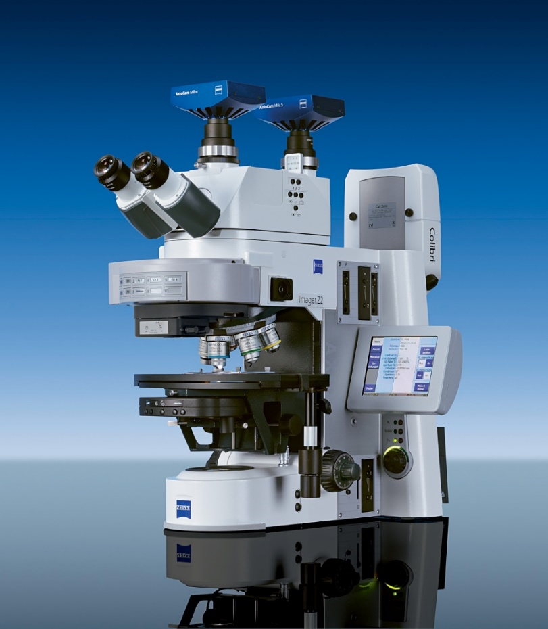
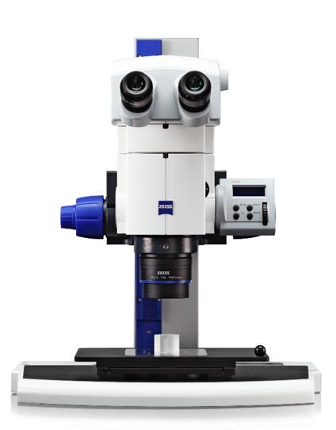
Light microscopes in the laboratory

Slide 7
Light microscopes in the laboratory
Compound microscope highest resolution
  ~200 nm Maximum
However, compound microscope is not 3D, even though binocular
Advantages of light
  Easy sample prep
  Live imaging

Slide 8
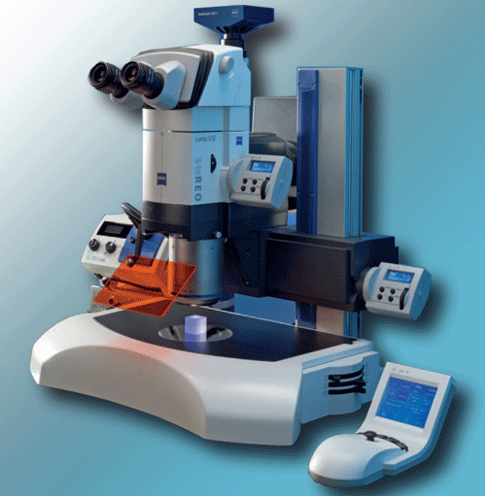
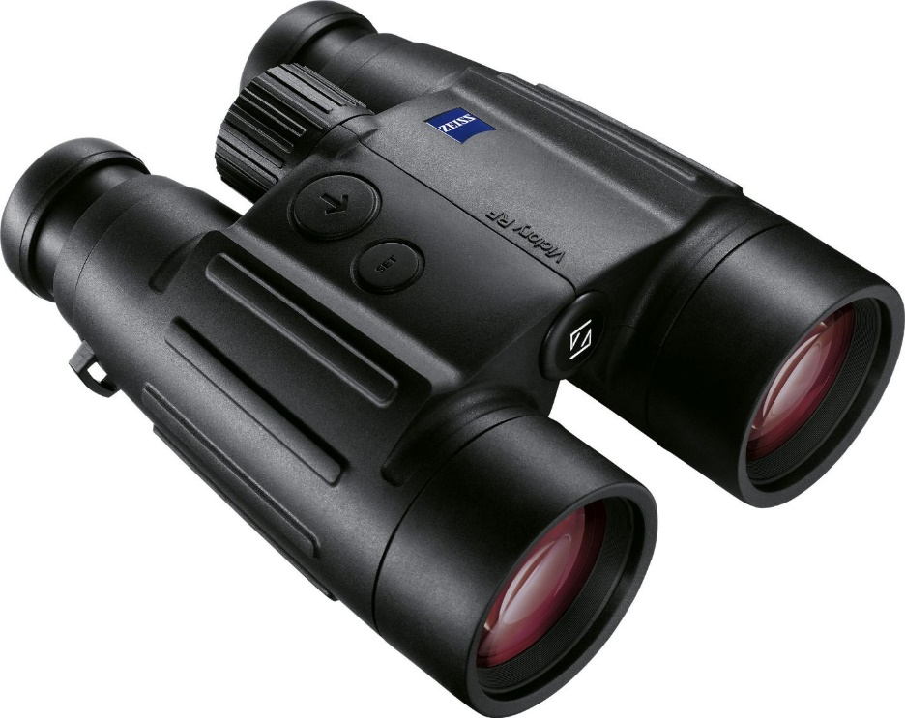
Stereo microscopes are to microscopes
As binoculars are to telescopes

Slide 9
Resolution vs Contrast
More than just magnification
Shorter wavelength
But hard to resolve without contrast!

Slide 10
Resolution vs Contrast
More than just magnification
Shorter wavelength
But hard to resolve without contrast!

Slide 11
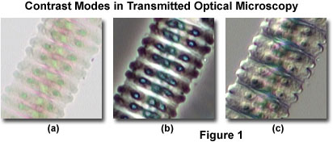
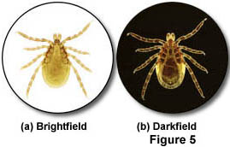
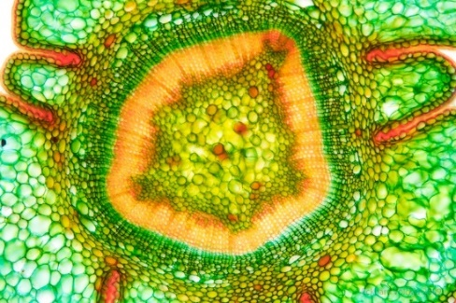
Resolution vs Contrast
Transparent specimen contrast
  Bright field 2-5%
  Phase & DIC 15-20%
  Stained specimen 25%
  Dark field 60%
https://www.flickr.com/photos/wunderkanone/4244591261
Notes:
Stained section of Taxus baccata, Sprout, 10x
https://www.flickr.com/photos/wunderkanone/4244591261/

Slide 12
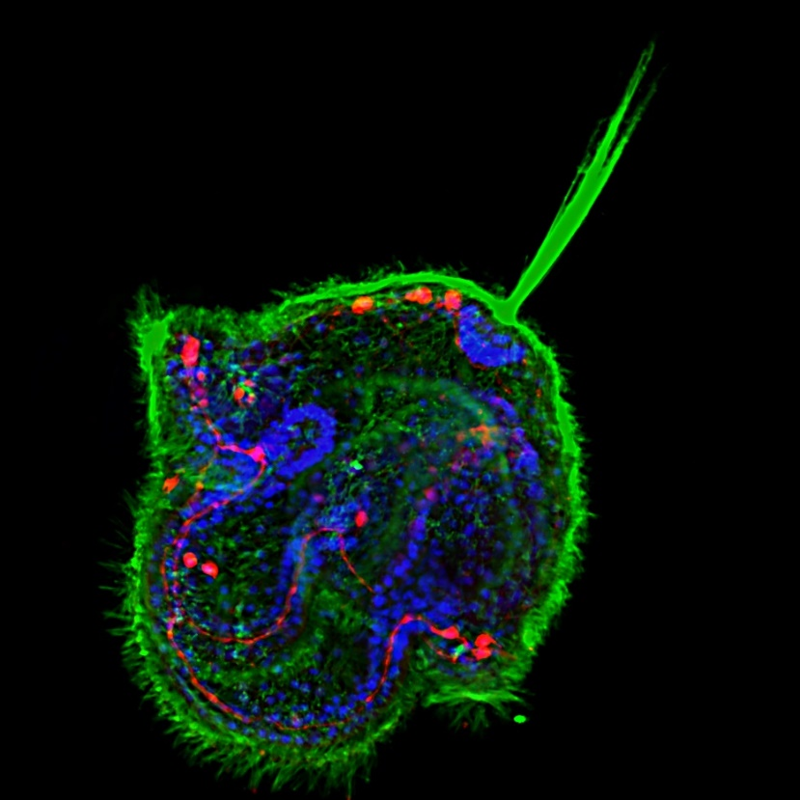
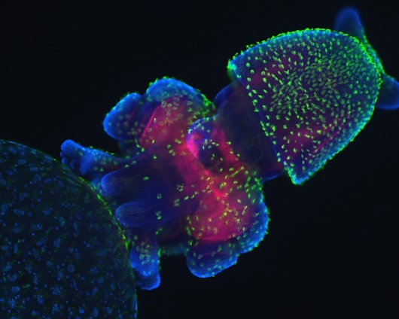
The Ultimate Contrast
Transparent specimen contrast
  Bright field 2-5%
  Phase & DIC 15-20%
  Stained specimen 25%
  Dark field 60%
  Fluorescence 75%
Notes:
Congratulations to Meii Chung of UT Austin, whose image of a Cerebratulus pilidium larva won first place in the latest voting round to choose a cover for Development from images taken by students of the 2010 Woods Hole Embryology course.
http://mblembryology.stowers.org/Development%20Covers.html
Confocal image of a squid embryo. All nuclei are stained with DAPI (blue). Phalloidin staining reveals neural structures (red), while cilia on the surface of the embryo are highlighted by acetylated tubulin staining (green). This image was taken by Davalyn Powell (University of Colorado Denver).

Slide 13
Biology 227: Methods in Modern Microscopy
Week 1 Introduction to Microscopes (Kohler illumination, Confocal microscope training)
Week 2 Applying Geometrical Optics (Making the Rochester Cloak)
Week 3 3D Laser Scanning Confocal Microscopy (LSCM)
Week 4 Begin Building a Light Sheet Microscope (openspim.org)
Week 5 FCS versus FRAP
Week 6 Live Imaging: Zebrafish embryos
Week 7 Multispectral Imaging
Week 8 Work on Assignments and building light sheet
Week 9 Work on Assignments and building light sheet
Week 10 Super Resolution Light Microscopy

Slide 14
Biology 227: Methods in Modern Microscopy
Week 1 Introduction to Microscopes (Kohler illumination, Confocal microscope training)
Week 2 Applying Geometrical Optics (Making the Rochester Cloak)
Week 3 3D Laser Scanning Confocal Microscopy (LSCM)
Week 4 Begin Building a Light Sheet Microscope (openspim.org)
Week 5 FCS versus FRAP
Week 6 Live Imaging: Zebrafish embryos
Week 7 Multispectral Imaging
Week 8 Work on Assignments and building light sheet
Week 9 Work on Assignments and building light sheet
Week 10 Super Resolution Light Microscopy

Slide 15
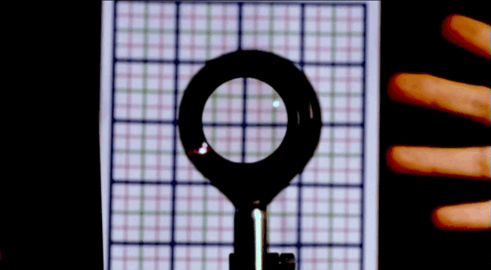
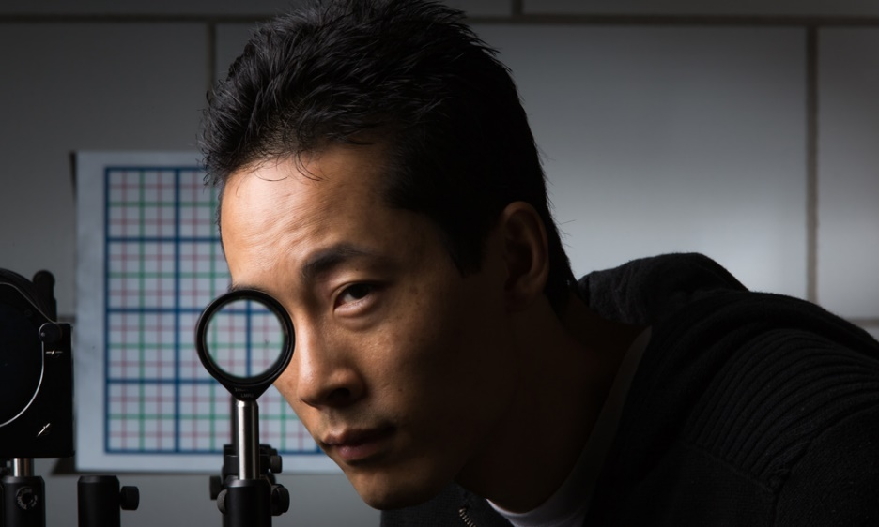
Applying geometrical optics.
Cloaking objects with simple lenses
Making objects invisible
Ray tracing still important for optical research
Paper by Choi and Howell from University of Rochester published 2014
  Choi JS, Howell JC. Paraxial ray optics cloaking. Optics express. 2014; 22(24):29465-78.

Slide 16
Biology 227: Methods in Modern Microscopy
Week 1 Introduction to Microscopes (Kohler illumination, Confocal microscope training)
Week 2 Applying Geometrical Optics (Making the Rochester Cloak)
Week 3 3D Laser Scanning Confocal Microscopy (LSCM)
Week 4 Begin Building a Light Sheet Microscope (openspim.org)
Week 5 FCS versus FRAP
Week 6 Live Imaging: Zebrafish embryos
Week 7 Multispectral Imaging
Week 8 Work on Assignments and building light sheet
Week 9 Work on Assignments and building light sheet
Week 10 Super Resolution Light Microscopy

Slide 17
The Ultimate Contrast
Transparent specimen contrast
  Bright field 2-5%
  Phase & DIC 15-20%
  Stained specimen 25%
  Dark field 60%
  Fluorescence 75%
Notes:
Congratulations to Meii Chung of UT Austin, whose image of a Cerebratulus pilidium larva won first place in the latest voting round to choose a cover for Development from images taken by students of the 2010 Woods Hole Embryology course.
http://mblembryology.stowers.org/Development%20Covers.html
Confocal image of a squid embryo. All nuclei are stained with DAPI (blue). Phalloidin staining reveals neural structures (red), while cilia on the surface of the embryo are highlighted by acetylated tubulin staining (green). This image was taken by Davalyn Powell (University of Colorado Denver).

Slide 18
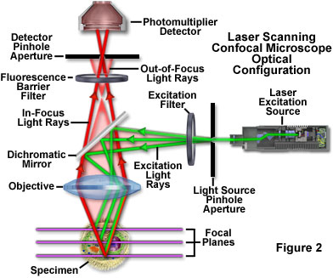
Improve fluorescence with optical sectioning:
Adding the 3rd Dimension
Wide-field microscopy
  Illuminating whole field of view
Deconvolution
  Computation based
Confocal microscopy
  Spot scanning
  Laser scanning confocal microscopy (LSCM)
Light sheet fluorescence microscopy (LSFM)
  Also called selective/single plane illumination microscopy (SPIM)
www.olympusfluoview.com
Notes:
Adds the third dimension

Slide 19
Biology 227: Methods in Modern Microscopy
Microscopes available in course lab, Church B168
  LSM 410 (x 2) inverted microscope
  LSM 310 upright microscope
  Stereo microscope, fluorescent
Download manuals from course web site!
Key to room in lock box code: 15629
Will also use microscopes in Beckman Institute Biological Imaging Facility (BIF), B133 Beckman Institute
Web site for BIF
  bioimaging.caltech.edu
  http://www.its.caltech.edu/~bif/
Notes:
Manuals for BIF at BIF web site

Slide 20
Current instruments: Beckman Institute Biological Imaging Facility (BIF)
LSM 710 ! # *
LSM 800 # *
LSM 510 i ! *
LSM 880 u ! # *
Spinning Disc # *
Leica DMI # *
LSM 880 u *
LaVision SPIM *
ZeissZ1 SPIM #*
! = two photon; # = incubation; * motorized stage

Slide 21
Biology 227: Methods in Modern Microscopy
Signing up to use microscopes in Beckman Institute Biological Imaging Facility (BIF), B133 Beckman Institute
Contact Steve Wilbert for training
  swilbert@caltech.edu
Web site for BIF
  bioimaging.caltech.edu
  http://www.its.caltech.edu/~bif/
Go to Calendar link and login in as an outside user
  Login: bi227@caltech.edu
  Password: 1562915629
Notes:
Manuals for BIF at BIF web site

Slide 22
Biology 227: Methods in Modern Microscopy
Week 1 Introduction to Microscopes (Kohler illumination, Confocal microscope training)
Week 2 Applying Geometrical Optics (Making the Rochester Cloak)
Week 3 3D Laser Scanning Confocal Microscopy (LSCM)
Week 4 Begin Building a Light Sheet Microscope (openspim.org)
Week 5 FCS versus FRAP
Week 6 Live Imaging: Zebrafish embryos
Week 7 Multispectral Imaging
Week 8 Work on Assignments and building light sheet
Week 9 Work on Assignments and building light sheet
Week 10 Super Resolution Light Microscopy

Slide 23
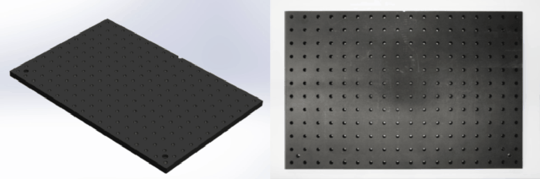
Building a light sheet fluorescence microscope (LSFM)
Also called selective/single plane illumination microscopy (SPIM)
Web site for open source SPIM, openspim.org
Thanks to Peter Gabriel Pitrone - DipRMS TechRMS FRMS,Light Sheet Fluorescence Microscopist and Imaging Specialist for Dr. Pavel Tomancak's research group at the Max Planck Institute of Molecular Cell Biology and Genetics

Slide 24
Biology 227: Methods in Modern Microscopy
Week 1 Introduction to Microscopes (Kohler illumination, Confocal microscope training)
Week 2 Applying Geometrical Optics (Making the Rochester Cloak)
Week 3 3D Laser Scanning Confocal Microscopy (LSCM)
Week 4 Begin Building a Light Sheet Microscope (openspim.org)
Week 5 FCS versus FRAP
Week 6 Live Imaging: Zebrafish embryos
Week 7 Multispectral Imaging
Week 8 Work on Assignments and building light sheet
Week 9 Work on Assignments and building light sheet
Week 10 Super Resolution Light Microscopy

Slide 25
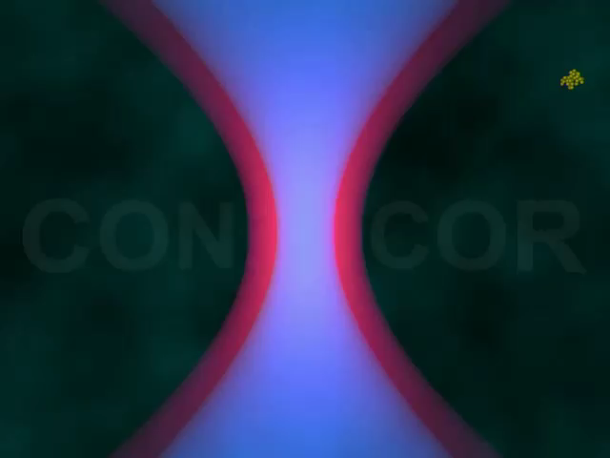
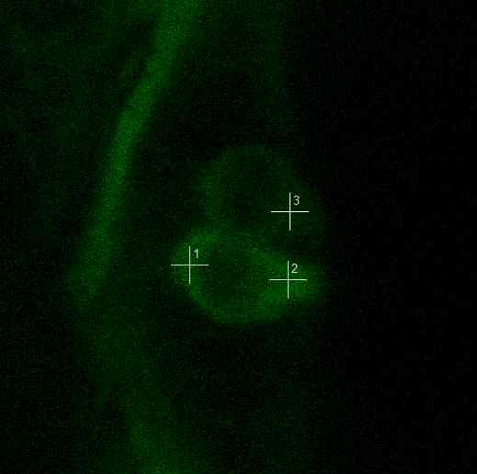
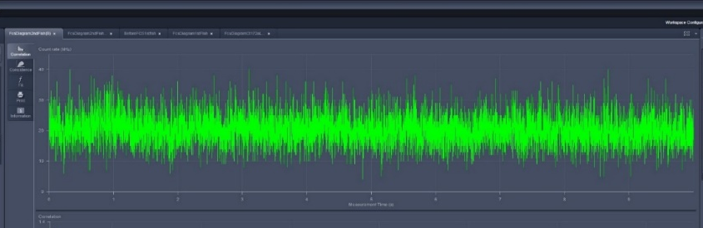
Fluorescence Correlation Spectroscopy (FCS)
Causes of fluctuations
Diffusion of labeled molecules due to Brownian motion
  In cells wide range of things cause movement (cellular trafficking, protein interaction etc.)
Photophysical processes of labeled molecules

Slide 26
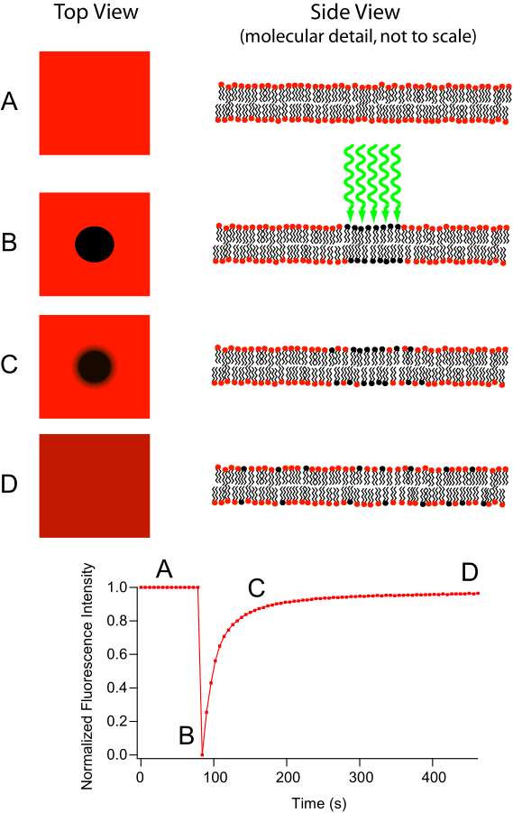
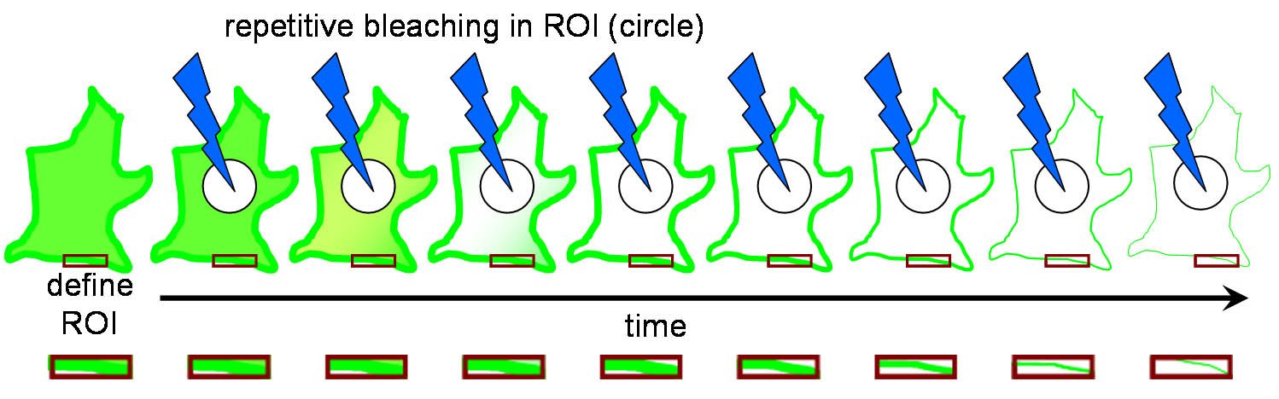
Fluorescent recovery after photobleaching (FRAP)
Diffusion coefficient:
ωr²
4τ_{d,i}
D=
Like FCS also used for calculating diffusion
Fluorescence Loss in Photobleaching (FLIP) related technique
Primary use of FLIP is to determine continuity of membranous organelles.
Notes:
The major difference between these two microscopy techniques is that FRAP involves the study of a cell’s ability to recover after a single photobleaching event whereas FLIP involves the study of how the loss of fluorescence spreads throughout the cell after multiple photobleaching events. This difference in purpose also leads to a difference in what parts of the cell are observed. In FRAP, the area that is actually photobleached is the area of interest. Conversely, in FLIP, the region of interest is just outside the region that is being photobleached. Another important difference is that in FRAP, there is a single photobleaching event and a recovery period to observe how well fluorophores move back to the bleached site. However, in FLIP, multiple photobleaching events occur to prevent the return of unbleached fluorophores to the bleaching region.
http://en.wikipedia.org/wiki/Fluorescence_loss_in_photobleaching
http://en.wikipedia.org/wiki/Fluorescence_recovery_after_photobleaching
http://www.olympusconfocal.com/applications/flipandfrap.html
"Frap diagram" by MDougM - Own work. Licensed under Public Domain via Wikimedia Commons - http://commons.wikimedia.org/wiki/File:Frap_diagram.svg#mediaviewer/File:Frap_diagram.svg
"Fluorescence Loss in Photobleaching Schematic" by Steven Lentz - was sent to me personally. Licensed under CC BY-SA 3.0 via Wikimedia Commons - http://commons.wikimedia.org/wiki/File:Fluorescence_Loss_in_Photobleaching_Schematic.jpg#mediaviewer/File:Fluorescence_Loss_in_Photobleaching_Schematic.jpg

Slide 27
Biology 227: Methods in Modern Microscopy
Week 1 Introduction to Microscopes (Kohler illumination, Confocal microscope training)
Week 2 Applying Geometrical Optics (Making the Rochester Cloak)
Week 3 3D Laser Scanning Confocal Microscopy (LSCM)
Week 4 Begin Building a Light Sheet Microscope (openspim.org)
Week 5 FCS versus FRAP
Week 6 Live Imaging: Zebrafish embryos
Week 7 Multispectral Imaging
Week 8 Work on Assignments and building light sheet
Week 9 Work on Assignments and building light sheet
Week 10 Super Resolution Light Microscopy

Slide 28
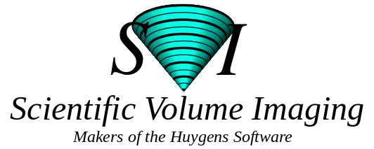
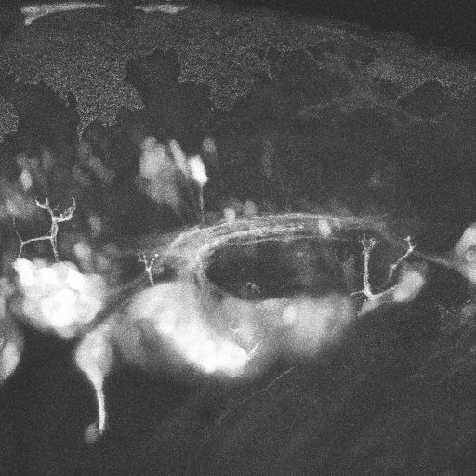
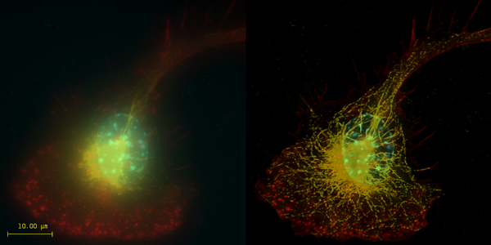
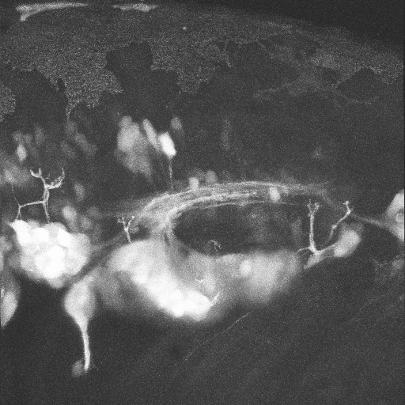
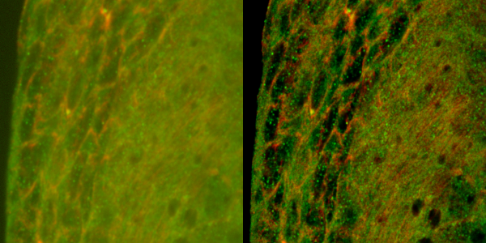
Image processing
3D Reconstruction
Deconvolution
A
A
P
Neural Gata-2 Promoter GFP-Transgenic Zebrafish; Shuo Lin, UCLA
Top: Macrophage - tubulin, actin & nucleus.
Bottom: Imaginal disc – α-tubulin, γ-tubulin.
Notes:
Top right: Macrophage fluorescently stained for tubulin (yellow), actin (red) and the nucleus (DAPI, blue). Left: original image, recorded with a wide field microscope. Right: the same dataset, deconvolved using Huygens Professional. The datasets are visualized with top-view maximum intensity projections.
Data courtesy of Dr. James Evans, Whitehead Institute, MIT Boston MA, USA. (See the EvansMacrophage for more image details).
Bottom right: Detail of an imaginal disc from a third instar Drosophila Melanogaster larva. Left: a slice of the original data, imaged using an Andor Revolution spinning disc confocal microscope.Right: the same slice, deconvolved using Huygens Professional. The fixed sample was stained against alfa-tubulin (green) and gamma-tubulin (red).
Recorded by Dr. Paula Sampaio, Advanced Light Microscopy Facility, University of Porto.

Slide 29
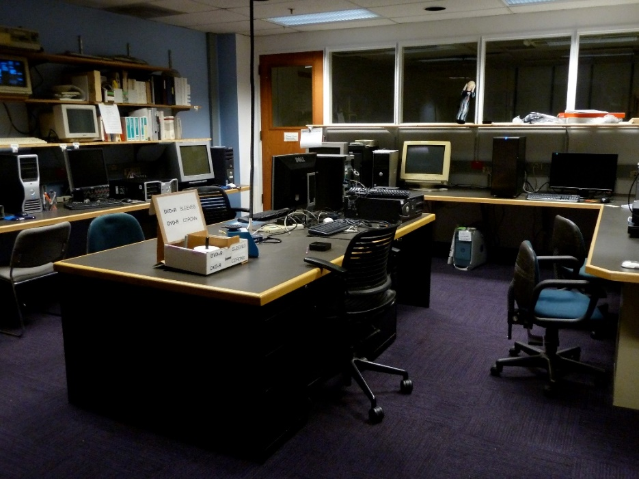
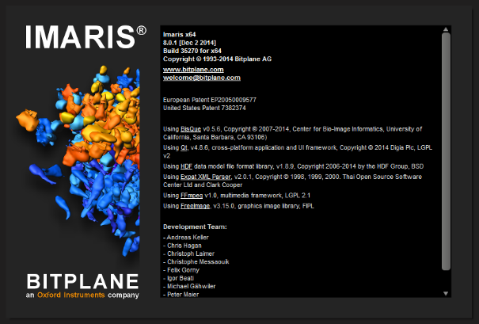

Image Processing:
Software Resources in BIF
The BIF has two computer workstations running the Imaris image processing software from Bitplane.
A third computer workstation, running Linux, for Huygens software from Scientific Volume Imaging B.V. (SVI), installed January 2014.

Slide 30
Biology 227: Methods in Modern Microscopy
Week 1 Introduction to Microscopes (Kohler illumination, Confocal microscope training)
Week 2 Applying Geometrical Optics (Making the Rochester Cloak)
Week 3 3D Laser Scanning Confocal Microscopy (LSCM)
Week 4 Begin Building a Light Sheet Microscope (openspim.org)
Week 5 FCS versus FRAP
Week 6 Live Imaging: Zebrafish embryos
Week 7 Multispectral Imaging
Week 8 Work on Assignments and building light sheet
Week 9 Work on Assignments and building light sheet
Week 10 Super Resolution Light Microscopy

Slide 31
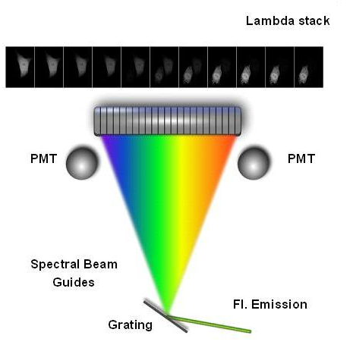
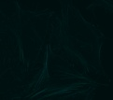
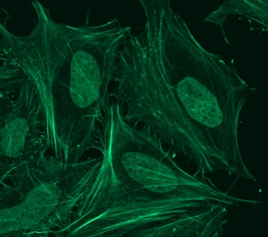
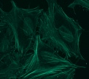
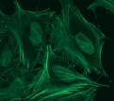
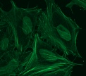
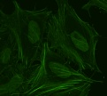
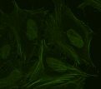
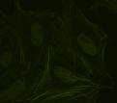
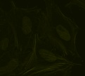
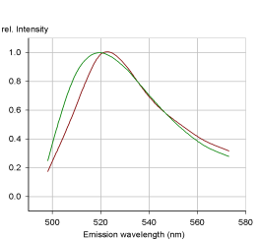
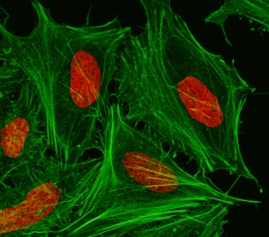
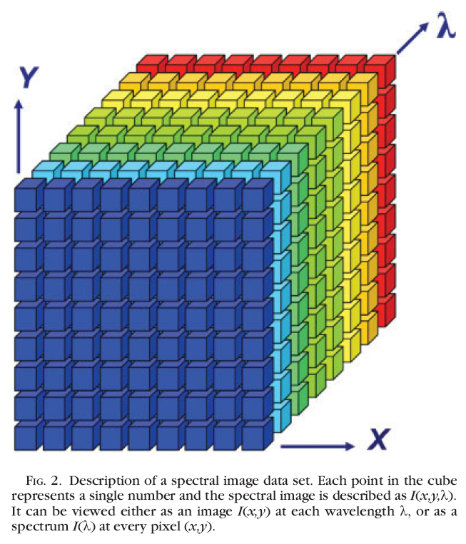
Spectral unmixing: general concept
Multi-channel Detector
Collect Lambda Stack
Raw Image
FITC
Sytox-green
Derive Emission Fingerprints
Garini et al, Cytometry Part A, 2006
Unmixed Image
Notes:
Important! For this experiment need 3 samples! One with each color alone then one with both. Crucial for distinguishing overlap.
http://bair.beatson.gla.ac.uk/pages1/confocals/SpectralUnmixing.htm

Slide 32
Biology 227: Methods in Modern Microscopy
Week 1 Introduction to Microscopes (Kohler illumination, Confocal microscope training)
Week 2 Applying Geometrical Optics (Making the Rochester Cloak)
Week 3 3D Laser Scanning Confocal Microscopy (LSCM)
Week 4 Begin Building a Light Sheet Microscope (openspim.org)
Week 5 FCS versus FRAP
Week 6 Live Imaging: Zebrafish embryos
Week 7 Multispectral Imaging
Week 8 Work on Assignments and building light sheet
Week 9 Work on Assignments and building light sheet
Week 10 Super Resolution Light Microscopy

Slide 33
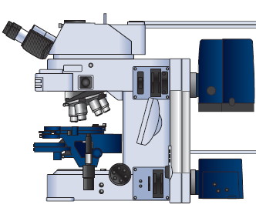
Illumination Techniques - Overview
Transmitted Light
Bright-field
Oblique
Darkfield
Phase Contrast
Polarized Light
DIC (Differential Interference Contrast)
Fluorescence - not any more > Epi !
Reflected (Incident) Light
Bright-field
Oblique
Darkfield
Not any more (DIC !)
Polarized Light
DIC (Differential Interference Contrast)
Fluorescence (Epi)

Slide 34
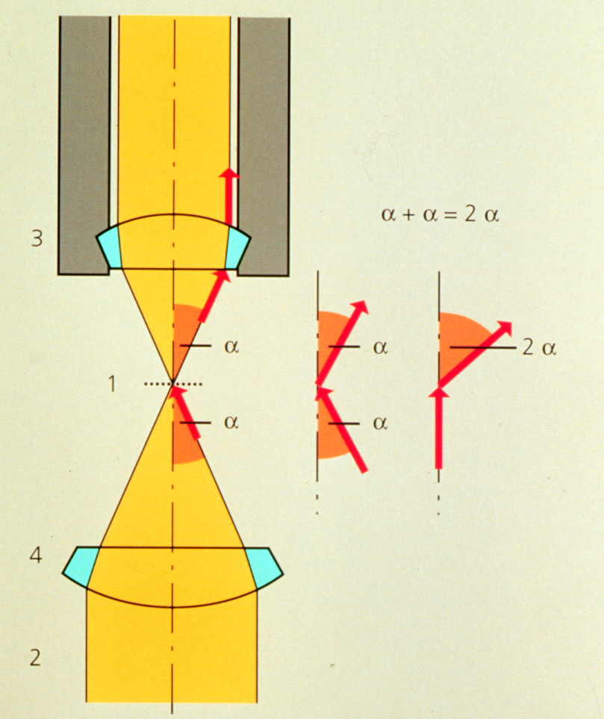
Condenser maximizes resolution
d_{min} = 1.22 λ / (NA _{objective} +NA _{condenser})
Kohler Illumination: Condenser and objective focused at the same plane

Slide 35
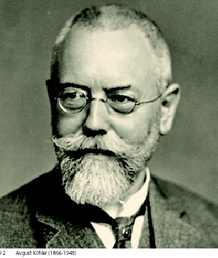
“Kohler” Illumination
Provides for most homogenous Illumination
Highest obtainable Resolution
Defines desired depth of field
Minimizes straylight and unnecessary Iradiation
Helps in focusing difficult-to-find structures
Establishes proper position for condenser elements, for all contrasting techniques
Prof. August Köhler:
1866-1948
Notes:
August Karl Johann Valentin Köhler (March 4, 1866 – March 12, 1948) was a German professor and early staff member of Carl Zeiss AG in Jena, Germany. He is best known for his development of the microscopy technique of Köhler illumination, an important principle in optimizing microscopic resolution power by evenly illuminating the field of view. This invention revolutionized light microscope design and is widely used in traditional as well as modern digital imaging techniques today.
At the time of the invention of his revolutionary illumination scheme as a graduate student at the University of Giessen, Köhler was working on overcoming problems with microphotography. Microscopes were illuminated by gas lamps, mirrors or other primitive light sources, resulting in an uneven specimen illumination unsuited for producing good quality photomicrographs using the slow-speed emulsions available at the time. Over the course of his work for his doctorate degree, Köhler developed a microscope configuration that allowed for an evenly illuminated field of view and reduced optical glare from the light source. It involved a collector lens for the lamp that allowed the light source to be focused on the front aperture of the condenser. This in turn allowed the condenser to be focused on the specimen using a field diaphragm and condenser focus control. This superior illumination scheme is still widely used in modern microscopes and forms the basis for phase contrast,^{[3]} differential interference contrast, epifluorescence, and confocal microscopy.^{[4]}
Köhler's groundbreaking work on microscope illumination was published in the Zeitschrift für wissenschaftliche Mikroskopie in 1893 in Germany,^{[5]} followed by an English summary of his work in the Journal of the Royal Microscopical Society one year later.^{[6]} Its significance was not noted until several years later when Köhler was invited to join the Carl Zeiss AG company based on his invention. A century after its first publication, a translation of Köhler's original article, A New System of Illumination for Photomicrographic Purposes, was reprinted in the Köhler Illumination Centenary commemorative issue by the Royal Microscopical Society in 1994.^{[7]} Today, the Köhler illumination is considered one of the most important principles in achieving the best optical resolution on a light microscope.

Slide 36
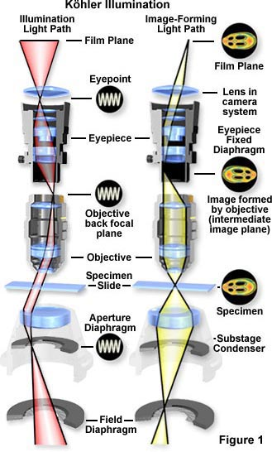
Kohler Rays
Kohler Illumination gives the most uniform illumination
Each part of the light source diverges to whole specimen
Each part of the specimen gets light that converges from the whole light source
Arrows mark
conjugate planes

Slide 37
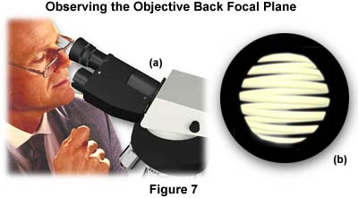
To look at the illumination planes
Remove eyepiece
Focus eye at infinity

Slide 38
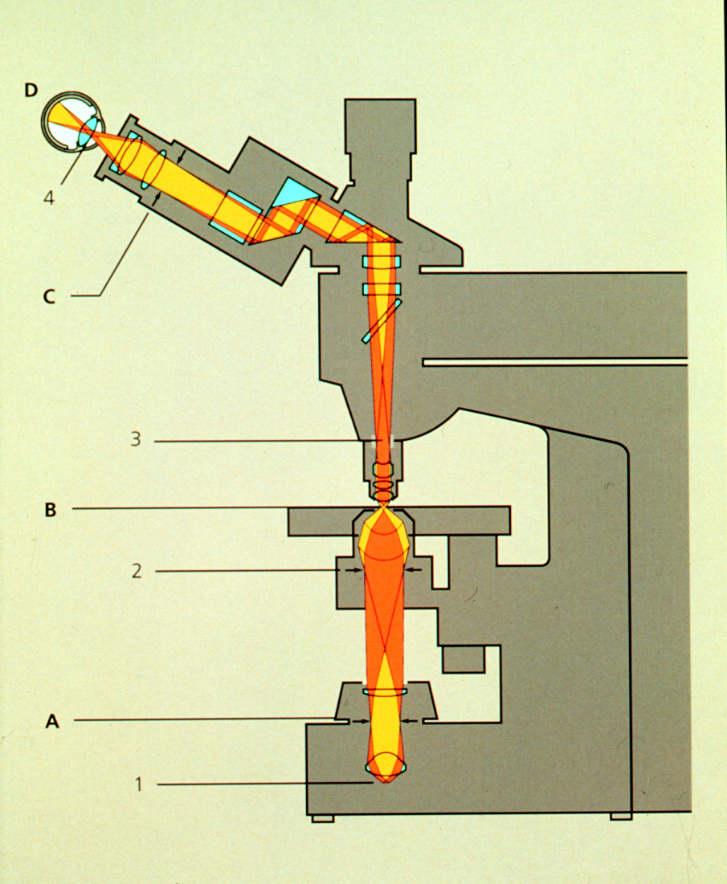
Requirements on Microscope
Condenser aperture
Condenser focus
& centering
Field aperture
Notes:
Condenser Aperture controls N.A. of condenser
Field Aperture controls region of specimen illuminated

Slide 39
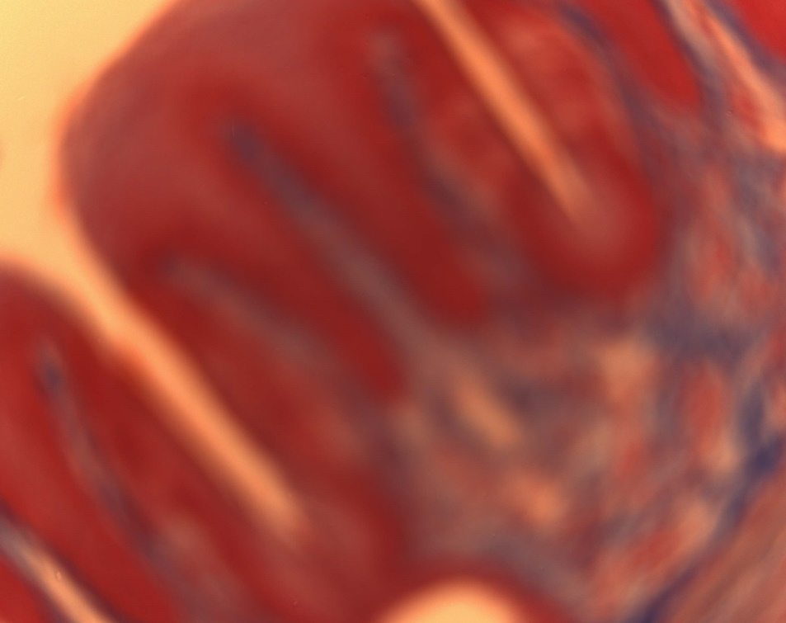

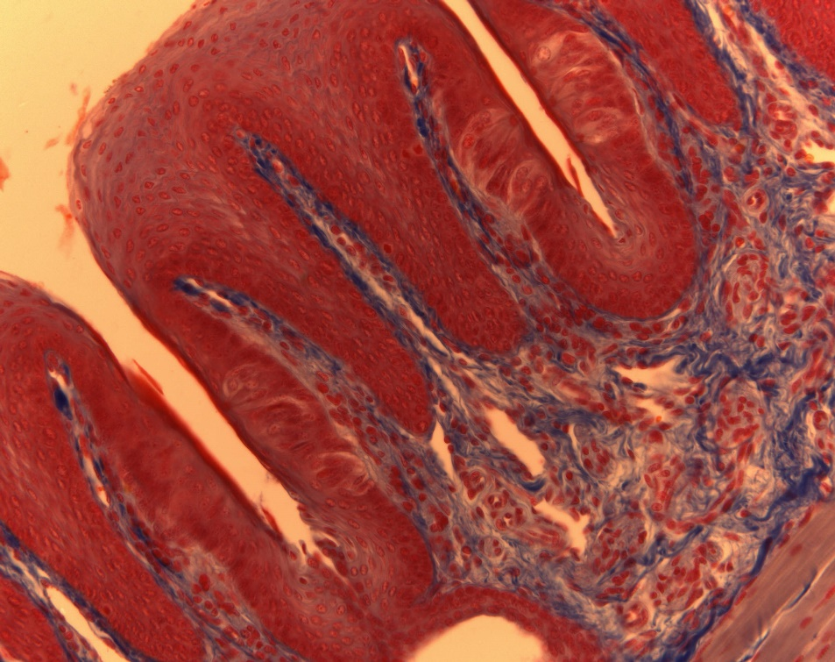
Koehler Illumination Steps:
Open Field and Condenser Diaphragms
Focus specimen
Correct for proper Color Temperature
Close Field Diaphragm
Focus Field Diaphragm – move condenser up and down
Center Field Diaphragm
Open to fill view
Observe Objective’s Back Focal Plane via Ph Telescope or by removing Ocular
Close Condenser Diaphragm to fill approx. 2/3 of Objective’s Aperture
Enjoy Image (changing Condenser Diaphragm alters Contrast / Resolution)

Slide 40
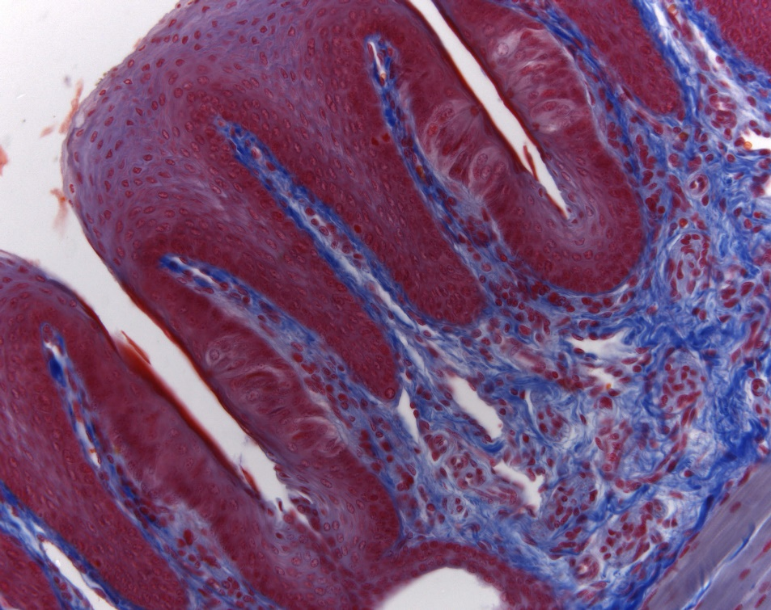
Open Field and Condenser Diaphragms
Focus specimen
Correct for proper Color Temperature
Close Field Diaphragm
Focus Field Diaphragm – move condenser up and down
Center Field Diaphragm
Open to fill view
Observe Objective’s Back Focal Plane via Ph Telescope or by removing Ocular
Close Condenser Diaphragm to fill approx. 2/3 of Objective’s Aperture
Enjoy Image (changing Condenser Diaphragm alters Contrast / Resolution)

Slide 41
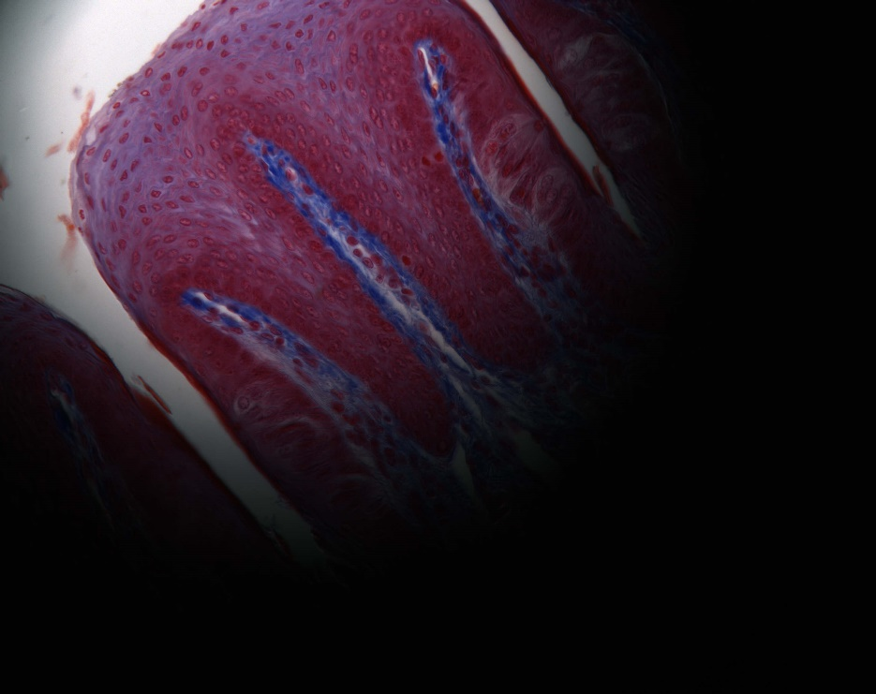
Open Field and Condenser Diaphragms
Focus specimen
Correct for proper Color Temperature
Close Field Diaphragm
Focus Field Diaphragm – move condenser up and down
Center Field Diaphragm
Open to fill view
Observe Objective’s Back Focal Plane via Ph Telescope or by removing Ocular
Close Condenser Diaphragm to fill approx. 2/3 of Objective’s Aperture
Enjoy Image (changing Condenser Diaphragm alters Contrast / Resolution)

Slide 42
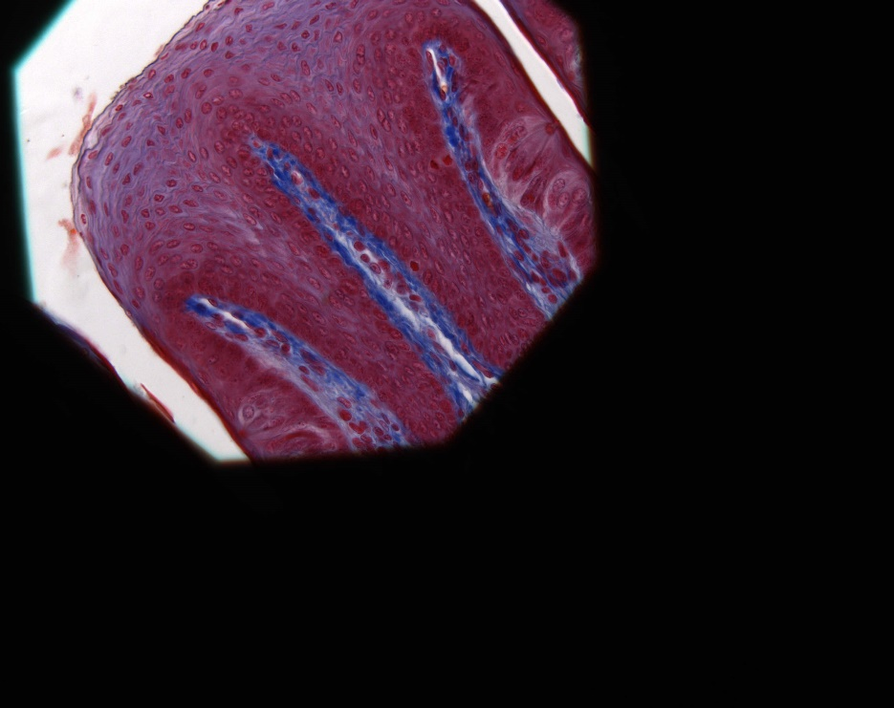
Open Field and Condenser Diaphragms
Focus specimen
Correct for proper Color Temperature
Close Field Diaphragm
Focus Field Diaphragm by
moving condenser up or down
Center Field Diaphragm
Open to fill view
Observe Objective’s Back Focal Plane via Ph Telescope or by removing Ocular
Close Condenser Diaphragm to fill approx. 2/3 of Objective’s Aperture
Enjoy Image (changing Condenser Diaphragm alters Contrast / Resolution)

Slide 43
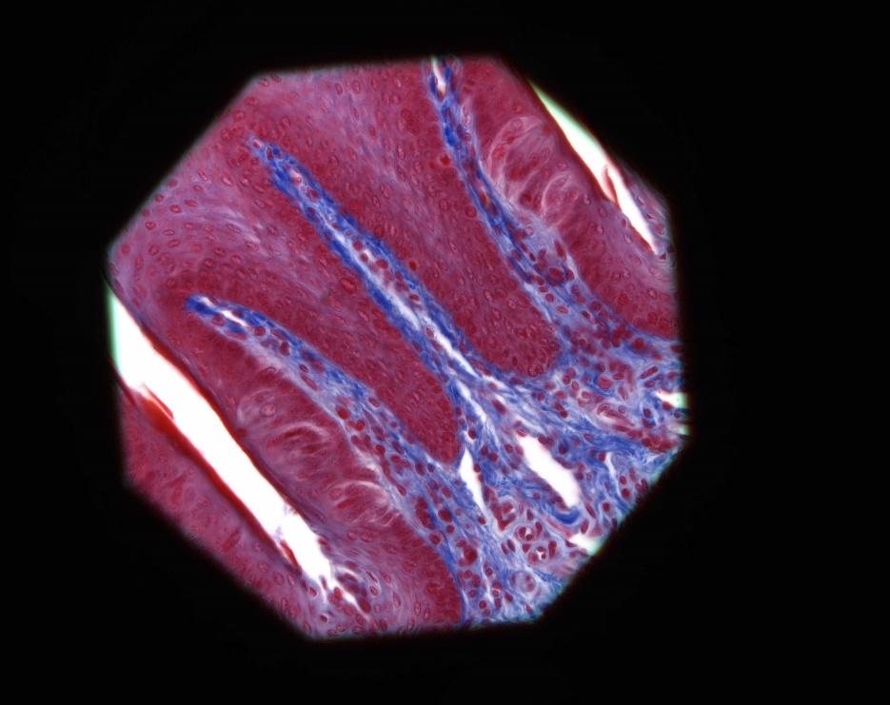
Open Field and Condenser Diaphragms
Focus specimen
Correct for proper Color Temperature
Close Field Diaphragm
Focus Field Stop by moving condenser up or down
Center Field Diaphragm
Open to fill view
Observe Objective’s Back Focal Plane via Ph Telescope or by removing Ocular
Close Condenser Diaphragm to fill approx. 2/3 of Objective’s Aperture
Enjoy Image (changing Condenser Diaphragm alters Contrast / Resolution)

Slide 44

Open Field and Condenser Diaphragms
Focus specimen
Correct for proper Color Temperature
Close Field Diaphragm
Focus Field Diaphragm – move condenser up and down
Center Field Diaphragm
Open to fill view of observer
Observe Objective’s Back Focal Plane via Ph Telescope or by removing Ocular
Close Condenser Diaphragm to fill approx. 2/3 of Objective’s Aperture
Enjoy Image (changing Condenser Diaphragm alters Contrast / Resolution)

Slide 45


Open Field and Condenser Diaphragms
Focus specimen
Correct for proper Color Temperature
Close Field Diaphragm
Focus Field Diaphragm – move condenser up and down
Center Field Diaphragm
Open to fill view
Observe Objective’s Back Focal Plane via Ph Telescope or by removing Ocular
Close Condenser Diaphragm to fill approx. 2/3 of Objective’s Aperture
BFP
Better: Depending on specimen’s inherent contrast, close condenser aperture to:
~ 0.3 - 0.9 x NA_{objective}

Slide 46

Done !

Slide 47
Kohler illumination interactive tutorial
http://zeiss-campus.magnet.fsu.edu/tutorials/basics/microscopealignment/indexflash.html

Slide 48
Microscopy Resources on the Web
http://www.olympusmicro.com
  Olympus
http://www.microscopyu.com
  Nikon
http://zeiss-campus.magnet.fsu.edu
  Zeiss

Slide 49

Acknowledgements
Scott E. Fraser, USC
Rudi Rottenfusser, Carl Zeiss
Paul Maddox, UNC

Slide 50

http://biblescripture.net/Greek.html

