Slide 1
Biology 227: Methods in Modern Microscopy
Andres Collazo, Director Biological Imaging Facility
Yonil Jung, Graduate Student, TA

Slide 2
Biology 227: Where and When?
  68 Church
  Monday &/or Wednesday Lectures in 151 Braun
    Some days may use 60 Church or 101 Kerkhoff
  10:00 am -11:00 am
  Lab times?
  12 Units (2-6-4)

Slide 3
Sister Course
Biology 177: Principles of Modern Microscopy
  Will be taught next year (Winter 2017)
  Lecture class
  Alternates with Biology 227
  Course web site
    http://www.its.caltech.edu/~bi177/

Slide 4
Biology 227: Methods in Modern Microscopy
227 TA: Yonil Jung
  Email: (jung830307@gmail.com)
Will work in groups
Course work:
  Lab Assignments, Five (50% of grade)
  Final Project (50% of grade)
  Final Project proposal due Feb. 3rd
  Final Project due March 16.
  No exams
Course web site:
  http://www.its.caltech.edu/~bi227/

Slide 5
Biology 227: Methods in Modern Microscopy
Week 1 Introduction to Microscopes (Kohler illumination, Confocal microscope training)
Week 2 Applying Geometrical Optics (Making the Rochester Cloak)
Week 3 2D Laser Scanning Confocal Microscopy (LSCM)
Week 4 3D LSCM; Begin Building a Light Sheet Microscope (openspim.org)
Week 5 Live Imaging I: Drosophila embryos
Week 6 Live Imaging II: Zebrafish embryos
Week 7 Multispectral Imaging
Week 8 Fluorescent Correlation Spectroscopy
Week 9 Comparisons of Different Optical Sectioning Methods
Week 10 Super Resolution Light Microscopy (the cheating method)

Slide 6

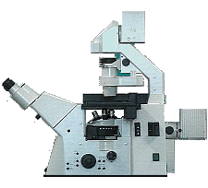
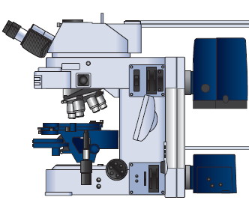
The basic light microscope types
Upright microscope
.
Inverted microscope

Slide 7
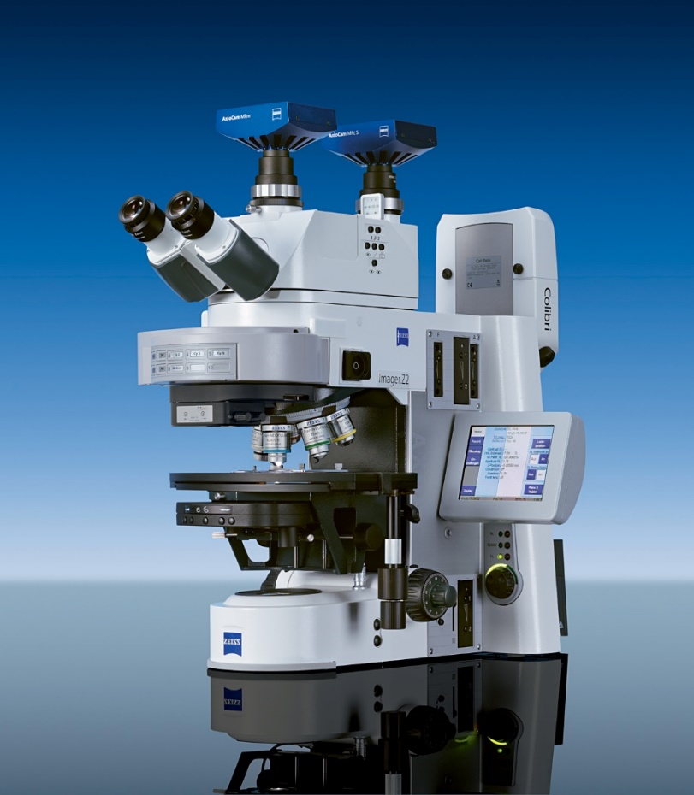
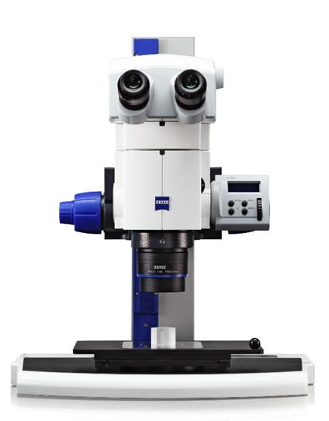
Light microscopes in the laboratory

Slide 8
Light microscopes in the laboratory
Compound microscope highest resolution
  ~200 nm Maximum
However, compound microscope is not 3D, even though binocular
Advantages of light
  Easy sample prep
  Live imaging

Slide 9
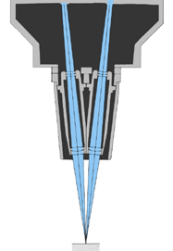
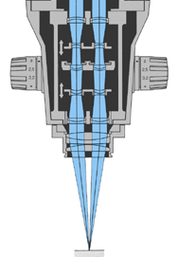
Greenough Type
Introduced first by Zeiss - 1897
Common Main Objective Type
Introduced first by Zeiss - 1946
Notes:
Common Main Objective type is also called Telescope type.

Slide 10
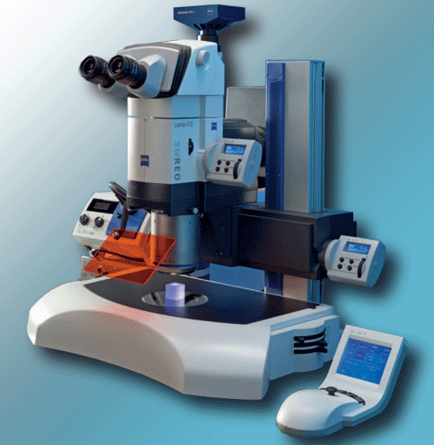
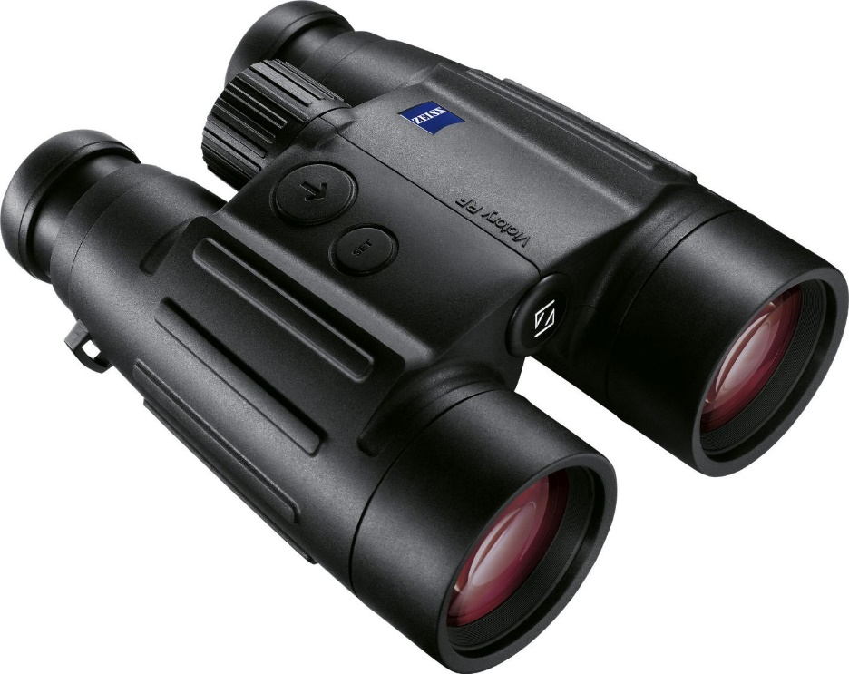
Stereo microscopes are to microscopes
As binoculars are to telescopes

Slide 11
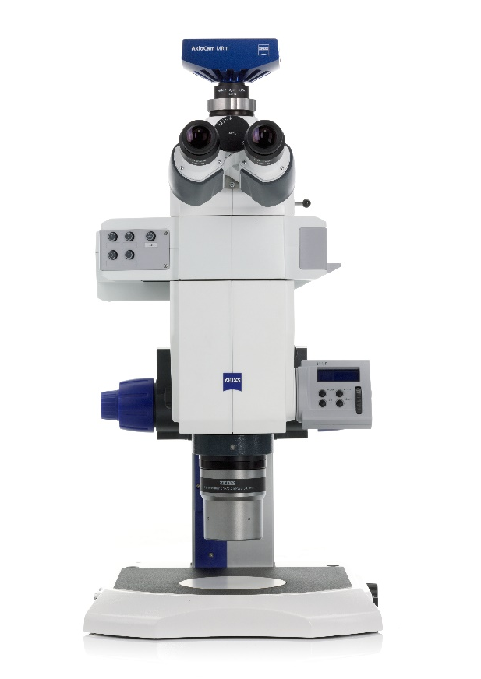
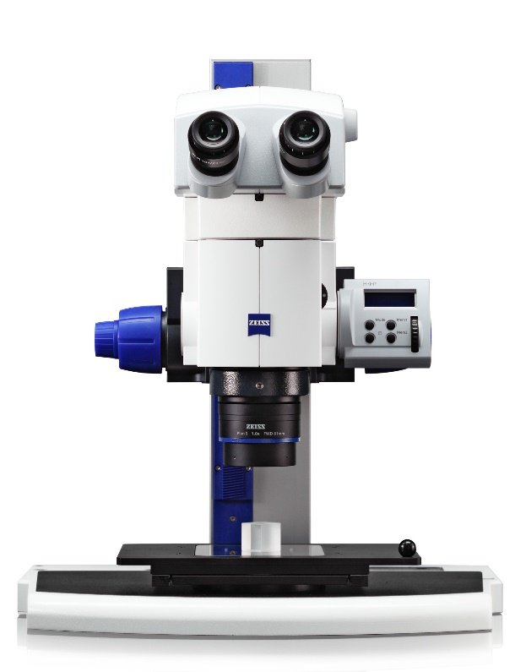
Distinguishing between normal and stereo microscopes not always easy
Discovery
Axio Zoom
Notes:
Why does this matter?

Slide 12
Distinguishing between normal and stereo microscopes not always easy
Discovery
Axio Zoom
Notes:
Why does this matter?

Slide 13
Resolution vs Contrast
More than just magnification
Shorter wavelength
Higher NA
But hard to resolve without contrast!

Slide 14
Resolution vs Contrast
More than just magnification
Shorter wavelength
Higher NA
But hard to resolve without contrast!

Slide 15
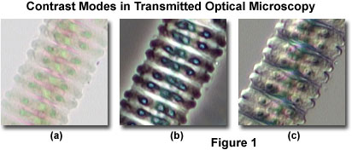
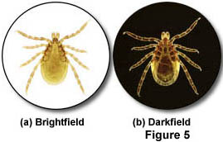
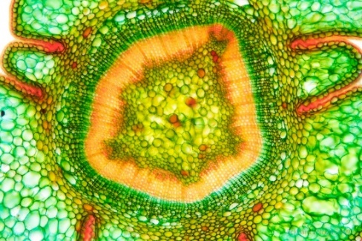
Resolution vs Contrast
Transparent specimen contrast
  Bright field 2-5%
  Phase & DIC 15-20%
  Stained specimen 25%
  Dark field 60%
https://www.flickr.com/photos/wunderkanone/4244591261
Notes:
Stained section of Taxus baccata, Sprout, 10x
https://www.flickr.com/photos/wunderkanone/4244591261/

Slide 16
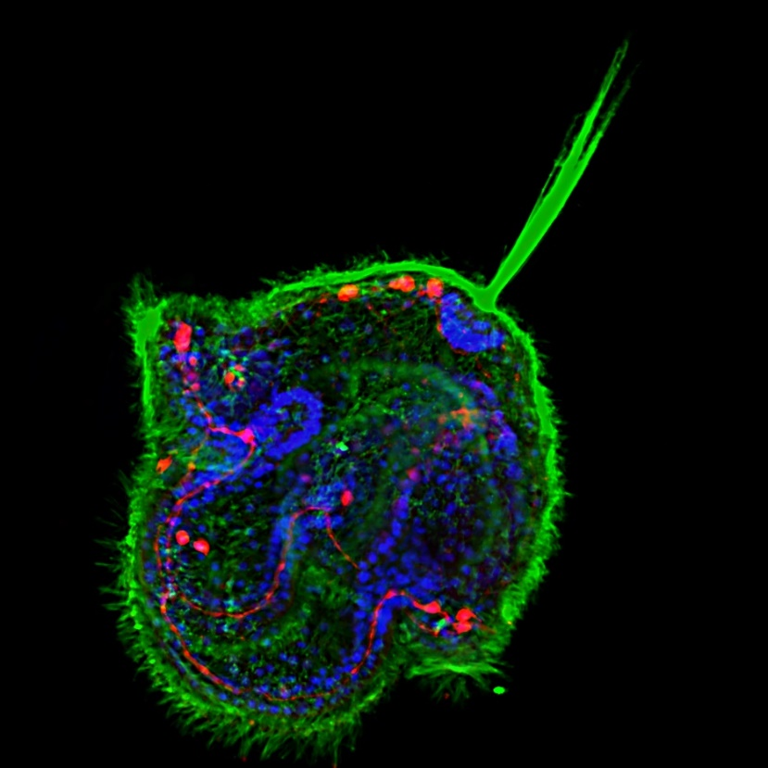
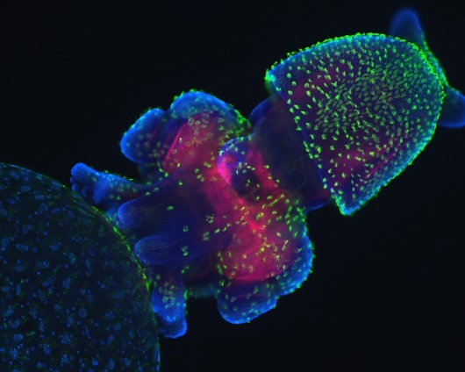
The Ultimate Contrast
Transparent specimen contrast
  Bright field 2-5%
  Phase & DIC 15-20%
  Stained specimen 25%
  Dark field 60%
  Fluorescence 75%
Notes:
Congratulations to Meii Chung of UT Austin, whose image of a Cerebratulus pilidium larva won first place in the latest voting round to choose a cover for Development from images taken by students of the 2010 Woods Hole Embryology course.
http://mblembryology.stowers.org/Development%20Covers.html
Confocal image of a squid embryo. All nuclei are stained with DAPI (blue). Phalloidin staining reveals neural structures (red), while cilia on the surface of the embryo are highlighted by acetylated tubulin staining (green). This image was taken by Davalyn Powell (University of Colorado Denver).

Slide 17
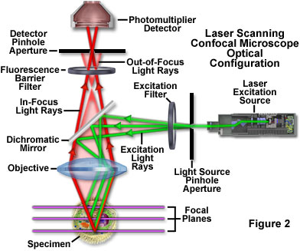
Improve fluorescence with optical sectioning
Wide-field microscopy
  Illuminating whole field of view
Confocal microscopy
  Spot scanning
  Laser scanning confocal microscopy (LSCM)
LSCM adds the 3rd Dimension
www.olympusfluoview.com
Notes:
Adds the third dimension

Slide 18
Biology 227: Methods in Modern Microscopy
Microscopes available in course lab, Church 68
  LSM 410 (x 2) inverted microscope
  LSM 310 upright microscope
  Stereo microscope, fluorescent
Download manuals from course web site!
Will also use microscopes in Beckman Institute Biological Imaging Facility (BIF), B133 Beckman Institute
Web site for BIF
  bioimaging.caltech.edu
  http://www.its.caltech.edu/~bif/
Notes:
Manuals for BIF at BIF web site

Slide 19
Current instruments: Beckman Institute Biological Imaging Facility (BIF)
LSM 710 ! # *
5 Exciter # *
LSM 510 i !
LSM 510 u ! *
Spinning Disc # *
Leica DMI # *
! = two photon; # = incubation; * motorized stage

Slide 20
Current instruments: Trading in
LSM 710 ! # *
5 Exciter # *
LSM 510 i !
LSM 510 u ! *
Spinning Disc # *
Leica DMI # *
! = two photon; # = incubation; * motorized stage

Slide 21
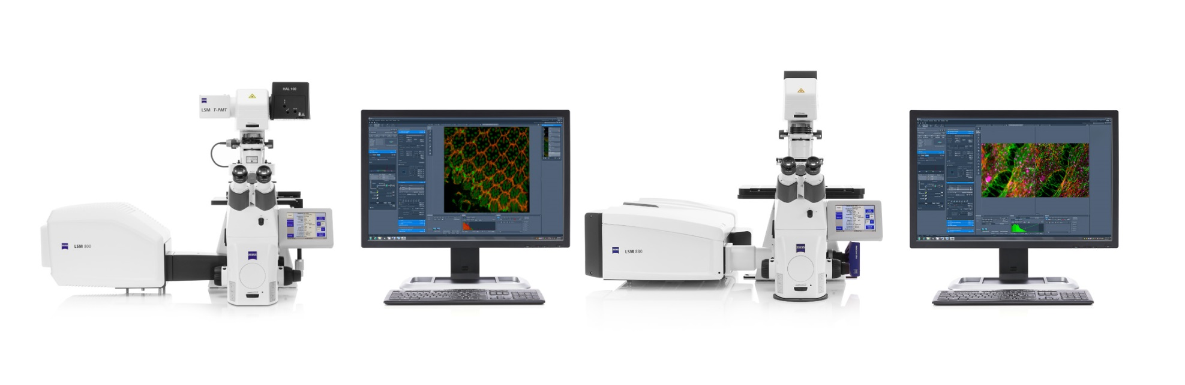
For Zeiss LSM 880 with Airyscan & LSM 800
Airyscan Available in All ZEISS LSM 8 Family Systems
LSM 800
LSM 880
Your Compact System for High-End Confocal Imaging
Your Flexible and Modular System for High-End Confocal Imaging

Slide 22
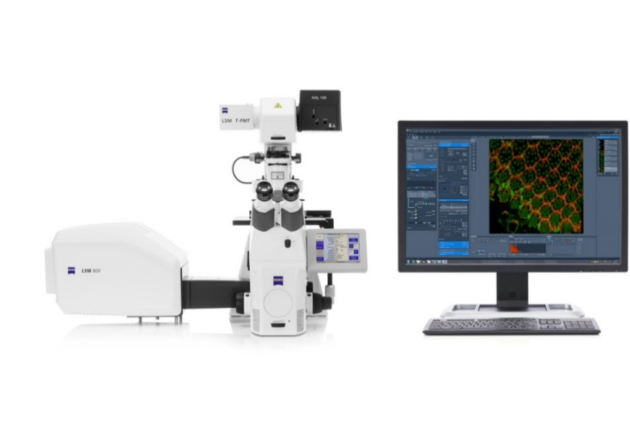
Zeiss LSM 800
Inverted microscope
Sequential Spectral Detection
3 supersensitive GaAsP Detectors
Incubator for live cell imaging
Definite Focus: optical auto focus
Motorized X-Y stage for tiling
Software for FRAP, FRET, Experiment Designer
Laser Lines: 405, 488, 561, 640

Slide 23
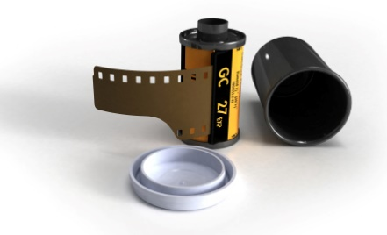
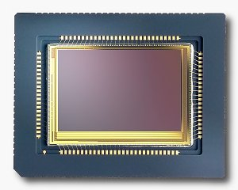
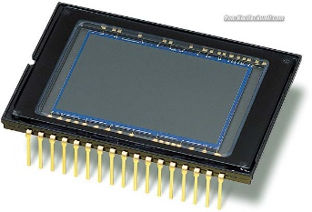
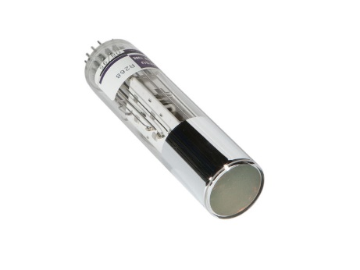
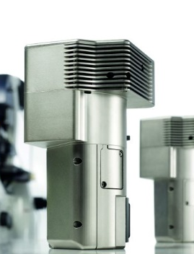
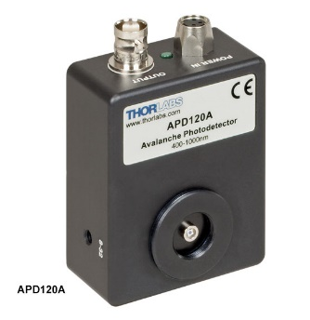
Detectors: From analog to digital
Film
CMOS (Complementary metal–oxide–semiconductor)
CCD (Charge coupled device)
PMT (Photomultiplier tube)
GaAsP (Gallium arsenide phosphide)
APD (Avalanche photodiode)

Slide 24
Detectors for microscopy
Film
CMOS (Complementary metal–oxide–semiconductor)
CCD (Charge coupled device)
PMT (Photomultiplier tube)
GaAsP (Gallium arsenide phosphide)
APD (Avalanche photodiode)
Array of detectors, like your retina
Bit Depth
  8 bits = 256
  12 ” = 4,096
  16 ” = 65,536
Maximize Histogram
Single point source detectors

Slide 25
Biology 227: Methods in Modern Microscopy
Week 1 Introduction to Microscopes (Koehler illumination, Confocal microscope training)
Week 2 Applying Geometrical Optics (Making the Rochester Cloak)
Week 3 2D Laser Scanning Confocal Microscopy (LSCM)
Week 4 3D LSCM; Begin Building a Light Sheet Microscope (openspim.org)
Week 5 Live Imaging I: Drosophila embryos
Week 6 Live Imaging II: Zebrafish embryos
Week 7 Multispectral Imaging
Week 8 Fluorescent Correlation Spectroscopy
Week 9 Comparisons of Different Optical Sectioning Methods
Week 10 Super Resolution Light Microscopy (the cheating method)

Slide 26
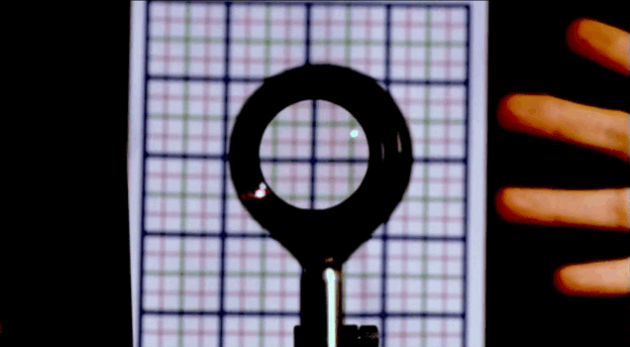
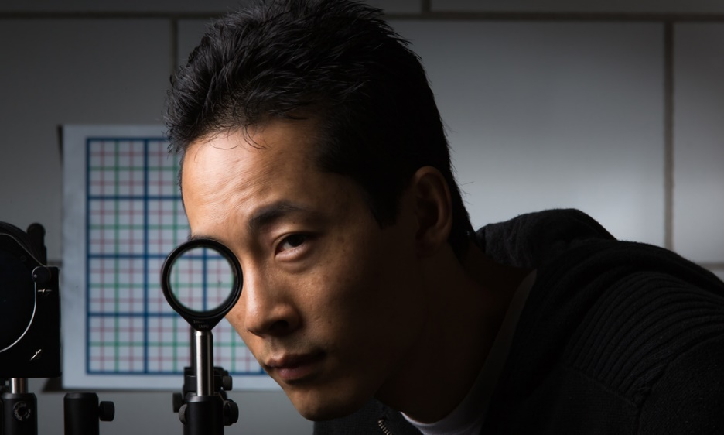
Applying geometrical optics.
Cloaking objects with simple lenses
Making objects invisible
Ray tracing still important for optical research
Paper by Choi and Howell from University of Rochester published 2014
  Choi JS, Howell JC. Paraxial ray optics cloaking. Optics express. 2014; 22(24):29465-78.

Slide 27
Biology 227: Methods in Modern Microscopy
Week 1 Introduction to Microscopes (Koehler illumination, Confocal microscope training)
Week 2 Applying Geometrical Optics (Making the Rochester Cloak)
Week 3 2D Laser Scanning Confocal Microscopy (LSCM)
Week 4 3D LSCM; Begin Building a Light Sheet Microscope (openspim.org)
Week 5 Live Imaging I: Drosophila embryos
Week 6 Live Imaging II: Zebrafish embryos
Week 7 Multispectral Imaging
Week 8 Fluorescent Correlation Spectroscopy
Week 9 Comparisons of Different Optical Sectioning Methods
Week 10 Super Resolution Light Microscopy (the cheating method)

Slide 28
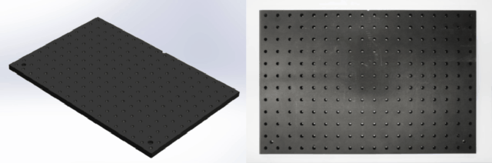
Building a light sheet fluorescence microscope (LSFM)
Also called selective/single plane illumination microscopy (SPIM)
Web site for open source SPIM, openspim.org
Thanks to Peter Gabriel Pitrone - DipRMS TechRMS FRMS,Light Sheet Fluorescence Microscopist and Imaging Specialist for Dr. Pavel Tomancak's research group at the Max Planck Institute of Molecular Cell Biology and Genetics

Slide 29
Biology 227: Methods in Modern Microscopy
Week 1 Introduction to Microscopes (Koehler illumination, Confocal microscope training)
Week 2 Applying Geometrical Optics (Making the Rochester Cloak)
Week 3 2D Laser Scanning Confocal Microscopy (LSCM)
Week 4 3D LSCM; Begin Building a Light Sheet Microscope (openspim.org)
Week 5 Live Imaging I: Drosophila embryos
Week 6 Live Imaging II: Zebrafish embryos
Week 7 Multispectral Imaging
Week 8 Fluorescent Correlation Spectroscopy
Week 9 Comparisons of Different Optical Sectioning Methods
Week 10 Super Resolution Light Microscopy (the cheating method)

Slide 30
Biology 227: Methods in Modern Microscopy
Week 1 Introduction to Microscopes (Koehler illumination, Confocal microscope training)
Week 2 Applying Geometrical Optics (Making the Rochester Cloak)
Week 3 2D Laser Scanning Confocal Microscopy (LSCM)
Week 4 3D LSCM; Begin Building a Light Sheet Microscope (openspim.org)
Week 5 Live Imaging I: Drosophila embryos
Week 6 Live Imaging II: Zebrafish embryos
Week 7 Multispectral Imaging
Week 8 Fluorescent Correlation Spectroscopy
Week 9 Comparisons of Different Optical Sectioning Methods
Week 10 Super Resolution Light Microscopy (the cheating method)

Slide 31
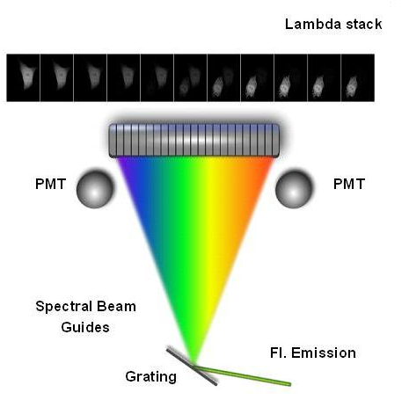

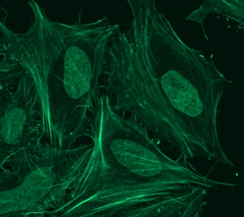
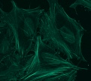
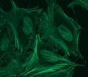
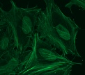
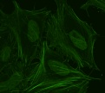
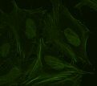
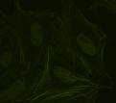
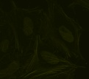
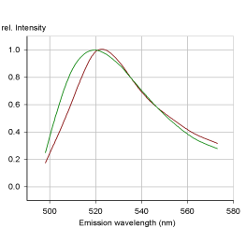
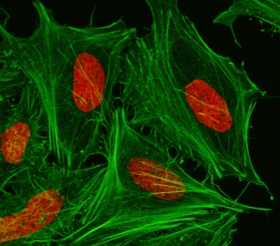
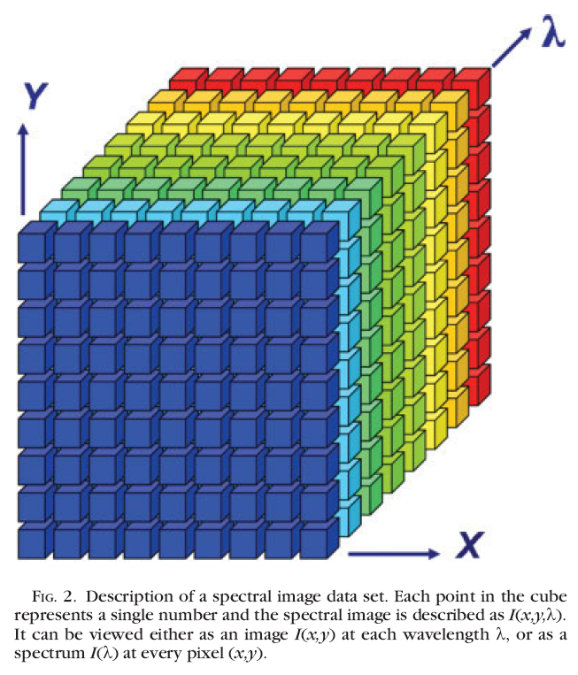
Spectral unmixing: general concept
Multi-channel Detector
Collect Lambda Stack
Raw Image
FITC
Sytox-green
Derive Emission Fingerprints
Garini et al, Cytometry Part A, 2006
Unmixed Image
Notes:
Important! For this experiment need 3 samples! One with each color alone then one with both. Crucial for distinguishing overlap.
http://bair.beatson.gla.ac.uk/pages1/confocals/SpectralUnmixing.htm

Slide 32
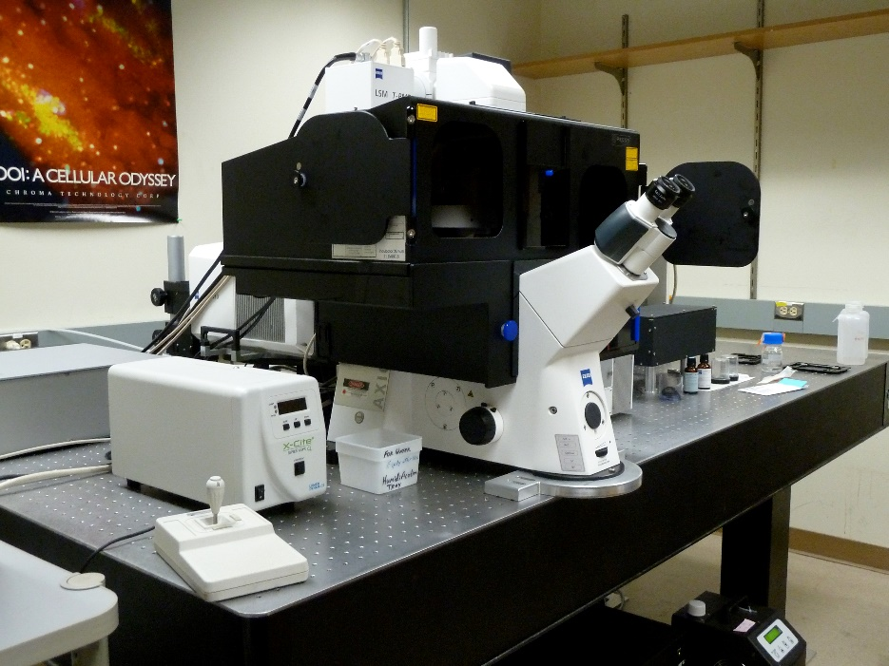
Zeiss LSM 710
Inverted microscope
Spectral Detector
Two NDDs for highest sensitivity
Incubator for live cell imaging
Two photon laser for deeper tissue imaging
Motorized X-Y stage for tiling

Slide 33
Biology 227: Methods in Modern Microscopy
Week 1 Introduction to Microscopes (Koehler illumination, Confocal microscope training)
Week 2 Applying Geometrical Optics (Making the Rochester Cloak)
Week 3 2D Laser Scanning Confocal Microscopy (LSCM)
Week 4 3D LSCM; Begin Building a Light Sheet Microscope (openspim.org)
Week 5 Live Imaging I: Drosophila embryos
Week 6 Live Imaging II: Zebrafish embryos
Week 7 Multispectral Imaging
Week 8 Fluorescent Correlation Spectroscopy
Week 9 Comparisons of Different Optical Sectioning Methods
Week 10 Super Resolution Light Microscopy (the cheating method)

Slide 34
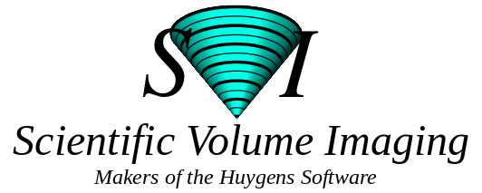
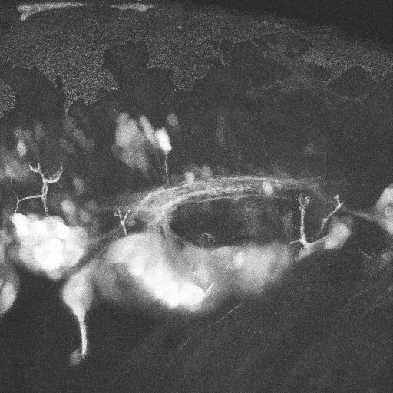
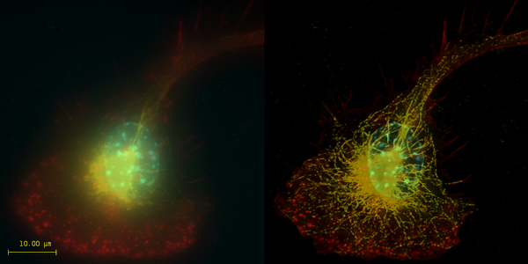
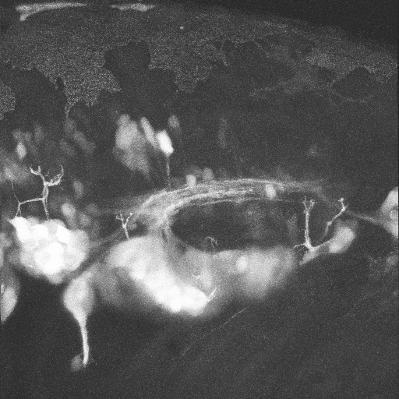
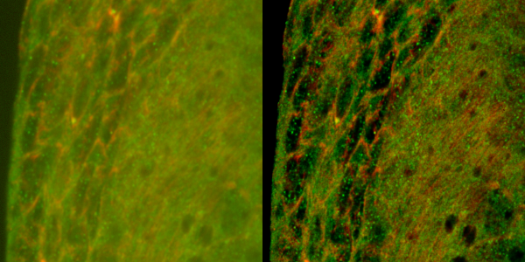
Image processing
3D Reconstruction
Deconvolution
A
A
P
Neural Gata-2 Promoter GFP-Transgenic Zebrafish; Shuo Lin, UCLA
Top: Macrophage - tubulin, actin & nucleus.
Bottom: Imaginal disc – α-tubulin, γ-tubulin.
Notes:
Top right: Macrophage fluorescently stained for tubulin (yellow), actin (red) and the nucleus (DAPI, blue). Left: original image, recorded with a wide field microscope. Right: the same dataset, deconvolved using Huygens Professional. The datasets are visualized with top-view maximum intensity projections.
Data courtesy of Dr. James Evans, Whitehead Institute, MIT Boston MA, USA. (See the EvansMacrophage for more image details).
Bottom right: Detail of an imaginal disc from a third instar Drosophila Melanogaster larva. Left: a slice of the original data, imaged using an Andor Revolution spinning disc confocal microscope.Right: the same slice, deconvolved using Huygens Professional. The fixed sample was stained against alfa-tubulin (green) and gamma-tubulin (red).
Recorded by Dr. Paula Sampaio, Advanced Light Microscopy Facility, University of Porto.

Slide 35
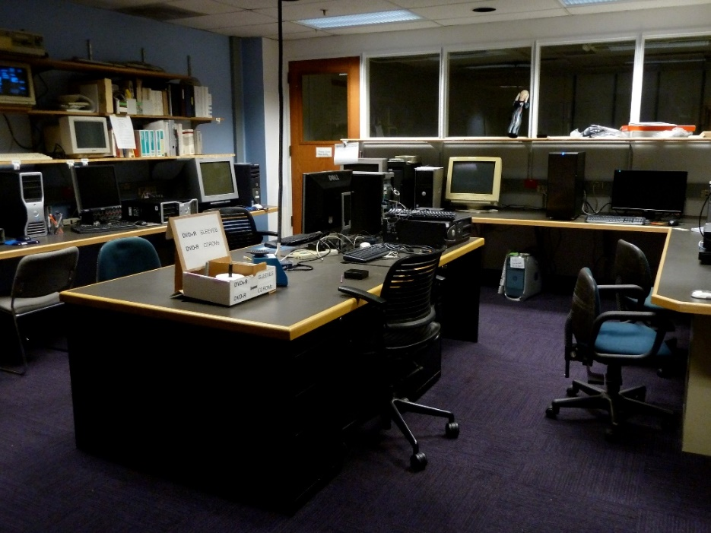
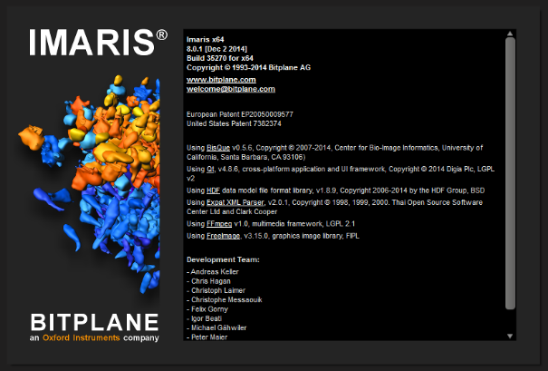

Image Processing:
Software Resources in BIF
The BIF has two computer workstations running the Imaris image processing software from Bitplane.
A third computer workstation, running Linux, for Huygens software from Scientific Volume Imaging B.V. (SVI), installed January 2014.

Slide 36
Biology 227: Methods in Modern Microscopy
Week 1 Introduction to Microscopes (Koehler illumination, Confocal microscope training)
Week 2 Applying Geometrical Optics (Making the Rochester Cloak)
Week 3 2D Laser Scanning Confocal Microscopy (LSCM)
Week 4 3D LSCM; Begin Building a Light Sheet Microscope (openspim.org)
Week 5 Live Imaging I: Drosophila embryos
Week 6 Live Imaging II: Zebrafish embryos
Week 7 Multispectral Imaging
Week 8 Fluorescent Correlation Spectroscopy
Week 9 Comparisons of Different Optical Sectioning Methods
Week 10 Super Resolution Light Microscopy (the cheating method)

Slide 37
Illumination Techniques - Overview
Transmitted Light
Bright-field
Oblique
Darkfield
Phase Contrast
Polarized Light
DIC (Differential Interference Contrast)
Fluorescence - not any more > Epi !
Reflected (Incident) Light
Bright-field
Oblique
Darkfield
Not any more (DIC !)
Polarized Light
DIC (Differential Interference Contrast)
Fluorescence (Epi)

Slide 38
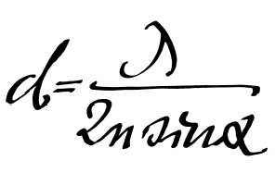
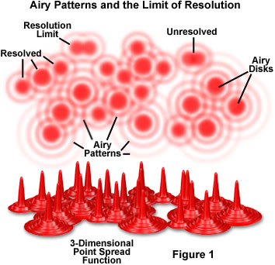
Resolution
More than just magnification
Shorter wavelength
Higher NA
R = 0.61λ/NA
R = 1.22λ/(NA(obj) + NA(cond))
Notes:
Ernst Abbe’s formula for resolution from when he was a scientist working at Zeiss. Published in late 1800s.

Slide 39
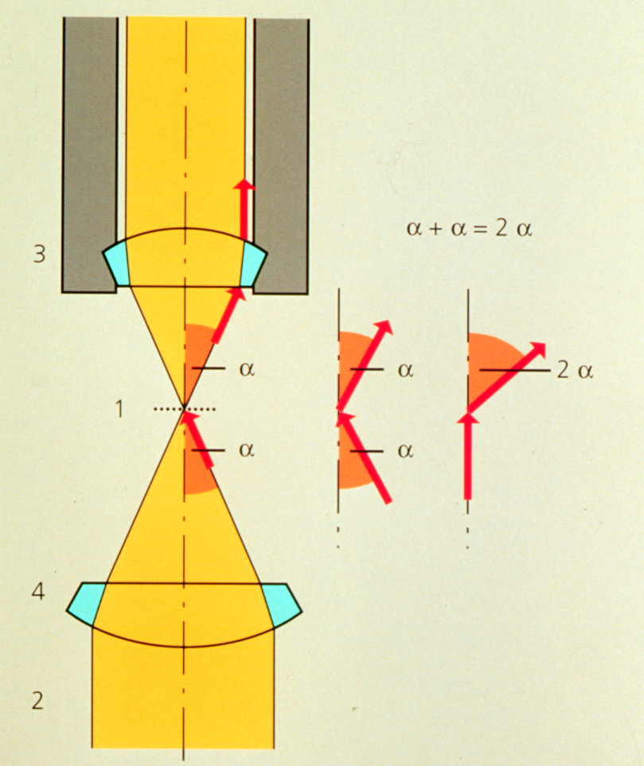
Condenser maximizes resolution
d_{min} = 1.22 λ / (NA _{objective} +NA _{condenser})
Kohler Illumination: Condenser and objective focused at the same plane

Slide 40

“Kohler” Illumination
Provides for most homogenous Illumination
Highest obtainable Resolution
Defines desired depth of field
Minimizes Straylight and unnecessary Iradiation
Helps in focusing difficult-to-find structures
Establishes proper position for condenser elements, for all contrasting techniques
Prof. August Köhler:
1866-1948
Notes:
August Karl Johann Valentin Köhler (March 4, 1866 – March 12, 1948) was a German professor and early staff member of Carl Zeiss AG in Jena, Germany. He is best known for his development of the microscopy technique of Köhler illumination, an important principle in optimizing microscopic resolution power by evenly illuminating the field of view. This invention revolutionized light microscope design and is widely used in traditional as well as modern digital imaging techniques today.
At the time of the invention of his revolutionary illumination scheme as a graduate student at the University of Giessen, Köhler was working on overcoming problems with microphotography. Microscopes were illuminated by gas lamps, mirrors or other primitive light sources, resulting in an uneven specimen illumination unsuited for producing good quality photomicrographs using the slow-speed emulsions available at the time. Over the course of his work for his doctorate degree, Köhler developed a microscope configuration that allowed for an evenly illuminated field of view and reduced optical glare from the light source. It involved a collector lens for the lamp that allowed the light source to be focused on the front aperture of the condenser. This in turn allowed the condenser to be focused on the specimen using a field diaphragm and condenser focus control. This superior illumination scheme is still widely used in modern microscopes and forms the basis for phase contrast,^{[3]} differential interference contrast, epifluorescence, and confocal microscopy.^{[4]}
Köhler's groundbreaking work on microscope illumination was published in the Zeitschrift für wissenschaftliche Mikroskopie in 1893 in Germany,^{[5]} followed by an English summary of his work in the Journal of the Royal Microscopical Society one year later.^{[6]} Its significance was not noted until several years later when Köhler was invited to join the Carl Zeiss AG company based on his invention. A century after its first publication, a translation of Köhler's original article, A New System of Illumination for Photomicrographic Purposes, was reprinted in the Köhler Illumination Centenary commemorative issue by the Royal Microscopical Society in 1994.^{[7]} Today, the Köhler illumination is considered one of the most important principles in achieving the best optical resolution on a light microscope.

Slide 41

Kohler Rays
Kohler Illumination gives the most uniform illumination
Each part of the light source diverges to whole specimen
Each part of the specimen gets light that converges from the whole light source
Arrows mark
conjugate planes

Slide 42

To look at the illumination planes
Remove eyepiece
Focus eye at infinity

Slide 43

Requirements on Microscope
Condenser aperture
Condenser focus
& centering
Field aperture
Notes:
Condenser Aperture controls N.A. of condenser
Field Aperture controls region of specimen illuminated

Slide 44


Koehler Illumination Steps:
Open Field and Condenser Diaphragms
Focus specimen
Correct for proper Color Temperature
Close Field Diaphragm
Focus Field Diaphragm – move condenser up and down
Center Field Diaphragm
Open to fill view
Observe Objective’s Back Focal Plane via Ph Telescope or by removing Ocular
Close Condenser Diaphragm to fill approx. 2/3 of Objective’s Aperture
Enjoy Image (changing Condenser Diaphragm alters Contrast / Resolution)

Slide 45

Open Field and Condenser Diaphragms
Focus specimen
Correct for proper Color Temperature
Close Field Diaphragm
Focus Field Diaphragm – move condenser up and down
Center Field Diaphragm
Open to fill view
Observe Objective’s Back Focal Plane via Ph Telescope or by removing Ocular
Close Condenser Diaphragm to fill approx. 2/3 of Objective’s Aperture
Enjoy Image (changing Condenser Diaphragm alters Contrast / Resolution)

Slide 46

Open Field and Condenser Diaphragms
Focus specimen
Correct for proper Color Temperature
Close Field Diaphragm
Focus Field Diaphragm – move condenser up and down
Center Field Diaphragm
Open to fill view
Observe Objective’s Back Focal Plane via Ph Telescope or by removing Ocular
Close Condenser Diaphragm to fill approx. 2/3 of Objective’s Aperture
Enjoy Image (changing Condenser Diaphragm alters Contrast / Resolution)

Slide 47

Open Field and Condenser Diaphragms
Focus specimen
Correct for proper Color Temperature
Close Field Diaphragm
Focus Field Diaphragm by
moving condenser up or down
Center Field Diaphragm
Open to fill view
Observe Objective’s Back Focal Plane via Ph Telescope or by removing Ocular
Close Condenser Diaphragm to fill approx. 2/3 of Objective’s Aperture
Enjoy Image (changing Condenser Diaphragm alters Contrast / Resolution)

Slide 48

Open Field and Condenser Diaphragms
Focus specimen
Correct for proper Color Temperature
Close Field Diaphragm
Focus Field Stop by moving condenser up or down
Center Field Diaphragm
Open to fill view
Observe Objective’s Back Focal Plane via Ph Telescope or by removing Ocular
Close Condenser Diaphragm to fill approx. 2/3 of Objective’s Aperture
Enjoy Image (changing Condenser Diaphragm alters Contrast / Resolution)

Slide 49

Open Field and Condenser Diaphragms
Focus specimen
Correct for proper Color Temperature
Close Field Diaphragm
Focus Field Diaphragm – move condenser up and down
Center Field Diaphragm
Open to fill view of observer
Observe Objective’s Back Focal Plane via Ph Telescope or by removing Ocular
Close Condenser Diaphragm to fill approx. 2/3 of Objective’s Aperture
Enjoy Image (changing Condenser Diaphragm alters Contrast / Resolution)

Slide 50


Open Field and Condenser Diaphragms
Focus specimen
Correct for proper Color Temperature
Close Field Diaphragm
Focus Field Diaphragm – move condenser up and down
Center Field Diaphragm
Open to fill view
Observe Objective’s Back Focal Plane via Ph Telescope or by removing Ocular
Close Condenser Diaphragm to fill approx. 2/3 of Objective’s Aperture
BFP
Better: Depending on specimen’s inherent contrast, close condenser aperture to:
~ 0.3 - 0.9 x NA_{objective}

Slide 51

Done !

Slide 52
Kohler illumination interactive tutorial
http://zeiss-campus.magnet.fsu.edu/tutorials/basics/microscopealignment/indexflash.html

Slide 53
Microscopy Resources on the Web
http://www.olympusmicro.com
  Olympus
http://www.microscopyu.com
  Nikon
http://zeiss-campus.magnet.fsu.edu
  Zeiss

Slide 54

Acknowledgements
Scott E. Fraser, USC
Rudi Rottenfusser, Carl Zeiss
Paul Maddox, UNC

Slide 55

http://biblescripture.net/Greek.html

