Slide 1
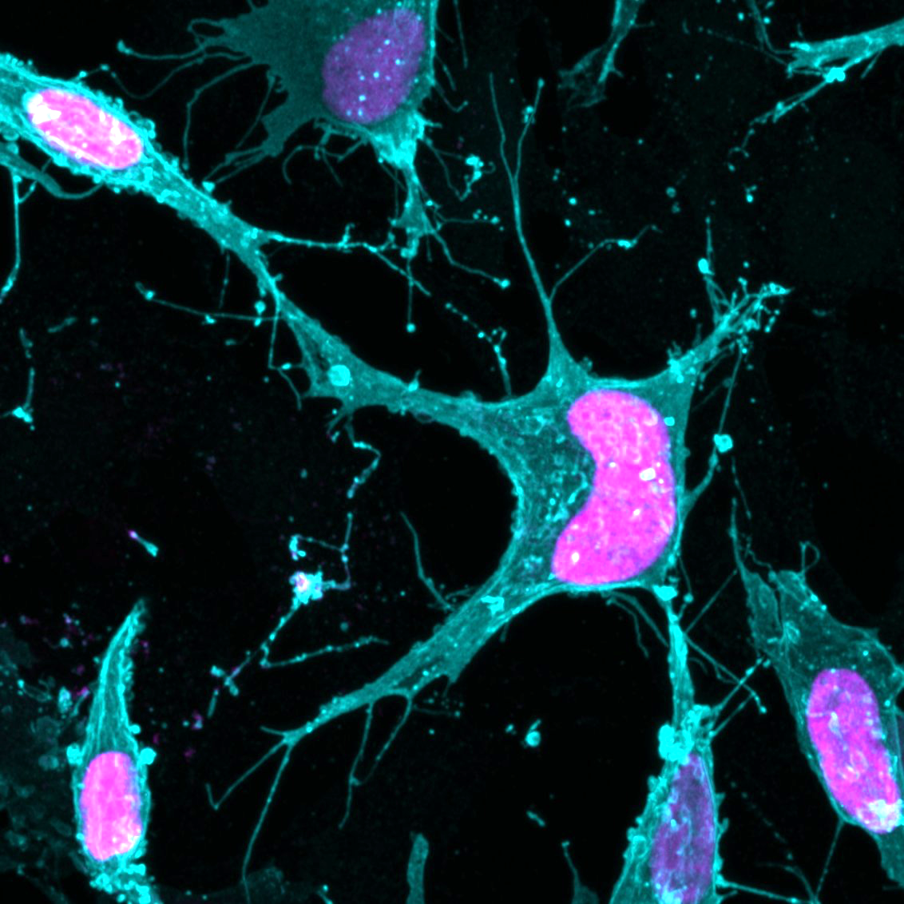
Basic Image
Analysis
Bi227
Steven Wilbert
Feb 24th, 2020

Slide 2
What is a digital image?

Slide 3
What is a digital image?
80 | 80 | 80 | 0 | 0 | 0
80 | 150 | 150 | 80 | 0 | 0
80 | 150 | 255 | 150 | 80 | 0
0 | 80 | 150 | 255 | 150 | 80
0 | 0 | 80 | 150 | 150 | 80
0 | 0 | 0 | 80 | 80 | 80
Image Histogram

Slide 4
What is a digital image?
80 | 80 | 80 | 0 | 0 | 0
80 | 150 | 150 | 80 | 0 | 0
80 | 150 | 255 | 150 | 80 | 0
0 | 80 | 150 | 255 | 150 | 80
0 | 0 | 80 | 150 | 150 | 80
0 | 0 | 0 | 80 | 80 | 80
Image Histogram

Slide 5
What is a digital image?
80 | 80 | 80 | 0 | 0 | 0
80 | 150 | 150 | 80 | 0 | 0
80 | 150 | 255 | 150 | 80 | 0
0 | 80 | 150 | 255 | 150 | 80
0 | 0 | 80 | 150 | 150 | 80
0 | 0 | 0 | 80 | 80 | 80
Image Histogram

Slide 6
What is a digital image?
80 | 80 | 80 | 0 | 0 | 0
80 | 150 | 150 | 80 | 0 | 0
80 | 150 | 255 | 150 | 80 | 0
0 | 80 | 150 | 255 | 150 | 80
0 | 0 | 80 | 150 | 150 | 80
0 | 0 | 0 | 80 | 80 | 80
Image Histogram

Slide 7
What is a digital image?
80 | 80 | 80 | 0 | 0 | 0
80 | 150 | 150 | 80 | 0 | 0
80 | 150 | 255 | 150 | 80 | 0
0 | 80 | 150 | 255 | 150 | 80
0 | 0 | 80 | 150 | 150 | 80
0 | 0 | 0 | 80 | 80 | 80
Image Histogram

Slide 8
Bit depth
8bit
0-255
16bit
0-65536
Gray Levels

Slide 9
How do we display an image?
Full Display Range
Cell 1
Cell 1
Cell 2
Cell 2
Analyze > Histogram

Slide 10
How do we display an image?
Full Display Range
Auto
Matched
Cell 1
Cell 1
Cell 2
Cell 2
Image > Adjust > Brightness/Contrast

Slide 11
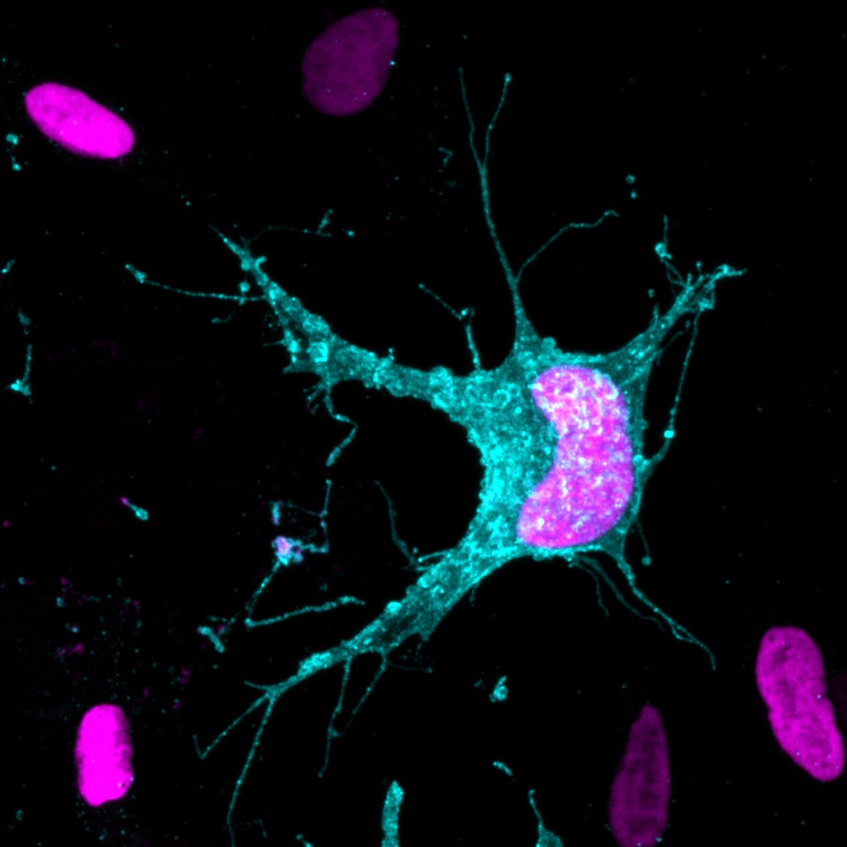
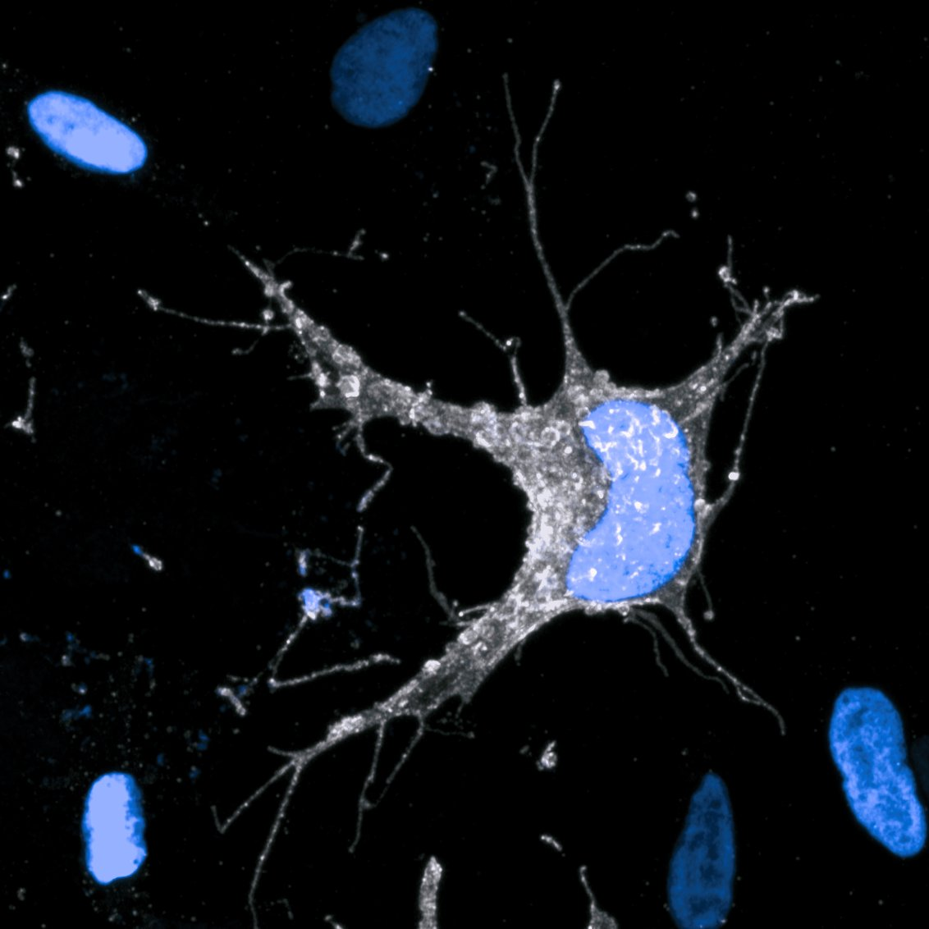
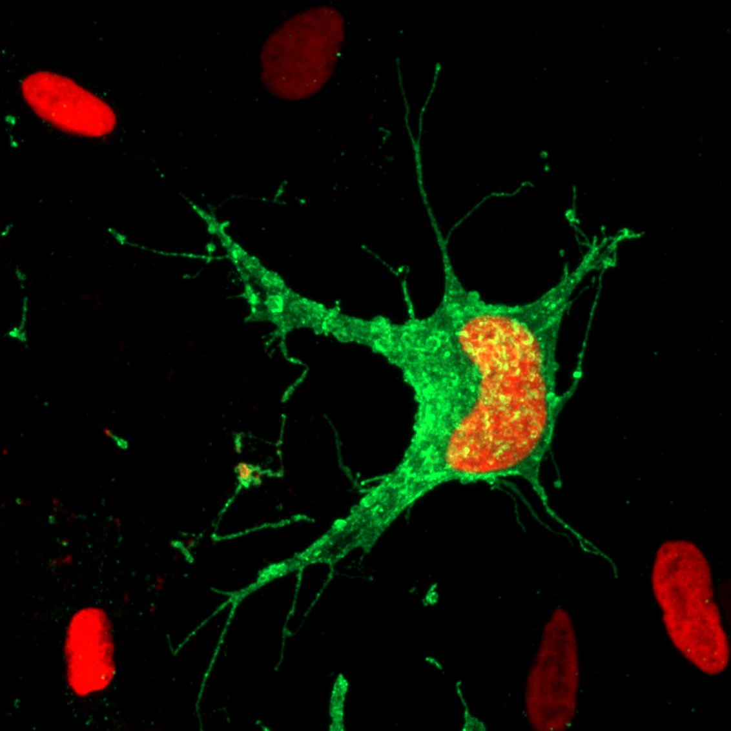
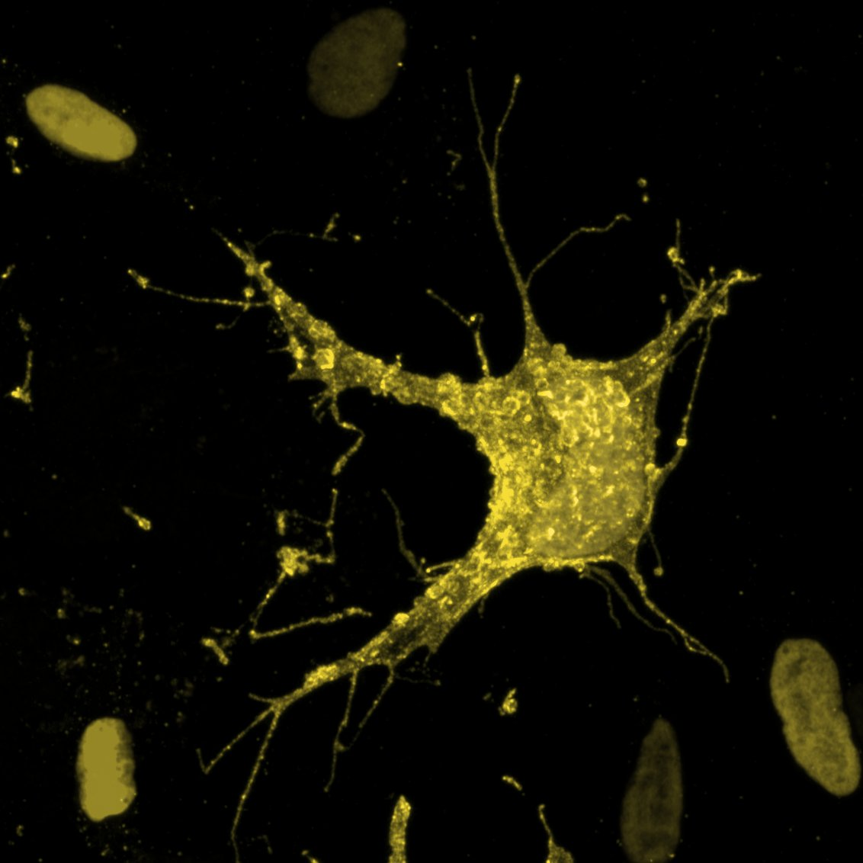
A note on safe color blind displays
Piacentino and Bronner 2018
Image > Color > Simulate Color Blindness

Slide 12
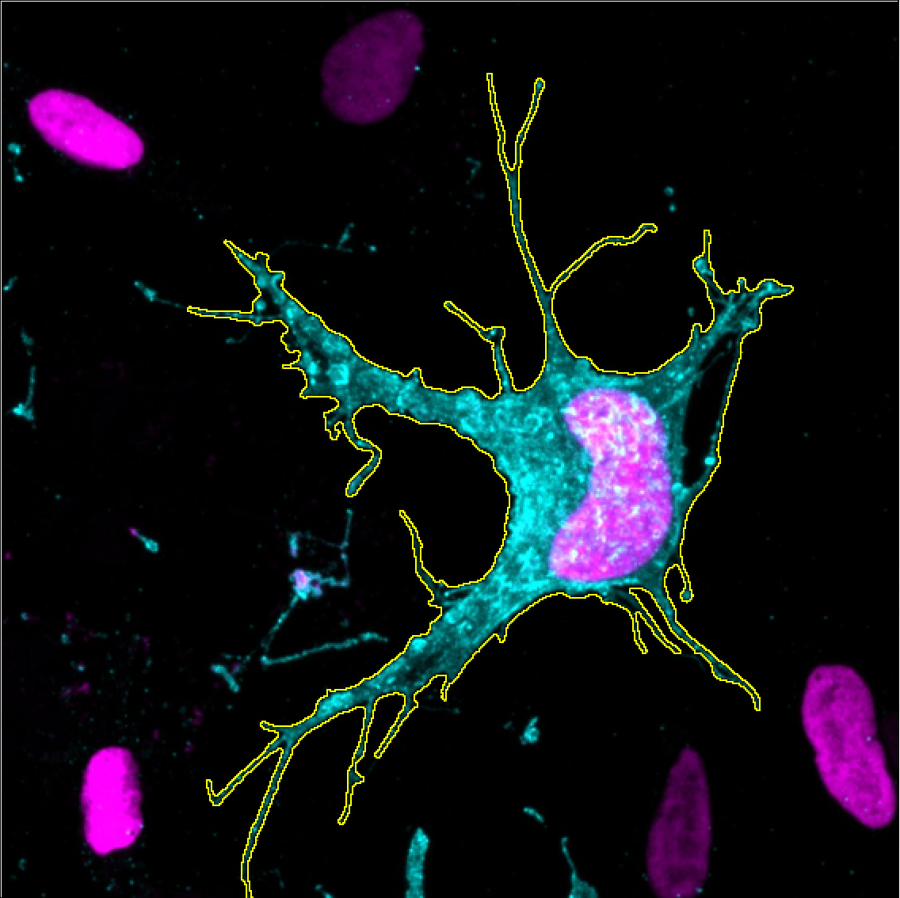
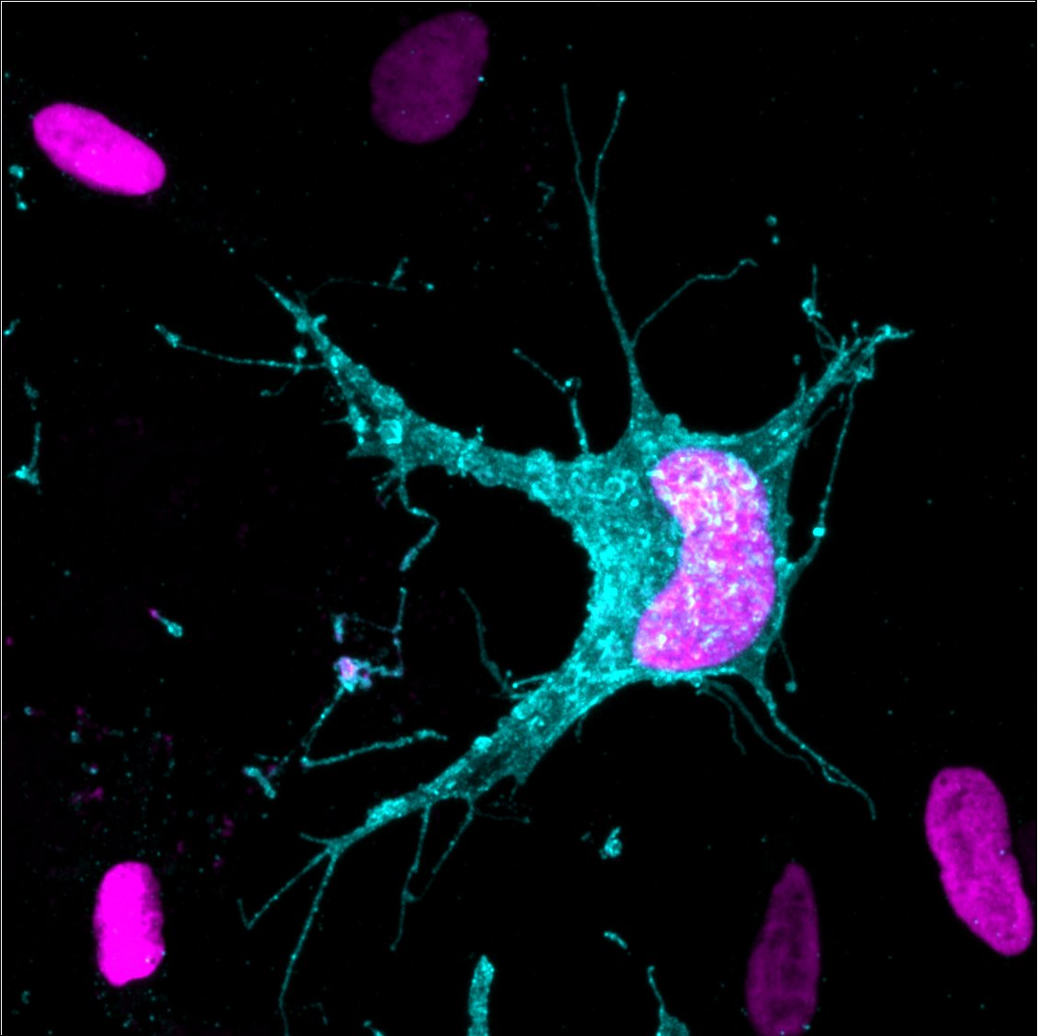
Making measurements
Size
Count
XYZ coordinates
Fluorescence intensity
Piacentino and Bronner 2018

Slide 13
Making measurements
Mean gray value
Full image: 100
ROI: 500
Piacentino and Bronner 2018
Analyze > Measure

Slide 14
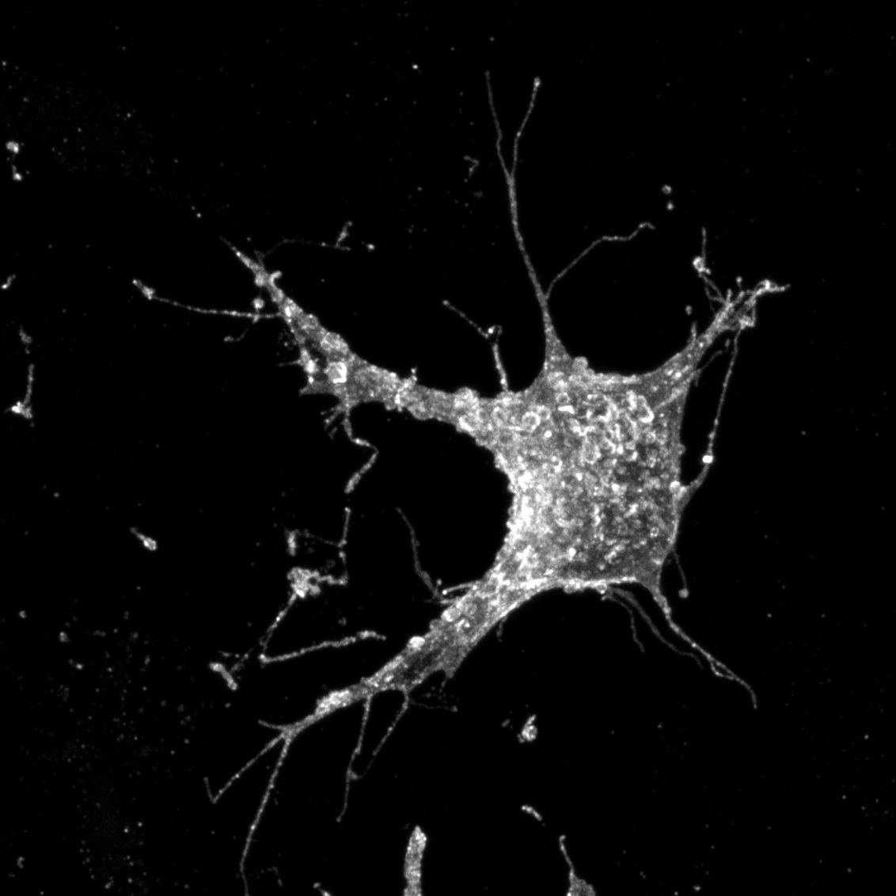
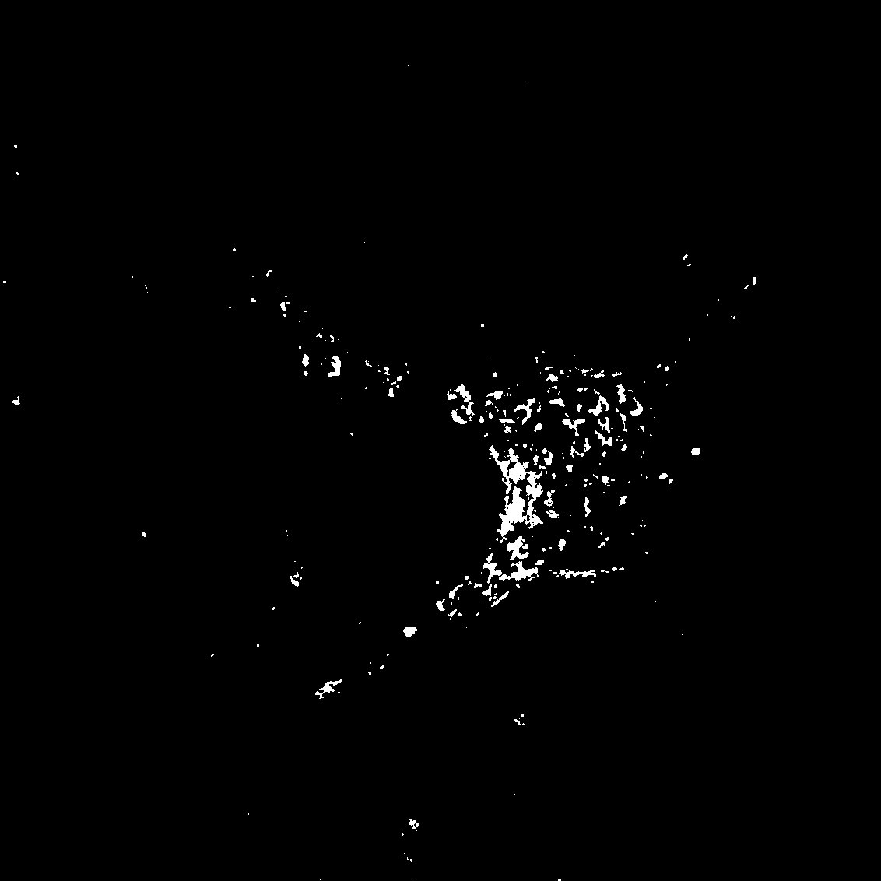
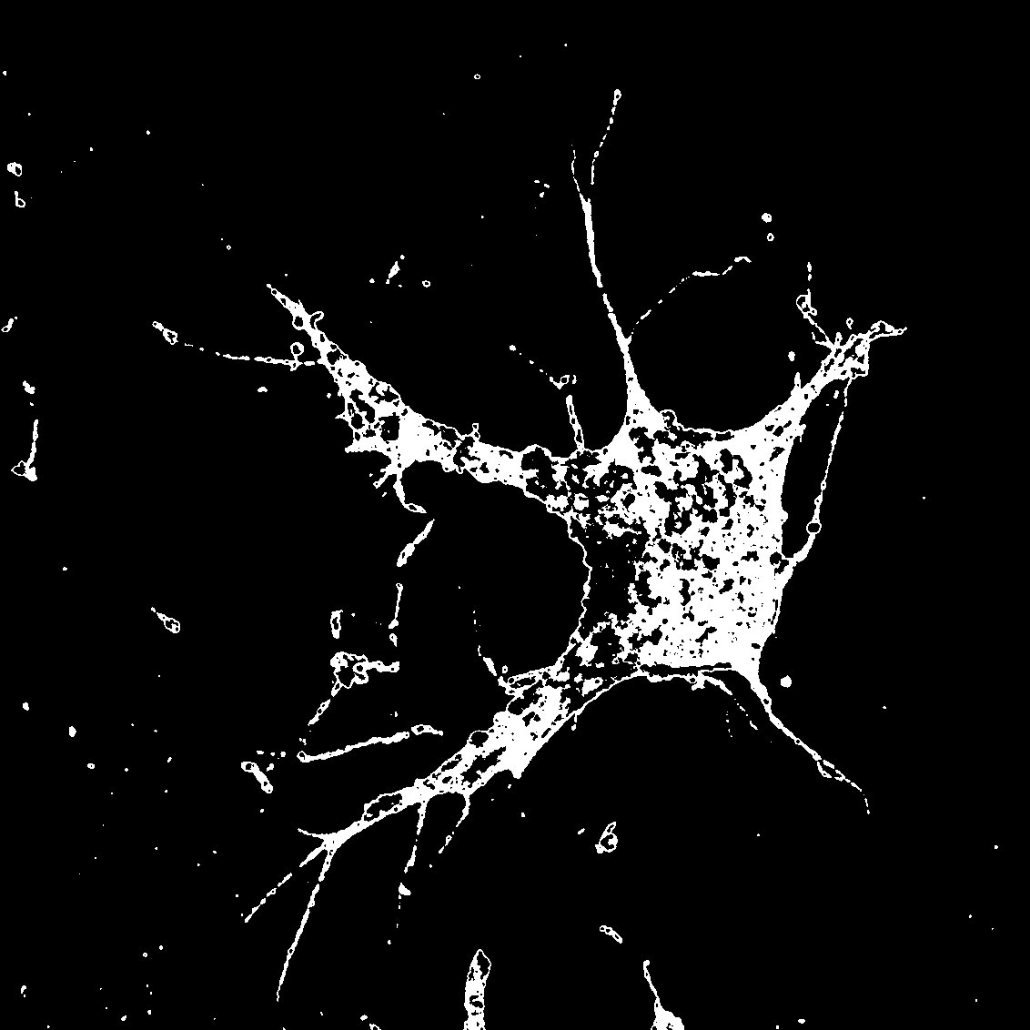
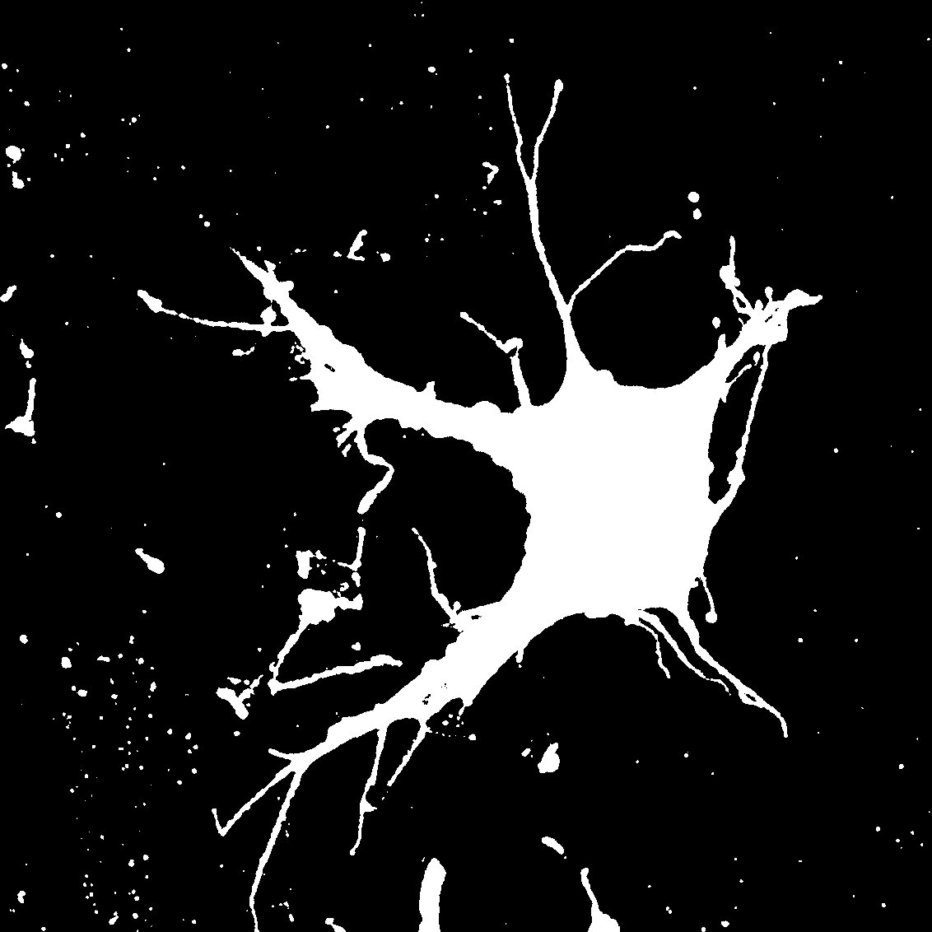
Thresholding
Histogram
Thresh 1
Thresh 2
Thresh 3
Raw
Binary Mask
Image > Adjust > Threshold

Slide 15
Median filtering
0
0
0
0
0
0
0
255
0
0
0
0
0
0
0
0
0
0
Process > Filter > Median

Slide 16
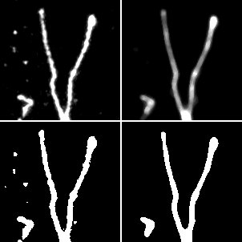
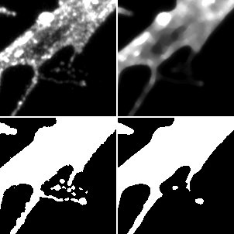
Median filtering
Raw
Median
Raw
Median
Process > Filter > Median

Slide 17
Size filtering
Raw Mask
Greater than 5µm²
Greater than 30µm²
Analyze > Analyze Particles

Slide 18
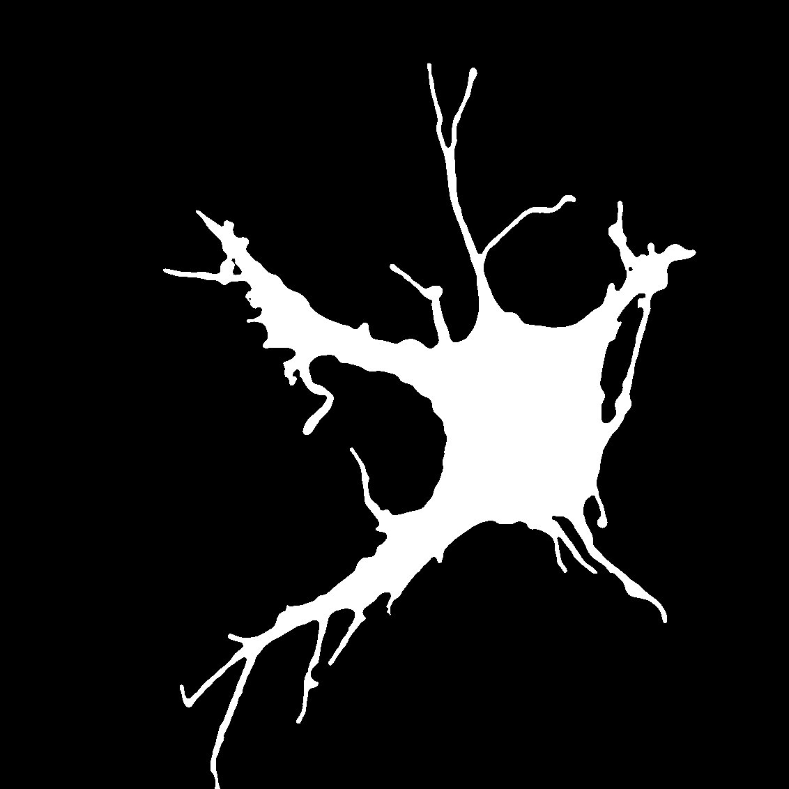
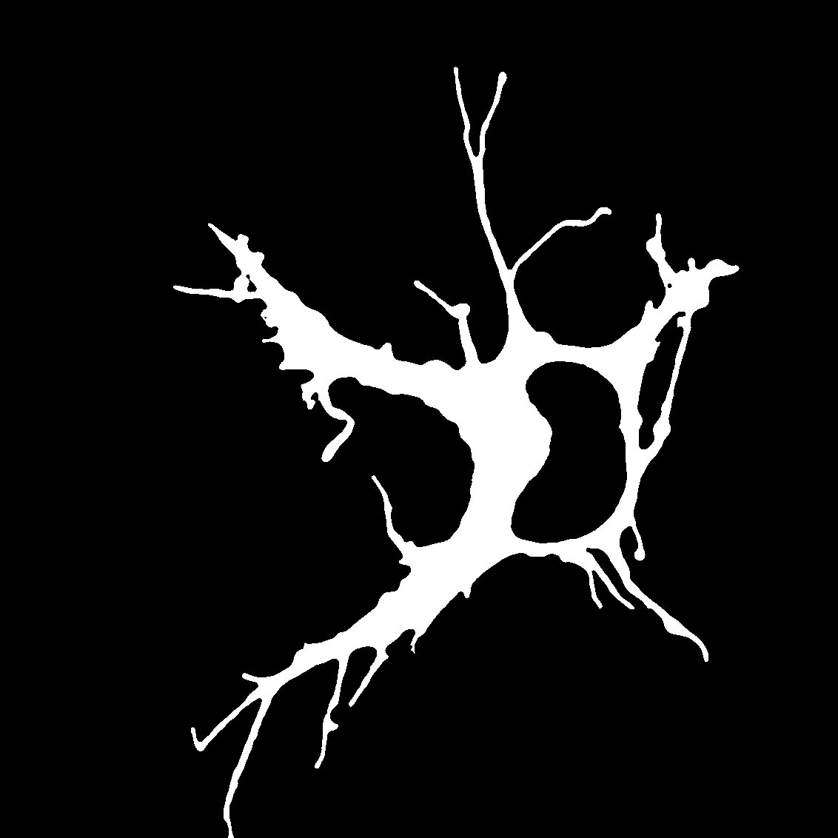
Image calculator
Whole cell mask
Nucleus mask
- Nucleus mask
Process > Image Calculator

Slide 19
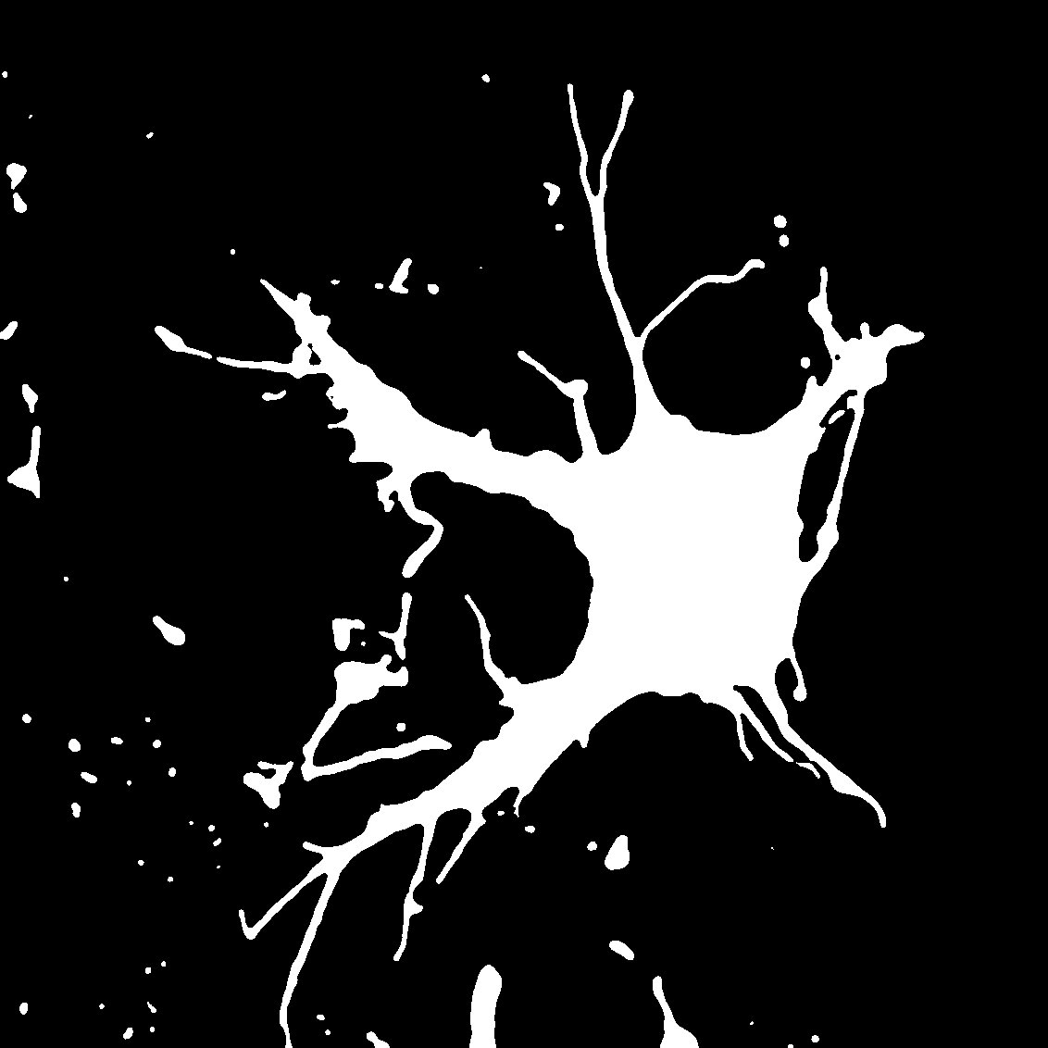
Creating analysis workflow
Raw
Filter > Threshold
Size filtering
Mask - Nucleus

