Slide 1
Biology 177: Principles of Modern Microscopy
Lecture 18:
High speed microscopy, Part 2

Slide 2
High speed microscopy, Part 2: Spatial light modulator microscope and other 3D sensors
Making laser scanning confocal microscopes faster
  Resonant scanner confocal
Techniques using high Numerical Aperture (NA) optics
  Multifocal plane microscopy (MUM)
  Aberration-free optical focusing
  Quadratically distorted grating
  Aberration-corrected multifocus microscopy (MFM)
Techniques not depending on high NA optics
  Fourier ptychographic microscopy (FPM)
  Holographic or Spatial light modulator (SLM) microscope
  SLM with extended depth of focus (EDOF)
  Digital holographic microscopy (DHM)
Discuss Feb 17th paper and last homework

Slide 3
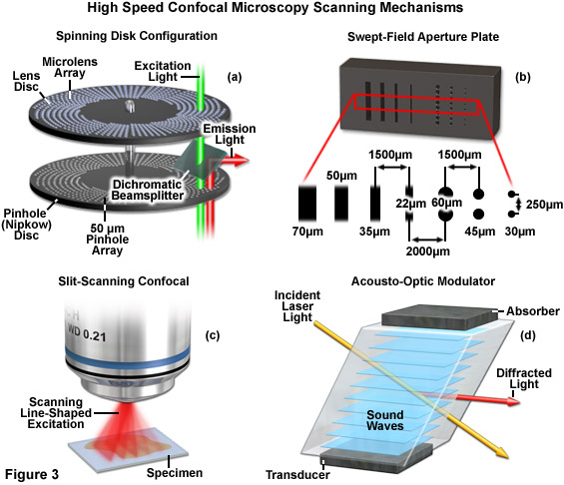
High speed confocal microscopes
Notes:
http://www.microscopyu.com/articles/confocal/resonantscanning.html
More info on Acousto-optic Modulator/Deflector (AOD)
Paper using AOD for multiphoton
http://biomedicaloptics.spiedigitallibrary.org/article.aspx?articleid=1102153
Paper using AOD for regular confocal
http://www.opticsinfobase.org/oe/fulltext.cfm?uri=oe-13-13-5151&id=84581
Saggau review
http://biomedicaloptics.spiedigitallibrary.org/article.aspx?articleid=1102202

Slide 4
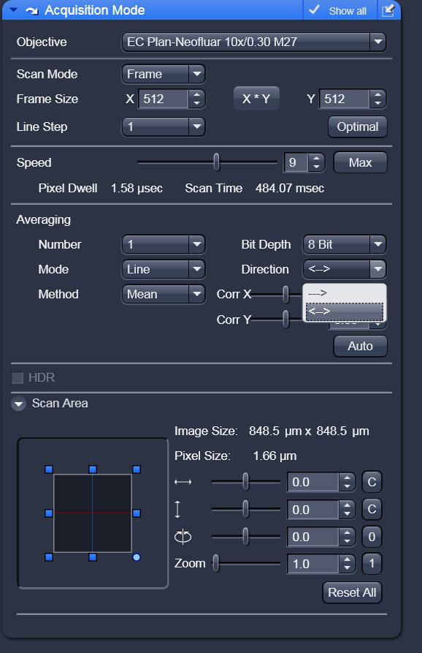
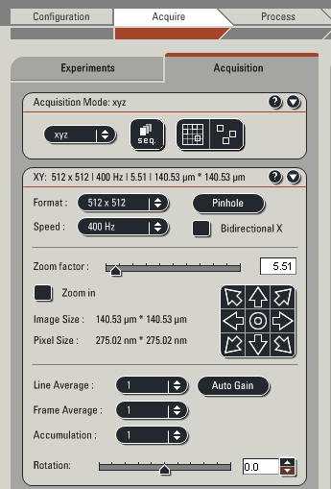


High speed Confocal Microscopy
Spinning disk systems
Swept-field (Nikon “LiveScan”)
Line-scanning (Zeiss LSM 5 Live)
Acousto-optic deflector (AOD)
Resonant scanner (Leica, Nikon, Olympus)
Double your scanning speed (Bidirectional)

Slide 5
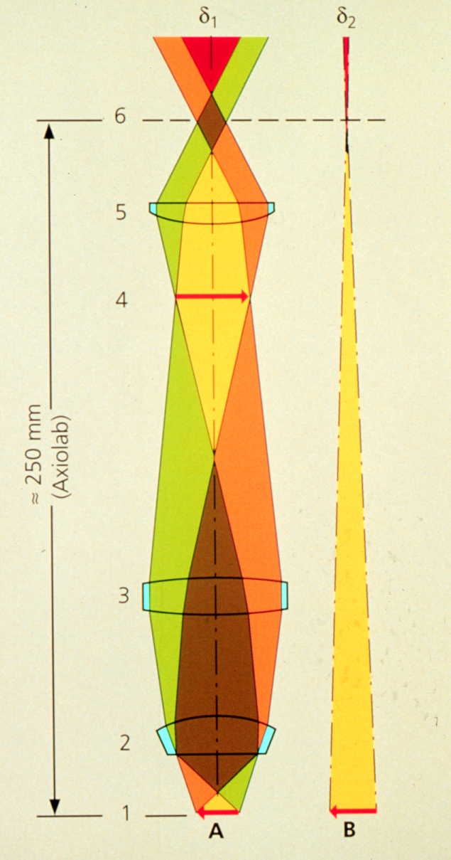
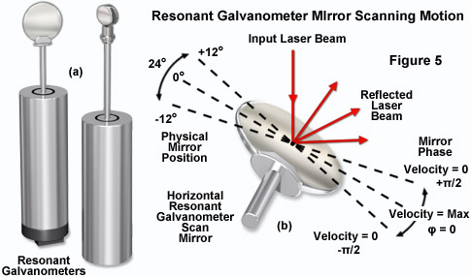
How to scan the laser beam?
Place galvanometer mirror at the telecentric point
laser
Notes:
http://www.microscopyu.com/articles/confocal/resonantscanning.html
A galvanometer is a type of sensitive ammeter: an instrument for detecting electric current. It is an analog electromechanical actuator that produces a rotary deflection of some type of pointer in response to electric current through its coil in a magnetic field.
"DynAXIS L" by Scanlab7 - Own work. Licensed under CC BY-SA 3.0 via Wikimedia Commons - http://commons.wikimedia.org/wiki/File:DynAXIS_L.jpg#mediaviewer/File:DynAXIS_L.jpg
Mirror galvanometer systems are used as beam positioning or beam steering elements in laser scanning systems.^{[citation needed]} For example, for material processing with high-power lasers, mirror galvanometer are typically high power galvanometer mechanisms used with closed loop servo control systems. The newest galvanometers designed for beam steering applications can have frequency responses over 10 kHz with appropriate servo technology. Closed-loop mirror galvanometers are also used in stereolithography, in laser sintering, in laser engraving, in laser beam welding, in laser TV, in laser displays, and in imaging applications such as Optical Coherence Tomography (OCT) retinal scanning. Almost all of these galvanometers are of the moving magnet type.^{[citation needed]}
http://www.edmundoptics.com/technical-resources-center/imaging/what-is-telecentricity/

Slide 6
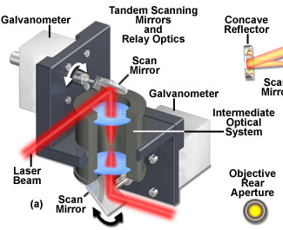
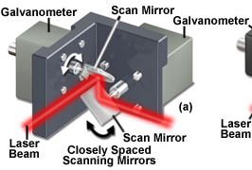
But confocal microscopes use 2 scanning mirrors (X,Y)
How do you have both at telecentric point?
Notes:
http://olympus.magnet.fsu.edu/primer/techniques/confocal/confocalscanningsystems.html

Slide 7
Resonant scanner vs standard galvo
Standard galvanometer
Resonant scanner
Complete point control of laser
Arbitrary scan geometries
Variable pixel dwell time
Example scan speeds:
  15 frames/sec at 256 x128 px
  4 frames/sec at 512 x512 px
  50 frames/sec at 200 x 50 px
  Line scan: 1kHz
Fastest frame rates
Example scan speeds:
  30 frames/sec at 512 x 512 px with an 8kHz mirror
  60 frames/sec at 512 x 256 px with an 8kHz mirror
12kHz mirror also available
Notes:
http://www.scientifica.uk.com/latest-news/419-galvo-or-resonant-scanning-guide

Slide 8
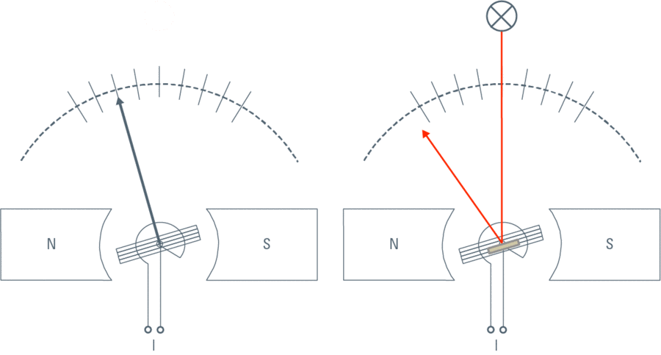
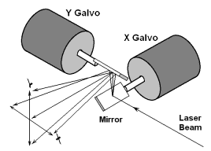
Resonant scanner
Problem 1: Scanning across field not linear
Notes:
Leica figure:
http://www.leica-microsystems.com/science-lab/smart-control-for-resonant-galvo-scanners/
Smaller figure from
http://elm-chan.org/works/vlp/report_e.html
Laser scanning flat field
http://www.laserfocusworld.com/articles/print/volume-50/issue-02/features/scanners-three-axis-laser-scanning-technology-improves-demanding-materials-processing-applications.html

Slide 9
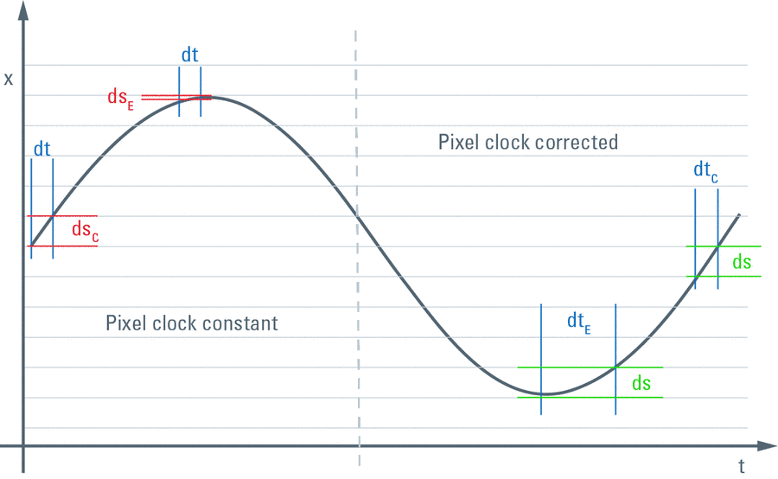
Resonant scanner
Notes:
Fig. 3: Left: when scanning sinusoidal and recording data with an uniform pixel clock dt, the signal would be drawn from non-equidistant points in the sample, and hence the image would be distorted. At the center, the image would be expanded due to the faster pace of the scanner (distance per time: ds_{C}). At the edges, the image would be squeezed due to the slow speed of the scanner (distance per time: ds_{E}).
Right: In order to acquire data at spatially equidistant points ds, the pixel clock has to be programmed for longer times at the edges (dt_{E}) and shorter times in the center (dt_{C}).
http://www.leica-microsystems.com/science-lab/smart-control-for-resonant-galvo-scanners/

Slide 10
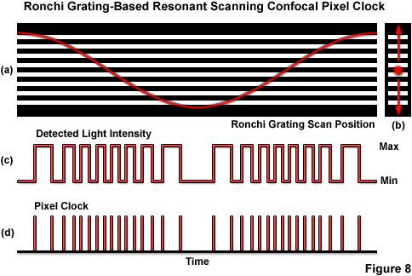
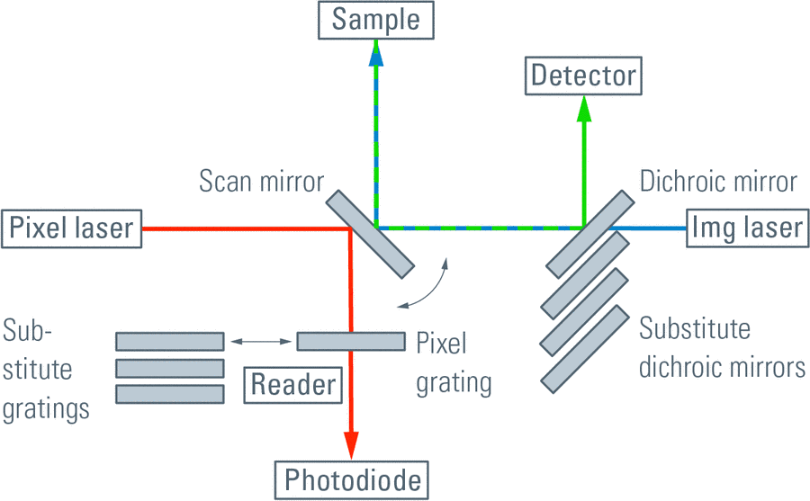
Resonant scanner
Fix with Ronchi grating and optical chopping
Notes:
Pedestrian solution
Presented in Figure 8 is an illustration of the basic concepts behind the use of a Ronchi grating coupled to a photodiode detector as a variable pixel clock. For purposes of clarity, the grating illustrated in Figure 8(a) contains only eight spacings of equal width superimposed with one complete cycle of cosinusoidal motion from the resonant galvanometer versus time (red curve; 125 microseconds). The actual grating has 256 line spacings and is far more compact in the linear dimensions due to the fact that the pixel clock laser actually retraces a single line (perpendicular to the opaque lines) across the grating surface in operation (Figure 8(b)). As the light beam enters and exits the clear regions of the Ronchi grating, the transmitted light intensity that is detected by the photodiode rises and falls in step with galvanometer motion (Figure 8(c)). Each transition (in this case, from dark to light) of light intensity detected by the photodiode is used to generate the pixel clock (Figure 8(d)) that triggers image capture by the microscope. Although the clock pulses illustrated in Figure 8(d) are non-uniformly spaced in time (ranging from approximately 70 to 160 nanoseconds), they nevertheless correspond to equal intervals in image space.
http://www.microscopyu.com/articles/confocal/resonantscanning.html
http://www.leica-microsystems.com/science-lab/smart-control-for-resonant-galvo-scanners/

Slide 11
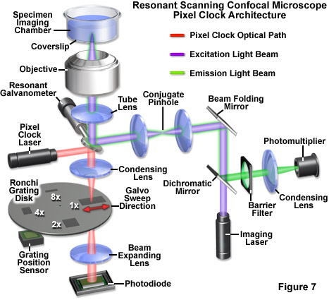
Resonant scanner
That is how Nikon addresses problem
Notes:
Image distortion induced by non-linear resonant galvanometer scanning is fortunately predictable and can be corrected using either software or hardware solutions. Regardless of the correction scheme involved to produce images, the most effective scanning strategy involves collecting data during both the forward and backward scans of the galvanometer mirror. Recording data during the forward scan is straightforward, but due to the fact that the backward scan reverses the direction in which pixels are recorded, the image data must be inverted using specialized read-write buffers or software. In practice, images are gathered at twice the normal width (in effect, 1024 pixels for a final image size of 512 x 512 pixels) and half the normal height (256 pixels). At the end of each forward x-axis sweep of the resonant galvanometer mirror, the vertical sawtooth signal supplied to the linear (y) galvanometer is incremented by one line and the reverse (x) scan commences. In this manner, the vertical scan progresses smoothly for 256 cycles until enough data for one image is acquired.
http://microscopyu.com/tutorials/flash/resonantscanning/confocalresonantscanning/index.html
Picture from this web site:
http://www.microscopyu.com/articles/confocal/resonantscanning.html

Slide 12
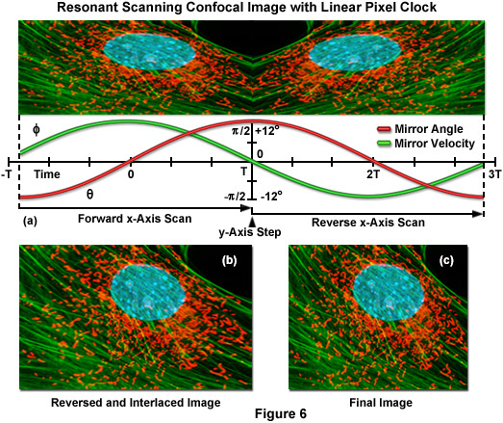
Resonant scanner
Besides hardware there are software corrections
How this all works.
Notes:
Software-based clocking schemes for resonant scanning confocal microscopy involve algorithms that are capable of pixel data linearization using look-up tables based on the predictable motion of the mirror. As an example, one popular algorithm first determines a phase constant for the mirror and frame grabber, and then locates the center pixel of the final image. This algorithm operates around the central plane of symmetry where the mirror position is known with a high degree of precision. Images are processed by examining one horizontal scan line at a time as they are delivered to the frame grabber. Pixel data is stored as received from the scanner at twice the final image width and half the final height. The first step in the process involves inverting data points from the second half of the horizontal scan line, followed by interlacing the inverted data between the data lines for the first half of the image (Figure 6(b)). Because the midpoint of the image may not be known with certainty due to a lag between collection of data and initiation of the horizontal synchronization signal that triggers acquisition, it is often necessary for the software to offset the inverted scan line by a few pixels. In this case, the right edge of the scan line then serves as a reference point for the image. The next step in the sequence is to apply a correction factor for each pixel or phase position relative to the center pixel. That pixel is then relocated to the correct position in the final image (Figure 6(c)). In the ideal case, using sophisticated high speed computers, incoming data can be analyzed on the fly and recorded to the hard drive in real time.
http://www.microscopyu.com/articles/confocal/resonantscanning.html

Slide 13
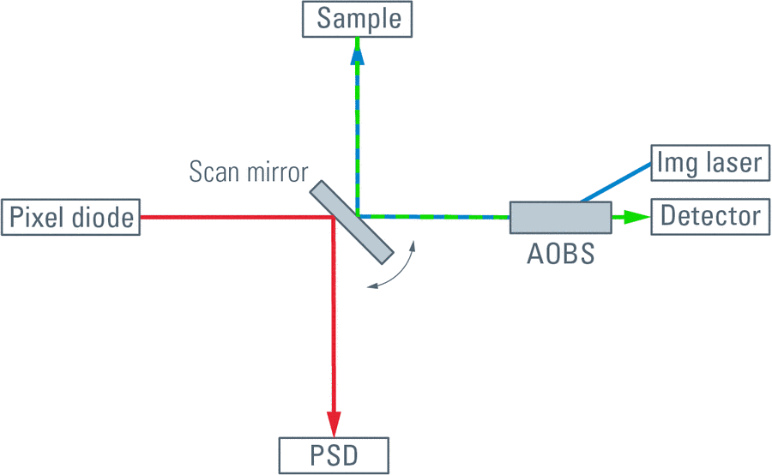
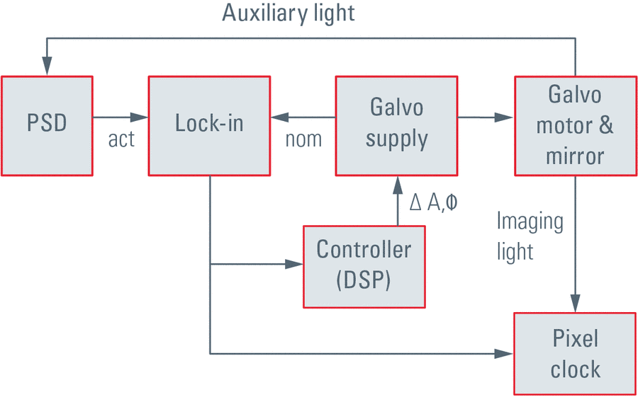
Resonant scanner
Leica uses another method
Advantages: continuous zoom & panning
Notes:
position-sensitive device (PSD),
Fig 5: Left: Schematic drawing of a resonant scanning confocal with lock-in pixel clock decoding. For imaging, the laser is directed through a programmable opto-acoustic splitter onto the scan mirror and excites the fluorochromes in the sample (blue trace). The emitted light (green trace) is descanned by the scan mirror, transmitted by the AOBS and converted into an electrical signal by the detector. An auxiliary IR diode is directed to the rear side (also reflecting) of the scan mirror (red trace). It reaches a position-sensitive device (PSD), which delivers a signal that can reproduce the full movement of the scan mirror.
Right: Block diagram of position-controlled tunable pixel clocking with resonant scanners. The movement of the mirror is monitored by a position-sensitive device (PSD) which feeds into a lock-in amplifier. Here, the actual movement (act) in terms of amplitude and phase are compared with the excitation signal (nom). A DSP-based controller adjusts any deviations from the optimal operation and provides the correct parameters to a pixel clock module. Here, the emission signal from the microscope is split into spatially equidistant segments (pixel clock). The actual integration time per pixel is also controllable and may cover the full pixel time (not equally long at the edges versus center), or trim the pixel integration time to temporally equidistant measurements.
http://www.leica-microsystems.com/science-lab/smart-control-for-resonant-galvo-scanners/

Slide 14
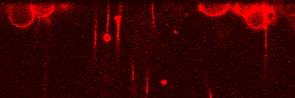
Confocal Speed - 90 fps
Crista Cilia Labeled in vivo with FM1-43

Slide 15
Resonant scanner
Problem 2: Signal to noise
Notes:
http://www.photonics.com/Article.aspx?AID=55047
Will insert 50 fps of cristae at

Slide 16
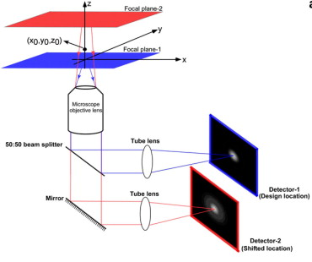
Multifocal plane microscopy (MUM)
Increases speed by imaging 2 focal planes at once.
Saw this in Bruker high speed super-resolution microscope
Ram, S., Prabhat, P., Chao, J., Sally Ward, E., Ober, R.J., 2008. High Accuracy 3D Quantum Dot Tracking with Multifocal Plane Microscopy for the Study of Fast Intracellular Dynamics in Live Cells. Biophysical Journal 95, 6025-6043.
Notes:
From Raimund Ober lab in Texas. Have taken it up to 4 focal planes.
http://www.sciencedirect.com/science/article/pii/S0006349508820176

Slide 17
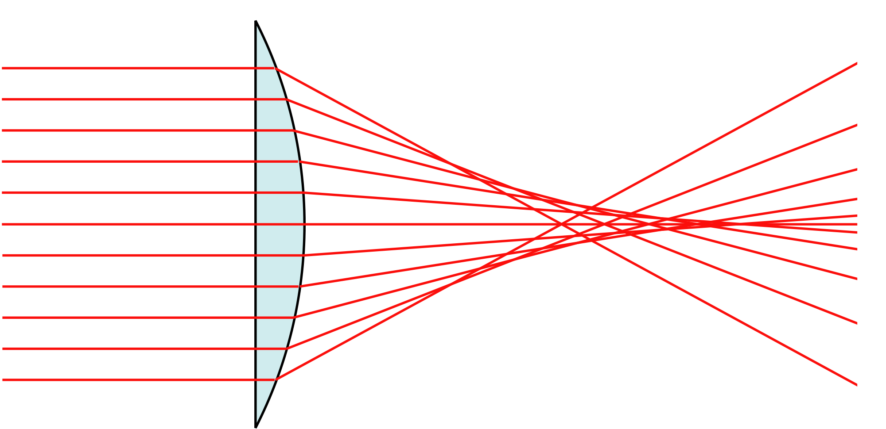
But problems with MUM
Need multiple cameras
Spherical aberrations
Notes:
However, refocusing by translating the camera away from the nominal focal plane induces spherical aberration after a refocus of a few microns²
http://commons.wikimedia.org/wiki/File:Spherical_aberration_2.svg

Slide 18
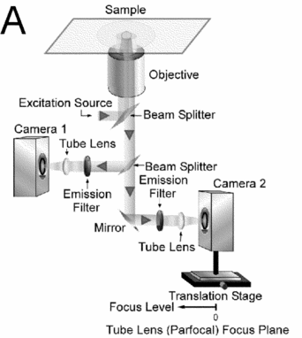
How do you capture multiple focal planes without aberrations?
Spherical aberrations result if two focal planes more than a few microns apart
So multiple focal planes from camera translation limited in z-dimension
Prabhat, P., Ram, S., Ward, E.S., Ober, R.J., 2004. Simultaneous imaging of different focal planes in fluorescence microscopy for the study of cellular dynamics in three dimensions. NanoBioscience, IEEE Transactions on 3, 237-242.

Slide 19
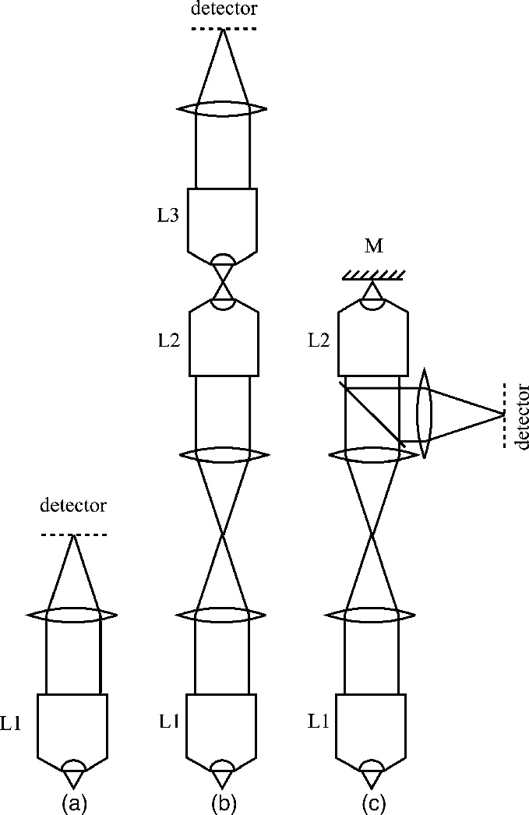
Can have aberration-free optical focusing, even with high N.A. objectives
High speed
No need to move objective or specimen
Just move small mirror
Normal configuration
Two microscopes back to back
Optically equivalent
Tube lens
Botcherby, E.J., Juskaitis, R., Booth, M.J., Wilson, T., 2007. Aberration-free optical refocusing in high numerical aperture microscopy. Optics letters 32, 2007-2009.
Notes:
The usual configuration for a high numerical aperture (NA) microscope is shown in Fig. 1a .
Refocusing on the detector side is a practical solution only if the spherical aberration can be avoided. Optical systems designed to satisfy the Herschel condition permit aberration-free imaging of points that lie along the optic axis. Perfect imaging of a volume region is therefore possible if both the sine and Herschel conditions are simultaneously satisfied. This occurs only in imaging systems with unity magnification, assuming dry lenses are used (if immersion lenses are used, the magnification must be equal to the ratio of immersion media refractive indices [3]) Such a magnification system could be built using two microscopes back to back [Fig. 1b]. An appropriate detector placed in the focal region of L2 would detect a diffraction-limited image of any chosen plane in the specimen. However, the resolution required of such a detector would be a fraction of a wavelength, far beyond the capabilities of presently available devices that typically have pixel sizes around 5–10 μm. Instead, we can probe the intermediate image in the focal region of L2 using another microscope comprising the objective L3 and a tube lens. This secondary imaging system magnifies the intermediate image so that it is compatible with the detector [Fig. 1b]. Like the original microscope of Fig. 1a, this secondary system produces an image of the focal plane of L3 and refocusing must be performed by shifting L3 along the optic axis. However, specimen disturbance is avoided as the axial scanning now occurs remotely in the optical system.
This can be avoided using the optically equivalent system of Fig. 1c. The intermediate image is formed using the same system as before. A planar mirror (M) mounted on an axial scanning stage is placed in the focal region of L2; this allows us to reuse L2 as part of the secondary imaging system. This system, composed of L2, the beam splitter, the tube lens, and the detector, creates an image of the focal plane of L2 on the detector. A quarter-wave plate and polarizing beam splitter can also be used to improve the optical throughput of this system. Refocusing is performed by scanning the mirror along the optic axis so that the plane of interest is imaged onto the detector. As the mirror can be small, this system permits high axial scan speed without specimen disturbance.
By one, and likewise by several, and even by an infinite number of thin lenses in contact, no more than two axis points can be reproduced without aberration of the third order. Freedom from aberration for two axis points, one of which is infinitely distant, is known as Herschel's condition.
From: https://en.wikipedia.org/wiki/Optical_aberration
http://www.opticsinfobase.org/ol/fulltext.cfm?uri=ol-32-14-2007&id=139063

Slide 20
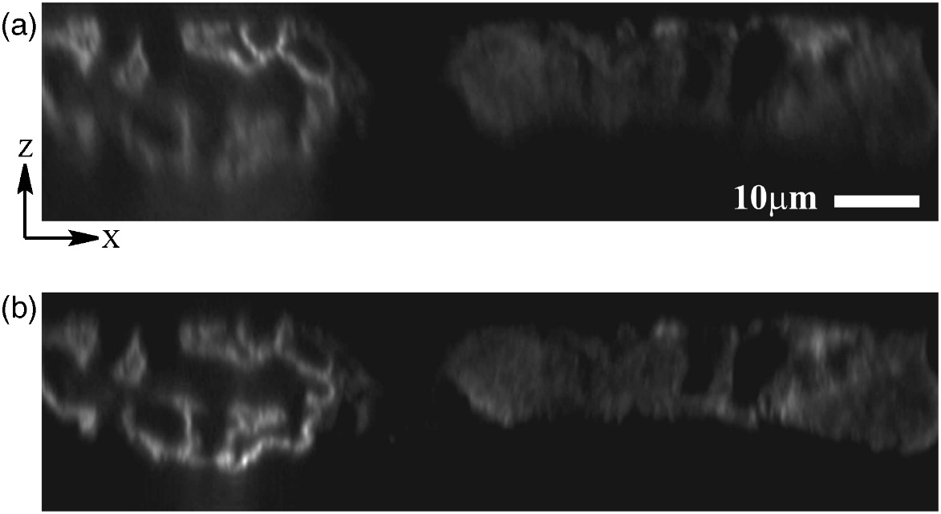
Aberration-free optical focusing
Particularly relevant to confocal and two photon microscopy
Aberration-free images over axial scan range of 70 μm with 1.4 NA objective lens
Refocusing implemented remotely from specimen
“Focus objective”
Focus via mirror
Botcherby, E.J., Juskaitis, R., Booth, M.J., Wilson, T., 2007. Aberration-free optical refocusing in high numerical aperture microscopy. Optics letters 32, 2007-2009.
Notes:
Fig. 3 Fluorescence confocal xz sections of a mouse kidney specimen acquired using a tandem scanning system. (a) Refocusing was performed using the low NA system, equivalent to shifting the scanning unit. (b) Refocusing was performed by shifting the reference mirror in the focus of a high NA objective.
http://www.opticsinfobase.org/ol/fulltext.cfm?uri=ol-32-14-2007&id=139063

Slide 21
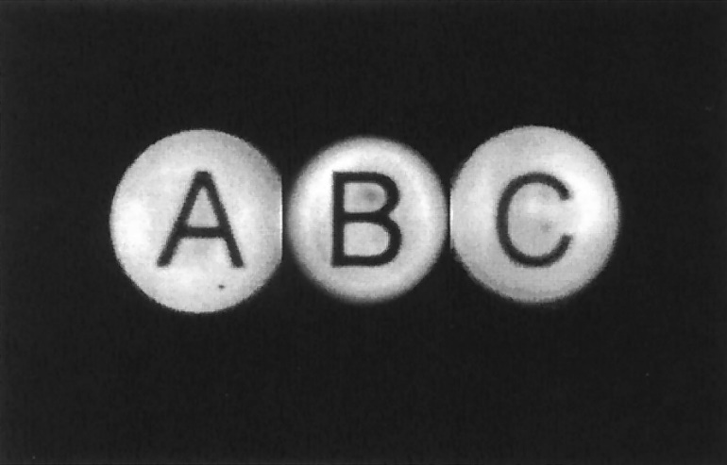
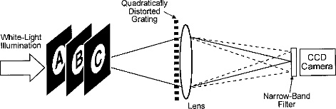
Can collect multiple focal planes with single camera
Using a diffraction grating as a beam splitter
Blanchard, P.M., Greenaway, A.H., 1999. Simultaneous multiplane imaging with a distorted diffraction grating. Appl. Opt. 38, 6692-6699.
Notes:
http://www.opticsinfobase.org/ao/fulltext.cfm?uri=ao-38-32-6692&id=43975

Slide 22
How do we do that?
Back to Diffraction orders
Remember light waves passing through two slits
0 order mostly background light
Image details mainly in +1, -1, +2, -2, +3, -3, etc. orders
0
-1
0
+1
-1
+1
-3
-2
+2
+3
-4
+4
-2
+2
-5
+5

Slide 23
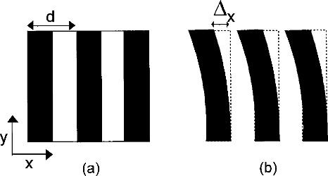
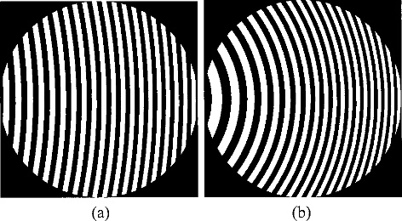

Quadratic distortion of diffraction grating
d is the grating period, $∆x$ is grating displacement
Blanchard, P.M., Greenaway, A.H., 1999. Simultaneous multiplane imaging with a distorted diffraction grating. Appl. Opt. 38, 6692-6699.
Notes:
where d is the grating period, m is the diffraction order into which the wave front is scattered, and Δ_{x} is the displacement of the grating strips relative to their undistorted position.
Hence all orders other than the zeroth order undergo a phase shift that is linearly dependent on the grating displacement, and the phase shift is of equal magnitude but opposite sign in the positive and the negative orders of the same coefficient.
This basic principle, often referred to as the detour phase effect, has been used to encode diffractive-optics elements and computer-generated holograms [2], [3] and for phase calibration of an aperture synthesis array. [4] In this way an arbitrary wave front can be generated by use of a binary-encoding technique.
http://www.opticsinfobase.org/ao/fulltext.cfm?uri=ao-38-32-6692&id=43975

Slide 24
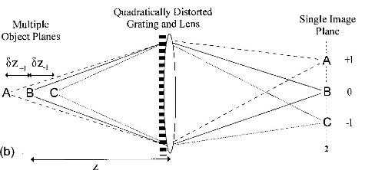
Use diffraction orders to carry different focal planes
Each order has in focus plane and out-of-focus images of other planes
More curvature more defocus
Notes:
The function of the quadratically distorted grating can be considered alternatively as a means of simultaneously imaging three different object planes. In reference to Fig. 3(b), if a camera is placed at image plane 2, the images formed in the three central diffraction orders correspond to in-focus images of the three object planes A, B, and C. The zero order is the sum of the out-of-focus images of objects A and C and an in-focus image of object B. If the degree of defocus is sufficient a good image of object B will result. Similarly, objects A and C will be discernible in the +1 and the -1 diffraction orders. The grating therefore generates side-by-side simultaneous images of three different object planes at a single detector plane. The image quality obtained when a distorted diffraction grating is used to image multiple planes within the object field will essentially be the same as if a through-focal series were obtained by alteration of the optical system to adjust its focus to image the same planes.

Slide 25

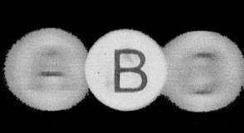
Benefits of grating based approach
The Good
The Bad
Preserves image resolution
Image registration
Loss of brightness can be fixed with phase grating
Simple optics, with no moving parts
Chromatic aberrations
Less bright
Monochromatic
Broadband
Notes:
The defocus-only gratings that we have described are, in fact, off-axis Fresnel zone-plate lenses. It is well known that zone-plate lenses have multiple on-axis foci. By using an off-axis portion, we retain the multiple foci but move the nonzero orders away from the optical axis, thus using the grating in a beam-splitting role.
A zone plate is a device used to focus light or other things exhibiting wave character.^{[1]} Unlike lenses or curved mirrors however, zone plates use diffraction instead of refraction or reflection. Based on analysis by Augustin-Jean Fresnel, they are sometimes called Fresnel zone plates in his honor. The zone plate's focusing ability is an extension of the Arago spot phenomenon caused by diffraction from an opaque disc.
A zone plate consists of a set of radially symmetric rings, known as Fresnel zones, which alternate between opaque and transparent. Light hitting the zone plate will diffract around the opaque zones. The zones can be spaced so that the diffracted light constructively interferes at the desired focus, creating an image there.
http://www.opticsinfobase.org/ao/fulltext.cfm?uri=ao-38-32-6692&id=43975

Slide 26
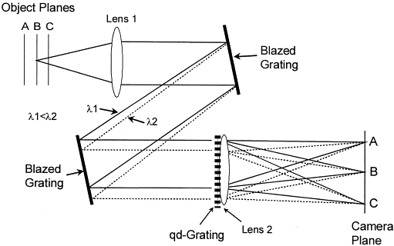
Can use dispersion before quadratically distorted grating to do color
Dispersion through blazed grating
Blanchard, P.M., Greenaway, A.H., 2000. Broadband simultaneous multiplane imaging. Optics Communications 183, 29-36.
Notes:
Two diffraction gratings with same period are required for wavelength dependent shift.
http://www.sciencedirect.com/science/article/pii/S0030401800008749

Slide 27
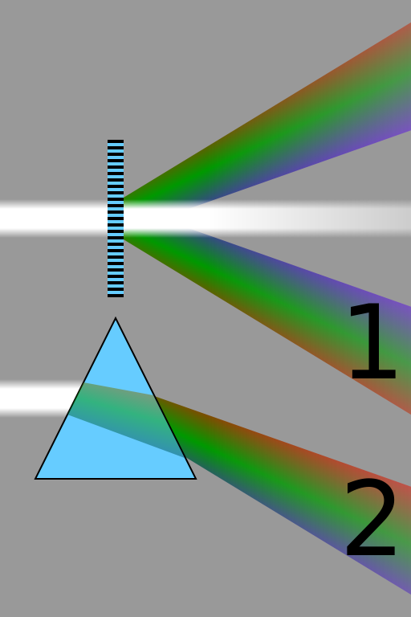
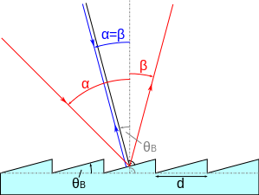
Blazed grating a type of diffraction grating
Diffraction grating
Refraction through prism
Blazed gratings diffract via reflection
Notes:
Comparison of the spectra obtained from a diffraction grating by diffraction (1), and a prism by refraction (2). Longer wavelengths (red) are diffracted more, but refracted less than shorter wavelengths (violet).
http://en.wikipedia.org/wiki/Blazed_grating
"Comparison refraction diffraction spectra" by Cmglee - Own work. Licensed under CC BY-SA 3.0 via Wikimedia Commons - http://commons.wikimedia.org/wiki/File:Comparison_refraction_diffraction_spectra.svg#mediaviewer/File:Comparison_refraction_diffraction_spectra.svg
"Blazed grating" by User:Patrick87 - Own work. Licensed under Public Domain via Wikimedia Commons - http://commons.wikimedia.org/wiki/File:Blazed_grating.svg#mediaviewer/File:Blazed_grating.svg

Slide 28
Combine multifocus imaging with aberration-free focusing for fast multicolor 3D imaging
Design parameters for aberration-corrected multifocus microscopy (MFM)
  Sensitivity to minimize photobleaching and phototoxicity and enable high-speed imaging of weakly fluorescent samples
  Multiple focal planes must be acquired without aberrations
  Corrected for chromatic dispersion that arises when a diffractive element is used to image non-monochromatic light
Abrahamsson, S., Chen, J., Hajj, B., Stallinga, S., Katsov, A.Y., Wisniewski, J., Mizuguchi, G., Soule, P., Mueller, F., Darzacq, C.D., Darzacq, X., Wu, C., Bargmann, C.I., Agard, D.A., Dahan, M., Gustafsson, M.G.L., 2013. Fast multicolor 3D imaging using aberration-corrected multifocus microscopy. Nat Meth 10, 60-63.
Notes:
http://www.nature.com/nmeth/journal/v10/n1/full/nmeth.2277.html
Fast multicolor 3D imaging using aberration-corrected multifocus microscopy

Slide 29
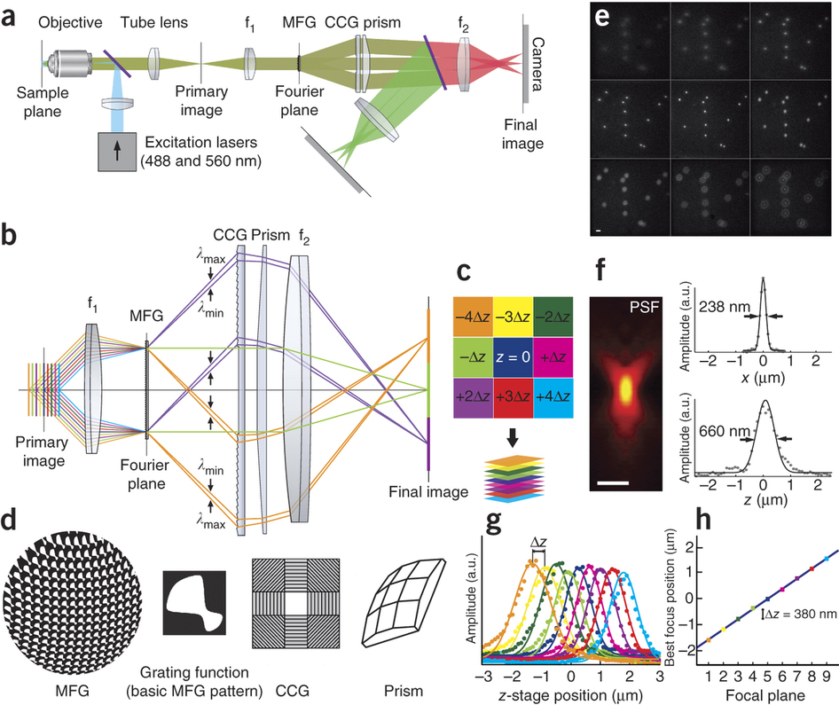
Aberration-corrected multifocus microscopy (MFM)
Abrahamsson, S., Chen, J., Hajj, B., Stallinga, S., Katsov, A.Y., Wisniewski, J., Mizuguchi, G., Soule, P., Mueller, F., Darzacq, C.D., Darzacq, X., Wu, C., Bargmann, C.I., Agard, D.A., Dahan, M., Gustafsson, M.G.L., 2013. Fast multicolor 3D imaging using aberration-corrected multifocus microscopy. Nat Meth 10, 60-63.
Notes:
(a) Multifocus optical elements are appended to a wide-field fluorescence microscope after the primary image plane (at the camera port). Two relay lenses (f₁ and f₂, first and second relay lens, with focal lengths f₁ = 150 and f₂ = 200 mm) create a conjugate pupil plane (Fourier plane) and the final image plane. The multifocus grating (MFG) is placed in the Fourier plane and followed by the chromatic correction grating (CCG) and prism. A dichroic mirror (purple) splits the color channels onto separate cameras. (b) The MFG splits and shifts the focus of the sample emission light to form an instant focal series, in which each focal plane corresponds to a diffractive order of the MFG. Ray colors denote individual focal planes (diffractive orders). The CCG and prism correct the chromatic dispersion, illustrated by rays of wavelengths λ_{max} and λ_{min}, introduced by the MFG. (c) The instant focal stack recorded on the camera is computationally assembled into a 3D volume. (d) Schematics of the MFG, a phase-only diffractive grating with etch depth π; the grating function (basic grating pattern) of the MFG, optimized to distribute light evenly into the central 3 × 3 diffractive orders that form the nine focal planes; the CCG, with panels containing blazed diffractive gratings that reverse the dispersion of the MFG (central panel is blank); and the prism, which directs the images to their positions on the camera. Note the geometrical distortion of the MFG pattern, which introduces a phase shift that is dependent on diffractive order (m_{x}, m_{y}) and gives rise to the focus shift in each plane of the multifocus image. (e) Raw, multifocus image of 200-nm fluorescent beads. As illustrated in c, the central tile is the (nondiffracted) traditional microscope image of the nominal focal plane. The surrounding eight tiles are the duplicate focus-shifted images, formed by diffraction in the MFG. The focus step between successive planes is Δz = 380 nm. (f) Axial (xz) point-spread function (PSF), radially averaged and displayed in log scale. (g) Gaussian curves fitted to the bead signal of each plane at different z positions of the stage. Best focus position is estimated as the maximum of the fitted curve (Supplementary Video 1). (h) Plot of the best focus position of each plane. The linear curve verifies the constant focus step Δz between planes. Scale bars, 1 μm.
http://www.nature.com/nmeth/journal/v10/n1/full/nmeth.2277.html
Fast multicolor 3D imaging using aberration-corrected multifocus microscopy

Slide 30
Aberration-corrected multifocus microscopy (MFM)
Multifocus grating (MFG) with fourier transforms revealing diffraction orders
MFG optimized for 515 nm
Worse at 615 nm
Notes:
http://www.nature.com/nmeth/journal/v10/n1/full/nmeth.2277.html

Slide 31
Aberration-corrected multifocus microscopy (MFM)
While can be used for high resolution imaging of single cells and even single molecule-tracking
Also used for “thicker” samples like C. elegans embryo
Notes:
Neuronal imaging of C. elegans embryo. (a) Multi-focus image (as recorded on the camera,
before assembling the planes into a 3D stack) of C. elegans embryo curled up inside its eggshell. In the full image sequence of 5.5 min this late embryo can be seen flipping around in its shell (Supplementary Videos 8-9). (b) Schematic illustrations of the unc-47 -expressing set of GABAergic neurons in the worm, and of the worm curled up inside its eggshel. (c) Multi-focus image of the
time-frame in a assembled into a z-projection. Scale bar: 20 µm.

Slide 32
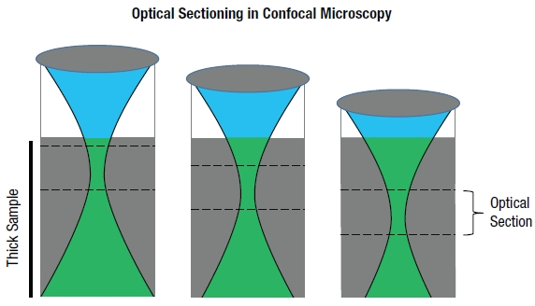
Problem with high Numerical Aperture (NA) objectives
Need for high resolution, but
Axial depth of focus (optical section) scales to NA⁻²
Focal volume proportional to NA⁻³
Notes:
http://www.opticsinfobase.org/oe/fulltext.cfm?uri=oe-21-13-16007&id=258369

Slide 33

Use low NA objectives and computationally reconstruct higher resolution image
Advantages of low power objective
  Bigger field of view
  Greater depth of focus
  Greater working distance
Fourier ptychographic microscopy (FPM)
Work of Changhuei Yang’s lab here at Caltech
http://www.biophot.caltech.edu/
Notes:
Ptychography is a technique invented by Walter Hoppe^{[1]} that aims to solve the diffraction-pattern phase problem by interfering adjacent Bragg reflections coherently and thereby determine their relative phase. In the original formulation, Hoppe envisaged that such interference could be effected by placing a very narrow aperture in the plane of the specimen so that each reciprocal-lattice point would be spread out and thus overlap with one another. The name ptychography, from the Greek for fold, derives from this optical configuration; each reciprocal lattice point is convolved with some function, and thus made to interfere with its neighbors. In fact, measuring only the intensities of interfering adjacent diffracted beams still leads to an ambiguity of two possible complex conjugates for each underlying complex diffraction amplitude. The original formulation of ptychography is equivalent to the well known theorem that for a finite specimen (that is one delineated by a narrow aperture, sometimes known as a finite support), the one-dimensional phase problem is soluble to within an ambiguity of 2N, where N is the number of Fourier components that make up the specimen.^{[2]} However, such ambiguities may be resolved by changing the phase, profile or position of the illuminating beam in some way.^{[1]} The fact that not only the intensities of the diffracted beams but also the intensities lying midway between the beams, where the convolved Bragg beams interfere, is an alternative statement of the Nyquist–Shannon sampling theorem for components of diffracted intensity. These components generally have twice the frequency (in reciprocal space) of their underlying complex amplitudes.
https://en.wikipedia.org/wiki/Ptychography

Slide 34
Fourier ptychographic microscopy (FPM)
Depends on computational regime to extract good images rather than optical system
Zheng, G., Horstmeyer, R., Yang, C., 2013. Wide-field, high-resolution Fourier ptychographic microscopy. Nat Photon 7, 739-745.
Notes:
Fig. S5 FPM flowchart with digital wavefront correction. A digital pupil function is introduced in steps 2 and 5 to model the connection between the actual sample profile and the captured intensity data, which may exhibit aberrations caused by defocus.

Slide 35
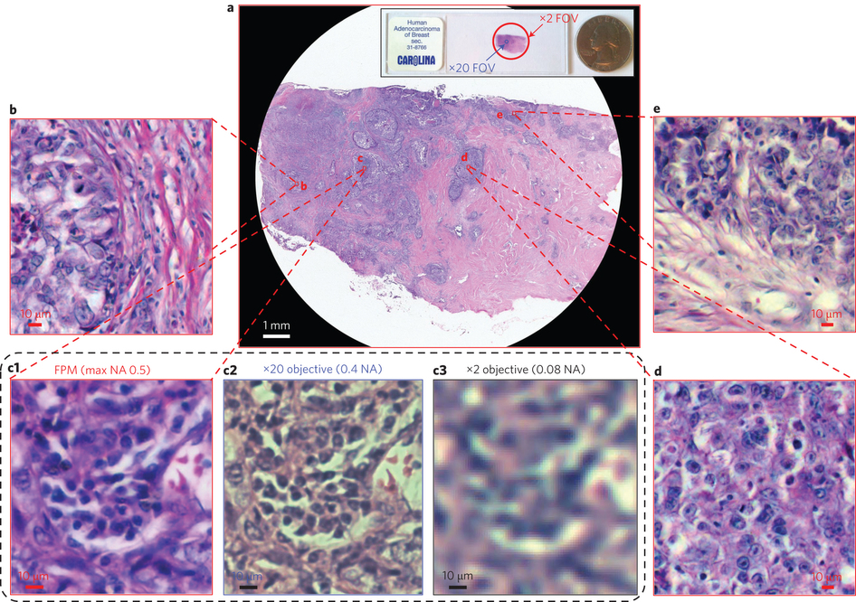
Fourier ptychographic microscopy (FPM)
With multiple illuminations and Fourier domain processing, low NA objective gives image of higher NA objective
Zheng, G., Horstmeyer, R., Yang, C., 2013. Wide-field, high-resolution Fourier ptychographic microscopy. Nat Photon 7, 739-745.
Notes:
2x 0.08 NA objective to generate equivalent to 20x with 0.5 NA image. Takes multiple images with different illumination angles and computationally fixes it in Fourier space. Iterative process

Slide 36
Solutions for large aperture volume imaging
Wavefront coding
  Dowski, E.R., Cathey, W.T., 1995. Extended depth of field through wave-front coding. Appl. Opt. 34, 1859-1866.
  Limited penetration into microscopy community
  For fluorescence has been problematic
    Complex structures with axial overlap and lack of contrast
    Raw images too muddled for disambiguation of features
    Makes computational recovery of these features complicated
Spatial light modulation
  Splitting beam into multiple beamlets
  Avoids wavefront problems
Notes:
Although wavefront coded, extended DOF systems have been successfully demonstrated, they have had limited penetration into the microscopy community. As applied to fluorescence microscopy, the principle limitations are that many real samples are complex structures with many axially overlapping features and can have a lack of inherent contrast without strong axial sectioning. These effects combine to yield raw images that are too muddled for effective disambiguation of objects, and the computational recovery of individual features becomes very difficult.
http://www.opticsinfobase.org/oe/fulltext.cfm?uri=oe-21-13-16007&id=258369
https://en.wikipedia.org/wiki/Wavefront_coding

Slide 37
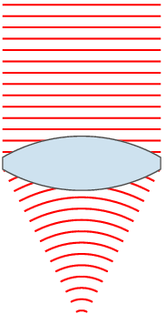
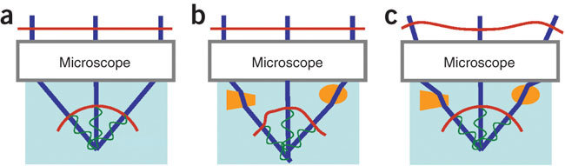
Remember discussion of adaptive optics for microscopes?
Problem of wavefront
Objective lens converts planar waves to spherical
SLM used in adaptive optics
Notes:
(a) An ideal microscope converts a planar wavefront (top red line) to a converging spherical one (bottom red semicircle) in a sample of the design optical properties. Propagation vectors or 'rays' (blue), defined by the direction normal to the wavefront, converge at a common point and, being in phase, constructively interfere there to create an optimal focus. Green sinusoidal curves denote the phase variation along each ray. (b) Inhomogeneities (orange) in the refractive index of the sample change the directions and phases of the rays, leading to a distorted wavefront and an enlarged focal volume with lower peak intensity. (c) Controlling the input wavefront using an active optical element (not shown) can cancel these aberrations, recovering a diffraction-limited focus.
http://www.nature.com/nmeth/journal/v7/n2/full/nmeth.1411.html

Slide 38

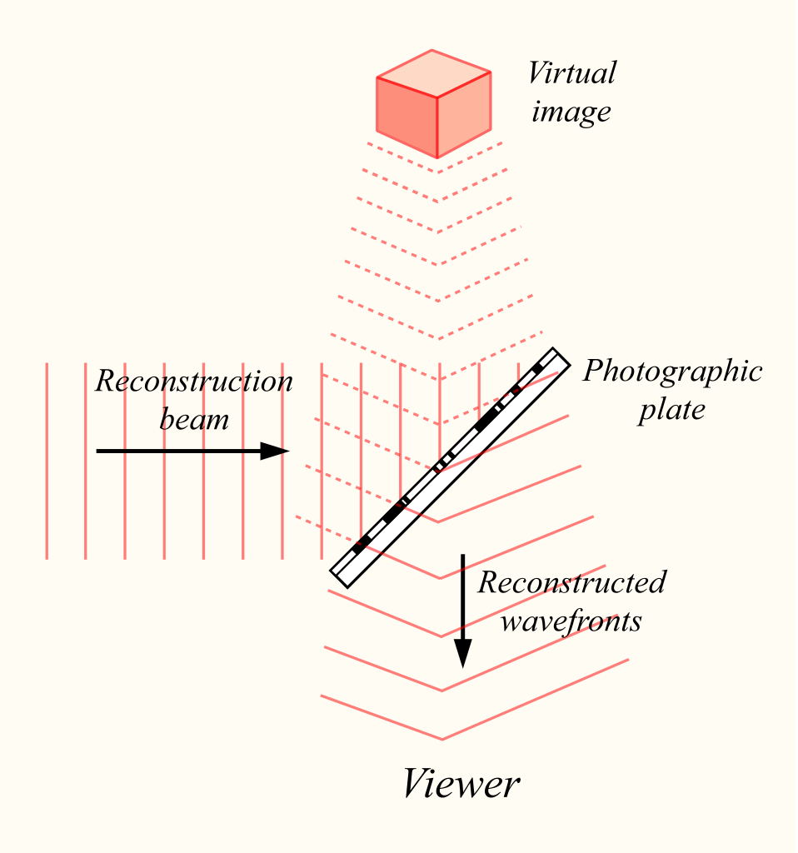
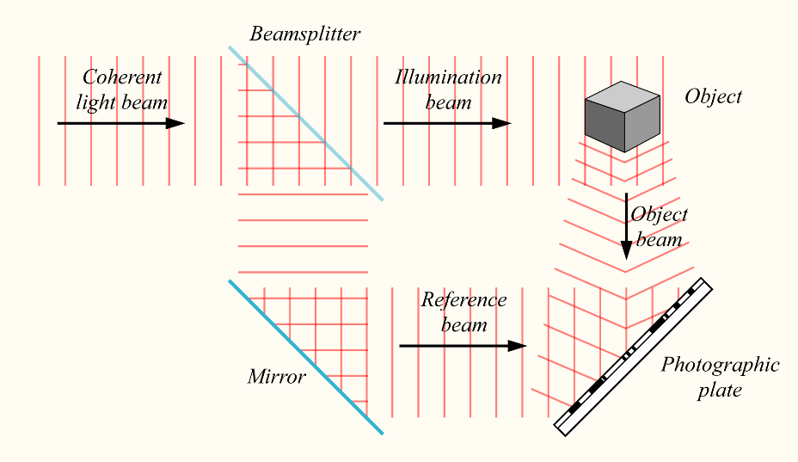
Holography
Was using holography to improve electron microscopes
For optical holography need lasers
Notes:
https://en.wikipedia.org/wiki/Holography

Slide 39
Holography versus photography
Records light from many directions not just one
Requires laser, can’t use normal light sources
No need for a lens
Needs second beam to see (reconstruction beam)
Requires specific illumination to see
Cut in half, see two of same image not half of it
More 3D cues
Hologram’s surface does not clearly map to image
Notes:
https://en.wikipedia.org/wiki/Holography

Slide 40
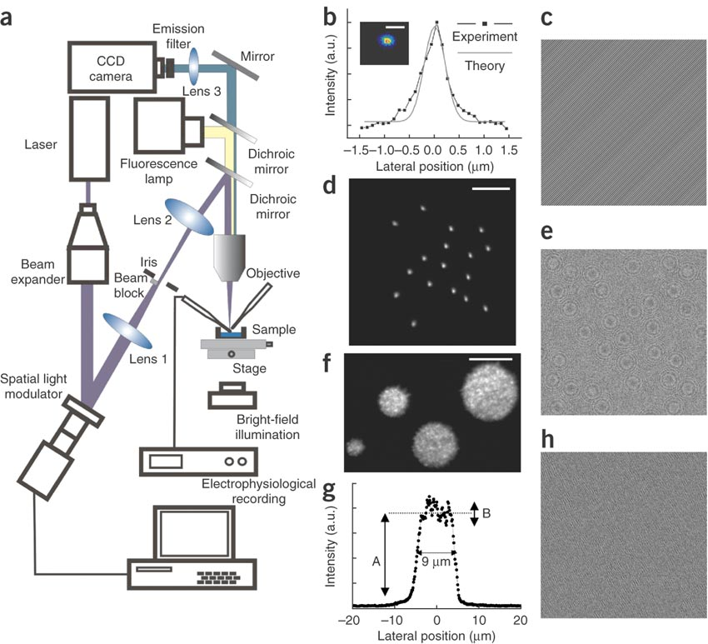
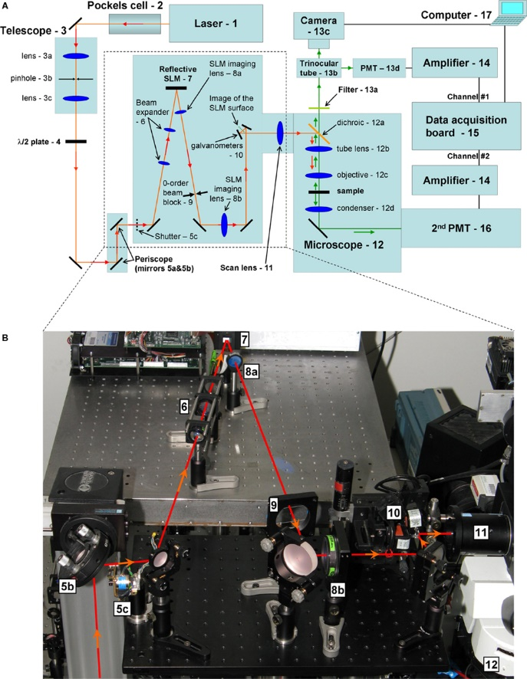
Holographic or Spatial Light Modulator (SLM) microscope (2008)
Holographic microscope
SLM microscope
Notes:
Layout of the optical setup. (b) A near diffraction-limited spot generated at a chosen position. Scale bar, 1 m. (c) Phase hologram used to generate the spot in b, showing the typical structures of a diffraction grating. (d) Simultaneous generation of 15 spots. Scale bar, 10 m. (e) Phase hologram used to create the multiple spots in d. Fresnel lenses are visible. These were used to focalize the different spots, superimposed on grating-like structures to control their lateral positions. (f) Excitation with multiple spots of diameters s = 12, 9.0, 6.5 and 3.5 m. Scale bar, 10 m. (g) Intensity profile across the spot in f with diameter of 9 m. A, mean intensity value; B, variation in intensity. (h) Phase hologram used to create the spots in f. The diffraction efficiency, , defined as the integrated intensity of the first order over the integrated intensity of the zeroth order with SLM off, was 63%, 46% and 50% for the phase holograms in c,e and h, respectively.
http://www.nature.com/nmeth/journal/v5/n9/full/nmeth.1241.html
Holographic microscope
http://journal.frontiersin.org/article/10.3389/neuro.04.005.2008/full
SLM microscope
http://www.opticsinfobase.org/oe/fulltext.cfm?uri=oe-21-13-16007&id=258369

Slide 41
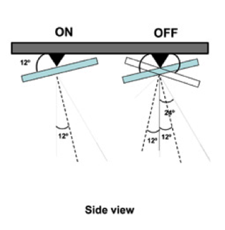
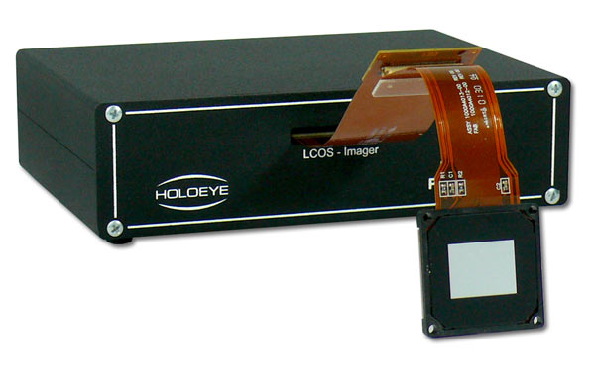
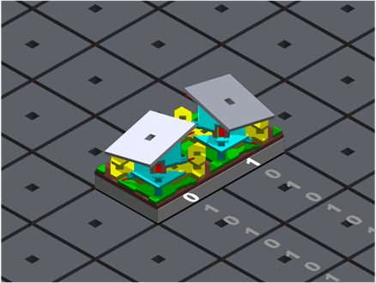
SLM competes with Digital-Multi-Mirror Device (DMD)
Phase only SLM generate image (diffraction pattern) by modulating phase not intensity of light
Slower (Hz), 3D, potentially
Can use two photon since full power available
DMDs produce image by removing light (on, off)
Faster (Khz), 2D
Wide field illumination
Notes:
This beam-multiplexing property is similar to the more traditional methods of producing arbitrary two-dimensional illumination patterns, such as digital micromirror devices (DMDs), based on wide-field illumination and use of a physical mask (Wang et al., 2007 ). But, as opposed to DMDs, phase-only SLMs generate an image (diffraction pattern) by modulating the phase, and not the amplitude, of the incoming light beam. While the phase-only SLM imprints the incoming beam with the phase pattern that produces the desired spatial profile of the excitation light in the far field, it does so not by removing light, like the DMDs, but by redistributing it. Because the full power of the laser is available, non-linear excitation is possible (e.g., multi-photon absorption or SHG).
http://journal.frontiersin.org/article/10.3389/neuro.04.005.2008/full
For example, for an illumination field of 50 50 m², using a digital micromirror would allow only a fraction of 0.008%, 0.2% and 9% of the incident light to be delivered in the three patterns in Figure 1b,d,f, whereas by phase modulation with an SLM we measured values of 63%, 46% and 50%, respectively.
http://www.nature.com/nmeth/journal/v5/n9/full/nmeth.1241.html

Slide 42
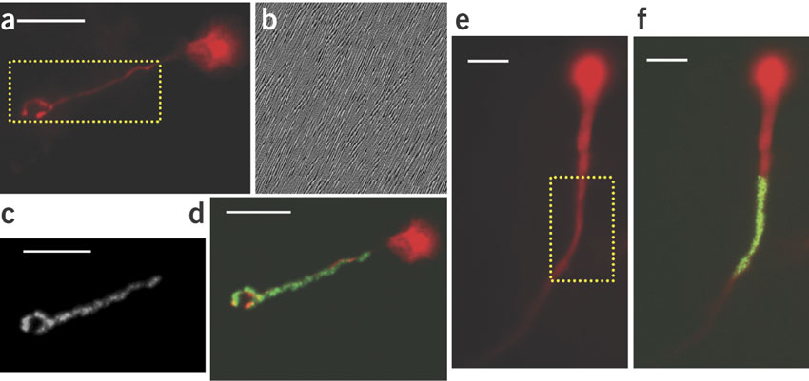
Holographic microscope
Allows fine shaping of excitation volume while maintaining decent power
Lutz, C., Otis, T.S., DeSars, V., Charpak, S., DiGregorio, D.A., Emiliani, V., 2008. Holographic photolysis of caged neurotransmitters. Nat Meth 5, 821-827.
Notes:
(a,b) Wide-field epifluorescence image of a cerebellar granule cell (a) in which a selected region of interest (dashed box) was used to obtain the phase hologram shown in b. (c) Illumination shape generated in coumarin at the objective focal plane with the phase hologram of b. (d) Overlay of a and c. (e) Similar to a but using a CA1 hippocampal pyramidal cell to calculate the phase hologram. (f) Similar to the image in d, overlay of the image in e, with the generated holographic spot (green). Scale bars, 10 m.

Slide 43
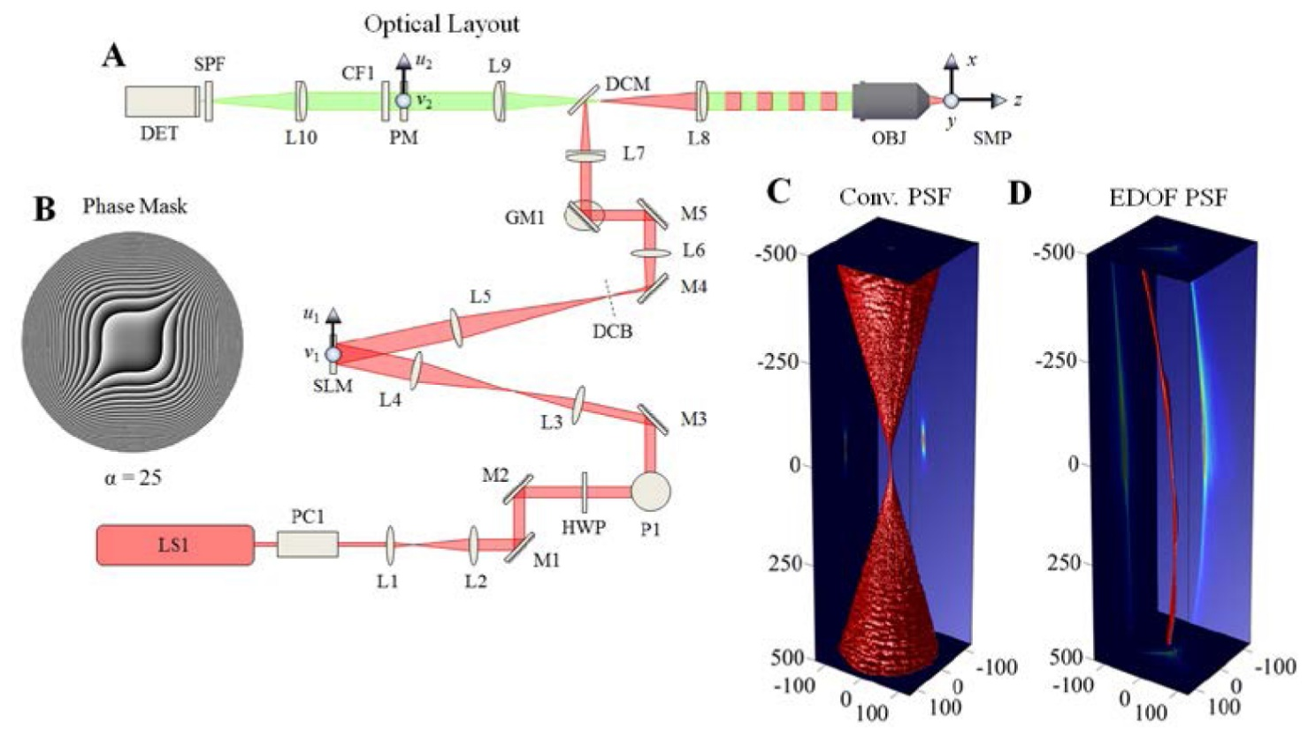
SLM microscope went from 2D to 3D with extended depth of field (EDOF)
SLM microscope
Wavefront coded imaging (adds EDOF)
Quirin, S., Peterka, D.S., Yuste, R., 2013. Instantaneous three-dimensional sensing using spatial light modulator illumination with extended depth of field imaging. Optics express 21, 16007-16021.
Notes:
For the particular case of extending the imaging DOF, the enhancement is gained by sacrificing the tightly-focused, symmetric spot traditionally chosen for optimal imaging of a single axial plane with high contrast, in favor of a highly aberrated PSF. By design, this aberrated PSF must overwhelm the aberrative effects of defocus over an extended axial range. After image acquisition, fast digital image restoration techniques (e.g. deconvolution) can be applied for estimating the original object free of these fixed optical aberrations. With such systems, the fall-off in intensity with defocus is much smaller and smoother than in a classical system thereby allowing multiple planes to be imaged simultaneously with similar fidelity. As a consequence, in properly engineered wavefront coding systems the nominally out-of-focus regions can now be imaged with higher SNR than traditionally available.
Fig. 3 Design of extended depth of field (EDOF) microscope. Panel A: Experimental configuration of the joint SLM and extended-DOF imaging microscope for 3D targeting and monitoring. The detailed description of each component is described in the section 4.1. The phase aberration shown in panel B is the ideal diffractive optical element for the cubic-phase modulation and placed in an accessible region between L9 and L10 without affecting the illumination pupil. The experimental PSF of the imaging system is presented for the conventional microscope in panel C and the extended DOF microscope in panel D. The three-dimensional volume in panels C and D represent the 50% intensity cutoff of each axial plane and the axis units are in μm

Slide 44
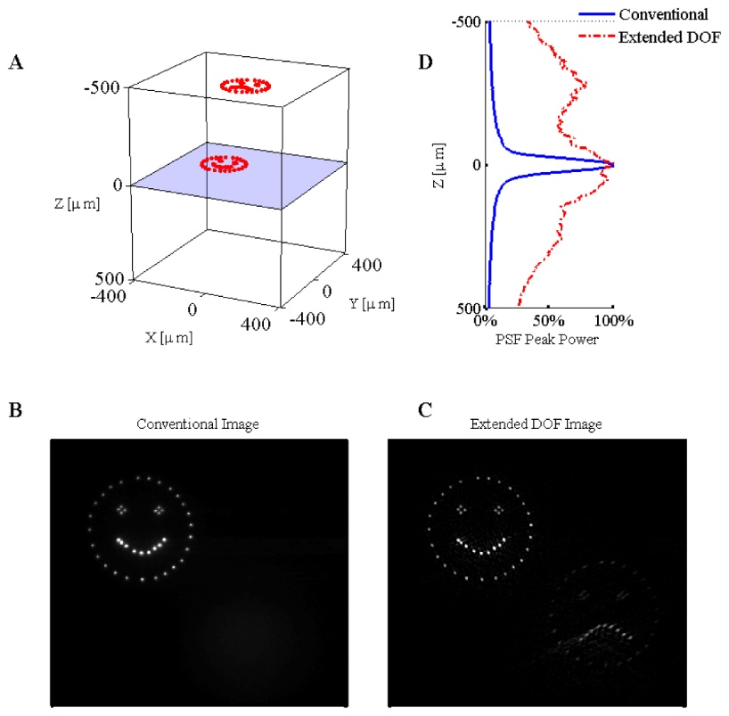
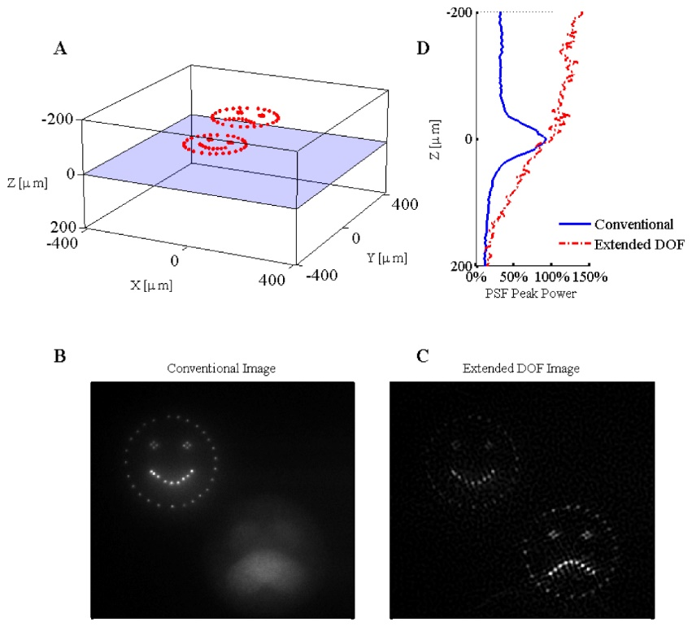
SLM microscope with EDOF
Transparent media
Scattering media
Notes:
Wavefront coding plus deconvolution
Fig. 5 Experimental results for the three-dimensional SLM illumination in transparent media with both the conventional and extended depth of field microscope. The three-dimensional illumination pattern is shown in panel A. The relative intensity of the fluorescence as a function of depth is given to the right of panel A. The results from imaging the three-dimensional pattern in bulk fluorescent material are given for the conventional microscope (panel B) and the extended DOF microscope (panel C). Contrast was enhanced to saturate 0.1% of the pixel values in panels B and C (Media 2).
Fig. 6 Experimental results for the three-dimensional SLM illumination in scattering media with both the conventional and extended depth of field microscope. The three-dimensional illumination pattern is shown in panel A. The focal plane is located 220µm below the surface of the scattering media. The relative intensity of the fluorescence as a function of depth is given to the right of panel A. The results from imaging the three-dimensional pattern in bulk fluorescent material are given for the conventional microscope (panel B) and the extended DOF microscope (panel C). Contrast was enhanced to saturate 0.02% of the pixel values in panels B and C (Media 3).

Slide 45
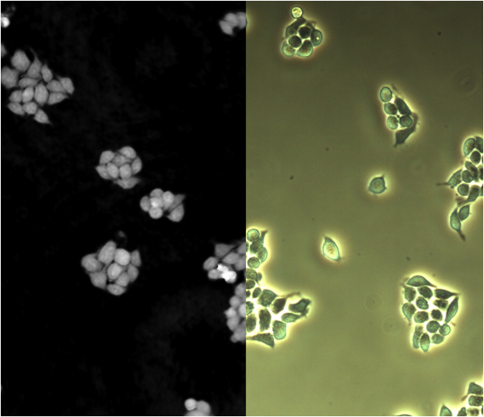
Digital holographic microscopy (DHM)
Uses wavefront to reconstruct image
Doesn’t require an objective
Notes:
Besides the ordinary bright field image, a phase shift image is created as well. The phase shift image is unique for digital holographic microscopy and gives quantifiable information about optical distance. In reflection DHM, the phase shift image forms a topography image of the object.
Easier to segment.
Figure 3. Comparison of a DHM phase shift image (left) and a phase contrast microscopy image (right).
http://en.wikipedia.org/wiki/Digital_holographic_microscopy
"Phase-Phase Contrast" by Egelberg. Licensed under CC BY-SA 3.0 via Wikimedia Commons - http://commons.wikimedia.org/wiki/File:Phase-Phase_Contrast.jpg#mediaviewer/File:Phase-Phase_Contrast.jpg
"OpticalSetupDHM" by User:Egelberg. Licensed under CC BY-SA 3.0 via Wikimedia Commons - http://commons.wikimedia.org/wiki/File:OpticalSetupDHM.jpg#mediaviewer/File:OpticalSetupDHM.jpg

Slide 46
Class survey
Bi117
https://docs.google.com/forms/d/1AZLyKxvh5Bg_yp3A_rPD_09EHnyf2leS-FqU-sPVEVU/viewform?usp=send_form
Notes:
Here are BUSAC's course surveys for the term. We strongly recommend that you fill them out, as it may be possible to implement changes before the final exam/end of term. Responses are anonymous, and you can fill out each survey once. Just select the form for each class. If you have any questions, comments, or suggestions, let me know.
The Biology Undergraduate Student Advisory Committee (BUSAC) is interested in improving communication between professors and students in biology. As part of this goal, we ask students for comments on courses shortly after midterms. The course catalog indicates that you are teaching a course this term, so we were wondering if you would like us to include your course in our evaluations.
Responses to the survey will be read and summarized (by me) into a short list of constructive comments according to our guidelines for appropriate course commentaries. If you would like me to survey your course, please let me know in the next few days. If there are specific questions you would like to ask students, I will include those as well.
Thank you,
Katie Ching
BUSAC Academic Chair
busac.caltech.edu

Slide 47
Reading from Feb. 17th: Thoughts?

Slide 48
Homework 6
We have looked at several different methods for optical sectioning of fluorescent samples. The two main methods are Laser Scanning Confocal Microscopy (LSCM) and light sheet microscopy or Selective Plane Illumination Microscopy (SPIM). LSCM has been around a long time compared to SPIM.
Question: Do you think that SPIM will replace LSCM or are these techniques complementary?

