Slide 1
Biology 177: Principles of Modern Microscopy
Lecture 16:
Super-resolution microscopy: Part 2

Slide 2
Lecture 16: Super-resolution microscopy and TIRFM
Single molecule imaging
Total internal reflection fluorescence microscopy (TIRFM)
Super-resolution techniques
RESOLFT
  STED
  GSD
Stochastic functional techniques
  PALM
  STORM
And the rest

Slide 3
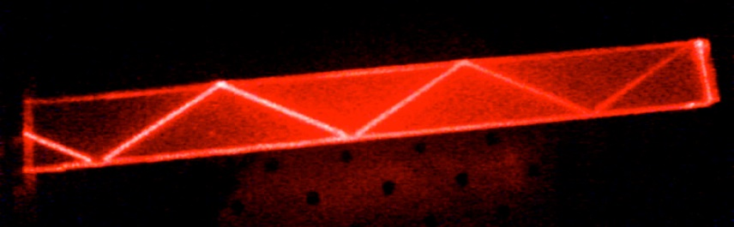
Where do we want to go in the future?
High speed
Single molecule imaging
  Fluorescence correlation spectroscopy (FCS)
  Total internal reflection microscopy (TIRF)
Super-resolution
θ_{i}
θ_{i}
Interface
Notes:
http://www.rsc.org/ConferencesAndEvents/RSCConferences/FD/molecule-fd2015/
A practical superlens, super lens or perfect lens, is a lens which uses metamaterials to go beyond the diffraction limit. The diffraction limit is an inherent limitation in conventional optical devices or lenses.^{[1]} In nano-optics, a plasmonic lens generally refers to a lens for surface plasmon polaritons (SPPs), i.e. a device that redirects SPPs to converge towards a single focal point. Since SPPs can have very small wavelength, they can converge into a very small and very intense spot, much smaller than the free-space wavelength and the diffraction limit.^{[1][2]} Surface plasmon polaritons (SPPs), are infrared or visible-frequency electromagnetic waves, which travel along a metal-dielectric or metal-air interface. The term "surface plasmon polariton" explains that the wave involves both charge motion in the metal ("surface plasmon") and electromagnetic waves in the air or dielectric ("polariton").^{[1]}
They are a type of surface wave, guided along the interface in much the same way that light can be guided by an optical fiber. SPPs are shorter in wavelength than the incident light (photons).^{[2]}
Metamaterials are artificial materials engineered to have properties that have not yet been found in nature.

Slide 4
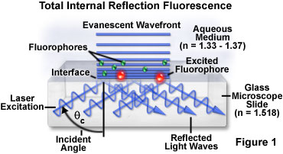
Total internal reflection fluorescence (TIRF) microscopy
Technique that dominates most single molecule imaging approaches
Notes:
http://micro.magnet.fsu.edu/primer/techniques/fluorescence/tirf/tirfhome.html
http://www.microscopyu.com/articles/fluorescence/tirf/tirfintro.html
http://olympus.magnet.fsu.edu/primer/techniques/fluorescence/tirf/tirfhome.html
http://www.nature.com/milestones/milelight/full/milelight17.html

Slide 5
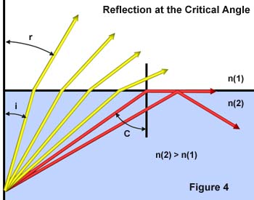
Internal reflection depends on refractive index differences
sin θ critical = η1 / η2
Notes:
Total internal reflection does not occur suddenly as a new phenomenon at the critical angle, but a continuous transition is followed from predominant refraction with a small amount of reflection, to total reflection when the critical angle is exceeded.
Matching refractive indices can eliminate internal reflection. Internal reflection depends on refractive index differences

Slide 6
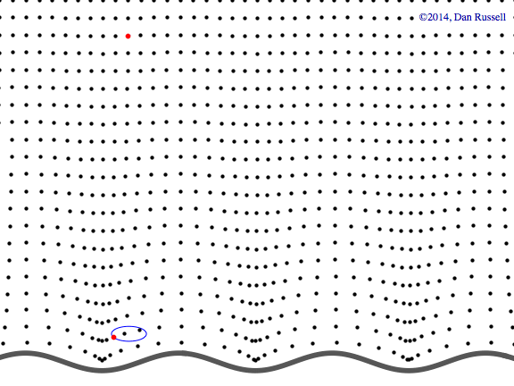
Evanescent waves
Near-field phenomenon
Higher frequency, more information
Formed at boundary between two media with different wave motion properties
Evanescent waves quantum tunneling phenomenon
Product of Schrödinger wave equations
Exponential decay
Notes:
http://www.acs.psu.edu/drussell/Demos/EvanescentWaves/EvanescentWaves.html

Slide 7
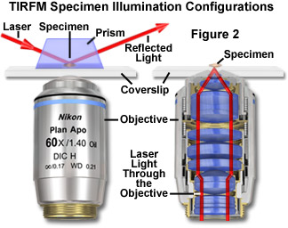
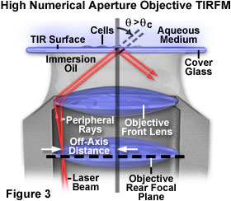
TIRFM illumination configurations
Prism method
Objective Lens method
Ideally NA of 1.45 or higher
Notes:
Combining this relationship with the condition for total internal reflection given above illustrates that living cells having a typical refractive index of 1.38 require illumination with an objective having a numerical aperture of greater than 1.38 in order to achieve total internal reflection. Light entering the objective must pass through the portion of the aperture cone corresponding to numerical aperture values larger than 1.38 in order to be totally reflected at the specimen-glass interface. If coherent laser illumination is employed, it must be focused at the periphery of the objective rear aperture to ensure that light will exit the front optical surface at an angle equal to or greater than the critical value. In the case of non-coherent illumination, such as that from an arc-discharge lamp, a mask in the form of an opaque disk must be introduced into the optical path to restrict light passing through the objective to the outer region of the rear aperture.
http://www.microscopyu.com/articles/fluorescence/tirf/tirfintro.html

Slide 8
TIRFM illumination configurations
Prism method
Objective Lens method
Restricts access to specimen (difficult to manipulate)
Most illuminate opposite objective so have to pass through specimen
If prism on same side then more complicated alignment
This is the way to go

Slide 9
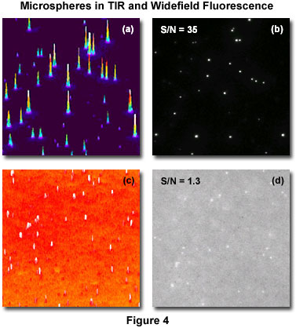
TIRFM applications
Benefits for imaging minute structures or single molecules in specimens with tons of fluorescence outside of optical plane of interest
Examples: Brownian motion of molecules in solution, vesicles undergoing endocytosis or exocytosis, or single protein trafficking in cells
Can get dramatic increase in signal-to-noise ratio from thin excitation region
Microsphere example
Notes:
Figure 4 presents images acquired of a solution of fluorescent microspheres utilizing the TIRFM method (Figure 4(b)) and conventional epi-fluorescence illumination (Figure 4(d)). To the left of each image is its corresponding intensity histogram (Figures 4(a) and 4(c)). The improved resolution of the spheres afforded by increasing the signal-to-noise ratio (S/N) from 1.3 to 35 is apparent in the images, and in the sharp localization and higher signal intensity in the histogram corresponding to the TIRFM image (Figure 4(a)).
http://www.microscopyu.com/articles/fluorescence/tirf/tirfintro.html

Slide 10
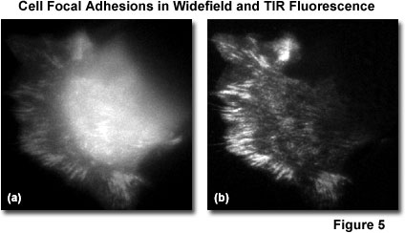
TIRFM applications
Ideal tool for investigation of both the mechanisms and dynamics of many of the proteins involved in cell-cell interactions
Live cell imaging
GFP-vinculin to see focal adhesions on coverslip
Notes:
Figure 5 presents comparative images of live cells (PtK1 kangaroo kidney epithelial cells expressing GFP-vinculin) utilizing a conventional widefield epi-fluorescence method (Figure 5(a)) and evanescent wave illumination (Figure 5(b)). The TIRFM image reveals localization of the fusion protein in cell focal adhesions at the substrate interface in dramatic contrast to the blur produced by out-of-plane fluorescence in the epi-illumination image. Live-cell imaging represents one of the most promising applications of the TIRFM technique.

Slide 11
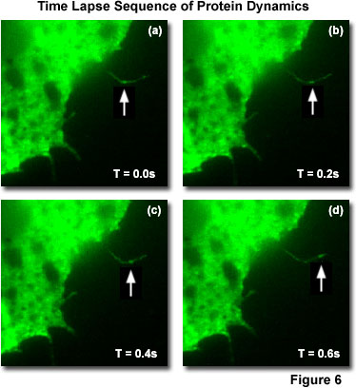
TIRFM applications
Single molecule imaging
Time lapse of GFP-Rac moving along filopodia
In fact, most single molecule imaging today done with TIRFM
Notes:
At the biomolecular level, TIRFM techniques have been utilized to image single molecules of the mutant protein GFP-Rac trafficking along thin filopodia of cells growing on a substrate (Figure 6). This protein is involved in cell motility, and knowledge of the dynamics of its interactions at the cell membrane are crucial to understanding the process. The visualization of single-molecule fluorescence with sufficient temporal resolution for dynamic studies is possible with TIRFM because of the outstanding signal-to-noise ratio afforded by the evanescent wave excitation. Figure 6 presents four sequential time lapse frames taken at 200-millisecond intervals, illustrating the movement of a GFP-Rac fusion protein molecule (arrows) through a fine filopodium of a Xenopus cell growing out on a substrate.
http://www.microscopyu.com/articles/fluorescence/tirf/tirfintro.html

Slide 12
TIRFM versus Confocal Microscopy
Confocal not limited to plane at interface, can go deeper
TIRFM has thinner optical section (100 nm vs 600 nm)
TIRFM, like two photon, only excites sample at focal plane
TIRFM is cheaper to implement than confocal
Notes:
http://olympus.magnet.fsu.edu/primer/techniques/fluorescence/tirf/tirfintro.html

Slide 13

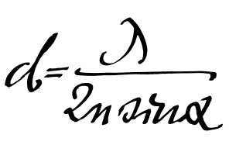
Super-resolution microscopy
Abbe (1873) reported that smallest resolvable distance between two points (d) using a conventional microscope may never be smaller than half the wavelength of the imaging light (~200 nm)
Is resolution diffraction limited?
Notes:
They fall into two broad categories, "true" super-resolution techniques, which capture information contained in evanescent waves, and "functional" super-resolution techniques, which use clever experimental techniques and known limitations on the matter being imaged to reconstruct a super-resolution image.^{[2]}
True subwavelength imaging techniques include those that utilize the Pendry Superlens and near field scanning optical microscopy, the 4Pi Microscope and structured illumination microscopy technologies like SIM and SMI. However, the majority of techniques of importance in biological imaging fall into the functional category.
There are two major groups of methods for functional super-resolution microscopy:
Deterministic super-resolution: The most commonly used emitters in biological microscopy, fluorophores, show a nonlinear response to excitation, and this nonlinear response can be exploited to enhance resolution. These methods include STED, GSD, RESOLFT and SSIM.
Stochastic super-resolution: The chemical complexity of many molecular light sources gives them a complex temporal behaviour, which can be used to make several close-by fluorophores emit light at separate times and thereby become resolvable in time. These methods include SOFI and all single-molecule localization methods (SMLM) such as SPDM, SPDMphymod, PALM, FPALM, STORM and dSTORM.

Slide 14
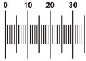
Super-resolution microscopy
Could always do super-resolution if could label points with different colors
Separate with different fluorescent filters (spectral unmixing)
Why fluorescence is such an important illumination technique
Hell, S.W., 2009. Microscopy and its focal switch. Nat Meth 6, 24-32.
Notes:
http://www.nature.com/nmeth/journal/v6/n1/full/nmeth.1291.html

Slide 15
Super-resolution microscopy
“True” super-resolution techniques
  Subwavelength imaging
  Capture information in evanescent waves
“Functional” super-resolution techniques
  Deterministic
    Exploit nonlinear responses of fluorophores
  Stochastic
    Exploit the complex temporal behaviors of fluorophores
Notes:
They fall into two broad categories, "true" super-resolution techniques, which capture information contained in evanescent waves, and "functional" super-resolution techniques, which use clever experimental techniques and known limitations on the matter being imaged to reconstruct a super-resolution image.^{[2]}
True subwavelength imaging techniques include those that utilize the Pendry Superlens and near field scanning optical microscopy, the 4Pi Microscope and structured illumination microscopy technologies like SIM and SMI. However, the majority of techniques of importance in biological imaging fall into the functional category.
There are two major groups of methods for functional super-resolution microscopy:
Deterministic super-resolution: The most commonly used emitters in biological microscopy, fluorophores, show a nonlinear response to excitation, and this nonlinear response can be exploited to enhance resolution. These methods include STED, GSD, RESOLFT and SSIM.
Stochastic super-resolution: The chemical complexity of many molecular light sources gives them a complex temporal behaviour, which can be used to make several close-by fluorophores emit light at separate times and thereby become resolvable in time. These methods include SOFI and all single-molecule localization methods (SMLM) such as SPDM, SPDMphymod, PALM, FPALM, STORM and dSTORM.

Slide 16
“Functional” super-resolution techniques
Deterministic
  Reversible Saturable (or Switchable) OpticaL Fluorescence Transitions (RESOLFT)
    STimulated Emission Depletion (STED)
    Ground State Depletion (GSD)
Stochastic
  STochastic Optical Reconstruction Microscopy (STORM)
  Photo Activated Localization Microscopy (PALM)
  Fluorescence Photo-Activation Localization Microscopy (FPALM)
Notes:
A trio of techniques independently surfaced during a four-month period in 2006 that elegantly demonstrated the sequential and stochastic readout with precise localization of multiple single molecules from specimens that were fluorescently labeled with photoswitchable dyes or optical highlighter fluorescent proteins at densities approaching those commonly employed in widefield and confocal fluorescence microscopy (ranging up to 100,000 molecules per square micrometer). These nearly identical single-molecule superresolution imaging techniques have been termed stochastic optical reconstruction microscopy (STORM; see Figure 1), photoactivated localization microscopy (PALM), and fluorescence photoactivation localization microscopy (FPALM). They rely on an activation laser applied at low power to trigger emission switching so that any particular molecule has a small probability of being photoactivated, but the majority of the population remains in the original (dark or native) emissive state. Although the major difference between the methods as they were originally published was simply the nature of the fluorescent probes used to achieve superresolution imaging, these techniques are virtually identical. In fact, the original STORM research report mentioned the use of fluorescent proteins, whereas the first PALM paper discussed the application of caged synthetic fluorophores.
http://www.microscopyu.com/articles/superresolution/stormintro.html
They fall into two broad categories, "true" super-resolution techniques, which capture information contained in evanescent waves, and "functional" super-resolution techniques, which use clever experimental techniques and known limitations on the matter being imaged to reconstruct a super-resolution image.^{[2]}
True subwavelength imaging techniques include those that utilize the Pendry Superlens and near field scanning optical microscopy, the 4Pi Microscope and structured illumination microscopy technologies like SIM and SMI. However, the majority of techniques of importance in biological imaging fall into the functional category.
There are two major groups of methods for functional super-resolution microscopy:
Deterministic super-resolution: The most commonly used emitters in biological microscopy, fluorophores, show a nonlinear response to excitation, and this nonlinear response can be exploited to enhance resolution. These methods include STED, GSD, RESOLFT and SSIM.
Stochastic super-resolution: The chemical complexity of many molecular light sources gives them a complex temporal behaviour, which can be used to make several close-by fluorophores emit light at separate times and thereby become resolvable in time. These methods include SOFI and all single-molecule localization methods (SMLM) such as SPDM, SPDMphymod, PALM, FPALM, STORM and dSTORM.

Slide 17
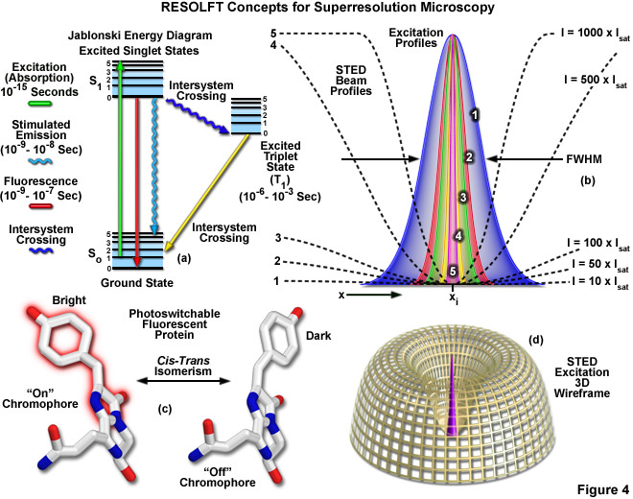
Reversible Saturable (or Switchable) Optical Fluorescence Transitions (RESOLFT)
Includes
STED
GSD
Notes:
Extremely high intensities are necessary for switching off the excited singlet state with STED (using what is termed a depletion laser), but switching to a metastable triplet or similar dark state (GSD) requires a light intensity between a thousand and a million times lower.
http://zeiss-campus.magnet.fsu.edu/articles/superresolution/introduction.html
http://www.microscopyu.com/articles/superresolution/stormintro.html

Slide 18
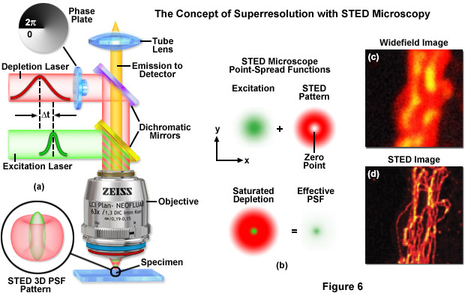
STED: STimulated Emission Depletion
http://zeiss-campus.magnet.fsu.edu

Slide 19

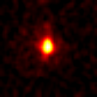
STED Microscopy means scanning a smaller focal spot across the sample
Point Spread Function: Confocal vs STED
measured with fluorescent nanoparticles under the same conditions
Typical lateral (X-Y)
resolution in a Confocal:
200x200 nm
Typical lateral (X-Y) FWHM
(Full Width Half Maximum)
in STED is 90x90 nm
STED z resolution is
confocal (500 nm)
STED enables separation
of structures even smaller
than its FWHM due to the
sharp peak. Actual
resolution is in the order
of 70 nm for raw data
(without deconvolution)
y
y
x
x

Slide 20
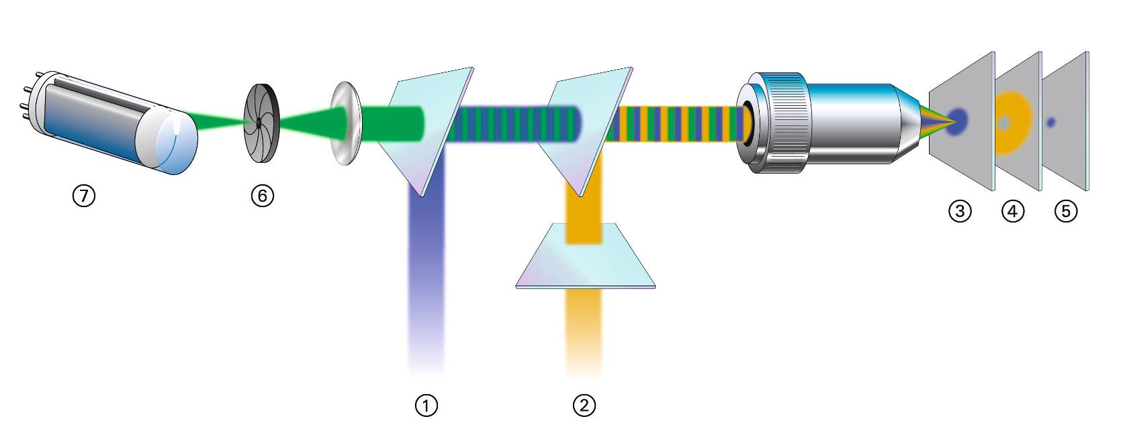
How to generate the small STED spot?
Two superimposed beams: excitation beam and donut-
shaped red-shifted depletion beam, pulsed and tightly synchronized
Donut-shaped beam depletes excited molecules in outer focal area before
fluorescence is emitted → sharpens up focus
Beam geometry and pulse timing is important

Slide 21
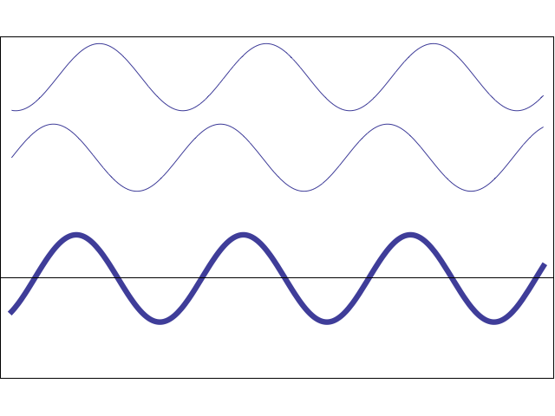
Characteristic of waves: Interference
Constructive Interference
Destructive Interference

Slide 22
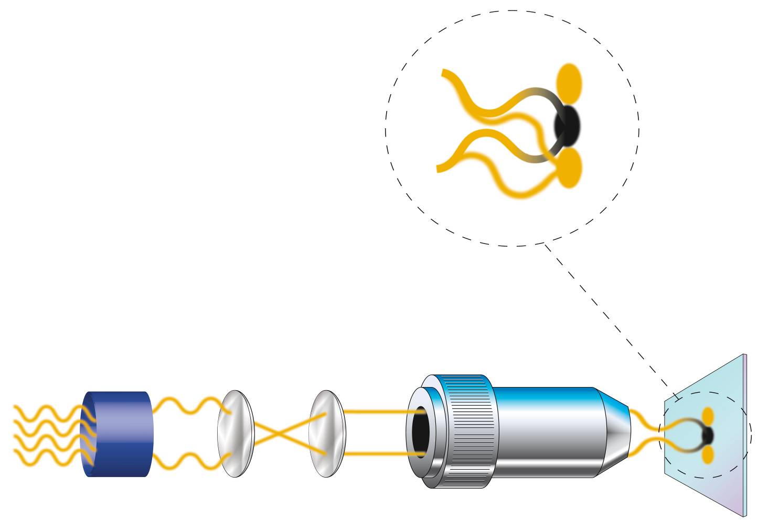
Beam geometry (I): the central minimum of the STED depletion donut is created by phase cancellation
Extinction
No extinction
No phase shift
λ/2 phase shift

Slide 23
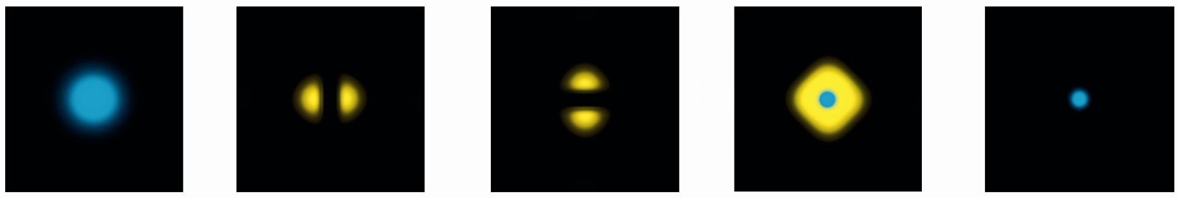





Beam geometry (II): the full STED donut is created by superimposition of two half donuts from two beams
Excitation Laser
Depletion
Laser Beam 1
(TiSa Laser)
Depletion
Laser Beam 2
(TiSa Laser)
Effective PSF
(Fluorescence)
Pupil:
Pupil:
Phase
Phase
Phase
+
λ
/2
+
λ
/2
+0
Phase
+0
φ=240nm
φ=90nm
Blue: Excitation spot
Yellow: Depletion beam

Slide 24
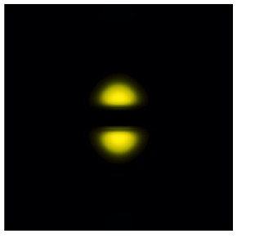
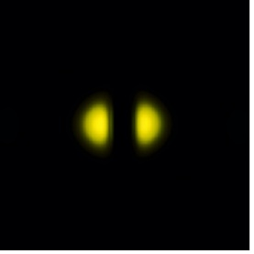
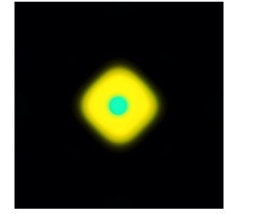
Beam geometry (III): STED unit connected to Confocal
Confocal
TCS SP5
SP5 Laser
UV Port
SP5 Detectors
AOBS
Scanner
PBS
λ
/2
Phase
plate
STED
depletion
beam
BS
STED
excitation
beam
STED
unit

Slide 25
Pulse timing: Stimulated Emission Depletion - Fluorescence is depleted before it is emitted
Fluorescence
~ns
Excitation
STED
10-
200 ps
Timing
Energy diagram
<1ps
Time
No fluorescence
emission
S
4
1
3
Stimulated
Emission
Fluorescence
Absorption
S
2
0
1

Slide 26
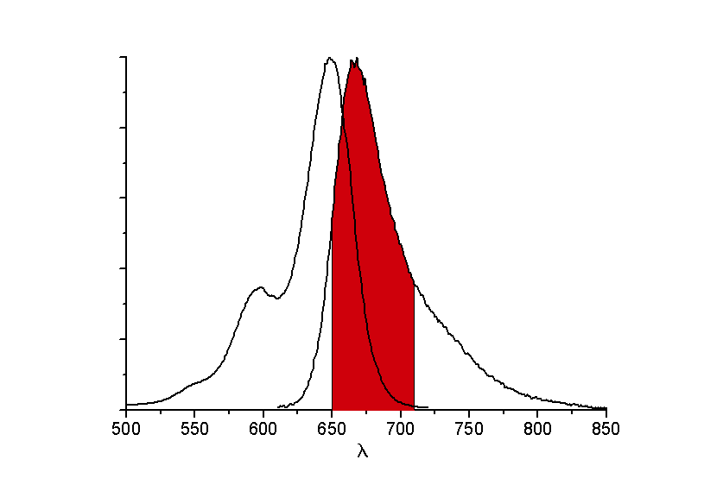
Original Leica STED required selected dyes and wavelengths
Excitation
STED
Detection
Band
Requirements:
Acceptable
photobleaching
No excitation
at λ_{STED}
Limitations:
Could only excite Cy5
Needed expensive pulsed two photon laser

Slide 27
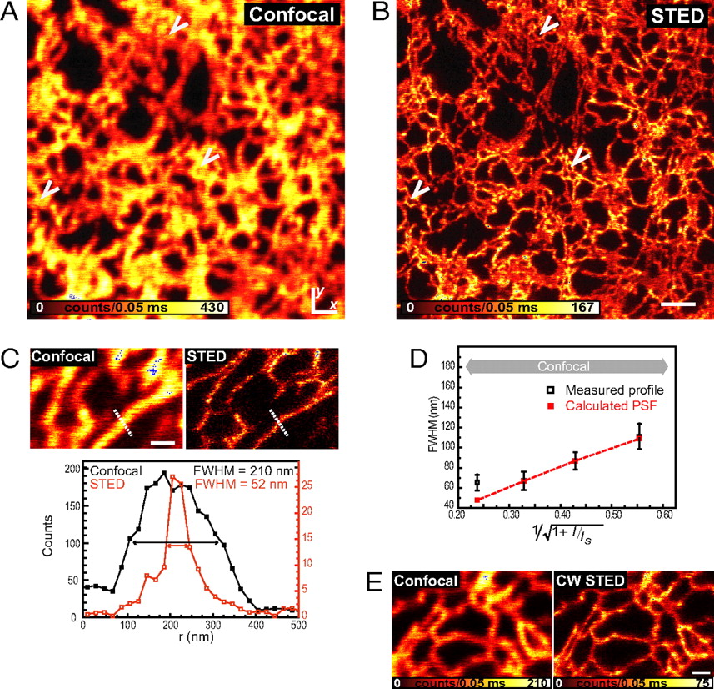
But both limitations were addressed with continuous wavelength (CW) lasers
CW laser needs ~4 x more power than pulsed laser
  Not because less efficient use of photons
  But to continuously illuminate fluorophore
Potentially larger instant fluorescence flux, great for fast STED imaging
Hein, B., Willig, K.I., Hell, S.W., 2008. Stimulated emission depletion (STED) nanoscopy of a fluorescent protein-labeled organelle inside a living cell. Proceedings of the National Academy of Sciences 105, 14271-14276.
Notes:
Living mammalian cell fluorescent protein citrine in ER
http://www.pnas.org/content/105/38/14271.full
Figure 2 legend below.
CW laser power stuff from this paper
http://www.nature.com/nmeth/journal/v4/n11/full/nmeth1108.html
Fig. 2. Subdiffraction-resolution imaging of the ER in a living mammalian cell. Shown are confocal (A) and simultaneously recorded (B) STED (x, y) images from the ER marked by the fluorescent protein Citrine targeted to the ER (raw data: 16.3-mW STED focal intensity). (Scale bar, 1 μm.) The arrows point out rings formed by the tubular network of the ER, which are visible only in the STED image. (C) Confocal and corresponding STED image revealing features of 52-nm FWHM as indicated by the profile below (raw data: 35.7-mW STED focal intensity), indicating that the lateral resolution in the STED image is <50 nm. (Scale bar, 500 nm.) (D) FWHM of the calculated effective STED point-spread function (PSF) and of the measured profile of an ER tubule versus the inverse of the square root of the STED beam intensity I (see Eq. 1). The measured FWHM values are based on 125 line profiles measured per individual value I in 5 different images; the error bars represent the quadratic mean of the respective SDs. For lower STED intensities I, the measured size of the ER elements decreases with the sharpening of the PSF, as expected from the square-root law, whereas for FWHM of ≈60 nm, no further decrease in the FWHM is observed, implying that the ER elements are, on average, ≈60 nm in width. (E) Confocal and corresponding STED image recorded with CW laser beams of 3 μW for excitation and 112 mW for STED (592-nm wavelength) at the sample, revealing tubules as small as 60 nm by STED. (Scale bar, 500 nm.)
In a typical implementation of a scanning STED microscope, a diffraction-limited spot of excitation light is overlaid with a red-shifted doughnut-shaped beam for STED (5). The wavelength of the STED beam is tuned to the red edge of the emission spectrum of the fluorescent marker so that it is able to deexcite the potentially excited molecules through stimulated emission.
Finally, we show in this application that a cost-effective continuous-wave (CW) fiber laser for STED yields a resolving power that is comparable to the one provided by a complex laser system, thus opening a simple and economic pathway to 3D-fluorescence nanoscopy of the living cell interior.

Slide 28
STED focal spot formation - summary
STED focal spot size and resolution depend on:
  Intensity of depletion light
  Quality of central depletion minimum
  There is no fundamental resolution limit
  High energy depletion pulses or CW lasers needed
  Special (pulsed) excitation and depletion lasers needed
  Fluorescence dyes must perform efficient depletion at high
  photostability => selected „STED dyes“
  Low signal + high sampling => relatively slow image aquisition

Slide 29
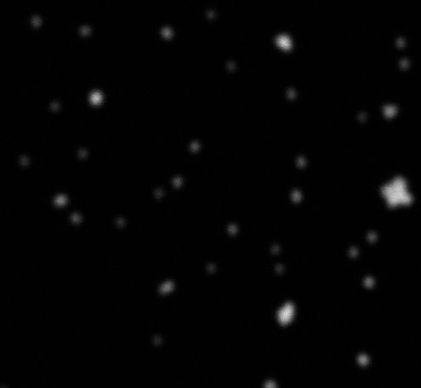
STED example images
65 nm fluorescent beads are not resolved in a Confocal
Confocal

Slide 30
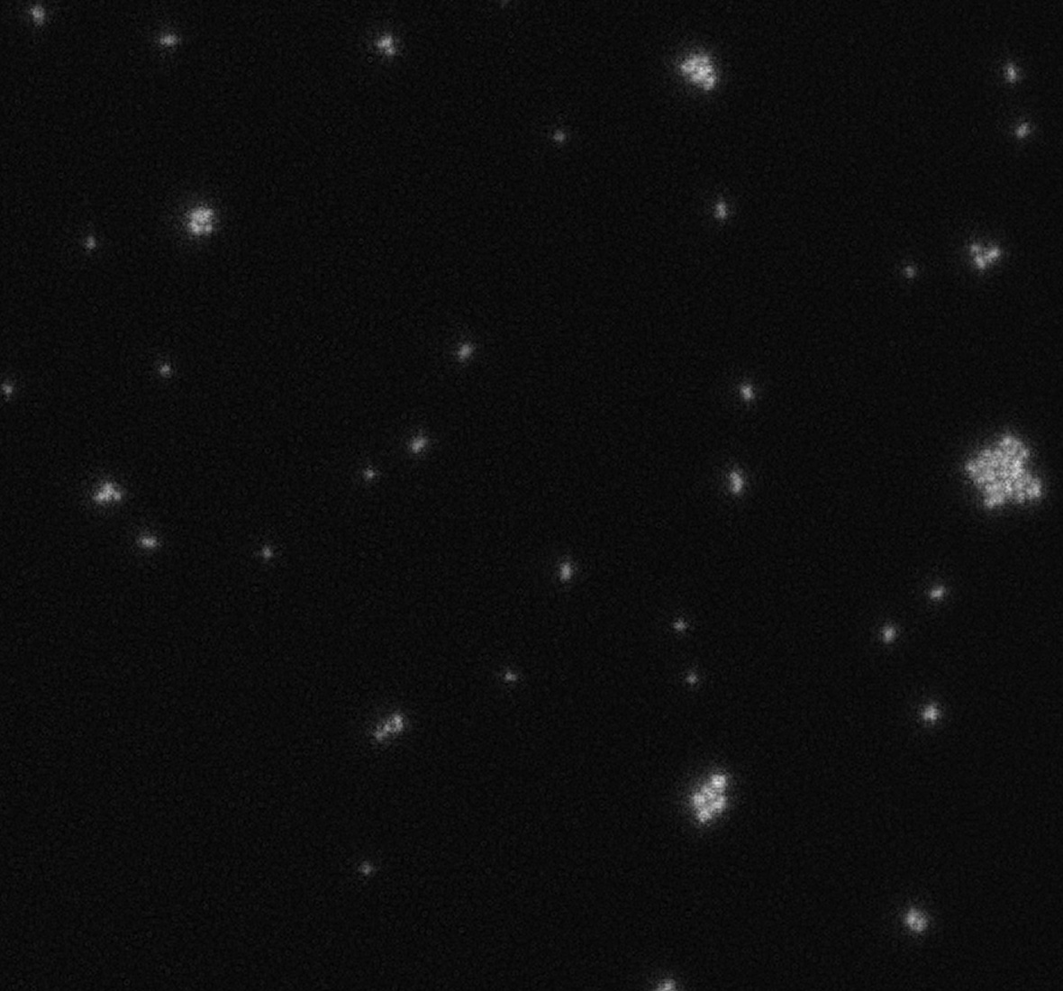
STED example images
65 nm fluorescent beads are resolved with STED
STED

Slide 31
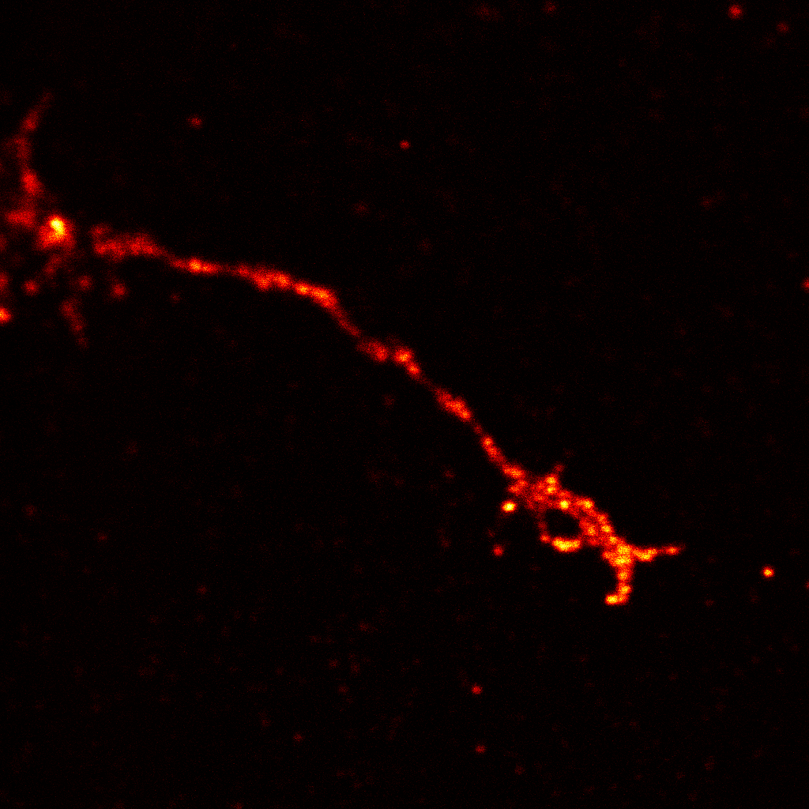
STED example images
Confocal – Neuromuscular Synapses
Substructures
are not resolved
1 micrometer

Slide 32
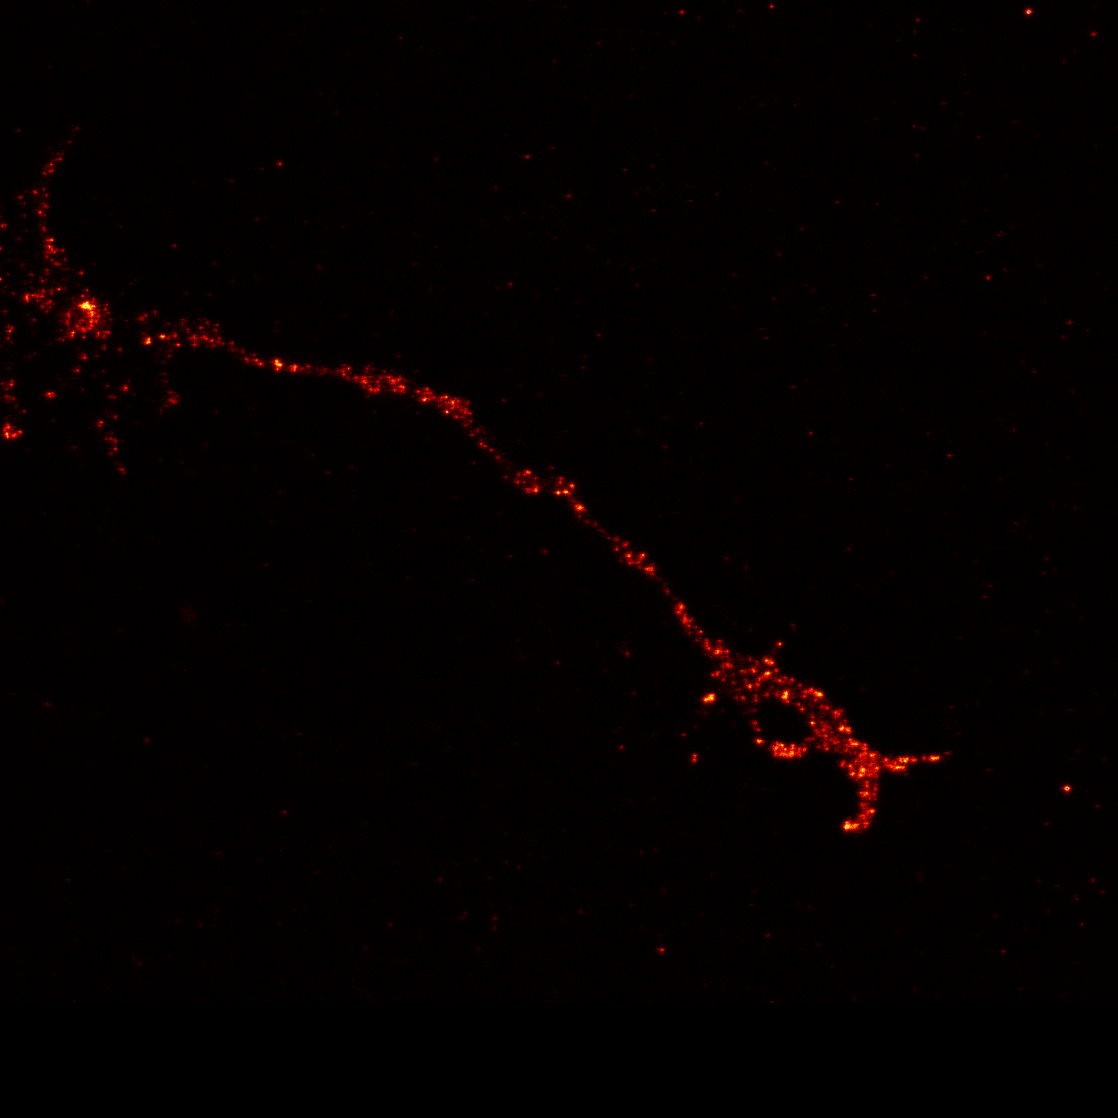
STED example images
STED – Neuromuscular Synapses
STED resolves substructures of presynaptic active zones (Ca channels) Images are taken from Drosophila neuromuscular synapses. Bruchpilot protein stained with
ATTO 647N.
2048x2048 pixels
Courtesy
Stephan Sigrist
Wuerzburg
1 micrometer

Slide 33
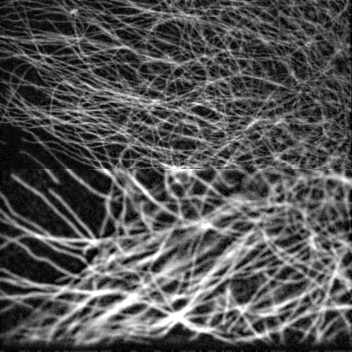
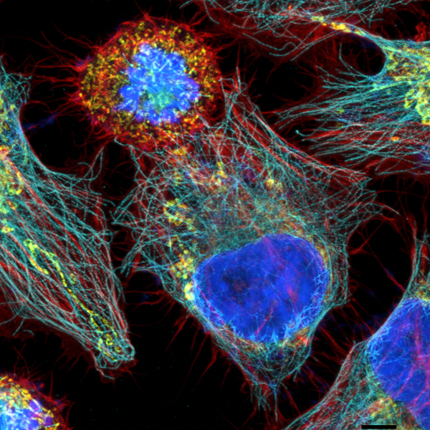
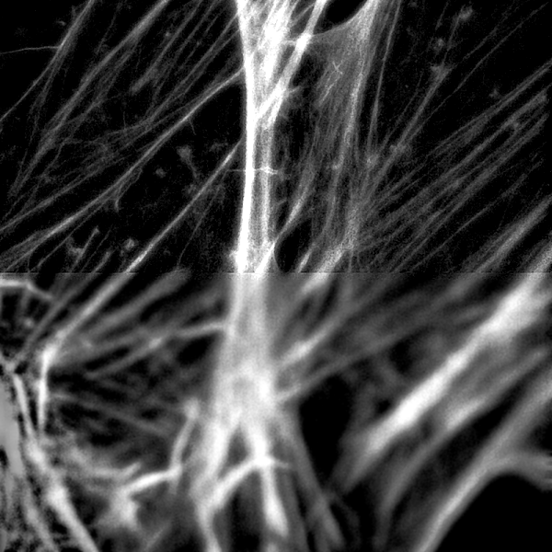
STED example images
STED is combined with multicolor confocal imaging
STED
Tubulin
Confocal
STED
Actin
Confocal
Mouse fibroblasts,
1 micrometer

Slide 34
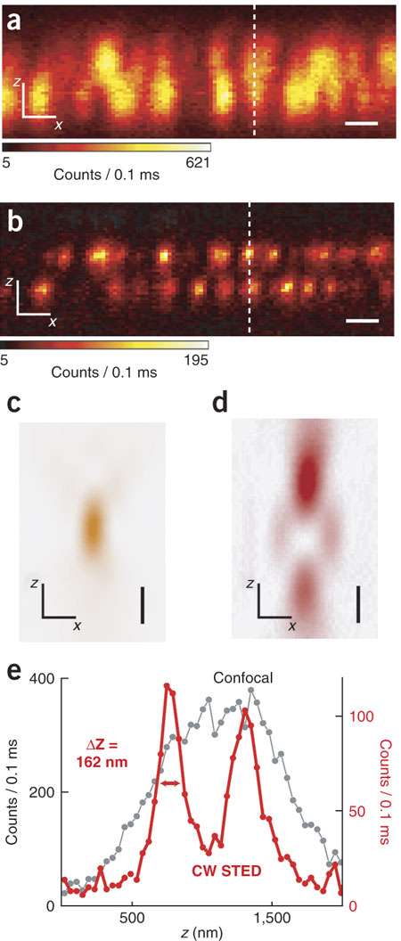
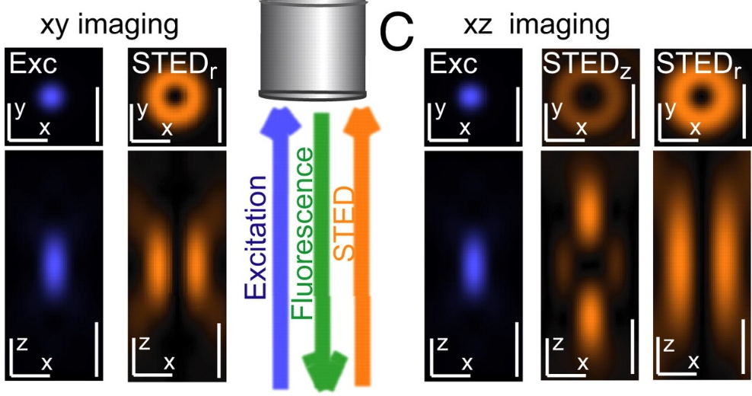
3D STED improves Z resolution
Create axial donut
Willig, K.I., Harke, B., Medda, R., Hell, S.W., 2007. Nat Meth 4, 915-918.
Hein, B., Willig, K.I., Hell, S.W., 2008. PNAS 105, 14271-14276.
Notes:
(a|[ndash]|d) Confocal (a) and CW-STED (b) images of bead clusters recorded with the excitation spot (c) overlapped by an axial STED doughnut (d) improving the resolution primarily along the optic axis (z), but also in the focal plane (x,y). Scale bars, 500 nm. (e) Intensity profiles along the z axis extracted from images in a and b at the dashed lines, quantifying the axial resolution gain in CW STED over confocal microscopy with this doughnut.
http://www.nature.com/nmeth/journal/v4/n11/full/nmeth1108.html
Fig. 1. Schematic showing the use of the excitation and deexcitation (STED) beams for 3D STED imaging inside a living cell. (A) An objective lens focuses the beams (blue, excitation; orange, STED) into the ER while also collecting the resulting beam of fluorescence photons. Images are acquired by translating the focused laser beams through the cell. (B) xy imaging: excitation spot (blue) and cylindrically shaped focal spot (orange) for stimulated emission, squeezing the fluorescent spot in the xy plane (STED_{r} or r-doughnut). Both the lateral (x, y) cross-sections in the focal plane and the axial cross-section (x, z) are shown (Upper and Lower, respectively). (C) xz imaging: excitation spot (blue) and STED spot composition consisting of a spot featuring a maximum above and below the focal plane along the z axis, referred to as STED_{z}, plus an enlarged r-doughnut STED_{r}. All spots represent data calculated by using the experimental conditions applied. (Scale bars, 500 nm.)
http://www.pnas.org/content/105/38/14271/F1.expansion.html
http://www.leica-microsystems.com/products/confocal-microscopes/leica-tcs-sp8-configurable-confocal/details/product/leica-tcs-sp8-sted-3x/#sted3x-3d
http://www.leica-microsystems.com/science-lab/3d-sted-stimulated-emission-depletion-microscopy/

Slide 35
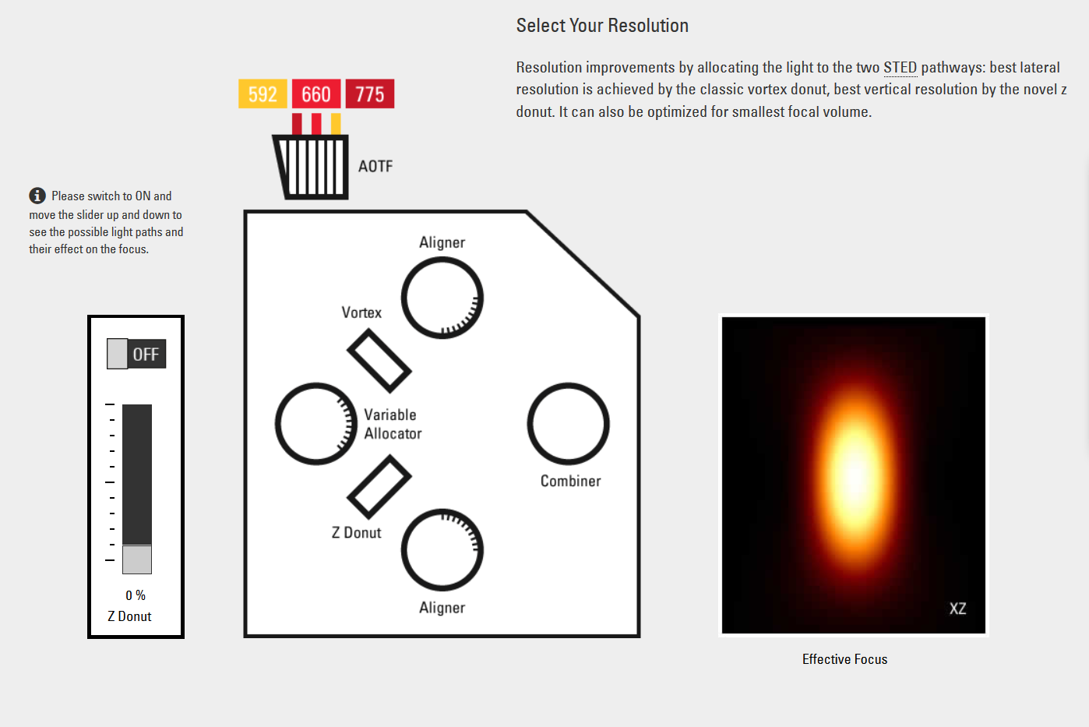
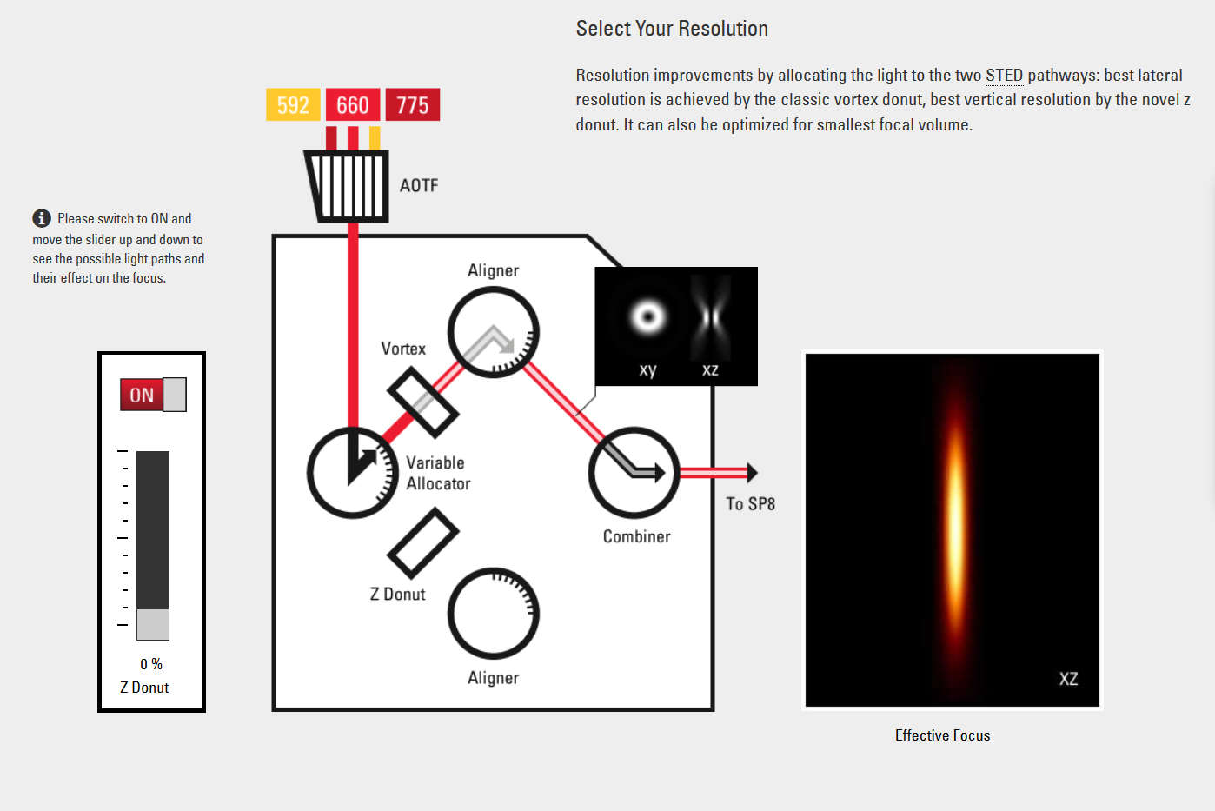
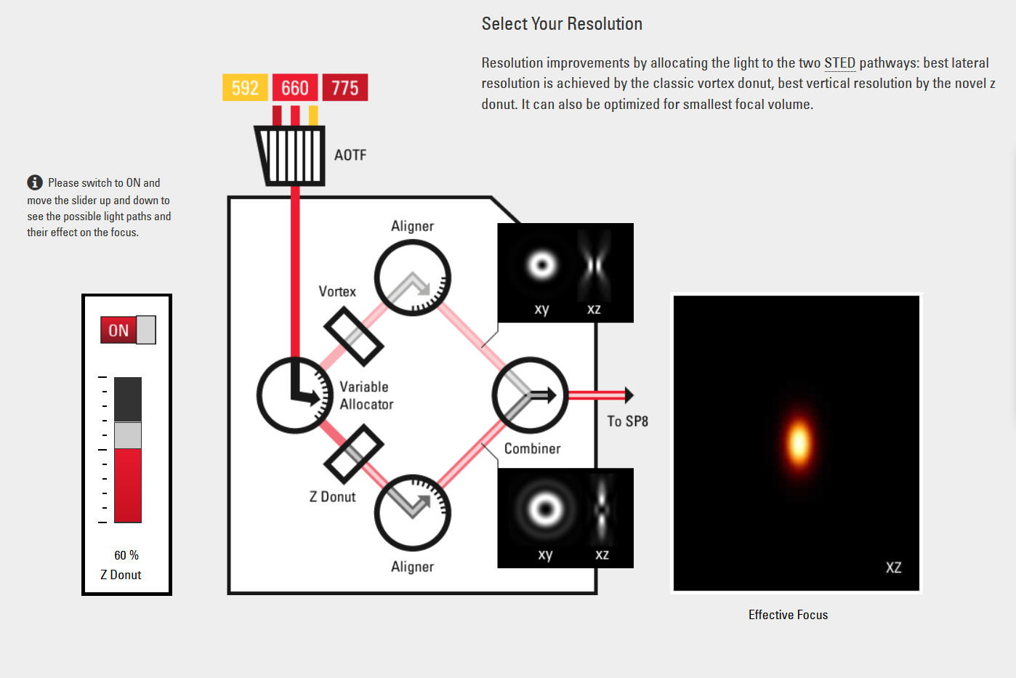
3D STED improves Z resolution
Notes:
http://www.leica-microsystems.com/products/confocal-microscopes/leica-tcs-sp8-configurable-confocal/details/product/leica-tcs-sp8-sted-3x/#sted3x-3d
http://www.leica-microsystems.com/science-lab/3d-sted-stimulated-emission-depletion-microscopy/

Slide 36
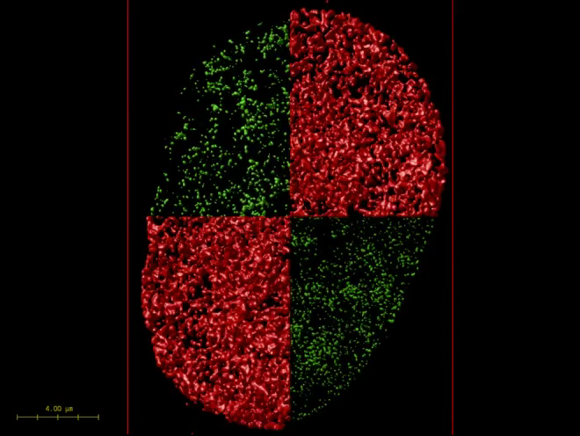
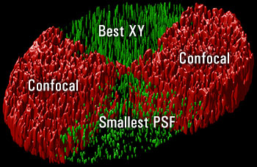
3D STED improves Z resolution

Slide 37
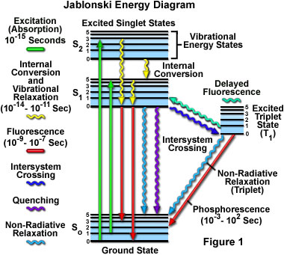
Ground State Depletion (GSD) Microscopy
Can be used on confocal or wide field microscope
Need to be careful not to go from triplet state to bleaching
Oxygen scavengers very helpful to increase triplet state time
Bretschneider, S., Eggeling, C., Hell, S.W., 2007. Breaking the Diffraction Barrier in Fluorescence Microscopy by Optical Shelving. Physical Review Letters 98, 218103.
Notes:
A recovery of the fluorescence is important, because our concept relies on scanning. In other words, the T1 fluorophores need to relax to S0 before the beam moves on. We thus have to balance the shelving time τT, the intersystem crossing rate kISC, and the photobleaching activity.
For example, τT can be increased by decreasing the concentration of molecular oxygen through sample embedding media that contains oxygen scavengers, such as Vectashield. In fact, we found Vectashield to be appropriate for GSD because, as shown in Fig. 1, we readily depleted the fluorescence down to 10% while still having a substantial fluorescence flux during probing.
Photobleaching is known to involve transient dark states, especially the excited levels of these states, as starting points [10,11]. Therefore, the selection of dye-media combinations entailing low photobleaching is mandatory. We surprisingly found effective optical shelving in rather different fluorophore classes, such as atto-, rhodamine-, cyanine-, fluorescein-, bodipy- and alexa dyes, and also in different media, such as Vectashield, poly-vinyl-alcohol, and aqueous solvents, as detailed in the auxiliary material [14]. Optimizing the fluorophores and the mounting media should lead to further improvements in GSD performance. Because of increased spin-orbit coupling, the presence of heavy atoms, such as chloride or bromide, should increase the triplet population [14,15], while additional exposure to near-infrared light may shorten the triplet lifetime by reverse intersystem crossing [16]. Heavy-atom doped fluorophores are expected to facilitate GSD microscopy under aqueous conditions. A different option is to apply low temperatures for increasing both the T1 lifetime and the photostability.
http://journals.aps.org/prl/abstract/10.1103/PhysRevLett.98.218103#fulltext

Slide 38
Intersystem Crossing (ISC) Problem 2: Reactive oxygen
ISC
~0.03
Excited triplet
state
4nsec
0.8 emitted
fluorescence
Phosphorescence
(usec - msec)
Triplet state lifetime shortened by oxygen
(20msec if none; 0.1 usec if oxygen present
Good news: Returns dye to ground state
Bad news: Creates reactive oxygen

Slide 39
“Functional” super-resolution techniques
Deterministic
  Reversible Saturable (or Switchable) OpticaL Fluorescence Transitions (RESOLFT)
    STimulated Emission Depletion (STED)
    Ground State Depletion (GSD)
Stochastic
  STochastic Optical Reconstruction Microscopy (STORM)
  Photo Activated Localization Microscopy (PALM)
  Fluorescence Photo-Activation Localization Microscopy (FPALM)
Notes:
A trio of techniques independently surfaced during a four-month period in 2006 that elegantly demonstrated the sequential and stochastic readout with precise localization of multiple single molecules from specimens that were fluorescently labeled with photoswitchable dyes or optical highlighter fluorescent proteins at densities approaching those commonly employed in widefield and confocal fluorescence microscopy (ranging up to 100,000 molecules per square micrometer). These nearly identical single-molecule superresolution imaging techniques have been termed stochastic optical reconstruction microscopy (STORM; see Figure 1), photoactivated localization microscopy (PALM), and fluorescence photoactivation localization microscopy (FPALM). They rely on an activation laser applied at low power to trigger emission switching so that any particular molecule has a small probability of being photoactivated, but the majority of the population remains in the original (dark or native) emissive state. Although the major difference between the methods as they were originally published was simply the nature of the fluorescent probes used to achieve superresolution imaging, these techniques are virtually identical. In fact, the original STORM research report mentioned the use of fluorescent proteins, whereas the first PALM paper discussed the application of caged synthetic fluorophores.
http://www.microscopyu.com/articles/superresolution/stormintro.html
These three methods were published independently during a short period of time and their principle is identical. STORM was originally described using Cy5 and Cy3 dyes attached to nucleic acids or proteins,^{[47]} while PALM and FPALM was described using photoswitchable fluorescent proteins.^{[48][49]}
http://en.wikipedia.org/wiki/Super-resolution_microscopy#Stochastic_functional_techniques
They fall into two broad categories, "true" super-resolution techniques, which capture information contained in evanescent waves, and "functional" super-resolution techniques, which use clever experimental techniques and known limitations on the matter being imaged to reconstruct a super-resolution image.^{[2]}
True subwavelength imaging techniques include those that utilize the Pendry Superlens and near field scanning optical microscopy, the 4Pi Microscope and structured illumination microscopy technologies like SIM and SMI. However, the majority of techniques of importance in biological imaging fall into the functional category.
There are two major groups of methods for functional super-resolution microscopy:
Deterministic super-resolution: The most commonly used emitters in biological microscopy, fluorophores, show a nonlinear response to excitation, and this nonlinear response can be exploited to enhance resolution. These methods include STED, GSD, RESOLFT and SSIM.
Stochastic super-resolution: The chemical complexity of many molecular light sources gives them a complex temporal behaviour, which can be used to make several close-by fluorophores emit light at separate times and thereby become resolvable in time. These methods include SOFI and all single-molecule localization methods (SMLM) such as SPDM, SPDMphymod, PALM, FPALM, STORM and dSTORM.

Slide 40
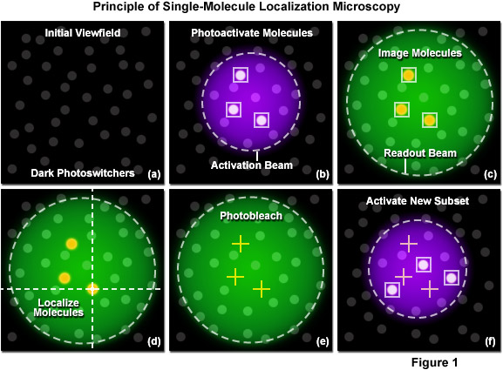
Single-molecule localization (SML) microscopy
Stochastic functional techniques
Notes:
http://zeiss-campus.magnet.fsu.edu/articles/superresolution/palm/practicalaspects.html
http://www.microscopyu.com/articles/superresolution/stormintro.html

Slide 41
Single-molecule localization microscopy
Stochastic functional techniques
STED vs STORM
How STORM works

Slide 42
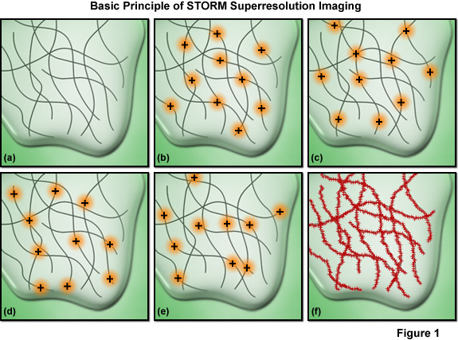
Single-molecule localization microscopy
Must have sufficient density of molecules being localized
Notes:
Among the critical aspects that must be considered are the accuracy of each individual localization measurement, the density of probes that have been localized in the final image (commonly termed molecular density), and the physical size of the labels themselves. The relationship between resolution and the localization precision of a single molecule is readily determined. The ability to resolve two fluorescent molecules as separate entities is limited by the localization precision, which determines the position (and uncertainty) of each molecule and thus the distance between the pair. The localization precision, in turn, is primarily dependent upon the number of photons collected from the fluorescent molecules during a single activation-deactivation cycle, provided the background noise is negligible.
Presented in Figure 7 is an important concept involving one of the most critical factors influencing spatial resolution in single-molecule superresolution imaging. The resolution versus molecular density is represented in Figure 7 as a series of yellow pixels in a test pattern. Features that might be present in a specimen are imaged at a progressively lower signal-to-noise ratio (fraction of pixels measured) as the molecular density decreases (from the bottom to the top of Figure 7) and these features become unresolvable when the mean molecular separation approaches feature size (the top row in Figure 7). Thus, as described in Equation (5), in order to achieve N-fold higher resolution in dimensions D, N^{D}-fold more pixels must be acquired. In order to realize such a resolution gain without compromising either the imaging speed or the signal-to-noise ratio, the signal collection rate (photons detected per second) must increase by a factor of at least N^{D}, which requires an N^{D}-fold higher exposure to the excitation laser for each image required.

Slide 43
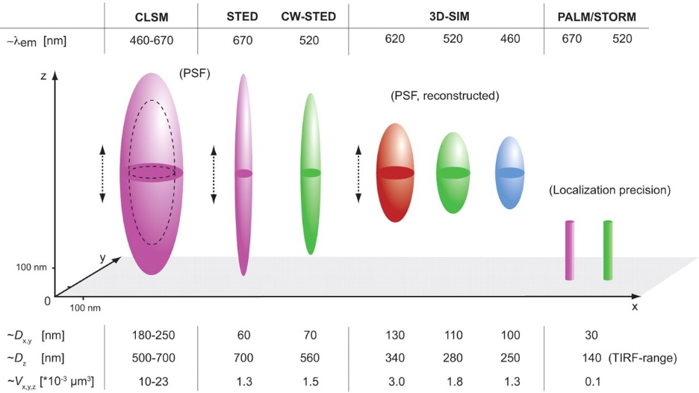
Each super-resolution techniques have pluses and minuses but all methods are improving
Schermelleh, L., Heintzmann, R., Leonhardt, H., 2010. A guide to super-resolution fluorescence microscopy. The Journal of Cell Biology 190, 165-175.
Notes:
http://jcb.rupress.org/content/190/2/165.full

Slide 44


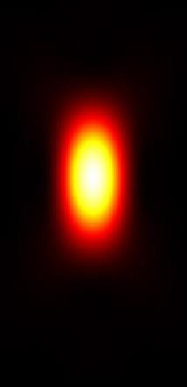

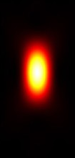

Evolution of Super-resolution Microscopy
100 nm
X
Z
Confocal
SIM
STED
Single- molecule localization (SML)
XY resolution:
Z resolution:
250 nm
500-700 nm
100-130 nm
250-350 nm
40-60 nm
100-700 nm
20-30 nm
50-80 nm

Slide 45
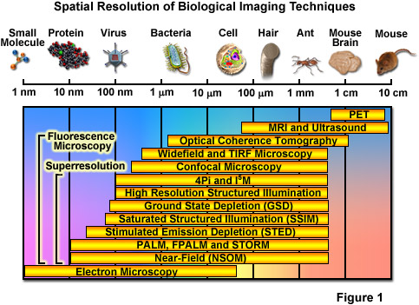
Spatial Resolution of Biological Imaging Techniques
“True” super-resolution
“Functional”
Notes:
http://zeiss-campus.magnet.fsu.edu/articles/superresolution/introduction.html

Slide 46
One problem with all super-resolution techniques?

Slide 47
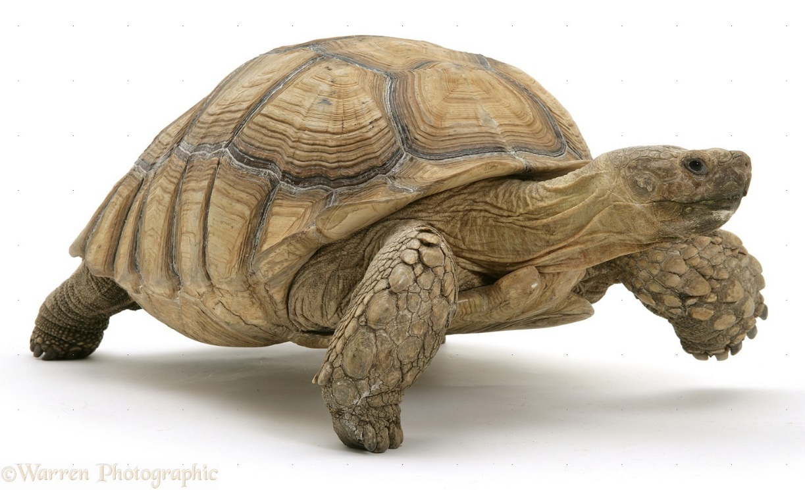
One problem with all super-resolution techniques?
They are slow

Slide 48
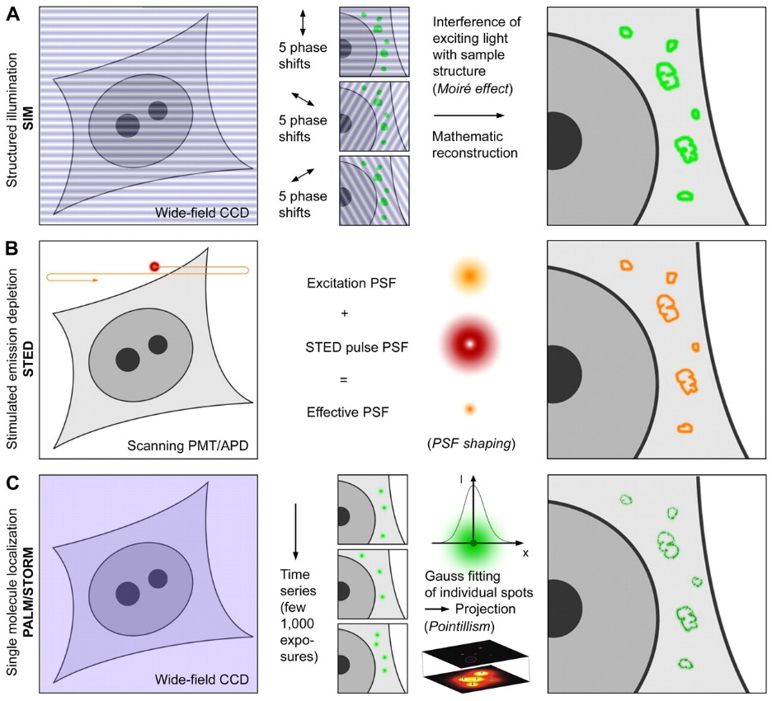
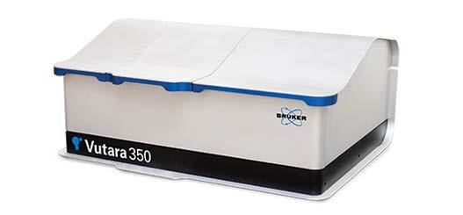
But many techniques getting faster and being used for live imaging
STED
Structured illumination microscopy (SIM)
PALM/STORM
Notes:
http://jcb.rupress.org/content/190/2/165.full

Slide 49
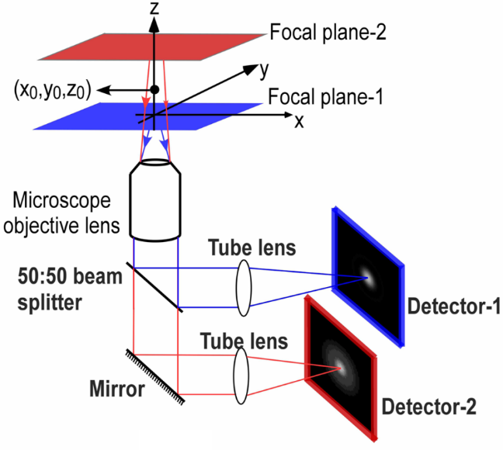
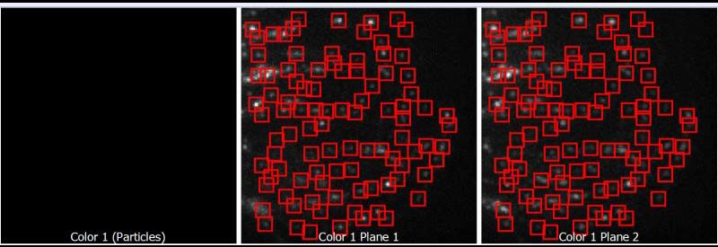
Bruker vutara imaging two focal planes at once
Biplane imaging increases speed
Schematic of MUM (Multifocal plane microscopy)
Notes:
"Schematic diagram of a multifocal plane microscope" by Sripad Ram - For Ward Ober Lab websitePreviously published: http://www4.utsouthwestern.edu/wardlab/index.asp. Licensed under CC BY-SA 3.0 via Wikipedia - http://en.wikipedia.org/wiki/File:Schematic_diagram_of_a_multifocal_plane_microscope.PNG#mediaviewer/File:Schematic_diagram_of_a_multifocal_plane_microscope.PNG
http://en.wikipedia.org/wiki/Multifocal_plane_microscopy

Slide 50
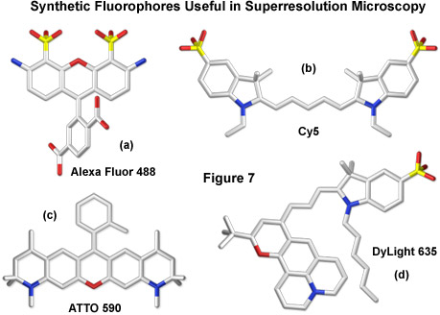


Sample Labeling Choices for PALM/STORM (SML) Imaging
Organic dyes or Genetically encoded fluorescent proteins
Organic dyes generally preferred for SML labeling over fluorescent proteins since they emit more photons.
Fluorescent proteins are live cell compatible
c
c
Notes:
http://zeiss-campus.magnet.fsu.edu/articles/superresolution/palm/introduction.html
http://www.microscopyu.com/articles/superresolution/stormintro.html

Slide 51
Single Molecule Localization Probes
Preferred Organic Dyes
Excitation Laser Line (nm) | Dye | Excitation Maximum (nm) | Emission Maximum (nm)
488 | ATTO 488 | 501 | 523
 | Alexa 488 | 495 | 519
561 | Cy3B | 559 | 570
 | Alexa 568 | 578 | 603
 | Alexa 555 | 555 | 580
640 | Alexa 647 | 650 | 665
 | Cy5 | 649 | 670
 | DyLight 650 | 652 | 672
750 | Alexa 750 | 749 | 775
 | DyLight 755 | 754 | 776

Slide 52
Photoswitchable Fluorescent Proteins (Genetically-Encoded)
Probe | Type | λ_{PA} (nm) | λ_{X} (nm) | λ_{EM} (nm) | Variants
PSCFP2 | 0→A (Irrev) | Violet (~400) | 490 | 511 | PSCFP
PA-GFP | 0→A (Irrev) | Violet | 504 | 517
Dronpa | 0→A (Rev*) | *activ. w violet quench w blue | 503 | 518 | Fastlime, Dronpa3
Dendra2 | A→B (Irrev) | Violet-Blue | 553 | 573 | Dendra
EosFP | A→B (Irrev) | Violet | 569 | 581 | mEos3.2, tdEos
Kaede | A→B (Irrev) | Violet | 572 | 580
KikGR | A→B (Irrev) | Violet | 583 | 593
PAmCherry | 0→A (Irrev) | Violet | 564 | 595 | 1&2

Slide 53

Combining the best of organic dyes and Fluorescent Proteins: SNAP, CLIP and Halo Tags
New labeling technologies are being developed to exploit the best features of organic dyes and genetically encoded proteins
https://www.neb.com/tools-and-resources/feature-articles/snap-tag-technologies- novel-tools-to-study-protein-function

Slide 54

Combining the best of organic dyes and Fluorescent Proteins: SNAP, CLIP and Halo Tags
Imaging proteins inside cells with fluorescent tags
Crivat & Taraska. Trends in Biotechnology. 30, 8-16 (2012)

Slide 55
Original References for SNAP, CLIP and Halo Tags
SNAP Tag: Keppler et al. A general method for the covalent labeling of fusion proteins with small molecules in vivo. Nat. Biotechnology. 21, 86-89 (2003)
CLIP Tag: Gautier et al. An engineered protein tag for multiprotein labeling in living cells. Chemistry & Biology 15, 128-136 (2008)
Halo Tag: Los et al. HaloTag: A Novel Protein Labeling Technology for Cell Imaging and Protein Analysis. ACS Chemical Biology 3, 373-382 (2008)
Notes:
Gautier, A., Juillerat, A., Heinis, C., Corrêa Jr, I.R., Kindermann, M., Beaufils, F., Johnsson, K., 2008. An Engineered Protein Tag for Multiprotein Labeling in Living Cells. Chemistry & Biology 15, 128-136.
Keppler, A., Gendreizig, S., Gronemeyer, T., Pick, H., Vogel, H., Johnsson, K., 2003. A general method for the covalent labeling of fusion proteins with small molecules in vivo. Nat Biotech 21, 86-89.
Los, G.V., Encell, L.P., McDougall, M.G., Hartzell, D.D., Karassina, N., Zimprich, C., Wood, M.G., Learish, R., Ohana, R.F., Urh, M., Simpson, D., Mendez, J., Zimmerman, K., Otto, P., Vidugiris, G., Zhu, J., Darzins, A., Klaubert, D.H., Bulleit, R.F., Wood, K.V., 2008. HaloTag: A Novel Protein Labeling Technology for Cell Imaging and Protein Analysis. ACS Chemical Biology 3, 373-382.
http://www.nature.com/nbt/journal/v21/n1/full/nbt765.html
http://www.sciencedirect.com/science/article/pii/S1074552108000410
http://pubs.acs.org/doi/full/10.1021/cb800025k

Slide 56



Live-cell Imaging using mEos3.2
Biological System: Live HeLa Cell
Label: mEos3.2-clathrin light chain
Imaged at 600 fps for 58 s
2 seconds per SR image
Imaged in PBS
Adapted from Huang et al. Nat. Meth. 10, 653-658 (2013)
Notes:
Super-resolution image of mEos3.2-labeled clathrin-coated pits (CCPs) in a live HeLa cell. The localization estimates are colored according to their recording time. (b) The enlarged image of the area marked by the yellow box in a reveals that movements of the structures over the course of recording obscure the details in the image. (c) Rings representing axial projections of CCPs can be resolved when only a 2-s time window of the data is displayed. (d–f) Peroxisome dynamics in a live COS-7 cell labeled by tdEos. (d) Overview image of an 83-s data set. Data have been colored as in a. (e) Super-resolution images (top) and maximum projections (bottom) of the raw data from the area in the green box in d in 0.5-s time intervals. (f) Super-resolution images at 0.5-s time resolution of the area highlighted by the blue box in d. See also Supplementary Figure 11 and Supplementary Videos 1,2,3,4,5 and 8.
Video 3: Super-resolution video for a small cutout of a larger data set of mEOS3.2-labeled CCPs in a live HeLa cell (1) (55,160 KB, Download) Raw data were recorded as described in the Online Methods. Acquired images were analyzed using single-emitter fitting (Online Methods). 1,200 frames were combined to reconstruct each super-resolution image corresponding to a 2-s time window. Localization estimates in each image were binned into 10-nm pixels for display. To generate the video, we combined all 28 super-resolution images into a 3D data stack and smoothed with a 3D Gaussian kernel with σ_{x,y} = 10 nm and σ_{t} = 2 s to aid visualization. The resulting stack was converted into a video playing back at 15 frames per second. Scale bar, 500 nm.
Video 4: Super-resolution video for a small cutout of a larger data set of mEOS3.2-labeled CCPs in a live HeLa cell (2) (37,431 KB, Download) This video corresponds to the data set shown in Figure 3a–c. Raw data were recorded as described in the Online Methods. Acquired images were analyzed using single-emitter fitting (Online Methods). 1,200 frames were combined to reconstruct each super-resolution image corresponding to a 2-s time window. Localization estimates in each image were binned into 10-nm pixels for display. To generate the video, we combined all 19 super-resolution images into a 3D data stack and smoothed with a 3D Gaussian kernel with σ_{x,y} = 10 nm and σ_{t} = 2 s to aid visualization. The resulting stack was converted into a video playing back at 15 frames per second. Scale bar, 500 nm.
http://www.nature.com/nmeth/journal/v10/n7/full/nmeth.2488.html

Slide 57
Live-cell Imaging using mEos3.2
Notes:
Video 1: Super-resolution video of mEOS3.2-labeled CCPs in a live HeLa cell (105,080 KB, Download) Raw data were recorded as described in the Online Methods. Acquired images were analyzed using single-emitter fitting (Online Methods). 1,200 frames were combined to reconstruct each super-resolution image corresponding to a 2-s time window. Localization estimates in each image were binned into 20-nm pixels for display. To generate the video, we combined all 40 super-resolution images into a three-dimensional (3D) data stack and smoothed with a 3D Gaussian kernel with σ_{x,y} = 20 nm and σ_{t} = 2 s to aid visualization. The resulting stack was converted into a video playing back at 15 frames per second. Scale bar, 5 μm.
http://www.nature.com/nmeth/journal/v10/n7/full/nmeth.2488.html#supplementary-information

Slide 58


Super-resolution fluorescence imaging of organelles in live cells with photoswitchable membrane probes
Conventional Super-resolution Conventional Super-resolution
the plasma membrane labeled with DiI in a hippocampal neuron (15 sec)
mitochondria labeled with MitoTracker Red in a BS-C-1 cell (10 sec)
the ER labeled with ER-Tracker Red in a BS-C-1 cell (10 sec)
lysosomes labeled with LysoTracker Red in a BS-C-1 cell (1 sec)
Scale bars, 1 μm.
Shim et al. PNAS. 109, 13978-13983 (2012)

Slide 59

Super-resolution imaging in live Caulobacter crescentus cells using photoswitchable EYFP
Biteen et al. Nat. Methods. 5, 947-949 (2008)
Notes:
http://www.nature.com/nmeth/journal/v5/n11/full/nmeth.1258.html

Slide 60
Super-resolution Techniques
Direct STochastical Optical Reconstruction Microscopy (dSTORM)
  Basically another form of GSD Microscopy
Points Accumulation for Imaging in Nanoscale Topography (PAINT)
  Shift in emission spectra when binds target
interferometric PhotoActivated Localization Microscopy (iPALM)
  Combines PALM with simultaneous multiphase interferometry
Notes:
another strategy to achieve super-resolution (Sharonov and Hochstrasser, 2006). It takes
advantage of changes in fluorescence parameters (shift in emission spectrum) of a fluorescence label (Nile Red) as induced upon its binding to an intracellular target (hydrophobic membrane). The method was named PAINT (Points Accumulation for Imaging in Nanoscale Topography). Since then many schemes to control active fluorophore concentrations have been developed
http://www.pnas.org/content/103/50/18911.full
dSTORM another name for GSD
iPALM
http://www.pnas.org/content/106/9/3125.full

Slide 61
Super-resolution requirements
High power lasers
Special fluorophores
Concentration of fluorophores
Special optics
Computational processing
Fast detectors
Sensitive detectors
Precise X,Y,Z positioning

Slide 62
Performance range of optical microscopy
SIM/STP
MRI
OCT
SPIM
Depth
(um)
CLSM
LM
NSOM
TIRF
Resolution
(um)
Notes:
serial two-photon (STP) tomography
http://www.nature.com/nature/journal/v508/n7495/full/nature13186.html#methods
http://www.nature.com/nmeth/journal/v9/n3/full/nmeth.1854.html

Slide 63

Homework 5
There are so many different ways to do super-resolution microscopy. Interestingly, an entirely novel method was just published this year in Science called expansion microscopy.
Question: What makes this super-resolution technique so novel compared to all the others?
Hint: see this figure from Ke, M.-T., Fujimoto, S., Imai, T., 2013. Nat Neurosci 16, 1154-1161.

Slide 64

Expansion microscopy
Well-known property of polyelectrolyte gels, dialyzing them in water causes expansion of polymer network into extended conformations
Transparent because mostly water
Notes:
Fig. 1 Expansion microscopy (ExM) concept. (A) Schematic of (i) collapsed polyelectrolyte network, showing crosslinker (dot) and polymer chain (line), and (ii) expanded network after H₂O dialysis. (B) Photograph of fixed mouse brain slice. (C) Photograph, post-ExM, of the sample (B) under side illumination. (D) Schematic of label that can be anchored to the gel at site of a biomolecule. (E) Schematic of microtubules (green) and polymer network (orange). (F) The label of (D), hybridized to the oligo-bearing secondary antibody top (top gray shape) bound via the primary (bottom gray shape) to microtubules (purple), is incorporated into the gel (orange lines) via the methacryloyl group (orange dot) and remains after proteolysis (dotted lines). Scale bars, (B) and (C) 5 mm. Schematics are not to scale.
http://www.sciencemag.org/content/347/6221/543.full

Slide 65

Expansion microscopy
Morphology excellent
Clathrin-coated pits (M,N)
Isotropy
Notes:
http://www.sciencemag.org/content/347/6221/543.full

Slide 66
Homework 6
We have looked at several different methods for optical sectioning of fluorescent samples. The two main methods are Laser Scanning Confocal Microscopy (LSCM) and light sheet microscopy or Selective Plane Illumination Microscopy (SPIM). LSCM has been around a long time compared to SPIM.
Question: Do you think that SPIM will replace LSCM or are these techniques complementary?

Slide 67

Schermelleh, L., Heintzmann, R., Leonhardt, H., 2010. A guide to super-resolution fluorescence microscopy. The Journal of Cell Biology 190, 165-175.
Notes:
http://jcb.rupress.org/content/190/2/165.full

Slide 68

Super-resolution structured illumination microscopy (SR-SIM)
The visualization of fine spatial information via moiré fringes is illustrated by Figure 6, where panel (a) consists of fine spatial details of a portrait of Ernst Abbe that, upon mixing with the linear structure from panel (b), results in lower frequency moiré fringes that make the portrait much easier to recognize, as seen in Figure 6(c).
Notes:
Lateral resolution can be increased over the classical Abbe limit by a factor of two (approximately 100 to 120 nanometers) in structured illumination without discarding any emission light using laser-generated spatially structured illumination coupled to a widefield fluorescence microscope in what is termed superresolution (SR) SIM. Similar to the non-linear superresolution technique of SSIM described above, the linear SR-SIM structured light wavefronts render normally inaccessible high-resolution information available in the form of moiré fringes that contain harmonic frequencies from the specimen that are not available in conventional fluorescence microscopy. Thus, if two fine patterns are superposed in a multiplicative fashion, a beat pattern (moiré fringes) will appear in their product. In this case, one of the patterns is the spatial fluorophore distribution in the specimen and the other is the structured excitation light intensity.
http://zeiss-campus.magnet.fsu.edu/articles/superresolution/introduction.html
http://zeiss-campus.magnet.fsu.edu/articles/superresolution/supersim.html

