Slide 1
Biology 177: Principles of Modern Microscopy
Lecture 14:
Single Molecule Imaging

Slide 2
Lecture 14: Single molecule imaging
Review of Super resolution technique
  NSOM
FRAP/FLIP
Fluorescence fluctuation spectroscopy (FFS)
  Fluorescence correlation spectroscopy (FCS)
    Some concrete examples of what we can learn
  Fluorescence cross correlation spectroscopy (FCCS)
  Photon counting histogram (PCH)
Total internal reflection fluorescence microscopy (TIRFM)

Slide 3
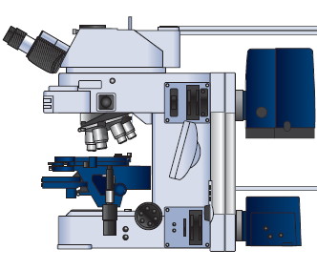
NSOM, like far-field, is amenable to different contrast methods
Absorption
Polarization
Refractive index
Reflected Light
Fluorescence
Spectral imaging
Reflected
Transmitted Light
Notes:
Betzig, E., Trautman, J.K., 1992. Near-Field Optics: Microscopy, Spectroscopy, and Surface Modification Beyond the Diffraction Limit. Science 257, 189-195.

Slide 4
Direct imaging of single molecule with NSOM (1993)
Instrument described in 1992 Science paper
Shear force mode with non-optical feedback
In 1993 Eric Betzig and Robert Chichester used NSOM for repetitive single molecule imaging, DiI
Notes:
carbocyanine dye
In 1993, this situation changed markedly when Eric Betzig and Robert Chichester reported the first repetitive imaging of single fluorophores at room temperature with a new technique called near-field scanning optical microscopy (NSOM) that repeatedly scans an extremely small optical probe over a sample. This provided molecule-scale spatial localization and information on molecular orientation. The potential biological applications of single-molecule imaging captured the imaginations of microscopists and biologists alike, but because of its invasiveness and complexity NSOM proved largely unsuitable for complex biological samples.
http://www.sciencemag.org/content/257/5067/189.abstract?sid=78a939a7-a92c-4260-a999-85346db22447
Betzig, E., Trautman, J.K., 1992. Near-Field Optics: Microscopy, Spectroscopy, and Surface Modification Beyond the Diffraction Limit. Science 257, 189-195.
http://www.sciencemag.org/content/262/5138/1422.short
Betzig, E., Chichester, R.J., 1993. Single Molecules Observed by Near-Field Scanning Optical Microscopy. Science 262, 1422-1425.
http://www.nature.com/milestones/milelight/full/milelight17.html
Fig. 1. Near-field scanning optic
microscopy : conception and real­ ity. (A) As originally conceived ( 10), an illuminated aperture acts as a light source of subwavelength dimensions that can be scanned close to an object to generate a superresolution image. (B) As we implemented it, the aperture is at the end of a sharp probe,and shear forces between the tip and sample
are measured to automatically control the relative separation for scanning rough surfaces . The scan
head is designed as an attachment to a commercial optical microscope, which results in a wide range of possible magnifications . The near-field signal can also be partitioned to obtain information from several contrast mechanisms at once.

Slide 5
Fluorescence correlation spectroscopy (FCS)
In 1972 Watt Webb’s laboratory at Cornell put fluorescence microscopy to new use
Studied reaction kinetics
Ethidium bromide binding to DNA
  Individually don’t fluoresce but together glow under UV
Could detect single molecules but could not repeatedly detect the same molecule
Notes:
http://www.nature.com/milestones/milelight/full/milelight10.html
1990 invented two photon confocal microscopy

Slide 6
Fluorescence Fluctuation Spectroscopy (FFS)
Fluorescence Correlation Spectroscopy (FCS)
Photon Counting Histogram (PCH)
Fluorescence Cross-Correlation Spectroscopy (FCCS)
  FCS with more than 1 color

Slide 7
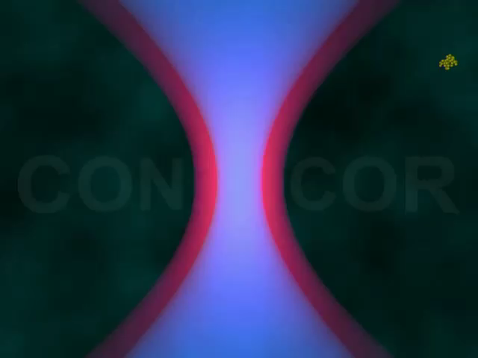
Fluorescence Fluctuation Spectroscopy (FFS)
Causes of fluctuations
Diffusion of labeled molecules due to Brownian motion
  In cells wide range of things cause movement (cellular trafficking, protein interaction etc.)
Photophysical processes of labeled molecules

Slide 8
Fluctuations Carry the Information
Measured intensity fluctuations reflects (mobile fraction only)
  Number of particles
    concentration
  Diffusion of particles
    interaction
  Brightness
    Oligomerization
A particle that transits the confocal volume will generate groups of pulses.
  The correlation function calculates the mean duration time t of these groups.
  The variance/histogram of the signal yields information about oligomeric state
δI(t)
<I(t)>
δI(t)
FCS
PCH
Notes:
The principle of FCS is being able to observe one or a few fluorescent particles enter and leave a small illuminated volume. If the sample, solution or cell, has a high concentration of tagged molecules it becomes hard to observe the needed fluctuations. I generally give the analogy of a crowded lecture hall. If the lecture hall is crowded and you were observing the lecture hall you would be less apt to notice if some one entered or left the room (i.e. a small fluctuation from the mean number of people in the hall). If only a few people were in the hall, then if someone left it would be very easy to notice (i.e. a large fluctuation from the mean number of people in the hall). This is why a large immobile population is not good for FCS. Fluctuations about the mean intensity is the information used for all FFS techniques.

Slide 9
Fluorescence Fluctuation Spectroscopy (FFS)
Bacia et al., Nature Methods 2006
Notes:
Bacia, K., Kim, S.A., Schwille, P., 2006. Fluorescence cross-correlation spectroscopy in living cells. Nat Methods 3, 83-89.

Slide 10
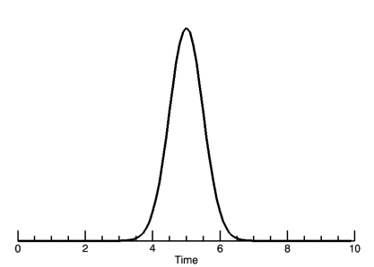
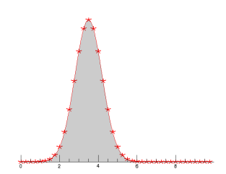
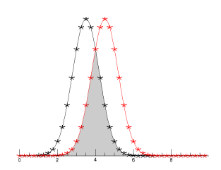
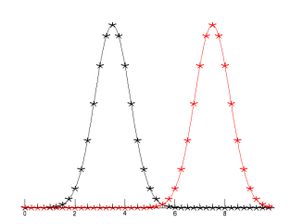
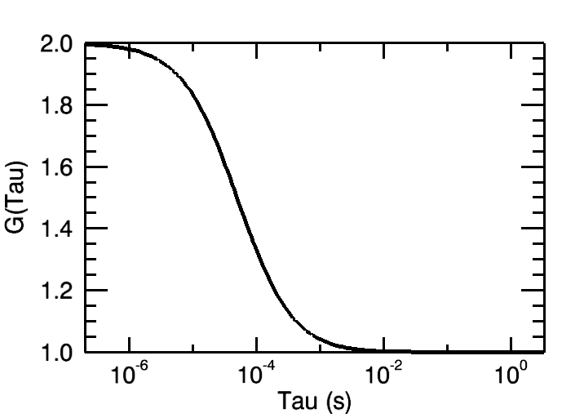
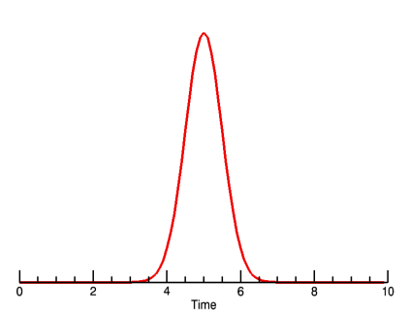
Creating the Autocorrelation Function
τ=0
τ=τ_{D}
τ=inf
Photon Burst
δI(t)
δI(t+τ)
“Copy” signal
Notes:
The fluctuations generated can be analyzed in many ways. FCS relies on the auto-correlation function which is a signal processing technique. The autocorrelation compares a signal against itself. In this case, a particle enters the focal volume and generates a photon burst. The collected signal is “copied” and the two copies are compared against one another as you shift the “copy” in time. The copy signal is shifted by some amount of time given by the greek symbol tau. All data analysis will be done in reference to the shift time tau.

Slide 11
FCS Correlation Function
The correlation function
CF G(τ)
amplitude: number of molecules
Decay time: diffusion time
offset: very slow processes

Slide 12
Autocorrelation Function
Factors influencing the fluorescence signal:
κQ = quantum yield and detector sensitivity (how bright is our probe). This term could contain the fluctuation of the fluorescence intensity due to internal processes
C(r,t) is a function of the fluorophore concentration over time. This is the term that contains the “physics” of the diffusion processes
W(r) describes our
observation volume
Notes:
Lecture 5
FCS, Autocorrelation, PCH, Cross-correlation
Enrico Gratton

Slide 13
Autocorrelation Yields Diffusion and Concentration
Fit Autocorrelation curve for Diffusion time (τ_{D}) and particle concentration N
Notes:
The larger the particle, the longer it will take to transverse the focal volume thus the photon burst will be longer in time. This results in the correlation function moving the left for larger particles. The diffusion time gives information about the diffusion coefficient, the molecular weight and possibly the viscosity of the media. The correlation curve amplitude is inversely proportional to the particle concentration. The concentration, N, is the average number of molecules in the focal volume at one time. Standard dye solutions with known diffusion coefficients can be used to characterize the focal volume. Once that is done, you can use the focal volume information and the Number of particles to get an accurate measure of the MOBILE concentration (mol/L). The curve amplitude being inversely proportional to the particle number makes sense because the higher the N, the smaller the fluctuations will be from the mean intensity giving less correlation.
ALL DATA IS FIT USING A NON-LINEAR LEAST SQUARES ERRORS FUNCTION TO GET DIFFUSION TIMES AND N. You will run the risk of getting bad results with bad curve fitting or curve fitting interpretation.

Slide 14
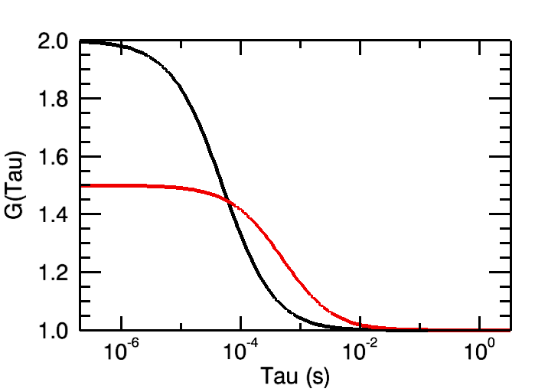
Autocorrelation Yields Diffusion and Concentration
Fit Autocorrelation curve for Diffusion time (τ_{D}) and particle concentration N
Notes:
The larger the particle, the longer it will take to transverse the focal volume thus the photon burst will be longer in time. This results in the correlation function moving the left for larger particles. The diffusion time gives information about the diffusion coefficient, the molecular weight and possibly the viscosity of the media. The correlation curve amplitude is inversely proportional to the particle concentration. The concentration, N, is the average number of molecules in the focal volume at one time. Standard dye solutions with known diffusion coefficients can be used to characterize the focal volume. Once that is done, you can use the focal volume information and the Number of particles to get an accurate measure of the MOBILE concentration (mol/L). The curve amplitude being inversely proportional to the particle number makes sense because the higher the N, the smaller the fluctuations will be from the mean intensity giving less correlation.
ALL DATA IS FIT USING A NON-LINEAR LEAST SQUARES ERRORS FUNCTION TO GET DIFFUSION TIMES AND N. You will run the risk of getting bad results with bad curve fitting or curve fitting interpretation.

Slide 15
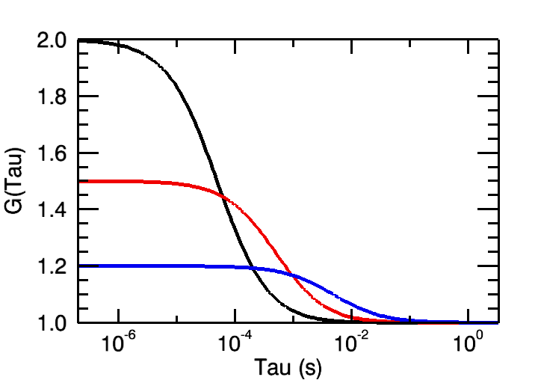
Autocorrelation Yields Diffusion and Concentration
Fit Autocorrelation curve for Diffusion time (τ_{D}) and particle concentration N
Notes:
The larger the particle, the longer it will take to transverse the focal volume thus the photon burst will be longer in time. This results in the correlation function moving the left for larger particles. The diffusion time gives information about the diffusion coefficient, the molecular weight and possibly the viscosity of the media. The correlation curve amplitude is inversely proportional to the particle concentration. The concentration, N, is the average number of molecules in the focal volume at one time. Standard dye solutions with known diffusion coefficients can be used to characterize the focal volume. Once that is done, you can use the focal volume information and the Number of particles to get an accurate measure of the MOBILE concentration (mol/L). The curve amplitude being inversely proportional to the particle number makes sense because the higher the N, the smaller the fluctuations will be from the mean intensity giving less correlation.
ALL DATA IS FIT USING A NON-LINEAR LEAST SQUARES ERRORS FUNCTION TO GET DIFFUSION TIMES AND N. You will run the risk of getting bad results with bad curve fitting or curve fitting interpretation.

Slide 16
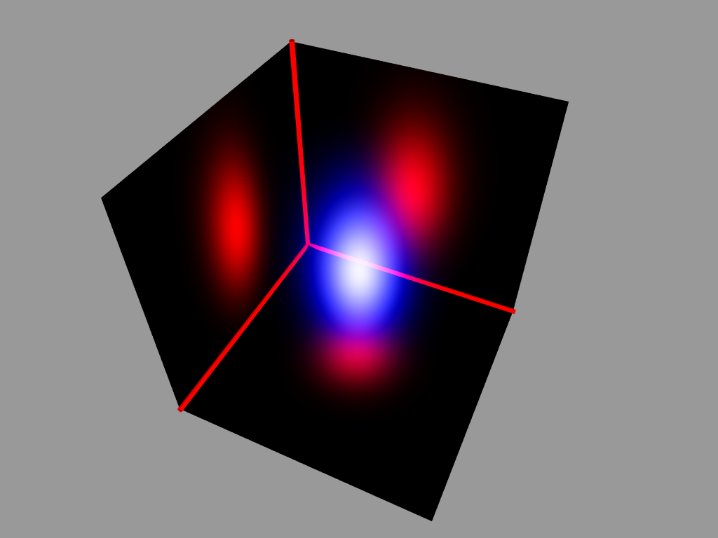
What about the excitation (or observation) volume shape?

Slide 17
Effect of Shape on the (Two-Photon) Autocorrelation Functions:
For a 2-dimensional Gaussian excitation volume:
1-photon equation contains a 4, instead of 8
For a 3-dimensional Gaussian excitation volume:

Slide 18
Independent Processes Contribute Fluctuations
Contributions of single independent processes multiply
More process system
1.5
exponential
1.4
1.3
triplet
)
τ
G(
1.2
diffusion
1.1
1.0
1E-6
1E-5
1E-4
1E-3
0.01
0.1
1
10
100
1000
10000
τ
[ms]

Slide 19
Additional Equations for these independent processes:
3D Gaussian Confocor analysis:
... where N is the average particle number, τ_{D} is the diffusion time (related to D, τ_{D}=w²/8D, for two photon and τ_{D}=w²/4D for 1-photon excitation), and S is a shape parameter, equivalent to w/z in the previous equations.
Triplet state term:
..where T is the triplet state amplitude and τ_{T} is the triplet lifetime.

Slide 20
Combining the Processes
τ_{D1} = 100 μs
τ_{D2} = 50 ms
f₁ = 40%
f₂ = 60%
N_{diff} = 0.2
SP = 5
TF = 10%
τ_{T} = 1 ms

Slide 21
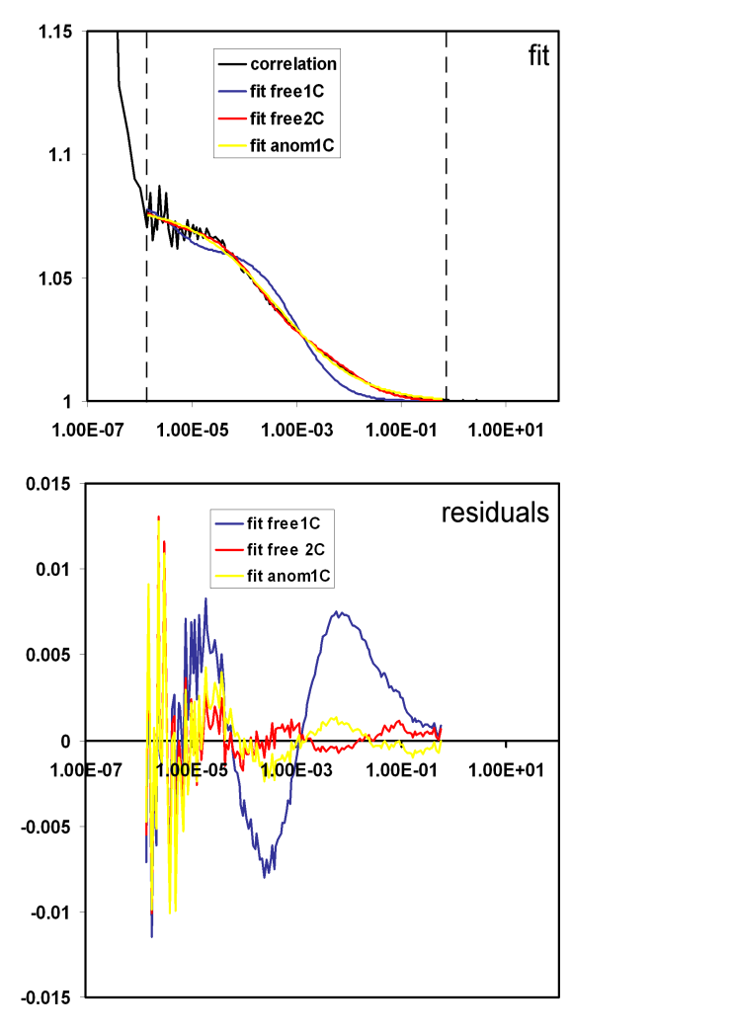
Fitting with Correct Model

Slide 22
Fitting with Correct Model
Schwille and Haustein 2004

Slide 23
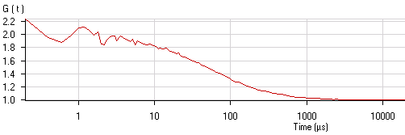
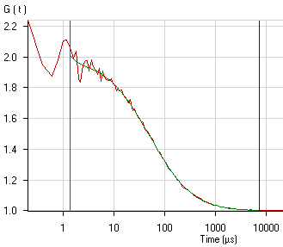
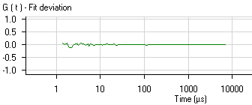


Work Flow for FCS
Diffusion coefficient:
ωr²
4τ_{d,i}
D=
I(t)
AC: compare signal w/ itself
CC: compare signal w/ another
1
<I>
δI(t)
2
t
3
Principle steps
Measuring fluctuation intensities
Calculating correlation function
Fitting to biophysical model

Slide 24
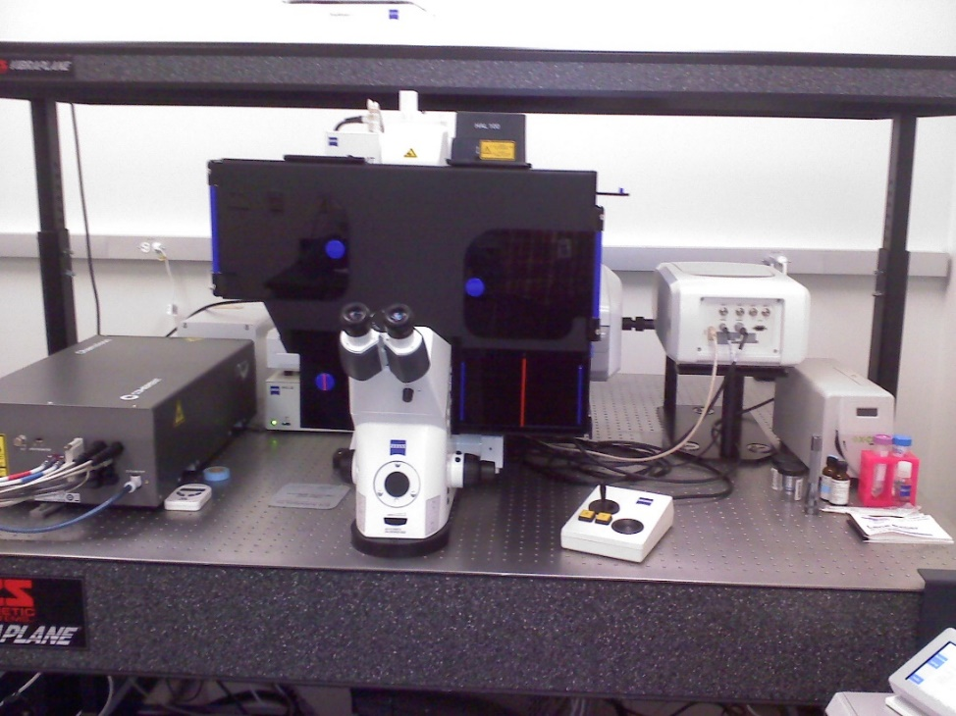
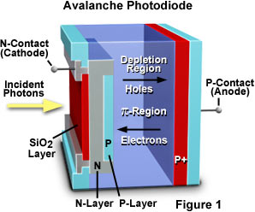
Zeiss ConfoCor3: FCS Setup on a Laser Scanning Confocal Microscope
Avalanche Photodiode Detector (APD)
Single Photon Sensitivity
Focus to tiny volume (<1 femtoliter)
Schwille and Haustein 2004
Notes:
http://hamamatsu.magnet.fsu.edu/articles/avalanche.html
http://www.photonics.com/EDU/Handbook.aspx?AID=25535

Slide 25
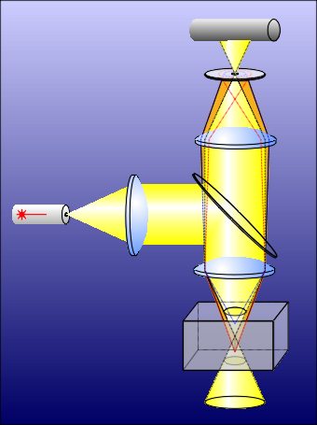
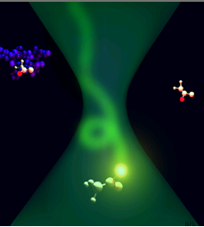
ConfoCor 3: Confocal Volume
Diffraction limited spot
Advanced confocal optics realized in the ConfoCor 3 limits detection to a cylinder approximately 1,5 µm in height and 0.3 μm in diameter.
Focus and confocal detection define a measuring volume smaller than 1/4 femto liter (1 femto liter = 10⁻¹⁵ liter).
0,3 μm
Sample
1,5 μm

Slide 26
Fluorescence Fluctuation Spectroscopy (FFS)
Diffusion coefficient:
ωr²
4τ_{d,i}
D=
Bacia et al., Nature Methods 2006
Notes:
Bacia, K., Kim, S.A., Schwille, P., 2006. Fluorescence cross-correlation spectroscopy in living cells. Nat Methods 3, 83-89.

Slide 27
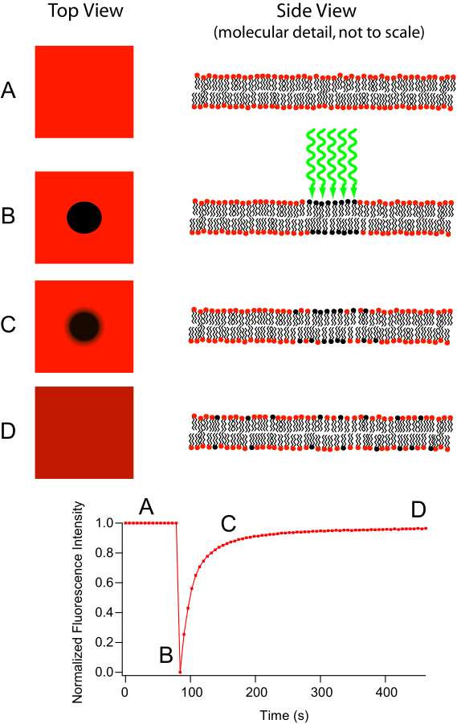
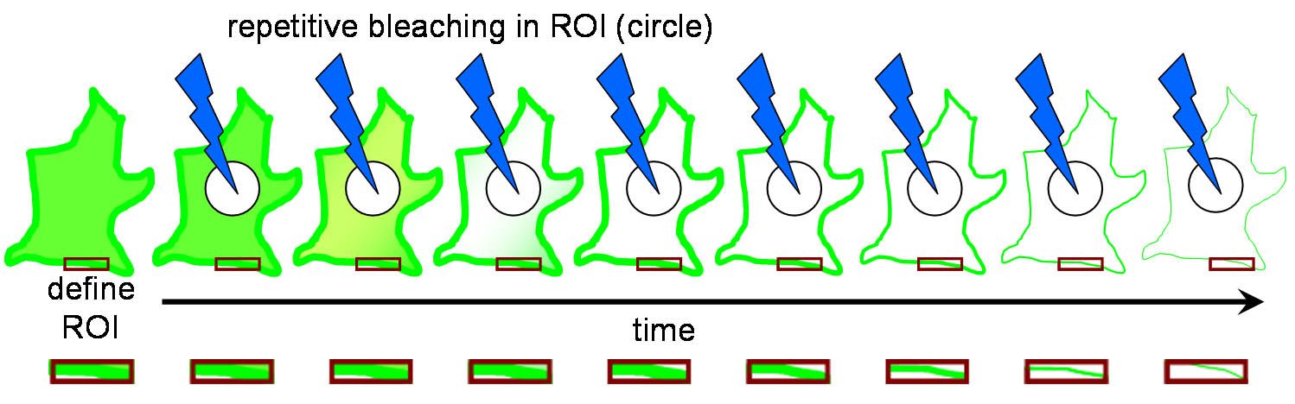
Fluorescent recovery after photobleaching (FRAP)
Diffusion coefficient:
ωr²
4τ_{d,i}
D=
Like FCS also used for calculating diffusion
Fluorescence Loss in Photobleaching (FLIP) related technique
Primary use of FLIP is to determine continuity of membranous organelles.
Notes:
The major difference between these two microscopy techniques is that FRAP involves the study of a cell’s ability to recover after a single photobleaching event whereas FLIP involves the study of how the loss of fluorescence spreads throughout the cell after multiple photobleaching events. This difference in purpose also leads to a difference in what parts of the cell are observed. In FRAP, the area that is actually photobleached is the area of interest. Conversely, in FLIP, the region of interest is just outside the region that is being photobleached. Another important difference is that in FRAP, there is a single photobleaching event and a recovery period to observe how well fluorophores move back to the bleached site. However, in FLIP, multiple photobleaching events occur to prevent the return of unbleached fluorophores to the bleaching region.
http://en.wikipedia.org/wiki/Fluorescence_loss_in_photobleaching
http://en.wikipedia.org/wiki/Fluorescence_recovery_after_photobleaching
http://www.olympusconfocal.com/applications/flipandfrap.html
"Frap diagram" by MDougM - Own work. Licensed under Public Domain via Wikimedia Commons - http://commons.wikimedia.org/wiki/File:Frap_diagram.svg#mediaviewer/File:Frap_diagram.svg
"Fluorescence Loss in Photobleaching Schematic" by Steven Lentz - was sent to me personally. Licensed under CC BY-SA 3.0 via Wikimedia Commons - http://commons.wikimedia.org/wiki/File:Fluorescence_Loss_in_Photobleaching_Schematic.jpg#mediaviewer/File:Fluorescence_Loss_in_Photobleaching_Schematic.jpg

Slide 28
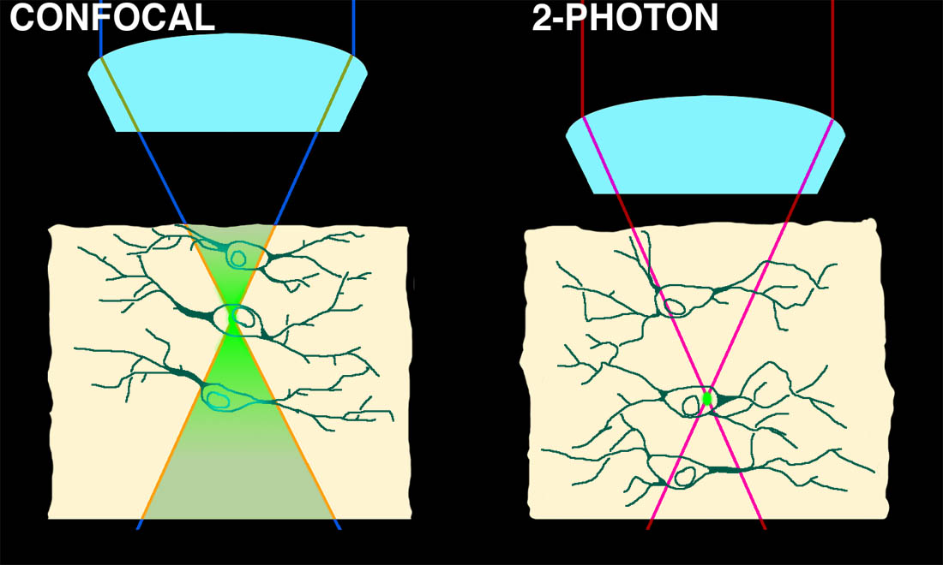

Two-Photon microscopy: Good for FRAP?
Optical sectioning by non-linear absorbance
Notes:
While FRAP has been around for a while what development really made this technique take off?

Slide 29
FRAP has been around since 1976
Again developed by Watt Webb’s laboratory at Cornell
Though it’s been around for a while can you guess what development really made FRAP take off?
Notes:
http://www.ncbi.nlm.nih.gov/pmc/articles/PMC1334945/

Slide 30
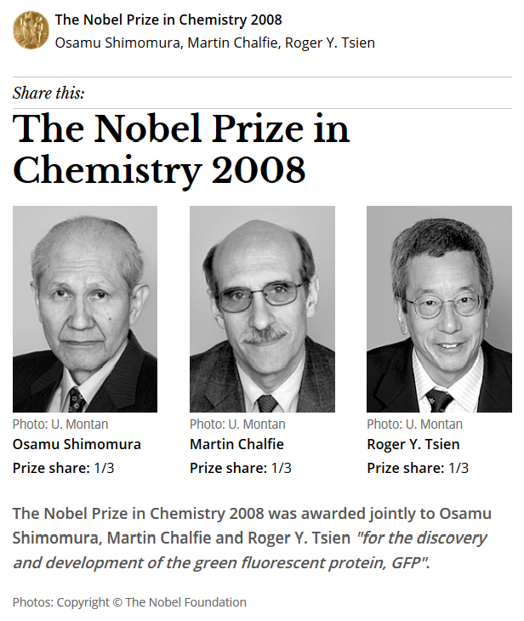
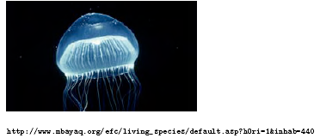
Green Fluorescent Protein
From marine invertebrate, Crystal jelly (Aequorea Victoria)
Can be coded in genes and made by the organism

Slide 31
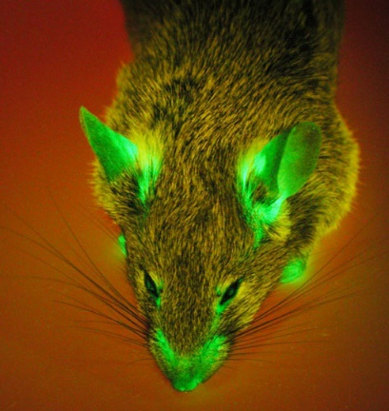
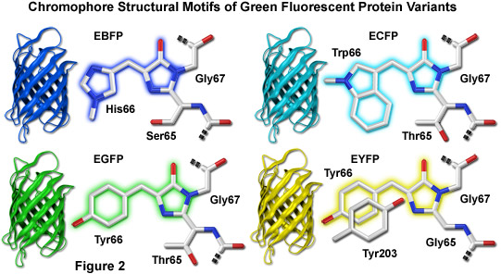
Green Fluorescent Protein
First fluorescent protein discovered and developed for biological use
Mutated for temp stability, color and turnover rate
Importance of monomer vs dimer or tetramer
Notes:
http://www.olympusconfocal.com/applications/fpcolorpalette.html
http://www.micro.magnet.fsu.edu/primer/techniques/fluorescence/fluorescentproteins/fluorescentproteinshome.html

Slide 32
Choosing Fluorescent Proteins
Shaner, N.C., Steinbach, P.A., Tsien, R.Y., 2005. A guide to choosing fluorescent proteins. Nat Meth 2, 905-909.
Notes:
Shaner, N.C., Steinbach, P.A., Tsien, R.Y., 2005. A guide to choosing fluorescent proteins. Nat Meth 2, 905-909.

Slide 33
Fluorescence Fluctuation Spectroscopy (FFS)
Fluorescence Correlation Spectroscopy (FCS)
Photon Counting Histogram (PCH)
Fluorescence Cross-Correlation Spectroscopy (FCCS)
  FCS with more than 1 color
Advantages over FRAP and FRET

Slide 34
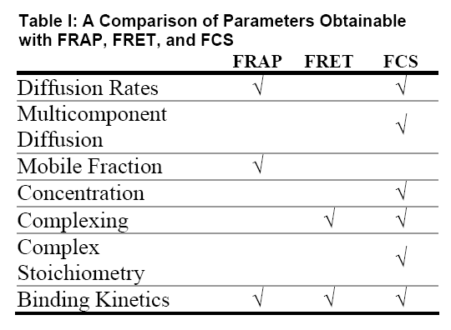
Fluorescence Fluctuation Spectroscopy (FFS)
Advantages over FRAP and FRET
Table: http://www.fcsxpert.com/

Slide 35
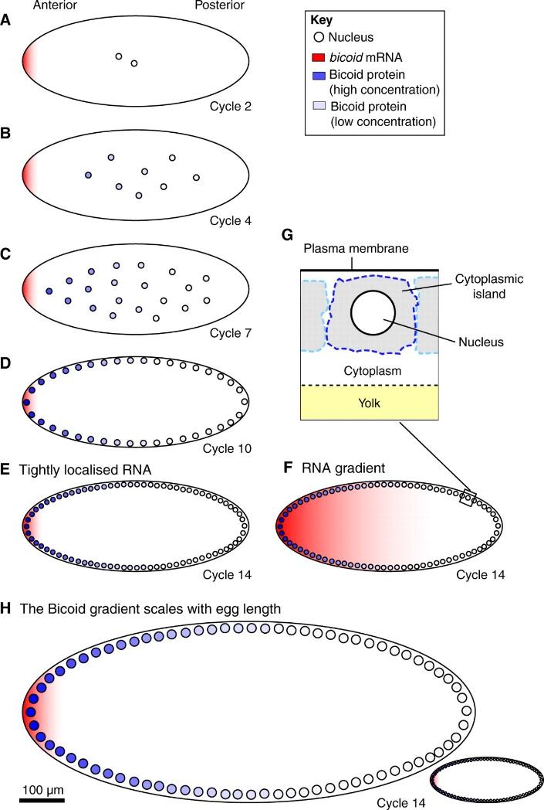
But what do you do when FRAP and FCS give different results?
Drosophila bicoid protein gradient
With FRAP measured D=0.3 μm²/second
With FCS measured D=∼7 μm²/second
Which result do you believe?
Notes:
http://www.sciencedirect.com/science/article/pii/S0092867407006630
Wieschaus Cell paper
http://www.ncbi.nlm.nih.gov/pmc/articles/PMC2920644/
FCS paper
Development paper by Wieschaus reviewing his result
http://dev.biologists.org/content/137/14/2253.full
Schematic of the Bicoid gradient in the syncytial Drosophila embryo. (A-G) Bicoid, as a transcription factor, accumulates within nuclei during interphase. The nuclear Bicoid gradient, which decreases in concentration with distance from the anterior pole, forms in less than 3 hours in a Drosophila embryo that is ~500 μm long (AP axis) and can be observed (B) before nuclei migrate to the surface of the embryo. During the first ~80 minutes (corresponding to cell cycles 1-8), nuclei proliferate in the centre of the embryo (A-C), and then migrate to the surface of the embryo in cycle 9. During the last five cell cycles, nuclei divide at the surface of the embryo (D,E). Nuclei replicate every ~9 minutes during the first nine cell cycles, but this slows to ~20 minutes in cycle 13. Nuclei are ~10 μm in diameter in pre-cycle 14 embryos (A-D) but ~6 μm in cycle 14 (E). The extent to which the mRNA encoding Bicoid, which is initially tightly localised to the anterior pole (A), becomes delocalised is a matter of controversy. Two alternative bicoid RNA distributions during cycle 14 are shown in E and F. (G) Illustration of the nucleus and surrounding cytoplasm. (H) In species that produce larger or smaller eggs than Drosophila melanogaster, the Bicoid gradient scales with egg length.

Slide 36
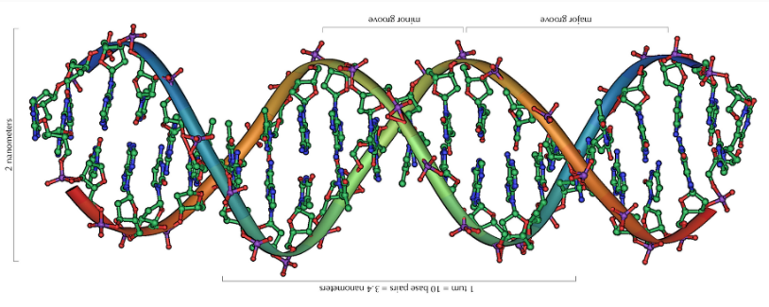
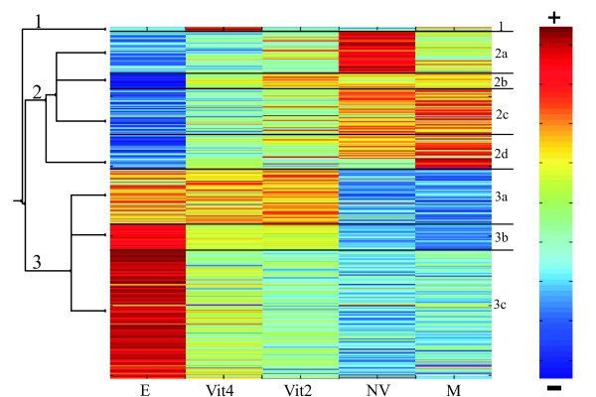
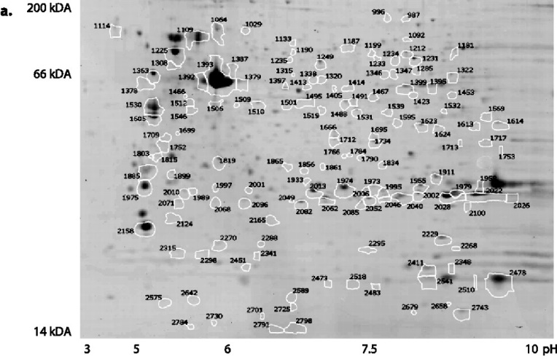
Meeting Summary on Impact of Genomics on Drug Discovery and Development
Genome (What could happen)
Transcriptome (What might be happening)
Levi, L., et al. (2009). Revealing genes associated with vitellogenesis in the liver of the zebrafish (Danio rerio) by transcriptome profiling. BMC Genomics 10, 141.
Proteome (What is happening)
Lucitt, M. B., et al. (2008). Analysis of the Zebrafish Proteome during Embryonic Development. Molecular & Cellular Proteomics 7, 981-994.
Rastan, S. (2001). Genomics: saviour or millstone? Trends in Genetics 17, 247-248.

Slide 37
Meeting Summary on Impact of Genomics on Drug Discovery and Development
Genome (What could happen)
Transcriptome (What might be happening)
Levi, L., et al. (2009). Revealing genes associated with vitellogenesis in the liver of the zebrafish (Danio rerio) by transcriptome profiling. BMC Genomics 10, 141.
“Proteomics faces the most formidable technical obstacles, primarily resolution and reproducibility. Getting away from gel-based methods is likely to hold the key to success.”
Proteome (What is happening)
Lucitt, M. B., et al. (2008). Analysis of the Zebrafish Proteome during Embryonic Development. Molecular & Cellular Proteomics 7, 981-994.
Rastan, S. (2001). Genomics: saviour or millstone? Trends in Genetics 17, 247-248.

Slide 38
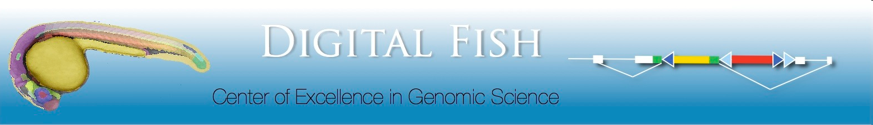
FlipTrap Screen; Le Trinh & Scott Fraser (Caltech)
Transposon-based gene-trapping technology
Gene trapping vector: Citrine (YFP) flanked by splice acceptor & donor, forward orientation; mCherry (RFP) polyadenylation signal, reverse orientation; lox & FRT sites
Insertion of artificial citrine exon into intron of an actively expressed gene by Tol2-mediated transposition
Produces full-length fluorescent fusion protein
Endogenous expression of Citrine labeled protein
lox sites allow Cre-mediated excision of citrine & splice donor sequence, “flipping” mCherry & polyA signal into forward orientation, mutating gene
http://www.fliptrap.org

Slide 39
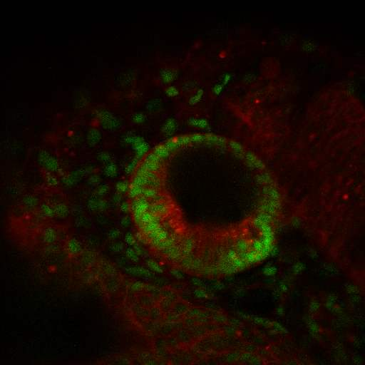
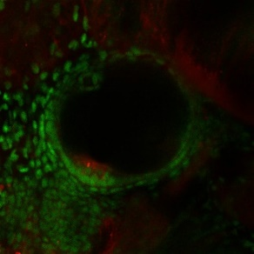
Flip Trap Screen Labels Endogenous Proteins:
Different Sub-Cellular Compartments and Cell Types
Zebrafish Ear Development
α- Catenin
1 day
memCherry
Cell Membrane
Nuclei
2 days
memCherry
3-4 days
FM1-43
Cytoplasm
Cytoplasm+Nuclei

Slide 40
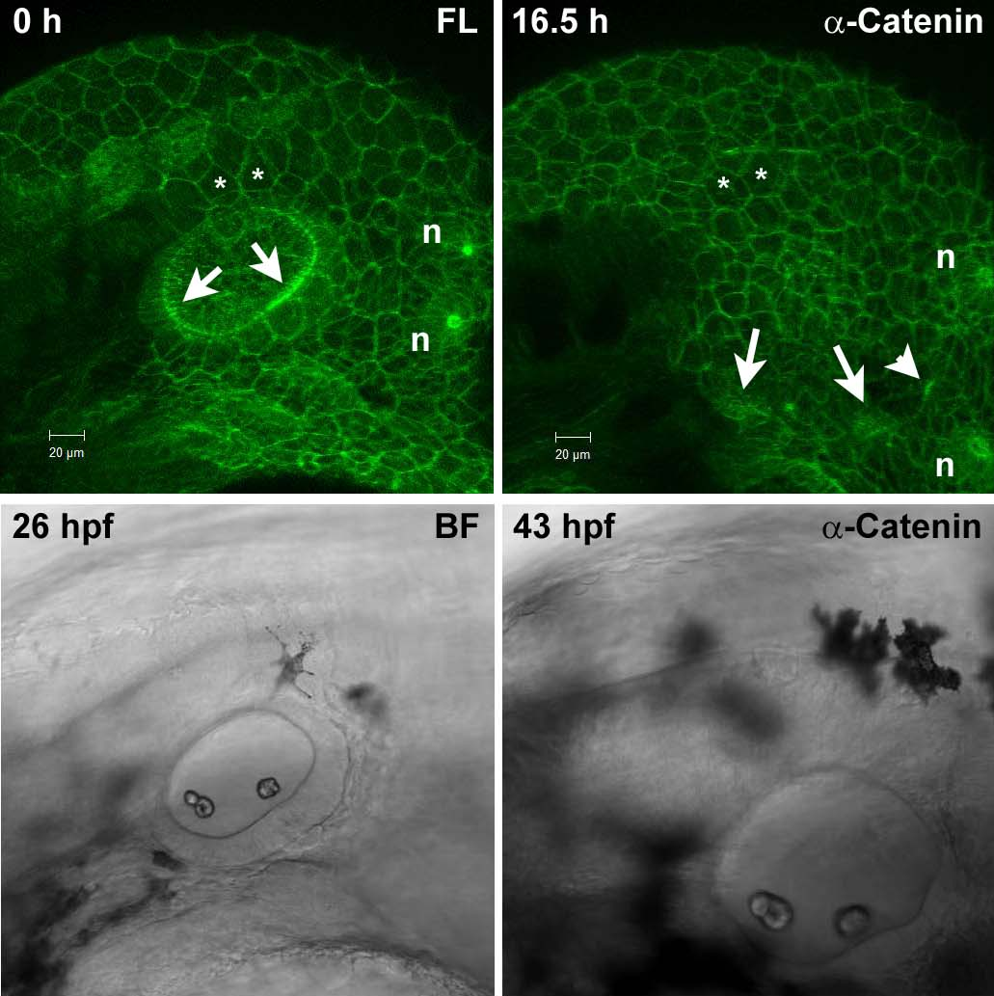
FCS Detects Intracellular Variations
α-Catenin time-lapse beginning 26 hpf
Time-lapse 16 hrs, 50 min
Expressed in cell membranes
Concentrated in sensory organs; apical.
D
A

Slide 41
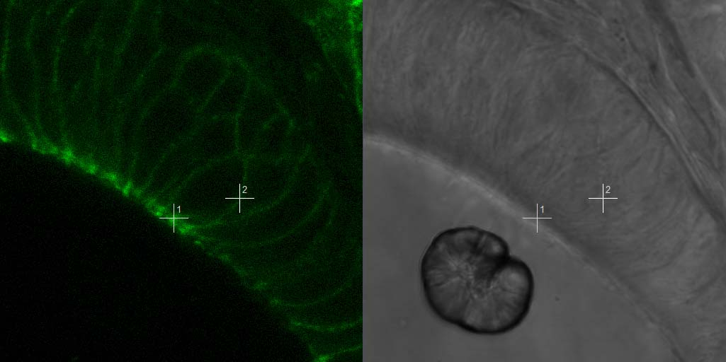
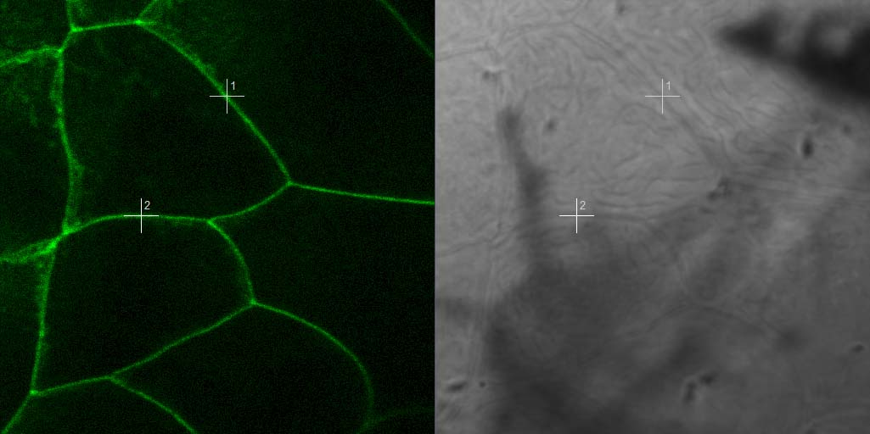
Diffusion Coefficients Similar to those Obtained Using FRAP
Hair Cells
Epidermis
α-Catenin
30 hpf
E-Cadherin: Published FRAP measurements
Spot Adherens Junctions (SAJ),
Drosophila embryonic epithelium
0.06 Highest; 0.005 Lowest (mm²/sec)
P= 0.00094
P= 1.23 x 10⁻⁵
N=31
N=30
N=32
Cavey, M., Rauzi, M., Lenne, P. F. and Lecuit, T. (2008). Nature 453, 751-6.

Slide 42
Epithelial transitions during pharyngeal pouch formation
Wnt signaling role in pharyngeal pouch formation
Adherens junction
Choe Chong P, Collazo A, Trinh Le A, Pan L, Moens Cecilia B, Crump JG (2013) Wnt-Dependent Epithelial Transitions Drive Pharyngeal Pouch Formation. Developmental Cell 24: 296-309.

Slide 43
Alcama immunoglobulin-domain protein functions to restabilize adherens junctions
Use α-Catenin protein labeled transgenic zebrafish line to study protein mobility at adherens junction.
Alcama associates with α-Catenin at adherens junction
At transitional stage endodermal epithelium is destabilized

Slide 44
Expressed in cytoplasm dorsal roof of otocyst; nonsensory inner ear cells
Later in all dorsal nonsensory cells, semicircular canals
19+ hours Time-lapse beginning at 28 hpf
D
A

Slide 45
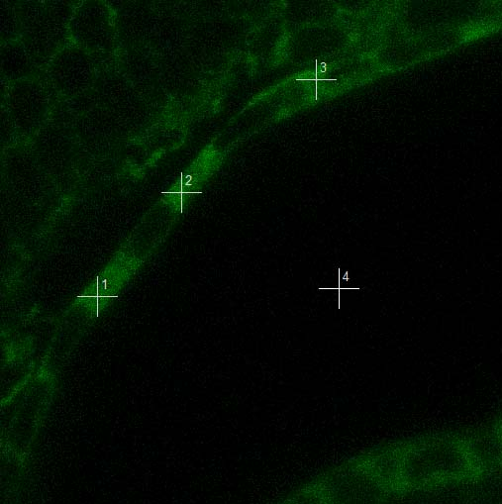
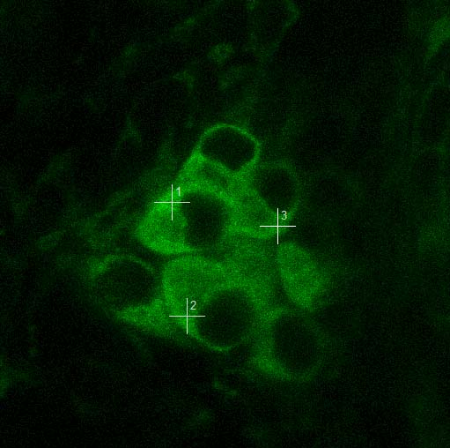
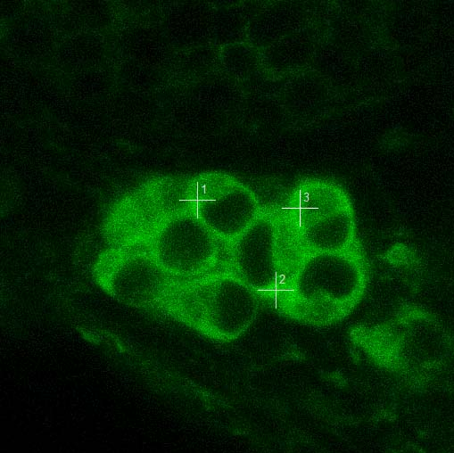
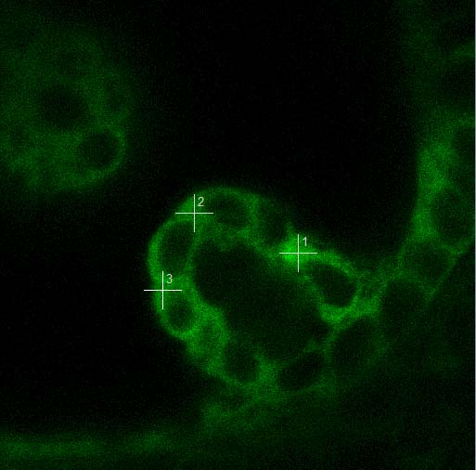
Dorsal Roof
Pllg Neurons
Trigeminal Neurons
55 hpf
48 hpf
55 hpf
Canals
52 hpf

Slide 46
expressed in sensory hair cell nuclei and cytoplasm
Turns on as hair cells differentiate
Expressed in auditory ganglion neurons
Time-lapse beginning 52 hpf, 15 hrs, 40 min
D
A

Slide 47
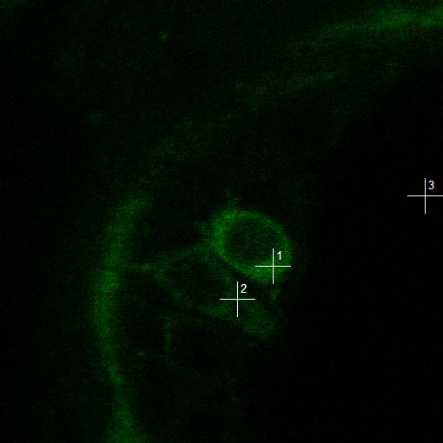
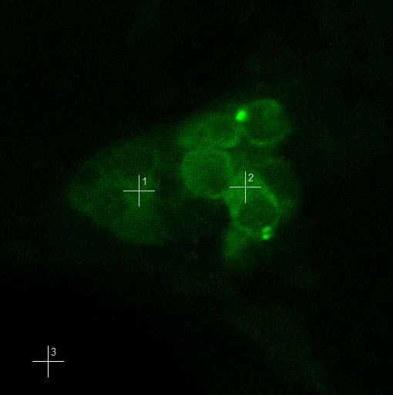
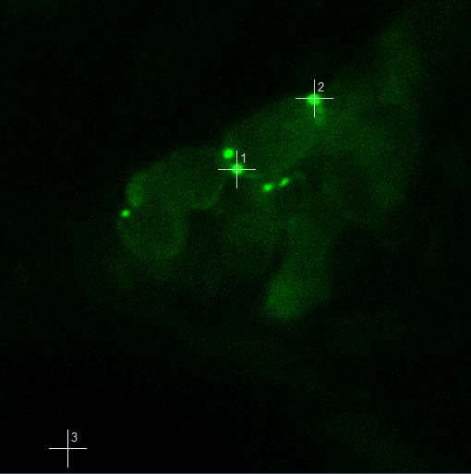
50 hpf
Gt(gnb2-citrine)^{ct172a}
SA
citrine
SD
pA
mCherry
v
f
citrine
α
γ
WD40
WD40
β
Hair cells
Neurons PLLG
Puncta
83 hpf
83 hpf
83 hpf

Slide 48
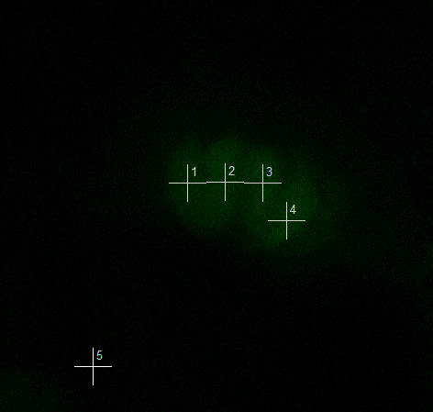
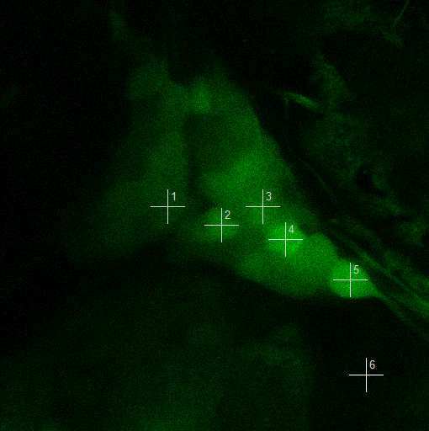
citrine
GTPase
rab
GTP
endosome
Hair Cells
Trigeminal Neurons

Slide 49
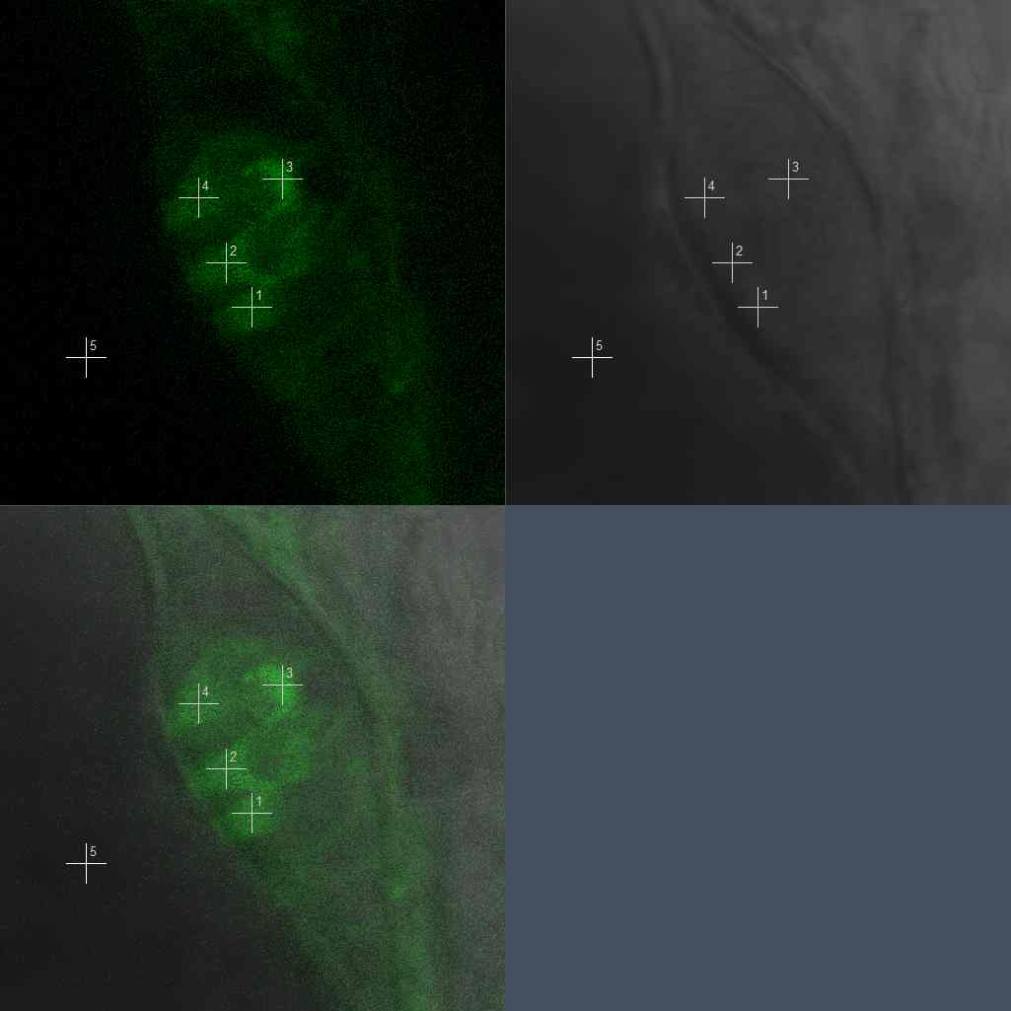
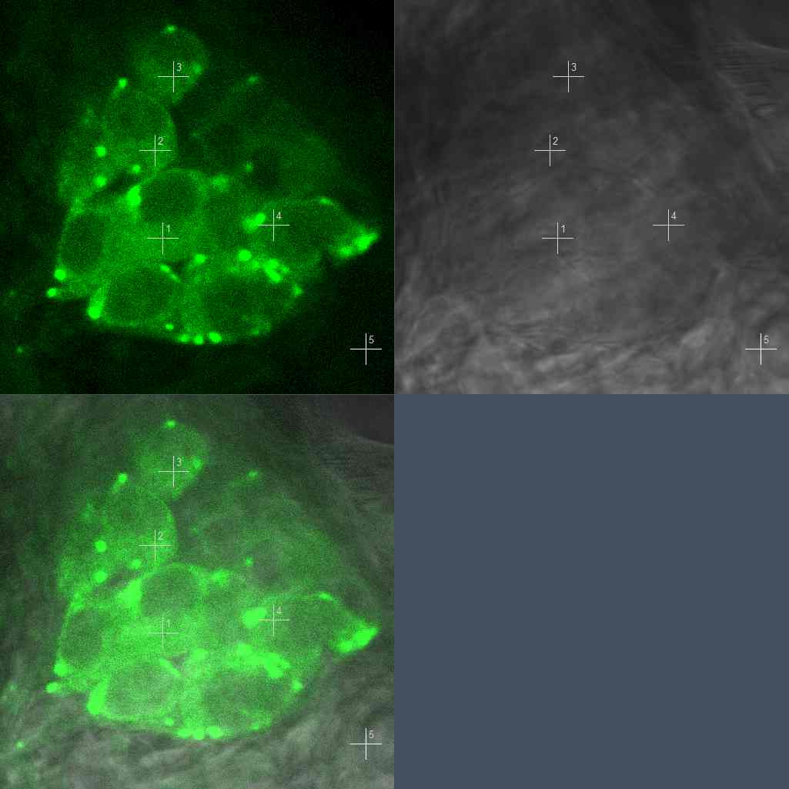
SA
citrine
SD
pA
mCherry
citrine
α
γ
WD40
WD40
β
Hair Cells
Post LLg Neurons

Slide 50
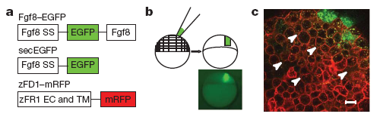
Published FCS Studies in Zebrafish Have Used Exogenously Expressed Proteins
Proteins acting as morphogen
  Yu, S. R., M. Burkhardt, et al. (2009). Nature 461(7263): 533-536.
Receptor ligand interactions
  Ries, J., S. R. Yu, et al. (2009). Nat Methods 6(9): 643-645.

Slide 51
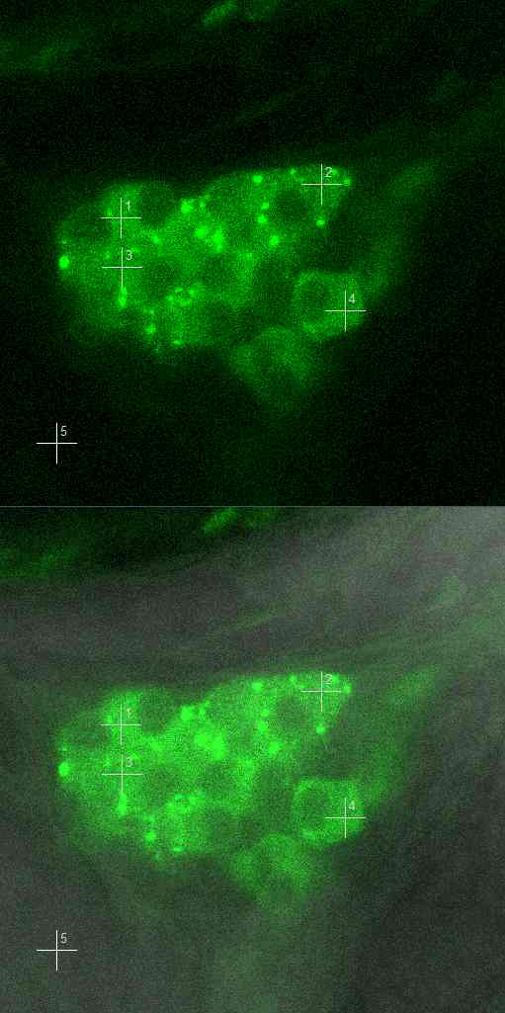
Less in Hair Cells than Neurons
Hair Cells
Neurons
Count rate [kHz] | Count rate [kHz]
9.367 | 59.853
7.969 | 47.827
6.868 | 31.992
3.571 | 53.144
Trigeminal Ganglion
Lateral Crista
Post. Lateral Line Ganglion

Slide 52



Expressing Tagged Proteins by mRNA Injection Can Lead to
Over-expression and Incorrect Estimates of Diffusion Rates
vs

Slide 53
What Do Differences in Diffusion Coefficients Mean?
Binding to larger protein?

Slide 54
What Do Differences in Diffusion Coefficients Mean?
Binding to larger protein?
  But 100x the mass only 1/3 reduction.

Slide 55
What Do Differences in Diffusion Coefficients Mean?
Binding to larger protein?
  But 100x the mass only 1/3 reduction.
Cell Membrane
More likely causing interactions with cytoskeleton, organelles or other structures
Nucleus
Mitochondria

Slide 56
Conclusion of examples
FCS + Flip Trap lines provide unique insights into protein kinetics in vivo.
    Intracellular differences across subcellular regions
    Developmental transitions in protein kinetics
Endogenous protein concentrations crucial for accurate FCS measurements

Slide 57

Fluorescence Cross-Correlation Spectroscopy
Photon Burst Ch.1
Cross-Correlation uses spectrally separable fluorophores to probe for interaction
Cross Correlation Curve Amplitude directly relates to interaction
Photon Burst Ch.2
Notes:
FCCS is not too much different than single color FCS. FCCS is used to observe interaction and is much more sensitive that using differing diffusion times in single color FCS. Instead of making a “copy” signal you have two signals. The signals are then correlated together and the resulting curve gives you information about particle interaction.

Slide 58

Cross Correlation Reveals Details of Particle Binding
Autocorrelation reveals portion of unbound particles
Cross correlation reveals bound portion
Binding constant can be calculated

Slide 59

Controls Provide a Basis for Comparison for Cross-Correlation
Spectral cross talk can lead to false cross-correlation
With dual excitation lasers and differing expression levels, cross-correlation is never “perfect”
Controls needed for Comparison
Slaughter et al, PNAS. 2007.
Notes:
Some practical considerations. Need good spectral separation, eGFP-mCherry work fine, but have some bleed through. Too much bleed through can give a high amount of false cross-correlation. With 2-color one photon FCCS the overlap for both excitation lasers is not perfect. That is to say, a 488 laser will have a smaller PSF than the 561nm laser. This results in cross-correlation standards giving results that are not “perfect.” If perfect the cross correlation curve will overlap the two auto-correlation curves. Need controls!
http://www.pnas.org/content/104/51/20320.full

Slide 60

Photon Counting Histogram
Photon count distribution originates from a convolution of two sources
  Photon Detection Statistics
    Poisson
  Particle Number Fluctuations
    Poisson
Further complications come from variations in PSF
Information Gained
  Concentration
  Brightness
frequency
(ε_{n}=1.0)
(ε_{n}=2.2)
(ε_{n}=3.7)
Increasing Brightness
Photon Counts
(Qian and Elson, 1989, Applied Polymer Symposia. John Wiley and Sons, New York. 305-314,1990; Chen et al, 1999 Biophys J. 77: 553–567.; Muller et al, 2000 Biophys J 78:474–486).

Slide 61

Brightness Reveals Oligomerization
Slaughter et al, PloS ONE. 2008.

