Slide 1
Biology 177: Principles of Modern Microscopy
Lecture 13:
Super-resolution microscopy: Part I

Slide 2
Lecture 13: Fluorescent labeling, multi-sprectral imaging and FRET
Review of previous lecture
FRET
FLIM
Super resolution microscopy
  NSOM
Scanning probe microscopy

Slide 3
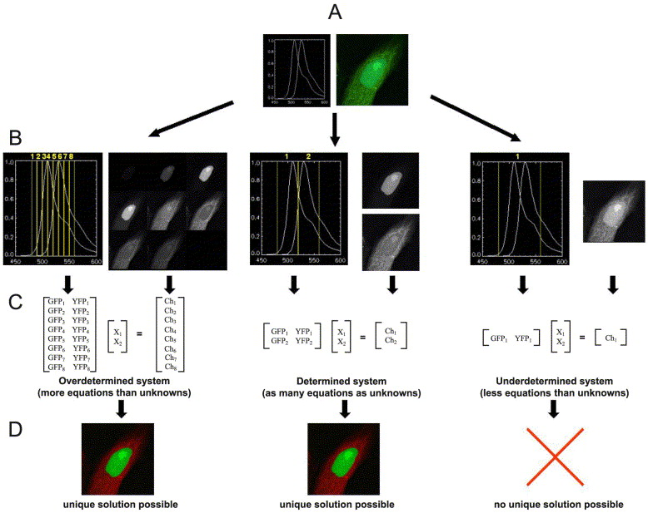
Summary of spectral unmixing
Notes:
Signal intensity of a given wavelength λ = sum of detector channels where A_{i}: relative contribution by specific fluorophores i with reference spectrum R_{i}(λ).
Steps in linear unmixing outlined for a sample expressing EGFP- and YFP-tagged fusion proteins. The cells shown express EGFP with a nuclear localization signal in the nucleus and YFP-labelled tubulin. A: On the left image the spectra of EGFP and YFP and on the right image cells as perceived in the microscope are shown. EGFP and YFP fluorescence both appear green and can thus not be distinguished by eye. B: The respective detection channels (yellow) are indicated in the plots of the spectra and the image contributions to the individual detection channels are displayed next to them as a gallery. C: In the unmixing formulas, which need to be applied to every pixel in the acquired images, the normalized spectral contributions of EGFP or YFP to each channel derived from the reference λ-stack are expressed as GFP_{n} and YFP_{n}. The unknown contributions of GFP and YFP to be determined are expressed as X₁, X₂, respectively. The pixel specific gray values derived from the acquired images of cells are expressed as Ch_{n}. D: Images after linear unmixing. GFP is shown in green and YFP in red. B, C, D left column: the number of detection channels (eight) exceeds the number of fluorophores (two) and linear unmixing of EGFP and YFP is possible. B, C, D middle column: the number of detection channels (two) matches the number of fluorophores (two) and represents the minimum number of detection channels required to allow linear unmixing of EGFP and YFP. B, C, D right column: one detection channel is not sufficient to distinguish EGFP and YFP and a unique solution of the equations is impossible.

Slide 4
Förster Resonance Energy Transfer (FRET)
Great method for the detection of:
  Protein-protein interactions
  Enzymatic activity
  Small molecules inside a cell
Notes:
http://www.nature.com/nmeth/journal/v5/n5/full/nmeth.1207.html

Slide 5
FRET:
Resonance Energy Transfer (non-radiative)
The Good: FRET as a molecular yardstick
Transfer of energy from one dye to another
Depends on:
Spectral overlap
Distance
Alignment
Notes:
Forster resonance energy transfer instead of fluorescence energy transfer.
Molecular yardsticks are for defining spatial dimensions

Slide 6
donor
acceptor
FRET:
Optimize spectral overlap
Optimize κ² -- alignment of dipoles
Minimize direct excitement of the acceptor
(extra challenge for filter design)
Notes:
Perpendicular is not good.

Slide 7
FRET Diagram
Non-radiative transfer
4nsec
-xx-
Less
-xx-
Less
0.8 emitted

Slide 8
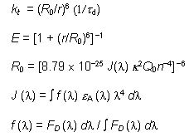


K_{T} = (1/τ_{D}) • [R₀/r]⁶
The Förster Equations.
R₀ = 2.11 × 10⁻² • [κ² • J(λ) • η⁻⁴ • Q_{D}]^{1/6}
J (λ)
ε_{A}
r is the center-to-center distance (in cm) between the donor and acceptor
τ_{D} is the fluorescence lifetime of the donor in the absence of FRET
κ² is the dipole-dipole orientation factor,
Q_{D} is the quantum yield of the donor in the absence of the acceptor
η is the refractive index of the intervening medium,
F_{D} (λ) is the fluorescence emission intensity at a given wavelength λ (in cm)
ε_{A} (λ) is the extinction coefficient of the acceptor (in cm ⁻¹ M ⁻¹).
The orientation factor κ² can vary between 0 and 4, but
typically κ² = 2/3 for randomly oriented molecules (Stryer, 1978).
When r = R₀, the efficiency of FRET is 50%
(fluorescein-tetramethylrhodamine pair is 55 Å)
Notes:
J spectral overlap integral
R₀ = the Forster radius of about 3-6 Nm
E = the FRET energy transfer efficiency
Both the rate (K(T)) and the efficiency (E(T)) of energy transfer are directly related to the lifetime of the donor fluorophore in the presence and absence of the acceptor.
http://www.olympusmicro.com/primer/techniques/fluorescence/fret/fretintro.html
http://en.wikipedia.org/wiki/F%C3%B6rster_resonance_energy_transfer
http://www.anatomy.usyd.edu.au/mru/fret/abot.html
http://www.nature.com/nbt/journal/v21/n11/full/nbt896.html

Slide 9
More about FRET (Förster Resonance Energy Transfer)
Isolated donor
Donor distance too great
Donor distance correct
Effective between 10-100 Å only
Emission and excitation spectrum must significantly overlap
Note: donor transfers non-radiatively to the acceptor
From J. Paul Robinson, Purdue University

Slide 10
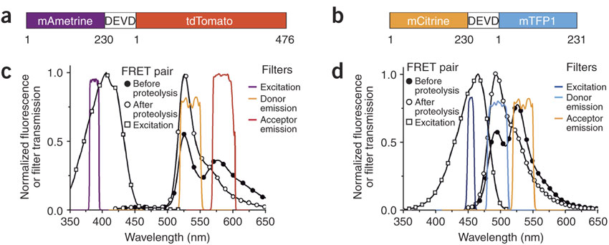
Optimizing FRET: Designs of new FRET pairs
Difficult to find two FRET pairs that can use in same cell
Used as Caspase 3 biosensors and for ratiometric imaging
Notes:
Figure 1. Caspase-3 biosensors based on dual FRET pairs.
(a,b) Schematics of caspase-3 biosensors. "DEVD" represents the sequence LGGTGSGSGDEVDG. Numbers indicate first and last residue of each fluorescent protein. (c) The emission spectrum of mAmetrine-DEVD-tdTomato before and after proteolysis, the excitation spectrum of mAmetrine, and the transmission profiles of excitation and emission filters used for FRET imaging. (d) The emission spectrum of mCitrine-DEVD-mTFP1 before and after proteolysis, the excitation spectrum of mTFP1, and the profiles of the excitation and emission filters.
Ai, H.-w., Hazelwood, K.L., Davidson, M.W., Campbell, R.E., 2008. Fluorescent protein FRET pairs for ratiometric imaging of dual biosensors. Nat Meth 5, 401-403.

Slide 11
Properties of fluorescent protein variants
Shaner et al, Nature Biotechnology, 2004
Notes:
Remember extinction coefficient here actually is the molar absorption coefficient.
Bleaching in seconds; obviously longer better, to a point

Slide 12
Optimizing FRET: Designs of new FRET pairs
mAmetrine developed by directed protein evolution from violet excitable GFP variant
Bright, extinction coefficient = 44,800 M⁻¹ cm⁻¹
Quantum yield = 0.58
But bleaches, 42% of mCitrine time and 1.7% of tdTomato
Notes:
Ai, H.-w., Hazelwood, K.L., Davidson, M.W., Campbell, R.E., 2008. Fluorescent protein FRET pairs for ratiometric imaging of dual biosensors. Nat Meth 5, 401-403.

Slide 13
Problems with FRET
4nsec
The acceptor excited directly by the exciting light
  “FRET” signal with no exchange
  Increased background
  Decreases effective range for FRET assay

Slide 14
Problems with FRET
2. Hard to really serve as a molecular yardstick*
  Orientation seldom known
      assume κ² = 2/3 (random assortment)
  Exchange depends on environment of dipoles
  Amount of FRET varies with the lifetime of the donor fluorophore
* r = R₀, the efficiency of FRET is 50%
(fluorescein-tetramethylrhodamine pair is 55 Å)
Notes:
See this paper for more Kappa squared and other variable cautions.
http://www.nature.com/nbt/journal/v21/n11/full/nbt896.html

Slide 15
Amount of FRET varies with the lifetime of the donor fluorophore
4nsec
Longer lifetime of the donor gives longer time to permit the energy transfer (more for longer)
Added Bonus: Allows lifetime detection to reject direct excitement of the acceptor (FRET=late)

Slide 16
Fluorescence Lifetime Imaging Microscopy (FLIM)
Measure spatial distribution of differences in the timing of fluorescence excitation of fluorophores
Combines microscopy with fluorescence spectroscopy
Fluorescent lifetimes very short (ns) so need fast excitation and/or fast detectors
Requirements for FLIM instruments
  Excitation light intensity modulated or pulsed
  Emitted fluorescence measured time resolved
Notes:
FLIM has its roots in two fields of research: 1) microscopy and 2) fluorescence spectroscopy. In the latter field of research, non-spatially-resolved fluorescence lifetime measurements were performed since 1926 [1], i.e. long before FLIM was developed. Typically, bulk measurements were carried out using cuvettes. Not surprisingly, most of the methodology and nomenclature used in FLIM today, e.g.‘frequency-domain’, and ‘time-domain’, have their origins in instruments that were used for cuvette-based lifetime measurements.
van Munster, E., Gadella, T.J., 2005. Fluorescence Lifetime Imaging Microscopy (FLIM), in: Rietdorf, J. (Ed.), Microscopy Techniques. Springer Berlin Heidelberg, pp. 143-175.

Slide 17
Fluorescence Lifetime Imaging Microscopy (FLIM)
Two methods for FLIM
  Frequency-domain
    Intensity of excitation light continuously modulated
    For emission measure phase shift & decrease in modulation
  Time-domain
    Pulsed excitation that is faster than fluorescence lifetime
    Emission measurement is time-resolved
Notes:
The first instrument combining time resolved fluorescence spectroscopy with microscopy, dates back to 1959 [2]. In this instrument, only single point measurements could be done, so strictly speaking no actual imaging was done. The first instrument measuring spatially resolved lifetimes was described in 1989 [3]. Due to the requirement of short light pulses and fast detection, time-domain measurements became possible only about 40 years later than frequency-domain measurements using a flashlamp as excitation source [16].
van Munster, E., Gadella, T.J., 2005. Fluorescence Lifetime Imaging Microscopy (FLIM), in: Rietdorf, J. (Ed.), Microscopy Techniques. Springer Berlin Heidelberg, pp. 143-175.

Slide 18
FRET and FLIM
Donor fluorescence lifetime during FRET reduced compared to control donor fluorescence lifetime
During FRET, donor fluorescence lifetime less than control donor fluorescence lifetime (τ_{D})
But isn’t it easier to image decreases in donor fluorescence intensity rather than measure fluorescence lifetime?
K_{T} = (1/τ_{D}) • [R₀/r]⁶
Notes:
Both the rate (K(T)) and the efficiency (E(T)) of energy transfer are directly related to the lifetime of the donor fluorophore in the presence and absence of the acceptor.
In other words the donor fluorescence (or excited-state) lifetime in a FRET situation (τ_{FRET}⁾ is reduced as compared to the control donor fluorescence lifetime t (see Eq. 14 in which
t_{FRET} = t (1 – E) (14)
where E is the energy transfer efficiency).
http://olympus.magnet.fsu.edu/primer/techniques/fluorescence/fret/fretintro.html
van Munster, E., Gadella, T.J., 2005. Fluorescence Lifetime Imaging Microscopy (FLIM), in: Rietdorf, J. (Ed.), Microscopy Techniques. Springer Berlin Heidelberg, pp. 143-175.

Slide 19
FRET and FLIM
Remember all those nonlinearities from last lecture?
Brightness (or intensity) of fluorophore, as measured on your image, more than just εQ
  Local concentration of fluorophore
  Optical path of microscope
  Local excitation light intensity
  Local fluorescence detection efficiency
FLIM provides independent measure of local donor lifetime
Notes:
The problem with quantitative imaging of intensities is that they do not depend only on the local quantum yield of the fluorophores but also on i) the local concentration of the fluorophore, ii) the optical path of the micro- scope, iii) the local excitation light intensity and iv) the local fluorescence detection efficiency. Especially the local concentration of the fluorophore is not easily determined separately from the local quantum yield. In contrast, FLIM does provide an independent estimate of the local donor lifetime (proportional to the donor quantum yield), independent of i–iv mentioned above. Hereby FLIM is a robust technique for measuring FRET.
εQ=molar absorption coefficient times quantum yield.
van Munster, E., Gadella, T.J., 2005. Fluorescence Lifetime Imaging Microscopy (FLIM), in: Rietdorf, J. (Ed.), Microscopy Techniques. Springer Berlin Heidelberg, pp. 143-175.

Slide 20
Going back to those problems with FRET:
These drawbacks can all be used to make sensors
Change in FRET for changes in:
Orientation
  cameleon dye for Ca++
Local environment
  Phosphate near fluorophore
  Membrane voltage (flash)
Change in lifetime of donor
  Binding of molecule displacing water

Slide 21
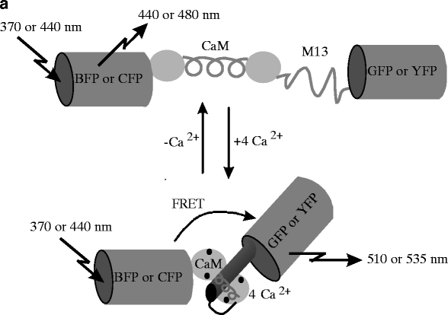
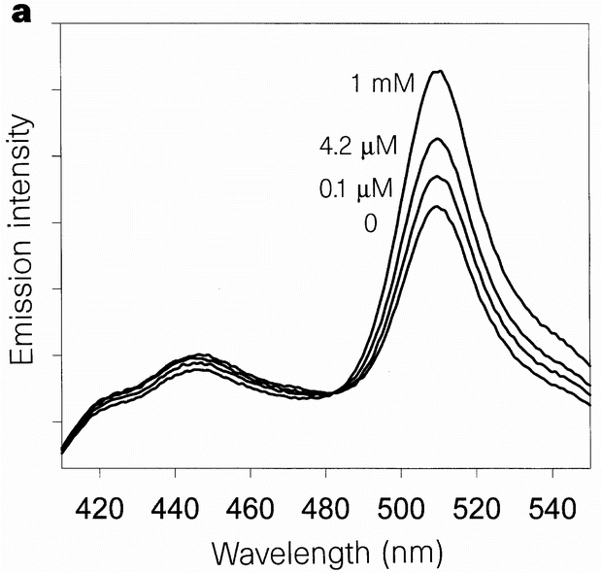
Cameleon: FRET-based and genetically-encoded calcium probe
Calmodulin bonds Ca²⁺
and changes its conformation
[Ca²⁺]
Miyawaki et al, Nature, 1997
Cameleon family: calmodulin-based indicators of [Ca²⁺] using FRET
isosbestic point
Notes:
Isosbestic point best for ratiometric measures
http://www.nature.com/nature/journal/v388/n6645/full/388882a0.html

Slide 22
Paper to read
Pearson, H., 2007. The good, the bad and the ugly. Nature 447, 138-140.
http://www.nature.com/nature/journal/v447/n7141/full/447138a.html

Slide 23
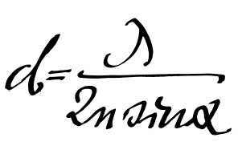
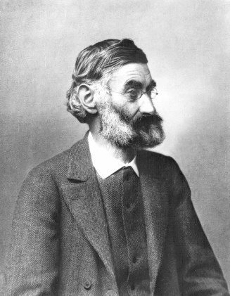
Spatial Resolution of Biological Imaging Techniques
Resolution is diffraction limited.
Abbe (1873) reported that smallest resolvable distance between two points (d) using a conventional microscope may never be smaller than half the wavelength of the imaging light (~200 nm)
Ernst Abbe (1840-1905)
Notes:
http://www.nature.com/milestones/milelight/full/milelight03.html

Slide 24

Super-resolution microscopy
Most recent Nobel prize in Chemistry
Many ways to achieve
Some more super than others.
Notes:
They fall into two broad categories, "true" super-resolution techniques, which capture information contained in evanescent waves, and "functional" super-resolution techniques, which use clever experimental techniques and known limitations on the matter being imaged to reconstruct a super-resolution image.^{[2]}
True subwavelength imaging techniques include those that utilize the Pendry Superlens and near field scanning optical microscopy, the 4Pi Microscope and structured illumination microscopy technologies like SIM and SMI. However, the majority of techniques of importance in biological imaging fall into the functional category.
There are two major groups of methods for functional super-resolution microscopy:
Deterministic super-resolution: The most commonly used emitters in biological microscopy, fluorophores, show a nonlinear response to excitation, and this nonlinear response can be exploited to enhance resolution. These methods include STED, GSD, RESOLFT and SSIM.
Stochastic super-resolution: The chemical complexity of many molecular light sources gives them a complex temporal behaviour, which can be used to make several close-by fluorophores emit light at separate times and thereby become resolvable in time. These methods include SOFI and all single-molecule localization methods (SMLM) such as SPDM, SPDMphymod, PALM, FPALM, STORM and dSTORM.

Slide 25
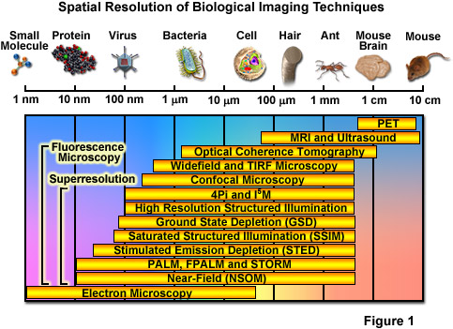
Spatial Resolution of Biological Imaging Techniques
Notes:
http://zeiss-campus.magnet.fsu.edu/articles/superresolution/introduction.html

Slide 26
Super-resolution microscopy
“True” super-resolution techniques
  Subwavelength imaging
  Capture information in evanescent waves
  Quantum mechanical phenomenon
“Functional” super-resolution techniques
  Deterministic
    Exploit nonlinear responses of fluorophores
  Stochastic
    Exploit the complex temporal behaviors of fluorophores
Notes:
They fall into two broad categories, "true" super-resolution techniques, which capture information contained in evanescent waves, and "functional" super-resolution techniques, which use clever experimental techniques and known limitations on the matter being imaged to reconstruct a super-resolution image.^{[2]}
True subwavelength imaging techniques include those that utilize the Pendry Superlens and near field scanning optical microscopy, the 4Pi Microscope and structured illumination microscopy technologies like SIM and SMI. However, the majority of techniques of importance in biological imaging fall into the functional category.
There are two major groups of methods for functional super-resolution microscopy:
Deterministic super-resolution: The most commonly used emitters in biological microscopy, fluorophores, show a nonlinear response to excitation, and this nonlinear response can be exploited to enhance resolution. These methods include STED, GSD, RESOLFT and SSIM.
Stochastic super-resolution: The chemical complexity of many molecular light sources gives them a complex temporal behaviour, which can be used to make several close-by fluorophores emit light at separate times and thereby become resolvable in time. These methods include SOFI and all single-molecule localization methods (SMLM) such as SPDM, SPDMphymod, PALM, FPALM, STORM and dSTORM.

Slide 27
Spatial Resolution of Biological Imaging Techniques
“True” super-resolution
“Functional”
Notes:
http://zeiss-campus.magnet.fsu.edu/articles/superresolution/introduction.html

Slide 28
Near-Field Scanning Optical Microscopy (NSOM)
Scanning Near-Field Optical Microscopy (SNOM)
Likely the super-resolution technique with the highest resolution
But only for superficial structures
A form of Scanning Probe Microscopy (SPM)

Slide 29
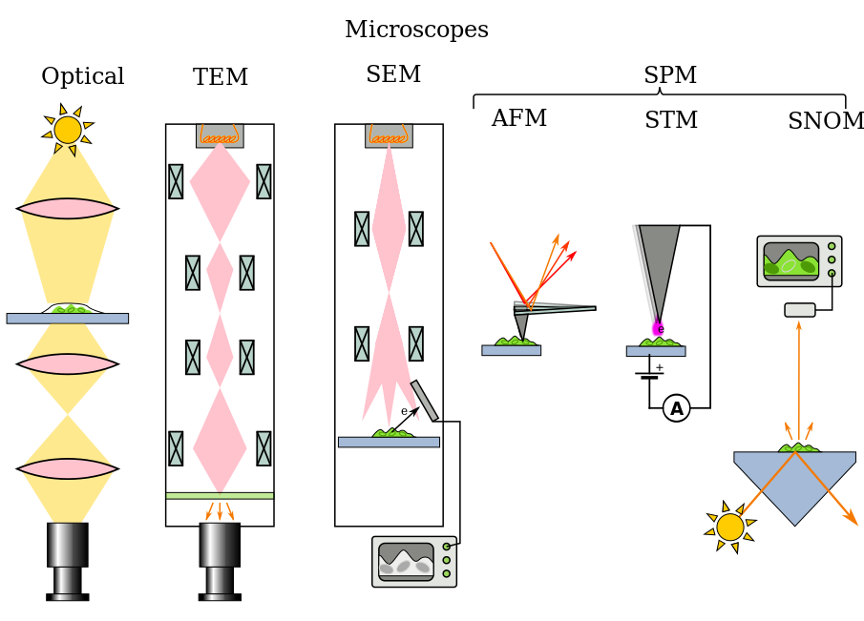
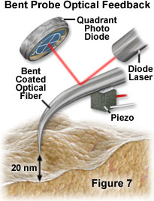
Notes:
https://en.wikipedia.org/wiki/Microscope
http://micro.magnet.fsu.edu/primer/techniques/nearfield/nearfieldintro.html
Figure 7

Slide 30
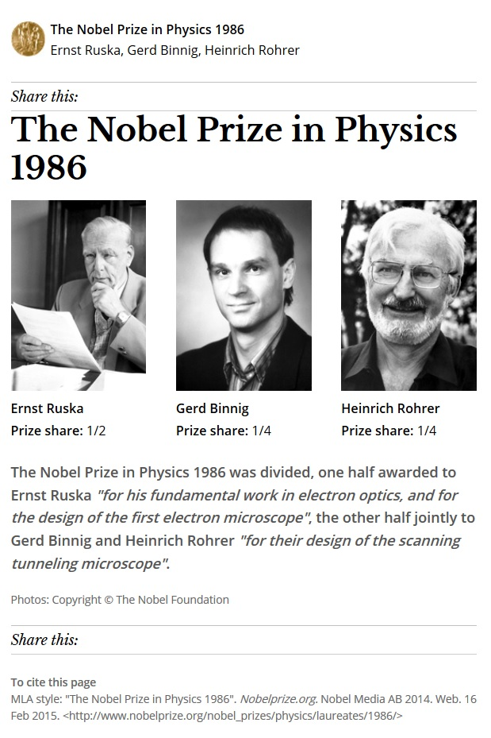
Scanning Tunneling Microscopy
Images surface at atomic level
Developed in 1981
Binning and Rohrer won Nobel for its development
Notes:
Quantum tunneling related phenomenon to evanescent waves, Schrodinger wave equation
Quantum tunnelling or tunneling (see spelling differences) refers to the quantum mechanical phenomenon where a particle tunnels through a barrier that it classically could not surmount.

Slide 31
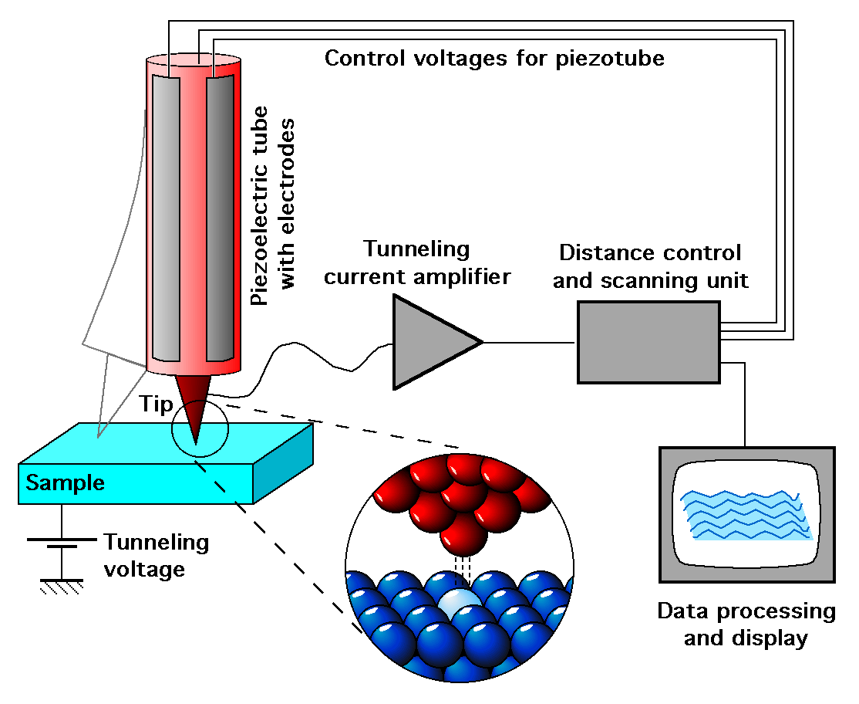
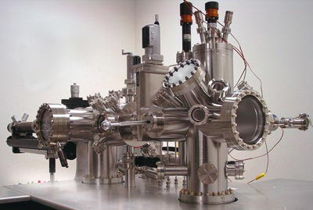
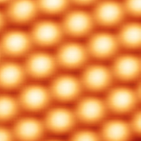
Scanning Tunneling Microscopy
Images surface at atomic level
Developed in 1981
Binning and Rohrer won Nobel for its development
Works via quantum tunneling
Schrödinger equation
Notes:
Quantum tunneling related phenomenon to evanescent waves, Schrodinger wave equation
http://en.wikipedia.org/wiki/Scanning_tunneling_microscope
http://www.ieap.uni-kiel.de/surface/ag-kipp/stm/stm.htm
"Silicium-atomes" by Guillaume Baffou - Image de microscopie à effet tunnel réalisée au lppm à Orsay. Licensed under CC BY-SA 3.0 via Wikimedia Commons - http://commons.wikimedia.org/wiki/File:Silicium-atomes.png#mediaviewer/File:Silicium-atomes.png
Quantum tunnelling or tunneling (see spelling differences) refers to the quantum mechanical phenomenon where a particle tunnels through a barrier that it classically could not surmount.

Slide 32
Near-Field Scanning Optical Microscopy (NSOM)
Break the diffraction limit by working in the near-field
Illuminated “spot” is smaller than diffraction limit
(about the size of the tip for a distance equivalent to tip diameter)
Launch light through small aperture
Near-field = distance of a couple of tip diameters
Notes:
One of the more intuitive super-resolution techniques

Slide 33
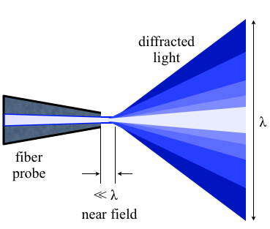
NSOM working in the near-field
Aperture diameter less than the wavelength of light
In 1993 Eric Betzig and Robert Chichester used NSOM for repetitive single molecule imaging
Notes:
In 1993, this situation changed markedly when Eric Betzig and Robert Chichester reported the first repetitive imaging of single fluorophores at room temperature with a new technique called near-field scanning optical microscopy (NSOM) that repeatedly scans an extremely small optical probe over a sample. This provided molecule-scale spatial localization and information on molecular orientation. The potential biological applications of single-molecule imaging captured the imaginations of microscopists and biologists alike, but because of its invasiveness and complexity NSOM proved largely unsuitable for complex biological samples.
http://www.nature.com/milestones/milelight/full/milelight17.html
"Nearfield optics" by Zogdog602 - Own work. Licensed under CC BY 3.0 via Wikimedia Commons - http://commons.wikimedia.org/wiki/File:Nearfield_optics.png#mediaviewer/File:Nearfield_optics.png

Slide 34
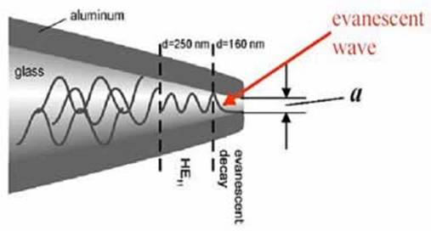
NSOM working in the near-field
Near-field near surface of object, < λ of light
Near-field consists of light as evanescent wave
Evanescent waves higher frequency, more information
Evanescent waves quantum tunneling phenomenon
Product of Schrödinger wave equations
Notes:
http://micro.magnet.fsu.edu/primer/techniques/nearfield/nearfieldintro.html
http://www.azonano.com/article.aspx?ArticleID=1205

Slide 35
Near-Field Scanning Optical Microscopy (NSOM)
How to make an NSOM tip
Tip of pulled quartz fiber
Aluminize tip to minimize loss of light
Very small fraction of light makes it through small (50nm) aperture

Slide 36
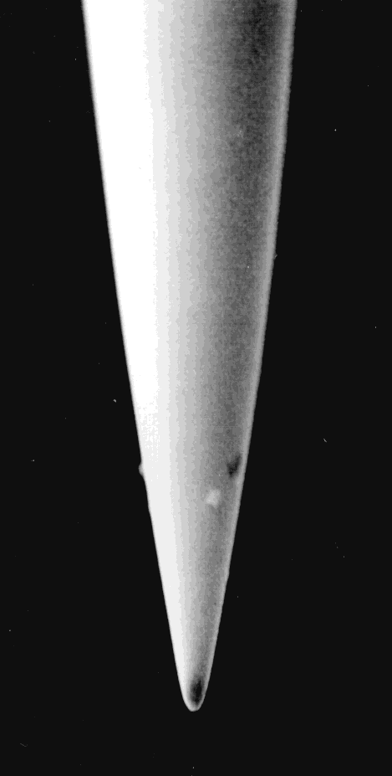
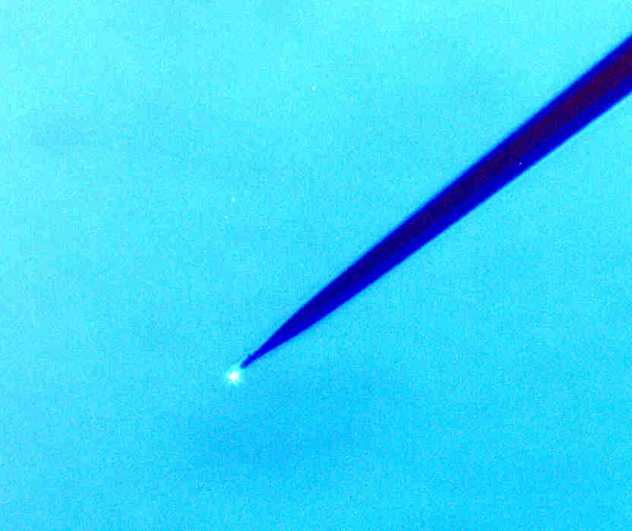
Near-Field Scanning Optical Microscopy (NSOM)
SEM of tip
Tip shining on sample
(can detect with wide-field)

Slide 37
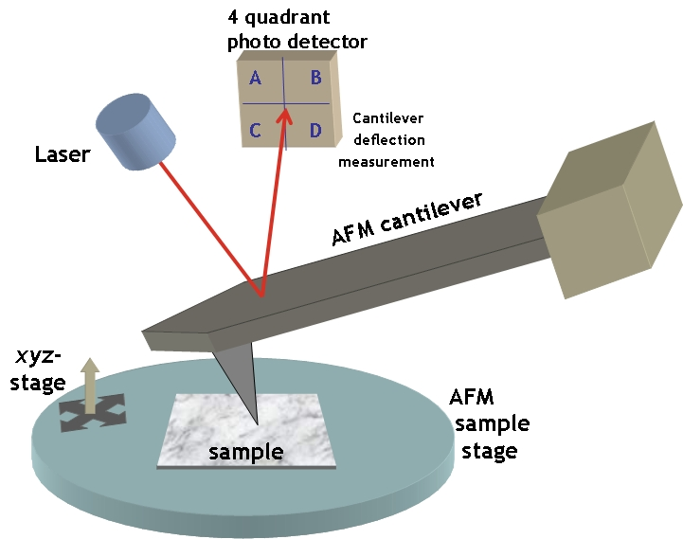
How to move the tip? Steal from AFM
Atomic Force Microscopy (AFM)
Notes:
Sharp tip at end of swinging cantilever
http://simple.wikipedia.org/wiki/Atomic_force_microscope

Slide 38
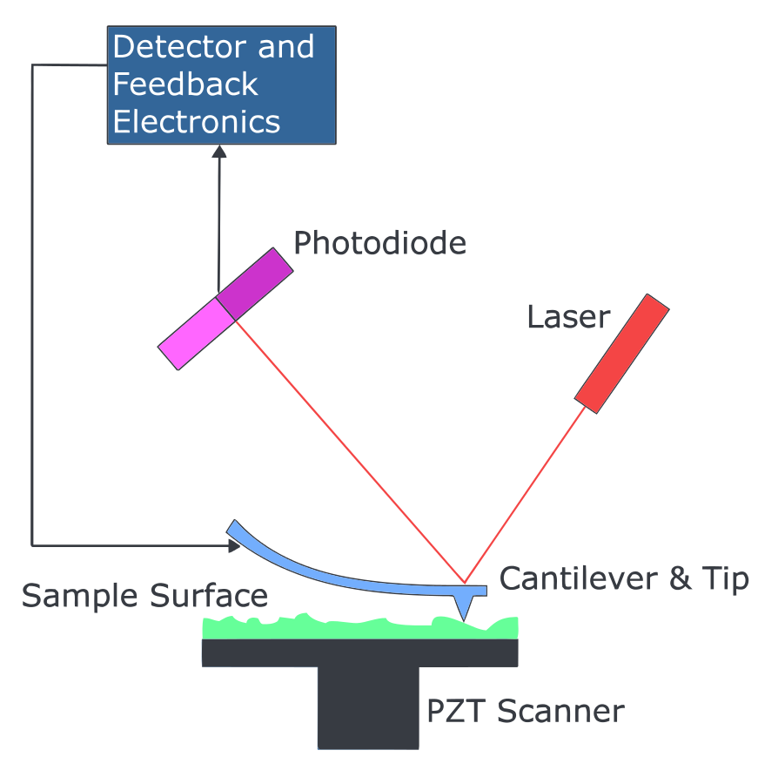
Atomic Force Microscopy (AFM)
Child of STM
Invented by Gerd Binnig, first experiments 1986
1000 times better resolution than optical microscopes
Scan specimen surface with very sharp tip
Notes:
http://en.wikipedia.org/wiki/Atomic_force_microscopy
"Atomic force microscope block diagram". Licensed under Public Domain via Wikimedia Commons - http://commons.wikimedia.org/wiki/File:Atomic_force_microscope_block_diagram.svg#mediaviewer/File:Atomic_force_microscope_block_diagram.svg

Slide 39
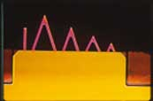
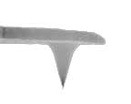

AFM tips
Most made of silicon but borosilicate glass and silicon nitride also used
Silicon Nitride
Sharp tip
Super tip
Notes:
Super sharp tips provide better resolution. low spring constant and high sensitivity of a Silicon Nitride
Bruker's Sharp Microlever (MSNL) probes are the industry standard forhigh-performance imaging with TappingMode in fluid. These probes marrythe sharpness of a Silicon tip with the low spring constant and highsensitivity of a Silicon Nitride cantilever, for an unprecedented levelof high-resolution and force control on just about any sample, in anymedium. The unique design of each MSNL probe includes six cantileverswith varying degrees of force constants and resonant frequencies,providing enough versatility to cover a large majority of sample types.

Slide 40
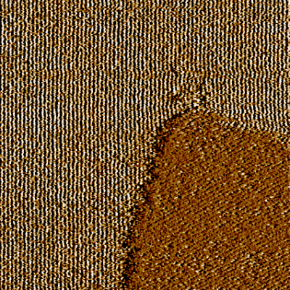
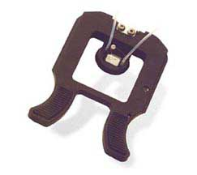
Atomic Force Microscopy (AFM)
Big advantage over SEM is that can image in liquid
Requires liquid cell for AFM
Two patches with different micelle orientation
Notes:
Figure 2: 400 nm AFM scans of Cetyltrimethylammonium chloride (CTAC) hemi-cylinders on a graphite surface. The images are taken at intervals of 70 sec. and show a dynamic competition between two patches of different micelle orientation.
Figure 2 shows an animated series of four images that were acquired on a graphite surface that is immersed in a 10 mM solution of Cetyltrimethyl-ammonium chloride (CTAC) surfactant. The images are all taken from the very same area of the sample, in intervals of 70 seconds. The parallel lines with a spacing of about 5 nm represent hemi-cylindrical micellar aggregates of surfactant on graphite. All images show two areas with different orientations of the lines, making an angle of 120�. The image series documents a lively competition between the two areas, illustrating the dynamic nature of these aggregates. Based on this experimental evidence, an advanced model of the adsorption process was developed that takes into account interactions on the atomic scale as well as on the mesoscopic scale
http://www.princeton.edu/~cml/html/research/surfactant_aggregates.html

Slide 41
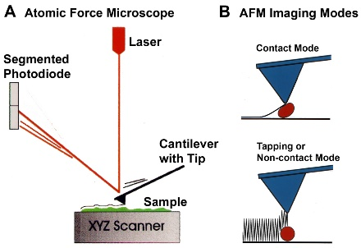
AFM has two types of imaging modes
Notes:
AFM imaging in contact mode can damage or distort some soft biological samples. Tapping Mode or Non-contact Mode minimizes this problem by having the tip oscillate over the sample, making only brief intermittent contacts. This mode also provides additional information about the sample surface in the phase image that corresponds to the height image.
http://web.physics.ucsb.edu/~hhansma/biomolecules.htm

Slide 42
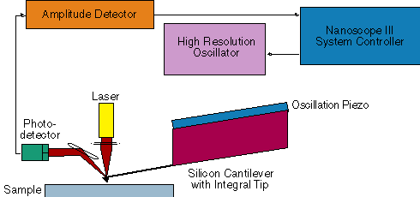
Modification to do tapping or non-contact mode
Notes:
In non-contact atomic force microscopy mode, the tip of the cantilever does not contact the sample surface. The cantilever is instead oscillated at either its resonant frequency (frequency modulation) or just above (amplitude modulation) where the amplitude of oscillation is typically a few nanometers (<10 nm) down to a few picometers.^{[14]} The van der Waals forces, which are strongest from 1 nm to 10 nm above the surface, or any other long-range force that extends above the surface acts to decrease the resonance frequency of the cantilever. This decrease in resonant frequency combined with the feedback loop system maintains a constant oscillation amplitude or frequency by adjusting the average tip-to-sample distance. Measuring the tip-to-sample distance at each (x,y) data point allows the scanning software to construct a topographic image of the sample surface.

Slide 43
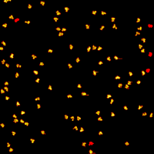
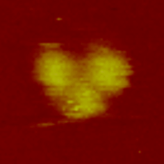
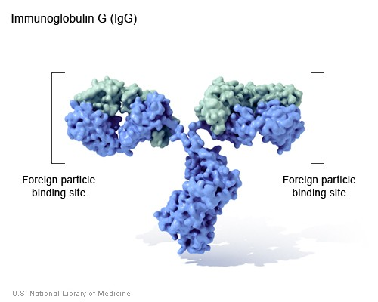
AFM (tapping mode) of IgG
Notes:
http://ghr.nlm.nih.gov/handbook/illustrations/igg

Slide 44
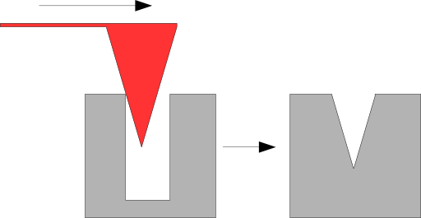
AFM does have some disadvantages
Imaging area is small
Scan speed slow
Can be affected by nonlinearities
Image artifacts, e.g. steep walls or overhangs
Notes:
A disadvantage of AFM compared with the scanning electron microscope (SEM) is the single scan image size. In one pass, the SEM can image an area on the order of square millimeters with a depth of field on the order of millimeters, whereas the AFM can only image a maximum height on the order of 10-20 micrometers and a maximum scanning area of about 150×150 micrometers. One method of improving the scanned area size for AFM is by using parallel probes in a fashion similar to that of millipede data storage.
The scanning speed of an AFM is also a limitation. Traditionally, an AFM cannot scan images as fast as a SEM, requiring several minutes for a typical scan, while a SEM is capable of scanning at near real-time, although at relatively low quality. The relatively slow rate of scanning during AFM imaging often leads to thermal drift in the image^{[28][29][30]} making the AFM less suited for measuring accurate distances between topographical features on the image. However, several fast-acting designs ^{[31][32]} were suggested to increase microscope scanning productivity including what is being termed videoAFM (reasonable quality images are being obtained with videoAFM at video rate: faster than the average SEM). To eliminate image distortions induced by thermal drift, several methods have been introduced.^{[28][29][30]}
AFM images can also be affected by nonlinearity, hysteresis,^{[33]} and creep of the piezoelectric material and cross-talk between the x, y, z axes that may require software enhancement and filtering. Such filtering could "flatten" out real topographical features. However, newer AFMs utilize real-time correction software (for example, feature-oriented scanning^{[28][34]}) or closed-loop scanners, which practically eliminate these problems. Some AFMs also use separated orthogonal scanners (as opposed to a single tube), which also serve to eliminate part of the cross-talk problems.
Showing an AFM artifact arising from a tip with a high radius of curvature with respect to the feature that is to be visualized.
As with any other imaging technique, there is the possibility of image artifacts, which could be induced by an unsuitable tip, a poor operating environment, or even by the sample itself, as depicted on the right. These image artifacts are unavoidable; however, their occurrence and effect on results can be reduced through various methods. Artifacts resulting from a too-coarse tip can be caused for example by inappropriate handling or de facto collisions with the sample by either scanning too fast or having an unreasonably rough surface, causing actual wearing of the tip.
AFM artifact, steep sample topography
Due to the nature of AFM probes, they cannot normally measure steep walls or overhangs. Specially made cantilevers and AFMs can be used to modulate the probe sideways as well as up and down (as with dynamic contact and non-contact modes) to measure sidewalls, at the cost of more expensive cantilevers, lower lateral resolution and additional artifacts.

Slide 45
Near-Field Scanning Optical Microscopy (NSOM)
Break the diffraction limit by working in the near-field
Like AFM can do NSOM with tapping mode
Requires bent tip
Move tip up and down like AFM
Not best way of doing NSOM
  Hard to make probe
  Bend causes loss of light
Notes:
There are several drawbacks in the application of bent optical probes, each of which can be attributed to the bend itself. A significant problem is the increased difficulty of the probe fabrication, especially when applying a metal coating to the tip. An additional disadvantage is the increased optical loss that occurs due to the bend in the probe. This loss in throughput efficiency is significant, and some published measurements indicate that bent optical fiber probes are at least an order of magnitude less efficient than conventional straight fiber probes. In certain operational modes of NSOM, the intensity loss is not a serious limitation because additional light can be coupled into the fiber to compensate, assuming sufficient laser power is available. The increase in optical coupling is an option because the optical losses, as well as increased heating, occur at the bend in the fiber and not at the aperture of the probe, where local heating would present a major problem. Another potential drawback with bent probes is a change in certain tip properties that occurs due to the presence of the bend, such as a decrease in extinction coefficients when performing polarized light measurements. Extinction ratios of approximately 70:1 have been measured in the far-field utilizing bent tips, as compared to values of greater than 100:1 with conventional straight fiber probes.

Slide 46
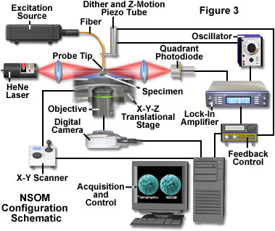
If not tapping like AFM how else to scan tip in NSOM?
Shear force mode.
Advantage: don’t need laser to keep track of probe.
To keep tip in near-field, need to be ~50nm from surface
Notes:
The main problem associated with this type of feedback mechanism is that the light source (for example, a laser), which is used to detect the tip vibration frequency, phase, and amplitude, becomes a potential source of stray photons that can interfere with the detection of the NSOM signal. One mechanism for dealing with this effective increase in background signal is to provide a feedback light source that has a different wavelength (usually longer) than the near-field source. This scheme requires additional filtration in front of the detector to selectively block the unwanted photons originating within the feedback system. In most cases, the added filters also block a small percentage of the near-field photons, resulting in reduced signal levels. A non-optical feedback method is not subject to problems of this nature, and is a primary reason that methods such as the tuning-fork technique (described below) have become increasingly popular.

Slide 47
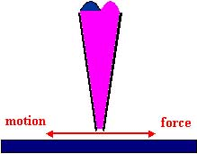
Sense presence of surface from dithering tip (lateral)
(Increased shear force when surface is near)
Keep dithering amplitude low <10 nm
Notes:
Betzig used this approach in 1992 to make NSOM more useful
The shear-force feedback method laterally dithers the probe tip at a mechanical resonance frequency in proximity to the specimen surface. The dither amplitude is usually kept low (less than 10 nanometers) to prevent adversely affecting the optical resolution. For optimum image quality, shear-force feedback techniques are usually restricted to use with specimens that have relatively low surface relief, and longer scan times are required compared to operation in tapping mode. However, the straight probes typically employed in shear-force feedback techniques are easier to fabricate and have a lower cost per probe than their bent probe counterparts.
http://micro.magnet.fsu.edu/primer/techniques/nearfield/nearfieldintro.html
http://zeiss-campus.magnet.fsu.edu/articles/superresolution/introduction.html

Slide 48
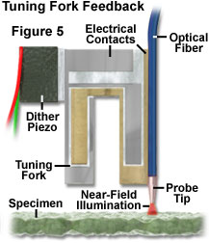
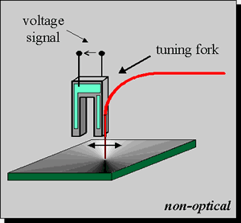
Shear force mode with non optical feedback
Use real-time feedback to keep probe in near-field range but not touching
Tip can be oscillated at resonance frequency
Tip can be straight
  Easier to make
  Cheaper
  But surface needs to be relatively flat
Notes:
There are several advantages of the tuning fork method that have led to its increased favor over optical techniques of tip regulation. Since the detection of the tip motion is not optical, there is no risk of additional stray light being introduced in the vicinity of the aperture that might interfere with the NSOM signal detection. Additionally, the tuning fork system does not require the tedious alignment procedures of a separate external laser source and associated focusing optical components. Because of the compactness and relative ease of use, the tuning fork method lends itself to applications requiring remote operation, such as those employed in vacuum systems or environmental control chambers.
The basic configuration of the tuning-fork method used for shear-force tip feedback consists of a single mode optical fiber attached to one arm of a quartz crystal tuning fork, which is oscillated at the tuning fork's resonance frequency. The equivalent circuit for the tuning fork is a series RLC resonator in parallel with package capacitance. The most common tuning fork resonance frequency is 32,768 hertz (Hz), but the devices are available with resonances ranging from 10 kilohertz to several tens of megahertz.

Slide 49
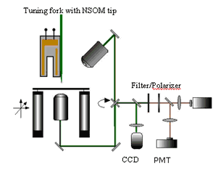
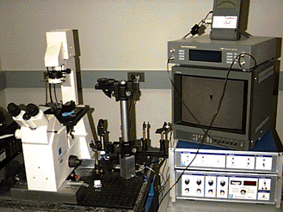
NSOM instrument

Slide 50
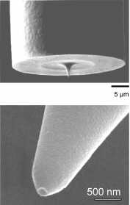
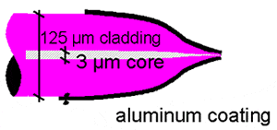
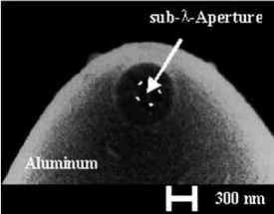
NSOM tips

Slide 51
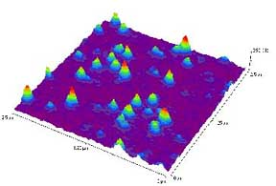
NSOM images
Single molecules of DiI on glass surface

Slide 52
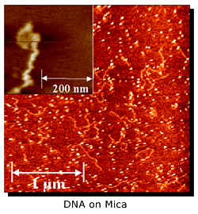
NSOM images

Slide 53
NSOM disadvantages
Practically zero working distance and small depth of field.
Extremely long scan times for high resolution images or large specimen areas.
Very low little light through such a tiny aperture.
Only features at surface of specimens can be studied.
Fiber optic probes are somewhat problematic for imaging soft materials due to their high spring constants, especially in shear-force mode.

Slide 54
Performance range of optical microscopy
SIM/STP
MRI
OCT
SPIM
Depth
(um)
CLSM
LM
NSOM
TIRF
Resolution
(um)
Notes:
serial two-photon (STP) tomography
http://www.nature.com/nature/journal/v508/n7495/full/nature13186.html#methods
http://www.nature.com/nmeth/journal/v9/n3/full/nmeth.1854.html

Slide 55
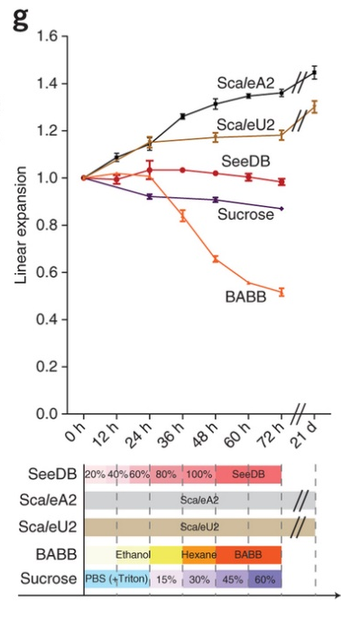
Homework 5
There are so many different ways to do super-resolution microscopy. Interestingly, an entirely novel method was just published this year in Science called expansion microscopy.
Question: What makes this super-resolution technique so novel compared to all the others?
Hint: see this figure from Ke, M.-T., Fujimoto, S., Imai, T., 2013. Nat Neurosci 16, 1154-1161.

