Slide 1
Biology 177: Principles of Modern Microscopy
Lecture 12:
Fluorescent labeling, multi-spectral imaging and FRET

Slide 2
Lecture 12: Fluorescent labeling, multi-sprectral imaging and FRET
How to characterize the performance of fluorescent probes?
“Quantitative“ Fluorescence
  Fluorescence linearity (non-linearity)
    Dye, microscope, camera
  Flat-fielding to linearize
  Quantitating the image
  Multispectral imaging
  FRET

Slide 3
Our discussion of fluorescence has made hidden assumption that dyes have an ideal behavior
How true is this?
Fluorescent Dye
Dipole antenna
Delocalized electrons
Longer dipole, longer λ
Notes:
http://micro.magnet.fsu.edu/primer/techniques/fluorescence/fluorescenceintro.html
http://olympusmicro.com/primer/java/jablonski/solventeffects/index.html

Slide 4
A good dye must absorb light well (high extinction coef.)
Dye in cuvette
Blue light absorbed
Beer’s Law
I_{out} = I_{in} e^{-ax}
I_{absorbed} = I_{out} - I_{in}
= I_{in}(1-e^{-εcx})
ε = extinction coefficient
For Fluorescein
ε ~ 70,000/(cm M/liter)
490nm
Light absorbed
Wavelength
Notes:
Beer Lambert Law
x = distance light travels through the material
α = attenuation coefficient
The attenuation coefficient is a quantity that characterizes how easily a material or medium can be penetrated by a beam of light. A large attenuation coefficient means that the beam is quickly "attenuated" (weakened) as it passes through the medium, and a small attenuation coefficient means that the medium is relatively transparent to the beam.
α = ε c
c = concentration of attenuating species in material
ε =extinction coefficient also called molar absorption coefficient, absorptivity of attenuator

Slide 5
Fluorophore absorption
Green dye in cuvette
L
I_{in}
I_{out}
Blue light absorbed
Beer-Lambert law
I_{out} = I_{in} exp (- ε L c)
I_{absorbed} = I_{out} - I_{in}
I_{in}: incident light intensity (in W.cm⁻²)
L: absorption path length (in cm)
c: concentration of the absorber (in M or mol.L⁻¹)
ε: molar absorption coefficient (in M⁻¹cm⁻¹ or mol⁻¹.L.cm⁻¹)
Fluorescein ε ~ 70,000 M⁻¹.cm⁻¹
eGFP ε ~ 55,000 M⁻¹.cm⁻¹
Light absorbed
Wavelength
Notes:
Classically, the Beer–Lambert law was first devised independently where Lambert's law stated that absorbance is directly proportional to the thickness of the sample, and Beer's law stated that absorbance is proportional to the concentration of the sample. The modern derivation of the Beer–Lambert law combines the two laws and correlate the absorbance to both, the concentration as well as the thickness (path length) of the sample.

Slide 6
Fluorophore absorption
Other expressions of the Beer-Lambert law:
I_{out} = I_{in} exp (- ε L c)
I_{out} = I_{in} exp (- σ L N)
I_{out} = I_{in} exp (- µ_{a} L)
I_{in}: incident light intensity in W.cm⁻²
L: absorption path length in cm
c: concentration of the absorber in M or mol.L⁻¹
N: density of the absorber in molecule.cm⁻³
ε: molar absorption coefficient in M⁻¹cm⁻¹ or mol⁻¹.L.cm⁻¹
σ: absorption cross section in cm² or cm².molecule⁻¹
µ_{a}: absorption (attenuation) coefficient in cm⁻¹
N = N_{Avogadro} . 10⁻³ c (1L = 10³ cm³)
ε = N_{Avogadro} . 10⁻³ σ = 6.022 10²⁰ σ
eGFP
ε = 55,000 M⁻¹.cm⁻¹
σ = 9.13 10⁻¹⁷ cm².molecule⁻¹
Notes:
To describe the attenuation coefficient in a way independent of the material density, one introduces the cross section σ = μ/n, where n is the numerical density (number of atoms per volume) of the material. σ has the dimension of an area; it expresses the likelihood of interaction between particles.
The attenuation (or absorption) coefficient is a quantity that characterizes how easily a material or medium can be penetrated by a beam of light. A large attenuation coefficient means that the beam is quickly "attenuated" (weakened) as it passes through the medium, and a small attenuation coefficient means that the medium is relatively transparent to the beam.

Slide 7
Fluorophore absorption
µ_{t} = µ_{a} + µ_{s}
In the literature…
The “extinction coefficient” is usually given in tables.
confusions:
- “extinction coefficient” used for “absorption coefficient” (it assumes the scattering coefficient is negligible)
- “extinction coefficient” used for “molar extinction coefficient” (check the unit!)
ε(λ)!
The maximum is given in tables, or the excitation wavelength is indicated.
extinction
coefficient
absorption
coefficient
scattering
coefficient
µ_{t}= εc
µ_{a} = ε_{a} c
ε = ε_{a} if no scattering
molar
extinction
coefficient
molar
absorption
coefficient

Slide 8
Fluorophore absorption
Example: Properties of fluorescent protein variants
it is the molar absorption coefficient
Shaner et al, Nature Biotechnology, 2004

Slide 9
Fluorophore absorption
Green dye in cuvette
L
I_{emitted}
Green light emitted
I_{in}
I_{out}
Blue light absorbed
Quantum Yield
Q = I_{emitted} /I_{absorbed}
= # photons emitted / # photons absorbed
(I_{absorbed} = I_{out} - I_{in)}
Fluorescein Q ~ 0.8
Rhodamine B Q ~ 0.3
eGPP Q ~ 0.6
Stokes Shift
490nm
520nm
Light absorbed
Light emitted
Wavelength

Slide 10
Fluorophore brightness = εQ
Example: Properties of fluorescent protein variants
DsRed εQ ~ 0.79 x 75,000 ~ 59,250 M⁻¹.cm⁻¹ (100%)
mRFP1 εQ ~ 0.25 x 50,000 ~ 12,500 M⁻¹.cm⁻¹ (21%)
eGFP εQ ~ 0.6 x 55,000 ~ 33,000 M⁻¹.cm⁻¹ (56%)
Fluorescein εQ ~ 0.8 x 70,000 ~ 56,000 M⁻¹.cm⁻¹ (95%) (dye!)
Notes:
Shaner et al, Nature Biotechnology, 2004

Slide 11
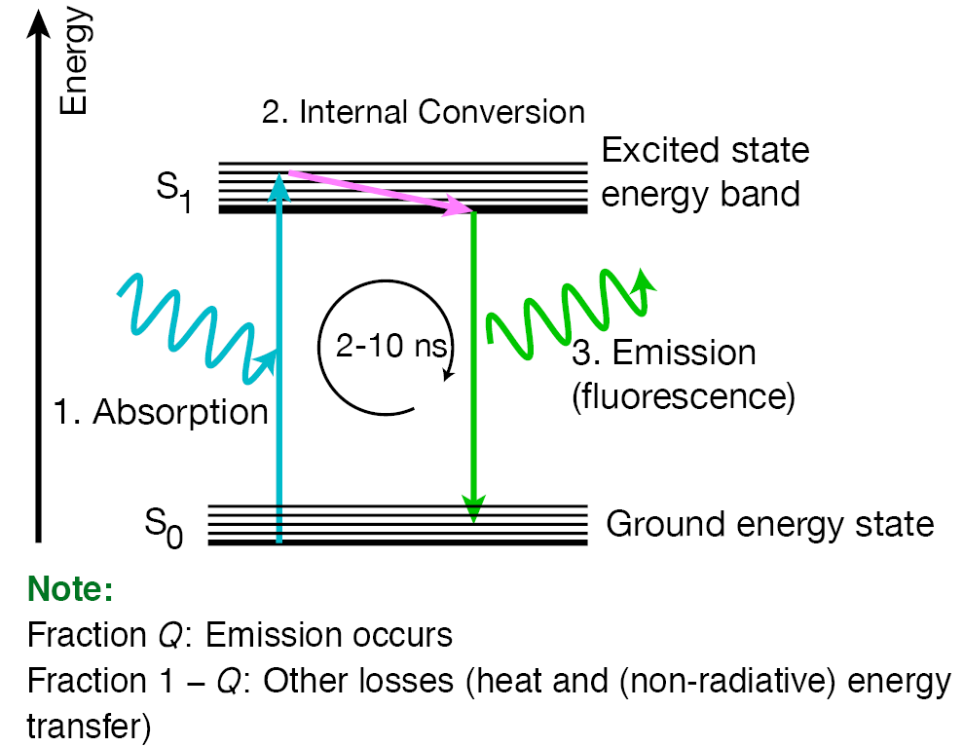
The dilute limit
Extinction coefficient and quantum yield corresponds to “well behaved” dye in the dilute limit: dilute photon and dilute dye
From Michael Liebling, UCSB

Slide 12
The dilute limit: dilute photons
As photons hit specimen: dye molecules excited and less dye left unexcited
Saturation!
Dye remaining to be excited
Emission Intensity
Excitation intensity
Excitation intensity

Slide 13
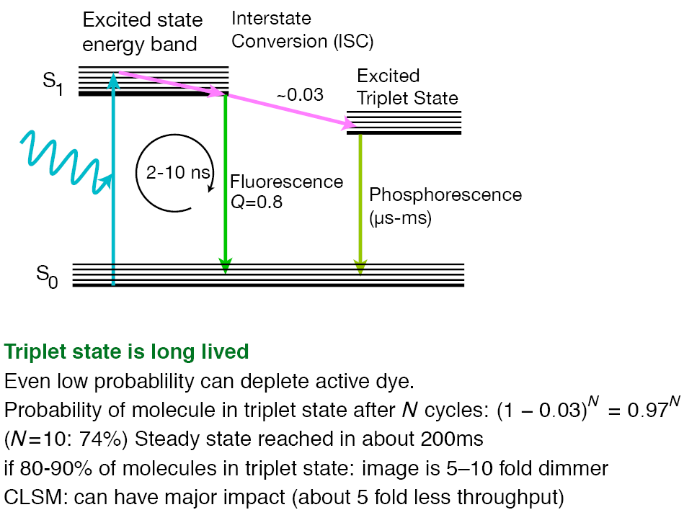
Interstate (or Intersystem) crossing (ISC)
From Michael Liebling, UCSB

Slide 14
Interstate crossing (ISC) and photobleaching
As ISC takes place: less dye molecules available and unexcitable dye accumulates
From Michael Liebling, UCSB

Slide 15
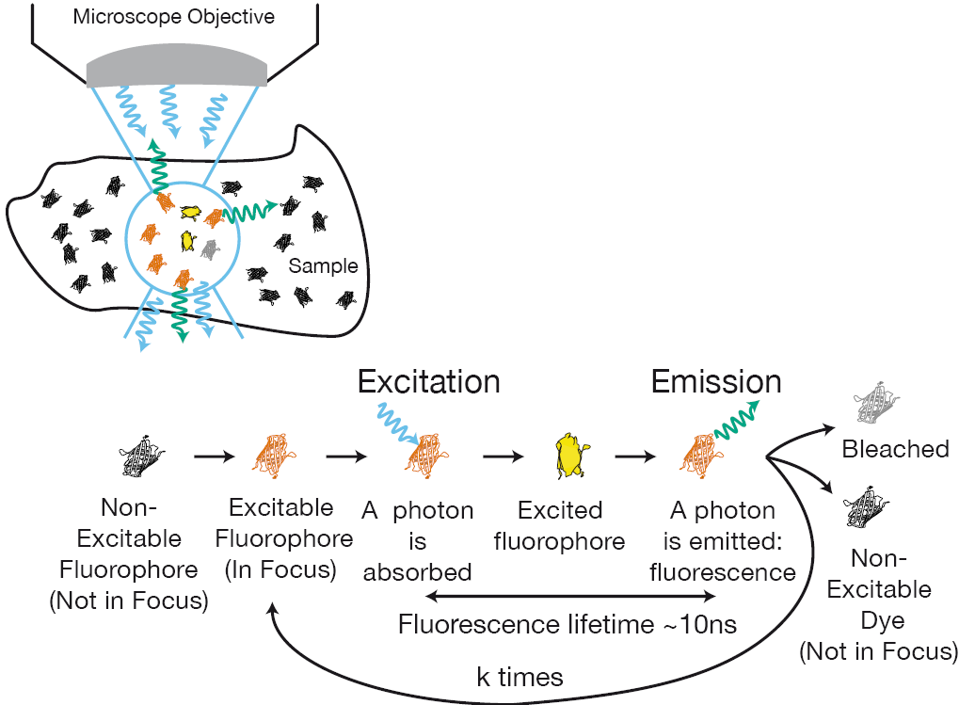
Cycle of a fluorophore
From Michael Liebling, UCSB

Slide 16
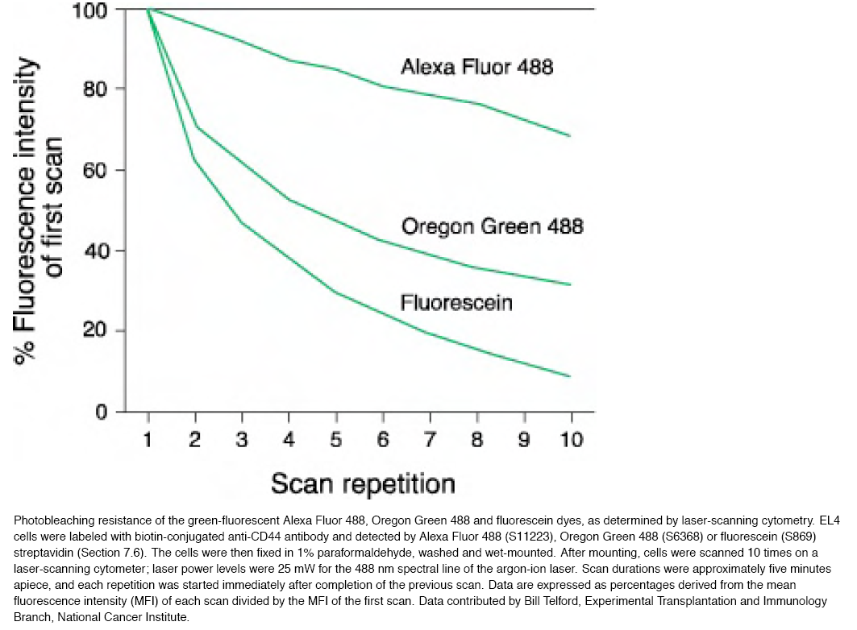
Interstate crossing (ISC) and photobleaching
A good dye is more photostable (less photobleaching)

Slide 17
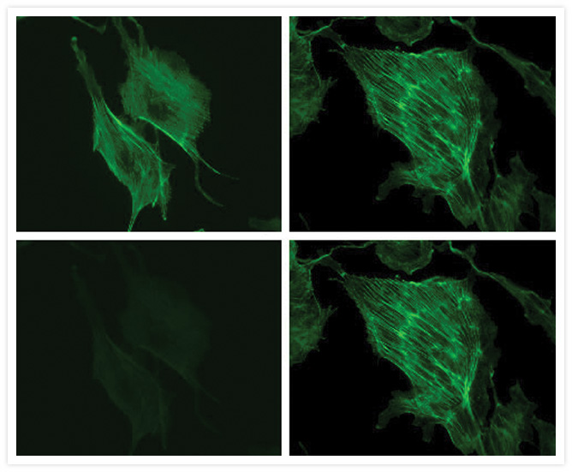
Interstate crossing (ISC) and photobleaching
Fluorescein
Alexa 488
after 30 seconds
Bovine pulmonary artery endothelial cells (BPAEC) were labeled with fluorescein phalloidin (left panels, Cat. no. F432), or Alexa Fluor® 488 phalloidin (right panels, Cat. no. A12379), which labels filamentous actin, and mounted in PBS. The cells were placed under constant illumination on the microscope with an FITC filter set using a 60× objective. Images were acquired at one-second intervals for 30 seconds. Under these illumination conditions, fluoresce in photobleached to about 20% of its initial value in 30 seconds; the fluorescence of Alexa Fluor® 488 phalloidin stayed at the initial value under the same illumination conditions.
Notes:
http://www.lifetechnologies.com/us/en/home/technical-resources/research-tools/image-gallery/image-gallery-detail.altid.g001270.html

Slide 18
Photobleaching characterization
Example: Properties of fluorescent protein variants
Shaner et al, Nature Biotechnology, 2004
Notes:
Bleaching in seconds; obviously longer better, to a point

Slide 19
Resonance Energy Transfer (non-radiative)
Transfer of energy from one dye to another
Depends on:
Spectral overlap
Distance
Alignment
Notes:
http://www.olympusmicro.com/primer/techniques/fluorescence/fret/fretintro.html

Slide 20
RET is not always between dissimilar dyes
“Self-quenching” of dye
(“hot-potato” the energy until lost)
~0.1uM
Depends on:
Dye Concentration
Geometry
Environment
Log I
Log [dye]
Notes:
In a living biological sample can be difficult to reach such high dye concentration without killing cells or making them sick.

Slide 21
~0.1uM
“Self-quenching” of dye
Depends on:
Dye Concentration
Geometry
Log I
Log [dye]
Hard for emission from this one
Easier emission from this one
A uniformly dyed structure
Instead, looks “hollow”

Slide 22
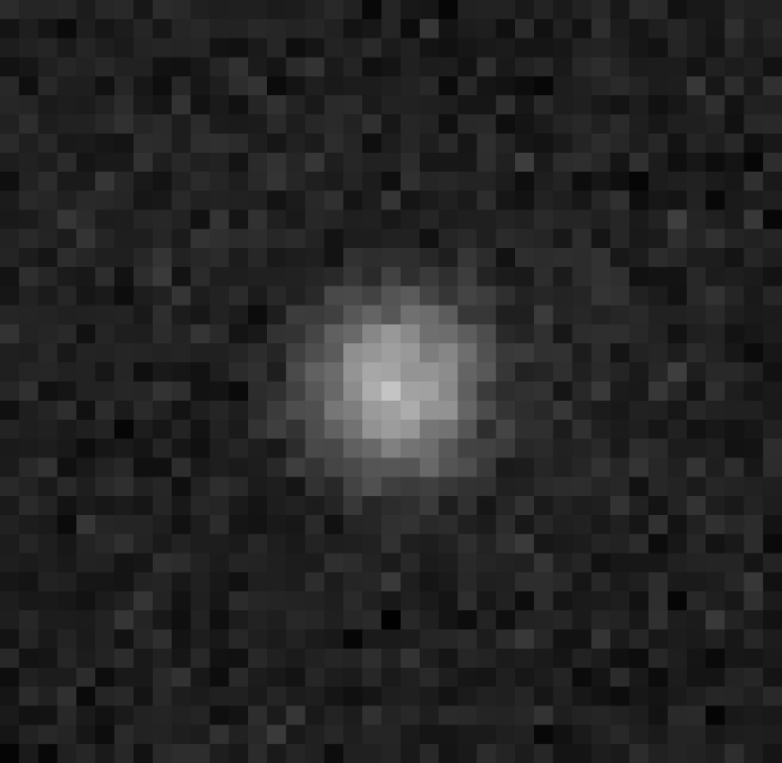
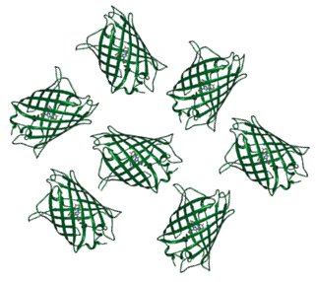
Fluorescence quantification based on signal intensity
input: [fluorophore]
Output: pixel grey levels
Example:
in = level of expression of a fluorescent protein
out = fluorescent signal and grey level of pixel on an image.
Notes:
Want higher bit depth. Do not bother with 8 bit images even though using it in these examples.

Slide 23
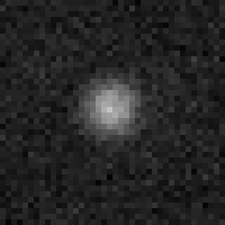
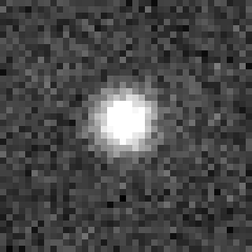
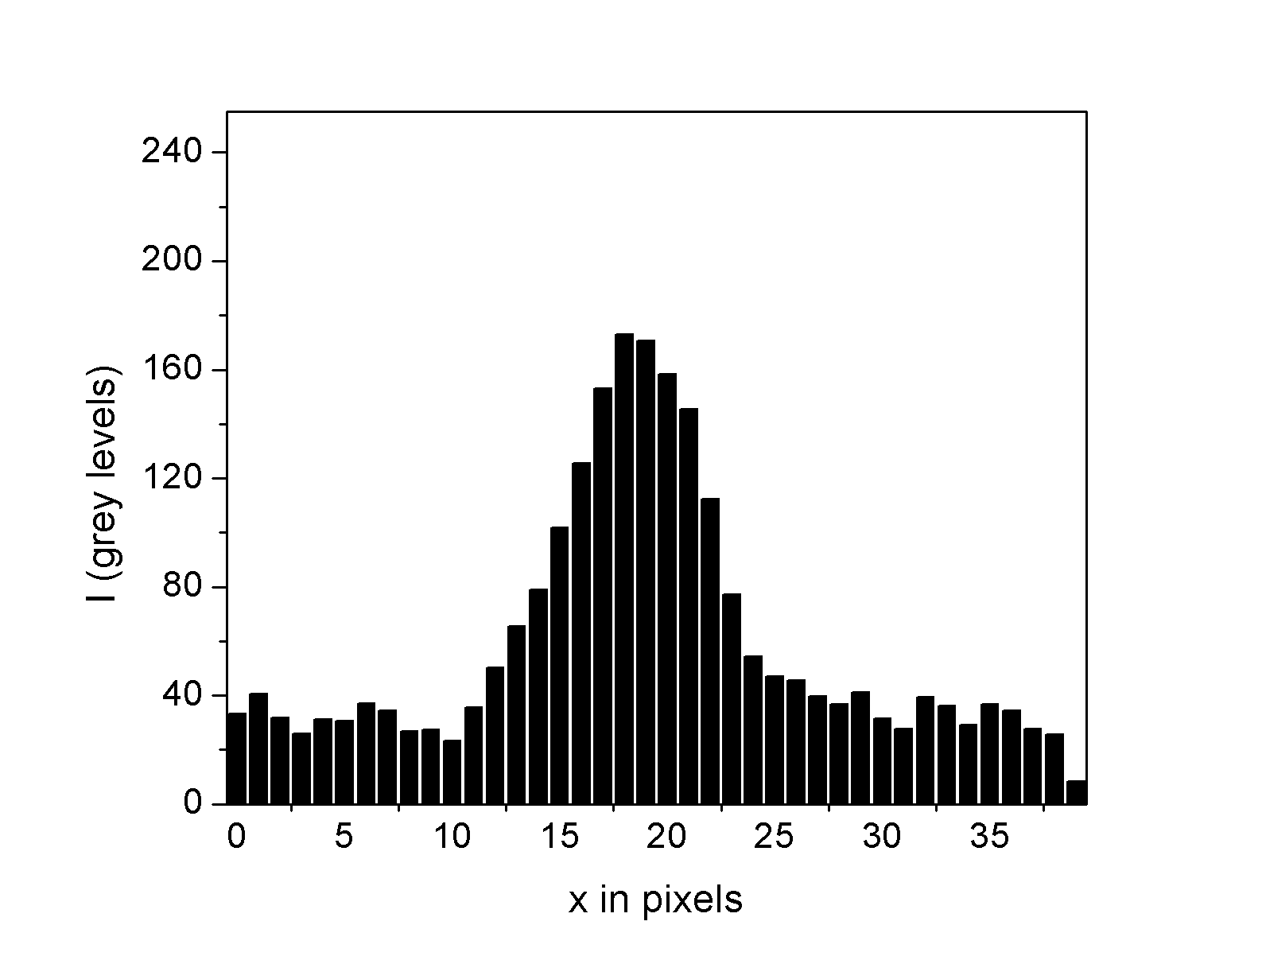
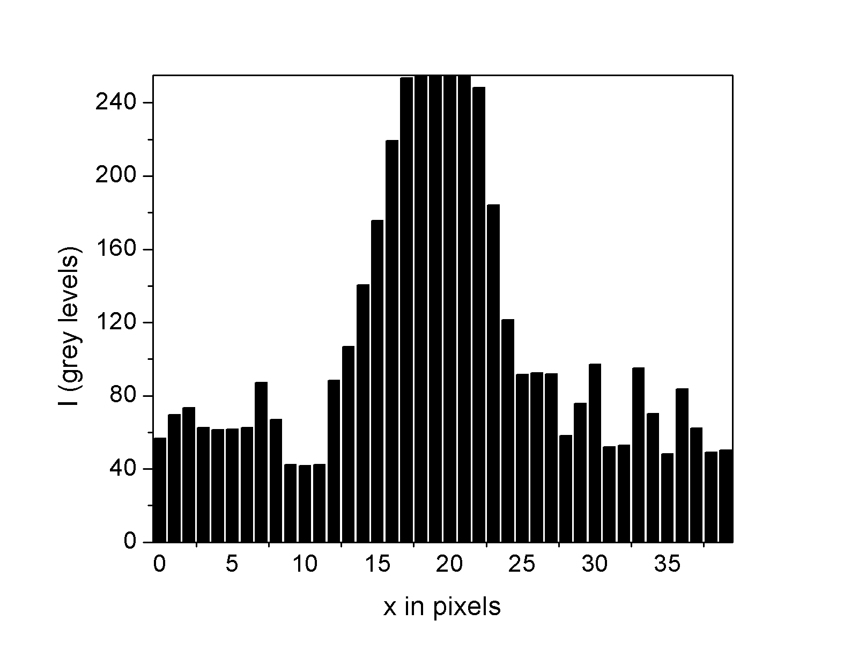
Example of nonlinearity: Pixel saturation
(detector or digital contrast)
Solution(s): use less power!!!, decrease the acquisition time, decrease [fluorophore],…
Notes:
What is the bit depth?

Slide 24
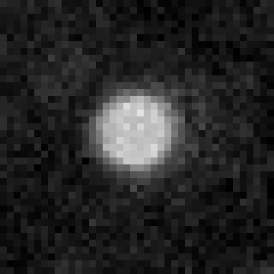
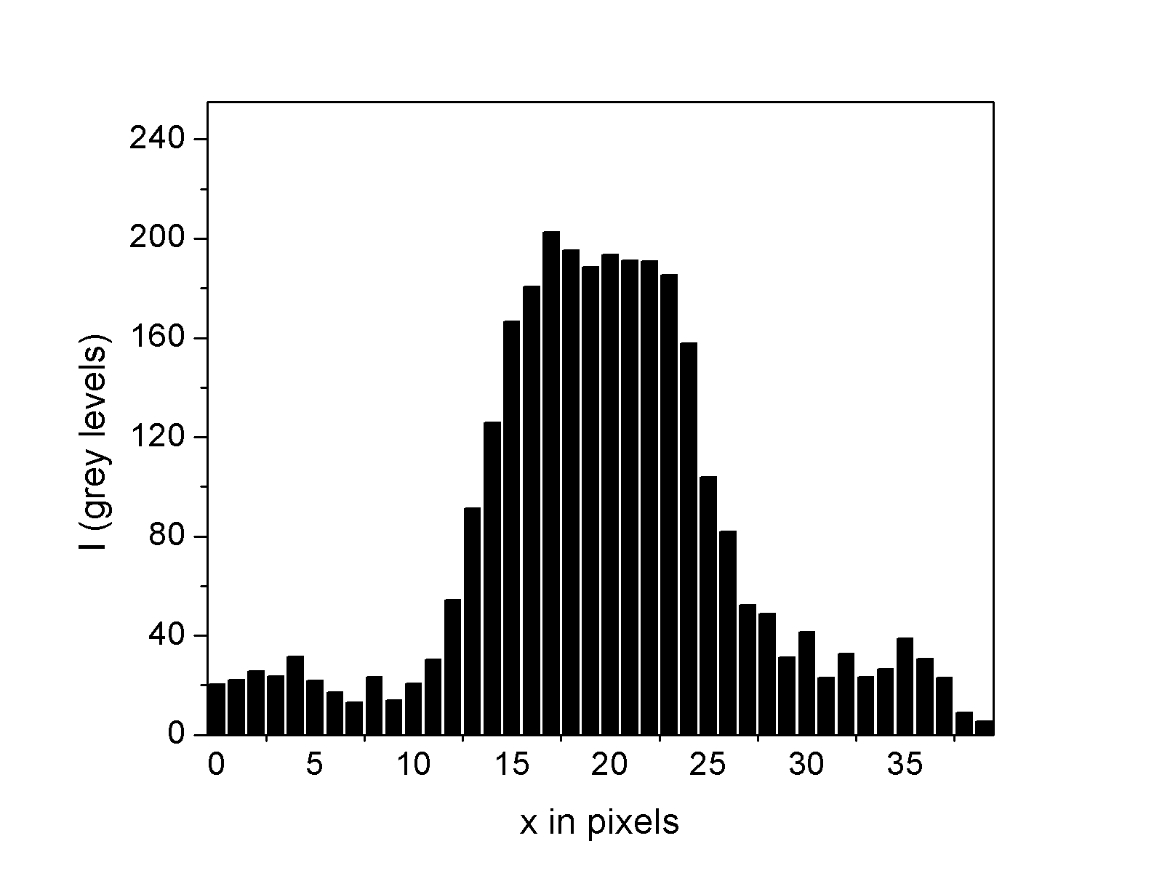
Example of nonlinearity: Fluorophore saturation
Solution(s): use less power!!!, decrease the acquisition time,…

Slide 25
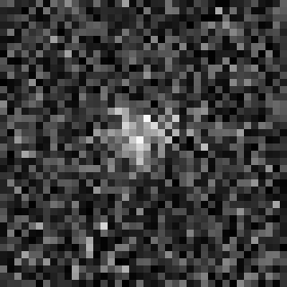
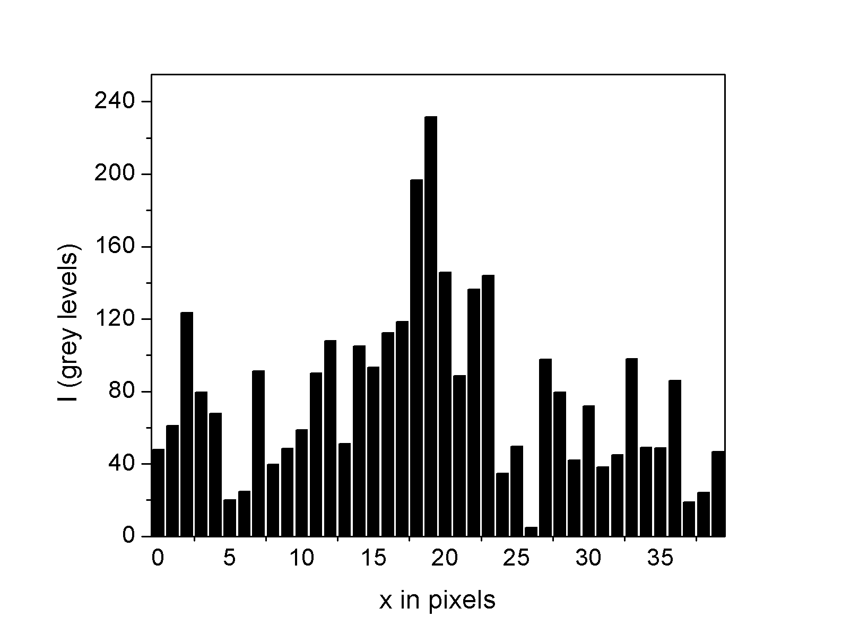
Example of nonlinearity: Noise
Solution(s): optimize the excitation wavelength, increase the acquisition time, use more power, use a stronger fluorophore, increase [fluorophore],…

Slide 26
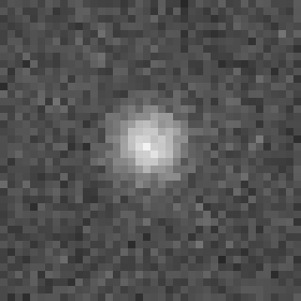
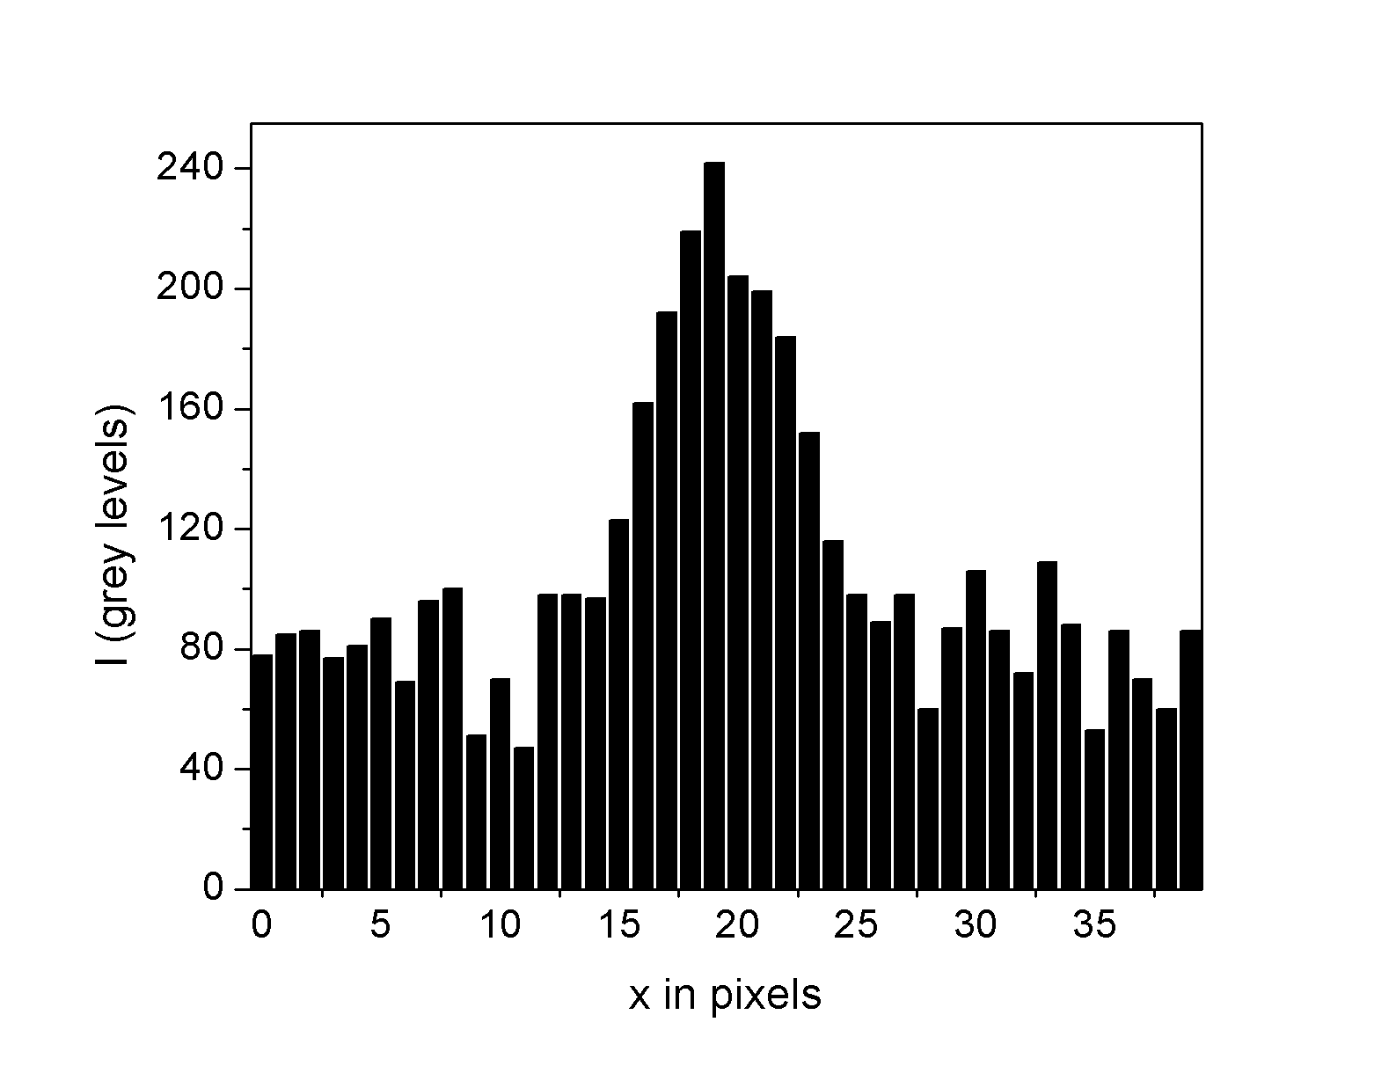
Example of nonlinearity: Photo-induced fluorescence
Solution(s): use less power!

Slide 27
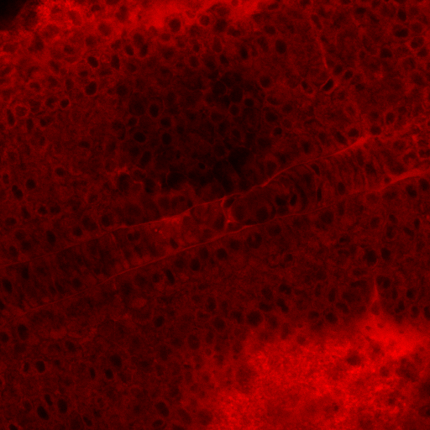
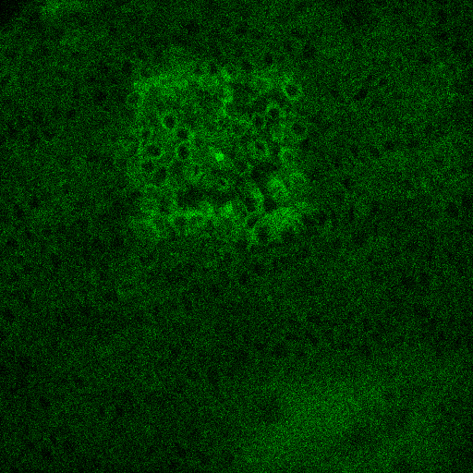
Example of nonlinearity: Photo-induced fluorescence
zoom out after imaging in this area
Bleaching!
Induced
auto-fluorescence!
Red channel
Green channel

Slide 28
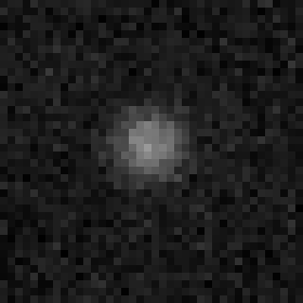
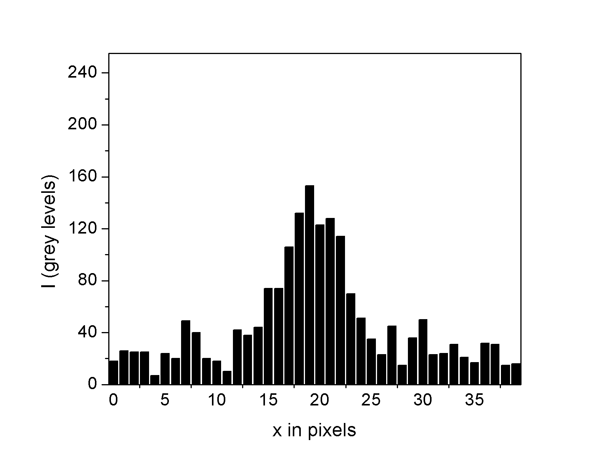
Compare what is comparable: Imaging depth
Same object imaged at different tissue depth…
The fluorescence level depends on
the depth of imaging and the optical properties of the tissue
(variation from one sample to another)…
All dyes look redder as you look deeper in tissue

Slide 29
How to protect yourself from non-linearities?
You can’t - but you can look for diagnostic defects
  Edges to structures
  Asymmetries in intensity
Test: reduce laser; does image reduce proportionately?
Avoid over-labeling
Avoid over-stimulating
“When in doubt, reduce intensity of stimulation”

Slide 30
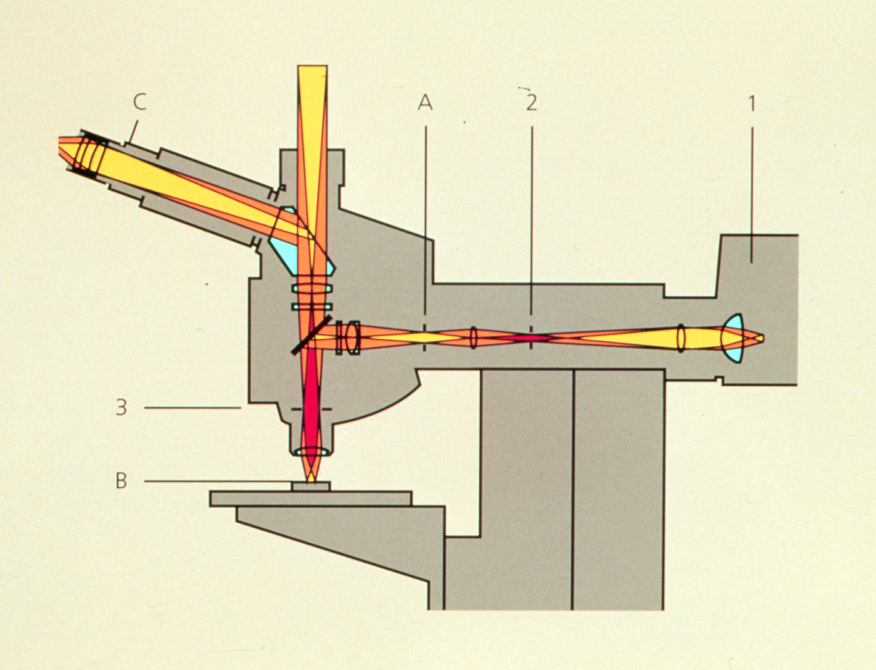
Microscope has non-linearities
Camera
Relay optics
Eyepieces
light source
(image of arc)
Objective

Slide 31
Microscope has non-linearities
Camera
Relay optics
Eyepieces
light source
(image of arc)
Objective

Slide 32
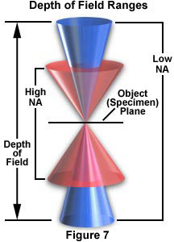
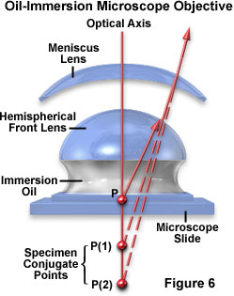
Objective lens better at collecting light near center

Slide 33
Microscope has non-linearities
Camera
Relay optics
Eyepieces
light source
(image of arc)
Objective

Slide 34
No free lunch from Confocal
Good: Single detector
Bad: Very sensitive to optical aberrations
Good: Single light source
Bad: Easy to saturate dye (less excitation, ISC)
Notes:
Why is single detector good?

Slide 35
Optical aberrations
Spherical aberration
Lateral chromatic aberration
Detector
Detector
Focus deeper below coverglass
Not corrected for
  spherical aberration
  chromatic aberration

Slide 36
Solution: Flat Fielding (pixel by pixel correction)
Requirements:
Specimen of uniform intensity
Set of specimens of different known brightness
Slide with double-stick tape
Cut holes in tape
Drop dye in holes
Different [dye] in each hole
Coverslip over the top

Slide 37
On pixel by pixel basis
Plot I vs dye concentration [dye]
Calculate slope & intercept
Intensity
Watch for warning sign
Sublinear -> self-quenching
[dye]
References:
Kindler & Kennedy (1996) J Neurosci Methods 68:61-70
Stollberg & Fraser (1988) J Cell Biol 107: 1397–1408.

Slide 38
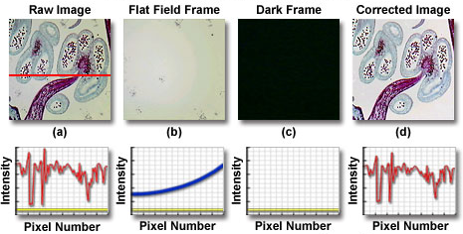
Flat-field correction of digital image
Corrected Image = [(Raw Image – Dark Frame) * M] / (Flat field Frame- Dark Frame)
Notes:
http://www.olympusmicro.com/primer/digitalimaging/imageprocessingintro.html
http://www.princetoninstruments.com/cms/index.php/library/51-ccd-primer/152-flat-field-correction
http://www.roper.co.jp/Html/roper/tech_note/html/timagecal.htm

Slide 39
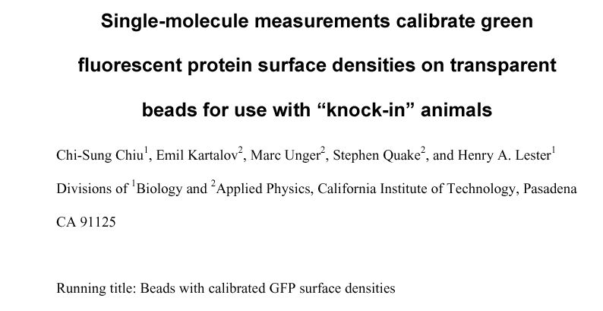
So how many fluorophores does a given intensity equal?
J Neurosci Methods 105:55-63 (2001)

Slide 40
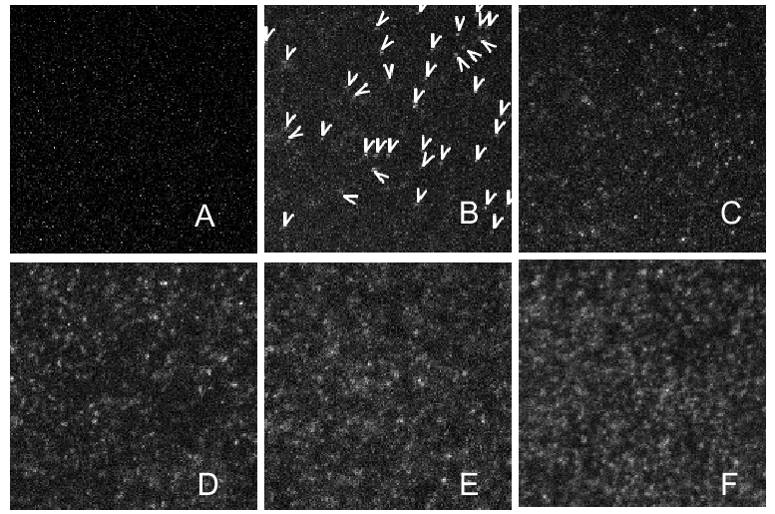
Single molecule calibration: Beads with Ni-NTA; GFP::His₆
0 pM
1 pM
10 pM
J Neurosci Methods 105:55-63 (2001)
Alternative: use viruses with defined numbers of GFP’s
Notes:
Fig. 1. Images of single histidine-tagged green fluorescent protein (beads at increasing densities in an area of 150 × 150 pixels (16.75 × 16.75 µm). Panel A shows that the blank bead does not have the typical ‘GFP points’. Panels B– F show images of the beads after incubation with solutions of increasing concentrations (10− 12, 2.5 × 10− 12, 5 × 10− 12, 10− 11, and 2.5 × 10− 11 In panel B, the arrowheads point to the 38 images accepted as arising from GFP molecules.

Slide 41
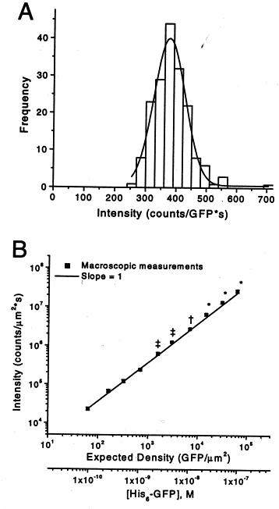
Macroscopic measurements based on single molecule calibration
Intensity proportional to # of GFP on beads over 3 orders of magnitude (Olympus)
Over 4 orders of magnitude for Nikon microscope
Density of membrane proteins can be measured to accuracy of about 20%
J Neurosci Methods 105:55-63 (2001)
Notes:
Fig. 2. Calibrations of beads. These results were obtained using the Olympus microscope at an incident beam intensity of 22.8 W/cm². (A) Histogram of fluorescence intensity distributions, fitted to a Gaussian with an average value of 376.4±2.6 counts/s (n=178). (B) The X axes are the [His₆-GFP] in the incubation solutions, and the resulting expected density of green fluorescent protein (GFP) molecules on the beads. The expected density assumes that binding to the beads is quantitative and that all bound His₆-GFP molecules are active, with the average fluorescence as in panel A. The Y value is the average fluorescence intensity, in counts/μm². Results for beads carrying the highest six densities were multiplied by a ‘photobleaching corrective factor’<1 to correct for reduced bleaching due to the use of neutral density filters on the excitation beam (see text). The correction factor for the 2.0 OD filter (*) is 0.781, for the 1.0 OD filter (†) 0.803, and for the 0.7 OD filter (‡) 0.825. Standard errors of the observations are smaller than the symbol size. (C) Measured intensity is compared with the expected intensity, computed as expected density×average fluorescence counts per GFP.

Slide 42
Multispectral Imaging
Spectral or Lambda Scanning
Instead of Z – stacks, collect λ – stacks

Slide 43
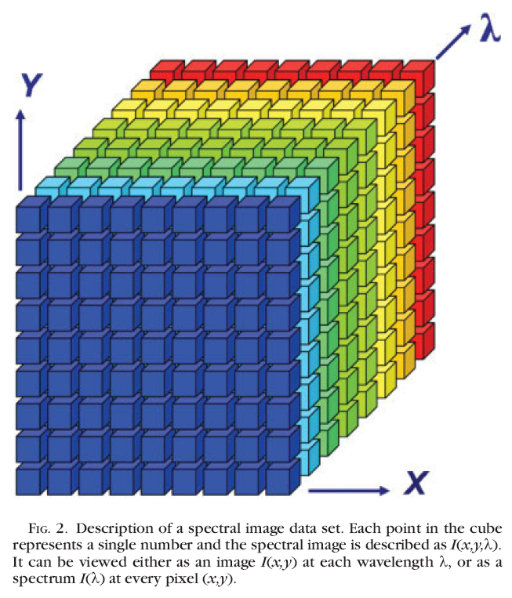
Spectral image dataset
λ-stack
λ can be:
(i) λ_{excitation}
images acquired in a single channel at different λ_{excitation}
(ii) λ_{emission}
images acquired at a single λ_{excitation} in several channels at different (λ_{emission})
Garini et al, Cytometry Part A, 2006

Slide 44
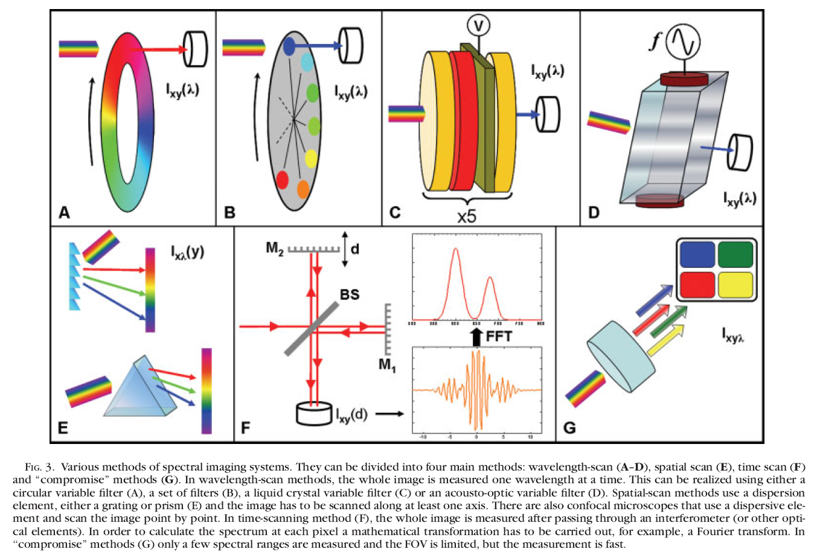
Spectral image dataset
Garini et al, Cytometry Part A, 2006
Notes:
Wave-length scans (A-D); Spatial Scan (E) is what will concentrate on.

Slide 45
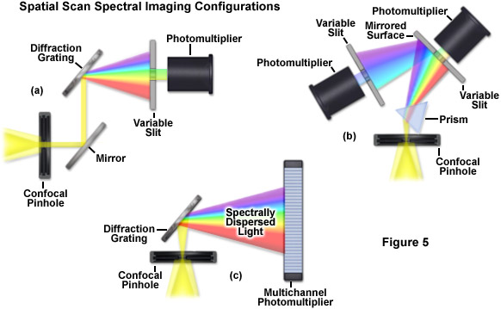



Spectral imaging methods: Spatial-scan
3 Different ways used by microscope companies
Notes:
http://zeiss-campus.magnet.fsu.edu/articles/spectralimaging/introduction.html

Slide 46
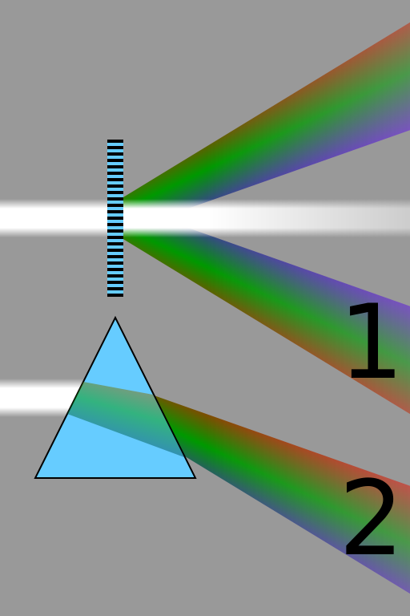
Dispersion through refraction versus diffraction
Diffraction grating
Refraction through prism
Note how longer wavelengths (red) diffract at greater angle than shorter wavelengths (blue) but they refract at smaller angle than shorter wavelengths.
Notes:
Comparison of the spectra obtained from a diffraction grating by diffraction (1), and a prism by refraction (2). Longer wavelengths (red) are diffracted more, but refracted less than shorter wavelengths (violet).
"Comparison refraction diffraction spectra" by Cmglee - Own work. Licensed under CC BY-SA 3.0 via Wikimedia Commons - http://commons.wikimedia.org/wiki/File:Comparison_refraction_diffraction_spectra.svg#mediaviewer/File:Comparison_refraction_diffraction_spectra.svg

Slide 47
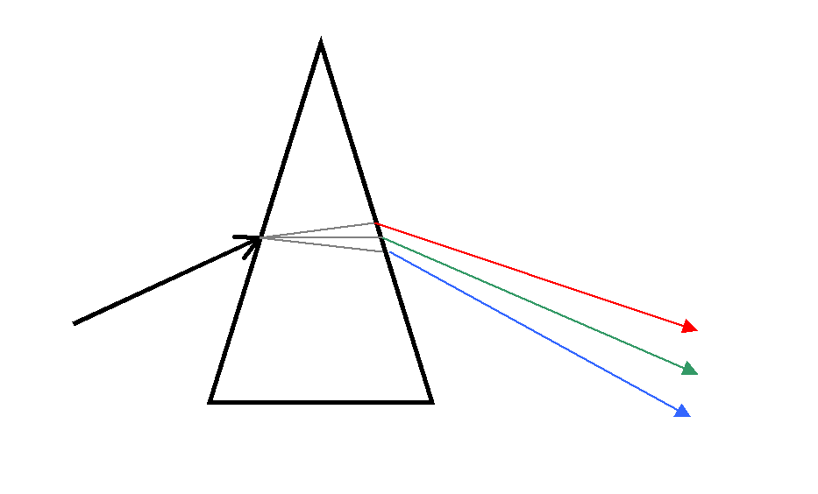
Monochromator: Optical instrument for generating single colors
Used in optical measuring instruments
How a monochromator works according to the principle of dispersion
Most actually disperse through diffraction, not prism
Monochromator (Prism Type)
Entrance Slit
Exit Slit
Notes:
A monochromator is an optical device that transmits a mechanically selectable narrow band of wavelengths of light or other radiation chosen from a wider range of wavelengths available at the input.

Slide 48
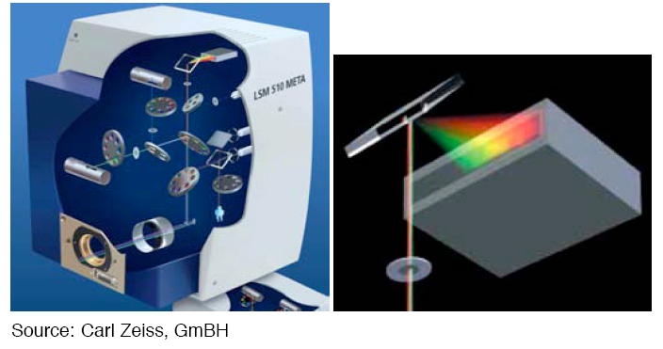
Spectral imaging with a grating

Slide 49
History of the Zeiss META detector
Where did the idea of a multichannel detector come from?

Slide 50


History of the Zeiss META detector
Where did the idea of a multichannel detector come from?
Collaboration between the Jet Propulsion Laboratory, Scott Fraser’s lab here at Caltech and Zeiss

Slide 51
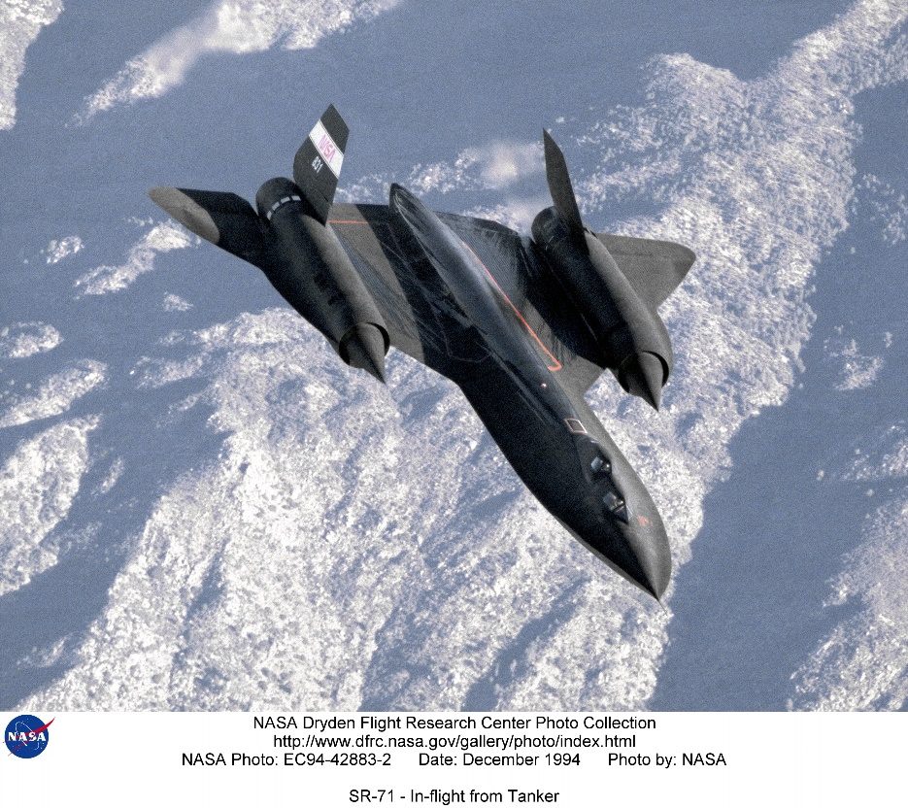
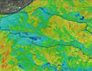

Airborne Visible/Infrared Imaging Spectrometer (AVIRIS)
Instrument for earth imaging and ecological research.
Instrument has 224 detectors.
Covers a range from 380 nm to 2500 nm.
Notes:
http://www.dfrc.nasa.gov/Gallery/Photo/SR-71/HTML/EC94-42883-2.html

Slide 52
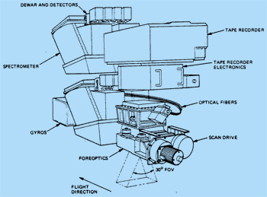
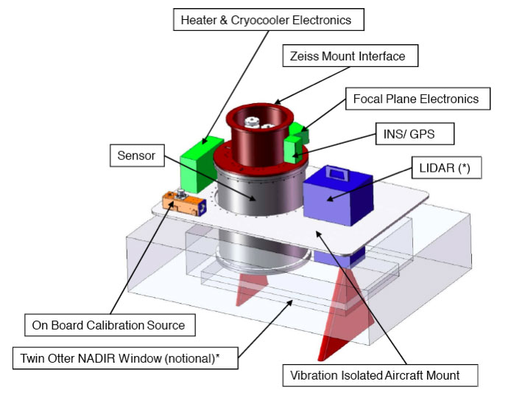
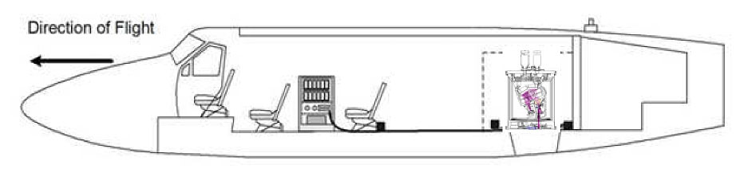
Airborne Visible/Infrared Imaging Spectrometer (AVIRIS)
Original
Next Generation (AVIRISng)
Notes:
Note size of the detector. Too big for confocal.
http://airbornescience.jpl.nasa.gov/instruments/avirisng
http://aviris.jpl.nasa.gov/aviris/concept.html

Slide 53
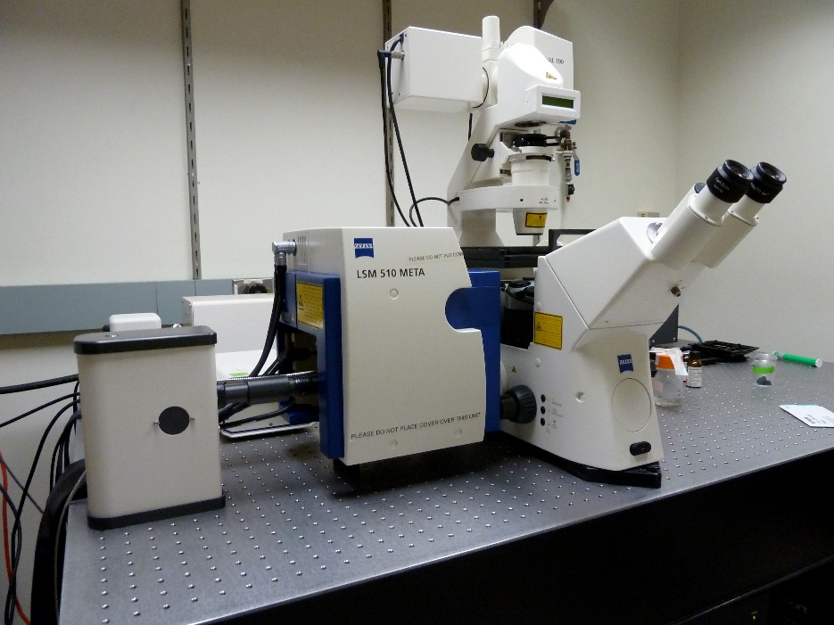
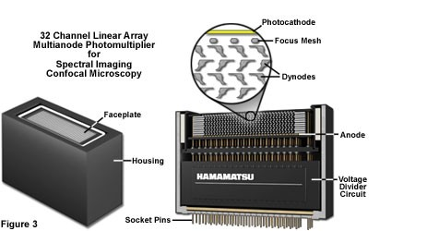
History of the Zeiss META detector
Zeiss META had 8* channel detector
Replaced by 32 channel Quasar detector
Notes:
First Meta
http://bair.beatson.gla.ac.uk/pages1/confocals/SpectralUnmixing.htm
http://www.zeiss.com/microscopy/en_us/campus/spectral-imaging/practical-aspects-of-spectral-imaging.html#configuration

Slide 54

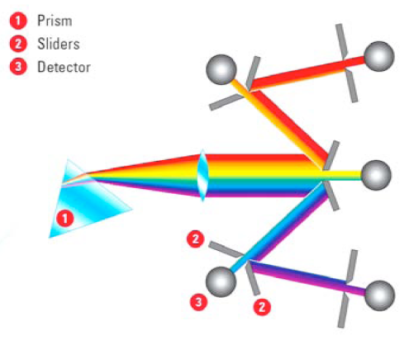
Spectral imaging with a prism and mirrors

Slide 55
Spectral image dataset
λ-stack
λ can be:
(i) λ_{excitation}
images acquired in a single channel at different λ_{excitation}
(ii) λ_{emission}
images acquired at a single λ_{excitation} in several channels at different (λ_{emission})
Garini et al, Cytometry Part A, 2006
Notes:
Leica feature

Slide 56
Leica lambda squared map
White light laser that emits from 470 to 670 nanometers

Slide 57
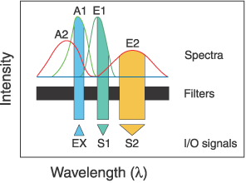
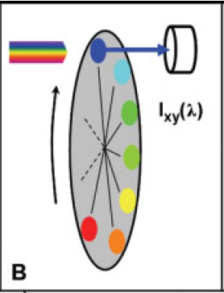
Choose spectrally well-separated dyes
Source: Zimmermann, T., 2005. Spectral Imaging and Linear Unmixing in Light Microscopy, in: Rietdorf, J. (Ed.), Microscopy Techniques. Springer Berlin Heidelberg, pp. 245-265.
if not possible: use spectral unmixing!
Notes:
Wave-length scans (A-D);

Slide 58
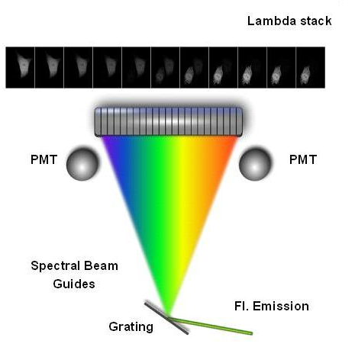

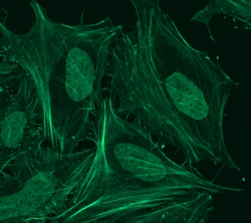
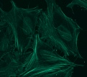
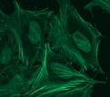
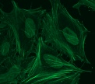
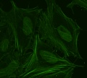





Spectral unmixing: general concept
Multi-channel Detector
Collect Lambda Stack
Raw Image
FITC
Sytox-green
Derive Emission Fingerprints
Unmixed Image
Notes:
Important! For this experiment need 3 samples! One with each color alone then one with both. Crucial for distinguishing overlap.
http://bair.beatson.gla.ac.uk/pages1/confocals/SpectralUnmixing.htm

Slide 59

Linear spectral unmixing: principle
To solve and obtain Ai for each pixel
From Michael Liebling, UCSB
Notes:
Signal = relative contribution X reference spectra

Slide 60


Linear spectral unmixing: principle
2 possibilities:
From Michael Liebling, UCSB

Slide 61
Spectral unmixing
8 channel detector (can you guess the instrument used?)
Using Emission spectra
Example of parallel acquisition
Reference spectra important
Notes:
Fig. 2 Spectral imaging of fluorescence signals.Contributions of CFP, GFP and YFP to eight
successive spectral channels are shown. The distribution of emission signal to the channels
is a direct representation of the fluorophore emission spectrum and constitutes a spectral
signature.With linear unmixing using these spectral signatures as reference, even combined
and mixed signals can be clearly separated into the fluorophores that contribute to the total
signal

Slide 62


Spectral unmixing: GFP/YFP

Slide 63

Spectral unmixing: Leica lambda stack

Slide 64

Spectral unmixing: Leica lambda stack

Slide 65

Spectral unmixing: Leica lambda stack

Slide 66


Spectral unmixing of autofluorescence
Red and green arrows indicate regions from which sample spectra were obtained.
Blue = computed spectrum
(a) Image obtained at the peak of one of the quantum dots.
(b) Unmixed image of the 570-nm quantum dot.
(c) Unmixed image of the 620-nm quantum dot.
(d) Combined pseudocolor image of (b) (green), (c), and autofluorescence channel (in white).
Mansfield et al, Journal of Biomedical Optics (2005)

Slide 67

Determine the two photon spectra of uncharacterized dye
In vivo Hair Cell Dye, FM1-43 Spectra

Slide 68
Spectral or Lambda Scanning
Separate very similar colored fluorophores
  e.g. FITC and Sytox green.
Could be used to eliminate non-specific background fluorescence that has different emission spectra.
Different technologies for spectrum detection
  Sequentially (Leica SP)
  Simultaneously (Zeiss QUASAR)

