Slide 1
Biology 177: Principles of Modern Microscopy
Lecture 10:
Scattering, clearing and adaptive optics

Slide 2
Lecture 10: Scattering, clearing and adaptive optics
Scattering and absorption of light
How to deal with scattering and absorption
Obstacles to transparency
Techniques for making samples transparent
History of clearing
Modern approaches: CLARITY and beyond
Adaptive optics

Slide 3
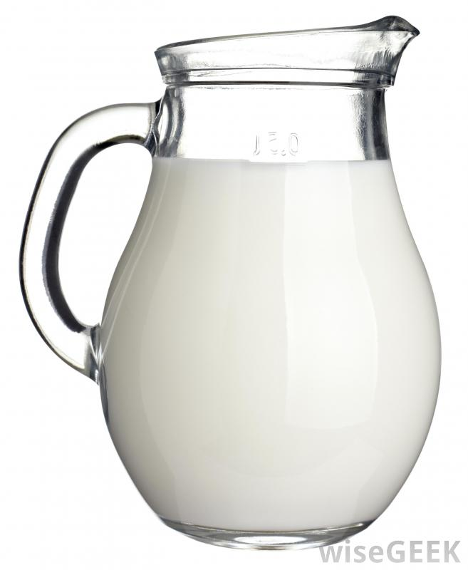
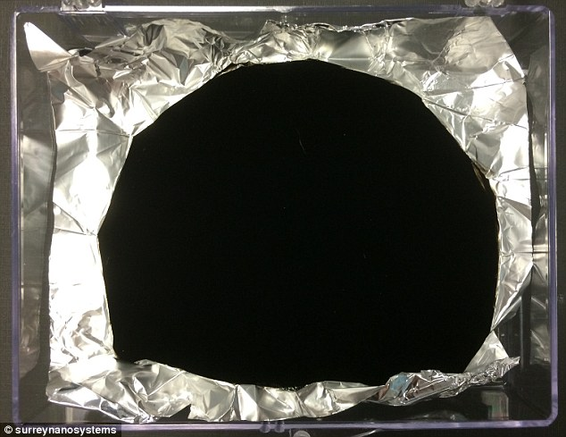
Opaque materials can either scatter or absorb light
Scattering
  Milky
  Common for many biological materials we want to image
Absorption
  Black
  Pigment containing cells one of few biological examples
Vanta black absorbs 99.965% of light
Notes:
http://www.dailymail.co.uk/sciencetech/article-2690424/Scientists-discover-new-black-British-researchers-devise-material-dark-looks-like-black-hole.html
http://www.iflscience.com/technology/new-super-black-material-absorbs-99965-light

Slide 4
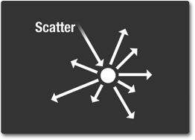
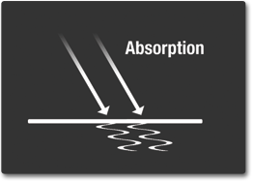
Scattering and Absorption of Light
Scattering
  Physical process causing light to deviate from a straight path
Absorption
  Photons of light transfer their energy to material they hit
Notes:
http://missionscience.nasa.gov/ems/03_behaviors.html

Slide 5
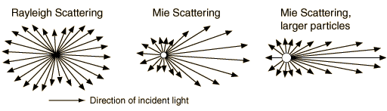
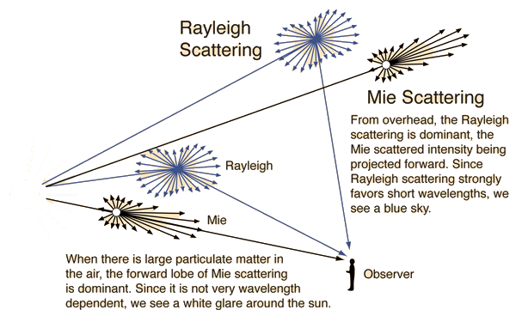
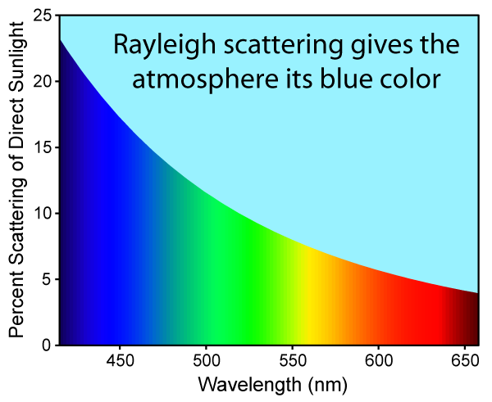

Scattering: Why the sky is blue and clouds are white
Rayleigh scattering
  Favors shorter wavelengths as function of $1/{\text{λ}\text{4}}$
  Particle size <1/10th wavelength
Mie scattering
  No favorites
  Particle size > wavelength
Notes:
http://hyperphysics.phy-astr.gsu.edu/hbase/hframe.html

Slide 6
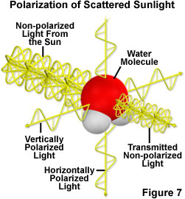
Rayleigh scattering results in polarized light
Over 50% is horizontally polarized.
Insects can see this polarization and use it to navigate
Even when sun not visible: like cloudy days or at night
Notes:
http://www.microscopyu.com/articles/polarized/polarizedlightintro.html
https://en.wikipedia.org/wiki/Rayleigh_sky_model

Slide 7
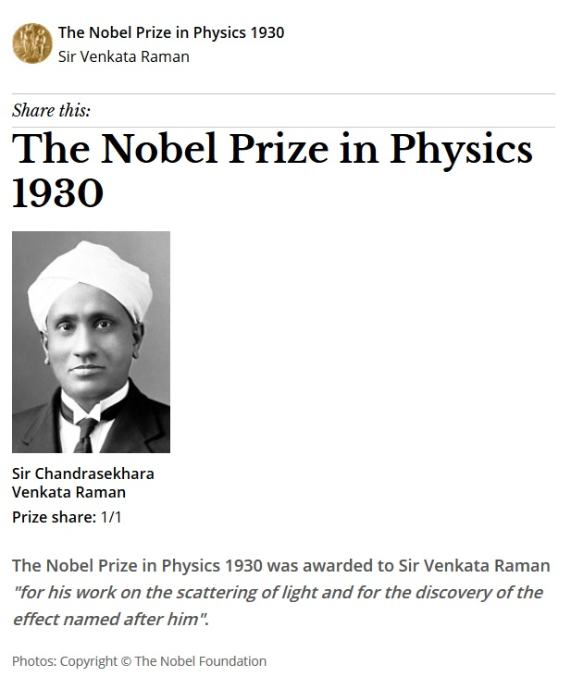
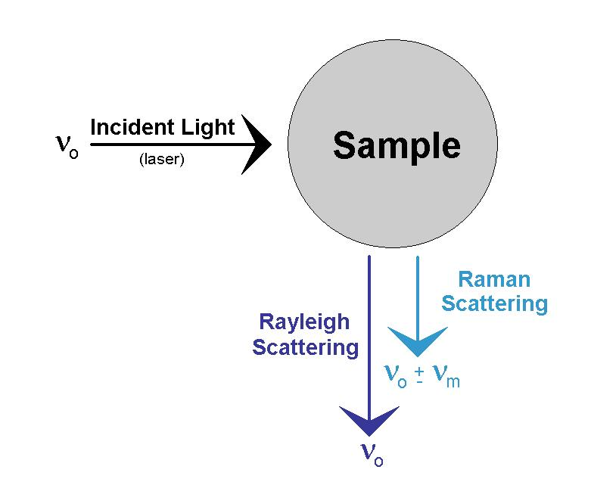
Another type of scattering
Most light is scattered at same frequency and wavelength but some scatters with different frequency.
Notes:
Raman spectroscopy valuable for microscopy, produces polarized light with useful information.
https://en.wikipedia.org/wiki/Raman_spectroscopy#Microspectroscopy
When photons are scattered from an atom or molecule, most photons are elastically scattered (Rayleigh scattering), such that the scattered photons have the same energy (frequency and wavelength) as the incident photons. A small fraction of the scattered photons (approximately 1 in 10 million) are scattered by an excitation, with the scattered photons having a frequency different from, and usually lower than, that of the incident photons.^{[4]}
http://www.thephysicsmill.com/2014/03/23/sky-blue-lord-rayleigh-sir-raman-scattering/

Slide 8
For light microscopy, how do we deal with scattering and absorption?

Slide 9
For light microscopy, how do we deal with scattering and absorption?
Histology: Fixing and sectioning
Only look at the surface of samples
Only look at transparent samples
Clearing: make our samples transparent
Use longer wavelengths, better penetration but not without its problems
Use a different imaging modality, ultrasound or MRI
Adaptive optics: stick with visible light but fix problem

Slide 10
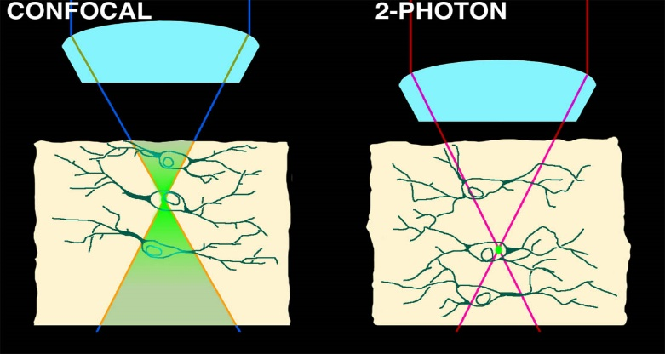
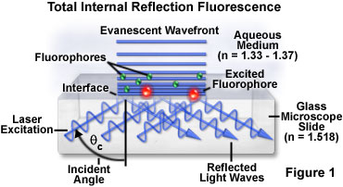
For light microscopy, how do we deal with scattering and absorption?
Histology
Transparent embryos
Transparent adult
Transparent adult
Longer wavelengths
Only image surface

Slide 11
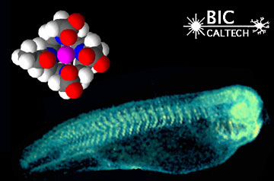
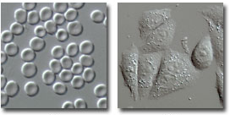
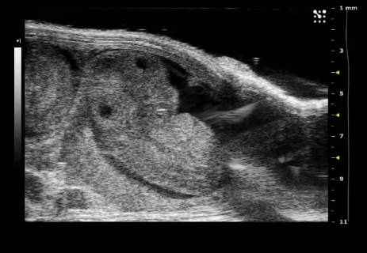
For light microscopy, how do we deal with scattering and absorption?
Cell culture transparent
MRI
Ultrasound
Notes:
http://www.olympusmicro.com/primer/techniques/dic/dicphasecomparison.html
http://umanitoba.ca/faculties/medicine/units/cacs/sam/8479.html

Slide 12
For light microscopy, how do we deal with scattering and absorption?
Histology: Fixing and sectioning
Only look at the surface of samples
Only look at transparent samples
Clearing: make our samples transparent
Use longer wavelengths, better penetration but not without its problems
Use a different imaging modality, ultrasound or MRI
Adaptive optics: stick with visible light but fix problem

Slide 13
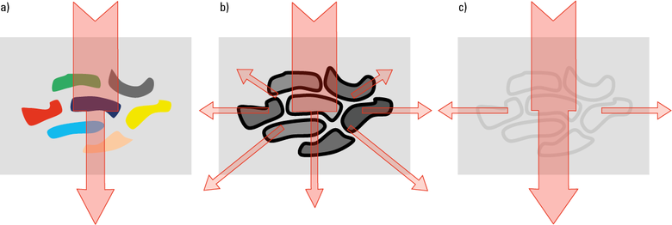
Obstacles to transparency
Absorption and scattering
Differences in refractive index
Notes:
Fig. 2: a) Low transparency through absorbing pigments; b) Low transparency due to effective scattering at surfaces with changing refractive index; c) High transparency after equalization of refractive indices.
http://www.leica-microsystems.com/science-lab/clearing-procedures-for-deep-tissue-imaging/

Slide 14
Refraction - the bending of light as it passes from one material to another.
Snell’s Law: η1 sin θ1 = η2 sin θ2
θ1
θ2
θ1
n₁
n₂
n₁

Slide 15
Scattering worsens as go deeper into tissues
Causes distortions along Z-axis even with optical sectioning as seen with Confocal microscopy
Matching refractive index (η) of objective to the media containing specimen helps to avoid Z-axis artifacts
η = speed of light in vacuum /speed in medium
Material Refractive Index
Air 1.0003
Water 1.33
Glycerin 1.47
Immersion Oil 1.518
Glass 1.52
Diamond 2.42

Slide 16
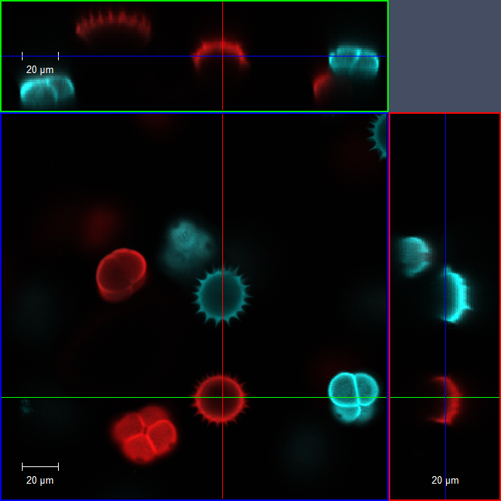
Matching refractive index (η) and increasing numerical aperture (N.A.) to avoid Z-axis distortions
20x Dry
0.8 NA
Notes:
20x objective zoomed 2x for 40x equivalent image

Slide 17
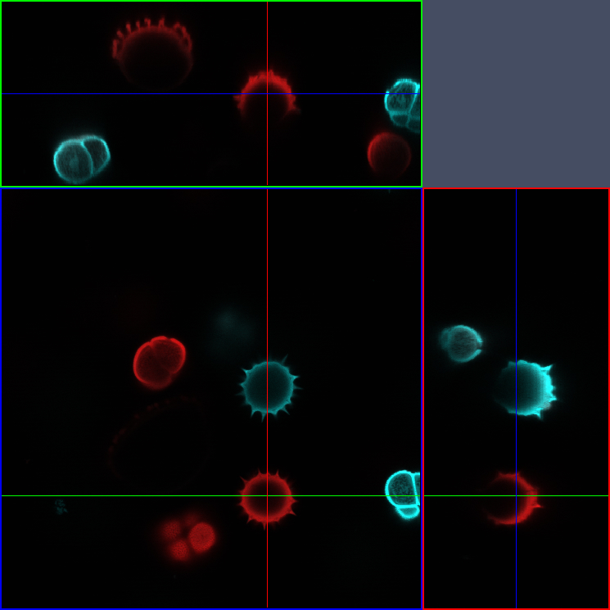
Matching refractive index (η) and increasing numerical aperture (N.A.) to avoid Z-axis distortions
40x Oil
1.3 NA

Slide 18
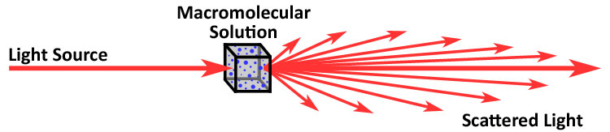
But objective can correct for only a few changes in refractive index
Biological samples, especially thick ones, can have a wealth of different refractive indices
Macromolecular samples great at scattering light
Notes:
In fact scattering most precise way to measure molecular weight of macromolecules
http://www.polyanalytik.com/gpc-light-scattering.php

Slide 19
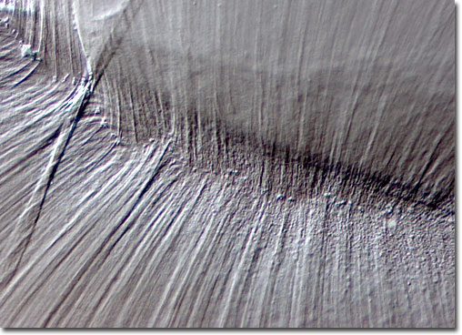
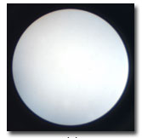
Kohler illumination can help minimize scattering
Important for DIC (Nomarski) microscopy and maximizing resolution
Aperture only crucial if your sample fills the whole field of view.
Condenser aperture must be opened to just within field of view. Can you tell why?
Notes:
http://www.olympusmicro.com/primer/techniques/dic/dicphasecomparison.html

Slide 20
Obstacles to transparency
Absorption by pigments
Differences in refractive index
Which is the more challenging problem?
Notes:
Fig. 2: a) Low transparency through absorbing pigments; b) Low transparency due to effective scattering at surfaces with changing refractive index; c) High transparency after equalization of refractive indices.
http://www.leica-microsystems.com/science-lab/clearing-procedures-for-deep-tissue-imaging/

Slide 21
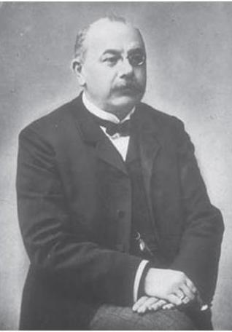
Clearing tissues goes back to 1914
Werner Spalteholz was German anatomist who developed first clearing protocol
Treatment with benzyl alcohol and methyl salicylate
Werner Spalteholz
(1861-1940)
Notes:
Shultze in 1897 first did clearing with KOH
http://www.leica-microsystems.com/science-lab/clearing-procedures-for-deep-tissue-imaging/#c135933
http://translate.google.com/translate?hl=en&sl=de&tl=en&u=http%3A%2F%2Fde.wikipedia.org%2Fwiki%2FWerner_Spalteholz

Slide 22
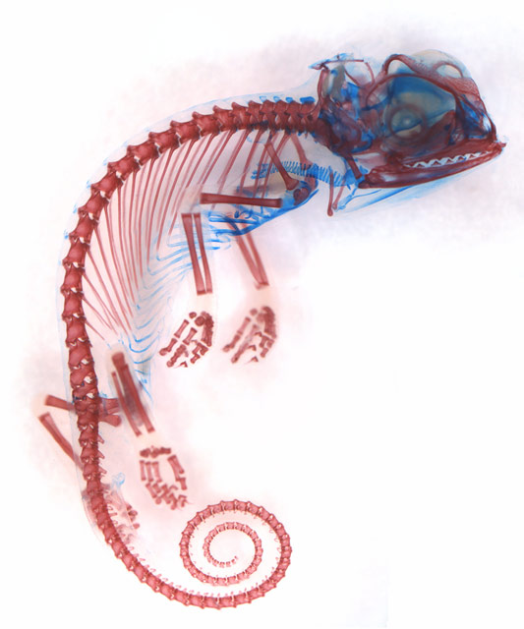
Cleared and stained specimens
Alizarin red labels bone, alcian blue labels cartilage
Popular skeletal preparation
Long used by Anatomists and Systematists
6th Place in 2013 Nikon Photo Competition
Dorit Hockman
Notes:
http://www.nikonsmallworld.com/people/image/dorit-hockman/1
Chamaeleo calyptratus (veiled chameleon) embryo showing cartilage (blue) and bone (red)
- see: Bone
Technique:
Brightfield

Slide 23
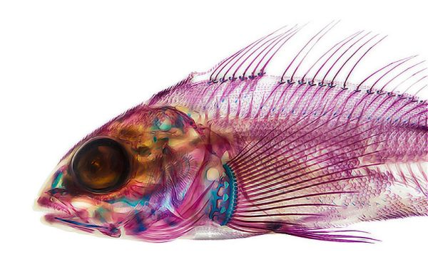
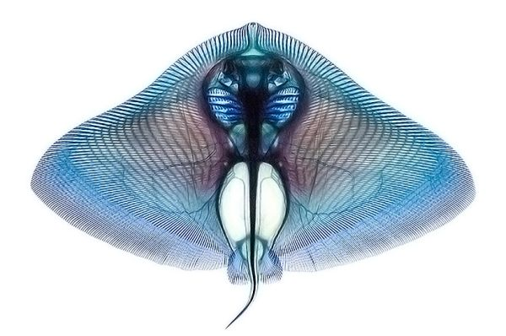
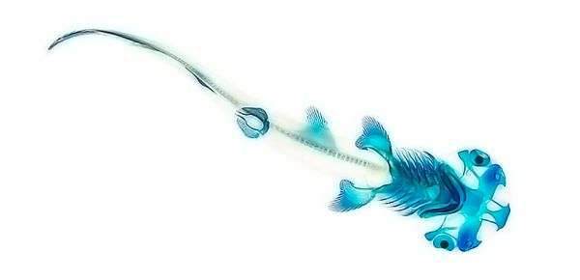
Cleared and stained specimens
Technique goes back to at least the 1930’s
Modern protocol from Dingerkus and Uhler (1977)
Important because allowed study of intact internal skeleton
Notes:
http://randommization.com/2014/01/03/dyed-fish-show-anatomy/
http://bestiarumosteo.blogspot.com/2014/02/clearing-and-staining_27.html
http://archive.org/stream/clearingstaining04davis/clearingstaining04davis_djvu.txt

Slide 24
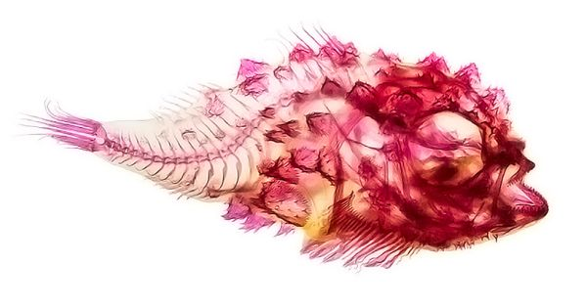
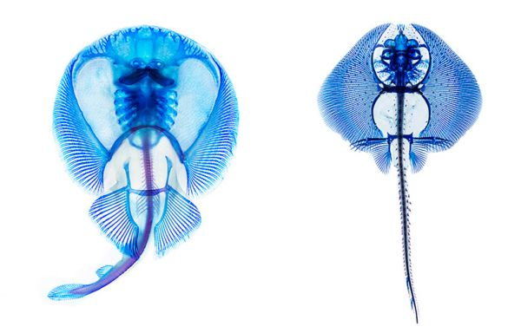
Cleared and stained specimens
Make animals transparent with strong alkali solution (KOH) and glycerin
Remove pigment with hydrogen peroxide, ultra-violet light, or other bleaching agents
Embryos and larva fast but adults can take weeks
Notes:
http://randommization.com/2014/01/03/dyed-fish-show-anatomy/
Marks, S.B., Collazo, A., 1998. Direct development in Desmognathus aeneus (Caudata : Plethodontidae): A staging table. Copeia, 637-648.
http://archive.org/stream/clearingstaining04davis/clearingstaining04davis_djvu.txt

Slide 25
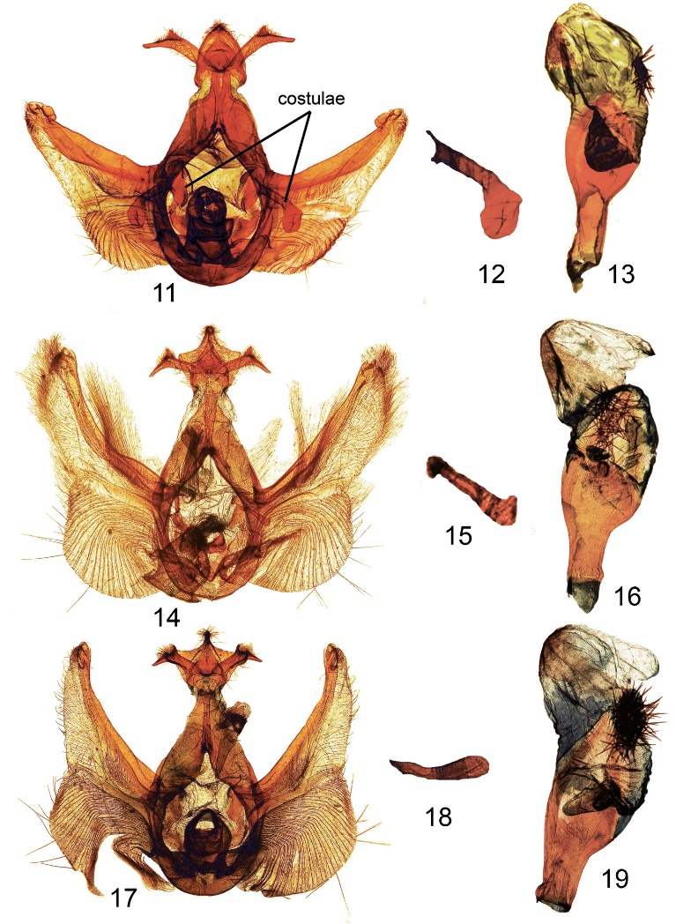
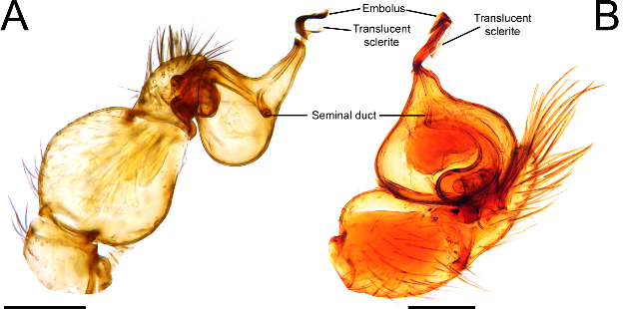
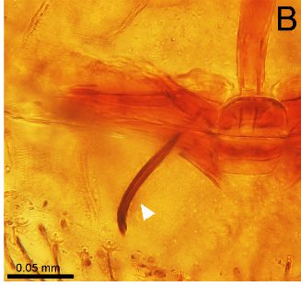
Arthropods can be cleared with clove oil
Prepared with KOH and clove oil, imaged in Canadian balsam
Used to study genitalia of arthropods for systematics
Notes:
http://zookeys.pensoft.net/articles.php?id=3018&display_type=list&element_type=1
New moth species
Smaller figures of spider. Figure 1. Unicorn catleyi, female genitalia. (A) Epigastric region in ventral view; (B) internal genitalia cleared in a clove oil in dorsal view; (C) digested genitalia in lactic acid; (D) anterior elements of the genitalia; (E) posterior receptaculum. Arrowheads point to the embolus tip, black arrows point to the gland ducts of the posterior receptaculum, black dots delineate the margins of the posterior receptaculum. AMP, anterior median plate; PMP, posterior median plate.

Slide 26
Clearing techniques
Major task of clearing methods is to "equalize" the refractive index without destroying 3D structure and without degradation of possibly present fluorochromes.

Slide 27
How to reduce refractive index differences
Remove water and replace it with an organic compound that has a higher refractive index
Increase refractive index of aqueous phases by adding water-soluble compounds, such as glucose, fructose or urea.
Replace water with polar solvents with higher refractive index
Notes:
http://www.leica-microsystems.com/science-lab/clearing-procedures-for-deep-tissue-imaging/

Slide 28
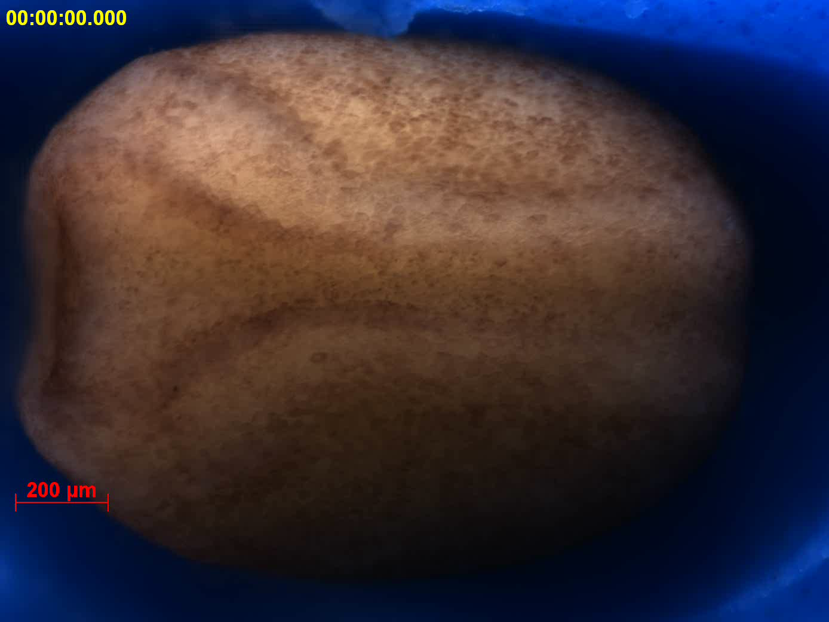
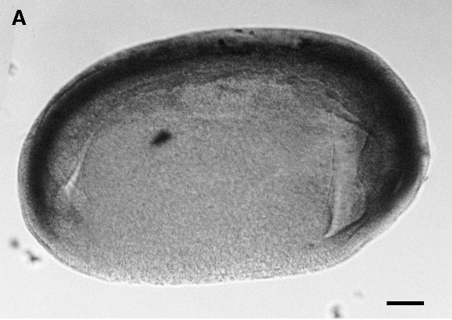
Remove water and replace it with an organic compound that has a higher refractive index
Benzyl alcohol and benzylbenzoate (BABB)
Dibenzyl ether (DBE)
Dehydrate with ethanol or tetrahydrofuran
Notes:
Xenopus embryos not very transparent
Hemmatibrivanlou, A., Frank, D., Bolce, M.E., Brown, B.D., Sive, H.L., Harland, R.M., 1990. Localization of Specific Messenger-Rnas in Xenopus Embryos By Whole-Mount Insitu Hybridization. Development 110, 325-Continues.
Hemmati-Brivanlou, A., Frank, D., Bolce, M.E., Brown, B.D., Sive, H.L., Harland, R.M., 1990. Localization of specific mRNAs in Xenopus embryos by whole-mount in situ hybridization. Development 110, 325-330.

Slide 29
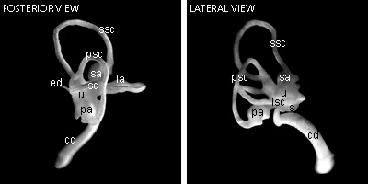
Remove water and replace it with an organic compound that has a higher refractive index
Solvent | Refractive Index (η)
Water | 1.33
BABB | 1.56
Methyl salicylate | 1.52
Dibenzyl ether | 1.56
2,2’-thiodiethanol | 1.52
Glycerol | 1.47
Notes:
http://www.nature.com/neuro/journal/v16/n8/full/nn.3447.html

Slide 30
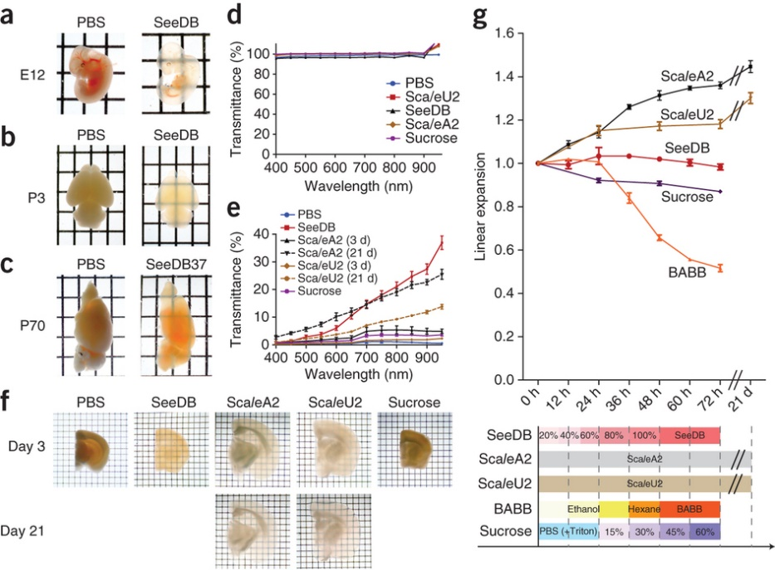
Increase refractive index of aqueous phases by adding water-soluble compounds
Sucrose
Fructose (SeeDB)
  Reaches 1.490 at 25 °C and 1.502 at 37 °C
Urea (Sca/e)
  Refractive indices 1.382, 1.387 and 1.380 at 589, 486 and 656 nm
Notes:
SeeDB (See Deep Brain)
(a) Whole embryos (E12) were cleared with SeeDB using a 3-d clearing protocol (g, bottom). (b) Neonatal (P3) whole-brain samples cleared with SeeDB (using an optimized protocol for neonatal brain, SeeDBp; Supplementary Fig. 4). SeeDB-treated samples kept their original morphology, whereas those treated with ScaleA2 often fell apart during incubation because ScaleA2 causes tissue sample fragility (data not shown). (c) Adult hemi-brain samples (P70) cleared with SeeDB37. The images presented in a–c are transmission images. (d) Transmittance curves of various clearing agents (mean ± s.e.m., n = 3 measurements). (e) Transmittance curves of mouse brain samples cleared with various clearing agents. Myelinated structures in adult brain cause non-homogeneous scattering; we used P21 mouse hemi-forebrain samples because they showed more homogeneous scattering. Transmittance was measured along the medial-lateral axis (the thickest part), which was 5.13 ± 0.19 mm (mean ± s.d., n = 3 hemi-forebrains) before clearing. Data are presented as the mean ± s.e.m. (n = 3 hemi-forebrains each). (f) Adult brain slices (P66, 1.5 mm thick) cleared with various clearing agents (transmission images). Note that white matter was fully cleared with SeeDB, but not with ScaleA2 or ScaleU2. (g) Sample expansion and shrinkage during the optical clearing. Hemi-forebrain samples (P21) were cleared with SeeDB, ScaleA2, ScaleU2, sucrose or BABB according to the timeline shown at the bottom. Optical clearing using ScaleA2 caused ~150% sample expansion per dimension. BABB caused ~50% linear sample shrinkage. In contrast, optical clearing with SeeDB did not cause obvious changes in sample volumes. Error bars indicate s.e.m. (n = 3 hemi-forebrains each). Grids are 2.6 × 3.2 mm (a–c) and 1 × 1 mm (f).

Slide 31
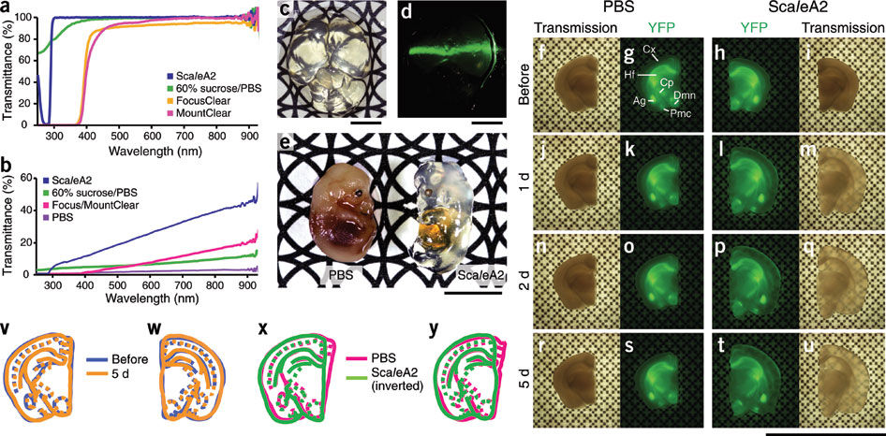
Increase refractive index of aqueous phases by adding water-soluble compounds
ScaleA2, composed of 4 M urea, 10% glycerol and 0.1% Triton X-100
Notes:
http://www.nature.com/neuro/journal/v14/n11/full/nn.2928.html

Slide 32
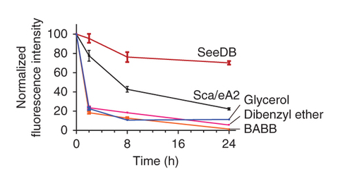
Increase refractive index of aqueous phases by adding water-soluble compounds
Advantages
  Does not shrink tissue
  Preserves fluorescence

Slide 33
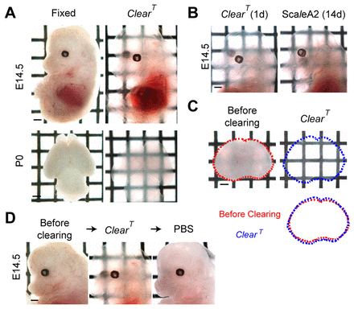
Replace water with polar solvents with higher refractive index
ClearT uses incubation with Formamide (η = 1.45)
Another variant ClearT² adds Polyethylene glycol to preserve GFP fluorescence
Notes:
http://dev.biologists.org/content/140/6/1364.full

Slide 34
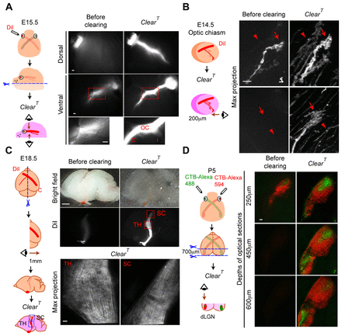
Replace water with polar solvents with higher refractive index
Advantages
  Preserves lipids because no detergent
  So lipophilic carbocyanine dyes (DiI) are retained
  Does not change tissue volume
  Fast
Notes:
http://dev.biologists.org/content/140/6/1364.full

Slide 35
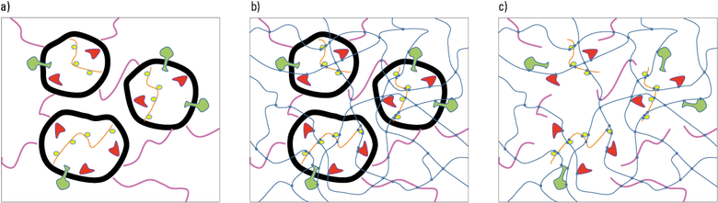
CLARITY is one of the newest clearing protocols
Make tissues transparent without destroying proteins
Notes:
Fig. 3: a) Biological tissue with membranes (thick black lines) supporting the spatial distribution of proteins (colored). b) After perfusion with polymer components, the proteins are pinned to a hydrogel (thin blue lines) with crosslinks (blue dots). c) After removal of the membranes, the tissue is transparent and even permeable to macromolecules, e.g. antibodies and fluorochromes. The proteins and other biomolecules are fixed to their in-vivo coordinates.

Slide 36
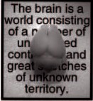
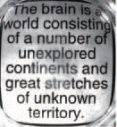
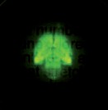
ARTICLE
doi:10.1038/nature12107
Structural and molecular interrogation of intact biological systems
Kwanghun Chung^{1,2}, Jenelle Wallace¹, Sung-Yon Kim¹, Sandhiya Kalyanasundaram², Aaron S. Andalman^{1,2},
Thomas J. Davidson^{1,2}, Julie J. Mirzabekov¹, Kelly A. Zalocusky^{1,2}, Joanna Mattis¹, Aleksandra K. Denisin¹, Sally Pak¹, Hannah Bernstein¹, Charu Ramakrishnan¹, Logan Grosenick¹, Viviana Gradinaru² & Karl Deisseroth^{1,2,3,4}
YFP
Chung et al. Nature 2013

Slide 37
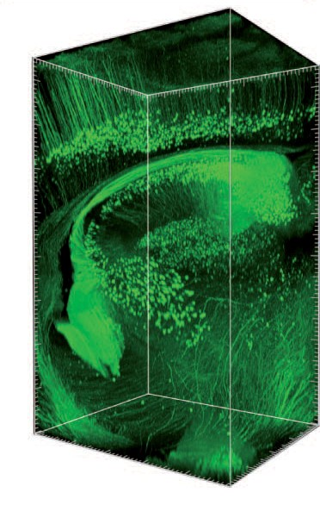
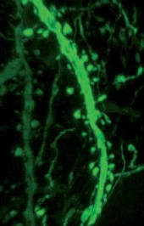
f
Thy1–eYFP
Cerebral neocortex
Alveus
Hippocampus
Thalamus
Section
Chung et al. Nature 2013

Slide 38
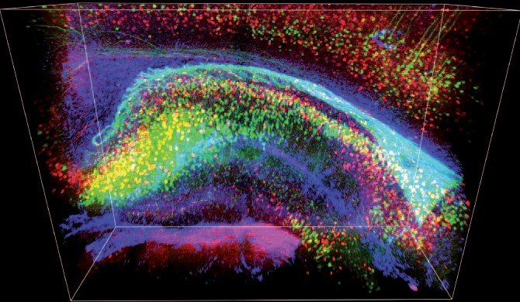
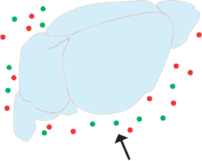
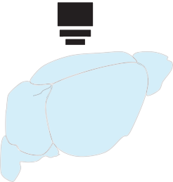
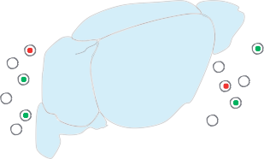

Compatible with immunostaining
3D rendering
Cortex
Whole-tissue immunostaining
alv
CA1
Antibodies
DG
CA3
eYFP PV GFAP
Whole-tissue imaging
Detergent-mediated antibody removal
Projection
1st round e Projection
After elution f Projection
2nd round
SNR
eYFP TH
cp
eYFP TH (eluted)
eYFP GFAP
Chung et al. Nature 2013

Slide 39

Motivation: circuit studies - tracing long-range axonal projections and single cell phenotyping
Allen Brain Explorer

Slide 40














CLARITY: the basics
Step 1: hydrogel monomer infusion (days 1–3)
Proteins
+
2
o C
o
DNA
ER
+
H H
NH
NH
2
4 °C
Vesicle
Plasma membrane
NHCH₂NHCOC=C
Step 2: hydrogel–tissue hybridization (day 3)
CH CH₂
C O NHCH₂NH
NHCH₂NH
C O CH CH₂
37 °C
Hydrogel
Step 3: electrophoretic tissue clearing (days 5–9)
Temperature-controlled buffer circulator
Extracted lipids in SDS micelle
Top view: cut through
SDS micelle
Electrode
ETC
chamber
Buffer filter
Target tissue
Inlet port
Electrode connector
Electrode
Electrophoresis power supply
CLARITY for mapping the nervous system
Kwanghun Chung^{1,2} & Karl Deisseroth^{1–4}

Slide 41


Single-Cell Phenotyping within
Resource
Transparent Intact Tissue through Whole-Body Clearing
Bin Yang,¹ Jennifer B. Treweek,¹ Rajan P. Kulkarni,^{1,2} Benjamin E. Deverman,¹ Chun-Kan Chen,¹ Eric Lubeck,¹ Sheel Shah,¹ Long Cai,³ and Viviana Gradinaru^{1,}*
¹Division of Biology and Biological Engineering, California Institute of Technology, Pasadena, CA 91125, USA
²Division of Dermatology, Department of Medicine, David Geffen School of Medicine at UCLA, Los Angeles, CA 90095, USA
³Division of Chemistry and Chemical Engineering, California Institute of Technology, Pasadena, CA 91125, USA
*Correspondence: viviana@caltech.edu http://dx.doi.org/10.1016/j.cell.2014.07.017
without bisacrylamide
bisacrylamide
proteins
PACT- rapid clearing and staining of 1-2mm thick tissue slices
Yang et al. Cell 2013

Slide 42


PAssive CLARITY Technique (PACT)

Slide 43

Perfusion-assisted Agent Release in Situ (PARS)

Slide 44

Whole-body clearing

Slide 45

Whole-body clearing and antibody delivery

Slide 46

CLARITY objective
HC FLUOTAR L 25x/1.00 IMM (ne = 1.457)
$$$$$

Slide 47


Adaptive optics: First used on telescopes
Improve performance of optical systems by reducing the effect of wavefront distortions:
Correct deformations of incoming wavefront by deforming a mirror in order to compensate for distortion
Notes:
"Deformable mirror correction" by 2pem - Own work. Licensed under CC BY-SA 3.0 via Wikimedia Commons - https://commons.wikimedia.org/wiki/File:Deformable_mirror_correction.svg#mediaviewer/File:Deformable_mirror_correction.svg
"Laser Towards Milky Ways Centre" by ESO/Yuri Beletsky (ybialets at eso.org) - no fallback page found for autotranslate (base=ESO-source/i18n, lang=en)This tag does not indicate the copyright status of the attached work. A normal copyright tag is still required. See Commons:Licensing for more information.. Licensed under CC BY 4.0 via Wikimedia Commons - https://commons.wikimedia.org/wiki/File:Laser_Towards_Milky_Ways_Centre.jpg#mediaviewer/File:Laser_Towards_Milky_Ways_Centre.jpg

Slide 48


Adaptive optics: Telescopes
First implemented in early 1990’s when computers advanced enough
MicroElectroMechanical Systems (MEMS) based deformable mirrors most widely used technology for wavefront shaping
Using natural or artificial guide stars
Notes:
"A Laser Strike at the Galactic Center" by Yuri Beletsky - NASA Astronomy Picture of the Day. Licensed under CC BY 4.0 via Wikimedia Commons - http://commons.wikimedia.org/wiki/File:A_Laser_Strike_at_the_Galactic_Center.jpg#mediaviewer/File:A_Laser_Strike_at_the_Galactic_Center.jpg
http://www.npr.org/2013/06/24/190986008/for-sharpest-views-scope-the-sky-with-quick-change-mirrors

Slide 49

Adaptive optics: from telescopes to microscopes?
Much easier for telescopes than for microscopes
Harder to compensate for biological tissues than for atmosphere
Approaches that don’t require wavefront sensor
Notes:
http://lyot.org/background/adaptive_optics.html

Slide 50

Adaptive optics for microscope
Problem of wavefront
Objective lens converts planar waves to spherical
Relatively simple change when no aberrations

Slide 51

Adaptive optics for microscope
Problem of wavefront
Objective lens converts planar waves to spherical
Relatively simple change when no aberrations
Notes:
(a) An ideal microscope converts a planar wavefront (top red line) to a converging spherical one (bottom red semicircle) in a sample of the design optical properties. Propagation vectors or 'rays' (blue), defined by the direction normal to the wavefront, converge at a common point and, being in phase, constructively interfere there to create an optimal focus. Green sinusoidal curves denote the phase variation along each ray. (b) Inhomogeneities (orange) in the refractive index of the sample change the directions and phases of the rays, leading to a distorted wavefront and an enlarged focal volume with lower peak intensity. (c) Controlling the input wavefront using an active optical element (not shown) can cancel these aberrations, recovering a diffraction-limited focus.
http://www.nature.com/nmeth/journal/v7/n2/full/nmeth.1411.html

Slide 52


Adaptive optics for microscope
(a) Schematic of focusing by a high-NA objective lens.
Principle of aberration correction: conjugate phase introduced in the back focal plane of objective is cancelled out by the specimen-induced aberrations
Booth M J Phil. Trans. R. Soc. A 2007;365:2829-2843
©2007 by The Royal Society
Notes:
(a) Schematic of focusing by a high-NA objective lens. Planar wavefronts in the pupil are converted into convergent spherical wavefronts in the focus. (b) The effects of focusing through a refractive index mismatch, where refraction at the interface distorts the wavefronts. (c) Focusing through a complex specimen, where refractive index variations introduce aberrations. (d) The principle of aberration correction—a conjugate phase introduced in the pupil is cancelled out by the specimen-induced aberrations.

Slide 53
Adaptive optics for microscope
Do not use wavefront sensor
Retrieve information directly from image
Info on phase differences, multiple focal planes
Iterative process of optimization
Notes:
http://www.opticsinfobase.org/oe/fulltext.cfm?uri=oe-15-13-8176&id=138521

Slide 54
Adaptive optics for microscope
Two methods for adaptive optics without wavefront sensor
Search algorithm based
  Need information on aberrations and object structure
  Model free algorithm
Imaging based
  Predominantly independent of object structure
  Only need information on aberrations

Slide 55
Adaptive optics for microscope
Image based adaptive optics
  Modal: corrects wavefront across whole back focal plane of objective
  Zonal: wavefront measured and corrected in discreet zone
    Like astronomers.

Slide 56


Adaptive optics for microscope
Betzig lab work applying image based zonal analysis
Faster
Notes:
(a–c) Experiment schematic is shown on the right in c. Lateral (x-y) and axial (x-z and y-z) images of a single bead under a brain slice, with only system correction applied (a), with a fourfold increase in display gain (b) and after full AO correction (c). (d) Lateral intensity profiles along the orange and blue lines in a and c. (e) The final corrective wavefront, after subtraction of system aberrations, using 12 independent subregions and direct phase measurement. (f,g) Lateral (x-y) and axial (la-z) images of a pair of 1-μm beads with only system correction applied. Display gain is increased fourfold in g relative to that in f. (h) Images of the same bead pair after full AO correction. (i) Lateral intensity profiles along the orange and blue lines in f and h. (j) The final corrective wavefront, in units of excitation light wavelength (850 nm), using the overlapping mask algorithm with 72 masks, each covering 1/9 of the rear pupil area, leading to 81 subregions of unique phase. Scale bars, 2 μm.

Slide 57
References for Adaptive Optics
Booth, M.J., 2007. Adaptive optics in microscopy. Philosophical transactions. Series A, Mathematical, physical, and engineering sciences 365, 2829-2843.
Bourgenot, C., Saunter, C.D., Taylor, J.M., Girkin, J.M., Love, G.D., 2012. 3D adaptive optics in a light sheet microscope. Optics express 20, 13252-13261.
Gould, T.J., Burke, D., Bewersdorf, J., Booth, M.J., 2012. Adaptive optics enables 3D STED microscopy in aberrating specimens. Optics express 20, 20998-21009.
Izeddin, I., El Beheiry, M., Andilla, J., Ciepielewski, D., Darzacq, X., Dahan, M., 2012. PSF shaping using adaptive optics for three-dimensional single-molecule super-resolution imaging and tracking. Optics express 20, 4957-4967.
Ji, N., Milkie, D.E., Betzig, E., 2010. Adaptive optics via pupil segmentation for high-resolution imaging in biological tissues. Nat Meth 7, 141-147.

Slide 58

Final word on absorption and scattering of light
Light enters ocean and water absorbs longer wavelengths.
Deeper into ocean only blue light remains

Slide 59
Homework 4
Under a methane sea. The lakes and oceans on Saturn’s moon Titan are cold (100 K) bodies of hydrocarbons. What color would you see deep under these liquid bodies? Let’s assume they are mostly made of methane (CH₄).
Hint – (1) What visible wavelengths are absorbed by methane? (2) Why are Jupiter and Saturn brownish while Neptune and Uranus are blue?

