Slide 1
Biology 177: Principles of Modern Microscopy
Lecture 08:
Contrast and Resolution

Slide 2
Lecture 8: Contrast and Resolution
Bright-field
Tinctorial dyes: the first contrast
Review of Kohler Illumination
Tradeoffs in Contrast/Resolution
Dark Field
Rheinberg Contrast
Phase Contrast
Techniques for plastic

Slide 3
Illumination Techniques - Overview
Transmitted Light
Bright-field
Oblique
Darkfield
Phase Contrast
Polarized Light
DIC (Differential Interference Contrast)
Fluorescence - not any more > Epi !
Reflected (Incident) Light
Bright-field
Oblique
Darkfield
Not any more (DIC !)
Polarized Light
DIC (Differential Interference Contrast)
Fluorescence (Epi)

Slide 4
Bright-Field Illumination
Simplest technique to set up
True color technique
Proper Technique for Measurements
  Dimensional or Spectral
What is the problem with Bright-Field microcopy?
Notes:
Low contrast technique.
Illustrated in Figure 2 is an unstained (Figure 2(a)) and stained (Figure 2(b)) specimen of the marine organism Obelia, imaged in the MIC-D digital microscope using brightfield illumination. Requiring two separate generations to complete the lifecycle, the first generation of Obelia lives in hydroid colonies, consisting of polyps. The polyps are stalk-like forms (as illustrated in the figure) that attach to a surface (usually the ocean bottom) by means of root-like filaments. This comparison is a vivid demonstration of the dramatic difference in contrast observed between amplitude specimens, which have been stained, and those having very little absorption, rendering them almost transparent in brightfield illumination.

Slide 5
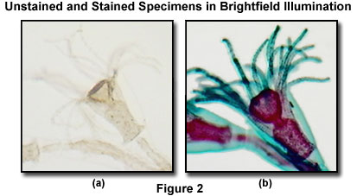
Bright-Field Illumination
Simplest technique to set up
True color technique
Proper Technique for Measurements
  Dimensional or Spectral
What is the problem with Bright-Field microcopy?
Notes:
Low contrast technique.
Illustrated in Figure 2 is an unstained (Figure 2(a)) and stained (Figure 2(b)) specimen of the marine organism Obelia, imaged in the MIC-D digital microscope using brightfield illumination. Requiring two separate generations to complete the lifecycle, the first generation of Obelia lives in hydroid colonies, consisting of polyps. The polyps are stalk-like forms (as illustrated in the figure) that attach to a surface (usually the ocean bottom) by means of root-like filaments. This comparison is a vivid demonstration of the dramatic difference in contrast observed between amplitude specimens, which have been stained, and those having very little absorption, rendering them almost transparent in brightfield illumination.

Slide 6
C ONTRAST
0 Units
50 Units
100 Units
50 Units
50
50
50 – 100 / 50 + 100 = -0.33
50 – 0 / 50 + 0 = 1
50 – 50 / 50 + 50 = 0

Slide 7
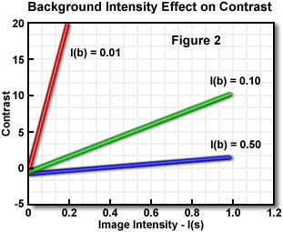
Contrast depends on background brightness
Transparent specimen contrast
  Bright field 2-5%
  Phase & DIC 15-20%
  Stained specimen 25%
  Dark field 60%
  Fluorescence 75%
Notes:
http://www.microscopyu.com/articles/formulas/specimencontrast.html

Slide 8
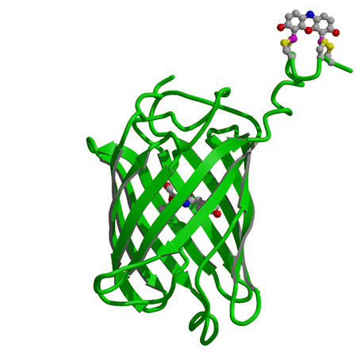
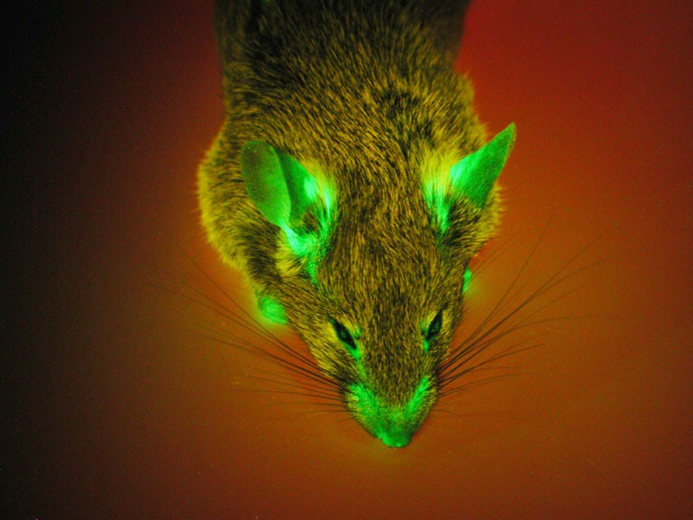
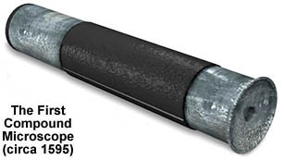
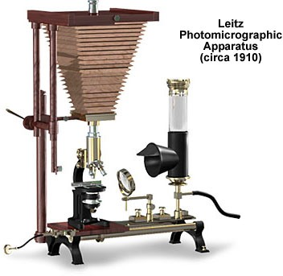
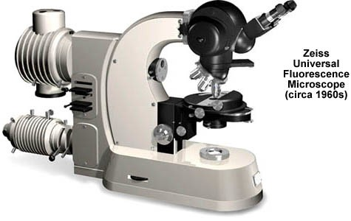
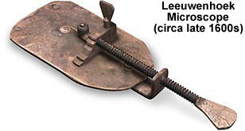
History of microscopy
Video microscopy developed early 1980s (MBL)
1595: The first compound microscope built by Zacharias Janssen
1994: GFP used to tag proteins in living cells
1910: Leitz builds first “photo- microscope”
1955: Nomarski invents Differential Interference Contrast (DIC) microscopy
1600
1700
1800
1900
2000
2010
1680: Antoni van Leeuwenhoek awarded fellowship in the Royal Society for his advances in microscopy
Super-Resolution light Microscopy
1960: Zeiss introduces the “Universal” model
1934: Frits Zernike invents phase contrast microscopy
Images taken from:
Molecular Expression and Tsien Lab (UCSD) web pages
Slide from Paul Maddox, UNC

Slide 9
Before oil what was the world’s commodity?
Notes:
https://janeaustensworld.wordpress.com/2011/03/07/regency-fashion-printed-cotton-fabrics/

Slide 10

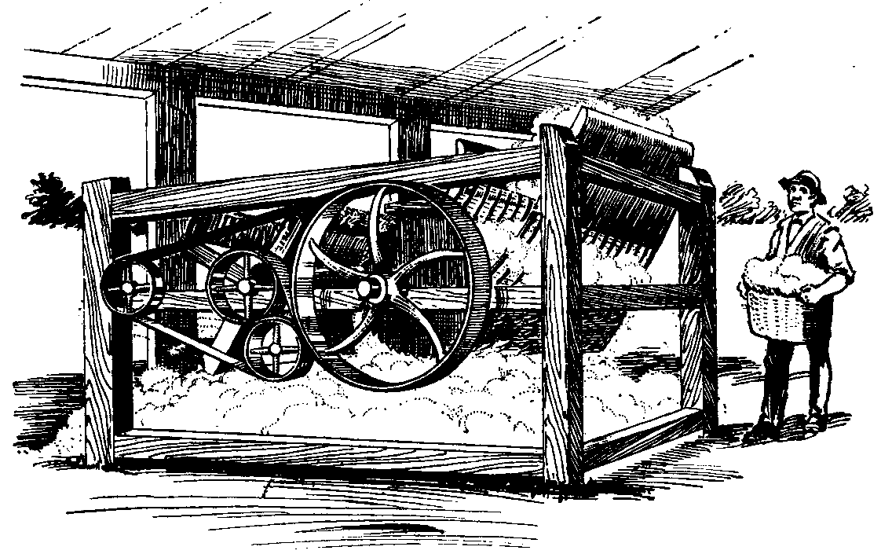
Before oil what was the world’s commodity?
Cotton
Notes:
https://janeaustensworld.wordpress.com/2011/03/07/regency-fashion-printed-cotton-fabrics/

Slide 11
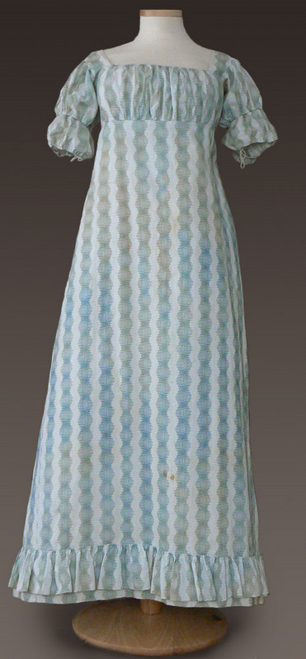

Before oil what was the world’s commodity?
Cotton
Clothing
Notes:
https://janeaustensworld.wordpress.com/2011/03/07/regency-fashion-printed-cotton-fabrics/

Slide 12
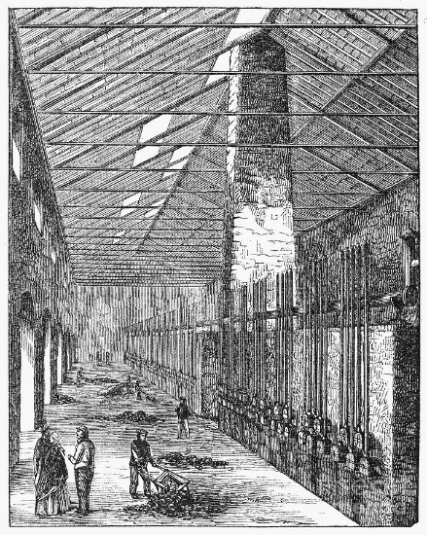
Textiles drove another industry with fortuitous side benefits for microscopy
Coal gas
By product of coking
Made in gasworks
Replaced by natural gas in 1940s & 1950s
With coal tar crucial for nascent chemical industry

Slide 13

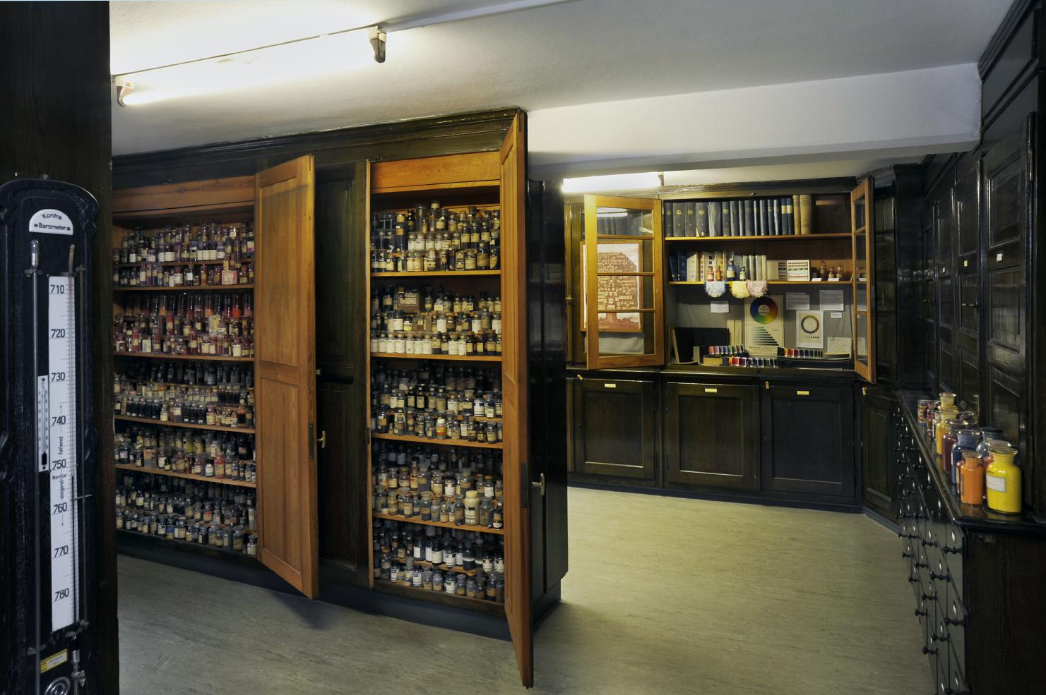
Germany quickly dominated the Chemical Industry
By the end of the 19th Century (late 1800s)
Historical collection of > 10,000 dyes at Technical University Dresden, Germany.
Adolf von Bayer, fluorescein 1871.
Notes:
With the development of the synthetic dye industry, it was not long before Adolf von Bayer synthesized the first fluorescent dye, fluorescein, in 1871. Paul Ehrlich used the fluorescent dye uranin (a sodium salt of fluorescein) in 1882 to determine the pathway of secretion of aqueous humour in the eye — representing the first use of a fluorescent dye in animal physiology.
http://www.nature.com/milestones/milelight/full/milelight02.html
https://en.wikipedia.org/wiki/Dye
Neuschwanstein Castle
"Blick in Farbstoffsammlung 01" by Jü - Own work. Licensed under CC0 via Wikimedia Commons - https://commons.wikimedia.org/wiki/File:Blick_in_Farbstoffsammlung_01.JPG#mediaviewer/File:Blick_in_Farbstoffsammlung_01.JPG

Slide 14
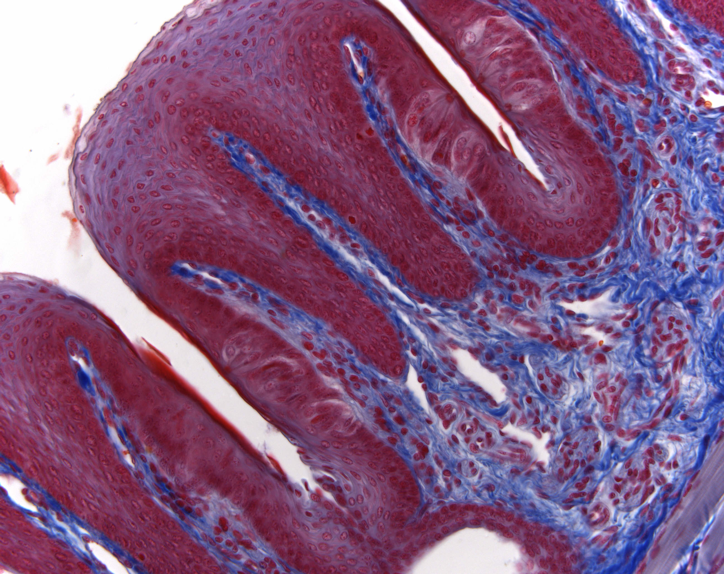
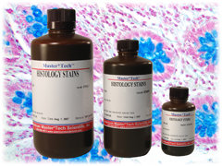
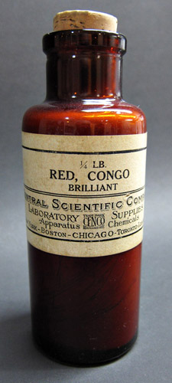
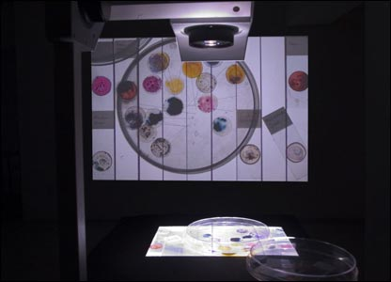
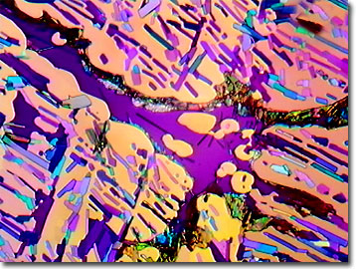
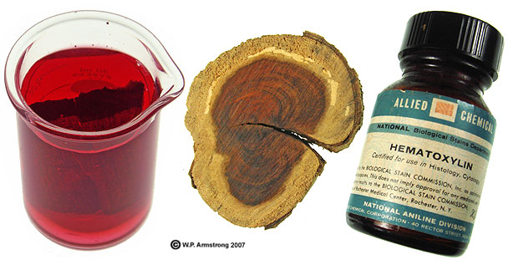
Notes:
Congo red was a cotton dye, used for axons then amyloid
Cresyl violet is a synthetic dye that is widely utilized to stain neuronal tissues. Because it is a basic stain, it readily binds to the acidic components of the neuronal cytoplasm such as RNA-rich ribosomes, as well as the nuclei and nucleoli of the nerve cells.
http://micro.magnet.fsu.edu/optics/olympusmicd/galleries/polarized/cresylviolet.html

Slide 15
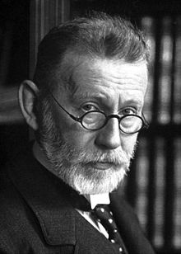
Tinctorial methods for Histology were revolutionary
Provides contrast with high resolution
While many dyes were from natural materials (haematoxylin from tropical logwood) chemical synthesis starting in 19th century transformative
Henry Perkin’s aniline purple
First malaria treatment using synthetic dye methylene blue by Paul Ehrlich
Paul Ehrlich won 1908 Nobel prize in medicine for work in immunology
Notes:
These included Tyrian purple from a type of Mediterranean shell fish, alizarin from the madder plant, saffron from the stamens of the crocus, and carmine, much favoured by the early micro­ scopists and first used by Leeuwenhoek in the 18th century.² This last dye is extracted from cochineal, which is obtained from the female beetle of that name. Iodine was also quite popular for colouring specimens, particularly among French workers. Raspail used iodine in 1825 to demonstrate starch in plant cells, and Claude Bernard, the famous French physiolo-
Gist used it to stain a substance in liver³ that he would later (1849) identify and call glycogen.
Picric acid was used for dyeing silk in the
1840s, but seems not to have been taken up by histologists until Roberts, an English micro­ scopist, used it as a general stain for tissue pro­ tein in 1863. A significant event took place in 1856 in terms of dye formation, when a young English chemist named Henry Perkin (fig 1), synthesised the first aniline dye that he named aniline purple, ⁸ and became better known as Perkin's mauve. This opened up new horizons for the dyeing of textiles and, ultimately, the staining of tissue in the histology laboratory. Perkin's fortunes were assured when, in future years, his purple dye came to be used to colour some of the early postage stamps and a favour­ ite ballgown belonging to Queen Victoria. He was knighted in 1906. Other new aniline dyes
http://waynesword.palomar.edu/ecoph4.htm
Cook, H.C., 1997. Origins of ... tinctorial methods in histology. Journal of clinical pathology 50, 716-720.

Slide 16
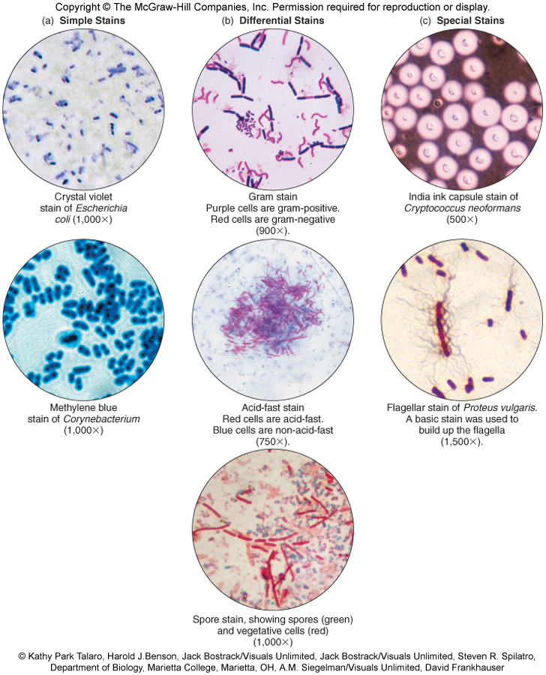
Microbiological stains

Slide 17
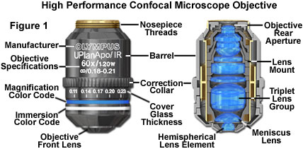
The most important microscope component
The Objective: example of one optimized for confocal microscopy
Notes:
Presented in Figure 1 is a high performance objective designed specifically for use with laser illumination in both the visible and infrared regions of the spectrum. The objective is a 60x flat-field (plan) apochromat water immersion model, which is corrected for wavelengths ranging from 450 to 1,100 nanometers. Among the useful applications for this objective is simultaneous fluorescence and differential interference contrast (DIC) observations without suffering chromatic aberration between the visible fluorescence and infrared DIC images. The objective is also fitted with a correction collar that enables adjustment for fluctuations in cover glass thickness and reduction in spherical aberration when imaging deep within tissues or through aqueous solutions. Similar objectives with spherical and chromatic aberration correction in the 400-700 nanometer region are also available, as are models designed for ultraviolet imaging down to 350 nanometers.
The general demands placed upon the objective in the confocal instrument are similar to those in other critical microscopy applications, although the ever-expanding requirements imposed by new techniques have made it more common than ever to approach the performance limits of these lens systems. The specific limitations of certain applications have made it apparent that other objective characteristics may be as important, or more important, than those traditionally considered paramount. In order to meet essential requirements of currently promising techniques, manufacturers have introduced new optics specifically aimed at optimizing performance for these methods. The development of high numerical aperture, highly corrected water immersion objectives is an example of response to the dramatic increase in living cell and tissue research, which is by necessity conducted in aqueous media. It is possible that specific requirements in confocal microscopy will lead to the development of optics that less stringently correct one or more of the resolution-compromising aberrations in favor of achieving other design goals that are more critical in confocal performance. A commonly-discussed example is the need for higher photon collection efficiency in living cell studies, which may provide an incentive for development of objectives that sacrifice correction of certain aberrations in order to maximize transmittance, especially in crucial fluorophore emission wavelength bands.
http://www.olympusconfocal.com/theory/confocalobjectives.html

Slide 18
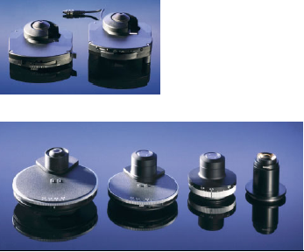
The second most important microscope component
The Condenser

Slide 19
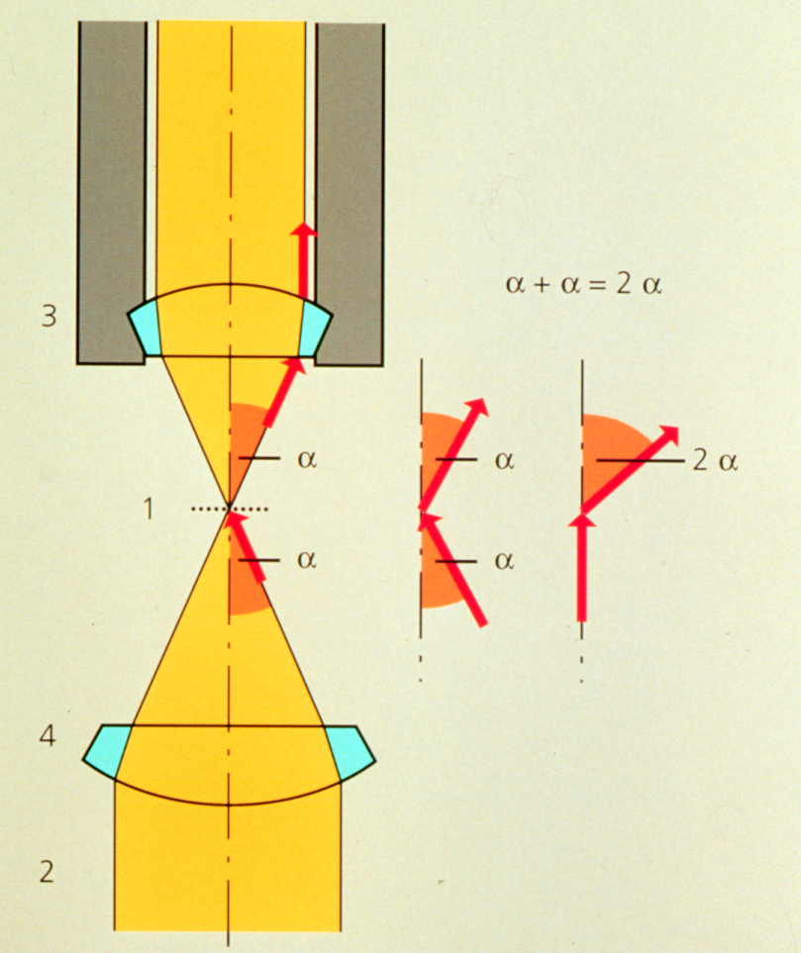
Condenser maximizes resolution
d_{min} = 1.22 λ / (NA _{objective} +NA _{condenser})
Kohler Illumination: Condenser and objective focused at the same plane

Slide 20
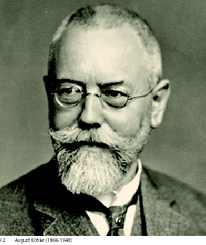
“Kohler” Illumination
Provides for most homogenous Illumination
Highest obtainable Resolution
Defines desired depth of field
Minimizes Straylight and unnecessary Iradiation
Helps in focusing difficult-to-find structures
Establishes proper position for condenser elements, for all contrasting techniques
Prof. August Köhler:
1866-1948
Notes:
August Karl Johann Valentin Köhler (March 4, 1866 – March 12, 1948) was a German professor and early staff member of Carl Zeiss AG in Jena, Germany. He is best known for his development of the microscopy technique of Köhler illumination, an important principle in optimizing microscopic resolution power by evenly illuminating the field of view. This invention revolutionized light microscope design and is widely used in traditional as well as modern digital imaging techniques today.
At the time of the invention of his revolutionary illumination scheme as a graduate student at the University of Giessen, Köhler was working on overcoming problems with microphotography. Microscopes were illuminated by gas lamps, mirrors or other primitive light sources, resulting in an uneven specimen illumination unsuited for producing good quality photomicrographs using the slow-speed emulsions available at the time. Over the course of his work for his doctorate degree, Köhler developed a microscope configuration that allowed for an evenly illuminated field of view and reduced optical glare from the light source. It involved a collector lens for the lamp that allowed the light source to be focused on the front aperture of the condenser. This in turn allowed the condenser to be focused on the specimen using a field diaphragm and condenser focus control. This superior illumination scheme is still widely used in modern microscopes and forms the basis for phase contrast,^{[3]} differential interference contrast, epifluorescence, and confocal microscopy.^{[4]}
Köhler's groundbreaking work on microscope illumination was published in the Zeitschrift für wissenschaftliche Mikroskopie in 1893 in Germany,^{[5]} followed by an English summary of his work in the Journal of the Royal Microscopical Society one year later.^{[6]} Its significance was not noted until several years later when Köhler was invited to join the Carl Zeiss AG company based on his invention. A century after its first publication, a translation of Köhler's original article, A New System of Illumination for Photomicrographic Purposes, was reprinted in the Köhler Illumination Centenary commemorative issue by the Royal Microscopical Society in 1994.^{[7]} Today, the Köhler illumination is considered one of the most important principles in achieving the best optical resolution on a light microscope.

Slide 21
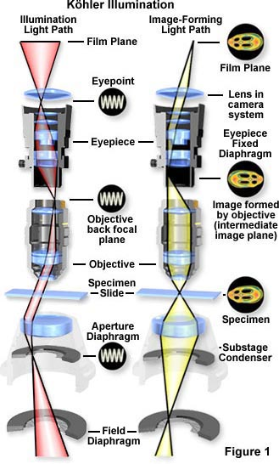
Kohler Rays
Kohler Illumination gives the most uniform illumination
Each part of the light source diverges to whole specimen
Each part of the specimen gets light that converges from the whole light source
Arrows mark
conjugate planes

Slide 22
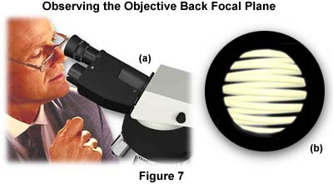
To look at the illumination planes
Remove eyepiece
Focus eye at infinity

Slide 23
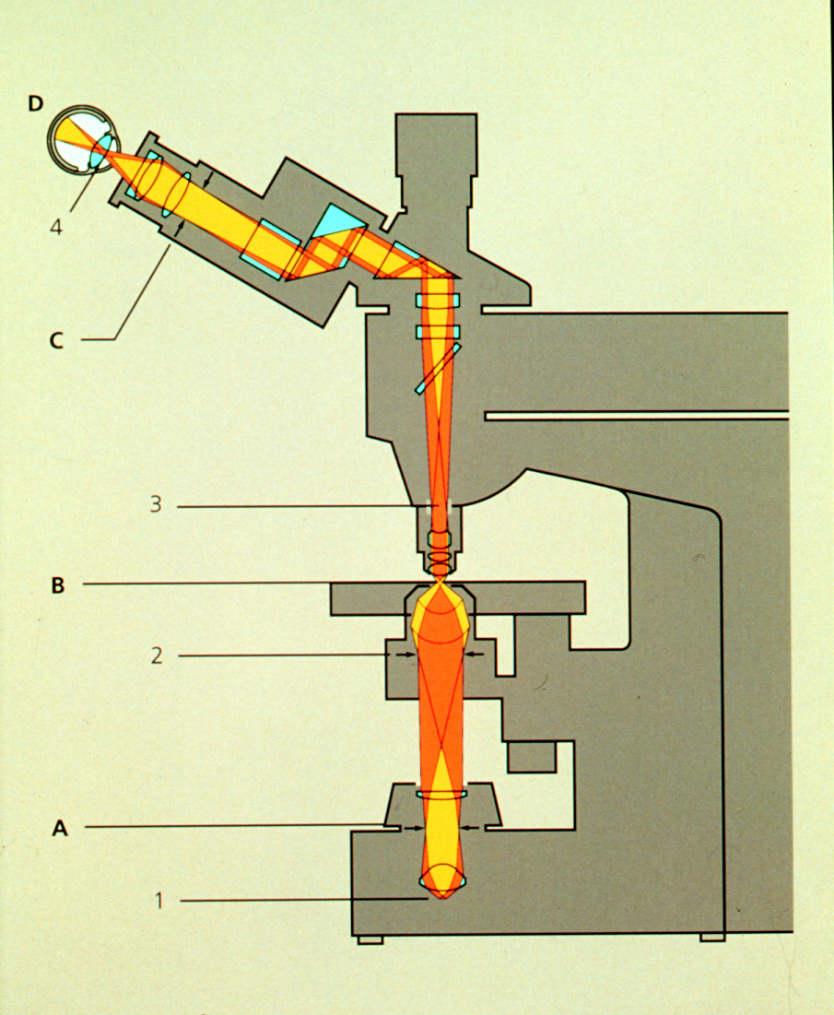
Requirements on Microscope
Condenser aperture
Condenser focus
& centering
Field aperture
Notes:
Condenser Aperture controls N.A. of condenser
Field Aperture controls region of specimen illuminated

Slide 24
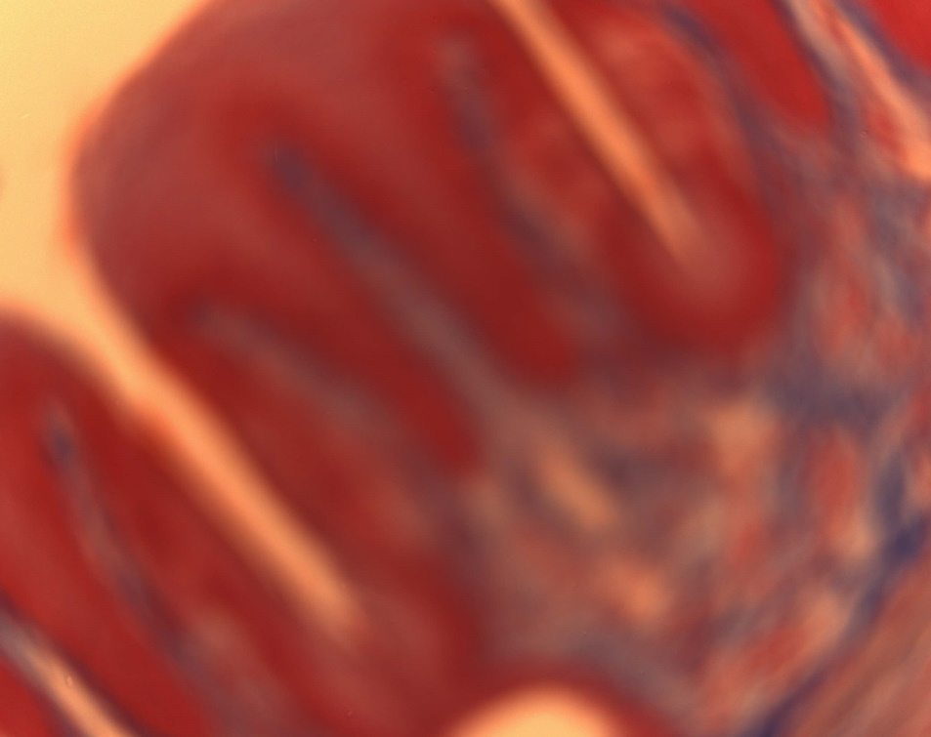

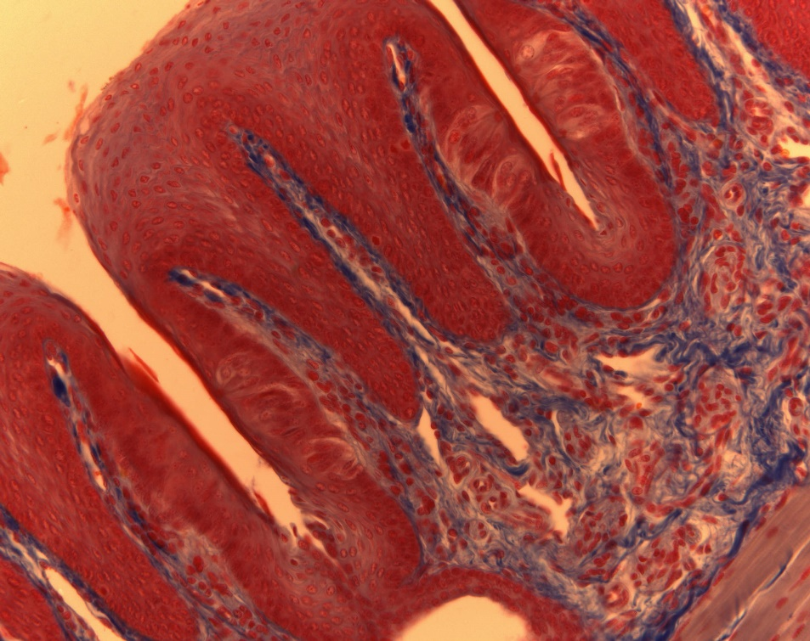
Koehler Illumination Steps:
Open Field and Condenser Diaphragms
Focus specimen
Correct for proper Color Temperature
Close Field Diaphragm
Focus Field Diaphragm – move condenser up and down
Center Field Diaphragm
Open to fill view
Observe Objective’s Back Focal Plane via Ph Telescope or by removing Ocular
Close Condenser Diaphragm to fill approx. 2/3 of Objective’s Aperture
Enjoy Image (changing Condenser Diaphragm alters Contrast / Resolution)

Slide 25
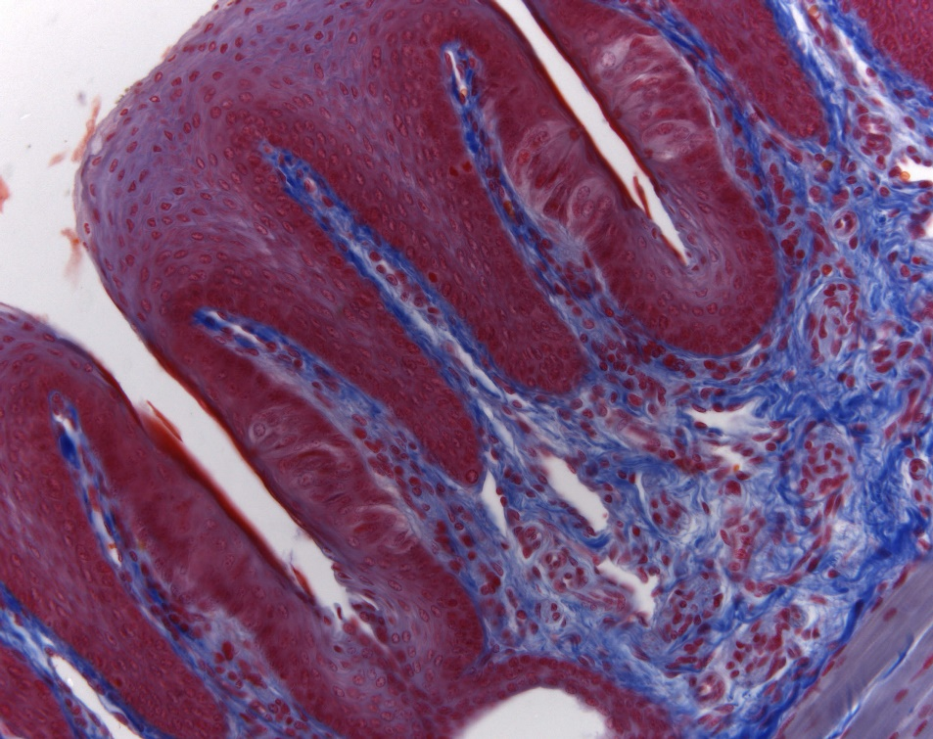
Open Field and Condenser Diaphragms
Focus specimen
Correct for proper Color Temperature
Close Field Diaphragm
Focus Field Diaphragm – move condenser up and down
Center Field Diaphragm
Open to fill view
Observe Objective’s Back Focal Plane via Ph Telescope or by removing Ocular
Close Condenser Diaphragm to fill approx. 2/3 of Objective’s Aperture
Enjoy Image (changing Condenser Diaphragm alters Contrast / Resolution)

Slide 26
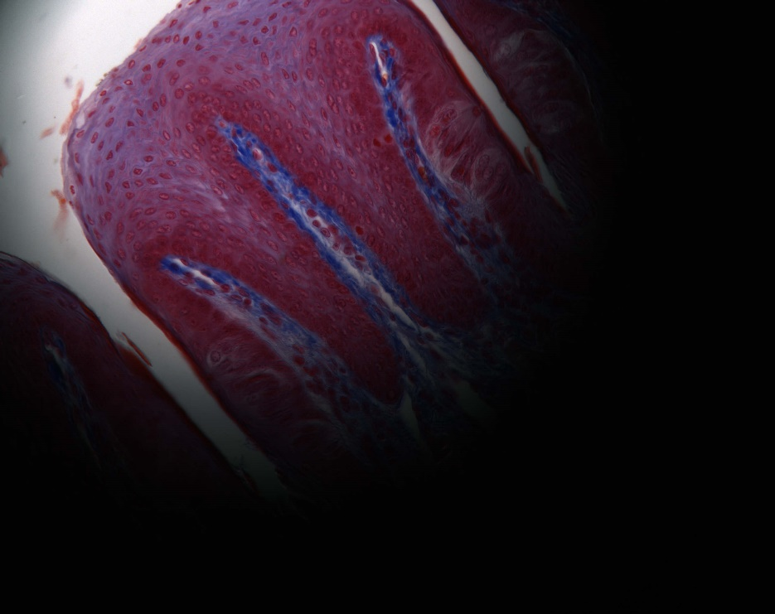
Open Field and Condenser Diaphragms
Focus specimen
Correct for proper Color Temperature
Close Field Diaphragm
Focus Field Diaphragm – move condenser up and down
Center Field Diaphragm
Open to fill view
Observe Objective’s Back Focal Plane via Ph Telescope or by removing Ocular
Close Condenser Diaphragm to fill approx. 2/3 of Objective’s Aperture
Enjoy Image (changing Condenser Diaphragm alters Contrast / Resolution)

Slide 27
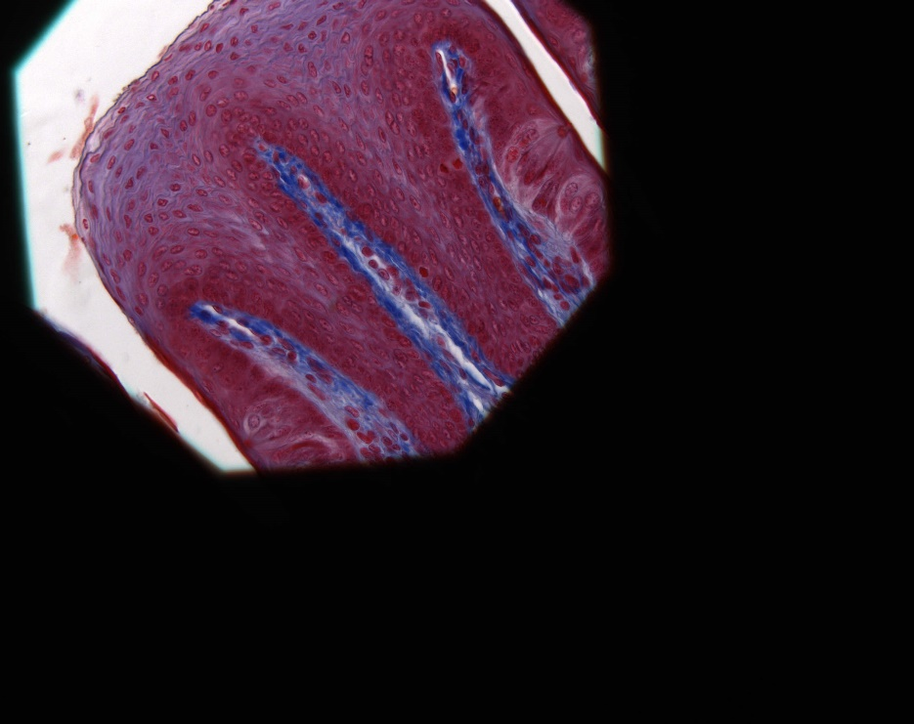
Open Field and Condenser Diaphragms
Focus specimen
Correct for proper Color Temperature
Close Field Diaphragm
Focus Field Diaphragm by
moving condenser up or down
Center Field Diaphragm
Open to fill view
Observe Objective’s Back Focal Plane via Ph Telescope or by removing Ocular
Close Condenser Diaphragm to fill approx. 2/3 of Objective’s Aperture
Enjoy Image (changing Condenser Diaphragm alters Contrast / Resolution)

Slide 28
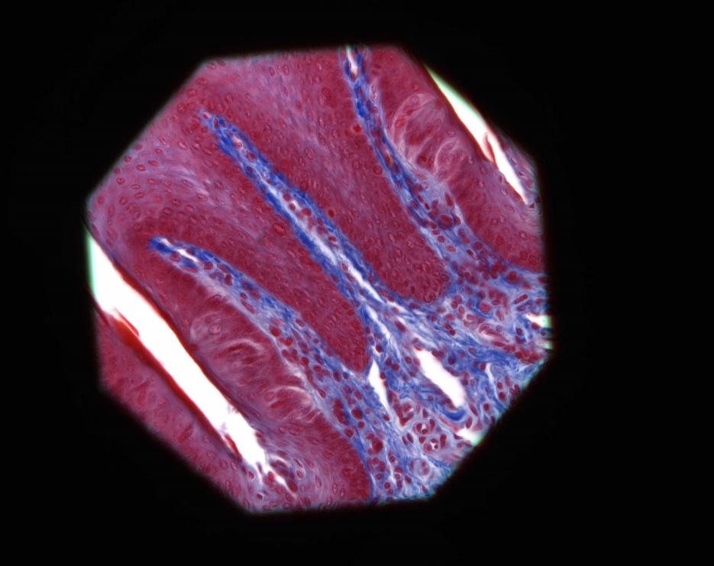
Open Field and Condenser Diaphragms
Focus specimen
Correct for proper Color Temperature
Close Field Diaphragm
Focus Field Stop by moving condenser up or down
Center Field Diaphragm
Open to fill view
Observe Objective’s Back Focal Plane via Ph Telescope or by removing Ocular
Close Condenser Diaphragm to fill approx. 2/3 of Objective’s Aperture
Enjoy Image (changing Condenser Diaphragm alters Contrast / Resolution)

Slide 29
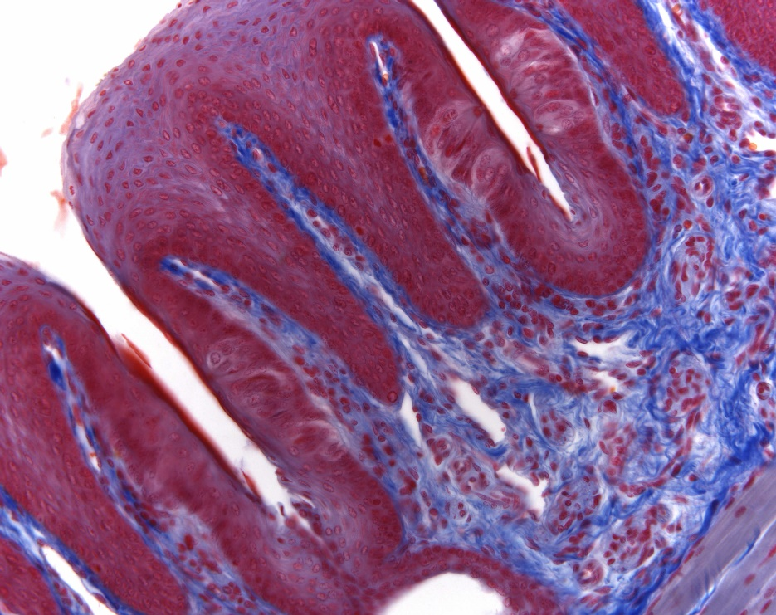
Open Field and Condenser Diaphragms
Focus specimen
Correct for proper Color Temperature
Close Field Diaphragm
Focus Field Diaphragm – move condenser up and down
Center Field Diaphragm
Open to fill view of observer
Observe Objective’s Back Focal Plane via Ph Telescope or by removing Ocular
Close Condenser Diaphragm to fill approx. 2/3 of Objective’s Aperture
Enjoy Image (changing Condenser Diaphragm alters Contrast / Resolution)

Slide 30
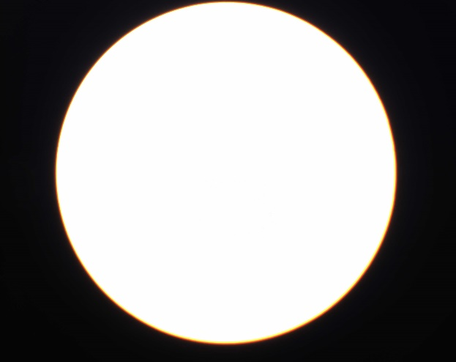
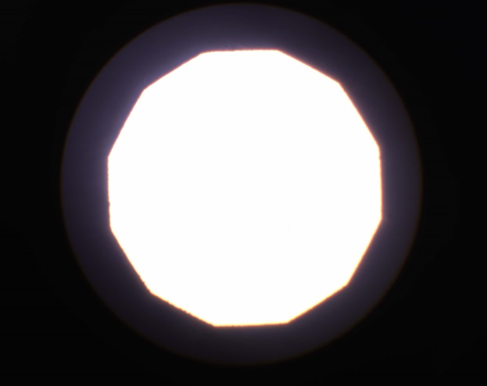
Open Field and Condenser Diaphragms
Focus specimen
Correct for proper Color Temperature
Close Field Diaphragm
Focus Field Diaphragm – move condenser up and down
Center Field Diaphragm
Open to fill view
Observe Objective’s Back Focal Plane via Ph Telescope or by removing Ocular
Close Condenser Diaphragm to fill approx. 2/3 of Objective’s Aperture
BFP
Better: Depending on specimen’s inherent contrast, close condenser aperture to:
~ 0.3 - 0.9 x NA_{objective}

Slide 31
Done !

Slide 32
Kohler illumination interactive tutorial
http://zeiss-campus.magnet.fsu.edu/tutorials/basics/microscopealignment/indexflash.html

Slide 33
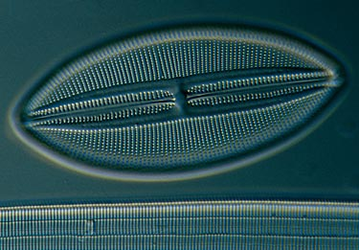
Microscopy as a compromise
Magnification
Resolution
Brightness
Contrast

Slide 34
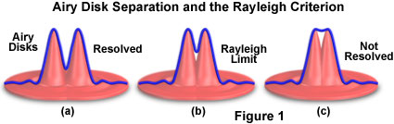
Compromise between Resolution and Contrast
The Big Challenge: highest resolution is not the highest contrast.
d = 0.61λ/NA
λ=wavelength; NA=Numerical Apeture

Slide 35
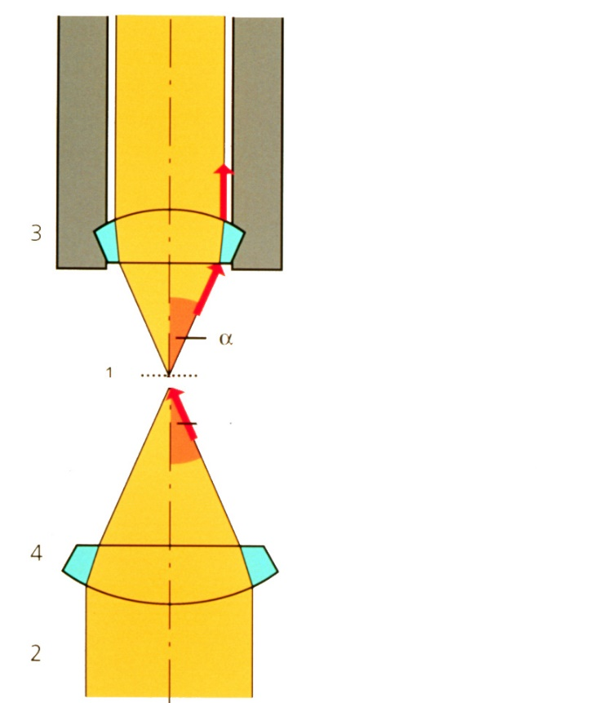
How to get contrast
Bad Idea Number 1:
“Dropping” the condenser
Objects scatter light into the objective (dust)
Gives contrast, but at the cost of NA
(spherical aberration in condenser)
(bad launch of waves for diffraction)

Slide 36
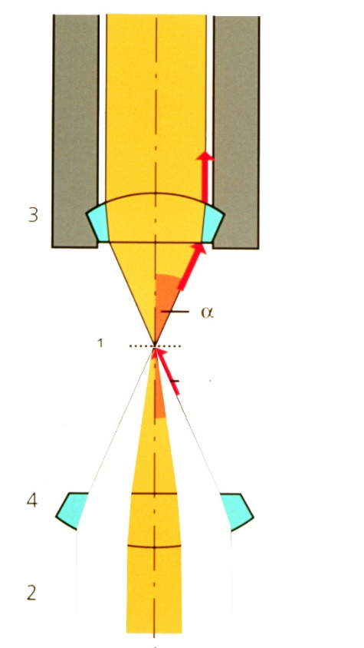
How to get contrast
Bad Idea Number 2:
“Stopping down” the condenser
Gives contrast, but at the cost of NA
(bad launch of waves for diffraction)
Notes:
Less Bad Idea than Number 1.

Slide 37
Effect of Aperture on Contrast
Image Plane
Undiffracted + Diffracted Light
Objective BFP
Objective
Large scattering angles miss the objective
Scattering specimen
Condenser
Condenser FFP (Aperture)

Slide 38
Effect of Aperture on Contrast
Image Plane
At smaller aperture angles, less diffracted light gets through the objective. This increases the difference between signal and background  more contrast
Objective BFP
Objective
Large scattering angles miss the objective
Scattering specimen
Condenser
Condenser FFP (Aperture)
Notes:
Can see why loose resolution!

Slide 39
Illumination Techniques - Overview
Transmitted Light
Bright-field
Oblique
Darkfield
Phase Contrast
Polarized Light
DIC (Differential Interference Contrast)
Fluorescence - not any more > Epi !
Reflected (Incident) Light
Bright-field
Oblique
Darkfield
Not any more (DIC !)
Polarized Light
DIC (Differential Interference Contrast)
Fluorescence (Epi)

Slide 40
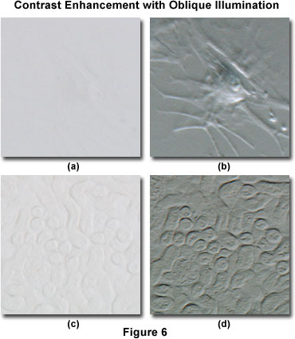
Oblique Illumination
(a.k.a. “poor man’s DIC”)
Off-center Illumination
Resolution in off-axis direction not compromised
Converts specimen gradients thickness refractive index and absorption into gray-level differences
Enhancement of Surface Topography
Shadowing of Edges
Bovine arterial cell (a,b)
Mouse kidney (c,d)
Notes:
Oblique illumination can dramatically increase specimen contrast when compared to conventional brightfield techniques, as illustrated by the digital images presented in Figure 6. The specimen in Figure 6(a) is a bovine arterial cell that has been imaged using brightfield illumination with the condenser aperture adjusted for maximum contrast. It is obvious that the specimen is almost invisible and details are very difficult to distinguish in brightfield illumination. In contrast, when the specimen is illuminated obliquely using sector stops placed near the condenser aperture (Figure 6(b)), contrast is dramatically increased and many cellular details, including location of the nucleus and pseudopods, become visible. This particular specimen is difficult to image, regardless of the contrast enhancement technology employed by the microscopist (including phase contrast, differential interference contrast, darkfield, or Hoffman modulation contrast).
A somewhat easier specimen to image is the mouse kidney thick section presented in Figures 6(c) and 6(d). In brightfield illumination (Figure 6(c)), some specimen detail is visible, but specific features are difficult to distinguish and the overall image suffers from a serious lack of contrast. Utilizing sector stops to illuminate the specimen obliquely produces a significant improvement in contrast, as shown in Figure 6(d). In this digital image, minute specimen details become visible that were previously difficult to observe in brightfield illumination.
http://www.olympusmicro.com/primer/techniques/oblique/obliqueintro.html

Slide 41
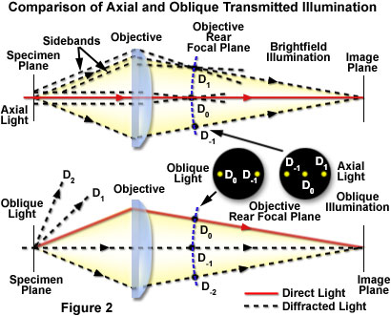
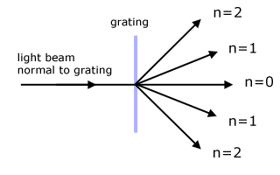
Required Microscope Components for Oblique Illumination:
Condenser Aperture has to be able to be moved off Center, e.g. via
  Turret Condenser or
  Independent Slider
Note how oblique illumination shifts diffraction orders to one side
Notes:
The apparent three-dimensional effect afforded by oblique illumination techniques does not represent the actual specimen geometry or topography, and should not be employed to conduct measurements of specimen dimensions. The true value of the oblique illumination image is in revealing transitions in refractive index or other optical path differences within the specimen that enable the morphology and internal structural arrangement to be more clearly understood. The technique can be applied to a variety of materials that appear nearly invisible or transparent in brightfield illumination and cannot be stained or otherwise chemically or thermally treated to enhance contrast. Study of living organisms and processes such as in vitro fertilization, glass or acrylic fibers, chemical crystals, and other unstained materials can be facilitated by the utilization of an easily controlled oblique illumination system.

Slide 42
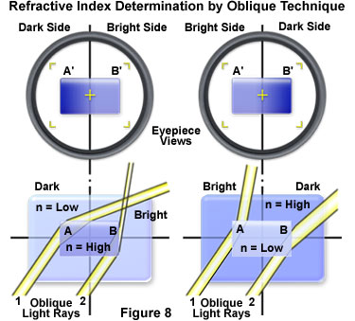
Oblique Illumination
Apparent 3D effect cannot be used for topographic or geometric measurements
However it can reveal differences in refractive index across the specimen
Notes:
The apparent three-dimensional effect afforded by oblique illumination techniques does not represent the actual specimen geometry or topography, and should not be employed to conduct measurements of specimen dimensions. The true value of the oblique illumination image is in revealing transitions in refractive index or other optical path differences within the specimen that enable the morphology and internal structural arrangement to be more clearly understood. The technique can be applied to a variety of materials that appear nearly invisible or transparent in brightfield illumination and cannot be stained or otherwise chemically or thermally treated to enhance contrast. Study of living organisms and processes such as in vitro fertilization, glass or acrylic fibers, chemical crystals, and other unstained materials can be facilitated by the utilization of an easily controlled oblique illumination system.

Slide 43
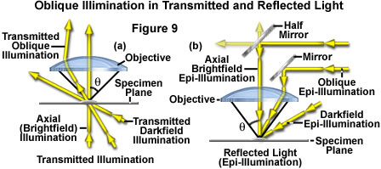
Oblique Illumination
Like most of these illumination techniques, can be used for incident (reflected) or transmitted light

Slide 44
Advanced Oblique illumination techniques
Phase contrast
    Which we will discuss later
Hoffman Modulation Contrast
Notes:
http://www.olympusmicro.com/primer/techniques/oblique/obliqueintro.html

Slide 45
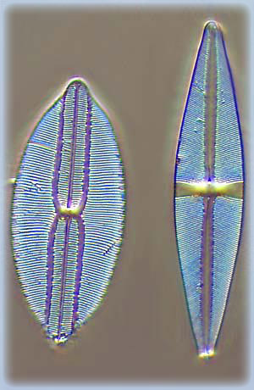
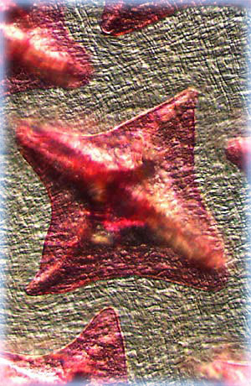
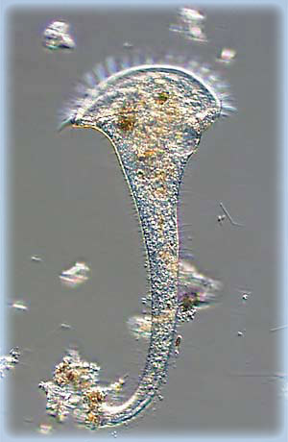
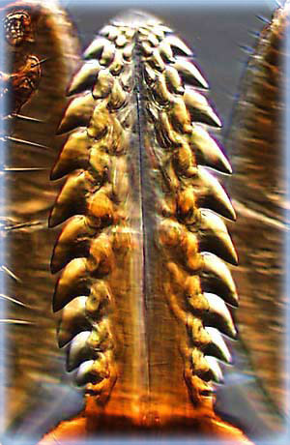
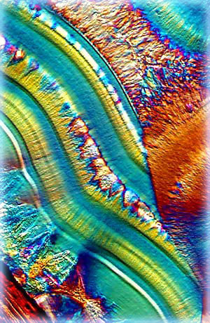
Advanced Oblique illumination techniques
Phase contrast
    Which we will discuss later
Hoffman Modulation Contrast
Notes:
Unlike the phase plate in phase contrast microscopy, the Hoffman modulator is designed not to alter the phase of light passing through any of the zones. When viewed under modulation contrast optics, transparent objects that are essentially invisible in ordinary brightfield microscopy take on an apparent three-dimensional appearance dictated by phase gradients. The modulator does not introduce changes in the phase relationship of light passing through different portions of the modulator, but influences the principal zeroth order maxima. Higher order diffraction maxima are unaffected. Measurements using a Michelson interferometer confirm that the phase changes of light passed through a Hoffman-style modulator varies (if any) by a factor of less than λ/20.
http://www.olympusmicro.com/primer/techniques/oblique/obliqueintro.html

Slide 46
Hoffman Modulation Contrast
For unstained (live) specimens
Combination of oblique illumination and attenuation of non-diffracted light
Simulated 3-D image (similar to DIC)
Less resolution, not as specific as DIC
No “Halo”-effect
Unlike Phase does not shift wavelength (λ/20)
Usable with plastic, birefringent dishes
Notes:
Stentor Protozoan (Trumpet Mode)
This trumpet-shaped protozoan was captured in its never-ending feeding frenzy after being rescued from a stagnant pond in Tallahassee, Florida. The image was made using Hoffman modulation contrast illumination to view a sample of the pond on a microscope slide.

Slide 47

Hoffman Modulation Contrast
3% transmittance
Required Components:
  Specially Modified Objective (With Built-in Modulator)
  Modified Condenser with off-axis slit (double slit with polarizer)
Notes:
The Hoffman Modulation Contrast system is designed to increase visibility and contrast in unstained and living material by detecting optical gradients (or slopes) and converting them into variations of light intensity. This technique was invented by Dr. Robert Hoffman in 1975, and employs several accessories that have been adapted to a number of commercial microscopes.
http://www.olympusmicro.com/primer/techniques/hoffman.html

Slide 48



Dark Field Illumination
Maximizes detectability
Cost in resolution

Slide 49

Notes:
Bright field

Slide 50

Notes:
Dark field

Slide 51

Dark field illumination is the elimination of the 0 order (Undeviated light that is not diffracted)
10x
40x
63x
-1
0
+1
-2
+2
+3
+4
+5
Blue “light”
Notes:
Interference of Coherent Waves

Slide 52
Dark Field Illumination
Central Dark field via hollow cone
Oblique Dark field via Illumination from the side
Undeviated light (Zero-order) blocked off so black background
Only Scattered / Diffracted Light visible
Shows Sub-resolution Details, Particles, Defects etc. with excellent, reversed contrast
Good Technique for Live Specimens
Not for Measurements (Wrong Sizes)
“Detection” Term More Appropriate Than “Resolution”

Slide 53

Dark Field Illumination
Required conditions for Dark field:
  Illumination Aperture must be larger than objective aperture
  i.e. direct light must bypass observer
Low NA Objective
High NA Objective
Notes:
Recommended special Condenser:
Ultra Darkfield Condenser 1.2/1.4 Oil

Slide 54


Dark Field Illumination
Dark-field - The GOOD:
  High NA Condenser
  “Kohler” Illumination
Dark-field - The BAD:
  Lower NA light collection
  Don’t collect 0th order
Need special objectives & filter cube for incident (reflected) illumination
Notes:
The objective illustrated in Figure 3 is a catadioptric system, which uses both reflecting and refracting optical elements and surfaces to form the oblique hollow cone of illumination necessary to view the specimen in darkfield mode. A cylinder of light entering the hollow periphery of the objective first encounters a curved lens element that directs light to a mirrored internal surface of the objective lens barrel. Light is reflected from the barrel directly through the glass element and is then reflected from the mirrored internal surface of the outer objective barrel, before being refracted to form the hollow cone of illumination by a second lens element. Light diffracted and refracted by the specimen is then able to enter the front lens of the objective. This concept can be further studied by examining the interactive Java tutorial on reflected darkfield objectives.
http://micro.magnet.fsu.edu/primer/techniques/darkfieldreflect.html

Slide 55

Rheinberg Illumination
Special variant of Dark field illumination
The Good: Striking contrast
The Bad: “dark field” like resolution
(good for seeing things, not as good for measuring)
Notes:
Rheinberg illumination is a special variant of dark field illumination in which transparent, colored filters are inserted just before the condenser so that light rays at high aperture are differently colored than those at low aperture (i.e. the background to the specimen may be blue while the object appears self-luminous red). Other color combinations are possible but their effectiveness is quite variable.^{[3]}

Slide 56



Notes:
The outer ring can also be divided into alternating sectors of color as illustrated in Figure 5. The sector filters are especially effective in the study of warp-proof fabrics, crystal faces, diatoms, and wood sections where the length-width dimensions are displayed in contrasting colors.

Slide 57

Rheinberg Illumination
Which filter was used to take the picture of the tick?

Slide 58
History of microscopy
Video microscopy developed early 1980s (MBL)
1595: The first compound microscope built by Zacharias Janssen
1994: GFP used to tag proteins in living cells
1910: Leitz builds first “photo- microscope”
1955: Nomarski invents Differential Interference Contrast (DIC) microscopy
1600
1700
1800
1900
2000
2010
1680: Antoni van Leeuwenhoek awarded fellowship in the Royal Society for his advances in microscopy
Super-Resolution light Microscopy
1960: Zeiss introduces the “Universal” model
1934: Frits Zernike invents phase contrast microscopy
Images taken from:
Molecular Expression and Tsien Lab (UCSD) web pages
Slide from Paul Maddox, UNC

Slide 59

Phase contrast illumination
Revolutionary technique for live cell imaging
Used today in almost every tissue culture lab
Depends on phase shift for contrast
Dutch scientist Frits Zernike was awarded the Nobel Prize for his discovery
Gabriel Popescu research with phase
Notes:
Gabriel Popescu
Quantitative phase imaging QPI , Diffraction Phase Microscopy DPM
Edwards, C., Bhaduri, B., Griffin, B.G., Goddard, L.L., Popescu, G., 2014. Epi-illumination diffraction phase microscopy with white light. Optics letters 39, 6162-6165.
Light.ece.uiuc .edu
Spatial light interference microscopy SLIM
phase contrast vs DIC
Quantify phase shift
Phase noise
Diffraction phase microscopy
Diffraction grating at image plane
Optics Letters 2006 optics express 2006
RBC fluctuations
SLIM white light commercial microscope
Backfocal plane to LCPM multiple phases
SLIM AFM
Common path interferometer
SLIM fluorescence
Nature Photonics 2014
Weigh E coli SLIM
20 fg resolution
Cycle dependent growth
How cell mass distributes through time and space
Differentiation neurons 13 days
Dispersion relation for fluorescence
Tissue biopsies
Biopsy imaging by SLIM
Need 1 micron resolution
Phi Optics company
Half terabyte images scanning slide 4 phase images

Slide 60

Phase contrast illumination
Characteristics of a wave
  Phase shift is any change that occurs in the phase of one quantity, or in the phase difference between two or more quantities
  Small phase differences between 2 waves cannot be detected by the human eye but can be enhanced optically

Slide 61
Phase contrast illumination
For unstained (Live) Specimens
Good Depth of Field
Easy alignment (usually pre-aligned)
Orientation independent
No polarizers > Plastic dishes OK to use
Reduced resolution (small condenser NA)
“Halo” effect
Not good for thick samples
Notes:
A major artifact of phase contrast imaging is the bright halos of light that appear on the borders surrounding the specimen. Halos occur in phase contrast microscopy because the circular phase-retarding (and neutral density) ring located in the objective phase plate also transmits a small degree of diffracted light from the specimen (it is not restricted to passing surround waves alone). The problem is compounded by the fact that the width of the non-diffracted light (zeroth-order) surround wavefront projected onto the phase plate by the condenser annulus is smaller than the actual width of the phase plate ring. Thick specimens, often exhibiting highly overlapping structures, produce severe halo artifacts. Therefore, phase contrast is a method that is only recommended for very thin specimens where several structures are not physically lying on top of each other. In a thick specimen, details may be blended into an image that, in the final analysis, is no longer legible. (from http://zeiss-campus.magnet.fsu.edu/articles/basics/contrast.html)

Slide 62

Phase contrast illumination
Cells have higher η than water
  Light moves slower in higher η
  Light has shorter λ
Light will be phase-retarded
How to harvest this?

Slide 63

Phase contrast illumination
Illumination from Phase Ring
  Defined position of the 0th Order
Phase Ring attenuates the 0th Order
  (also phase shifts)
Makes image more dependent on subtle changes in 1st Order
Refraction of light by specimen focuses light inside of the phase ring
(spherical cells appear “phase bright”)
http://www.microscopyu.com/tutorials/java/phasecontrast/opticaltrain/index.html
Notes:
The most important parameter in the basic design of a phase contrast microscope is to isolate the surround and diffracted light waves emerging from the specimen so that they occupy different locations in the diffraction plane at the rear aperture of the objective. This interactive tutorial explores light pathways through a phase contrast microscope and dissects the incident electromagnetic wave into surround (S), diffracted (D), and resultant (particle; P) components. (from Nikon web site)
The image of a specimen in phase contrast can be influenced by appropriately selecting the retardation of the direct (non-diffracted) beam through careful selection of the phase ring in the objective. Depending on the retardation value selected, objects with a higher refractive index than their surroundings appear either brighter or darker than their surroundings. This is also called either positive or negative phase contrast. In modern microscopes, positive phase contrast is standard, where the darkness of object features increases with their refractive index. The effect simulates absorption to the observer's eye in areas where a higher refractive index produces high contrast features. This impression is considered the optimum, particularly with cells and tissue in aqueous media because cell nuclei and organelles, for example, appear darker than the cytoplasm. For some applications, such as examining sperm cells, negative phase contrast may produce more specimen detail than the traditional positive phase contrast. (from: http://zeiss-campus.magnet.fsu.edu/articles/basics/contrast.html)

Slide 64

Non-diffracted and diffracted light are focused via tube lens ⑧into intermediate image and interfere with each other; ¼+¼= ½ wave shift causes destructive interference i.e. Specimen detail appears dark ⑨
Affected rays from specimen, expressed by the higher diffraction orders, do not pass through phase ring of objective >¼ wave retarded ⑦
Tube Lens
Objective Phase Ring a) attenuates the non-diffracted 0th Order b) shifts it ¼ wave forward ⑥
Objective
Specimen
Condenser
Illumination from Condenser Phase Ring ①(“0” Order) > meets phase ring ⑤ of objective

Slide 65


Phase contrast illumination
Required Components for Phase Contrast:
  Objective with built-in Phase Ring
  Condenser or Slider with Appropriate, Centerable Phase Ring (#1 or 2 or 3), usually pre-aligned
Required Adjustment:
  Align phase rings to be exactly superimposed (after Koehler Illumination)

Slide 66


How does Phase differ from Hoffman illumination?
Phase is insensitive to polarization, birefringence & orientation (circle)
Less light starved
Hoffman modulation contrast is orientation dependent (slit)
Dimmer than phase
Notes:
Unlike differential interference contrast and Hoffman modulation contrast, the circular geometry of phase contrast illumination and detection enables specimen observation without orientation-dependent artifacts. Phase contrast is also insensitive to polarization and birefringence effects, which is a major advantage when observing tissue culture cells growing in plastic vessels. (Nikon u)
There are also several disadvantages and limitations of the Hoffman Modulation Contrast system. Images must be viewed with caution because different observers can "see" a "hill" in the image as a "valley" or vice versa as the pseudo three-dimensional image is observed through the eyepiece. The system is most sensitive to gradients perpendicular to the length of the slit, resulting in the requirement for some degree of skill in orientation of the specimen for best effect.

Slide 67
VAREL (variable relief) contrast
(1996 – Zeiss)
Combination of Phase and Hoffman modulated contrast
For unstained (live) specimens
Combination of oblique illumination and attenuation of non-diffracted light
No “Halo”-effect
Complementary technique to Phase (easy switchover)
Simulated 3-D image (similar to DIC)
Less resolution than DIC
Works with plastic dishes

Slide 68

VAREL (variable relief) contrast
Required Components for Varel:
  Objective with Varel- and Phase ring
  Slider or Condenser with specific Varel 1, 2 and Phase rings
Hoffman Modulated Contrast
Notes:
A newly developed contrasting technique, in which phase contrast is combined with inclined unilateral illumination (similar to HMC), has been developed for the examination of living cells in culture vessels. An additional stop shaped like a ring sector is used on the illumination side, permitting unilateral inclined illumination. Three illumination modes, unilateral darkfield, VAREL (variable relief) contrast, and inclined brightfield (similar to oblique illumination or HMC) are set by shifting the stop in the radial direction from the outside to the inside (see Figure 7) and a segment of a matching annulus is moved into position. This slit directs the source illumination to pass through a second ring of high absorption on the objective aperture's periphery, which suppresses its intensity by an amount dependent upon the density of the outer ring. The diffracted orders of light pass through the objective without being suppressed by the VAREL ring. You can also manipulate the position of the slit if you want to vary the extent the source illumination is suppressed.
Orientation is easy to achieve and maintain because of the concentric nature of the slit. Furthermore, because of the VAREL ring's location in the objective, VAREL and phase contrast rings can be combined in the same objective. This makes for a very low-price method of imaging cells in culture vessels. The problems of imaging in both traditional and routine tissue culture applications can be resolved with this method, it is a successful option for the examination of living objects (micromanipulation), and a range of structures with varying optical thickness are easily imaged with VAREL. Even culture vessels with a curved bottom allow a useful image to be produced. Phase contrast alone sometimes fails in such cases because a curved chamber base acts like a lens and impairs the superimposition of phase rings. A slider contains two of the mentioned sectors to allow illumination to be performed from the left or right, as required. This makes it possible to contrast cells even near the edges of the holes in microtiter plates.
http://zeiss-campus.magnet.fsu.edu/articles/basics/contrast.html

Slide 69


