Slide 1
Biology 177: Principles of Modern Microscopy
Lecture 07:
Confocal Microscopy
Adding the Third Dimension

Slide 2
Lecture 7: Confocal Microscopy
Optical Sectioning: adding the third dimension
Wide-field Imaging
  Point Spread Function
  Deconvolution
Confocal Laser Scanning Microscopy
  Confocal Aperture
  Optical aberrations
Spinning disk confocal
Two-photon Laser Scanning Microscopy

Slide 3
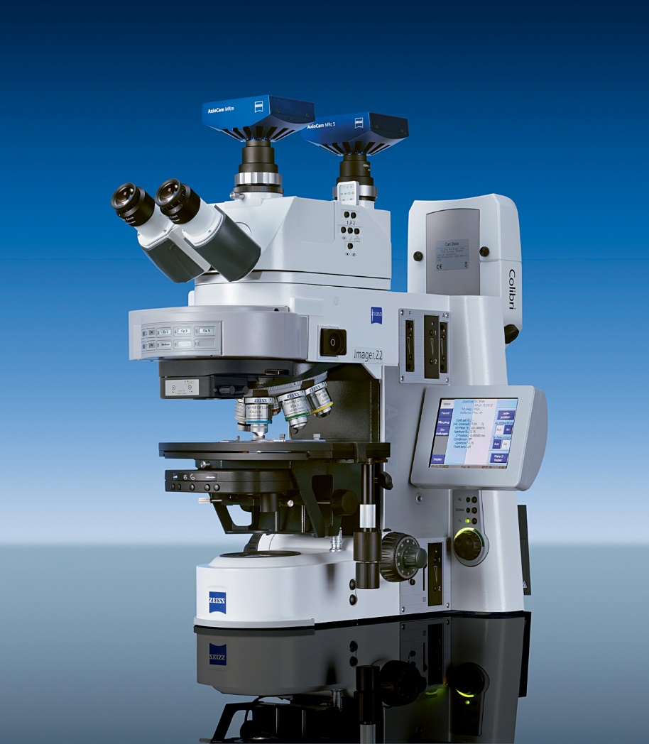
Improve fluorescence with optical sectioning
Wide-field microscopy
  Illuminating whole field of view
Confocal microscopy
  Spot scanning
Near-field microscopy
  For super-resolution
  TIRF
Remember, typical compound microscope is not 3D, even though binocular

Slide 4
Overview of Optical sectioning Methods
Deconvolution
  Point-Spread function (PSF) information is used to calculate light back to its origin
  Post processing of an image stack
Confocal and Multi-photon Laser Scanning Microscopy
  Pinhole prevents out-of-focus light getting to the sensor(s) (PMT - Photomultiplier)
  Multi Photon does not require pinhole
Spinning disk systems
  A large number of pinholes (used for excitation and emission) is used to prevent out-of-focus light getting to the camera
  Especially those using Nipkow disk and microlens
Notes:
Deconvolution mostly used with wide field microscopes but can be used for confocal data as well

Slide 5
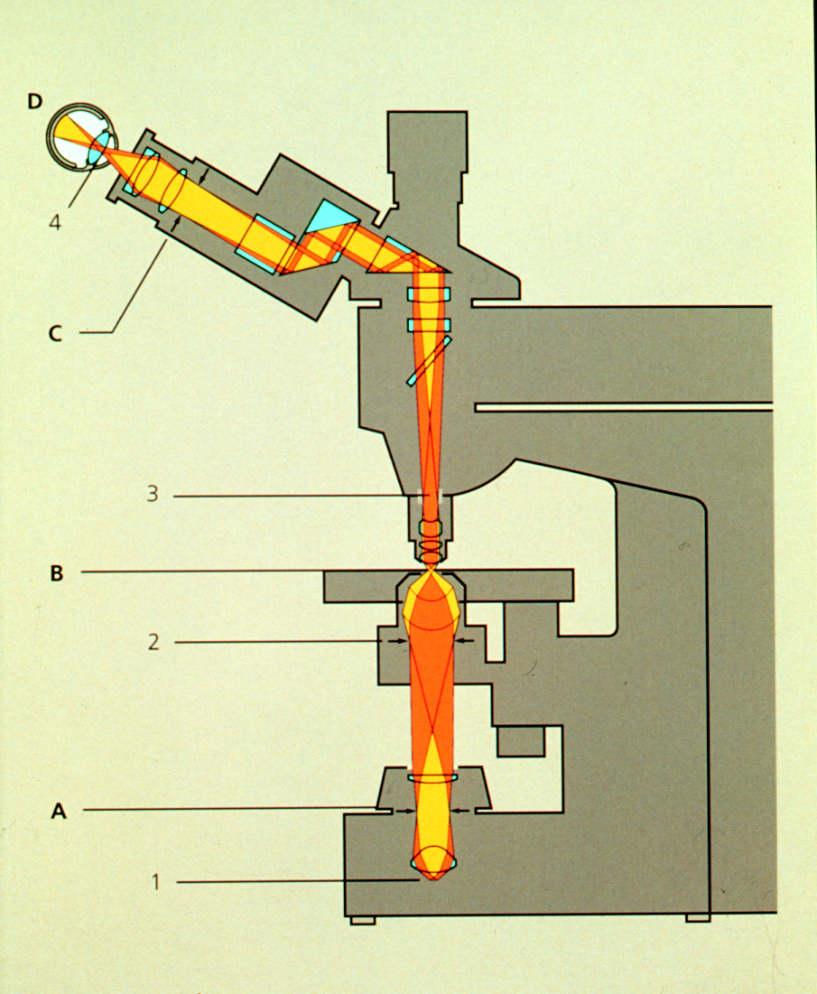
Widefield imaging: entire field of view illuminated
And projected onto a planar sensor

Slide 6
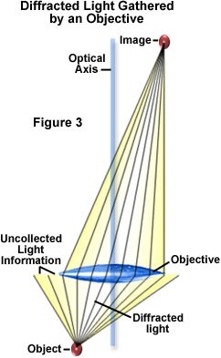
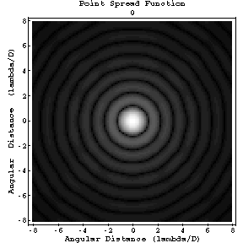
Widefield imaging: detail in the image from collecting diffracted light
Larger aperture = more diffraction peaks = higher resolution
Therefore, for any finite aperture:
  Diffraction limit gives size of central maximum
  Extended point spread function
Point Spread Function: Image of an infinitely small object.

Slide 7
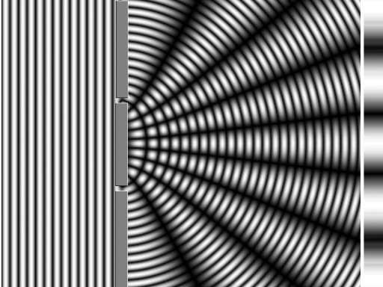
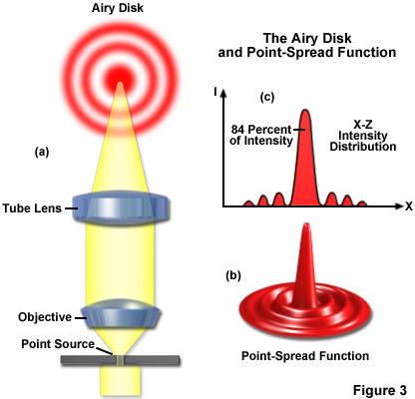
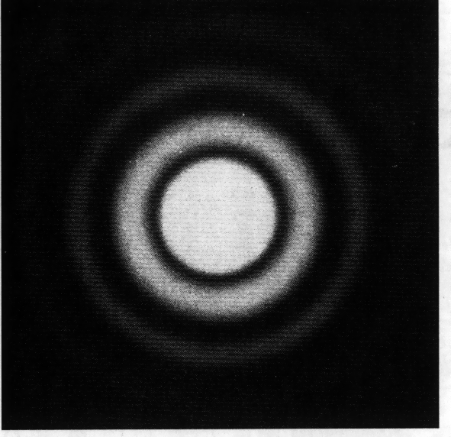
Relationship between diffraction, airy disk and point spread function
Two slit diffraction pattern
Airy disk – 2D
Point spread function -3D
Though often defined as the same that is not quite true

Slide 8
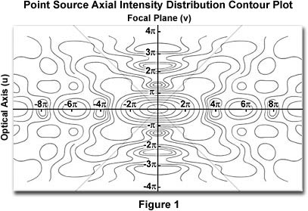
Point Spread Function is three dimensional
Image of subdiffraction limit spot
Subdiffraction limit spot
Thus, each spot in specimen will be blurred onto the sensor
(Aperture and “Missing Cone”)

Slide 9
To reduce contribution of blurring to the image: Deconvolution
Compute model of what might have generated the image
Image blurred by PSF
Compare and iterate
Compute how model would be blurred by PSF
Deconvolution depends on data from focal planes above and below focal plane being analyzed.

Slide 10
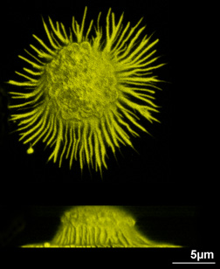
Image deconvolution
Inputs:
  3-D image stack
  3-D PSF (bead image)
Requires:
  Time
  Computer memory
Artifacts?
  Algorithms so good now
Note: z-axis blurring from the missing cone is minimized but not eliminated

Slide 11
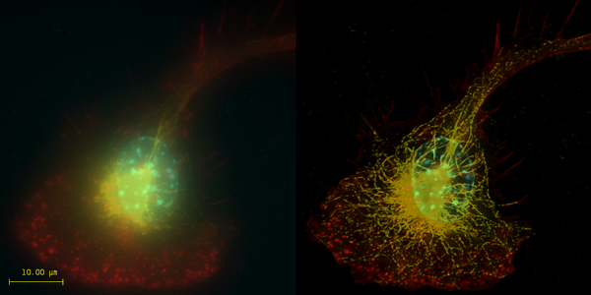

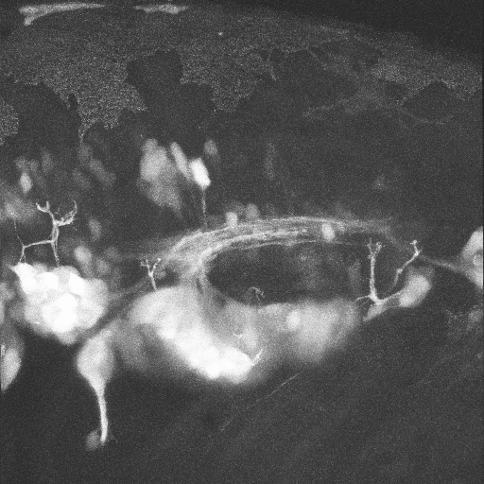
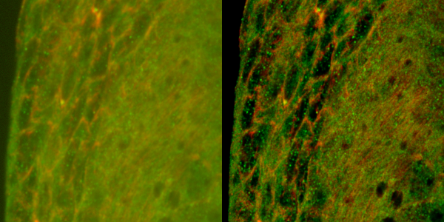
Optical sectioning even when 3D image stack is incomplete
Deconvolution
Confocal microscopy
A
A
P
Top: Macrophage - tubulin, actin & nucleus.
Bottom: Imaginal disc – α-tubulin, γ-tubulin.
Neural Gata-2 Promoter GFP-Transgenic Zebrafish; with Shuo Lin, UCLA
Notes:
Top right: Macrophage fluorescently stained for tubulin (yellow), actin (red) and the nucleus (DAPI, blue). Left: original image, recorded with a wide field microscope. Right: the same dataset, deconvolved using Huygens Professional. The datasets are visualized with top-view maximum intensity projections.
Data courtesy of Dr. James Evans, Whitehead Institute, MIT Boston MA, USA. (See the EvansMacrophage for more image details).
Bottom right: Detail of an imaginal disc from a third instar Drosophila Melanogaster larva. Left: a slice of the original data, imaged using an Andor Revolution spinning disc confocal microscope.Right: the same slice, deconvolved using Huygens Professional. The fixed sample was stained against alfa-tubulin (green) and gamma-tubulin (red).
Recorded by Dr. Paula Sampaio, Advanced Light Microscopy Facility, University of Porto.

Slide 12
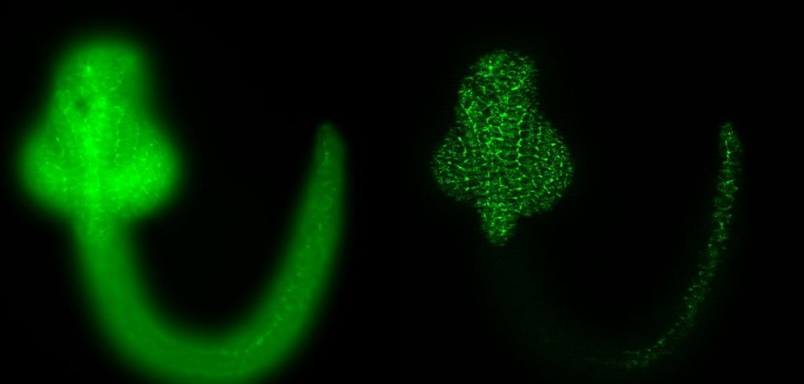
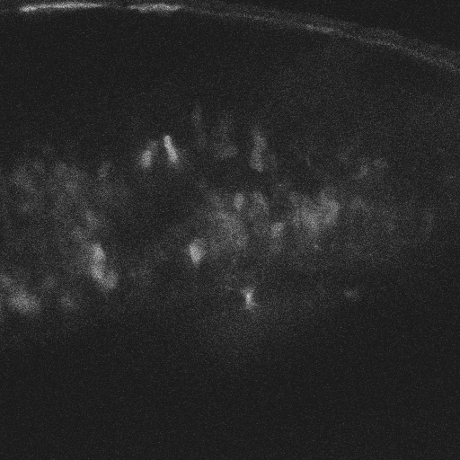
Optical Sectioning: Increased Contrast and Sharpness.
Examples: Zebrafish images, Inner ear
Zebrafish wide-field, optical section
Confocal microscope Z-stack
Notes:
Bit Depth
8 bits = 256
12 ” = 4,096
16 ” = 65,536
Maximize Histogram

Slide 13
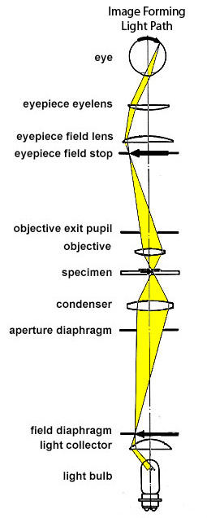
How else to fill in the missing cone?
Need more data in the Z-axis --> Confocal microscopy
PMT Detector
Detection Pinhole
Confocal pinholes
Dichroic
Beam Splitter
Excitation Laser
Excitation Pinhole
Objective
Conjugate
Focal Planes

Slide 14
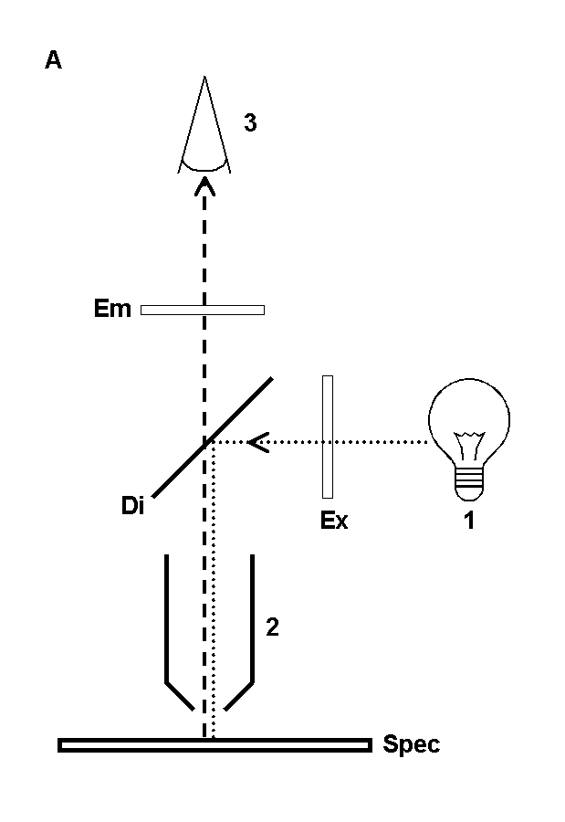
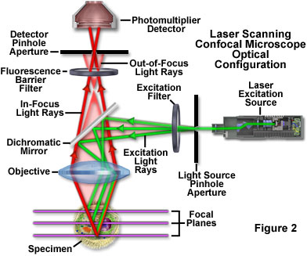
Confocal Microscopy just a form of
Fluorescence Microscopy
www.olympusfluoview.com

Slide 15
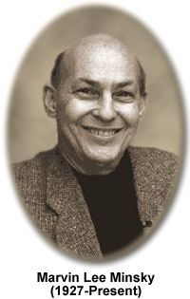
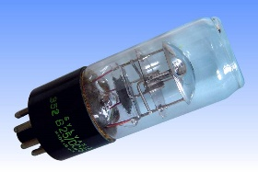
Confocal Microscopy
(Minsky, 1957)
Yes that Marvin Minsky of MIT AI (Artificial Intelligence) lab fame.
Three confocal places
Notes:
Minsky utilized a pinhole placed in front of a zirconium arc source as the point source of light
http://www.lamptech.co.uk/Spec%20Sheets/Sylvania%20Zirconia%20B25.htm
http://micro.magnet.fsu.edu/optics/timeline/people/minsky.html

Slide 16
Pinhole: Axial Filtering
Identical Lens
Focal Points

Slide 17
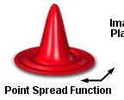
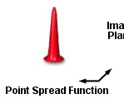
Aperture trims the PSF: increased resolution in XY plane
Cost: Loss of light

Slide 18
Aperture trims the PSF: increased resolution in XY plane
But at a cost in brightness:
  Thinner section means less labeled material in image
  Aperture rejects some in focus light
  Subtle scattering or distortion rejects more light

Slide 19
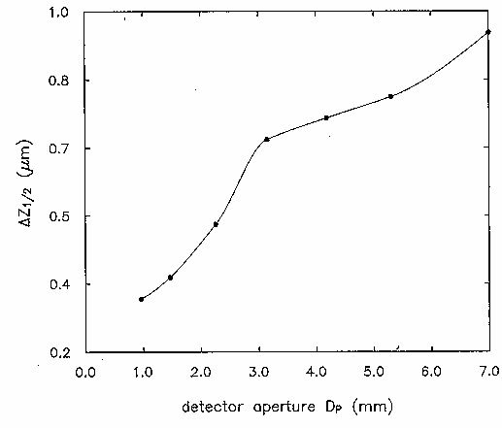
Optical section thickness vs pinhole size
% light passed by aperture
Apparent brightness will be the product of these two!!

Slide 20
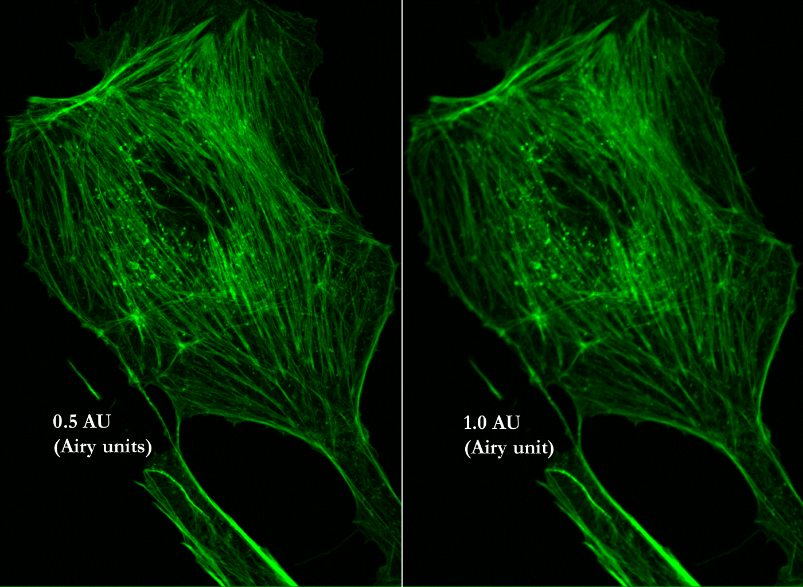
Resolution, Signal and Pinhole Diameter
Best Resolution
Best Signal to Noise
http://depts.washington.edu/keck/leica/pinhole.htm

Slide 21
Why does confocal add depth discrimination?
Light projected on a single spot in the specimen
Good: excitation falls off by the distance from the focus squared
Spatial filter in front of the detector
Good: detection falls off by the distance from the focus squared
Bad: illumination of regions that are not used to generate an image
Optical sectioning
Combined, sensitivity falls off by (distance from the focus)⁴

Slide 22
But this arrangement generates an “image” of only one point in the specimen
Only a single point is imaged at a time.
Detector signal must be decoded by a computer to reconstruct image.
Imaging point needs to be scanned somehow.

Slide 23
Scan Specimen
Good:
Microscope works on axis
Best correction for optical aberrations
Most uniform light collection efficiency
Bad:
Slow
Sloshes specimen

Slide 24
Scan Microscope Head
Good:
Specimen doesn’t move
Microscope works on axis
Best correction for optical aberrations
Most uniform light collection efficiency
Bad:
Slow
Optics can be more complicated

Slide 25
Scan Laser
Good:
Faster
Specimen moves slowly—less sloshing
Bad:
Very high requirements on objective
Light collection may be non-uniform off-axis
More complicated

Slide 26
Confocal Terminology
LSCM
  Laser Scanning Confocal Microscopy
CLSM
  Confocal Laser Scanning Microscopy
CSLM
  Confocal Scanning Laser Microscopy
LSM
  Laser Scanning Microscopy
Notes:
http://www.sciencedirect.com/science/article/pii/S096399690100117X
http://en.wikipedia.org/wiki/Confocal_laser_scanning_microscopy

Slide 27
Optical Aberrations: Imperfections in optical systems
Chromatic (blue=shorter wavelength)
Spherical
Curvature of field

Slide 28
Spherical Aberration
Zone of Confusion

Slide 29
Spherical aberration: Light misses aperture (and defocused)

Slide 30
Higher index of refraction results in shorter f
Chromatic Aberration
  Lateral (magnification)
  Axial (focus shift)
f
Shift of focus
i
o
Change in magnification

Slide 31
Lateral chromatic aberration - light misses aperture
Detector

Slide 32
Curvature of field: Flat object does not project a flat image
f
i
o
Results in a “port hole” image: dimmer at edges

Slide 33
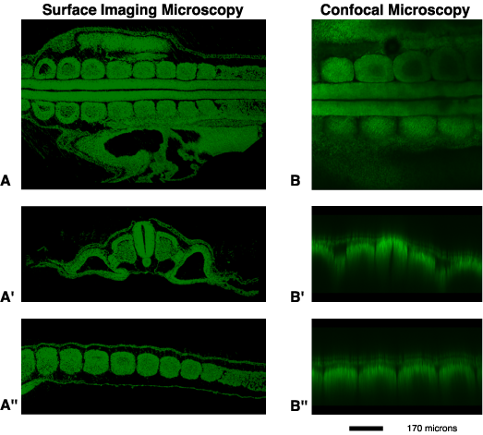
Aberrations result in loss of signal and soft focus at depth
Notes:
http://www.ncbi.nlm.nih.gov/pubmed/12412023
Dlx5/6 all

Slide 34
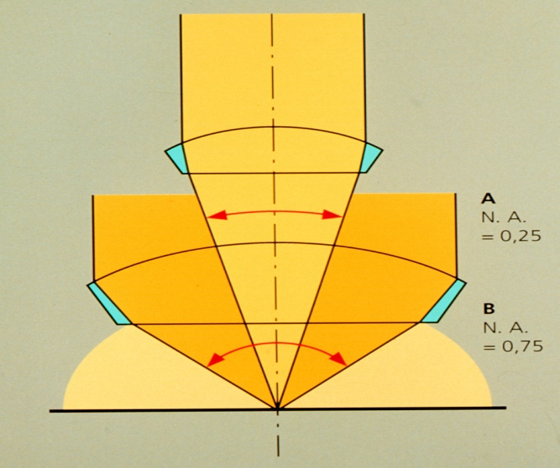
Optical Aberrations:
  Image dimmer with depth
  Image dimmer at edges
  Image resolution compromised
θ
N.A. = η sin θ
Can’t fight losses with smaller NA
Remember N.A. and image brightness
Epifluorescence
Brightness = fn (NA⁴ / magnification²)
10x 0.5 NA is 8 times brighter than 10x 0.3NA

Slide 35
N.A. has a major effect on image resolution
Minimum resolvable distance
d_{min} = 1.22 λ / (NA _{objective} +NA _{condenser})
d
d_{min}
Resolution requires collecting diffracted rays
Larger N.A. can collect higher order rays
can collect 1st order rays from smaller d_{min}

Slide 36
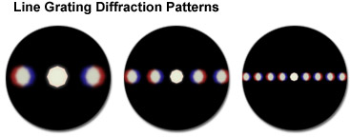
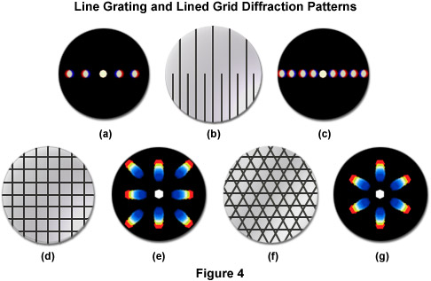
Larger N.A. can collect higher order rays can collect 1st order rays from smaller d_{min}
10x
40x
63x
-1
0
+1
-2
+2
+3
-1
+1
+4
d_{min}
+5
d_{min}
Blue “light”
-1
+1
Notes:
Interference of Coherent Waves

Slide 37
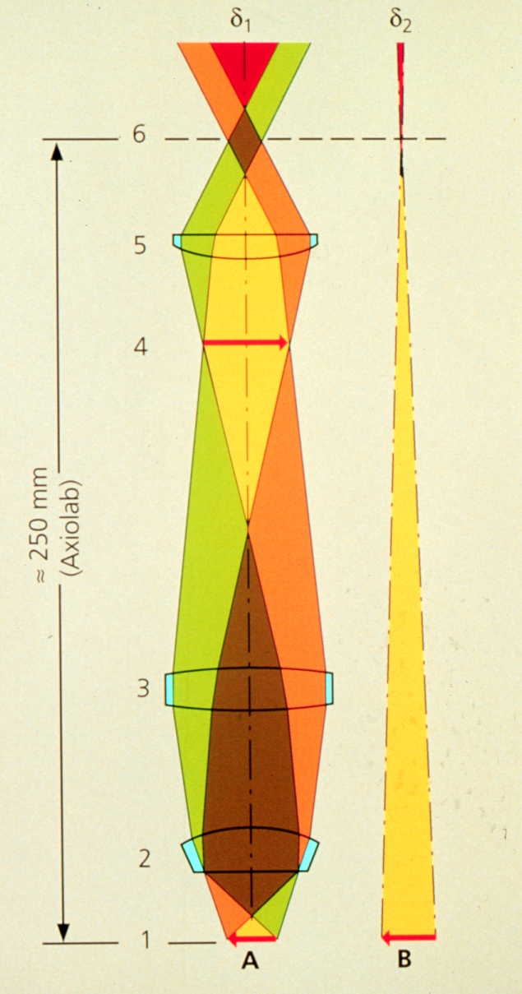
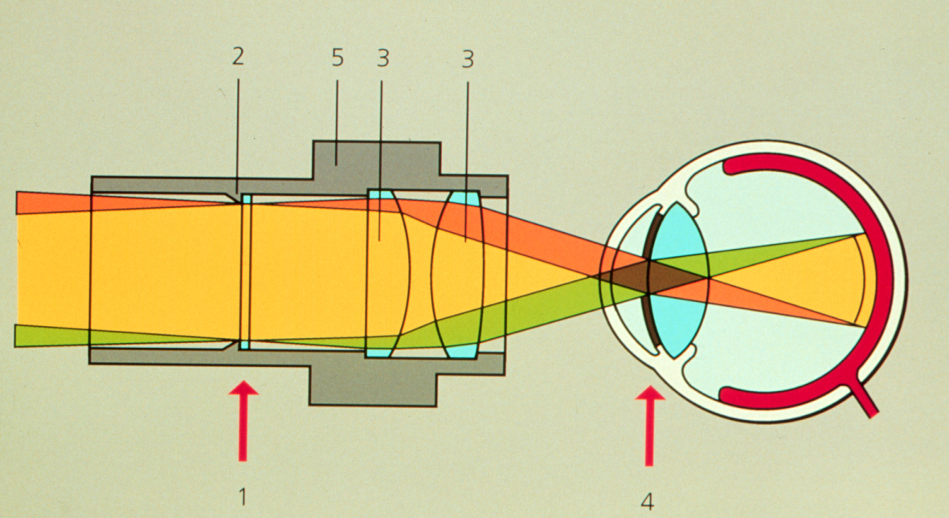
How to scan the laser beam?
Place galvanometer mirror at the telecentric point
All light travels through the same zone
Angle at which the light travels dictates the position in the specimen plane
Not imaging but illumination conjugate plane.
Telecentric Plane
Notes:
A galvanometer is a type of sensitive ammeter: an instrument for detecting electric current. It is an analog electromechanical actuator that produces a rotary deflection of some type of pointer in response to electric current through its coil in a magnetic field.
Telecentric plane is one of the illumination conjugate planes

Slide 38
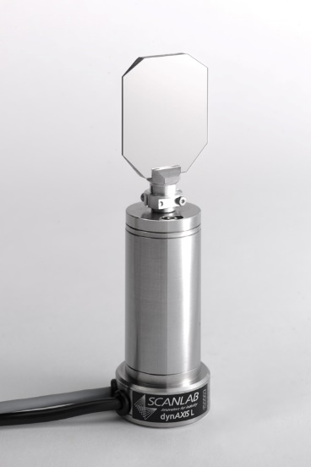
How to scan the laser beam?
Place galvanometer mirror at the telecentric point
laser
Modern closed-loop galvanometer-driven laser scanning mirror from Scanlab
Notes:
A galvanometer is a type of sensitive ammeter: an instrument for detecting electric current. It is an analog electromechanical actuator that produces a rotary deflection of some type of pointer in response to electric current through its coil in a magnetic field.
"DynAXIS L" by Scanlab7 - Own work. Licensed under CC BY-SA 3.0 via Wikimedia Commons - http://commons.wikimedia.org/wiki/File:DynAXIS_L.jpg#mediaviewer/File:DynAXIS_L.jpg
Mirror galvanometer systems are used as beam positioning or beam steering elements in laser scanning systems.^{[citation needed]} For example, for material processing with high-power lasers, mirror galvanometer are typically high power galvanometer mechanisms used with closed loop servo control systems. The newest galvanometers designed for beam steering applications can have frequency responses over 10 kHz with appropriate servo technology. Closed-loop mirror galvanometers are also used in stereolithography, in laser sintering, in laser engraving, in laser beam welding, in laser TV, in laser displays, and in imaging applications such as Optical Coherence Tomography (OCT) retinal scanning. Almost all of these galvanometers are of the moving magnet type.^{[citation needed]}

Slide 39
Scanners can introduce optical aberrations
Goal: Place galvanometer mirror at the telecentric point
All light travels through the same zone
Angle at which the light travels dictates the position in the specimen plane
Not imaging but illumination conjugate plane.
Notes:
http://www.olympusmicro.com/primer/techniques/confocal/confocalscanningsystems.html
http://www.edmundoptics.com/technical-resources-center/imaging/what-is-telecentricity/
http://www.lhup.edu/~dsimanek/3d/telecent.htm

Slide 40
Position is critical
Place galvanometer mirror AT the telecentric point
laser
If not at telecentric point,
Spherical aberration results
How can two mirrors be at the same point??
Optical relay
(without aberration)

Slide 41
Problem: Optical aberrations from simple lens systems
f
i
o

Slide 42
Simple pair of lenses can minimize problem
(equal and opposite distortions)
Focal
Point
Focal
Point
f

Slide 43
1:1 Image relay
Focal
Point
f

Slide 44
Position is critical
Place galvanometer mirror AT the telecentric point
Optically two mirrors can be at the same point
Optical relay
(without aberration)

Slide 45
Limitations: Phototoxicity
Sample is continuously exposed to light.
Weaker signal within sample requires stronger excitation and causes more toxicity.

Slide 46
Limitations: Photobleaching
Scanning causes repeated exposure above and below.

Slide 47
Loss of sectioning by Scattering

Slide 48
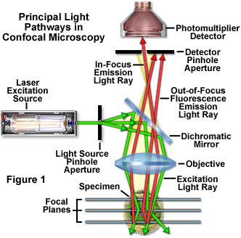
How else to do confocal microscopy?
Confocal microscopes can be slow. Can we go faster?

Slide 49
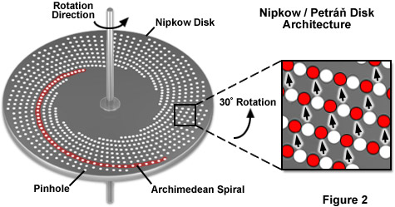
Tandem spinning disk scanner
EMCCD or CMOS Camera
Illumination through this side
Detection through this side
Alignment is critical
Most of light hits mask not hole

Slide 50
Nipkow disk
~1% pass
Notes:
A Nipkow disk (sometimes Anglicized as Nipkov disk; patented in 1884), also known as scanning disk, is a mechanical, geometrically operating image scanning device, invented by Paul Gottlieb Nipkow. This scanning disk was a fundamental component in mechanical television through the 1920s and 1930s.

Slide 51
Nipkow disk with microlenses
>>1% pass
Yokogawa

Slide 52
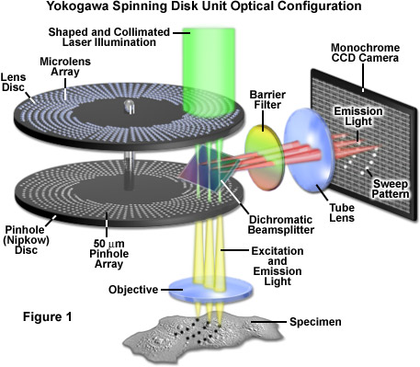
Nipkow disk with microlenses
http://zeiss-campus.magnet.fsu.edu/tutorials/spinningdisk/yokogawa/index.html

Slide 53
Optical sectioning without an aperture?
Two-Photon laser-scanning microscopy
Pinhole aperture

Slide 54
Conventional Fluorescence
(Jablonski diagram)
4nsec
Emitted light is a linear function of the exciting light
0.8 emitted

Slide 55
Two-Photon Excited Fluorescence
(Jablonski diagram)
4nsec
0.8 emitted
Excitation from coincident absorption of two photons

Slide 56
Two-Photon Excited Fluorescence
Very low probability: required intense pulsed laser light
Requires two photons: excitation is a function of (exciting light)²
Exciting light falls off by (distance from focus)²
Thus, Emission falls off by (distance from focus)⁴
--> Optical Sectioning without a confocal aperture!!

Slide 57
TPLSM depth discrimination by selective excitation
Light projected on a single spot in the specimen
Good: illumination falls off by the distance from the focus squared
And
Excitation depends on the square of the intensity
Spatial filter in front of the detector
Good: detection falls off by the distance from the focus squared
Bad: illumination of regions that are not used to generate an image
Optical sectioning
Combined, sensitivity falls off by (distance from the focus)⁴
Notes:
TPLSM – Two photon laser scanning microscopy

Slide 58
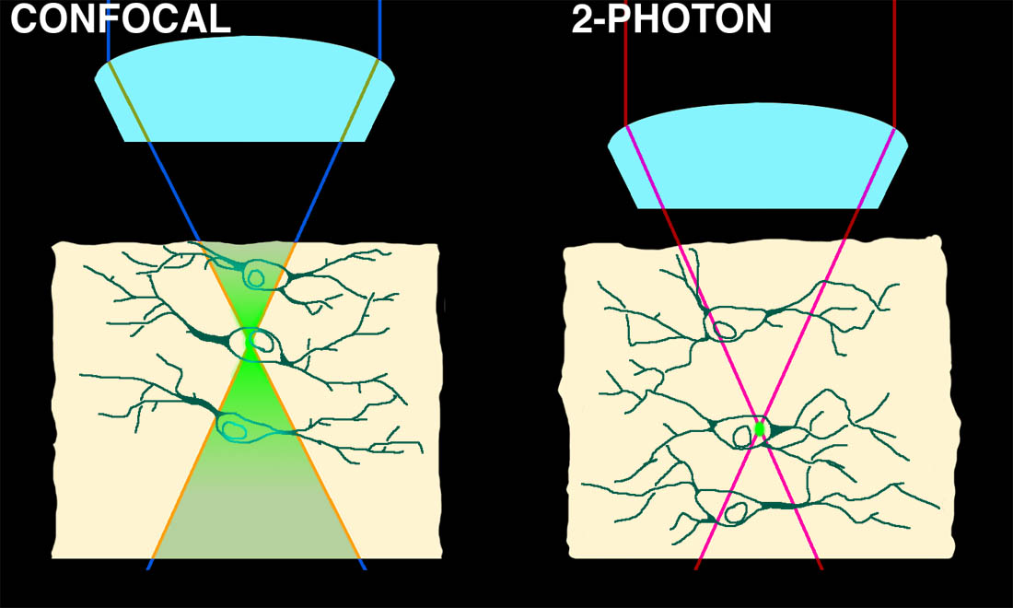

Two-Photon microscopy
Optical sectioning by non-linear absorbance
--> broad excitation maxima

Slide 59
Two-photon microscopy is somewhat color-blind
TPLSM excitation at 900nm excites multiple dyes and GFP variants

Slide 60
Two Photon Microscopy
Advantages
Disadvantages
No need for pinhole
No bleaching beyond focal plane
Potentially more sensitive
IR goes deeper into tissue
Laser $$$
Samples with melanin
Samples with multiple fluorescent labels
Slightly lower resolution because of IR laser

Slide 61
Confocal Z-resolution an order of magnitude worse than X-Y resolution
Confocal 3D data sets are not isotropic
Distortions along Z-axis
Higher N.A. not only improves X-Y resolution but also Z
Matching refractive index (η) to avoid Z-axis artifacts
η = speed of light in vacuum /speed in medium
Material Refractive Index
Air 1.0003
Water 1.33
Glycerin 1.47
Immersion Oil 1.518
Glass 1.52
Diamond 2.42

Slide 62
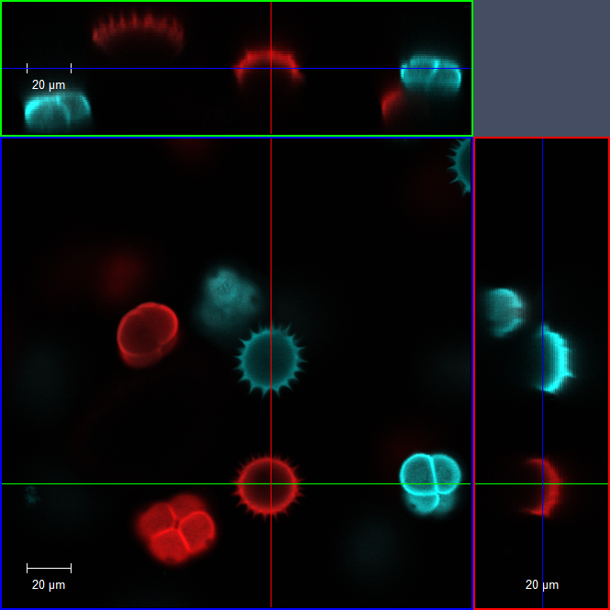
Matching refractive index (η) and increasing numerical aperture (N.A.) to avoid Z-axis distortions
20x Dry
0.8 NA
Notes:
20x objective zoomed 2x for 40x equivalent image

Slide 63
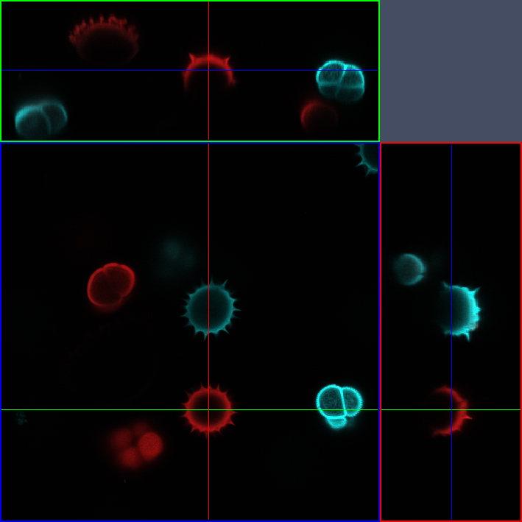
Matching refractive index (η) and increasing numerical aperture (N.A.) to avoid Z-axis distortions
40x water
1.2 NA

Slide 64
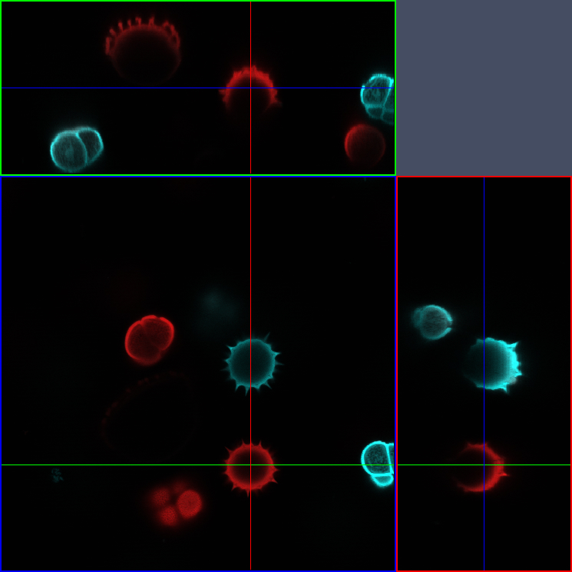
Matching refractive index (η) and increasing numerical aperture (N.A.) to avoid Z-axis distortions
40x Oil
1.3 NA

Slide 65
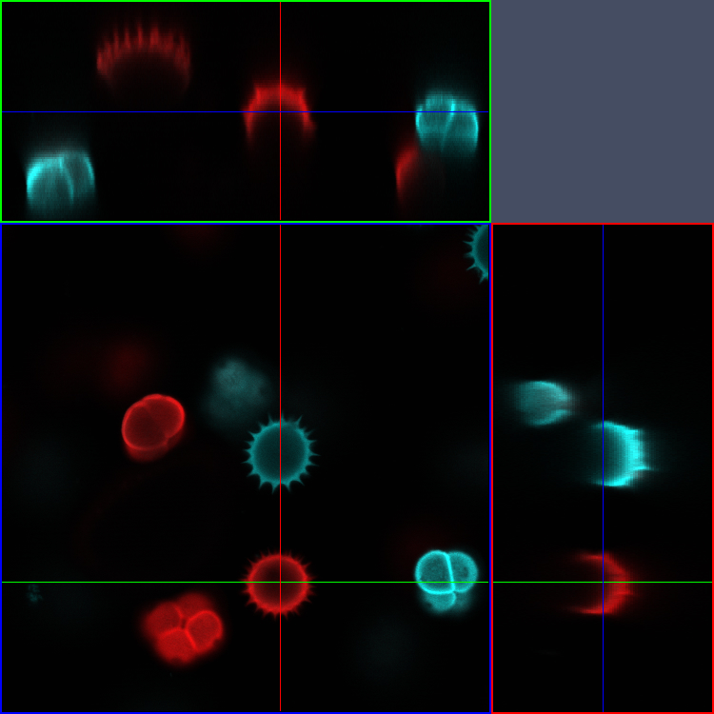
Matching refractive index (η) and increasing numerical aperture (N.A.) to avoid Z-axis distortions
20x Dry
1.52 NA corr

Slide 66
N.A. has a major effect on image brightness
Transmitted light
Brightness = fn (NA² / magnification²)
10x 0.5 NA is 3 times brighter than 10x 0.3NA
Epifluorescence
Brightness = fn (NA⁴ / magnification²)
10x 0.5 NA is 8 times brighter than 10x 0.3NA

Slide 67
Homework 3
Since confocal microscopy is very photon starved, it is important to get objectives that are bright.
For this assignment let’s assume you have a 10x objective with an N.A. of 0.3. Calculate the N.A. a 20x, 40x and 60x would need to have to be as bright as this 10x.
Do the same for a 10x with an N.A. of 0.5. Also note if the 20x, 40x or 60x would be a dry, water or oil objective.
Hint – Assume Brightness for fluorescence equals NA⁴ / Mag²

Slide 68
Metric Prefixes
Prefix Symbol Factor
Zeta Z 1021 1,000,000,000,000,000,000,000
Exa E 10^{18 1,000,000,000,000,000,000}
Peta P 10^{15 1,000,000,000,000,000}
Tera ¹⁾ T 10^{12 1,000,000,000,000}
Giga ²⁾ G 10^{9 1,000,000,000}
Mega ³⁾ M 10^{6 1,000,000}
kilo ⁴⁾ k 10^{3 1,000}
hecto ⁵⁾ h 10² ¹⁰⁰
Deka D 10¹ ¹⁰
- 10⁰ ¹
deci ⁶⁾ d 10^{-1 0.1}
centi ⁷⁾ c 10^{-2 0.01}
milli ⁸⁾ m 10^{-3 0.001}
micro ⁹⁾ µ 10^{-6 0.000 001}
nano ¹⁰⁾ n 10^{-9 0.000 000 001}
Ångstrøm Å 10^{-10 0.000 000 000 1}
pico ¹¹⁾ p 10^{-12 0.000 000 000 001}
femto ¹²⁾ f 10^{-15 0.000 000 000 000 001}
atto a 10^{-18 0.000 000 000 000 000 001}
zepto z 10-21 0.000 000 000 000 000 000 001
Examples:
1) Tbytes = Tera bytes = 10¹² Bytes (storage capacity of computers)
2) Ghz = Gigahertz = 10⁹ Hertz (frequency)
3) MΩ = Megohm = Million Ohm (resistance)
4) kW = kilowattt = 1000 Watt (power) ≅ ¾ HP
5) hl = hectoliter = Hundred liters (volume of barrels)
6) (dm)³ = decimeter³ = cubic decimeter = 1 liter
7) cm = centimeter (length) ≅ 3/8”
8) mV = millivolt (voltage)
9) µA = microampere (current)
10) ng = nanogram (weight)
11) pf = picofarad (capacitance)
12) fl = femtoliter (volume)

Slide 69


Conjugate Planes in Infinity Optics
Retina
Eye
Eyepoint
Eyepiece
Intermediate Image
TubeLens
Imaging Path
Objective Back Focal Plane
Objective
Specimen
Condenser
Condenser Aperture Diaphragm
Field Diaphragm
Illumination Path
Collector
Light Source

