Slide 1
Biology 177: Principles of Modern Microscopy
Lecture 06:
Fluorescence Microscopy

Slide 2
Lecture 6: Fluorescence Microscopy
Detectors for Microscopy, Part 2
  CMOS, PMT and APD
Phenomenon of Fluorescence
  Energy Diagram
  Rates of excitation, emission, ISC
  Practical Issues
    Lighting, Filters
Homework 2 review

Slide 3
Detectors for microscopy
Film
CMOS (Complementary metal–oxide–semiconductor)
CCD (Charge coupled device)
PMT (Photomultiplier tube)
GaAsP (Gallium arsenide phosphide)
APD (Avalanche photodiode)
Array of detectors, like your retina
Single point source detectors

Slide 4
Let’s look at an actual example
Visualizing hearing in vivo

Slide 5
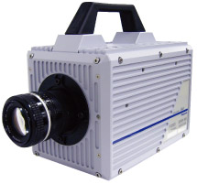
High speed cameras
Used by the military so expensive
10,000 frames/sec.
Fastcam 1024 PCI
  Photron, up to 100,000 fps
  47,000 with LED illumination and DIC
ProAnalyst software
  Xcetex, Cambridge, Mass
Actually Fastcam SA5

Slide 6
Nyquist criterion
Sampling frequency needs to be greater than twice the frequency trying to image
Undersampling can result in aliasing
Such differences can result in distortions or artifacts
  Avoid the “wagon wheel” effect
Notes:
In terms of a function's own bandwidth (B), as depicted above, the Nyquist criterion is often stated as f_{s} > 2B. And 2B is called the Nyquist rate for functions with bandwidth B. When the Nyquist criterion is not met (B > ½ f_{s}), a condition called aliasing occurs, which results in some inevitable differences between x(t) and a reconstructed function that has less bandwidth. In most cases, the differences are viewed as distortion.

Slide 7
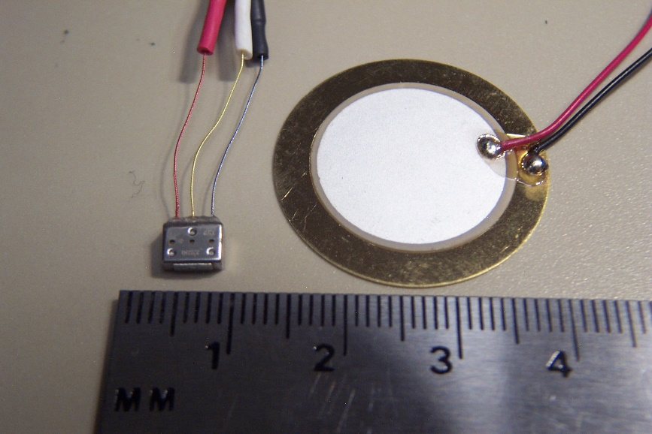
Visualizing Hearing In Vivo
Spontaneous otoacoustic emissions
  In vivo SOAE 600 Hz to 60 kHz
  In vitro hair bundle motions < 100 Hz
Playing sounds 100 to 2000 Hz
Experimental Setup
  High magnification DIC microscopy
  High speed camera 6000 fps +
  Specialized data analysis software
Speaker
Specimen
Water-filled tube
Glass bottom dish

Slide 8
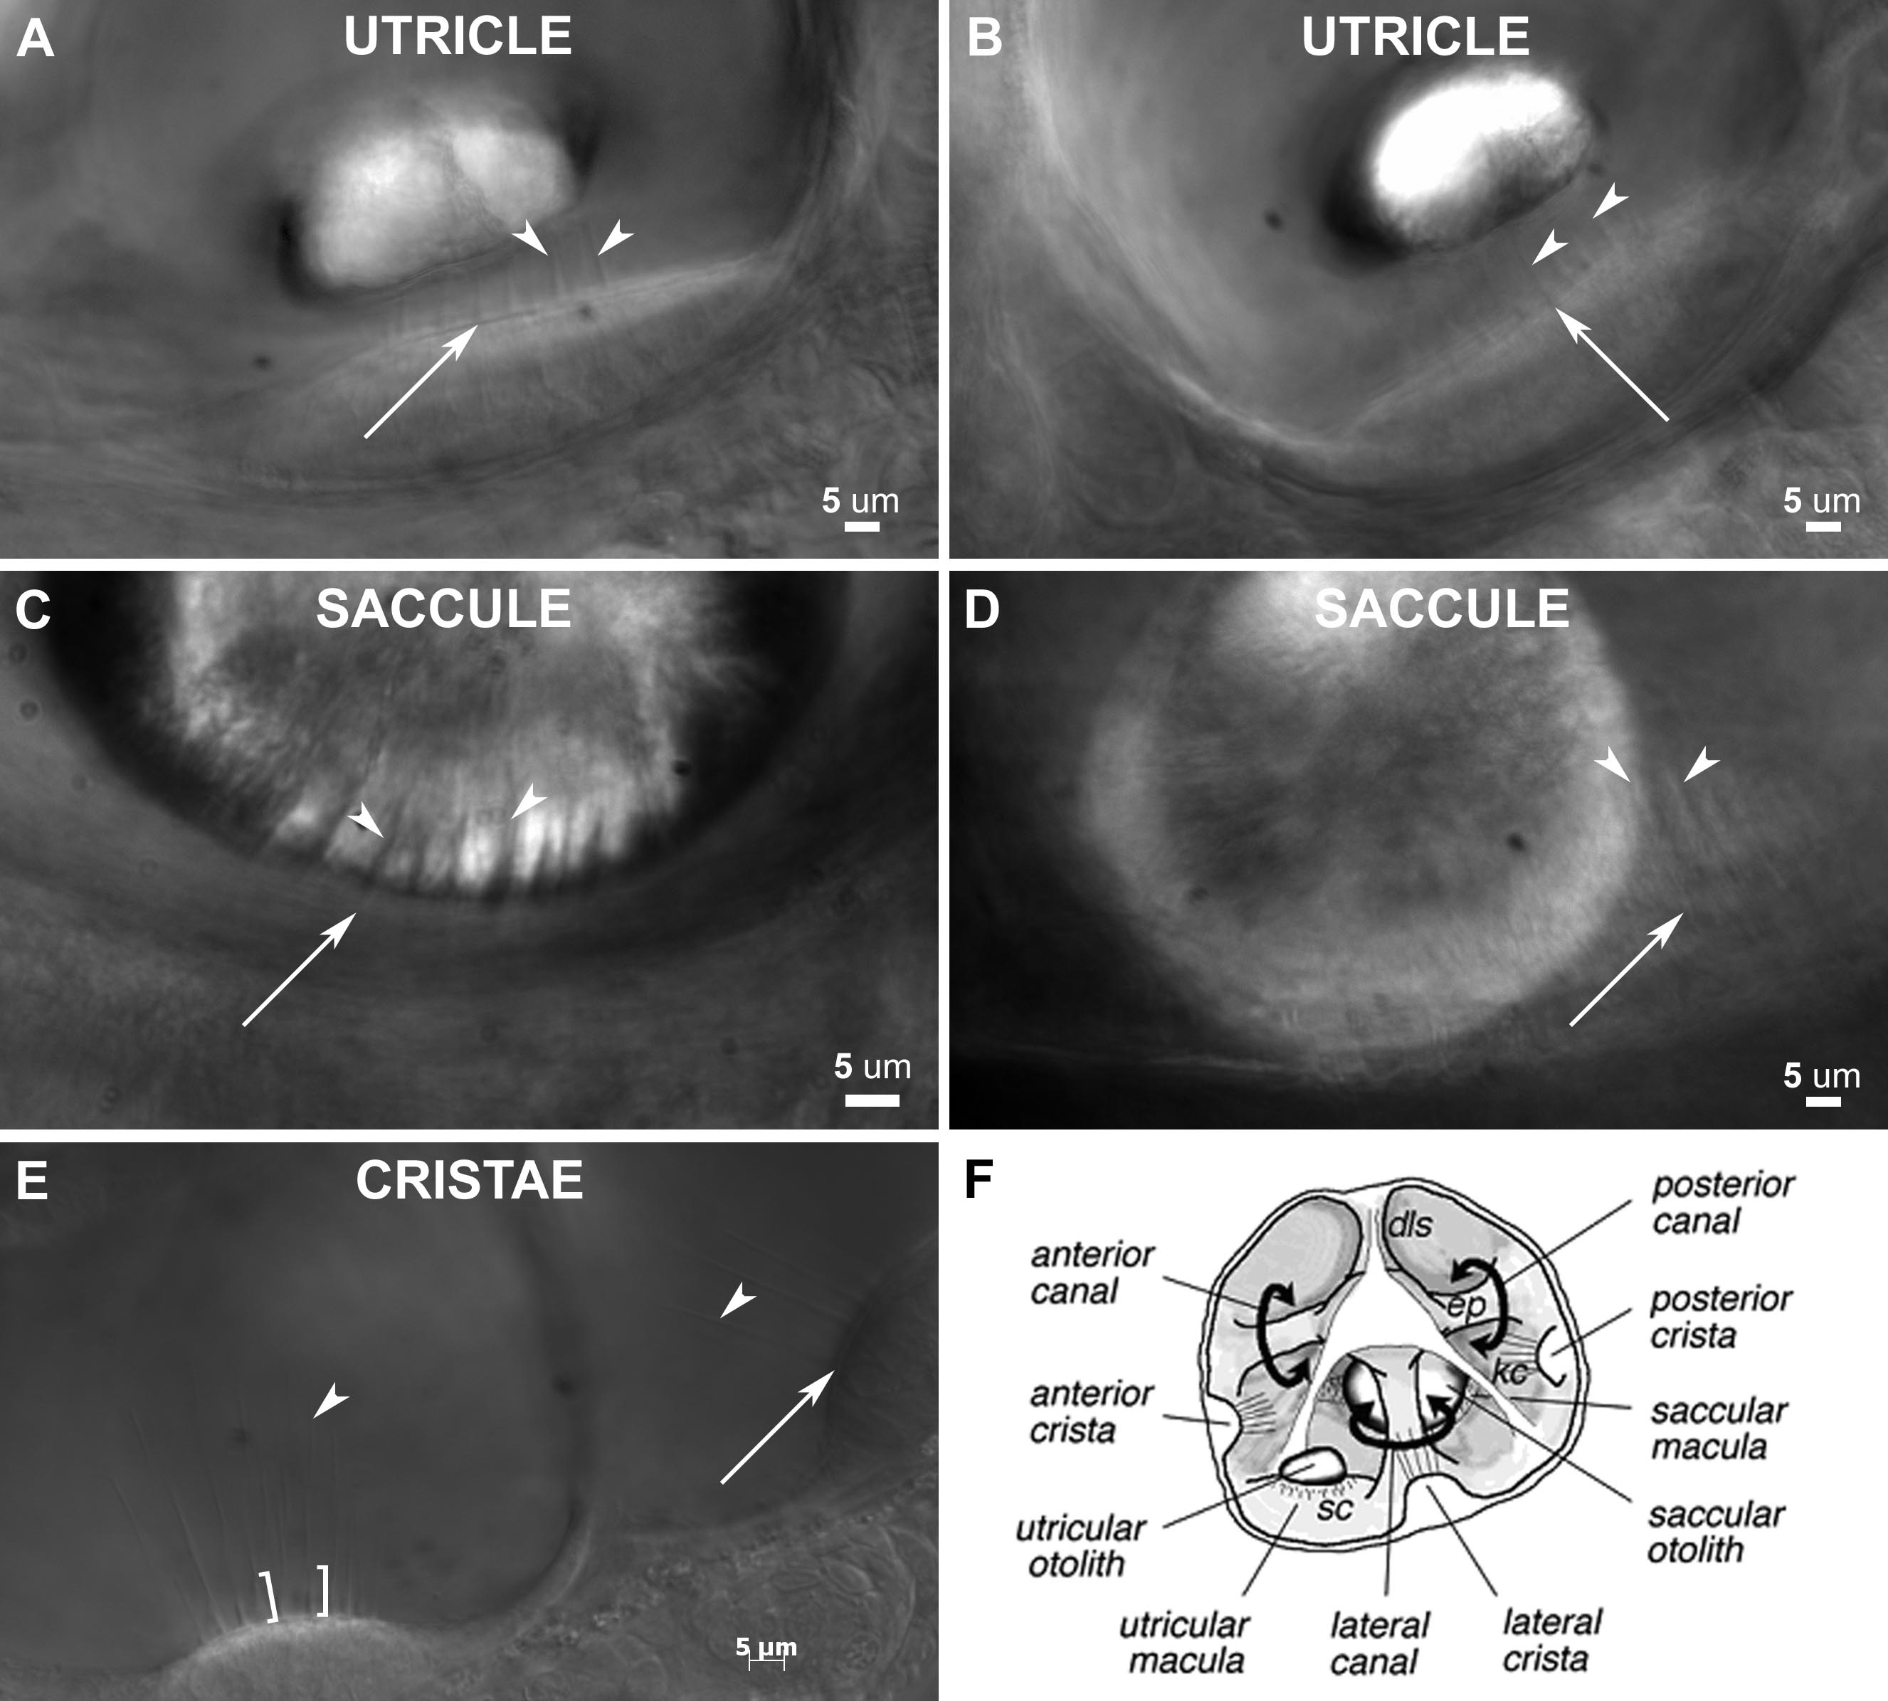

Slide 9
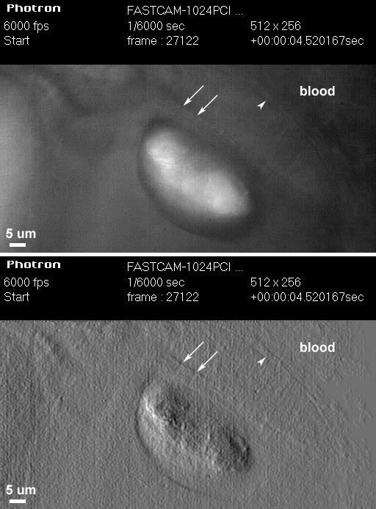
Temporal Resolution: Ultra High-Speed Video
1000 fps is 1024x1024
6000 fps reduced to 512x256, 1024x128, etc.
High Power LED System-36AD3500, Lightspeed Technologies, Campbell, CA
  20/80 to 90/10 on/off
Fastcam SA1 (Photron, San Diego, CA), 5400 fps at 1024x1024

Slide 10
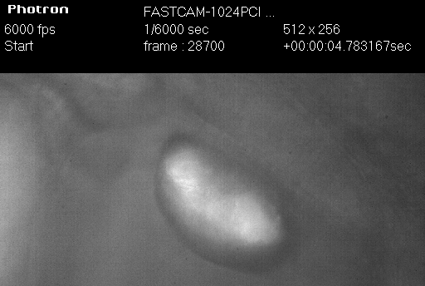
6000 fps movie played at 30 fps

Slide 11
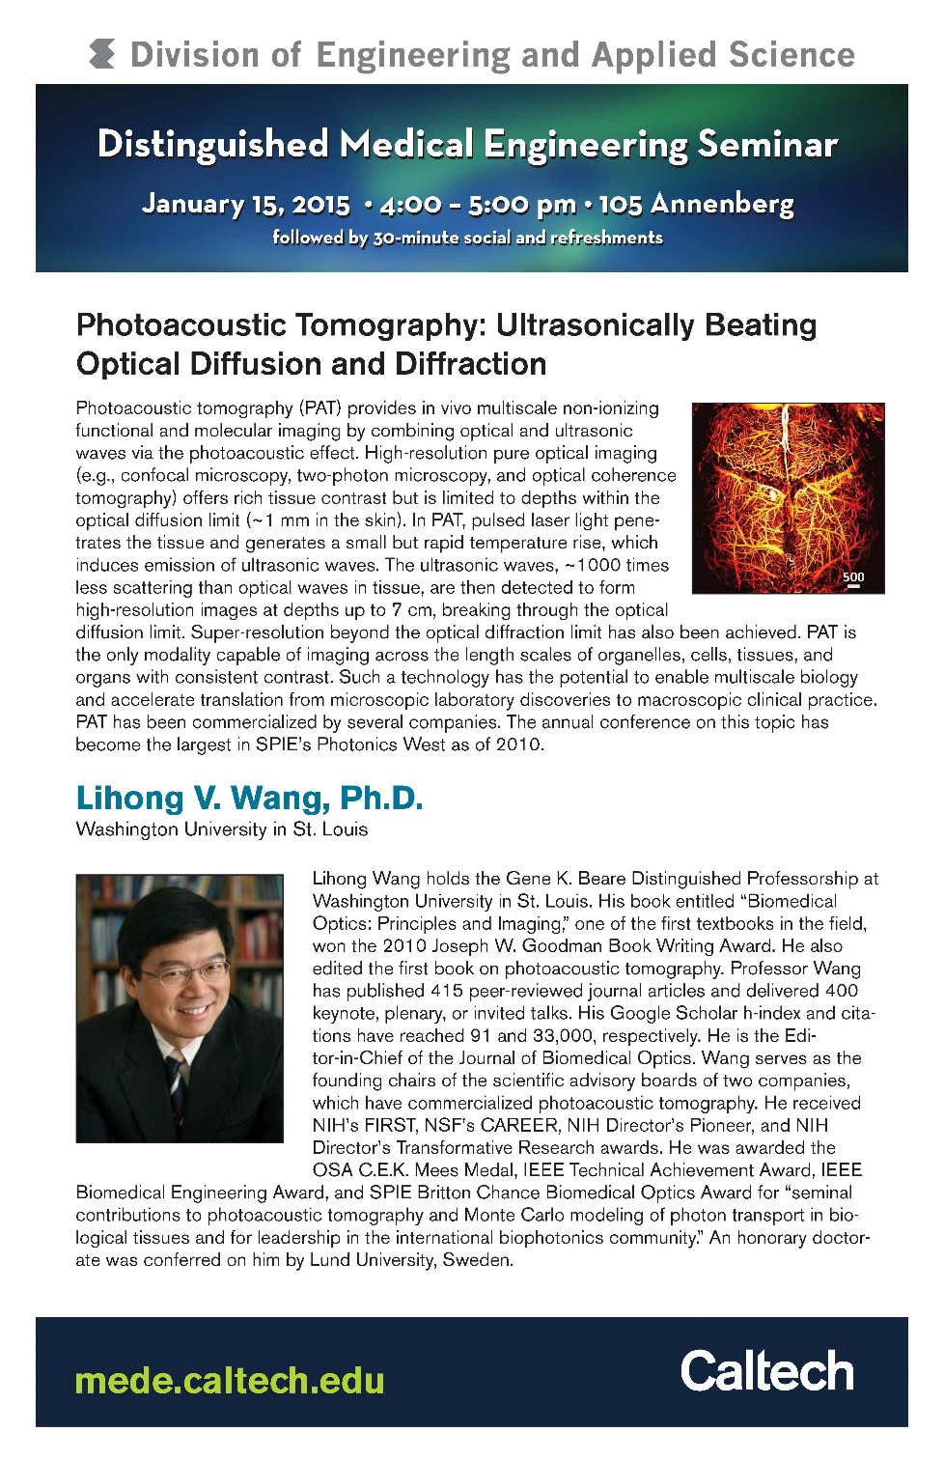
Med Engineering Seminar Last Week
Lihong V. Wang
Working on Detector that can go 1,000,000,000 frames/sec!
So we all know the problem here

Slide 12

Med Engineering Seminar Last Week
Lihong V. Wang
Working on Detector that can go 1,000,000,000 frames/sec!
So we all know the problem here

Slide 13
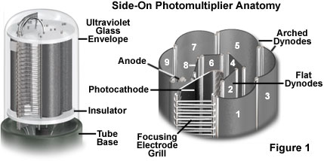
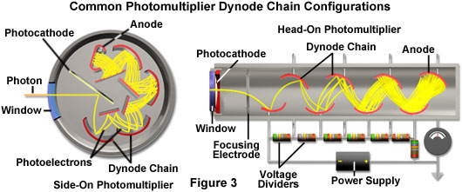
Photomultiplier Tube (PMT)
Two types of Photomultipliers
  Side-on, most popular due to high performance rating and low cost
  Head-on
Notes:
Point source detector
The two most popular photomultiplier designs have configurations that place the sensitive photocathode element either at the end (head-on) or on the side (side-on) of the vacuum tube (see Figure 3). Incident light is detected through a window at the top of the glass envelope in head-on designs, and through the curved side in side-on photomultipliers. Due to their high performance ratings and low cost, side-on photomultipliers are the most widely used tubes for general photometric applications, such as spectrophotometry, fluorimetry, and confocal microscopy. Side-on photomultipliers contain an opaque and relatively thick reflection-mode photocathode surrounded by a circular cage-like dynode element chain. Incident photoelectrons do not pass through the photocathode in a side-on photomultiplier, but instead are ejected from the front face and angled toward the first dynode element.
In contrast, the photocathode in an end-on photomultiplier must be of precise thickness as well as composition, and is semi-transparent. The photoemissive material is deposited on the surface of an optical window so that electrons are emitted from the side of the photocathode opposite that of the incident radiation. If the photocathode is too thick, more photons will be absorbed but fewer photoelectrons will be emitted from the rear surface. Alternatively, if the photocathode is too thin, photons may pass straight through without being absorbed. Because of these differences in design, side-on photomultipliers having photocathodes of similar composition to head-on tubes often exhibit higher quantum efficiencies.

Slide 14
Photomultiplier Tube (PMT)
PMTs use electric potential to amplify electrons
Photons impact a phosphor screen creating electrons
Electrons are multiplied by impacting other surfaces (Dynode chain)
Increasing the gain increases the number of electrons produced in a non-linear fashion
So increasing Gain increases signal

Slide 15
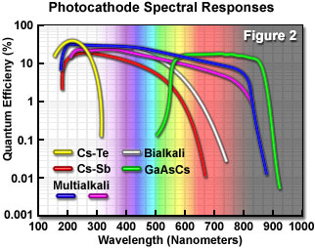
Photomultiplier Tube (PMT)
PMTs less sensitive in the red
Can buy PMTs that are more “green” sensitive or more “red”sensitive
  But not much difference
Notes:
Even with their superior gain characteristics, photomultipliers have some disadvantages when compared to other types of detectors. The gain and dark current performance of individual photomultipliers from the same production run can vary widely, often by a factor of 2 to 5 for a particular design. In addition, the devices can be damaged by exposure to high illumination levels, often requiring very long recovery times (some never recover from high intensity illumination). Modern photocathodes yield very good visible and ultraviolet performance, but sensitivity drops dramatically in the longer visible wavelengths and infrared. Photomultipliers require a stabilized high voltage power supply, which increases the cost of using these detectors. Finally, even in the most sensitive wavelength region, about two-thirds of the incident light is not detected by the photocathode and does not contribute to photomultiplier gain.

Slide 16
As with CCDs, PMTs have same Noise problems
Shot noise
  Random fluctuations in the photon population
Dark current
  Noise caused by spontaneous electron formation/accumulation in the wells (usually due to heat)
Readout noise
  Grainy noise you see when you expose the chip with no light

Slide 17
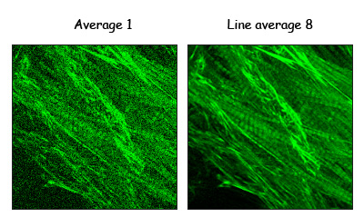
The cost of increasing gain
More electrons means more noise
This is what causes the noise in scanning confocal images
  Averaging can decrease the noise
Notes:
http://microscopy.duke.edu/learn/introtomicroscopy/confocals.html

Slide 18
Dynamic Range (bit depth)
Full well capacity/read noise
2^8 = 256 gray values = 8 bits, 2^10 = 1024 grays values = 10 bits, etc
8 bit (video camera)
  Your eye can detect this range, computers and printers are therefore designed around this value
16 bit
  Good to detect very dim and very bright things in the same field of view without saturation (maxing out the range)
  Very good for quantifying fluorescence
  Have to convert to 8 bits for presentations
Notes:
Applies to PMT and CCD

Slide 19
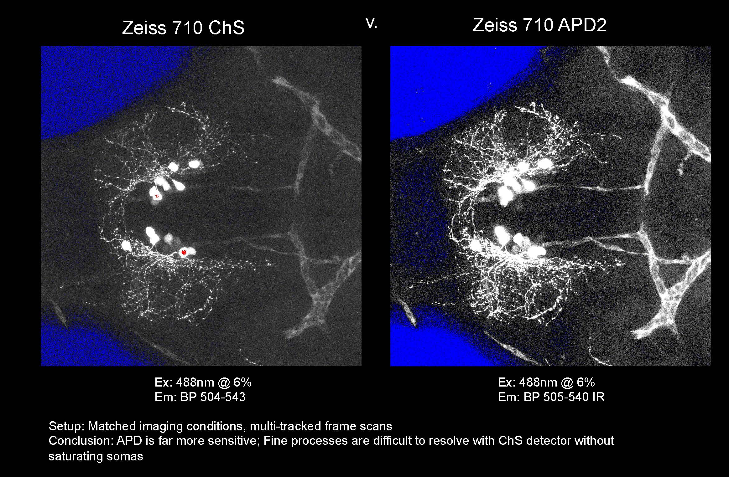
Confocal Imaging: Avalanche Photodiodes
Cindy Chiu from David Prober’s Lab, Caltech
Notes:
APD not linear. This can be good.

Slide 20
Fluorescence Microscopy
The Ultimate in Contrast

Slide 21
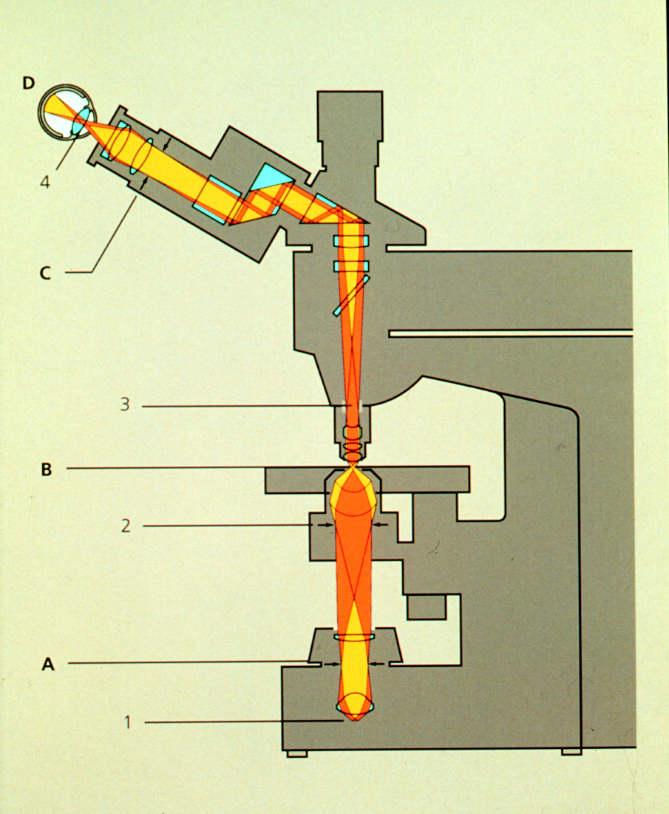
Thus Far, have considered compound microscope, and the microscope optics as a projection system (into eye)
Deliver light to the specimen
Image light from the specimen
Contrast from light absorbed, diffracted

Slide 22
Transmitted light microscopy: photons out of the microscope are some fraction of the photons in
Now, turn our attention to fluorescence, based on the absorption and re-emission of photons
Fluorescent Dye
Dipole antenna
Delocalized electrons
Longer dipole, longer λ

Slide 23
Fluorescence
Easy to set up: Objective = Condenser
Highly specific technique, wide selection of markers
Detection and Identification of Proteins, Bacteria, Viruses
Basics for
  Special Techniques eg. TIRF, FRET, FRAP etc.
  3-D imaging
  Deconvolution
  Structured Illumination
  Confocal Techniques

Slide 24
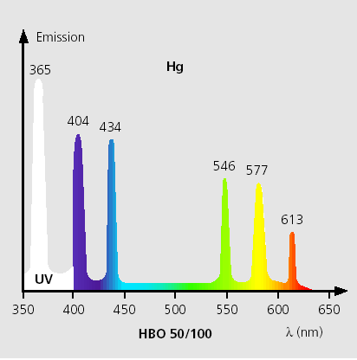
Light sources
Mercury (Hg)
Xenon, Hg/Xe Combination
Laser
LED’s
Tungsten Halogen

Slide 25
A good dye must absorb light well (high extinction coef.)
Dye in cuvette
Blue light absorbed
Beer’s Law
I_{out} = I_{in} e^{-ax}
I_{absorbed} = I_{out} - I_{in}
= I_{in}(1-e^{-εcx})
ε = extinction coefficient
For Fluorescein
ε ~ 70,000/(cm M/liter)
490nm
Light absorbed
Wavelength
Notes:
Beer Lambert Law
x = distance light travels through the material
α = attenuation coefficient
The attenuation coefficient is a quantity that characterizes how easily a material or medium can be penetrated by a beam of light. A large attenuation coefficient means that the beam is quickly "attenuated" (weakened) as it passes through the medium, and a small attenuation coefficient means that the medium is relatively transparent to the beam.
α = ε c
c = concentration of attenuating species in material
ε =extinction coefficient also called molar absorption coefficient, absorptivity of attenuator

Slide 26
Where does energy go?
Green light emitted
Blue light absorbed
Quantum Yield = light emitted/light absorbed
Q ~ 0.8 fluorescein
~ 0.3 rhodamine
Stokes Shift
490nm
520nm

Slide 27
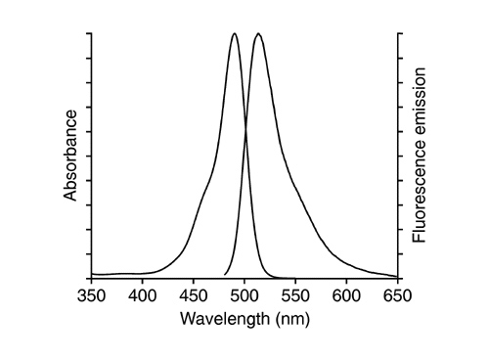
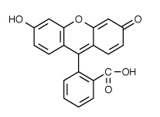
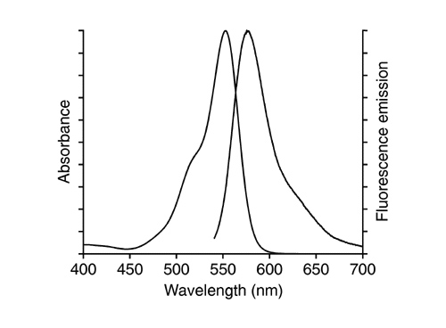
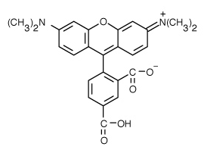
Co-fluorescein
Co-TM rhodamine

Slide 28
Which dye is better?
1 - absorb well (high ε )
2 - emit well (high Q)
Brightness ~ εQ
(fluorescein 0.8 * 70,000 = 57,000)
(rhodamine 0.3 * 90,000 = 27,000)

Slide 29
Go deeper to explain bleaching and background
(Jablonski diagram)
4nsec
Other losses
Heat
Energy transfer
0.8 emitted

Slide 30
Add in Interstate Crossing (ISC)
ISC
~0.03
Excited triplet
state
0.8 emitted
fluorescence
4nsec
Phosphorescence
(usec - msec)
Triplet state is long lived.
therefore even low probability can deplete active dye
(steady state reached in ~200msec
~80-90% in triplet --> 5-10 fold dimmer)
CLSM: can have a major impact (~5 fold less throughput)

Slide 31
Interstate Crossing (ISC) Problem 2: Reactive oxygen
ISC
~0.03
Excited triplet
state
4nsec
0.8 emitted
fluorescence
Phosphorescence
(usec - msec)
Triplet state lifetime shortened by oxygen
(20msec if none; 0.1 usec if oxygen present
Good news: Returns dye to ground state
Bad news: Creates reactive oxygen

Slide 32
Aside: Phosphor Imager
ISC
High probability
Very
slow
Excited triplet
state
Phosphorescence
(very slow)
Accumulate triplet state (thermally stable)
“read out” with scanning red laser
Gives energy for transition to singlet state
Emission of light proportional to the stored triplet

Slide 33
Issues in fluorescence
1. No dye is perfect < 100,000 photons total
(ISC, bleaching)
2. Every emitted photon is sacred
(NA 1.25 collects ~20%)
(clsm w/ PMT collects 0.02% - 0.3%)
3. Signal/noise limited by number of photons
Counting error N ± sqrt(N)
Image requires >200 photons/pixel

Slide 34
Not enough fluorescence photons?
If >200 photons/ pixel needed
Microscope records 0.02%
Need about 100,000 photons/pixel
~ lifetime of a dye
Given dwell-time of laser beam, ISC, collection efficiency
Lucky to record 1 photon/dye/scan
Every emitted photon is sacred!
Maximize throughput (filters, lenses, mirrors)
Minimize Bleaching

Slide 35
To reduce bleaching:
Shorten Triplet lifetime
Antibleach Agents:
Retinoids, carotinoids, glutathione
Vitamin E, N-propyl gallate
Eliminate Oxygen (scavenger, bubble N₂)
No reactive oxygen produced
(but lengthens triplet lifetime)

Slide 36
Can’t get more light by turning up the laser:
Dye saturates as I is increased
Intense laser beam depletes dye in ground state
Pumps more dye into the triplet state
(reactive oxygen and silent)
Noise doesn’t saturate
Autofluorescence in cell
flavins, NADH, NADPH
Raman spectrum of water
(488nm in; 584nm out)

Slide 37
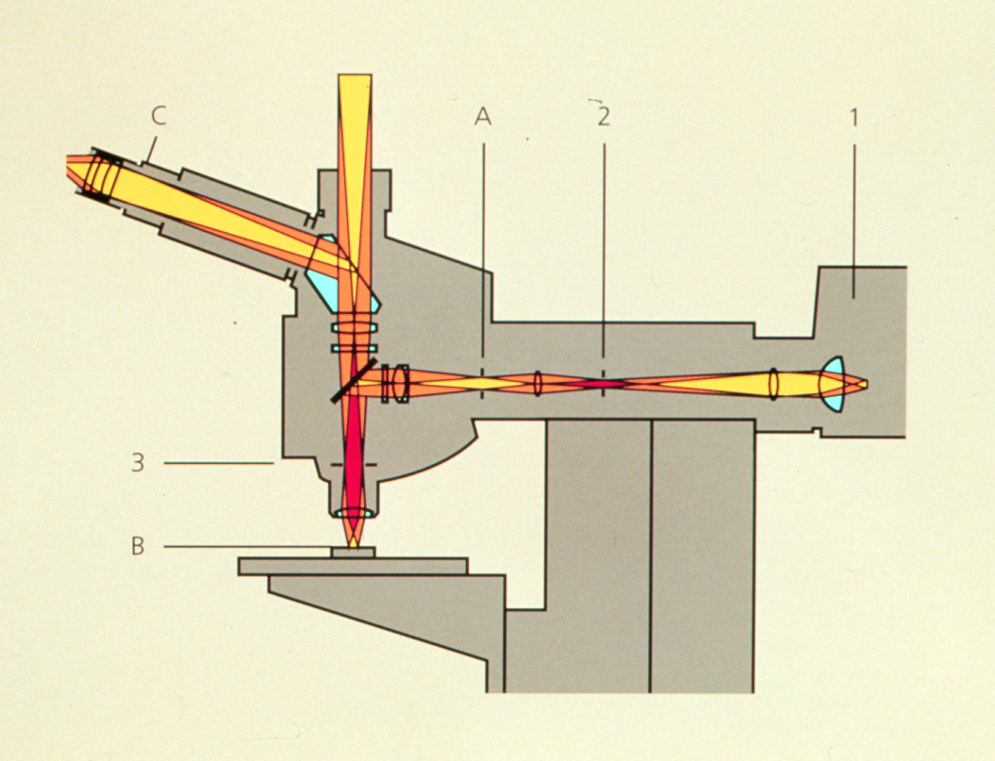
Optimize light collection, uniformity of illumination
High NA, Kohler illumination

Slide 38
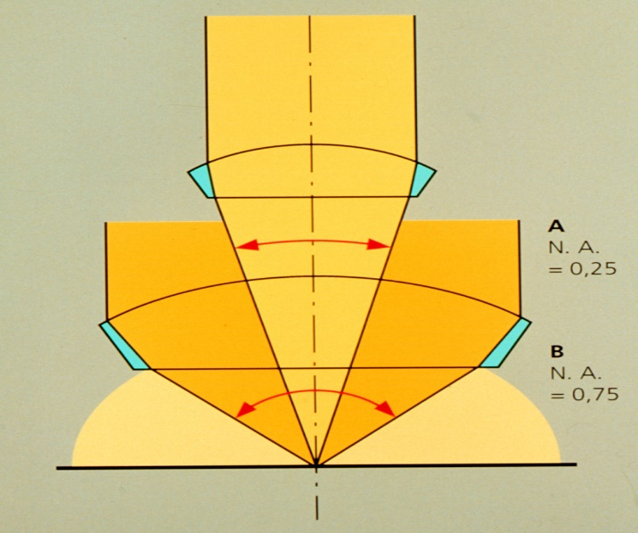
N.A. and image brightness
Transmitted light
Brightness = fn (NA² / magnification²)
θ
N.A. = η sin θ
10x 0.5 NA is 3 times brighter than 10x 0.3NA
Epifluorescence
Brightness = fn (NA⁴ / magnification²)
10x 0.5 NA is 8 times brighter than 10x 0.3NA

Slide 39
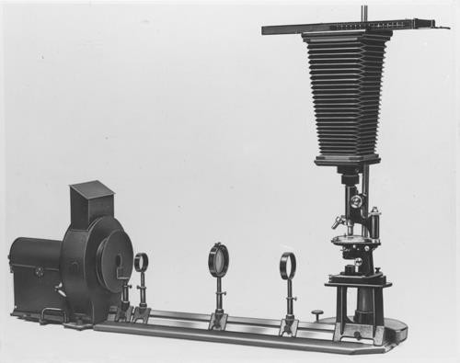

First Fluorescence microscope
Built by Henry Seidentopf & August Köhler (1908)
Used transmitted light path
So dangerous that couldn’t look through it, needed camera
Image credit: corporate.zeiss.com “Technical Milestones of Microscopy”
Notes:
Inspired by Ernst Abbe's finding that shorter wavelength light leads to higher resolution, August Köhler constructed the first ultraviolet (UV) microscope at Zeiss Optical Works in Jena, Germany, in 1904. The instrument used UV illumination from a cadmium arc lamp and allowed photographic reproduction of objects at twice the resolution of visible light microscopes. Köhler also noted that some objects emitted light of longer wavelength on illumination with UV, but it was the physicist Oskar Heimstädt who, in 1911, used this observation as the basis for the construction of the first successful fluorescence microscope.

Slide 40
First epi-fluorescence microscope
Designed in 1929 by German pharmacologist Philipp Ellinger & anatomist August Hirt
Used yellow barrier filter between objective and ocular to block reflected excitation light
Would be custom made, specialized instrument for almost 40 years
Notes:
In what they called an 'intravital microscope' the excitation light passed through a series of filters before the right wavelength hit the objective lens and triggered emission of fluorescent light in the observed tissue. A yellow barrier filter between the objective and ocular prevented most reflected excitation light from interfering with observation. Ellinger and Hirt imaged kidney and liver tissue in rodents injected with the fluorochromes fluorescein and trypaflavin.
http://www.nature.com/milestones/milelight/full/milelight04.html

Slide 41
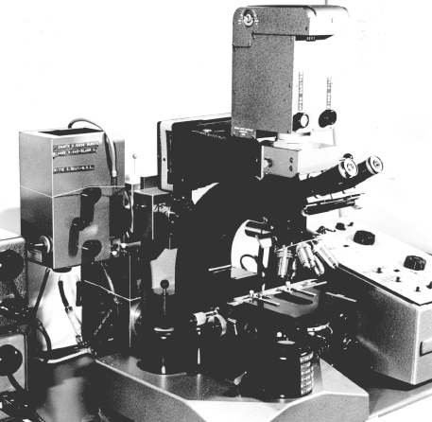
Key advance dichroic mirrors!
Dutch scientist Bas Ploem developed these in 1967
Dichromatic mirrors converted epi-fluorescence microscope from a tool that could be used only by trained specialists to a universal and indispensable instrument for modern biology
Prototype of first epi-illumination fluorescence microscope that he developed in Amsterdam in the sixties
Notes:
http://www.cyto.purdue.edu/cdroms/cyto10a/cytometryhistory/individualhistories/tanke.html
http://www.cyto.purdue.edu/cdroms/cyto10a/cytometryhistory/individualhistories/ploem.html
http://www.nature.com/milestones/milelight/full/milelight04.html

Slide 42
Choose filters well
Excitation
Dichroic
Emission
Optimize the light path for collection

Slide 43
Emission filter:
Selectively detect dye
Dichroic Reflector:
Bounce exciting λ
Pass emitted λ
Excitation filter:
Selectively excite dye

Slide 44
How to separate wavelengths: Interference Filters
Basic principle based on reflection from mirror
mirror
Reflection from higher index --> 180 degree shift
(separated for clarity below)
Notes:
A dichroic filter, thin-film filter, or interference filter is a very accurate color filter used to selectively pass light of a small range of colors while reflecting other colors. By comparison, dichroic mirrors and dichroic reflectors tend to be characterized by the color(s) of light that they reflect, rather than the color(s) they pass. (See dichroism for the etymology of the term.)

Slide 45
Interference Filters
Add a layer of intermediate index
3% reflection from glass
(higher index --> 180 degree shift
(separated for clarity below)
Less light passed
Constructive interference
λ/2
Note: thickness of layer in terms of wavelength
Notes:
A dichroic filter, thin-film filter, or interference filter is a very accurate color filter used to selectively pass light of a small range of colors while reflecting other colors. By comparison, dichroic mirrors and dichroic reflectors tend to be characterized by the color(s) of light that they reflect, rather than the color(s) they pass. (See dichroism for the etymology of the term.)

Slide 46
Interference Filters are wavelength dependent
λ ₂ = 2 x λ ₁
λ ₁
Less light passed
Constructive interference
λ/2
λ ₂
most light passed
Destructive interference
(antireflection coating)
λ/4
Same thickness is smaller in terms of wavelength for λ ₂
Notes:
A dichroic filter, thin-film filter, or interference filter is a very accurate color filter used to selectively pass light of a small range of colors while reflecting other colors. By comparison, dichroic mirrors and dichroic reflectors tend to be characterized by the color(s) of light that they reflect, rather than the color(s) they pass. (See dichroism for the etymology of the term.)

Slide 47
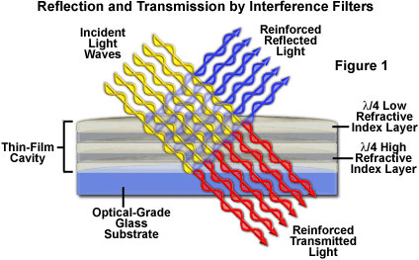
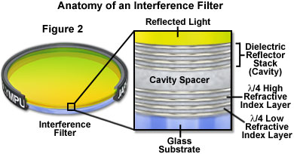
Interference filters: the movie
Reflect one wavelength while passing another
Innovation that relatively inexpensive to make
Link to Java Tutorial
http://www.olympusfluoview.com/theory/interferencefilters.html
Notes:
Recent technological achievements in bandpass filter design have led to the relatively inexpensive construction of thin-film interference filters featuring major improvements in wavelength selection and transmission performance. These filters operate by transmitting a selected wavelength region with high efficiency while rejecting, through reflection and destructive interference, all other wavelengths.

Slide 48
Dichroic reflector
Issues:
How steep,
How efficient to excite
How efficient to collect
Dichroic reflectors tend to be characterized by the color(s) of light that they reflect, rather than the color(s) they pass
Notes:
Also called Dichroic mirror

Slide 49
Emission filter:
Selectively detect dye
Dichroic Reflector:
Bounce exciting λ
Pass emitted λ
Excitation filter:
Selectively excite dye

Slide 50
Epi - Fluorescence
(Specimen containing green fluorescing Fluorochrome)
Observation port
Excitation Filter
Emission Filter
FL
Light Source
Dichromatic Mirror
Specimen containing green fluorescing Fluorochrome

Slide 51
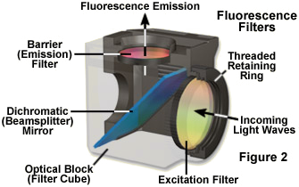
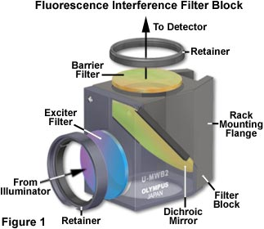
Here is what they look like
Nikon
Olympus

Slide 52
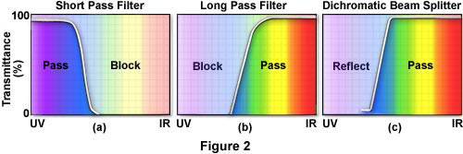
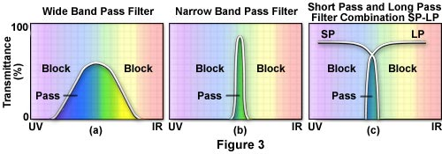
Different kinds of Emission and Excitation Filters

Slide 53
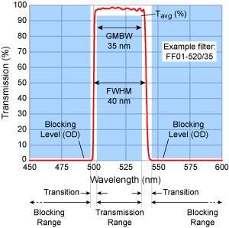
Reading bandpass filter spectrum
All have a center wavelength
Guaranteed Minimum Bandwidth (GMBW)
This is less than the FWHM
Example 520/35 filter (502.5-537.5)
Notes:
http://www.semrock.com/bandwidth.aspx
Full Width at Half Maximum (FWHM)

Slide 54
Final Note:
Resonance Energy Transfer (non-radiative)
The Bad: Self-quenching
If dye at high concentration
“hot-potato” the energy until lost

Slide 55
Final Note:
Resonance Energy Transfer (non-radiative)
The Good: FRET as a molecular yardstick
Transfer of energy from one dye to another
Depends on:
Spectral overlap
Distance
Alignment

Slide 56
donor
acceptor
FRET:
Optimize spectral overlap
Optimize κ² -- alignment of dipoles
Minimize direct excitement of the acceptor
(extra challenge for filter design)

Slide 57
Homework 2
The answer.

Slide 58

The Finitely Corrected Compound Microscope
B
Eyepiece
A
B
150 mm (tube length = 160mm)
Objective
Objective Mount (Flange)
In most finitely corrected systems, the eyepiece has to correct for the Lateral Chromatic Aberrations of the objectives, since the intermediate image is not fully corrected.
(Note: the LCA correction is done in a brand-specific fashion)

Slide 59
The Compound Microscope (infinity corrected)
Eyepiece
Tube lens
(Zeiss: f=164.5mm)
Objective

Slide 60
Homework 2: Why are most modern microscopes “infinity corrected”
Hint - think of the influence of a piece of glass
Image
Eyepiece
image
Eyepiece
Lens of eye

Slide 61
Take special case:
Glass at right angle to second principle ray
Simplify by removing eyepiece and eye
Image
Eyepiece
image
Eyepiece
Lens of eye

Slide 62
Take special case:
Glass at right angle to second principle ray
Zone of Confusion: Rays fail to intersect at only one place
Image
Eyepiece
image
Refraction of principle rays

Slide 63
“Infinity correction” provides a region in which an optical flat will not create a zone of confusion
Tube lens
Objective
Image
Eyepiece
“Infinity” Domain
Eyepiece
image
Lens of eye

Slide 64
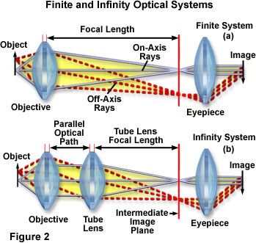
Infinity optics creates a domain in which all rays from same point in object are parallel
Good Aspects:
Optical flats inserted have no effect (shift doesn’t matter)
Magnification unchanged by adding accessories
BUT:
Remember that thin lens laws no longer apply
Infinity domain
http://microscopy.fsu.edu/primer/anatomy/infinityintro.html

Slide 65
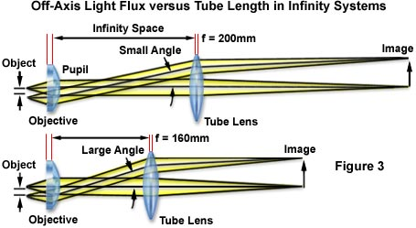
Different manufacturers have elected different compromises
  Length of objective lens
  Diameter of objective lens
  Focal length of tube lens
Nikon. Leica
Zeiss
Longer tube lens focal length easier to design,
But requires larger diameter threads.

Slide 66


Conjugate Planes in Infinity Optics
Retina
Eye
Eyepoint
Eyepiece
Intermediate Image
TubeLens
Imaging Path
Objective Back Focal Plane
Objective
Specimen
Condenser
Condenser Aperture Diaphragm
Field Diaphragm
Illumination Path
Collector
Light Source

Slide 67
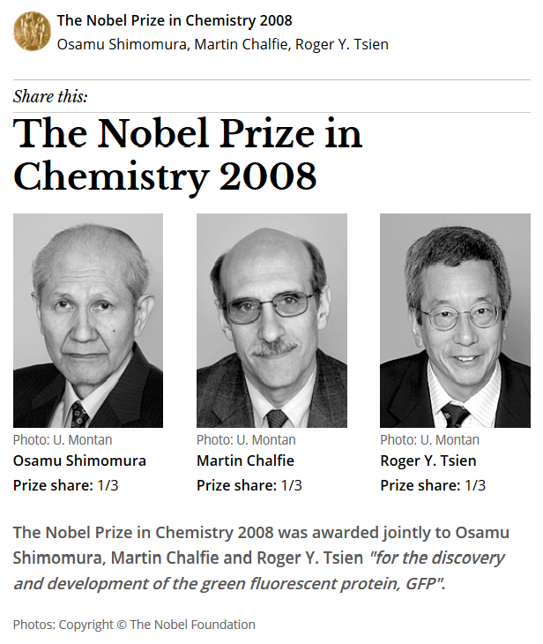
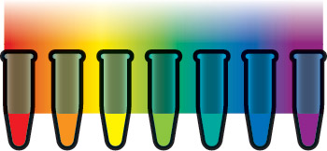
Fluorescent proteins
Proteins from marine invertebrates
Can be coded in genes and made by the organism
Now come in a variety of colors

Slide 68
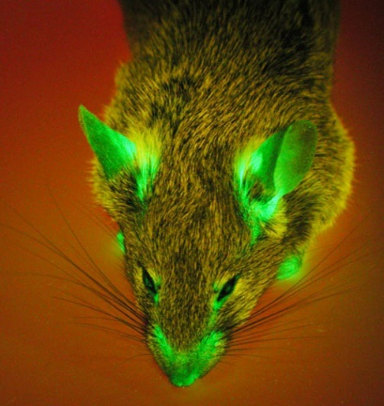
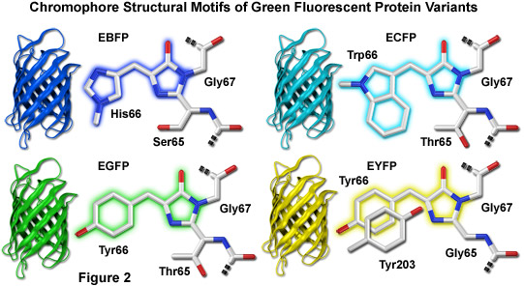
Green Fluorescent Protein
First fluorescent protein discovered and developed for biological use
Mutated for temp stability, color and turnover rate
Importance of monomer vs dimer or tetramer
Notes:
http://www.olympusconfocal.com/applications/fpcolorpalette.html
http://www.micro.magnet.fsu.edu/primer/techniques/fluorescence/fluorescentproteins/fluorescentproteinshome.html

Slide 69
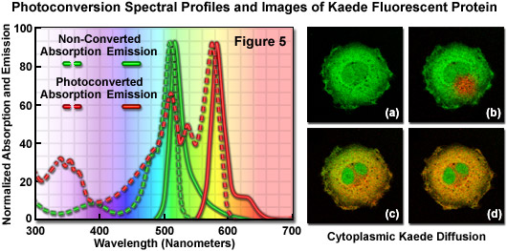
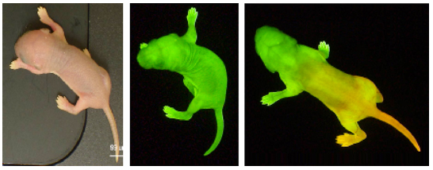
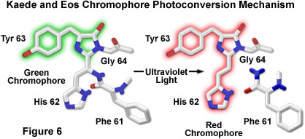
Photoconvertible Proteins
Kaede, coral fluorescent protein, tetramer
Dendra2, from soft coral, monomer
UV Laser (405 nm) to convert green to red
ROI (Region Of Interest) allows precise targeting
www.amalgaam.co.jp
www.olympusfluoview.com

