Slide 1
Biology 177: Principles of Modern Microscopy
Lecture 03:
Microscope optics and introduction of the wave nature of light

Slide 2
Lecture 3: Microscope Optics
Particle and wave nature of light
Review of thin lens law
Dispersion
Aberrations
Aperture: Resolution and Brightness
Two Most Important Microscope Components
Kohler Illumination
N.A. and Resolution

Slide 3
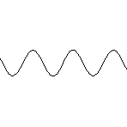
Basic properties of light
Particle Movement
Wave
Either property may be used to explain the various phenomena of light
Notes:
Now either property may be used to explain the various phenomena of light

Slide 4
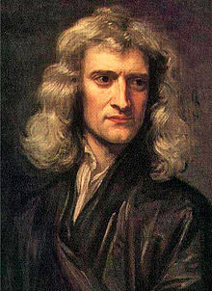
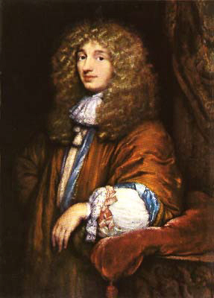
Particle versus wave theories of light in the 17th Century.
Corpuscular theory
Wave theory
Light made up of small discrete particles (corpuscles)
Particles travel in straight line
Sir Isaac Newton was biggest proponent
Different colors caused by different wavelengths
Light spreads in all directions
First deduced by Robert Hooke and mathematically formulated by Christiaan Hyugens
Treatise on Light
Notes:
Isaac Newton (1642-1726/7) argued that the geometric nature of reflection and refraction of light could only be explained if light was made of particles, referred to as corpuscles, because waves do not tend to travel in straight lines. Newton sought to prove Christiaan Huygens' theory that light was made of waves. In his 44th trial in a series of experiments concerning physics of light, he concluded that light is made of particles and not waves by having passed a beam of white light through two prisms which were held at such an angle that the light split into a spectrum after passing through the first prism and then was recomposed, back into white light, by the second prism.
Robert Hooke FRS (/hʊk/; 28 July [O.S. 18 July] 1635 – 3 March 1703) was an English natural philosopher, architect and polymath. Author of the seminal book on microscopy called Micrographia. Coined the word cell.
Christiaan Huygens, FRS (/ˈhaɪɡənz/ or /ˈhɔɪɡənz/; Dutch: [ˈɦœy̆ɣə(n)s] ( listen)) (Latin: Hugenius) (14 April 1629 – 8 July 1695) was a prominent Dutch mathematician and scientist. He is known particularly as an astronomer, physicist, probabilist and horologist. His seminal work titled: Treatise on Light
In which are explained the causes of that which occurs in reflexion, & in refraction and particularly in the strange refraction of Iceland crystal . Available through project Gutenberg: http://www.gutenberg.org/files/14725/14725-h/14725-h.htm

Slide 5
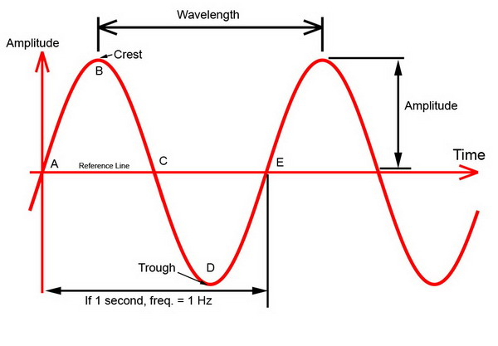
Characteristics of a wave
Wavelength (λ) is distance between crests or troughs
Amplitude is half the difference in height between crest and trough.
Notes:
http://www.billavista.com/atv/Articles/Offroad_Radios_and_Comms/index.html
Source of image.

Slide 6
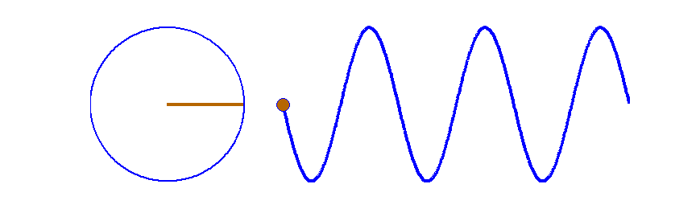
Characteristics of a wave
Period is time it takes two crests or two troughs to travel through the same point in space.
  Example: Measure the time from the peak of a water wave as it passes by a specific marker to the next peak passing by the same spot.
Frequency (ν) is reciprocal of its period = 1/period [Hz or 1/sec]
  Example: If the period of a wave is three seconds, then the frequency of the wave is 1/3 per second, or 0.33 Hz.
Notes:
Fig. 7. A travelling sinusoidal wave. Each point along the wave executes SHM as shown by the circle. The waveform advances to the right one wavelength in a time of one period. Matlab script: ag_sine_circle.m. Animated gif: ag_sineC.gif
http://www.physics.usyd.edu.au/teach_res/mp/doc/wm_string_1.htm
Gif is from Matlab tutorial.

Slide 7
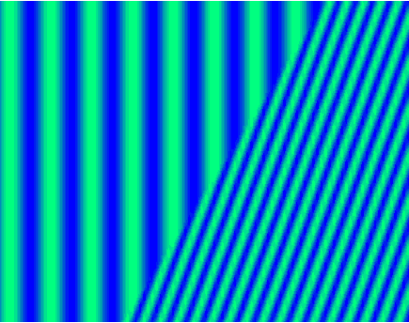
Characteristics of a wave
Velocity (or speed) at which a wave travels can be calculated from the wavelength and frequency.
Velocity in Vacuum (c) = 2.99792458 • 10⁸ m/sec
Frequency remains constant while light travels through different media. Wavelength and speed change.
c = ν λ
Notes:
http://imgarcade.com/1/refraction-of-waves-animation/

Slide 8
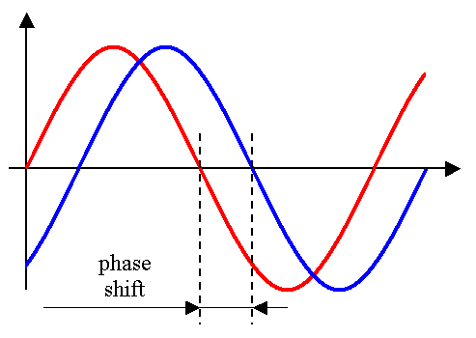
Characteristics of a wave
Phase shift is any change that occurs in the phase of one quantity, or in the phase difference between two or more quantities
Small phase differences between 2 waves cannot be detected by the human eye

Slide 9
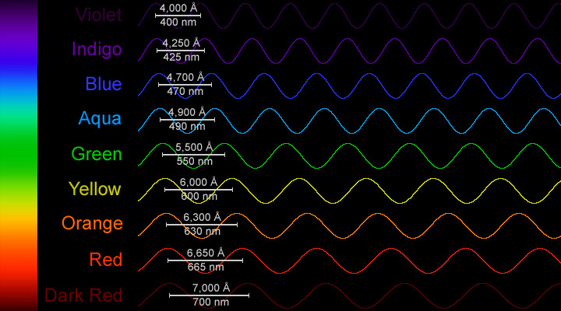
What is white light?
A combination of all wavelengths originating from the source
Notes:
https://www.windows2universe.org/physical_science/magnetism/images/visible_spectrum_waves_big_jpg_image.html

Slide 10
Refraction as explained through Fermat’s principle of least time
Light takes path that requires shortest time
Wave theory explains how light “smells” alternate paths
θ1
θ2
η1
η2
Feynman Lectures on Physics, Volume I, Chapter 26
http://feynmanlectures.caltech.edu/I_26.html
Notes:
Pierre de Fermat (French: [pjɛːʁ dəfɛʁma]; 17^{[2]} August 1601 or 1607^{[1]} – 12 January 1665) was a French lawyer at the Parlement of Toulouse, France, and an amateur mathematician.

Slide 11
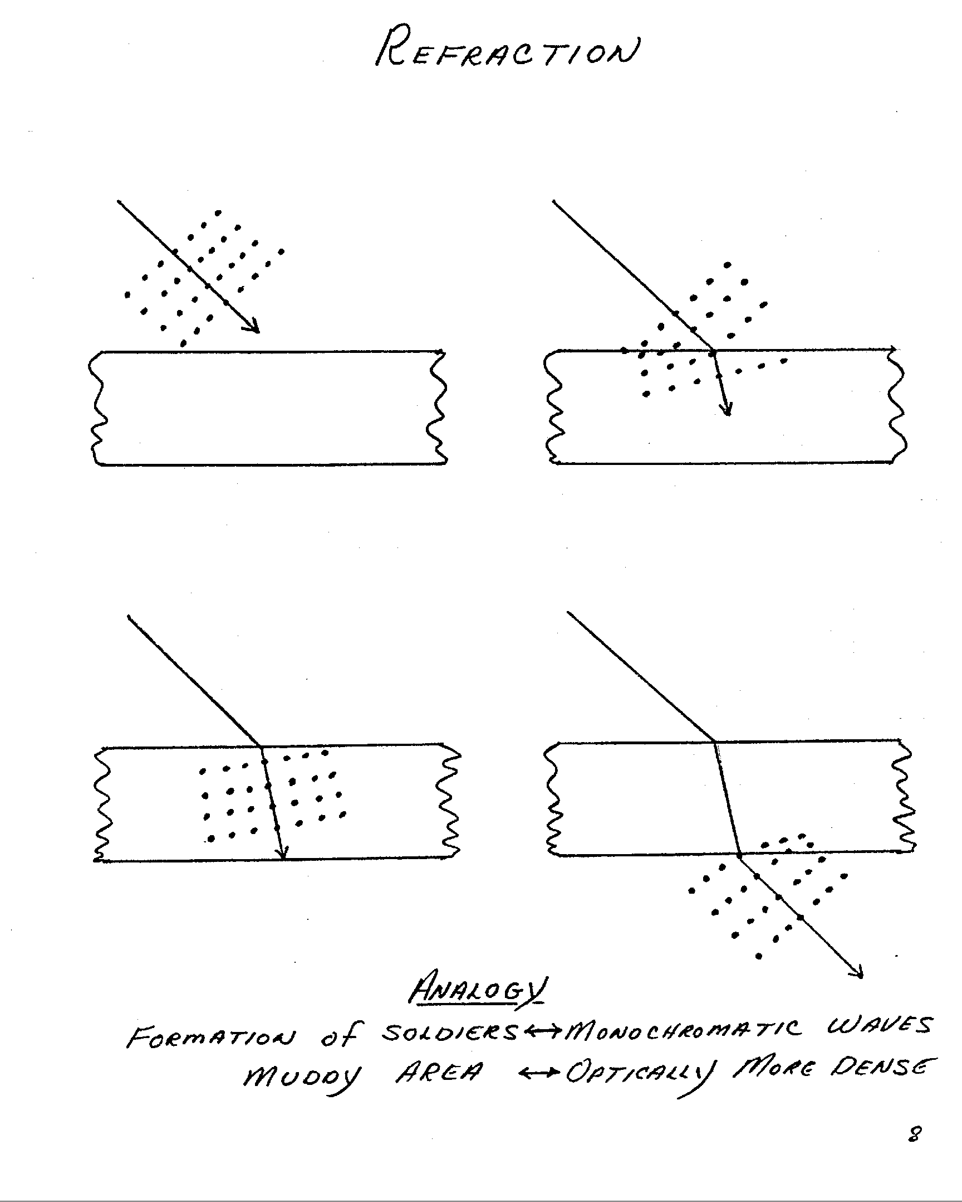
Refraction (Marching Band Analogy)
Notes:
Christiaan Hyugens thought Refraction best understood through wave theory: waves traveled more slowly in a dense medium (like waves in shallow water). Newton explained refraction poorly via changes in acceleration due to gravity.

Slide 12
Refraction (Marching Band Analogy)

Slide 13
Refraction (Marching Band Analogy)

Slide 14
Refraction (Marching Band Analogy)

Slide 15
Thin lens laws
1. Ray through center of lens is straight

Slide 16
Thin lens law 2
2. Light rays that enter the lens parallel to the optical axis leaves through Focal Point
Focal
Point

Slide 17
Thin lens law 3
3. Light rays that enter the lens from the focal point exit parallel to the optical axis.
Focal
Point

Slide 18
Applying thin lens law to our object, a gold can

Slide 19
1. Ray through center of lens is straight

Slide 20
2. Light rays that enter the lens parallel to the optical axis leaves through Focal Point

Slide 21
3. Light rays that enter the lens from the focal point, exit parallel to the optical axis.

Slide 22
Where the three lines intersect is where that point of the object is located
Notes:
Note that the object is magnified and inverted. Real Image.

Slide 23
Ray tracing convention for optics generally uses arrows to represent the object.
Notes:
Note that the object is magnified and inverted. Real Image.

Slide 24
Same three rules can be applied for each point along the object.

Slide 25
Thin Lens Equation
1/f = 1/o + 1/i
Magnification = i/o
f
i
o

Slide 26
For object directly on focal point, rays focused to infinity.
Where would this be useful?
∞
Notes:
Object located at greater than 2 x the focal distance result in small image. How cameras work.

Slide 27
For object within the focal point, a virtual image is created.
Only need two rays to locate object.
Notes:
Virtual images are located on side of lens opposite to viewer. Bad naming conventions as virtual images are as “real” as a real image.

Slide 28
Of course can use all three rules to trace three rays.

Slide 29
Same three rules can be applied to a concave lens.
Notes:
All concave lenses make virtual images that are smaller no matter where the object is located.

Slide 30
But again two rays are enough to locate virtual image.

Slide 31
Concave lens makes virtual image that is smaller no matter where object is located.
Notes:
All concave lenses make virtual images that are smaller no matter where the object is located.

Slide 32
Principle ray approach works for complex lens assemblies.
Focal lengths add as reciprocals:
1/f(total) = 1/f1 + 1/f2 + ... + 1/fn Remember: for concave lens f is negative
Notes:
Focal lengths add as reciprocals:
1/f(total) = 1/f1 + 1/f2 + ... + 1/fn - Remember: for concave lens f is negative
Problem: Two thin lenses together don’t make a thin lens. Notice that the central ray misses the image.
Solution: Use principle rays to define image from first lens. Then use the first image as the object for the second lens.

Slide 33
Another example: Begin with one convex lens.

Slide 34
Another example: Add a second convex lens.

Slide 35
Another example: Can determine real image formed by two convex lenses.
Notes:
Note that two convex lenses make a smaller image

Slide 36
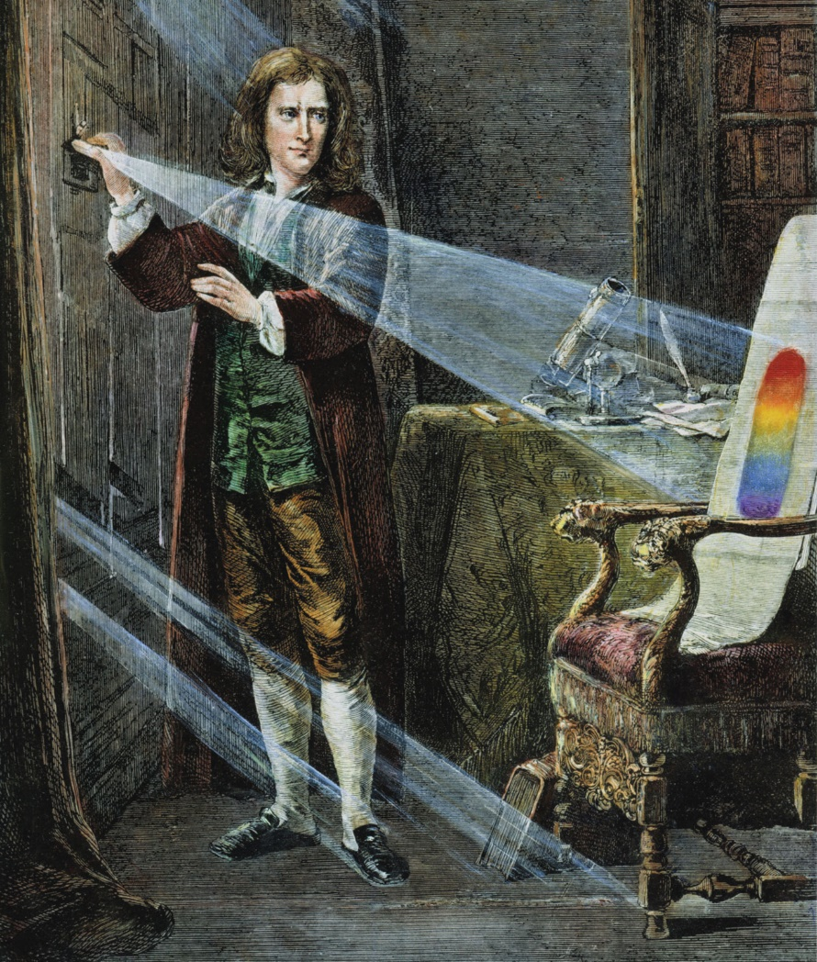
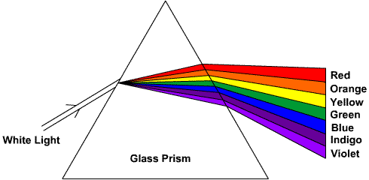
Dispersion: Separation of white light into spectral colors as a result of different amounts of refraction by different wavelengths of light.
Dispersive prisms typically triangular
Optical instruments requiring single colors
Back to Sir Isaac Newton

Slide 37
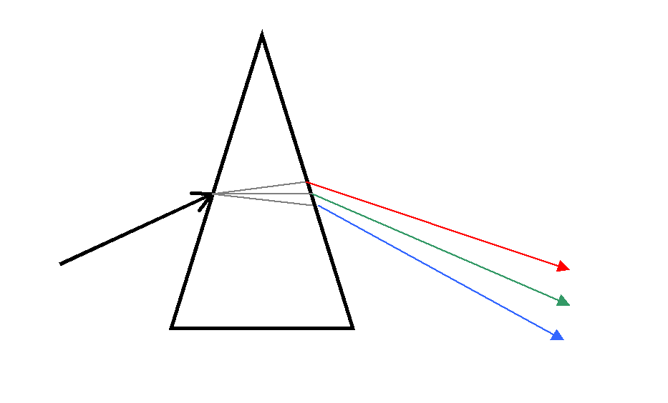
Monochromator: Optical instrument for generating single colors
Used in optical measuring instruments
How a monochromator works according to the principle of dispersion
Monochromator (Prism Type)
Entrance Slit
Exit Slit
Notes:
A monochromator is an optical device that transmits a mechanically selectable narrow band of wavelengths of light or other radiation chosen from a wider range of wavelengths available at the input.

Slide 38
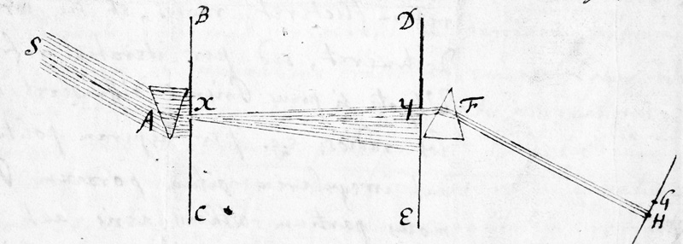
Why Isaac Newton did not believe the wave theory of light
Experiment with two prisms
If light was wave than should bend around objects
Color did not change when going through more glass
Isaac Newton's diagram of an experiment on light with two prisms. From a letter to the Royal Society, 6th June 1672
Notes:
Advocates of the wave theory had previously stated that light waves are made of white light, and that the colour spectrum, which can be seen through a prism, is formed because of corruption within the glass. This means that the more glass the light travels through, the more corrupt it will become. In order to prove that this was false, Newton passed a beam of white light through two prisms, which were held at such an angle that it split into a spectrum when passing through the first prism and was recomposed, back into white light, by the second. This showed that the spectrum was not caused by glass corrupting the light. Newton claimed that this was a 'crucial experiment'.
Newton claimed that Grimaldi's diffraction was simply a new kind of refraction. He argued that the geometric nature of the laws of reflection and refraction could only be explained if light was made of particles, which he referred to as corpuscles, as waves do not tend to travel in straight lines. After joining the Royal Society of London in 1672, Newton stated that the 44th trail in a series of experiments he had conducted earlier that year had proven that light is made of particles and not waves.
http://www.thestargarden.co.uk/NewtonAndLight.html
http://trailblazing.royalsociety.org/commentary.aspx?action=printCommentary&eventId=84

Slide 39
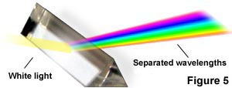
Dispersion of glass: disperses the different wavelengths of white light
Question: what’s wrong with this figure?
Material Blue (486nm) Yellow (589nm) Red (656nm)
Crown Glass 1.524 1.517 1.515
Flint Glass 1.639 1.627 1.622
Water 1.337 1.333 1.331
Cargille Oil 1.530 1.520 1.516

Slide 40
Dispersion of glass: disperses the different wavelengths of white light
θ
n₁ sin θ ₁ = n₂ sin θ ₂
Question: what’s wrong with this figure?
Material Blue (486nm) Yellow (589nm) Red (656nm)
Crown Glass 1.524 1.517 1.515
Flint Glass 1.639 1.627 1.622
Water 1.337 1.333 1.331
Cargille Oil 1.530 1.520 1.516

Slide 41
Homework 1: The index of refraction changes with wavelength (index is larger in blue than red).
How would you need to modify this diagram of the rays of red light to make it appropriate for blue light?
f
i
o

Slide 42
Higher index of refraction results in shorter f
Chromatic Aberration
Lateral (magnification)
Axial (focus shift)
f
Shift of focus
i
o
Change in magnification

Slide 43
Optical Aberrations: Imperfections in optical systems
Chromatic (blue = shorter focal length)
Spherical
Curvature of field

Slide 44
Spherical Aberration
Zone of Confusion

Slide 45
Curvature of field: Flat object does not project a flat image
(Problem: Cameras and Film are flat)
f
i
o
Notes:
Retina image is curved. Another reason your eyes see more than the camera.

Slide 46
Optical Aberrations: Imperfections in optical systems
Chromatic (blue = shorter focal length)
Spherical (rays near edge of lens bent more)
Curvature of field (worse near edges)
Potential Solution: Stop down lens

Slide 47
Spherical Aberration is reduced by smaller aperture
Less confused “Zone of Confusion”

Slide 48
Optical Aberrations: Imperfections in optical systems
Chromatic (blue = shorter focal length)
Spherical (rays near edge of lens bent more)
Curvature of field (worse near edges)
Potential Solution: Stop down lens
Problem: Brightness and Resolution

Slide 49
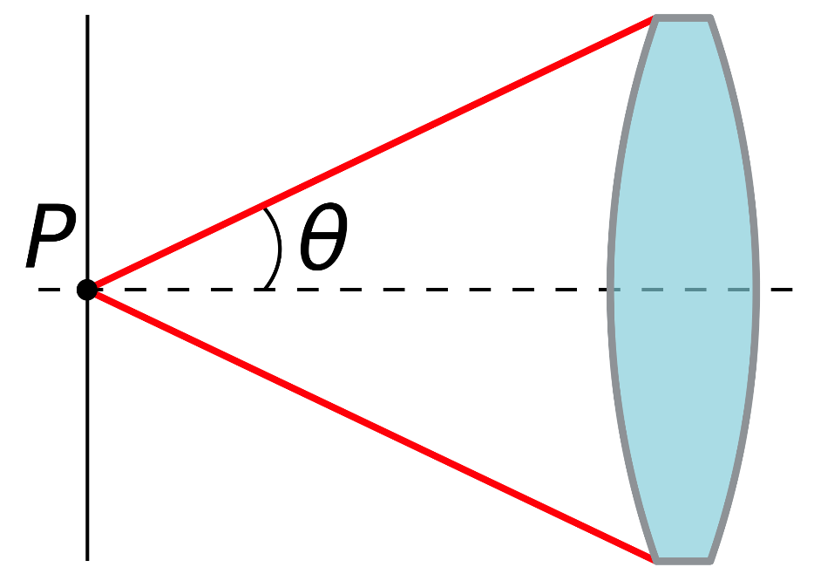
Need to Understand Numerical Aperture (N.A.)
Dimensionless number defining range of angles over which lens accepts light.
Refractive index (η) times half-angle (θ) of maximum cone of light that can enter or exit lens
N.A. = η sin θ
Notes:
In optics, the numerical aperture (NA) of an optical system is a dimensionless number that characterizes the range of angles over which the system can accept or emit light. By incorporating index of refraction in its definition, NA has the property that it is constant for a beam as it goes from one material to another provided there is no optical power at the interface. The exact definition of the term varies slightly between different areas of optics. Numerical aperture is commonly used in microscopy to describe the acceptance cone of an objective (and hence its light-gathering ability and resolution), and in fiber optics, in which it describes the range of angles within which light that is incident on the fiber will be transmitted along it.

Slide 50
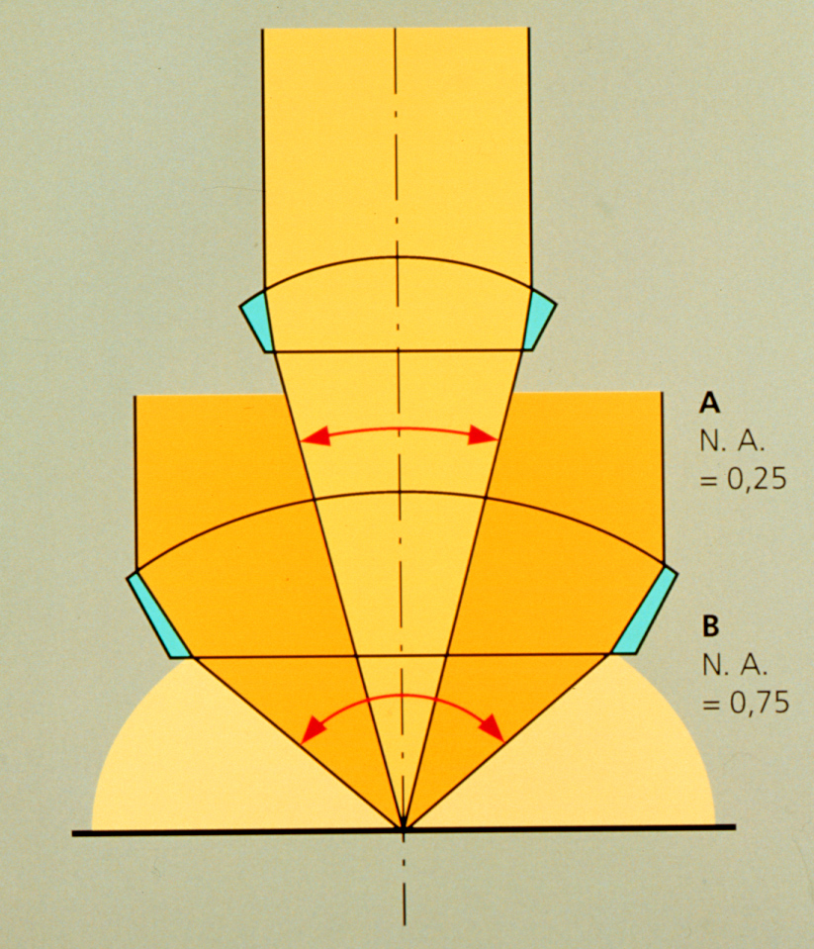
Larger Aperture collects more light
θ
N.A. = η sin θ
Notes:
In optics, the numerical aperture (NA) of an optical system is a dimensionless number that characterizes the range of angles over which the system can accept or emit light. By incorporating index of refraction in its definition, NA has the property that it is constant for a beam as it goes from one material to another provided there is no optical power at the interface. The exact definition of the term varies slightly between different areas of optics. Numerical aperture is commonly used in microscopy to describe the acceptance cone of an objective (and hence its light-gathering ability and resolution), and in fiber optics, in which it describes the range of angles within which light that is incident on the fiber will be transmitted along it.

Slide 51
N.A. = η sin θ
η = index of refraction
Material Refractive Index
Air 1.0003
Water 1.33
Glycerin 1.47
Immersion Oil 1.515
Note: sin θ ≤1, therefore N.A. ≤ η

Slide 52
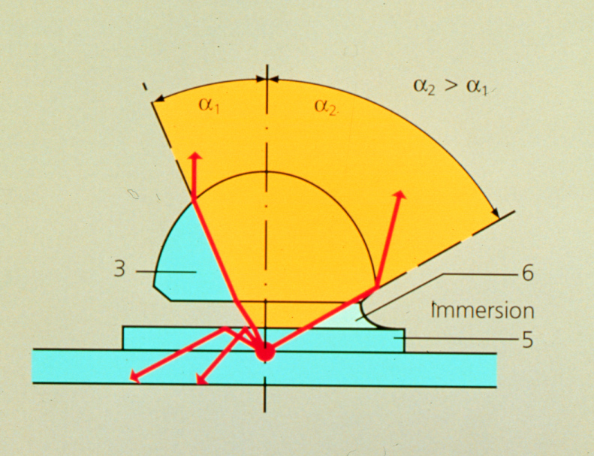
N.A. and immersion important for resolution and not loosing light to internal reflection.

Slide 53
How immersion medium affects the true N.A. and, consequently, resolution
No immersion (dry)
Max. Value for α = 90° (sin = 1)
Attainable: sinα = 0.95 (α = 72°)
Actual angle α₁:
Beampath
Snell’s Law:
n₁ sin β1 = n₂ sin β2
No oil
Oil
α₁
α₂
1
3
With immersion oil (3) n=1.518
No Total Reflection
Objective aperture fully usable
N.A._{max} = 1.45 > Actual angle α₂ :
α₁
α₂
2
Objective
Cover Slip, on slide
Immersion Oil

Slide 54
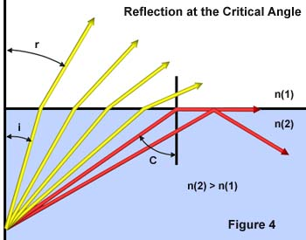
Internal reflection depends on refractive index differences
sin θ critical = η1 / η2
Notes:
Matching refractive indices can eliminate internal reflection. Internal reflection depends on refractive index differences

Slide 55
N.A. has a major effect on image brightness
Transmitted light
Brightness = fn (NA² / magnification²)
10x 0.5 NA is 3 times brighter than 10x 0.3NA
Epifluorescence
Brightness = fn (NA⁴ / magnification²)
10x 0.5 NA is 8 times brighter than 10x 0.3NA

Slide 56
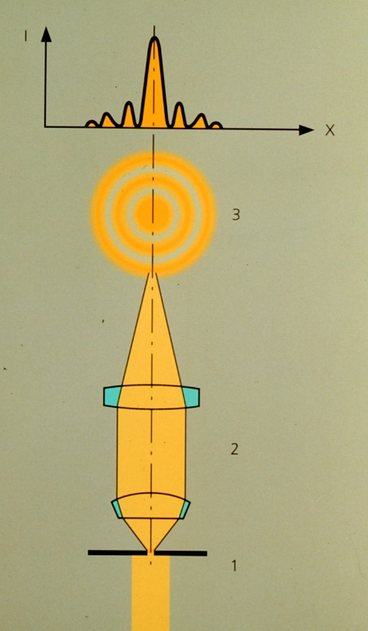
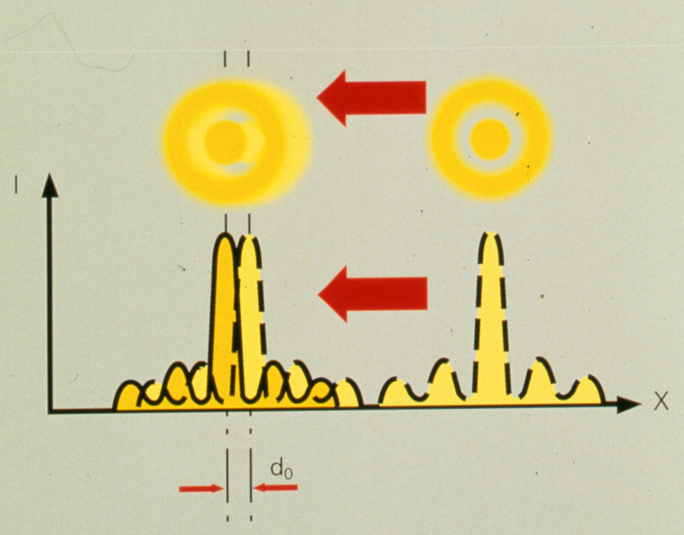
N.A. has a major effect on image resolution
Minimum resolvable distance
d_{min} = 1.22 λ / (NA _{objective} +NA _{condenser})

Slide 57
Optical Aberrations: Imperfections in optical systems
Chromatic (blue = shorter focal length)
Spherical (rays near edge of lens bent more)
Curvature of field (worse near edges)
BAD Potential Solution: Stop down lens
Problem: Brightness and Resolution
Real Solution: Good Optical Engineering

Slide 58
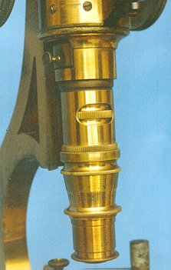
The most important microscope component
The Objective
Here is where good optical engineering really pays off

Slide 59
Example: Achromat doublet
Second lens creates equal and opposite chromatic aberration
BUT - at only one or two wavelength(s)

Slide 60

Dispersion in a plane-parallel glass plate (e.g. slide, cover slip, window of a vessel)
Chromatic Aberration can be defined as “unwanted” dispersion.
“White” Light

Slide 61
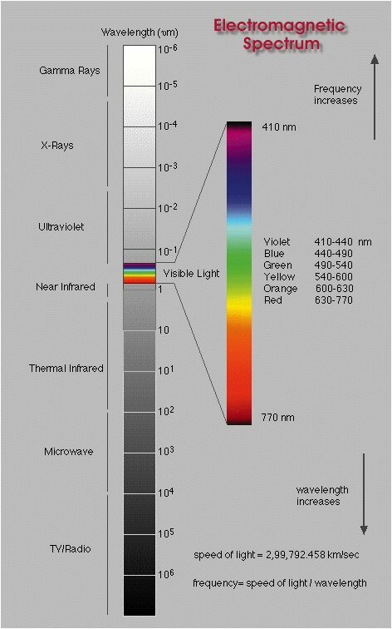
Named Spectral Lines
404.7 h Violet Hg
435.8 g Blue Hg
480.0 F‘ Blue Cd
486.1 F Blue H
546.1 e Green Hg
587.6 d Yellow He
589 D Sodium
643.8 C‘ Red Cd
656.3 C Red H
706.5 nm r Red He
Energy
Where did these named lines come from?
Notes:
Back to electromagnetic spectrum.

Slide 62
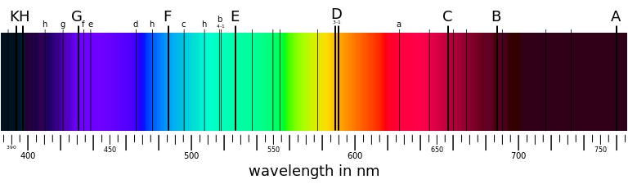
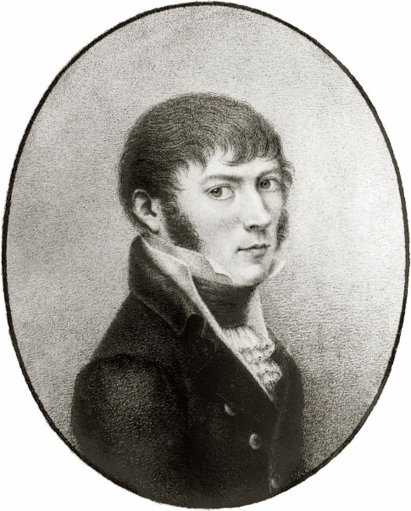
Fraunhofer lines
Dark lines in solar spectrum
First noted by William Wollaston in 1802
Independently discovered by Joseph Fraunhofer in 1814
Absorption by chemical elements (e.g. He, H, Na)
"Hiding in the Light"
Joseph Fraunhofer 1787-1826
Notes:
In 1802, the English chemist William Hyde Wollaston^{[1]} was the first person to note the appearance of a number of dark features in the solar spectrum.^{[2]} In 1814, Fraunhofer independently rediscovered the lines and began a systematic study and careful measurement of the wavelength of these features. In all, he mapped over 570 lines, and designated the principal features with the letters A through K, and weaker lines with other letters.
On episode 5 of Neil deGrasse Tyson’s Cosmos.

Slide 63
Why do we care about Fraunhofer lines?

Slide 64
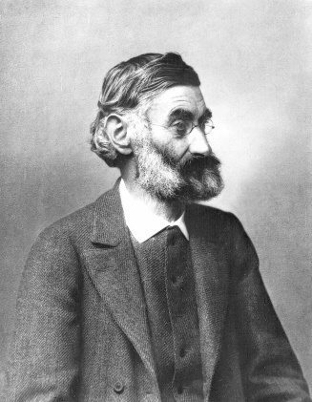
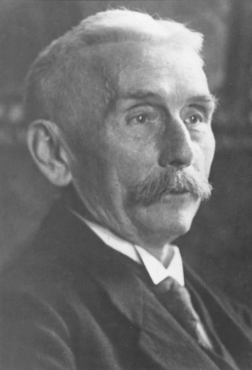
Why do we care about Fraunhofer lines?
Fraunhofer was a maker of fine optical glass
Special glass he made allowed him to see what Newton did not
Ernst Abbe, working with Otto Schott, would use these named spectral lines to characterize glass for microscope optics
Ernst Abbe (1840-1905)
Otto Schott (1851-1935)

Slide 65

Abbe number (V)
Measure of a material’s dispersion in relation to refractive index
Refractive indices at wavelengths of Fraunhofer D-, F- and C- spectral lines (589.3 nm, 486.1 nm and 656.3 nm respectively)
Instead of Na line can use He (V_{d}) or Hg (V_{e}) lines
High values of V indicating low dispersion (low chromatic aberration)
$$V_{D}=\frac{η_{D} − 1}{η_{F} − η_{C}}$$
Notes:
In physics and optics, the Abbe number, also known as the V-number or constringence of a transparent material, is a measure of the material's dispersion (variation of refractive index with wavelength) in relation to the refractive index, with high values of V indicating low dispersion (low chromatic aberration). It is named after Ernst Abbe (1840–1905), the German physicist who defined it.
Due to the difficulty and inconvenience in producing sodium and hydrogen lines, alternate definitions of the Abbe number are used in some contexts (ISO 7944).

Slide 66
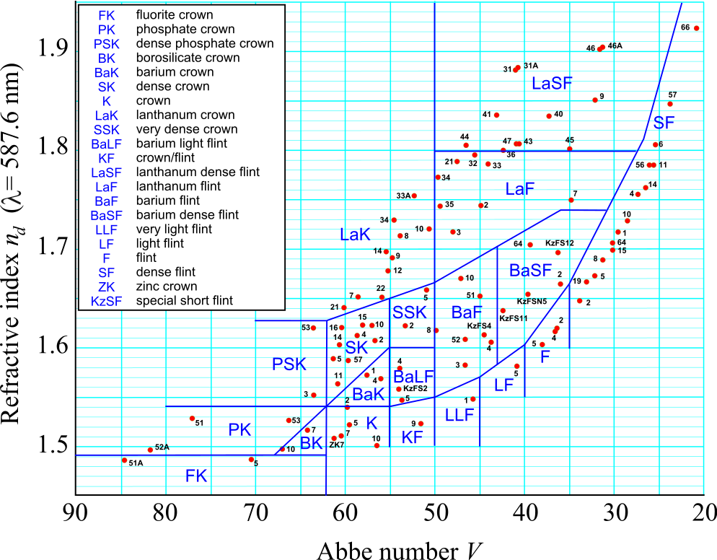
Abbe number (V)
Notes:
The most common types of glasses used in optics are crown glasses and flint glasses, designations based on their dispersions. Flint glasses contain lead. For example, a strong positive crown lens with its low dispersion may be used in a doublet with a weaker negative lens of flint glass (high dispersion) to correct for chromatic aberration.
http://hyperphysics.phy-astr.gsu.edu/hbase/geoopt/glass.html
In physics and optics, the Abbe number, also known as the V-number or constringence of a transparent material, is a measure of the material's dispersion (variation of refractive index with wavelength) in relation to the refractive index, with high values of V indicating low dispersion (low chromatic aberration). It is named after Ernst Abbe (1840–1905), the German physicist who defined it.
Due to the difficulty and inconvenience in producing sodium and hydrogen lines, alternate definitions of the Abbe number are used in some contexts (ISO 7944).

Slide 67
Objective names and corrections
Corrections: | Chromatic | Spherical | Other
Achromat | 2λ | -
Apochromat | 3λ | 2λ
PlanApochromat | 4-7λ | 3λ | Flat field
Fluor or Fluar | fewλ | fewλ | Max light
Neo Fluar | 2-3λ | 2-3λ

Slide 68
Definitions: Color Correction (axial)
Corrected Wavelength (nm):
UV VIS IR
Plan Neofluar - - (435) 480 546 - 644 - -
Plan Apochromat - - 435 480 546 - 644 - -
C-Apochromat 365 405 435 480 546 608 644 - -
IR C-Apochromat - - 435 480 546 608 644 800 1064
Notes:
Based on Fraunhofer line letters. For example 644 is red cadmium C’

Slide 69
Example: Achromat doublet
Convex lens of crown glass: low η and high Abbe number
Concave lens of flint glass: high η and low Abbe number
Notes:
Flint glass is optical glass that has relatively high refractive index and low Abbe number (high dispersion). Flint glasses are arbitrarily defined as having an Abbe number of 50 to 55 or less. The currently known flint glasses have refractive indices ranging between 1.45 and 2.00. A concave lens of flint glass is commonly combined with a convex lens of crown glass to produce an achromatic doublet lens because of their compensating optical properties, which reduces chromatic aberration (colour defects).
With respect to glass, the term flint derives from the flint nodules found in the chalk deposits of southeast England that were used as a source of high purity silica by George Ravenscroft, circa 1662, to produce a potash lead glass that was the precursor to English lead crystal.
Traditionally, flint glasses were lead glasses containing around 4–60% lead oxide; however, the manufacture and disposal of these glasses were sources of pollution. In many modern flint glasses, the lead can be replaced with other additives such as titanium dioxide and zirconium dioxide without significantly altering the optical properties of the glass.
Flint glass can be fashioned into rhinestones which are used as diamond simulants.
Electric Bulbs and Spectacle glasses are made of Flint glass.
Crown glass is a type of optical glass used in lenses and other optical components. It has relatively low refractive index (≈1.52) and low dispersion (with Abbe numbers around 60). Crown glass is produced from alkali-lime (RCH) silicates containing approximately 10% potassium oxide and is one of the earliest low dispersion glasses.
As well as the specific material named crown glass, there are other optical glasses with similar properties that are also called crown glasses. Generally, this is any glass with Abbe numbers in the range 50 to 85. For example, the borosilicate glass Schott BK7^{[1]} is an extremely common crown glass, used in precision lenses. Borosilicates contain about 10% boric oxide, have good optical and mechanical characteristics, and are resistant to chemical and environmental damage. Other additives used in crown glasses include zinc oxide, phosphorus pentoxide, barium oxide, fluorite and lanthanum oxide.
An achromatic doublet, which combines crown glass and flint glass.
A concave lens of flint glass is commonly combined with a convex lens of crown glass to produce an achromatic doublet. The dispersions of the glasses partially compensate for each other, producing reduced chromatic aberration compared to a singlet lens with the same focal length.

Slide 70
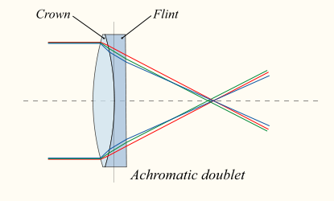
Example: Achromat doublet
Convex lens of crown glass: low η and high Abbe number
Concave lens of flint glass: high η and low Abbe number
Notes:
Flint glass is optical glass that has relatively high refractive index and low Abbe number (high dispersion). Flint glasses are arbitrarily defined as having an Abbe number of 50 to 55 or less. The currently known flint glasses have refractive indices ranging between 1.45 and 2.00. A concave lens of flint glass is commonly combined with a convex lens of crown glass to produce an achromatic doublet lens because of their compensating optical properties, which reduces chromatic aberration (colour defects).
With respect to glass, the term flint derives from the flint nodules found in the chalk deposits of southeast England that were used as a source of high purity silica by George Ravenscroft, circa 1662, to produce a potash lead glass that was the precursor to English lead crystal.
Traditionally, flint glasses were lead glasses containing around 4–60% lead oxide; however, the manufacture and disposal of these glasses were sources of pollution. In many modern flint glasses, the lead can be replaced with other additives such as titanium dioxide and zirconium dioxide without significantly altering the optical properties of the glass.
Flint glass can be fashioned into rhinestones which are used as diamond simulants.
Electric Bulbs and Spectacle glasses are made of Flint glass.
Crown glass is a type of optical glass used in lenses and other optical components. It has relatively low refractive index (≈1.52) and low dispersion (with Abbe numbers around 60). Crown glass is produced from alkali-lime (RCH) silicates containing approximately 10% potassium oxide and is one of the earliest low dispersion glasses.
As well as the specific material named crown glass, there are other optical glasses with similar properties that are also called crown glasses. Generally, this is any glass with Abbe numbers in the range 50 to 85. For example, the borosilicate glass Schott BK7^{[1]} is an extremely common crown glass, used in precision lenses. Borosilicates contain about 10% boric oxide, have good optical and mechanical characteristics, and are resistant to chemical and environmental damage. Other additives used in crown glasses include zinc oxide, phosphorus pentoxide, barium oxide, fluorite and lanthanum oxide.
An achromatic doublet, which combines crown glass and flint glass.
A concave lens of flint glass is commonly combined with a convex lens of crown glass to produce an achromatic doublet. The dispersions of the glasses partially compensate for each other, producing reduced chromatic aberration compared to a singlet lens with the same focal length.

Slide 71
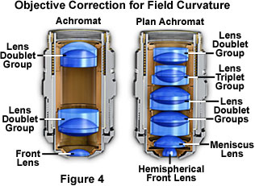
Internal structure of objectives
The Objective
http://www.microscopyu.com/articles/optics/objectiveintro.html

Slide 72
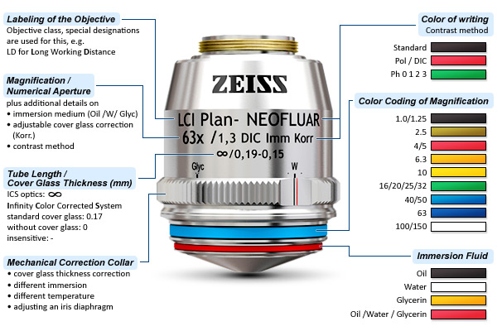
Deciphering an objective
http://zeiss-campus.magnet.fsu.edu

Slide 73
The Finitely Corrected Compound Microscope
B
Eyepiece
A
B
150 mm (tube length = 160mm)
Objective
Objective Mount (Flange)
In most finitely corrected systems, the eyepiece has to correct for the LCA of the objectives, since the intermediate image is not fully corrected.
LCA = lateral chromatic aberration

Slide 74
Homework 2: Why are most modern microscopes “infinity corrected”
Hint - think of the influence of a piece of glass
Image
Eyepiece
image
Eyepiece
Lens of eye

Slide 75
The Compound Microscope (infinity corrected)
Eyepiece
Tube lens
(Zeiss: f=164.5mm)
Objective

Slide 76
From a Microscope to a Telescope
Eyepiece
No “objective”
Objective (previously:Tube Lens)
∞
∞
Objective
∞
Eyepiece
∞
“Galilean” Type Telescope

Slide 77
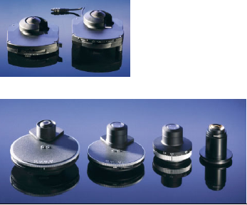
The second most important microscope component
The Condenser

Slide 78
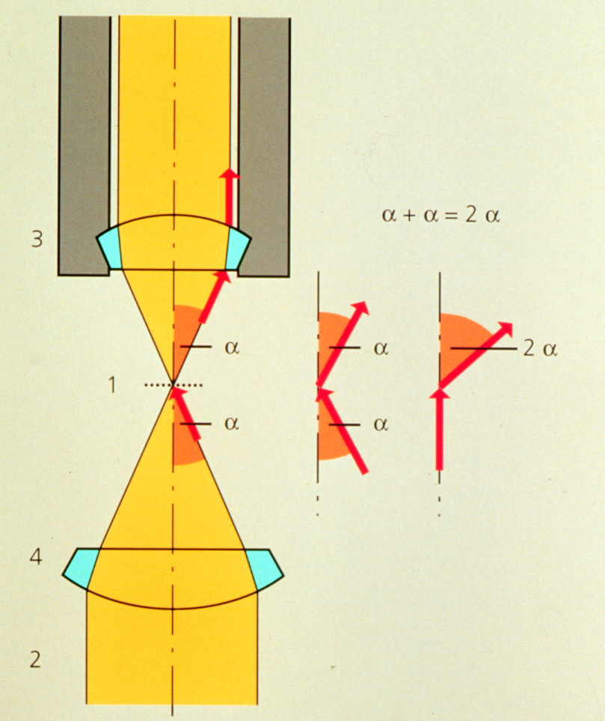
Condenser maximizes resolution
d_{min} = 1.22 λ / (NA _{objective} +NA _{condenser})
Kohler Illumination: Condenser and objective focused at the same plane

Slide 79
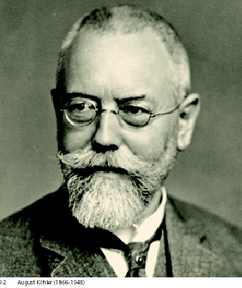
“Kohler” Illumination
Provides for most homogenous Illumination
Highest obtainable Resolution
Defines desired depth of field
Minimizes stray light and unnecessary Iradiation
Helps in focusing difficult-to-find structures
Establishes proper position for condenser elements, for all contrasting techniques
Prof. August Köhler:
1866-1948
Notes:
August Karl Johann Valentin Köhler (March 4, 1866 – March 12, 1948) was a German professor and early staff member of Carl Zeiss AG in Jena, Germany. He is best known for his development of the microscopy technique of Köhler illumination, an important principle in optimizing microscopic resolution power by evenly illuminating the field of view. This invention revolutionized light microscope design and is widely used in traditional as well as modern digital imaging techniques today.
At the time of the invention of his revolutionary illumination scheme as a graduate student at the University of Giessen, Köhler was working on overcoming problems with microphotography. Microscopes were illuminated by gas lamps, mirrors or other primitive light sources, resulting in an uneven specimen illumination unsuited for producing good quality photomicrographs using the slow-speed emulsions available at the time. Over the course of his work for his doctorate degree, Köhler developed a microscope configuration that allowed for an evenly illuminated field of view and reduced optical glare from the light source. It involved a collector lens for the lamp that allowed the light source to be focused on the front aperture of the condenser. This in turn allowed the condenser to be focused on the specimen using a field diaphragm and condenser focus control. This superior illumination scheme is still widely used in modern microscopes and forms the basis for phase contrast,^{[3]} differential interference contrast, epifluorescence, and confocal microscopy.^{[4]}
Köhler's groundbreaking work on microscope illumination was published in the Zeitschrift für wissenschaftliche Mikroskopie in 1893 in Germany,^{[5]} followed by an English summary of his work in the Journal of the Royal Microscopical Society one year later.^{[6]} Its significance was not noted until several years later when Köhler was invited to join the Carl Zeiss AG company based on his invention. A century after its first publication, a translation of Köhler's original article, A New System of Illumination for Photomicrographic Purposes, was reprinted in the Köhler Illumination Centenary commemorative issue by the Royal Microscopical Society in 1994.^{[7]} Today, the Köhler illumination is considered one of the most important principles in achieving the best optical resolution on a light microscope.

Slide 80
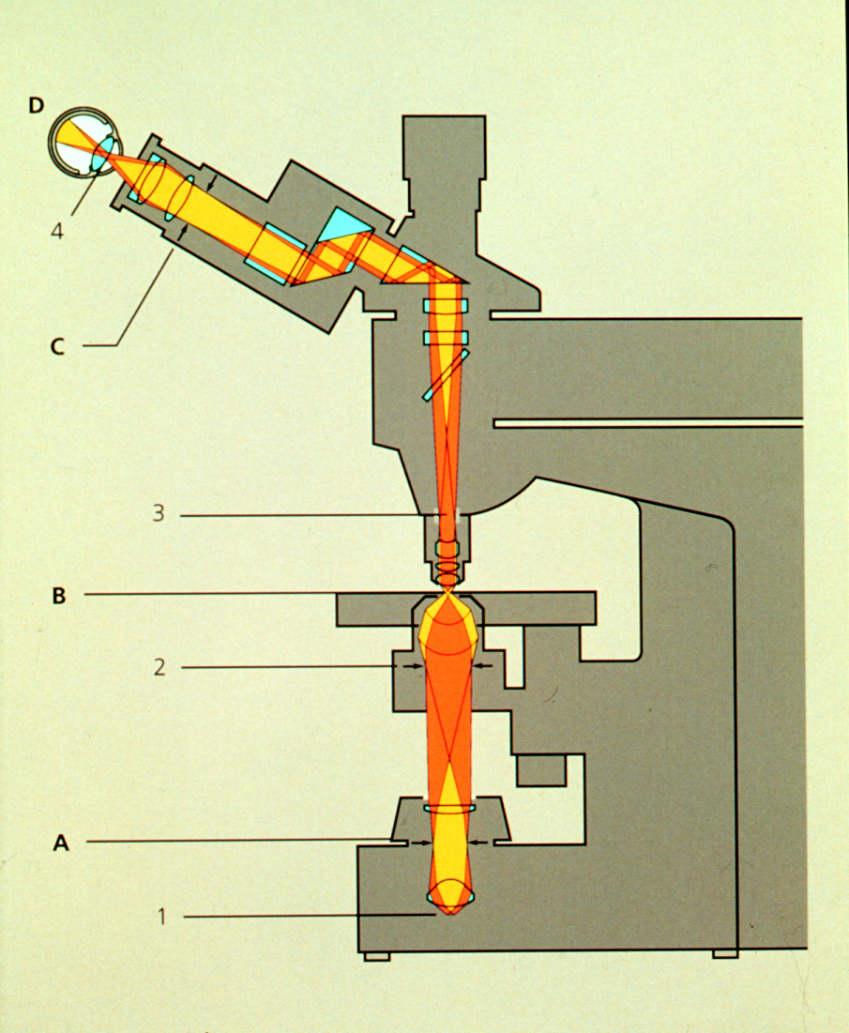
Condenser aperture
Field aperture
Notes:
Can see condenser aperture by removing eyepiece and looking into scope.

Slide 81
Condenser aperture
Field aperture
Condenser Aperture controls N.A. of condenser
Field Aperture controls region of specimen illuminated

Slide 82
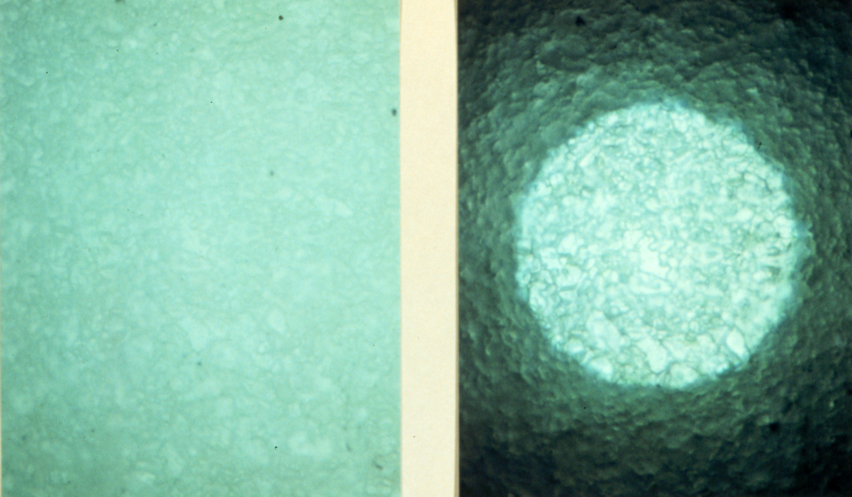
Kohler Step 1: Close field aperture
Move condenser up-down to focus image of the field aperture

Slide 83
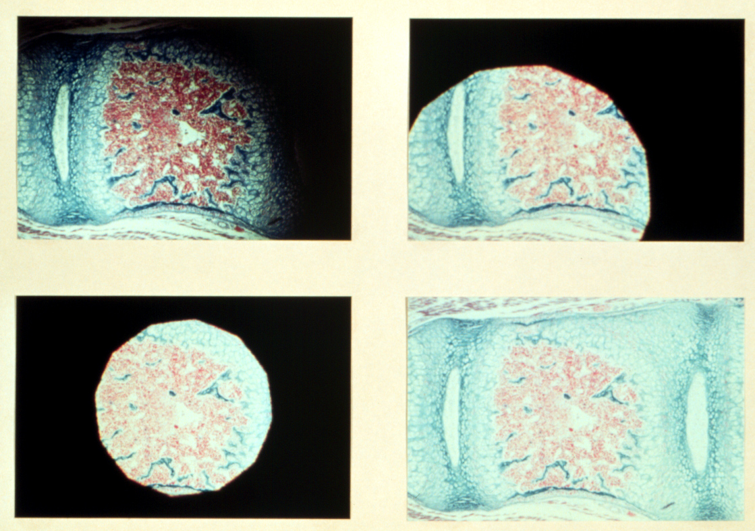
Kohler Step 2: Center image of field aperture
Move condenser adjustment
centered

Slide 84
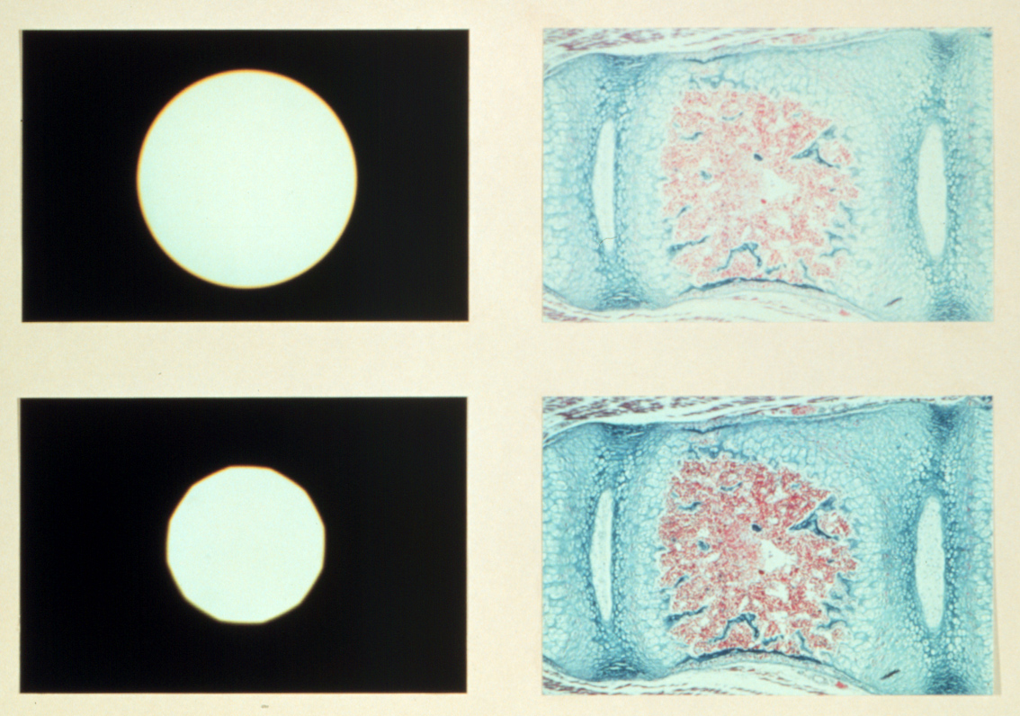
Kohler Illumination gives best resolution
Set Condenser aperture so
NA_{condenser} = 0.9 x NA_{objective}
Open field aperture to fill view

Slide 85
Condenser N.A. and Resolution
If NA is too small, there is no light at larger angles. Resolution suffers.
If NA is too large, scattering of out-of-field light washes out features. Bad contrast

Slide 86
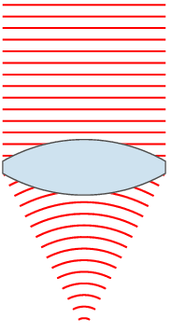
Collapse of Newton's corpuscular theory and the rise of the wave theory
By the 1800’s the wave theory was required to explain such phenomenon as diffraction, interference and refraction.
Airy disk is an intensity distribution of a diffraction limited spot helpful for defining resolution.

Slide 87
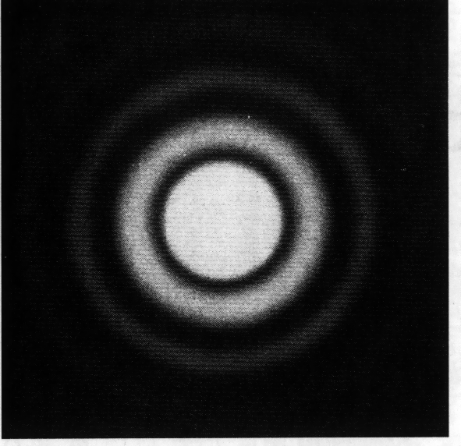
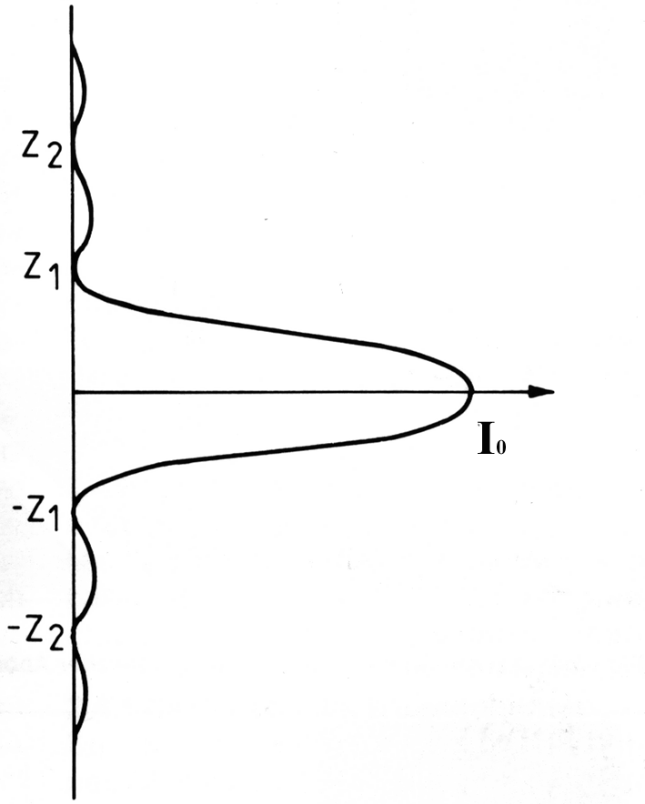
Intensity Distribution of a diffraction-limited spot
Airy Disk
Named after Sir George Biddell Airy English mathematician and astronomer
Notes:
In optics, the Airy disk (or Airy disc) and Airy pattern are descriptions of the best focused spot of light that a perfect lens with a circular aperture can make, limited by the diffraction of light.
The diffraction pattern resulting from a uniformly-illuminated circular aperture has a bright region in the center, known as the Airy disk which together with the series of concentric bright rings around is called the Airy pattern. Both are named after George Biddell Airy.

Slide 88
Airy disks and resolution
Minimum resolvable distance requires that the two airy disks don’t overlap
d_{min} = 1.22 λ / (NA _{objective} +NA _{condenser})

Slide 89
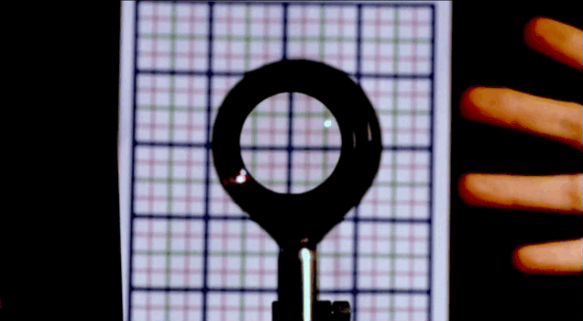
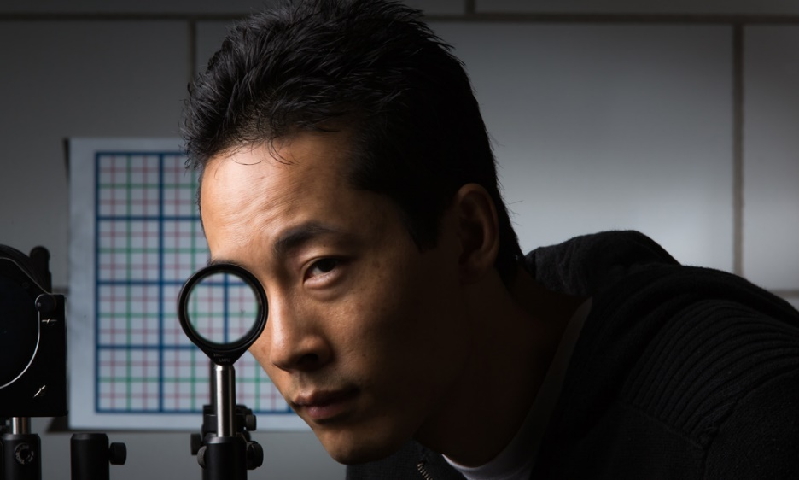
Another trick with ray optics
Making objects invisible
Ray tracing still important for optical research
Paper by Choi and Howell from University of Rochester published 2014
http://arxiv.org/abs/1409.4705v2

Slide 90
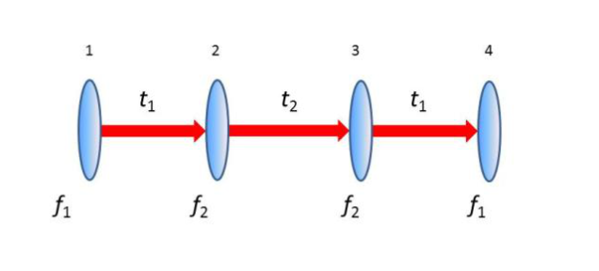
Perfect cloak at small angles using simple optics
Paraxial rays are those at small angles
Uses 4 off the shelf lenses: two with a focal length of f₁ and two with focal lengths of f₂

Slide 91
Perfect cloak at small angles using simple optics
Lens with f₁ separated from lens with f₂ by sum of their focal lengths = t₁.
Separate the two sets by t₂=2 f₂ (f₁+ f₂) / (f₁— f₂) apart, so that the two f₂ lenses are t₂ apart.

