Slide 1
Biology 177: Principles of Modern Microscopy
Lecture 02:
Geometrical Optics

Slide 2
Lecture 2: Geometrical Optics
Speed of light and refractive index
Thin lens law
Simple optical system
Compound microscope I
Refractive indices and super lenses

Slide 3
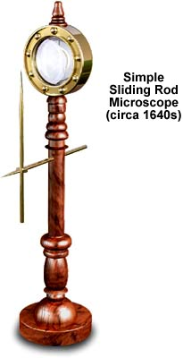
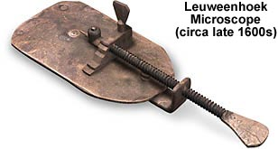
Simple microscope
How does it magnify?
By how much does it magnify?
Will the image be upright?
Why can’t this work for mag>100?
Why does the image have color halos?
Notes:
Magnification ?
Right side up or upside down?
Why is metal creating pupil?

Slide 4
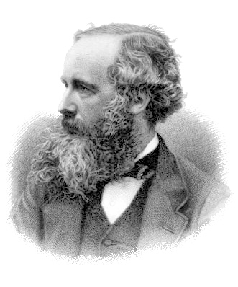
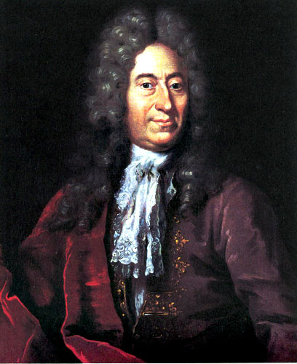
The speed of light
299,792,458 metres per second in a vacuum
The meter is now defined by the speed of light (1983)
First measured by the Danish Astronomer Ole Rømer in 1676
James Clerk Maxwell proposed all electromagnetic waves move at the speed of light (1865)
Ole Rømer
James Clerk Maxwell
Notes:
BBC: Albert Einstein has been voted the greatest physicist of all time in an end of the millennium poll, pushing Sir Isaac Newton into second place. Maxwell 3rd. The survey was conducted among 100 of today's leading physicists.

Slide 5
How did we learn that the speed of light was finite?

Slide 6
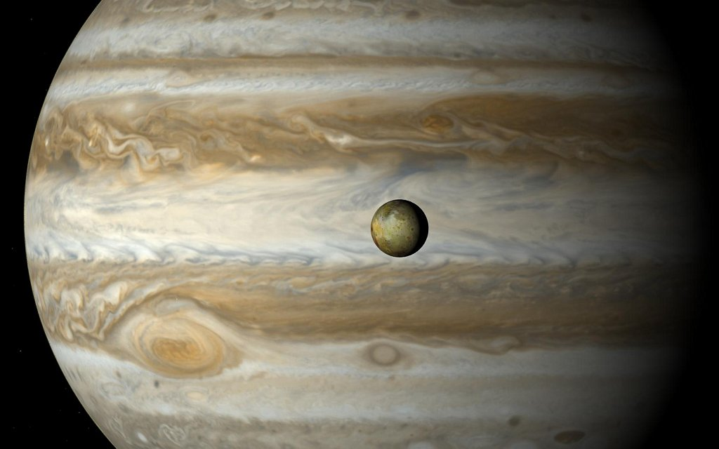
How did we learn that the speed of light was finite?
Hint

Slide 7
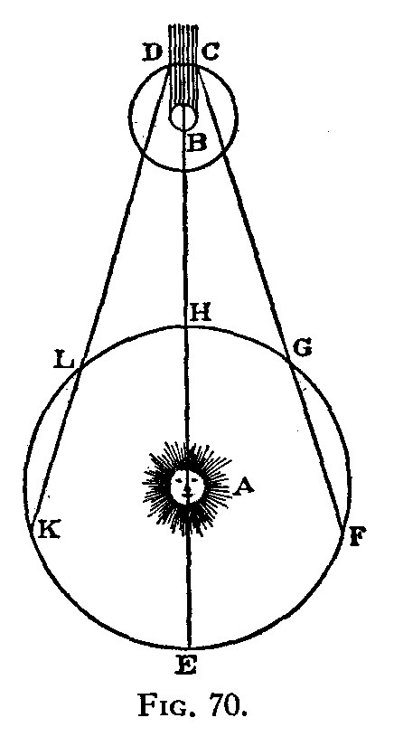
How did we learn that the speed of light was finite?
Hint
Ole Rømer in 1676
Notes:
Looked at orbit of Io around Jupiter. Io just discovered by Galileo in 1610. Io orbits at a good plane from earth so that it is eclipsed by Jupiter.

Slide 8
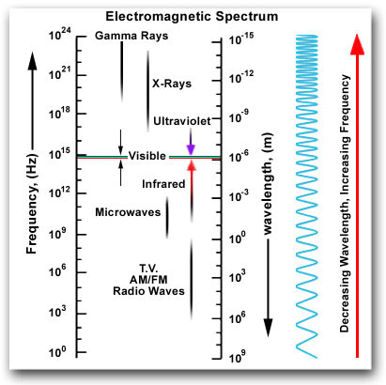
Let’s review some of the concepts from last lecture
Absorption
Reflection
Transmission
Refraction
(λ)
(ν)
Notes:
Discussed why we use visible light and its being perfect for analysis via geometrical optics.

Slide 9
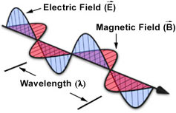
For most of today, will ignore the wave nature and concentrate on the particle nature.
Define the index of refraction, η
η = speed of light in vacuum /speed in medium
η = λ in vacuum / λ in medium
c = ν λ
Notes:
Frequency does not change with medium.

Slide 10
Refractive index η
Medium Refractive Index
Air 1.0003
Water 1.33
Glycerin 1.47
Immersion Oil 1.518
Glass 1.56 – 1.46
Diamond 2.42
Velocity in medium
299203
225032
203600
197162
191854 - 204995
123675

Slide 11
COMPLICATION: η Depends on the wavelength
Material Blue (486nm) Yellow (589nm) Red (656nm)
Crown Glass 1.524 1.517 1.515
Flint Glass 1.639 1.627 1.622
Water 1.337 1.333 1.331
Cargille Oil 1.530 1.520 1.516
(more on this next lecture)

Slide 12
Refraction - the bending of light as it passes from one material to another.
Snell’s Law: η1 sin θ1 = η2 sin θ2
θ1
Normal (perpendicular to interface of different materials)
θ2
Optical axis
η1
η2

Slide 13
Light beam through a plane-parallel glass plate
Snell’s Law: η1 sin θ1 = η2 sin θ2
θ1
θ2
??
n₁
n₂
n₁

Slide 14
Light beam through a plane-parallel glass plate
Snell’s Law: η1 sin θ1 = η2 sin θ2
θ1
θ2
θ1
n₁
n₂
n₁

Slide 15
Could apply Snell’s Law to something as complex as a lens
η1 sin θ1 = η2 sin θ2 = η3 sin θ3 = ….
η1
η2

Slide 16
Easier way: Thin lens laws
1. Ray through center of lens is straight
η1
η2
Notes:
In this chapter we shall discuss some elementary applications of the ideas of the previous chapter to a number of practical devices, using the approximation called geometrical optics. This is a most useful approximation in the practical design of many optical systems and instruments. Geometrical optics is either very simple or else it is very complicated. By that we mean that we can either study it only superficially, so that we can design instruments roughly, using rules that are so simple that we hardly need deal with them here at all, since they are practically of high school level, or else, if we want to know about the small errors in lenses and similar details, the subject gets so complicated that it is too advanced to discuss here!
http://feynmanlectures.caltech.edu/I_27.html#Ch27-S1

Slide 17
Easier way: Thin lens laws
1. Ray through center of lens is straight
(white lie - small error if glass is thin)
η1
η2

Slide 18
Thin lens law 2
2. Light rays that enter the lens parallel to the optical axis leave through Focal Point
Focal
Point

Slide 19
Thin lens law 3
3. Light rays that enter the lens from the focal point exit parallel to the optical axis.
f
Focal
Point

Slide 20
Using the lens laws to predict the behavior of imaging systems
(principle ray technique)
Mark Focal Pt
f
f
Object

Slide 21
Draw in central ray
Object

Slide 22
Draw in central ray
In parallel; out via focal point

Slide 23
Draw in central ray
In parallel; out via focal point
From focal point; out parallel

Slide 24
Draw in central ray
In parallel; out via focal point
From focal point; out parallel
Image
Intersection defines image

Slide 25
Thin Lens Equation
1/f = 1/o + 1/i
f
i
o

Slide 26
Thin Lens Equation
1/f = 1/o + 1/i
Magnification = i/o
f
i
o

Slide 27
Convex Lenses (convergent lenses)
Positive focal lengths
Real images
Upside-down
Can project
f
i
o

Slide 28
Thin lens law (Concave Lenses)
Light rays that enter the lens parallel to the optical axis exit as if they came from the focal point on the opposite side.

Slide 29
Concave Lenses
Focal length is defined as negative
Images are virtual

Slide 30
Principle ray approach works for complex lens assemblies
i

Slide 31
Focal lengths add as reciprocals:
1/f(total) = 1/f1 + 1/f2 + ... + 1/fn Remember: for concave lens f is negative

Slide 32
Problem: Two thin lenses together don’t make a thin lens
Notice that the central ray misses the image

Slide 33
Solution: Use principle rays to define image from first lens. Then use the first image as the object for the second lens
Notice that the central ray misses the image

Slide 34
To avoid reciprocals: Define Diopter (D)
D = 1/focal length (in meters)
D(total) = D1 + D2 + ... + Dn Remember: for concave lens D is negative

Slide 35
Other placements of object
Object inside front focal point; out diverging
Location of “virtual” image in object space

Slide 36
Move specimen to f; creates image at infinity
Magnification = 250mm/f
f
i
o

Slide 37
Object at front focal point; out parallel (∞)
Magnification = 250mm/f
∞

Slide 38
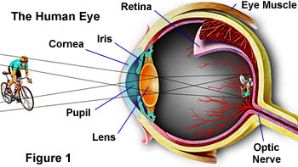
How does all this relate to a microscope?
Optics to generate a larger image on the retina
Comfortable near point about 250mm
Define size at 250mm as magnification = 1

Slide 39
Could get a larger retinal image if object were closer
Limited accommodation (especially with age)
Limited range
Solution: Add a “loupe” in front of eye
Allow eye to focus at infinity for o ≤ 250mm

Slide 40
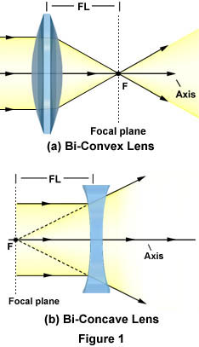
Real image
  Can project
  Upside down
Virtual image
  Can’t project
  Rightside up

Slide 41
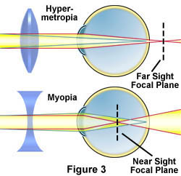
Can look at both real and virtual image
(basis of corrective eyeglasses)
Reminder that our eyes are the last component
of an optical microscope design

Slide 42
Image in the eye are different sizes (different magnifications) depending on their distance from the eye.
Accommodation of the lens changes f to make it possible.
M_{B} ~ 2x M_{A}
A
B

Slide 43
Conventional Viewing Distance
?
1x
250 mm

Slide 44
“Magnification” 1x
1x
f = 250 mm
1x

Slide 45
Magnification via Single Lens
1x
f = 250 mm
Magnifying Glass (Loupe)
5x
Example: f=50mm
Notes:
Why can’t this work for mag>100? Lens gets more spherical and closer to focal point.

Slide 46
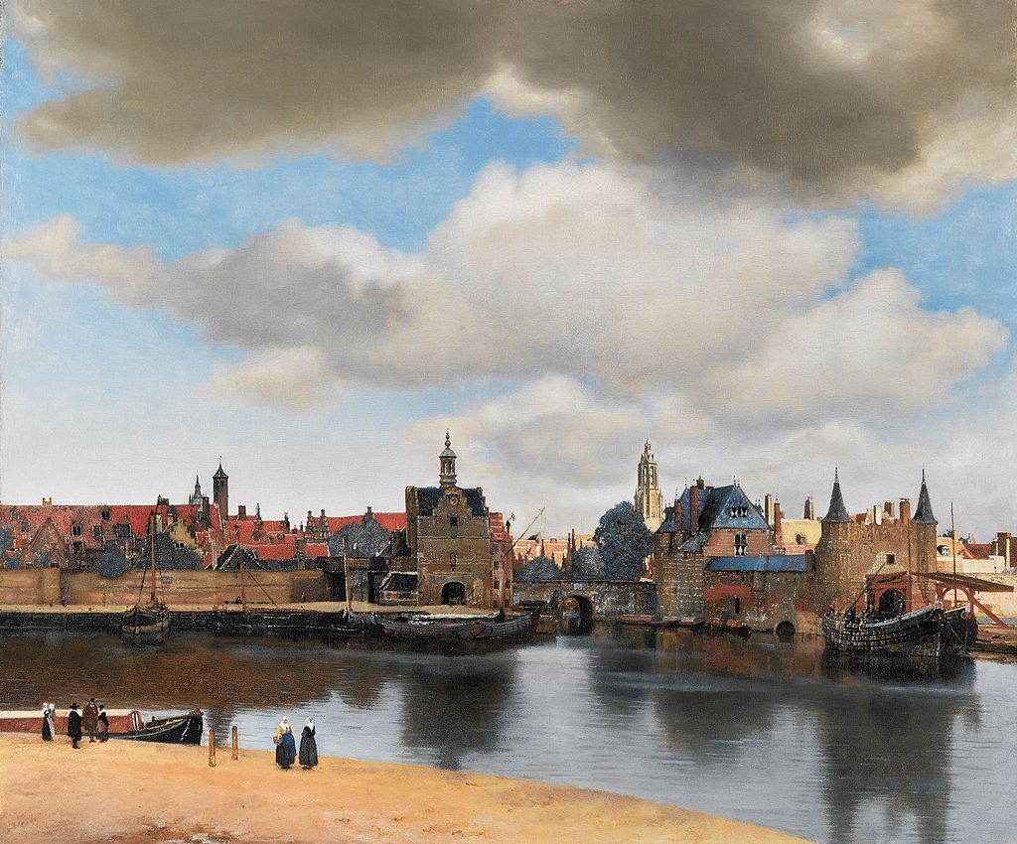
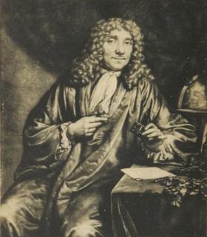
Magnification??
Delft
Antonie van Leeuwenhoek
1632-1723
Notes:
The Leewenhoek microscope was simplicity in itself. It had a single lens mounted on a metal plate with screws to move the specimen across the field of view and to focus its image. The lens was the key and permitted magnification of 70 to 270. (web site seems incorrect on magnification range)
http://www.asu.edu/courses/phs208/patternsbb/PiN/rdg/elmicr/optical.shtml

Slide 47
How to get magnification > 100??
Compound microscope
  Objective lens (next to the object)
Objective Lens
Real image
Magnification = I/O
I=160mm (old microscopes)
Image

Slide 48
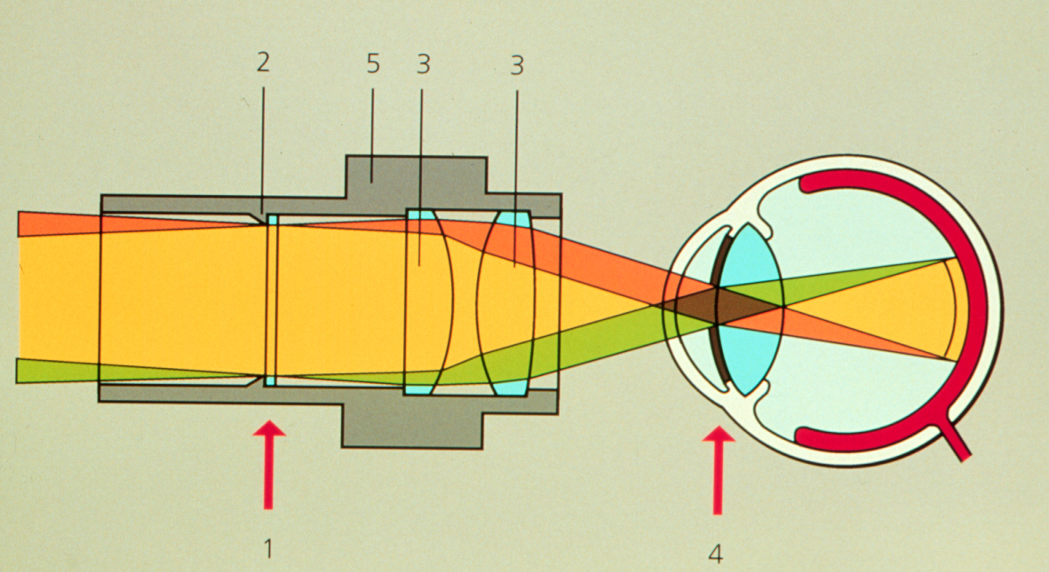
How to get magnification > 100??
Compound microscope
Objective lens (next to the object)
Eyepiece (f = 25mm; 10x)
Reticle position
(in focus for eye)
Note rays are parallel

Slide 49
How to get magnification > 100??
Compound microscope
Objective lens (next to the object)
Eyepiece (f = 25mm; 10x)
Objective Lens
Image
Eyepiece
image
Eyepiece
Lens of eye

Slide 50
How to get magnification > 100??
Compound microscope
Objective lens (next to the object)
Eyepiece (f = 25mm; 10x)
Objective Lens
Image
Eyepiece
image
Eyepiece
Lens of eye

Slide 51
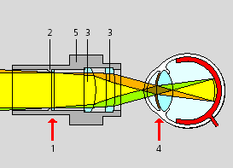
The Eyepiece (Ocular)
Intermediate Image
Eyepoint (Exit Pupil)
Note: If you need a magnifier, turn eyepiece
upside down and move close to eye

Slide 52
The Eyepiece (Ocular)
Question: why does the eye need to be at the focus of the eyepiece?
Intermediate Image
Eyepoint (Exit Pupil)

Slide 53
Eye at focal point because…
…it maximizes field of view.

Slide 54
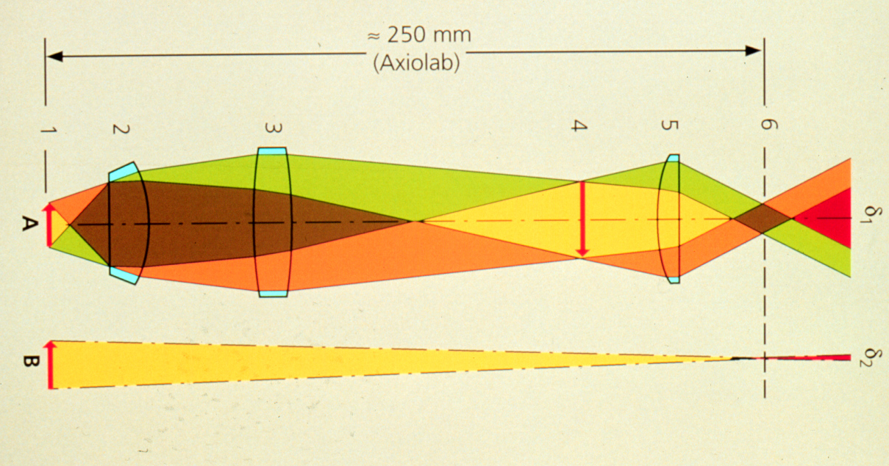
Object viewed through microscope vs the unaided eye
(250 mm from eye)
Compound microscope
Large image on retina
1x view
Small image on retina

Slide 55
Homework 1: The index of refraction changes with wavelength (index is larger in blue than red).
How would you need to modify this diagram of the rays of red light to make it appropriate for blue light?
f
i
o
Hint: higher index of refraction results in shorter f

Slide 56
Let’s come back to refractive index (η)
Material | Refractive Index
Air | 1.0003
Water | 1.33
Glycerin | 1.47
Immersion Oil | 1.515
Glass | 1.52
Diamond | 2.42
η = speed of light in vacuum /speed in medium
Notes:
What do you notice about the values?

Slide 57
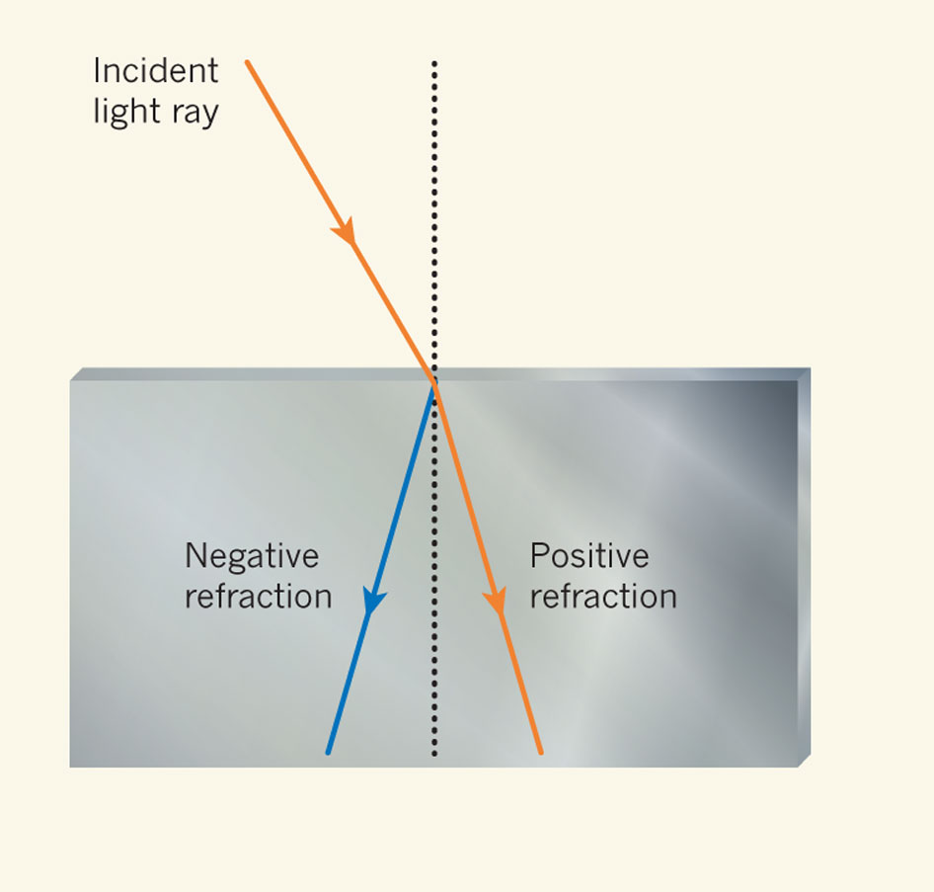
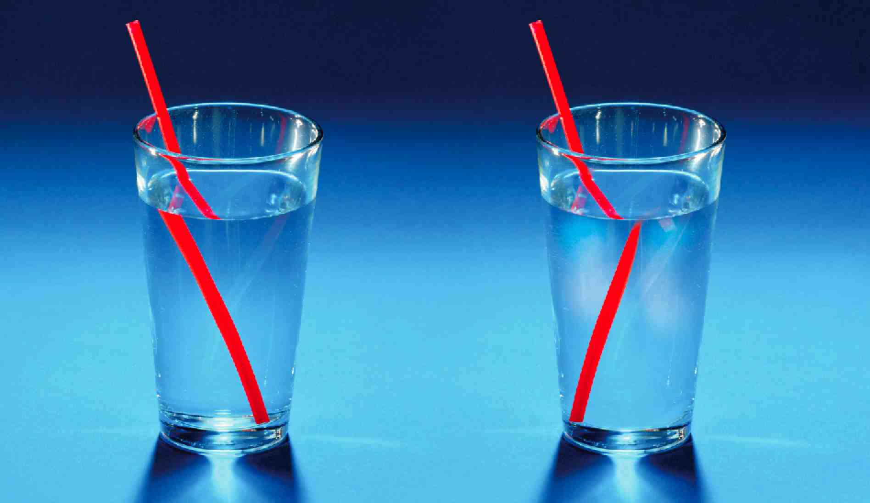
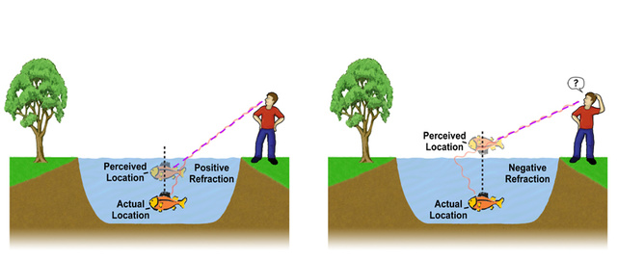
Metamaterials with negative refractive indices would produce bizarre images
Image not real!
Tyc T, Zhang X (2011) Forum Optics: Perfect lenses in focus. Nature 480: 42-43.
Notes:
http://www.nature.com/nature/journal/v480/n7375/full/480042a.html
Straw image from http://www.extremetech.com/extreme/168060-the-first-quantum-metamaterial-raises-more-questions-than-it-answers

Slide 58
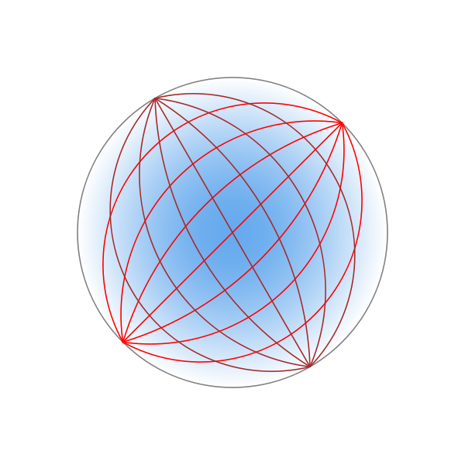
Metamaterials with negative refractive indices could be used to make superlenses for super resolution microcopy
Do you need to perfect lens?
Maxwell's fish-eye lens could do it with positive refractive indices
  Refractive index changes across lens (blue shading)
Luneburg lens
Tyc T, Zhang X (2011) Forum Optics: Perfect lenses in focus. Nature 480: 42-43.
Notes:
Darker blue, higher refractive index. Like a gravitational lens
A practical superlens, super lens or perfect lens, is a lens which uses metamaterials to go beyond the diffraction limit. The diffraction limit is an inherent limitation in conventional optical devices or lenses.[1] In nano-optics, a plasmonic lens generally refers to a lens for surface plasmon polaritons (SPPs), i.e. a device that redirects SPPs to converge towards a single focal point. Since SPPs can have very small wavelength, they can converge into a very small and very intense spot, much smaller than the free-space wavelength and the diffraction limit.[1][2] Surface plasmon polaritons (SPPs), are infrared or visible-frequency electromagnetic waves, which travel along a metal-dielectric or metal-air interface. The term "surface plasmon polariton" explains that the wave involves both charge motion in the metal ("surface plasmon") and electromagnetic waves in the air or dielectric ("polariton").[1]
They are a type of surface wave, guided along the interface in much the same way that light can be guided by an optical fiber. SPPs are shorter in wavelength than the incident light (photons).[2]
Metamaterials are artificial materials engineered to have properties that have not yet been found in nature.

