Slide 1
Biology 177: Principles of Modern Microscopy
Andres Collazo, Director Biological Imaging Facility
Ravi Nath, Graduate Student, TA

Slide 2
Biology 177: Where and When?
  Broad 200
  Tuesday & Thursday
  10:30 am -12:00 pm
  Will this start time work for people?

Slide 3
Sister Course
Biology 227: Methods in Modern Microscopy
  Will be taught next year (Winter 2016)
  Laboratory class
  Located in Church, room 68
  Attendance limited

Slide 4
Biology 177: Principles of Modern Microscopy
What it will be:
    Basic optics and microscopy
    Laser scanning microscopy
    Contrast Mechanisms
    Image rendering and processing
What it can’t be:
    A review of all microscopy techniques
    Optics design, etc

Slide 5
Biology 177: Principles of Modern Microscopy
Fundamentals of light microscopy
  wide-field
  confocal microscopy
Contrast and sample preparation
  phase and DIC optics
  fluorescent labels
Advanced techniques
  quantitative imaging
  two photon microscopy
  super resolution microscopy
  3-D imaging and rendering
  light sheet microscopy
  fluorescence correlation spectroscopy

Slide 6
Biology 177: Principles of Modern Microscopy
Course Work:
  Reading
  Simple problem sets
  Projects
  No exams
Projects (two):
  Read and summarize a publication
  Describe technology
  How could it have been done better?
  Must say one good thing about paper.
Note: Auditors welcome

Slide 7
Biology 177: Principles of Modern Microscopy
177 TA:
Ravi Nath (rnath@caltech.edu)
Course website:
http://www.its.caltech.edu/~bi177/
Dropbox account for lectures, etc.

Slide 8
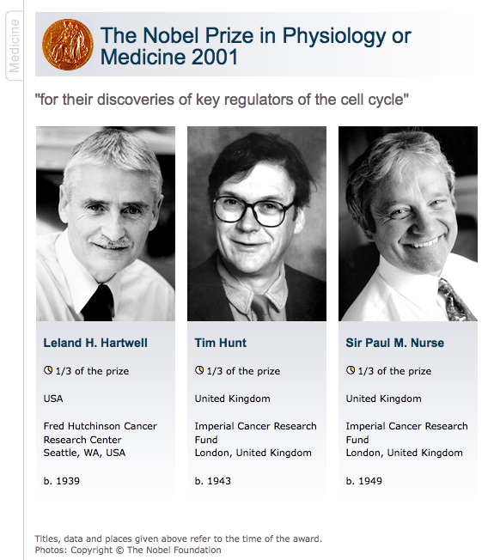
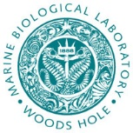
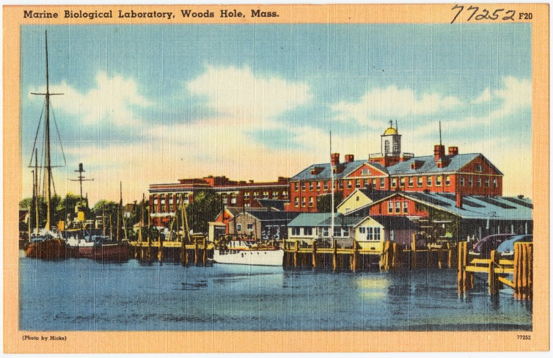
Why does light pass through glass?
Lecture by Tim Hunt.
Summer Courses at the Woods Hole Marine Biological Laboratory
www.mbl.edu
Notes:
Glass an amorphous solid. Photon does not hit electron with enough energy to excite, so light is transmitted through glass. But not UV because does have enough energy to excite electrons.

Slide 9
How does a photon of light interact with solids?
Absorption
Reflection
  Mirror
Transmission
  Glass is an amorphous solid
  Photons pass through without interacting with electrons
This brings us to a branch of physics called optics
Notes:
Tim Hunt June 21, 2004 lecture to Physiology and Embryology class. Began with question of how photons pass through glass. Einsteins 1905 paper on Brownian motion. Influenced by James Maxwell who showed light didn’t need a medium to propagate through. Was Maxwell right about light diffusion?
17th March - submits “On a heuristic point of view concerning the production and transformation of light” to Annalen der Physik (AdP17). This provides a solution of the puzzling photoelectric effect noticed by Heinrich Hertz in 1888. It overturned the wave theory of light, which even Hertz proclaimed as a certainty in the 1890s. It claims a reality for Planck’s quanta of energy, and heralds the beginning of quantum theory. Einstein wrote in the paper:
“Energy during the propagation of a ray of light is not continuously distributed over steadily increasing spaces, but it consists of a finite number of energy quanta localised at points in space, moving without dividing and capable of being absorbed or generated only as entities.”
The revolutionary theory of light as energy quanta (named photons by Gilbert Lewis in 1926) rather than continuous waves was very slow to take hold. Notably Robert Millikan, at the University of Chicago, experimented at length from 1912 to 1915 to try to disprove the predictions of Einstein’s theory. Eventually he had to concede “…its unambiguous experimental verification in spite of its unreasonableness since it seems to violate everything that we knew about the interference of light.” Only in 1923 did experiments of light diffusion directly demonstrate its quantised nature.
It was this theory on the photoelectric effect that was cited as the principal contribution that earned Einstein the 1921 Nobel Prize.

Slide 10
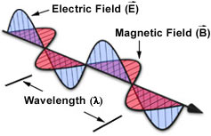
Optics – understanding the behavior and properties of light.
Based on the bending of light as it passes from one material to another
Duality of light
  Particle nature
  Wave nature
Notes:
In optics, the corpuscular theory of light, arguably set forward by Pierre Gassendi and Thomas Hobbes states that light is made up of small discrete particles called "corpuscles" (little particles) which travel in a straight line with a finite velocity and possess impetus.
Isaac Newton argued that the geometric nature of reflection and refraction of light could only be explained if light was made of particles, referred to as corpuscles, because waves do not tend to travel in straight lines. Newton sought to prove Christiaan Huygens' theory that light was made of waves. In his 44th trial in a series of experiments concerning physics of light, he concluded that light is made of particles and not waves by having passed a beam of white light through two prisms which were held at such an angle that the light split into a spectrum after passing through the first prism and then was recomposed, back into white light, by the second prism.
It was largely developed by Sir Isaac Newton. Newton's theory remained in force for more than 100 years and took precedence over Huygens' wave front theory, partly because of Newton’s great prestige. When the corpuscular theory failed to adequately explain the diffraction, interference and polarization of light it was abandoned in favour of Huygens' wave theory.^{[4]} To some extent, Newton's corpuscular(particle) theory of light re-emerged in the 20th century, as light phenomenon is currently explained as particle and wave.

Slide 11
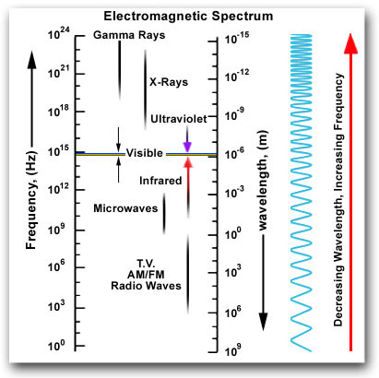
Why use visible light for microscopy?
Planck–Einstein relation
(λ)
E = h ν
ν = c/λ
E = hc/λ
(ν)
Notes:
Within this vast range of wavelengths, there are three or more regions of approximation which are especially interesting. In one of these, a condition exists in which the wavelengths involved are very small compared with the dimensions of the equipment available for their study; furthermore, the photon energies, using the quantum theory, are small compared with the energy sensitivity of the equipment. Under these conditions we can make a rough first approximation by a method called geometrical optics. If, on the other hand, the wavelengths are comparable to the dimensions of the equipment, which is difficult to arrange with visible light but easier with radiowaves, and if the photon energies are still negligibly small, then a very useful approximation can be made by studying the behavior of the waves, still disregarding the quantum mechanics. This method is based on the classical theory of electromagnetic radiation, which will be discussed in a later chapter. Next, if we go to very short wavelengths, where we can disregard the wave character but the photons have a very large energy compared with the sensitivity of our equipment, things get simple again. This is the simple photon picture, which we will describe only very roughly. The complete picture, which unifies the whole thing into one model, will not be available to us for a long time.
Planck constant = 6.62606957(29)×10⁻³⁴ joule seconds (J·s) or (N·m·s)

Slide 12
Geometrical optics
Approximation important technically and historically
Analogous to Newtonian mechanics for macroscopic objects
Light as collection of rays
Simplest example:
  Light striking a mirror
  Angle of incidence = angle of reflection
θ_{i}
θ_{r}
Mirror

Slide 13
Refraction of Light
Passing from one medium to another
Deviation angle (θ_{r}) gets larger the more light tilted from vertical
One of few places in Greek physics with experimental results
θ_{i}
Interface
θ_{r}

Slide 14
Refraction of Light
Passing from one medium to another
Deviation angle (θ_{r}) gets larger the more light tilted from vertical
One of few places in Greek physics with experimental results
θ_{i}
Interface
θ_{r}

Slide 15
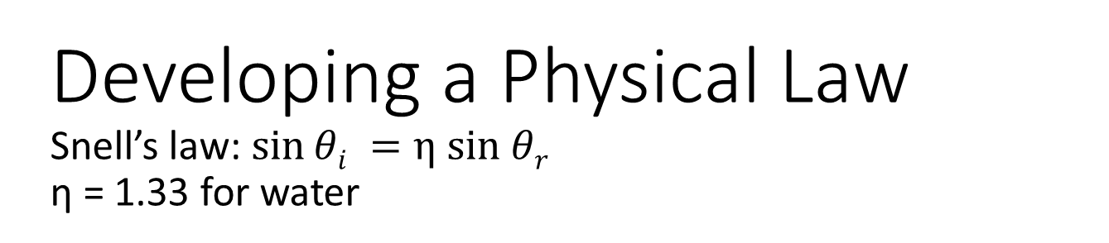
Developing a Physical Law
Snell’s law: $\sin{θi =η sin θr}$ η = 1.33 for water
Claudius Ptolemy 150 AD
Willebrord Snell 1621
Angle in air | Angle in water
10° | 8°
20° | 15-1/2°
30° | 22-1/2°
40° | 29°
50° | 35°
60° | 40-1/2°
70° | 45-1/2°
80° | 50°
Angle in air | Angle in water
10° | 7-1/2°
20° | 15°
30° | 22°
40° | 29°
50° | 35°
60° | 40-1/2°
70° | 45°
80° | 48°
Notes:
important steps in the development of physical law: first we observe an effect, then we measure it and list it in a table; then we try to find the rule by which one thing can be connected with another. The above numerical table was made in 140 a.d., but it was not until 1621 that someone finally found the rule connecting the two angles!
In 1615 he planned and carried into practice a new method of finding the radius of the earth, by determining the distance of one point on its surface from the parallel of latitude of another, by means of triangulation. His work Eratosthenes Batavus ("The Dutch Eratosthenes"), published in 1617, describes the method and gives as the result of his operations between Alkmaar and Bergen op Zoom—two towns separated by one degree of the meridian—which he measured to be equal to 117,449 yards (107.395 km). The actual distance is approximately 111 km. Snellius was also a distinguished mathematician, producing a new method for calculating π—the first such improvement since ancient times. He rediscovered the law of refraction in 1621.

Slide 16
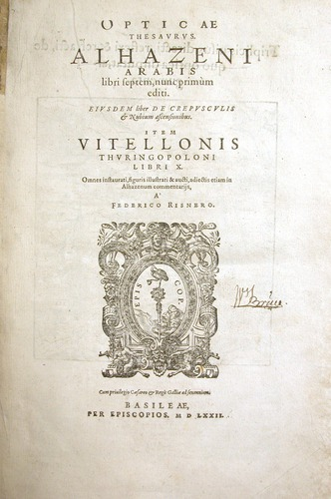
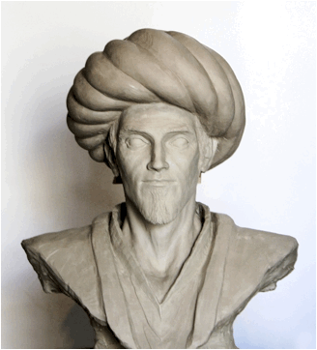
Important to acknowledge non-Western influences
Alhazen, medieval Arab Scholar
Wrote 7 volume Book of Optics (1011-1021)
Translated to Latin in 12th or 13th Century
Standard text on optics for next 400 years
Had a formulation of Snell’s law
2015 United Nations International Year of Light. (http://www.light2015.org)
Notes:
The Book of Optics (Arabic: Kitāb al-Manāẓir‎ (كتاب المناظر); Latin: De Aspectibus or Perspectiva; Italian: Deli Aspecti) is a seven-volume treatise on optics and other fields of study composed by the medieval Arab scholar Ibn al-Haytham, known in the West as Alhazen (965– c. 1040 AD).
Born c. 965 in Basra, which was then part of the Buyid emirate,^{[1]} to an Arab family,^{[21][22]} he lived mainly in Cairo, Egypt, dying there at age 74.^{[15]} During the Islamic Golden Age, Basra was a "key beginning of learning",^{[23]} and he was educated there and in Baghdad, the capital of the Abbasid Caliphate and the focus of the "high point of Islamic civilization".^{[23]} During his time in Basra, he trained for government work and became Minister for the area.^{[17]}
This translation was read by and greatly influenced a number of Western scientists including: Roger Bacon,^{[31]} Robert Grosseteste,^{[32]} Witelo, Giambattista della Porta,^{[33]} Leonardo Da Vinci,^{[34]} Galileo Galilei,^{[35]} Christian Huygens,^{[36]} René Descartes,^{[35]} and Johannes Kepler.^{[37]} His research in catoptrics (the study of optical systems using mirrors) centred on spherical and parabolic mirrors and spherical aberration. He made the observation that the ratio between the angle of incidence and refraction does not remain constant, and investigated the magnifying power of a lens.
During the Middle Ages, Greek ideas about optics were resurrected and extended by writers in the Muslim world. One of the earliest of these was Al-Kindi (c. 801–73) who wrote on the merits of Aristotelian and Euclidean ideas of optics, favouring the emission theory since it could better quantify optical phenomenon.^{[10]} In 984, the Persian mathematician Ibn Sahl wrote the treatise "On burning mirrors and lenses", correctly describing a law of refraction equivalent to Snell's law.^{[11]} He used this law to compute optimum shapes for lenses and curved mirrors. In the early 11th century, Alhazen (Ibn al-Haytham) wrote the Book of Optics (Kitab al-manazir) in which he explored reflection and refraction and proposed a new system for explaining vision and light based on observation and experiment.^{[12][13][14][15][16]} He rejected the "emission theory" of Ptolemaic optics with its rays being emitted by the eye, and instead put forward the idea that light reflected in all directions in straight lines from all points of the objects being viewed and then entered the eye, although he was unable to correctly explain how the eye captured the rays.^{[17]} Alhazen's work was largely ignored in the Arabic world but it was anonymously translated into Latin around 1200 A.D. and further summarised and expanded on by the Polish monk Witelo^{[18]} making it a standard text on optics in Europe for the next 400 years.

Slide 17
Why does light take the long path?
Fermat’s principle of least time
Light takes path that requires shortest time
Explains why you can see the sun after its sets below horizon
θ_{i}
Interface
θ_{r}
Feynman Lectures on Physics, Volume I, Chapter 26
http://feynmanlectures.caltech.edu/I_26.html

Slide 18
Why does light take the long path?
Fermat’s principle of least time
Light takes path that requires shortest time
Explains why you can see the sun after its sets below horizon
Also explains angle of reflection
A
θ_{i}
θ_{r}
Mirror
A’
Feynman Lectures on Physics, Volume I, Chapter 26
http://feynmanlectures.caltech.edu/I_26.html

Slide 19
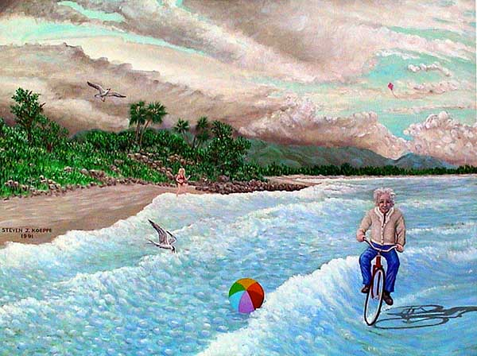
Notes:
Wave nature of light. Diffraction.

Slide 20
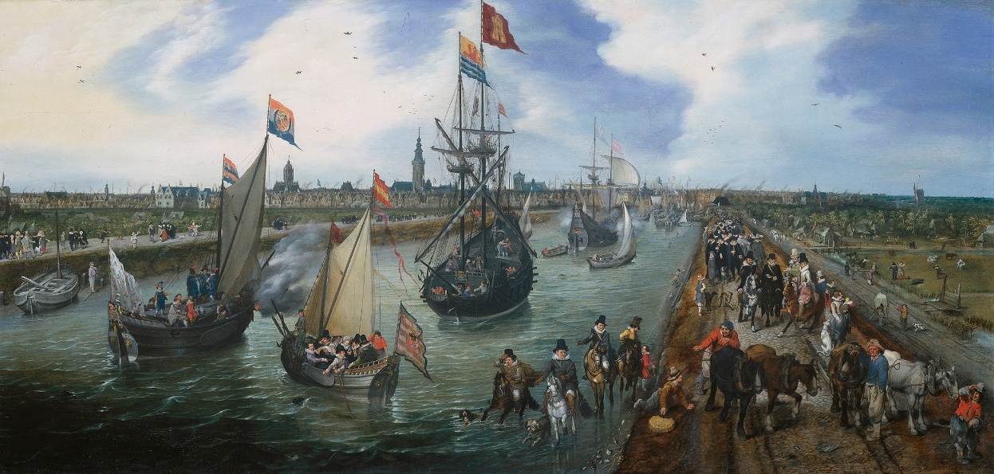
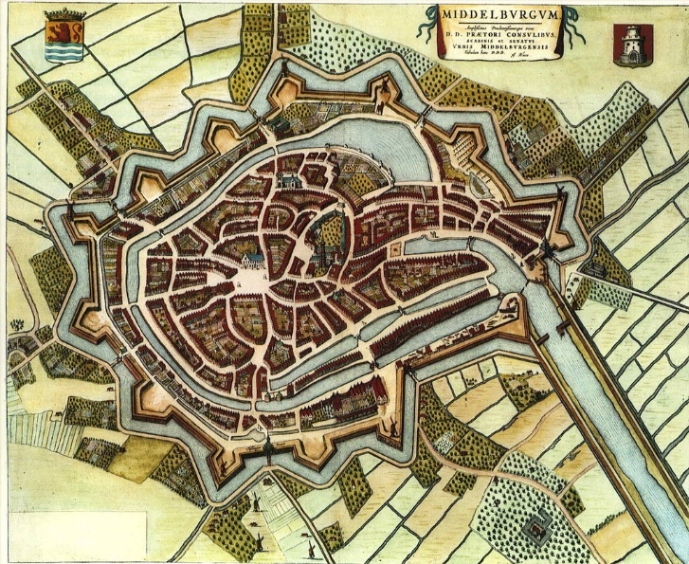
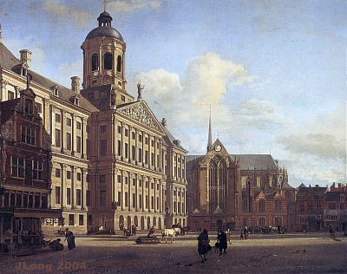
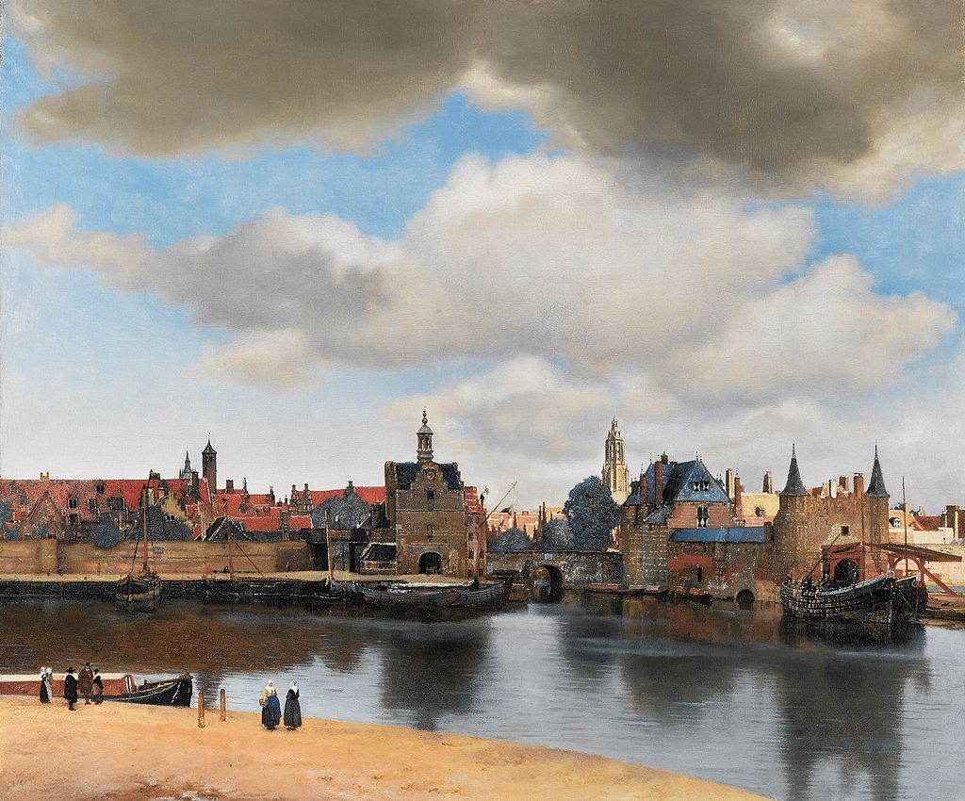
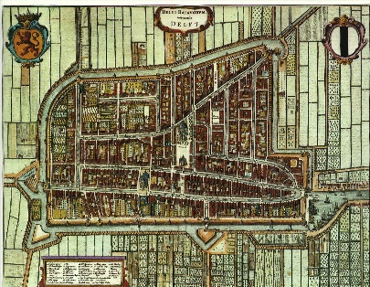
History of the microscope begins in the Netherlands
Middelburg
Amsterdam
Delft
Late 1500’s to 1600’s
Notes:
The first wearable eyeglasses were invented in Italy around 1286.^{[20]} This was the start of the optical industry of grinding and polishing lenses for these "spectacles", first in Venice and Florence in the thirteenth century,^{[21]} and later in the spectacle making centres in both the Netherlands and Germany.^{[22]} Spectacle makers created improved types of lenses for the correction of vision based more on empirical knowledge gained from observing the effects of the lenses rather than using the rudimentary optical theory of the day (theory which for the most part could not even adequately explain how spectacles worked).^{[23][24]} This practical development, mastery, and experimentation with lenses led directly to the invention of the compound optical microscope around 1595, and the refracting telescope in 1608, both of which appeared in the spectacle making centres in the Netherlands.^{[25][26]}

Slide 21
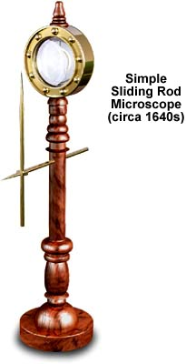
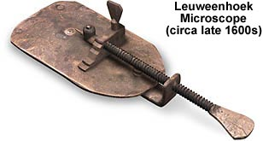
How do these first microscopes differ from a magnifying glass?
Simple microscopes
  One lens
http://micro.magnet.fsu.edu/primer/museum/index.html

Slide 22
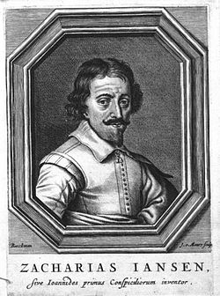
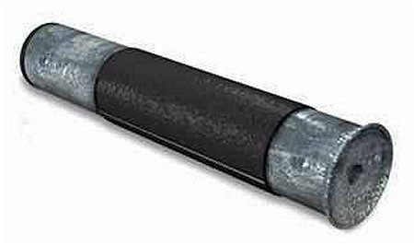
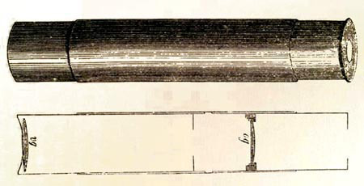
Simple versus compound microscopes
Simple has single lens (or group of lenses) creating one magnified image
Compound has 2 sets of lenses, one creates magnified image inside microscope, 2nd set magnifies to create 2nd image
Zacharias Janssen may have invented first microscope, which was compound (~1595)
http://www.history-of-the-microscope.org
Notes:
It is difficult to say who invented the compound microscope. The Dutch spectacle-maker Zacharias Janssen is sometimes claimed to have invented it in 1590 (a claim made by his son and fellow countrymen, in different testimony in 1634 and 1655).^{[6][7][8]} Another claim is that Janssen's competitor, Hans Lippershey, invented the compound microscope. Another favorite for the title of 'inventor of the microscope' was Galileo Galilei. He developed an occhiolino or compound microscope with a convex and a concave lens in 1609. Galileo's microscope was celebrated in the Accademia dei Lincei in 1624 and was the first such device to be given the name "microscope" a year later by fellow Lincean Giovanni Faber. Faber coined the name from the Greek words μικρόν (micron) meaning "small", and σκοπεῖν (skopein) meaning "to look at", a name meant to be analogous with "telescope", another word coined by the Linceans.
The earliest known working telescopes appeared in 1608 and are credited to Hans Lippershey. Among many others who claimed to have made the discovery were Zacharias Janssen, a spectacle-maker in Middelburg, and Jacob Metius of Alkmaar. The design of these early refracting telescopes consisted of a convex objective lens and a concave eyepiece. Galileo used this design the following year. In 1611, Johannes Kepler described how a telescope could be made with a convex objective lens and a convex eyepiece lens and by 1655 astronomers such as Christiaan Huygens were building powerful but unwieldy Keplerian telescopes with compound eyepieces. Hans Lippershey is the earliest person documented to have applied for a patent for the device.^{[1]}

Slide 23
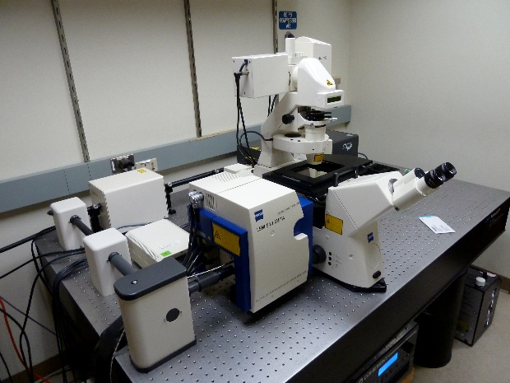
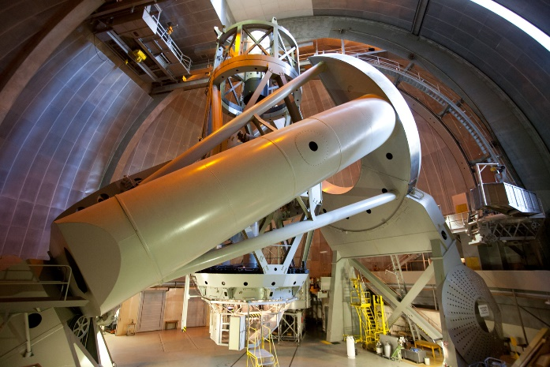
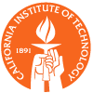
Differences Between Microscopes and Telescopes
Microscope
Telescope

Slide 24
Differences Between Microscopes and Telescopes
Microscope
Telescope
Small objects
Close up
Here and now
Large objects
Far away
Time machine

Slide 25

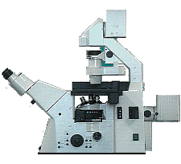
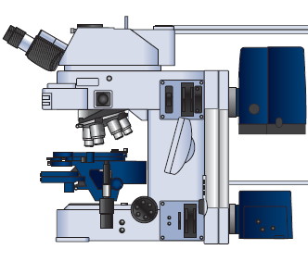
The basic light microscope types
Upright microscope
.
Inverted microscope

Slide 26
Illumination via Transmitted Light
Upright microscope
.
Inverted microscope
The specimen must be transparent !

Slide 27
Illumination via “Reflected” (Incident) Light
Upright microscope
.
Inverted microscope
Eg. Fluorescence, Opaque Samples

Slide 28
Mixed Illumination
Upright microscope
.
Inverted microscope

Slide 29
Illumination Techniques - Overview
Transmitted Light
Brightfield
Oblique
Darkfield
Phase Contrast
Polarized Light
DIC (Differential Interference Contrast)
Fluorescence - not any more > Epi !
Incident Light
Brightfield
Oblique
Darkfield
Not any more (DIC !)
Polarized Light
DIC (Differential Interference Contrast)
Fluorescence (Epi)

Slide 30
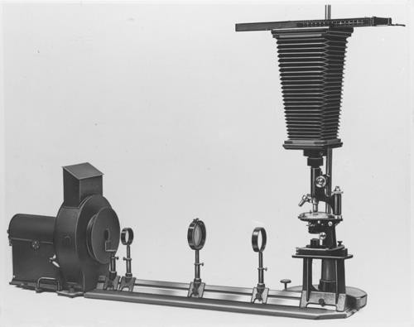

Fluorescence microscopy
First fluorescence microscope built by Henry Seidentopf & August Köhler (1908)
Used transmitted light path
So dangerous that couldn’t look through it, needed camera
Image credit: corporate.zeiss.com “Technical Milestones of Microscopy”

Slide 31
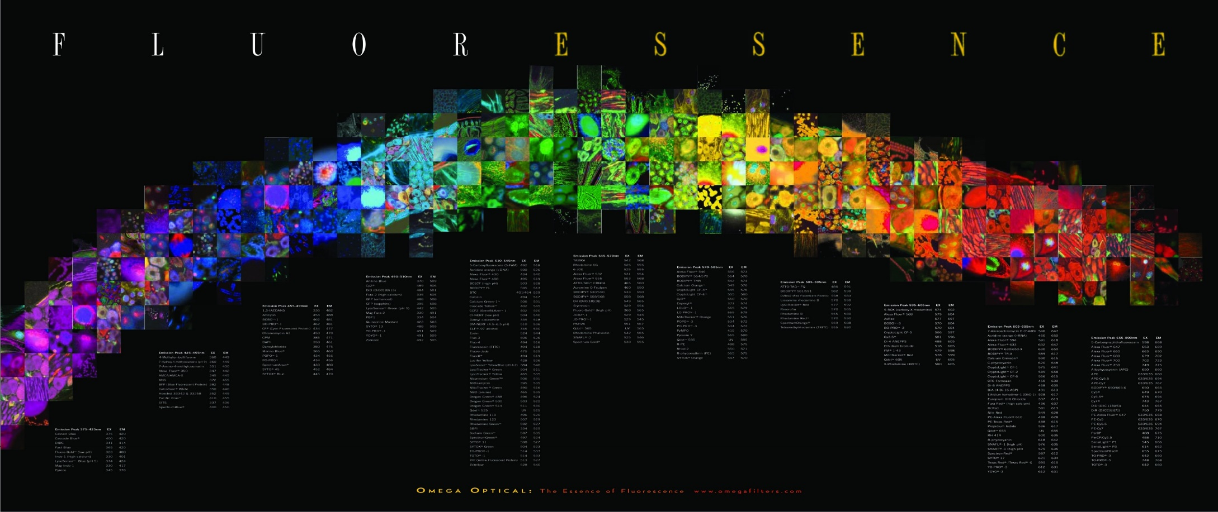
The “F” words
FRET
FFS
FLIM
FCS
FIGS
FRAP
FLAM
FACS
FCCS
Notes:
FACS (fluorescence-activated cell sorting). One of several important cell sorting techniques used in the separation of different cell lines (especially those isolated from animal tissues).
FIGS (Fluorescence image-guided surgery) is a medical imaging technique that uses fluorescence to detect properly labeled structures during surgery.

Slide 32
The “F” words
FRET
FFS
FLIM
FCS
FIGS
FRAP
FLAM
FACS
FCCS
Notes:
FACS (fluorescence-activated cell sorting). One of several important cell sorting techniques used in the separation of different cell lines (especially those isolated from animal tissues).
FIGS (Fluorescence image-guided surgery) is a medical imaging technique that uses fluorescence to detect properly labeled structures during surgery.

Slide 33
The “F” words
FRET
FFS
FLIM
FCS
FIGS
FRAP
FLAM
FACS
FCCS
Notes:
FACS (fluorescence-activated cell sorting). One of several important cell sorting techniques used in the separation of different cell lines (especially those isolated from animal tissues).
FIGS (Fluorescence image-guided surgery) is a medical imaging technique that uses fluorescence to detect properly labeled structures during surgery.

Slide 34
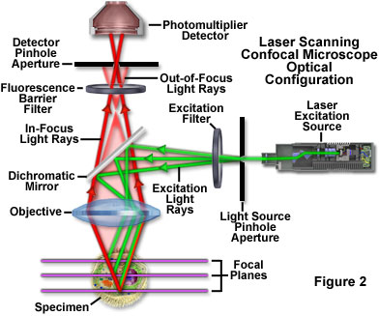
Improve fluorescence with optical sectioning
Wide-field microscopy
  Illuminating whole field of view
Confocal microscopy
  Spot scanning
Near-field microscopy
  For super-resolution
www.olympusfluoview.com
Notes:
Adds the third dimension

Slide 35
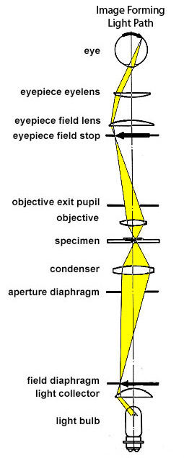
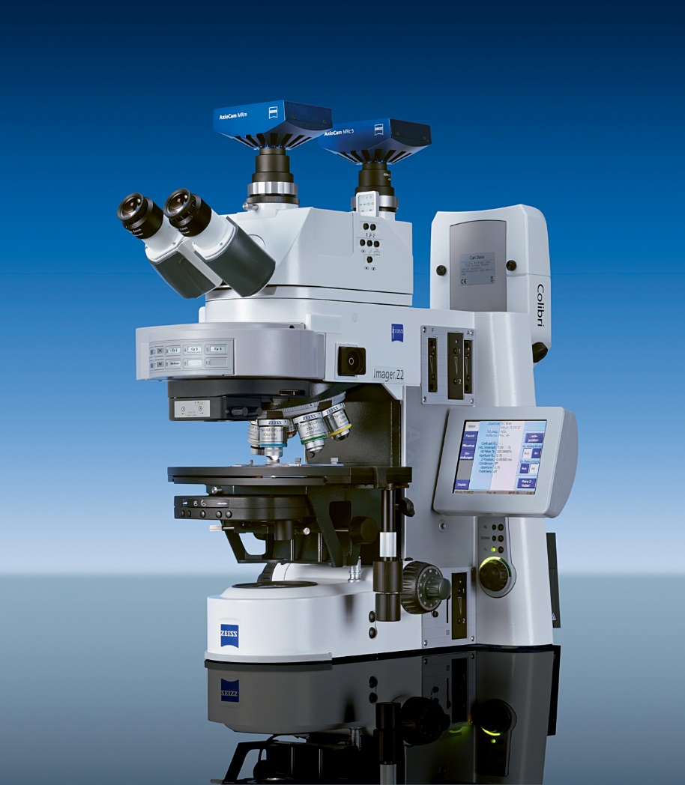
Typical compound microscope is not 3D, even though binocular

Slide 36
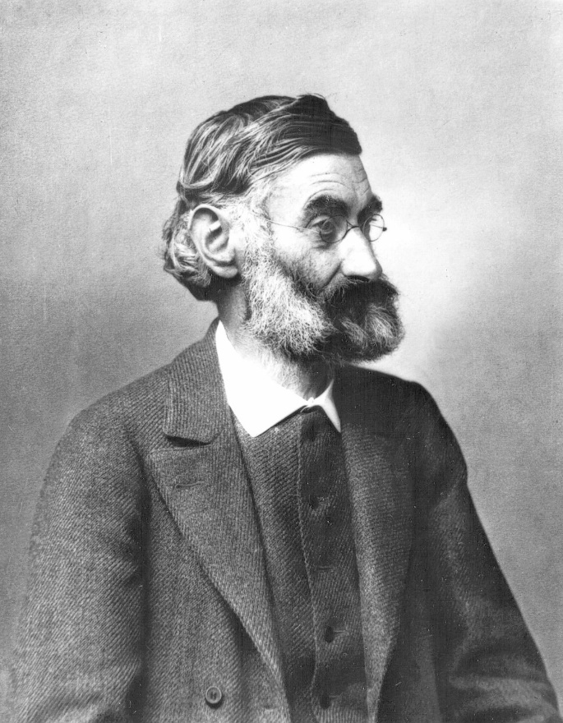
Stereo (dissecting) microscopes compound, binocular and 3D
“Couldn’t one build a microscope for both eyes, and thereby generate spatial images?”
Question addressed to Ernst Abbe in 1896
by Horatio S. Greenough
Ernst Abbe (1840-1905)
Notes:
In 1866, he became a research director at the Zeiss Optical Works, and in 1868 he invented the apochromatic lens, a microscope lens which eliminates both the primary and secondary color distortion.^{[2]} He designed the first refractometer, which he described in a booklet published in 1874.^{[3]} He created the Abbe number, a measure of any transparent material's variation of refractive index with wavelength and Abbe's criterion, which tests the hypothesis, that a systematic trend exists in a set of observations (in terms of resolving power this criterion stipulates that an angular separation cannot be less than the ratio of the wavelength to the aperture diameter, see angular resolution).^{[4]} Already a professor in Jena, he was hired by Carl Zeiss to improve the manufacturing process of optical instruments, which back then was largely based on trial and error.
Abbe was the first to define the term numerical aperture,^{[5]} as the sine of the half angle multiplied by the refractive index of the medium filling the space between the cover glass and front lens.
Abbe is credited by many for discovering the resolution limit of the microscope, and the formula (published in 1873)

Slide 37
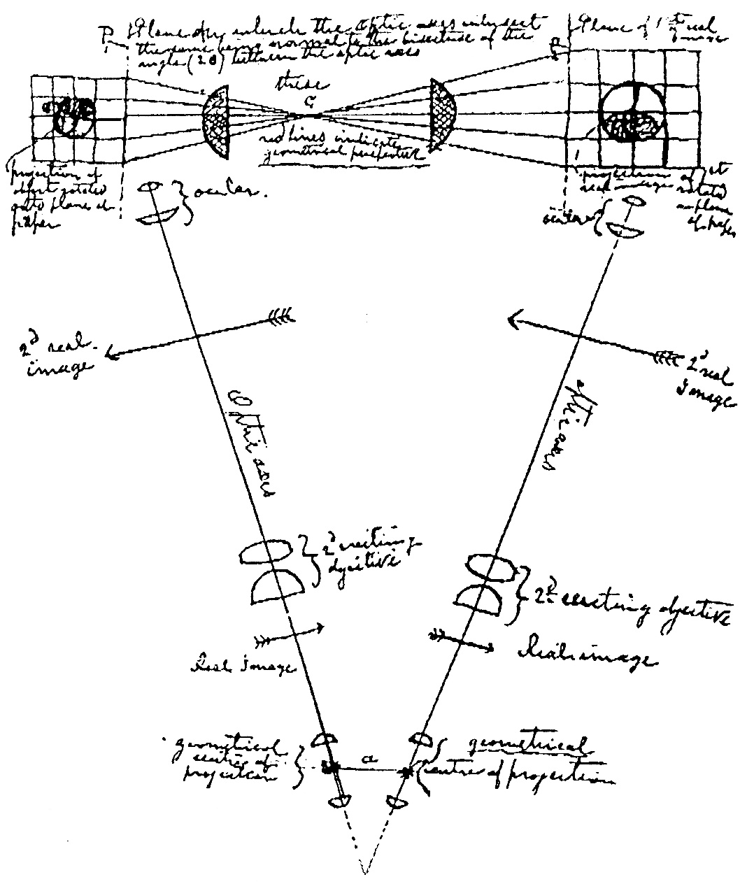
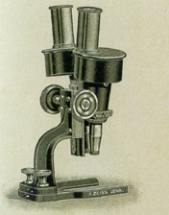
1897 – the first Stereo Microscope in the world, built by Zeiss
Drawing by Horatio S. Greenough - 1896
Notes:
1896, in a letter from Horatio S. Greenough to Ernst Abbe: “Couldn’t one build a microscope for both eyes, and thereby generate spatial images”?

Slide 38
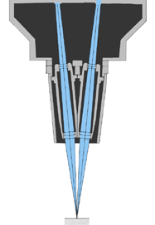
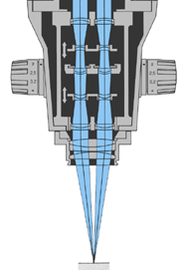
Greenough Type
Introduced first by Zeiss - 1897
Common Main Objective Type
Introduced first by Zeiss - 1946
Notes:
Common Main Objective type is also called Telescope type.

Slide 39
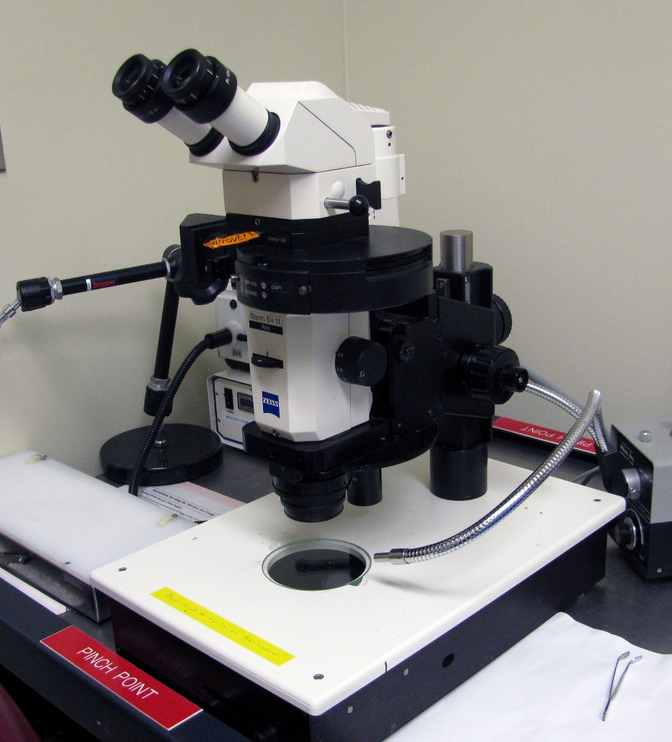
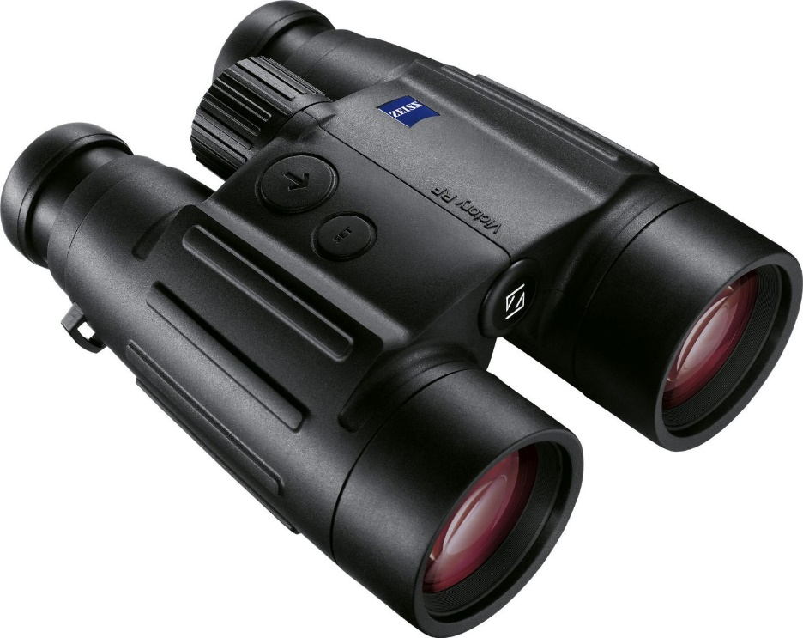
Stereo microscopes are to microscopes
As binoculars are to telescopes

Slide 40
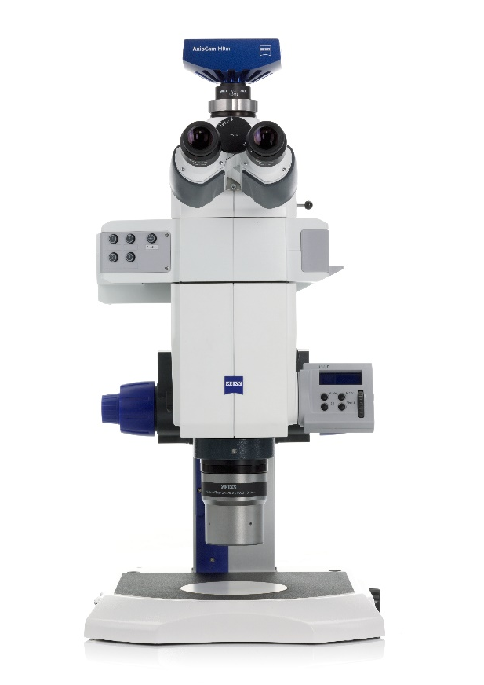
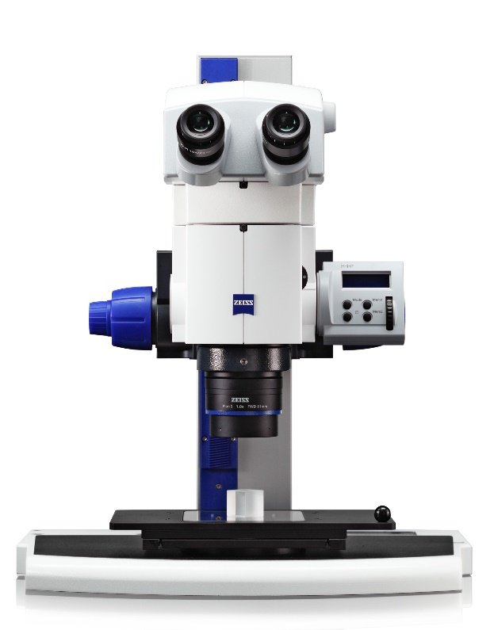
Distinguishing between normal and stereo microscopes not always easy
Discovery
Axio Zoom
Notes:
Why does this matter?

Slide 41
Distinguishing between normal and stereo microscopes not always easy
Discovery
Axio Zoom
Notes:
Why does this matter?

Slide 42
What was the first image sensor?
What was the first image processor?

Slide 43
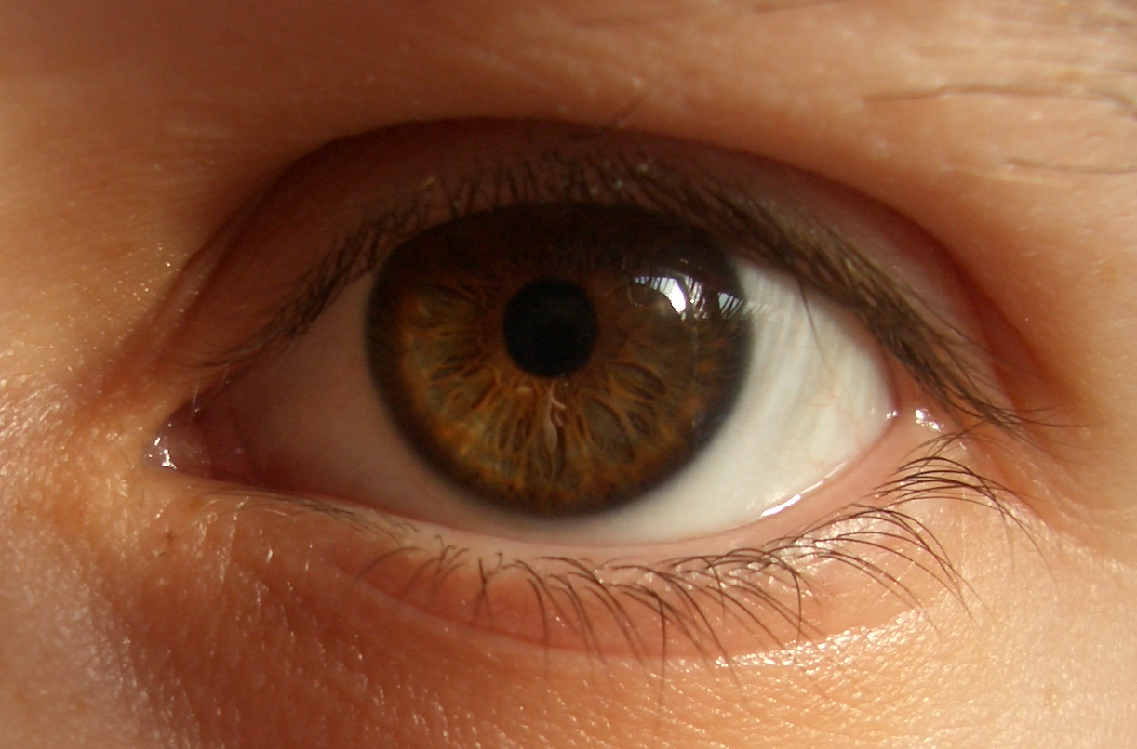
What was the first image sensor?
What was the first image processor?
The eye

Slide 44
What was the first image sensor?
What was the first image processor?
The eye

Slide 45
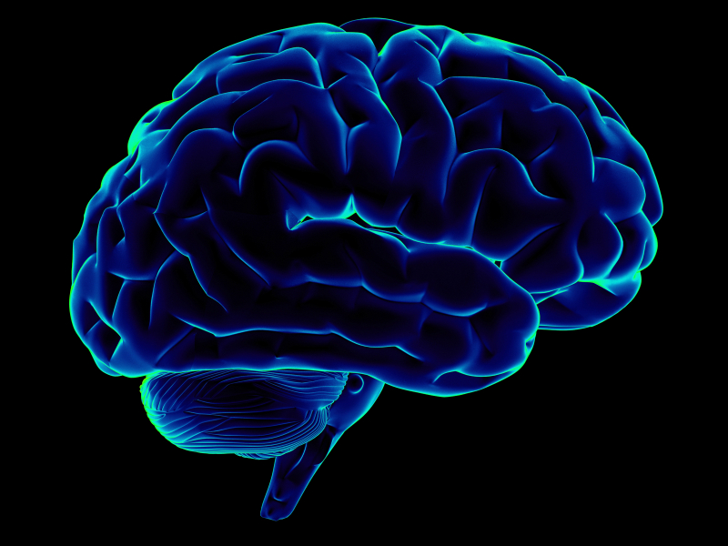
What was the first image sensor?
What was the first image processor?
The eye
The brain

Slide 46
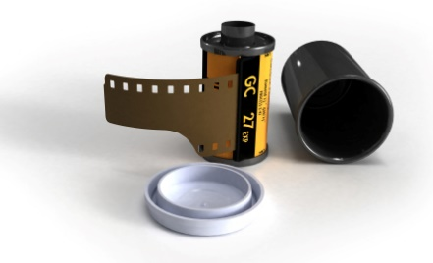
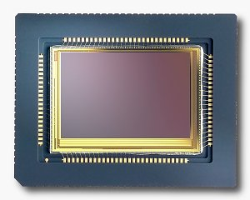
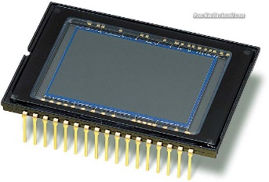
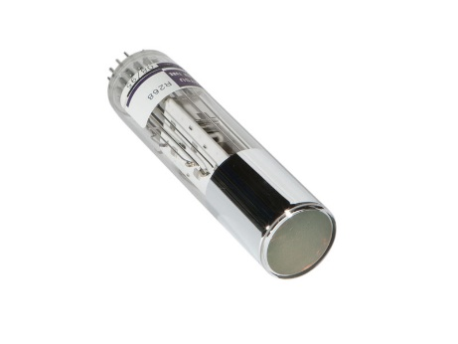
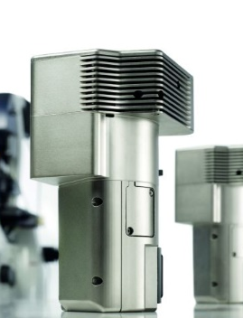
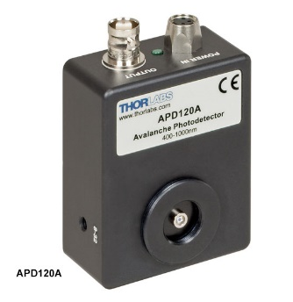
Detectors: From analog to digital
Film
CMOS (Complementary metal–oxide–semiconductor)
CCD (Charge coupled device)
PMT (Photomultiplier tube)
GaAsP (Gallium arsenide phosphide)
APD (Avalanche photodiode)

Slide 47
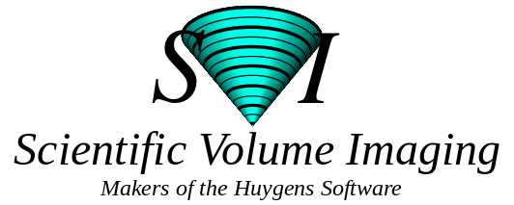
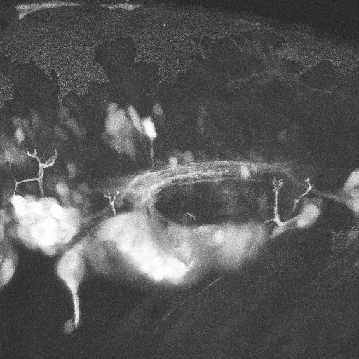
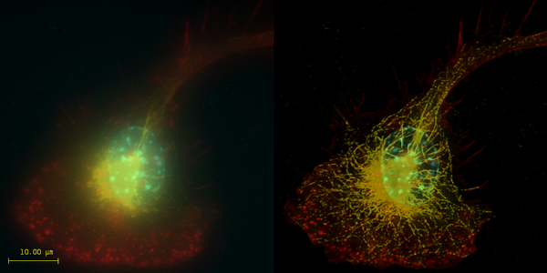
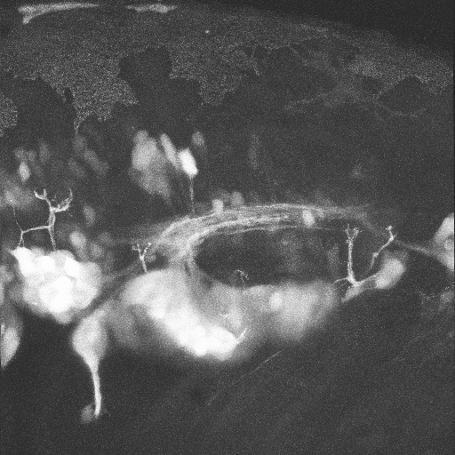

Image processing
3D Reconstruction
Deconvolution
A
A
P
Neural Gata-2 Promoter GFP-Transgenic Zebrafish; Shuo Lin, UCLA
Top: Macrophage - tubulin, actin & nucleus.
Bottom: Imaginal disc – α-tubulin, γ-tubulin.
Notes:
Top right: Macrophage fluorescently stained for tubulin (yellow), actin (red) and the nucleus (DAPI, blue). Left: original image, recorded with a wide field microscope. Right: the same dataset, deconvolved using Huygens Professional. The datasets are visualized with top-view maximum intensity projections.
Data courtesy of Dr. James Evans, Whitehead Institute, MIT Boston MA, USA. (See the EvansMacrophage for more image details).
Bottom right: Detail of an imaginal disc from a third instar Drosophila Melanogaster larva. Left: a slice of the original data, imaged using an Andor Revolution spinning disc confocal microscope.Right: the same slice, deconvolved using Huygens Professional. The fixed sample was stained against alfa-tubulin (green) and gamma-tubulin (red).
Recorded by Dr. Paula Sampaio, Advanced Light Microscopy Facility, University of Porto.

Slide 48


How do we document observations using microscopes?
Francesco Stelluti first to publish in 1625
Cofounder of Accademia dei Lincei
Hand drawings
Giovanni Faber another member of Accademia dei Lincei coined the word microscope (~1625)
Notes:
Francesco Stelluti (12 January 1577 – November 1652) was an Italian polymath who worked in the fields of mathematics, microscopy, literature, and astronomy. Alongside Federico Cesi and Johannes Van Heeck, he founded the Accademia dei Lincei in August 1603. In 1625 he published the first accounts of observations using the microscope^{[1]} and his Persio tradotto in verso schiolto e dichiarato, published in Rome in 1630, is the first book to contain images of organisms viewed through the microscope.^{[2]}
A polymath (Greek: πολυμαθής, polymathēs, "having learned much")^{[1]} is a person whose expertise spans a significant number of different subject areas; such a person is known to draw on complex bodies of knowledge to solve specific problems. The term was first used in the seventeenth century; the related term, polyhistor, is an ancient term with similar meaning.
Giovanni Faber has been credited with giving the microscope its name. In 1609 fellow Lincean Galileo developed a compound microscope with a convex and a concave lens which he called the occhiolino, the "little eye". In 1624 Galileo presents his occhiolino to Prince Federico Cesi, founder of the Accademia dei Lincei. One year later Giovanni Faber coined the word microscope from the Greek words μικρόν (micron) meaning "small", and σκοπεῖν (skopein) meaning "to look at". The word was meant to be analogous with telescope, another word coined by the Linceans.^{[5][6]}
Founded in 1603 by Federico Cesi, it was one of the first academies of science to exist in Italy and a locus for the incipient scientific revolution. The academy was named after the lynx, an animal whose sharp vision symbolizes the observational prowess that science requires. "The Lincei did not long survive the death in 1630 of Cesi, its founder and patron",^{[1]} and "disappeared in 1651".^{[2]} It was revived in the 1870s to become the national academy of Italy, encompassing both literature and science among its concerns.^{[3]}

Slide 49




First camera that could take permanent photographs invented in 1826
Joseph Niépce French inventor
Perfected with Louis Daguerre
Camera obscura, 5th century B.C, Mozi
Camera lucida, 1807, William Hyde Wollaston
Notes:
Before the development of the photographic camera, it had been known for hundreds of years that some substances, such as silver salts, darkened when exposed to sunlight.^{[24]} The first person to use this chemistry to create images was Thomas Wedgwood.^{[24]} To create images, Wedgwood placed items, such as leaves and insect wings, on ceramic pots coated with silver nitrate, and exposed the set-up to light. These images weren't permanent, however, as Wedgwood didn't employ a fixing mechanism. The date of his first experiments in photography is unknown, but he is believed to have indirectly advised James Watt (1736–1819) on the practical details prior to 1800. In a letter that has been variously dated to 1790, 1791 and 1799, Watt wrote to Josiah Wedgwood:
The forerunner to the photographic camera was the camera obscura.^{[8]} In the fifth century B.C., the Chinese philosopher Mo Ti noted that a pinhole can form an inverted and focused image, when light passes through the hole and into a dark area.^{[9]} Mo Ti is the first recorded person to have exploited this phenomenon to trace the inverted image to create a picture.^{[10]}
William Hyde Wollaston PRS (/ˈwʊləstən/; 6 August 1766 – 22 December 1828) was an English chemist and physicist. in 1793 he obtained a doctorate in medicine from Cambridge University, and was a fellow of his college from 1787 to 1828.^{[1]}

Slide 50







1904 Microscopy exhibit of Arthur E. Smith that shocked Edwardian London.
Royal Society's Annual Conversazione

Slide 51

1904 Microscopy exhibit of Arthur E. Smith that shocked Edwardian London.

Slide 52






History of microscopy
Video microscopy developed early 1980s (MBL)
1595: The first compound microscope built by Zacharias Janssen
1994: GFP used to tag proteins in living cells
1910: Leitz builds first “photo- microscope”
1955: Nomarski invents Differential Interference Contrast (DIC) microscopy
1600
1700
1800
1900
2000
2010
1680: Antoni van Leeuwenhoek awarded fellowship in the Royal Society for his advances in microscopy
Super-Resolution light Microscopy
1960: Zeiss introduces the “Universal” model
1934: Frits Zernike invents phase contrast microscopy
Images taken from:
Molecular Expression and Tsien Lab (UCSD) web pages
Slide from Paul Maddox, UNC

Slide 53
Resolution
More than just magnification
Can understand through geometrical optics,
But best understood by looking at wave not particle nature of light
Future lecture
Notes:
Reason not emphasizing resolution in these first two lectures.

Slide 54
Resolution vs Contrast
More than just magnification
Can understand through geometrical optics,
But best understood by looking at wave not particle nature of light
Future lecture
Note simultaneous contrast illusion

Slide 55

Super-resolution microscopy
Most recent Nobel prize
Many ways to achieve
  True
  Functional
2 lectures on this
These techniques tend to be slow
Notes:
They fall into two broad categories, "true" super-resolution techniques, which capture information contained in evanescent waves, and "functional" super-resolution techniques, which use clever experimental techniques and known limitations on the matter being imaged to reconstruct a super-resolution image.^{[2]}
True subwavelength imaging techniques include those that utilize the Pendry Superlens and near field scanning optical microscopy, the 4Pi Microscope and structured illumination microscopy technologies like SIM and SMI. However, the majority of techniques of importance in biological imaging fall into the functional category.
There are two major groups of methods for functional super-resolution microscopy:
Deterministic super-resolution: The most commonly used emitters in biological microscopy, fluorophores, show a nonlinear response to excitation, and this nonlinear response can be exploited to enhance resolution. These methods include STED, GSD, RESOLFT and SSIM.
Stochastic super-resolution: The chemical complexity of many molecular light sources gives them a complex temporal behaviour, which can be used to make several close-by fluorophores emit light at separate times and thereby become resolvable in time. These methods include SOFI and all single-molecule localization methods (SMLM) such as SPDM, SPDMphymod, PALM, FPALM, STORM and dSTORM.

Slide 56


In America we like things fast.
Fast food
Fast cars

Slide 57

In America we like things fast.
Fast food
Fast cars
Fast microscopes
  Temporal resolution
  Many ways to achieve
  2 Lectures on this
Image Credit: Michael Weber

Slide 58
Can you see the problem of high speed microscopy?

Slide 59

Can you see the problem of high speed microscopy?
SETS

Slide 60

Where do we want to go in the future?
High speed
Super-resolution
Single molecule imaging
  Fluorescence correlation spectroscopy (FCS)
  Total internal reflectance microscopy (TIRF)
(Photo by Jonathan Stephens http://www.jrsfilm.com/)
Notes:
http://www.rsc.org/ConferencesAndEvents/RSCConferences/FD/molecule-fd2015/
A practical superlens, super lens or perfect lens, is a lens which uses metamaterials to go beyond the diffraction limit. The diffraction limit is an inherent limitation in conventional optical devices or lenses.^{[1]} In nano-optics, a plasmonic lens generally refers to a lens for surface plasmon polaritons (SPPs), i.e. a device that redirects SPPs to converge towards a single focal point. Since SPPs can have very small wavelength, they can converge into a very small and very intense spot, much smaller than the free-space wavelength and the diffraction limit.^{[1][2]} Surface plasmon polaritons (SPPs), are infrared or visible-frequency electromagnetic waves, which travel along a metal-dielectric or metal-air interface. The term "surface plasmon polariton" explains that the wave involves both charge motion in the metal ("surface plasmon") and electromagnetic waves in the air or dielectric ("polariton").^{[1]}
They are a type of surface wave, guided along the interface in much the same way that light can be guided by an optical fiber. SPPs are shorter in wavelength than the incident light (photons).^{[2]}
Metamaterials are artificial materials engineered to have properties that have not yet been found in nature.

Slide 61
Where do we want to go in the future?
High speed
Super-resolution
Single molecule imaging
  Fluorescence correlation spectroscopy (FCS)
  Total internal reflectance microscopy (TIRF)
θ_{i}
Interface
θ_{r}
Notes:
http://www.rsc.org/ConferencesAndEvents/RSCConferences/FD/molecule-fd2015/
A practical superlens, super lens or perfect lens, is a lens which uses metamaterials to go beyond the diffraction limit. The diffraction limit is an inherent limitation in conventional optical devices or lenses.^{[1]} In nano-optics, a plasmonic lens generally refers to a lens for surface plasmon polaritons (SPPs), i.e. a device that redirects SPPs to converge towards a single focal point. Since SPPs can have very small wavelength, they can converge into a very small and very intense spot, much smaller than the free-space wavelength and the diffraction limit.^{[1][2]} Surface plasmon polaritons (SPPs), are infrared or visible-frequency electromagnetic waves, which travel along a metal-dielectric or metal-air interface. The term "surface plasmon polariton" explains that the wave involves both charge motion in the metal ("surface plasmon") and electromagnetic waves in the air or dielectric ("polariton").^{[1]}
They are a type of surface wave, guided along the interface in much the same way that light can be guided by an optical fiber. SPPs are shorter in wavelength than the incident light (photons).^{[2]}
Metamaterials are artificial materials engineered to have properties that have not yet been found in nature.

Slide 62
Where do we want to go in the future?
High speed
Super-resolution
Single molecule imaging
  Fluorescence correlation spectroscopy (FCS)
  Total internal reflectance microscopy (TIRF)
θ_{i}
Interface
θ_{r}
Notes:
http://www.rsc.org/ConferencesAndEvents/RSCConferences/FD/molecule-fd2015/
A practical superlens, super lens or perfect lens, is a lens which uses metamaterials to go beyond the diffraction limit. The diffraction limit is an inherent limitation in conventional optical devices or lenses.^{[1]} In nano-optics, a plasmonic lens generally refers to a lens for surface plasmon polaritons (SPPs), i.e. a device that redirects SPPs to converge towards a single focal point. Since SPPs can have very small wavelength, they can converge into a very small and very intense spot, much smaller than the free-space wavelength and the diffraction limit.^{[1][2]} Surface plasmon polaritons (SPPs), are infrared or visible-frequency electromagnetic waves, which travel along a metal-dielectric or metal-air interface. The term "surface plasmon polariton" explains that the wave involves both charge motion in the metal ("surface plasmon") and electromagnetic waves in the air or dielectric ("polariton").^{[1]}
They are a type of surface wave, guided along the interface in much the same way that light can be guided by an optical fiber. SPPs are shorter in wavelength than the incident light (photons).^{[2]}
Metamaterials are artificial materials engineered to have properties that have not yet been found in nature.

Slide 63

Where do we want to go in the future?
High speed
Super-resolution
Single molecule imaging
  Fluorescence correlation spectroscopy (FCS)
  Total internal reflectance microscopy (TIRF)
θ_{i}
θ_{i}
Interface
Notes:
http://www.rsc.org/ConferencesAndEvents/RSCConferences/FD/molecule-fd2015/
A practical superlens, super lens or perfect lens, is a lens which uses metamaterials to go beyond the diffraction limit. The diffraction limit is an inherent limitation in conventional optical devices or lenses.^{[1]} In nano-optics, a plasmonic lens generally refers to a lens for surface plasmon polaritons (SPPs), i.e. a device that redirects SPPs to converge towards a single focal point. Since SPPs can have very small wavelength, they can converge into a very small and very intense spot, much smaller than the free-space wavelength and the diffraction limit.^{[1][2]} Surface plasmon polaritons (SPPs), are infrared or visible-frequency electromagnetic waves, which travel along a metal-dielectric or metal-air interface. The term "surface plasmon polariton" explains that the wave involves both charge motion in the metal ("surface plasmon") and electromagnetic waves in the air or dielectric ("polariton").^{[1]}
They are a type of surface wave, guided along the interface in much the same way that light can be guided by an optical fiber. SPPs are shorter in wavelength than the incident light (photons).^{[2]}
Metamaterials are artificial materials engineered to have properties that have not yet been found in nature.

Slide 64


Visualize Single Proteins in Living, Intact Organisms

Slide 65
Microscopy Resources on the Web
http://www.olympusmicro.com
  Olympus
http://www.microscopyu.com
  Nikon
http://zeiss-campus.magnet.fsu.edu
  Zeiss

Slide 66

Acknowledgements
Scott E. Fraser, USC
Rudi Rottenfusser, Carl Zeiss
Paul Maddox, UNC

Slide 67

http://biblescripture.net/Greek.html

