Slide 1
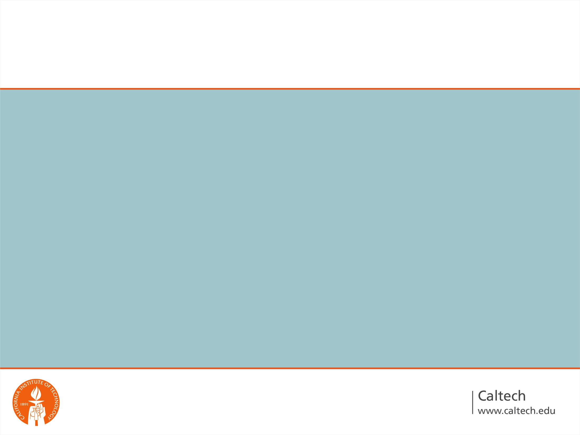
Principles of Light-Sheet Microscopy
Antti Lignell, PhD
Prof. Cai Lab
Bi 177 Guest Lecture
Feb 23 2015

Slide 2

Overview
Introduction to light-sheet microscopy
  Historical perspective
  Modern light-sheet microscopy and its benefits over more conventional methods
  Layout and function of our setups
    How to build-up one
Sample images
Next-generation light-sheet systems
  Case study: CLARITY light-sheet

Slide 3

Every Biologist Would Like to Image
Their favorite biological sample with high resolution, deep tissue penetration, fast imaging, and small photo bleaching
  Often large trade-offs
  Compromising between these parameters

Slide 4
Traditional Biolab Imaging Methods
Epifluorescence microscopy
Confocal microscopy
Pros:
  Easy to use, low cost
  Good 2D resolution
Cons:
  No optical sectioning
    Messy 3D images
    Tissue sections (fixed cells)
  Photo bleaching
Pros:
  Optical sectioning
  Improved axial and lateral resolution
  Improved penetration (2 photon)
Cons:
  Slow scan speed
  Photo bleaching
  Cost (especially for 2 phot.)

Slide 5
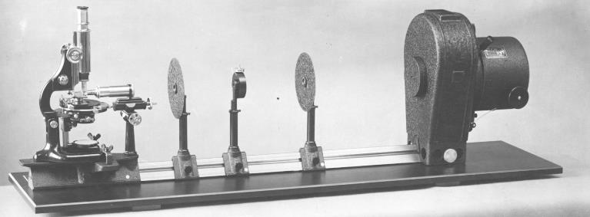
Ultramicroscope - 1903
Henry Seidentopf built the slit ultramicroscope with the help of Richard Zsigmundy at the turn of the 20th century. Zsigmundy later won the Nobel prize in Chemistry in 1925 for his work on colloids.

Slide 6
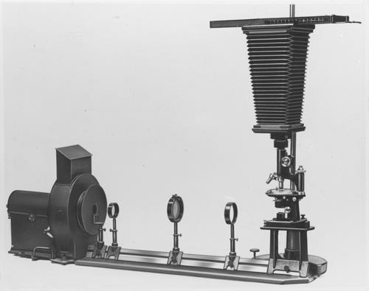
Fluorescence microscope - 1908
Seidentopf then went on to work with August Köhler on a novel transmitted light fluorescence microscope only 5 years later
Why did they not incorporate both systems together to make a light sheet fluorescence microscope?!
Lack of the correct technology

Slide 7
Innovations needed for the light-sheet microscopy
Hardware:
Coherent light source such as a laser - 1960
Digital array detectors such as CCDs – 1969
Computers to store the data - 1970 (or later)
Biochemistry:
Fluorescent markers – antibodies and FISH
Fluorescent proteins, in situ expression

Slide 8
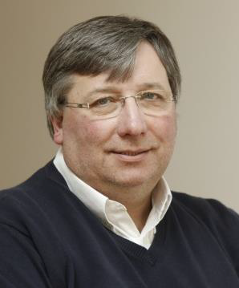
The Idea’s Time Has Come
Ernst Stelzer put all the pieces together with the help of Jan Huisken in 2004 - a full century later
Last year was 10 year anniversary of this discovery

Slide 9
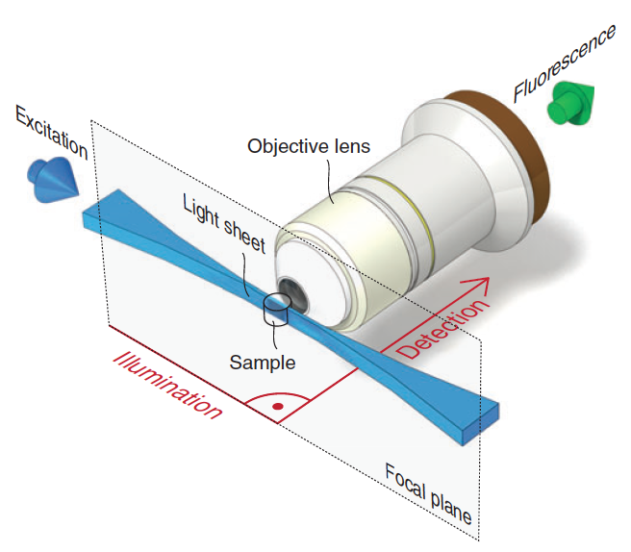
Light-Sheet Microscopy
Optical sectioning of a sample with laser-light sheet
Illumination light sheet thickness 1-10 μm
  Comparable to the depth of field an objective
Fast detection of an entire 2D FOV with a single shot
  3D images by moving a sample or light sheet z-axis
  Dynamics
Minimal photo bleaching
Lack of commercial systems
  Zeiss Z.1 the first commercial system

Slide 10
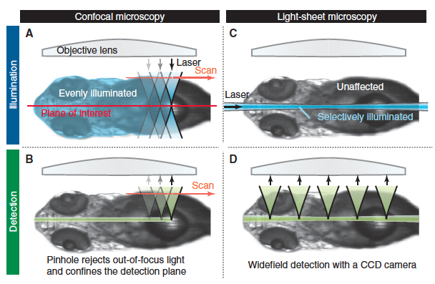
Confocal vs. light-sheet
Bleaching
Autofluor.
Scan speed

Slide 11
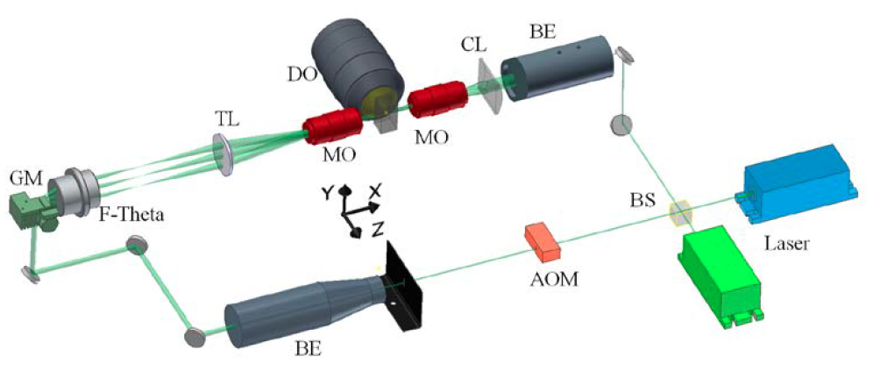
Basics of a light-sheet scope

Slide 12
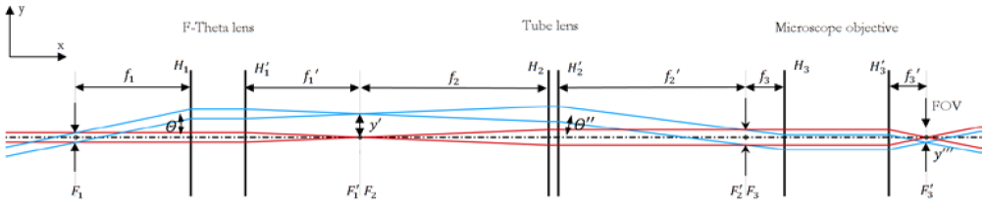
Basics of a light-sheet scope
Lasers and beam shaping

Slide 13
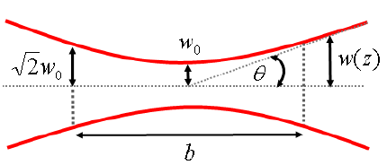
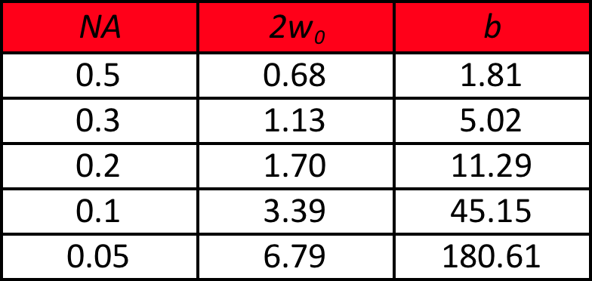
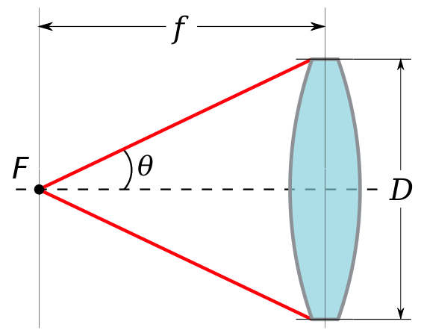
Basics of a light-sheet scope
For 533nm in water

Slide 14
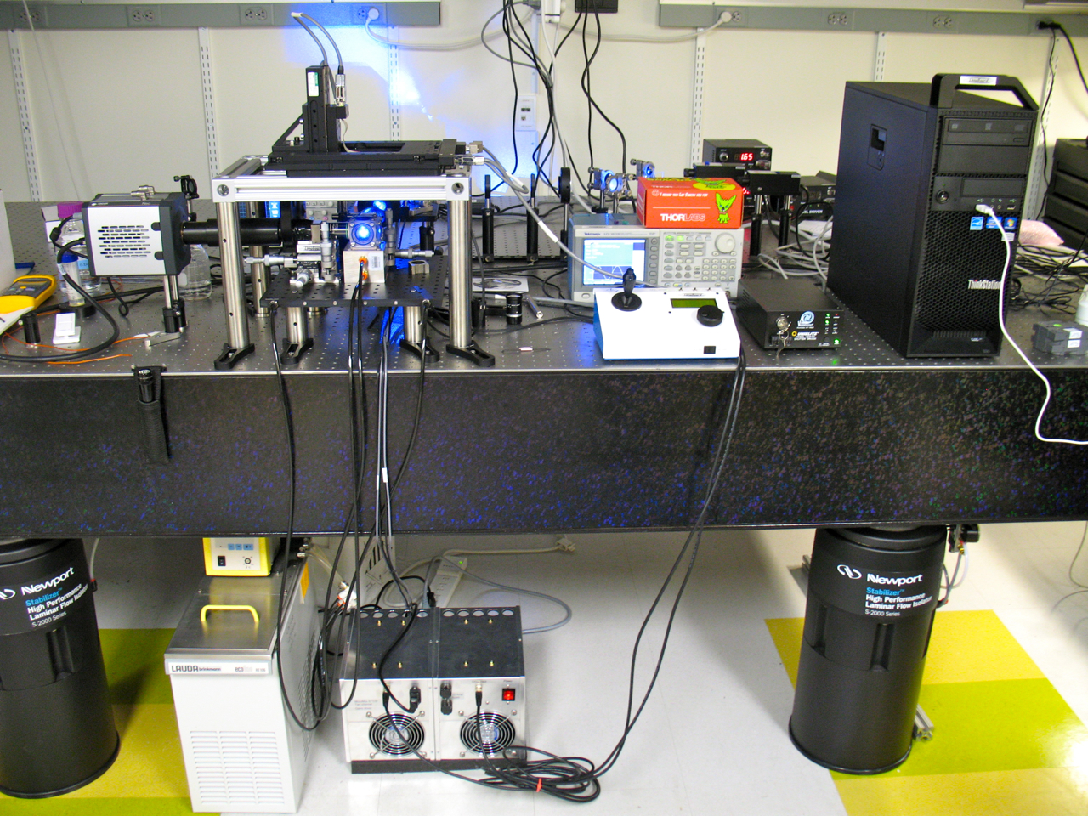
The Longboard
The Longboard

Slide 15
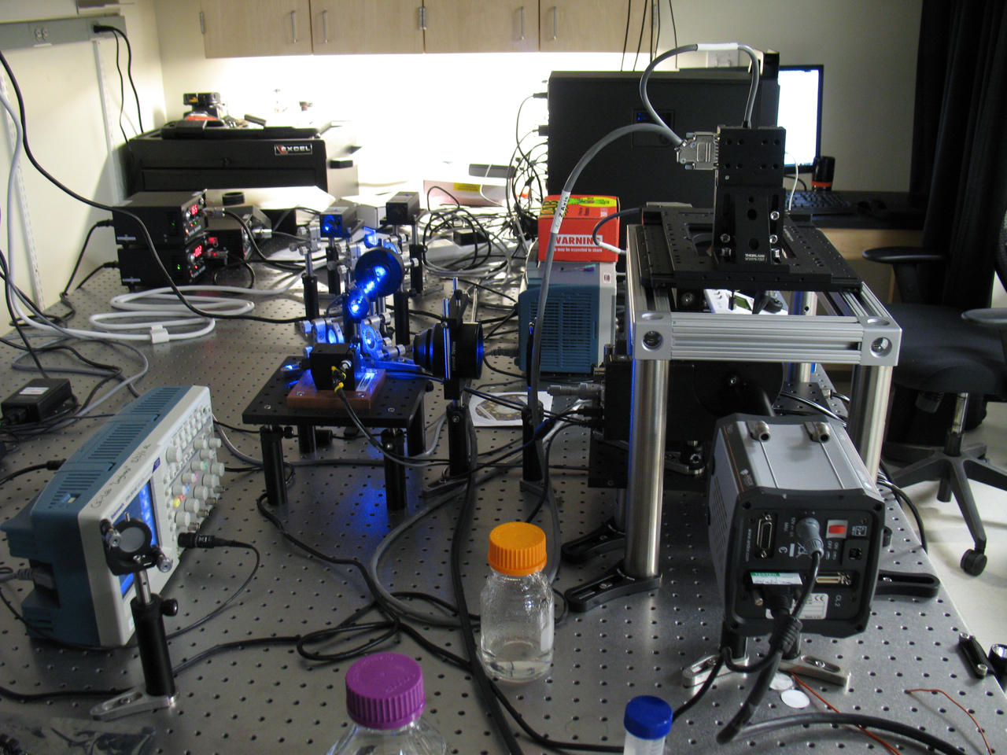
The Longboard
The Longboard

Slide 16
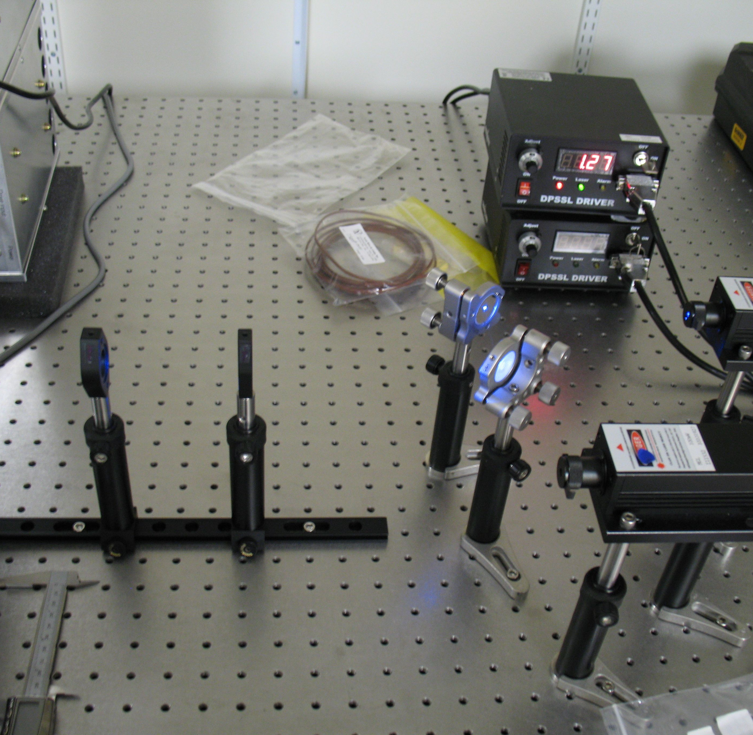
Lasers and Beam Shaping
Galilean beam expander
Plano-concave and plano-convex lenses (achromatic)
separation = f₁ + f₂
1.5 mm dia beam expanded to 5 mm

Slide 17
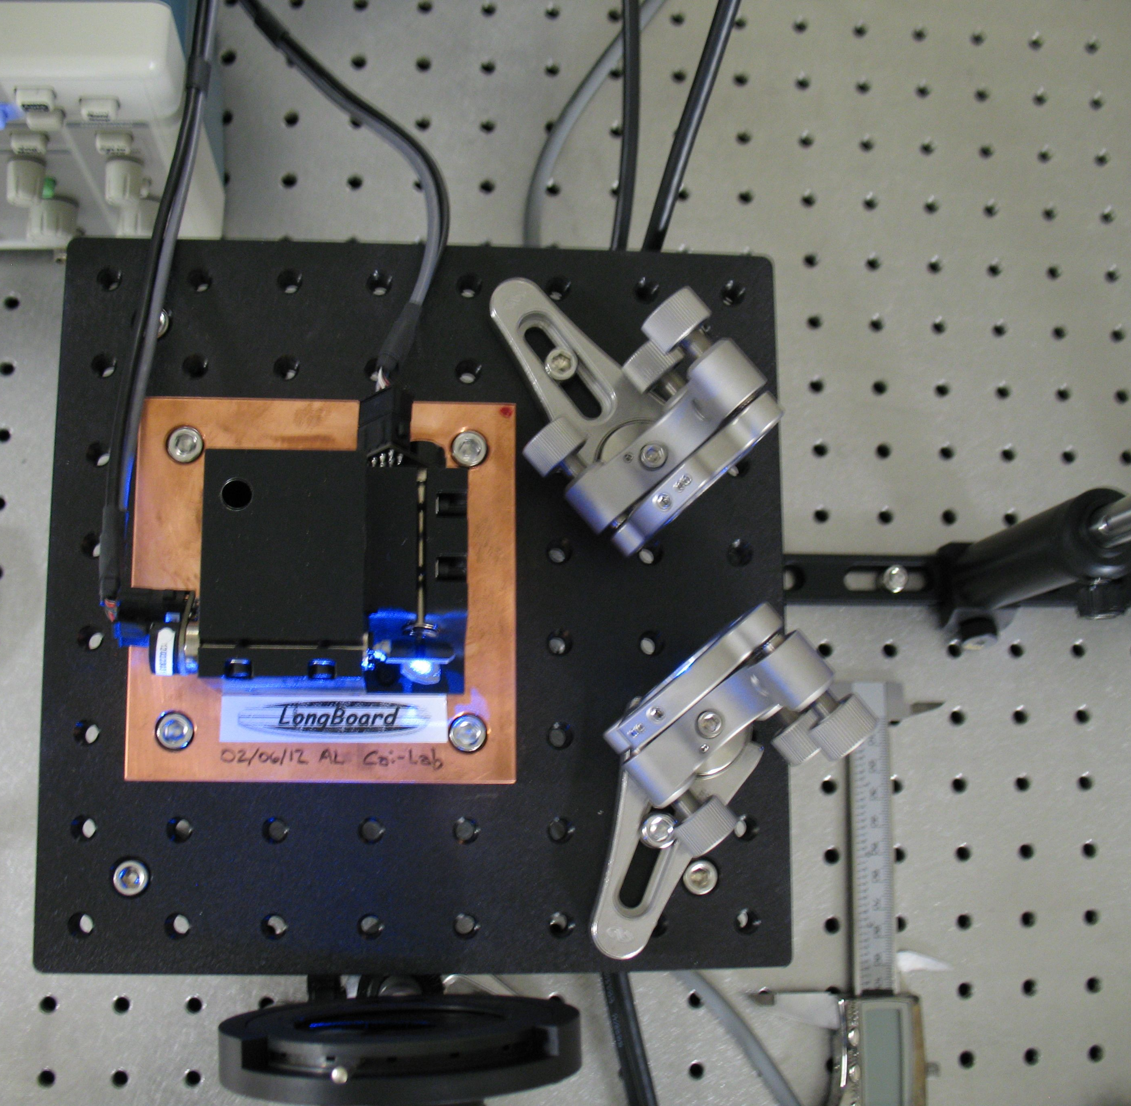
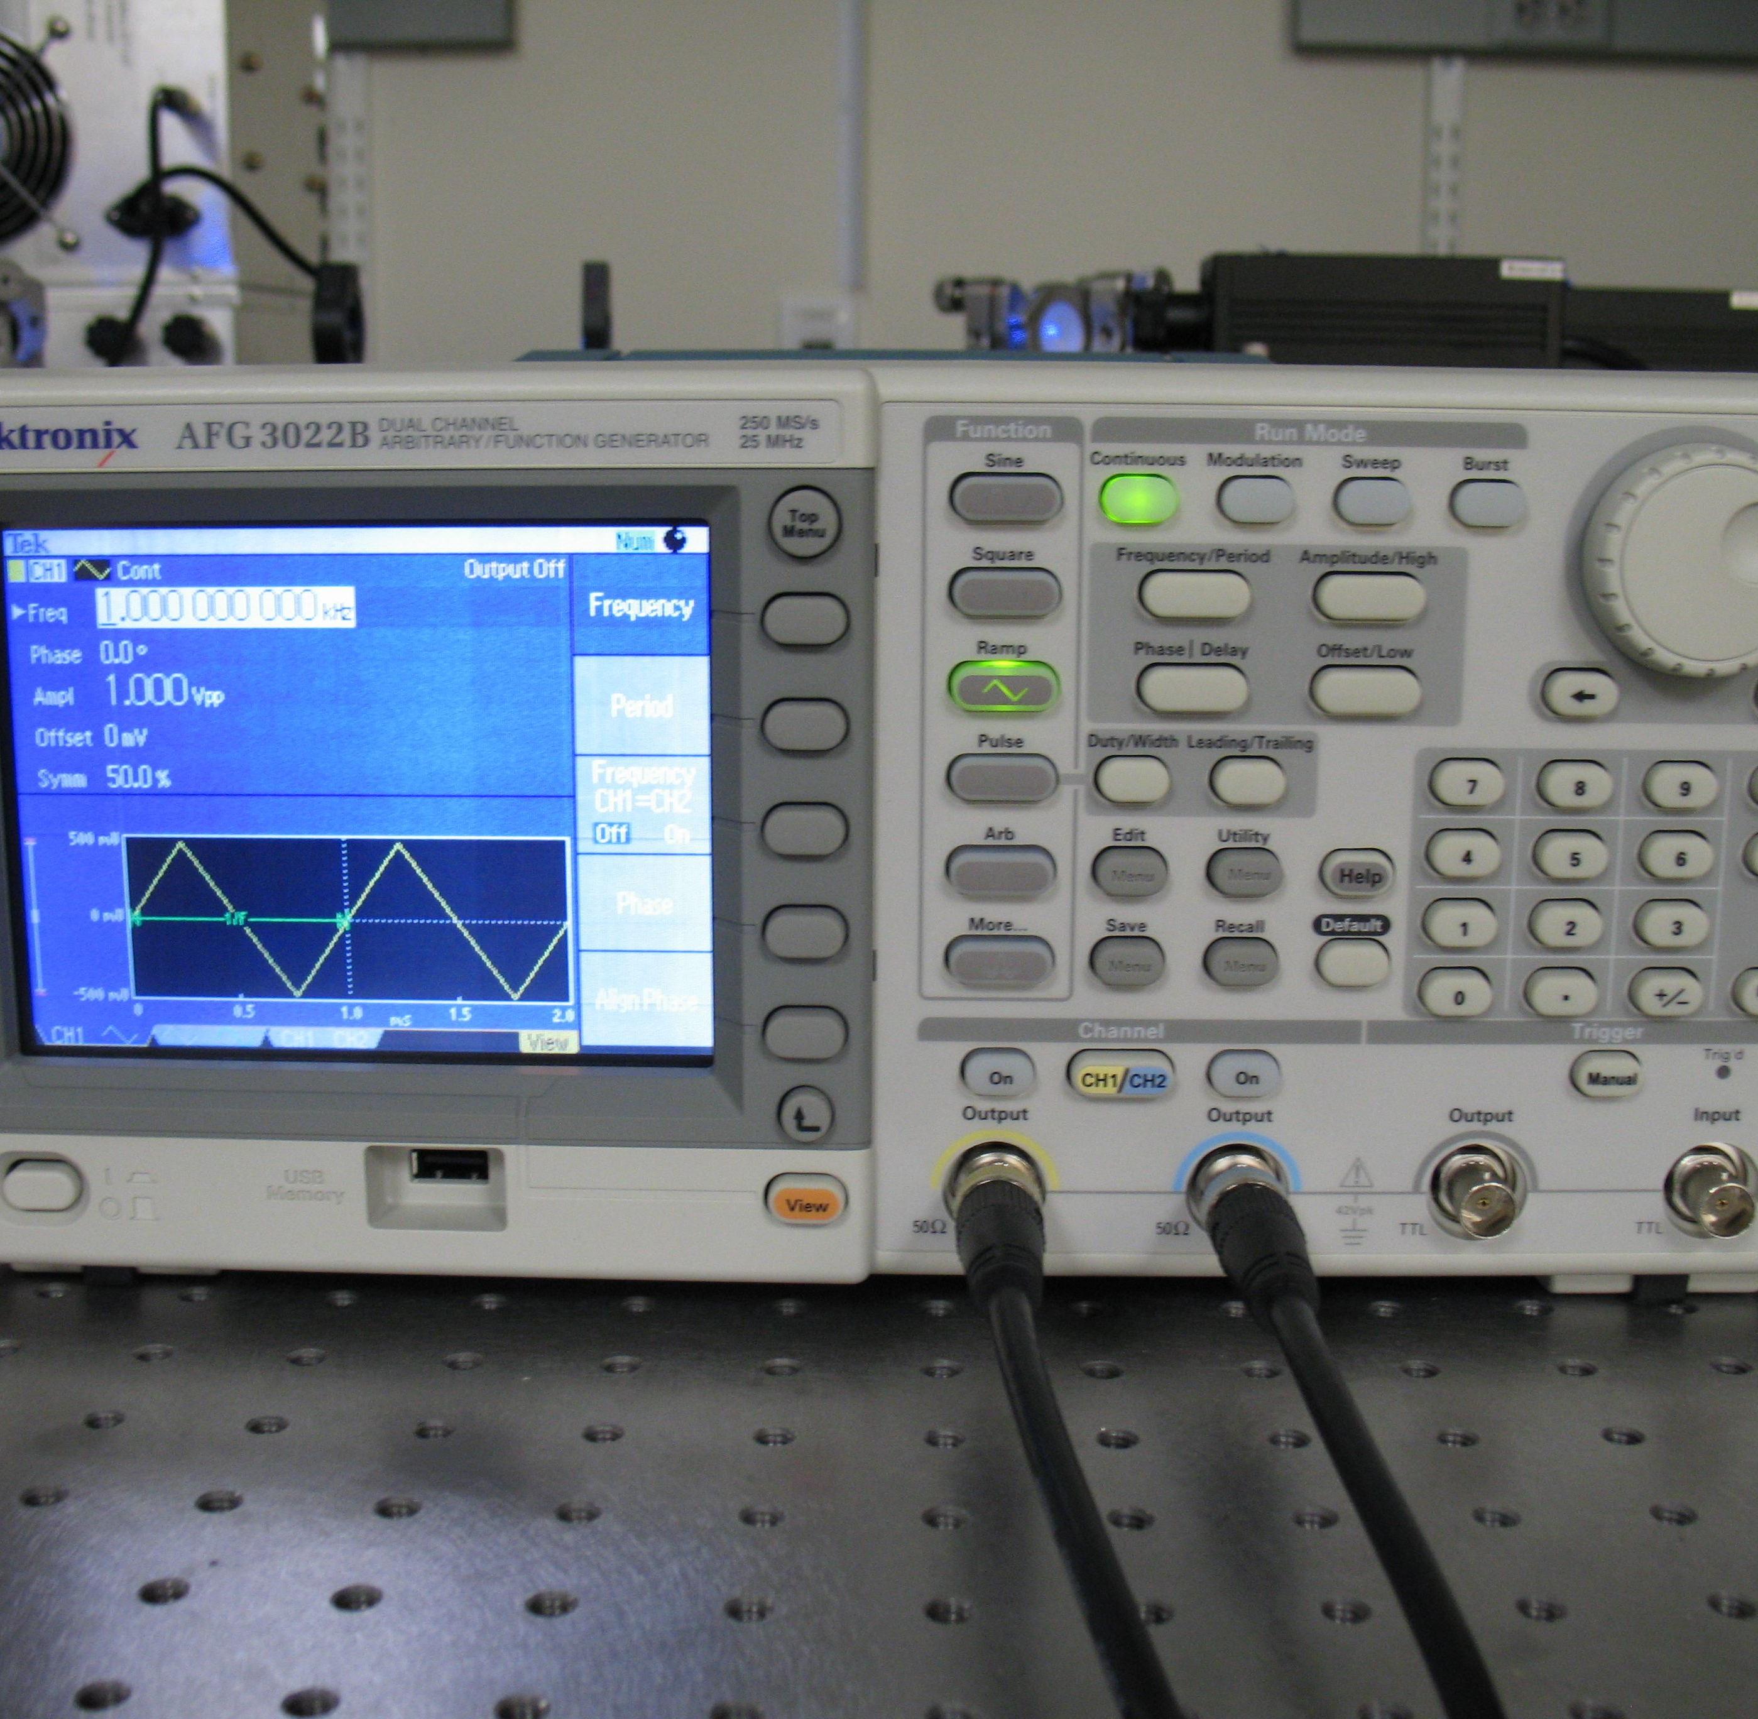
Galvo Scanner

Slide 18
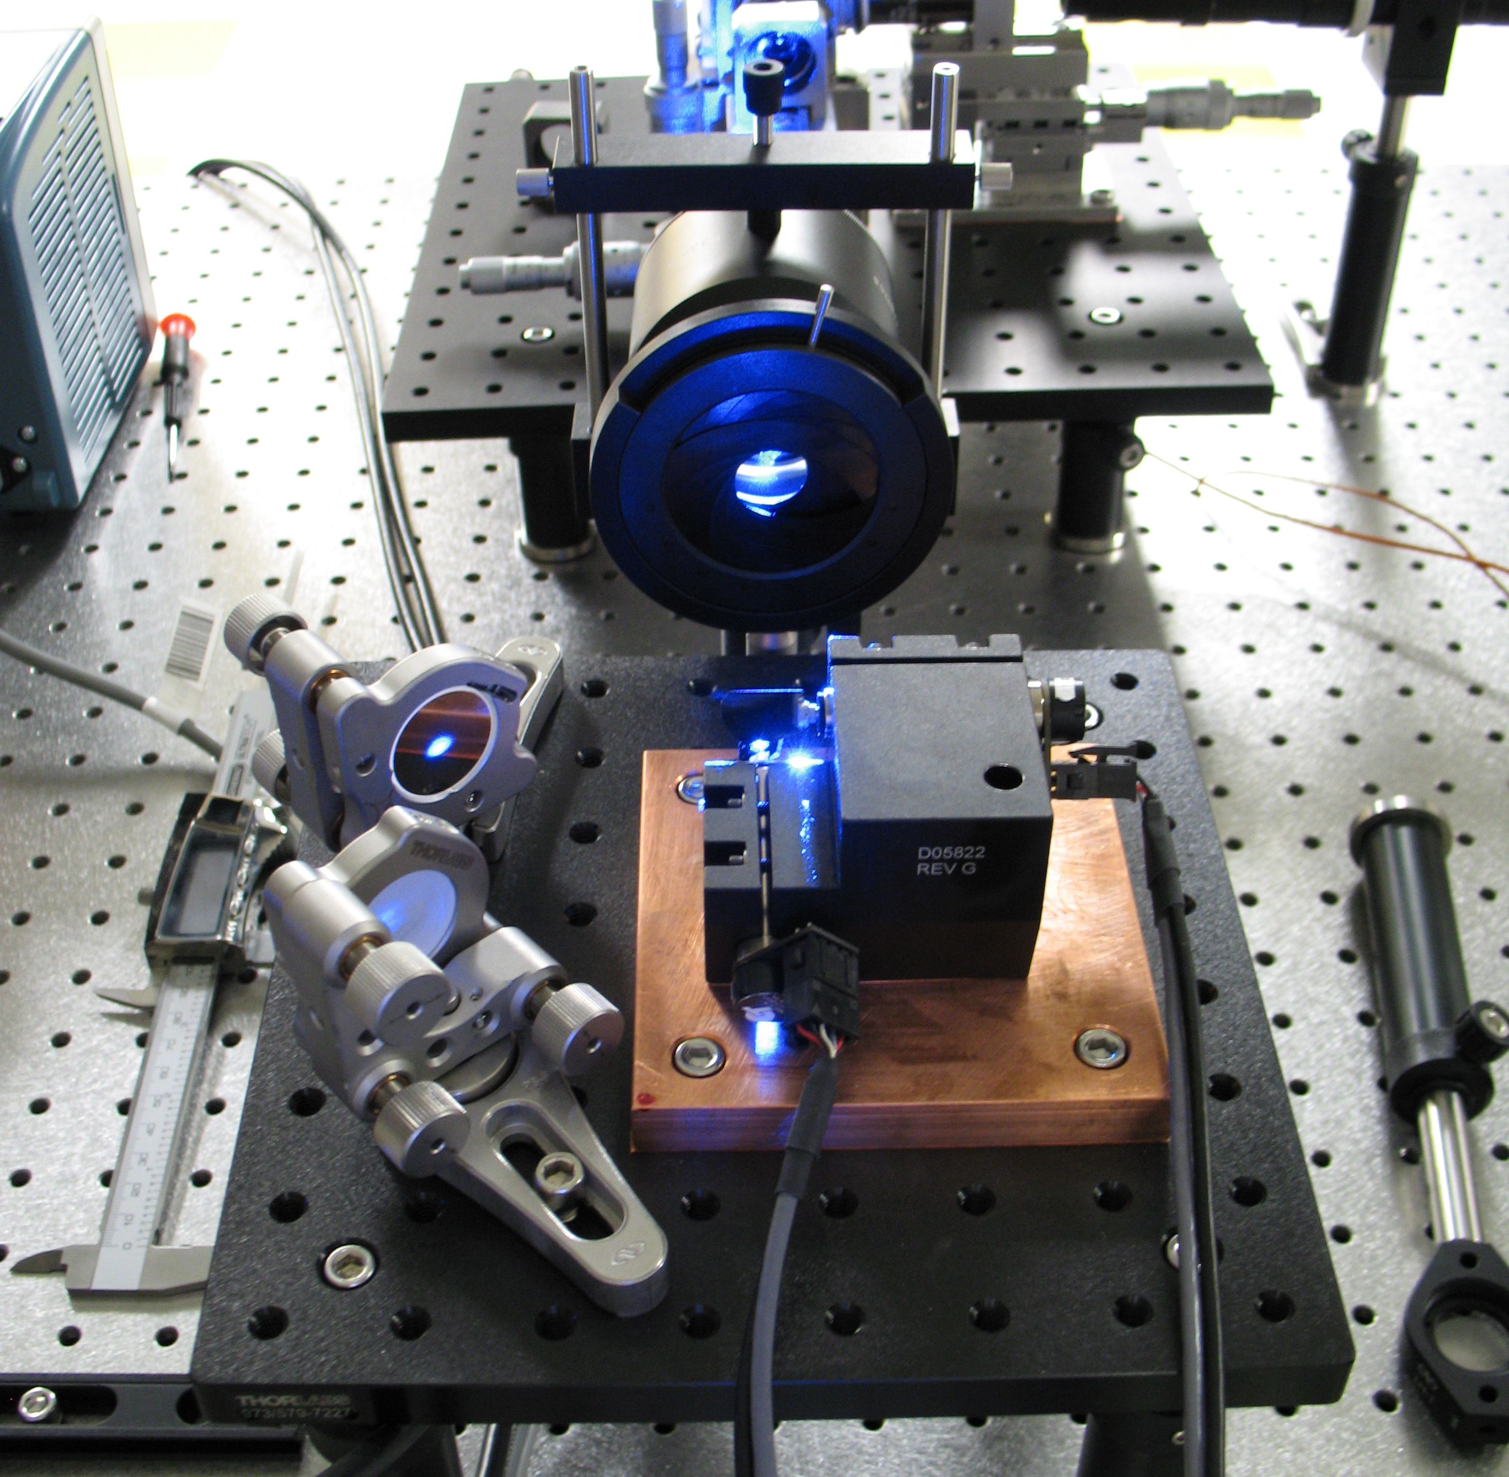
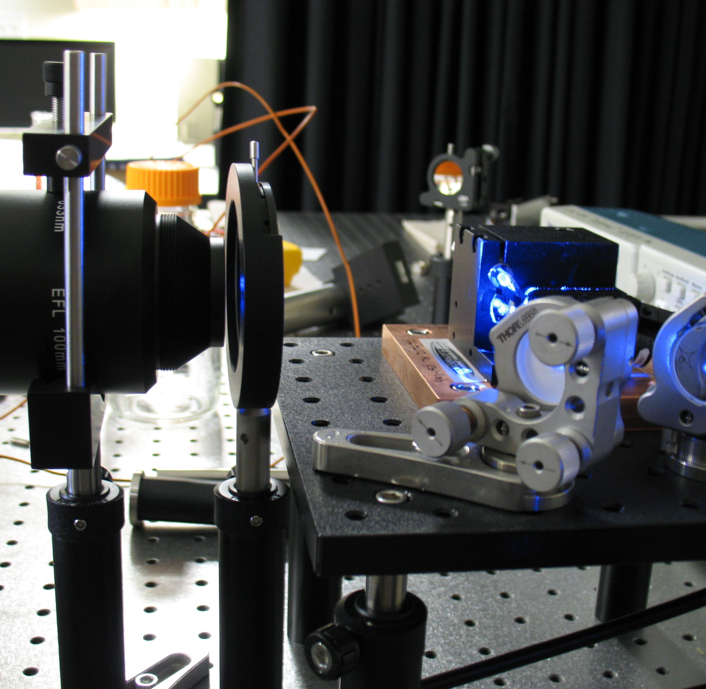
F-theta lens and beam shaping

Slide 19
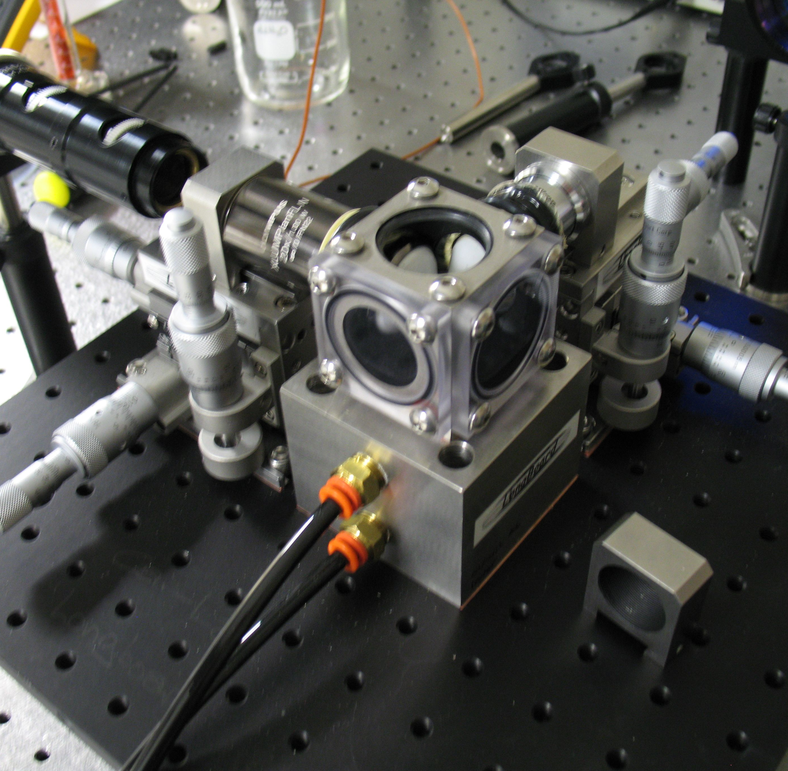
Sample Holder

Slide 20
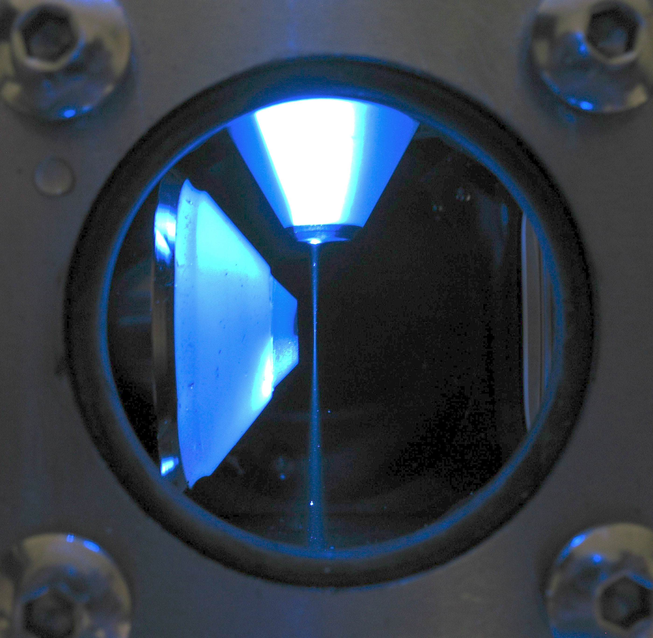
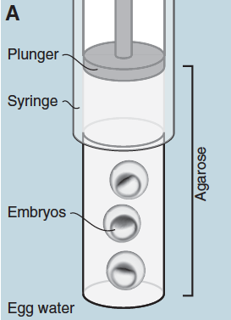
Sample

Slide 21
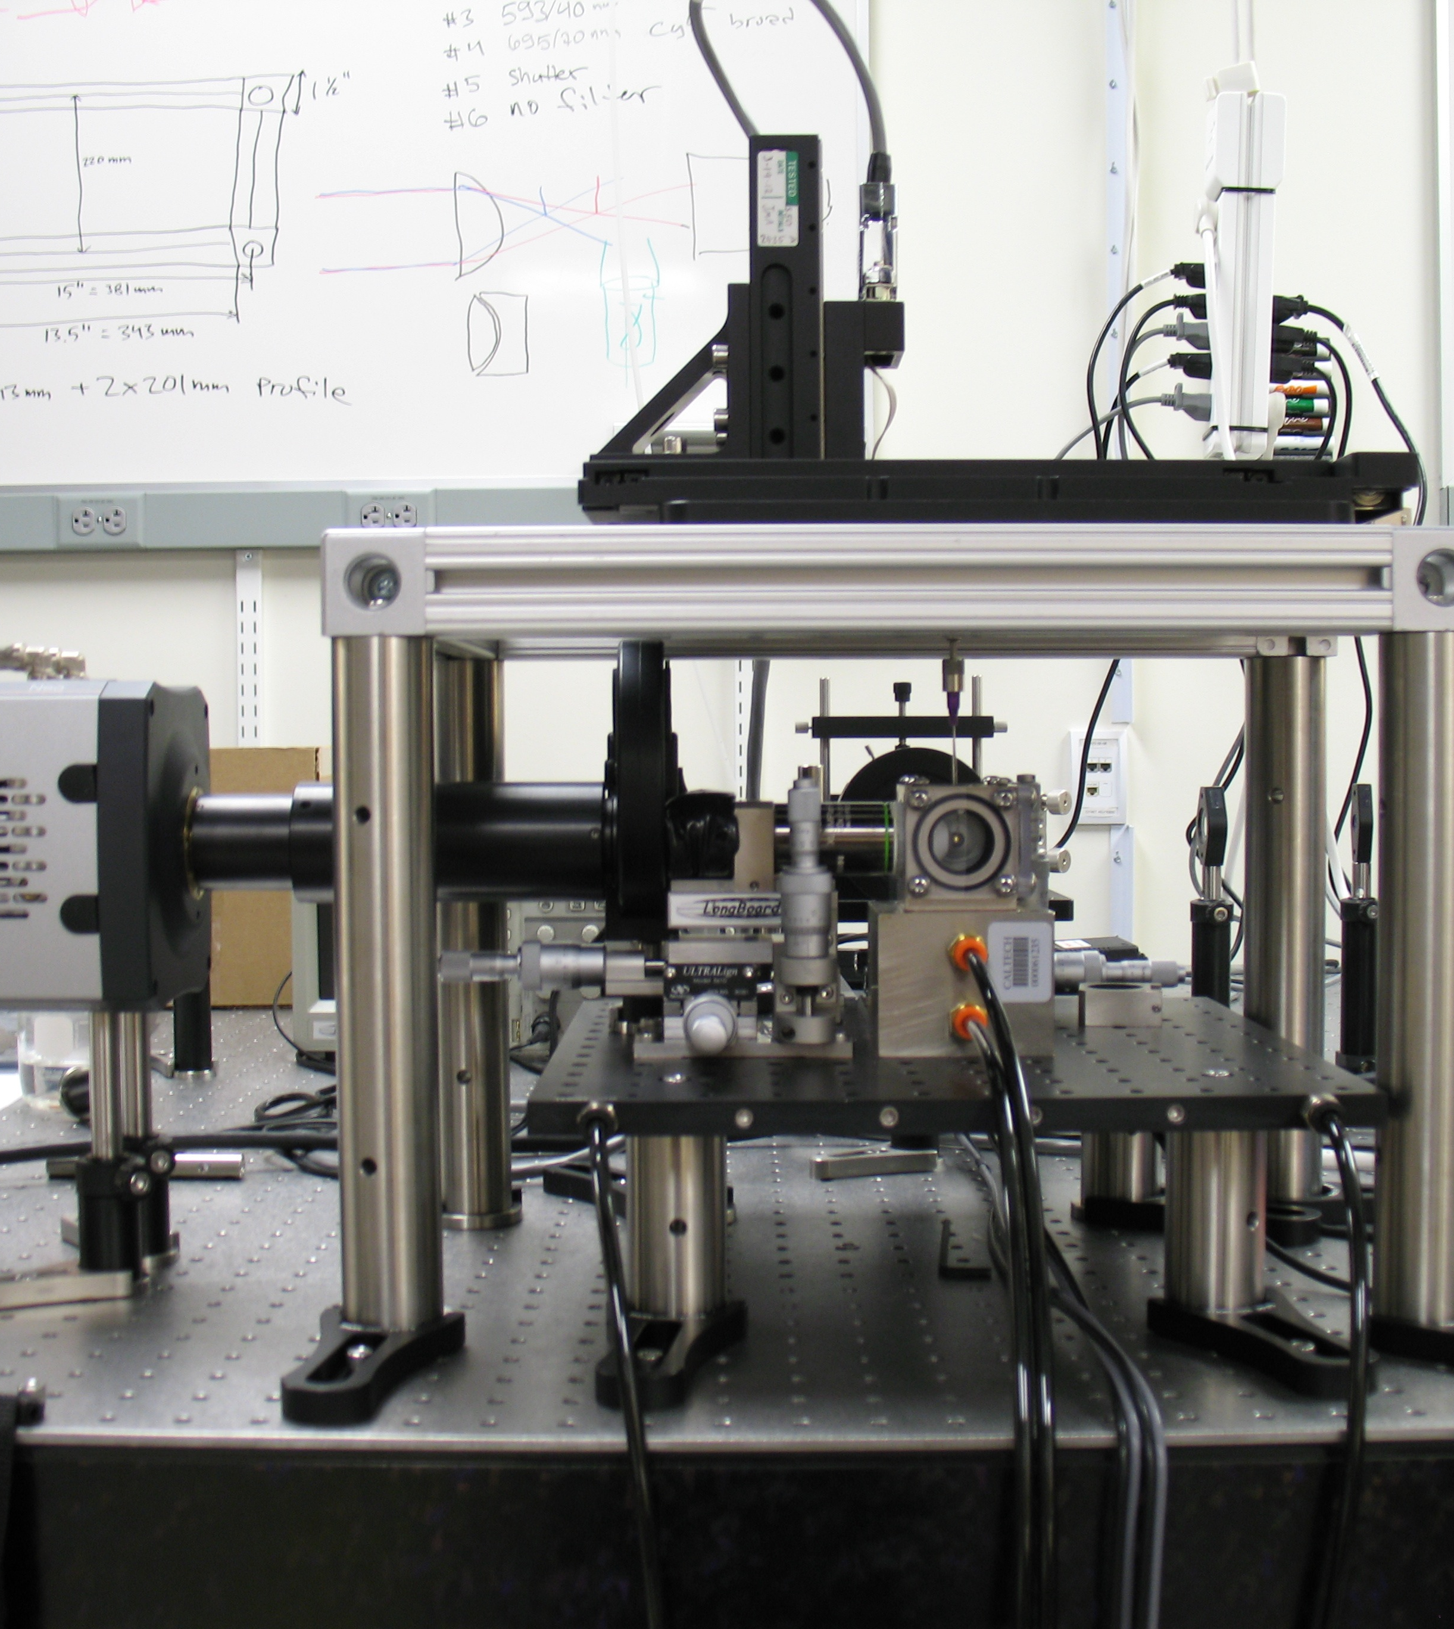
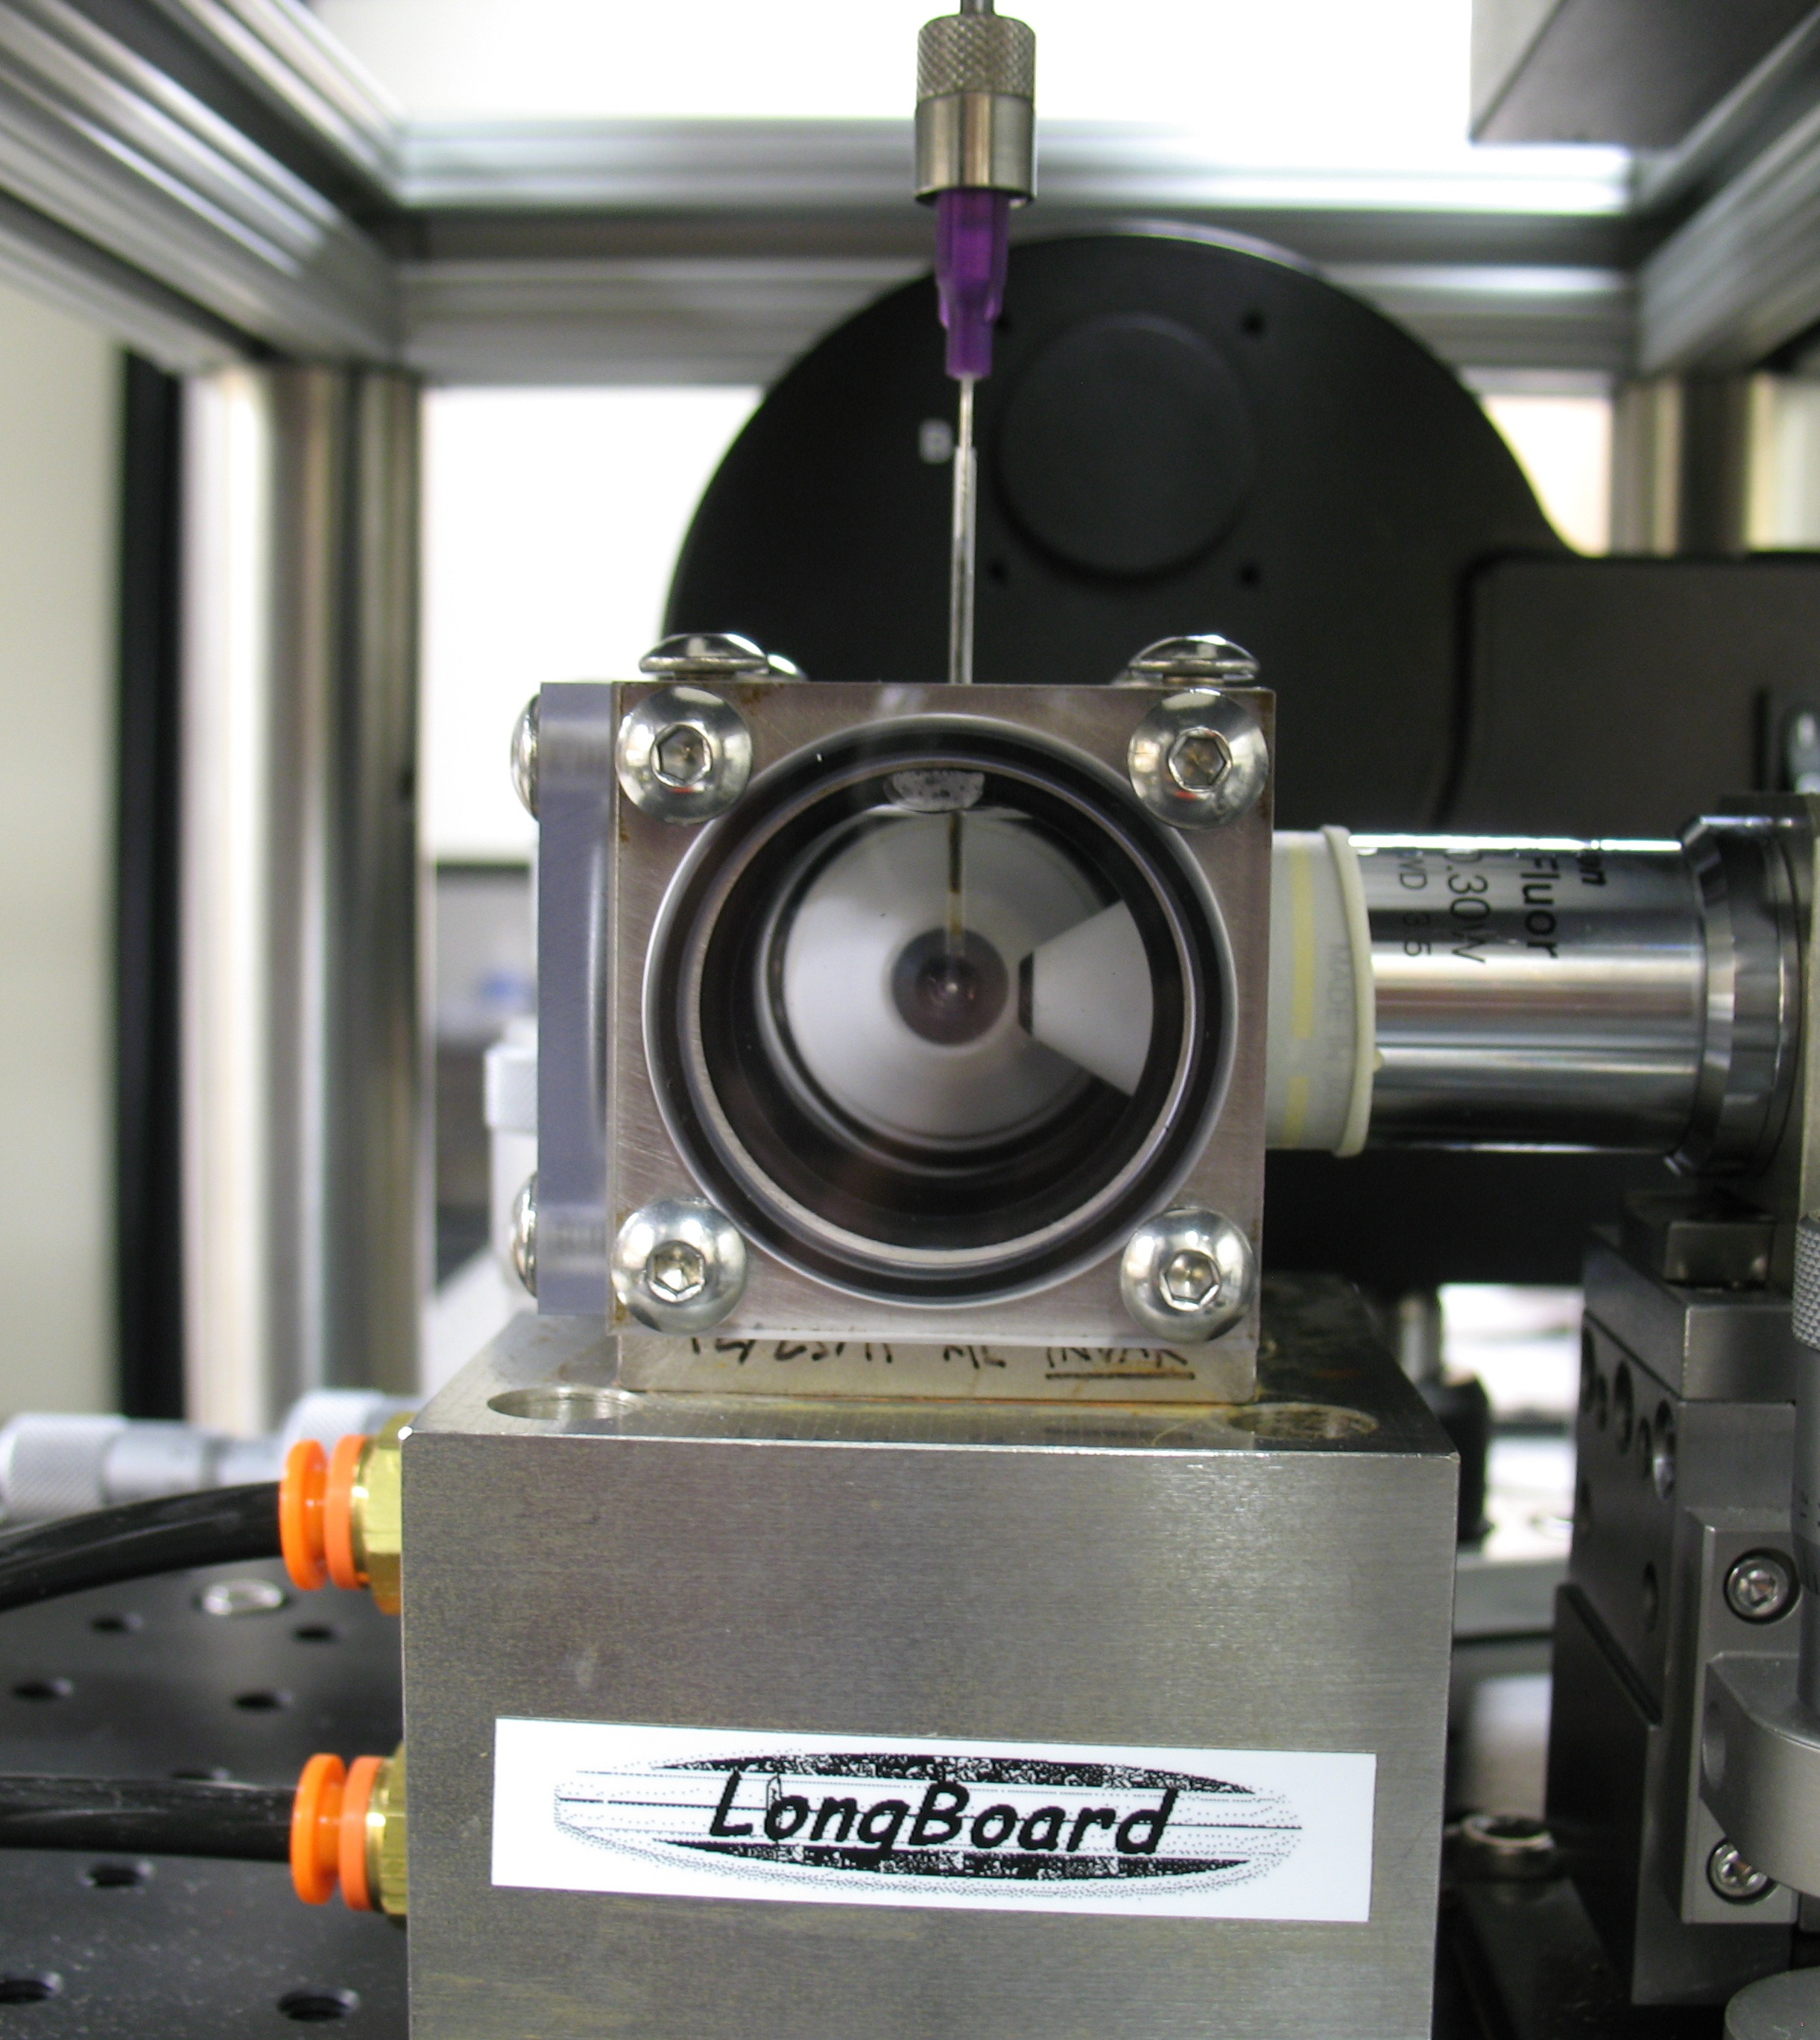
XYZ-Theta Stage

Slide 22
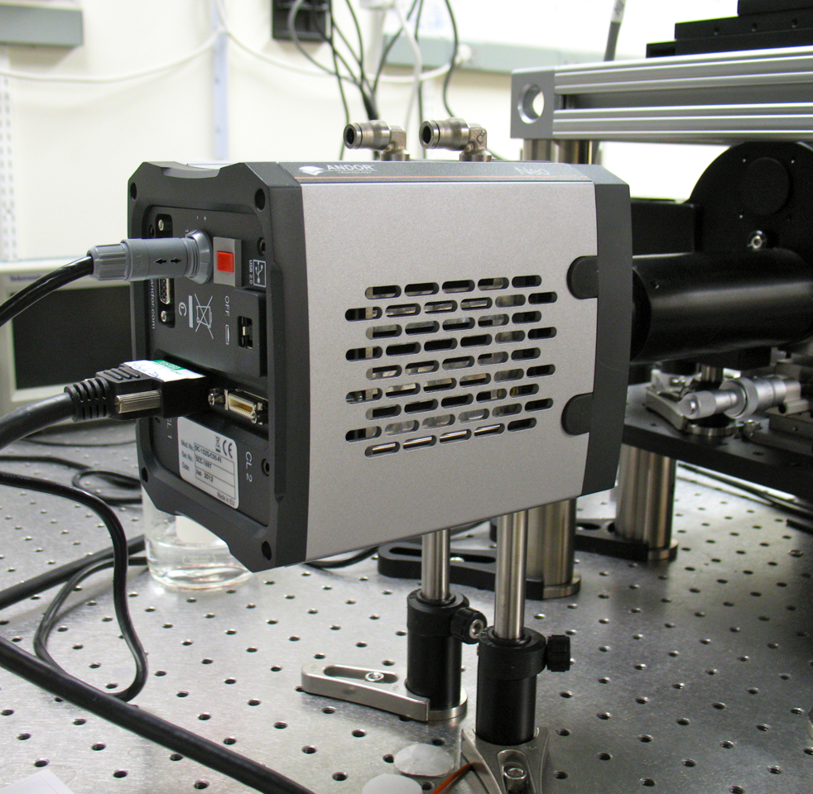
Detection
Andor NEO 2nd gen. sCMOS
5 Mpixel sCMOS chip (6.5 μm pixel size)
  30/100 fps (full resolution)
    Half-panel 200 fps etc.
  1 e⁻ readout noise
  TE cooling down to -40C
  >55% QE in visible region
  5xFOV compared to a typical EM-CCD
    Large samples
  Rolling/Global shutter

Slide 23
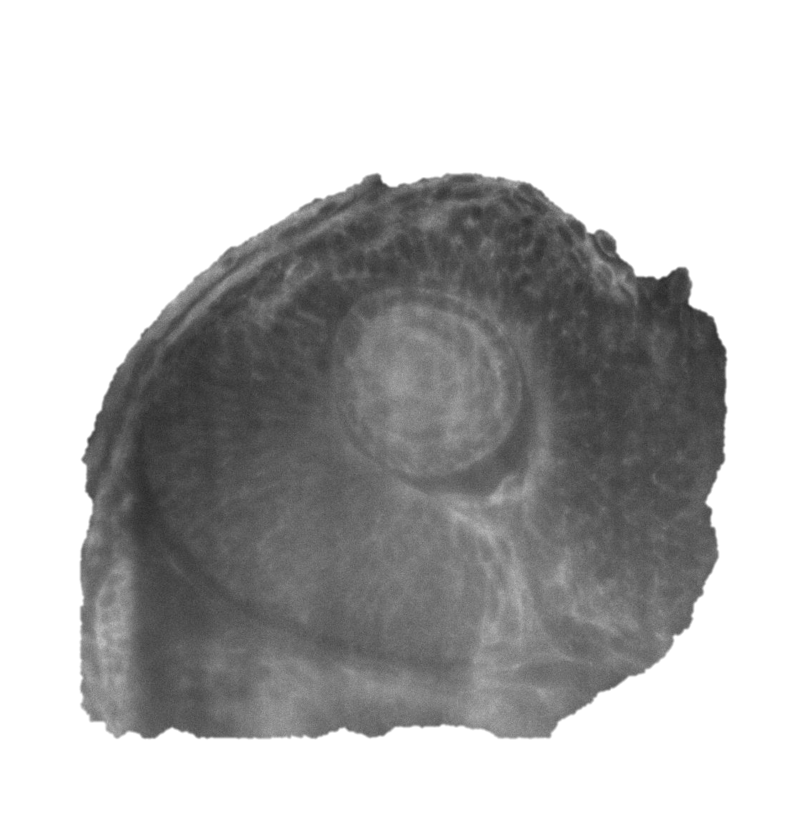
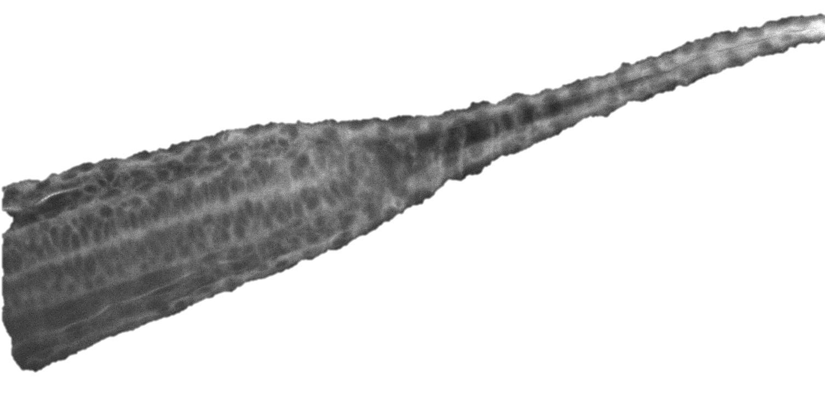
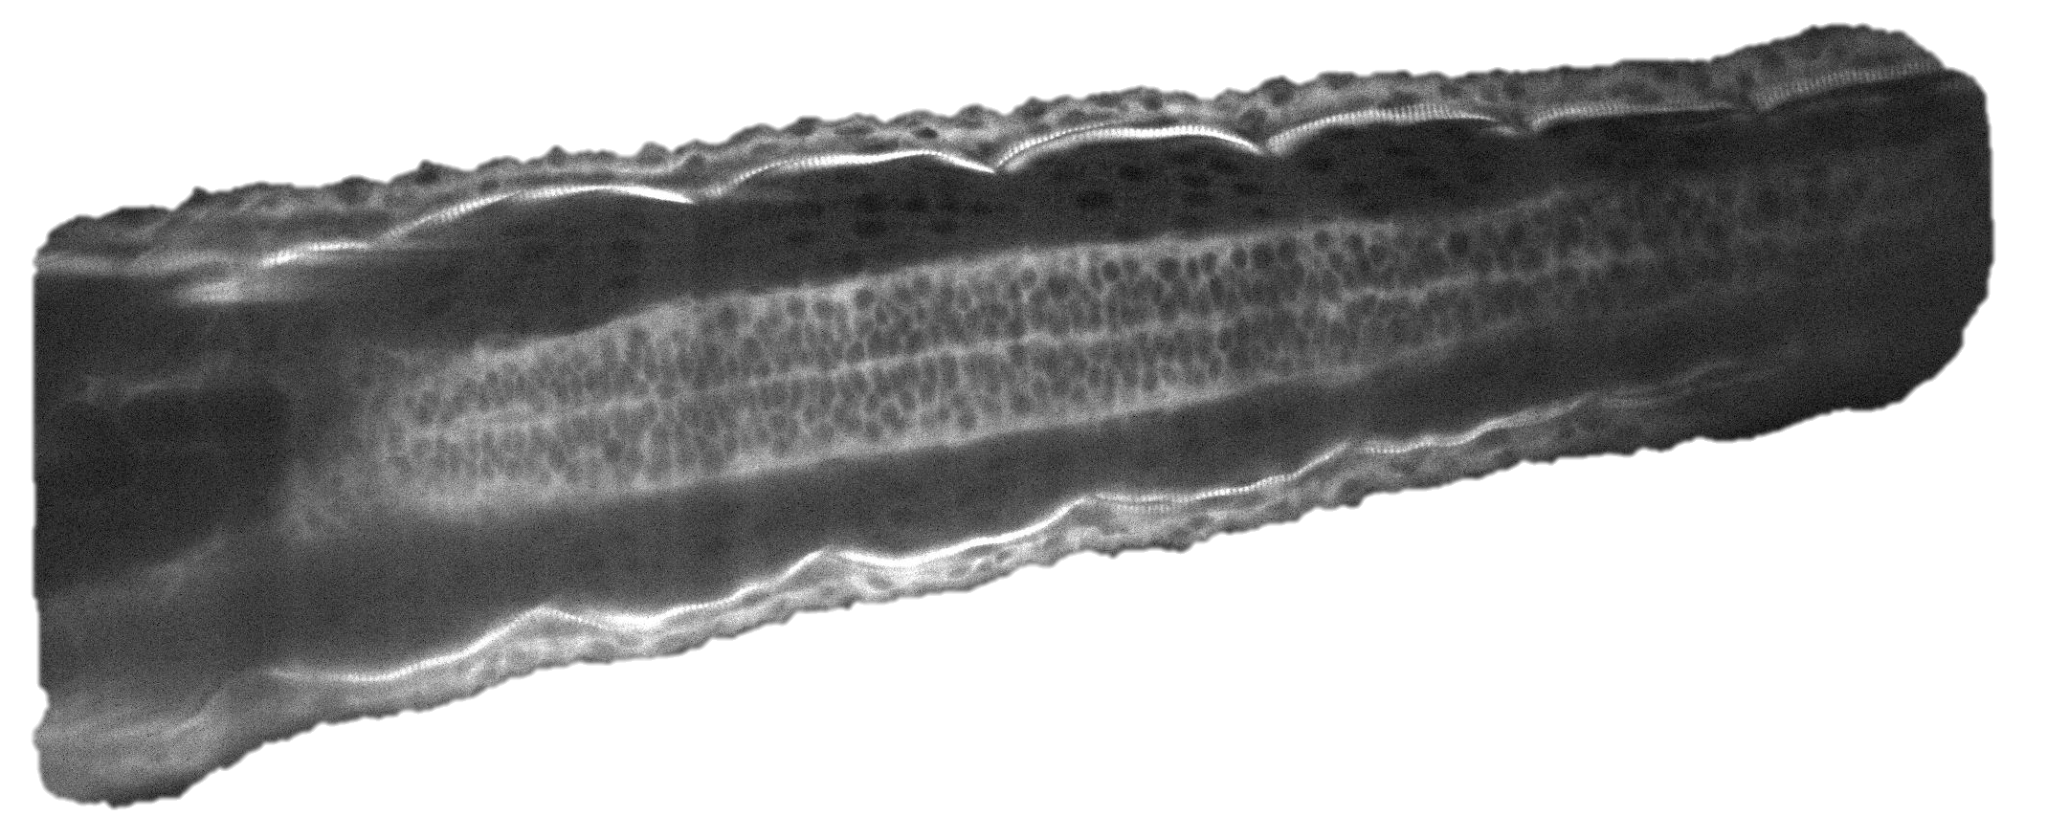
Longboard Sample Pics

Slide 24
Longboard Sample Pics

Slide 25
Longboard Sample Pics

Slide 26
Longboard Sample Pics

Slide 27
Visualization of Embryo Development with FP/SPIM
Stelzer et. al, Science 322, 1065 (2008)

Slide 28
High-Speed Imaging of Danio Heart Beating

Slide 29
Next-Generation SPIM
Bessel-beam illumination
  Highly directional and narrow light-sheet
  Lattice light-sheet microscope
Two-photon SPIM
  Deeper light penetration into the sample
  Even less photo bleaching
Tissue-cleared CLARITY samples
  Refractive index matching solution and optics
  Extremely deep sample imaging

Slide 30
Case-Study: CLARITY Upgrade
CLARITY Protocol
  Polyacrylamide network
  SDS to clear sample from fat
  Refractive index matching solution (RIMS)
Challenges
  The entire mouse brain would produce over 30TB of data and would take several weeks to image even with the light-sheet microscope
  Specific RIMS objectives with custom RI and extremely large working distance
Collaboration between Gradinaru Lab and Cai Lab
Alon Greenbaum as a primary collaborator

Slide 31
Case-Study: CLARITY Upgrade
Content removed since article is under review

Slide 32
Case-Study: CLARITY Upgrade
Content removed since article is under review

Slide 35
How much does it cost?
Epi-fluorescence microscope
  $30-50k
Confocal Laser Scanning
  $100-200k 1-photon
  $500k-1M 2-photon
Zeiss Lightsheet Z.1
  $500k++
Home-made SPIM
  $30-100k (2-photon $100-150k extra)

Slide 36
Conclusions
Light-sheet microscopy is a great method to study larger biological samples
  Optical sectioning
  Fast imaging
    Live samples
    Fast dynamics
    Large samples
  Extremely small photo bleaching
    Long/continuous exposure
  Relatively easy and cheap to build up
  Serious candidate to replace LSCM in many applications?

Slide 37
Literature
Jan Huisken et al. Science 305, 1007 (2004)
Jan Huisken et al. Optical Lett. 32, 2608 (2007)
Philipp J. Keller et al. Science 322, 1065 (2008)
Philipp J Keller et al. Curr. Opin. Neurobiology 18, 624 (2008)
Emmanuel G. Reynaud et al. HFSP Journal 2, 266 (2008)
Jan Huisken et al. Development 136, 1963 (2009)
Philipp J Keller et al. Nat. Methods 7, 637 (2010)
Thomas A. Planchon et al. Nat. Methods 8, 417 (2011)
Thai V Truong et al. Nat. Methods 8, 757 (2011)
Peter A. Santi J. Histochem Cytochem 59, 129 (2011)

