Slide 1
Neurobiology, Optogenetics, and Optics
Ravi Nath
2015/02/10

Slide 2
Outline
A quick Primer on Neurobiology
Obama’s take on Neurobiology
Neurobiology and Tool development
Existing tools
Opsins
GCaMP
Voltage Sensors
Connectome vs Functional Connectome
All-optical Interrogation of C. elegans

Slide 3
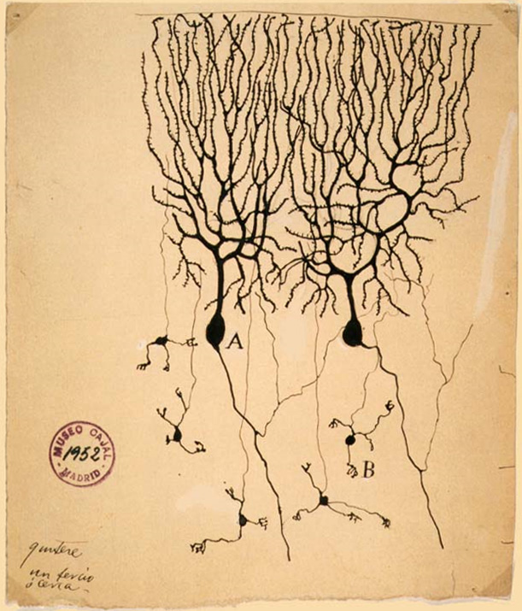
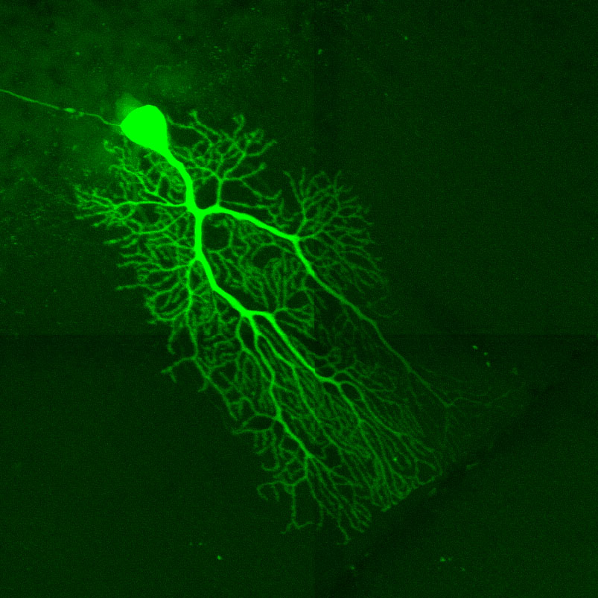
Neurobiology Primer
Notes:
http://www.hhmi.org/biointeractive/molecular-mechanism-synaptic-function

Slide 4
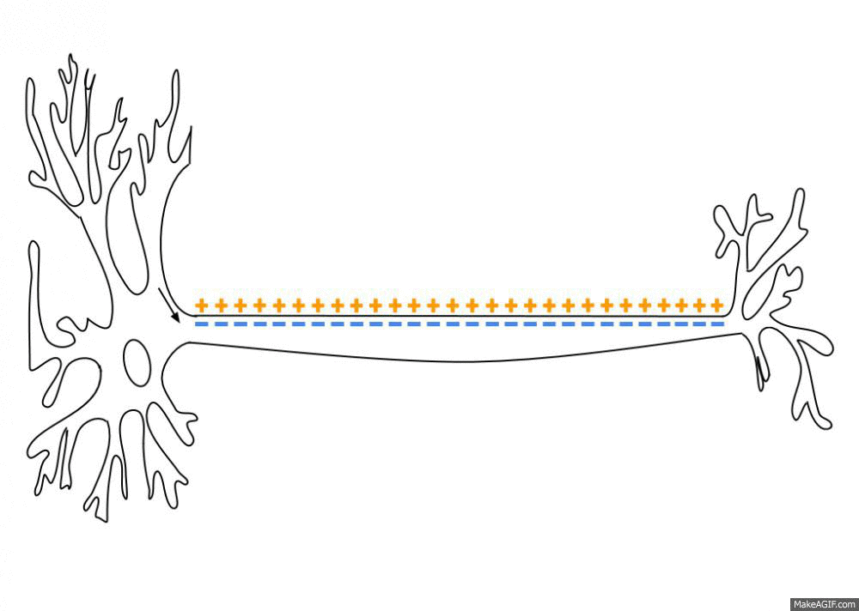

Neurobiology Primer
via Wikimedia Commons
Notes:
http://www.hhmi.org/biointeractive/molecular-mechanism-synaptic-function

Slide 5
Big Questions in Neurobiology
Connectome
Different Neuronal Types
Functional Connectome
Neural Circuits of Behavior
Computational Models
Understand and Treat Human Brain Disorders
Notes:
http://www.braininitiative.nih.gov/2025/index.htm

Slide 6
Obama’s BRAIN Initiative
10 years
1st 5 years: technology development
2nd 5 years: integrating technologies to make fundamental new discoveries
Suggested Budget of $400 million/year over the next five years (FY16-20), and continues at $500 million/year subsequently (FY21-25)
BRAIN 2025: A Scientific Vision
Notes:
http://www.braininitiative.nih.gov/2025/index.htm

Slide 7
BRAIN Initiative Optics Funding
$ 300 million already collected/donated
1/3 was donated for developments in optics
Photonics Industry: $30 million to develop new optics and photonics for neuroscience
HHMI: $70 million to develop new imaging technologies
whitehouse.gov
Notes:
U.S. Photonics Industry Leaders are committing $30 million to tackle challenges of the BRAIN Initiative: The National Photonics Initiative (NPI), an alliance of major scientific societies, industry and academic organizations, is convening a Photonics Industry Neuroscience Group to focus on developing new optics and photonics technologies in support of the BRAIN Initiative. This multidisciplinary industry group is comprised of influential U.S. industry leaders including Accumetra, LLC; Agilent, Applied Scientific Instrumentation; Coherent; Hamamatsu; Inscopix, Inc.; Spectra—Physics; and THORLABS. The Photonics Industry Neuroscience Group will work closely with the BRAIN Initiative leadership and with the neuroscience research community to advance optics and photonics research and technology development. The NPI industry group will invest at least $30 million in existing and future research and development spending over the next three years to advance optics and photonics technology challenges in neuroscience, such as:
o Developing the imaging optics, laser sources, automated scanning technology, and high resolution cameras to provide a ten- to one-hundred-fold increase in the capability of imaging groups of thousands of active neurons;
o Developing miniature, affordable, and portable/implantable microscopes compatible with high-throughput facilities for therapeutic screening based on neural activity signatures;
o Using large-scale, high-throughput protein engineering technology, develop a new generation of fluorescent indicators of neural activity with ten-fold improvements in efficiency and temporal response; and
o Developing automated software for detailed mapping of the human brain, architecture, neuronal wiring geometry, and dynamic activity from three- dimensional data sets generated by MRI, CT, and microscopic imaging.
• Howard Hughes Medical Institute invested more than $70 million to support the goals of the BRAIN Initiative during the past year, and plans a similar level of commitment in 2015: Howard Hughes Medical Institute (HHMI) has invested more than $70 million to support the BRAIN Initiative during the past year at its Janelia Research Campus and in the laboratories of HHMI Investigators at universities throughout the United States. This investment has been focused on developing new imaging technologies and understanding how information is stored and processed in neural networks. A similar level of commitment is expected in 2015, including large-scale efforts at Janelia for neuroanatomical studies using light and electron microscopy, and for the development of improved sensors of neuronal activity and other genetic reagents.

Slide 8
5 Years and 1.6 Billion Dollars on Technology Development
Technologies, such as Optogenetics and Biosensors, allow neurobiologists to better dissect neural circuits
Tool development will require a multidisciplinary approach (bioengineers, microscopist, computer scientists, and biologist)

Slide 9
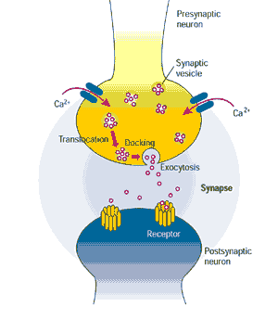
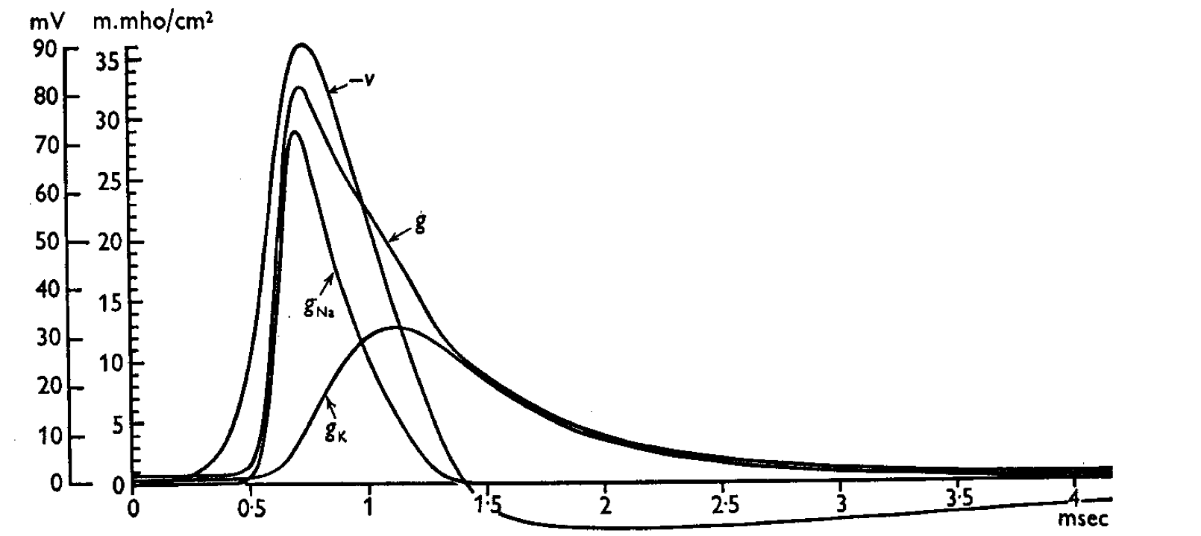
Action Potential
Neurobiology tools take advantage of ion fluxes of an action potential
J. Physiol 1952

Slide 10
Requirements for Neurobiology Tools
Spatial and temporal precision
Any ideas?

Slide 11
‘Aspects of the conceptual inspiration for optogenetics can be traced to the 1970s. In 1979 Francis Crick, taking note of the complexity of the mammalian brain and the fact that electrodes cannot readily distinguish different cell types (Crick, 1979), suggested that a major challenge facing neuroscience was the need to precisely control activity in one cell type while leaving the others unaltered. Crick later speculated in lectures that light might be a relevant control tool, but without a concept for how this could be done.’
Neuron 71, July 14, 2011
Notes:
Ofer Yizhar,1 Lief E. Fenno,1 Thomas J. Davidson,1 Murtaza Mogri,1 and Karl Deisseroth1,2,3,4,*

Slide 12
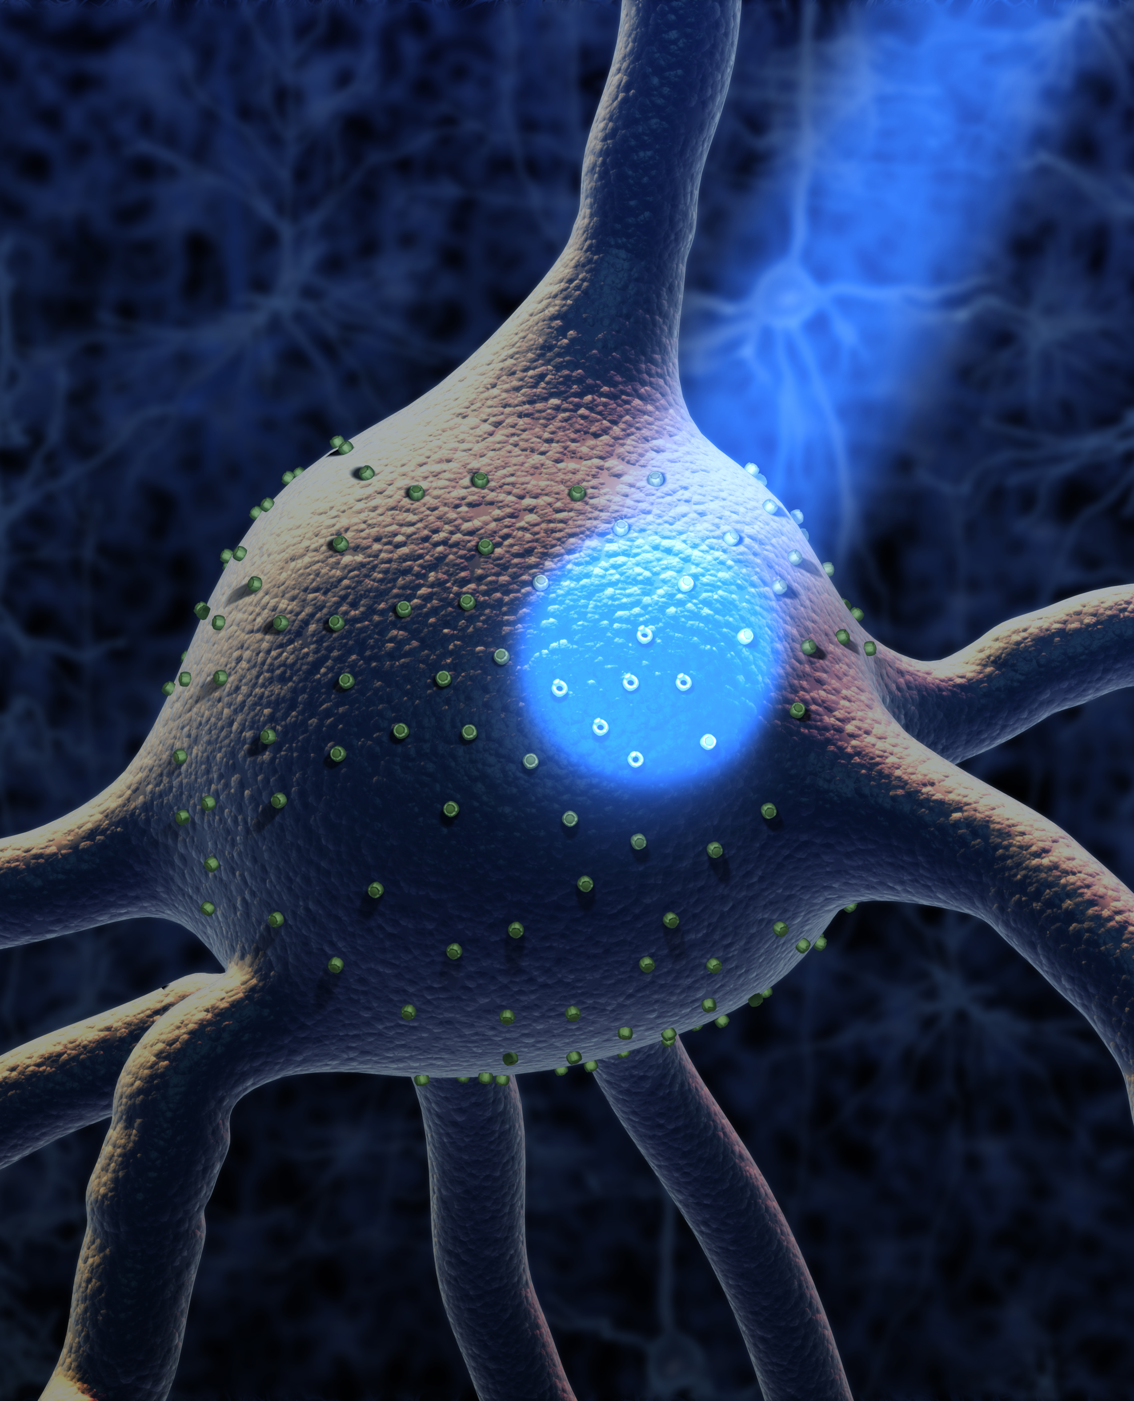
Optogenetics

Slide 13
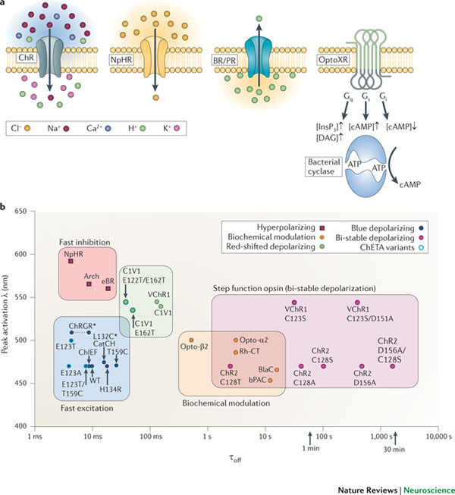
Opsins
Sensory photoreceptors for algea
Light sensitive ion channel
Require retinal as a co-factor
Notes:
Notice the peak excitation wavelength of the opsins. A protein engineering challenge is to excite opsins with red light (or even IR shifted).
NOTE: opsins are excited by a spectrum of wavelengths!
CONCERNS: intensity/power (mWmm-2) and wavelength

Slide 14
Optogenetics
Channelrhodopsin (ChR2): Cation Channel
Halorhodopsins (NpHR): Anion Channel
Optogenetics describes the use of microbial opsins to investigate neuronal circuits.
Great spatial and temporal resolution (milli-seconds)

Slide 15
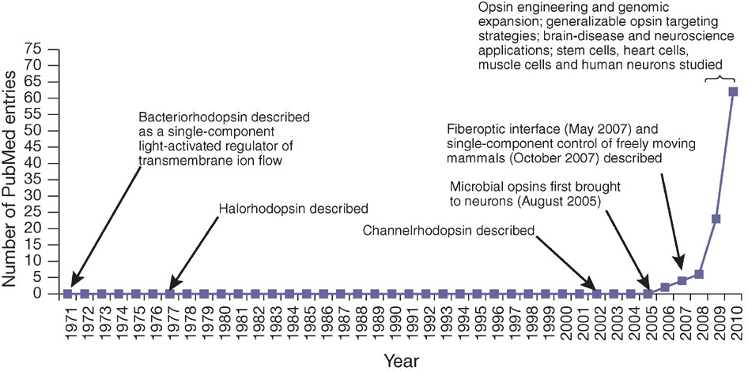
Optogenetics
Nature Methods

Slide 16
Advantages of Opsins
Activate or inhibit neurons with excellent spatial and temporal resolution
Opsins can be expressed in individual, or populations of neurons
Necessity and sufficiency
Notes:
http://www.youtube.com/watch?v=v7uRFVR9BPU
http://www.youtube.com/watch?v=I64X7vHSHOE
http://www.nature.com/nature/journal/v470/n7333/extref/nature09736-s5.mov

Slide 17
Disadvantages of Opsins
Changing natural properties of the membrane by overexpressing a channel protein
At least with blue light, there is enough energy to damage tissue
The light used is a confounding variable
Challenging to deliver opsins and install fiber optics

Slide 18
Genetically Encoded Neural Imaging
Ca++ indicators
Voltage Sensors
Notes:
http://vimeo.com/58448563

Slide 19
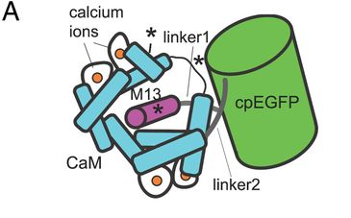
GCaMP
Genetically Encoded Calcium Indicator
Calmodulin (CaM) is an important post-synaptic density protein that binds Ca++
Ca++ binds to CaM and causes a conformational change that causes GFP fluoresence
Notes:
http://vimeo.com/58448563
http://www.nature.com/nmeth/journal/v10/n10/fig_tab/nmeth.2637_SV2.html

Slide 20
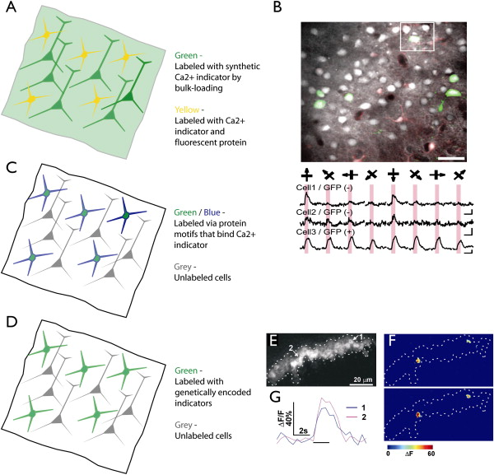

Source: Neuron , Volume 57, Issue 5, Pages 634-660 (DOI:10.1016/j.neuron.2008.01.002)
Notes:
Strategies for Imaging Genetically Specified Neuronal Populations with [Ca2+] Indicators.
(A) All neurons are labeled nondiscriminately by bulk-loading with a [Ca2+] indicator (diffuse green). A genetically specified set of neurons express a fluorescent protein (yellow).(B) [Ca2+] imaging in mice expressing GFP in GABAergic interneurons. (Top) Image showing neurons bulk-loaded with [Ca2+] indicator. GFP fluorescence is overlaid in green. (Bottom) Responses of GFP-negative and GFP-positive (GABAergic) neurons to oriented bars. Modifed from Sohya et al., 2007.(C) A genetically specified subpopulation of neurons express a protein (such as tetracysteine motifs; blue) that makes them susceptible to labeling by modified versions of [Ca2+] indicators (such as biarsenicals; green).(D) A genetically specified subpopulation of neurons express a genetically encoded [Ca2+] indicator (green).(E–G) Imaging odor-evoked activity in Kenyon cells of the Drosophila mushroom body using genetically encoded [Ca2+] indicators (G-CaMP1.3) in vivo. (E) G-CaMP fluorescence showing the mushroom body. (F) Two responses to the same odor (difference image; 2 s after odor onset minus baseline). Two Kenyon cells show strong activity. (G) Time course of G-CaMP responses. Modified from Wang et al., 2004.

Slide 21
GCaMP
Fluorescence Microscopy Refresher
Excitation: 485 nm
Emission: 510 nm
The emission wavelength overlaps with the wavelengths that activate opsins!
RCaMP, a red-shifted GCaMP, circumvents this technical difficulty. Another approach is to shift the wavelength of activation of opsins

Slide 22
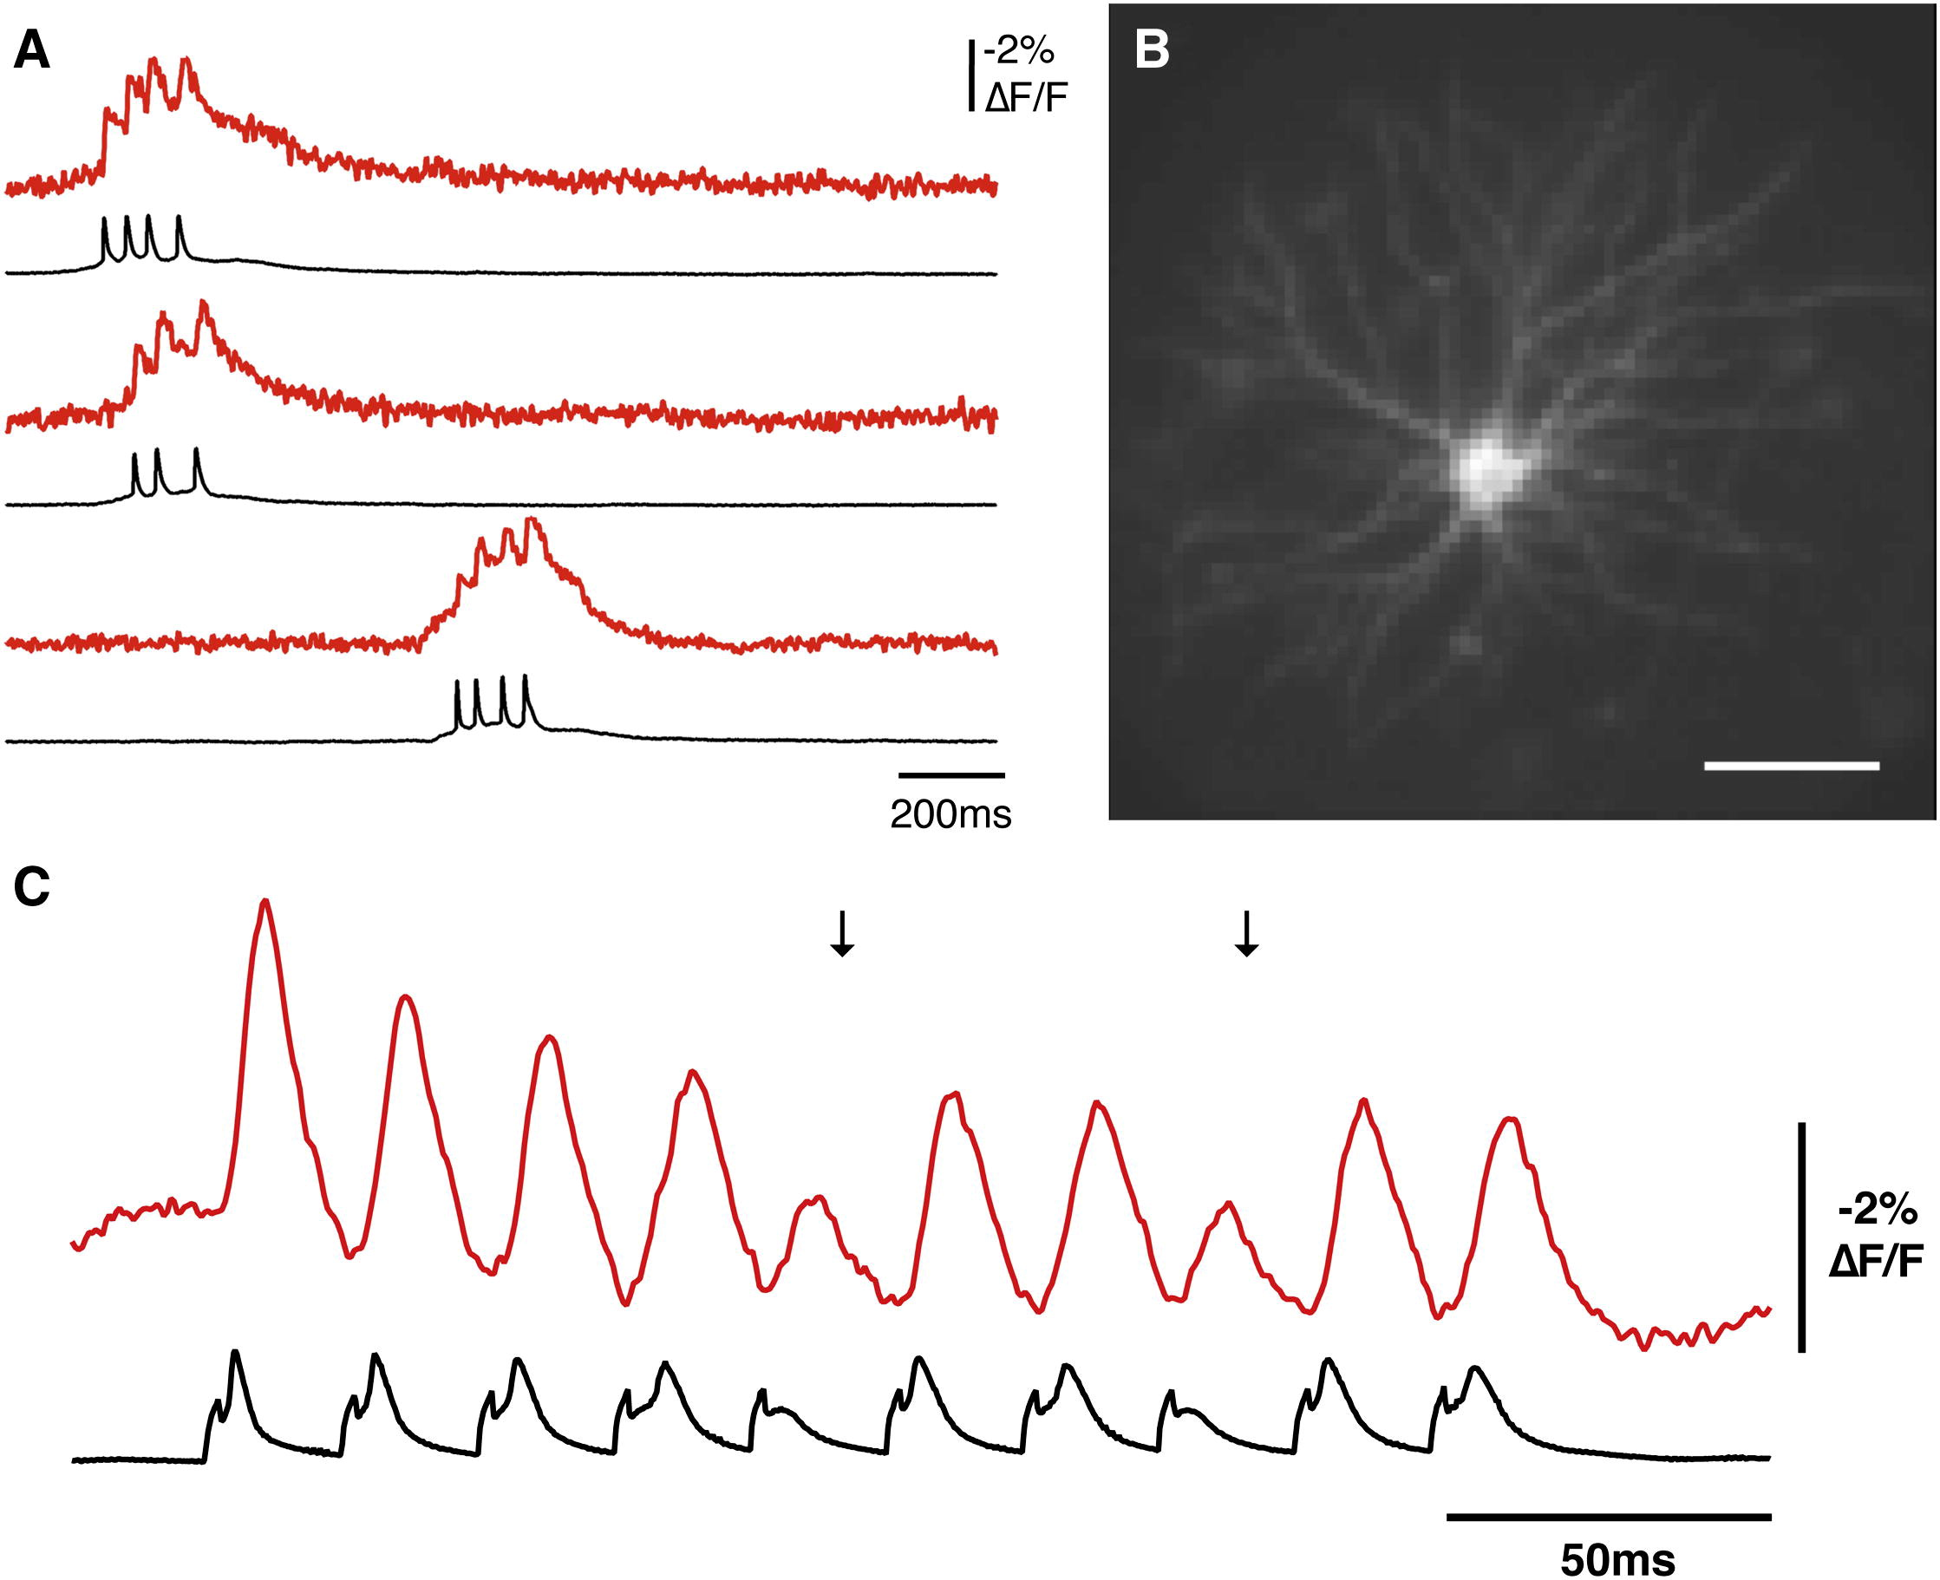
Voltage-Sensors
Neuron Volume 75, Issue 5 2012 779 - 785
Notes:
Figure 3
(A) Sample traces of single trial recordings of spontaneous action potential bursts from the neuron shown in (B). All optical traces have double exponential subtraction of bleach and were low pass filtered with a Kaiser-Bessel 30 filter (200 Hz cut off).
(B) An 80 × 80 depixelated image of the neuron presented in (A). Scale bar: 50 μm.
(C) The optical and voltage recording of a stimulated action potential burst from a different neuron expressing the ArcLight A242 probe. All traces have double exponential subtraction of bleach and used a Binomial smoothing of one and a τ of four.

Slide 23
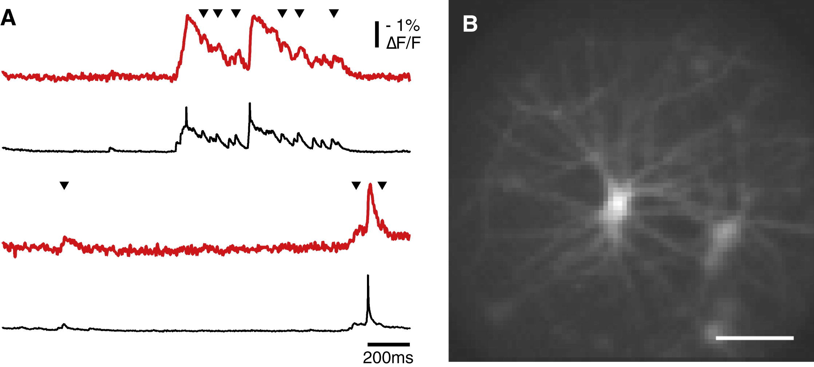
Voltage-Sensors
Detection of Sub-threshold events
Neuron Volume 75, Issue 5 2012 779 - 785
Notes:
Figure 4
(A) Sample traces of single trial recordings of spontaneous subthreshold and action potential activity from the neuron shown in (B). All optical traces have double exponential subtraction of the bleach and are low pass filtered with a Kaiser-Bessel 30 filter (200 Hz cut off). The arrowheads indicate the depolarizations (likely EPSPs) that triggered visible changes in the optical recordings.
(B) An 80 × 80 depixelated image of the neuron presented in (A). Scale bar: 50 μm.

Slide 24
Advantages of Neural Imaging
Genetically encoded indicators target specific neural sub-types based on genetic identity
Can record from many neurons simultaneously
Can detect sub-threshold activity

Slide 25
Disadvantages of Neural Imaging
GCaMP buffers Ca++
Voltage sensors change membrane properties
Can be invasive
Need to process the image. Not as precise and accurate as electrophysiology (better optics can help!)

Slide 26
All-optical Interrogation of Neural Circuits
Optogenetics, GCaMP, and voltage sensors to dissect neural circuit function
Activate/inhibit individual or populations of neurons with opsins
Analyze voltage/calcium oscillations and behavior

Slide 27
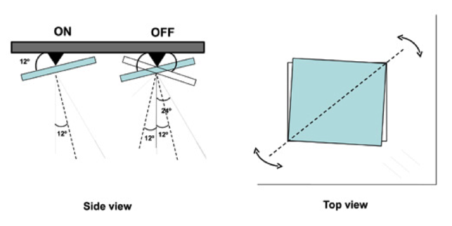

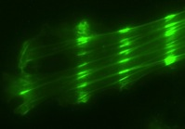
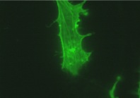
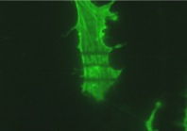
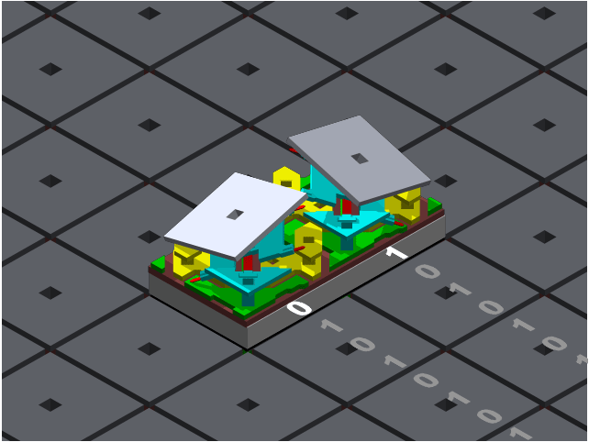
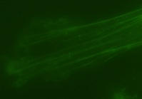
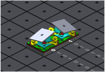
Digital-Multi-Mirror Device (DMD) – Andor Mosaic 3
27
Slide by Andor
Notes:
A DMD is a pixel array of micro-mirrors (100’s of thousand to millions) that act on a +12/-12 degree hinge. The mirrors that are in the ON state reflect light into the path of the microscope. Mirrors in the OFF state send light to a light dump inside the Mosaic 3. In this way, we can draw regions of interest (ROIs) of mirrors in the ON state, thereby creating ROIs of precise patterns of light on the sample plain. The key advantage to this approach over a galvonometer based approach (MicroPoint, FRAPPA) is the ability to simultaneously turn ON and OFF ROIs in uSec precision and to create ROIs that turn ON / OFF simultaneously.
By Kevin

Slide 28
Dissection of Neural Circuits
How do neural circuits drive and regulate: sleep, mental illness, sensation, mating behavior, aggression, and neurological diseases
An all-optical approach to answer these questions by using genetically encoded opsins, voltage sensors, and calcium indicators

Slide 29
Technical Challenges of All-optical Interrogation of Neural Circuits
Precise excitation and emission wavelengths of all fluorescent molecules (GFP, voltage sensors, GCaMP)
Wavelengths that activate opsins
Light-intensities could harm sample and activate opsins

Slide 30
Approach to Technical Challenges
Optics:
LEDs with specific wavelength and constant illumination
Filters/dichorics for unwanted wavelengths
Multimirror arrays for targeted illumination
Cameras that can capture images quickly

Slide 31
Approach to Technical Challenges
Protein engineering:
Voltage-sensors, calcium indicators, and other indicators of neuron activity with fast kinetics and large changes in fluorescence
Shift the wavelength of all tools to facilitate opsin activation with fluorescent indicators of neuron activity

