Slide 1
Bi/BE 177: Principles of Modern Microscopy
Lecture 16: Super-resolution microscopy: Part 2
Andres Collazo, Director Biological Imaging Facility
Wan-Rong (Sandy) Wong, Graduate Student, TA

Slide 2
Lecture 16: Single molecule imaging technique (TIRFM) and Super-resolution microscopy
Super-resolution techniques
  RESOLFT
    STED
  Stochastic functional techniques
    PALM
    STORM
SIM
Zeiss Airyscan
Discuss Homework 5 and reading 2.

Slide 3
Questions about last lecture?

Slide 4
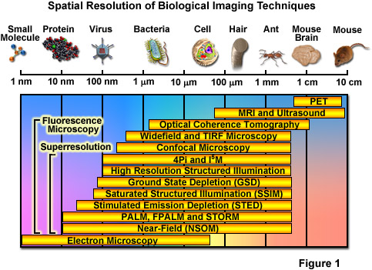
Spatial Resolution of Biological Imaging Techniques
“True” super-resolution
“Functional”
Notes:
http://zeiss-campus.magnet.fsu.edu/articles/superresolution/introduction.html

Slide 5

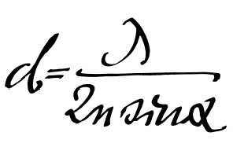
Super-resolution microscopy
Abbe (1873) reported that smallest resolvable distance between two points (d) using a conventional microscope may never be smaller than half the wavelength of the imaging light (~200 nm)
Is resolution diffraction limited?
Notes:
They fall into two broad categories, "true" super-resolution techniques, which capture information contained in evanescent waves, and "functional" super-resolution techniques, which use clever experimental techniques and known limitations on the matter being imaged to reconstruct a super-resolution image.^{[2]}
True subwavelength imaging techniques include those that utilize the Pendry Superlens and near field scanning optical microscopy, the 4Pi Microscope and structured illumination microscopy technologies like SIM and SMI. However, the majority of techniques of importance in biological imaging fall into the functional category.
There are two major groups of methods for functional super-resolution microscopy:
Deterministic super-resolution: The most commonly used emitters in biological microscopy, fluorophores, show a nonlinear response to excitation, and this nonlinear response can be exploited to enhance resolution. These methods include STED, GSD, RESOLFT and SSIM.
Stochastic super-resolution: The chemical complexity of many molecular light sources gives them a complex temporal behaviour, which can be used to make several close-by fluorophores emit light at separate times and thereby become resolvable in time. These methods include SOFI and all single-molecule localization methods (SMLM) such as SPDM, SPDMphymod, PALM, FPALM, STORM and dSTORM.

Slide 6
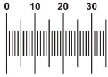
Super-resolution microscopy
Could always do super-resolution if could label points with different colors
Separate with different fluorescent filters (spectral unmixing)
Why fluorescence is such an important illumination technique
Hell, S.W., 2009. Microscopy and its focal switch. Nat Meth 6, 24-32.
Notes:
http://www.nature.com/nmeth/journal/v6/n1/full/nmeth.1291.html

Slide 7
Super-resolution microscopy
“True” super-resolution techniques
  Subwavelength imaging
  Capture information in evanescent waves
“Functional” super-resolution techniques
  Deterministic
    Exploit nonlinear responses of fluorophores
  Stochastic
    Exploit the complex temporal behaviors of fluorophores
Notes:
They fall into two broad categories, "true" super-resolution techniques, which capture information contained in evanescent waves, and "functional" super-resolution techniques, which use clever experimental techniques and known limitations on the matter being imaged to reconstruct a super-resolution image.^{[2]}
True subwavelength imaging techniques include those that utilize the Pendry Superlens and near field scanning optical microscopy, the 4Pi Microscope and structured illumination microscopy technologies like SIM and SMI. However, the majority of techniques of importance in biological imaging fall into the functional category.
There are two major groups of methods for functional super-resolution microscopy:
Deterministic super-resolution: The most commonly used emitters in biological microscopy, fluorophores, show a nonlinear response to excitation, and this nonlinear response can be exploited to enhance resolution. These methods include STED, GSD, RESOLFT and SSIM.
Stochastic super-resolution: The chemical complexity of many molecular light sources gives them a complex temporal behaviour, which can be used to make several close-by fluorophores emit light at separate times and thereby become resolvable in time. These methods include SOFI and all single-molecule localization methods (SMLM) such as SPDM, SPDMphymod, PALM, FPALM, STORM and dSTORM.

Slide 8
“Functional” super-resolution techniques
Deterministic
  Reversible Saturable (or Switchable) OpticaL Fluorescence Transitions (RESOLFT)
    STimulated Emission Depletion (STED)
    Ground State Depletion (GSD)
Stochastic
  STochastic Optical Reconstruction Microscopy (STORM)
  Photo Activated Localization Microscopy (PALM)
  Fluorescence Photo-Activation Localization Microscopy (FPALM)
Notes:
A trio of techniques independently surfaced during a four-month period in 2006 that elegantly demonstrated the sequential and stochastic readout with precise localization of multiple single molecules from specimens that were fluorescently labeled with photoswitchable dyes or optical highlighter fluorescent proteins at densities approaching those commonly employed in widefield and confocal fluorescence microscopy (ranging up to 100,000 molecules per square micrometer). These nearly identical single-molecule superresolution imaging techniques have been termed stochastic optical reconstruction microscopy (STORM; see Figure 1), photoactivated localization microscopy (PALM), and fluorescence photoactivation localization microscopy (FPALM). They rely on an activation laser applied at low power to trigger emission switching so that any particular molecule has a small probability of being photoactivated, but the majority of the population remains in the original (dark or native) emissive state. Although the major difference between the methods as they were originally published was simply the nature of the fluorescent probes used to achieve superresolution imaging, these techniques are virtually identical. In fact, the original STORM research report mentioned the use of fluorescent proteins, whereas the first PALM paper discussed the application of caged synthetic fluorophores.
http://www.microscopyu.com/articles/superresolution/stormintro.html
They fall into two broad categories, "true" super-resolution techniques, which capture information contained in evanescent waves, and "functional" super-resolution techniques, which use clever experimental techniques and known limitations on the matter being imaged to reconstruct a super-resolution image.^{[2]}
True subwavelength imaging techniques include those that utilize the Pendry Superlens and near field scanning optical microscopy, the 4Pi Microscope and structured illumination microscopy technologies like SIM and SMI. However, the majority of techniques of importance in biological imaging fall into the functional category.
There are two major groups of methods for functional super-resolution microscopy:
Deterministic super-resolution: The most commonly used emitters in biological microscopy, fluorophores, show a nonlinear response to excitation, and this nonlinear response can be exploited to enhance resolution. These methods include STED, GSD, RESOLFT and SSIM.
Stochastic super-resolution: The chemical complexity of many molecular light sources gives them a complex temporal behaviour, which can be used to make several close-by fluorophores emit light at separate times and thereby become resolvable in time. These methods include SOFI and all single-molecule localization methods (SMLM) such as SPDM, SPDMphymod, PALM, FPALM, STORM and dSTORM.

Slide 9
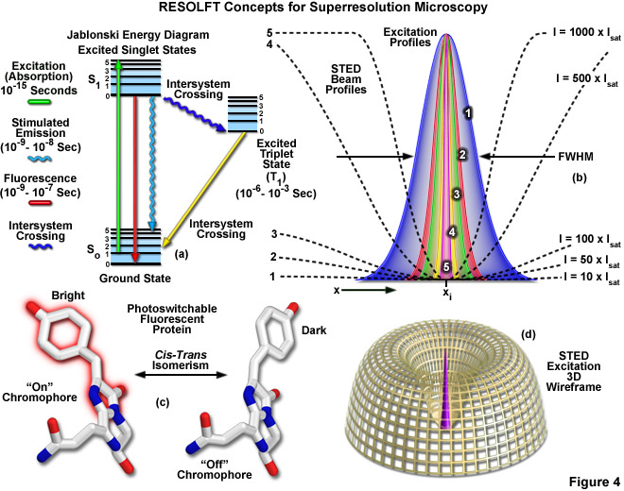
Reversible Saturable (or Switchable) Optical Fluorescence Transitions (RESOLFT)
Includes
STED
GSD
Notes:
Extremely high intensities are necessary for switching off the excited singlet state with STED (using what is termed a depletion laser), but switching to a metastable triplet or similar dark state (GSD) requires a light intensity between a thousand and a million times lower.
http://zeiss-campus.magnet.fsu.edu/articles/superresolution/introduction.html
http://www.microscopyu.com/articles/superresolution/stormintro.html

Slide 10
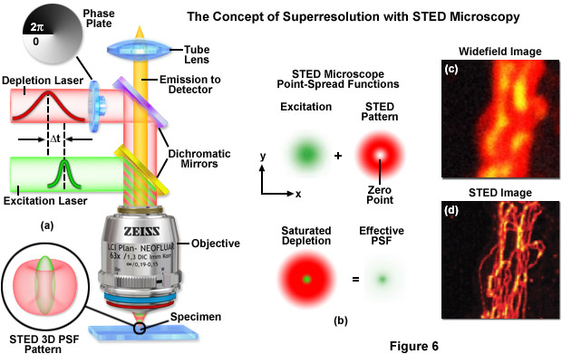
STED: STimulated Emission Depletion
http://zeiss-campus.magnet.fsu.edu

Slide 11
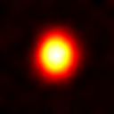
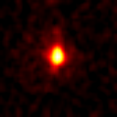
STED Microscopy means scanning a smaller focal spot across the sample
Point Spread Function: Confocal vs STED
measured with fluorescent nanoparticles under the same conditions
Typical lateral (X-Y)
resolution in a Confocal:
200x200 nm
Typical lateral (X-Y) FWHM
(Full Width Half Maximum)
in STED is 90x90 nm
STED z resolution is
confocal (500 nm)
STED enables separation
of structures even smaller
than its FWHM due to the
sharp peak. Actual
resolution is in the order
of 70 nm for raw data
(without deconvolution)
y
y
x
x

Slide 12
Pulse timing: Stimulated Emission Depletion - Fluorescence is depleted before it is emitted
Fluorescence
~ns
Excitation
STED
10-
200 ps
Timing
Energy diagram
<1ps
Time
No fluorescence
emission
S
4
1
3
Stimulated
Emission
Fluorescence
Absorption
S
2
0
1

Slide 13
“Functional” super-resolution techniques
Deterministic
  Reversible Saturable (or Switchable) OpticaL Fluorescence Transitions (RESOLFT)
    STimulated Emission Depletion (STED)
    Ground State Depletion (GSD)
Stochastic
  STochastic Optical Reconstruction Microscopy (STORM)
  Photo Activated Localization Microscopy (PALM)
  Fluorescence Photo-Activation Localization Microscopy (FPALM)
Notes:
A trio of techniques independently surfaced during a four-month period in 2006 that elegantly demonstrated the sequential and stochastic readout with precise localization of multiple single molecules from specimens that were fluorescently labeled with photoswitchable dyes or optical highlighter fluorescent proteins at densities approaching those commonly employed in widefield and confocal fluorescence microscopy (ranging up to 100,000 molecules per square micrometer). These nearly identical single-molecule superresolution imaging techniques have been termed stochastic optical reconstruction microscopy (STORM; see Figure 1), photoactivated localization microscopy (PALM), and fluorescence photoactivation localization microscopy (FPALM). They rely on an activation laser applied at low power to trigger emission switching so that any particular molecule has a small probability of being photoactivated, but the majority of the population remains in the original (dark or native) emissive state. Although the major difference between the methods as they were originally published was simply the nature of the fluorescent probes used to achieve superresolution imaging, these techniques are virtually identical. In fact, the original STORM research report mentioned the use of fluorescent proteins, whereas the first PALM paper discussed the application of caged synthetic fluorophores.
http://www.microscopyu.com/articles/superresolution/stormintro.html
These three methods were published independently during a short period of time and their principle is identical. STORM was originally described using Cy5 and Cy3 dyes attached to nucleic acids or proteins,^{[47]} while PALM and FPALM was described using photoswitchable fluorescent proteins.^{[48][49]}
http://en.wikipedia.org/wiki/Super-resolution_microscopy#Stochastic_functional_techniques
They fall into two broad categories, "true" super-resolution techniques, which capture information contained in evanescent waves, and "functional" super-resolution techniques, which use clever experimental techniques and known limitations on the matter being imaged to reconstruct a super-resolution image.^{[2]}
True subwavelength imaging techniques include those that utilize the Pendry Superlens and near field scanning optical microscopy, the 4Pi Microscope and structured illumination microscopy technologies like SIM and SMI. However, the majority of techniques of importance in biological imaging fall into the functional category.
There are two major groups of methods for functional super-resolution microscopy:
Deterministic super-resolution: The most commonly used emitters in biological microscopy, fluorophores, show a nonlinear response to excitation, and this nonlinear response can be exploited to enhance resolution. These methods include STED, GSD, RESOLFT and SSIM.
Stochastic super-resolution: The chemical complexity of many molecular light sources gives them a complex temporal behaviour, which can be used to make several close-by fluorophores emit light at separate times and thereby become resolvable in time. These methods include SOFI and all single-molecule localization methods (SMLM) such as SPDM, SPDMphymod, PALM, FPALM, STORM and dSTORM.

Slide 14
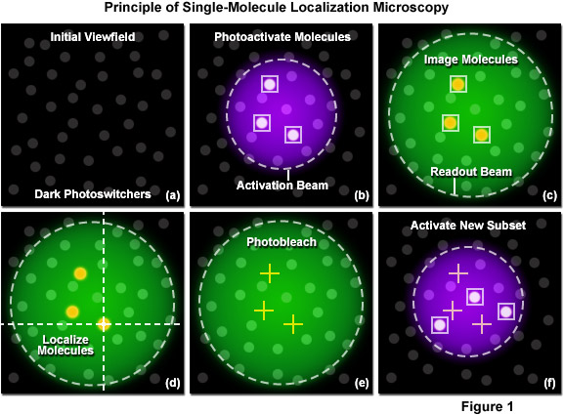
Single-molecule localization (SML) microscopy
Stochastic functional techniques
Notes:
http://zeiss-campus.magnet.fsu.edu/articles/superresolution/palm/practicalaspects.html
http://www.microscopyu.com/articles/superresolution/stormintro.html

Slide 15
Single-molecule localization microscopy
Stochastic functional techniques
STED vs STORM
How STORM works

Slide 16
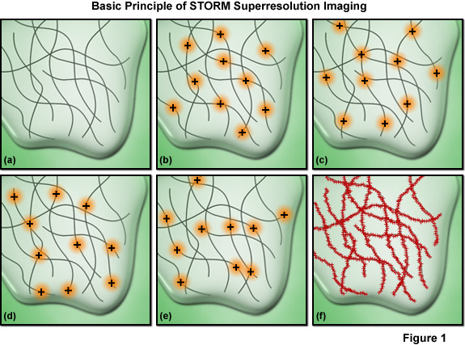
Single-molecule localization microscopy
Must have sufficient density of molecules being localized
Notes:
Among the critical aspects that must be considered are the accuracy of each individual localization measurement, the density of probes that have been localized in the final image (commonly termed molecular density), and the physical size of the labels themselves. The relationship between resolution and the localization precision of a single molecule is readily determined. The ability to resolve two fluorescent molecules as separate entities is limited by the localization precision, which determines the position (and uncertainty) of each molecule and thus the distance between the pair. The localization precision, in turn, is primarily dependent upon the number of photons collected from the fluorescent molecules during a single activation-deactivation cycle, provided the background noise is negligible.
Presented in Figure 7 is an important concept involving one of the most critical factors influencing spatial resolution in single-molecule superresolution imaging. The resolution versus molecular density is represented in Figure 7 as a series of yellow pixels in a test pattern. Features that might be present in a specimen are imaged at a progressively lower signal-to-noise ratio (fraction of pixels measured) as the molecular density decreases (from the bottom to the top of Figure 7) and these features become unresolvable when the mean molecular separation approaches feature size (the top row in Figure 7). Thus, as described in Equation (5), in order to achieve N-fold higher resolution in dimensions D, N^{D}-fold more pixels must be acquired. In order to realize such a resolution gain without compromising either the imaging speed or the signal-to-noise ratio, the signal collection rate (photons detected per second) must increase by a factor of at least N^{D}, which requires an N^{D}-fold higher exposure to the excitation laser for each image required.

Slide 17
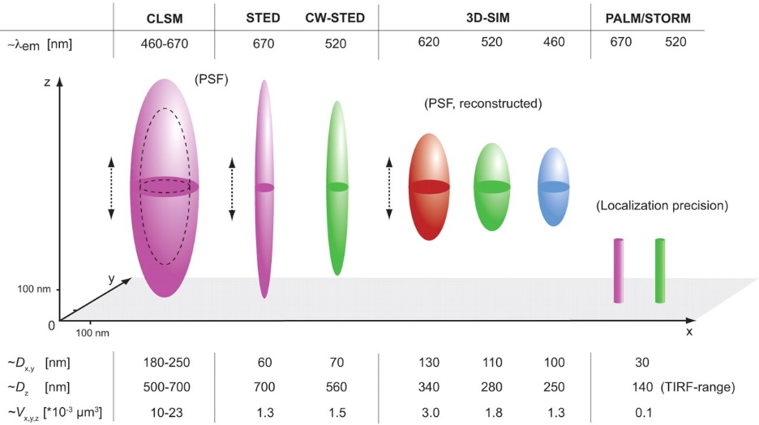
Each super-resolution techniques have pluses and minuses but all methods are improving
Schermelleh, L., Heintzmann, R., Leonhardt, H., 2010. A guide to super-resolution fluorescence microscopy. The Journal of Cell Biology 190, 165-175.
Notes:
http://jcb.rupress.org/content/190/2/165.full

Slide 18
Super-resolution requirements
High power lasers
Special fluorophores
Concentration of fluorophores
Special optics
Computational processing
Fast detectors
Sensitive detectors
Precise X,Y,Z positioning

Slide 19
Comparing different super-resolution (SR) techniques
(200 nm normal)
Technique | Photons needed | Resolution | Intensity | Time (sec)
STED | 1,000 | 20 nm | 10⁴ - 10⁹ | >60
Localization | 14,400 | 20 nm | 10³ - 10⁴ | >20
SR-SIM | 8 | 100 nm | 10 - 10² | 0.1 – 1.0
What is the difference between super-resolution (SR) SPIM and regular SPIM?

Slide 20
Super-resolution microscopy
Functional super-resolution techniques won Nobel
SIM did not win
SIM not considered to be super-resolution
Notes:
They fall into two broad categories, "true" super-resolution techniques, which capture information contained in evanescent waves, and "functional" super-resolution techniques, which use clever experimental techniques and known limitations on the matter being imaged to reconstruct a super-resolution image.^{[2]}
True subwavelength imaging techniques include those that utilize the Pendry Superlens and near field scanning optical microscopy, the 4Pi Microscope and structured illumination microscopy technologies like SIM and SMI. However, the majority of techniques of importance in biological imaging fall into the functional category.
There are two major groups of methods for functional super-resolution microscopy:
Deterministic super-resolution: The most commonly used emitters in biological microscopy, fluorophores, show a nonlinear response to excitation, and this nonlinear response can be exploited to enhance resolution. These methods include STED, GSD, RESOLFT and SSIM.
Stochastic super-resolution: The chemical complexity of many molecular light sources gives them a complex temporal behaviour, which can be used to make several close-by fluorophores emit light at separate times and thereby become resolvable in time. These methods include SOFI and all single-molecule localization methods (SMLM) such as SPDM, SPDMphymod, PALM, FPALM, STORM and dSTORM.

Slide 21
Remember overview of Optical sectioning Methods?
Deconvolution
  Point-Spread function (PSF) information is used to calculate light back to its origin
  Post processing of an image stack
Confocal and Multi-photon Laser Scanning Microscopy
  Pinhole prevents out-of-focus light getting to the sensor(s) (PMT - Photomultiplier)
  Multi Photon does not require pinhole
Spinning disk systems
  A large number of pinholes (used for excitation and emission) is used to prevent out-of-focus light getting to the camera
  Especially those using Nipkow disk and microlens
Structured Illumination Microscopy (SIM)
Notes:
Deconvolution mostly used with wide field microscopes but can be used for confocal data as well

Slide 22
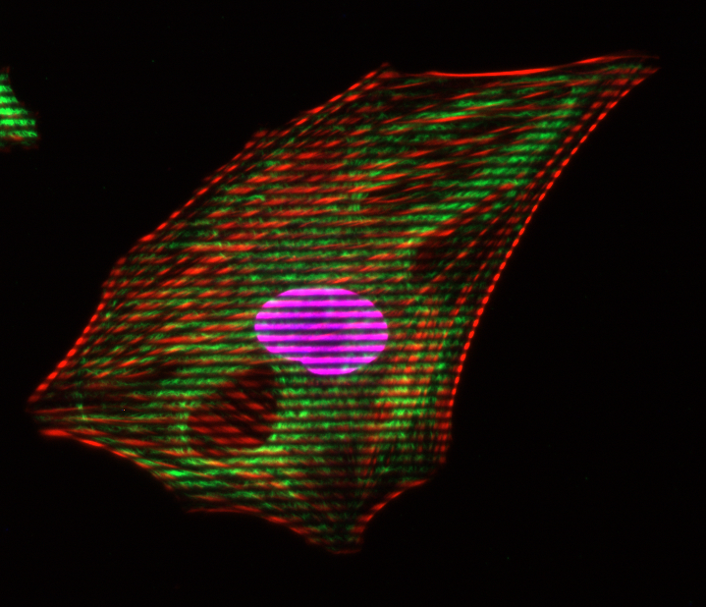
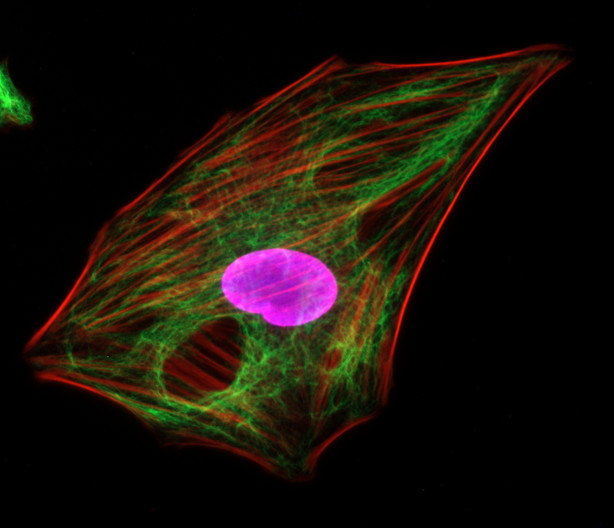
Structured Illumination
- The Principle
Grid pattern is projected into the focal plane of the objective
Visible in the eyepiece and the camera

Slide 23
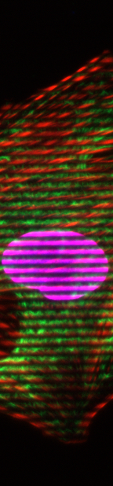
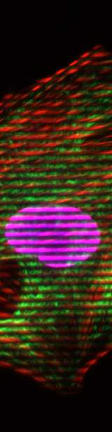
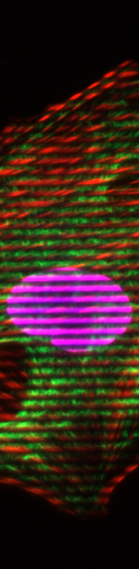
Structured Illumination
- The Principle
Grid pattern is projected into the focal plane of the objective
Visible in the eyepiece and the camera
The grid pattern is moving in 3-15 different positions (phases)
Example: 3 Phases
Each pixel intensity is calculated as:
(simplified equation)
1
2
3

Slide 24
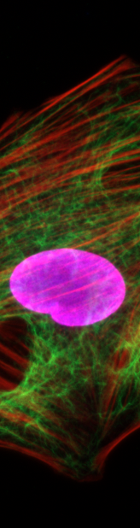
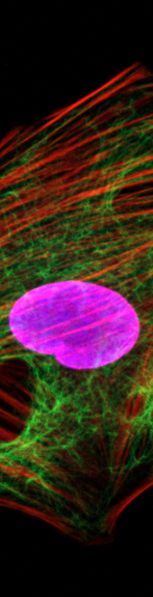
Structured Illumination
- The Principle
If the local change in contrast is high, the structure is inside the focal plane
If the local change in contrast is zero, the structure is not inside the focal plane
Conventional
1 phase
2 phase
3 phase
Sectioned

Slide 25
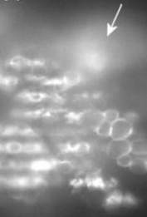
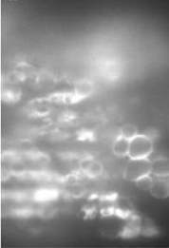
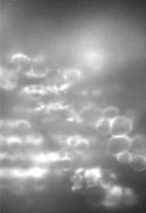
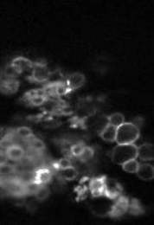
Structured Illumination
- The Contrast is the Key
No visible grid → out of focus light
Position 1
Position 2
Position 3
Optical section
Visible grid → structures in focus
Notes:
The algorithm is looking for a change in the local contrast. The algorithm is demodulating the images.
Simple image analysis algorithm detects the brightness differences of the 3 raw images and removes the out-of-focus signals in the image (demodulation)

Slide 26
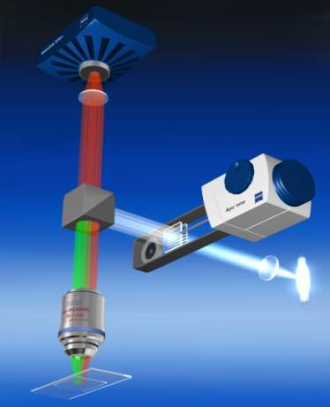
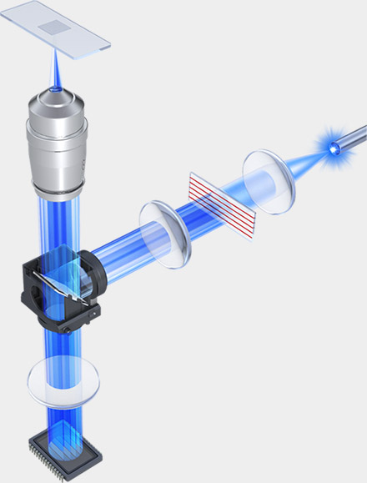
Structured Illumination Microscopy (SIM)
Option for wide-field microscope
Zeiss Apotome 2
Keyence BZ-X700
Notes:
Grab bag of methods that are not

Slide 27
Spatial Resolution of Biological Imaging Techniques
“True” super-resolution
“Functional”
Notes:
http://zeiss-campus.magnet.fsu.edu/articles/superresolution/introduction.html

Slide 28
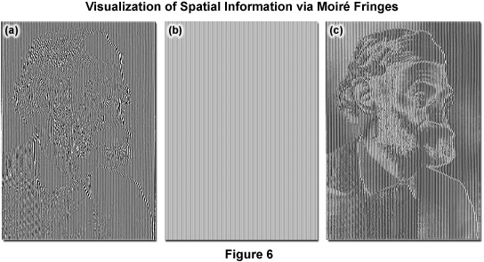
Super-resolution structured illumination microscopy (SR-SIM)
The visualization of fine spatial information via moiré fringes is illustrated by Figure 6, where panel (a) consists of fine spatial details of a portrait of Ernst Abbe that, upon mixing with the linear structure from panel (b), results in lower frequency moiré fringes that make the portrait much easier to recognize, as seen in Figure 6(c).
Notes:
Lateral resolution can be increased over the classical Abbe limit by a factor of two (approximately 100 to 120 nanometers) in structured illumination without discarding any emission light using laser-generated spatially structured illumination coupled to a widefield fluorescence microscope in what is termed superresolution (SR) SIM. Similar to the non-linear superresolution technique of SSIM described above, the linear SR-SIM structured light wavefronts render normally inaccessible high-resolution information available in the form of moiré fringes that contain harmonic frequencies from the specimen that are not available in conventional fluorescence microscopy. Thus, if two fine patterns are superposed in a multiplicative fashion, a beat pattern (moiré fringes) will appear in their product. In this case, one of the patterns is the spatial fluorophore distribution in the specimen and the other is the structured excitation light intensity.
http://zeiss-campus.magnet.fsu.edu/articles/superresolution/introduction.html
http://zeiss-campus.magnet.fsu.edu/articles/superresolution/supersim.html

Slide 29
How does super-resolution SIM differ from normal SIM?
It’s all due to the number of different gratings
Zeiss Apotome uses 1 grating
Keyence uses up to 2 gratings
For super-resolution Mats Gustafsson found that 3 different grating orientations were required (gratings finer also)
Notes:
Heintzmann, R., Cremer, C.G., 1999. Laterally modulated excitation microscopy: improvement of resolution by using a diffraction grating, pp. 185-196.
Gustafsson, M.G.L., 2000. Surpassing the lateral resolution limit by a factor of two using structured illumination microscopy. Journal of Microscopy 198, 82-87.
Fig. 1. Concept of resolution enhancement by structured illumination. (a) If two line patterns are superposed (multiplied), their product will
contain moireÂ fringes (seen here as the apparent vertical stripes in the overlap region). (b) A conventional microscope is limited by diffraction.
The set of low-resolution information that it can detect defines a circular `observable region' of reciprocal space. (c) A sinusoidally striped
illumination pattern has only three Fourier components. The possible positions of the two side components are limited by the same circle that
defines the observable region (dashed). If the sample is illuminated with such structured light, moireÂ fringes will appear which represent
information that has changed position in reciprocal space. The amounts of that movement correspond to the three Fourier components of the
illumination. The observable region will thus contain, in addition to the normal information, moved information that originates in two offset
regions (d). From a sequence of such images with different orientation and phase of the pattern, it is possible to recover information from an
area twice the size of the normally observable region, corresponding to twice the normal resolution (e).

Slide 30
Examples of SR-SIM images from Gustafsson
121 nm beads
Actin cytoskeleton
Notes:
Fig. 3. A cluster of fluorescent microspheres of nominal diameter
121 nm, as imaged by conventional (a), confocal (b), and
structured illumination (c) microscopy. The confocal microscope
was operated under maximum resolution conditions. The apparent
size (FWHM) of isolated beads is approximately 130 nm in the
structured illumination image, compared to 290 and 210 nm for
conventional and confocal microscopy.
Fig. 4. The actin cytoskeleton at the edge of a HeLa cell, as imaged by (a, c) conventional and (b, d) structured illumination microscopy. (c, d)
Enlargements of the boxed areas in (a) and (b), respectively. Fibres separated by less than the resolution limit of the conventional microscope
are well resolved using structured illumination (d). The apparent widths (FWHM) of the finest protruding fibres [small arrows in (a, b)] are
lowered to 110±120 nm in (b), compared to 280±300 nm in (a).

Slide 31
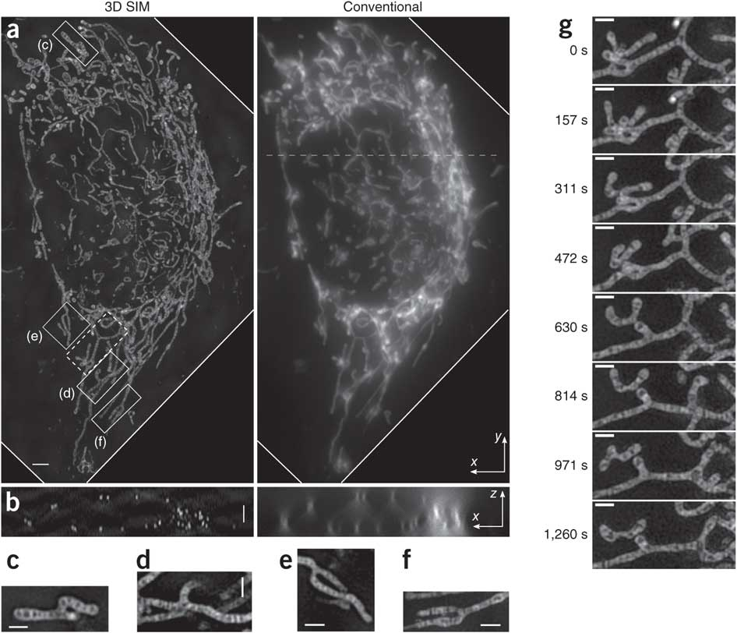
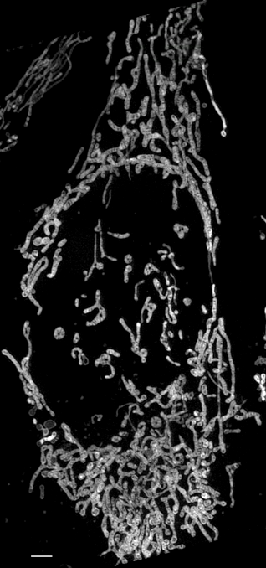
3D SR-SIM uses SLM from Gustafsson (2011)
MitoTracker Green acquired at 20 sec intervals
Notes:
Figure 2 | Live 3D SIM and conventional wide-field microscopy images of a HeLa cell stained with MitoTracker Green. (a) Maximum-intensity projection along z dimension through the cell volume at time 0 of a 50-time-point series. Each SIM volume was acquired in 20.33 s (that is, 35-ms exposure time × 38 axial planes × 15 patterns + 38 axial planes × 10-ms z-stage settle time). (b) One x–z cross-section of the same volume sliced through the dashed line shown in a. (c–f) Single-plane x–y slices corresponding to the boxed regions in a. (g) Eight time frames of the region boxed with dashed line in a. Each frame is a maximum-intensity projection along z over a 1.3 μm thickness that contains the featured ‘Y’-shaped mitochondrion. Scale bars, 2 μm (a,b) and 1 μm (c–g).
Shao, L., Kner, P., Rego, E.H., Gustafsson, M.G.L., 2011. Super-resolution 3D microscopy of live whole cells using structured illumination. Nat Meth 8, 1044-1046.

Slide 32
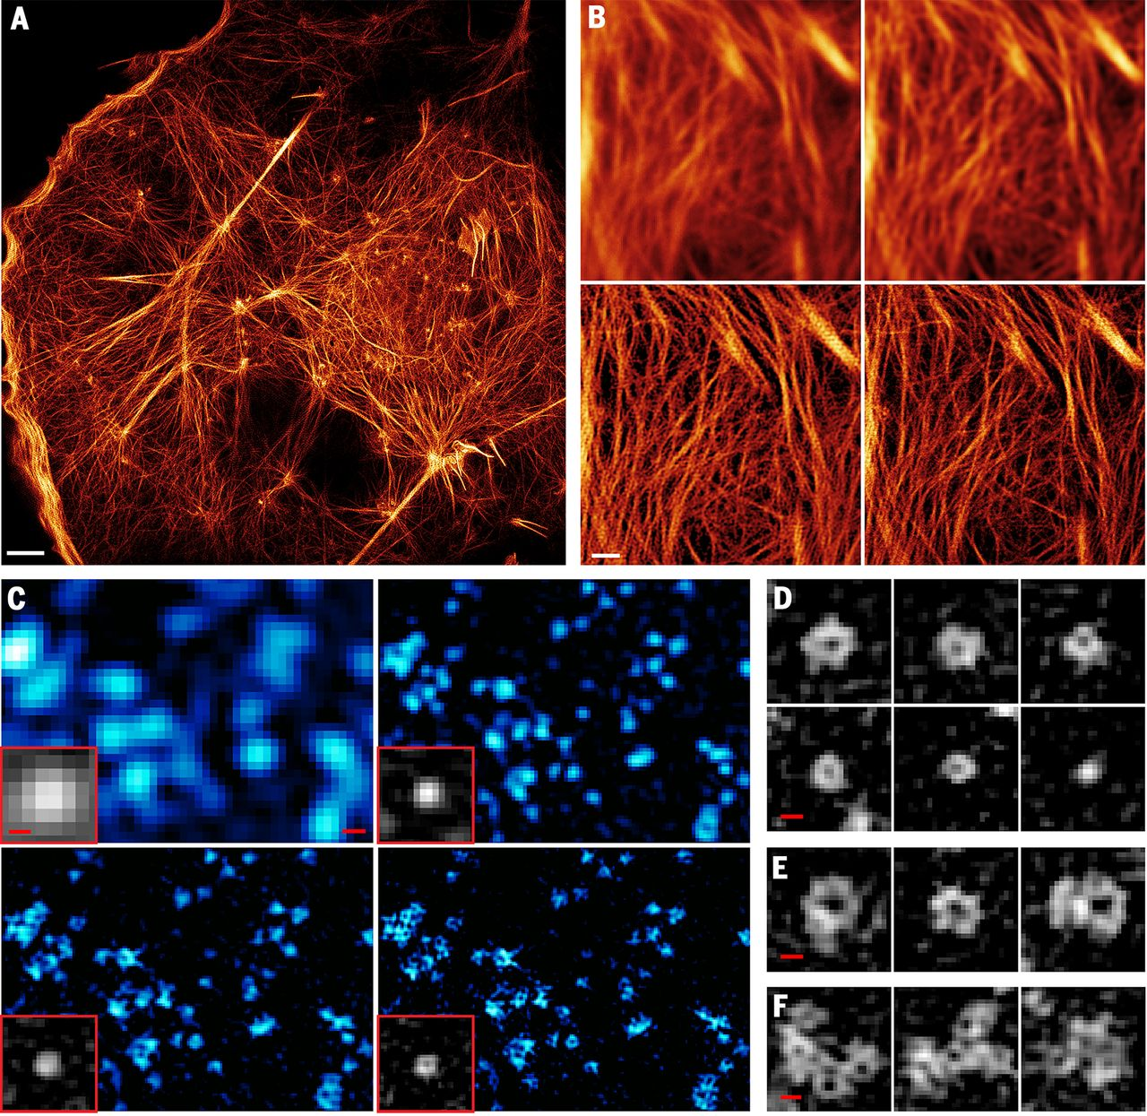
SR-SIM can get even better with TIRF + high NA lens (1.7) + reversibly photoswitchable fluorescent protein
TIRF
TIRF + deconvolution
TIRF-SIM
PA-NL-SIM
Notes:
Nonlinear TIRF-SIM with patterned activation; Actin cytoskeleton
Li, D., Shao, L., Chen, B.-C., Zhang, X., Zhang, M., Moses, B., Milkie, D.E., Beach, J.R., Hammer, J.A., Pasham, M., Kirchhausen, T., Baird, M.A., Davidson, M.W., Xu, P., Betzig, E., 2015. Extended-resolution structured illumination imaging of endocytic and cytoskeletal dynamics. Science 349.

Slide 33
SR-SIM can get even better with TIRF + high NA lens (1.7) + reversibly photoswitchable fluorescent protein
TIRF + decon (220 nm)
TIRF-SIM (97 nm)
PA-NL-SIM (62 nm)
Saturated PA-NL-SIM (45)
Notes:
Nonlinear TIRF-SIM with patterned activation caveolin, caveolea
Li, D., Shao, L., Chen, B.-C., Zhang, X., Zhang, M., Moses, B., Milkie, D.E., Beach, J.R., Hammer, J.A., Pasham, M., Kirchhausen, T., Baird, M.A., Davidson, M.W., Xu, P., Betzig, E., 2015. Extended-resolution structured illumination imaging of endocytic and cytoskeletal dynamics. Science 349.

Slide 34
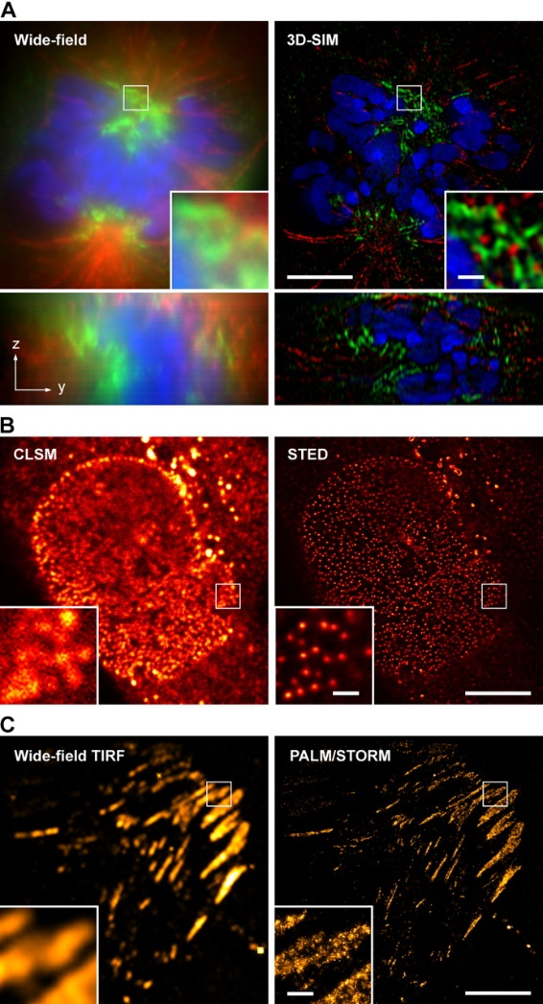
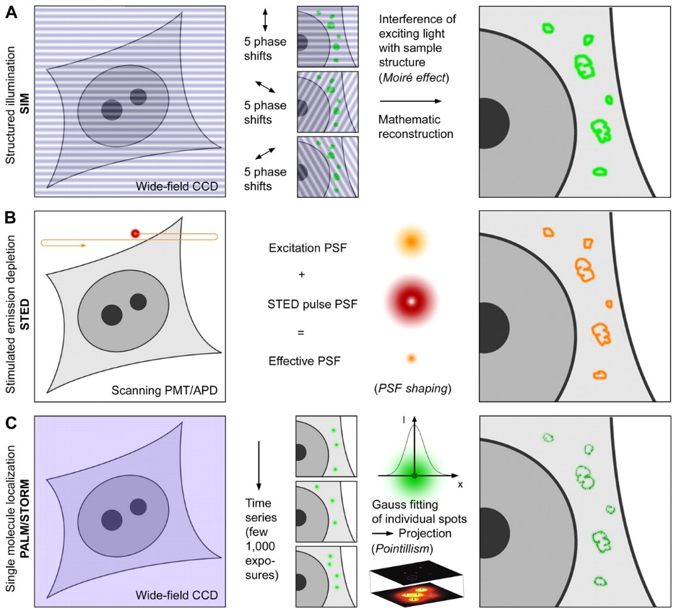
Schermelleh, L., Heintzmann, R., Leonhardt, H., 2010. A guide to super-resolution fluorescence microscopy. The Journal of Cell Biology 190, 165-175.
Notes:
http://jcb.rupress.org/content/190/2/165.full

Slide 35
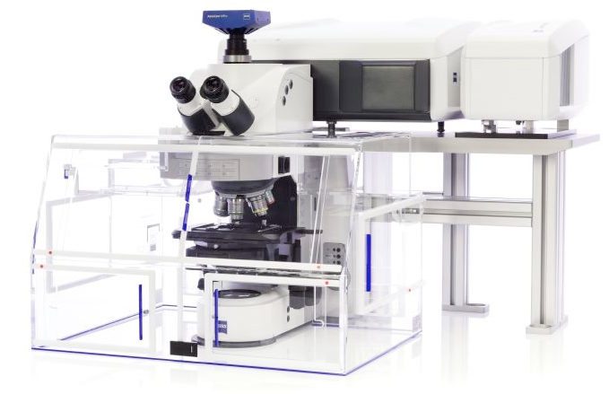
Zeiss Airyscan yet another means to achieve super-resolution
Available here at Caltech in the BIF

Slide 36

Conventional scanning confocal and the 1 A.u. limit.
PH = 1 A.u. is the standard setting for resolution.
PH = 1 A.u.
A point-like emitter generates a
diffraction limited pattern (~ PSF)
excitation
excitation and detection
are scanned in sync
detection
scan
At 1 A.u. The PSF is mapped directly 1:1
Intensity
~ 240 nm
scan
Notes:
The practical limit for the pinhole-size in confocal microscopy is 1.A.u. the resolution achieved at that setting is comparable to the classical limits postulated by Abbé or Rayleigh. The spatial image of a point-like emitter recorded with a confocal microscope with a 1 A.u. pinhole will correspond to the classically defined PSF.

Slide 37
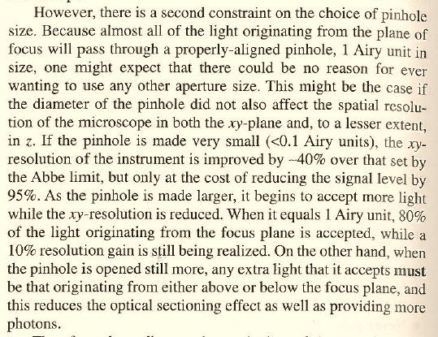
Scanning confocal and the 1 Airy unit pinhole “limit”.
At PH < 1 AU signal loss is larger than gain in resolution.
The potential to increase resolution by closing the pinhole (PH) is not a new idea (red)
One finds this idea described in many places, including Pawley’s Handbook of Confocal Microscopy
The price to pay, however, is
sacrificing 95% of the signal
(green).
The famous 1 AU setting
is more of a practical barrier
than a theoretical limit.
Fortunately, now there is
a clever workaround with
Airyscan...
Notes:
One main aspect of Airyscan is its capability to achieve superresolution (in the sense of Abbé or Rayleigh). The idea, indeed, is not new – It is widely known that confocal microscopes carry the capability to convolve excitation with detection and result in a factor-sqrt(2) ammeliorated resolution. However, in order to tap into this regime, the pinhole must be much smaller than the PSF itself. The loss of signal in this case poses, in the mojority of cases, an unsurmountable difficulty. As noted previously, Airyscan acts as if scanning with 0.2 A.u. pinholes, however, because the light is collected from the whole array, each pixel is in effect scanned at least 32 times. Since all photons are collected the loss of signal is virtually avoided.

Slide 38
Airyscan: PH ~ 0.2 A.u. scanning without loss.
A single element improves resolution
PH = 0.2 a.u.
A point-like emitter generates a
diffraction limited pattern (~ PSF)
excitation
By collecting just the central element
the PSF is weaker but smaller
detection
scan
Intensity
~170nm
scan
Notes:
Airyscan acts as if scanning with 0.2 A.u. pinholes, however, because the light is collected from the whole array, each pixel is - in effect - scanned at least 32 times. Since all photons are collected the loss of signal is virtually avoided. The PSF can be re-mapped as shown, generating a smaller PSF by a factor sqrt(2). This is true in every direction (including z – not shown, here). At this level of oversampling, one is generating ideal conditions for deconvolution. A deconvolution step applied to these images generates a further increase, of about 1.2-fold, in resolution. This additional push in resolution, however, depends on image quality and cannot be expected to work perfectly all the times.

Slide 39
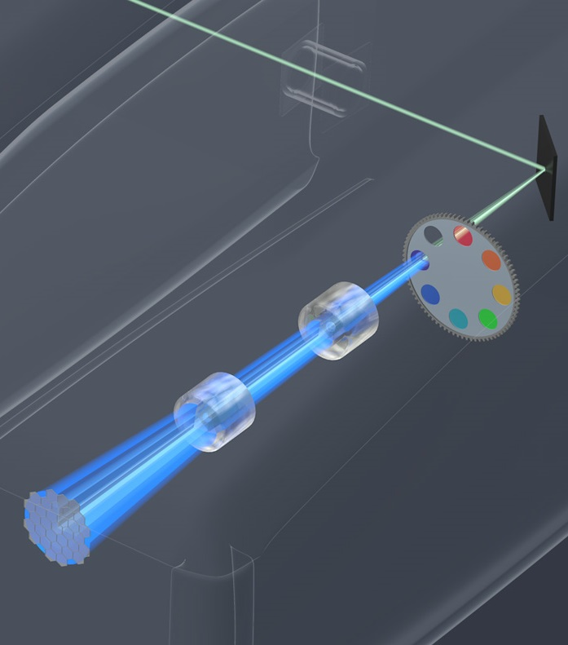
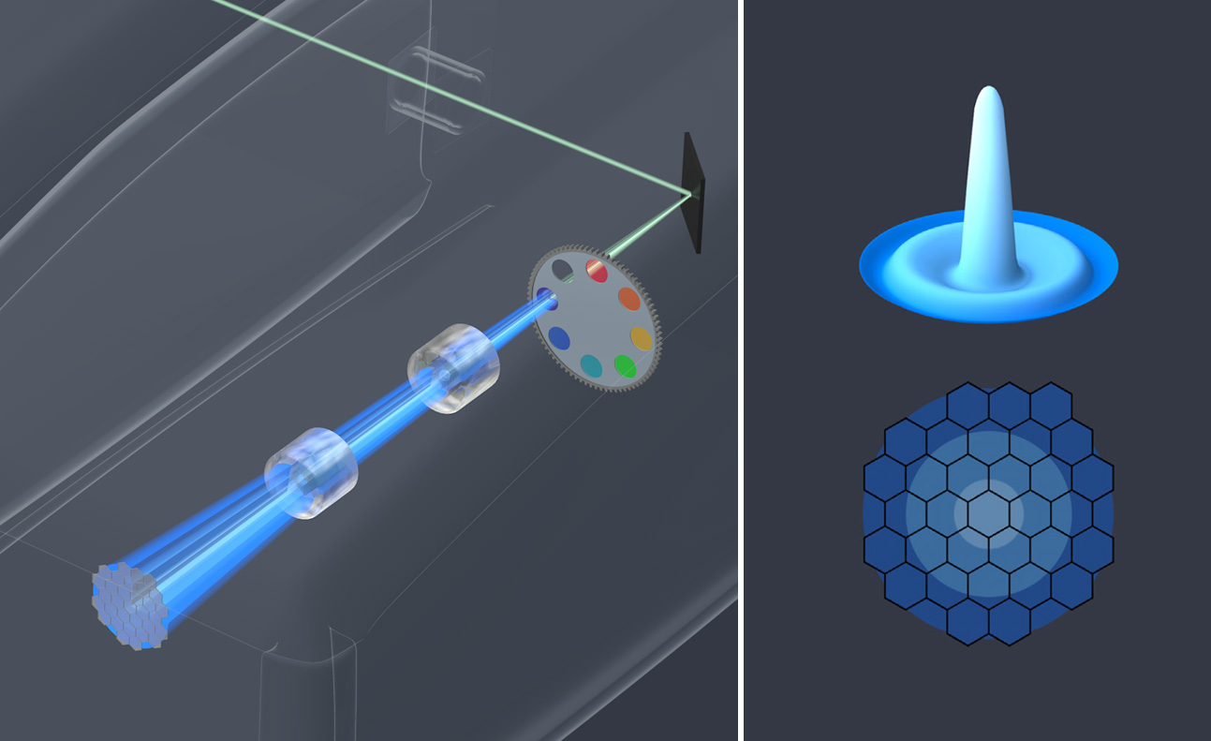
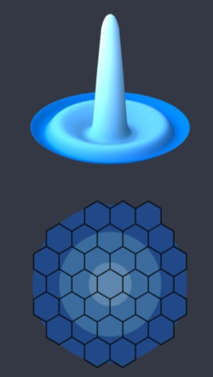
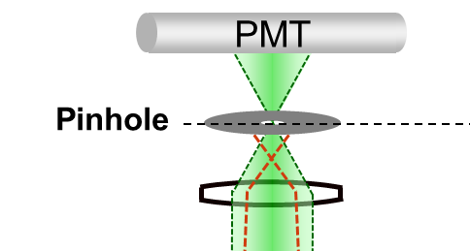

Airyscan Detection
Unique 32 GaAsP-PMT design
Replaced with New Design
LSM 880 output port
filter wheel
Y
adaptive zoom optics
32 GaAsP-PMT array
X
Notes:
Airyscan is a 32-channel GaAsP detector array arranged in a hexagonal grid. The full intensity distribution passing the pinhole reaches this detector. Each GaAsP subunit can be seen as a detector with a smaller pinhole. In effect every pixel on the image is generated from 32 subunits – either using the space information to generate superresolution or collecting all photons as an ordinary detector...

Slide 40
Airyscan: PH ~ 0.2 A.u. scanning without loss.
A single element improves resolution
PH = 1,25 a.u.
A point-like emitter generates a
diffraction limited pattern (~ PSF)
excitation
By collecting just the central element
the PSF is weaker but smaller
detection
subunit
~ 0.2 A.u.
scan
Intensity
~170nm
scan
Notes:
Airyscan acts as if scanning with 0.2 A.u. pinholes, however, because the light is collected from the whole array, each pixel is - in effect - scanned at least 32 times. Since all photons are collected the loss of signal is virtually avoided. The PSF can be re-mapped as shown, generating a smaller PSF by a factor sqrt(2). This is true in every direction (including z – not shown, here). At this level of oversampling, one is generating ideal conditions for deconvolution. A deconvolution step applied to these images generates a further increase, of about 1.2-fold, in resolution. This additional push in resolution, however, depends on image quality and cannot be expected to work perfectly all the times.

Slide 41
Airyscan: PH ~ 0.2 A.u. scanning without loss.
A single element – even if offset still improves resolution
PH = 1,25 a.u.
A point-like emitter generates a
diffraction limited pattern (~ PSF)
excitation
By using an element offset from the
centre, resolution is still improved
detection
subunit
~ 0.2 A.u.
scan
Intensity
scan
Notes:
Airyscan acts as if scanning with 0.2 A.u. pinholes, however, because the light is collected from the whole array, each pixel is - in effect - scanned at least 32 times. Since all photons are collected the loss of signal is virtually avoided. The PSF can be re-mapped as shown, generating a smaller PSF by a factor sqrt(2). This is true in every direction (including z – not shown, here). At this level of oversampling, one is generating ideal conditions for deconvolution. A deconvolution step applied to these images generates a further increase, of about 1.2-fold, in resolution. This additional push in resolution, however, depends on image quality and cannot be expected to work perfectly all the times.

Slide 42
Airyscan: PH ~ 0.2 A.u. scanning without loss.
Combining the data
PH = 1,25 a.u.
Image formation:
1 = Offset signal
2 = Add signal
excitation
detection
subunit
~ 0.2 A.u.
scan
Intensity
scan
Notes:
Airyscan acts as if scanning with 0.2 A.u. pinholes, however, because the light is collected from the whole array, each pixel is - in effect - scanned at least 32 times. Since all photons are collected the loss of signal is virtually avoided. The PSF can be re-mapped as shown, generating a smaller PSF by a factor sqrt(2). This is true in every direction (including z – not shown, here). At this level of oversampling, one is generating ideal conditions for deconvolution. A deconvolution step applied to these images generates a further increase, of about 1.2-fold, in resolution. This additional push in resolution, however, depends on image quality and cannot be expected to work perfectly all the times.

Slide 43
Airyscan: PH ~ 0.2 A.u. scanning without loss.
With 32 detectors all photons are recorded and mapped at the same time
PH = 1,25 a.u.
excitation
All elements are acquired simultaneously, and can be remapped for better resolution and sensitivity
The PSF is mapped directly 1:√2
detection
subunit
~ 0.2 A.u.
Intensity
Get an extra push beyond the limit using deconvolution (down to 1:1,7)
~ 140 nm
scan
Notes:
Airyscan acts as if scanning with 0.2 A.u. pinholes, however, because the light is collected from the whole array, each pixel is - in effect - scanned at least 32 times. Since all photons are collected the loss of signal is virtually avoided. The PSF can be re-mapped as shown, generating a smaller PSF by a factor sqrt(2). This is true in every direction (including z – not shown, here). At this level of oversampling, one is generating ideal conditions for deconvolution. A deconvolution step applied to these images generates a further increase, of about 1.2-fold, in resolution. This additional push in resolution, however, depends on image quality and cannot be expected to work perfectly all the times.

Slide 44
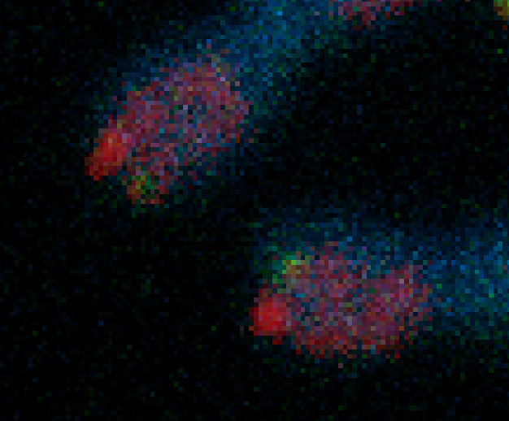
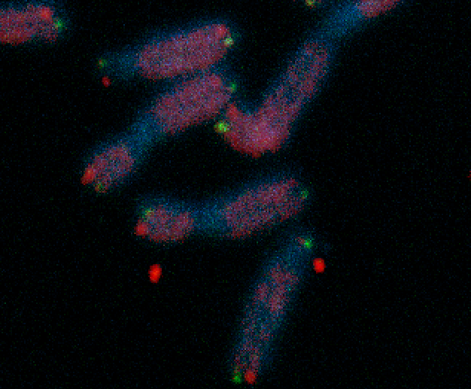
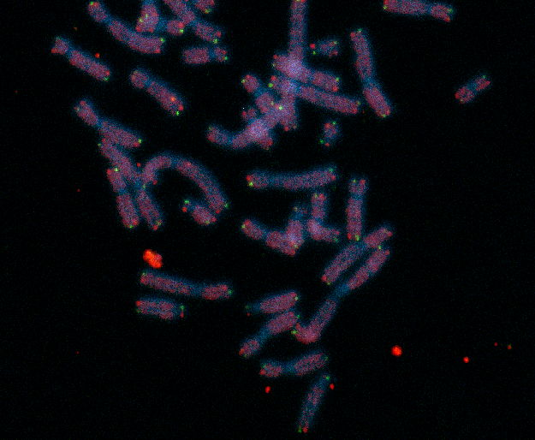
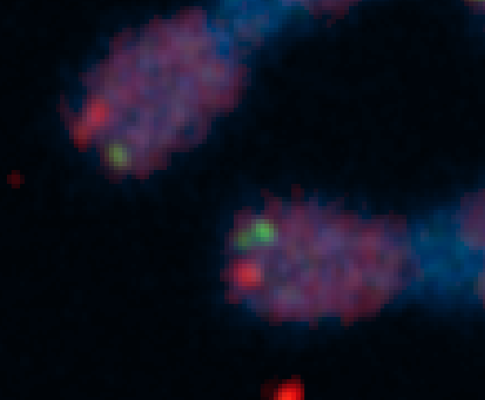
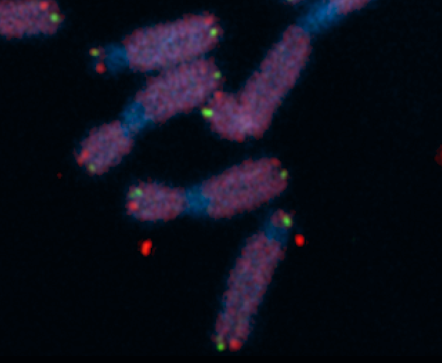
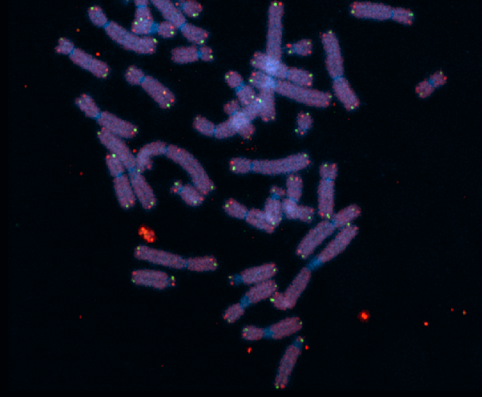
ZEISS LSM 880 – Airyscan enhances resolution, boosts SNR “...thereby allowing for a much more accurate quantification“ (Karlseder and Fitzpatrick, The Salk Institute, La Jolla, CA, USA)
2 µm
2 µm
2 µm
2 µm
Telomere replication without RTEL1: Stalled forks and telomere breakage visualized as doubled dots using Airyscan. Resolution is meaningless without good SNR.
Courtesy: J. Karlseder Ph.D. (Molecular and Cell Biology Laboratory) and
J. Fitzpatrick Ph.D. (Director, Waitt Advanced Biophotonics Core),
The Salk Institute, La Jolla, USA.
Notes:
The principle can be demonstrated by acquiring images. For example of a real sample
The images and the following text is courtesy of J. Karlseder Ph.D. (Molecular and Cell Biology Laboratory) and
J. Fitzpatrick Ph.D. (Director, Waitt Advanced Biophotonics Core),
The Salk Institute, La Jolla, USA.
Sample :
The cells are IMR90 human diploid lung fibroblasts. They are primary cells at population doubling 45, grown at 3% oxygen, 7.5% CO2 in DMEM supplemented with 15% fetal bovine serum.
The DNA has been stained with DAPI, the telomeric G strand (leading strand) in green with a Peptide Nucleic Acid probe (Alexa 488-CCCTAACCCTAACCCTAA) and the telomeric C strand (lagging strand) in red with a Peptide Nucleic Acid probe (Alexa-546-TTAGGGTTAGGGTTAGGG).
Prior to their harvest the cells have been treated with siRNAs targeting RTEL1 (2). RTEL1 is a helicase that is essential for telomere replication, and lack of the protein leads to stalled forks at telomeres and telomere breakage. This can be seen by individual telomeres that appear as more than one dot, as highlighted in the images. The new detection method is far superior to the old one detecting multiple telomere dots, thereby allowing for a much more accurate quantification of telomere replication problems.

Slide 45
Homework 6: due 7 March.
During this class we have discussed several different ways of doing optical sectioning which provides us with the 3rd Dimension. We have also learned that microscopy usually involves compromises, with some microscopy techniques working better for one type of experiment than another. For this assignment you are going to compare and contrast two different microscopy techniques for doing optical sectioning. List one advantage and one disadvantage that one technique has over the other.
1: List two optical sectioning techniques.
2: List an advantage that one technique has over the other.
3: List a disadvantage that one technique has over the other.

Slide 46
Homework 5
Early on during zebrafish development, many molecules are involved in patterning the embryo’s tissues and axes. One possible explanation for this complex patterning is Alan Turing’s reaction-diffusion model. To test this you have fluorescently tagged three proteins involved in this process. Your hypothesis is that one protein acts at a long distance while another acts at a short distance and the third at an intermediate distance.
Questions: What fluorescent technique would you use to determine the mobility of these three proteins? What would you predict is the relative mobility of these three proteins?

Slide 47
Homework 5
Early on during zebrafish development, many molecules are involved in patterning the embryo’s tissues and axes. One possible explanation for this complex patterning is Alan Turing’s reaction-diffusion model. To test this you have fluorescently tagged three proteins involved in this process. Your hypothesis is that one protein acts at a long distance while another acts at a short distance and the third at an intermediate distance.
Questions: What fluorescent technique would you use to determine the mobility of these three proteins? What would you predict is the relative mobility of these three proteins?
Answer: (1) FRAP or FCS; (2) Protein acting at a long distance has a higher diffusion coefficient than the protein acting at an intermediate distance while the protein acting at a short distance has a very low diffusion coefficient. Long distance > intermediate > short.

Slide 48
This example is based on an actual paper.
Müller, P., Rogers, K.W., Jordan, B.M., Lee, J.S., Robson, D., Ramanathan, S., Schier, A.F., 2012. Differential Diffusivity of Nodal and Lefty Underlies a Reaction-Diffusion Patterning System. Science 336, 721-724.
They used FRAP to determine the mobility of four different proteins 2 nodals (Cyclops and Squint) and 2 Lefties.
Notes:
Figure S18. Measurement of effective diffusion coefficients. (A-B) FRAP experimental overview. A cuboidal volume was bleached into embryos
uniformly expressing secreted fluorescent fusion proteins (A). Medial optical slices were imaged every 10 s following bleaching. The average intensity
in the bleached region recovers over time (B) and can be used to calculate the diffusion coefficient of the fluorescent species. (C-F) Embryos
were injected at the one-cell stage with 30 pg of mRNA encoding Cyclops-GFP (C), Squint-GFP (D), Lefty1-GFP (E) or Lefty2-GFP (F). Uniformly
expressed Nodal- or Lefty-GFP fusion proteins were locally photobleached at blastula stages. Optical slices were acquired every 10 s after the
bleach for a total of 50 min. The effective diffusion coefficient, D, was determined by fitting the resulting recovery profile (black) with simulated recovery
curves (red) that were numerically generated using a model that includes diffusion, production and clearance in a three-dimensional embryo-like
geometry (Text S6). Results for individual embryos are shown normalized to the final time point, and average diffusion coefficients are listed here
and in Table S6.

Slide 49
Cyclops slow, Squint intermediate & Lefty fast.
Notes:
Figure S18. Measurement of effective diffusion coefficients. (A-B) FRAP experimental overview. A cuboidal volume was bleached into embryos
uniformly expressing secreted fluorescent fusion proteins (A). Medial optical slices were imaged every 10 s following bleaching. The average intensity
in the bleached region recovers over time (B) and can be used to calculate the diffusion coefficient of the fluorescent species. (C-F) Embryos
were injected at the one-cell stage with 30 pg of mRNA encoding Cyclops-GFP (C), Squint-GFP (D), Lefty1-GFP (E) or Lefty2-GFP (F). Uniformly
expressed Nodal- or Lefty-GFP fusion proteins were locally photobleached at blastula stages. Optical slices were acquired every 10 s after the
bleach for a total of 50 min. The effective diffusion coefficient, D, was determined by fitting the resulting recovery profile (black) with simulated recovery
curves (red) that were numerically generated using a model that includes diffusion, production and clearance in a three-dimensional embryo-like
geometry (Text S6). Results for individual embryos are shown normalized to the final time point, and average diffusion coefficients are listed here
and in Table S6.

Slide 50
2D versus 3D model.
Notes:
Figure S19. FRAP geometries. (A) Average embryo geometry during FRAP experiments. Embryos were injected with mRNA encoding GFP fusion
constructs at the one-cell stage, generating embryos that uniformly express the GFP fusions (green). FRAP experiments were performed at late
blastula stages, when the blastoderm forms a dome on top of the yolk. A cuboidal volume was bleached into the center of the embryo (black), and
recovery of fluorescence was observed in a medial optical section (red). This geometry was used for three-dimensional simulations of FRAP experiments
(3D analysis model) with the geometric parameters indicated in (B). (C) Medial optical section acquired during FRAP experiments (twodimensional
view of the red line in (A)). The bleached window is indicated in black. This geometry was used for two-dimensional simulations of FRAP
experiments (2D analysis model) as shown in (D).The analysis areas inside the bleach window (Awin), outside the bleach window (Aout) and the
entire slice (Asl) used to calculate spatial intensity averages are indicated. (E) Three-dimensional extension of the two-dimensional model shown in
(C) and (D). The slice would extend to infinity above and below the depicted cylinder geometry. (F) Averaging of the eight octants (Q1-Q8) for the first
image taken after photobleaching defines the initial condition Ī0 in the imaging plane used for three-dimensional simulations of FRAP experiments.
(G) Simulated FRAP recovery curves in two- and three-dimensional model geometries. FRAP experiments were simulated using the 3D or 2D analysis
models for a range of diffusion coefficients, D, from 0.1 to 50 μm2/s without clearance or production. For the initial condition, the concentration in
the bleached region was set to a value of zero and to a value of one everywhere else. The resulting recovery curves in the bleached window were
normalized to the concentration at the final time point t = 3000 s. Note that the recovery profiles in two- and three-dimensional geometries are similar
for small values of D, but different for higher diffusivities. (H) The 3D analysis model was used to generate a recovery curve given a diffusion coefficient
of 10 μm2/s (red). This simulated curve was then fitted using the 2D model (blue). Consistent with (G), the 2D fit results in a lower diffusion
coefficient, highlighting the differences between the 2D and 3D approaches and the importance of using the appropriate geometry when fitting FRAP
data.

Slide 51
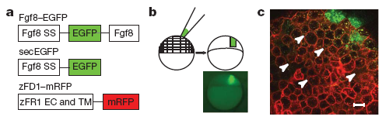
Why did they use FRAP instead of FCS?
Proteins acting as morphogen
  Yu, S. R., M. Burkhardt, et al. (2009). Nature 461(7263): 533-536.
Receptor ligand interactions
  Ries, J., S. R. Yu, et al. (2009). Nat Methods 6(9): 643-645.

Slide 52
Why did they use FRAP instead of FCS?
Proteins acting as morphogen
  Yu, S. R., M. Burkhardt, et al. (2009). Nature 461(7263): 533-536.

Slide 53
Paper to read
McConnell, G., Trägårdh, J., Amor, R., Dempster, J., Reid, E., Amos, W.B., 2016. A novel optical microscope for imaging large embryos and tissue volumes with sub-cellular resolution throughout. eLife 5, e18659.
https://elifesciences.org/content/5/e18659

Slide 54
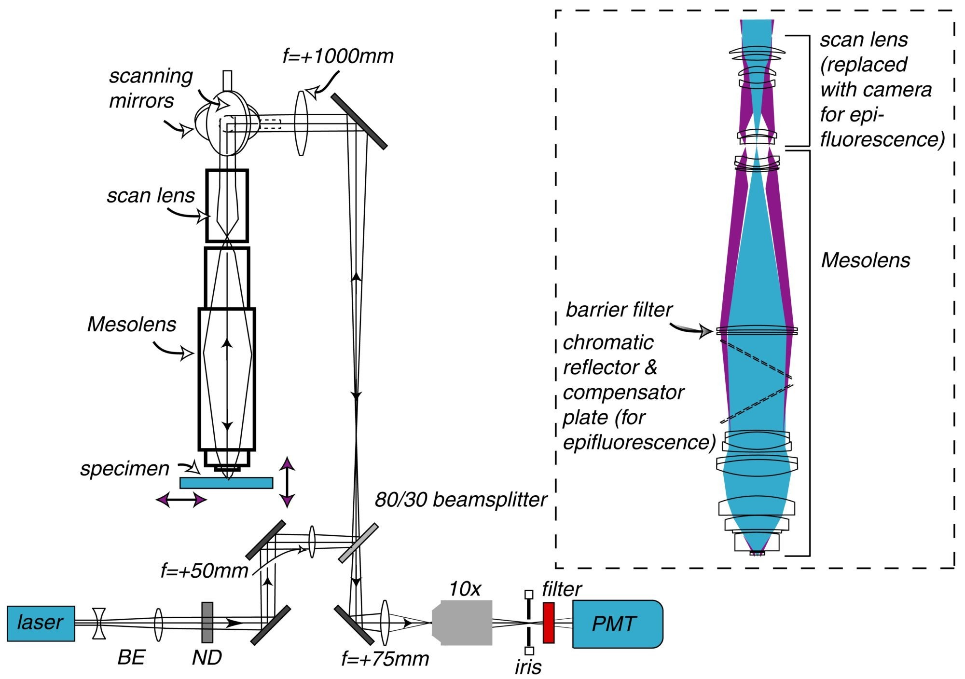
Mesolens: low mag with high NA
Notes:
Schematic diagram of the laser scanning confocal Mesolens system.
BE=beam expander, ND= neutral density filter. Only one detection channel is shown here for ease of presentation. Inset: Illustration of the optical train of the Mesolens and scan lens. Also shown is the position of the compensator plates and camera when the Mesolens is used for wide-field epi-fluorescence imaging.

Slide 55
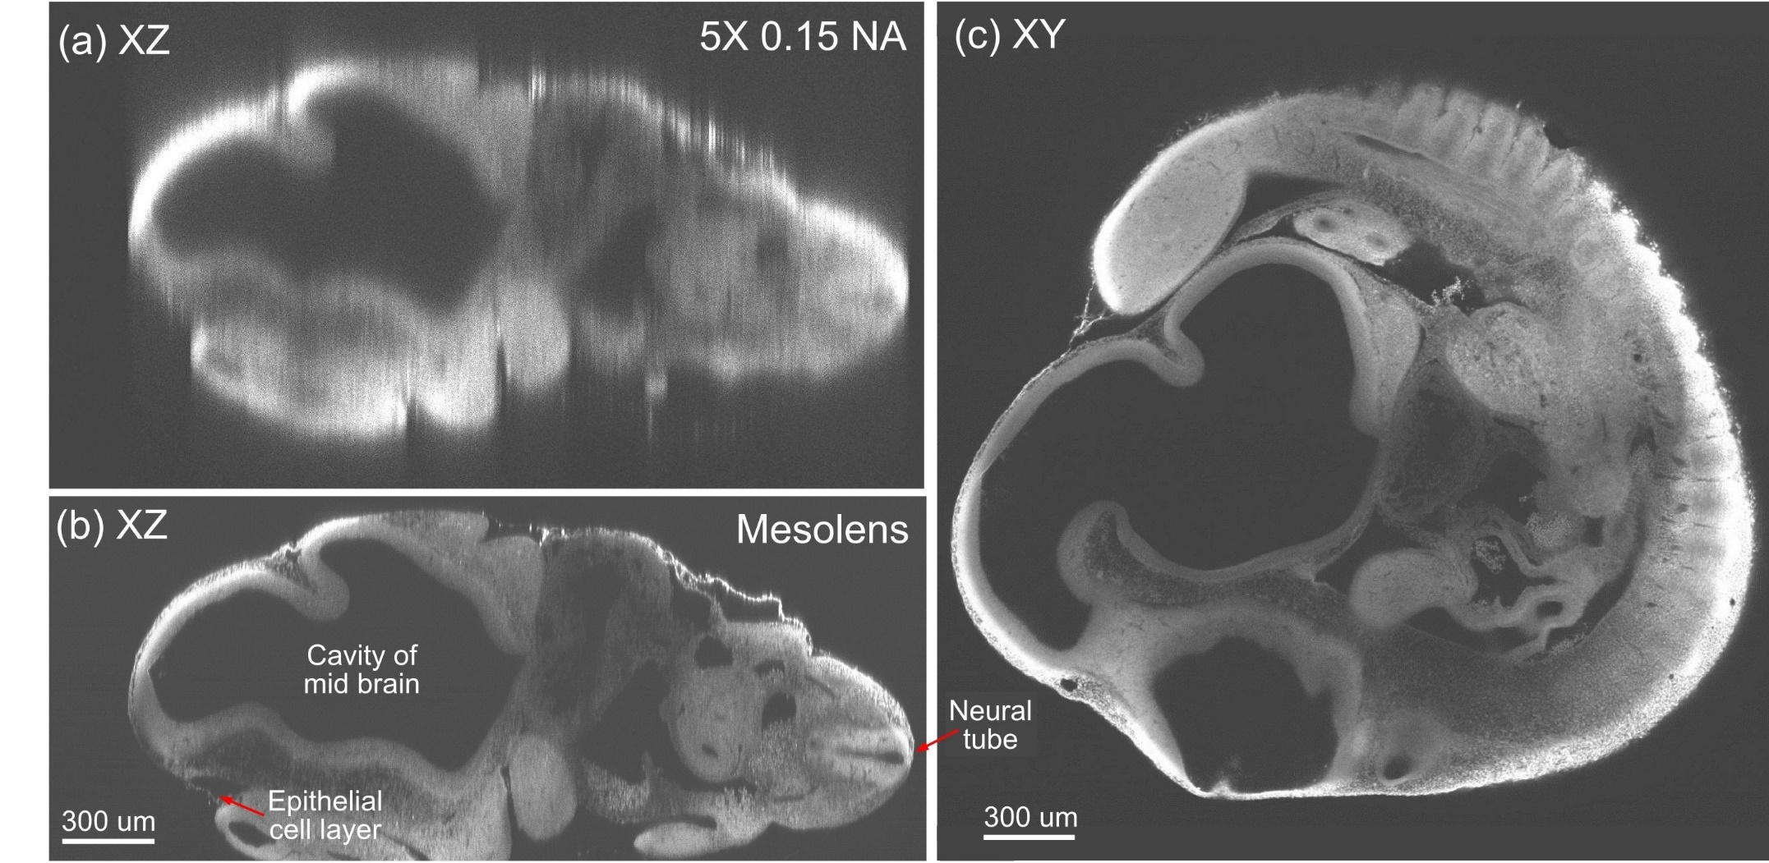
Mesolens: low mag with high NA
Notes:
Optical sectioning of an optically-cleared and fluorescently-stained 10 day old mouse embryo.(a) is the embryo imaged in XZ using a dry objective lens of similarly low magnification to the Mesolens (5x/0.15 N.A., HCX PL Fluotar, Leica Microsystems). (b) is the same embryo imaged at the same region in XZ using the Mesolens with oil immersion. The Mesolens can image throughout the entire 2 mm thick embryo with sub-cellular resolution: individual nuclei can be observed all the way through. This is in contrast to the image with the commercial low magnification, low N.A. objective, where the long needle-like vertical structures indicate a very poor z resolution. Figure 4c shows an XY cross section at a depth of around 1 mm into the same specimen imaged using the Mesolens. Full resolution versions of (b) and (c) are available as Figure 4—figure supplements 1 and 2.

Slide 56
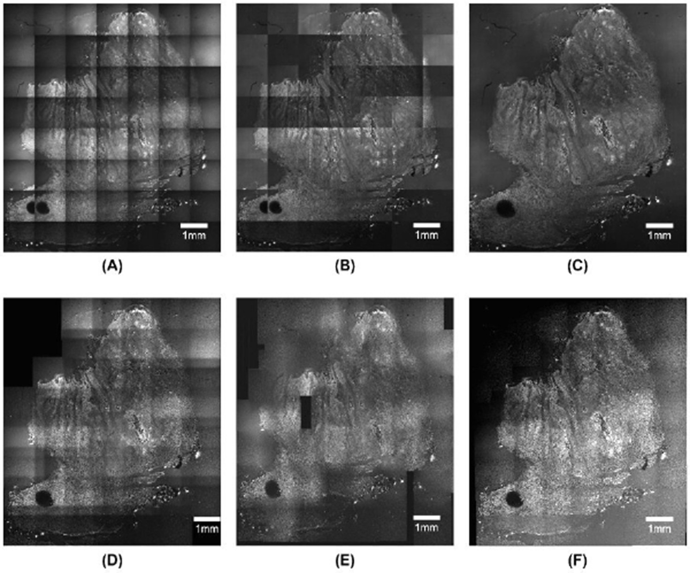
Mesolens: low mag with high NA
Notes:
Tiling versus Mesolens

Slide 57
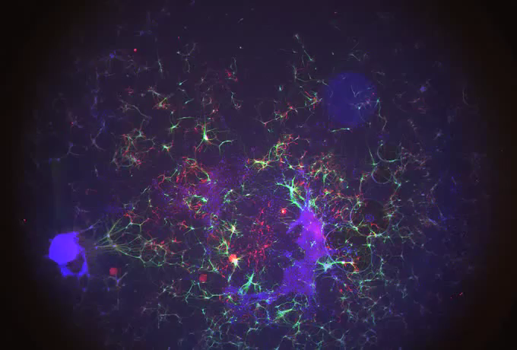
Mesolens: advantages and disadvantages

