Slide 1
Bi/BE 177: Principles of Modern Microscopy
Lecture 13: Single Molecule Imaging
Andres Collazo, Director Biological Imaging Facility
Ke Ding, Graduate Student, TA
Wan-Rong (Sandy) Wong, Graduate Student, TA

Slide 2
Lecture 13: Single molecule imaging
Overview of approaches
Fluorescence fluctuation spectroscopy (FFS)
  Fluorescence correlation spectroscopy (FCS)
    Some concrete examples of what we can learn
  Fluorescence cross correlation spectroscopy (FCCS)
  Photon counting histogram (PCH)
FRAP/FLIP

Slide 3
Questions about last lecture?

Slide 4
Single molecule imaging
Detection versus Resolving
  Can’t resolve but can detect
Applications?

Slide 5
Single molecule imaging
Detection versus Resolving
  Can’t resolve but can detect
Applications?
Tracking single molecules using light microscopy

Slide 6
Single molecule imaging
Detection versus Resolving
  Can’t resolve but can detect
Applications?
Tracking single molecules using light microscopy
  Following the same molecule over time
  Discerning behavior of single molecules from a population

Slide 7
Single molecule imaging
Detection versus Resolving
  Can’t resolve but can detect
Applications?
Tracking single molecules using light microscopy
  Following the same molecule over time
  Discerning behavior of single molecules from a population
Problems?
Notes:
Density

Slide 8
Single molecule imaging
Detection versus Resolving
  Can’t resolve but can detect
Applications?
Tracking single molecules using light microscopy
  Following the same molecule over time
  Discerning behavior of single molecules from a population
Problems?

Slide 9
Tracking single molecules using light microscopy
Following the same molecule over time

Slide 10
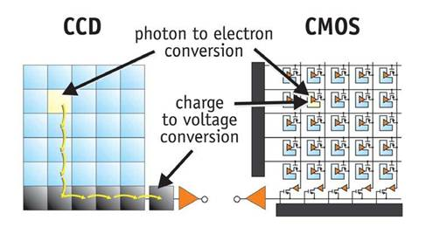
Tracking single molecules using light microscopy
Following the same molecule over time
Use EMCCD or sCMOS camera?
  Electron multiplication (Cascade) CCD
  Scientific CMOS
Notes:
http://meroli.web.cern.ch/lecture_cmos_vs_ccd_pixel_sensor.html

Slide 11
Single molecule imaging
Detection versus Resolving
  Can’t resolve but can detect
Applications?
Tracking single molecules using light microscopy
  Following the same molecule over time
  Discerning behavior of single molecules from a population
Problems?

Slide 12
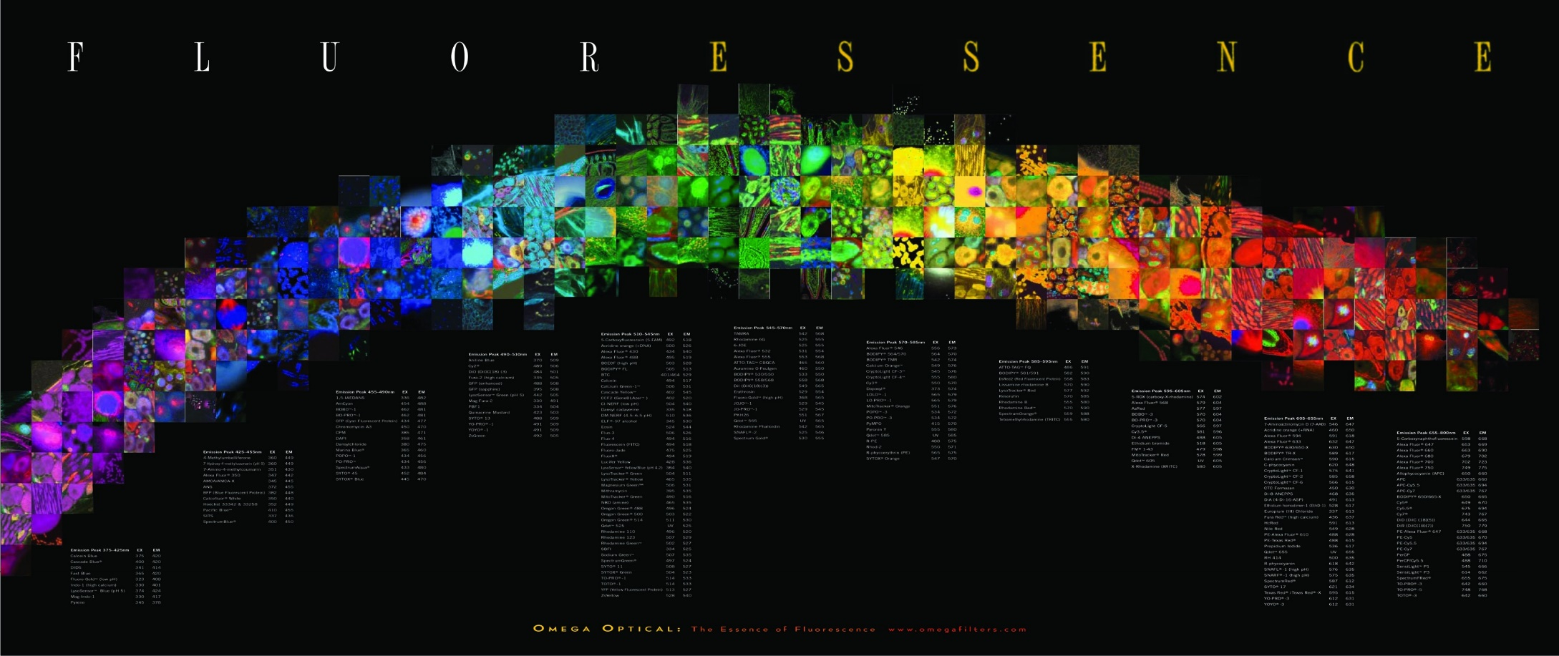
The “F” words
FRET
FFS
FLIM
FCS
FIGS
FRAP
FLAM
FACS
FCCS
Notes:
FACS (fluorescence-activated cell sorting). One of several important cell sorting techniques used in the separation of different cell lines (especially those isolated from animal tissues).
FIGS (Fluorescence image-guided surgery) is a medical imaging technique that uses fluorescence to detect properly labeled structures during surgery.

Slide 13
The “F” words
FRET
FFS
FLIM
FCS
FIGS
FRAP
FLAM
FACS
FCCS
Notes:
FACS (fluorescence-activated cell sorting). One of several important cell sorting techniques used in the separation of different cell lines (especially those isolated from animal tissues).
FIGS (Fluorescence image-guided surgery) is a medical imaging technique that uses fluorescence to detect properly labeled structures during surgery.

Slide 14
Fluorescence correlation spectroscopy (FCS)
In 1972 Watt Webb’s laboratory at Cornell put fluorescence microscopy to new use
Studied reaction kinetics
Ethidium bromide binding to DNA
  Individually don’t fluoresce but together glow under UV
Could detect single molecules but could not repeatedly detect the same molecule
Notes:
http://www.nature.com/milestones/milelight/full/milelight10.html
1990 invented two photon confocal microscopy

Slide 15
Fluorescence Fluctuation Spectroscopy (FFS)
Fluorescence Correlation Spectroscopy (FCS)
Photon Counting Histogram (PCH)
Fluorescence Cross-Correlation Spectroscopy (FCCS)
  FCS with more than 1 color

Slide 16
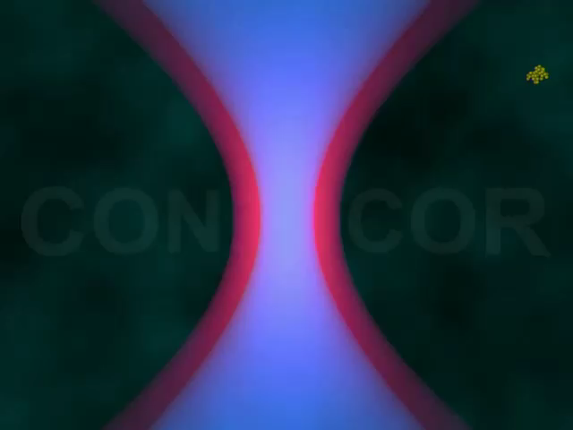
Fluorescence Fluctuation Spectroscopy (FFS)
Causes of fluctuations
Diffusion of labeled molecules due to Brownian motion
  In cells wide range of things cause movement (cellular trafficking, protein interaction etc.)
Photophysical processes of labeled molecules

Slide 17
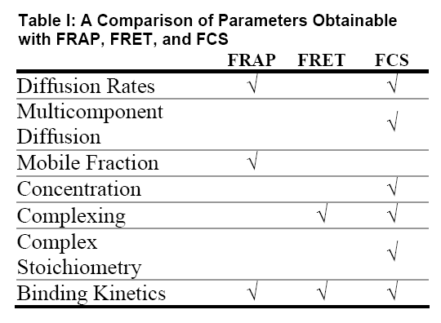
Fluorescence Fluctuation Spectroscopy (FFS)
Advantages over FRAP and FRET
Table: http://www.fcsxpert.com/

Slide 18
Fluctuations Carry the Information
Measured intensity fluctuations reflects (mobile fraction only)
  Number of particles
    concentration
  Diffusion of particles
    interaction
  Brightness
    Oligomerization
A particle that transits the confocal volume will generate groups of pulses.
  The correlation function calculates the mean duration time t of these groups.
  The variance/histogram of the signal yields information about oligomeric state
δI(t)
<I(t)>
δI(t)
FCS
PCH
Notes:
The principle of FCS is being able to observe one or a few fluorescent particles enter and leave a small illuminated volume. If the sample, solution or cell, has a high concentration of tagged molecules it becomes hard to observe the needed fluctuations. I generally give the analogy of a crowded lecture hall. If the lecture hall is crowded and you were observing the lecture hall you would be less apt to notice if some one entered or left the room (i.e. a small fluctuation from the mean number of people in the hall). If only a few people were in the hall, then if someone left it would be very easy to notice (i.e. a large fluctuation from the mean number of people in the hall). This is why a large immobile population is not good for FCS. Fluctuations about the mean intensity is the information used for all FFS techniques.

Slide 19
Fluorescence Fluctuation Spectroscopy (FFS)
Bacia et al., Nature Methods 2006
Notes:
Bacia, K., Kim, S.A., Schwille, P., 2006. Fluorescence cross-correlation spectroscopy in living cells. Nat Methods 3, 83-89.

Slide 20
Fluorescence Fluctuation Spectroscopy (FFS)
Diffusion coefficient:
ωr²
4τ_{d,i}
D=
Bacia et al., Nature Methods 2006
Notes:
Bacia, K., Kim, S.A., Schwille, P., 2006. Fluorescence cross-correlation spectroscopy in living cells. Nat Methods 3, 83-89.

Slide 21
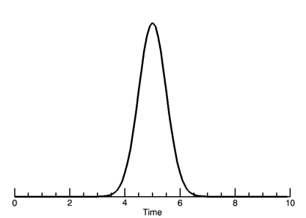
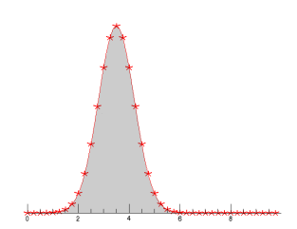
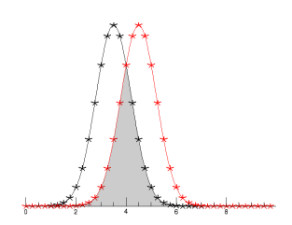
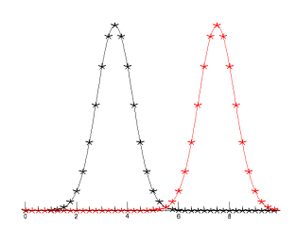
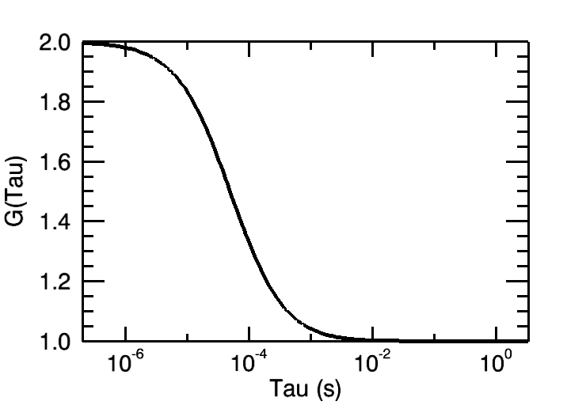
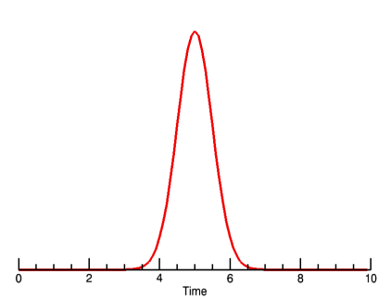
Creating the Autocorrelation Function
τ=0
τ=τ_{D}
τ=inf
Photon Burst
δI(t)
δI(t+τ)
“Copy” signal
Notes:
The fluctuations generated can be analyzed in many ways. FCS relies on the auto-correlation function which is a signal processing technique. The autocorrelation compares a signal against itself. In this case, a particle enters the focal volume and generates a photon burst. The collected signal is “copied” and the two copies are compared against one another as you shift the “copy” in time. The copy signal is shifted by some amount of time given by the greek symbol tau. All data analysis will be done in reference to the shift time tau.

Slide 22
FCS Correlation Function
The correlation function
CF G(τ)
amplitude: number of molecules
Decay time: diffusion time
offset: very slow processes

Slide 23
Autocorrelation Function
Factors influencing the fluorescence signal:
κQ = quantum yield and detector sensitivity (how bright is our probe). This term could contain the fluctuation of the fluorescence intensity due to internal processes
C(r,t) is a function of the fluorophore concentration over time. This is the term that contains the “physics” of the diffusion processes
W(r) describes our
observation volume
Notes:
Lecture 5
FCS, Autocorrelation, PCH, Cross-correlation
Enrico Gratton

Slide 24
Autocorrelation Yields Diffusion and Concentration
Fit Autocorrelation curve for Diffusion time (τ_{D}) and particle concentration N
Notes:
The larger the particle, the longer it will take to transverse the focal volume thus the photon burst will be longer in time. This results in the correlation function moving the left for larger particles. The diffusion time gives information about the diffusion coefficient, the molecular weight and possibly the viscosity of the media. The correlation curve amplitude is inversely proportional to the particle concentration. The concentration, N, is the average number of molecules in the focal volume at one time. Standard dye solutions with known diffusion coefficients can be used to characterize the focal volume. Once that is done, you can use the focal volume information and the Number of particles to get an accurate measure of the MOBILE concentration (mol/L). The curve amplitude being inversely proportional to the particle number makes sense because the higher the N, the smaller the fluctuations will be from the mean intensity giving less correlation.
ALL DATA IS FIT USING A NON-LINEAR LEAST SQUARES ERRORS FUNCTION TO GET DIFFUSION TIMES AND N. You will run the risk of getting bad results with bad curve fitting or curve fitting interpretation.

Slide 25
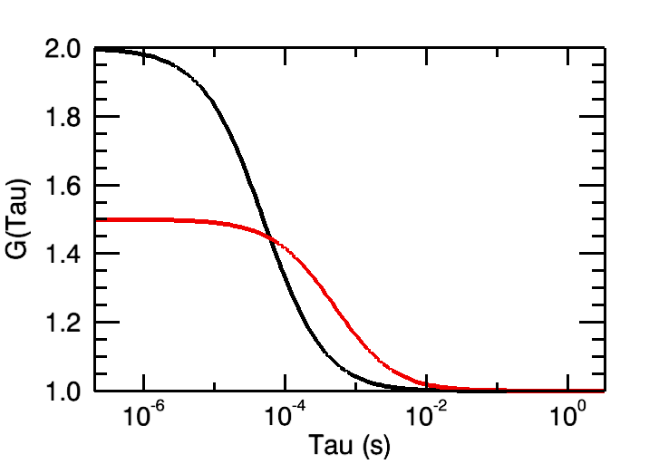
Autocorrelation Yields Diffusion and Concentration
Fit Autocorrelation curve for Diffusion time (τ_{D}) and particle concentration N
Notes:
The larger the particle, the longer it will take to transverse the focal volume thus the photon burst will be longer in time. This results in the correlation function moving the left for larger particles. The diffusion time gives information about the diffusion coefficient, the molecular weight and possibly the viscosity of the media. The correlation curve amplitude is inversely proportional to the particle concentration. The concentration, N, is the average number of molecules in the focal volume at one time. Standard dye solutions with known diffusion coefficients can be used to characterize the focal volume. Once that is done, you can use the focal volume information and the Number of particles to get an accurate measure of the MOBILE concentration (mol/L). The curve amplitude being inversely proportional to the particle number makes sense because the higher the N, the smaller the fluctuations will be from the mean intensity giving less correlation.
ALL DATA IS FIT USING A NON-LINEAR LEAST SQUARES ERRORS FUNCTION TO GET DIFFUSION TIMES AND N. You will run the risk of getting bad results with bad curve fitting or curve fitting interpretation.

Slide 26
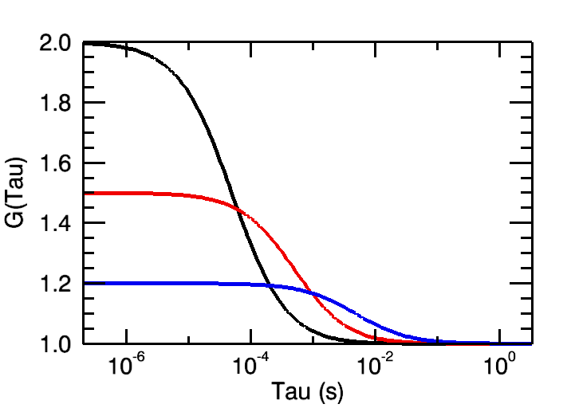
Autocorrelation Yields Diffusion and Concentration
Fit Autocorrelation curve for Diffusion time (τ_{D}) and particle concentration N
Notes:
The larger the particle, the longer it will take to transverse the focal volume thus the photon burst will be longer in time. This results in the correlation function moving the left for larger particles. The diffusion time gives information about the diffusion coefficient, the molecular weight and possibly the viscosity of the media. The correlation curve amplitude is inversely proportional to the particle concentration. The concentration, N, is the average number of molecules in the focal volume at one time. Standard dye solutions with known diffusion coefficients can be used to characterize the focal volume. Once that is done, you can use the focal volume information and the Number of particles to get an accurate measure of the MOBILE concentration (mol/L). The curve amplitude being inversely proportional to the particle number makes sense because the higher the N, the smaller the fluctuations will be from the mean intensity giving less correlation.
ALL DATA IS FIT USING A NON-LINEAR LEAST SQUARES ERRORS FUNCTION TO GET DIFFUSION TIMES AND N. You will run the risk of getting bad results with bad curve fitting or curve fitting interpretation.

Slide 27
Independent Processes Contribute Fluctuations
Contributions of single independent processes multiply
More process system
1.5
exponential
1.4
1.3
triplet
)
τ
G(
1.2
diffusion
1.1
1.0
1E-6
1E-5
1E-4
1E-3
0.01
0.1
1
10
100
1000
10000
τ
[ms]

Slide 28
Additional Equations for these independent processes:
3D Gaussian Confocor analysis:
... where N is the average particle number, τ_{D} is the diffusion time (related to D, τ_{D}=w²/8D, for two photon and τ_{D}=w²/4D for 1-photon excitation), and S is a shape parameter, equivalent to w/z in the previous equations.
Triplet state term:
..where T is the triplet state amplitude and τ_{T} is the triplet lifetime.

Slide 29
Add in Interstate Crossing (ISC)
ISC
~0.03
Excited triplet
state
0.8 emitted
fluorescence
4nsec
Phosphorescence
(usec - msec)
Triplet state is long lived.
Therefore even low probability can deplete active dye
(steady state reached in ~200msec
~80-90% in triplet --> 5-10 fold dimmer)
Triplet state lifetime shortened by oxygen
(20 msec if none; 0.1 usec if oxygen present)

Slide 30
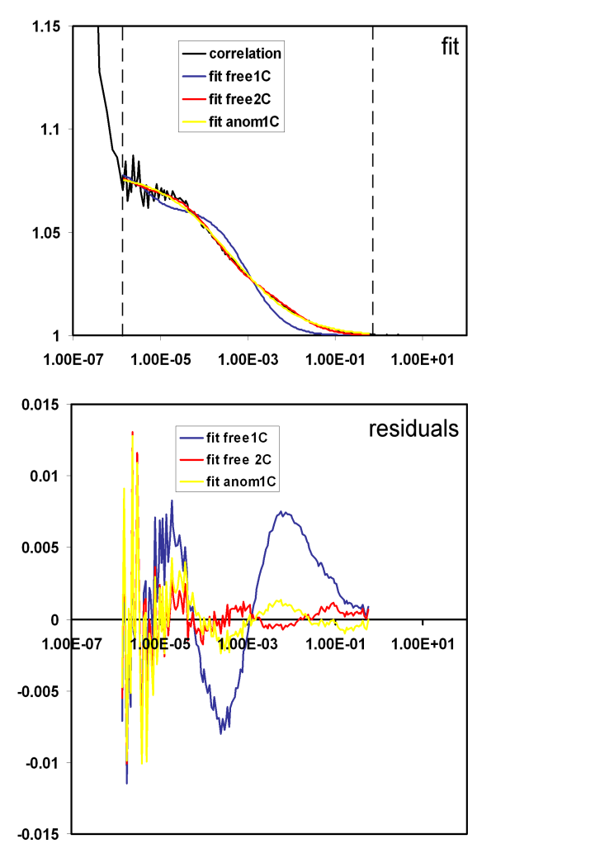
Fitting with Correct Model

Slide 31
Fitting with Correct Model
Schwille and Haustein 2004

Slide 32
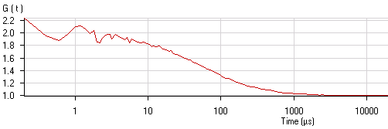
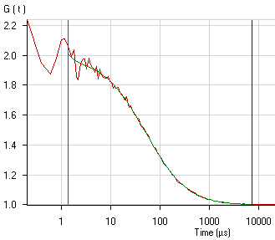
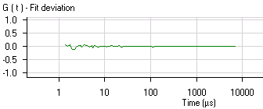


Work Flow for FCS
Diffusion coefficient:
ωr²
4τ_{d,i}
D=
I(t)
AC: compare signal w/ itself
CC: compare signal w/ another
1
<I>
δI(t)
2
t
3
Principle steps
Measuring fluctuation intensities
Calculating correlation function
Fitting to biophysical model

Slide 33
FCS also benefits from FLIM (Fluorescence Lifetime Imaging Microscopy)
FCS measurements at single point allow kinetic and diffusion properties, concentration and aggregation state of fluorescently labeled molecules to be determined.
FLIM measurement of fluorescent lifetime of fluorophore is sensitive to the molecular environment of that fluorophore.
FCS and FLIM allow information to be gathered on diffusional mobility, protein clustering and interactions, and molecular environment.
Notes:
Breusegem, S.Y., Levi, M., Barry, N.P., 2006. Fluorescence Correlation Spectroscopy and Fluorescence Lifetime Imaging Microscopy. Nephron Experimental Nephrology 103, e41-e49.

Slide 34
Fluorescence Lifetime Imaging Microscopy (FLIM)
Measure spatial distribution of differences in the timing of fluorescence excitation of fluorophores
Combines microscopy with fluorescence spectroscopy
Fluorescent lifetimes very short (ns) so need fast excitation and/or fast detectors
Requirements for FLIM instruments
  Excitation light intensity modulated or pulsed
  Emitted fluorescence measured time resolved
Notes:
FLIM has its roots in two fields of research: 1) microscopy and 2) fluorescence spectroscopy. In the latter field of research, non-spatially-resolved fluorescence lifetime measurements were performed since 1926 [1], i.e. long before FLIM was developed. Typically, bulk measurements were carried out using cuvettes. Not surprisingly, most of the methodology and nomenclature used in FLIM today, e.g.‘frequency-domain’, and ‘time-domain’, have their origins in instruments that were used for cuvette-based lifetime measurements.
van Munster, E., Gadella, T.J., 2005. Fluorescence Lifetime Imaging Microscopy (FLIM), in: Rietdorf, J. (Ed.), Microscopy Techniques. Springer Berlin Heidelberg, pp. 143-175.

Slide 35
Fluorescence Lifetime Imaging Microscopy (FLIM)
ISC
~0.03
Excited triplet
state
0.8 emitted
fluorescence
4nsec
Phosphorescence
(μsec - msec)
Triplet state is long lived.

Slide 36
Fluorescence Lifetime Imaging Microscopy (FLIM)
Two methods for FLIM
  Frequency-domain
    Intensity of excitation light continuously modulated
    For emission measure phase shift & decrease in modulation
  Time-domain
    Pulsed excitation that is faster than fluorescence lifetime
    Emission measurement is time-resolved
Notes:
The first instrument combining time resolved fluorescence spectroscopy with microscopy, dates back to 1959 [2]. In this instrument, only single point measurements could be done, so strictly speaking no actual imaging was done. The first instrument measuring spatially resolved lifetimes was described in 1989 [3]. Due to the requirement of short light pulses and fast detection, time-domain measurements became possible only about 40 years later than frequency-domain measurements using a flashlamp as excitation source [16].
van Munster, E., Gadella, T.J., 2005. Fluorescence Lifetime Imaging Microscopy (FLIM), in: Rietdorf, J. (Ed.), Microscopy Techniques. Springer Berlin Heidelberg, pp. 143-175.

Slide 37
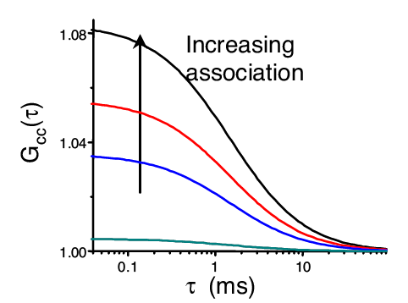
Fluorescence Cross-Correlation Spectroscopy
Photon Burst Ch.1
Cross-Correlation uses spectrally separable fluorophores to probe for interaction
Cross Correlation Curve Amplitude directly relates to interaction
Photon Burst Ch.2
Notes:
FCCS is not too much different than single color FCS. FCCS is used to observe interaction and is much more sensitive that using differing diffusion times in single color FCS. Instead of making a “copy” signal you have two signals. The signals are then correlated together and the resulting curve gives you information about particle interaction.

Slide 38
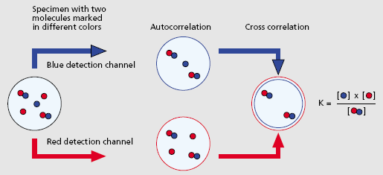
Cross Correlation Reveals Details of Particle Binding
Autocorrelation reveals portion of unbound particles
Cross correlation reveals bound portion
Binding constant can be calculated

Slide 39
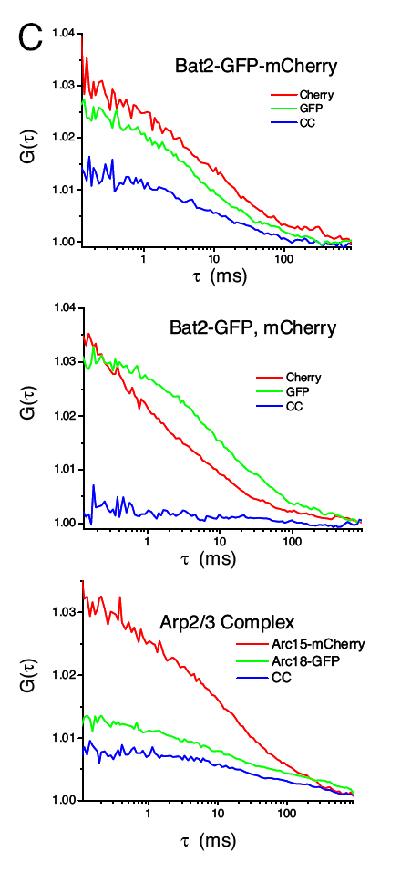
Controls Provide a Basis for Comparison for Cross-Correlation
Spectral cross talk can lead to false cross-correlation
With dual excitation lasers and differing expression levels, cross-correlation is never “perfect”
Controls needed for Comparison
Slaughter et al, PNAS. 2007.
Notes:
Some practical considerations. Need good spectral separation, eGFP-mCherry work fine, but have some bleed through. Too much bleed through can give a high amount of false cross-correlation. With 2-color one photon FCCS the overlap for both excitation lasers is not perfect. That is to say, a 488 laser will have a smaller PSF than the 561nm laser. This results in cross-correlation standards giving results that are not “perfect.” If perfect the cross correlation curve will overlap the two auto-correlation curves. Need controls!
http://www.pnas.org/content/104/51/20320.full

Slide 40
Fluctuations Carry the Information
Measured intensity fluctuations reflects (mobile fraction only)
  Number of particles
    concentration
  Diffusion of particles
    interaction
  Brightness
    Oligomerization
A particle that transits the confocal volume will generate groups of pulses.
  The correlation function calculates the mean duration time t of these groups.
  The variance/histogram of the signal yields information about oligomeric state
δI(t)
<I(t)>
δI(t)
FCS
PCH
Notes:
The principle of FCS is being able to observe one or a few fluorescent particles enter and leave a small illuminated volume. If the sample, solution or cell, has a high concentration of tagged molecules it becomes hard to observe the needed fluctuations. I generally give the analogy of a crowded lecture hall. If the lecture hall is crowded and you were observing the lecture hall you would be less apt to notice if some one entered or left the room (i.e. a small fluctuation from the mean number of people in the hall). If only a few people were in the hall, then if someone left it would be very easy to notice (i.e. a large fluctuation from the mean number of people in the hall). This is why a large immobile population is not good for FCS. Fluctuations about the mean intensity is the information used for all FFS techniques.

Slide 41
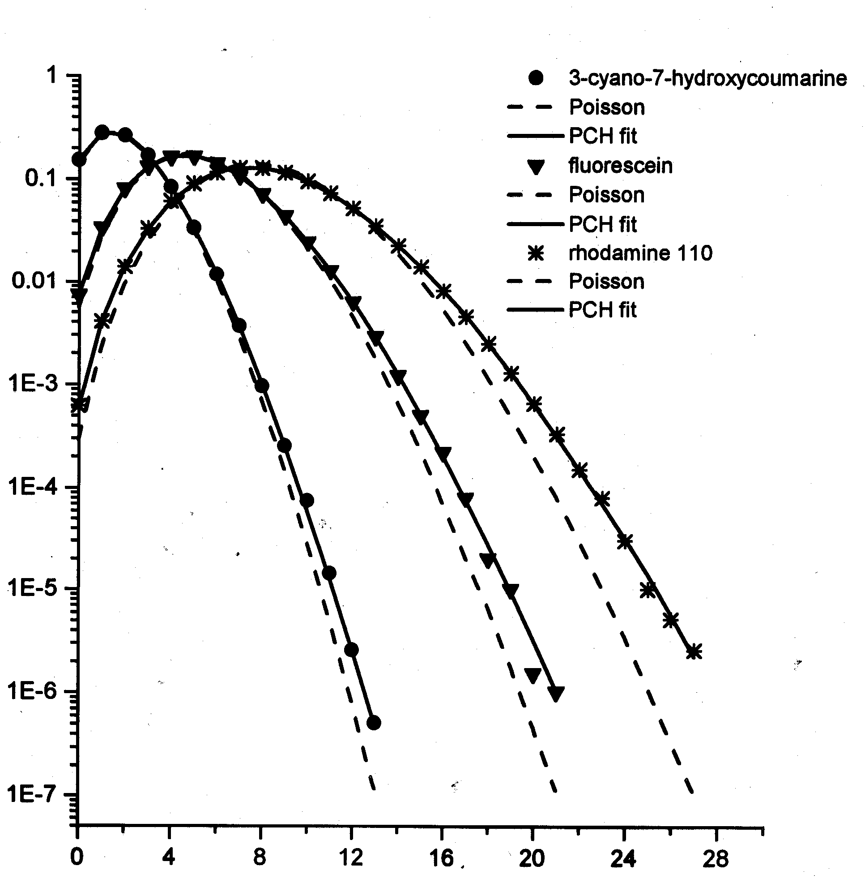
Photon Counting Histogram
Photon count distribution originates from a convolution of two sources
  Photon Detection Statistics
    Poisson
  Particle Number Fluctuations
    Poisson
Further complications come from variations in PSF
Information Gained
  Concentration
  Brightness
frequency
(ε_{n}=1.0)
(ε_{n}=2.2)
(ε_{n}=3.7)
Increasing Brightness
Photon Counts
(Qian and Elson, 1989, Applied Polymer Symposia. John Wiley and Sons, New York. 305-314,1990; Chen et al, 1999 Biophys J. 77: 553–567.; Muller et al, 2000 Biophys J 78:474–486).

Slide 42
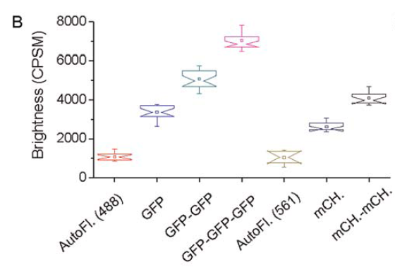
Brightness Reveals Oligomerization
Slaughter et al, PloS ONE. 2008.

Slide 43
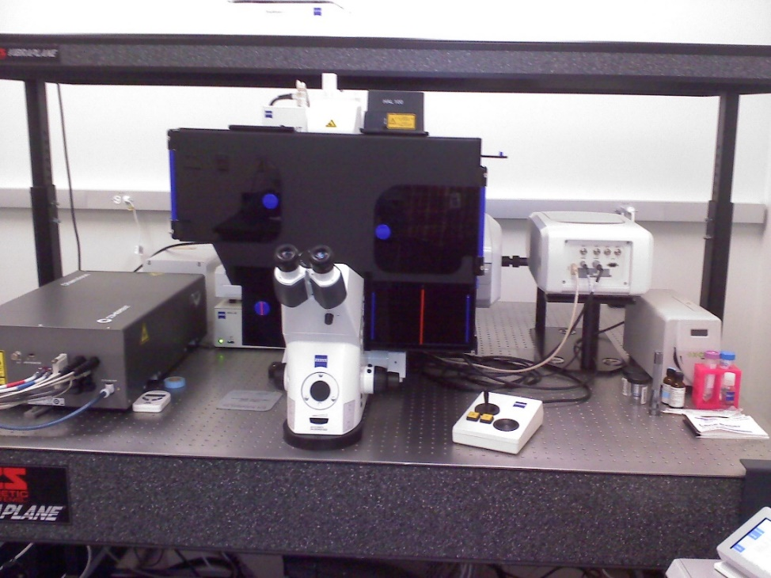
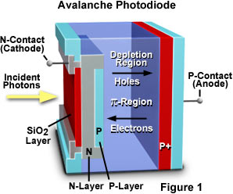
Zeiss ConfoCor3: FCS Setup on a Laser Scanning Confocal Microscope
Avalanche Photodiode Detector (APD)
Single Photon Sensitivity
Focus to tiny volume (<1 femtoliter)
Schwille and Haustein 2004
Notes:
http://hamamatsu.magnet.fsu.edu/articles/avalanche.html
http://www.photonics.com/EDU/Handbook.aspx?AID=25535

Slide 44
Flip trap screen (http://www.fliptrap.org)
Le Trinh et al. Gene Dev. 2011
Transposon based gene trapping technology (Tol2)
Gene trapping vector: Citrine (YFP) flanked by splice acceptor & donor, forward orientation; mCherry (RFP) polyadenylation signal, reverse orientation; lox & FRT sites
Notes:
Visualize proteome via fluorescent tagging of full-length endogenous proteins
Flip trap screen done in the laboratories of Scott Fraser and Marianne Bronner at Caltech published in 2011

Slide 45
Flip Trap Screen Labels Endogenous Proteins:
Different Sub-Cellular Compartments and Cell Types

Slide 46
Nucleus has Distinct Structural and Functional Compartments
Lanctot, C., T. Cheutin, et al. (2007). "Dynamic genome architecture in the nuclear space: regulation of gene expression in three dimensions." Nat Rev Genet 8(2): 104-115.

Slide 50
Lanctot, C., T. Cheutin, et al. (2007). Nat Rev Genet 8(2): 104-115.

Slide 51
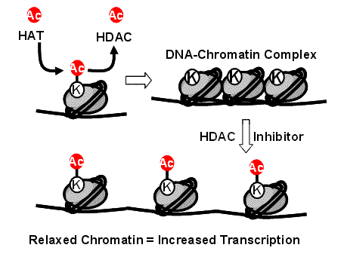
http://blog.biotek.com/2010/04/sbs-2010-conference-epigenetics.html

Slide 52
FCS Detects Intracellular Variations

Slide 53
Diffusion Coefficients Similar to those Obtained Using FRAP
Cavey, M., Rauzi, M., Lenne, P. F. and Lecuit, T. (2008). Nature 453, 751-6.

Slide 54
Epithelial transitions during pharyngeal pouch formation
Wnt signaling role in pharyngeal pouch formation
Adherens junction
Choe Chong P, Collazo A, Trinh Le A, Pan L, Moens Cecilia B, Crump JG (2013) Wnt-Dependent Epithelial Transitions Drive Pharyngeal Pouch Formation. Developmental Cell 24: 296-309.

Slide 55
Alcama immunoglobulin-domain protein functions to restabilize adherens junctions
Use α-Catenin protein labeled transgenic zebrafish line to study protein mobility at adherens junction.
Alcama associates with α-Catenin at adherens junction
At transitional stage endodermal epithelium is destabilized

Slide 56
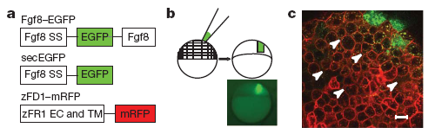
Published FCS Studies in Zebrafish Have Used Exogenously Expressed Proteins
Proteins acting as morphogen
  Yu, S. R., M. Burkhardt, et al. (2009). Nature 461(7263): 533-536.
Receptor ligand interactions
  Ries, J., S. R. Yu, et al. (2009). Nat Methods 6(9): 643-645.

Slide 57
Less Gnb2 in Hair Cells than Neurons

Slide 59
What Do Differences in Diffusion Coefficients Mean?
Binding to larger protein?

Slide 60
What Do Differences in Diffusion Coefficients Mean?
Binding to larger protein?
  But 100x the mass only 1/3 reduction.

Slide 61
What Do Differences in Diffusion Coefficients Mean?
Binding to larger protein?
  But 100x the mass only 1/3 reduction.
Cell Membrane
More likely causing interactions with cytoskeleton, organelles or other structures
Nucleus
Mitochondria

Slide 62
Conclusion of examples
FCS + Flip Trap lines provide unique insights into protein kinetics in vivo.
    Intracellular differences across subcellular regions
    Developmental transitions in protein kinetics
Endogenous protein concentrations crucial for accurate FCS measurements

Slide 63
Fluorescence Fluctuation Spectroscopy (FFS)
Diffusion coefficient:
ωr²
4τ_{d,i}
D=
Bacia et al., Nature Methods 2006
Notes:
Bacia, K., Kim, S.A., Schwille, P., 2006. Fluorescence cross-correlation spectroscopy in living cells. Nat Methods 3, 83-89.

Slide 64
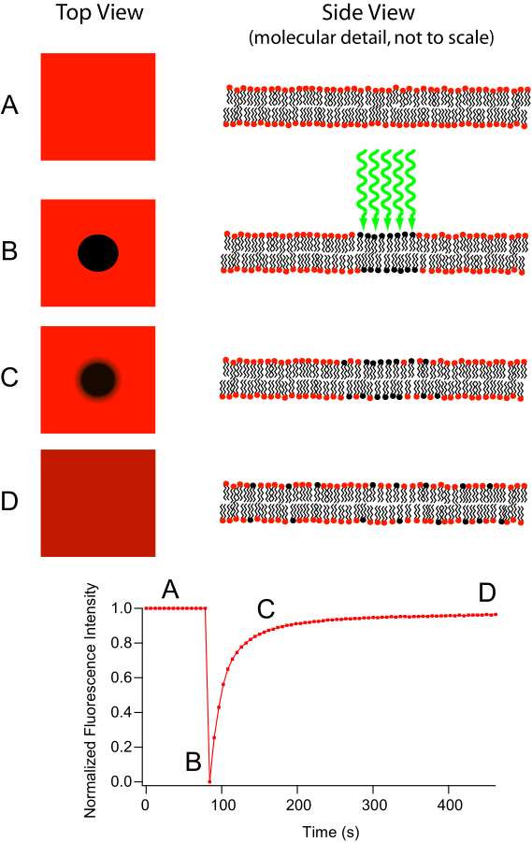
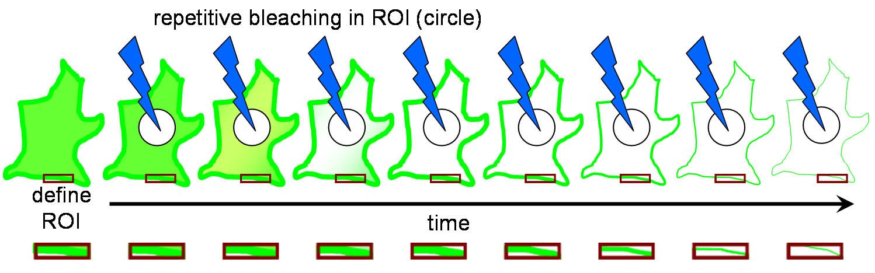
Fluorescent recovery after photobleaching (FRAP)
Diffusion coefficient:
ωr²
4τ_{d,i}
D=
Like FCS also used for calculating diffusion
Fluorescence Loss in Photobleaching (FLIP) related technique
Primary use of FLIP is to determine continuity of membranous organelles.
Notes:
The major difference between these two microscopy techniques is that FRAP involves the study of a cell’s ability to recover after a single photobleaching event whereas FLIP involves the study of how the loss of fluorescence spreads throughout the cell after multiple photobleaching events. This difference in purpose also leads to a difference in what parts of the cell are observed. In FRAP, the area that is actually photobleached is the area of interest. Conversely, in FLIP, the region of interest is just outside the region that is being photobleached. Another important difference is that in FRAP, there is a single photobleaching event and a recovery period to observe how well fluorophores move back to the bleached site. However, in FLIP, multiple photobleaching events occur to prevent the return of unbleached fluorophores to the bleaching region.
http://en.wikipedia.org/wiki/Fluorescence_loss_in_photobleaching
http://en.wikipedia.org/wiki/Fluorescence_recovery_after_photobleaching
http://www.olympusconfocal.com/applications/flipandfrap.html
"Frap diagram" by MDougM - Own work. Licensed under Public Domain via Wikimedia Commons - http://commons.wikimedia.org/wiki/File:Frap_diagram.svg#mediaviewer/File:Frap_diagram.svg
"Fluorescence Loss in Photobleaching Schematic" by Steven Lentz - was sent to me personally. Licensed under CC BY-SA 3.0 via Wikimedia Commons - http://commons.wikimedia.org/wiki/File:Fluorescence_Loss_in_Photobleaching_Schematic.jpg#mediaviewer/File:Fluorescence_Loss_in_Photobleaching_Schematic.jpg

Slide 65
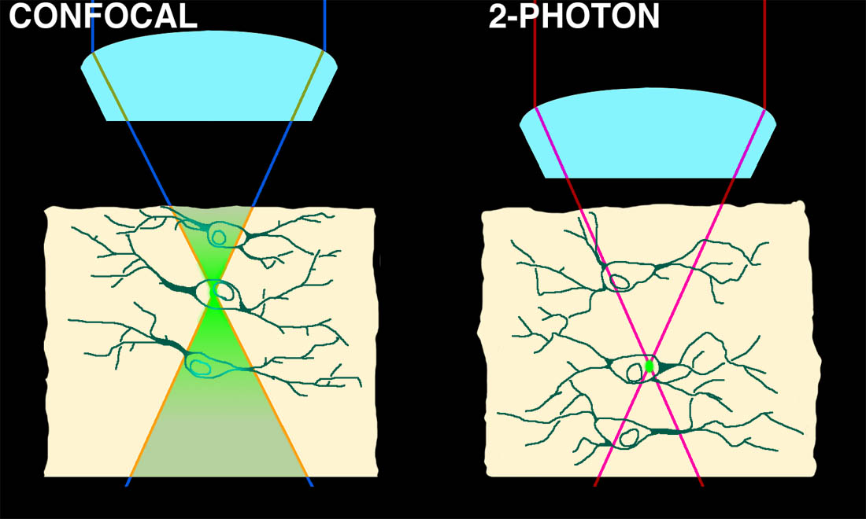

Two-Photon microscopy: Good for FRAP?
Optical sectioning by non-linear absorbance
Notes:
While FRAP has been around for a while what development really made this technique take off?

Slide 66
FRAP has been around since 1976
Again developed by Watt Webb’s laboratory at Cornell
Though it’s been around for a while can you guess what development really made FRAP take off?
Notes:
http://www.ncbi.nlm.nih.gov/pmc/articles/PMC1334945/

Slide 67
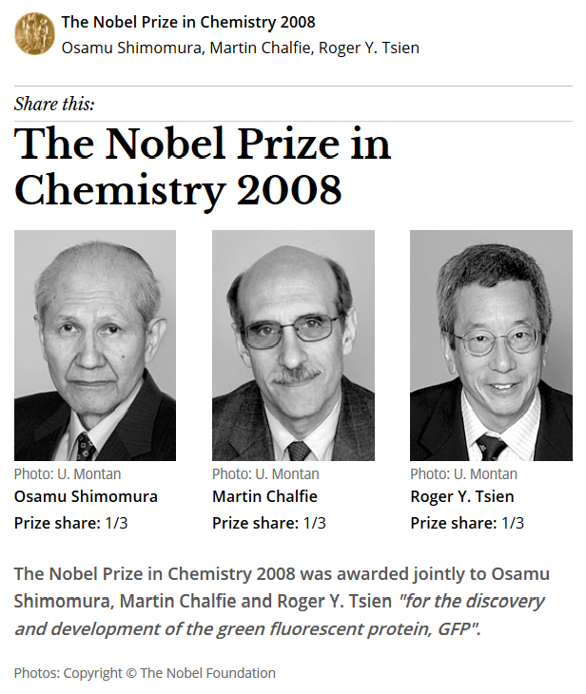
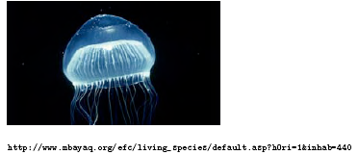
Green Fluorescent Protein
From marine invertebrate, Crystal jelly (Aequorea Victoria)
Can be coded in genes and made by the organism

Slide 68
Fluorescence Fluctuation Spectroscopy (FFS)
Fluorescence Correlation Spectroscopy (FCS)
Photon Counting Histogram (PCH)
Fluorescence Cross-Correlation Spectroscopy (FCCS)
  FCS with more than 1 color
Advantages over FRAP and FRET

Slide 69
Fluorescence Fluctuation Spectroscopy (FFS)
Advantages over FRAP and FRET
Table: http://www.fcsxpert.com/

Slide 70
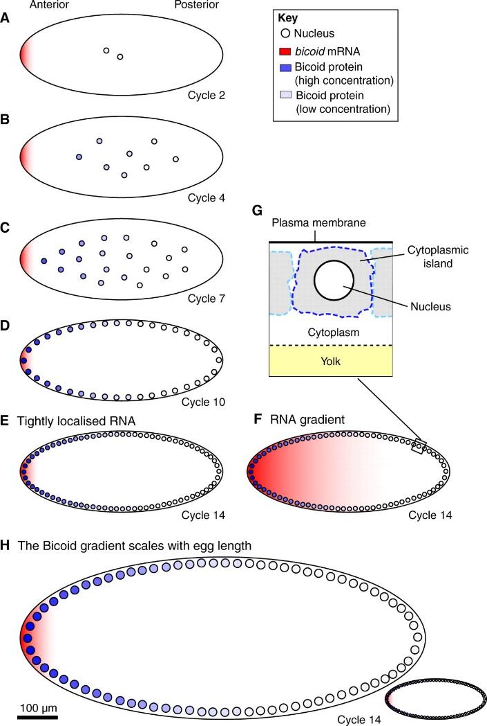
But what do you do when FRAP and FCS give different results?
Drosophila bicoid protein gradient
With FRAP measured D=0.3 μm²/second
With FCS measured D=∼7 μm²/second
Which result do you believe?
Notes:
http://www.sciencedirect.com/science/article/pii/S0092867407006630
Wieschaus Cell paper
http://www.ncbi.nlm.nih.gov/pmc/articles/PMC2920644/
FCS paper
Development paper by Wieschaus reviewing his result
http://dev.biologists.org/content/137/14/2253.full
Schematic of the Bicoid gradient in the syncytial Drosophila embryo. (A-G) Bicoid, as a transcription factor, accumulates within nuclei during interphase. The nuclear Bicoid gradient, which decreases in concentration with distance from the anterior pole, forms in less than 3 hours in a Drosophila embryo that is ~500 μm long (AP axis) and can be observed (B) before nuclei migrate to the surface of the embryo. During the first ~80 minutes (corresponding to cell cycles 1-8), nuclei proliferate in the centre of the embryo (A-C), and then migrate to the surface of the embryo in cycle 9. During the last five cell cycles, nuclei divide at the surface of the embryo (D,E). Nuclei replicate every ~9 minutes during the first nine cell cycles, but this slows to ~20 minutes in cycle 13. Nuclei are ~10 μm in diameter in pre-cycle 14 embryos (A-D) but ~6 μm in cycle 14 (E). The extent to which the mRNA encoding Bicoid, which is initially tightly localised to the anterior pole (A), becomes delocalised is a matter of controversy. Two alternative bicoid RNA distributions during cycle 14 are shown in E and F. (G) Illustration of the nucleus and surrounding cytoplasm. (H) In species that produce larger or smaller eggs than Drosophila melanogaster, the Bicoid gradient scales with egg length.

Slide 71
Homework 5
Early on during zebrafish development, many molecules are involved in patterning the embryo’s tissues and axes. One possible explanation for this complex patterning is Alan Turing’s reaction-diffusion model. To test this you have fluorescently tagged three proteins involved in this process. Your hypothesis is that one protein acts at a long distance while another acts at a short distance and the third at an intermediate distance.
Questions: What fluorescent technique would you use to determine the mobility of these three proteins? What would you predict is the relative mobility of these three proteins?

