Slide 1
Bi/BE 177: Principles of Modern Microscopy
Lecture 03: Microscope optics and the design of microscopes
Andres Collazo, Director Biological Imaging Facility
Ke Ding, Graduate Student, TA
Wan-Rong (Sandy) Wong, Graduate Student, TA

Slide 2
Lecture 3: Microscope Optics
Particle and wave nature of light
Applying geometrical optics, the Rochester cloak
Infinity optics
Dispersion
Aberrations
Fraunhofer lines
Two Most Important Microscope Components
N.A. and Resolution

Slide 3
Questions about last lecture?

Slide 4
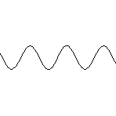
Basic properties of light
Particle Movement
Wave
Either property may be used to explain the various phenomena of light
Notes:
Now either property may be used to explain the various phenomena of light

Slide 5
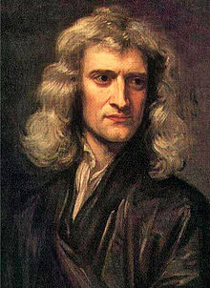
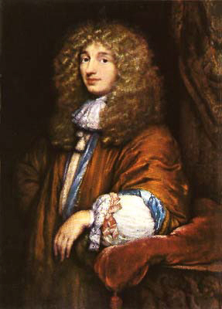
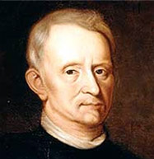
Particle versus wave theories of light in the 17th Century.
Corpuscular theory
Wave theory
Light made up of small discrete particles (corpuscles)
Particles travel in straight line
Sir Isaac Newton was biggest proponent
Different colors caused by different wavelengths
Light spreads in all directions
First deduced by Robert Hooke and mathematically formulated by Christiaan Hyugens
Treatise on Light
Notes:
Isaac Newton (1642-1726/7) argued that the geometric nature of reflection and refraction of light could only be explained if light was made of particles, referred to as corpuscles, because waves do not tend to travel in straight lines. Newton sought to prove Christiaan Huygens' theory that light was made of waves. In his 44th trial in a series of experiments concerning physics of light, he concluded that light is made of particles and not waves by having passed a beam of white light through two prisms which were held at such an angle that the light split into a spectrum after passing through the first prism and then was recomposed, back into white light, by the second prism.
Robert Hooke FRS (/hʊk/; 28 July [O.S. 18 July] 1635 – 3 March 1703) was an English natural philosopher, architect and polymath. Author of the seminal book on microscopy called Micrographia. Coined the word cell. Fought with Hyugens about the invention of the balance spring for watches.
Christiaan Huygens, FRS (/ˈhaɪɡənz/ or /ˈhɔɪɡənz/; Dutch: [ˈɦœy̆ɣə(n)s] ( listen)) (Latin: Hugenius) (14 April 1629 – 8 July 1695) was a prominent Dutch mathematician and scientist. He is known particularly as an astronomer, physicist, probabilist and horologist. His seminal work titled: Treatise on Light
In which are explained the causes of that which occurs in reflexion, & in refraction and particularly in the strange refraction of Iceland crystal . Available through project Gutenberg: http://www.gutenberg.org/files/14725/14725-h/14725-h.htm

Slide 6
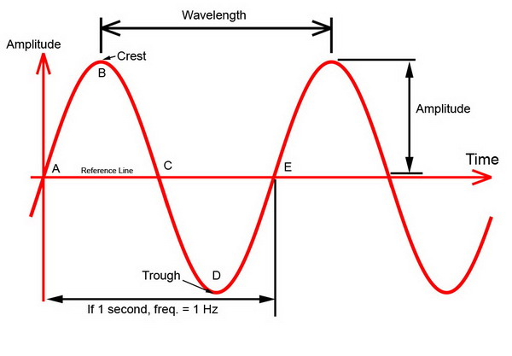
Characteristics of a wave
Wavelength (λ) is distance between crests or troughs
Amplitude is half the difference in height between crest and trough.
Notes:
http://www.billavista.com/atv/Articles/Offroad_Radios_and_Comms/index.html
Source of image.

Slide 7
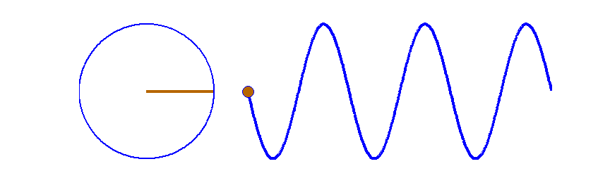
Characteristics of a wave
Period is time it takes two crests or two troughs to travel through the same point in space.
  Example: Measure the time from the peak of a water wave as it passes by a specific marker to the next peak passing by the same spot.
Frequency (ν) is reciprocal of its period = 1/period [Hz or 1/sec]
  Example: If the period of a wave is three seconds, then the frequency of the wave is 1/3 per second, or 0.33 Hz.
Notes:
Fig. 7. A travelling sinusoidal wave. Each point along the wave executes SHM as shown by the circle. The waveform advances to the right one wavelength in a time of one period. Matlab script: ag_sine_circle.m. Animated gif: ag_sineC.gif
http://www.physics.usyd.edu.au/teach_res/mp/doc/wm_string_1.htm
Gif is from Matlab tutorial.

Slide 8
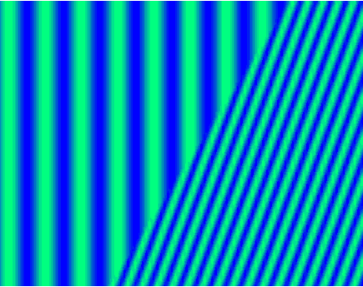
Characteristics of a wave
Velocity (or speed) at which a wave travels can be calculated from the wavelength and frequency.
Velocity in Vacuum (c) = 2.99792458 • 10⁸ m/sec
Frequency remains constant while light travels through different media. Wavelength and speed change.
c = ν λ
Notes:
http://imgarcade.com/1/refraction-of-waves-animation/

Slide 9
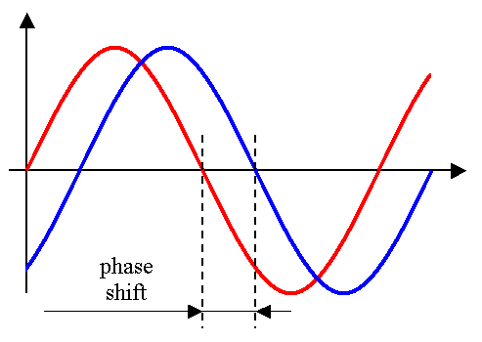
Characteristics of a wave
Phase shift is any change that occurs in the phase of one quantity, or in the phase difference between two or more quantities
Small phase differences between 2 waves cannot be detected by the human eye

Slide 10
Refraction as explained through Fermat’s principle of least time
Light takes path that requires shortest time
Wave theory explains how light “smells” alternate paths
θ1
θ2
η1
η2
Feynman Lectures on Physics, Volume I, Chapter 26
http://feynmanlectures.caltech.edu/I_26.html
Notes:
Pierre de Fermat (French: [pjɛːʁ dəfɛʁma]; 17^{[2]} August 1601 or 1607^{[1]} – 12 January 1665) was a French lawyer at the Parlement of Toulouse, France, and an amateur mathematician.

Slide 11
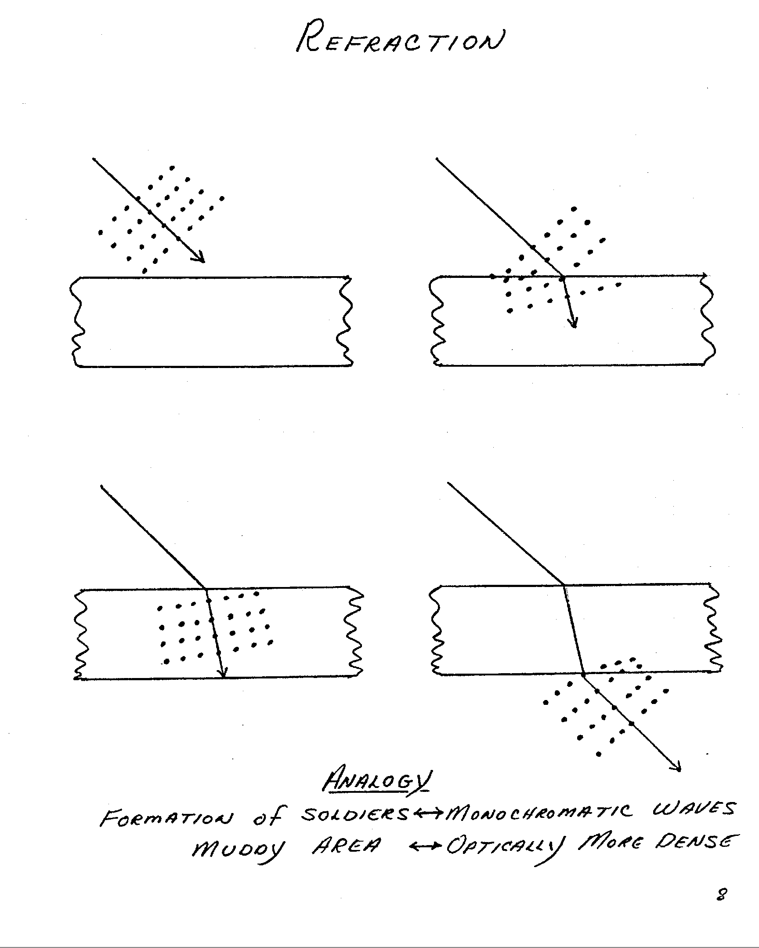
Refraction (Marching Band Analogy)
Notes:
Christiaan Hyugens thought Refraction best understood through wave theory: waves traveled more slowly in a dense medium (like waves in shallow water). Newton explained refraction poorly via changes in acceleration due to gravity.

Slide 12
Refraction (Marching Band Analogy)

Slide 13
Refraction (Marching Band Analogy)

Slide 14
Refraction (Marching Band Analogy)

Slide 15
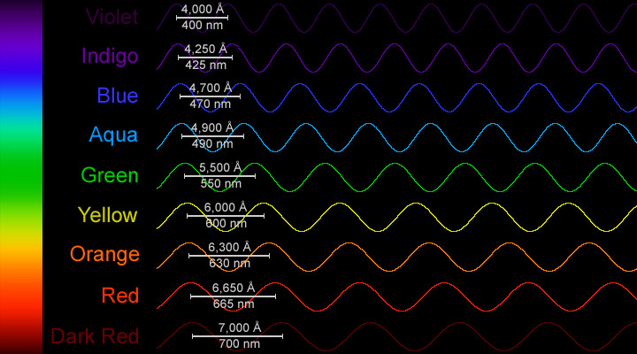
What is white light?
A combination of all wavelengths originating from the source
Notes:
https://www.windows2universe.org/physical_science/magnetism/images/visible_spectrum_waves_big_jpg_image.html

Slide 16
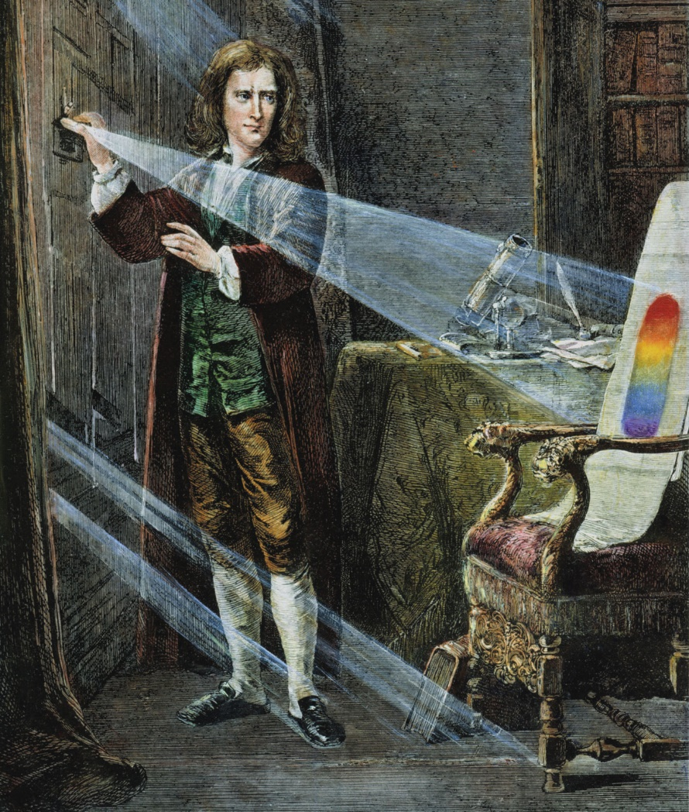
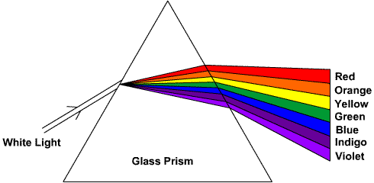
Dispersion: Separation of white light into spectral colors as a result of different amounts of refraction by different wavelengths of light.
Dispersive prisms typically triangular
Back to Sir Isaac Newton

Slide 17
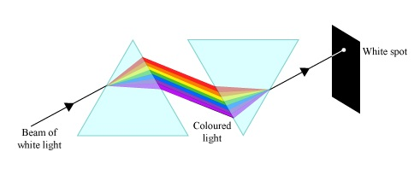
Why Isaac Newton did not believe the wave theory of light
Experiment with two prisms
If light was wave than should bend around objects
Color did not change when going through more glass
Notes:
Advocates of the wave theory had previously stated that light waves are made of white light, and that the colour spectrum, which can be seen through a prism, is formed because of corruption within the glass. This means that the more glass the light travels through, the more corrupt it will become. In order to prove that this was false, Newton passed a beam of white light through two prisms, which were held at such an angle that it split into a spectrum when passing through the first prism and was recomposed, back into white light, by the second. This showed that the spectrum was not caused by glass corrupting the light. Newton claimed that this was a 'crucial experiment'.
Newton claimed that Grimaldi's diffraction was simply a new kind of refraction. He argued that the geometric nature of the laws of reflection and refraction could only be explained if light was made of particles, which he referred to as corpuscles, as waves do not tend to travel in straight lines. After joining the Royal Society of London in 1672, Newton stated that the 44th trial in a series of experiments he had conducted earlier that year had proven that light is made of particles and not waves.
http://www.thestargarden.co.uk/NewtonAndLight.html
http://thefishbowlnetwork.com/blog/tag/isaac-newton/

Slide 18
Geometrical optics
Thin lens laws
Snell’s law works better for thicker lenses
Modern day application of geometrical optics
  The Rochester cloak

Slide 19
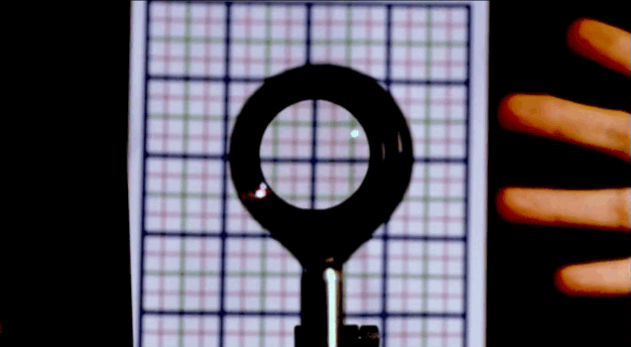
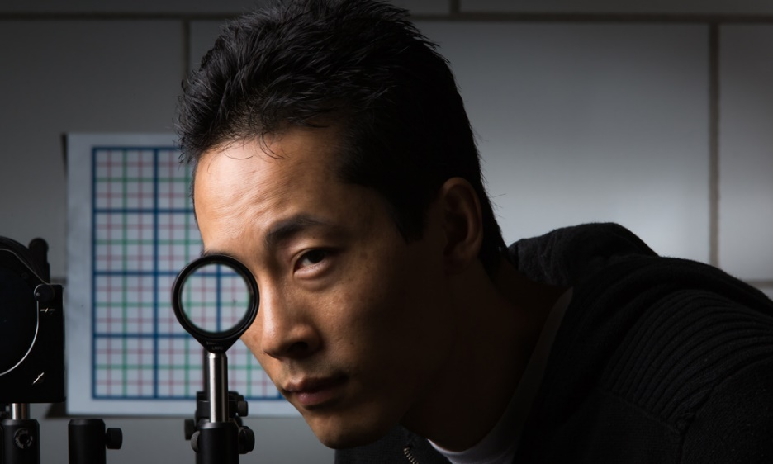
Applying geometrical optics.
Cloaking objects with simple lenses
Making objects invisible
Ray tracing still important for optical research
Paper by Choi and Howell from University of Rochester published 2014
  Choi JS, Howell JC. Paraxial ray optics cloaking. Optics express. 2014; 22(24):29465-78.

Slide 20
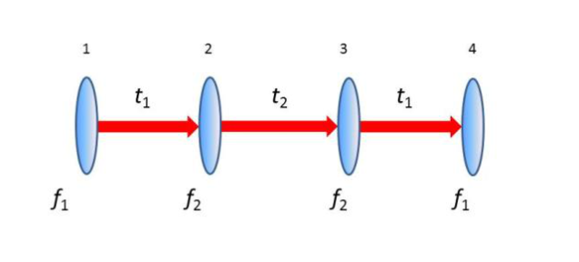
Perfect cloak at small angles using simple optics
Paraxial rays are those at small angles
Uses 4 off the shelf lenses: two with a focal length of f₁ and two with focal lengths of f₂

Slide 21
Perfect cloak at small angles using simple optics
Lens with f₁ separated from lens with f₂ by sum of their focal lengths = t₁.
Separate the two sets by t₂=2 f₂ (f₁+ f₂) / (f₁— f₂) apart, so that the two f₂ lenses are t₂ apart.

Slide 22
Perfect cloak at small angles using simple optics
Lenses used are achromatic doublets
For first and last lenses (1 and 4), 200 mm focal length, 50 mm diameter composed of BK7 and SF2 glass.
For center two lenses (2 and 3), 75 mm focal length, 50 mm diameter composed of SF11 and BAF11 glasses.

Slide 23
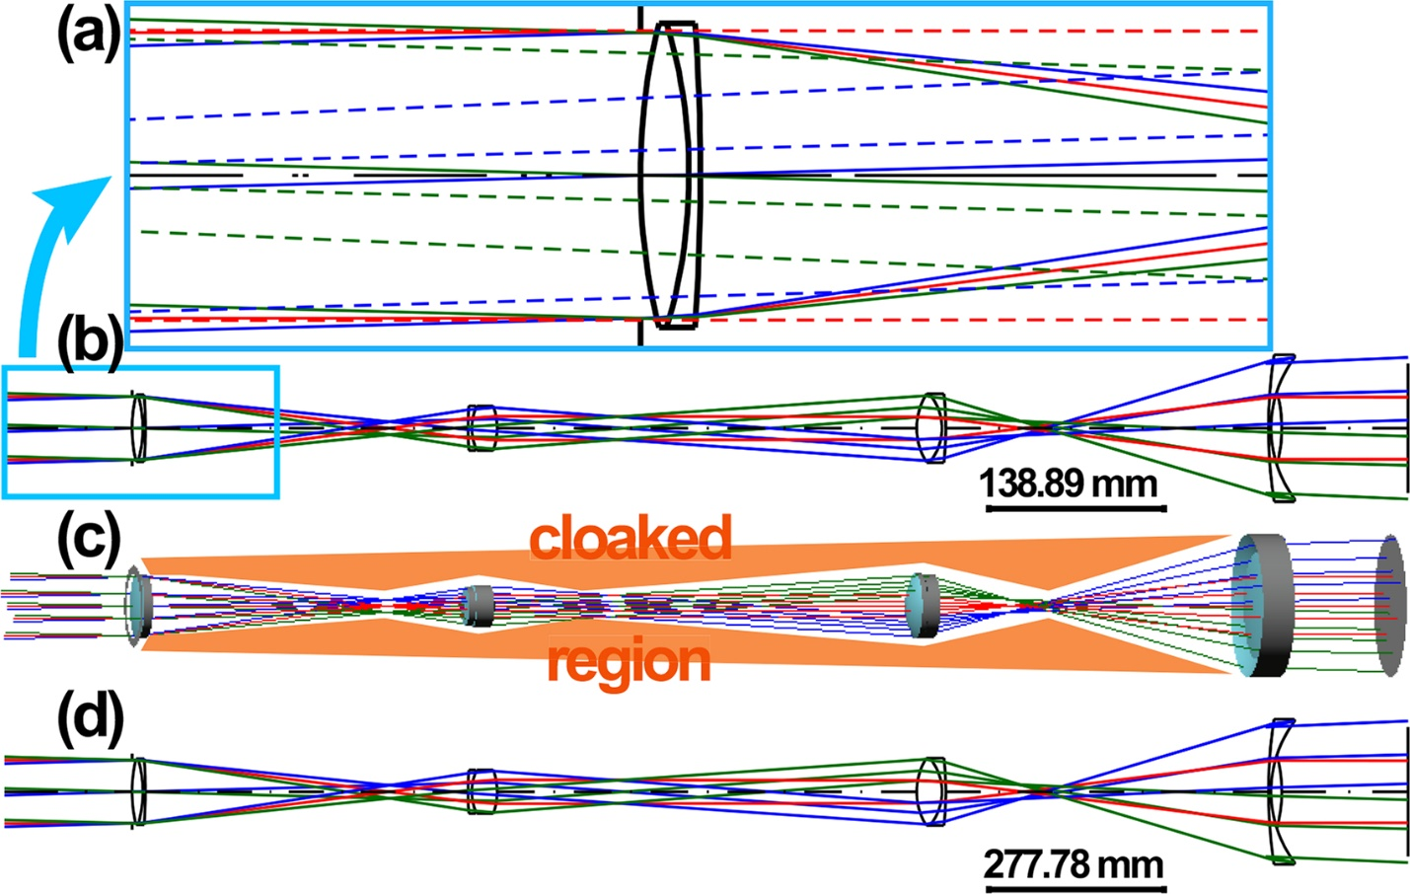
Perfect cloak at small angles using simple optics
Ray diagrams can get complex.
Notes:
Fig. 4 CODE V simulation of a symmetric, perfect paraxial cloak, with four lenses using rays. Four achromatic doublets are placed with separations determined from Eq. (1). Entrance pupil is 50 mm, with −1.5° to 1.5° field-of-view. Simulations are shown with no separate optimization. Object is placed at infinity. (a) Zoomed-in region of (b) with image rays (dashed; traced back to the first lens) added to compare with the original rays (solid). We see that the angles are nearly identical, and the transverse shifts are small. (b) Full simulation using off-the-shelf optics. (c) 3D rendering. The cloaking region (shaded) is a cylindrical region between the first and last lenses. (d) Scaling of (b) by a factor of 2. The cloaking size is doubled in each dimension by doubling the optical curvatures, lengths and entrance pupil. Only the length scales distinguish (d) from (b).

Slide 24
Building a compound microscope
Remember this is how we could get higher magnifications than simple microscope
What’s all the fuss about infinity optics?

Slide 25
How to get magnification > 100??
Compound microscope
Objective lens (next to the object)
Eyepiece (f = 25mm; 10x)
Objective Lens
Image
Eyepiece
image
Eyepiece
Lens of eye

Slide 26

The Finitely Corrected Compound Microscope
B
Eyepiece
A
B
150 mm (tube length = 160mm)
Objective
Objective Mount (Flange)
In most finitely corrected systems, the eyepiece has to correct for the LCA of the objectives, since the intermediate image is not fully corrected.
LCA = lateral chromatic aberration

Slide 27
The Compound Microscope (infinity corrected)
Eyepiece
Tube lens
(Zeiss: f=164.5mm)
Objective
Notes:
Manufacturer Tube Lens
Focal Length
(Millimeters) Parfocal Distance
(Millimeters) Thread Type
Leica 200 45 M25
Nikon 200 60 M25
Olympus 180 45 RMS
Zeiss 165 45 RMS

Slide 28
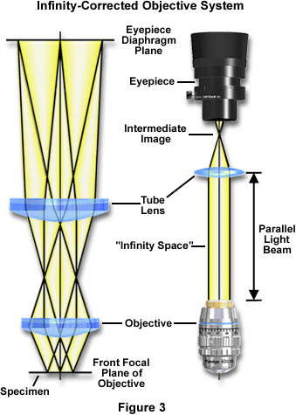
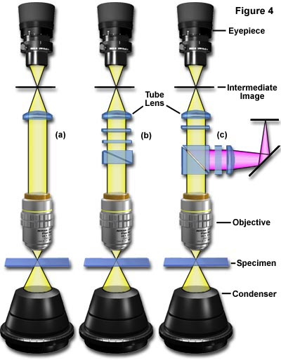
The Compound Microscope (infinity corrected)
Notes:
https://micro.magnet.fsu.edu/primer/anatomy/tubelength.html
http://www.leica-microsystems.com/science-lab/widefield-microscopy/infinity-optical-systems/

Slide 29
From a Microscope to a Telescope
Eyepiece
No “objective”
Objective (previously:Tube Lens)
∞
∞
Objective
∞
Eyepiece
∞
“Galilean” Type Telescope

Slide 30
Dirty little secret about lenses
Simple lens law hides a major problem about lenses
To paraphrase Feynman, we fool ourselves by concentrating on paraxial rays near the optical axis
Notes:
Feynman lecture 27 on geometrical optics

Slide 31
Optical Aberrations: Imperfections in optical systems
Chromatic (blue = shorter focal length)
Spherical
Curvature of field

Slide 32
Dispersion in a plane-parallel glass plate (e.g. slide, cover slip, window of a vessel)
Chromatic Aberration can be defined as “unwanted” dispersion.
“White” Light

Slide 33
Spherical Aberration
Zone of Confusion
Notes:
Everything great with paraxial rays

Slide 34
Curvature of field: Flat object does not project a flat image
(Problem: Cameras and Film are flat)
f
i
o
Notes:
Retina image is curved. Another reason your eyes see more than the camera.

Slide 35
Optical Aberrations: Imperfections in optical systems
Chromatic (blue = shorter focal length)
Spherical (rays near edge of lens bent more)
Curvature of field (worse near edges)
Potential Solution: Stop down lens

Slide 36
Spherical Aberration is reduced by smaller aperture
Less confused “Zone of Confusion”

Slide 37
Optical Aberrations: Imperfections in optical systems
Chromatic (blue = shorter focal length)
Spherical (rays near edge of lens bent more)
Curvature of field (worse near edges)
Potential Solution: Stop down lens
Problem: Brightness and Resolution

Slide 38
Optical Aberrations: Imperfections in optical systems
Chromatic (blue = shorter focal length)
Spherical (rays near edge of lens bent more)
Curvature of field (worse near edges)
Potential Solution: Stop down lens
Problem: Brightness and Resolution
Real Solution: Good Optical Engineering
BAD

Slide 39
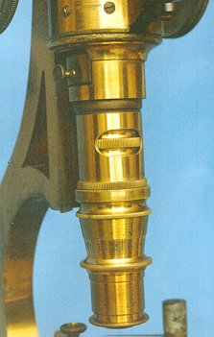
The most important microscope component
The Objective
Here is where good optical engineering really pays off

Slide 40
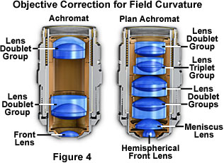
Internal structure of objectives: Consider the glass used to make lenses
The Objective
http://www.microscopyu.com/articles/optics/objectiveintro.html

Slide 41
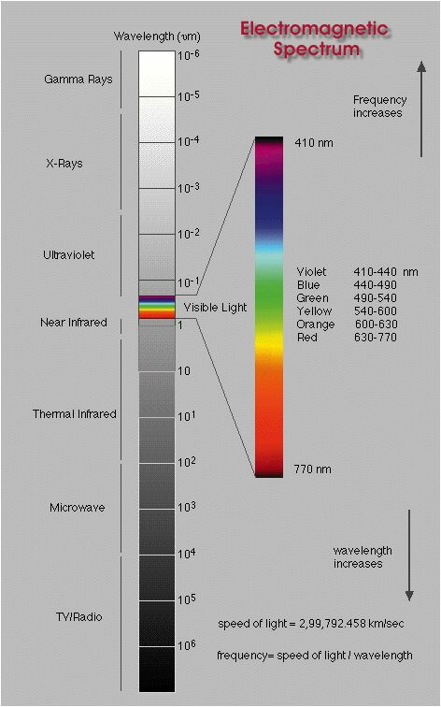
Named Spectral Lines
404.7 h Violet Hg
435.8 g Blue Hg
480.0 F‘ Blue Cd
486.1 F Blue H
546.1 e Green Hg
587.6 d Yellow He
589 D Sodium
643.8 C‘ Red Cd
656.3 C Red H
706.5 nm r Red He
Energy
Where did these named lines come from?
Notes:
Back to electromagnetic spectrum.

Slide 42
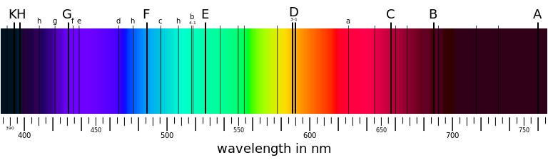
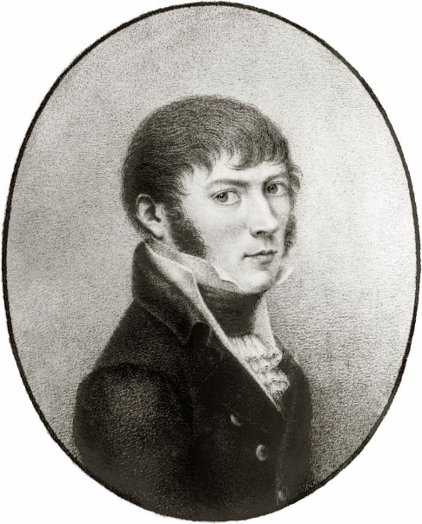
Fraunhofer lines
Dark lines in solar spectrum
First noted by William Wollaston in 1802
Independently discovered by Joseph Fraunhofer in 1814
Absorption by chemical elements (e.g. He, H, Na)
"Hiding in the Light"
Joseph Fraunhofer 1787-1826
Notes:
In 1802, the English chemist William Hyde Wollaston^{[1]} was the first person to note the appearance of a number of dark features in the solar spectrum.^{[2]} In 1814, Fraunhofer independently rediscovered the lines and began a systematic study and careful measurement of the wavelength of these features. In all, he mapped over 570 lines, and designated the principal features with the letters A through K, and weaker lines with other letters.
On episode 5 of Neil deGrasse Tyson’s Cosmos.

Slide 43
Why do we care about Fraunhofer lines?

Slide 44
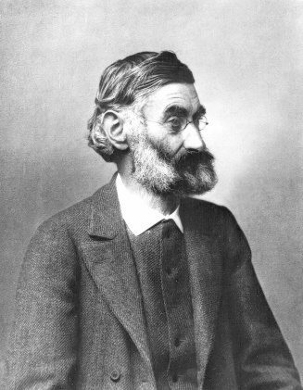
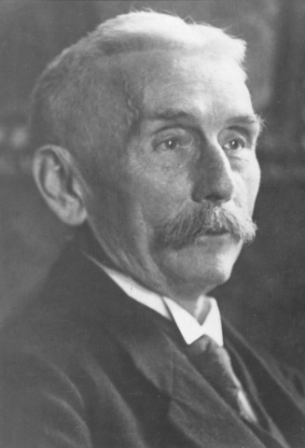
Why do we care about Fraunhofer lines?
Fraunhofer was a maker of fine optical glass
Special glass he made allowed him to see what Newton did not
Ernst Abbe, working with Otto Schott, would use these named spectral lines to characterize glass for microscope optics
Ernst Abbe (1840-1905)
Otto Schott (1851-1935)

Slide 45

Abbe number (V)
Measure of a material’s dispersion in relation to refractive index
Refractive indices at wavelengths of Fraunhofer D-, F- and C- spectral lines (589.3 nm, 486.1 nm and 656.3 nm respectively)
Instead of Na line can use He (V_{d}) or Hg (V_{e}) lines
High values of V indicating low dispersion (low chromatic aberration)
$$V_{D}=\frac{η_{D} − 1}{η_{F} − η_{C}}$$
Notes:
In physics and optics, the Abbe number, also known as the V-number or constringence of a transparent material, is a measure of the material's dispersion (variation of refractive index with wavelength) in relation to the refractive index, with high values of V indicating low dispersion (low chromatic aberration). It is named after Ernst Abbe (1840–1905), the German physicist who defined it.
Due to the difficulty and inconvenience in producing sodium and hydrogen lines, alternate definitions of the Abbe number are used in some contexts (ISO 7944).

Slide 46
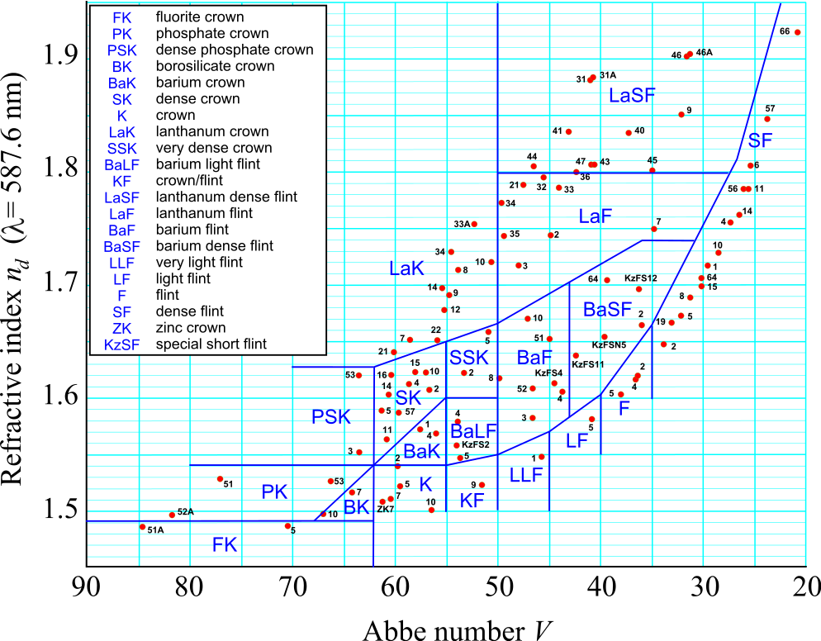
Abbe number (V)
Notes:
For first and last lenses (1 and 4), 200 mm focal length, 50 mm diameter composed of BK7 and SF2 glass.
For center two lenses (2 and 3), 75 mm focal length, 50 mm diameter composed of SF11 and BAF11 glasses
The most common types of glasses used in optics are crown glasses and flint glasses, designations based on their dispersions. Flint glasses contain lead. For example, a strong positive crown lens with its low dispersion may be used in a doublet with a weaker negative lens of flint glass (high dispersion) to correct for chromatic aberration.
http://hyperphysics.phy-astr.gsu.edu/hbase/geoopt/glass.html
In physics and optics, the Abbe number, also known as the V-number or constringence of a transparent material, is a measure of the material's dispersion (variation of refractive index with wavelength) in relation to the refractive index, with high values of V indicating low dispersion (low chromatic aberration). It is named after Ernst Abbe (1840–1905), the German physicist who defined it.
Due to the difficulty and inconvenience in producing sodium and hydrogen lines, alternate definitions of the Abbe number are used in some contexts (ISO 7944).

Slide 47
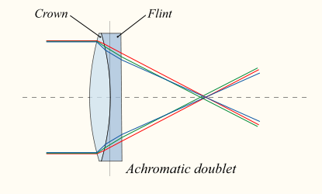
Example: Achromat doublet
Convex lens of crown glass: low η and high Abbe number
Concave lens of flint glass: high η and low Abbe number
Notes:
Flint glass is optical glass that has relatively high refractive index and low Abbe number (high dispersion). Flint glasses are arbitrarily defined as having an Abbe number of 50 to 55 or less. The currently known flint glasses have refractive indices ranging between 1.45 and 2.00. A concave lens of flint glass is commonly combined with a convex lens of crown glass to produce an achromatic doublet lens because of their compensating optical properties, which reduces chromatic aberration (colour defects).
With respect to glass, the term flint derives from the flint nodules found in the chalk deposits of southeast England that were used as a source of high purity silica by George Ravenscroft, circa 1662, to produce a potash lead glass that was the precursor to English lead crystal.
Traditionally, flint glasses were lead glasses containing around 4–60% lead oxide; however, the manufacture and disposal of these glasses were sources of pollution. In many modern flint glasses, the lead can be replaced with other additives such as titanium dioxide and zirconium dioxide without significantly altering the optical properties of the glass.
Flint glass can be fashioned into rhinestones which are used as diamond simulants.
Electric Bulbs and Spectacle glasses are made of Flint glass.
Crown glass is a type of optical glass used in lenses and other optical components. It has relatively low refractive index (≈1.52) and low dispersion (with Abbe numbers around 60). Crown glass is produced from alkali-lime (RCH) silicates containing approximately 10% potassium oxide and is one of the earliest low dispersion glasses.
As well as the specific material named crown glass, there are other optical glasses with similar properties that are also called crown glasses. Generally, this is any glass with Abbe numbers in the range 50 to 85. For example, the borosilicate glass Schott BK7^{[1]} is an extremely common crown glass, used in precision lenses. Borosilicates contain about 10% boric oxide, have good optical and mechanical characteristics, and are resistant to chemical and environmental damage. Other additives used in crown glasses include zinc oxide, phosphorus pentoxide, barium oxide, fluorite and lanthanum oxide.
An achromatic doublet, which combines crown glass and flint glass.
A concave lens of flint glass is commonly combined with a convex lens of crown glass to produce an achromatic doublet. The dispersions of the glasses partially compensate for each other, producing reduced chromatic aberration compared to a singlet lens with the same focal length.

Slide 48
Example: Achromat doublet
Second lens creates equal and opposite chromatic aberration
BUT - at only one or two wavelength(s)
Notes:
Flint glass is optical glass that has relatively high refractive index and low Abbe number (high dispersion). Flint glasses are arbitrarily defined as having an Abbe number of 50 to 55 or less. The currently known flint glasses have refractive indices ranging between 1.45 and 2.00. A concave lens of flint glass is commonly combined with a convex lens of crown glass to produce an achromatic doublet lens because of their compensating optical properties, which reduces chromatic aberration (colour defects).
With respect to glass, the term flint derives from the flint nodules found in the chalk deposits of southeast England that were used as a source of high purity silica by George Ravenscroft, circa 1662, to produce a potash lead glass that was the precursor to English lead crystal.
Traditionally, flint glasses were lead glasses containing around 4–60% lead oxide; however, the manufacture and disposal of these glasses were sources of pollution. In many modern flint glasses, the lead can be replaced with other additives such as titanium dioxide and zirconium dioxide without significantly altering the optical properties of the glass.
Flint glass can be fashioned into rhinestones which are used as diamond simulants.
Electric Bulbs and Spectacle glasses are made of Flint glass.
Crown glass is a type of optical glass used in lenses and other optical components. It has relatively low refractive index (≈1.52) and low dispersion (with Abbe numbers around 60). Crown glass is produced from alkali-lime (RCH) silicates containing approximately 10% potassium oxide and is one of the earliest low dispersion glasses.
As well as the specific material named crown glass, there are other optical glasses with similar properties that are also called crown glasses. Generally, this is any glass with Abbe numbers in the range 50 to 85. For example, the borosilicate glass Schott BK7^{[1]} is an extremely common crown glass, used in precision lenses. Borosilicates contain about 10% boric oxide, have good optical and mechanical characteristics, and are resistant to chemical and environmental damage. Other additives used in crown glasses include zinc oxide, phosphorus pentoxide, barium oxide, fluorite and lanthanum oxide.
An achromatic doublet, which combines crown glass and flint glass.
A concave lens of flint glass is commonly combined with a convex lens of crown glass to produce an achromatic doublet. The dispersions of the glasses partially compensate for each other, producing reduced chromatic aberration compared to a singlet lens with the same focal length.

Slide 49
Good optical Engineering
What to look for when buying a new microscope
Minimize number of lenses, prisms and mirrors
  Do you agree?

Slide 50
Good optical Engineering
What to look for when buying a new microscope
Minimize number of lenses, prisms and mirrors
  Do you agree?
But the best lenses may have the most optical elements
Can you see one trend in designing new objectives?

Slide 51
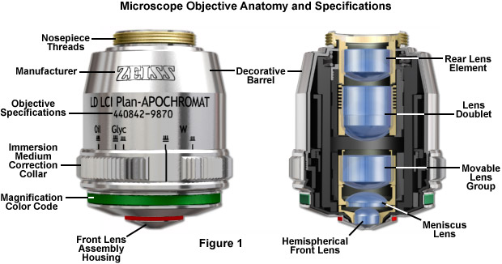
The Microscope’s Most Important Component
The objective

Slide 52
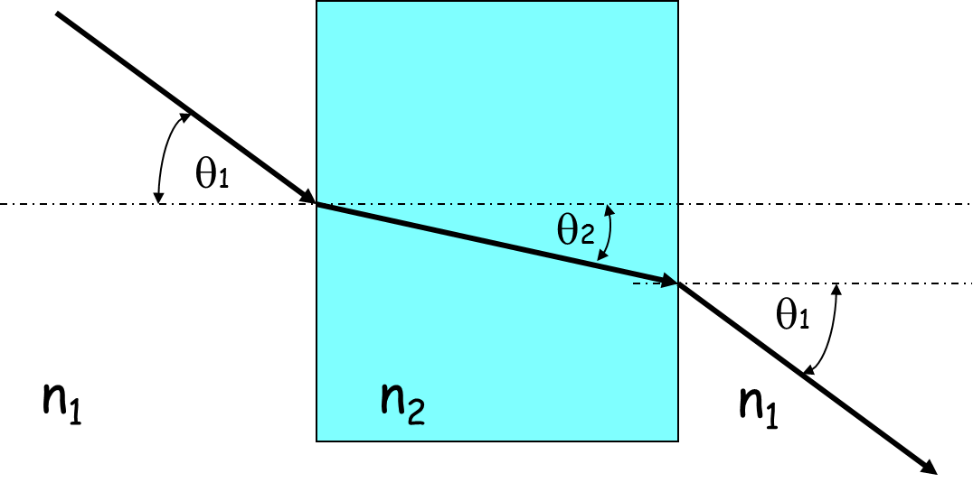
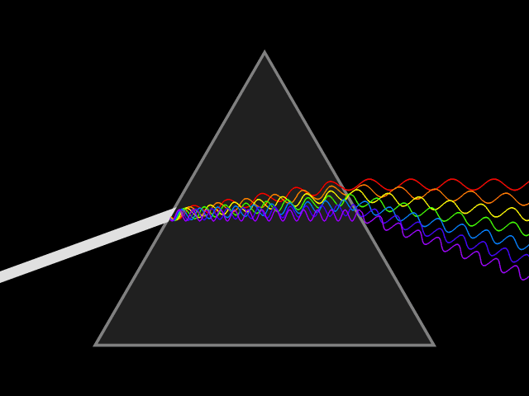
Objective names and aberrations
Refraction: light bends as it passes from one material to another
Dispersion: Blue light (shorter wavelengths) bends more than red light (longer wavelengths)

Slide 53
Objective names and aberrations
Refractive index η
Air 1.0003
Glycerin 1.47
Immersion Oil 1.518
Diamond 2.42
Material Blue (486nm) Yellow (589nm) Red (656nm)
Crown Glass 1.524 1.517 1.515
Flint Glass 1.639 1.627 1.622
Water 1.337 1.333 1.331
Cargille Oil 1.530 1.520 1.516

Slide 54
Objective names and corrections
Corrections: | Chromatic | Spherical | Other
Achromat | 2λ | -
Apochromat | 3λ | 2λ
PlanApochromat | 4-7λ | 3λ | Flat field
Fluor or Fluar | fewλ | fewλ | Max light
Neo Fluar | 2-3λ | 2-3λ
Corrected Wavelength (nm):
UV VIS IR
Plan Neofluar - - (435) 480 546 - 644 - -
Plan Apochromat - - 435 480 546 - 644 - -
C-Apochromat 365 405 435 480 546 608 644 - -
IR C-Apochromat - - 435 480 546 608 644 800 1064

Slide 55
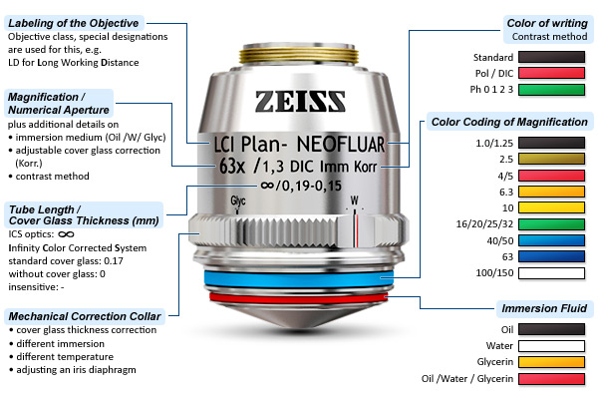
Objective names and resolution
http://zeiss-campus.magnet.fsu.edu

Slide 56
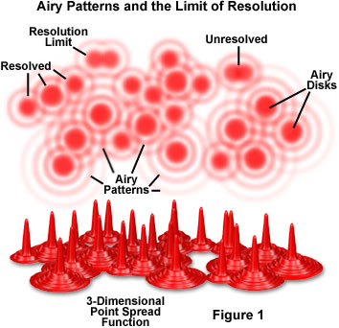
Resolution
More than just magnification
Shorter wavelength
Higher Numerical Aperture (NA)
Ernst Abbe presented resolution formula in 1876
R = 0.61λ/NA
Notes:
Ernst Abbe’s formula for resolution from when he was a scientist working at Zeiss. Published in late 1800s.

Slide 57
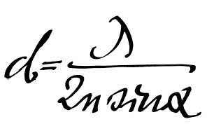
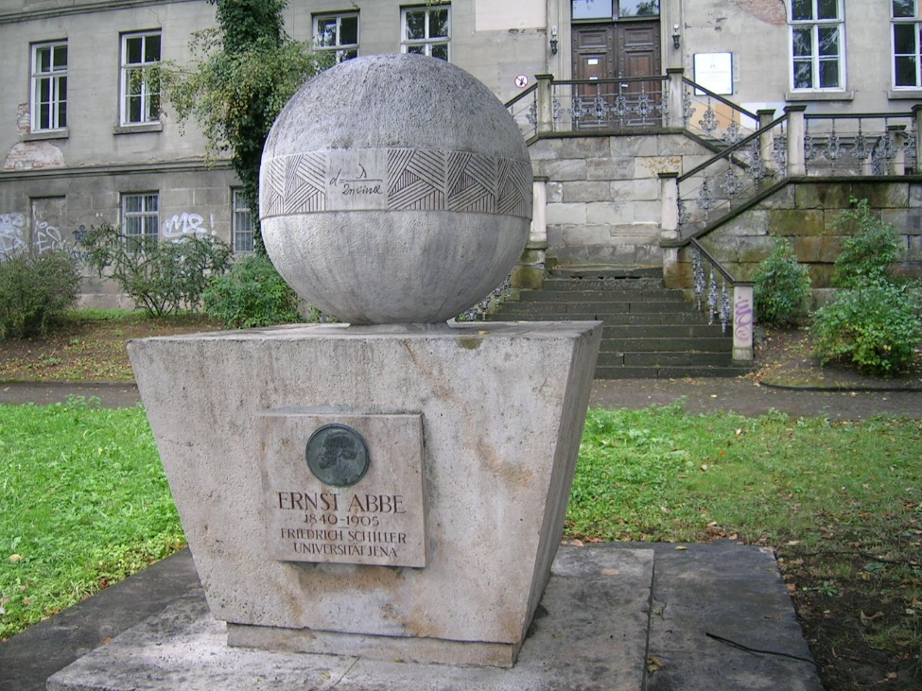
Resolution
More than just magnification
Shorter wavelength
Higher Numerical Aperture (NA)
Ernst Abbe presented resolution formula in 1876
Literally carved in stone
R = 0.61λ/NA
Notes:
Ernst Abbe’s formula for resolution from when he was a scientist working at Zeiss. Published in late 1800s.

Slide 58
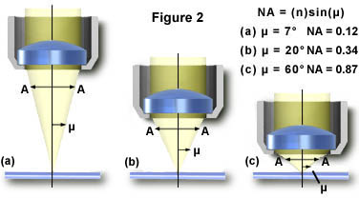
Numerical Aperture and Resolution
Resolution: smallest distance between two points on a specimen that can still be distinguished as two separate entities.
R = 0.61λ/NA
Notes:
http://micro.magnet.fsu.edu/primer/anatomy/numaperture.html

Slide 59
Numerical Aperture and Resolution
Resolution: smallest distance between two points on a specimen that can still be distinguished as two separate entities.
R = 0.61λ/NA
Notes:
http://micro.magnet.fsu.edu/primer/anatomy/numaperture.html

Slide 60
Numerical Aperture and Resolution
Resolution: smallest distance between two points on a specimen that can still be distinguished as two separate entities.
R = 0.61λ/NA
R = 1.22λ/(NA(obj) + NA(cond))
Notes:
http://micro.magnet.fsu.edu/primer/anatomy/numaperture.html

Slide 61
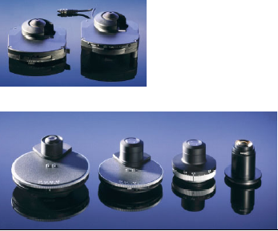
The second most important microscope component
The Condenser

Slide 62
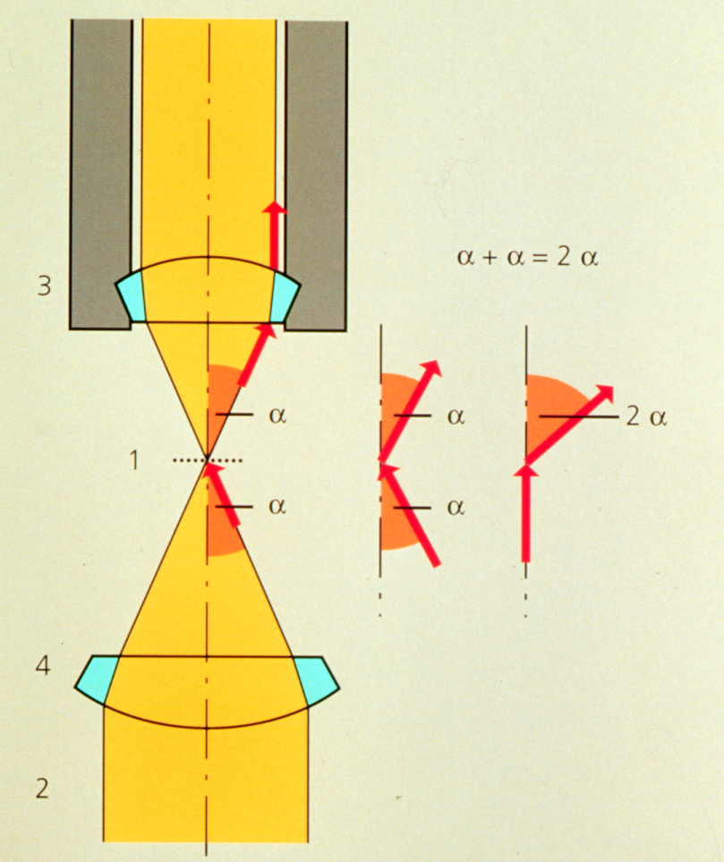
Condenser maximizes resolution
d_{min} = 1.22 λ / (NA _{objective} +NA _{condenser})
Kohler Illumination: Condenser and objective focused at the same plane

Slide 63
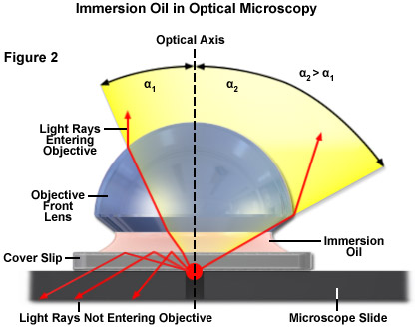
How immersion medium affects the true N.A. and, consequently, resolution.

Slide 64
How immersion medium affects the true N.A. and, consequently, resolution.
No immersion (dry)
Max. Value for α = 90° (sin = 1)
Attainable: sinα = 0.95 (α = 72°)
Actual angle α₁:
Beampath
Snell’s Law:
n₁ sin β1 = n₂ sin β2
No oil
Oil
α₁
α₂
1
3
With immersion oil (3) n=1.518
No Total Reflection
Objective aperture fully usable
N.A._{max} = 1.45 > Actual angle α₂ :
α₁
α₂
2
Objective
Cover Slip, on slide
Immersion Oil
Notes:
Note 39 degree angle max for dry objective

Slide 65
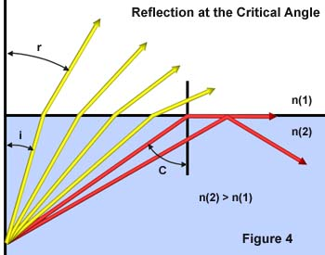
Internal reflection depends on refractive index differences
sin θ critical = η1 / η2
Notes:
Matching refractive indices can eliminate internal reflection. Internal reflection depends on refractive index differences

Slide 66
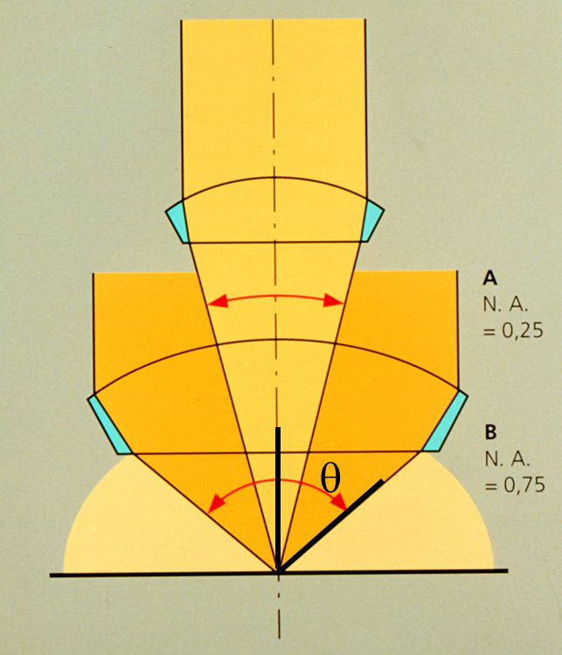
Good optical Engineering and N.A.
If NA is too small, there is no light at larger angles. Resolution suffers.
If NA is too large, may not have enough working distance. Lose ability to image deeper.

Slide 67
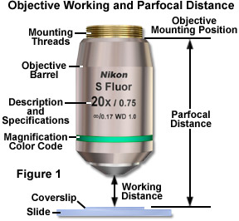
Relationship between N.A. and working distance of objective
Working distance: measure of the space between objective and cover-slip where specimen is in focus
Parfocality: When changing objectives, specimen remains in focus.
Can see how this works at this link.
Notes:
http://zeiss-campus.magnet.fsu.edu/tutorials/basics/numericalaperturelightcones/indexflash.html

Slide 68
Good optical Engineering and N.A.
N.A. has a major effect on image brightness
Transmitted light
  Brightness = fn (NA² / magnification²)
  10x 0.5 NA is 3 times brighter than 10x 0.3NA
Epifluorescence
  Brightness = fn (NA⁴ / magnification²)
  10x 0.5 NA is 8 times brighter than 10x 0.3NA
Lower magnifications are brighter but higher magnifications can have higher NA.

Slide 69
Good optical Engineering and N.A.
How does higher N.A. provide higher resolution?
Why does taking in more light provide higher resolution?

Slide 70
Good optical Engineering and N.A.
How does higher N.A. provide higher resolution?
Why does taking in more light provide higher resolution?
Airy pattern of diffraction limited spot

Slide 71
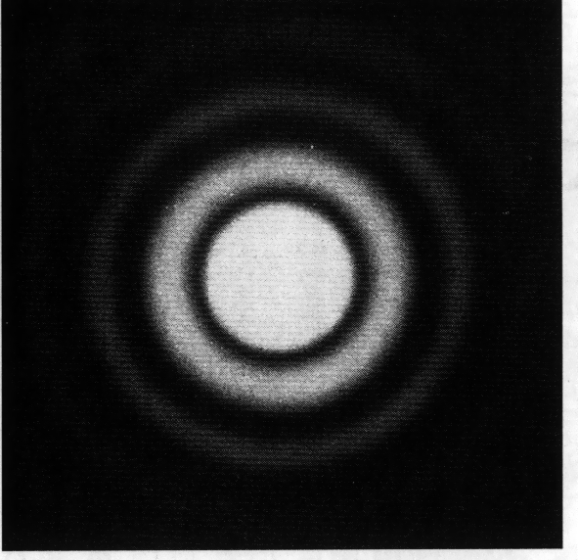
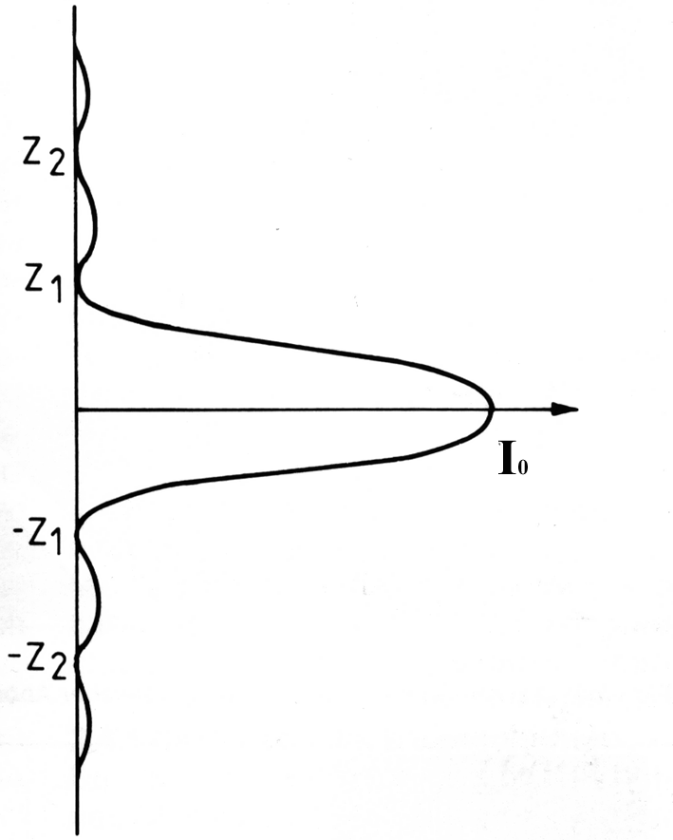
Intensity Distribution of a diffraction-limited spot
Airy Disk
Named after Sir George Biddell Airy English mathematician and astronomer
Notes:
In optics, the Airy disk (or Airy disc) and Airy pattern are descriptions of the best focused spot of light that a perfect lens with a circular aperture can make, limited by the diffraction of light.
The diffraction pattern resulting from a uniformly-illuminated circular aperture has a bright region in the center, known as the Airy disk which together with the series of concentric bright rings around is called the Airy pattern. Both are named after George Biddell Airy.

Slide 72
Good optical Engineering and N.A.
Higher N.A. provides brighter image.
Higher N.A. provides higher resolution.
Is it possible to have both high N.A. and long working distance?

Slide 73
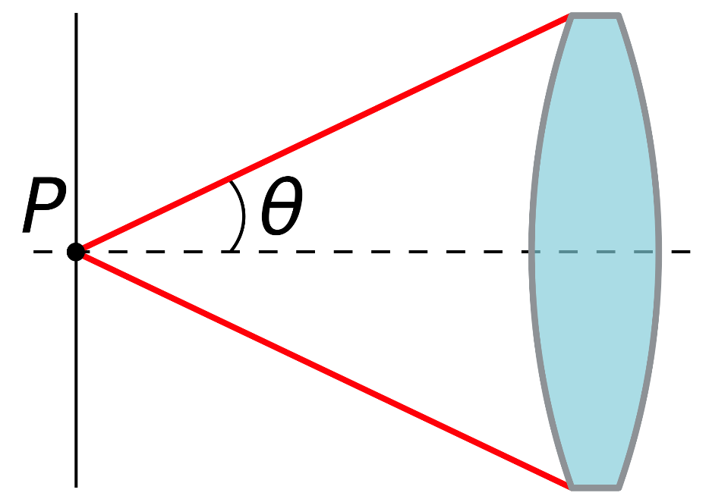
Good optical Engineering and N.A.
Is it possible to have both high N.A. and long working distance?

Slide 74
Good optical Engineering and N.A.
Is it possible to have both high N.A. and long working distance?

Slide 75
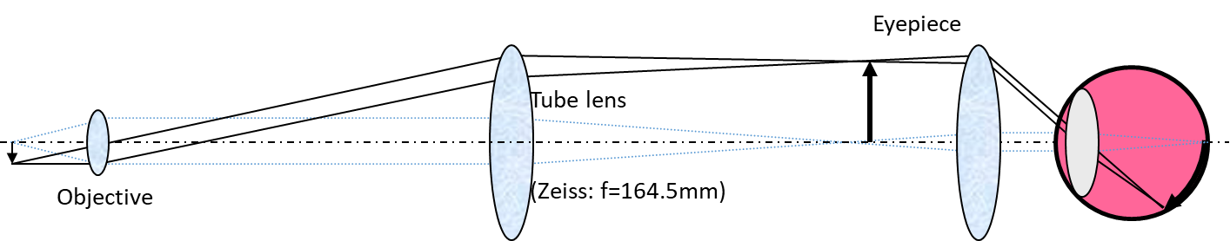
Homework 2 (due January 22, 2019)
All four of the big microscope manufacturing companies (Leica, Nikon, Olympus, Zeiss) have gone to infinity optics. In the diagram we saw in Lecture the objective appears to be a single lens. Question #1: Where would the object be located relative to the focal point of this lens?
Hint – One of the thin lens laws provides the answer.
Continued on next slide

Slide 76
Homework 2 (due January 22, 2019)
In reality, most microscope objectives consist of multiple lenses as illustrated below. This provides many advantages to the capabilities of a microscope objective. as we heard in lecture (i.e. higher magnifications, correction of aberrations). The objective illustrated below currently does not output an image towards infinity. Exercise #2: Let’s make an infinity lens. Draw a lens in the objective cross section illustrated below, indicating it’s focal length, to make the last image formed by the three lenses (the green one) go out into infinity.
Hint – You only have to worry about the last green image for placing your lens.

