Slide 1
Biology 177: Principles of Modern Microscopy
Lecture 18:
High speed microscopy, Part 2
Andres Collazo, Director Biological Imaging Facility
Wan-Rong (Sandy) Wong, Graduate Student, TA

Slide 2
High speed microscopy, Part 2: Spatial light modulator microscope and other 3D sensors
Making super-resolution techniques faster
Techniques using high Numerical Aperture (NA) optics
  Multifocal plane microscopy (MUM)
  Aberration-free optical focusing
  Quadratically distorted grating
  Aberration-corrected multifocus microscopy (MFM)
Techniques not depending on high NA optics
  Fourier ptychographic microscopy (FPM)
  Holographic or Spatial light modulator (SLM) microscope
  SLM with extended depth of focus (EDOF)
  Digital holographic microscopy (DHM)
Discuss OpenSpim paper

Slide 3
One problem with all super-resolution techniques?

Slide 4
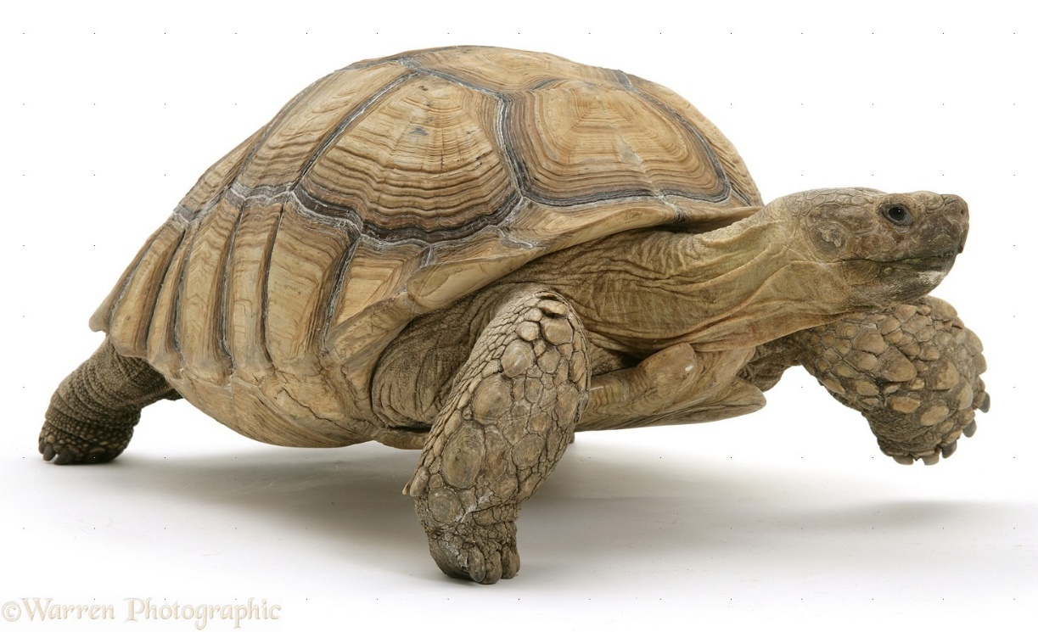
One problem with all super-resolution techniques?
They are slow

Slide 5
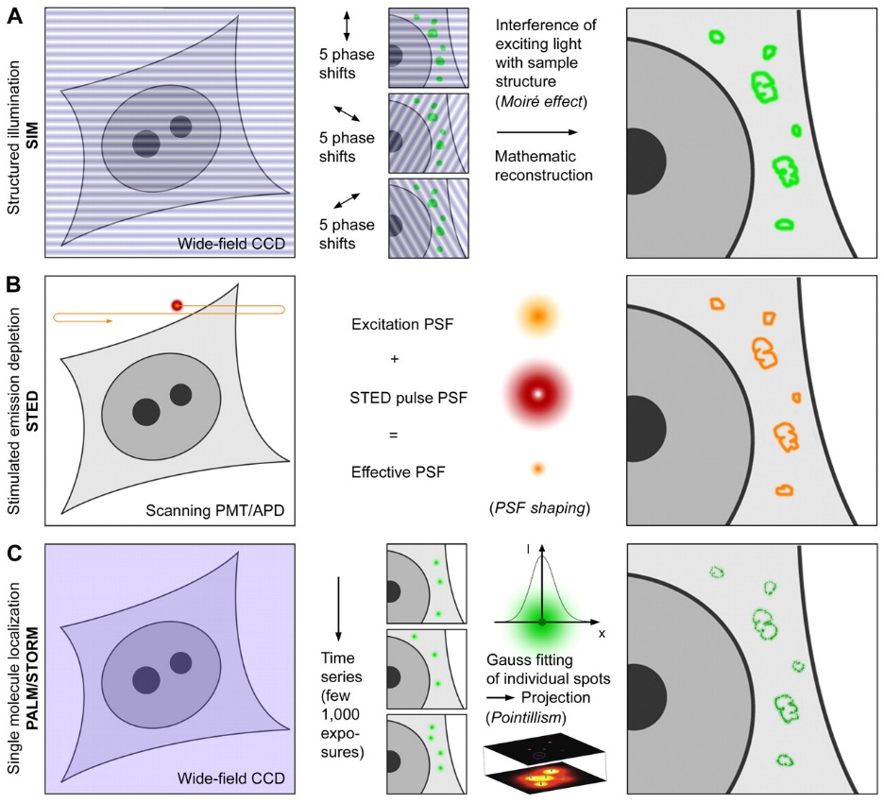
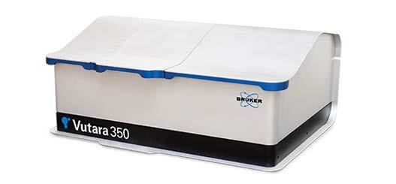
But many techniques getting faster and being used for live imaging
STED
Structured illumination microscopy (SIM)
PALM/STORM
Notes:
http://jcb.rupress.org/content/190/2/165.full

Slide 6
But many techniques getting faster and being used for live imaging
STED
Structured illumination microscopy (SIM)
PALM/STORM
Notes:
http://jcb.rupress.org/content/190/2/165.full

Slide 7
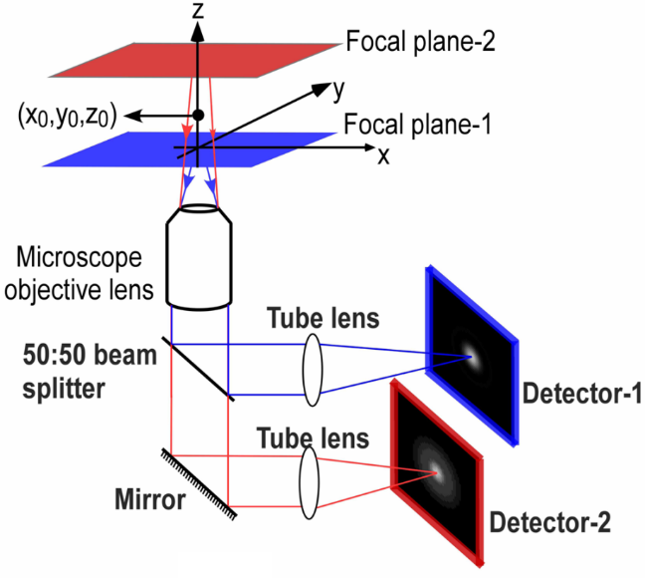
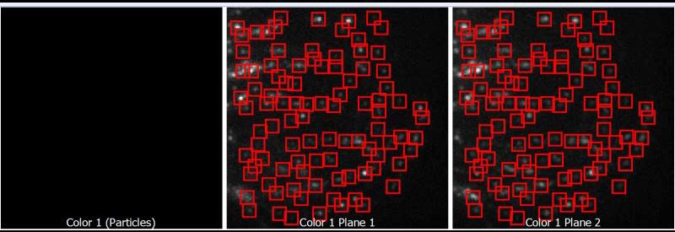
Bruker vutara imaging two focal planes at once
Biplane imaging increases speed
Schematic of MUM (Multifocal plane microscopy)
Notes:
"Schematic diagram of a multifocal plane microscope" by Sripad Ram - For Ward Ober Lab websitePreviously published: http://www4.utsouthwestern.edu/wardlab/index.asp. Licensed under CC BY-SA 3.0 via Wikipedia - http://en.wikipedia.org/wiki/File:Schematic_diagram_of_a_multifocal_plane_microscope.PNG#mediaviewer/File:Schematic_diagram_of_a_multifocal_plane_microscope.PNG
http://en.wikipedia.org/wiki/Multifocal_plane_microscopy

Slide 8
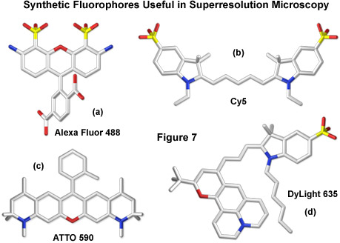
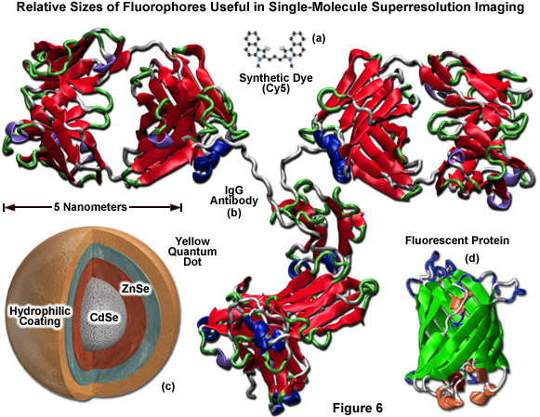
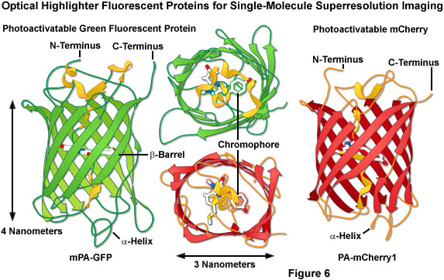
Sample Labeling Choices for PALM/STORM (SML) Imaging
Organic dyes or Genetically encoded fluorescent proteins
Organic dyes generally preferred for SML labeling over fluorescent proteins since they emit more photons.
Fluorescent proteins are live cell compatible
c
c
Notes:
http://zeiss-campus.magnet.fsu.edu/articles/superresolution/palm/introduction.html
http://www.microscopyu.com/articles/superresolution/stormintro.html

Slide 9

Single Molecule Localization Probes
Preferred Organic Dyes
Excitation Laser Line (nm) | Dye | Excitation Maximum (nm) | Emission Maximum (nm)
488 | ATTO 488 | 501 | 523
 | Alexa 488 | 495 | 519
561 | Cy3B | 559 | 570
 | Alexa 568 | 578 | 603
 | Alexa 555 | 555 | 580
640 | Alexa 647 | 650 | 665
 | Cy5 | 649 | 670
 | DyLight 650 | 652 | 672
750 | Alexa 750 | 749 | 775
 | DyLight 755 | 754 | 776

Slide 10
Photoswitchable Fluorescent Proteins (Genetically-Encoded)
Probe | Type | λ_{PA} (nm) | λ_{X} (nm) | λ_{EM} (nm) | Variants
PSCFP2 | 0→A (Irrev) | Violet (~400) | 490 | 511 | PSCFP
PA-GFP | 0→A (Irrev) | Violet | 504 | 517
Dronpa | 0→A (Rev*) | *activ. w violet quench w blue | 503 | 518 | Fastlime, Dronpa3
Dendra2 | A→B (Irrev) | Violet-Blue | 553 | 573 | Dendra
EosFP | A→B (Irrev) | Violet | 569 | 581 | mEos3.2, tdEos
Kaede | A→B (Irrev) | Violet | 572 | 580
KikGR | A→B (Irrev) | Violet | 583 | 593
PAmCherry | 0→A (Irrev) | Violet | 564 | 595 | 1&2

Slide 11

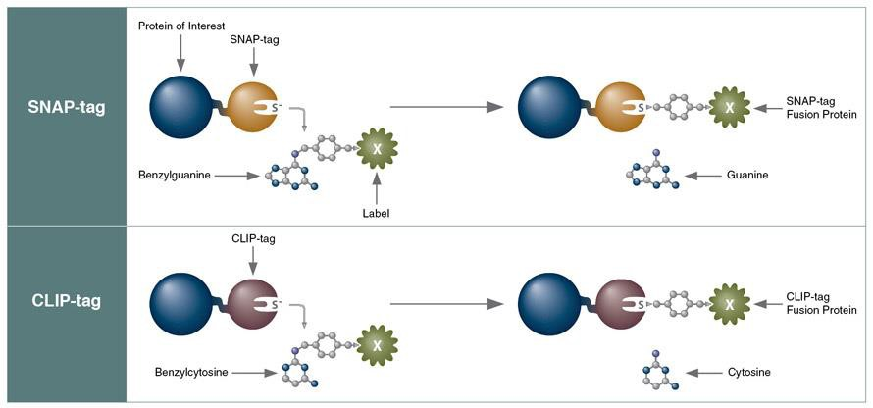
Combining the best of organic dyes and Fluorescent Proteins: SNAP, CLIP and Halo Tags
New labeling technologies are being developed to exploit the best features of organic dyes and genetically encoded proteins
novel-tools-to-study-protein-function
Notes:
The most versatile of these tags is the SNAP-tag, a 20 kDa mutant of the DNA repair protein O6-alkylguanine-DNA alkyltransferase that reacts specifically and rapidly with benzylguanine (BG) derivatives (Figure 1), leading to irreversible covalent labeling of the SNAP-tag with a synthetic probe (2)
The second tag introduced by NEB is a sibling of the SNAP-tag, the CLIP-tag (3). The CLIP-tag was created by engineering the substrate specificity of the SNAP-tag, permitting it to react specifically with O₂-benzylcytosine (BC) derivatives (Figure 1). The main application of the CLIP-tag is dual-labeling of fusion proteins in conjunction with the SNAP-tag.
In summary, NEB is offering four fully orthogonal labeling technologies (SNAP-tag, CLIP-tag, MCP-tag and ACP-tag) which can be used to selectively label corresponding fusion proteins with synthetic probes in both cell imaging and in vitro applications.
New England Bioscience

Slide 12
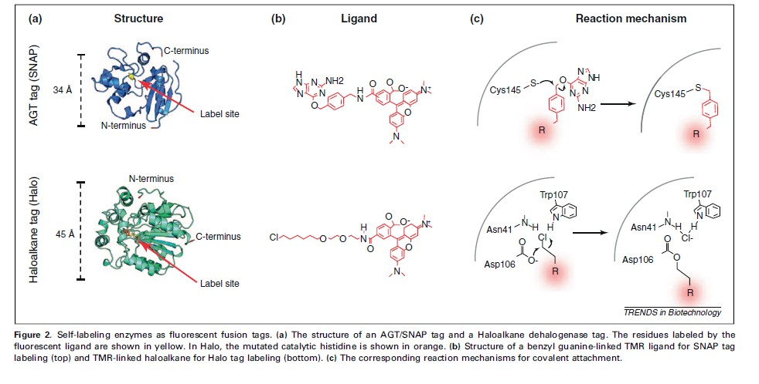
Combining the best of organic dyes and Fluorescent Proteins: SNAP, CLIP and Halo Tags
Imaging proteins inside cells with fluorescent tags
Crivat & Taraska. Trends in Biotechnology. 30, 8-16 (2012)
Notes:
Aside from AGT, the bacterial enzyme haloalkane dehalogenase (marketed as Halo tag) has been developed as a self-labeling fusion tag (Figure 2) [2]. Like AGT, this enzyme covalently attaches a modified flurophore ligand to an active-site residue.
Second, a series of self-labeling enzymes have been developed that can covalently attach a fluorescent ligand to one of its own amino acid residues. These enzymes are similar in size to FPs and are commonly called Halo tags and SNAP/CLIP tags 2, 3 and 4. If these enzymes are fused in frame to a protein, the pair can be labeled by introducing a cell-permeable fluorescent ligand, which covalently reacts with the fusion tag.
Fourth, small cell-permeable biarsenical dyes, FLAsH and ReAsH, have been developed that can covalently react with a short peptide sequence 6 and 7. The amino acid sequence that recognizes the bisarsenic is small, only four amino acids in length. However, optimized sequences of 12 amino acids increase the specificity of labeling [8].

Slide 13
Original References for SNAP, CLIP and Halo Tags
SNAP Tag: Keppler et al. A general method for the covalent labeling of fusion proteins with small molecules in vivo. Nat. Biotechnology. 21, 86-89 (2003)
CLIP Tag: Gautier et al. An engineered protein tag for multiprotein labeling in living cells. Chemistry & Biology 15, 128-136 (2008)
Halo Tag: Los et al. HaloTag: A Novel Protein Labeling Technology for Cell Imaging and Protein Analysis. ACS Chemical Biology 3, 373-382 (2008)
Notes:
Gautier, A., Juillerat, A., Heinis, C., Corrêa Jr, I.R., Kindermann, M., Beaufils, F., Johnsson, K., 2008. An Engineered Protein Tag for Multiprotein Labeling in Living Cells. Chemistry & Biology 15, 128-136.
Keppler, A., Gendreizig, S., Gronemeyer, T., Pick, H., Vogel, H., Johnsson, K., 2003. A general method for the covalent labeling of fusion proteins with small molecules in vivo. Nat Biotech 21, 86-89.
Los, G.V., Encell, L.P., McDougall, M.G., Hartzell, D.D., Karassina, N., Zimprich, C., Wood, M.G., Learish, R., Ohana, R.F., Urh, M., Simpson, D., Mendez, J., Zimmerman, K., Otto, P., Vidugiris, G., Zhu, J., Darzins, A., Klaubert, D.H., Bulleit, R.F., Wood, K.V., 2008. HaloTag: A Novel Protein Labeling Technology for Cell Imaging and Protein Analysis. ACS Chemical Biology 3, 373-382.
http://www.nature.com/nbt/journal/v21/n1/full/nbt765.html
http://www.sciencedirect.com/science/article/pii/S1074552108000410
http://pubs.acs.org/doi/full/10.1021/cb800025k

Slide 14
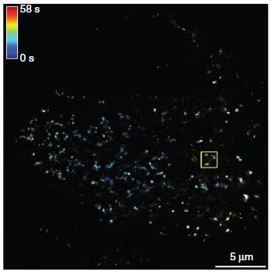
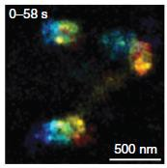
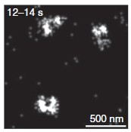
Live-cell Imaging using mEos3.2
Biological System: Live HeLa Cell
Label: mEos3.2-clathrin light chain
Imaged at 600 fps for 58 s
2 seconds per SR image
Imaged in PBS
Adapted from Huang et al. Nat. Meth. 10, 653-658 (2013)
Notes:
Super-resolution image of mEos3.2-labeled clathrin-coated pits (CCPs) in a live HeLa cell. The localization estimates are colored according to their recording time. (b) The enlarged image of the area marked by the yellow box in a reveals that movements of the structures over the course of recording obscure the details in the image. (c) Rings representing axial projections of CCPs can be resolved when only a 2-s time window of the data is displayed. (d–f) Peroxisome dynamics in a live COS-7 cell labeled by tdEos. (d) Overview image of an 83-s data set. Data have been colored as in a. (e) Super-resolution images (top) and maximum projections (bottom) of the raw data from the area in the green box in d in 0.5-s time intervals. (f) Super-resolution images at 0.5-s time resolution of the area highlighted by the blue box in d. See also Supplementary Figure 11 and Supplementary Videos 1,2,3,4,5 and 8.
Video 3: Super-resolution video for a small cutout of a larger data set of mEOS3.2-labeled CCPs in a live HeLa cell (1) (55,160 KB, Download) Raw data were recorded as described in the Online Methods. Acquired images were analyzed using single-emitter fitting (Online Methods). 1,200 frames were combined to reconstruct each super-resolution image corresponding to a 2-s time window. Localization estimates in each image were binned into 10-nm pixels for display. To generate the video, we combined all 28 super-resolution images into a 3D data stack and smoothed with a 3D Gaussian kernel with σ_{x,y} = 10 nm and σ_{t} = 2 s to aid visualization. The resulting stack was converted into a video playing back at 15 frames per second. Scale bar, 500 nm.
Video 4: Super-resolution video for a small cutout of a larger data set of mEOS3.2-labeled CCPs in a live HeLa cell (2) (37,431 KB, Download) This video corresponds to the data set shown in Figure 3a–c. Raw data were recorded as described in the Online Methods. Acquired images were analyzed using single-emitter fitting (Online Methods). 1,200 frames were combined to reconstruct each super-resolution image corresponding to a 2-s time window. Localization estimates in each image were binned into 10-nm pixels for display. To generate the video, we combined all 19 super-resolution images into a 3D data stack and smoothed with a 3D Gaussian kernel with σ_{x,y} = 10 nm and σ_{t} = 2 s to aid visualization. The resulting stack was converted into a video playing back at 15 frames per second. Scale bar, 500 nm.
http://www.nature.com/nmeth/journal/v10/n7/full/nmeth.2488.html

Slide 15
Live-cell Imaging using mEos3.2
Notes:
Video 1: Super-resolution video of mEOS3.2-labeled CCPs in a live HeLa cell (105,080 KB, Download) Raw data were recorded as described in the Online Methods. Acquired images were analyzed using single-emitter fitting (Online Methods). 1,200 frames were combined to reconstruct each super-resolution image corresponding to a 2-s time window. Localization estimates in each image were binned into 20-nm pixels for display. To generate the video, we combined all 40 super-resolution images into a three-dimensional (3D) data stack and smoothed with a 3D Gaussian kernel with σ_{x,y} = 20 nm and σ_{t} = 2 s to aid visualization. The resulting stack was converted into a video playing back at 15 frames per second. Scale bar, 5 μm.
http://www.nature.com/nmeth/journal/v10/n7/full/nmeth.2488.html#supplementary-information

Slide 16
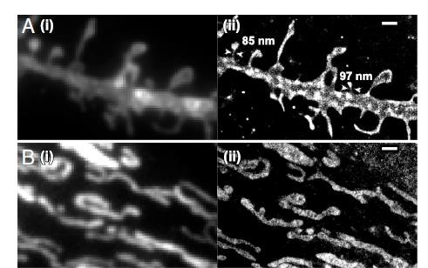
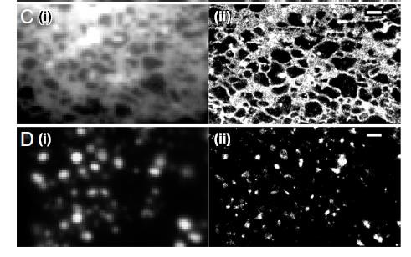
Super-resolution fluorescence imaging of organelles in live cells with photoswitchable membrane probes
Conventional Super-resolution Conventional Super-resolution
the plasma membrane labeled with DiI in a hippocampal neuron (15 sec)
mitochondria labeled with MitoTracker Red in a BS-C-1 cell (10 sec)
the ER labeled with ER-Tracker Red in a BS-C-1 cell (10 sec)
lysosomes labeled with LysoTracker Red in a BS-C-1 cell (1 sec)
Scale bars, 1 μm.
Shim et al. PNAS. 109, 13978-13983 (2012)

Slide 17
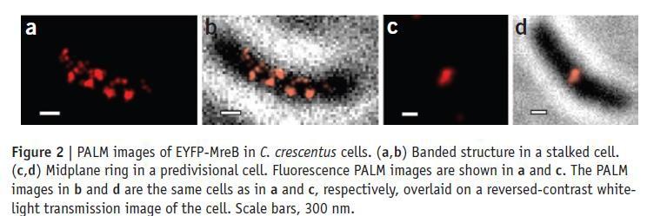
Super-resolution imaging in live Caulobacter crescentus cells using photoswitchable EYFP
Biteen et al. Nat. Methods. 5, 947-949 (2008)
Notes:
W E Moerner¹
http://www.nature.com/nmeth/journal/v5/n11/full/nmeth.1258.html

Slide 18
High speed microscopy even faster without super-resolution
Making super-resolution techniques faster
Techniques using high Numerical Aperture (NA) optics
  Multifocal plane microscopy (MUM)
  Aberration-free optical focusing
  Quadratically distorted grating
  Aberration-corrected multifocus microscopy (MFM)
Techniques not depending on high NA optics
  Fourier ptychographic microscopy (FPM)
  Holographic or Spatial light modulator (SLM) microscope
  SLM with extended depth of focus (EDOF)
  Digital holographic microscopy (DHM)

Slide 19
High speed microscopy even faster without super-resolution
Making super-resolution techniques faster
Techniques using high Numerical Aperture (NA) optics
  Multifocal plane microscopy (MUM)
  Aberration-free optical focusing
  Quadratically distorted grating
  Aberration-corrected multifocus microscopy (MFM)
Techniques not depending on high NA optics
  Fourier ptychographic microscopy (FPM)
  Holographic or Spatial light modulator (SLM) microscope
  SLM with extended depth of focus (EDOF)
  Digital holographic microscopy (DHM)

Slide 20
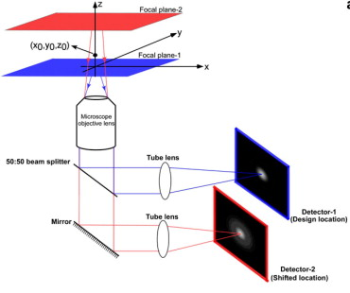
Multifocal plane microscopy (MUM)
Increases speed by imaging 2 focal planes at once.
Saw this in Bruker high speed super-resolution microscope
Ram, S., Prabhat, P., Chao, J., Sally Ward, E., Ober, R.J., 2008. High Accuracy 3D Quantum Dot Tracking with Multifocal Plane Microscopy for the Study of Fast Intracellular Dynamics in Live Cells. Biophysical Journal 95, 6025-6043.
Notes:
From Raimund Ober lab in Texas. Have taken it up to 4 focal planes. Original paper did TIRF for one plane and epifluor for other. Now use machined ports to different focal planes.
http://www.sciencedirect.com/science/article/pii/S0006349508820176

Slide 21
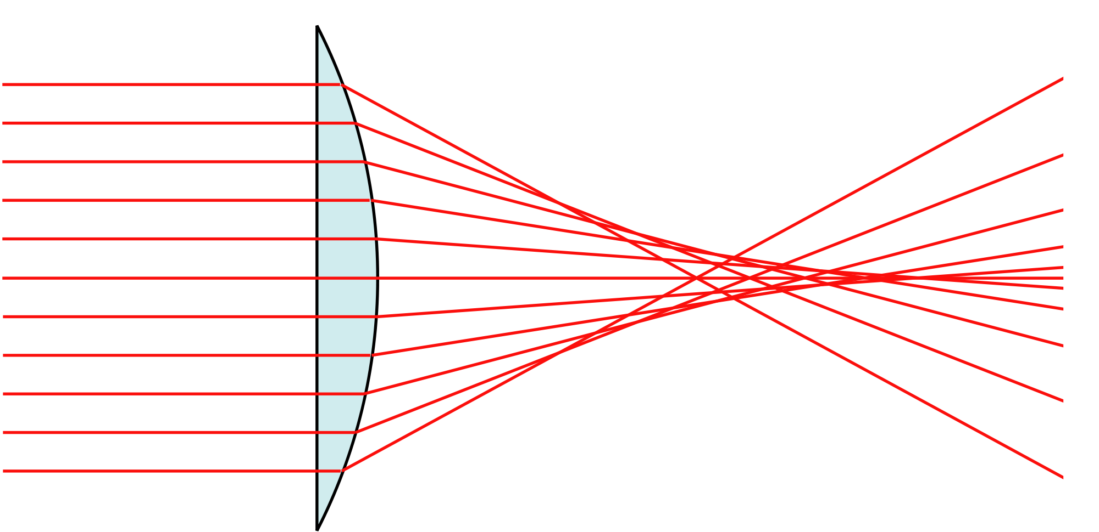
But problems with MUM
Need multiple cameras
Spherical aberrations
Notes:
Mulitple camera alignments a pain, see OMX. However, refocusing by translating the camera away from the nominal focal plane induces spherical aberration after a refocus of a few microns²
http://commons.wikimedia.org/wiki/File:Spherical_aberration_2.svg

Slide 22
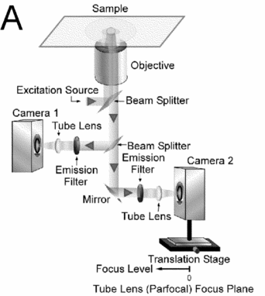
How do you capture multiple focal planes without aberrations?
Spherical aberrations result if two focal planes more than a few microns apart
So multiple focal planes from camera translation limited in z-dimension
Prabhat, P., Ram, S., Ward, E.S., Ober, R.J., 2004. Simultaneous imaging of different focal planes in fluorescence microscopy for the study of cellular dynamics in three dimensions. NanoBioscience, IEEE Transactions on 3, 237-242.
Notes:
Fine for super-resolution when focal planes close but

Slide 23
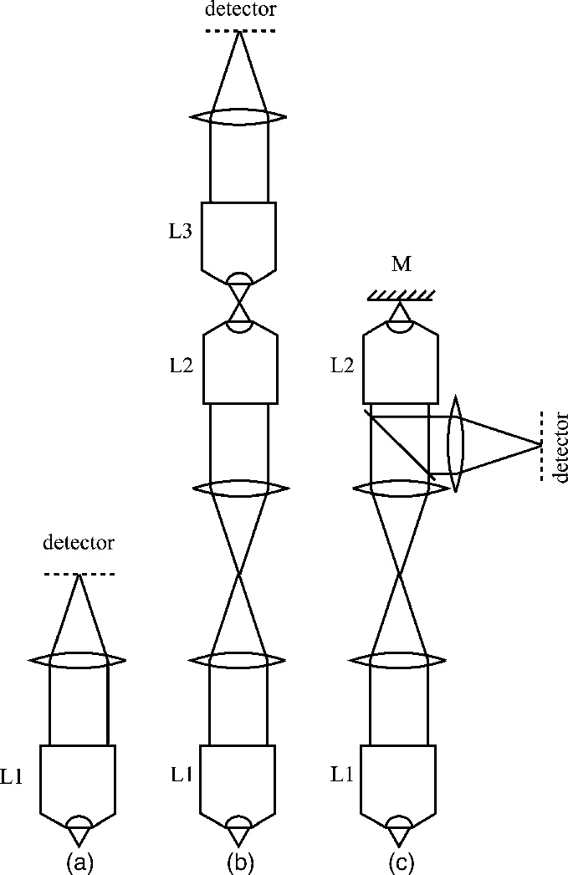
Can have aberration-free optical focusing, even with high N.A. objectives
High speed
No need to move objective or specimen
Just move small mirror
Normal configuration
Two microscopes back to back
Optically equivalent
Tube lens
Botcherby, E.J., Juskaitis, R., Booth, M.J., Wilson, T., 2007. Aberration-free optical refocusing in high numerical aperture microscopy. Optics letters 32, 2007-2009.
Notes:
The usual configuration for a high numerical aperture (NA) microscope is shown in Fig. 1a .
Refocusing on the detector side is a practical solution only if the spherical aberration can be avoided. Optical systems designed to satisfy the Herschel condition permit aberration-free imaging of points that lie along the optic axis. Perfect imaging of a volume region is therefore possible if both the sine and Herschel conditions are simultaneously satisfied. This occurs only in imaging systems with unity magnification, assuming dry lenses are used (if immersion lenses are used, the magnification must be equal to the ratio of immersion media refractive indices [3]) Such a magnification system could be built using two microscopes back to back [Fig. 1b]. An appropriate detector placed in the focal region of L2 would detect a diffraction-limited image of any chosen plane in the specimen. However, the resolution required of such a detector would be a fraction of a wavelength, far beyond the capabilities of presently available devices that typically have pixel sizes around 5–10 μm. Instead, we can probe the intermediate image in the focal region of L2 using another microscope comprising the objective L3 and a tube lens. This secondary imaging system magnifies the intermediate image so that it is compatible with the detector [Fig. 1b]. Like the original microscope of Fig. 1a, this secondary system produces an image of the focal plane of L3 and refocusing must be performed by shifting L3 along the optic axis. However, specimen disturbance is avoided as the axial scanning now occurs remotely in the optical system.
This can be avoided using the optically equivalent system of Fig. 1c. The intermediate image is formed using the same system as before. A planar mirror (M) mounted on an axial scanning stage is placed in the focal region of L2; this allows us to reuse L2 as part of the secondary imaging system. This system, composed of L2, the beam splitter, the tube lens, and the detector, creates an image of the focal plane of L2 on the detector. A quarter-wave plate and polarizing beam splitter can also be used to improve the optical throughput of this system. Refocusing is performed by scanning the mirror along the optic axis so that the plane of interest is imaged onto the detector. As the mirror can be small, this system permits high axial scan speed without specimen disturbance.
By one, and likewise by several, and even by an infinite number of thin lenses in contact, no more than two axis points can be reproduced without aberration of the third order. Freedom from aberration for two axis points, one of which is infinitely distant, is known as Herschel's condition.
From: https://en.wikipedia.org/wiki/Optical_aberration
http://www.opticsinfobase.org/ol/fulltext.cfm?uri=ol-32-14-2007&id=139063

Slide 24
Remember relay lenses from Confocal lecture?
Simple pair of lenses can minimize problem
(equal and opposite distortions)
Focal
Point
Focal
Point
f

Slide 25
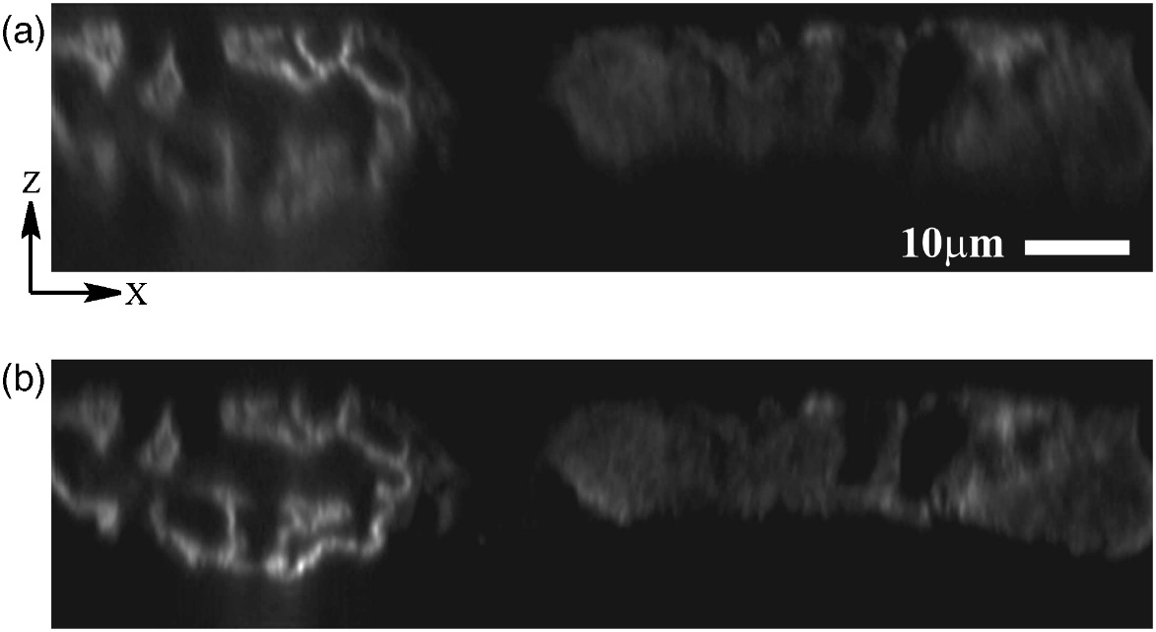
Aberration-free optical focusing
Particularly relevant to confocal and two photon microscopy
Aberration-free images over axial scan range of 70 μm with 1.4 NA objective lens
Refocusing implemented remotely from specimen
“Focus objective”
Focus via mirror
Botcherby, E.J., Juskaitis, R., Booth, M.J., Wilson, T., 2007. Aberration-free optical refocusing in high numerical aperture microscopy. Optics letters 32, 2007-2009.
Notes:
For the first stack, the dry reference objective was replaced by a low NA 100 mm achromatic doublet. The mirror was then scanned in steps of 0.2 mm, starting from the focal position of the 100 mm lens. This was optically equivalent to moving the CSU10 pinhole array away from the tube lens if we had used the system in Fig. 1a. The 𝑥𝑧image generated is shown in Fig. 3a. The top of the image shows good detail, but spherical aberration reduces the image quality when refocusing to deeper regions of the specimen.
The second stack was taken by holding the specimen stationary and scanning the reference mirror in steps of 0.4 𝜇m
. As can be seen in Fig. 3b, the imaging resolution was maintained at all scan depths.
Fig. 3 Fluorescence confocal xz sections of a mouse kidney specimen acquired using a tandem scanning system. (a) Refocusing was performed using the low NA system, equivalent to shifting the scanning unit. (b) Refocusing was performed by shifting the reference mirror in the focus of a high NA objective.
http://www.opticsinfobase.org/ol/fulltext.cfm?uri=ol-32-14-2007&id=139063

Slide 26
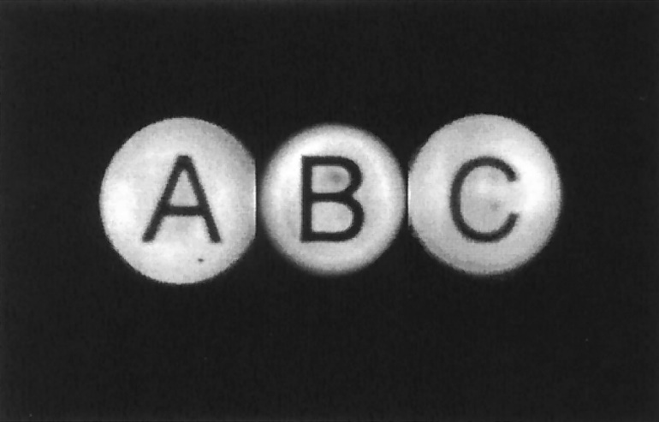
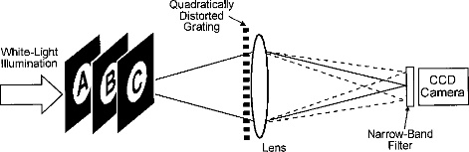
Can collect multiple focal planes with single camera
Using a diffraction grating as a beam splitter
Blanchard, P.M., Greenaway, A.H., 1999. Simultaneous multiplane imaging with a distorted diffraction grating. Appl. Opt. 38, 6692-6699.
Notes:
http://www.opticsinfobase.org/ao/fulltext.cfm?uri=ao-38-32-6692&id=43975

Slide 27
How do we do that?
Back to Diffraction orders
Remember light waves passing through two slits
0 order mostly background light
Image details mainly in +1, -1, +2, -2, +3, -3, etc. orders
0
-1
0
+1
-1
+1
-3
-2
+2
+3
-4
+4
-2
+2
-5
+5

Slide 28
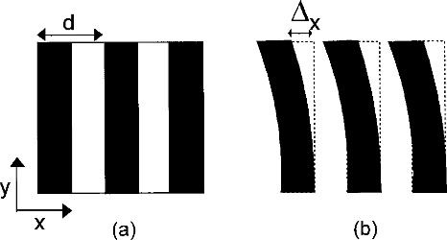
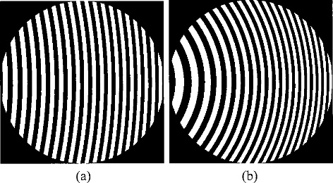

Quadratic distortion of diffraction grating
d is the grating period, $∆x$ is grating displacement
Blanchard, P.M., Greenaway, A.H., 1999. Simultaneous multiplane imaging with a distorted diffraction grating. Appl. Opt. 38, 6692-6699.
Notes:
where d is the grating period, m is the diffraction order into which the wave front is scattered, and Δ_{x} is the displacement of the grating strips relative to their undistorted position.
Hence all orders other than the zeroth order undergo a phase shift that is linearly dependent on the grating displacement, and the phase shift is of equal magnitude but opposite sign in the positive and the negative orders of the same coefficient.
This basic principle, often referred to as the detour phase effect, has been used to encode diffractive-optics elements and computer-generated holograms [2], [3] and for phase calibration of an aperture synthesis array. [4] In this way an arbitrary wave front can be generated by use of a binary-encoding technique.
http://www.opticsinfobase.org/ao/fulltext.cfm?uri=ao-38-32-6692&id=43975

Slide 29
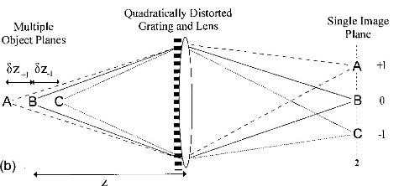
Use diffraction orders to carry different focal planes
Each order has in focus plane and out-of-focus images of other planes
More curvature more defocus
Notes:
The function of the quadratically distorted grating can be considered alternatively as a means of simultaneously imaging three different object planes. In reference to Fig. 3(b), if a camera is placed at image plane 2, the images formed in the three central diffraction orders correspond to in-focus images of the three object planes A, B, and C. The zero order is the sum of the out-of-focus images of objects A and C and an in-focus image of object B. If the degree of defocus is sufficient a good image of object B will result. Similarly, objects A and C will be discernible in the +1 and the -1 diffraction orders. The grating therefore generates side-by-side simultaneous images of three different object planes at a single detector plane. The image quality obtained when a distorted diffraction grating is used to image multiple planes within the object field will essentially be the same as if a through-focal series were obtained by alteration of the optical system to adjust its focus to image the same planes.

Slide 30

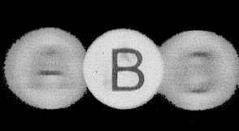
Benefits of grating based approach
The Good
The Bad
Preserves image resolution
Image registration
Loss of brightness can be fixed with phase grating
Simple optics, with no moving parts
Chromatic aberrations
Less bright
Monochromatic
Broadband
Notes:
The defocus-only gratings that we have described are, in fact, off-axis Fresnel zone-plate lenses. It is well known that zone-plate lenses have multiple on-axis foci. By using an off-axis portion, we retain the multiple foci but move the nonzero orders away from the optical axis, thus using the grating in a beam-splitting role.
A zone plate is a device used to focus light or other things exhibiting wave character.^{[1]} Unlike lenses or curved mirrors however, zone plates use diffraction instead of refraction or reflection. Based on analysis by Augustin-Jean Fresnel, they are sometimes called Fresnel zone plates in his honor. The zone plate's focusing ability is an extension of the Arago spot phenomenon caused by diffraction from an opaque disc.
A zone plate consists of a set of radially symmetric rings, known as Fresnel zones, which alternate between opaque and transparent. Light hitting the zone plate will diffract around the opaque zones. The zones can be spaced so that the diffracted light constructively interferes at the desired focus, creating an image there.
http://www.opticsinfobase.org/ao/fulltext.cfm?uri=ao-38-32-6692&id=43975

Slide 31
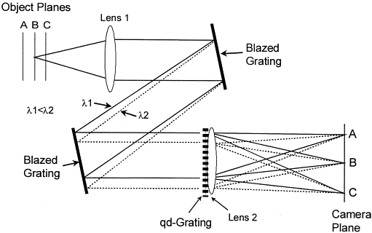
Can use dispersion before quadratically distorted grating to do color
Dispersion through blazed grating
Blanchard, P.M., Greenaway, A.H., 2000. Broadband simultaneous multiplane imaging. Optics Communications 183, 29-36.
Notes:
Two diffraction gratings with same period are required for wavelength dependent shift.
http://www.sciencedirect.com/science/article/pii/S0030401800008749

Slide 32
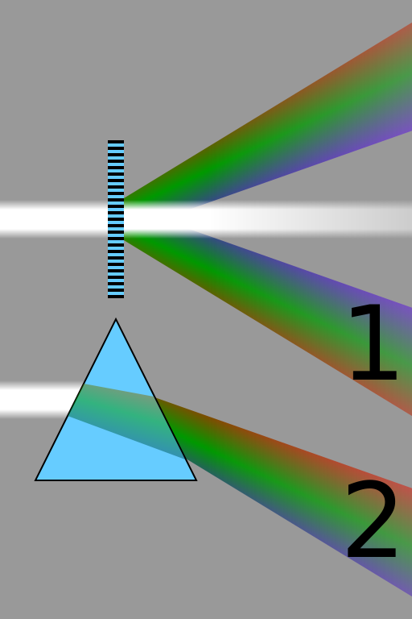
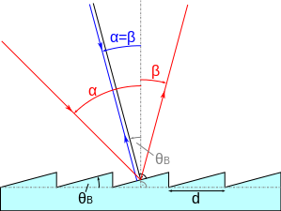
Blazed grating a type of diffraction grating
Diffraction grating
Refraction through prism
Blazed gratings diffract via reflection
Notes:
Comparison of the spectra obtained from a diffraction grating by diffraction (1), and a prism by refraction (2). Longer wavelengths (red) are diffracted more, but refracted less than shorter wavelengths (violet).
http://en.wikipedia.org/wiki/Blazed_grating
"Comparison refraction diffraction spectra" by Cmglee - Own work. Licensed under CC BY-SA 3.0 via Wikimedia Commons - http://commons.wikimedia.org/wiki/File:Comparison_refraction_diffraction_spectra.svg#mediaviewer/File:Comparison_refraction_diffraction_spectra.svg
"Blazed grating" by User:Patrick87 - Own work. Licensed under Public Domain via Wikimedia Commons - http://commons.wikimedia.org/wiki/File:Blazed_grating.svg#mediaviewer/File:Blazed_grating.svg

Slide 33
Combine multifocus imaging with aberration-free focusing for fast multicolor 3D imaging
Design parameters for aberration-corrected multifocus microscopy (MFM)
  Sensitivity to minimize photobleaching and phototoxicity and enable high-speed imaging of weakly fluorescent samples
  Multiple focal planes must be acquired without aberrations
  Corrected for chromatic dispersion that arises when a diffractive element is used to image non-monochromatic light
Abrahamsson, S., Chen, J., Hajj, B., Stallinga, S., Katsov, A.Y., Wisniewski, J., Mizuguchi, G., Soule, P., Mueller, F., Darzacq, C.D., Darzacq, X., Wu, C., Bargmann, C.I., Agard, D.A., Dahan, M., Gustafsson, M.G.L., 2013. Fast multicolor 3D imaging using aberration-corrected multifocus microscopy. Nat Meth 10, 60-63.
Notes:
http://www.nature.com/nmeth/journal/v10/n1/full/nmeth.2277.html
Fast multicolor 3D imaging using aberration-corrected multifocus microscopy

Slide 34
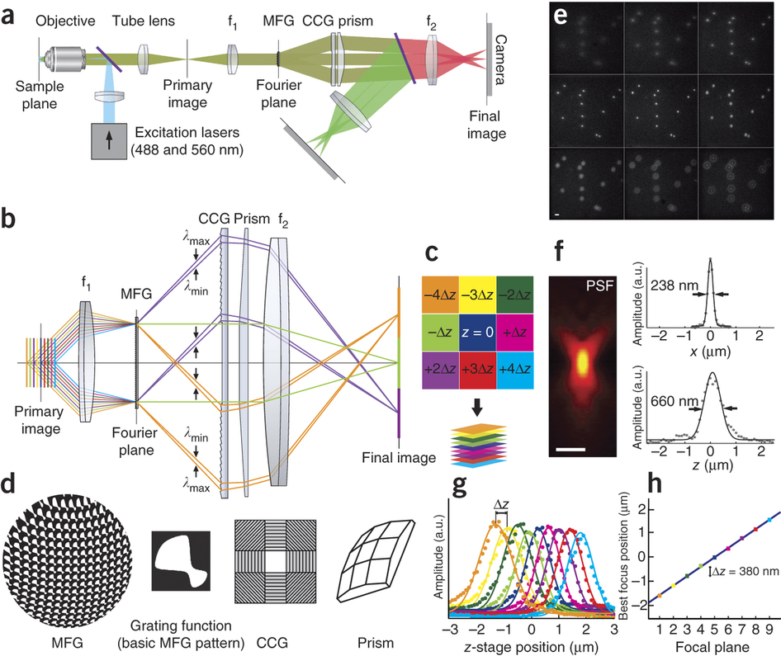
Aberration-corrected multifocus microscopy (MFM)
Abrahamsson, S., Chen, J., Hajj, B., Stallinga, S., Katsov, A.Y., Wisniewski, J., Mizuguchi, G., Soule, P., Mueller, F., Darzacq, C.D., Darzacq, X., Wu, C., Bargmann, C.I., Agard, D.A., Dahan, M., Gustafsson, M.G.L., 2013. Fast multicolor 3D imaging using aberration-corrected multifocus microscopy. Nat Meth 10, 60-63.
Notes:
(a) Multifocus optical elements are appended to a wide-field fluorescence microscope after the primary image plane (at the camera port). Two relay lenses (f₁ and f₂, first and second relay lens, with focal lengths f₁ = 150 and f₂ = 200 mm) create a conjugate pupil plane (Fourier plane) and the final image plane. The multifocus grating (MFG) is placed in the Fourier plane and followed by the chromatic correction grating (CCG) and prism. A dichroic mirror (purple) splits the color channels onto separate cameras. (b) The MFG splits and shifts the focus of the sample emission light to form an instant focal series, in which each focal plane corresponds to a diffractive order of the MFG. Ray colors denote individual focal planes (diffractive orders). The CCG and prism correct the chromatic dispersion, illustrated by rays of wavelengths λ_{max} and λ_{min}, introduced by the MFG. (c) The instant focal stack recorded on the camera is computationally assembled into a 3D volume. (d) Schematics of the MFG, a phase-only diffractive grating with etch depth π; the grating function (basic grating pattern) of the MFG, optimized to distribute light evenly into the central 3 × 3 diffractive orders that form the nine focal planes; the CCG, with panels containing blazed diffractive gratings that reverse the dispersion of the MFG (central panel is blank); and the prism, which directs the images to their positions on the camera. Note the geometrical distortion of the MFG pattern, which introduces a phase shift that is dependent on diffractive order (m_{x}, m_{y}) and gives rise to the focus shift in each plane of the multifocus image. (e) Raw, multifocus image of 200-nm fluorescent beads. As illustrated in c, the central tile is the (nondiffracted) traditional microscope image of the nominal focal plane. The surrounding eight tiles are the duplicate focus-shifted images, formed by diffraction in the MFG. The focus step between successive planes is Δz = 380 nm. (f) Axial (xz) point-spread function (PSF), radially averaged and displayed in log scale. (g) Gaussian curves fitted to the bead signal of each plane at different z positions of the stage. Best focus position is estimated as the maximum of the fitted curve (Supplementary Video 1). (h) Plot of the best focus position of each plane. The linear curve verifies the constant focus step Δz between planes. Scale bars, 1 μm.
http://www.nature.com/nmeth/journal/v10/n1/full/nmeth.2277.html
Fast multicolor 3D imaging using aberration-corrected multifocus microscopy

Slide 35
Aberration-corrected multifocus microscopy (MFM)
Multifocus grating (MFG) with fourier transforms revealing diffraction orders
MFG optimized for 515 nm
Worse at 615 nm
Notes:
http://www.nature.com/nmeth/journal/v10/n1/full/nmeth.2277.html

Slide 36
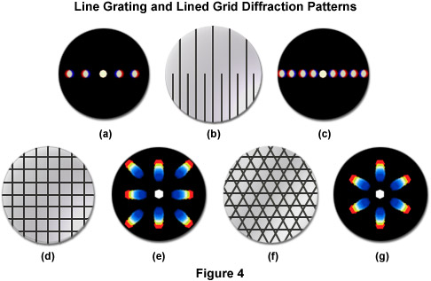
Remember back to diffraction and Image Formation
Diffraction patterns of line gratings and other structures (coarse to fine grating)
Notes:
The closer the spacing of a line grating, the fewer the spectra that will be captured by a given objective, as illustrated in Figure 4(a-c). The diffraction pattern illustrated in Figure 4(a) was captured by a 40x objective imaging the lower portion the line grating in Figure 4(b), where the slits are closer together. In Figure 4(c), the objective is focused on the upper portion of the line grating (Figure 4(b)) where the slits are farther apart, and more spectra are captured by the objective. The direct light and the light from the higher order diffraction maxima are focused by the objective to form an image in the intermediate image plane at the fixed diaphragm of the eyepiece. Here the direct and diffracted light rays interfere and are thus reconstituted into the real, inverted image that is seen by the eye lens of the eyepiece and further magnified. This is illustrated in Figure 4(d) through Figure 4(g) with two types of diffraction gratings. The square grid illustrated in Figure 4(d) represents the orthoscopic image of the grid (in effect, the usual specimen image observed through the eyepieces) as seen through the full aperture of the objective. The diffraction pattern derived from this grid is shown as a conoscopic image that would be seen at the rear focal plane of the objective (Figure 4(e)). Likewise, the orthoscopic image of a hexagonally arranged grid (Figure 4(f)) produces a corresponding hexagonally arranged conoscopic image (Figure 4(g)) of first order diffraction patterns.

Slide 37
Aberration-corrected multifocus microscopy (MFM)
While can be used for high resolution imaging of single cells and even single molecule-tracking
Also used for “thicker” samples like C. elegans embryo
Notes:
Neuronal imaging of C. elegans embryo. (a) Multi-focus image (as recorded on the camera,
before assembling the planes into a 3D stack) of C. elegans embryo curled up inside its eggshell. In the full image sequence of 5.5 min this late embryo can be seen flipping around in its shell (Supplementary Videos 8-9). (b) Schematic illustrations of the unc-47 -expressing set of GABAergic neurons in the worm, and of the worm curled up inside its eggshel. (c) Multi-focus image of the
time-frame in a assembled into a z-projection. Scale bar: 20 µm.

Slide 38
High speed microscopy even faster without super-resolution
Making super-resolution techniques faster
Techniques using high Numerical Aperture (NA) optics
  Multifocal plane microscopy (MUM)
  Aberration-free optical focusing
  Quadratically distorted grating
  Aberration-corrected multifocus microscopy (MFM)
Techniques not depending on high NA optics
  Fourier ptychographic microscopy (FPM)
  Holographic or Spatial light modulator (SLM) microscope
  SLM with extended depth of focus (EDOF)
  Digital holographic microscopy (DHM)

Slide 39
High speed microscopy even faster without super-resolution
Making super-resolution techniques faster
Techniques using high Numerical Aperture (NA) optics
  Multifocal plane microscopy (MUM)
  Aberration-free optical focusing
  Quadratically distorted grating
  Aberration-corrected multifocus microscopy (MFM)
Techniques not depending on high NA optics
  Fourier ptychographic microscopy (FPM)
  Holographic or Spatial light modulator (SLM) microscope
  SLM with extended depth of focus (EDOF)
  Digital holographic microscopy (DHM)

Slide 40
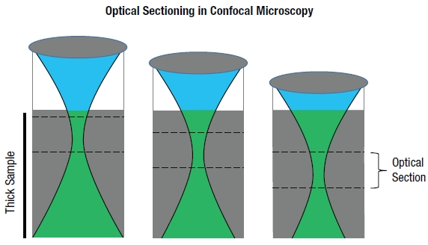
Problem with high Numerical Aperture (NA) objectives
Need for high resolution, but
Axial depth of focus (optical section) scales to NA⁻²
Focal volume proportional to NA⁻³
Notes:
http://www.opticsinfobase.org/oe/fulltext.cfm?uri=oe-21-13-16007&id=258369

Slide 41
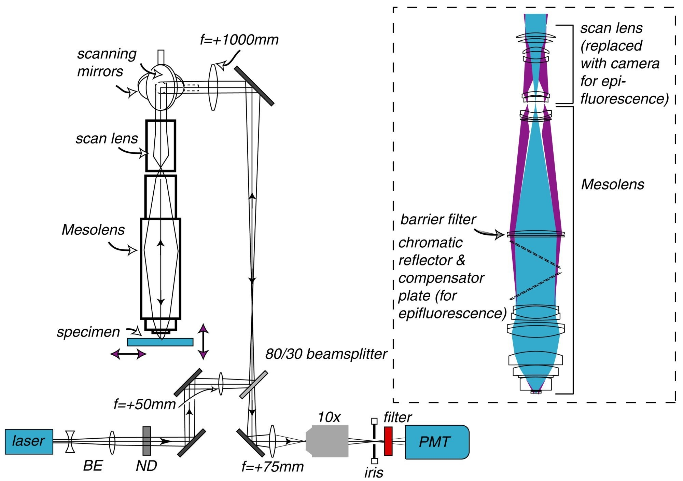
Why Mesolens so great: low mag with high NA
Notes:
Schematic diagram of the laser scanning confocal Mesolens system.
BE=beam expander, ND= neutral density filter. Only one detection channel is shown here for ease of presentation. Inset: Illustration of the optical train of the Mesolens and scan lens. Also shown is the position of the compensator plates and camera when the Mesolens is used for wide-field epi-fluorescence imaging.

Slide 42

Use low NA objectives and computationally reconstruct higher resolution image
Advantages of low power objective
  Bigger field of view
  Greater depth of focus
  Greater working distance
Fourier ptychographic microscopy (FPM)
Work of Changhuei Yang’s lab here at Caltech
http://www.biophot.caltech.edu/
EE/BE/MedE 166 (Optical Methods for Biomedical Imaging and Diagnosis)
Notes:
Ptychography is a technique invented by Walter Hoppe^{[1]} that aims to solve the diffraction-pattern phase problem by interfering adjacent Bragg reflections coherently and thereby determine their relative phase. In the original formulation, Hoppe envisaged that such interference could be effected by placing a very narrow aperture in the plane of the specimen so that each reciprocal-lattice point would be spread out and thus overlap with one another. The name ptychography, from the Greek for fold, derives from this optical configuration; each reciprocal lattice point is convolved with some function, and thus made to interfere with its neighbors. In fact, measuring only the intensities of interfering adjacent diffracted beams still leads to an ambiguity of two possible complex conjugates for each underlying complex diffraction amplitude. The original formulation of ptychography is equivalent to the well known theorem that for a finite specimen (that is one delineated by a narrow aperture, sometimes known as a finite support), the one-dimensional phase problem is soluble to within an ambiguity of 2N, where N is the number of Fourier components that make up the specimen.^{[2]} However, such ambiguities may be resolved by changing the phase, profile or position of the illuminating beam in some way.^{[1]} The fact that not only the intensities of the diffracted beams but also the intensities lying midway between the beams, where the convolved Bragg beams interfere, is an alternative statement of the Nyquist–Shannon sampling theorem for components of diffracted intensity. These components generally have twice the frequency (in reciprocal space) of their underlying complex amplitudes.
https://en.wikipedia.org/wiki/Ptychography

Slide 43
Fourier ptychographic microscopy (FPM)
Depends on computational regime to extract good images rather than optical system
Zheng, G., Horstmeyer, R., Yang, C., 2013. Wide-field, high-resolution Fourier ptychographic microscopy. Nat Photon 7, 739-745.
Notes:
Fig. S5 FPM flowchart with digital wavefront correction. A digital pupil function is introduced in steps 2 and 5 to model the connection between the actual sample profile and the captured intensity data, which may exhibit aberrations caused by defocus.

Slide 44
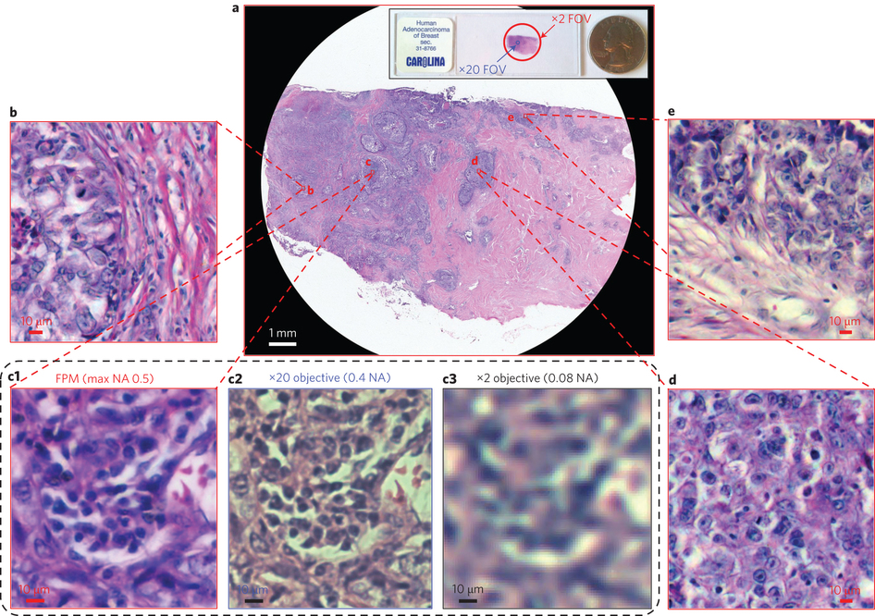
Fourier ptychographic microscopy (FPM)
With multiple illuminations and Fourier domain processing, low NA objective gives image of higher NA objective
Zheng, G., Horstmeyer, R., Yang, C., 2013. Wide-field, high-resolution Fourier ptychographic microscopy. Nat Photon 7, 739-745.
Notes:
2x 0.08 NA objective to generate equivalent to 20x with 0.5 NA image. Takes multiple images with different illumination angles and computationally fixes it in Fourier space. Iterative process

Slide 45
Solutions for large aperture volume imaging (increased depth of field/focus)
Wavefront coding
  Dowski, E.R., Cathey, W.T., 1995. Extended depth of field through wave-front coding. Appl. Opt. 34, 1859-1866.
  Limited penetration into microscopy community
  For fluorescence has been problematic
    Complex structures with axial overlap and lack of contrast
    Raw images too muddled for disambiguation of features
    Makes computational recovery of these features complicated
Spatial light modulation
  Splitting beam into multiple beamlets
  Avoids wavefront problems
Notes:
Although wavefront coded, extended DOF systems have been successfully demonstrated, they have had limited penetration into the microscopy community. As applied to fluorescence microscopy, the principle limitations are that many real samples are complex structures with many axially overlapping features and can have a lack of inherent contrast without strong axial sectioning. These effects combine to yield raw images that are too muddled for effective disambiguation of objects, and the computational recovery of individual features becomes very difficult.
http://www.opticsinfobase.org/oe/fulltext.cfm?uri=oe-21-13-16007&id=258369
https://en.wikipedia.org/wiki/Wavefront_coding

Slide 46
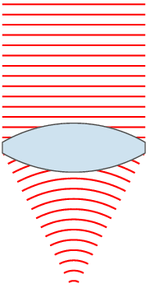
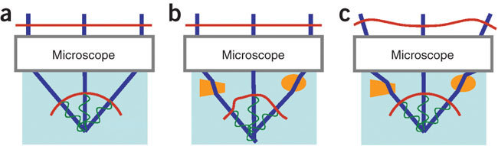
Remember discussion of adaptive optics for microscopes?
Problem of wavefront
Objective lens converts planar waves to spherical
SLM used in adaptive optics
Notes:
(a) An ideal microscope converts a planar wavefront (top red line) to a converging spherical one (bottom red semicircle) in a sample of the design optical properties. Propagation vectors or 'rays' (blue), defined by the direction normal to the wavefront, converge at a common point and, being in phase, constructively interfere there to create an optimal focus. Green sinusoidal curves denote the phase variation along each ray. (b) Inhomogeneities (orange) in the refractive index of the sample change the directions and phases of the rays, leading to a distorted wavefront and an enlarged focal volume with lower peak intensity. (c) Controlling the input wavefront using an active optical element (not shown) can cancel these aberrations, recovering a diffraction-limited focus.
http://www.nature.com/nmeth/journal/v7/n2/full/nmeth.1411.html

Slide 47
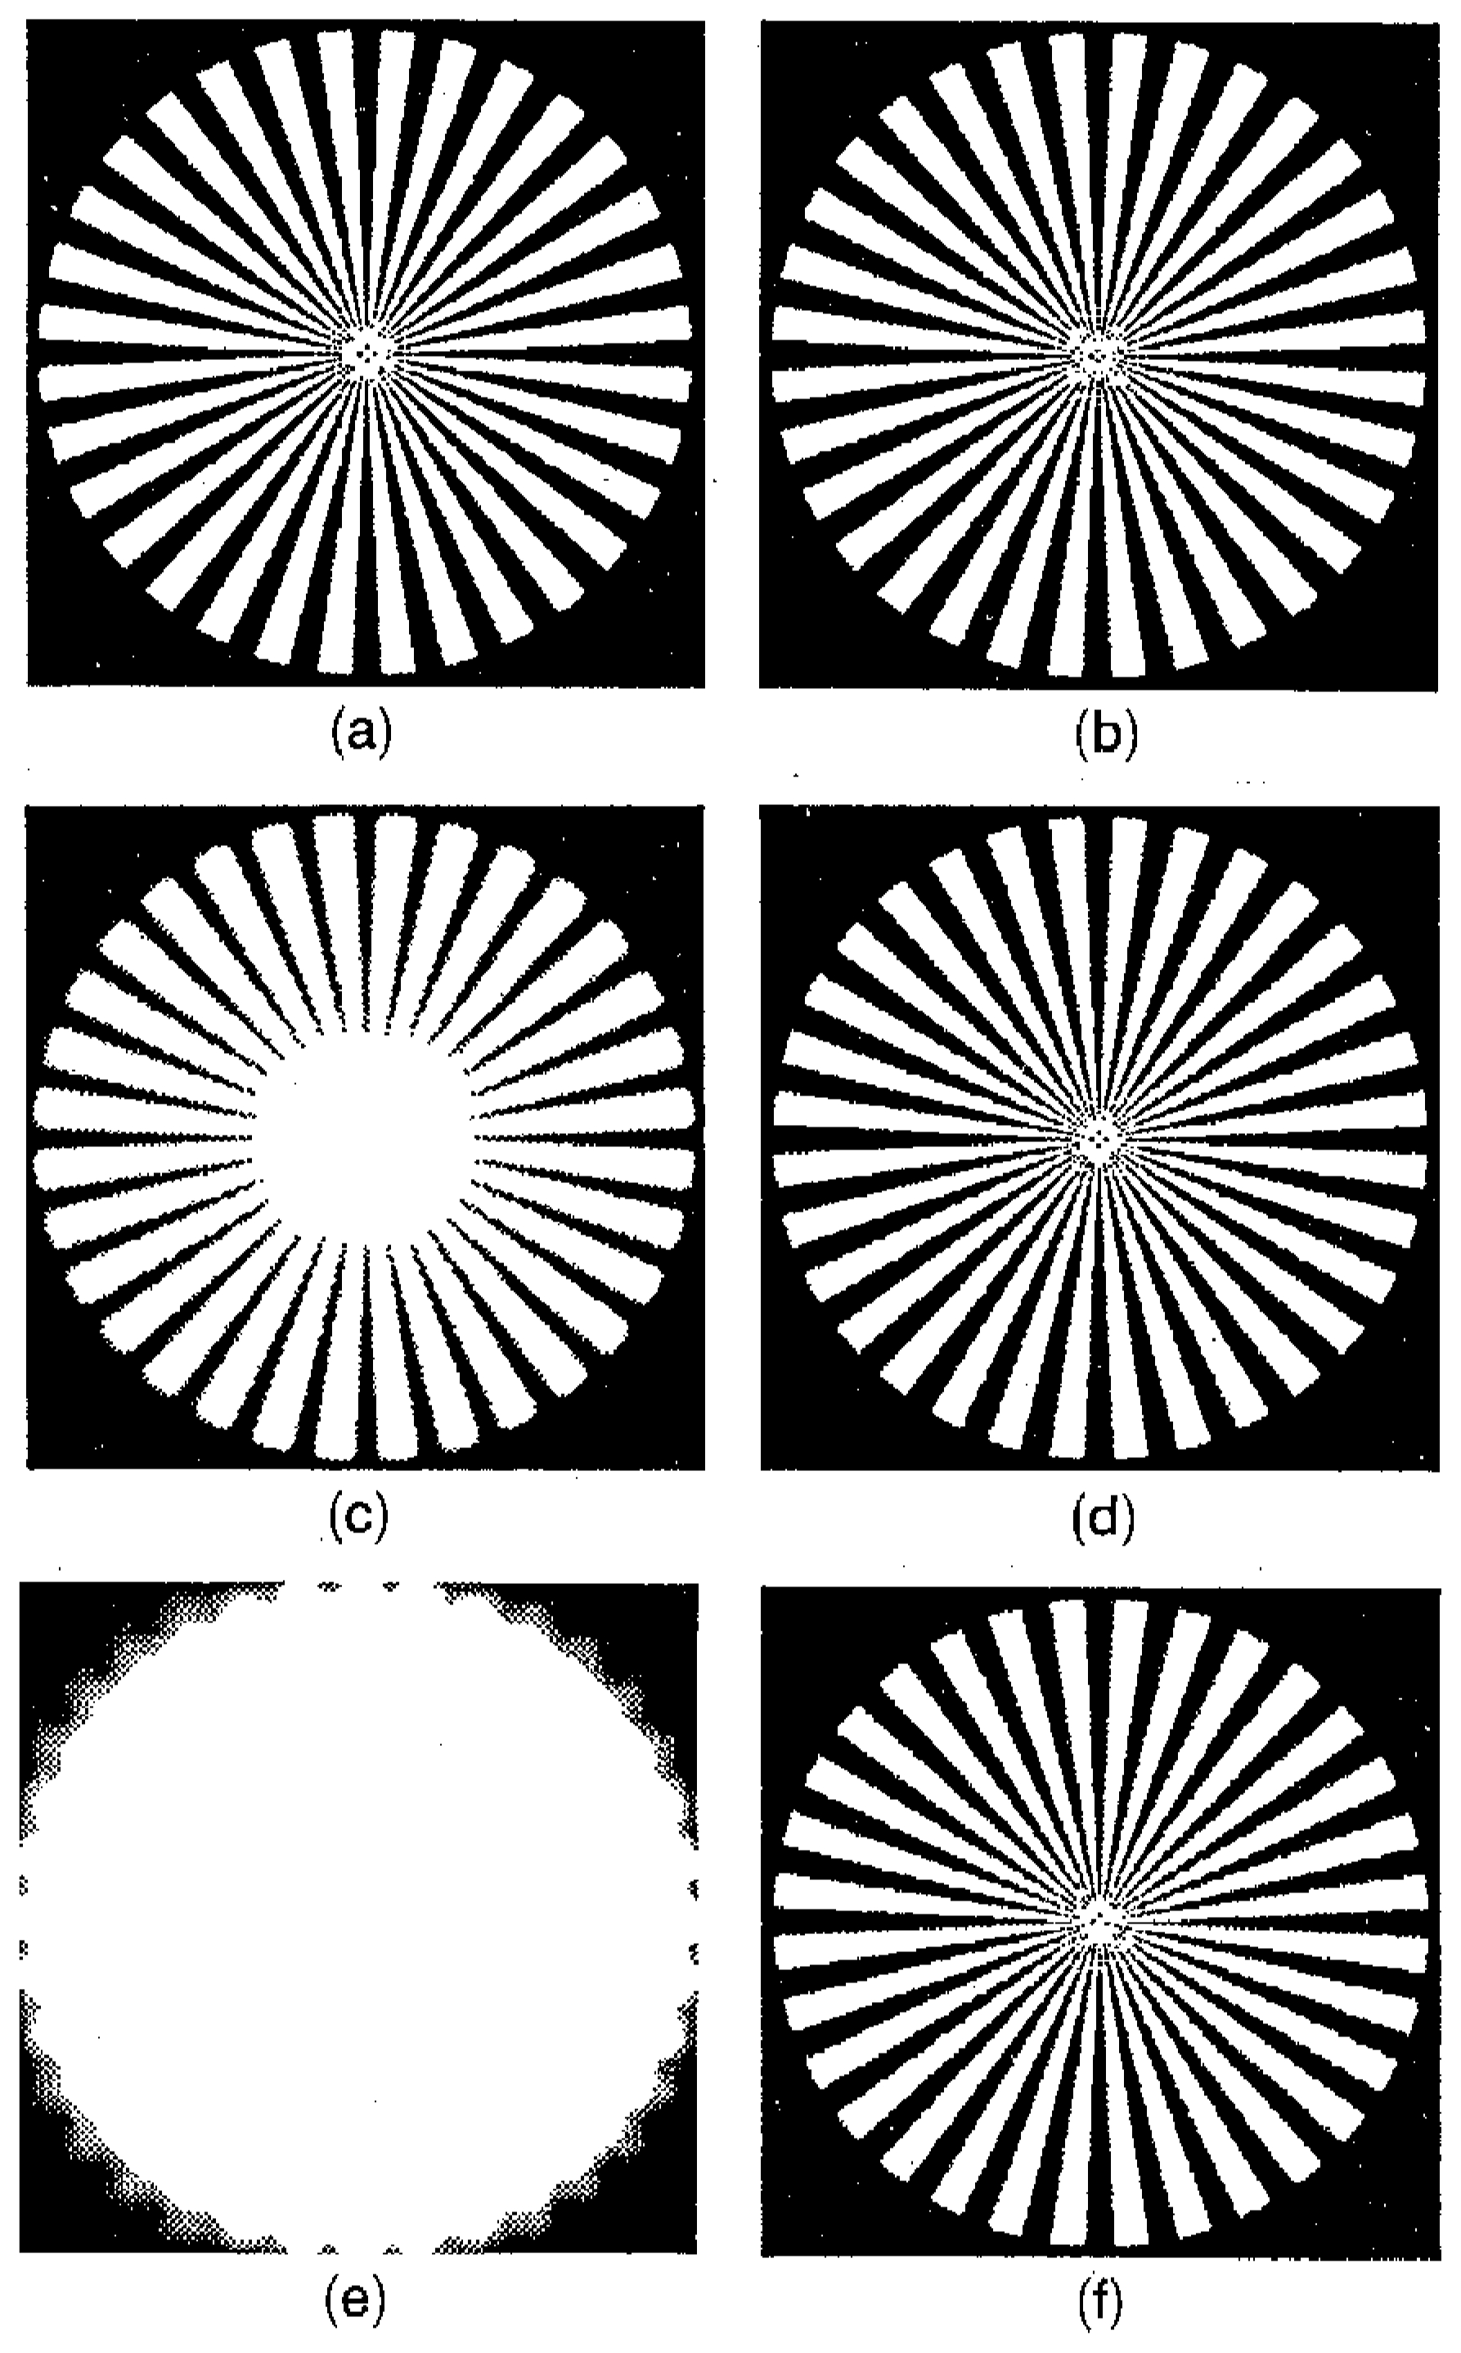
Wavefront coding for extended depth of focus
Phase mask to modify illumination of sample
Optical transfer function (OTF) has no regions of zero values so can do deconvolution
Spatial light modulation improved on this
Notes:
Fig. 8 Simulated images of a spoke target from a standard optical system (first column) and a cubic-pm optical–digital system (second column). (a), (b) (Geometrically in focus; (c), (d) mild misfocus; (e), (f) extreme misfocus.
https://www.osapublishing.org/ao/fulltext.cfm?uri=ao-34-11-1859&id=45359

Slide 48
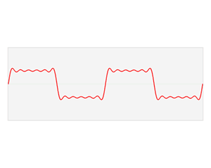
Remember way back in our Diffraction lecture?
Diffraction helps explain how an image is broken down to its underlying components
It is what a Fourier transform does
Used to understand Optical Transfer Function (OTF)

Slide 49
Optical transfer function (OTF) Fourier transform of the point-spread function (PSF)
Fourier transform
Inverse fourier transform
i
o

Slide 50
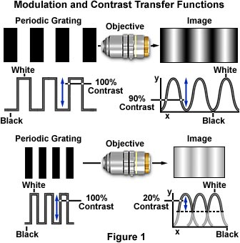
Modulation transfer function
Resolution and performance of optical microscope can be characterized by the modulation transfer function (MTF)
MTF is measurement of microscope's ability to transfer contrast from the specimen to the image plane at specific resolution.
Incorporates resolution and contrast into one specification
Notes:
http://www.edmundoptics.com/technical-resources-center/optics/modulation-transfer-function
http://www.microscopyu.com/articles/optics/mtfintro.html
http://en.wikipedia.org/wiki/Optical_transfer_function
where I(max) is the maximum intensity displayed by a repeating structure and I(min) is the minimum intensity found in the same specimen. By convention, the modulation transfer function is normalized to unity at zero spatial frequency. Modulation is typically less in the image than in the specimen and there is often a slight phase displacement of the image relative to the specimen. By comparing several specimens having differing spatial frequencies, it can be determined that both image modulation and phase shifts will vary as a function of spatial frequency. By definition, the modulation transfer function (MTF) is described by the equation:
This quantity, as discussed above, is an expression of the contrast alteration observed in the image of a sinusoidal object as a function of spatial frequency. In addition, there is a position or phase shift of the sinusoid that is dependent upon spatial frequency in both the horizontal and vertical coordinates. A good example occurs in video microscopy where the raster scanning process produces slightly different responses resulting in a variation between the horizontal and vertical modulation transfer functions.
http://www.microscopyu.com/articles/optics/mtfintro.html

Slide 51
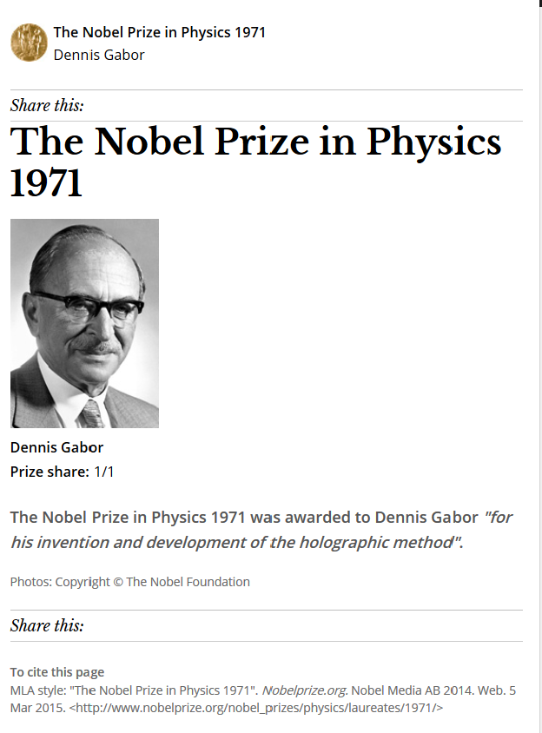
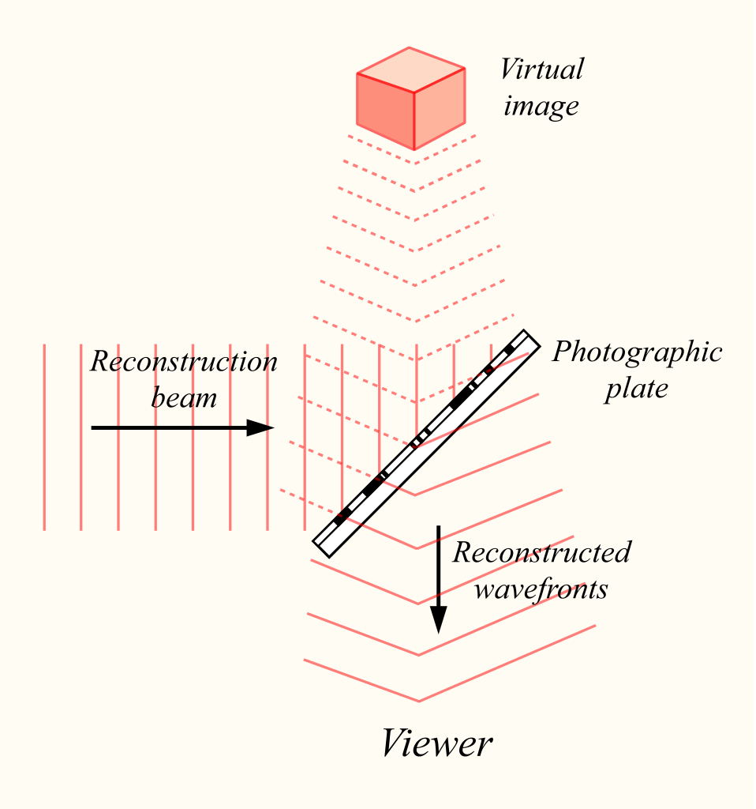
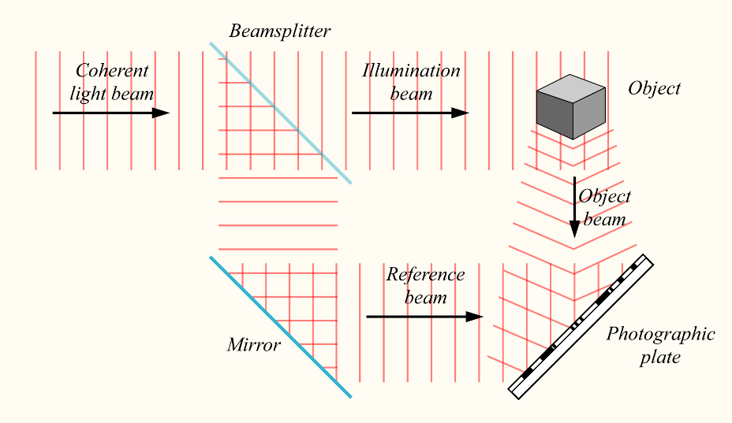
Holography
Was using holography to improve electron microscopes
For optical holography need lasers
Notes:
https://en.wikipedia.org/wiki/Holography

Slide 52
Holography versus photography
Records light from many directions not just one
Requires laser, can’t use normal light sources
No need for a lens
Needs second beam to see (reconstruction beam)
Requires specific illumination to see
Cut in half, see two of same image not half of it
More 3D cues
Hologram’s surface does not clearly map to image
Notes:
https://en.wikipedia.org/wiki/Holography

Slide 53
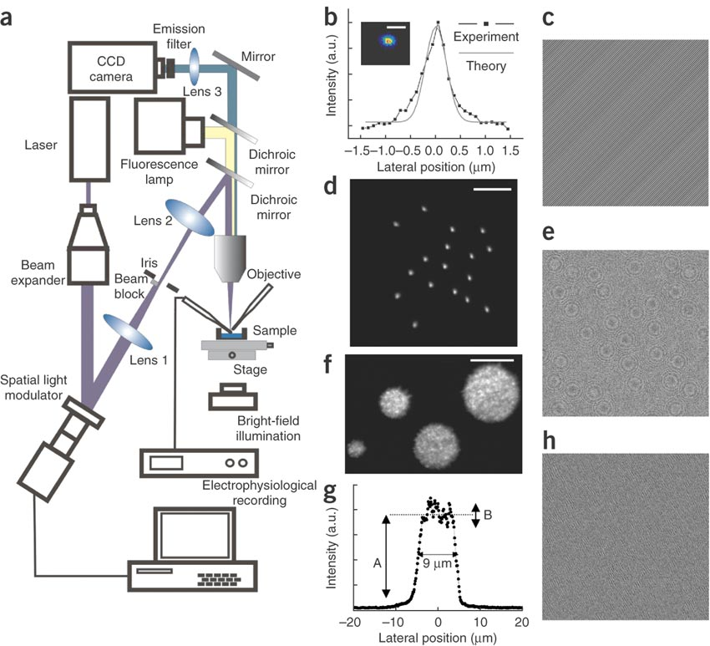
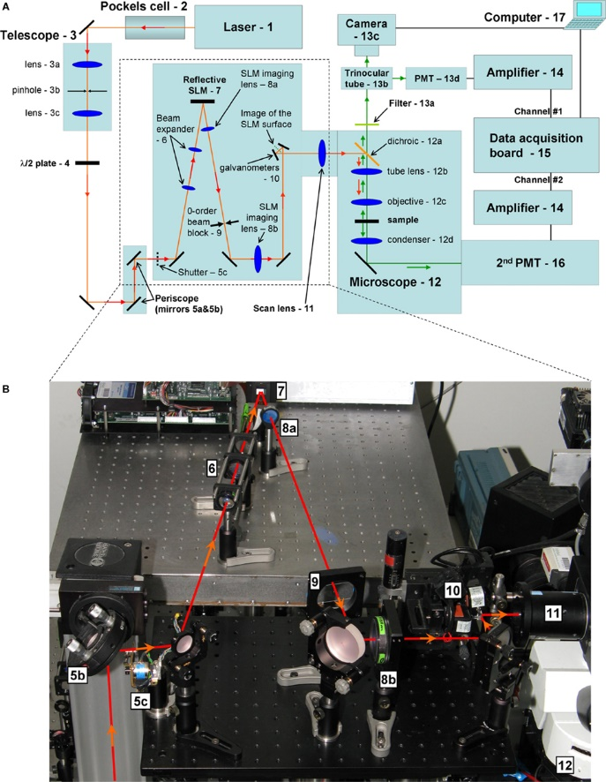
Holographic or Spatial Light Modulator (SLM) microscope (2008)
Holographic microscope
SLM microscope
Notes:
Layout of the optical setup. (b) A near diffraction-limited spot generated at a chosen position. Scale bar, 1 m. (c) Phase hologram used to generate the spot in b, showing the typical structures of a diffraction grating. (d) Simultaneous generation of 15 spots. Scale bar, 10 m. (e) Phase hologram used to create the multiple spots in d. Fresnel lenses are visible. These were used to focalize the different spots, superimposed on grating-like structures to control their lateral positions. (f) Excitation with multiple spots of diameters s = 12, 9.0, 6.5 and 3.5 m. Scale bar, 10 m. (g) Intensity profile across the spot in f with diameter of 9 m. A, mean intensity value; B, variation in intensity. (h) Phase hologram used to create the spots in f. The diffraction efficiency, , defined as the integrated intensity of the first order over the integrated intensity of the zeroth order with SLM off, was 63%, 46% and 50% for the phase holograms in c,e and h, respectively.
http://www.nature.com/nmeth/journal/v5/n9/full/nmeth.1241.html
Holographic microscope
http://journal.frontiersin.org/article/10.3389/neuro.04.005.2008/full
SLM microscope
http://www.opticsinfobase.org/oe/fulltext.cfm?uri=oe-21-13-16007&id=258369

Slide 54
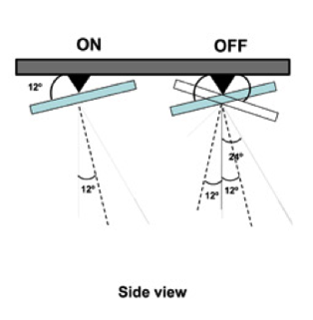
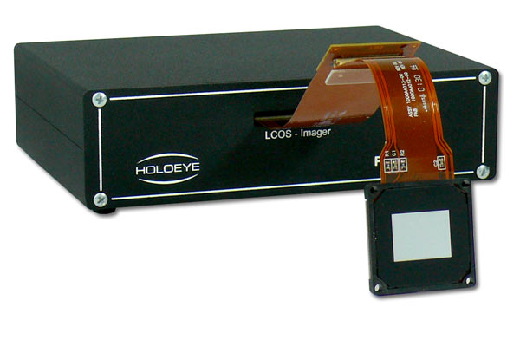
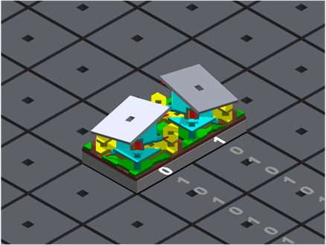
SLM competes with Digital-Multi-Mirror Device (DMD)
Phase only SLM generate image (diffraction pattern) by modulating phase not intensity of light
Slower (Hz), 3D, potentially
Can use two photon since full power available
DMDs produce image by removing light (on, off)
Faster (Khz), 2D
Wide field illumination
Notes:
This beam-multiplexing property is similar to the more traditional methods of producing arbitrary two-dimensional illumination patterns, such as digital micromirror devices (DMDs), based on wide-field illumination and use of a physical mask (Wang et al., 2007 ). But, as opposed to DMDs, phase-only SLMs generate an image (diffraction pattern) by modulating the phase, and not the amplitude, of the incoming light beam. While the phase-only SLM imprints the incoming beam with the phase pattern that produces the desired spatial profile of the excitation light in the far field, it does so not by removing light, like the DMDs, but by redistributing it. Because the full power of the laser is available, non-linear excitation is possible (e.g., multi-photon absorption or SHG).
http://journal.frontiersin.org/article/10.3389/neuro.04.005.2008/full
For example, for an illumination field of 50 50 m², using a digital micromirror would allow only a fraction of 0.008%, 0.2% and 9% of the incident light to be delivered in the three patterns in Figure 1b,d,f, whereas by phase modulation with an SLM we measured values of 63%, 46% and 50%, respectively.
http://www.nature.com/nmeth/journal/v5/n9/full/nmeth.1241.html

Slide 55
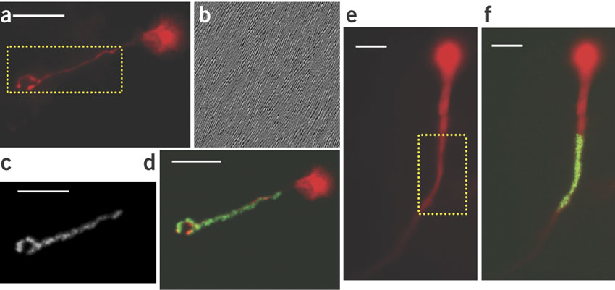
Holographic microscope
Allows fine shaping of excitation volume while maintaining decent power
Lutz, C., Otis, T.S., DeSars, V., Charpak, S., DiGregorio, D.A., Emiliani, V., 2008. Holographic photolysis of caged neurotransmitters. Nat Meth 5, 821-827.
Notes:
(a,b) Wide-field epifluorescence image of a cerebellar granule cell (a) in which a selected region of interest (dashed box) was used to obtain the phase hologram shown in b. (c) Illumination shape generated in coumarin at the objective focal plane with the phase hologram of b. (d) Overlay of a and c. (e) Similar to a but using a CA1 hippocampal pyramidal cell to calculate the phase hologram. (f) Similar to the image in d, overlay of the image in e, with the generated holographic spot (green). Scale bars, 10 m.

Slide 56

SLM microscope went from 2D to 3D with extended depth of field (EDOF)
SLM microscope
Wavefront coded imaging (adds EDOF)
Quirin, S., Peterka, D.S., Yuste, R., 2013. Instantaneous three-dimensional sensing using spatial light modulator illumination with extended depth of field imaging. Optics express 21, 16007-16021.
Notes:
For the particular case of extending the imaging DOF, the enhancement is gained by sacrificing the tightly-focused, symmetric spot traditionally chosen for optimal imaging of a single axial plane with high contrast, in favor of a highly aberrated PSF. By design, this aberrated PSF must overwhelm the aberrative effects of defocus over an extended axial range. After image acquisition, fast digital image restoration techniques (e.g. deconvolution) can be applied for estimating the original object free of these fixed optical aberrations. With such systems, the fall-off in intensity with defocus is much smaller and smoother than in a classical system thereby allowing multiple planes to be imaged simultaneously with similar fidelity. As a consequence, in properly engineered wavefront coding systems the nominally out-of-focus regions can now be imaged with higher SNR than traditionally available.
Fig. 3 Design of extended depth of field (EDOF) microscope. Panel A: Experimental configuration of the joint SLM and extended-DOF imaging microscope for 3D targeting and monitoring. The detailed description of each component is described in the section 4.1. The phase aberration shown in panel B is the ideal diffractive optical element for the cubic-phase modulation and placed in an accessible region between L9 and L10 without affecting the illumination pupil. The experimental PSF of the imaging system is presented for the conventional microscope in panel C and the extended DOF microscope in panel D. The three-dimensional volume in panels C and D represent the 50% intensity cutoff of each axial plane and the axis units are in μm

Slide 57


SLM microscope with EDOF
Transparent media
Scattering media
Notes:
Wavefront coding plus deconvolution
Fig. 5 Experimental results for the three-dimensional SLM illumination in transparent media with both the conventional and extended depth of field microscope. The three-dimensional illumination pattern is shown in panel A. The relative intensity of the fluorescence as a function of depth is given to the right of panel A. The results from imaging the three-dimensional pattern in bulk fluorescent material are given for the conventional microscope (panel B) and the extended DOF microscope (panel C). Contrast was enhanced to saturate 0.1% of the pixel values in panels B and C (Media 2).
Fig. 6 Experimental results for the three-dimensional SLM illumination in scattering media with both the conventional and extended depth of field microscope. The three-dimensional illumination pattern is shown in panel A. The focal plane is located 220µm below the surface of the scattering media. The relative intensity of the fluorescence as a function of depth is given to the right of panel A. The results from imaging the three-dimensional pattern in bulk fluorescent material are given for the conventional microscope (panel B) and the extended DOF microscope (panel C). Contrast was enhanced to saturate 0.02% of the pixel values in panels B and C (Media 3).

Slide 58

Digital holographic microscopy (DHM)
Uses wavefront to reconstruct image
Doesn’t require an objective
Notes:
Besides the ordinary bright field image, a phase shift image is created as well. The phase shift image is unique for digital holographic microscopy and gives quantifiable information about optical distance. In reflection DHM, the phase shift image forms a topography image of the object.
Easier to segment.
Figure 3. Comparison of a DHM phase shift image (left) and a phase contrast microscopy image (right).
http://en.wikipedia.org/wiki/Digital_holographic_microscopy
"Phase-Phase Contrast" by Egelberg. Licensed under CC BY-SA 3.0 via Wikimedia Commons - http://commons.wikimedia.org/wiki/File:Phase-Phase_Contrast.jpg#mediaviewer/File:Phase-Phase_Contrast.jpg
"OpticalSetupDHM" by User:Egelberg. Licensed under CC BY-SA 3.0 via Wikimedia Commons - http://commons.wikimedia.org/wiki/File:OpticalSetupDHM.jpg#mediaviewer/File:OpticalSetupDHM.jpg

Slide 59

Commercial systems available
Nanolive 3D cell explorer
Not for fluorescently labeled samples*
Link to movies made with system
Notes:
http://www.nature.com/nphoton/journal/v7/n2/full/nphoton.2012.329.html

Slide 60
Class survey
Bi177
https://access.caltech.edu/tqfr/taker/queue
Notes:
Here are BUSAC's course surveys for the term. We strongly recommend that you fill them out, as it may be possible to implement changes before the final exam/end of term. Responses are anonymous, and you can fill out each survey once. Just select the form for each class. If you have any questions, comments, or suggestions, let me know.
The Biology Undergraduate Student Advisory Committee (BUSAC) is interested in improving communication between professors and students in biology. As part of this goal, we ask students for comments on courses shortly after midterms. The course catalog indicates that you are teaching a course this term, so we were wondering if you would like us to include your course in our evaluations.
Responses to the survey will be read and summarized (by me) into a short list of constructive comments according to our guidelines for appropriate course commentaries. If you would like me to survey your course, please let me know in the next few days. If there are specific questions you would like to ask students, I will include those as well.
Thank you,
Katie Ching
BUSAC Academic Chair
busac.caltech.edu

Slide 61


Microscopy: OpenSPIM 2.0. (openspim.org)
A maturing open hardware and open-source software movement seeks to expand DIY light-sheet microscopy
Vivien Marx. Technology Feature. Nat Meth 13, 979-982.
Notes:
Marx, V., 2016. Microscopy: OpenSPIM 2.0. Nat Meth 13, 979-982.

