Slide 1
Biology 177: Principles of Modern Microscopy
Lecture 17:
Super-resolution microscopy: Part 2
Andres Collazo, Director Biological Imaging Facility
Wan-Rong (Sandy) Wong, Graduate Student, TA

Slide 2
Lecture 17: Single molecule imaging technique (TIRFM) and Super-resolution microscopy
Total internal reflection fluorescence microscopy (TIRFM)
Super-resolution techniques
  RESOLFT
    STED
  Stochastic functional techniques
    PALM
    STORM
SIM
Zeiss Airyscan

Slide 3
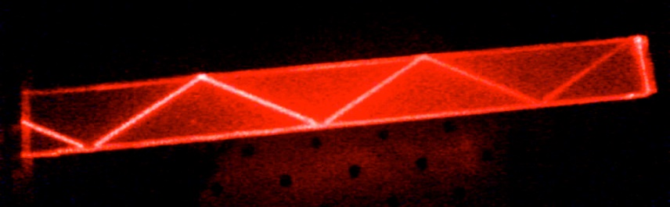
Where do we want to go in the future?
High speed
Single molecule imaging
  Fluorescence correlation spectroscopy (FCS)
  Total internal reflection microscopy (TIRF)
Super-resolution
θ_{i}
θ_{i}
Interface
Notes:
http://www.rsc.org/ConferencesAndEvents/RSCConferences/FD/molecule-fd2015/
A practical superlens, super lens or perfect lens, is a lens which uses metamaterials to go beyond the diffraction limit. The diffraction limit is an inherent limitation in conventional optical devices or lenses.^{[1]} In nano-optics, a plasmonic lens generally refers to a lens for surface plasmon polaritons (SPPs), i.e. a device that redirects SPPs to converge towards a single focal point. Since SPPs can have very small wavelength, they can converge into a very small and very intense spot, much smaller than the free-space wavelength and the diffraction limit.^{[1][2]} Surface plasmon polaritons (SPPs), are infrared or visible-frequency electromagnetic waves, which travel along a metal-dielectric or metal-air interface. The term "surface plasmon polariton" explains that the wave involves both charge motion in the metal ("surface plasmon") and electromagnetic waves in the air or dielectric ("polariton").^{[1]}
They are a type of surface wave, guided along the interface in much the same way that light can be guided by an optical fiber. SPPs are shorter in wavelength than the incident light (photons).^{[2]}
Metamaterials are artificial materials engineered to have properties that have not yet been found in nature.

Slide 4
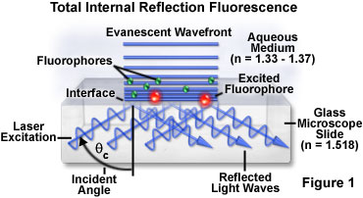
Total internal reflection fluorescence (TIRF) microscopy
Technique that dominates most single molecule imaging approaches
Notes:
http://micro.magnet.fsu.edu/primer/techniques/fluorescence/tirf/tirfhome.html
http://www.microscopyu.com/articles/fluorescence/tirf/tirfintro.html
http://olympus.magnet.fsu.edu/primer/techniques/fluorescence/tirf/tirfhome.html
http://www.nature.com/milestones/milelight/full/milelight17.html

Slide 5
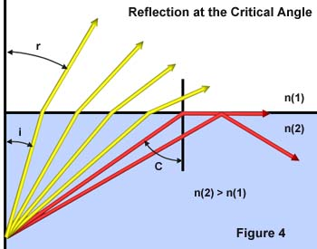
Internal reflection depends on refractive index differences
sin θ critical = η1 / η2
Notes:
Total internal reflection does not occur suddenly as a new phenomenon at the critical angle, but a continuous transition is followed from predominant refraction with a small amount of reflection, to total reflection when the critical angle is exceeded.
Matching refractive indices can eliminate internal reflection. Internal reflection depends on refractive index differences

Slide 6
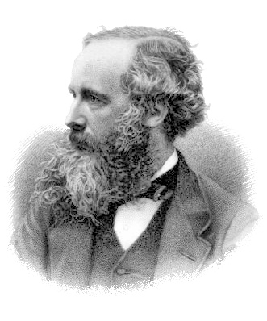
Remember Maxwell’s equation and the term that acts at a distance?
This is what allows electric and magnetic fields to act at a distance.
Now come back to terms that act at a short distance.
Evanescent waves act at very short distance.
If could harness this information could get super-resolution.
http://feynmanlectures.caltech.edu/I_28.html
Notes:
BBC: Albert Einstein has been voted the greatest physicist of all time in an end of the millennium poll, pushing Sir Isaac Newton into second place. Maxwell 3rd. The survey was conducted among 100 of today's leading physicists.
The gradually discovered properties of electricity and magnetism, of electric forces of attraction and repulsion, and of magnetic forces, showed that although these forces were rather complex, they all fell off inversely as the square of the distance. Maxwell noted that the equations or the laws that had been discovered up to this time were mutually inconsistent when he tried to put them all together, and in order for the whole system to be consistent, he had to add another term to his equations. With this new term there came an amazing prediction, which was that a part of the electric and magnetic fields would fall off much more slowly with the distance than the inverse square, namely, inversely as the first power of the distance! And so he realized that electric currents in one place can affect other charges far away, and he predicted the basic effects with which we are familiar today—radio transmission, radar, and so on.

Slide 7
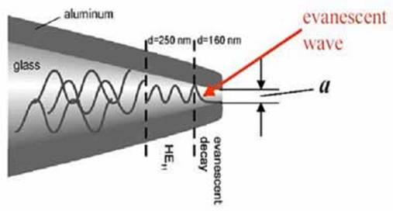
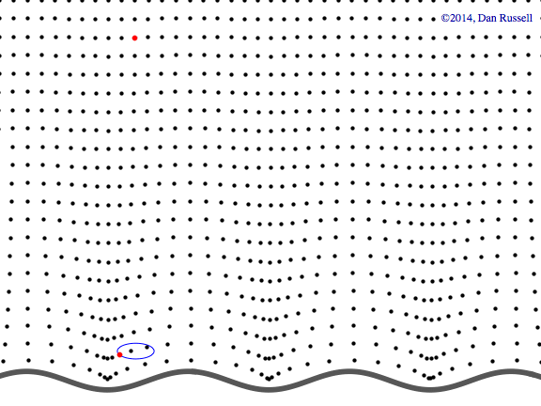
Evanescent waves
Near-field phenomenon
Higher frequency, more information
Formed at boundary between two media with different wave motion properties
Evanescent waves quantum tunneling phenomenon
Product of Schrödinger wave equations
Exponential decay
Notes:
http://www.acs.psu.edu/drussell/Demos/EvanescentWaves/EvanescentWaves.html

Slide 8
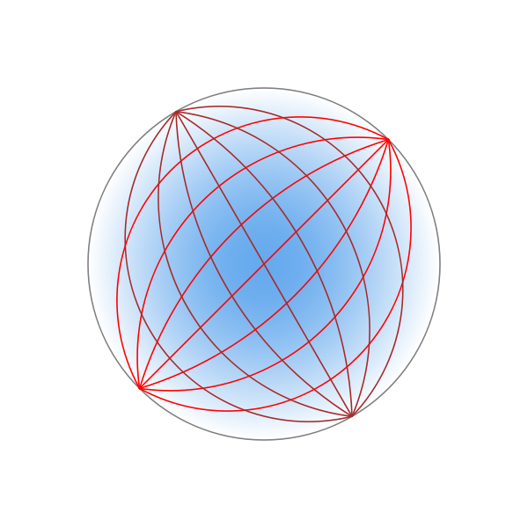
Metamaterials with negative refractive indices could be used to make superlenses for super resolution microcopy
Maxwell's fish-eye lens could do it with positive refractive indices
  Refractive index changes across lens (blue shading)
Harness information on resolution from evanescent waves
Type of Luneburg lens
Tyc T, Zhang X (2011) Forum Optics: Perfect lenses in focus. Nature 480: 42-43.
Notes:
Darker blue, higher refractive index. Like a gravitational lens
A practical superlens, super lens or perfect lens, is a lens which uses metamaterials to go beyond the diffraction limit. The diffraction limit is an inherent limitation in conventional optical devices or lenses.[1] In nano-optics, a plasmonic lens generally refers to a lens for surface plasmon polaritons (SPPs), i.e. a device that redirects SPPs to converge towards a single focal point. Since SPPs can have very small wavelength, they can converge into a very small and very intense spot, much smaller than the free-space wavelength and the diffraction limit.[1][2] Surface plasmon polaritons (SPPs), are infrared or visible-frequency electromagnetic waves, which travel along a metal-dielectric or metal-air interface. The term "surface plasmon polariton" explains that the wave involves both charge motion in the metal ("surface plasmon") and electromagnetic waves in the air or dielectric ("polariton").[1]
They are a type of surface wave, guided along the interface in much the same way that light can be guided by an optical fiber. SPPs are shorter in wavelength than the incident light (photons).[2]
Metamaterials are artificial materials engineered to have properties that have not yet been found in nature.
https://en.wikipedia.org/wiki/Luneburg_lens

Slide 9
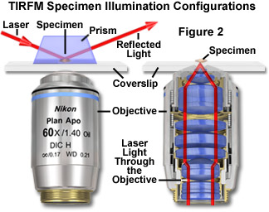
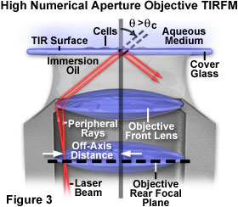
TIRFM illumination configurations
Prism method
Objective Lens method
Ideally NA of 1.45 or higher
Notes:
Combining this relationship with the condition for total internal reflection given above illustrates that living cells having a typical refractive index of 1.38 require illumination with an objective having a numerical aperture of greater than 1.38 in order to achieve total internal reflection. Light entering the objective must pass through the portion of the aperture cone corresponding to numerical aperture values larger than 1.38 in order to be totally reflected at the specimen-glass interface. If coherent laser illumination is employed, it must be focused at the periphery of the objective rear aperture to ensure that light will exit the front optical surface at an angle equal to or greater than the critical value. In the case of non-coherent illumination, such as that from an arc-discharge lamp, a mask in the form of an opaque disk must be introduced into the optical path to restrict light passing through the objective to the outer region of the rear aperture.
http://www.microscopyu.com/articles/fluorescence/tirf/tirfintro.html

Slide 10
TIRFM illumination configurations
Prism method
Objective Lens method
Restricts access to specimen (difficult to manipulate)
Most illuminate opposite objective so have to pass through specimen
If prism on same side then more complicated alignment
This is the way to go
But …

Slide 11
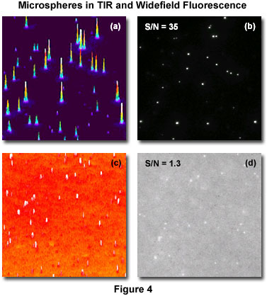
TIRFM applications
Benefits for imaging minute structures or single molecules in specimens with tons of fluorescence outside of optical plane of interest
Examples: Brownian motion of molecules in solution, vesicles undergoing endocytosis or exocytosis, or single protein trafficking in cells
Can get dramatic increase in signal-to-noise ratio from thin excitation region
Microsphere example
Notes:
Figure 4 presents images acquired of a solution of fluorescent microspheres utilizing the TIRFM method (Figure 4(b)) and conventional epi-fluorescence illumination (Figure 4(d)). To the left of each image is its corresponding intensity histogram (Figures 4(a) and 4(c)). The improved resolution of the spheres afforded by increasing the signal-to-noise ratio (S/N) from 1.3 to 35 is apparent in the images, and in the sharp localization and higher signal intensity in the histogram corresponding to the TIRFM image (Figure 4(a)).
http://www.microscopyu.com/articles/fluorescence/tirf/tirfintro.html

Slide 12
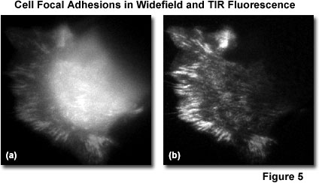
TIRFM applications
Ideal tool for investigation of both the mechanisms and dynamics of many of the proteins involved in cell-cell interactions
Live cell imaging
GFP-vinculin to see focal adhesions on coverslip
Notes:
Figure 5 presents comparative images of live cells (PtK1 kangaroo kidney epithelial cells expressing GFP-vinculin) utilizing a conventional widefield epi-fluorescence method (Figure 5(a)) and evanescent wave illumination (Figure 5(b)). The TIRFM image reveals localization of the fusion protein in cell focal adhesions at the substrate interface in dramatic contrast to the blur produced by out-of-plane fluorescence in the epi-illumination image. Live-cell imaging represents one of the most promising applications of the TIRFM technique.

Slide 13
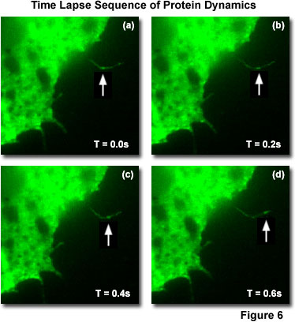
TIRFM applications
Single molecule imaging
Time lapse of GFP-Rac moving along filopodia
In fact, most single molecule imaging today done with TIRFM
Notes:
At the biomolecular level, TIRFM techniques have been utilized to image single molecules of the mutant protein GFP-Rac trafficking along thin filopodia of cells growing on a substrate (Figure 6). This protein is involved in cell motility, and knowledge of the dynamics of its interactions at the cell membrane are crucial to understanding the process. The visualization of single-molecule fluorescence with sufficient temporal resolution for dynamic studies is possible with TIRFM because of the outstanding signal-to-noise ratio afforded by the evanescent wave excitation. Figure 6 presents four sequential time lapse frames taken at 200-millisecond intervals, illustrating the movement of a GFP-Rac fusion protein molecule (arrows) through a fine filopodium of a Xenopus cell growing out on a substrate.
http://www.microscopyu.com/articles/fluorescence/tirf/tirfintro.html

Slide 14
TIRFM versus Confocal Microscopy
Confocal not limited to plane at interface, can go deeper
TIRFM has thinner optical section (100 nm vs 600 nm)
TIRFM, like two photon, only excites sample at focal plane
TIRFM is cheaper to implement than confocal
TIRFM is NOT super-resolution (except in Z)
Notes:
http://olympus.magnet.fsu.edu/primer/techniques/fluorescence/tirf/tirfintro.html

Slide 15
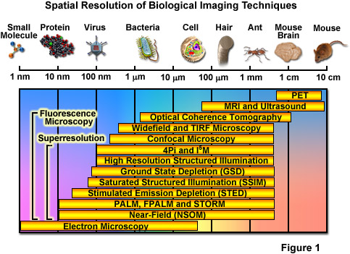
Spatial Resolution of Biological Imaging Techniques
“True” super-resolution
“Functional”
Notes:
http://zeiss-campus.magnet.fsu.edu/articles/superresolution/introduction.html

Slide 16

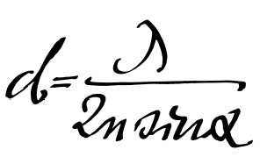
Super-resolution microscopy
Abbe (1873) reported that smallest resolvable distance between two points (d) using a conventional microscope may never be smaller than half the wavelength of the imaging light (~200 nm)
Is resolution diffraction limited?
Notes:
They fall into two broad categories, "true" super-resolution techniques, which capture information contained in evanescent waves, and "functional" super-resolution techniques, which use clever experimental techniques and known limitations on the matter being imaged to reconstruct a super-resolution image.^{[2]}
True subwavelength imaging techniques include those that utilize the Pendry Superlens and near field scanning optical microscopy, the 4Pi Microscope and structured illumination microscopy technologies like SIM and SMI. However, the majority of techniques of importance in biological imaging fall into the functional category.
There are two major groups of methods for functional super-resolution microscopy:
Deterministic super-resolution: The most commonly used emitters in biological microscopy, fluorophores, show a nonlinear response to excitation, and this nonlinear response can be exploited to enhance resolution. These methods include STED, GSD, RESOLFT and SSIM.
Stochastic super-resolution: The chemical complexity of many molecular light sources gives them a complex temporal behaviour, which can be used to make several close-by fluorophores emit light at separate times and thereby become resolvable in time. These methods include SOFI and all single-molecule localization methods (SMLM) such as SPDM, SPDMphymod, PALM, FPALM, STORM and dSTORM.

Slide 17
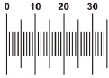
Super-resolution microscopy
Could always do super-resolution if could label points with different colors
Separate with different fluorescent filters (spectral unmixing)
Why fluorescence is such an important illumination technique
Hell, S.W., 2009. Microscopy and its focal switch. Nat Meth 6, 24-32.
Notes:
http://www.nature.com/nmeth/journal/v6/n1/full/nmeth.1291.html

Slide 18
Super-resolution microscopy
“True” super-resolution techniques
  Subwavelength imaging
  Capture information in evanescent waves
“Functional” super-resolution techniques
  Deterministic
    Exploit nonlinear responses of fluorophores
  Stochastic
    Exploit the complex temporal behaviors of fluorophores
Notes:
They fall into two broad categories, "true" super-resolution techniques, which capture information contained in evanescent waves, and "functional" super-resolution techniques, which use clever experimental techniques and known limitations on the matter being imaged to reconstruct a super-resolution image.^{[2]}
True subwavelength imaging techniques include those that utilize the Pendry Superlens and near field scanning optical microscopy, the 4Pi Microscope and structured illumination microscopy technologies like SIM and SMI. However, the majority of techniques of importance in biological imaging fall into the functional category.
There are two major groups of methods for functional super-resolution microscopy:
Deterministic super-resolution: The most commonly used emitters in biological microscopy, fluorophores, show a nonlinear response to excitation, and this nonlinear response can be exploited to enhance resolution. These methods include STED, GSD, RESOLFT and SSIM.
Stochastic super-resolution: The chemical complexity of many molecular light sources gives them a complex temporal behaviour, which can be used to make several close-by fluorophores emit light at separate times and thereby become resolvable in time. These methods include SOFI and all single-molecule localization methods (SMLM) such as SPDM, SPDMphymod, PALM, FPALM, STORM and dSTORM.

Slide 19
“Functional” super-resolution techniques
Deterministic
  Reversible Saturable (or Switchable) OpticaL Fluorescence Transitions (RESOLFT)
    STimulated Emission Depletion (STED)
    Ground State Depletion (GSD)
Stochastic
  STochastic Optical Reconstruction Microscopy (STORM)
  Photo Activated Localization Microscopy (PALM)
  Fluorescence Photo-Activation Localization Microscopy (FPALM)
Notes:
A trio of techniques independently surfaced during a four-month period in 2006 that elegantly demonstrated the sequential and stochastic readout with precise localization of multiple single molecules from specimens that were fluorescently labeled with photoswitchable dyes or optical highlighter fluorescent proteins at densities approaching those commonly employed in widefield and confocal fluorescence microscopy (ranging up to 100,000 molecules per square micrometer). These nearly identical single-molecule superresolution imaging techniques have been termed stochastic optical reconstruction microscopy (STORM; see Figure 1), photoactivated localization microscopy (PALM), and fluorescence photoactivation localization microscopy (FPALM). They rely on an activation laser applied at low power to trigger emission switching so that any particular molecule has a small probability of being photoactivated, but the majority of the population remains in the original (dark or native) emissive state. Although the major difference between the methods as they were originally published was simply the nature of the fluorescent probes used to achieve superresolution imaging, these techniques are virtually identical. In fact, the original STORM research report mentioned the use of fluorescent proteins, whereas the first PALM paper discussed the application of caged synthetic fluorophores.
http://www.microscopyu.com/articles/superresolution/stormintro.html
They fall into two broad categories, "true" super-resolution techniques, which capture information contained in evanescent waves, and "functional" super-resolution techniques, which use clever experimental techniques and known limitations on the matter being imaged to reconstruct a super-resolution image.^{[2]}
True subwavelength imaging techniques include those that utilize the Pendry Superlens and near field scanning optical microscopy, the 4Pi Microscope and structured illumination microscopy technologies like SIM and SMI. However, the majority of techniques of importance in biological imaging fall into the functional category.
There are two major groups of methods for functional super-resolution microscopy:
Deterministic super-resolution: The most commonly used emitters in biological microscopy, fluorophores, show a nonlinear response to excitation, and this nonlinear response can be exploited to enhance resolution. These methods include STED, GSD, RESOLFT and SSIM.
Stochastic super-resolution: The chemical complexity of many molecular light sources gives them a complex temporal behaviour, which can be used to make several close-by fluorophores emit light at separate times and thereby become resolvable in time. These methods include SOFI and all single-molecule localization methods (SMLM) such as SPDM, SPDMphymod, PALM, FPALM, STORM and dSTORM.

Slide 20
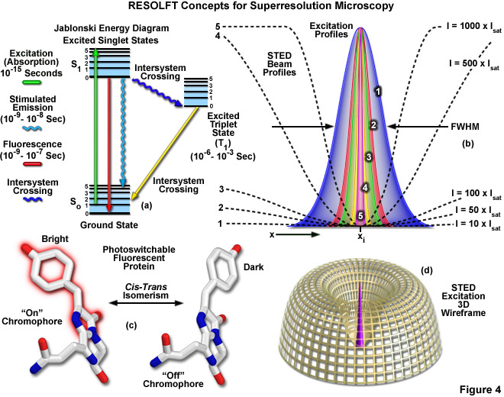
Reversible Saturable (or Switchable) Optical Fluorescence Transitions (RESOLFT)
Includes
STED
GSD
Notes:
Extremely high intensities are necessary for switching off the excited singlet state with STED (using what is termed a depletion laser), but switching to a metastable triplet or similar dark state (GSD) requires a light intensity between a thousand and a million times lower.
http://zeiss-campus.magnet.fsu.edu/articles/superresolution/introduction.html
http://www.microscopyu.com/articles/superresolution/stormintro.html

Slide 21
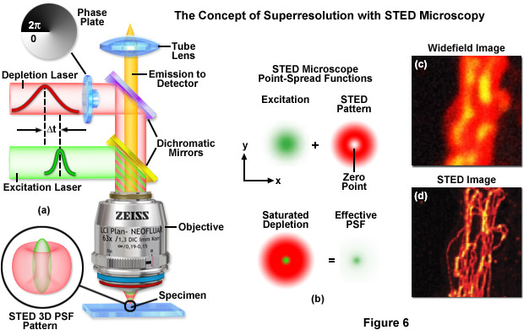
STED: STimulated Emission Depletion
http://zeiss-campus.magnet.fsu.edu

Slide 22

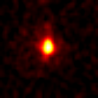
STED Microscopy means scanning a smaller focal spot across the sample
Point Spread Function: Confocal vs STED
measured with fluorescent nanoparticles under the same conditions
Typical lateral (X-Y)
resolution in a Confocal:
200x200 nm
Typical lateral (X-Y) FWHM
(Full Width Half Maximum)
in STED is 90x90 nm
STED z resolution is
confocal (500 nm)
STED enables separation
of structures even smaller
than its FWHM due to the
sharp peak. Actual
resolution is in the order
of 70 nm for raw data
(without deconvolution)
y
y
x
x

Slide 23
Pulse timing: Stimulated Emission Depletion - Fluorescence is depleted before it is emitted
Fluorescence
~ns
Excitation
STED
10-
200 ps
Timing
Energy diagram
<1ps
Time
No fluorescence
emission
S
4
1
3
Stimulated
Emission
Fluorescence
Absorption
S
2
0
1

Slide 24
“Functional” super-resolution techniques
Deterministic
  Reversible Saturable (or Switchable) OpticaL Fluorescence Transitions (RESOLFT)
    STimulated Emission Depletion (STED)
    Ground State Depletion (GSD)
Stochastic
  STochastic Optical Reconstruction Microscopy (STORM)
  Photo Activated Localization Microscopy (PALM)
  Fluorescence Photo-Activation Localization Microscopy (FPALM)
Notes:
A trio of techniques independently surfaced during a four-month period in 2006 that elegantly demonstrated the sequential and stochastic readout with precise localization of multiple single molecules from specimens that were fluorescently labeled with photoswitchable dyes or optical highlighter fluorescent proteins at densities approaching those commonly employed in widefield and confocal fluorescence microscopy (ranging up to 100,000 molecules per square micrometer). These nearly identical single-molecule superresolution imaging techniques have been termed stochastic optical reconstruction microscopy (STORM; see Figure 1), photoactivated localization microscopy (PALM), and fluorescence photoactivation localization microscopy (FPALM). They rely on an activation laser applied at low power to trigger emission switching so that any particular molecule has a small probability of being photoactivated, but the majority of the population remains in the original (dark or native) emissive state. Although the major difference between the methods as they were originally published was simply the nature of the fluorescent probes used to achieve superresolution imaging, these techniques are virtually identical. In fact, the original STORM research report mentioned the use of fluorescent proteins, whereas the first PALM paper discussed the application of caged synthetic fluorophores.
http://www.microscopyu.com/articles/superresolution/stormintro.html
These three methods were published independently during a short period of time and their principle is identical. STORM was originally described using Cy5 and Cy3 dyes attached to nucleic acids or proteins,^{[47]} while PALM and FPALM was described using photoswitchable fluorescent proteins.^{[48][49]}
http://en.wikipedia.org/wiki/Super-resolution_microscopy#Stochastic_functional_techniques
They fall into two broad categories, "true" super-resolution techniques, which capture information contained in evanescent waves, and "functional" super-resolution techniques, which use clever experimental techniques and known limitations on the matter being imaged to reconstruct a super-resolution image.^{[2]}
True subwavelength imaging techniques include those that utilize the Pendry Superlens and near field scanning optical microscopy, the 4Pi Microscope and structured illumination microscopy technologies like SIM and SMI. However, the majority of techniques of importance in biological imaging fall into the functional category.
There are two major groups of methods for functional super-resolution microscopy:
Deterministic super-resolution: The most commonly used emitters in biological microscopy, fluorophores, show a nonlinear response to excitation, and this nonlinear response can be exploited to enhance resolution. These methods include STED, GSD, RESOLFT and SSIM.
Stochastic super-resolution: The chemical complexity of many molecular light sources gives them a complex temporal behaviour, which can be used to make several close-by fluorophores emit light at separate times and thereby become resolvable in time. These methods include SOFI and all single-molecule localization methods (SMLM) such as SPDM, SPDMphymod, PALM, FPALM, STORM and dSTORM.

Slide 25
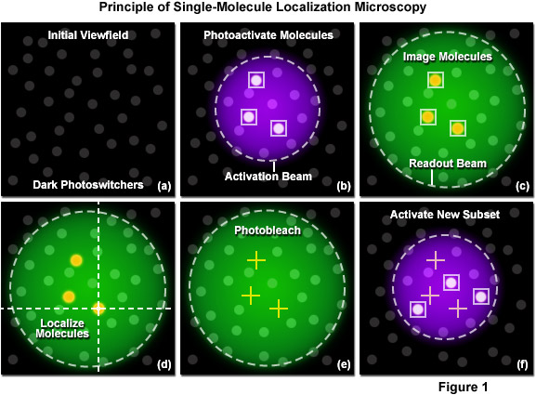
Single-molecule localization (SML) microscopy
Stochastic functional techniques
Notes:
http://zeiss-campus.magnet.fsu.edu/articles/superresolution/palm/practicalaspects.html
http://www.microscopyu.com/articles/superresolution/stormintro.html

Slide 26
Single-molecule localization microscopy
Stochastic functional techniques
STED vs STORM
How STORM works

Slide 27
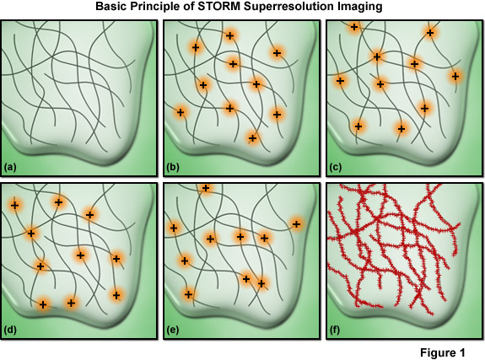
Single-molecule localization microscopy
Must have sufficient density of molecules being localized
Notes:
Among the critical aspects that must be considered are the accuracy of each individual localization measurement, the density of probes that have been localized in the final image (commonly termed molecular density), and the physical size of the labels themselves. The relationship between resolution and the localization precision of a single molecule is readily determined. The ability to resolve two fluorescent molecules as separate entities is limited by the localization precision, which determines the position (and uncertainty) of each molecule and thus the distance between the pair. The localization precision, in turn, is primarily dependent upon the number of photons collected from the fluorescent molecules during a single activation-deactivation cycle, provided the background noise is negligible.
Presented in Figure 7 is an important concept involving one of the most critical factors influencing spatial resolution in single-molecule superresolution imaging. The resolution versus molecular density is represented in Figure 7 as a series of yellow pixels in a test pattern. Features that might be present in a specimen are imaged at a progressively lower signal-to-noise ratio (fraction of pixels measured) as the molecular density decreases (from the bottom to the top of Figure 7) and these features become unresolvable when the mean molecular separation approaches feature size (the top row in Figure 7). Thus, as described in Equation (5), in order to achieve N-fold higher resolution in dimensions D, N^{D}-fold more pixels must be acquired. In order to realize such a resolution gain without compromising either the imaging speed or the signal-to-noise ratio, the signal collection rate (photons detected per second) must increase by a factor of at least N^{D}, which requires an N^{D}-fold higher exposure to the excitation laser for each image required.

Slide 28
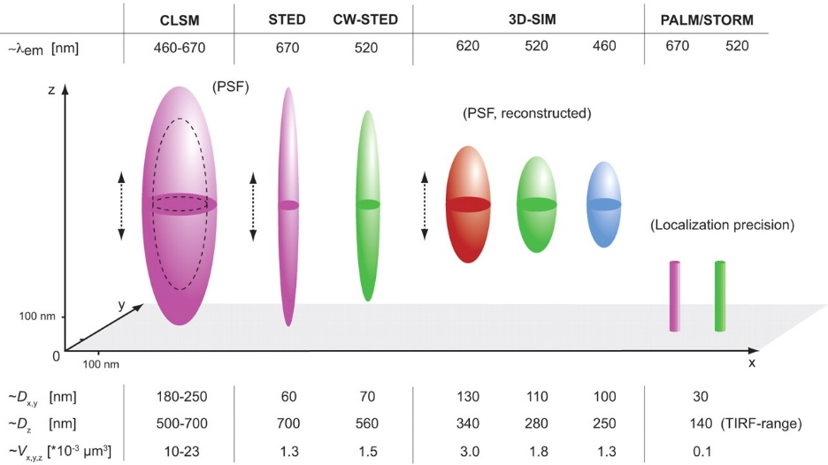
Each super-resolution techniques have pluses and minuses but all methods are improving
Schermelleh, L., Heintzmann, R., Leonhardt, H., 2010. A guide to super-resolution fluorescence microscopy. The Journal of Cell Biology 190, 165-175.
Notes:
http://jcb.rupress.org/content/190/2/165.full

Slide 29
Super-resolution requirements
High power lasers
Special fluorophores
Concentration of fluorophores
Special optics
Computational processing
Fast detectors
Sensitive detectors
Precise X,Y,Z positioning

Slide 30
Comparing different super-resolution (SR) techniques
(200 nm normal)
Technique | Photons needed | Resolution | Intensity | Time (sec)
STED | 1,000 | 20 nm | 10⁴ - 10⁹ | >60
Localization | 14,400 | 20 nm | 10³ - 10⁴ | >20
SR-SIM | 8 | 100 nm | 10 - 10² | 0.1 – 1.0
What is the difference between super-resolution (SR) SPIM and regular SPIM?

Slide 31
Remember overview of Optical sectioning Methods?
Deconvolution
  Point-Spread function (PSF) information is used to calculate light back to its origin
  Post processing of an image stack
Confocal and Multi-photon Laser Scanning Microscopy
  Pinhole prevents out-of-focus light getting to the sensor(s) (PMT - Photomultiplier)
  Multi Photon does not require pinhole
Spinning disk systems
  A large number of pinholes (used for excitation and emission) is used to prevent out-of-focus light getting to the camera
  Especially those using Nipkow disk and microlens
Structured Illumination Microscopy (SIM)
Notes:
Deconvolution mostly used with wide field microscopes but can be used for confocal data as well

Slide 32
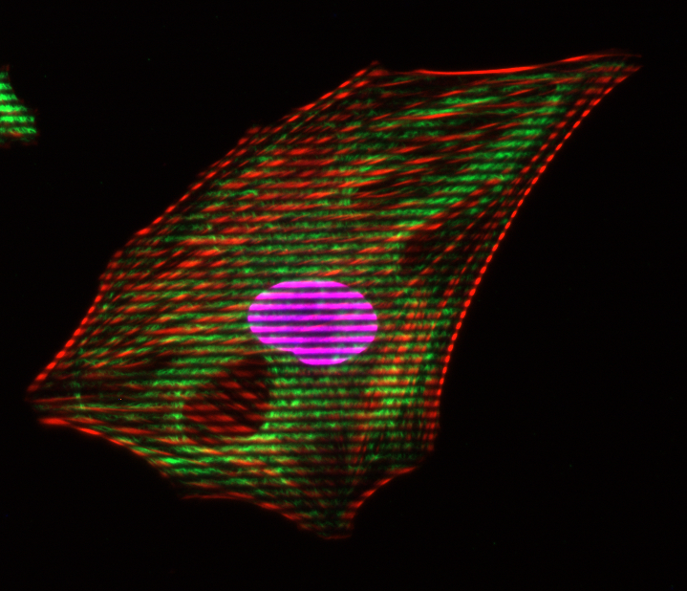
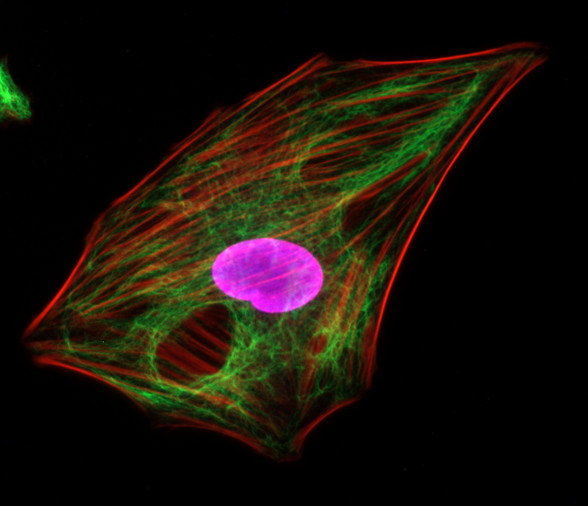
Structured Illumination
- The Principle
Grid pattern is projected into the focal plane of the objective
Visible in the eyepiece and the camera

Slide 33
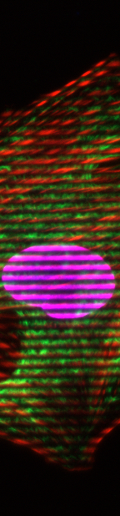
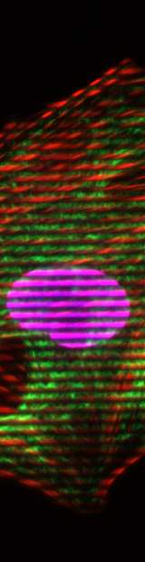
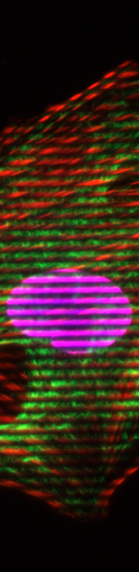
Structured Illumination
- The Principle
Grid pattern is projected into the focal plane of the objective
Visible in the eyepiece and the camera
The grid pattern is moving in 3-15 different positions (phases)
Example: 3 Phases
Each pixel intensity is calculated as:
(simplified equation)
1
2
3

Slide 34
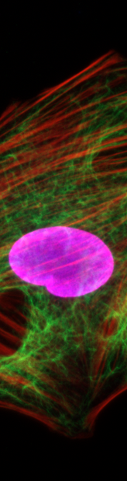
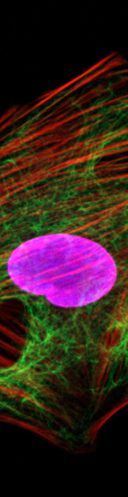
Structured Illumination
- The Principle
If the local change in contrast is high, the structure is inside the focal plane
If the local change in contrast is zero, the structure is not inside the focal plane
Conventional
1 phase
2 phase
3 phase
Sectioned

Slide 35
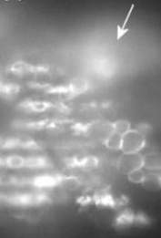
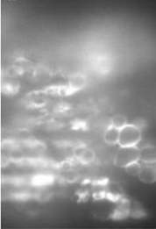
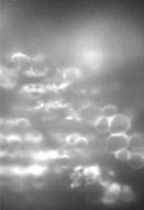
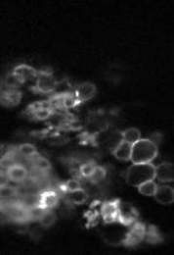
Structured Illumination
- The Contrast is the Key
No visible grid → out of focus light
Position 1
Position 2
Position 3
Optical section
Visible grid → structures in focus
Notes:
The algorithm is looking for a change in the local contrast. The algorithm is demodulating the images.
Simple image analysis algorithm detects the brightness differences of the 3 raw images and removes the out-of-focus signals in the image (demodulation)

Slide 36
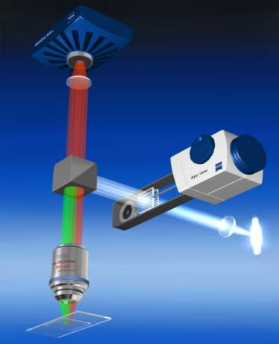
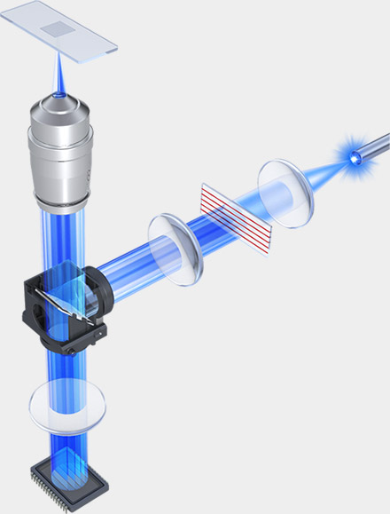
Structured Illumination Microscopy (SIM)
Option for wide-field microscope
Zeiss Apotome 2
Keyence BZ-X700
Notes:
Grab bag of methods that are not

Slide 37
Super-resolution microscopy
Functional super-resolution techniques won Nobel
SIM did not win
SIM not considered to be super-resolution
Notes:
They fall into two broad categories, "true" super-resolution techniques, which capture information contained in evanescent waves, and "functional" super-resolution techniques, which use clever experimental techniques and known limitations on the matter being imaged to reconstruct a super-resolution image.^{[2]}
True subwavelength imaging techniques include those that utilize the Pendry Superlens and near field scanning optical microscopy, the 4Pi Microscope and structured illumination microscopy technologies like SIM and SMI. However, the majority of techniques of importance in biological imaging fall into the functional category.
There are two major groups of methods for functional super-resolution microscopy:
Deterministic super-resolution: The most commonly used emitters in biological microscopy, fluorophores, show a nonlinear response to excitation, and this nonlinear response can be exploited to enhance resolution. These methods include STED, GSD, RESOLFT and SSIM.
Stochastic super-resolution: The chemical complexity of many molecular light sources gives them a complex temporal behaviour, which can be used to make several close-by fluorophores emit light at separate times and thereby become resolvable in time. These methods include SOFI and all single-molecule localization methods (SMLM) such as SPDM, SPDMphymod, PALM, FPALM, STORM and dSTORM.

Slide 38
Spatial Resolution of Biological Imaging Techniques
“True” super-resolution
“Functional”
Notes:
http://zeiss-campus.magnet.fsu.edu/articles/superresolution/introduction.html

Slide 39
How does super-resolution SIM differ from normal SIM?
It’s all due to the number of different gratings
Zeiss Apotome uses 1 grating
Keyence uses up to 2 gratings
For super-resolution Mats Gustafsson found that 3 different grating orientations were required (gratings finer also)
Notes:
Heintzmann, R., Cremer, C.G., 1999. Laterally modulated excitation microscopy: improvement of resolution by using a diffraction grating, pp. 185-196.
Gustafsson, M.G.L., 2000. Surpassing the lateral resolution limit by a factor of two using structured illumination microscopy. Journal of Microscopy 198, 82-87.
Fig. 1. Concept of resolution enhancement by structured illumination. (a) If two line patterns are superposed (multiplied), their product will
contain moireÂ fringes (seen here as the apparent vertical stripes in the overlap region). (b) A conventional microscope is limited by diffraction.
The set of low-resolution information that it can detect defines a circular `observable region' of reciprocal space. (c) A sinusoidally striped
illumination pattern has only three Fourier components. The possible positions of the two side components are limited by the same circle that
defines the observable region (dashed). If the sample is illuminated with such structured light, moireÂ fringes will appear which represent
information that has changed position in reciprocal space. The amounts of that movement correspond to the three Fourier components of the
illumination. The observable region will thus contain, in addition to the normal information, moved information that originates in two offset
regions (d). From a sequence of such images with different orientation and phase of the pattern, it is possible to recover information from an
area twice the size of the normally observable region, corresponding to twice the normal resolution (e).

Slide 40
Examples of SR-SIM images from Gustafsson
121 nm beads
Actin cytoskeleton
Notes:
Fig. 3. A cluster of fluorescent microspheres of nominal diameter
121 nm, as imaged by conventional (a), confocal (b), and
structured illumination (c) microscopy. The confocal microscope
was operated under maximum resolution conditions. The apparent
size (FWHM) of isolated beads is approximately 130 nm in the
structured illumination image, compared to 290 and 210 nm for
conventional and confocal microscopy.
Fig. 4. The actin cytoskeleton at the edge of a HeLa cell, as imaged by (a, c) conventional and (b, d) structured illumination microscopy. (c, d)
Enlargements of the boxed areas in (a) and (b), respectively. Fibres separated by less than the resolution limit of the conventional microscope
are well resolved using structured illumination (d). The apparent widths (FWHM) of the finest protruding fibres [small arrows in (a, b)] are
lowered to 110±120 nm in (b), compared to 280±300 nm in (a).

Slide 41
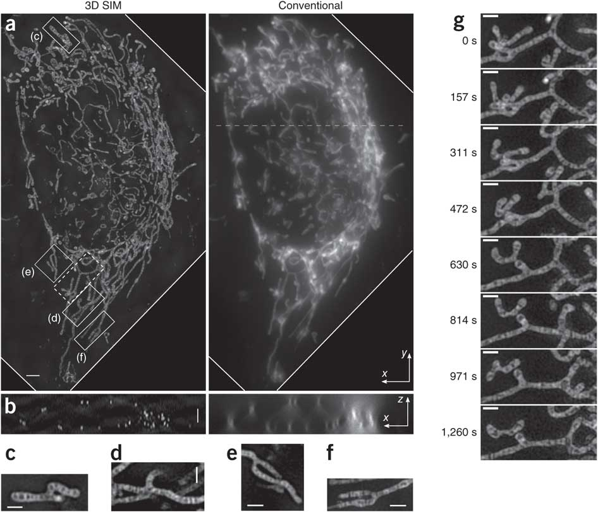
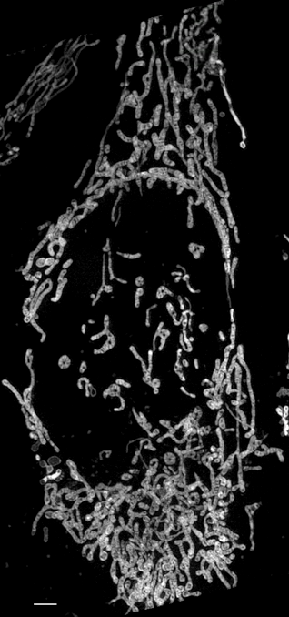
3D SR-SIM uses SLM from Gustafsson (2011)
MitoTracker Green acquired at 20 sec intervals
Notes:
Figure 2 | Live 3D SIM and conventional wide-field microscopy images of a HeLa cell stained with MitoTracker Green. (a) Maximum-intensity projection along z dimension through the cell volume at time 0 of a 50-time-point series. Each SIM volume was acquired in 20.33 s (that is, 35-ms exposure time × 38 axial planes × 15 patterns + 38 axial planes × 10-ms z-stage settle time). (b) One x–z cross-section of the same volume sliced through the dashed line shown in a. (c–f) Single-plane x–y slices corresponding to the boxed regions in a. (g) Eight time frames of the region boxed with dashed line in a. Each frame is a maximum-intensity projection along z over a 1.3 μm thickness that contains the featured ‘Y’-shaped mitochondrion. Scale bars, 2 μm (a,b) and 1 μm (c–g).
Shao, L., Kner, P., Rego, E.H., Gustafsson, M.G.L., 2011. Super-resolution 3D microscopy of live whole cells using structured illumination. Nat Meth 8, 1044-1046.

Slide 42
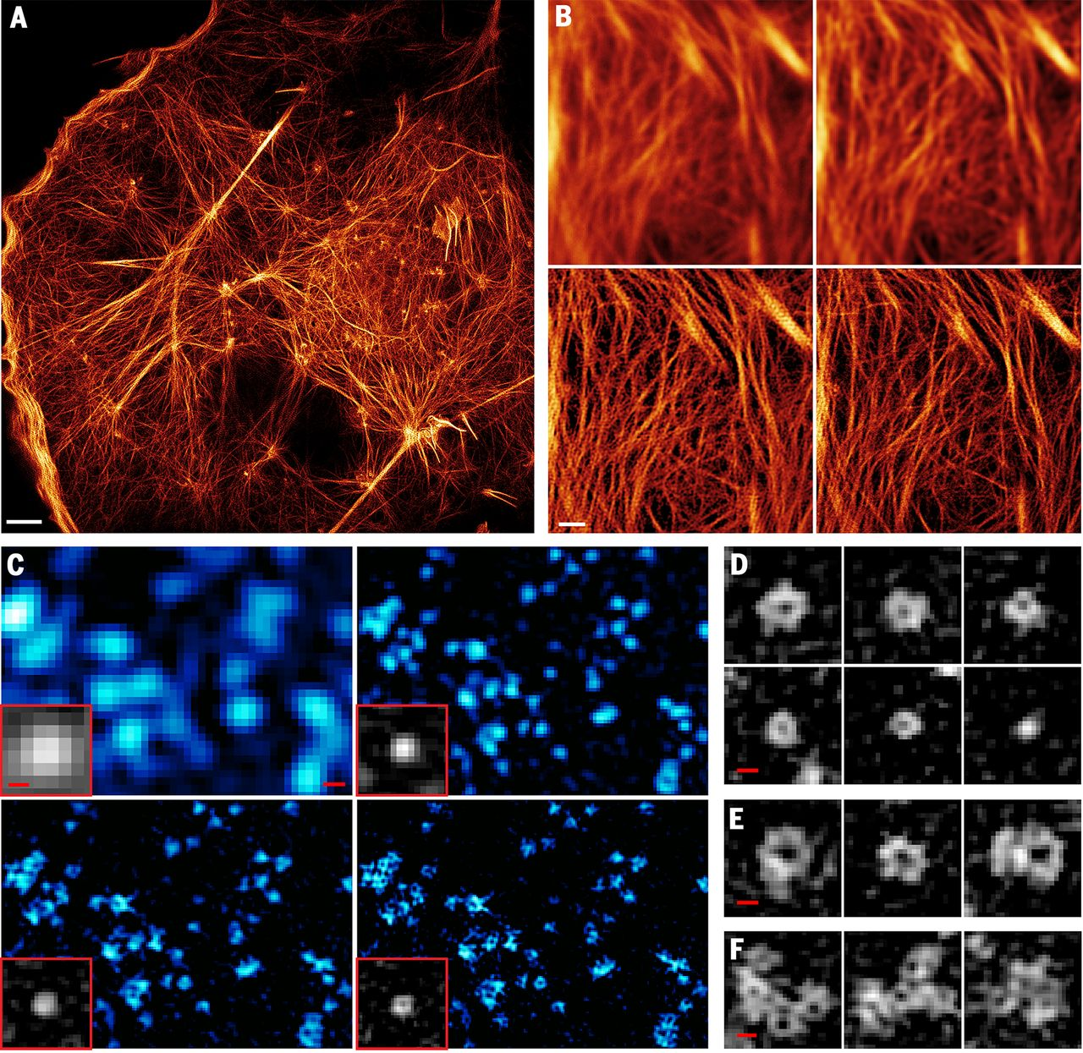
SR-SIM can get even better with TIRF + high NA lens (1.7) + reversibly photoswitchable fluorescent protein
TIRF
TIRF + deconvolution
TIRF-SIM
PA-NL-SIM
Notes:
Nonlinear TIRF-SIM with patterned activation; Actin cytoskeleton
Li, D., Shao, L., Chen, B.-C., Zhang, X., Zhang, M., Moses, B., Milkie, D.E., Beach, J.R., Hammer, J.A., Pasham, M., Kirchhausen, T., Baird, M.A., Davidson, M.W., Xu, P., Betzig, E., 2015. Extended-resolution structured illumination imaging of endocytic and cytoskeletal dynamics. Science 349.

Slide 43
SR-SIM can get even better with TIRF + high NA lens (1.7) + reversibly photoswitchable fluorescent protein
TIRF + decon (220 nm)
TIRF-SIM (97 nm)
PA-NL-SIM (62 nm)
Saturated PA-NL-SIM (45)
Notes:
Nonlinear TIRF-SIM with patterned activation caveolin, caveolea
Li, D., Shao, L., Chen, B.-C., Zhang, X., Zhang, M., Moses, B., Milkie, D.E., Beach, J.R., Hammer, J.A., Pasham, M., Kirchhausen, T., Baird, M.A., Davidson, M.W., Xu, P., Betzig, E., 2015. Extended-resolution structured illumination imaging of endocytic and cytoskeletal dynamics. Science 349.

Slide 44
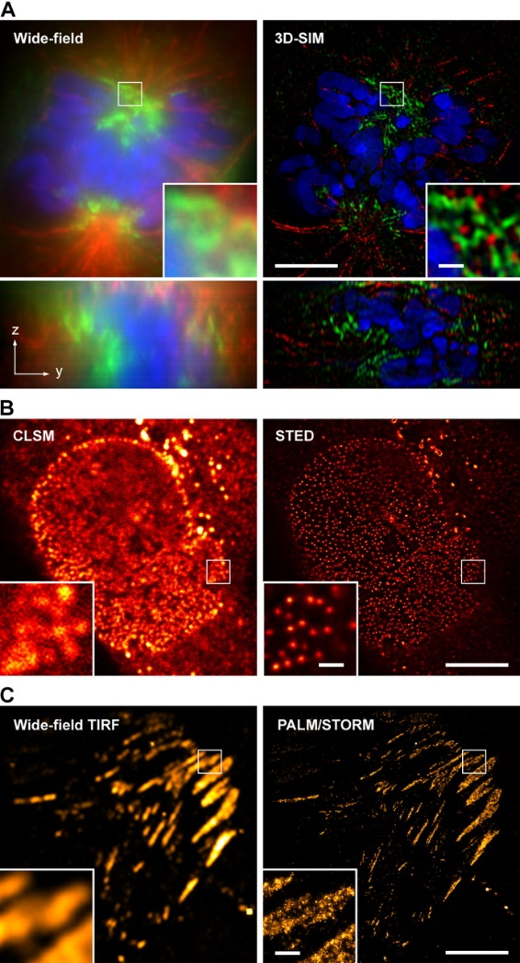
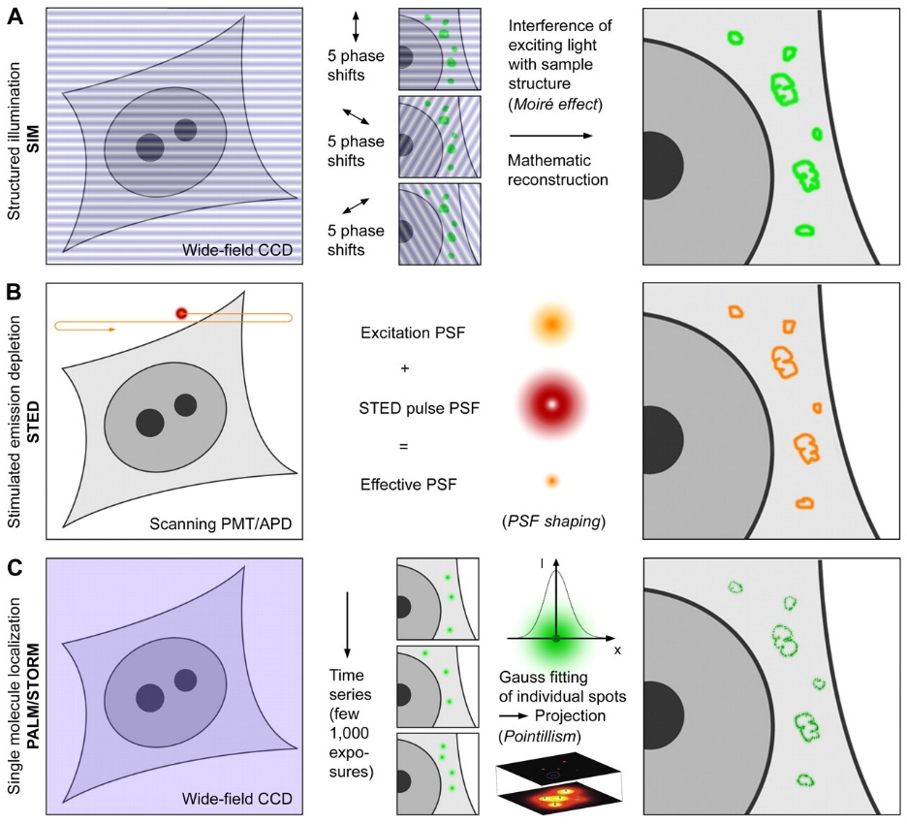
Schermelleh, L., Heintzmann, R., Leonhardt, H., 2010. A guide to super-resolution fluorescence microscopy. The Journal of Cell Biology 190, 165-175.
Notes:
http://jcb.rupress.org/content/190/2/165.full

Slide 45
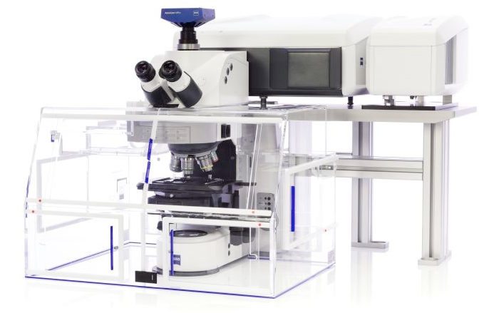
Zeiss Airyscan yet another means to achieve super-resolution
Available here at Caltech in the BIF

Slide 46

Conventional scanning confocal and the 1 A.u. limit.
PH = 1 A.u. is the standard setting for resolution.
PH = 1 A.u.
A point-like emitter generates a
diffraction limited pattern (~ PSF)
excitation
excitation and detection
are scanned in sync
detection
scan
At 1 A.u. The PSF is mapped directly 1:1
Intensity
~ 240 nm
scan
Notes:
The practical limit for the pinhole-size in confocal microscopy is 1.A.u. the resolution achieved at that setting is comparable to the classical limits postulated by Abbé or Rayleigh. The spatial image of a point-like emitter recorded with a confocal microscope with a 1 A.u. pinhole will correspond to the classically defined PSF.

Slide 47
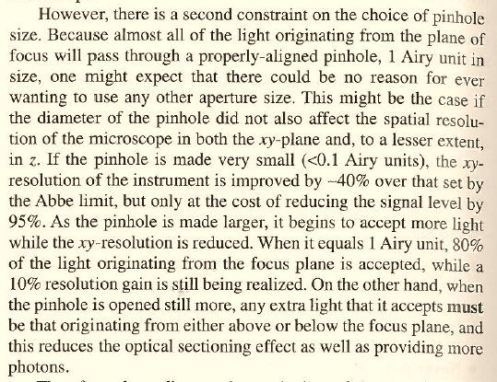
Scanning confocal and the 1 Airy unit pinhole “limit”.
At PH < 1 AU signal loss is larger than gain in resolution.
The potential to increase resolution by closing the pinhole (PH) is not a new idea (red)
One finds this idea described in many places, including Pawley’s Handbook of Confocal Microscopy
The price to pay, however, is
sacrificing 95% of the signal
(green).
The famous 1 AU setting
is more of a practical barrier
than a theoretical limit.
Fortunately, now there is
a clever workaround with
Airyscan...
Notes:
One main aspect of Airyscan is its capability to achieve superresolution (in the sense of Abbé or Rayleigh). The idea, indeed, is not new – It is widely known that confocal microscopes carry the capability to convolve excitation with detection and result in a factor-sqrt(2) ammeliorated resolution. However, in order to tap into this regime, the pinhole must be much smaller than the PSF itself. The loss of signal in this case poses, in the mojority of cases, an unsurmountable difficulty. As noted previously, Airyscan acts as if scanning with 0.2 A.u. pinholes, however, because the light is collected from the whole array, each pixel is in effect scanned at least 32 times. Since all photons are collected the loss of signal is virtually avoided.

Slide 48
Airyscan: PH ~ 0.2 A.u. scanning without loss.
A single element improves resolution
PH = 0.2 a.u.
A point-like emitter generates a
diffraction limited pattern (~ PSF)
excitation
By collecting just the central element
the PSF is weaker but smaller
detection
scan
Intensity
~170nm
scan
Notes:
Airyscan acts as if scanning with 0.2 A.u. pinholes, however, because the light is collected from the whole array, each pixel is - in effect - scanned at least 32 times. Since all photons are collected the loss of signal is virtually avoided. The PSF can be re-mapped as shown, generating a smaller PSF by a factor sqrt(2). This is true in every direction (including z – not shown, here). At this level of oversampling, one is generating ideal conditions for deconvolution. A deconvolution step applied to these images generates a further increase, of about 1.2-fold, in resolution. This additional push in resolution, however, depends on image quality and cannot be expected to work perfectly all the times.

Slide 49
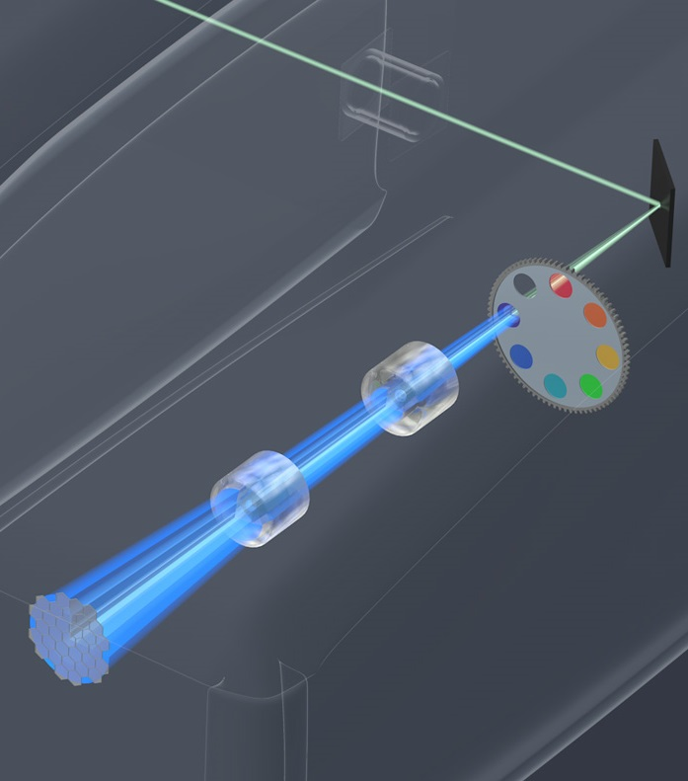
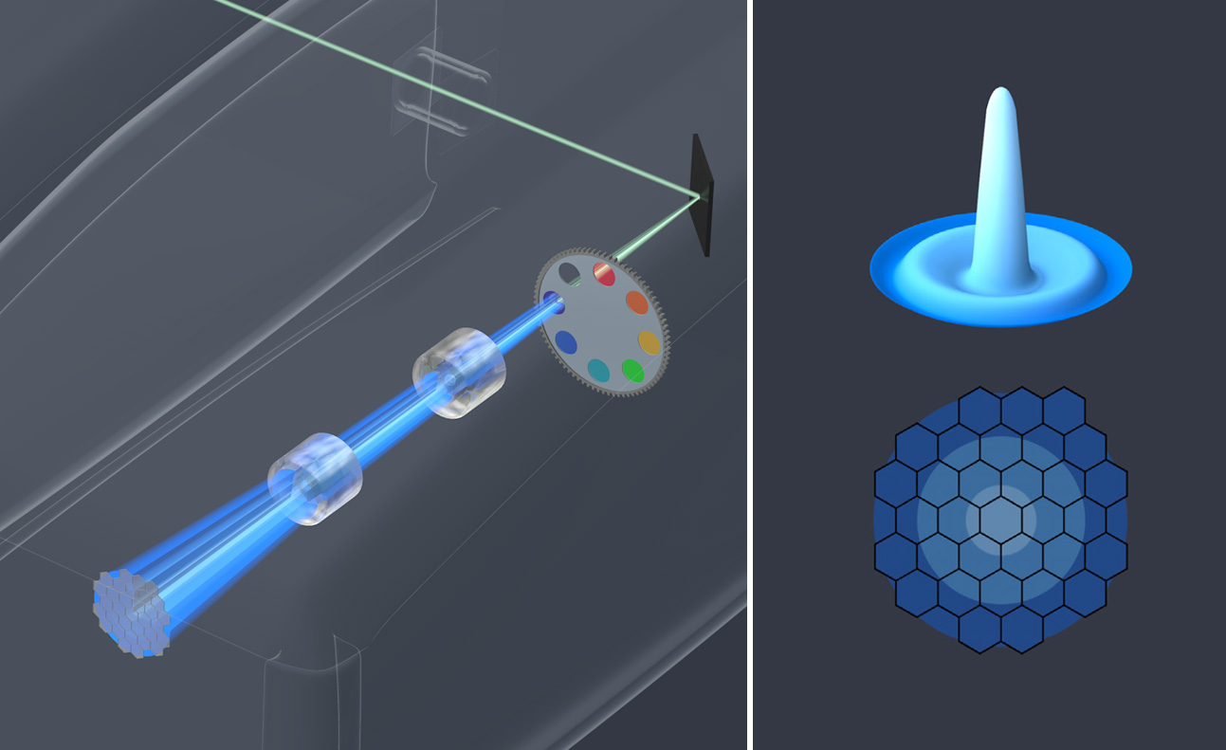
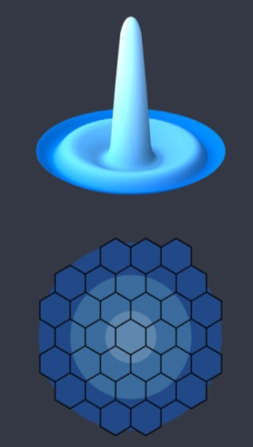
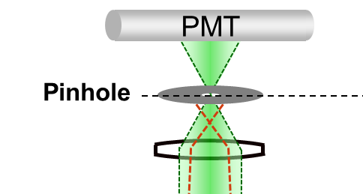

Airyscan Detection
Unique 32 GaAsP-PMT design
Replaced with New Design
LSM 880 output port
filter wheel
Y
adaptive zoom optics
32 GaAsP-PMT array
X
Notes:
Airyscan is a 32-channel GaAsP detector array arranged in a hexagonal grid. The full intensity distribution passing the pinhole reaches this detector. Each GaAsP subunit can be seen as a detector with a smaller pinhole. In effect every pixel on the image is generated from 32 subunits – either using the space information to generate superresolution or collecting all photons as an ordinary detector...

Slide 50
Airyscan: PH ~ 0.2 A.u. scanning without loss.
A single element improves resolution
PH = 1,25 a.u.
A point-like emitter generates a
diffraction limited pattern (~ PSF)
excitation
By collecting just the central element
the PSF is weaker but smaller
detection
subunit
~ 0.2 A.u.
scan
Intensity
~170nm
scan
Notes:
Airyscan acts as if scanning with 0.2 A.u. pinholes, however, because the light is collected from the whole array, each pixel is - in effect - scanned at least 32 times. Since all photons are collected the loss of signal is virtually avoided. The PSF can be re-mapped as shown, generating a smaller PSF by a factor sqrt(2). This is true in every direction (including z – not shown, here). At this level of oversampling, one is generating ideal conditions for deconvolution. A deconvolution step applied to these images generates a further increase, of about 1.2-fold, in resolution. This additional push in resolution, however, depends on image quality and cannot be expected to work perfectly all the times.

Slide 51
Airyscan: PH ~ 0.2 A.u. scanning without loss.
A single element – even if offset still improves resolution
PH = 1,25 a.u.
A point-like emitter generates a
diffraction limited pattern (~ PSF)
excitation
By using an element offset from the
centre, resolution is still improved
detection
subunit
~ 0.2 A.u.
scan
Intensity
scan
Notes:
Airyscan acts as if scanning with 0.2 A.u. pinholes, however, because the light is collected from the whole array, each pixel is - in effect - scanned at least 32 times. Since all photons are collected the loss of signal is virtually avoided. The PSF can be re-mapped as shown, generating a smaller PSF by a factor sqrt(2). This is true in every direction (including z – not shown, here). At this level of oversampling, one is generating ideal conditions for deconvolution. A deconvolution step applied to these images generates a further increase, of about 1.2-fold, in resolution. This additional push in resolution, however, depends on image quality and cannot be expected to work perfectly all the times.

Slide 52
Airyscan: PH ~ 0.2 A.u. scanning without loss.
Combining the data
PH = 1,25 a.u.
Image formation:
1 = Offset signal
2 = Add signal
excitation
detection
subunit
~ 0.2 A.u.
scan
Intensity
scan
Notes:
Airyscan acts as if scanning with 0.2 A.u. pinholes, however, because the light is collected from the whole array, each pixel is - in effect - scanned at least 32 times. Since all photons are collected the loss of signal is virtually avoided. The PSF can be re-mapped as shown, generating a smaller PSF by a factor sqrt(2). This is true in every direction (including z – not shown, here). At this level of oversampling, one is generating ideal conditions for deconvolution. A deconvolution step applied to these images generates a further increase, of about 1.2-fold, in resolution. This additional push in resolution, however, depends on image quality and cannot be expected to work perfectly all the times.

Slide 53
Airyscan: PH ~ 0.2 A.u. scanning without loss.
With 32 detectors all photons are recorded and mapped at the same time
PH = 1,25 a.u.
excitation
All elements are acquired simultaneously, and can be remapped for better resolution and sensitivity
The PSF is mapped directly 1:√2
detection
subunit
~ 0.2 A.u.
Intensity
Get an extra push beyond the limit using deconvolution (down to 1:1,7)
~ 140 nm
scan
Notes:
Airyscan acts as if scanning with 0.2 A.u. pinholes, however, because the light is collected from the whole array, each pixel is - in effect - scanned at least 32 times. Since all photons are collected the loss of signal is virtually avoided. The PSF can be re-mapped as shown, generating a smaller PSF by a factor sqrt(2). This is true in every direction (including z – not shown, here). At this level of oversampling, one is generating ideal conditions for deconvolution. A deconvolution step applied to these images generates a further increase, of about 1.2-fold, in resolution. This additional push in resolution, however, depends on image quality and cannot be expected to work perfectly all the times.

Slide 54
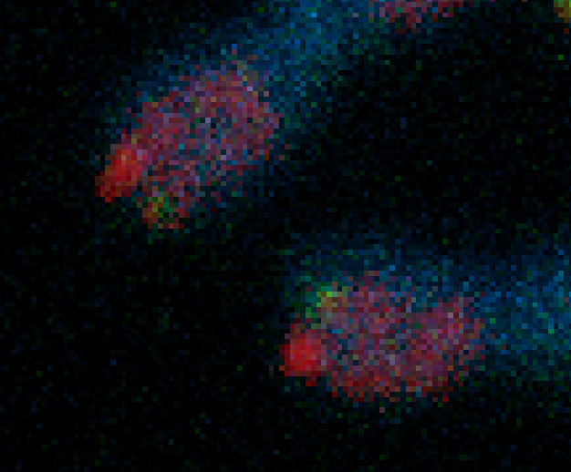
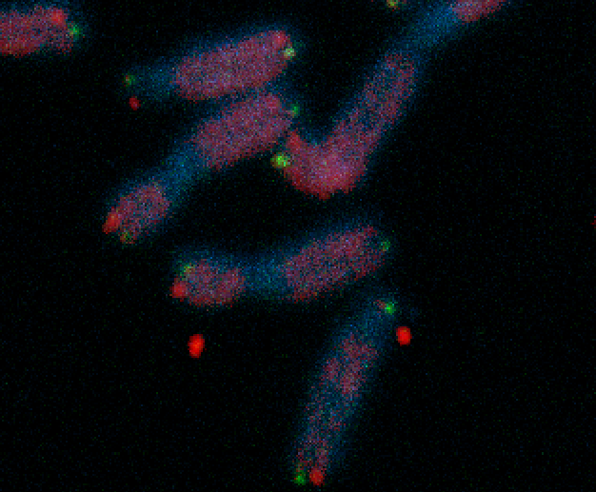
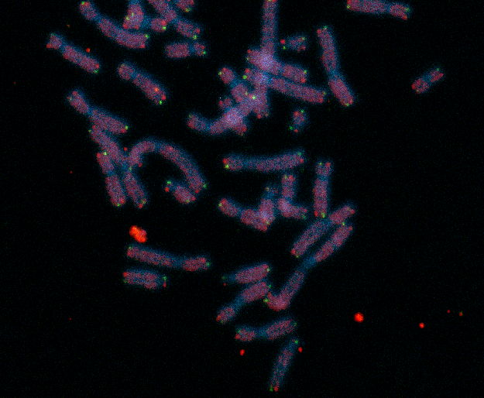
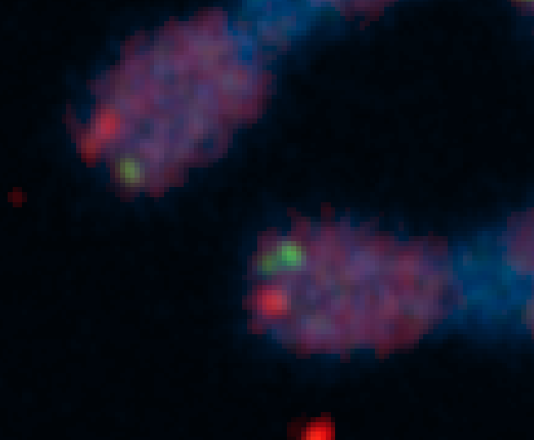
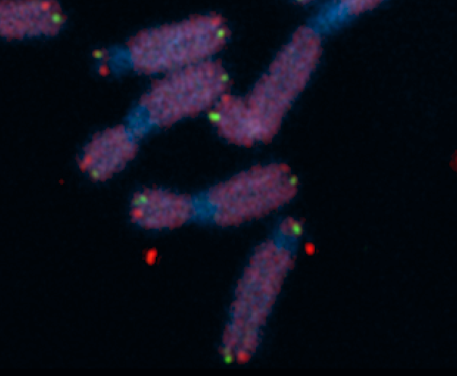

ZEISS LSM 880 – Airyscan enhances resolution, boosts SNR “...thereby allowing for a much more accurate quantification“ (Karlseder and Fitzpatrick, The Salk Institute, La Jolla, CA, USA)
2 µm
2 µm
2 µm
2 µm
Telomere replication without RTEL1: Stalled forks and telomere breakage visualized as doubled dots using Airyscan. Resolution is meaningless without good SNR.
Courtesy: J. Karlseder Ph.D. (Molecular and Cell Biology Laboratory) and
J. Fitzpatrick Ph.D. (Director, Waitt Advanced Biophotonics Core),
The Salk Institute, La Jolla, USA.
Notes:
The principle can be demonstrated by acquiring images. For example of a real sample
The images and the following text is courtesy of J. Karlseder Ph.D. (Molecular and Cell Biology Laboratory) and
J. Fitzpatrick Ph.D. (Director, Waitt Advanced Biophotonics Core),
The Salk Institute, La Jolla, USA.
Sample :
The cells are IMR90 human diploid lung fibroblasts. They are primary cells at population doubling 45, grown at 3% oxygen, 7.5% CO2 in DMEM supplemented with 15% fetal bovine serum.
The DNA has been stained with DAPI, the telomeric G strand (leading strand) in green with a Peptide Nucleic Acid probe (Alexa 488-CCCTAACCCTAACCCTAA) and the telomeric C strand (lagging strand) in red with a Peptide Nucleic Acid probe (Alexa-546-TTAGGGTTAGGGTTAGGG).
Prior to their harvest the cells have been treated with siRNAs targeting RTEL1 (2). RTEL1 is a helicase that is essential for telomere replication, and lack of the protein leads to stalled forks at telomeres and telomere breakage. This can be seen by individual telomeres that appear as more than one dot, as highlighted in the images. The new detection method is far superior to the old one detecting multiple telomere dots, thereby allowing for a much more accurate quantification of telomere replication problems.

Slide 55
Homework 6
If you are submitting a research grant to the National Institutes of Health (NIH) it requires a section called the Project Narrative, a succinct (2 to 3 sentences) summary of the proposed research in plain language. For this assignment write a Project Narrative (2 or 3 sentences) describing your favorite microscopy technique and the question it can address, in plain language.

Slide 56

Super-resolution structured illumination microscopy (SR-SIM)
The visualization of fine spatial information via moiré fringes is illustrated by Figure 6, where panel (a) consists of fine spatial details of a portrait of Ernst Abbe that, upon mixing with the linear structure from panel (b), results in lower frequency moiré fringes that make the portrait much easier to recognize, as seen in Figure 6(c).
Notes:
Lateral resolution can be increased over the classical Abbe limit by a factor of two (approximately 100 to 120 nanometers) in structured illumination without discarding any emission light using laser-generated spatially structured illumination coupled to a widefield fluorescence microscope in what is termed superresolution (SR) SIM. Similar to the non-linear superresolution technique of SSIM described above, the linear SR-SIM structured light wavefronts render normally inaccessible high-resolution information available in the form of moiré fringes that contain harmonic frequencies from the specimen that are not available in conventional fluorescence microscopy. Thus, if two fine patterns are superposed in a multiplicative fashion, a beat pattern (moiré fringes) will appear in their product. In this case, one of the patterns is the spatial fluorophore distribution in the specimen and the other is the structured excitation light intensity.
http://zeiss-campus.magnet.fsu.edu/articles/superresolution/introduction.html
http://zeiss-campus.magnet.fsu.edu/articles/superresolution/supersim.html

