Slide 1
Homework 5
Early on during zebrafish development, many molecules are involved in patterning the embryo’s tissues and axes. One possible explanation for this complex patterning is Alan Turing’s reaction-diffusion model. To test this you have fluorescently tagged three proteins involved in this process. Your hypothesis is that one protein acts at a long distance while another acts at a short distance and the third at an intermediate distance.
Questions: What fluorescent technique would you use to determine the mobility of these three proteins? What would you predict is the relative mobility of these three proteins?

Slide 2
Homework 5
Early on during zebrafish development, many molecules are involved in patterning the embryo’s tissues and axes. One possible explanation for this complex patterning is Alan Turing’s reaction-diffusion model. To test this you have fluorescently tagged three proteins involved in this process. Your hypothesis is that one protein acts at a long distance while another acts at a short distance and the third at an intermediate distance.
Questions: What fluorescent technique would you use to determine the mobility of these three proteins? What would you predict is the relative mobility of these three proteins?
Answer: (1) FRAP or FCS; (2) Protein acting at a long distance has a higher diffusion coefficient than the protein acting at an intermediate distance while the protein acting at a short distance has a very low diffusion coefficient. Long distance > intermediate > short.

Slide 3
This example is based on an actual paper.
Müller, P., Rogers, K.W., Jordan, B.M., Lee, J.S., Robson, D., Ramanathan, S., Schier, A.F., 2012. Differential Diffusivity of Nodal and Lefty Underlies a Reaction-Diffusion Patterning System. Science 336, 721-724.
They used FRAP to determine the mobility of four different proteins 2 nodals (Cyclops and Squint) and 2 Lefties.
Notes:
Figure S18. Measurement of effective diffusion coefficients. (A-B) FRAP experimental overview. A cuboidal volume was bleached into embryos
uniformly expressing secreted fluorescent fusion proteins (A). Medial optical slices were imaged every 10 s following bleaching. The average intensity
in the bleached region recovers over time (B) and can be used to calculate the diffusion coefficient of the fluorescent species. (C-F) Embryos
were injected at the one-cell stage with 30 pg of mRNA encoding Cyclops-GFP (C), Squint-GFP (D), Lefty1-GFP (E) or Lefty2-GFP (F). Uniformly
expressed Nodal- or Lefty-GFP fusion proteins were locally photobleached at blastula stages. Optical slices were acquired every 10 s after the
bleach for a total of 50 min. The effective diffusion coefficient, D, was determined by fitting the resulting recovery profile (black) with simulated recovery
curves (red) that were numerically generated using a model that includes diffusion, production and clearance in a three-dimensional embryo-like
geometry (Text S6). Results for individual embryos are shown normalized to the final time point, and average diffusion coefficients are listed here
and in Table S6.

Slide 4
Cyclops slow, Squint intermediate & Lefty fast.
Notes:
Figure S18. Measurement of effective diffusion coefficients. (A-B) FRAP experimental overview. A cuboidal volume was bleached into embryos
uniformly expressing secreted fluorescent fusion proteins (A). Medial optical slices were imaged every 10 s following bleaching. The average intensity
in the bleached region recovers over time (B) and can be used to calculate the diffusion coefficient of the fluorescent species. (C-F) Embryos
were injected at the one-cell stage with 30 pg of mRNA encoding Cyclops-GFP (C), Squint-GFP (D), Lefty1-GFP (E) or Lefty2-GFP (F). Uniformly
expressed Nodal- or Lefty-GFP fusion proteins were locally photobleached at blastula stages. Optical slices were acquired every 10 s after the
bleach for a total of 50 min. The effective diffusion coefficient, D, was determined by fitting the resulting recovery profile (black) with simulated recovery
curves (red) that were numerically generated using a model that includes diffusion, production and clearance in a three-dimensional embryo-like
geometry (Text S6). Results for individual embryos are shown normalized to the final time point, and average diffusion coefficients are listed here
and in Table S6.

Slide 5
2D versus 3D model.
Notes:
Figure S19. FRAP geometries. (A) Average embryo geometry during FRAP experiments. Embryos were injected with mRNA encoding GFP fusion
constructs at the one-cell stage, generating embryos that uniformly express the GFP fusions (green). FRAP experiments were performed at late
blastula stages, when the blastoderm forms a dome on top of the yolk. A cuboidal volume was bleached into the center of the embryo (black), and
recovery of fluorescence was observed in a medial optical section (red). This geometry was used for three-dimensional simulations of FRAP experiments
(3D analysis model) with the geometric parameters indicated in (B). (C) Medial optical section acquired during FRAP experiments (twodimensional
view of the red line in (A)). The bleached window is indicated in black. This geometry was used for two-dimensional simulations of FRAP
experiments (2D analysis model) as shown in (D).The analysis areas inside the bleach window (Awin), outside the bleach window (Aout) and the
entire slice (Asl) used to calculate spatial intensity averages are indicated. (E) Three-dimensional extension of the two-dimensional model shown in
(C) and (D). The slice would extend to infinity above and below the depicted cylinder geometry. (F) Averaging of the eight octants (Q1-Q8) for the first
image taken after photobleaching defines the initial condition Ī0 in the imaging plane used for three-dimensional simulations of FRAP experiments.
(G) Simulated FRAP recovery curves in two- and three-dimensional model geometries. FRAP experiments were simulated using the 3D or 2D analysis
models for a range of diffusion coefficients, D, from 0.1 to 50 μm2/s without clearance or production. For the initial condition, the concentration in
the bleached region was set to a value of zero and to a value of one everywhere else. The resulting recovery curves in the bleached window were
normalized to the concentration at the final time point t = 3000 s. Note that the recovery profiles in two- and three-dimensional geometries are similar
for small values of D, but different for higher diffusivities. (H) The 3D analysis model was used to generate a recovery curve given a diffusion coefficient
of 10 μm2/s (red). This simulated curve was then fitted using the 2D model (blue). Consistent with (G), the 2D fit results in a lower diffusion
coefficient, highlighting the differences between the 2D and 3D approaches and the importance of using the appropriate geometry when fitting FRAP
data.

Slide 6
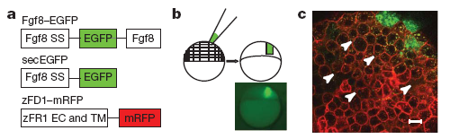
Why did they use FRAP instead of FCS?
Proteins acting as morphogen
  Yu, S. R., M. Burkhardt, et al. (2009). Nature 461(7263): 533-536.
Receptor ligand interactions
  Ries, J., S. R. Yu, et al. (2009). Nat Methods 6(9): 643-645.

Slide 7
Why did they use FRAP instead of FCS?
Proteins acting as morphogen
  Yu, S. R., M. Burkhardt, et al. (2009). Nature 461(7263): 533-536.

Slide 8
Paper to read
McConnell, G., Trägårdh, J., Amor, R., Dempster, J., Reid, E., Amos, W.B., 2016. A novel optical microscope for imaging large embryos and tissue volumes with sub-cellular resolution throughout. eLife 5, e18659.
https://elifesciences.org/content/5/e18659

Slide 9
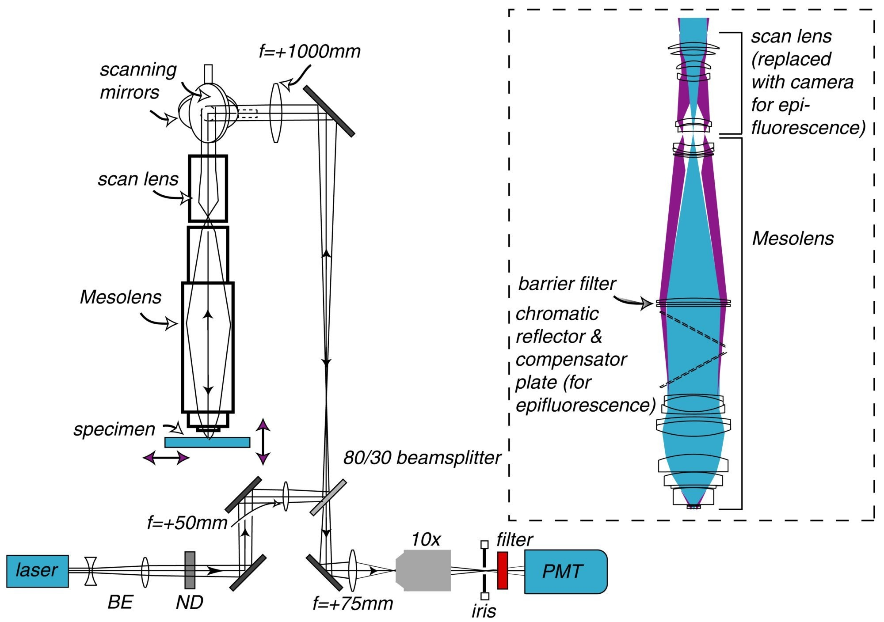
Mesolens: low mag with high NA
Notes:
Schematic diagram of the laser scanning confocal Mesolens system.
BE=beam expander, ND= neutral density filter. Only one detection channel is shown here for ease of presentation. Inset: Illustration of the optical train of the Mesolens and scan lens. Also shown is the position of the compensator plates and camera when the Mesolens is used for wide-field epi-fluorescence imaging.

Slide 10
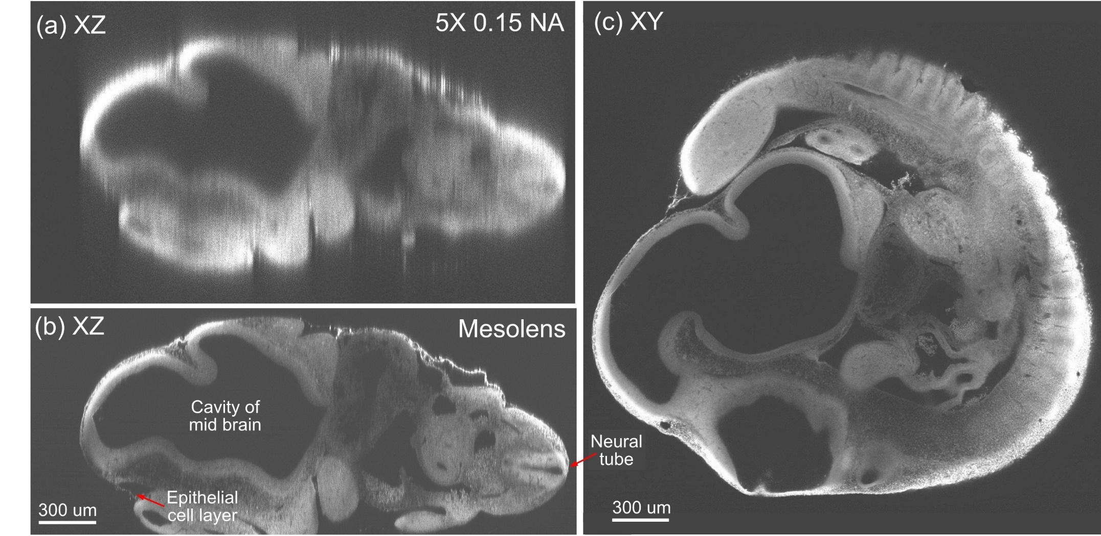
Mesolens: low mag with high NA
Notes:
Optical sectioning of an optically-cleared and fluorescently-stained 10 day old mouse embryo.(a) is the embryo imaged in XZ using a dry objective lens of similarly low magnification to the Mesolens (5x/0.15 N.A., HCX PL Fluotar, Leica Microsystems). (b) is the same embryo imaged at the same region in XZ using the Mesolens with oil immersion. The Mesolens can image throughout the entire 2 mm thick embryo with sub-cellular resolution: individual nuclei can be observed all the way through. This is in contrast to the image with the commercial low magnification, low N.A. objective, where the long needle-like vertical structures indicate a very poor z resolution. Figure 4c shows an XY cross section at a depth of around 1 mm into the same specimen imaged using the Mesolens. Full resolution versions of (b) and (c) are available as Figure 4—figure supplements 1 and 2.

Slide 11
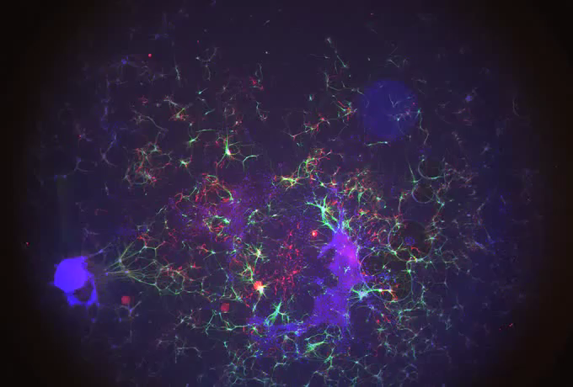
Mesolens: advantages and disadvantages

