Slide 1
Biology 177: Principles of Modern Microscopy
Lecture 13:
FRET, FLIM, Super-resolution microscopy Part I
Andres Collazo, Director Biological Imaging Facility
Wan-Rong (Sandy) Wong, Graduate Student, TA

Slide 2
Lecture 13: FRET, FLIM, NSOM
Review of previous lecture
FRET
FLIM
Super resolution microscopy
  NSOM

Slide 3
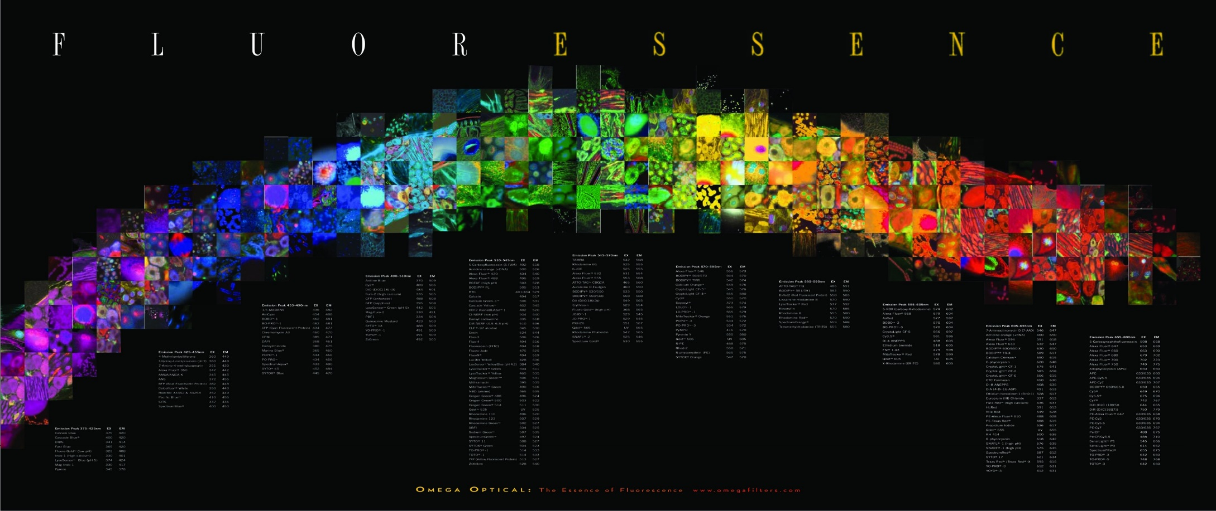
The “F” words
FRET
FFS
FLIM
FCS
FIGS
FRAP
FLAM
FACS
FCCS
Notes:
FACS (fluorescence-activated cell sorting). One of several important cell sorting techniques used in the separation of different cell lines (especially those isolated from animal tissues).
FIGS (Fluorescence image-guided surgery) is a medical imaging technique that uses fluorescence to detect properly labeled structures during surgery.

Slide 4
The “F” words
FRET
FFS
FLIM
FCS
FIGS
FRAP
FLAM
FACS
FCCS
Notes:
FACS (fluorescence-activated cell sorting). One of several important cell sorting techniques used in the separation of different cell lines (especially those isolated from animal tissues).
FIGS (Fluorescence image-guided surgery) is a medical imaging technique that uses fluorescence to detect properly labeled structures during surgery.

Slide 5
Förster Resonance Energy Transfer (FRET)
Great method for the detection of:
  Protein-protein interactions
  Enzymatic activity
  Small molecules interacting inside a cell
Notes:
http://www.nature.com/nmeth/journal/v5/n5/full/nmeth.1207.html

Slide 6
Remember our fluorescence discussion?
Resonance Energy Transfer (non-radiative)
The Bad: Self-quenching
If dye at high concentration
“hot-potato” the energy until lost

Slide 7
FRET:
Resonance Energy Transfer (non-radiative)
The Good: FRET as a molecular yardstick
Transfer of energy from one dye to another
Depends on:
Spectral overlap
Distance
Alignment
Notes:
Forster resonance energy transfer instead of fluorescence energy transfer.
Molecular yardsticks are for defining spatial dimensions

Slide 8
donor
acceptor
FRET:
Optimize spectral overlap
Optimize κ² -- alignment of dipoles
Minimize direct excitement of the acceptor
(extra challenge for filter design)
Notes:
Perpendicular is not good.

Slide 9
FRET Diagram
Non-radiative transfer
4nsec
-xx-
Less
-xx-
Less
0.8 emitted

Slide 10
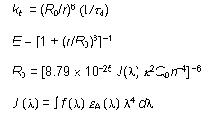




K_{T} = (1/τ_{D}) • [R₀/r]⁶
$$=1 − \frac{τ′D}{τD}$$
The Förster Equations.
R₀ = 2.11 × 10⁻² • [κ² • J(λ) • η⁻⁴ • Q_{D}]^{1/6}
J (λ)
ε_{A}
$$E =1 − \frac{F′D}{FD}$$
r is the center-to-center distance (in cm) between the donor and acceptor
τ_{D} is the fluorescence lifetime of the donor in the absence of FRET
κ² is the dipole-dipole orientation factor,
Q_{D} is the quantum yield of the donor in the absence of the acceptor
η is the refractive index of the intervening medium,
F_{D} (λ) is the fluorescence emission intensity at a given wavelength λ (in cm)
ε_{A} (λ) is the extinction coefficient of the acceptor (in cm ⁻¹ M ⁻¹).
The orientation factor κ² can vary between 0 and 4, but
typically κ² = 2/3 for randomly oriented molecules (Stryer, 1978).
When r = R₀, the efficiency of FRET is 50%
(fluorescein-tetramethylrhodamine pair is 55 Å)
Notes:
J spectral overlap integral
R₀ = the Forster radius of about 3-6 Nm
E = the FRET energy transfer efficiency
Both the rate (K(T)) and the efficiency (E(T)) of energy transfer are directly related to the lifetime of the donor fluorophore in the presence and absence of the acceptor.
http://www.olympusmicro.com/primer/techniques/fluorescence/fret/fretintro.html
http://en.wikipedia.org/wiki/F%C3%B6rster_resonance_energy_transfer
http://www.nature.com/nbt/journal/v21/n11/full/nbt896.html

Slide 11
FRET:
Resonance Energy Transfer (non-radiative)
The Good: FRET as a molecular yardstick
Transfer of energy from one dye to another
Depends on:
Spectral overlap
Distance
Alignment
Notes:
Forster resonance energy transfer instead of fluorescence energy transfer.
Molecular yardsticks are for defining spatial dimensions

Slide 12
Remember:
Going back to our Fluorescence lecture
How dipole affects FRET as a molecular yardstick
Fluorescent Dye
Dipole antenna
Delocalized electrons
Longer dipole, longer λ
Notes:
transition dipole moment (TDM)
http://www.nh.cas.cz/people/lazar/celler/emission.php

Slide 13
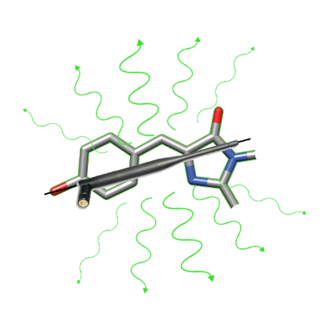
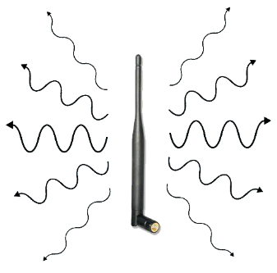
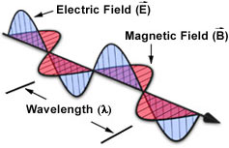
Fluorescent dye as dipole antenna
μ
Absorption depends on orientation
E
μ
Propagation direction
μ
E
Propagation direction
Notes:
electric dipole moment (µ) of the molecule
Quantum Yield and Polarization (1) Joachim Mueller
Fluorescence Workshop UMN Physics
June 8-10, 2006
Quantum yield, polarized light, dipole moment, photo- selection, dipole radiation, polarization and anisotropy
Antenna pictures from
http://www.nh.cas.cz/people/lazar/celler/emission.php

Slide 14
Fluorescent dye as dipole antenna
No emission along the dipole axis
μ_{E}
Orientation of fluorescence emission
Some emission along this direction
γ
Maximal emission normal to the dipole axis
Maximal emission normal to the dipole axis
No emission along the dipole axis
Dipole radiation pattern
Notes:
electric dipole moment (µ) of the molecule
Quantum Yield and Polarization (1) Joachim Mueller
Fluorescence Workshop UMN Physics
June 8-10, 2006
Quantum yield, polarized light, dipole moment, photo- selection, dipole radiation, polarization and anisotropy
Antenna pictures from
http://www.nh.cas.cz/people/lazar/celler/emission.php

Slide 15
Fluorescent dye as dipole antenna
Orientation of fluorescence emission affects FRET efficiency
Notes:
electric dipole moment (µ) of the molecule
Quantum Yield and Polarization (1) Joachim Mueller
Fluorescence Workshop UMN Physics
June 8-10, 2006
Quantum yield, polarized light, dipole moment, photo- selection, dipole radiation, polarization and anisotropy
Antenna pictures from
http://www.nh.cas.cz/people/lazar/celler/emission.php

Slide 16
More about FRET (Förster Resonance Energy Transfer)
Isolated donor
Donor distance too great
Donor distance correct
Effective between 10-100 Å only
Emission and excitation spectrum must significantly overlap
Note: donor transfers non-radiatively to the acceptor
From J. Paul Robinson, Purdue University

Slide 17
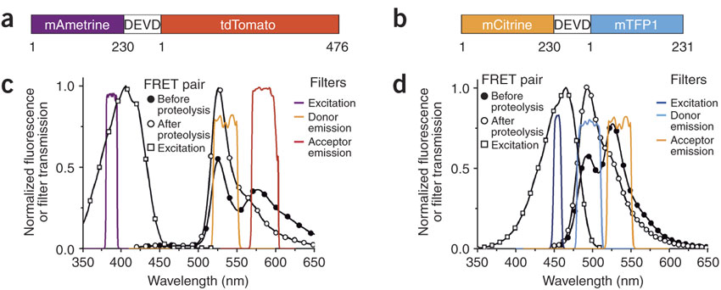
Optimizing FRET: Designs of new FRET pairs
Difficult to find two FRET pairs that can use in same cell
Used as Caspase 3 biosensors and for ratiometric imaging
Notes:
Figure 1. Caspase-3 biosensors based on dual FRET pairs.
(a,b) Schematics of caspase-3 biosensors. "DEVD" represents the sequence LGGTGSGSGDEVDG. Numbers indicate first and last residue of each fluorescent protein. (c) The emission spectrum of mAmetrine-DEVD-tdTomato before and after proteolysis, the excitation spectrum of mAmetrine, and the transmission profiles of excitation and emission filters used for FRET imaging. (d) The emission spectrum of mCitrine-DEVD-mTFP1 before and after proteolysis, the excitation spectrum of mTFP1, and the profiles of the excitation and emission filters.
Ai, H.-w., Hazelwood, K.L., Davidson, M.W., Campbell, R.E., 2008. Fluorescent protein FRET pairs for ratiometric imaging of dual biosensors. Nat Meth 5, 401-403.

Slide 18
Properties of fluorescent protein variants
Shaner et al, Nature Biotechnology, 2004
Notes:
Extinction coefficient here actually is the molar absorption coefficient.
Bleaching in seconds; obviously longer better, to a point

Slide 19
Fluorophore absorption
it is the molar absorption coefficient
Shaner et al, Nature Biotechnology, 2004

Slide 20
Fluorophore absorption
Green dye in cuvette
L
I_{in}
I_{out}
Blue light absorbed
Beer-Lambert law
I_{out} = I_{in} exp (- ε L c)
I_{absorbed} = I_{out} - I_{in}
I_{in}: incident light intensity (in W.cm⁻²)
L: absorption path length (in cm)
c: concentration of the absorber (in M or mol.L⁻¹)
ε: molar absorption coefficient (in M⁻¹cm⁻¹ or mol⁻¹.L.cm⁻¹)
Fluorescein ε ~ 70,000 M⁻¹.cm⁻¹
eGFP ε ~ 55,000 M⁻¹.cm⁻¹
Light absorbed
Wavelength
Notes:
A good dye must absorb light well (high extinction coef.)
Classically, the Beer–Lambert law was first devised independently where Lambert's law stated that absorbance is directly proportional to the thickness of the sample, and Beer's law stated that absorbance is proportional to the concentration of the sample. The modern derivation of the Beer–Lambert law combines the two laws and correlate the absorbance to both, the concentration as well as the thickness (path length) of the sample.

Slide 21
Fluorophore absorption
µ_{t} = µ_{a} + µ_{s}
In the literature…
The “extinction coefficient” is usually given in tables.
confusions:
- “extinction coefficient” used for “absorption coefficient” (it assumes the scattering coefficient is negligible)
- “extinction coefficient” used for “molar extinction coefficient” (check the unit!)
ε(λ)!
The maximum is given in tables, or the excitation wavelength is indicated.
extinction
coefficient
absorption
coefficient
scattering
coefficient
µ_{t}= εc
µ_{a} = ε_{a} c
ε = ε_{a} if no scattering
molar
extinction
coefficient
molar
absorption
coefficient

Slide 22
Fluorophore absorption
Green dye in cuvette
L
I_{emitted}
Green light emitted
I_{in}
I_{out}
Blue light absorbed
Quantum Yield
Q = I_{emitted} /I_{absorbed}
= # photons emitted / # photons absorbed
(I_{absorbed} = I_{out} - I_{in)}
Fluorescein Q ~ 0.8
Rhodamine B Q ~ 0.3
eGPP Q ~ 0.6
Stokes Shift
490nm
520nm
Light absorbed
Light emitted
Wavelength

Slide 23
Fluorophore brightness = ε Q
DsRed εQ ~ 0.79 x 75,000 ~ 59,250 M⁻¹.cm⁻¹ (100%)
mRFP1 εQ ~ 0.25 x 50,000 ~ 12,500 M⁻¹.cm⁻¹ (21%)
eGFP εQ ~ 0.6 x 55,000 ~ 33,000 M⁻¹.cm⁻¹ (56%)
Fluorescein εQ ~ 0.8 x 70,000 ~ 56,000 M⁻¹.cm⁻¹ (95%) (dye!)
Notes:
Shaner et al, Nature Biotechnology, 2004

Slide 24
Optimizing FRET: Designs of new FRET pairs
mAmetrine developed by directed protein evolution from violet excitable GFP variant
Bright, extinction coefficient = 44,800 M⁻¹ cm⁻¹
Quantum yield = 0.58
But bleaches, 42% of mCitrine time and 1.7% of tdTomato
Notes:
Ai, H.-w., Hazelwood, K.L., Davidson, M.W., Campbell, R.E., 2008. Fluorescent protein FRET pairs for ratiometric imaging of dual biosensors. Nat Meth 5, 401-403.

Slide 25
Problems with FRET
4nsec
The acceptor excited directly by the exciting light
  “FRET” signal with no exchange
  Increased background
  Decreases effective range for FRET assay

Slide 26
Problems with FRET
2. Hard to really serve as a molecular yardstick*
  Orientation seldom known
      assume κ² = 2/3 (random assortment)
  Exchange depends on environment of dipoles
  Amount of FRET varies with the lifetime of the donor fluorophore
* r = R₀, the efficiency of FRET is 50%
(fluorescein-tetramethylrhodamine pair is 55 Å)
Notes:
See this paper for more Kappa squared and other variable cautions.
http://www.nature.com/nbt/journal/v21/n11/full/nbt896.html

Slide 27
Amount of FRET varies with the lifetime of the donor fluorophore
4nsec
Longer lifetime of the donor gives longer time to permit the energy transfer (more for longer)
Added Bonus: Allows lifetime detection to reject direct excitement of the acceptor (FRET=late)

Slide 28
Fluorescence Lifetime Imaging Microscopy (FLIM)
Measure spatial distribution of differences in the timing of fluorescence excitation of fluorophores
Combines microscopy with fluorescence spectroscopy
Fluorescent lifetimes very short (ns) so need fast excitation and/or fast detectors
Requirements for FLIM instruments
  Excitation light intensity modulated or pulsed
  Emitted fluorescence measured time resolved
Notes:
FLIM has its roots in two fields of research: 1) microscopy and 2) fluorescence spectroscopy. In the latter field of research, non-spatially-resolved fluorescence lifetime measurements were performed since 1926 [1], i.e. long before FLIM was developed. Typically, bulk measurements were carried out using cuvettes. Not surprisingly, most of the methodology and nomenclature used in FLIM today, e.g.‘frequency-domain’, and ‘time-domain’, have their origins in instruments that were used for cuvette-based lifetime measurements.
van Munster, E., Gadella, T.J., 2005. Fluorescence Lifetime Imaging Microscopy (FLIM), in: Rietdorf, J. (Ed.), Microscopy Techniques. Springer Berlin Heidelberg, pp. 143-175.

Slide 29
Fluorescence Lifetime Imaging Microscopy (FLIM)
Two methods for FLIM
  Frequency-domain
    Intensity of excitation light continuously modulated
    For emission measure phase shift & decrease in modulation
  Time-domain
    Pulsed excitation that is faster than fluorescence lifetime
    Emission measurement is time-resolved
Notes:
The first instrument combining time resolved fluorescence spectroscopy with microscopy, dates back to 1959 [2]. In this instrument, only single point measurements could be done, so strictly speaking no actual imaging was done. The first instrument measuring spatially resolved lifetimes was described in 1989 [3]. Due to the requirement of short light pulses and fast detection, time-domain measurements became possible only about 40 years later than frequency-domain measurements using a flashlamp as excitation source [16].
van Munster, E., Gadella, T.J., 2005. Fluorescence Lifetime Imaging Microscopy (FLIM), in: Rietdorf, J. (Ed.), Microscopy Techniques. Springer Berlin Heidelberg, pp. 143-175.

Slide 30

FRET and FLIM
Donor fluorescence lifetime during FRET reduced compared to control donor fluorescence lifetime
During FRET, donor fluorescence lifetime less than control donor fluorescence lifetime (τ_{D})
But isn’t it easier to image decreases in donor fluorescence intensity rather than measure fluorescence lifetime?
K_{T} = (1/τ_{D}) • [R₀/r]⁶
$$=1 − \frac{τ′D}{τD}$$
Notes:
Both the rate (K(T)) and the efficiency (E(T)) of energy transfer are directly related to the lifetime of the donor fluorophore in the presence and absence of the acceptor.
In other words the donor fluorescence (or excited-state) lifetime in a FRET situation (τ_{FRET}⁾ is reduced as compared to the control donor fluorescence lifetime t (see Eq. 14 in which
t_{FRET} = t (1 – E) (14)
where E is the energy transfer efficiency).
http://olympus.magnet.fsu.edu/primer/techniques/fluorescence/fret/fretintro.html
van Munster, E., Gadella, T.J., 2005. Fluorescence Lifetime Imaging Microscopy (FLIM), in: Rietdorf, J. (Ed.), Microscopy Techniques. Springer Berlin Heidelberg, pp. 143-175.

Slide 31
FRET and FLIM: addressing nonlinearities
Brightness (or intensity) of fluorophore, as measured on your image, more than just εQ
  Local concentration of fluorophore
  Optical path of microscope
  Local excitation light intensity
  Local fluorescence detection efficiency
FLIM provides independent measure of local donor lifetime
Notes:
The problem with quantitative imaging of intensities is that they do not depend only on the local quantum yield of the fluorophores but also on i) the local concentration of the fluorophore, ii) the optical path of the micro- scope, iii) the local excitation light intensity and iv) the local fluorescence detection efficiency. Especially the local concentration of the fluorophore is not easily determined separately from the local quantum yield. In contrast, FLIM does provide an independent estimate of the local donor lifetime (proportional to the donor quantum yield), independent of i–iv mentioned above. Hereby FLIM is a robust technique for measuring FRET.
All those nonlinearities cause problems.
εQ=molar absorption coefficient times quantum yield.
van Munster, E., Gadella, T.J., 2005. Fluorescence Lifetime Imaging Microscopy (FLIM), in: Rietdorf, J. (Ed.), Microscopy Techniques. Springer Berlin Heidelberg, pp. 143-175.

Slide 32
Going back to those problems with FRET:
These drawbacks can all be used to make sensors
Change in FRET for changes in:
Orientation
  cameleon dye for Ca++
Local environment
  Phosphate near fluorophore
  Membrane voltage (flash)
Change in lifetime of donor
  Binding of molecule displacing water

Slide 33
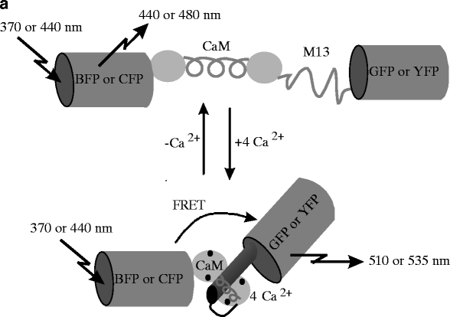
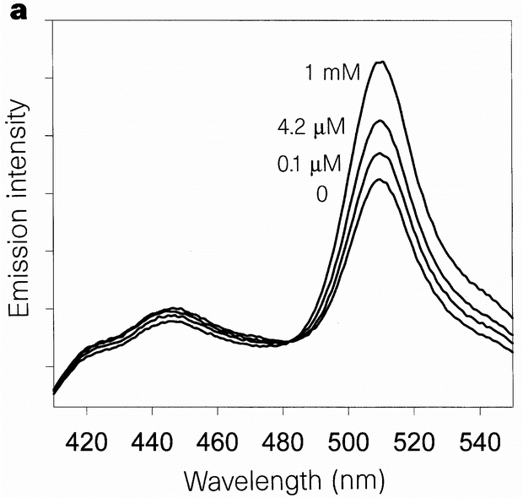
Cameleon: FRET-based and genetically-encoded calcium probe
Calmodulin bonds Ca²⁺
and changes its conformation
[Ca²⁺]
Miyawaki et al, Nature, 1997
Cameleon family: calmodulin-based indicators of [Ca²⁺] using FRET
isosbestic point
Notes:
Isosbestic point best for ratiometric measures
http://www.nature.com/nature/journal/v388/n6645/full/388882a0.html

Slide 34
Paper to read
Pearson, H., 2007. The good, the bad and the ugly. Nature 447, 138-140.
http://www.nature.com/nature/journal/v447/n7141/full/447138a.html

Slide 35
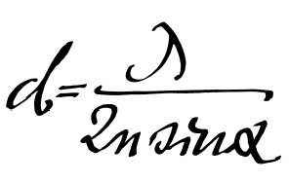
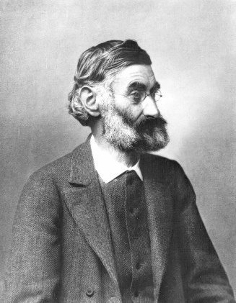
Spatial Resolution of Biological Imaging Techniques
Resolution is diffraction limited.
Abbe (1873) reported that smallest resolvable distance between two points (d) using a conventional microscope may never be smaller than half the wavelength of the imaging light (~200 nm)
Ernst Abbe (1840-1905)
Notes:
http://www.nature.com/milestones/milelight/full/milelight03.html

Slide 36

Super-resolution microscopy
Most recent Nobel prize in Chemistry
Many ways to achieve
Some more super than others.
Notes:
They fall into two broad categories, "true" super-resolution techniques, which capture information contained in evanescent waves, and "functional" super-resolution techniques, which use clever experimental techniques and known limitations on the matter being imaged to reconstruct a super-resolution image.^{[2]}
True subwavelength imaging techniques include those that utilize the Pendry Superlens and near field scanning optical microscopy, the 4Pi Microscope and structured illumination microscopy technologies like SIM and SMI. However, the majority of techniques of importance in biological imaging fall into the functional category.
There are two major groups of methods for functional super-resolution microscopy:
Deterministic super-resolution: The most commonly used emitters in biological microscopy, fluorophores, show a nonlinear response to excitation, and this nonlinear response can be exploited to enhance resolution. These methods include STED, GSD, RESOLFT and SSIM.
Stochastic super-resolution: The chemical complexity of many molecular light sources gives them a complex temporal behaviour, which can be used to make several close-by fluorophores emit light at separate times and thereby become resolvable in time. These methods include SOFI and all single-molecule localization methods (SMLM) such as SPDM, SPDMphymod, PALM, FPALM, STORM and dSTORM.

Slide 37
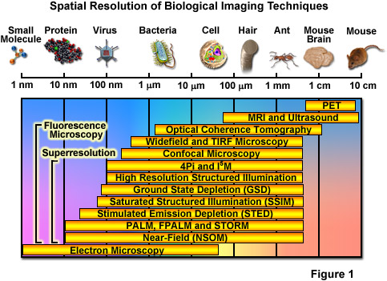
Spatial Resolution of Biological Imaging Techniques
Notes:
http://zeiss-campus.magnet.fsu.edu/articles/superresolution/introduction.html

Slide 38
Super-resolution microscopy
“True” super-resolution techniques
  Subwavelength imaging
  Capture information in evanescent waves
  Quantum mechanical phenomenon
“Functional” super-resolution techniques
  Deterministic
    Exploit nonlinear responses of fluorophores
  Stochastic
    Exploit the complex temporal behaviors of fluorophores
Notes:
They fall into two broad categories, "true" super-resolution techniques, which capture information contained in evanescent waves, and "functional" super-resolution techniques, which use clever experimental techniques and known limitations on the matter being imaged to reconstruct a super-resolution image.^{[2]}
True subwavelength imaging techniques include those that utilize the Pendry Superlens and near field scanning optical microscopy, the 4Pi Microscope and structured illumination microscopy technologies like SIM and SMI. However, the majority of techniques of importance in biological imaging fall into the functional category.
There are two major groups of methods for functional super-resolution microscopy:
Deterministic super-resolution: The most commonly used emitters in biological microscopy, fluorophores, show a nonlinear response to excitation, and this nonlinear response can be exploited to enhance resolution. These methods include STED, GSD, RESOLFT and SSIM.
Stochastic super-resolution: The chemical complexity of many molecular light sources gives them a complex temporal behaviour, which can be used to make several close-by fluorophores emit light at separate times and thereby become resolvable in time. These methods include SOFI and all single-molecule localization methods (SMLM) such as SPDM, SPDMphymod, PALM, FPALM, STORM and dSTORM.

Slide 39
Spatial Resolution of Biological Imaging Techniques
“True” super-resolution
“Functional”
Notes:
http://zeiss-campus.magnet.fsu.edu/articles/superresolution/introduction.html

Slide 40
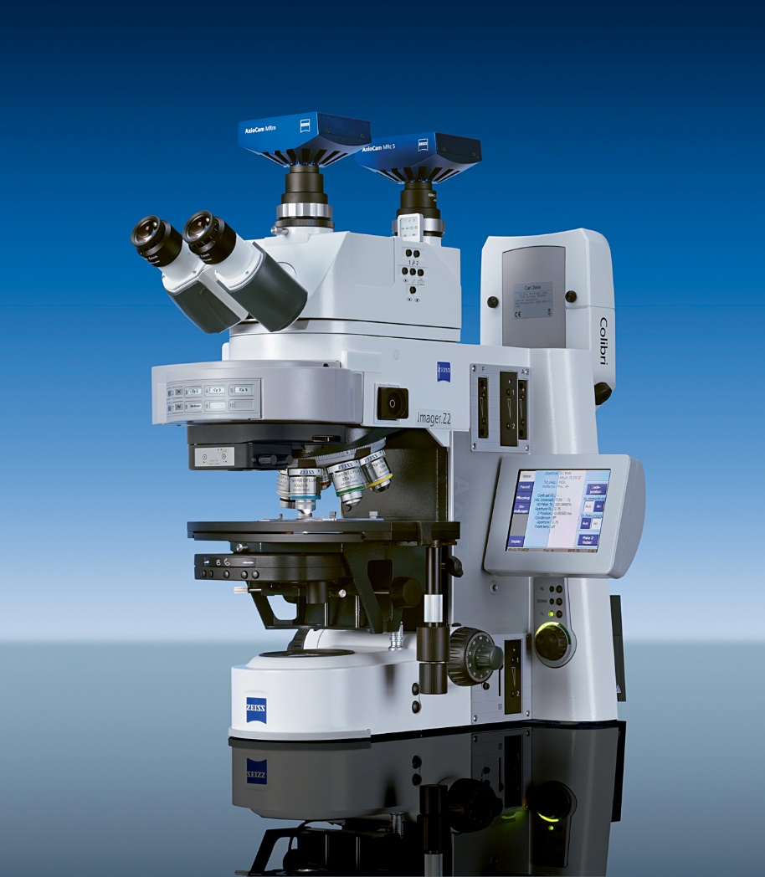
Remember the different types of microscopy from previous lecture?
Wide-field microscopy
  Illuminating whole field of view
Confocal microscopy
  Spot scanning
Near-field microscopy
  For super-resolution
  TIRF

Slide 41
Near-Field Scanning Optical Microscopy (NSOM)
Scanning Near-Field Optical Microscopy (SNOM)
Likely the super-resolution technique with the highest resolution
But only for superficial structures
A form of Scanning Probe Microscopy (SPM)

Slide 42
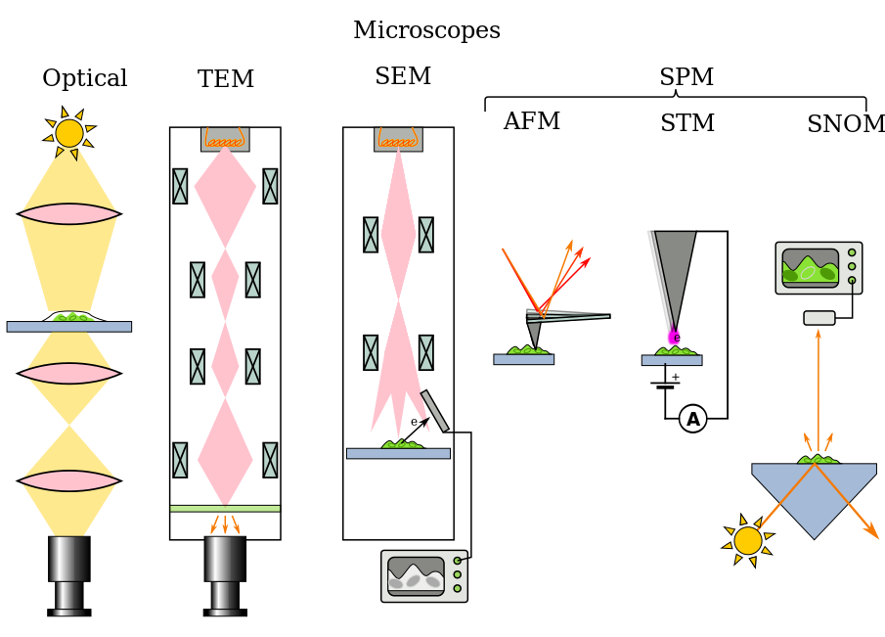
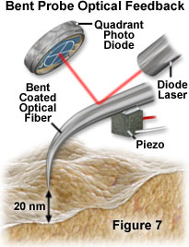
All the types of microscopes
Notes:
https://en.wikipedia.org/wiki/Microscope
http://micro.magnet.fsu.edu/primer/techniques/nearfield/nearfieldintro.html
Figure 7

Slide 43
Near-Field Scanning Optical Microscopy (NSOM)
Break the diffraction limit by working in the near-field
Illuminated “spot” is smaller than diffraction limit
(about the size of the tip for a distance equivalent to tip diameter)
Launch light through small aperture
Near-field = distance of a couple of tip diameters
Notes:
One of the more intuitive super-resolution techniques

Slide 44
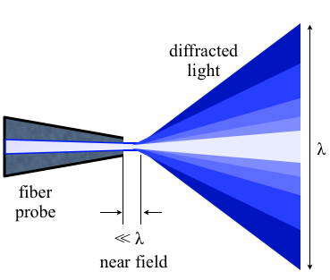
NSOM working in the near-field
Aperture diameter less than the wavelength of light
In 1993 Eric Betzig and Robert Chichester used NSOM for repetitive single molecule imaging
Notes:
In 1993, this situation changed markedly when Eric Betzig and Robert Chichester reported the first repetitive imaging of single fluorophores at room temperature with a new technique called near-field scanning optical microscopy (NSOM) that repeatedly scans an extremely small optical probe over a sample. This provided molecule-scale spatial localization and information on molecular orientation. The potential biological applications of single-molecule imaging captured the imaginations of microscopists and biologists alike, but because of its invasiveness and complexity NSOM proved largely unsuitable for complex biological samples.
http://www.nature.com/milestones/milelight/full/milelight17.html
"Nearfield optics" by Zogdog602 - Own work. Licensed under CC BY 3.0 via Wikimedia Commons - http://commons.wikimedia.org/wiki/File:Nearfield_optics.png#mediaviewer/File:Nearfield_optics.png

Slide 45
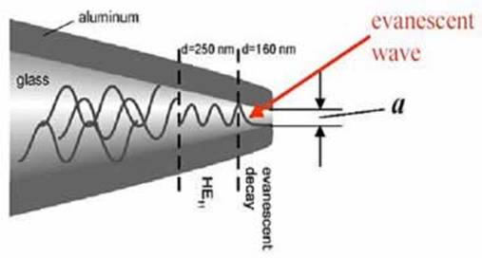
NSOM working in the near-field
Near-field near surface of object, < λ of light
Near-field consists of light as evanescent wave
Evanescent waves higher frequency, more information
Evanescent waves quantum tunneling phenomenon
Product of Schrödinger wave equations
Notes:
http://micro.magnet.fsu.edu/primer/techniques/nearfield/nearfieldintro.html
http://www.azonano.com/article.aspx?ArticleID=1205

Slide 46
Near-Field Scanning Optical Microscopy (NSOM)
How to make an NSOM tip
Tip of pulled quartz fiber
Aluminize tip to minimize loss of light
Very small fraction of light makes it through small (50nm) aperture

Slide 47
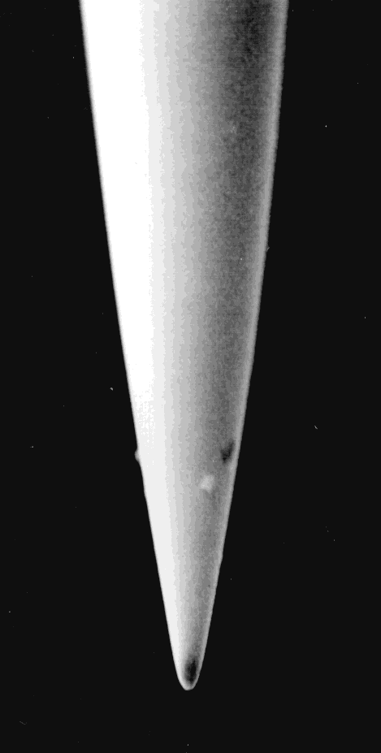
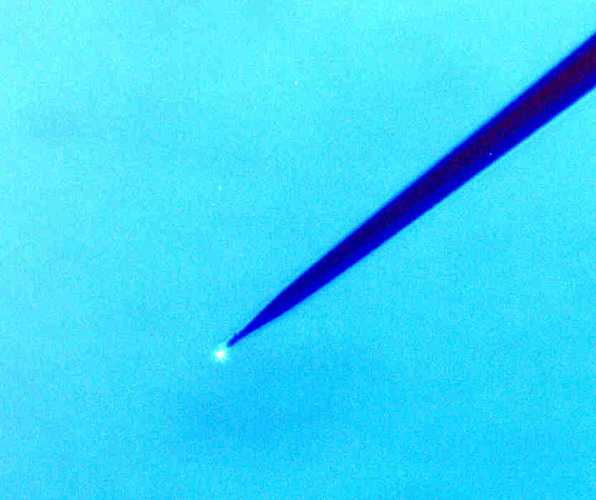
Near-Field Scanning Optical Microscopy (NSOM)
SEM of tip
Tip shining on sample
(can detect with wide-field)

Slide 48
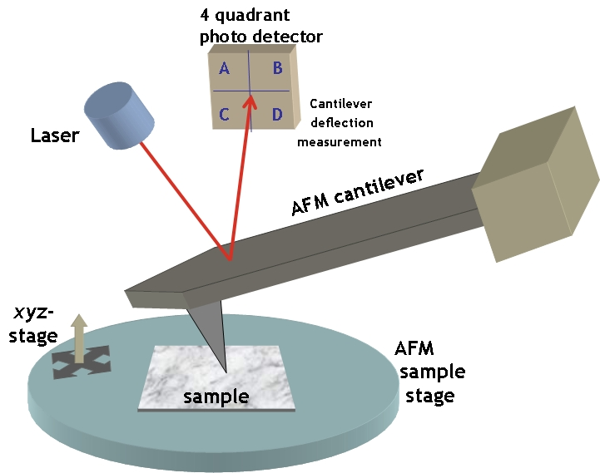
How to move the tip? Steal from AFM
Atomic Force Microscopy (AFM)
Notes:
Sharp tip at end of swinging cantilever
http://simple.wikipedia.org/wiki/Atomic_force_microscope

Slide 49
Near-Field Scanning Optical Microscopy (NSOM)
Break the diffraction limit by working in the near-field
Like AFM can do NSOM with tapping mode
Requires bent tip
Move tip up and down like AFM
Not best way of doing NSOM
  Hard to make probe
  Bend causes loss of light
Notes:
There are several drawbacks in the application of bent optical probes, each of which can be attributed to the bend itself. A significant problem is the increased difficulty of the probe fabrication, especially when applying a metal coating to the tip. An additional disadvantage is the increased optical loss that occurs due to the bend in the probe. This loss in throughput efficiency is significant, and some published measurements indicate that bent optical fiber probes are at least an order of magnitude less efficient than conventional straight fiber probes. In certain operational modes of NSOM, the intensity loss is not a serious limitation because additional light can be coupled into the fiber to compensate, assuming sufficient laser power is available. The increase in optical coupling is an option because the optical losses, as well as increased heating, occur at the bend in the fiber and not at the aperture of the probe, where local heating would present a major problem. Another potential drawback with bent probes is a change in certain tip properties that occurs due to the presence of the bend, such as a decrease in extinction coefficients when performing polarized light measurements. Extinction ratios of approximately 70:1 have been measured in the far-field utilizing bent tips, as compared to values of greater than 100:1 with conventional straight fiber probes.

Slide 50
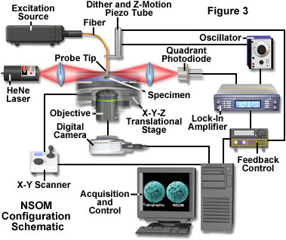
If not tapping like AFM how else to scan tip in NSOM?
Shear force mode.
Advantage: don’t need laser to keep track of probe.
To keep tip in near-field, need to be ~50nm from surface
Notes:
The main problem associated with this type of feedback mechanism is that the light source (for example, a laser), which is used to detect the tip vibration frequency, phase, and amplitude, becomes a potential source of stray photons that can interfere with the detection of the NSOM signal. One mechanism for dealing with this effective increase in background signal is to provide a feedback light source that has a different wavelength (usually longer) than the near-field source. This scheme requires additional filtration in front of the detector to selectively block the unwanted photons originating within the feedback system. In most cases, the added filters also block a small percentage of the near-field photons, resulting in reduced signal levels. A non-optical feedback method is not subject to problems of this nature, and is a primary reason that methods such as the tuning-fork technique (described below) have become increasingly popular.

Slide 51
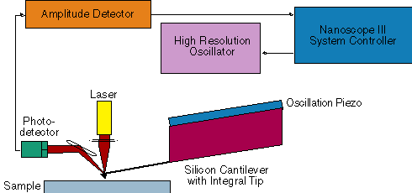
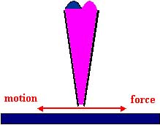
Sense presence of surface from dithering tip (lateral)
(Increased shear force when surface is near)
Keep dithering amplitude low <10 nm
Notes:
Betzig used this approach in 1992 to make NSOM more useful
The shear-force feedback method laterally dithers the probe tip at a mechanical resonance frequency in proximity to the specimen surface. The dither amplitude is usually kept low (less than 10 nanometers) to prevent adversely affecting the optical resolution. For optimum image quality, shear-force feedback techniques are usually restricted to use with specimens that have relatively low surface relief, and longer scan times are required compared to operation in tapping mode. However, the straight probes typically employed in shear-force feedback techniques are easier to fabricate and have a lower cost per probe than their bent probe counterparts.
http://micro.magnet.fsu.edu/primer/techniques/nearfield/nearfieldintro.html
http://zeiss-campus.magnet.fsu.edu/articles/superresolution/introduction.html

Slide 52
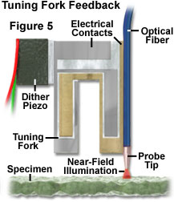
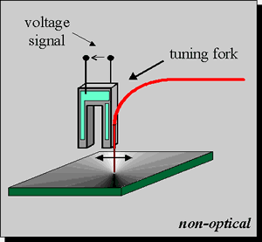
Shear force mode with non optical feedback
Use real-time feedback to keep probe in near-field range but not touching
Tip can be oscillated at resonance frequency
Tip can be straight
  Easier to make
  Cheaper
  But surface needs to be relatively flat
Notes:
There are several advantages of the tuning fork method that have led to its increased favor over optical techniques of tip regulation. Since the detection of the tip motion is not optical, there is no risk of additional stray light being introduced in the vicinity of the aperture that might interfere with the NSOM signal detection. Additionally, the tuning fork system does not require the tedious alignment procedures of a separate external laser source and associated focusing optical components. Because of the compactness and relative ease of use, the tuning fork method lends itself to applications requiring remote operation, such as those employed in vacuum systems or environmental control chambers.
The basic configuration of the tuning-fork method used for shear-force tip feedback consists of a single mode optical fiber attached to one arm of a quartz crystal tuning fork, which is oscillated at the tuning fork's resonance frequency. The equivalent circuit for the tuning fork is a series RLC resonator in parallel with package capacitance. The most common tuning fork resonance frequency is 32,768 hertz (Hz), but the devices are available with resonances ranging from 10 kilohertz to several tens of megahertz.

Slide 53
Illumination Techniques - Overview
Transmitted Light
Bright-field
Oblique
Darkfield
Phase Contrast
Polarized Light
DIC (Differential Interference Contrast)
Fluorescence - not any more > Epi !
Reflected (Incident) Light
Bright-field
Oblique
Darkfield
Not any more (DIC !)
Polarized Light
DIC (Differential Interference Contrast)
Fluorescence (Epi)

Slide 54
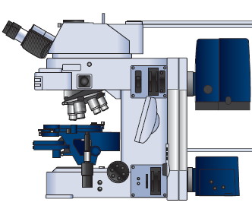
NSOM, like far-field, is amenable to different contrast methods
Absorption
Polarization
Refractive index
Reflected Light
Fluorescence
Spectral imaging
Reflected
Transmitted Light
Notes:
Betzig, E., Trautman, J.K., 1992. Near-Field Optics: Microscopy, Spectroscopy, and Surface Modification Beyond the Diffraction Limit. Science 257, 189-195.

Slide 55
Direct imaging of single molecule with NSOM (1993)
Instrument described in 1992 Science paper
Shear force mode with non-optical feedback
In 1993 Eric Betzig and Robert Chichester used NSOM for repetitive single molecule imaging, DiI
Notes:
carbocyanine dye
In 1993, this situation changed markedly when Eric Betzig and Robert Chichester reported the first repetitive imaging of single fluorophores at room temperature with a new technique called near-field scanning optical microscopy (NSOM) that repeatedly scans an extremely small optical probe over a sample. This provided molecule-scale spatial localization and information on molecular orientation. The potential biological applications of single-molecule imaging captured the imaginations of microscopists and biologists alike, but because of its invasiveness and complexity NSOM proved largely unsuitable for complex biological samples.
http://www.sciencemag.org/content/257/5067/189.abstract?sid=78a939a7-a92c-4260-a999-85346db22447
Betzig, E., Trautman, J.K., 1992. Near-Field Optics: Microscopy, Spectroscopy, and Surface Modification Beyond the Diffraction Limit. Science 257, 189-195.
http://www.sciencemag.org/content/262/5138/1422.short
Betzig, E., Chichester, R.J., 1993. Single Molecules Observed by Near-Field Scanning Optical Microscopy. Science 262, 1422-1425.
http://www.nature.com/milestones/milelight/full/milelight17.html
Fig. 1. Near-field scanning optic
microscopy : conception and real­ ity. (A) As originally conceived ( 10), an illuminated aperture acts as a light source of subwavelength dimensions that can be scanned close to an object to generate a superresolution image. (B) As we implemented it, the aperture is at the end of a sharp probe,and shear forces between the tip and sample
are measured to automatically control the relative separation for scanning rough surfaces . The scan
head is designed as an attachment to a commercial optical microscope, which results in a wide range of possible magnifications . The near-field signal can also be partitioned to obtain information from several contrast mechanisms at once.

Slide 56
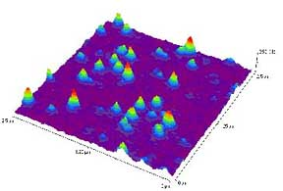
NSOM images
Single molecules of DiI on glass surface

Slide 57
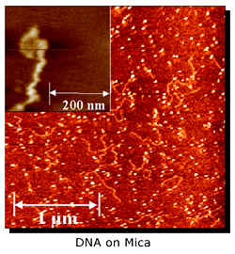
NSOM images

Slide 58
NSOM disadvantages

Slide 59
NSOM disadvantages
Practically zero working distance and small depth of field.
Extremely long scan times for high resolution images or large specimen areas.
Very low little light through such a tiny aperture.
Only features at surface of specimens can be studied.
Fiber optic probes are somewhat problematic for imaging soft materials due to their high spring constants, especially in shear-force mode.

Slide 60
Performance range of optical microscopy
SIM/STP
MRI
OCT
SPIM
Depth
(um)
CLSM
LM
NSOM
TIRF
Resolution
(um)
Notes:
serial two-photon (STP) tomography
http://www.nature.com/nature/journal/v508/n7495/full/nature13186.html#methods
http://www.nature.com/nmeth/journal/v9/n3/full/nmeth.1854.html

Slide 61
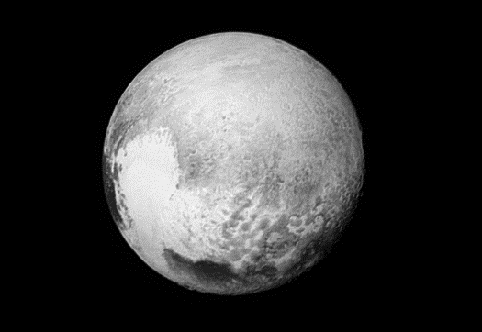
Homework 4
The New Horizons probe has given us new insights on the dwarf planet Pluto. What color is the sky of Pluto and explain why in terms of scattering?
Hint – The particles that scatter light in the atmosphere of Pluto (Tholins) are considered to be small like the smaller light scattering particles in earth’s atmosphere.

Slide 62

Pluto’s sky is blue
https://www.nasa.gov/nh/nh-finds-blue-skies-and-water-ice-on-pluto

Slide 63
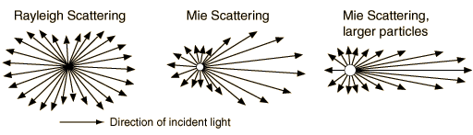
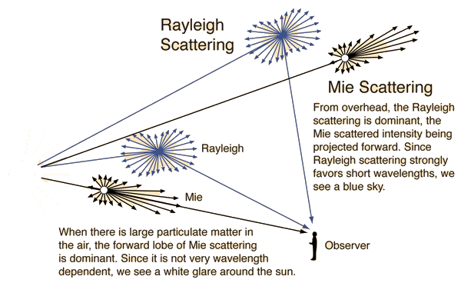
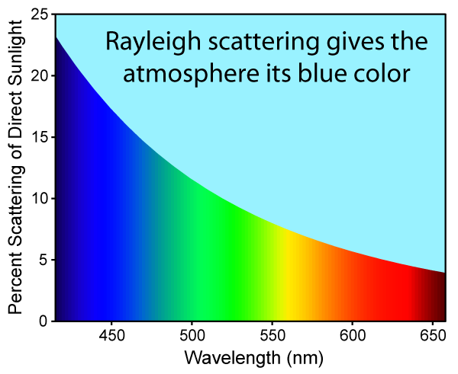
Scattering: Why the sky is blue and clouds are white
Rayleigh scattering
  Favors shorter wavelengths as function of $1/{\text{λ}\text{4}}$
  Particle size <1/10th wavelength
Mie scattering
  No favorites
  Particle size > wavelength
Notes:
http://hyperphysics.phy-astr.gsu.edu/hbase/hframe.html

